Slide 1
SNAP ML Dashboard Project

Slide 2
Key Visualizations & Variable Summaries
• Poverty rate varies widely among states.
• Strong relationship between poverty and SNAP participation.
• Benefits per person differ significantly by SNAP policy class.
• Several socioeconomic and demographic features drive SNAP outcomes.

Slide 3
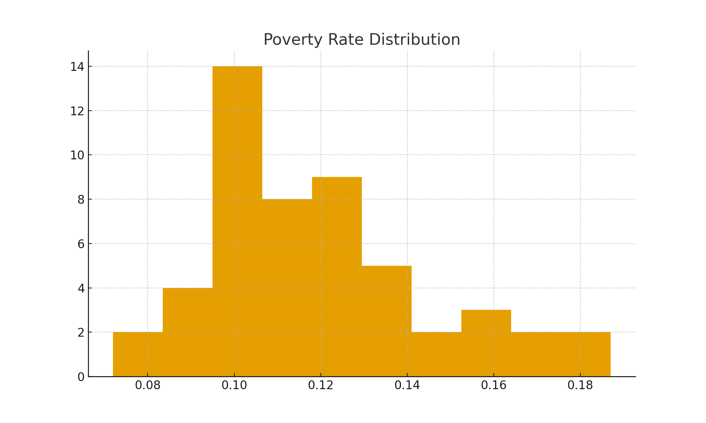
Poverty Rate Distribution

Slide 4
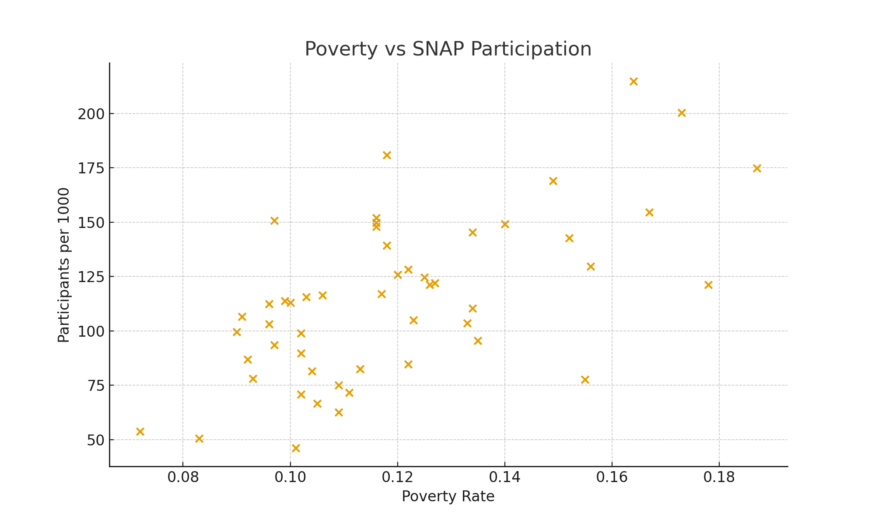
Poverty vs SNAP Participation

Slide 5
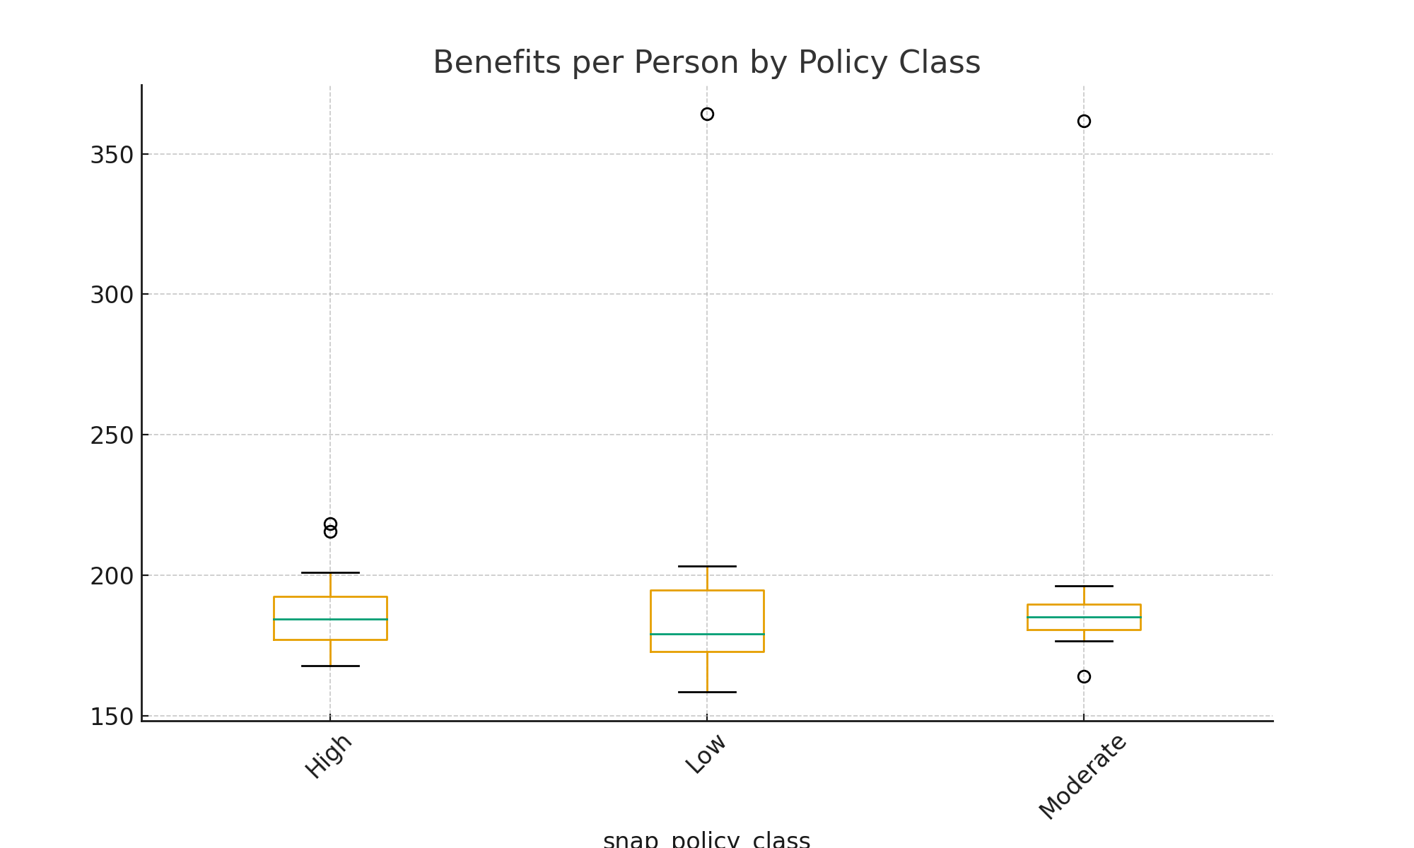
Benefits per Person by Policy Class

Slide 6
Research Questions
1. Can socioeconomic features predict SNAP policy class?
2. Which variables drive benefits_per_person?
3. Do states cluster naturally based on food insecurity and SNAP usage?
4. Can we create a prediction tool for policymakers?

Slide 7
Predictive Modeling Approach
• Regression (Linear, Ridge, Lasso) predicts benefits_per_person.
• Classification (Logistic, KNN, MLP) predicts SNAP policy class.
• High accuracy achieved in Logistic and MLP models.
• Interactive app allows users to test predictions with custom inputs.

Slide 8
Unsupervised Learning Findings
• K-means clustering (k=3) separates states into meaningful groups.
• PCA reveals strong separation by socioeconomic structure.
• Clusters align with SNAP policy types and poverty/benefit trends.

Slide 9
Dashboard Demo
• Full ML dashboard built using Dash.
• Includes EDA, Regression, Classification, Clustering, PCA.
• Custom prediction tool with user input sliders.
• Link: https://ds-6021-final-project-snap.onrender.com

