Slide 1



sales_insights_project
View in Power BI
Last data refresh:
7/17/2023 11:56:32 AM UTC
Downloaded at:
7/17/2023 12:04:10 PM UTC

Slide 2
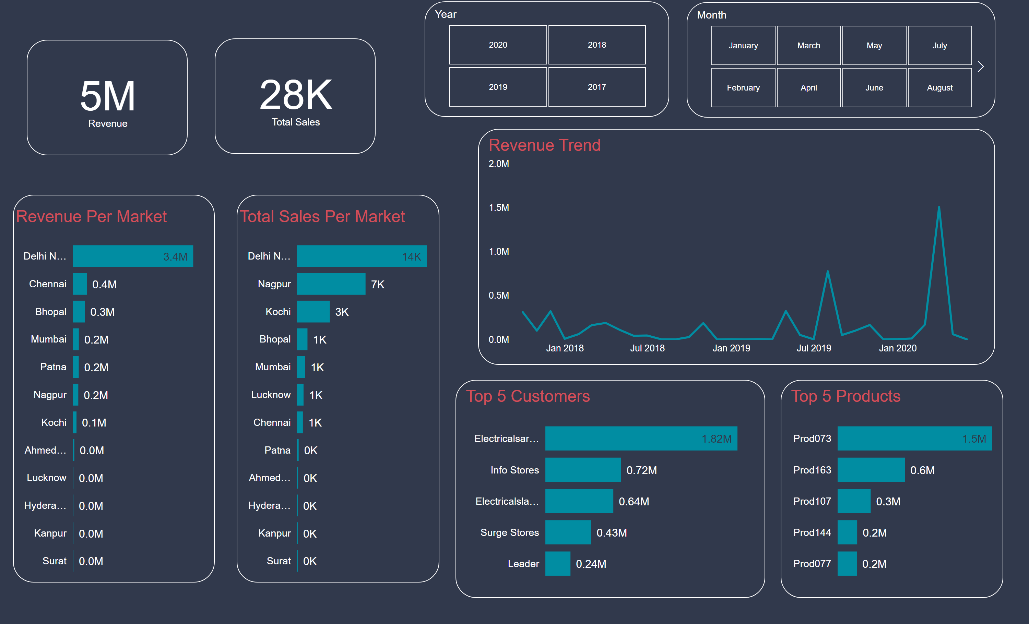
Key Insights
Notes:
card
No alt text provided
card
No alt text provided
Revenue Per Market
No alt text provided
Total Sales Per Market
No alt text provided
Year
No alt text provided
Month
No alt text provided
Top 5 Customers
No alt text provided
Top 5 Products
No alt text provided
Revenue Trend
No alt text provided

Slide 3
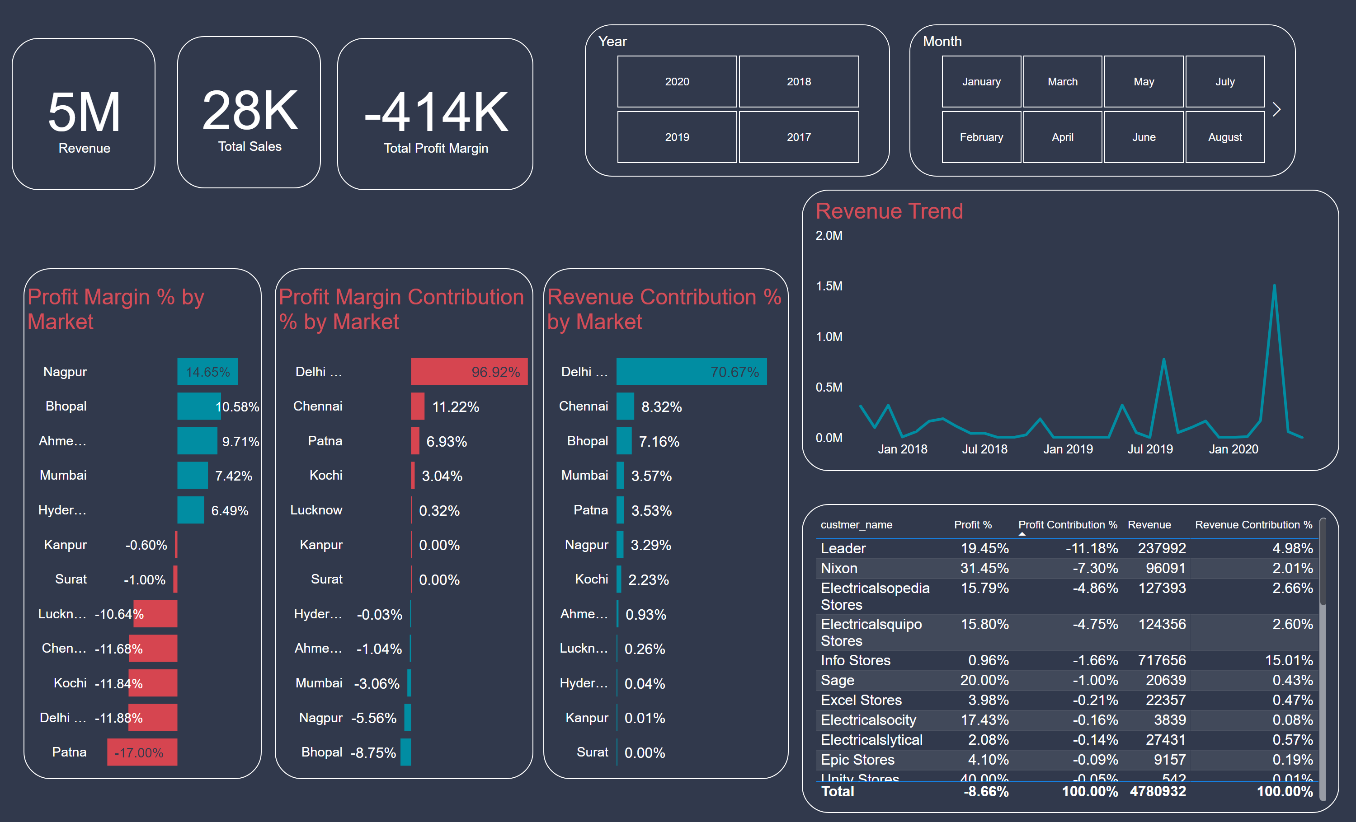
Profit Analysis
Notes:
card
No alt text provided
Profit Margin % by Market
No alt text provided
Profit Margin Contribution % by Market
No alt text provided
Year
No alt text provided
Month
No alt text provided
card
No alt text provided
card
No alt text provided
Revenue Contribution % by Market
No alt text provided
tableEx
No alt text provided
Revenue Trend
No alt text provided

Slide 4
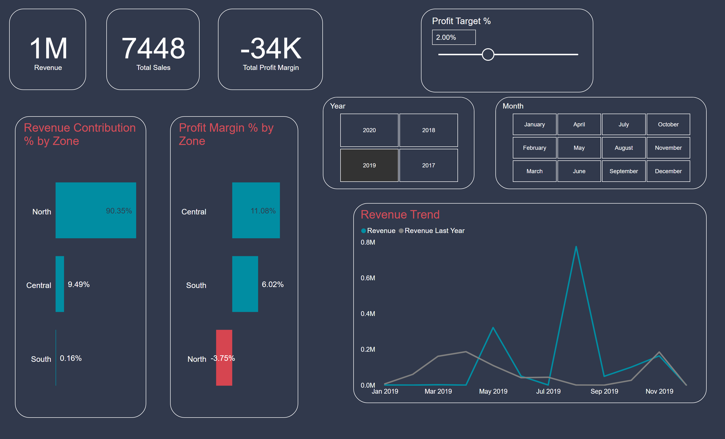
Performance Insights
Notes:
card
No alt text provided
Year
No alt text provided
Month
No alt text provided
card
No alt text provided
card
No alt text provided
Revenue Contribution % by Zone
No alt text provided
Revenue Trend
No alt text provided
slicer
No alt text provided
Profit Margin % by Zone
No alt text provided

