Slide 1

Air India Flight Booking: A Usability Redesign
Arnav Lokhande

Slide 2
Project overview
The product:
A flight-booking experience designed for travellers who want to compare flights, understand fares, and complete a booking with minimal confusion. The project compares the Air India website with a streamlined Figma prototype.
Add 2–3 screenshots of the final Figma prototype here.
Project duration:
July 2026 – October 2026

Slide 3
Project overview
The problem:
The original Air India booking flow can feel crowded because promotional messages, upgrade prompts, and fare details compete for attention. Users may struggle to identify the next step while comparing options.
The goal:
Create a cleaner flight-booking flow that helps users scan results, compare fare options, and move confidently from flight selection to booking confirmation.

Slide 4
Project overview
My role:
Individual UX designer and usability researcher.
Responsibilities:
Competitive review, user-flow planning, wireframing, Figma prototyping, usability testing, think-aloud interviews, survey collection, thematic analysis, and recommendations.

Slide 5
User research
Personas
Problem statements
User journey maps
Understanding
the user

Slide 6
User research: summary
Five participants unfamiliar with the project tested the original Air India website and the redesigned Figma prototype using the same flight-booking task. Think-aloud feedback and interview transcripts were reviewed for recurring themes; participants also completed a UX survey. The email receipts did not preserve numeric ratings, so no averages are reported.

Slide 7
User research: pain points
1
2
3
4
Information overload
Information overload
Information overload
Information overload
Write one to two sentences reflecting
on the pain point listed above and how it
will guide designs moving forward.
Write one to two sentences reflecting
on the pain point listed above and how it
will guide designs moving forward.
Write one to two sentences reflecting
on the pain point listed above and how it
will guide designs moving forward.
Write one to two sentences reflecting
on the pain point listed above and how it
will guide designs moving forward.

Slide 8
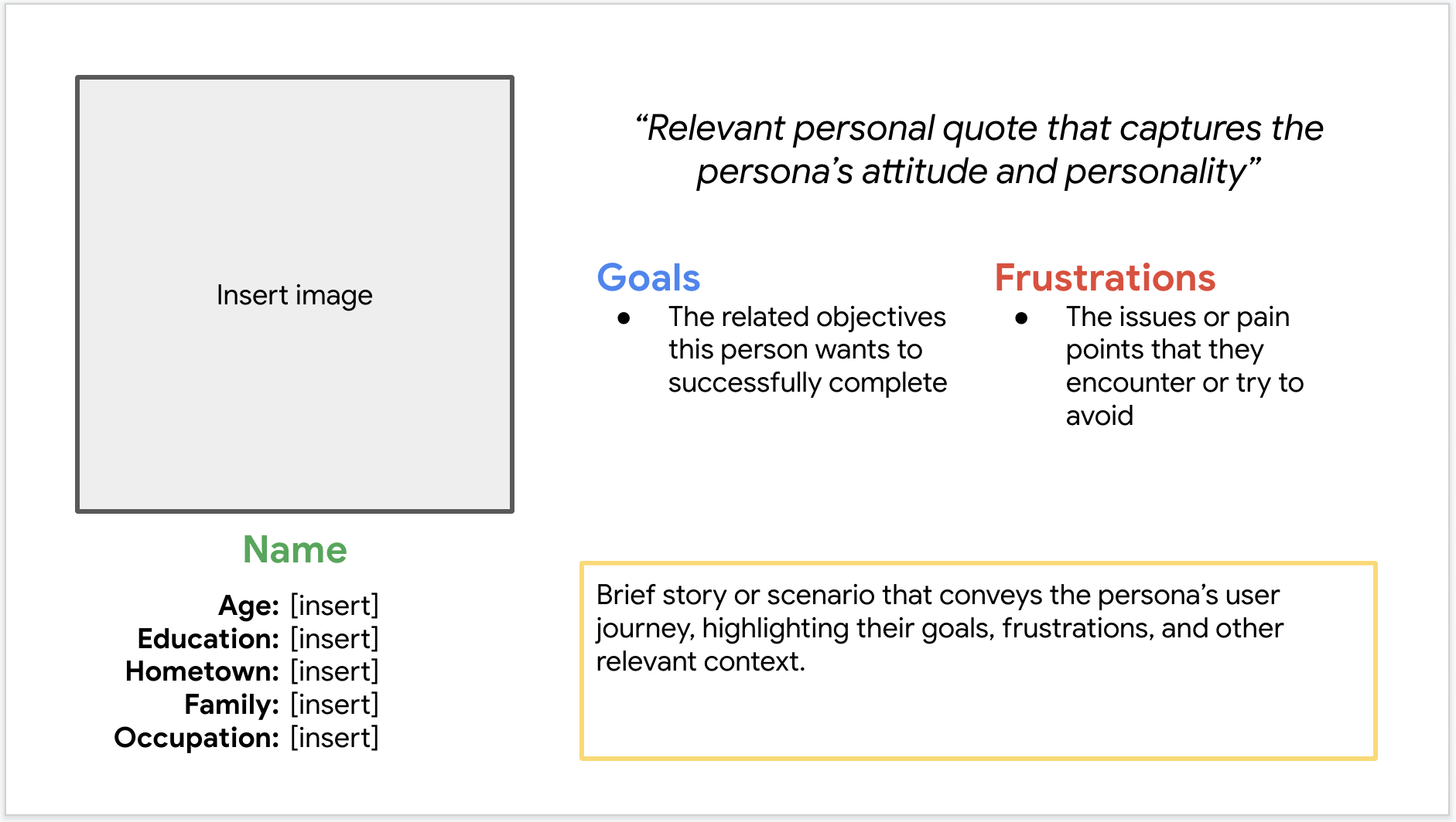
Persona: The Practical Traveller
Problem statement:
[User name] is a [user characteristics]
who needs [user need]
because [insight].

Slide 9
User journey map
Map the journey from entering trip details to selecting a flight and confirming the booking. At each step, prioritise the user's immediate question: where am I going, which option fits me, and what should I do next?
Insert your user journey map image here.

Slide 10
Paper wireframes
Digital wireframes
Low-fidelity prototype
Usability studies
Starting
the design

Slide 11
Paper wireframes
Map the journey from entering trip details to selecting a flight and confirming the booking. At each step, prioritise the user's immediate question: where am I going, which option fits me, and what should I do next?
Insert photos of your paper sketches and the selected refined version here.

Slide 12
Digital wireframes
Keep the key decision visible and easy to scan; reduce cognitive load by grouping related information.
Map the journey from entering trip details to selecting a flight and confirming the booking. At each step, prioritise the user's immediate question: where am I going, which option fits me, and what should I do next?
Insert a wireframe screenshot showing the flight-results layout and filters.
Keep the key decision visible and easy to scan; reduce cognitive load by grouping related information.

Slide 13
Digital wireframes
Keep the key decision visible and easy to scan; reduce cognitive load by grouping related information.
Map the journey from entering trip details to selecting a flight and confirming the booking. At each step, prioritise the user's immediate question: where am I going, which option fits me, and what should I do next?
Insert a wireframe screenshot showing fare selection and the primary Continue action.
Keep the key decision visible and easy to scan; reduce cognitive load by grouping related information.

Slide 14
Low-fidelity prototype
[Link to low-fidelity prototype and brief description of the user flow]
Insert a screenshot or GIF of the Figma prototype flow here.

Slide 15
Usability study: findings
Write a short introduction to the usability studies you conducted and your findings.
Original Air India website
Redesigned Figma prototype
1
The original site felt crowded
1
The original site felt crowded
2
The original site felt crowded
2
The original site felt crowded
3
The original site felt crowded
3
The original site felt crowded

Slide 16
Refining
the design
Mockups
High-fidelity prototype
Accessibility

Slide 17
Mockups
Before usability study
After usability study
Map the journey from entering trip details to selecting a flight and confirming the booking. At each step, prioritise the user's immediate question: where am I going, which option fits me, and what should I do next?
Insert original screen screenshot here.
Insert redesigned screen screenshot here.

Slide 18
Mockups
Before usability study
After usability study
Map the journey from entering trip details to selecting a flight and confirming the booking. At each step, prioritise the user's immediate question: where am I going, which option fits me, and what should I do next?
Insert original screen screenshot here.
Insert redesigned screen screenshot here.

Slide 19
Mockups
Insert final prototype screen here.
Insert final prototype screen here.
Insert final prototype screen here.
Insert final prototype screen here.

Slide 20
High-fidelity
prototype
[Link to high-fidelity prototype]
Insert a screenshot or GIF of the Figma prototype flow here.

Slide 21
Accessibility considerations
1
2
3
Use clear labels and a consistent visual hierarchy so users can identify important information and actions quickly.
Maintain readable text, adequate contrast, and sufficiently large interactive targets; verify these in the final Figma screens.
Use clear labels and a consistent visual hierarchy so users can identify important information and actions quickly.

Slide 22
Going forward
Takeaways
Next steps

Slide 23
Takeaways
Impact: In five qualitative sessions, participants generally preferred the prototype's cleaner layout and clearer actions. Participants described it as less overwhelming and smoother to use; this is directional feedback, not proof of improved task success at scale.
What I learned: Reducing clutter is not enough on its own: users still need essential fare details, clear passenger categories, and strong navigation cues. Testing both experiences revealed issues that were easy to overlook while designing alone.

Slide 24
Next steps
1
2
3
Run another usability round after revisions, especially around passenger types and the fare-to-confirmation flow, to check whether the observed confusion has been resolved.
Test with a broader mix of travellers and measure task completion, errors, and time-on-task to validate whether the redesign improves usability.
Review the original Google Forms response spreadsheet to calculate survey summaries, then refine accessibility and test the updated flow again.

Slide 25
Next, I would validate the prototype with more diverse travellers, measure task completion and time-on-task, and compare the survey scores using the original response spreadsheet. I would then refine accessibility and test the updated flow again.
Let’s connect!
Thank you for reviewing this case study. Contact: [add your preferred email] | Portfolio/Figma: [add your link].

