Slide 1
ZephyroTech
Arnav Maniar
Dhanvi Movva

Slide 2
TABLE OF CONTENTS
01
03
02
04
Wind Energy
Data Sources
Program Overview
Future Progression

Slide 3
INTRODUCTION
With the world increasingly relying on Wind Power, this project was designed to facilitate the construction of windmills by finding the best sites, optimal measurements, and overall power a windmill will generate.

Slide 4
01
Wind Energy

Slide 5
Renewable Energy
10% of energy
50% of renewable energy
Future replacement of fossil fuels - 60%
Tied fastest growing energy source
Notes:
A total of 10% of the energy produced in the US is generated by wind power. While this may not seem significant at first glance, keep in mind that wind is also the largest source of renewable energy, contributing 50% of the total renewable energy produced by the US. With the environmental harm caused by fossil fuels, which currently produce 60% of our total national energy, there has been a call for the expansion of renewable energy. As a result, wind energy, tied with solar energy, is one of the fastest growing renewabnle energy source.

Slide 6
Program Overview
02

Slide 7
How it Works
Python, JSON, HTML, CSS
Take address, distance, minimum land size, and testing period from client
Reverse geocode address to find county and cross checks with Attom API
Pulls wind data and runs energy and power calculations.
Finds most efficient model among 300+ models used in current US wind infrastructure
Takes user address, land, and distance input to find any lots matching parameters for sale in MLS data.
Notes:
Our program initially was created to find wind speeds and energy and power calculations given a user input of county, turbine model, testing period, and arm length. From there, we realized that we could take it a step further, and our new program only requires the user to input address, distance, minimum land size, and time for testing period. Our new program, ZephyroTech takes an address and automatically finds the county using geocoding, and then that county is automatically ran to find wind speed data. From there, our program iterates through a HUGE CSV published by the US Geological Survey, and it finds the most efficient model. Lastly, based on user input, the program will automatically search MLS data for property that is for sale that matches the parameters our clients have set, and returns those to the client for review.

Slide 8
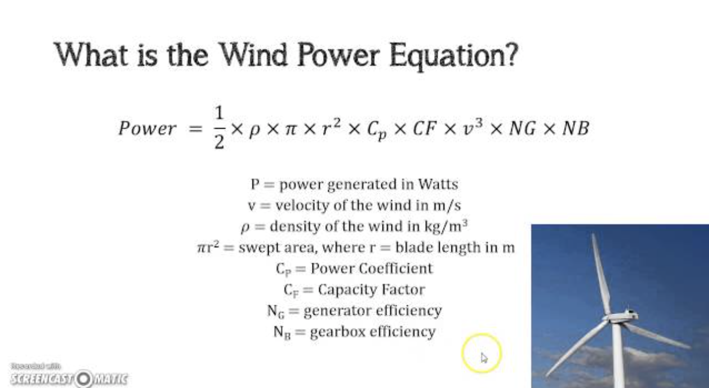



The Calculations
Notes:
The wind power equation used here was the main equation behind our algorithm. The beauty of our program is that every single one of these variables is automatically calculated and outputted. The county data is taken from address inputs by the user, which in turn can give us current wind velocities and the rest is mathematically calculated form there. Swept area is found per turbine model based on the radius of each arm.

Slide 9
03
Data Sources

Slide 10




OVERVIEW
US National Wind Turbine Database
Used for individual turbine data
Google Maps API
Used for Reverse Geocoding
Attom API
Used for Real Estate/MLS Data
Weather API
Used for Live Wind Data
Notes:
We have pulled data from four different data sources, all of which are officially verified and mass utilized.
These include, the US National Wind Turbine Database, which is maintained and created by Berkley and the US National Geographic Survey.
Google Maps API helps us to convert address into latitude and longitude and vice versa, which can be used for county data and ensuring accurate measurements.
Attom API is a publicly available MLS (Multiple Listing Service) that is used by real estate agents across the US for property listings.
Lastly, we use weather API to bring in wind data for our energy and power calculations for a specific region. These numbers help us to understand which turbine model is specifically best for each geographical location.
Combined, these four data sources bring us a HUGE amount of data that we can thoroughly analyze to ensure we are providing only the best and vetted data for our clients.

Slide 11
75,000 Data Points
Verified data published by US Geological Survey
Notes:
The main source of data that we used for our modeling and analysis is the public data from the US Geological Survey. This data contains more than 75,000 points within the US, with 27 different parameters we can use to compare against potential wind farm plots to determine suitable locations.

Slide 12
Future Plans
04

Slide 13
Progression Plan
Front End Development
Extensive Datasets
AI Implementation
Machine Learning Integration
Notes:
The first step in our progression plan is the Front End Development. Our current front-end framework leaves much to be desired, and with a little bit more time, that would be our immediate plan of action. After that, we can look into more extensive data sets, looking at trying to expand the data we are working with to other countries, and also including offshore wind farms in our data. With this increase in data, we can also look into Machine Learning Integration to more precisely track geographic attributes, which can be done by training our machine learning model on existing wind farm datasets. Our long term goal would be to implement AI into our project, which can help with analyzing our data on a much deeper level, finding robust patterns, and better predicting potential location for future wind infrastructure development.

Slide 14
THANKS!
WE APPRECIATE
YOUR ATTENTION!

