Slide 1
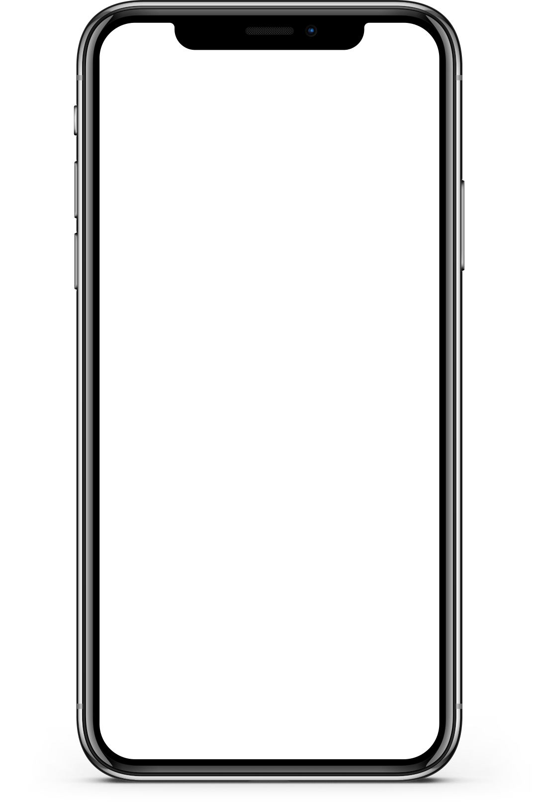

Login View
App
Logo
Login
Register

Slide 2


Home View
Activity
Active Matches 4
Outgoing Matches 3
Incoming Matches 2
People
John Doe
Joh
Tech News

Slide 3

Profile View
John Doe
mail@google.com
Interests
Movies
Tech
…
Music
…
…

