Slide 1
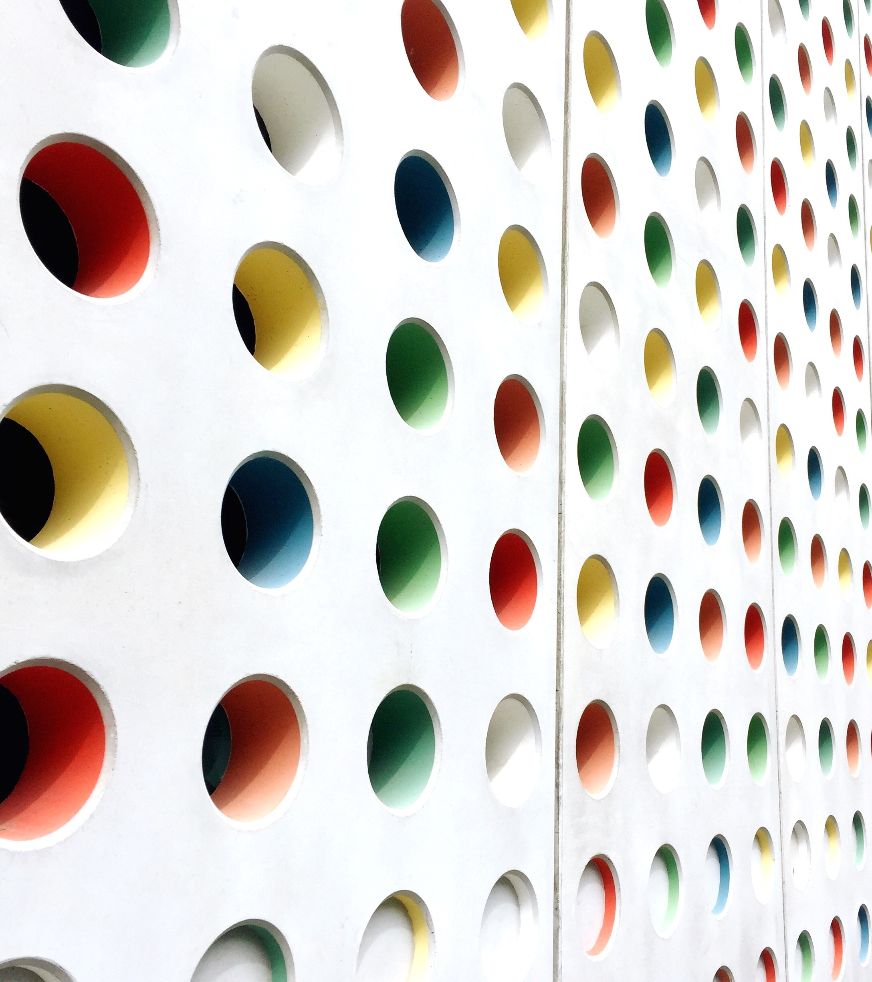
Pseudo-Arc Length Continuation
Arnav Gogate
23110043

Slide 2
Problem Statement: Solving Kirchhoff Rod Theory Problems using Keller’s pseudo arc-length continuation
Formulating the Boundary Value Problem
Applying the Finite Difference Method on the ODEs
Getting the algebraic equations from ODEs
Apply Keller’s Pseudo Arc Length Continuation algorithm
Import the equations into continuation file
Using Boundary Conditions to Formulate equations
Visualise the results.
(x,y) in our case

Slide 3
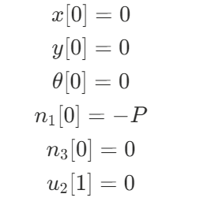

Kirchoff Rod Theory
Governing ODEs
Let number of equations be m
Boundary Conditions for our problem
Force Balance
1) $n_{1}^{′}=−u_{2}n_{3}−f_{1}$
2) $n_{3}^{′}=u_{2}n_{1}−f_{3}$
Momentum Balance
3)$K_{2}u_{2}^{′}=−n_{1}−l_{2}$
Kinematics and Constitutive Relations
4)$u_{2}=θ^{′}$
5)$r_{1}′ = sinθ$
6)$r_{3}′ = cosθ$

Slide 4
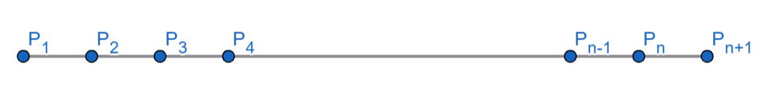
Finite Discretization Method
Step1: The domain is divided into n elements, so our domain has now n+1 points, including the endpoints.
Step 2: We want to evaluate the values of variables at the midpoints of these points(midpoint method)
Step 3: Define all the variables. We will have (n+1)*m Variables in total.
We have ‘m’ boundary conditions provided by the user.
Continuity gives us n*m more boundary conditions.
Hence, the system becomes solvable.
Step 4: After applying finite difference formulae to the derivatives within the equation, we finally have a giant list of n*m algebraic equations. We plug these into a pseudo arc length numerical continuation solver to get various solutions that vary with the parameter, in this case force P.

Slide 5
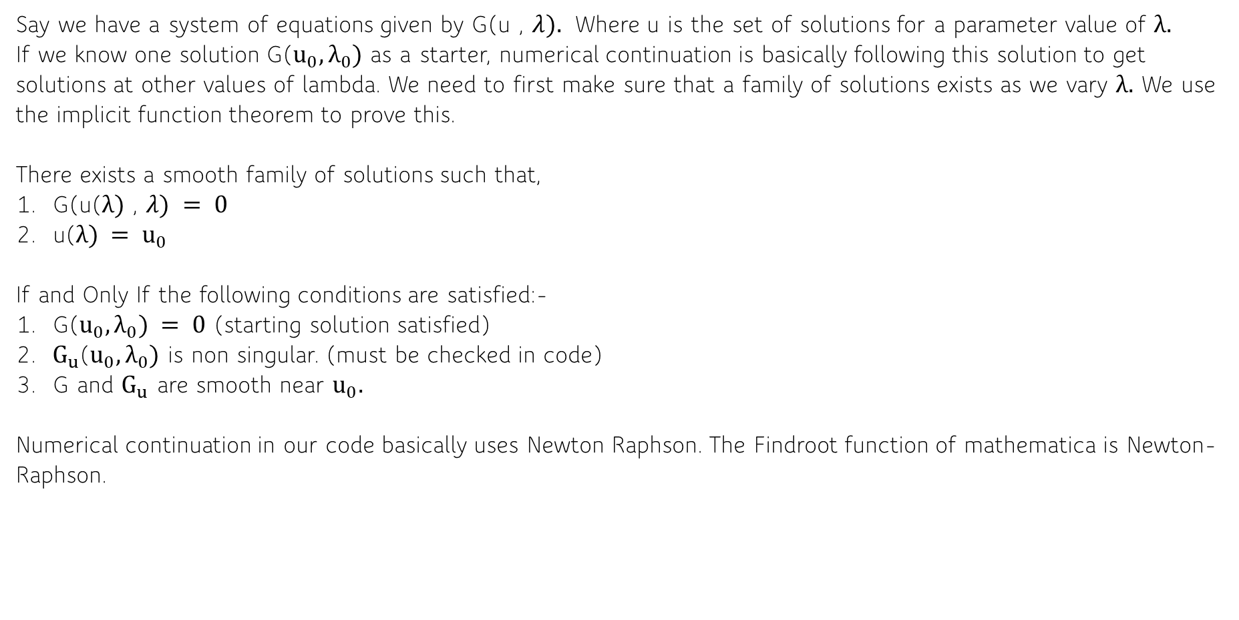
What is Numerical Continuation?
Say we have a system of equations given by G(u , $λ).$ Where u is the set of solutions for a parameter value of $λ.$
If we know one solution G($u_{0},λ_{0})$ as a starter, numerical continuation is basically following this solution to get solutions at other values of lambda. We need to first make sure that a family of solutions exists as we vary $λ.$ We use the implicit function theorem to prove this.
There exists a smooth family of solutions such that,
G(u($λ)$ , $λ) = 0$
u($λ) = u_{0}$
If and Only If the following conditions are satisfied:-
G($u_{0},λ_{0}) = 0$ (starting solution satisfied)
2. $G_{u}$($u_{0},λ_{0})$ is non singular. (must be checked in code)
G and $G_{u}$ are smooth near $u_{0}.$
Numerical continuation in our code basically uses Newton Raphson. The Findroot function of mathematica is Newton-Raphson.

Slide 6
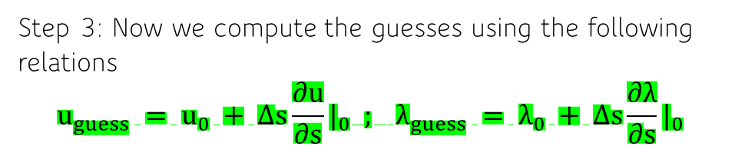
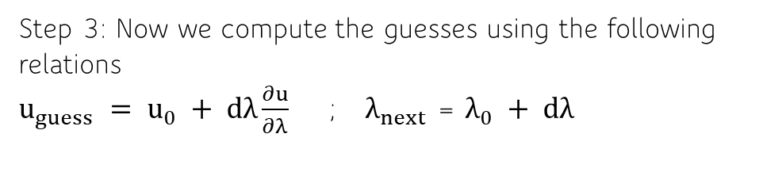
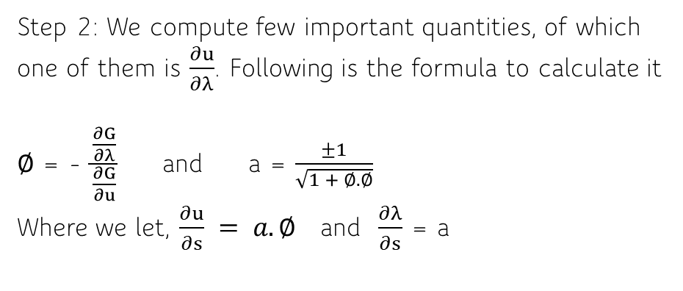
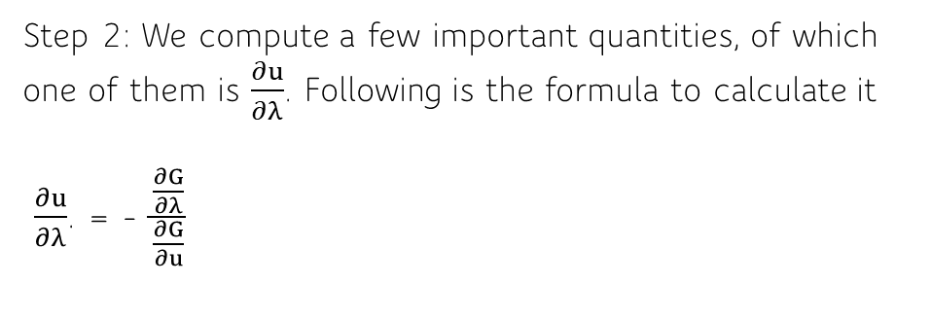
Parameter Continuation
Pseudo Arc-Length Continuation
Step 1: We have a known solution of the system G($u_{0},λ_{0})$
Step 1: We have a known solution of the system G($u_{0},λ_{0})$
Step 2: We compute a few important quantities, of which one of them is $\frac{∂u}{∂λ}$. Following is the formula to calculate it
$\frac{∂u}{∂λ}$. = - $\frac{\frac{∂G}{∂λ}}{\frac{∂G}{∂u}}$
Step 2: We compute few important quantities, of which one of them is $\frac{∂u}{∂λ}$. Following is the formula to calculate it
$∅$ = - $\frac{\frac{∂G}{∂λ}}{\frac{∂G}{∂u}}$ and a = $\frac{±1}{\sqrt{1 + ∅.∅}}$
Where we let, $\frac{∂u}{∂s} = a.∅$ and $\frac{∂λ}{∂s}$ = a
Step 3: Now we compute the guesses using the following relations
$u_{guess} = u_{0} + dλ\frac{∂u}{∂λ}$ ; $λ_{next}$ = $λ_{0} + dλ$
Step 3: Now we compute the guesses using the following relations
$$u_{guess} = u_{0} + ∆s\frac{∂u}{∂s}|_{0} ; λ_{guess} = λ_{0} + ∆s\frac{∂λ}{∂s}|_{0}$$

Slide 7
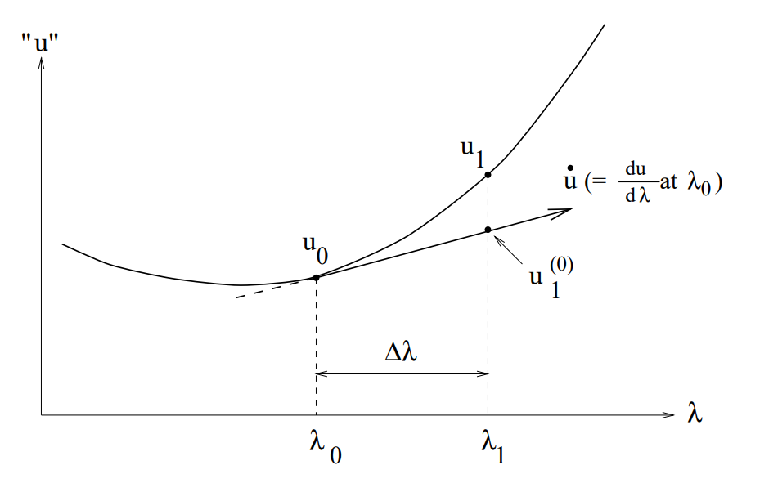
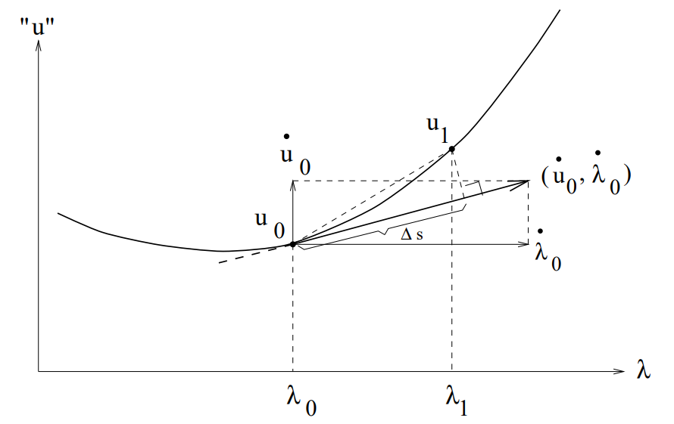
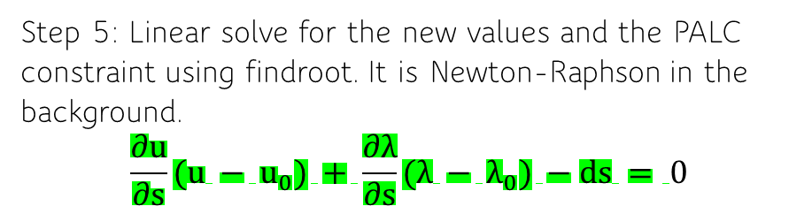
Parameter Continuation
Pseudo Arc-Length Continuation
Step 4: Graphical Representation
Step 4: Graphical Representation
Step 5: Linear solve for the new values using findroot. It is Newton-Raphson in the background.
Step 5: Linear solve for the new values and the PALC constraint using findroot. It is Newton-Raphson in the background.
$$\frac{∂u}{∂s}(u − u_{0}) + \frac{∂λ}{∂s}(λ − λ_{0}) −ds = 0$$
Step 6: Update Values in iteration loop.
Step 6: Update Values in iteration loop.

Slide 8
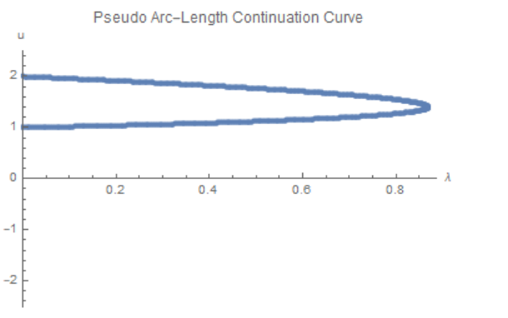
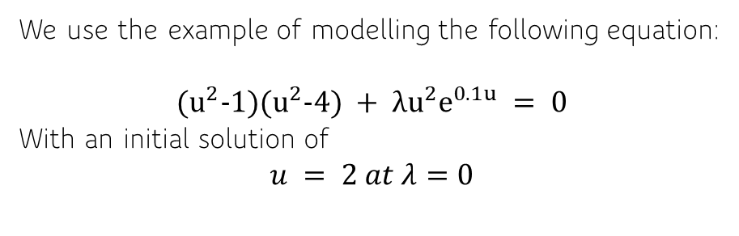
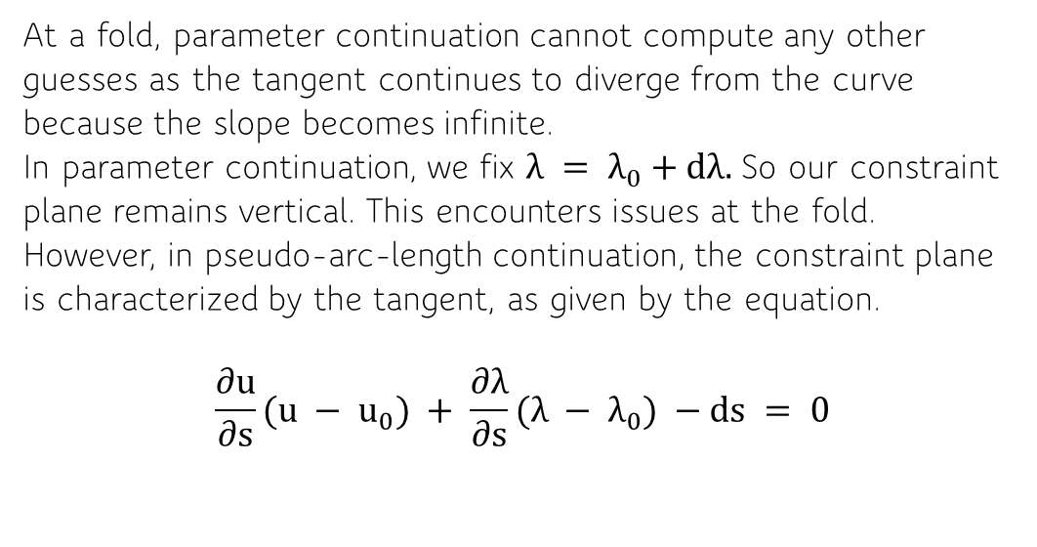
Why Pseudo-arc-length-continuation?
We use the example of modelling the following equation:
$${(u}^{2}−1)(u^{2}−4) + λu^{2}e^{0.1u} = 0$$
With an initial solution of
$$u = 2 at λ=0$$
At a fold, parameter continuation cannot compute any other guesses as the tangent continues to diverge from the curve because the slope becomes infinite.
In parameter continuation, we fix $λ = λ_{0}+dλ.$So our constraint plane remains vertical. This encounters issues at the fold.
However, in pseudo-arc-length continuation, the constraint plane is characterized by the tangent, as given by the equation.
$$\frac{∂u}{∂s}(u − u_{0}) + \frac{∂λ}{∂s}(λ − λ_{0}) −ds = 0$$

Slide 9
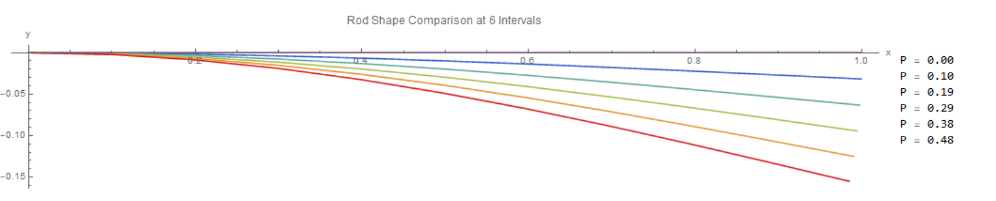
Deformation of Rod
Optional: Demonstration of the working of the code: Put n = 10 for quick results
The deformation of the rod is as expected. As the value of the applied Force is increased, the deformation of the rod increases. Our variation parameter here is the force P.

Slide 10
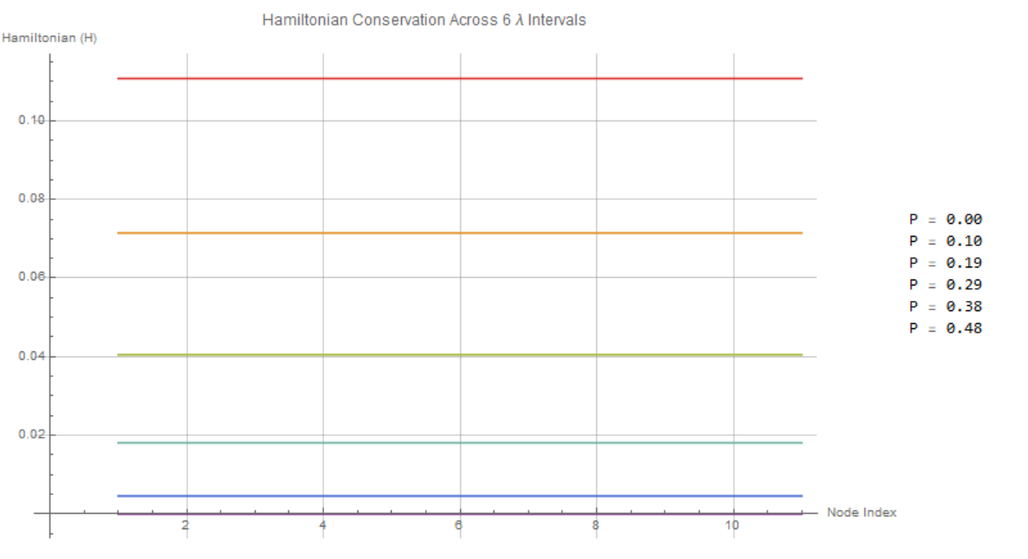
Validation(Hamiltonian conservation)

Slide 11
THANK YOU

