Slide 1
BCSE329L — BLOCKCHAIN AND DISTRIBUTED LEDGER TECHNOLOGY
Authentimed
AI + Blockchain Based Counterfeit Drug Detection System
Review 2 | Implementation Progress Report
Team
Arnav Sinha (23BKT0028)
Kapilan Kathirvel (23BKT0035)
Ashwin Raj (23BKT0103)
Faculty Guide
Ms. Sivaranjani A
Date
10 & 17 Sept 2026

Slide 2
01 RECAP
Recap of Review 1 — The Problem
1 in 10
$30.5 bn
>1 million
medical products in LMICs is
substandard or falsified (WHO)
spent globally every year on
falsified / substandard medicine
deaths per year attributed
to these products (WHO)
Research gap identified in Review 1
Static QR / barcode mandates (India Schedule H2, US DSCSA, EU FMD) make serialization compulsory — but a printed code carries no secret. A photograph of one genuine pack (as in the Feb 2025 Howrah seizure) can be reprinted on thousands of fakes, and a stateless scan only checks that a code exists, never whether that pack has already been sold.
Our framework's contribution: a stateful custody ledger where every pack carries a lifecycle state, not merely a registered identity — so duplication itself becomes detectable.
2

Slide 3
01 RECAP
What's Changed Since Review 1
1
Full-Stack Implementation
2
AI Packaging Verification
React frontend + Flask backend + Sepolia Testnet smart contract — a live deployed end-to-end system replacing the Review 1 design-only proposal.
OpenCV-based structural comparison checks the physical authenticity of packaging — extending scope from digital-only to digital + physical validation.
3
Dual-Factor Authentication
4
Stateful Replay Protection
QR-code serialization plus an embedded 10-char hidden PAN code (revealed via colour-channel processing) linked in Supabase PostgreSQL for stronger physical security.
The core Review-1 anti-cloning mechanism is implemented end-to-end: one scan per product, enforced on-chain.
3

Slide 4
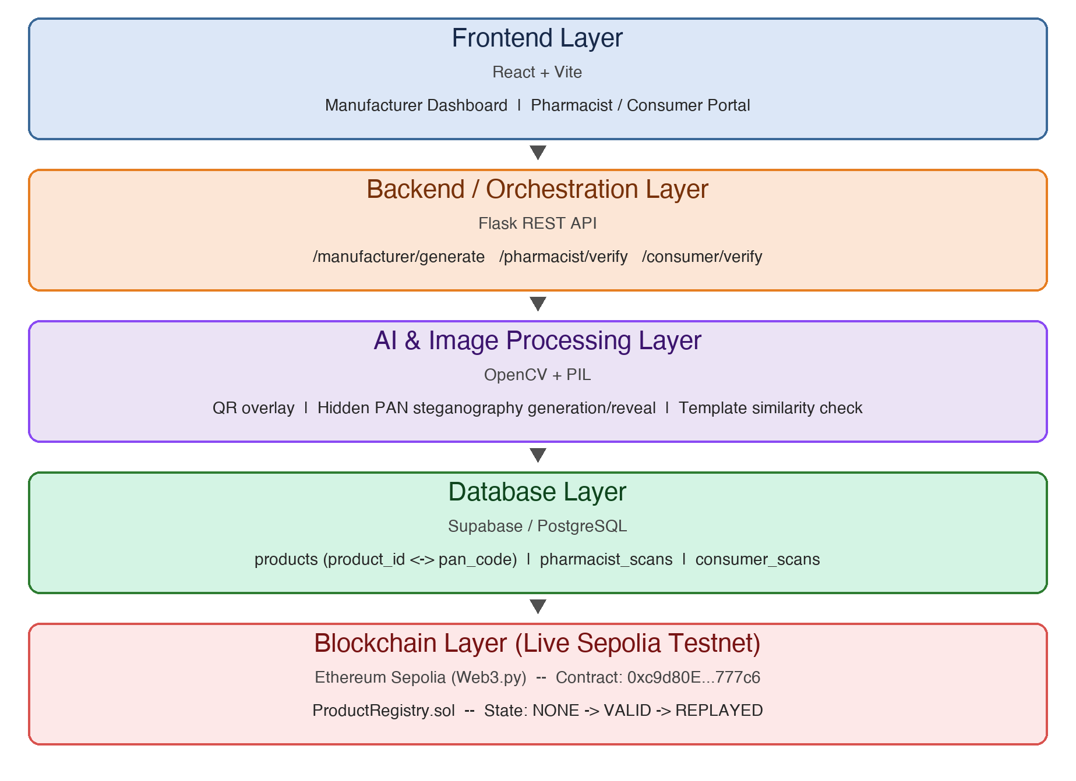
02 ARCHITECTURE
System Architecture
Five layers, deployed end-to-end
Key point
React/Vite frontend, a Flask orchestration backend, an OpenCV + PIL AI layer, Supabase/PostgreSQL for off-chain records, and an Ethereum Sepolia smart contract (ProductRegistry.sol) as single source of truth.
Only the fingerprint and lifecycle state live on-chain. Image data and similarity checks stay off-chain — the Review 1 design principle, now implemented.
4

Slide 5
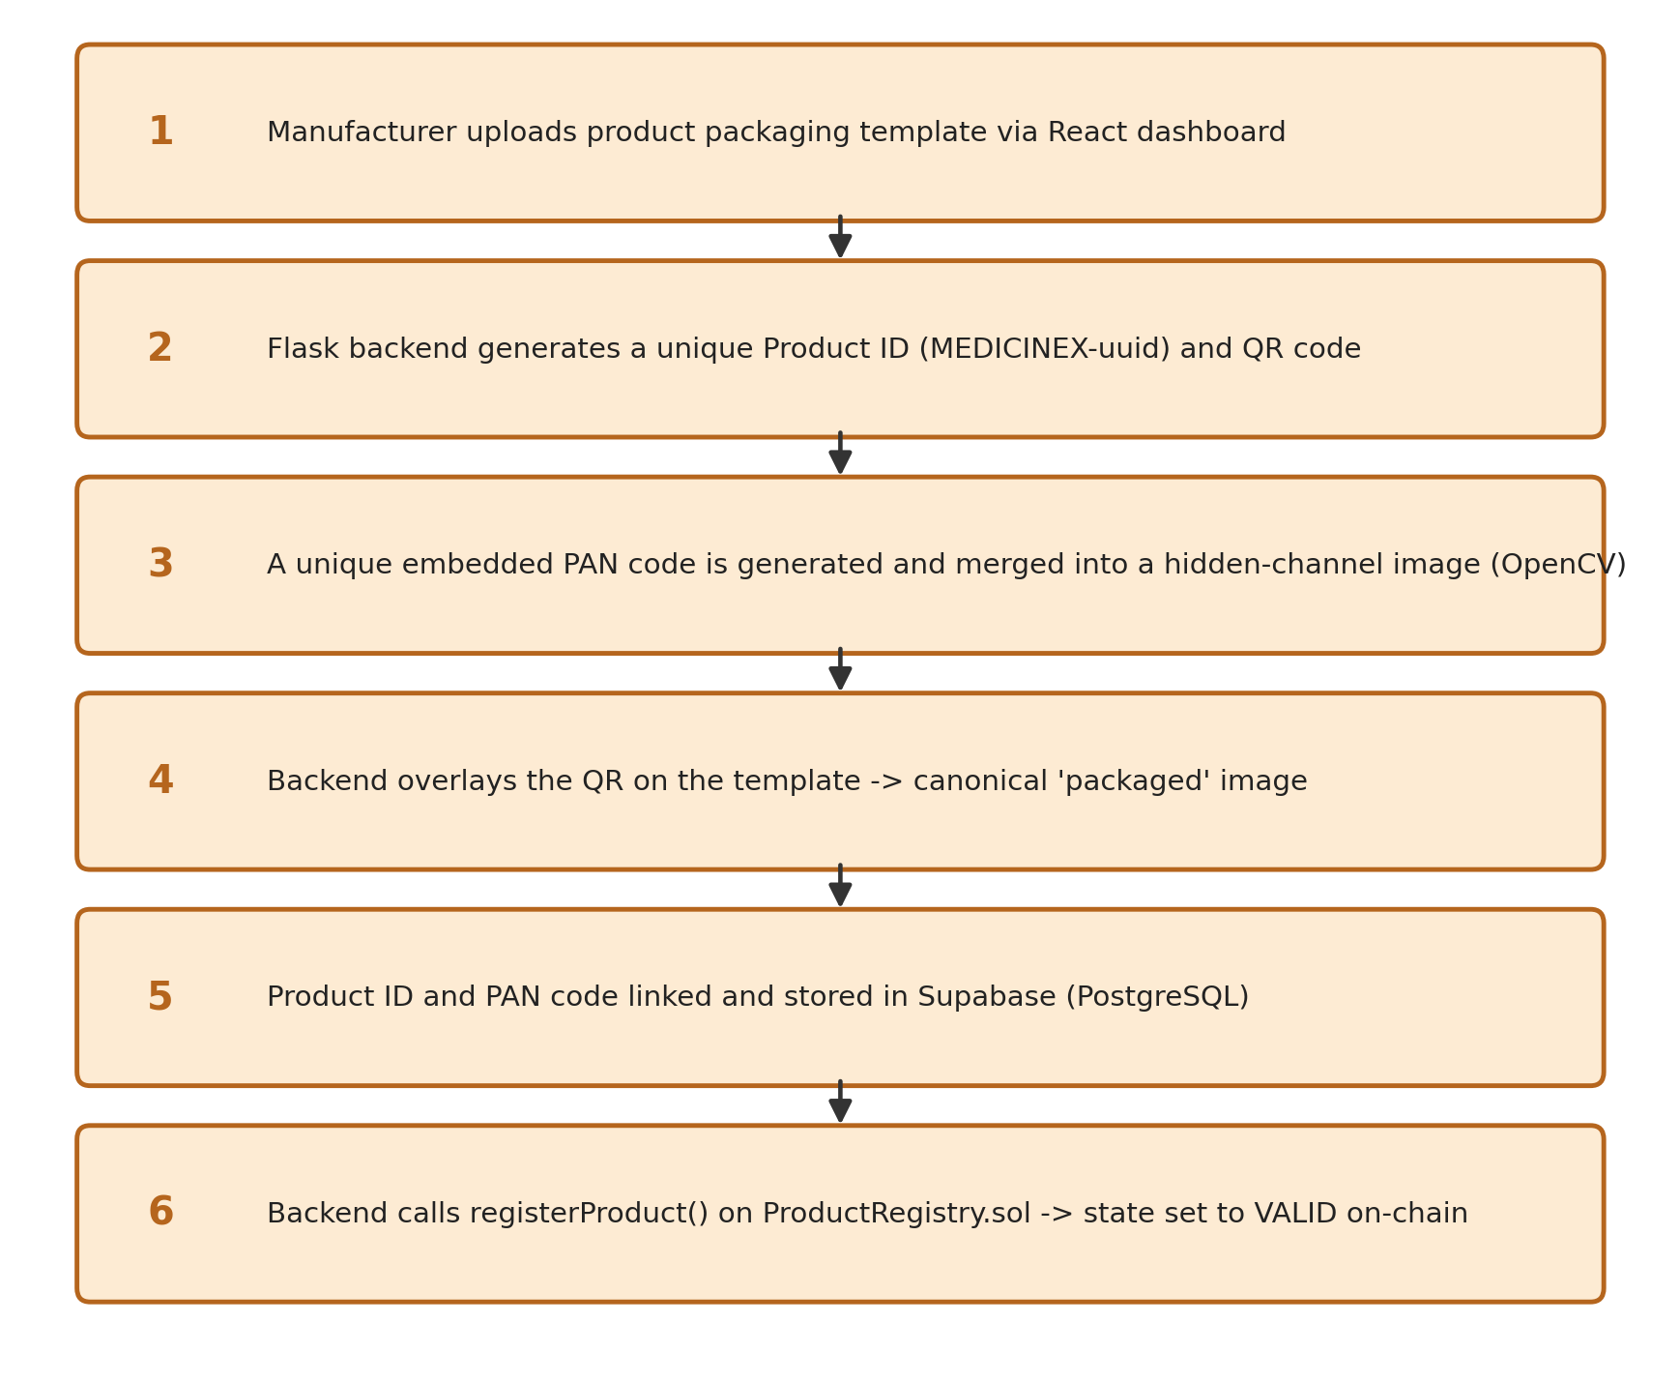
03 WORKFLOW / DATA FLOW
Workflow — Manufacturer Registration
The manufacturer uploads a packaging template. The backend mints a unique Product ID (MEDICINEX-uuid), generates a QR code and a hidden PAN code, produces the canonical packaged image, stores the mapping in Supabase, and registers the product on-chain in the VALID state.
Output: canonical packaged image + on-chain VALID state
5

Slide 6
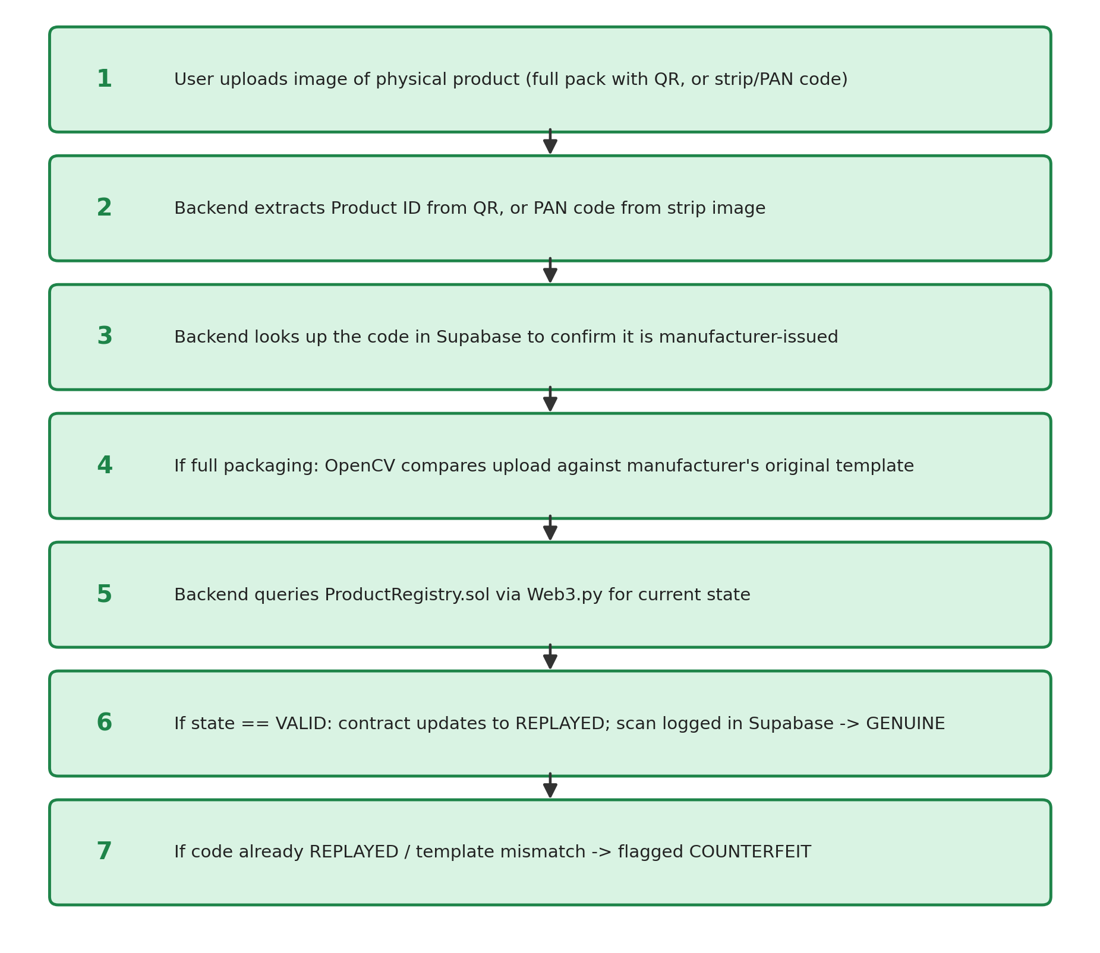
03 WORKFLOW / DATA FLOW
Workflow — Verification & Replay Detection
A pharmacist or consumer uploads a photo. The backend extracts the identifier, checks Supabase, runs the OpenCV template comparison for full-pack images, then queries the smart contract.
If state == VALID -> flips to REPLAYED, scan logged -> GENUINE
If already REPLAYED, or template mismatch -> COUNTERFEIT
A photographed and reprinted QR passes a stateless, database-only check — but is caught here the moment it is scanned a second time, because state lives on-chain.
6

Slide 7
04 DATASET
Dataset Details
No pre-collected external dataset is used. The verification task's 'ground truth' is each manufacturer's own registered template, so data is generated dynamically by the system itself.
Source
Manufacturer-uploaded packaging templates + dynamically generated QR / PAN codes
Preprocessing
OpenCV normalizes image resolution; extracts features for structural-similarity comparison; isolates R/G/B channels to embed and reveal the hidden PAN code
Storage
Packaged, hidden, and R/G/B reveal images are written to backend/generated/; only file references (not binary data) are passed to the frontend
Splits
No train/validation/test split — verification is a one-shot comparison against a single registered template, not a trained classifier
7

Slide 8
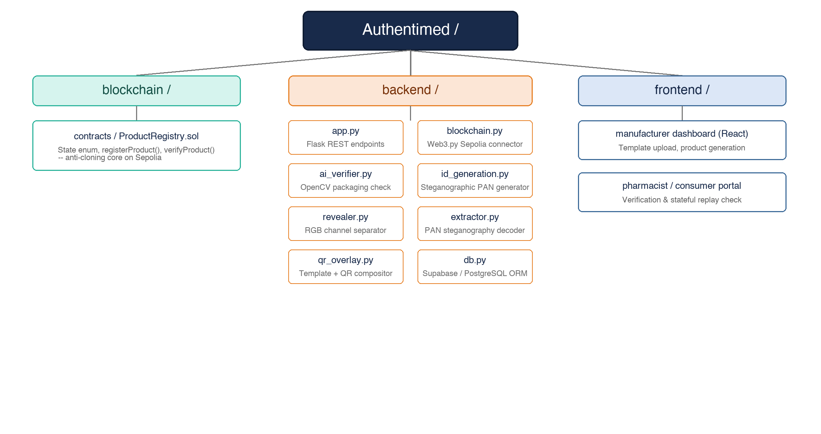
05 IMPLEMENTATION DETAILS
Implementation — Code Structure
8

Slide 9
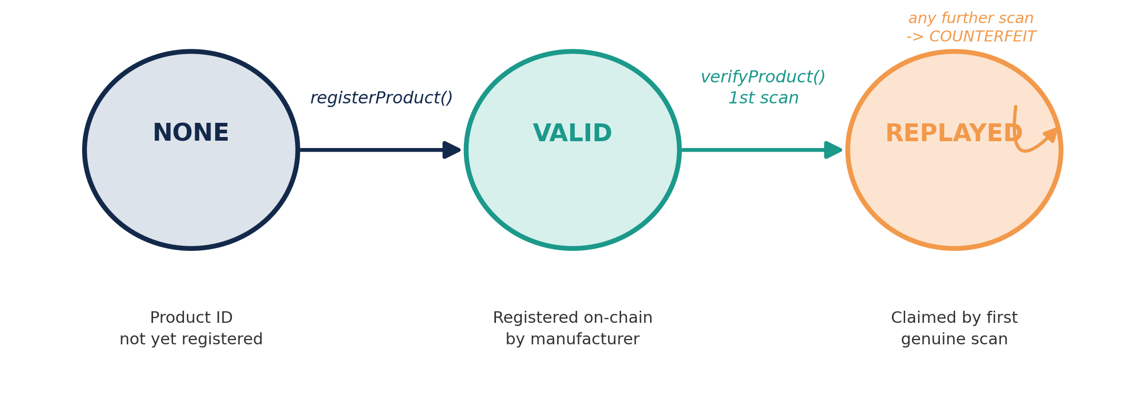
05 IMPLEMENTATION DETAILS (II) KEY ALGORITHM
Core Innovation — Anti-Cloning State Machine
Every registered product exists in exactly one on-chain state. A product may move VALID -> REPLAYED exactly once, inside ProductRegistry.sol — this single guarded transition is what turns a copied / reprinted QR code from an undetectable clone into an immediate COUNTERFEIT flag on its second use.
Stateless QR check
Stateful ledger check
confirms a code exists
confirms it hasn't been claimed
9

Slide 10
05 IMPLEMENTATION DETAILS (II) — KEY ALGORITHM
verifyProduct() — the guarded state transition
// SPDX-License-Identifier: MIT
pragma solidity ^0.8.28;
enum State { NONE, VALID, REPLAYED }
function registerProduct(string memory id) public onlyOwner {
require(products[id].state == State.NONE, "Already registered");
products[id] = Product({ manufacturer: msg.sender, state: State.VALID });
}
// Anti-cloning core: single guarded transition VALID -> REPLAYED
function verifyProduct(string memory id) public returns (bool) {
if (products[id].state == State.VALID) {
products[id].state = State.REPLAYED; // mark claimed
return true; // first scan: GENUINE
}
return false; // repeat scan: COUNTERFEIT
}
One-way state transition enforced on-chain; state lives in ProductRegistry.sol on Sepolia, so no off-chain service can re-validate an already-claimed pack.
10

Slide 11
05 IMPLEMENTATION DETAILS (II) KEY ALGORITHM
Dual-Factor Security — Hidden PAN Code
1
Generate PAN
A random packaging authentication number is generated per product at registration.
2
Embed in colour channel
The PAN is bit-encoded into steganographic segment masks (id_generation.py) written to image channels — invisible under normal viewing.
3
Link to Product ID
QR-derived Product ID and PAN code are stored as a linked pair in Supabase, so either factor verifies the same identity.
4
Reveal on scan
A strip-only scan extracts the blue channel and decodes the bit pattern back into the PAN string.
Why it matters: photographing visible packaging alone does not disclose the PAN factor — raising the bar beyond a simple QR copy-and-reprint attack.
11

Slide 12
05 IMPLEMENTATION DETAILS — EVIDENCE
Testing & Validation Results
Unit · Integration · Security / Adversarial testing performed on the running pipeline
# | Scenario | Expected | Actual
1 | Generate product | Success — on-chain registration | Success
2 | First pharmacist scan (genuine QR) | GENUINE | GENUINE
3 | Duplicate scan (replay attack) | COUNTERFEIT — replay detected | COUNTERFEIT — duplicate scan
4 | Valid QR on incorrect packaging | COUNTERFEIT — packaging check failed | COUNTERFEIT — AI validation failed
12

Slide 13
06 FINAL EVALUATION PLAN
Final Evaluation Plan
Metrics defined in the Review 1 proposal, and how each will be measured for Review 3
Evaluation Parameter | Planned Measurement Method
Verification correctness / clone detection rate | Scripted batch of genuine + duplicated QR submissions against the deployed contract; count correct GENUINE / COUNTERFEIT verdicts
False positive rate on legitimate rescans | Repeat legitimate manufacturer / regulator audit scans through a dedicated read-only path; confirm no false COUNTERFEIT flags
Gas cost per registration & verification | Deploy to Sepolia testnet; log gas used per registerProduct() / verifyProduct() call across a batch
End-to-end verification latency | Timed requests from image upload to verdict, across the AI check + contract call round trip
Scalability at realistic pack volumes | Load-test the Flask API with concurrent verification requests; measure throughput degradation
Usability (pharmacist / patient) | Structured walkthrough with test users on the React dashboards; task-completion time and error rate
13

Slide 14
07 PLAN FOR OUTCOME
Plan for Outcome
1
2
3
Public testnet deployment (COMPLETED)
Quantified results package
Role-based access control
ProductRegistry.sol deployed on Sepolia (0xc9d80E...777c6) via Web3.py in backend/blockchain.py.
Gas cost, latency, clone-detection and false-positive tables ready for Review 3's comparison section.
JWT-authenticated RBAC across regulator / manufacturer / distributor / pharmacist / patient roles.
4
5
6
Baseline comparison
IoT cold-chain extension
Multi-hop custody binding
Benchmark against static-QR / stateless-portal approaches (e.g. MediLedger-style prior art) named in Review 1.
Bring in the proposed Layer-2 sensing pipeline so substandard (not just falsified) products can be flagged.
Extend beyond direct manufacturer-to-pharmacist transfer to a full signed custody chain.
14

Slide 15
Thank You
Questions & Discussion
GitHub Repository
https://github.com/BruhGunned/Authentimed
Arnav Sinha (23BKT0028) · Kapilan Kathirvel (23BKT0035) · Ashwin Raj (23BKT0103)

Slide 16
05 IMPLEMENTATION DETAILS (III) — CODE SNIPPETS
Implementation Code Snippets — AI, Backend & Steganography
# ai-auth/verify.py - OpenCV AI Packaging Check
def verify_packaging(scan_path, template_path):
scan_blur, scan_col, scan_cent = extract_features(scan_img)
tpl_blur, tpl_col, tpl_cent = extract_features(tpl_img)
# 1. Blur Check (Laplacian Variance)
if scan_blur < tpl_blur * 0.7: return False
# 2. Color Check (RGB Mean Norm)
if norm(scan_col - tpl_col) > 80.0: return False
# 3. Centroid Check (Canny Edge Centroid)
if norm(scan_cent - tpl_cent) > 12.0: return False
return True # All AI packaging checks passed
# backend/id_generation.py - Steganography
def _validate_code(code):
# Format: 4 letters + 5 digits + 1 letter (10 chars)
if len(code) != 10 or not (code[:4].isalpha()
and code[4:9].isdigit() and code[9].isalpha()):
raise ValueError('Invalid 10-char PAN format')
return code.upper()
# Steganographic Blue Channel Embedding:
def _draw_character(pixels, x_offset, char, channel):
# Embeds segment masks into blue LSBs
pixels[x, y] = (r, g, b | mask_bit)
Modular Python Architecture: OpenCV structural comparison (ai-auth) + PIL steganographic bit-encoding (backend) execute off-chain.

