Slide 1
Process
IPC Through PIPE

Slide 2
Zombie Process
A zombie process is a process that has completed execution but still has an entry in the process table.
Occurs when a child process ends, but the parent process hasn't read its exit status using a wait() system call.
Characteristics:
No longer active or consuming CPU/memory resources.
Still holds a process ID.

Slide 3
Parent Process
Wait()
Parent Process
Fork()
Child Process
exec()
Child Process
Exit()
Child Process

Slide 4
Example of Zombie Process
#include<stdio.h>
#include<unistd.h>
int main()
{
pid_t t;
t=fork();
if(t==0)
{
printf("Child having id %d\n",getpid());
}
else
{
printf("Parent having id %d\n",getpid());
sleep(15); // Parent sleeps. Run the ps command during this time
}
}

Slide 5
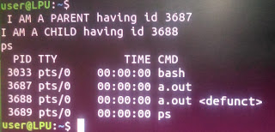
$gcc zombie.c $./a.out &
Notes:
Now Compile the program and run it using ./a.out &. The ‘&’ sign makes it run in the background. After you see the output of both the printf statement, note that the parent will go into sleep for 15 seconds. During this time type the command ‘ps’. The output will contain a process with defunct written in the end. Hence, this is the child process (can be verified from PID) which has become zombie.

Slide 6
Daemon Process
A background process that is not under the direct control of the user.
This process is usually started when the system is bootstrapped, and terminated with the system shut down.

Slide 7
Inter-Process Communication
Inter-process communication (IPC) is a mechanism that allows processes to communicate with each other and synchronize their actions.
Essential for process coordination, data sharing, and resource management.

Slide 8
Some of the common IPC mechanism
Pipes: Allows unidirectional communication between a parent and child process.
Shared Memory: Provides a memory segment that can be accessed by multiple processes.
Semaphores: Used for process synchronization and controlling access to shared resources.
Sockets: Allows communication between processes over a network or on the same machine.
Memory-Mapped Files: Maps a file or device into memory so that it can be accessed by multiple processes as if it were a part of their memory.

Slide 9
Remote Procedure Calls (RPC): Allows a process to execute code in another address space (usually on another machine) as if it were a local procedure call.
D-Bus: A high-level IPC mechanism used in Linux for communication between different applications.
Files: Processes can communicate by reading from and writing to a common file.
Signals: Asynchronous notifications sent to a process to notify it of an event (e.g., termination, user interrupts).

Slide 10
IPC (Inter-process communication) can be achieved using popen/pclose functions.
popen() function opens a process by creating a pipe, forking and invoking the shell.
Syntax:
#include<stdio.h>
FILE *popen(const char *command, const char *type)

Slide 11
PIPE
A pipe is a unidirectional communication channel used for IPC between two processes.
The data is handled in a first-in, first-out (FIFO) order.
A pipe is created using pipe().
On success it return two file descriptors pipefd[0] and pipefd[1].
pipefd[0] is the reading end of the pipe.
pipefd[1] is the writing end of the pipe.

Slide 12
Types of Pipes
Unnamed Pipes
Used for communication between parent and child processes.
Cannot be accessed outside the process tree where they were created.
Named Pipes (FIFOs)
Can be used for communication between unrelated processes.
Exists in the file system and can be accessed by multiple processes.

Slide 13
How Pipes Work
Data Flow: Data is written to one end of the pipe (write-end) and read from the other end (read-end).
Blocking Behavior: If the pipe is empty, read operations block until data is available; if the pipe is full, write operations block until space is available.

Slide 14
//Q. Program to send a message from parent process to child process using pipe()
#include<stdio.h> #include<unistd.h> #include<sys/types.h> #include<sys/wait.h> int main() { int fd[2],n; char buffer[100]; pid_t p; pipe(fd); //creates a unidirectional pipe with two end fd[0] and fd[1] p=fork(); if(p>0) //parent { printf("Parent Passing value to child\n"); write(fd[1],"hello\n",6); //fd[1] is the write end of the pipe wait(); } else // child { printf("Child printing received value\n"); n=read(fd[0],buffer,100); //fd[0] is the read end of the pipe write(1,buffer,n); } }
Notes:
The parent process create a pipe using pipe(fd) call and then creates a child process using fork(). Then the parent sends the data by writing to the writing end of the pipe by using the fd[1] file descriptor. The child then reads this using the fd[0] file descriptor and stores it in buffer. Then the child prints the received data from the buffer onto the scree

Slide 15
Use Cases
Command chaining in Unix/Linux shells (e.g., ls | grep).
Inter-process communication in client-server models within the same system.
Process synchronization in parallel processing.
Notes:
Inter-Process Communication in Daemons and Services:
Scenario: Daemons (background services) often need to communicate with client applications or other services running on the same system.
Use Case: Pipes can be used to allow a daemon to receive commands or data from client applications. For example, a print spooler daemon may receive print jobs via a pipe from various applications.

Slide 16
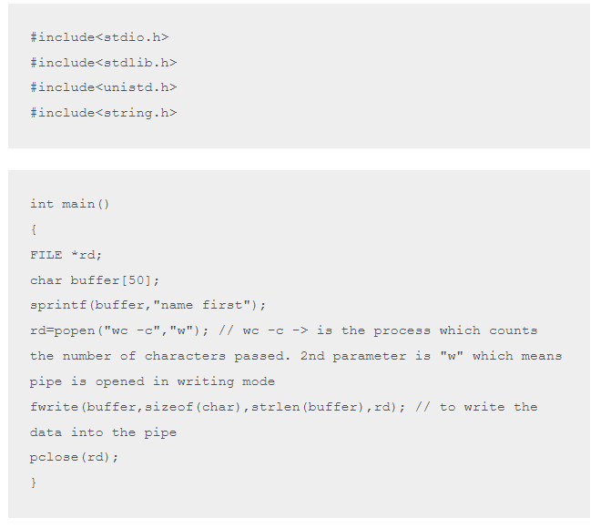
Program for IPC using popen()
Notes:
There are two programs “ipc1.c” (which will send the data) and “wc” command(which will receive the data). As the data will be sent to another process, so the mode of opening the pipe is writing mode “w”. popen() establishes the pipe between ipc1.c and wc. fwrite() function writes data into this pipe. ipc1.c stores some data in the buffer, then it connects with “wc” using popen. Finally, the fwrite() function writes data into the pipe. The data is received by “wc” which then counts the number of characters in the input and prints it

Slide 17
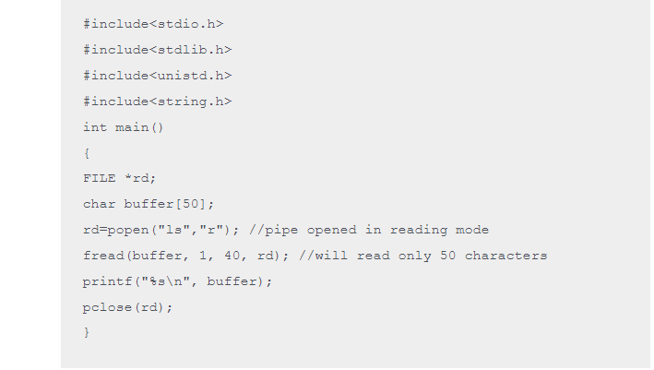
Program to read from a pipe i.e. to receive data from another process
Notes:
In this case, we establish the pipe between “ipc2.c” and “ls”. Since, the data will be read, hence, the pipe is opened in reading mode “r”. ls sends the data through the pipe. This data will be read by ipc2.c. So, this time our program is the one receiving the data. ls will send the list of files in current working directory. ipc2.c will read that, save it in buffer and then finally print it.

Slide 18
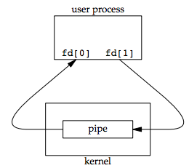
pipe() system call takes one integer array of size 2, as an argument, e.g.,
#include <unistd.h>
int fd[2]; pipe(fd);
/* Returns: 0 if OK, −1 on error */

Slide 19
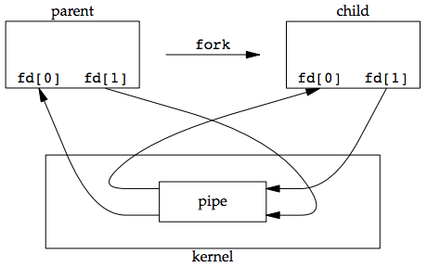
The child inherits all open file descriptors of the parent

Slide 20
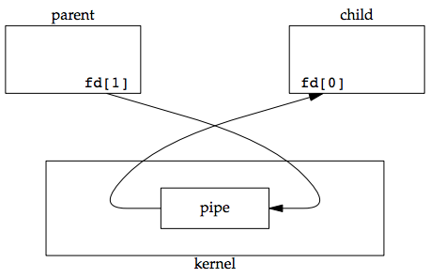
Parent closes its read file descriptor, and child closes the write file descriptor. // close(filedescriptor)

Slide 21
If a process writes to a PIPE without any read fd opened then write returns -1, i.e., write fails.
If a process reads from a PIPE without any write end opened, read returns 0 to indicate an end of file after all the data has been read from PIPE.
Technically, this end of file is not generated until all the write fds are not closed, and the reader waits until some input is available.
For writing, at least ONE read fd must be opened.
For reading, if you want end of pipe (or eof) character then all write fds must be closed.
Example, ls –l | wc –l
While executing wc –l, it won’t terminate if it doesn’t find eof character.

Slide 22
Assignments
You have an existing program, “input.c,” which prints a welcome message for the currently logged-in user and prints the date and time. The compiled file of this program is “input”. Write another program that calls the compiled file “input” and prints the data entered by the user.
Create a basic chat application using pipes where the parent and child processes can send and receive messages in a loop until a specific termination message (e.g., "exit") is sent.

