Slide 1

Raspberry Pi Network Attached Storage Arnav Surve CNIT 176

Slide 2
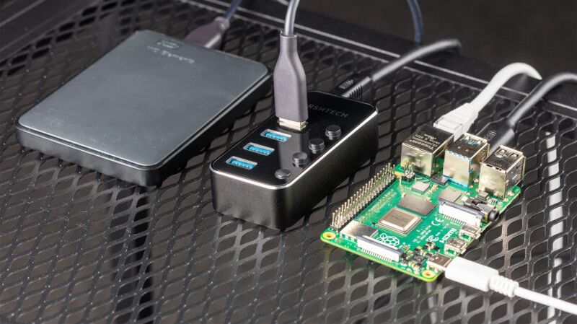
Business Case
File-level computer data storage server
Allows for data access between multiple users & from multiple devices via home or office wireless network
Easier collaboration and more effective data sharing
Can be used to host secure backups of important files

Slide 3

Architecture
ARM v6 SOC to run operating system, kernel, and software - specifically, OpenMediaVault
Wifi adapter to connect to CNIT Pi Wifi
SSH for remote login
SMB for network file access
USB ports for USB drive storage
Continuous power through power supply
Display and GPIO not required

Slide 4
Procedures

Slide 5
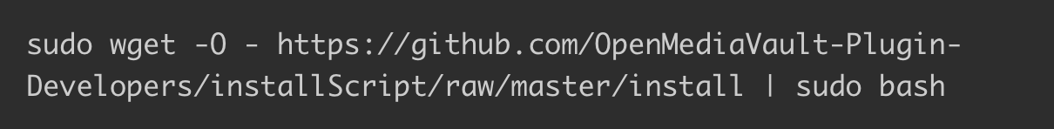
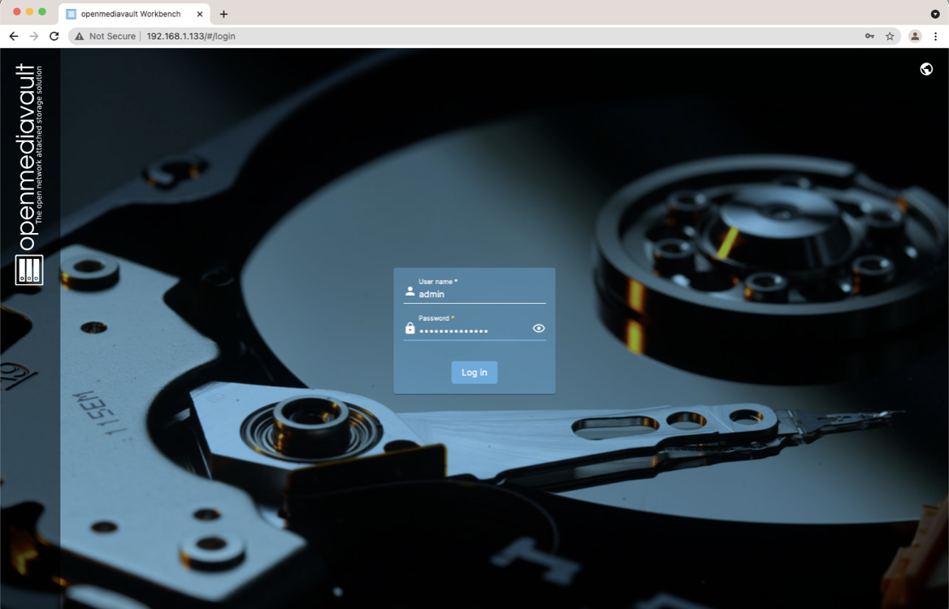
OPENMEDIAVAULT
Install OpenMediaVault
Visit Raspberry Pi IP address in personal computer browser
Login with username ‘admin’, password ‘openmediavault’

Slide 6
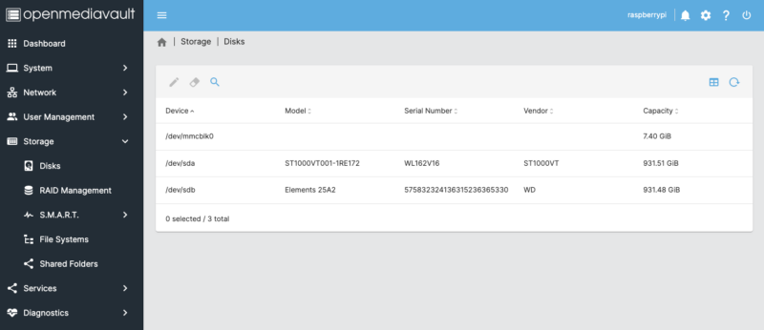
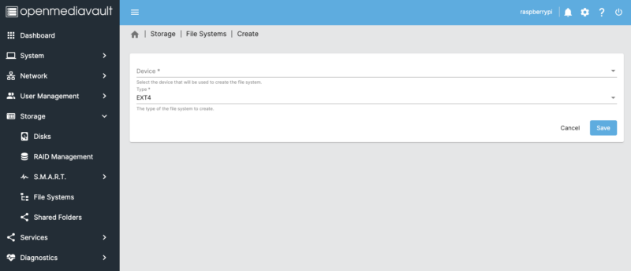
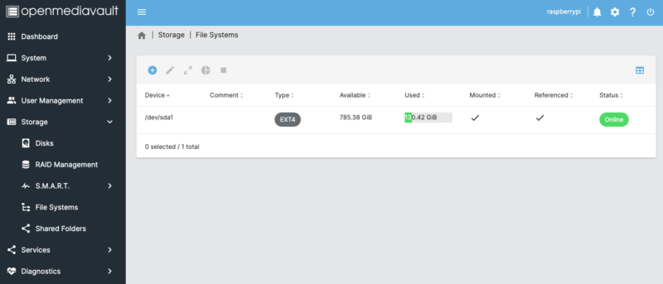
Network Access
Verify storage
All attached storage including microSD card should show
Create & mount new drive (USB)
Selected EXT4 for drive format

Slide 7
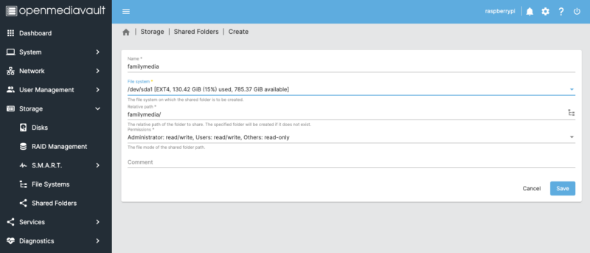
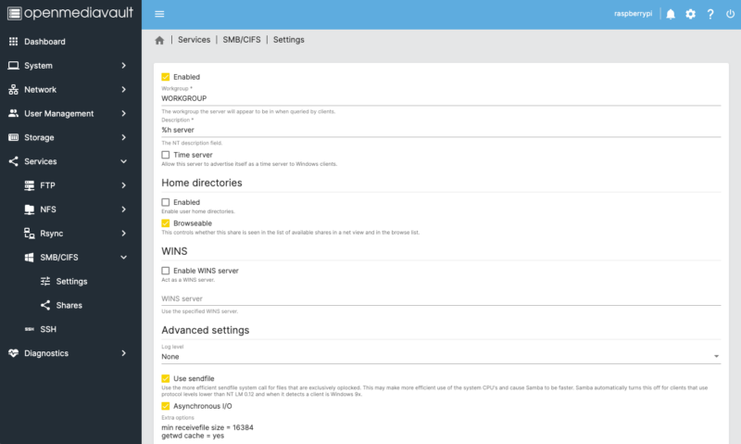
Network Access Contd.
Create shared folder
Assign name, select drive, grant user permissions
Ensure computers on network can find the folder
Select SMB/CIFS
Check ‘Enabled’ in settings
Select ‘Create’ under Shares and add shared folder

Slide 8
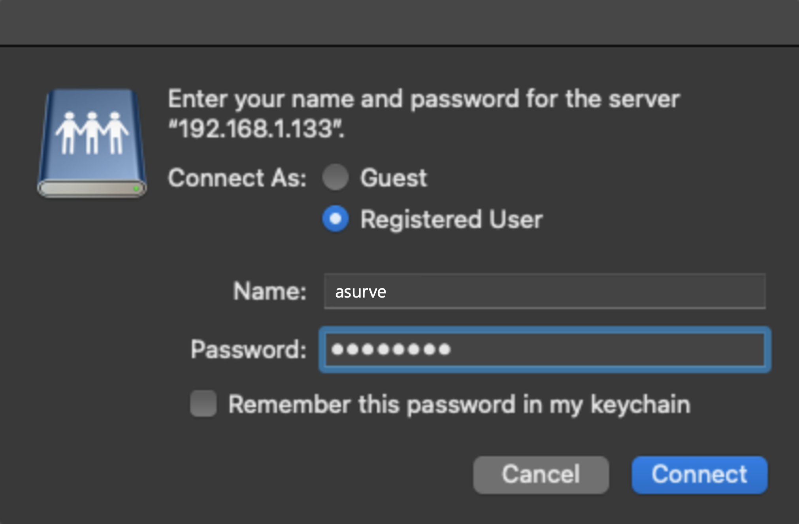
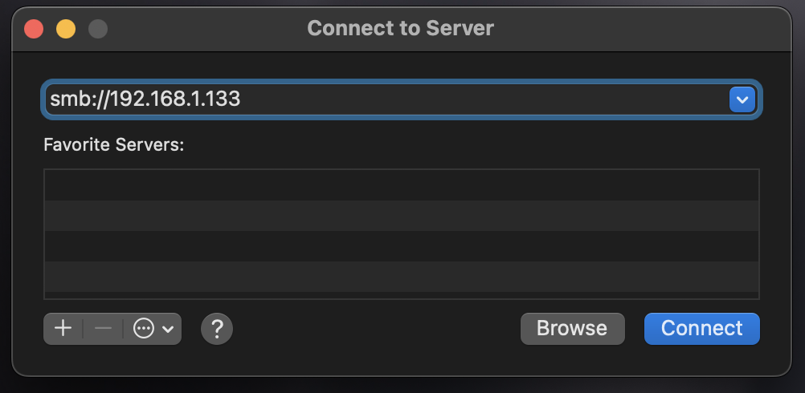

Network Access Contd.
Connect to SMB server on personal computer
Enter OpenMediaVault username & password (set earlier)
Shared folder is made available in file explorer

Slide 9
Results
All goals were met
Working file access through laptop
Did not test with other devices, only laptop available
Troubleshooting: When initially accessing the web interface, the login screen did not respond after entering openmediavault login credentials.
Solution: Tried solution stated at https://forum.openmediavault.org/index.php?thread/33600-how-to-fix-full-os-filesystem-gui-login-loop/. When this did not work, I reinstalled openmediavault which resolved the issue

Slide 10

Lessons Learned
In the future I would use a larger hard drive for more storage or a solid-state drive for faster read & write speeds.
For a more practical use case I would rather purchase a dedicated NAS storage device as they are more reliable, offer more storage, and perform much faster than a Raspberry Pi NAS.
I also contemplated whether cloud storage would be a better choice than using a NAS, but found that compared to cloud, a NAS provides more storage per cost

