Slide 1

Visual CV
Presented by: 1) Shruti Netake
2) Kirti Patil
3) Arnav Tambe
4) Devarsh Muthe
Mentor name: Prof. V. E. Pawar
Expert: Prof. S. S. Kadam

Slide 2
Introduction
Key Features
Literature Review
Drawbacks of Online Resume Builders
Problem Statement
Objectives of Work
Model Diagram
Proposed Solution
Implementation
Conclusion
References
Table Of Contents

Slide 3
We are going to create a application which helps students to get their Resume in hand just by filling up a simple form where important credentials need to be filled. This project is ideal for individuals who need to quickly create a resume without the need for complex software
The Visual CV is a simple, user-friendly Java application It prompts users for personal details, education, work experience, and skills, then formats this information into a structured resume.
The application will be easy to use and user-friendly.
It is compatible with mobile phones and other
devices. The application uses java and ideal for those needing a straightforward resume tool without complex features.
C
INTRODUCTION
B
A

Slide 4


01
INTERACTIVE INPUT:
02
The program prompts the user to enter details like full name, email, phone number, address, objective, education, work experience, and skills.
03
Key Features

Slide 5
01
INTERACTIVE INPUT:
02
The program prompts the user to enter details like full name, email, phone number, address, objective, education, work experience, and skills.
03
Key Features

Slide 6
01
AUTOMATIC FORMATTING:
02
The provided information is formatted into a neat and organized resume structure
03
Key Features

Slide 7
01
FILE OUTPUT:
02
The generated resume is automatically saved as a .txt file with a name based on the user's full name.
03
Key Features

Slide 8
Rinki Tyagi et al. (2020):
This study proposes an Android application that generates formal format resumes. Users can choose from various templates and save their resumes in different formats. The application is free and user-friendly, but requires internet. connectivity and is limited to the Android platform.
Advantages:
It is free of cost.
It saves time for users
lt helps users to focus on content.
In application creation and modification are very simple and user-friendly task.
Literature Review

Slide 9
Bharti Kungwani et al. (2021):
This web application, "Analytical Resume Builder," provides users with analyzed stats and. resumes of other graduates. This allows users to compare their profiles and gain insights into industry trends. Additionally, the application informs users about upcoming job opportunities. The online resume builder is one of the most fantastic systems for the people who are either recently graduated students in their domain or if they don't have enough idea about the resume or don't have enough time to create the resume of good designs or patterns, then this platform is a very productive place for them.
Literature Review

Slide 10
Resume Builder A web application for creating a resume (2020):
This application focuses on creating visually appealing resumes using various templates and fonts. It also allows users to add links to their online profiles, such as LinkedIn and GitHub. The application is simple to use but lacks advanced features like skill suggestions or personalized feedback.
Advantages :
It is free of cost.
It saves time for users.
It helps users to focus on content.
Disadvantages :
User needs to have internet connectivity.
The Application is only for Android OS user.
Literature Review

Slide 11
Shreekanth Marapaka, Ms.Shweta Ramteke (2017):
Their zeal to become highly qualified and skilled. The new technologies, specially, an internet has made a huge impact on knowledge management and information dissemination in education.
Advantages :
The main aim of developing this website was to reduce maximum chances of errors in manual work.
Save time for the process.
Also, students get notified by the SMS instantly.
Literature Review

Slide 12
Lack of Control over Content:
Drawbacks of Online Resume Builders
Online resume builders may shut down their services at any time, leaving you without access to your resume and potentially disrupting your job search.

Slide 13
Subjective Design:
Drawbacks of Online Resume Builders
Hyper-designed resumes, while visually appealing, may not be suitable for all industries or recruiters. What looks good to the designer or job searcher may not appeal to hiring managers.

Slide 14
Ineffective for Online Job Applications:
Drawbacks of Online Resume Builders
Designer resumes, which prioritize aesthetics over substance, may not provide recruiters with the necessary information to quickly screen candidates.

Slide 15
Drawbacks of Online Resume Builders
Limited Flexibility:
Online resume builders may restrict customization, making it difficult to tailor your resume to specific job requirements or industries.

Slide 16
Problem Statement
Many job seekers, particularly students and entry-level professionals, struggle to create effective resumes that stand out to employers. Existing resume-building tools often present challenges such as complexity, limited customization options, and a lack of guidance on content. This results in frustration and wasted time, leading to resumes that fail to effectively showcase the user's skills and experiences.

Slide 17
Objectives of works
The primary objective is to save time, and make a Resume Builder which is simple to update, and requires little or no technical knowledge to use.
To provide a quick and easy outcome.
Ensuring total security.

Slide 18
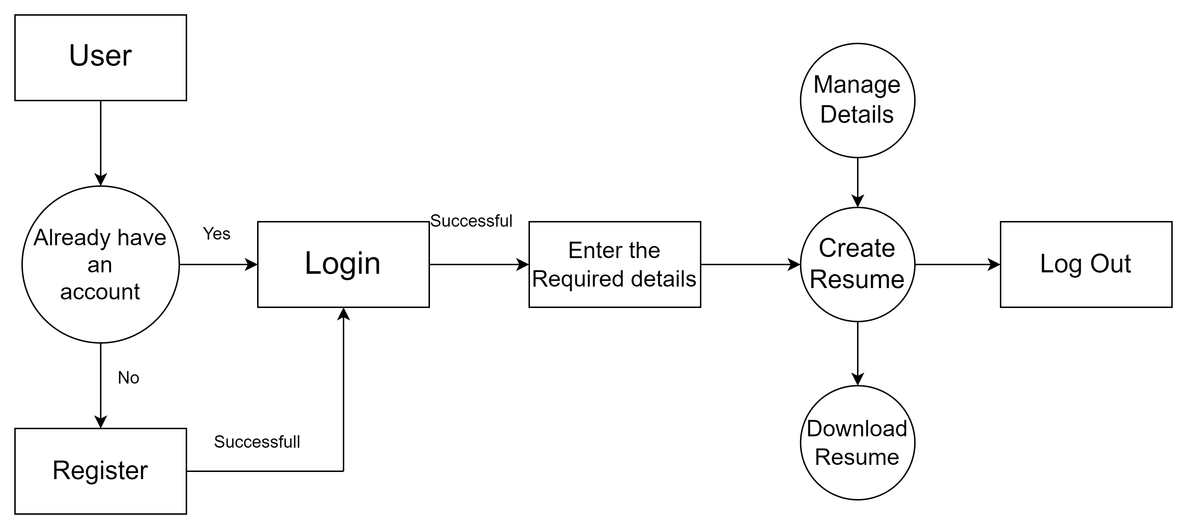
Model Diagram

Slide 19
The proposed solution is to develop an intuitive resume builder that addresses the key challenges faced by job seekers when creating resumes. This tool will combine ease of use with essential features, allowing users to produce professional resumes efficiently.
User Accounts:
Option for users to create accounts for saving multiple resume versions and tracking changes over time.
Intuitive Interface:
A clean, simple design that guides users through the resume creation process.
Proposed
Solution

Slide 20
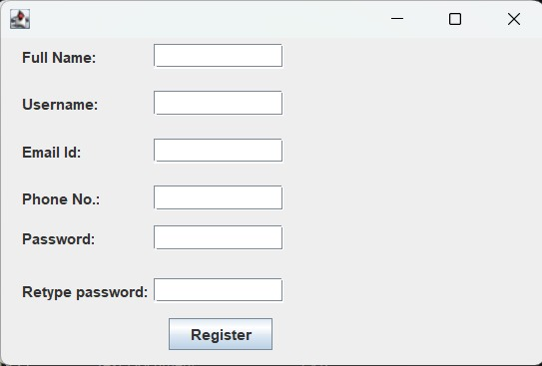
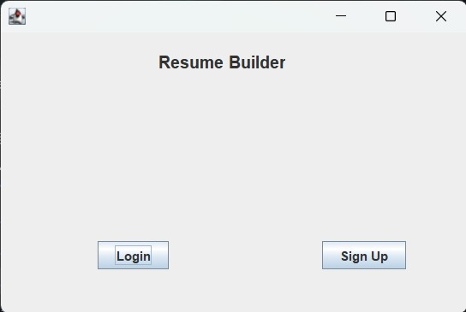
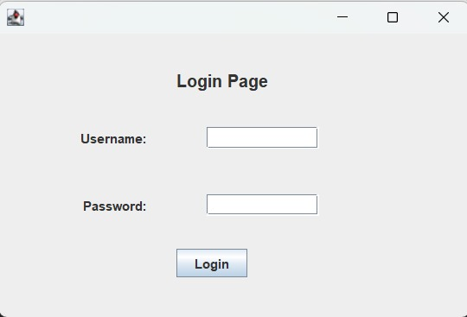
Implementation

Slide 21
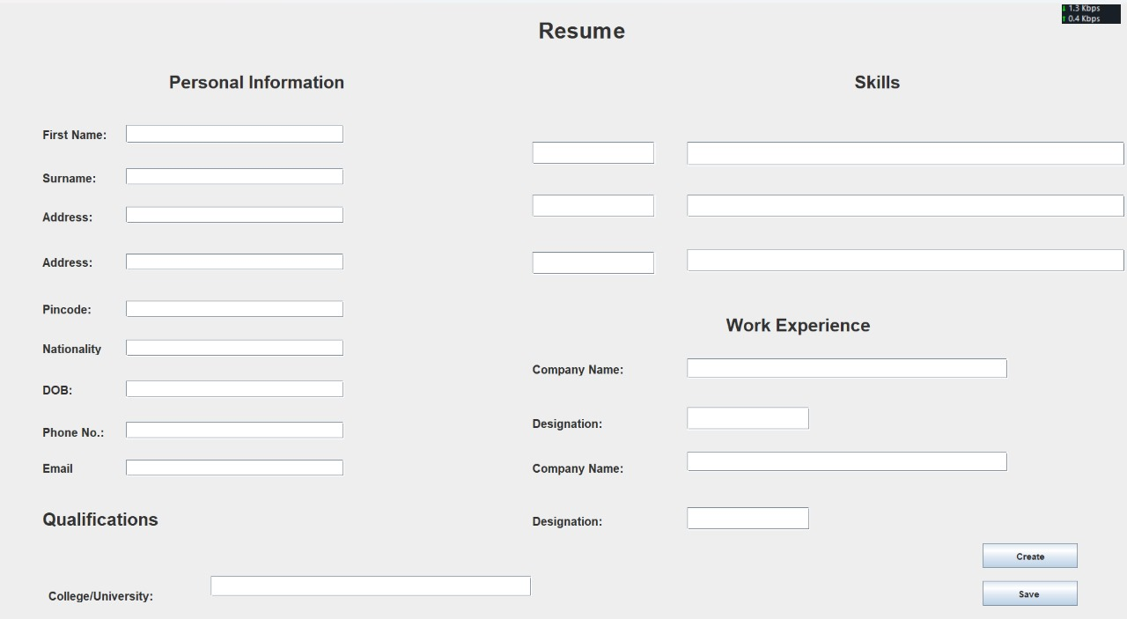
Implementation

Slide 22
A Visual CV is a tool that simplifies and streamlines the process of creating resumes. It enables users to input their information, and generate resumes. There are features such as data validation, saving and exporting options.. By incorporating thorough testing and addressing security, performance, and usability aspects, a Visual CV can empower job seekers in presenting their qualifications in a polished and professional manner.
Conclusion

Slide 23
Rinki Tyagi, Nihal Singh, Akanksha Baghel, Ankita Singh, “Resume Builder Application”, ISSN: 2321 9653; IC Value: 45.98; SJ Impact Factor:7.429, Volume 8 Issue V May 2020.
Bharti Kungwani, Amisha Manglani, Naman Dembal, Hiten Hirani, Laveen Sawlani, “Analytical Resume Builder – A web Application for Creating a resume which gives a best impact in this competitive world”, Annals of R.S.C.B.
https://ieeexplore.ieee.org
IJCRT- ”RESUME BUILDER- A WEB APPLICATION FOR CREATING A RESUME”, Volume 11, Issue 12 December 2023 | ISSN: 2320-2882.
References

Slide 24
THANK YOU!!

