Slide 1
Predicting Car-Free Households in US Census Block Groups
A Machine Learning Approach Using EPA's Smart Location Database
Lukas Becker
Notes:
My Research - on predicting car-free households – USA - using ML models

Slide 2
Content
Research Context & Motivation
Data Properties
Model Performance Comparison
Key Finding 1: The Boundary Problem
Key Finding 2: Feature Importance and Uncertainty
Key Finding 3: Model Uncertainty
Next steps
Notes:
First – after that – followed – in particular
Discuss – present
Of my predicted values
For my models
In general

Slide 3
Research Context
The Challenge
Predict % of zero-car households in Census Block Groups
220.000 records from EPA Smart Location Database
Why It Matters
Public transit investment
Sustainability planning
Transportation equity
Features
15 features preselected
Demographics • Urban density • Transit access • Economy
Notes:
CBG: geographic units used by the U.S. Census Bureau with up to 3000 people in one area (neighbourhood)
- understand new or changed neighbourhoods
- influence the Target variable
For topics …
P_WORKING_AGE
HOUSEHOLD_P_ACRE
TIMES_P_HOUR of TRANSIT_SERVICE
TOTAL_EMPLOYMENT

Slide 4
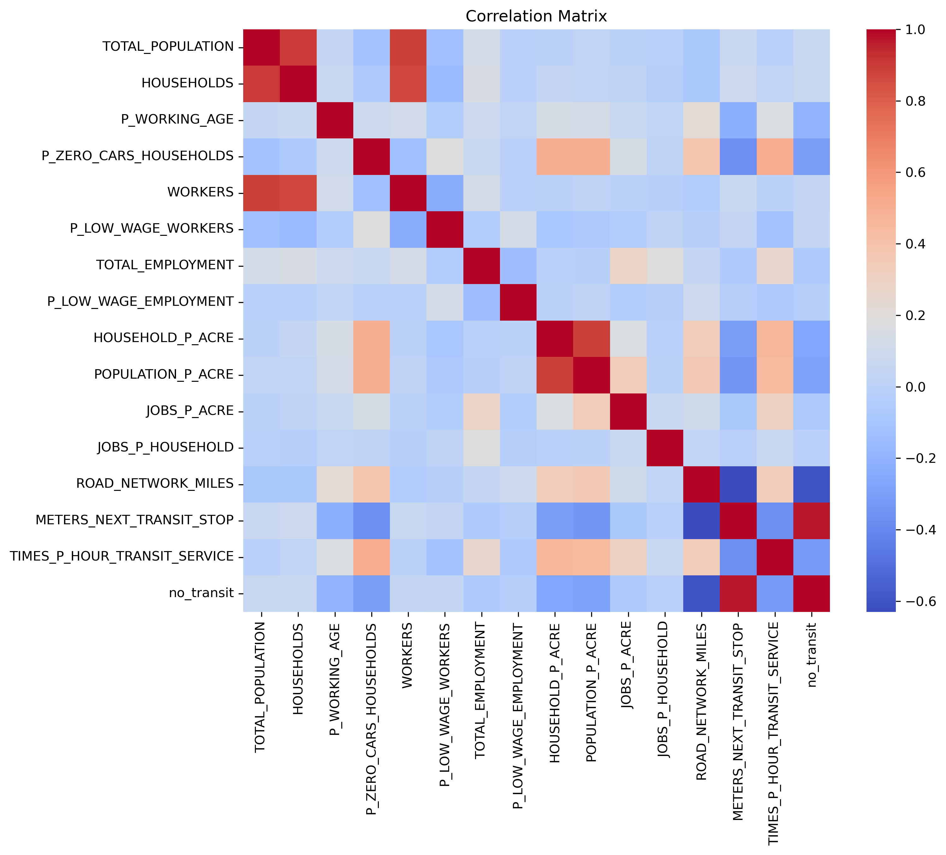
Data Properties
Highly right-skewed target variable: third quartile at 12%
Some features displaying significant correlation with target variable
Notes:
Skewed:
A lot of low values – target variable mean 9% - Special interest in lower percentages
Correlation
=> Show in heatmap
- not one strong correlation for one feature
- medium correlation for a few features
Models have something to work with

Slide 5
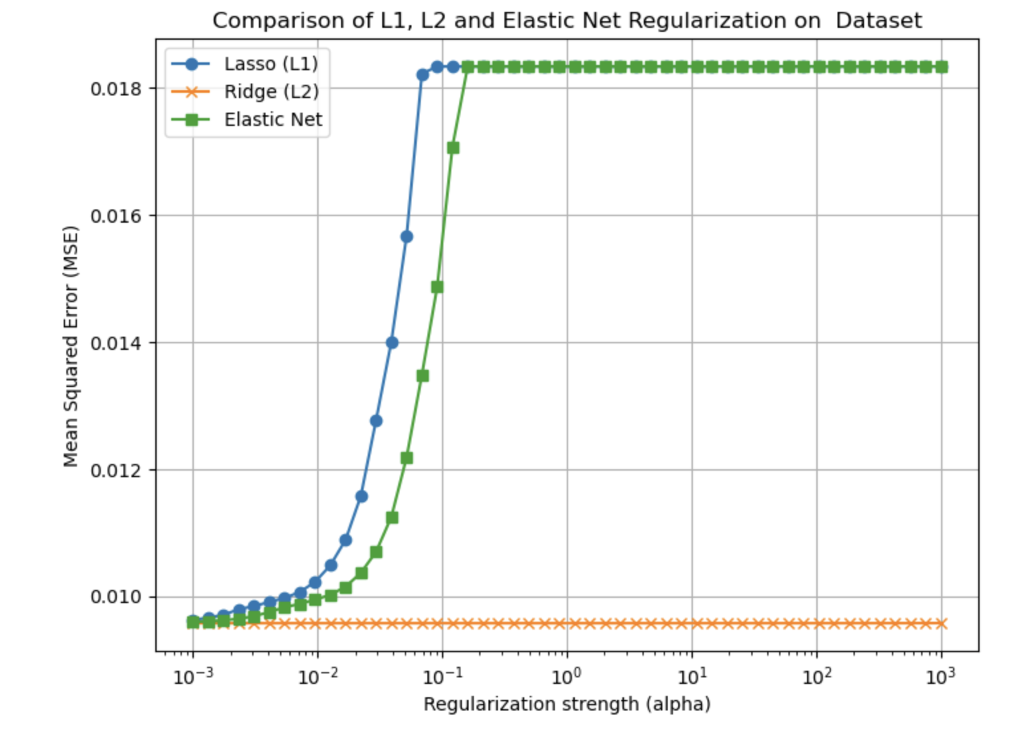
Model Performance
Regularization provided zero benefit => no overfitting
Relationships stable but not linear
Model | R² Score | Root Mean Squared Error
Linear Models (ALL) | 0.48 | 0.098
k-NN | 0.55 | 0.091
Random Forest | 0.63 | 0.082
Notes:
Regularization:
Lowest alpha value for regularization => ALL linear models identical
no regularization => no overfitting: large dataset of 220.000 records – train and test data same error metrics
R2:
jump suggests non-linear relationships
Radom Forest performs best - explains 63% of the data variance

Slide 6
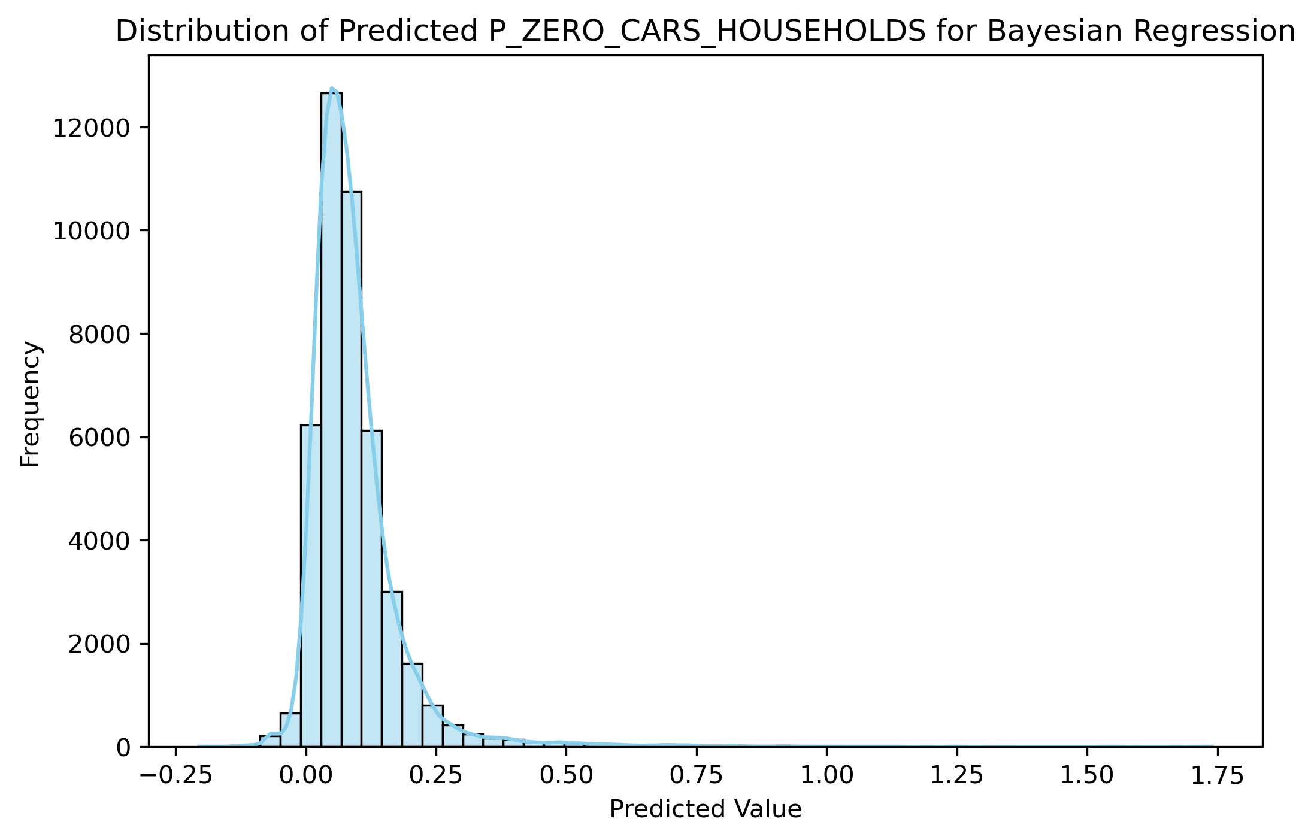
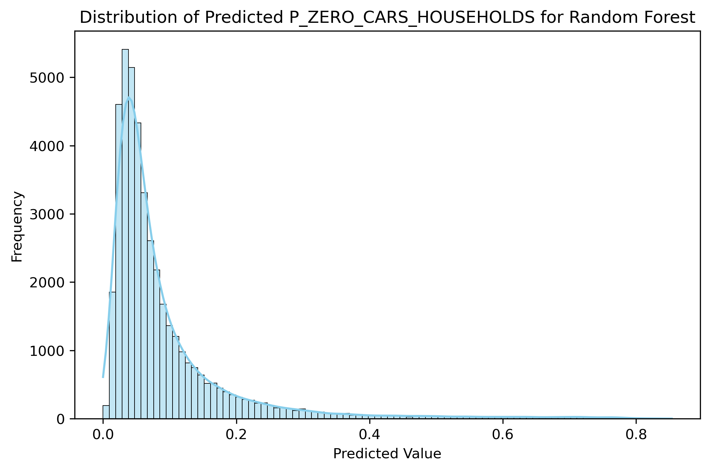
The Boundary Problem
Notes:
-> predictions between 0 and 1
Linear model = no boundary
Non-linear model => finds boundary – a tree Can't predict outside training range
Therefore, it performs better

Slide 7
Feature Importance and Uncertainty
Transit Frequency:
Consistent across all models
Household/Population Density:
Linear effect: smaller
RF importance: HIGHEST
Feature Uncertainty
High std errors in OLS (Bootstrapping)
Low std errors in Bayesian (no nonlinearity in model)
Best signal noise ratio for Random Forest
Notes:
Coef / Imp Bars:
-Transit frequency: easy to understand - for example More buses => fewer cars needed
-Linear Models use Pop Dens vs RF uses Household Density but with much higher imp. –> nonlinearity
Std Errors / Singal Noise Ratio:
-OLS predicts std errors right;
Bayesian based on normal assumptions does not, it tries to fit linearity on nonlinear data – can’t trust these errors
Forest has low std errors and high signal noise ratio – certain in predictions

Slide 8
Model Uncertainty
Model | Coverage | Avg Interval Width | Assessment
OLS | 95% | ±40% | Conservative
Bayesian Ridge | 95% | ±40%
Random Forest | 93% | ±23% | Decent balance
Model | Coverage | Avg Interval Width
OLS | 35% | ±3%
Bayesian Ridge | 35%
Random Forest | 43%
Notes:
How uncertain - Coverage: 95
OLS & Bayesian – useless interval of 40% for prediction
Forest – still too high interval
real word interval of 3%:
OLS & Bayesian weak with 35% coverage
Random Forest: okayish
Room for improvement

Slide 9
Next steps
Training a single decision tree for mental fit of nonlinearity
Training a neural network for hope of better performance
Examine model performances in different intervals of target variable
Notes:
See the rules behind it
Because of skewed data, How it behaves there
So that was an overview of my project
Thank you for your attention

