Slide 1
UEFA Euro 2024 Data
Probabilistic Machine Learning
By Valentina Gruber
07.07.2025

Slide 2
Research Objective and Hypothesis
Research Objective:
The aim is to identify player types without using the position designation. The grouping is based on player performance data using probabilistic clustering methods.
Hypothesis
There are different types of players that are not exclusively determined by the classic position (e.g. “striker”, “defender”) but can be recognized by game-related metrics.
07.07.2025 UEFA Euro 2024 Data

Slide 3
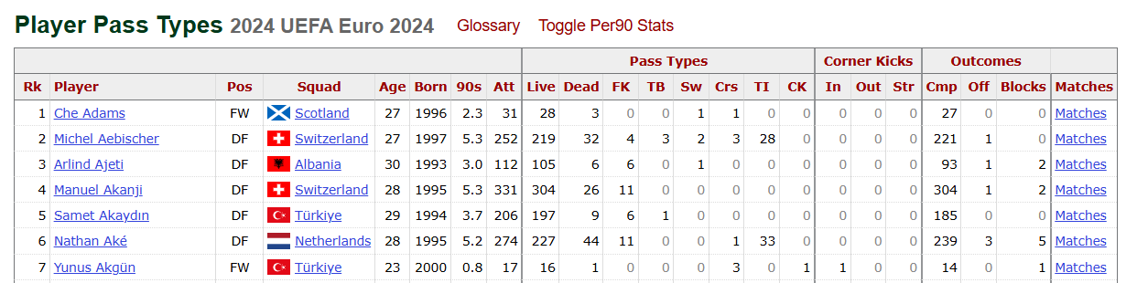
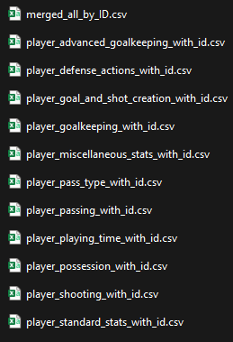
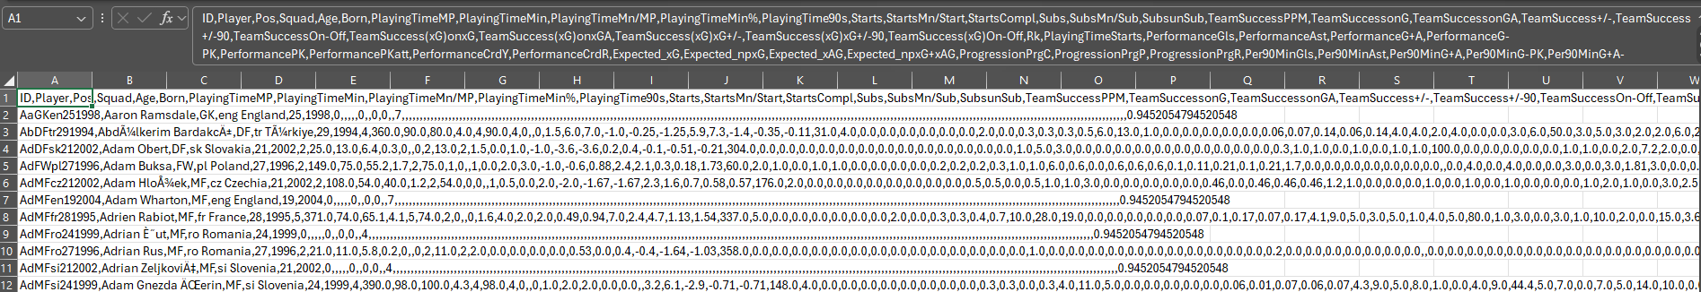
Data
Fbref.com
621 rows, 219 columns
07.07.2025 UEFA Euro 2024 Data

Slide 4
Explorative Data Analysis
High correlation (e.g. TacklesTkl & Tkl+Int) → which feature is important?
Different scaling
Missing values
High dimensionality: Many columns → difficult to create meaningful visualizations
07.07.2025 UEFA Euro 2024 Data

Slide 5
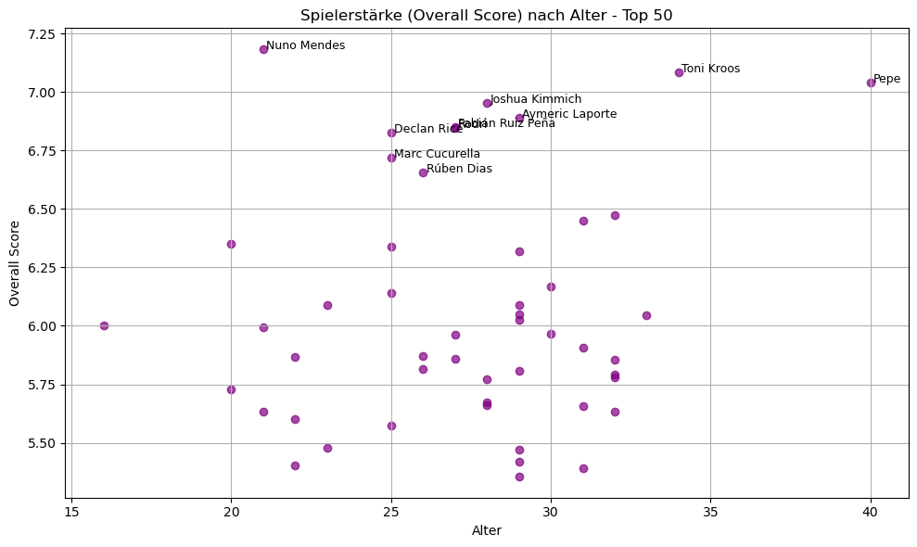
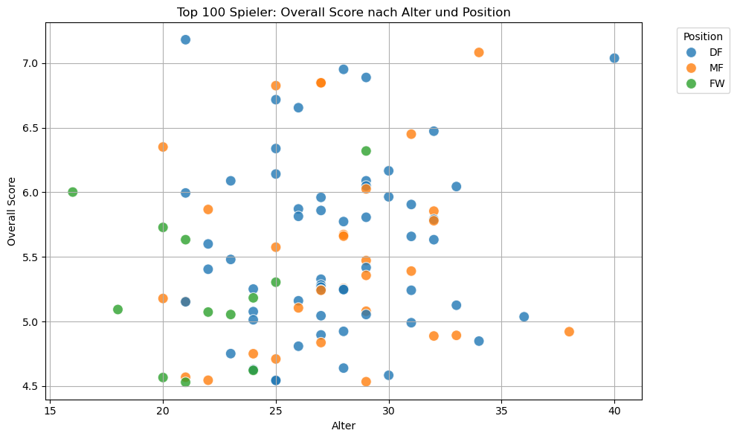
Small Analysis
07.07.2025 UEFA Euro 2024 Data

Slide 6
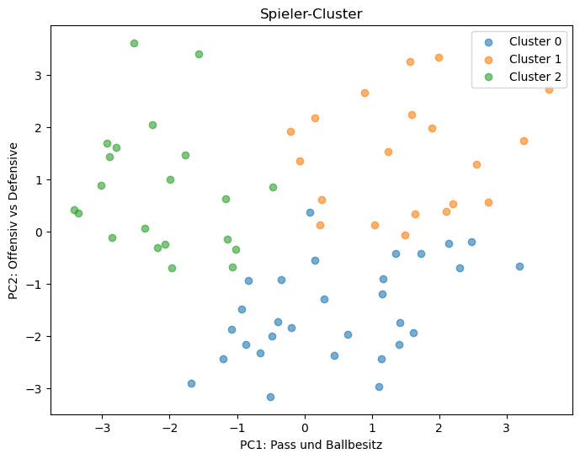
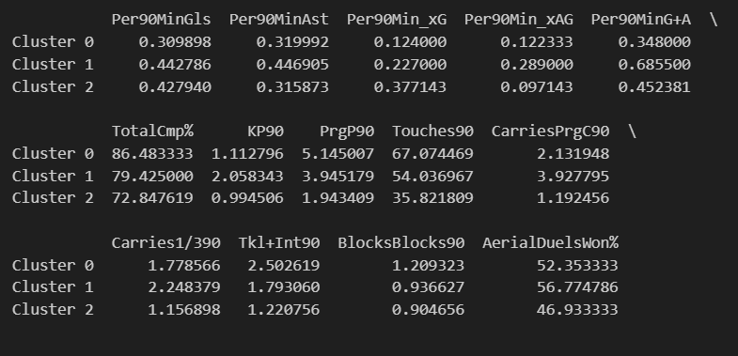
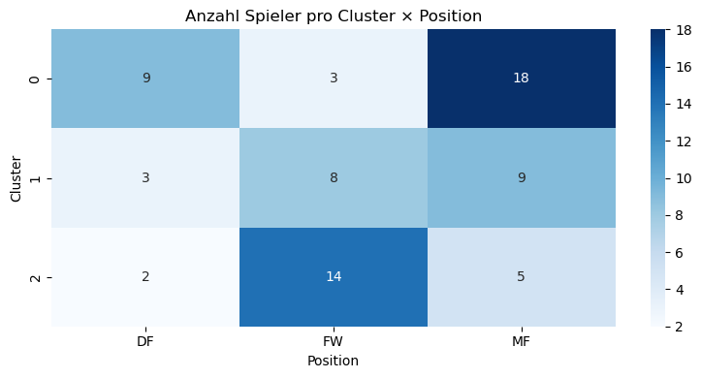
Clustering k-means
07.07.2025 UEFA Euro 2024 Data

Slide 7
Probabilistic Modell Plan
Objective: Identify player types / model probability distributions via playing styles
Why probabilistic?
Quantify uncertainties (e.g. with incomplete data)
Probabilities instead of hard clusters
Feature Selection & Data Handling:
Focus on non-obvious features (e.g., types of tackles, progressive passes…)
Exclude players with excessive missing values or use probabilistic imputation (e.g. based on position group averages)
07.07.2025 UEFA Euro 2024 Data

Slide 8
Probabilistic Modell Plan
Model: Gaussian Mixture Model (GMM)
A player can belong to several clusters with different probabilities
Tools: scikit-learn for GMM, or PyMC for fully Bayesian GMMs
Steps:
Choose number of clusters K (BIC, Silhouette, or ELBO)
Fit the model, analyze soft assignments
Use posterior probabilities to understand overlaps and uncertainty
07.07.2025 UEFA Euro 2024 Data

Slide 9
Probabilistic Modell Plan
Evaluation & Visualization:
Visualize player cluster probabilities (e.g., Player A: 60% Cluster 1, 30% Cluster 2, etc.)
Use PCA or UMAP for 2D projection of clusters
Analyze results by position, team, or role
07.07.2025 UEFA Euro 2024 Data

