Slide 1

Session 4: Sequence Alignment
KB8029 — Bioinformatics & Deep Learning
Arne Elofsson

Slide 2


BEFORE WE START
Log in to the lecture quiz
Log in to the quiz
Scan the code, or go to quiz.bioinfo.se/live
Log in with your university account
Answering counts as being at the lecture: up to 3 bonus points on the exam
Right or wrong is never graded, only whether you answered. Results are shown without names.
quiz.bioinfo.se/live
Notes:
The quiz is not anonymous, because answering is how attendance is counted: 3 bonus points on the main exam for answering in all 12 lectures, one point less per missed lecture (preliminary). Whether an answer is right or wrong is never used. The projected results never show names; the only names shown are the two drawn to explain their reasoning. Start the session on quiz.bioinfo.se before the lecture: quiz.bioinfo.se/live then leads to it.

Slide 3
BEFORE WE START
Warm-up: what do you know already?
3 quick questions
On the topics of today, one at a time, about 30 seconds each
Answer on your own, and guess if you do not know
It shows me where to start; right or wrong is never graded
Notes:
About 2 minutes in all. Open each question's round, halt it after about 30 seconds and glance at the results; do not explain the answers now, the lecture does that.

Slide 4
WARM-UP · 1 OF 3
Two genes in different species descend from one gene in their last common ancestor, split by speciation. They are ...
A paralogs
B orthologs
C analogs
D unrelated
Answer now
Scan the code, or go to
quiz.bioinfo.se/live
Notes:
Right: orthologs. Paralogs are split by a duplication. Block 1: homology.

Slide 5
WARM-UP · 2 OF 3
An affine gap penalty has g_open = −10 and g_ext = −1. What does one gap of length 3 cost?
A −12
B −13
C −30
D −3
Answer now
Scan the code, or go to
quiz.bioinfo.se/live
Notes:
Right: −12. g_open + (n − 1) g_ext = −10 − 2. Block 2.

Slide 6
WARM-UP · 3 OF 3
A column of a multiple alignment has the same amino acid in every sequence. What is its entropy?
A 0
B 1
C log₂ 20, the largest possible
D It depends on the amino acid
Answer now
Scan the code, or go to
quiz.bioinfo.se/live
Notes:
Right: 0. No surprise at all. Block 3: reading an alignment.

Slide 7
BEFORE WE START
What the room knows already
Where we start
Which topics most of you know, and which we take slowly today.
Show the results ▸ quiz.bioinfo.se/live/report
Notes:
Optional: show two or three of the results, the ones that most got wrong.

Slide 8
BEFORE WE START
Your questions before today
What you asked
The questions you sent in on Canvas before the lecture
The most common ones now; the others in the block where they belong
Notes:
About 5 minutes. Read the answers to this session's Canvas survey 'Questions before the lecture' the evening before (it closes at 18:00 the day before the lecture), pick the two or three most common questions, and answer them briefly now or say in which block they come.

Slide 9
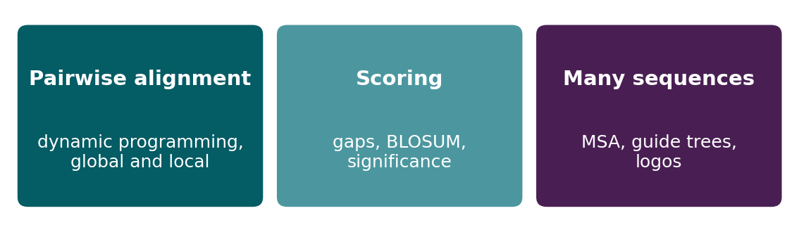
BEFORE WE START
In up to three words: what do you want to learn today?
Answer now
Scan the code, or go to
quiz.bioinfo.se/live
Notes:
A word cloud: the bigger the word, the more students wrote it. Come back to it at the end of the lecture.

Slide 10
BEFORE WE START
What you want to learn today
What the room wants to learn
Show the results ▸ quiz.bioinfo.se/live/report

Slide 11
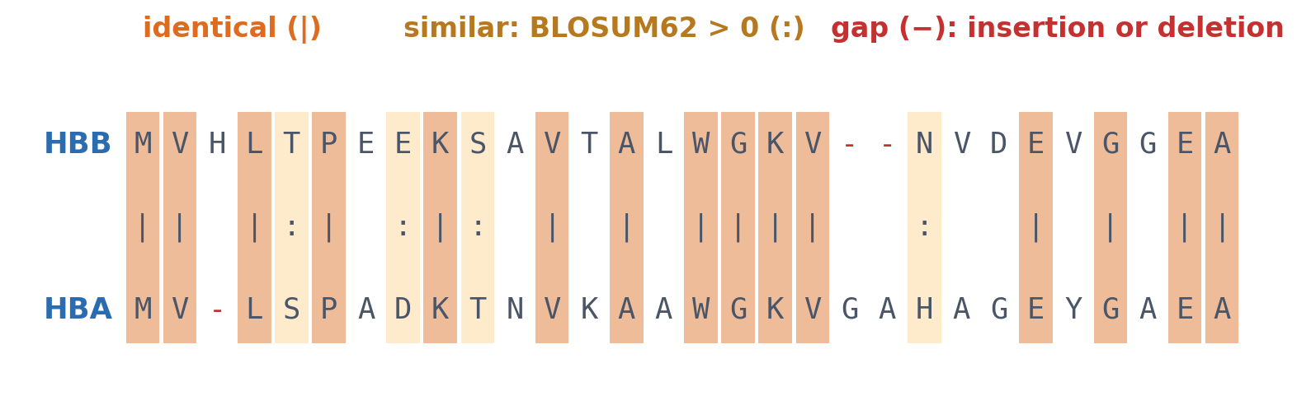
SESSION 4 · THE MAP
An alignment is a hypothesis: which residues correspond?
The start of the BLOSUM62 alignment of human β- and α-globin (HBB, HBA). Aligned pairs are substitutions or identities; gaps are insertions or deletions. The score says how plausible this history is under the chosen scoring scheme.
Alignment computed as in the course notebook (BLOSUM62, gap open −10, extend −0.5).
Notes:
Session 3 ended with two related sequences from the databases. Today's question: which residues correspond, and how much evidence does the alignment give for shared ancestry? The score is not the true history; most of the session is about the choices that go into the score.

Slide 12
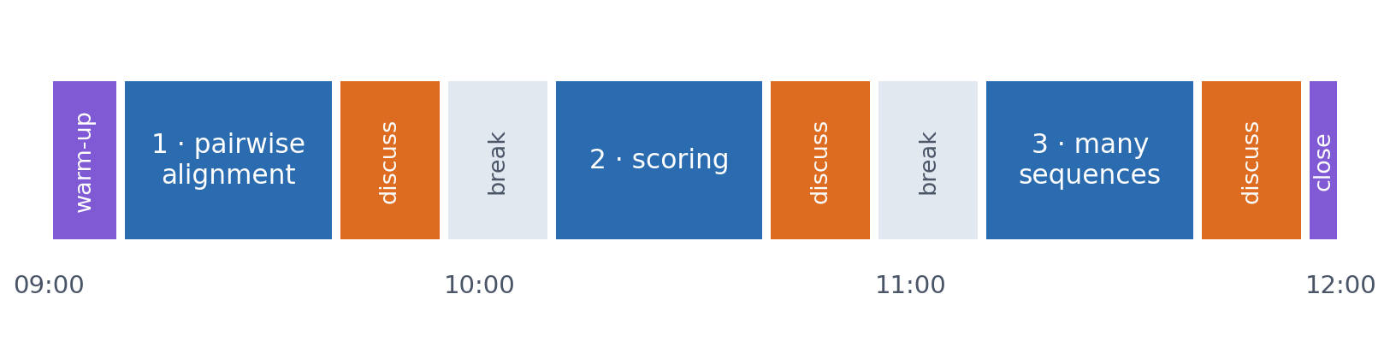
SESSION 4 · THE MORNING
Three blocks: about 30 min talk and 15 min discussion
Block 1: pairwise alignment by dynamic programming, global and local. Block 2: scoring it, with gap penalties, substitution matrices and significance. Block 3: many sequences, with multiple alignment, trees and logos.
Times are approximate: a 10 min start (warm-up quiz and your questions), two 15 min breaks and a 5 min close. Each block ends with a quiz question: guess, run the notebook and work out why it behaves as it does, discuss, answer again.

Slide 13
BLOCK 1 · ABOUT 30 MIN
Pairwise alignment needs an algorithm

Slide 14
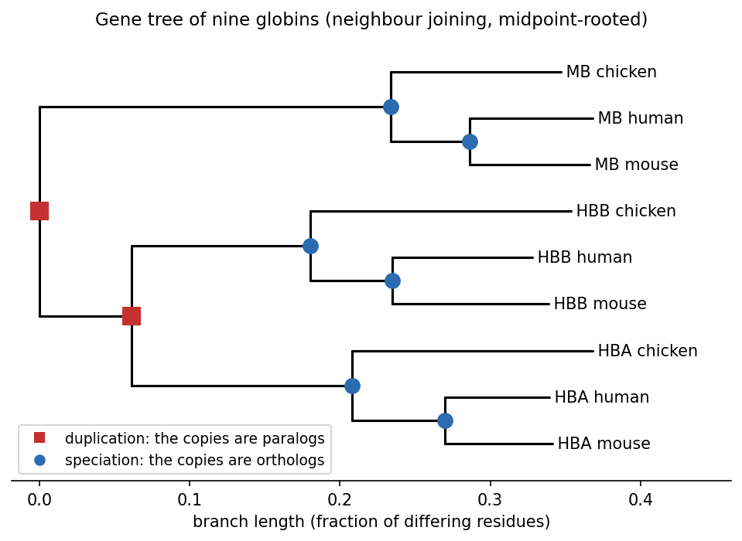
1 · HOMOLOGY
Homologs: orthologs and paralogs
▪ Homology: a common ancestor (yes or no)
▪ Identity, similarity: evidence for it
▪ Ortholog: split by a speciation
▪ Paralog: split by a duplication
Gene tree computed in the course notebook; see course.bioinfo.se/session04.html, 'Homology'.
Notes:
Homology is inferred, never observed, and it is not a percentage. Identity counts identical aligned pairs; similarity also counts residues with shared properties. The definitions refer to events, not genomes: human α-globin and mouse β-globin are paralogs too, because the α/β duplication happened before human and mouse diverged. Block 3 shows how to read this tree.

Slide 15
1 · WHY AN ALGORITHM
Where you place the sequences changes the answer
▪ Real sequences differ in length
▪ Insertions and deletions have accumulated
▪ Placement is the real problem
21.5%
identity, aligned
correctly
4%
identity, the same two
globins placed naively
See course.bioinfo.se/session04.html, 'Why alignment needs an algorithm'.
Notes:
When two sequences have the same length, identity is trivial: place one under the other and count. With insertions and deletions, the placement changes the answer dramatically, as these two example globins show.

Slide 16
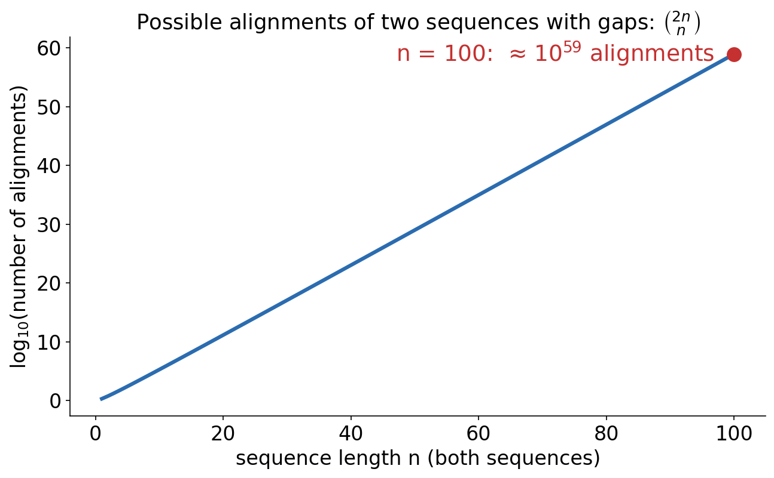
1 · WHY AN ALGORITHM
Brute force: try every alignment?
▪ n = 100: about 10⁵⁹ alignments
▪ Far too many to search
▪ Dynamic programming: optimal, without checking them all
See course.bioinfo.se/session04.html, 'Why alignment needs an algorithm'.
Notes:
The number of ways to align two sequences of length n with gaps grows like the binomial coefficient C(2n, n), about 9 × 10^58 for n = 100. The trick of dynamic programming: many candidate alignments share the same beginnings, so the best alignment of every pair of prefixes is solved once, stored and reused.

Slide 17
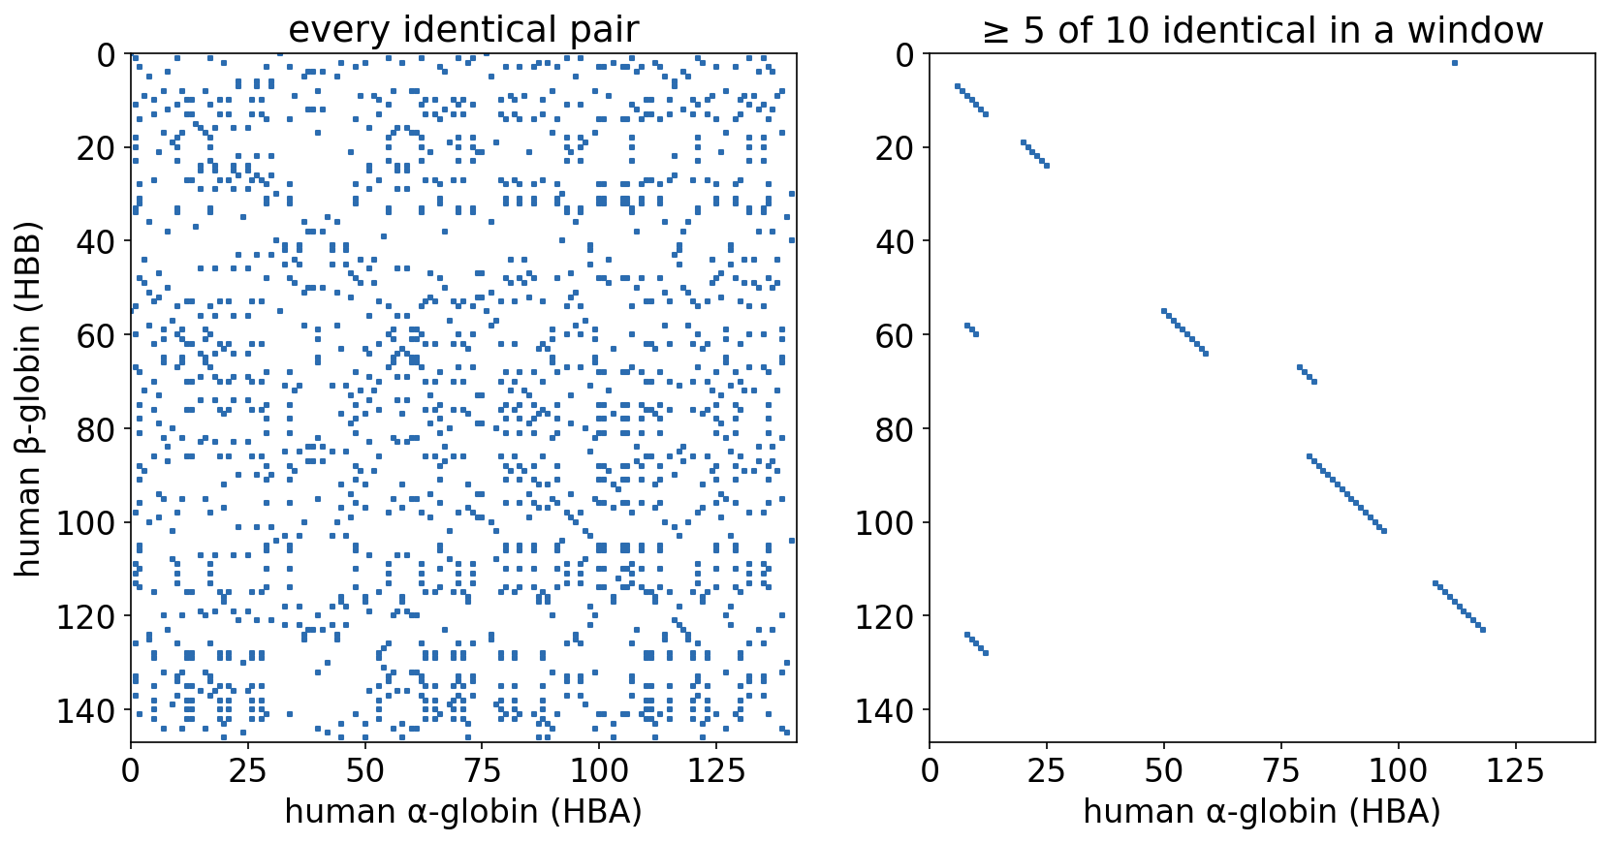
1 · DOT PLOTS
A dot plot: is there a match, and roughly where?
▪ A run of matches = a diagonal
▪ A window filter removes the noise
▪ No score, no alignment
HBB and HBA (human) as in the course notebook; see course.bioinfo.se/session04.html, 'Visualising alignments: dot plots'.
Notes:
One sequence along each axis, a dot wherever the residues match. Left: every identical pair, mostly noise with 20 amino acids. Right: only windows of 10 with at least 5 identities, and the diagonal appears. A long alignment is one long diagonal, a repeat several parallel diagonals, an inversion a diagonal in the opposite direction. BLAST's web output still includes a dot plot.

Slide 18
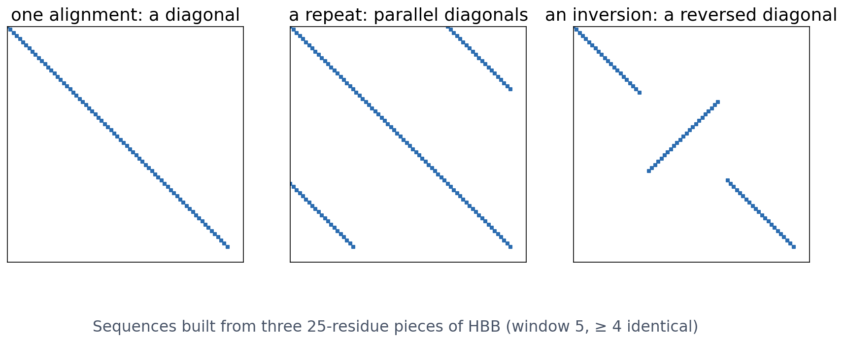
1 · DOT PLOTS
Reading a dot plot: diagonals, repeats, inversions
One long alignment is one diagonal; a repeated piece adds parallel diagonals; an inverted piece runs the other way. Then a score and an alignment need dynamic programming.
Constructed from pieces of HBB; see course.bioinfo.se/session04.html, 'Visualising alignments: dot plots'.
Notes:
These sequences are built for the picture: A+B+C against itself, A+B+A against itself, and A+B+C against A+reversed(B)+C, each piece 25 residues of HBB.

Slide 19
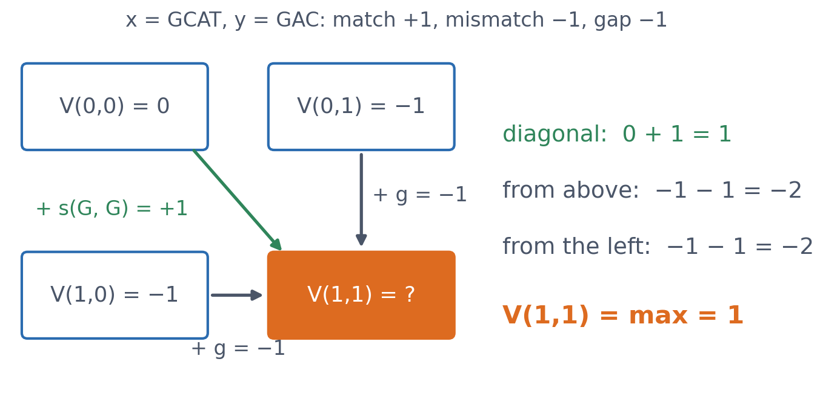
2 · DYNAMIC PROGRAMMING
Each cell: three candidates, keep the largest
▪ Diagonal: match or mismatch
▪ Up or left: a gap
▪ V(i,j): best score of the two prefixes
See course.bioinfo.se/session04.html, 'Dynamic programming: Needleman-Wunsch and Smith-Waterman'.
Notes:
V(i,j) = max{ V(i-1,j-1) + s(x_i, y_j), V(i-1,j) + g, V(i,j-1) + g }. The matrix has one extra row and column for the sequence starts, filled with multiples of the gap penalty. Every other cell is filled the same way; only the numbers change.

Slide 20
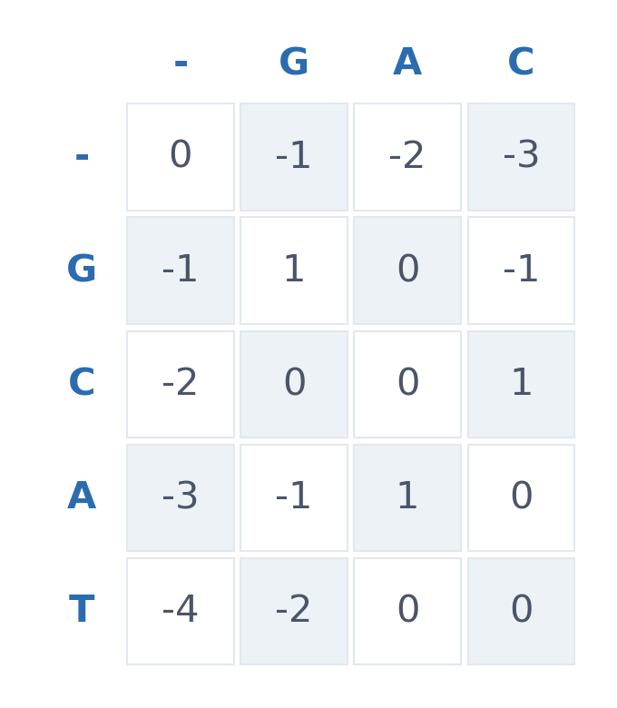
2 · DYNAMIC PROGRAMMING
Fill the whole matrix, row by row
▪ x = GCAT, y = GAC
▪ match +1, mismatch −1, gap −1
▪ First row and column: −1, −2, −3 …
▪ Bottom right: the best score, 0
See course.bioinfo.se/session04.html, Table 4.1.
Notes:
Fill one or two cells on the board with the room, for example V(2,2) = C vs A: diagonal 1 − 1 = 0, up 0 − 1 = −1, left 0 − 1 = −1, so 0. The bottom-right cell is the score of the best global alignment, but not yet the alignment itself.

Slide 21
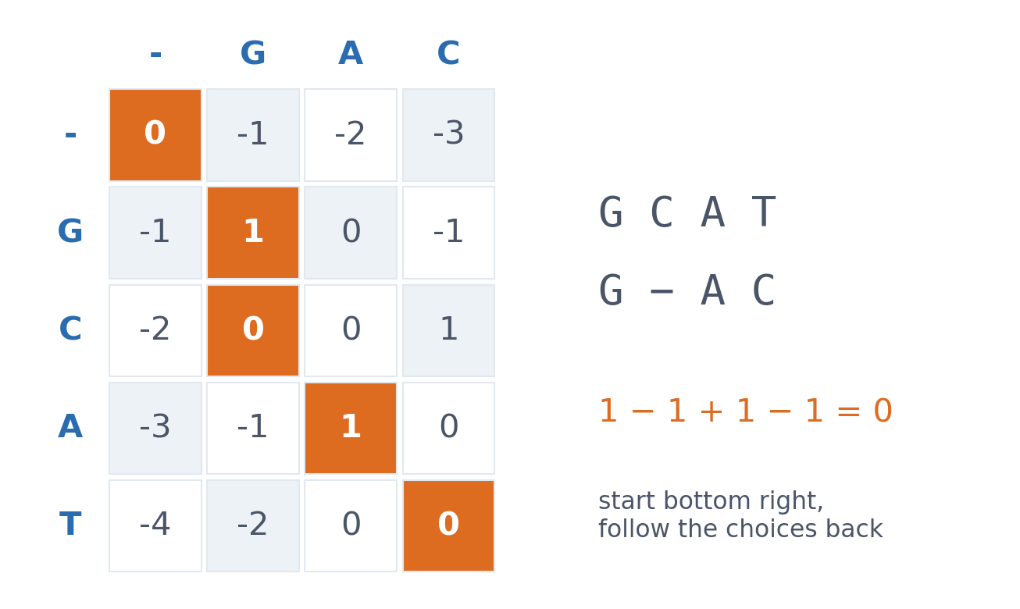
2 · DYNAMIC PROGRAMMING
Traceback: follow the choices back
▪ G = G, C deleted, A = A, T/C mismatch
▪ Score 0, from the corner
▪ Optimal, guaranteed
See course.bioinfo.se/session04.html, Table 4.1 (the path in bold).
Notes:
From each cell, step to the neighbour that produced its value: diagonal for an aligned pair, up or left for a gap. The course notebook does exactly this for VHLT vs VLC, printing every choice.

Slide 22
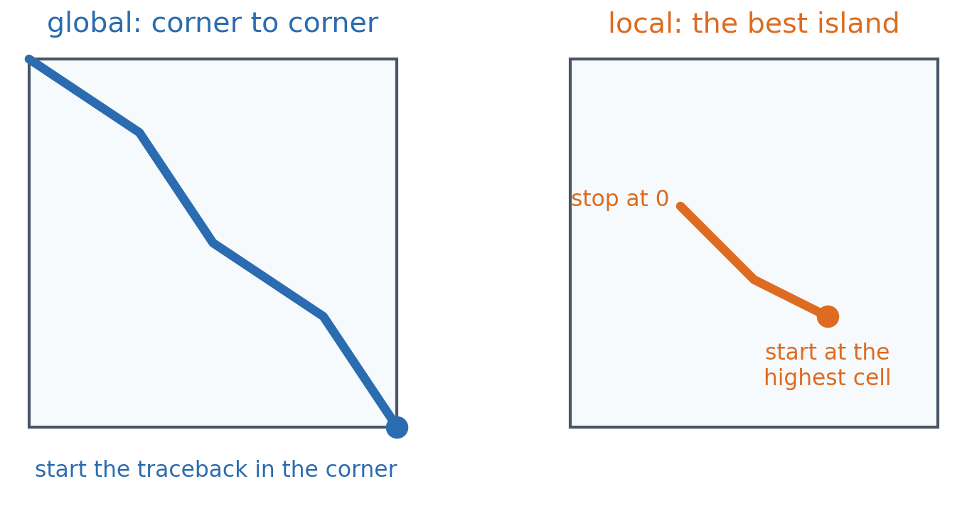
2 · GLOBAL AND LOCAL
Needleman-Wunsch (global) and Smith-Waterman (local)
▪ Global: both sequences, end to end
▪ Local: the best-matching region
▪ One change: negative cells → 0
See course.bioinfo.se/session04.html, 'Dynamic programming: Needleman-Wunsch and Smith-Waterman'.
Notes:
Smith-Waterman resets negative values to zero, starts the traceback at the highest-scoring cell anywhere in the matrix, and stops when it reaches a zero.

Slide 23
2 · GLOBAL AND LOCAL
Which one? A biological choice
Global
Local
two myoglobins
one shared domain, a motif
▪ Expected to correspond along most of their length
▪ Every residue must be placed
▪ Two large multidomain proteins
▪ A short motif inside a long sequence
See course.bioinfo.se/session04.html, 'Dynamic programming: Needleman-Wunsch and Smith-Waterman'.
Notes:
Forcing a global alignment on sequences that share only a domain buries the shared region under a long tail of meaningless gaps. How the gaps are penalised is the next block.

Slide 24
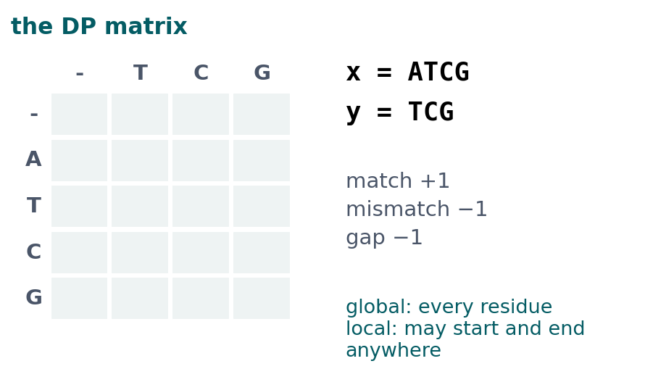
BLOCK 1 · QUIZ
Global or local: which scores higher?
x = ATCG, y = TCG; match +1, mismatch −1, gap −1. Global (Needleman-Wunsch) or local (Smith-Waterman)?
A Global 2, local 3
B Both 3: TCG against TCG either way
C Global 3, local 2
D Both 2: the A costs a gap either way
Guess on your own
Scan the code, or go to
quiz.bioinfo.se/live
Notes:
The old discussion problem 1. Small enough to fill the 5 × 4 matrix by hand. Let them guess before computing.

Slide 25
BLOCK 1 · QUIZ
Global or local: which scores higher?
How did the room answer?
Halt the round when most have answered, then show the results.
Show the results ▸ quiz.bioinfo.se/live/report
Notes:
Halt submission in the Control view, then open the results. Do not say which answer is right.

Slide 26
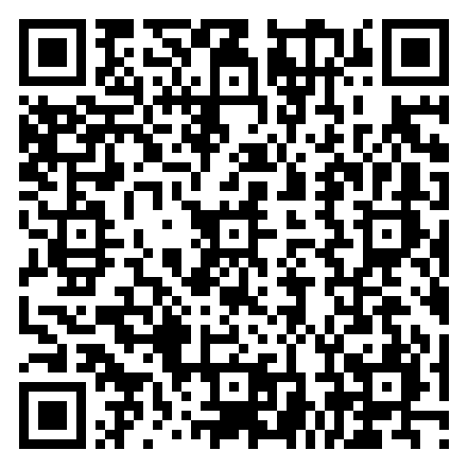
BLOCK 1 · QUIZ
Global or local: which scores higher?
Fix it, run it, discuss
Open the notebook: scan the code
Fix the line marked FIX, then run the cells
Did it come out as you guessed? Discuss with your neighbour
The notebook: https://colab.research.google.com/github/ElofssonLab/kb8029-book/blob/main/notebooks/session04-discussion-1.ipynb
Notes:
About 8 minutes. The notebook's FIX line fills the first column of the global matrix with zeros instead of i × gap, so the leading A is free and global also scores 3 (the second answer). Fixed: global 2, local 3.

Slide 27
BLOCK 1 · QUIZ
Global or local: which scores higher?
Answer again
Same question, after the discussion.
quiz.bioinfo.se/live
Notes:
Open the second round (post) in the Control view.

Slide 28
BLOCK 1 · QUIZ
Global or local: which scores higher?
Results, and who explains
Both rounds side by side.
Draw two to explain: one of you says how you reasoned.
Show the results ▸ quiz.bioinfo.se/live/report
To check it with code afterwards: discussion notebook 1 https://colab.research.google.com/github/ElofssonLab/kb8029-book/blob/main/notebooks/session04-discussion-1.ipynb
Notes:
Global 2: ATCG against -TCG, the A must go against a gap. Local 3: TCG against TCG, the A is left out. Local is never lower than global on the same pair, because it may leave out whatever costs points. Which to use is a biological choice: whole-length relatives or a shared domain.

Slide 29
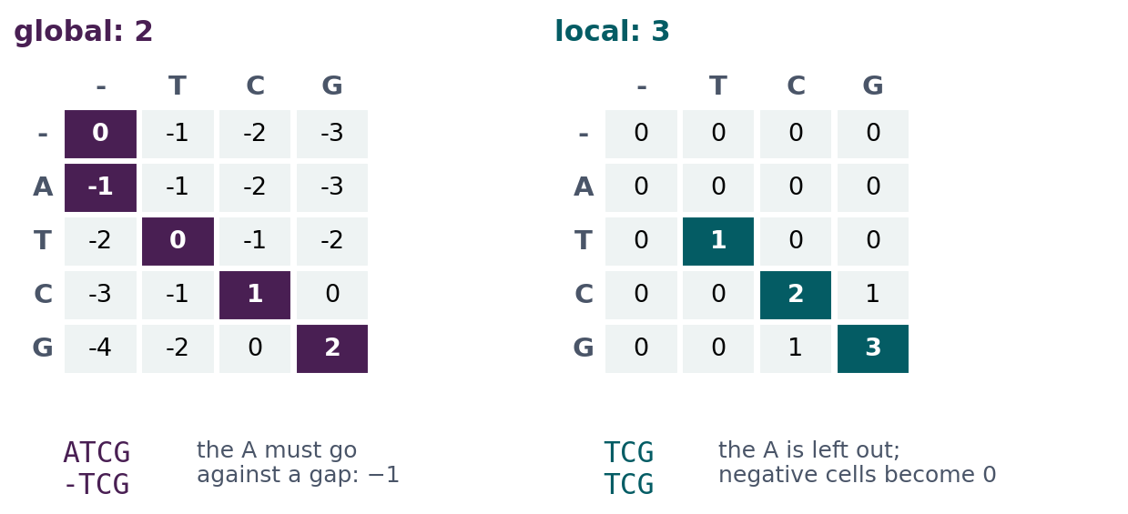
BLOCK 1 · QUIZ
The answer: global 2, local 3
Global alignment must place every residue, so the leading A goes against a gap (−1). Local alignment sets negative cells to 0 and may start anywhere, so it leaves the A out and scores the pure TCG match. The unfixed notebook had zeros in the first column: a global alignment that could skip the start for free.

Slide 30
BLOCK 1 DONE
Break

Slide 31
BLOCK 2 · ABOUT 30 MIN
Scoring: gaps, substitution matrices, significance

Slide 32
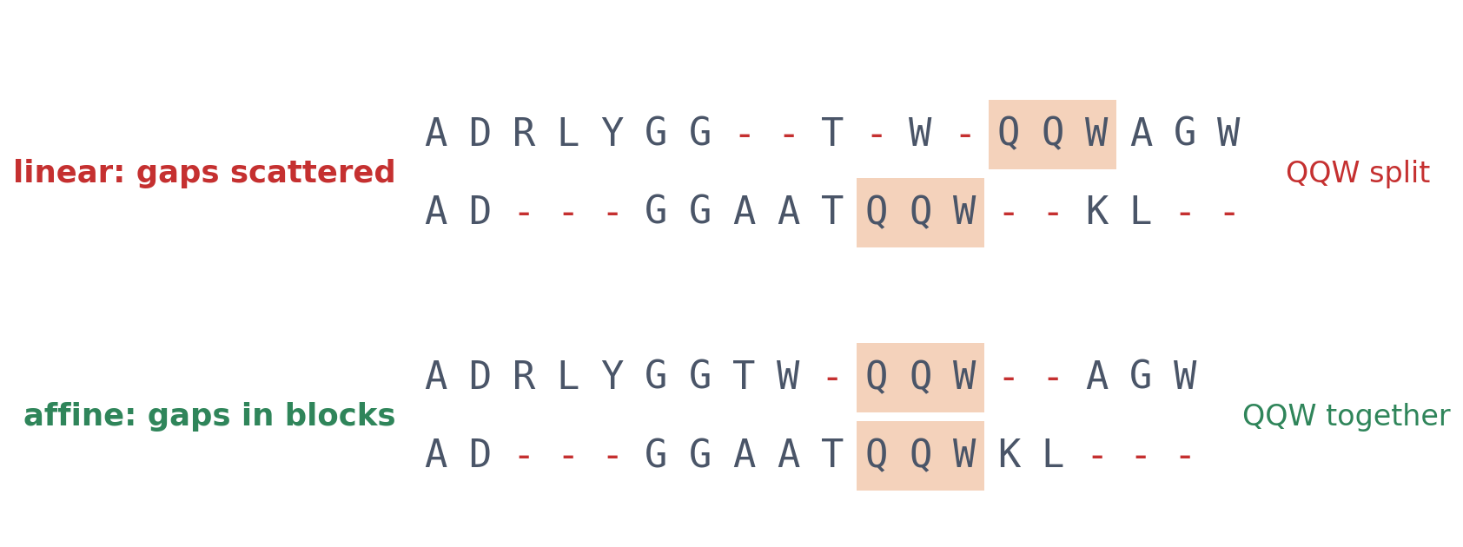
3 · GAP PENALTIES
Linear gaps scatter, affine gaps stay together
▪ Linear: every gap position costs the same
▪ Indels often hit whole stretches
▪ Affine keeps QQW intact
See course.bioinfo.se/session04.html, 'Gap penalties: linear vs. affine'.
Notes:
With a linear penalty, g(n) = n × g_op, the total is the same whether the gaps are spread out or bunched together, so single gaps can be scattered through a conserved block. Evolutionary insertions and deletions often affect contiguous stretches, so it is more realistic to charge more for opening a gap than for extending it.

Slide 33
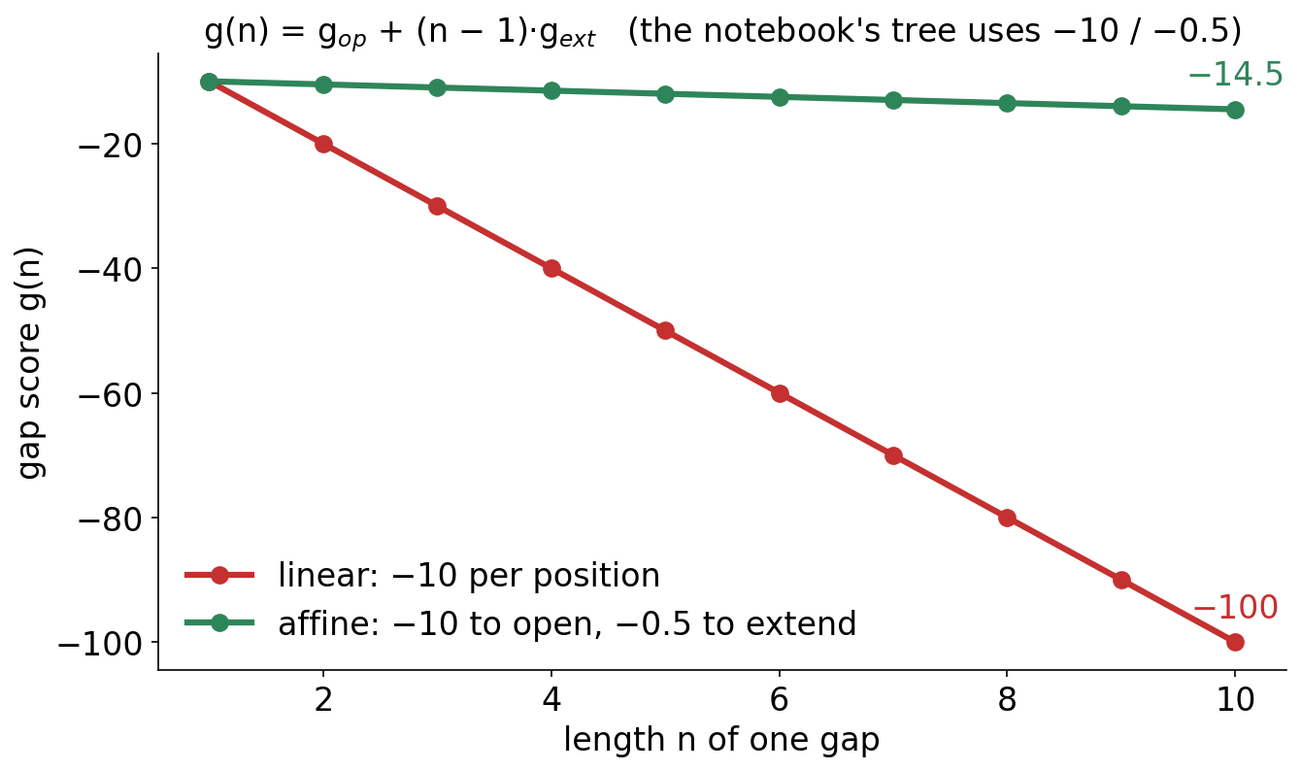
3 · GAP PENALTIES
Affine: expensive to open, cheap to extend
▪ g(n) = g_op + (n − 1)·g_ext
▪ g_ext ≪ g_op
▪ One long gap beats many short ones
Gap scores −10 / −0.5 as in the course notebook's pairwise alignments.
Notes:
With gap open −10 and extend −0.5, a 10-residue gap costs −14.5 as one block. Charged −10 per position (linear with the same opening cost) it would cost −100. Do not give the discussion's numbers here: the second discussion asks for block vs scattered with other parameters.

Slide 34
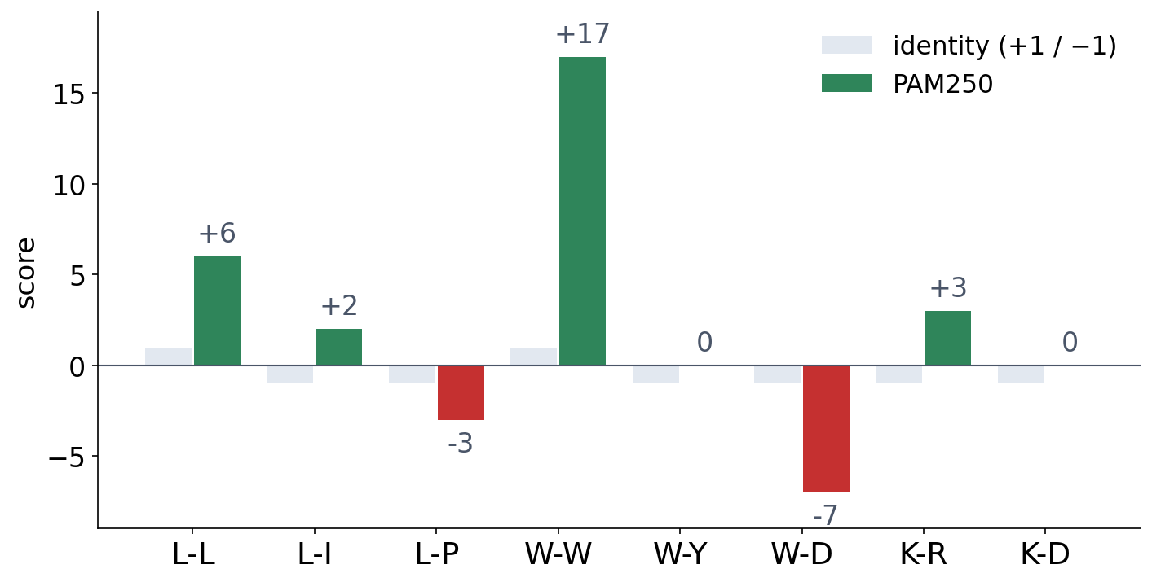
4 · SUBSTITUTION MATRICES
Not every mismatch costs the same
▪ Log-odds: seen in relatives vs by chance
▪ Positive: more often than chance
▪ K-R, L-I: conservative, positive
PAM250 scores printed by the course notebook (from Biopython).
Notes:
The score of residues a and b is roughly the log of how often they are aligned in related proteins divided by how often they would pair by chance. W-W scores +17 because tryptophan is rare, so an aligned W pair is very informative. Session 5's profiles use the same log-odds idea, one column at a time.

Slide 35
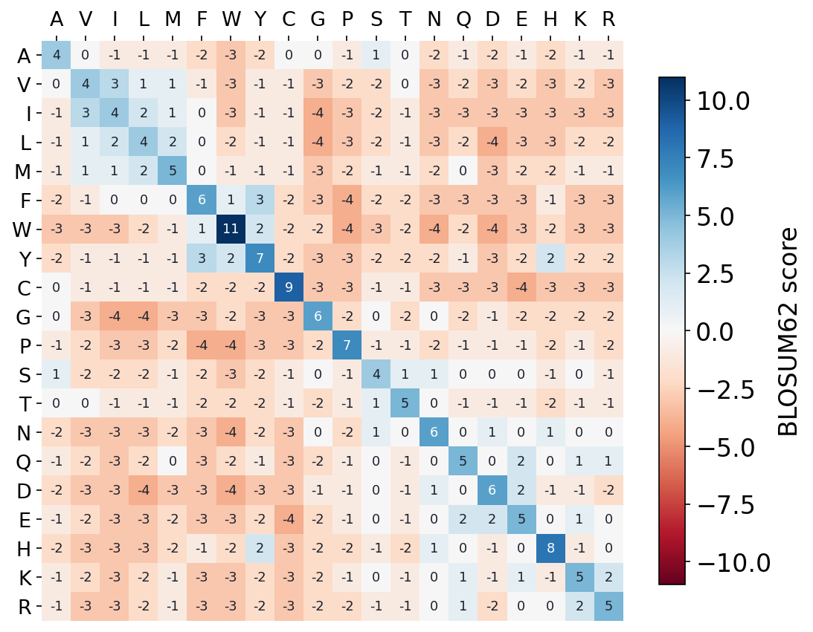
4 · SUBSTITUTION MATRICES
BLOSUM62: the whole matrix
▪ Diagonal: identities score highest
▪ Similar residues: small positive scores
▪ BLAST's default (Session 5)
BLOSUM62 from Biopython; residues ordered from hydrophobic to charged.
Notes:
The hydrophobic block (A, V, I, L, M) and the aromatic block (F, W, Y) are visible as positive patches, and so are K-R and D-E. Rare residues score high on the diagonal, because an aligned rare pair is more informative.

Slide 36
4 · SUBSTITUTION MATRICES
Two families: PAM and BLOSUM
PAM (Dayhoff 1978)
BLOSUM (Henikoff 1992)
close relatives, a model
distant relatives, counted
▪ Global alignments of closely related proteins
▪ Counts along a phylogenetic tree
▪ PAM250 extrapolated from short distances
▪ Local, ungapped blocks of distant proteins
▪ Counted directly: no tree
▪ Each matrix derived independently
See course.bioinfo.se/session04.html, 'Substitution matrices: PAM and BLOSUM'.

Slide 37
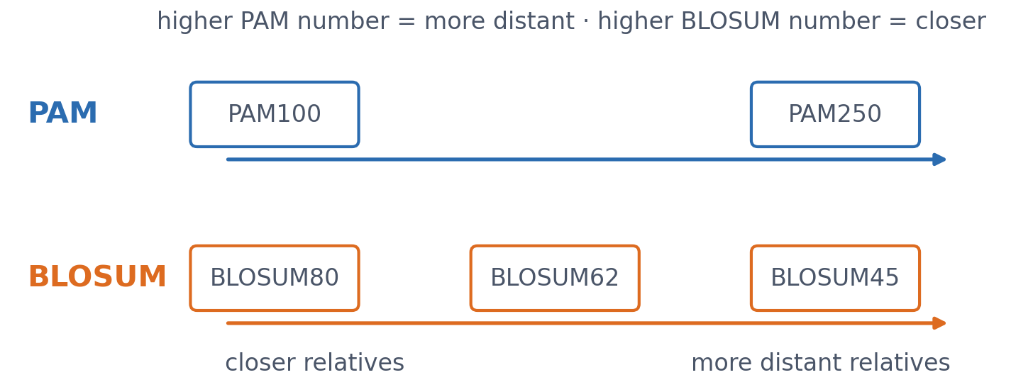
4 · SUBSTITUTION MATRICES
The numbering gotcha
PAM250 suits more divergent sequences than PAM100; BLOSUM80 suits more similar sequences than BLOSUM45. The two scales are not aligned with each other in this picture.
See course.bioinfo.se/session04.html, 'Substitution matrices: PAM and BLOSUM'.
Notes:
BLOSUM62 is the default in BLAST (Session 5).

Slide 38
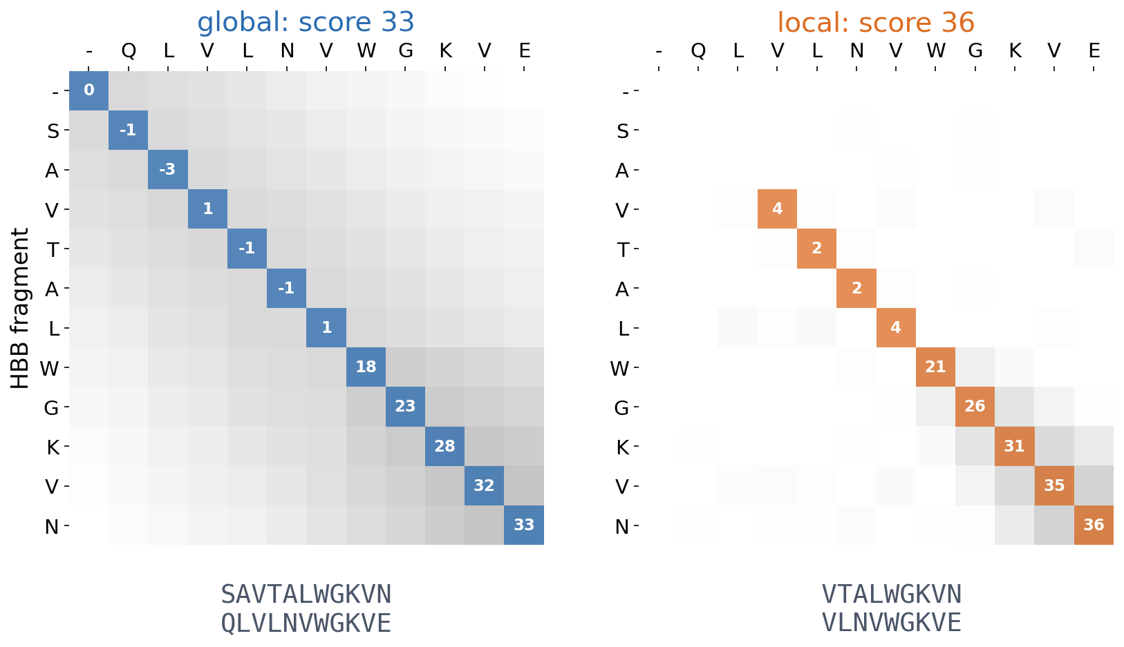
4 · PUTTING IT TOGETHER
HBB vs myoglobin fragments, scored with PAM250
Global alignment must use all of SAVTALWGKVN and QLVLNVWGKVE (score 33). Local alignment drops the unrelated start and keeps the shared WGKV region (score 36). Gap −8.
Course notebook, 'Global vs. local, side by side'.
Notes:
The local matrix has no negative numbers, and its path starts at the highest cell and stops at a zero. Ask: why is the local score higher? (The first two pairs cost points.)

Slide 39
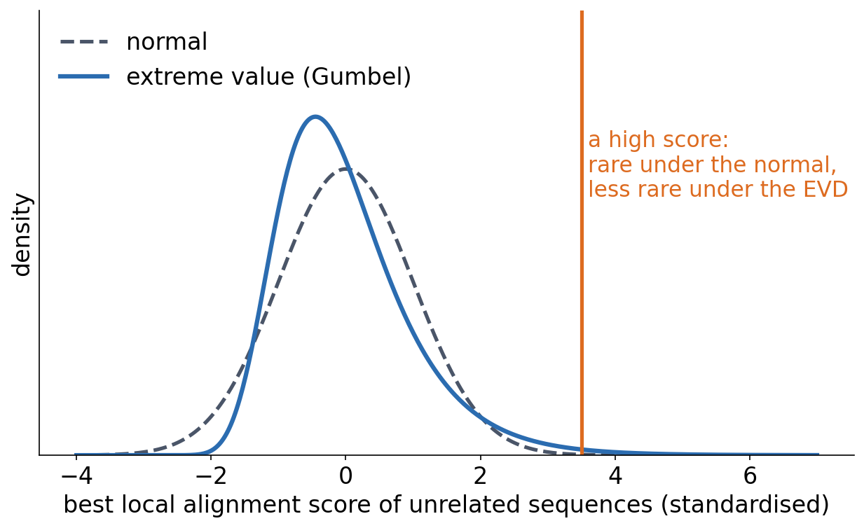
5 · SIGNIFICANCE
Is a high score good, or just chance?
▪ No universal threshold
▪ Compare with shuffled sequences
▪ Best local scores: extreme-value distribution
▪ Session 5: E-values
See course.bioinfo.se/session04.html, 'Is the score significant?'.
Notes:
The raw score depends on the sequence lengths, the matrix and the gap penalties. Calibrate it by aligning shuffled or unrelated sequences the same way: if the real score is far above almost all of them, chance is an unlikely explanation. Maxima of random scores follow an extreme-value distribution with a long right tail, not a normal one, so treating them as normal would make chance hits look too surprising. BLAST turns this into an E-value: hits this good expected by chance in a database of this size.

Slide 40
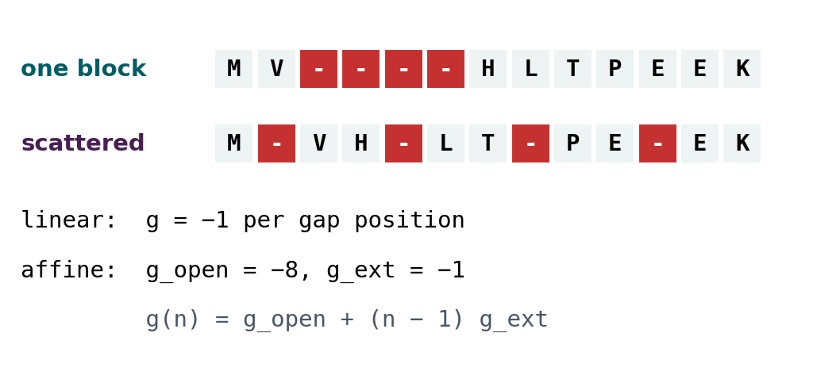
BLOCK 2 · QUIZ
What does affine charge for scattered gaps?
Four gap positions, as one block or as four single gaps. Linear (g = −1): −4 either way. Affine (g_open = −8, g_ext = −1)?
A −11 block, −32 scattered
B −11 for both, like linear
C −32 block, −11 scattered
D −8 block, −32 scattered
Guess on your own
Scan the code, or go to
quiz.bioinfo.se/live
Notes:
The old discussion problem 2. The formula g(n) = g_open + (n − 1) g_ext is on the figure.

Slide 41
BLOCK 2 · QUIZ
What does affine charge for scattered gaps?
How did the room answer?
Halt the round when most have answered, then show the results.
Show the results ▸ quiz.bioinfo.se/live/report
Notes:
Halt submission in the Control view, then open the results. Do not say which answer is right.

Slide 42

BLOCK 2 · QUIZ
What does affine charge for scattered gaps?
Fix it, run it, discuss
Open the notebook: scan the code
Fix the line marked FIX, then run the cells
Did it come out as you guessed? Discuss with your neighbour
The notebook: https://colab.research.google.com/github/ElofssonLab/kb8029-book/blob/main/notebooks/session04-discussion-2.ipynb
Notes:
About 8 minutes. The notebook's gap_cost never resets in_gap after a residue, so every later gap counts as an extension of the first: affine gives −11 for both rows (the second answer). Fixed with else: in_gap = False: −11 and −32.

Slide 43
BLOCK 2 · QUIZ
What does affine charge for scattered gaps?
Answer again
Same question, after the discussion.
quiz.bioinfo.se/live
Notes:
Open the second round (post) in the Control view.

Slide 44
BLOCK 2 · QUIZ
What does affine charge for scattered gaps?
Results, and who explains
Both rounds side by side.
Draw two to explain: one of you says how you reasoned.
Show the results ▸ quiz.bioinfo.se/live/report
To check it with code afterwards: discussion notebook 2 https://colab.research.google.com/github/ElofssonLab/kb8029-book/blob/main/notebooks/session04-discussion-2.ipynb
Notes:
−11 and −32. The block pays one opening and three extensions (−8 − 3); each scattered gap pays its own opening (4 × −8). Linear is indifferent, affine keeps gaps together in blocks, as real insertions and deletions are.

Slide 45
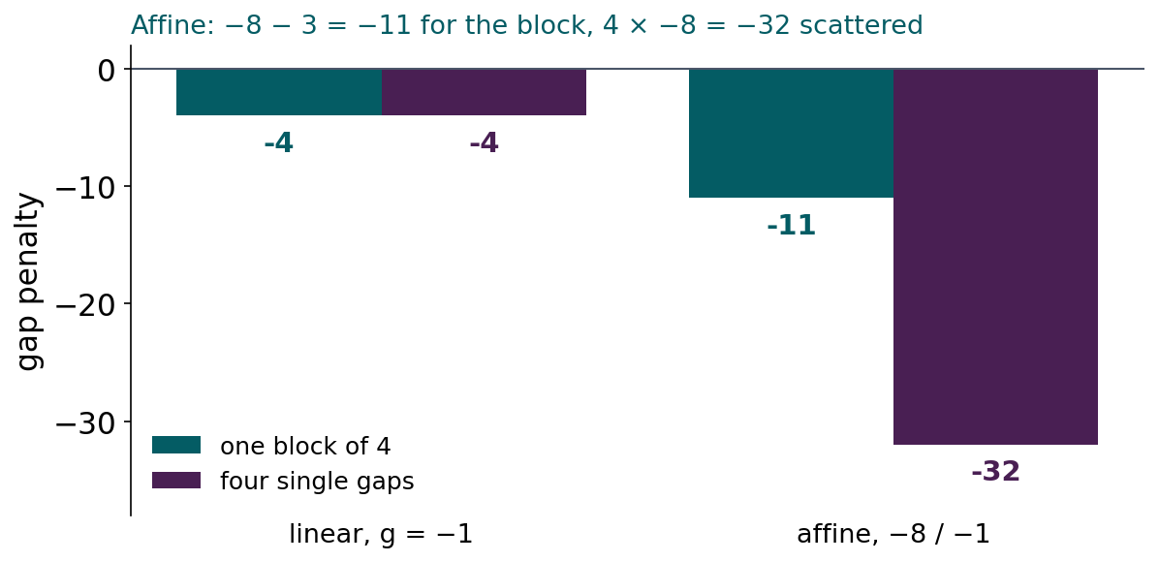
BLOCK 2 · QUIZ
The answer: −11 for the block, −32 scattered
Linear charges per gap position, so it cannot tell the two rows apart. Affine charges an opening cost for every separate gap: one block pays it once, four scattered gaps pay it four times. That is why affine penalties give alignments with gaps in blocks.

Slide 46
BLOCK 2 DONE
Break

Slide 47
BLOCK 3 · ABOUT 30 MIN
Many sequences: multiple alignment, trees and logos

Slide 48
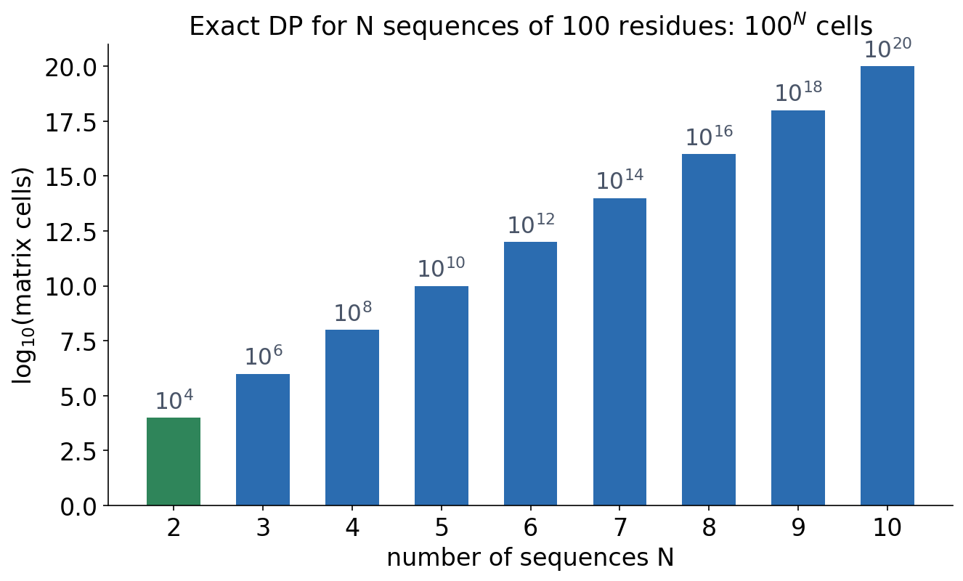
6 · MULTIPLE ALIGNMENT
Exact DP for many sequences is out of reach
▪ The cost grows exponentially with N
▪ Fine for a few short sequences
▪ Practical tools combine three ideas
See course.bioinfo.se/session04.html, 'Multiple sequence alignment'.
Notes:
For N sequences the DP matrix has one dimension per sequence: L^N cells for length L. Two sequences of 100 residues: 10^4 cells; ten: 10^20.

Slide 49
6 · MULTIPLE ALIGNMENT
Three ideas behind real MSA tools
Progressive
Iterative
Consistency
ClustalW
MUSCLE
T-Coffee
▪ Guide tree from pairwise distances
▪ Closest pair first, then add the rest
▪ Early mistakes persist
▪ Start from a progressive alignment
▪ Re-align parts, keep improvements
▪ Use agreement among all pairs
▪ A~B and B~C: prefer A~C
See course.bioinfo.se/session04.html, 'Multiple sequence alignment'.
Notes:
Real tools often combine several of these ideas; which works best depends on the number, length and divergence of the sequences.

Slide 50
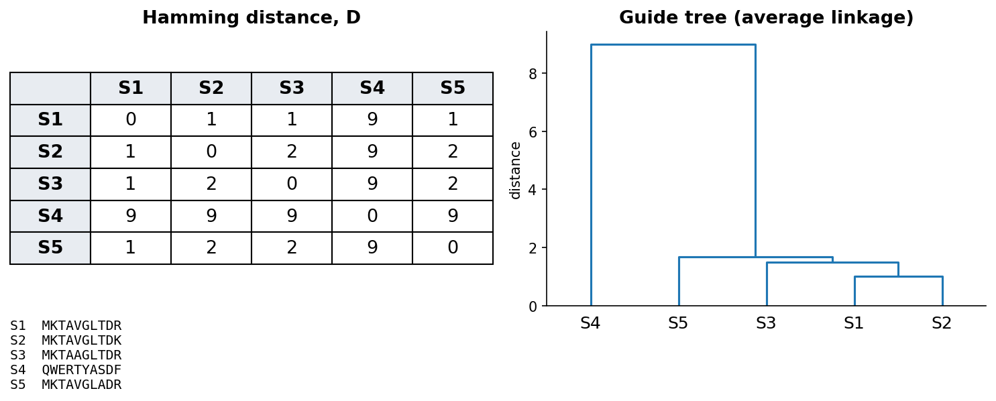
6 · MULTIPLE ALIGNMENT
The guide tree decides the order of alignment
Five toy sequences: every sequence starts as its own cluster, and the closest pair is merged repeatedly. S4 merges last, because it differs clearly from the other four. The merge order is the order of alignment.
See course.bioinfo.se/session04.html, 'Multiple sequence alignment'.
Notes:
A guide tree is only an ordering device, usually built by UPGMA, which assumes that all lineages evolve at the same rate. The third discussion asks whether it is a phylogeny, so let the room think about that rather than answering here.

Slide 51
7 · FROM ALIGNMENT TO TREE
Reading a gene tree
▪ Leaves: sequences. Nodes: ancestors
▪ Branch length: amount of change
▪ Midpoint root: order of events
▪ Red: duplication. Blue: speciation
Neighbour joining in the course notebook; see course.bioinfo.se/session04.html, 'From alignment to tree'.
Notes:
Neighbour joining uses the same distance matrix as a guide tree, but allows lineages to evolve at different rates. A clade is an ancestor with all its descendants. Distance methods give unrooted trees; a root comes from an outgroup or, as here, the midpoint of the longest path. Both top splits are duplications, because each branch still contains all three species.

Slide 52
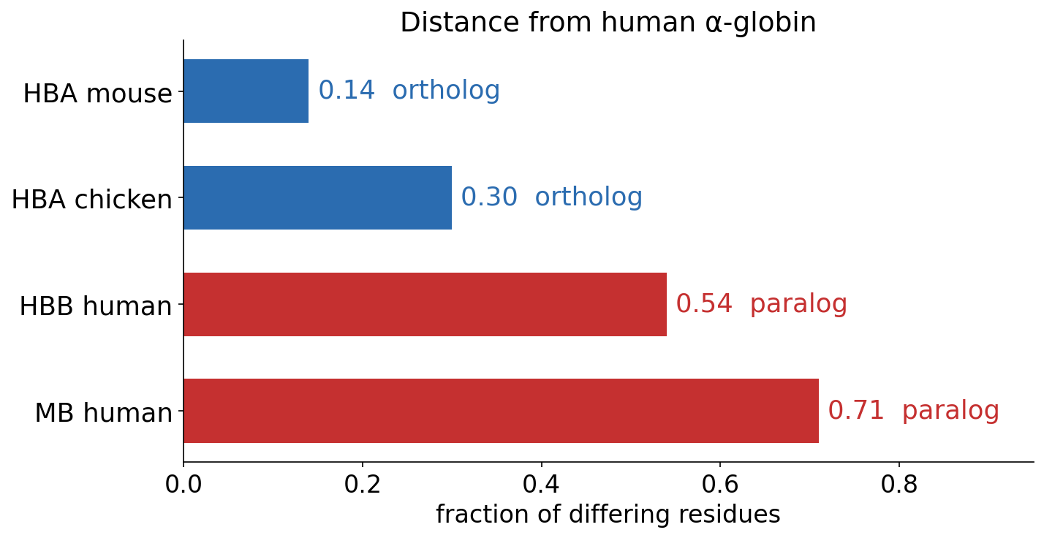
7 · FROM ALIGNMENT TO TREE
Orthologs are closer than paralogs
▪ Human vs mouse α-globin: orthologs
▪ Human α vs β: paralogs
▪ The tree, not the distance, decides
Distances printed by the course notebook.
Notes:
Human α-globin differs from mouse α-globin at 14% of positions and from chicken α-globin at 30% (orthologs), but from human β-globin at 54% (paralogs). Distance alone does not decide: a fast-evolving ortholog can be far away; the order of events in the tree does. The tree structure of sequences returns in Session 8's homology-aware splits and Session 12's coevolution.

Slide 53
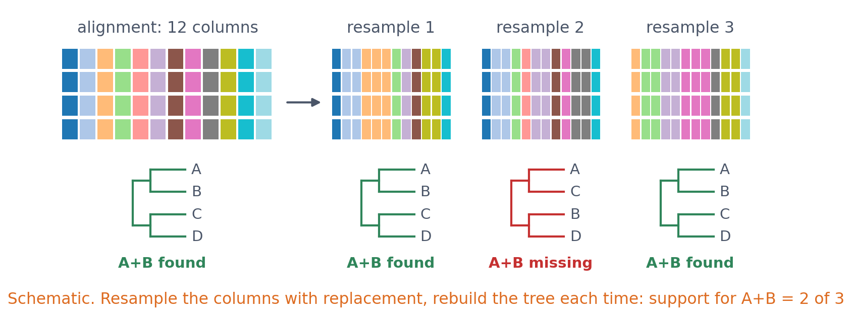
7 · FROM ALIGNMENT TO TREE
How much can you trust a branch? The bootstrap
Resample the alignment columns with replacement, rebuild the tree, and count how often each branch returns. Real phylogenetics adds substitution models and maximum likelihood (IQ-TREE, FastTree).
See course.bioinfo.se/session04.html, 'From alignment to tree'.

Slide 54
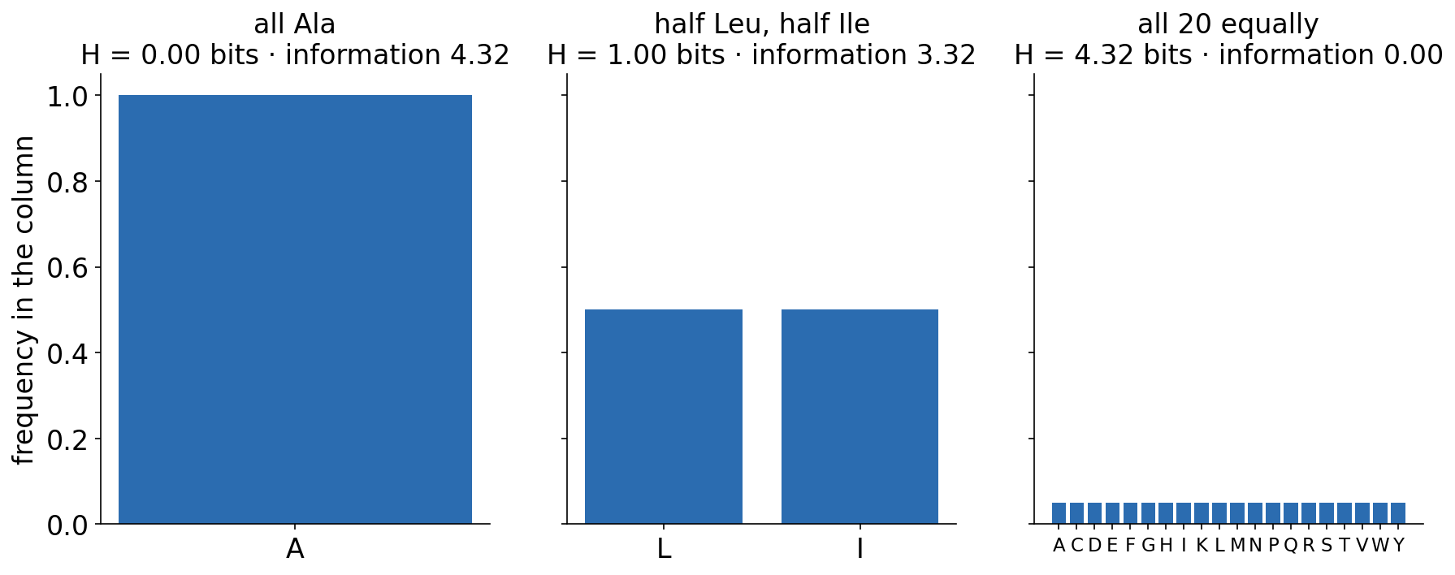
8 · READING AN ALIGNMENT
Entropy: how variable is a column?
▪ H = −Σ p log₂ p
▪ 0 bits: fully conserved
▪ 4.32 bits: all 20 equally common
▪ Information = 4.32 − H
See course.bioinfo.se/session04.html, 'Reading an alignment: entropy and sequence logos'.
Notes:
Session 1's entropy, applied to one alignment column. For DNA the maximum is log2 4 = 2 bits. This simple version assumes that all amino acids are equally common in the background; logo programs often correct for background frequencies and small samples.

Slide 55
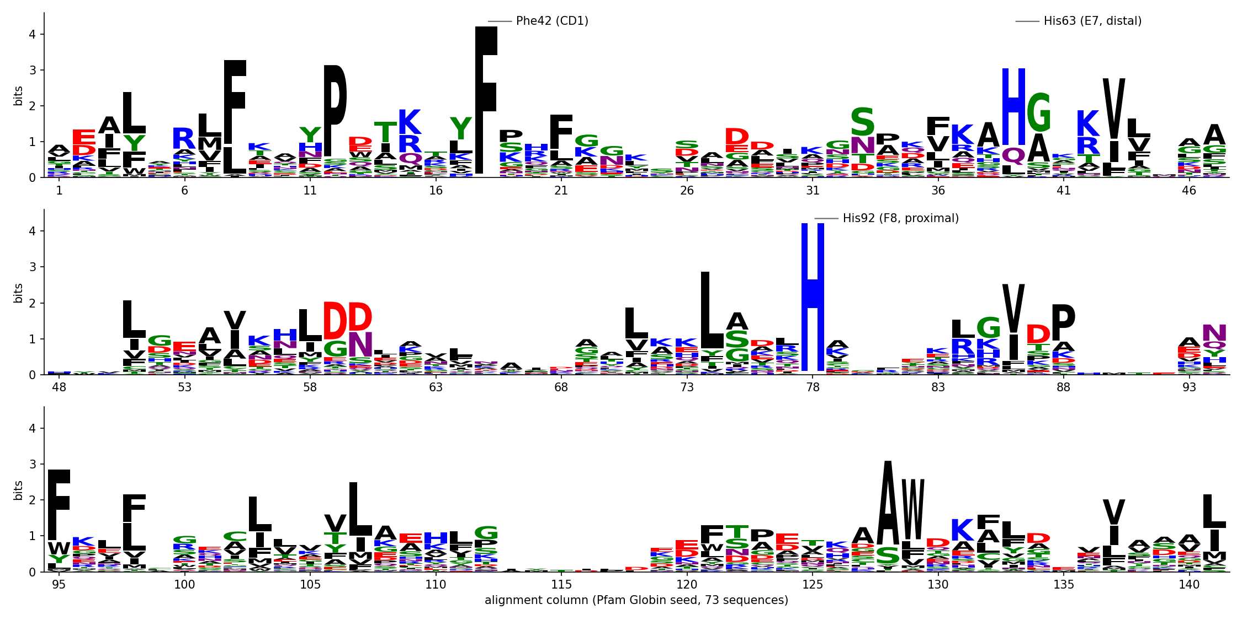
8 · READING AN ALIGNMENT
73 globins: what evolution keeps
Pfam Globin seed alignment. Stack height: information content; letter height: frequency. Phe42 and the proximal His92 (haem iron ligand) are identical in all 73; the distal His63 in 73%.
Drawn from Pfam PF00042 (InterPro) with logomaker; tools/builders/make_session04_logo.py.
Notes:
Ask first: which columns would you expect to be conserved in a family that binds haem? Then show the logo. Gaps also lower the stacks, because the height is multiplied by the fraction of sequences with a residue in that column.

Slide 56
8 · READING AN ALIGNMENT
The fold is kept, the sequence is not
▪ Only two columns identical in all 73
▪ Hydrophobic columns (black) hold the fold
▪ Few sequences: columns look conserved by chance
1.2 bits
the average
column
< 20%
identity, most
pairs of globins
See course.bioinfo.se/session04.html, 'Reading an alignment: entropy and sequence logos'.
Notes:
The rest of the fold is held together by positions that stay hydrophobic (L, V, I, F stacks) rather than by identical residues. Closely related sequences are over-represented in most alignments, so real tools weight the sequences. The lab compares a logo of 5 sequences with one of 73.

Slide 57
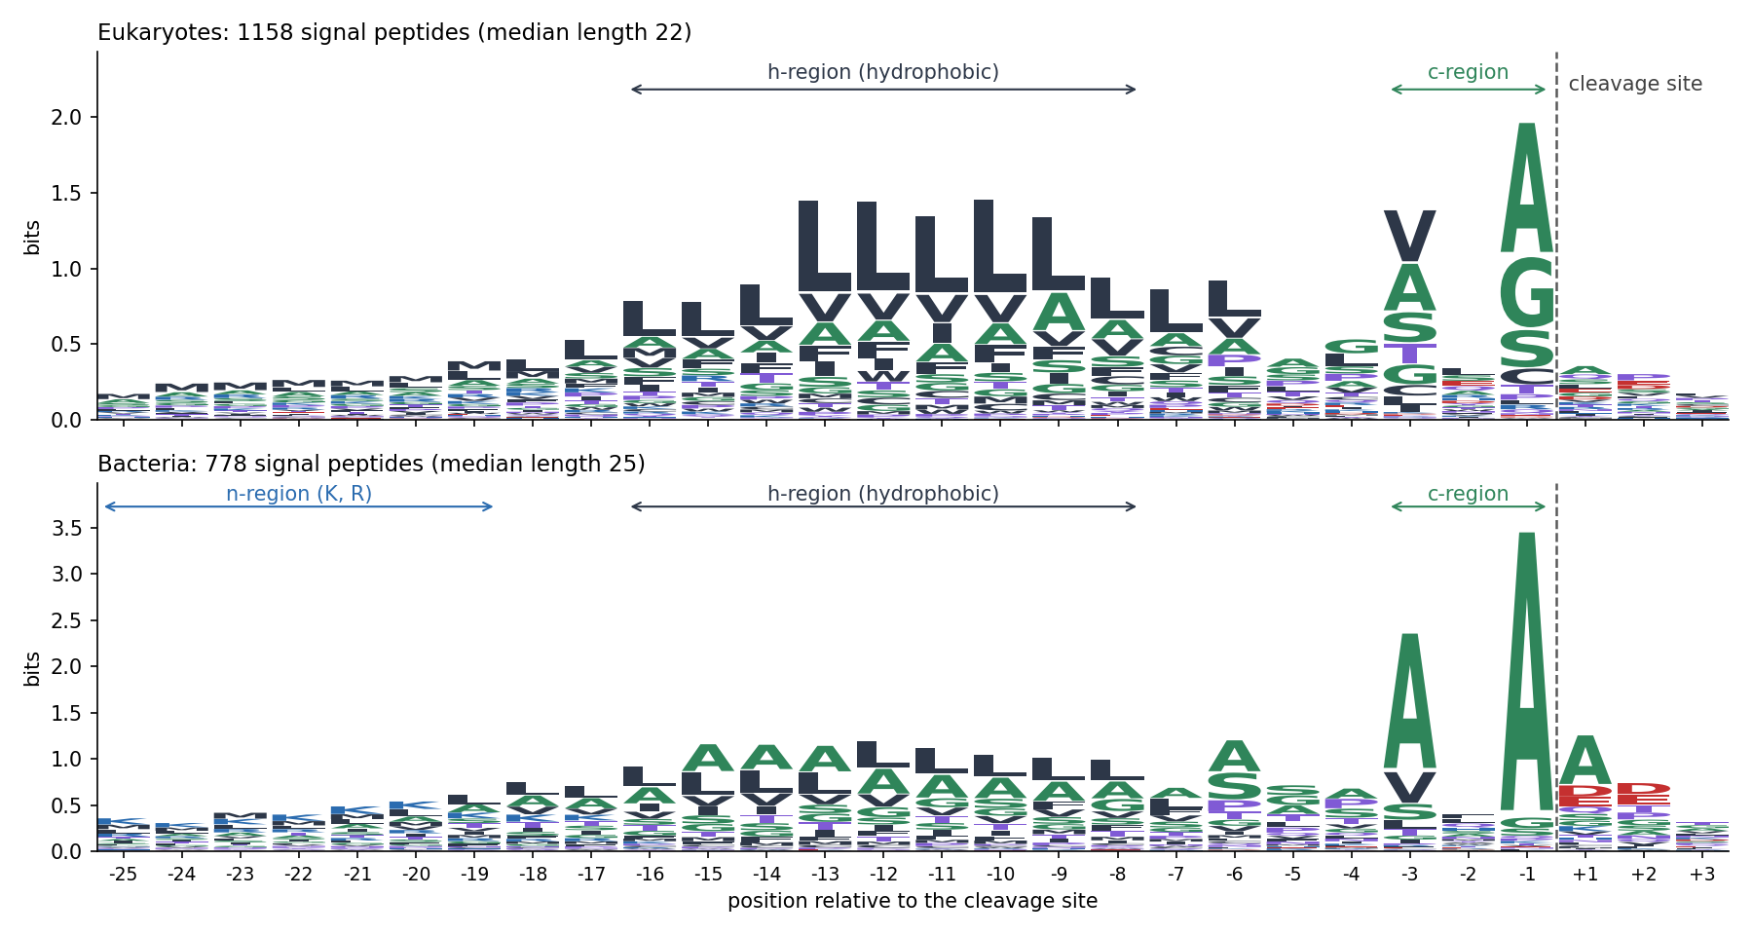
8 · READING AN ALIGNMENT
Signal peptides: a motif without a family
Unrelated proteins, aligned on the cleavage site instead of by homology. h-region: no column conserved, but all lean hydrophobic (L). Positions −3 and −1: small residues, the (−3, −1) rule. n-region (K, R): clearest in bacteria.
von Heijne (1983), Eur J Biochem 133:17; data: the Session 11 set (UniProt, experimental evidence).
Notes:
A signal peptide (15-30 residues) sends a protein into the secretory pathway and is then cut off. Two kinds of signal: a property of a stretch (hydrophobic h-region) and single positions (−3, −1, where signal peptidase needs small side chains). The two logos have different y-scales. Von Heijne turned this into a weight matrix in 1986 (Session 5's PSSM idea); Sessions 7, 8 and 11 come back to it.

Slide 58
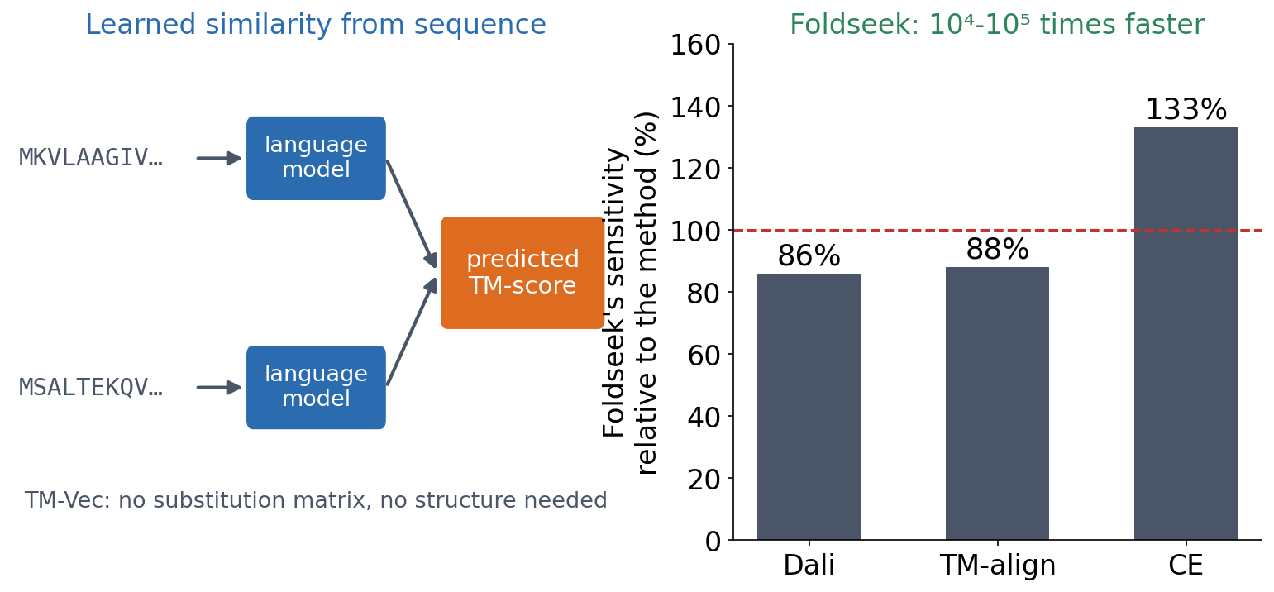
3 · OUTLOOK
Alignment without a substitution matrix
▪ Language models compare sequences
▪ TM-Vec: predicts structural similarity from sequence
▪ Foldseek: structures aligned 10⁴-10⁵ times faster
▪ Is a learned similarity still a hypothesis about evolution?
Hamamsy et al. (2023), Nature Biotechnology, doi:10.1038/s41587-023-01917-2; van Kempen et al. (2024), Nature Biotechnology 42:243.
Notes:
BLOSUM and PAM are explicit models of evolution: log-odds of substitutions counted in related proteins. TM-Vec (Hamamsy et al.) is a deep network trained to predict the TM-score of two proteins directly from their sequences, and finds remote homologs better than sequence alignment; DeepBLAST, from the same paper, aligns them from sequence alone. Foldseek describes each residue's 3D environment as a letter of a 20-letter structural alphabet and then aligns these strings with fast sequence-search machinery: four to five orders of magnitude faster, with 86%, 88% and 133% of the sensitivity of Dali, TM-align and CE. Question for the room: a substitution matrix is a hypothesis about evolution you can read. Is a learned similarity still one?

Slide 59
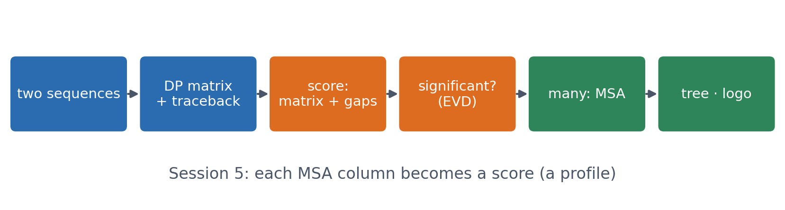
SUMMARY
From two sequences to a family
Dynamic programming finds the optimal alignment for a scoring scheme; the scheme (matrix and gaps) is a choice; a high score still has to beat chance. Many sequences give an MSA, a tree and a logo.
See course.bioinfo.se/session04.html, 'What's next'.

Slide 60
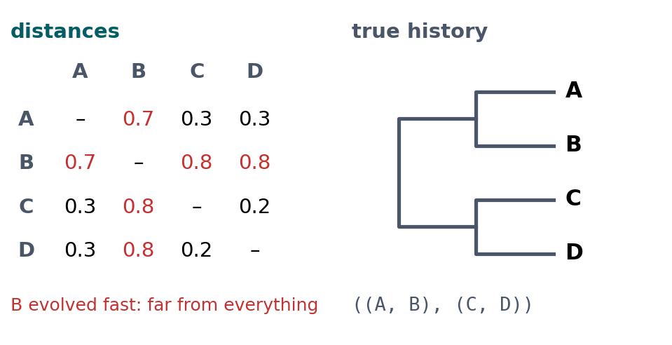
BLOCK 3 · QUIZ
What does the UPGMA guide tree do?
True history ((A, B), (C, D)), but B evolved fast. Progressive alignment builds its guide tree from the distances by UPGMA.
A A and B first: most recent ancestor
B C and D first, then A and B as relatives
C C and D first, then A; B last
D B first: it is the most different
Guess on your own
Scan the code, or go to
quiz.bioinfo.se/live
Notes:
The old discussion problem 3, part 2. UPGMA: repeatedly merge the two closest groups and average their distances.

Slide 61
BLOCK 3 · QUIZ
What does the UPGMA guide tree do?
How did the room answer?
Halt the round when most have answered, then show the results.
Show the results ▸ quiz.bioinfo.se/live/report
Notes:
Halt submission in the Control view, then open the results. Do not say which answer is right.

Slide 62
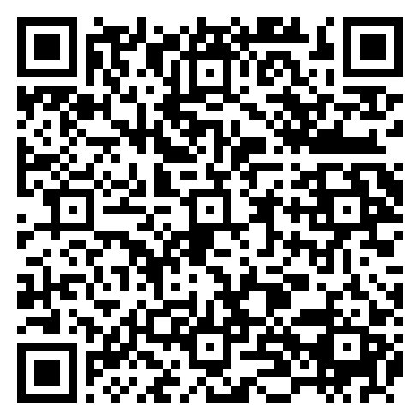
BLOCK 3 · QUIZ
What does the UPGMA guide tree do?
Fix it, run it, discuss
Open the notebook: scan the code
Fix the line marked FIX, then run the cells
Did it come out as you guessed? Discuss with your neighbour
The notebook: https://colab.research.google.com/github/ElofssonLab/kb8029-book/blob/main/notebooks/session04-discussion-3.ipynb
Notes:
About 8 minutes. The notebook's FIX line builds a neighbour-joining tree, which recovers the true history ((A, B), (C, D)): the second answer. Changed to upgma: C and D, then A, B last. Early finishers: when does the merge order matter, and is a guide tree a phylogeny?

Slide 63
BLOCK 3 · QUIZ
What does the UPGMA guide tree do?
Answer again
Same question, after the discussion.
quiz.bioinfo.se/live
Notes:
Open the second round (post) in the Control view.

Slide 64
BLOCK 3 · QUIZ
What does the UPGMA guide tree do?
Results, and who explains
Both rounds side by side.
Draw two to explain: one of you says how you reasoned.
Show the results ▸ quiz.bioinfo.se/live/report
To check it with code afterwards: discussion notebook 3 https://colab.research.google.com/github/ElofssonLab/kb8029-book/blob/main/notebooks/session04-discussion-3.ipynb
Notes:
C and D first (0.2), then A (0.3 from both), B last. UPGMA reads distance as time, so the fast-evolving B looks unrelated to everything. Neighbour joining corrects for unequal rates. A guide tree is an ordering device, not a phylogeny; the order matters most for divergent sequences.

Slide 65
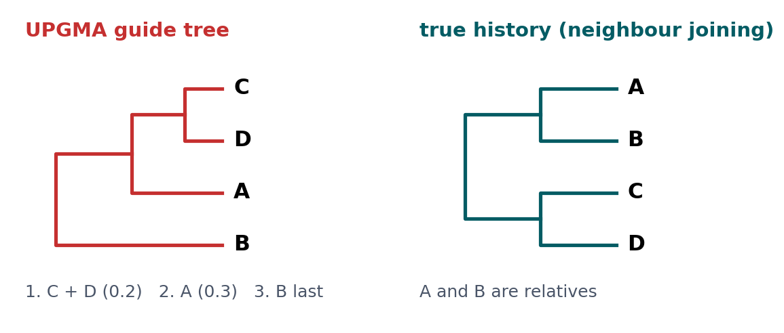
BLOCK 3 · QUIZ
The answer: C and D, then A; B is added last
UPGMA assumes a molecular clock, so B, far from everything only because it evolved fast, is added last and A ends up with C and D. Neighbour joining recovers A and B as relatives. For ordering an alignment that is acceptable; as a phylogeny it is wrong.

Slide 66
BEFORE YOU LEAVE
In up to three words: what was the hardest part of today?
Answer now
Scan the code, or go to
quiz.bioinfo.se/live
Notes:
A word cloud: the bigger the word, the more students wrote it. It shows what to repeat next time.

Slide 67
BEFORE YOU LEAVE
The hardest part of today
What the room found hardest
Show the results ▸ quiz.bioinfo.se/live/report

Slide 68
Session 5 next
Needleman-Wunsch does not scale to searching a whole database
BLAST's heuristic is the answer, and its E-value builds on today's significance idea
Today's lab covers both Session 4 and Session 5

