Slide 1

Session 5: Advanced Database Search & Profile Methods
KB8029 — Bioinformatics & Deep Learning
Arne Elofsson

Slide 2


BEFORE WE START
Log in to the lecture quiz
Log in to the quiz
Scan the code, or go to quiz.bioinfo.se/live
Log in with your university account
Answering counts as being at the lecture: up to 3 bonus points on the exam
Right or wrong is never graded, only whether you answered. Results are shown without names.
quiz.bioinfo.se/live
Notes:
The quiz is not anonymous, because answering is how attendance is counted: 3 bonus points on the main exam for answering in all 12 lectures, one point less per missed lecture (preliminary). Whether an answer is right or wrong is never used. The projected results never show names; the only names shown are the two drawn to explain their reasoning. Start the session on quiz.bioinfo.se before the lecture: quiz.bioinfo.se/live then leads to it.

Slide 3
BEFORE WE START
Warm-up: what do you know already?
3 quick questions
On the topics of today, one at a time, about 30 seconds each
Answer on your own, and guess if you do not know
It shows me where to start; right or wrong is never graded
Notes:
About 2 minutes in all. Open each question's round, halt it after about 30 seconds and glance at the results; do not explain the answers now, the lecture does that.

Slide 4
WARM-UP · 1 OF 3
BLAST reports a hit with E-value 0.001. What does that mean?
A The hit is homologous with 99.9% probability
B About 0.001 hits this good are expected by chance
C The sequences differ at 0.1% of their positions
D The alignment has 0.001 gaps per residue
Answer now
Scan the code, or go to
quiz.bioinfo.se/live
Notes:
Right: About 0.001 hits this good are expected by chance. The E-value counts chance hits in this search; it is not a probability of homology. Block 1.

Slide 5
WARM-UP · 2 OF 3
In one column of an alignment, 4 of 5 sequences have A. Without pseudocounts, what is the frequency of A?
A 4
B 0.25
C 0.2
D 0.8
Answer now
Scan the code, or go to
quiz.bioinfo.se/live
Notes:
Right: 0.8. Step 1 of building a PSSM. Block 2.

Slide 6
WARM-UP · 3 OF 3
In a Markov chain, the next state depends on ...
A only the current state
B all the earlier states
C nothing: it is random
D the final state
Answer now
Scan the code, or go to
quiz.bioinfo.se/live
Notes:
Right: only the current state. Block 3: profile hidden Markov models.

Slide 7
BEFORE WE START
What the room knows already
Where we start
Which topics most of you know, and which we take slowly today.
Show the results ▸ quiz.bioinfo.se/live/report
Notes:
Optional: show two or three of the results, the ones that most got wrong.

Slide 8
BEFORE WE START
Your questions before today
What you asked
The questions you sent in on Canvas before the lecture
The most common ones now; the others in the block where they belong
Notes:
About 5 minutes. Read the answers to this session's Canvas survey 'Questions before the lecture' the evening before (it closes at 18:00 the day before the lecture), pick the two or three most common questions, and answer them briefly now or say in which block they come.

Slide 9
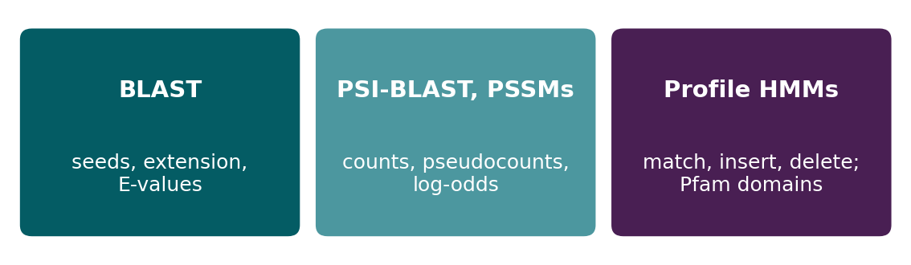
BEFORE WE START
In up to three words: what do you want to learn today?
Answer now
Scan the code, or go to
quiz.bioinfo.se/live
Notes:
A word cloud: the bigger the word, the more students wrote it. Come back to it at the end of the lecture.

Slide 10
BEFORE WE START
What you want to learn today
What the room wants to learn
Show the results ▸ quiz.bioinfo.se/live/report

Slide 11
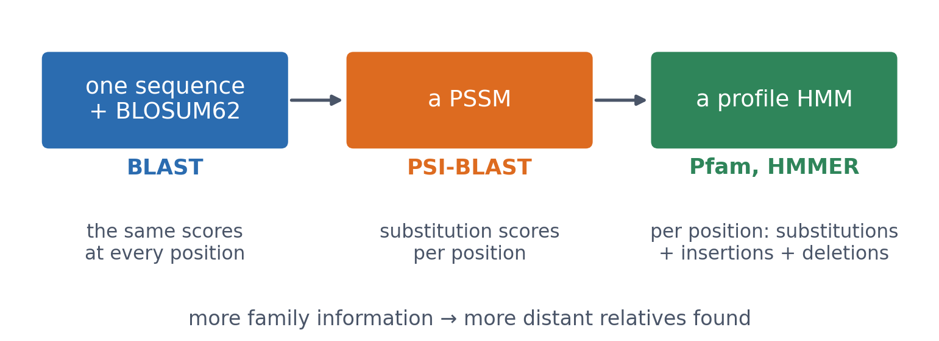
SESSION 5 · THE MAP
From one sequence to a model of the family
BLAST scores every position of the query with the same matrix. A PSSM gives every position its own substitution scores. A profile HMM adds where insertions and deletions are common.
See course.bioinfo.se/session05.html.
Notes:
Come back to this picture at the end. The thread of the session: the more the search knows about the family, the more distant the relatives it can find, and the more carefully the family has to be built.

Slide 12
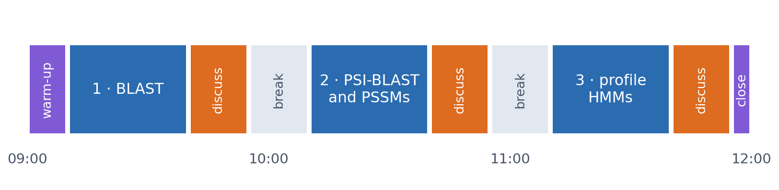
SESSION 5 · THE MORNING
Three blocks: about 30 min talk and 15 min discussion
Block 1: BLAST, how it searches and how to read its E-values. Block 2: PSI-BLAST and the position-specific scoring matrix (PSSM). Block 3: profile hidden Markov models.
Times are approximate: a 10 min start (warm-up quiz and your questions), two 15 min breaks and a 5 min close. Each block ends with a quiz question: guess, run the notebook and work out why it behaves as it does, discuss, answer again.

Slide 13
BLOCK 1 · ABOUT 30 MIN
BLAST: seed, extend, evaluate

Slide 14
1 · THE SCALING PROBLEM
Optimal alignment does not scale to a database
▪ DP is optimal, but slow per pair
▪ Times a hundred million sequences
▪ BLAST: speed instead of a guarantee
m × n
cells per pair
(Session 4)
> 10⁸
sequences in GenBank
and UniProt
See course.bioinfo.se/session05.html, 'The scaling problem, and BLAST's heuristic answer'.
Notes:
For two sequences a few hundred residues long, dynamic programming is no problem. For one query against well over a hundred million sequences it would take far too long. BLAST first looks for short near-exact matches and gives the expensive alignment step only to the promising regions.

Slide 15
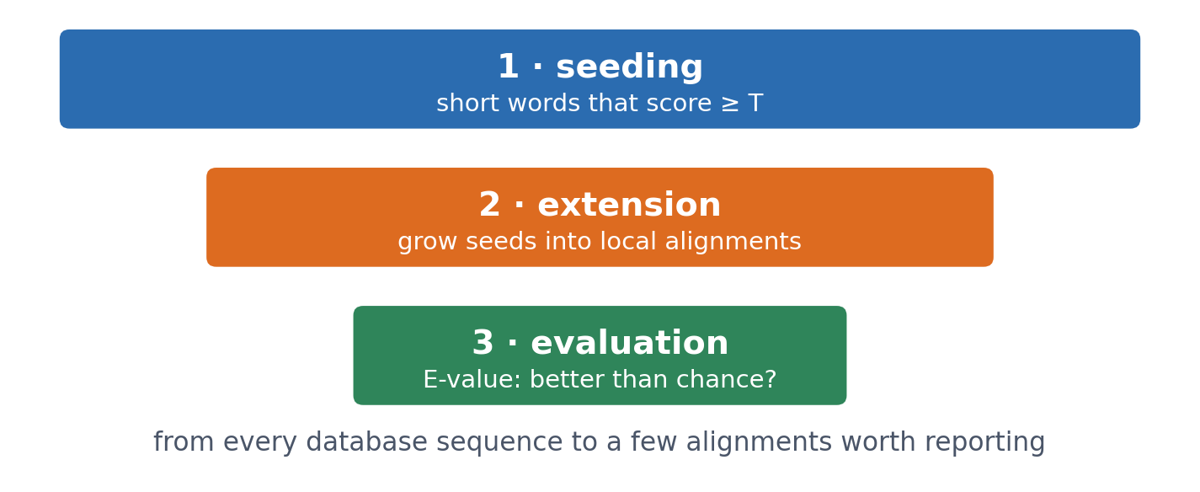
1 · BLAST
Three stages, each passing on less
▪ Seeding: find short matches
▪ Extension: grow them
▪ Evaluation: beat chance?
▪ Real BLAST adds refinements
See course.bioinfo.se/session05.html, 'The scaling problem, and BLAST's heuristic answer'.
Notes:
Production BLAST adds the two-hit rule (extend only when two seeds lie close together on the same diagonal), masking of low-complexity regions, gapped extension and composition corrections. None of these changes the logic of seed, extend, evaluate.

Slide 16
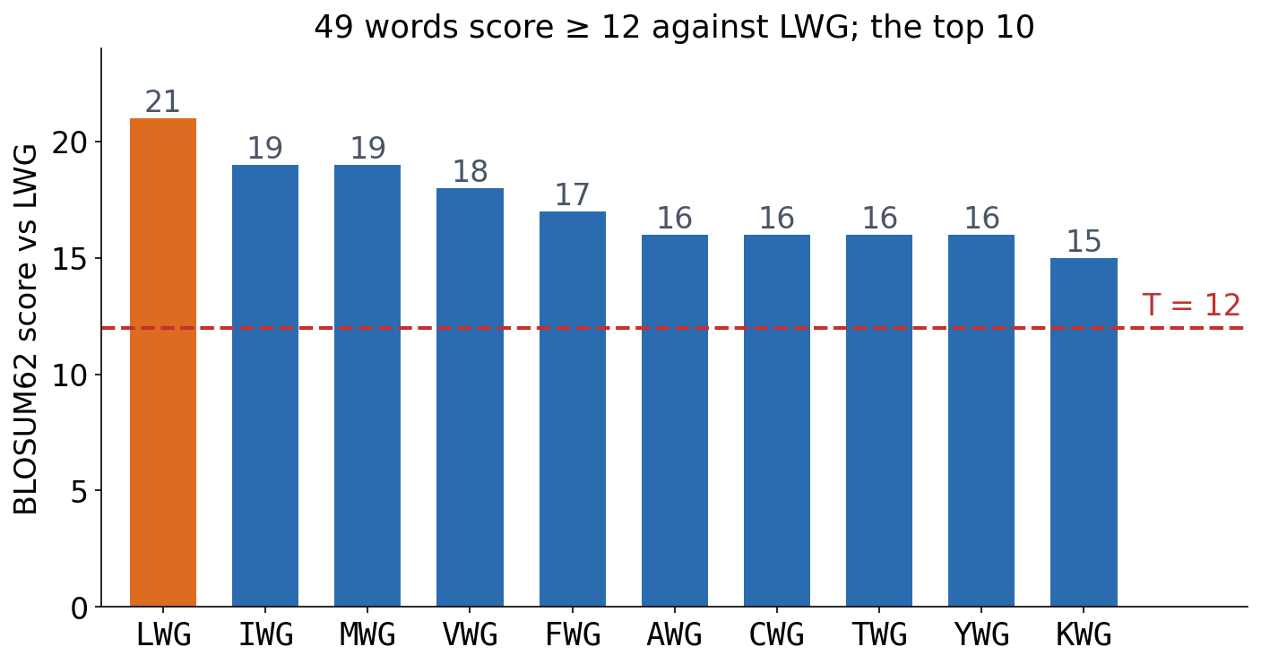
2 · SEEDING
Seeds: words that score at least T
▪ Protein words: 3 residues
▪ Not only exact matches
▪ Scored with BLOSUM62
▪ LWG: 49 words ≥ 12
Neighbour words computed from BLOSUM62, as in the course notebook.
Notes:
A query of length 200 has 198 overlapping 3-letter words. A real match may substitute a residue or two, so BLAST precomputes every word that scores above T against each query word. IWG and MWG score 19 against LWG because L-I and L-M are conservative substitutions.

Slide 17
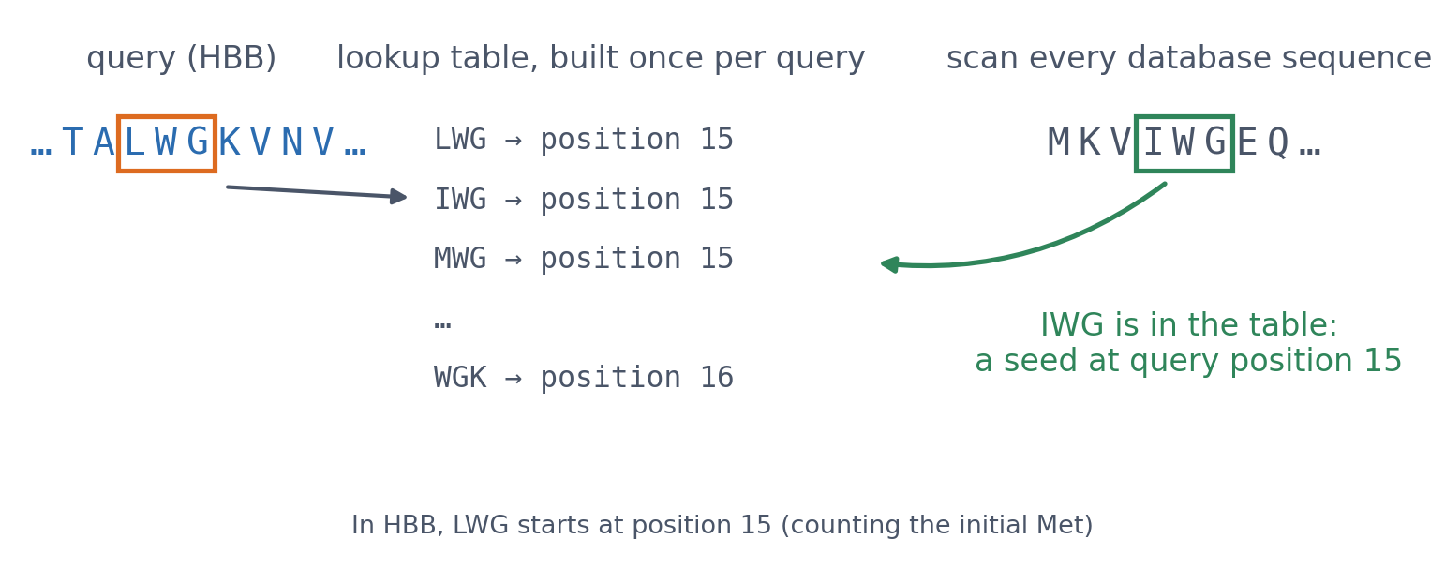
2 · SEEDING
The lookup table: built from the query, used while scanning
Every query word and its high-scoring neighbours go into a table. BLAST then reads each database sequence once: one table lookup per word, so the scan is linear in the size of the database.
See course.bioinfo.se/session05.html, 'Stage 1: seeding'.
Notes:
Only the few places that produce a seed go on to the expensive extension step.

Slide 18
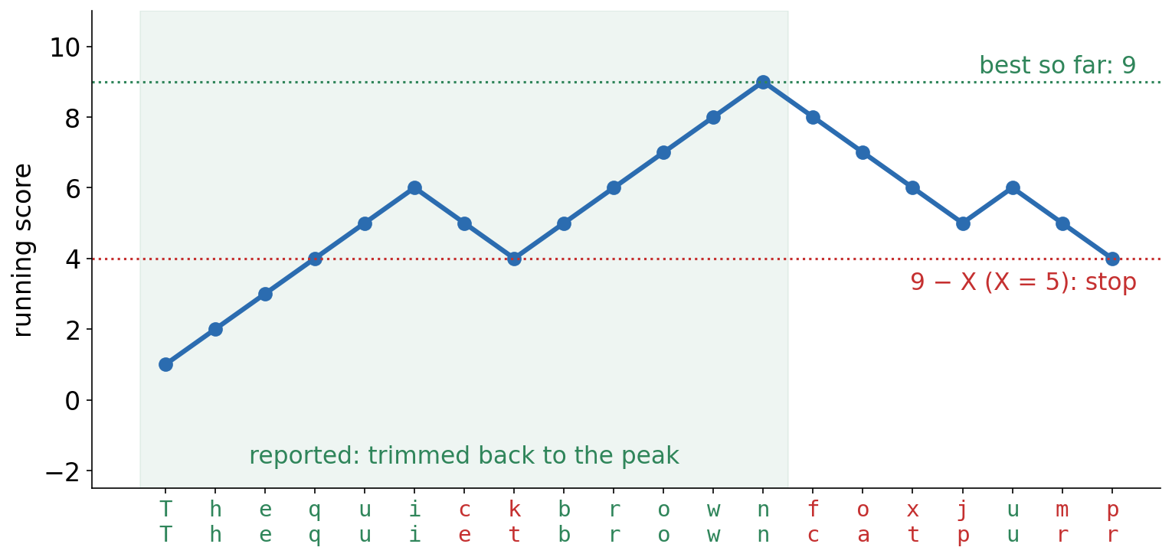
3 · EXTENSION
Extension and the X-drop rule
+1 for a match, −1 for a mismatch (spaces ignored). The running score peaks at 9 after 'brown'; once it is 5 below the peak, extension stops and the alignment is trimmed back to the peak: Thequickbrown / Thequietbrown.
Korf, Yandell & Bedell (2003); reproduced in the course notebook.
Notes:
BLAST tracks the running score and, separately, the best score so far. If the running score falls more than X below the best, the alignment is unlikely to recover. The ick/iet dip is survived because it is less than X.

Slide 19
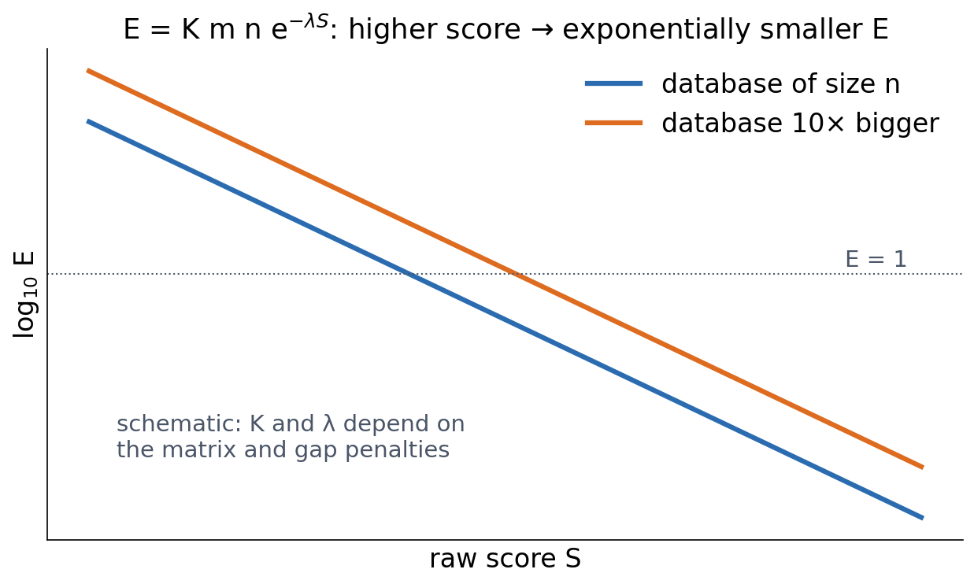
4 · EVALUATION
The E-value: hits this good expected by chance
▪ E = K m n e^(−λS)
▪ Higher score: exponentially smaller E
▪ Bigger database: bigger E
Karlin & Altschul (1990); see course.bioinfo.se/session05.html, 'Stage 3'.
Notes:
Karlin and Altschul proved that local alignment scores of random sequences follow an extreme-value (Gumbel) distribution (Session 4). m and n are the lengths of the query and the database; K and λ belong to the scoring system. Real BLAST uses slightly smaller effective lengths and composition corrections. An E-value is only meaningful together with the database it was computed against.

Slide 20
4 · EVALUATION
Bit score or E-value?
Bit score
E-value
S′ = (λS − ln K) / ln 2
E = K m n e^(−λS)
▪ Normalises away the scoring system
▪ Comparable across searches and matrices
▪ No universal cutoff
▪ Depends on the database size
▪ The one to read for significance
▪ E = 63: no evidence at all
See course.bioinfo.se/session05.html, 'Stage 3: is this hit significant?'.

Slide 21
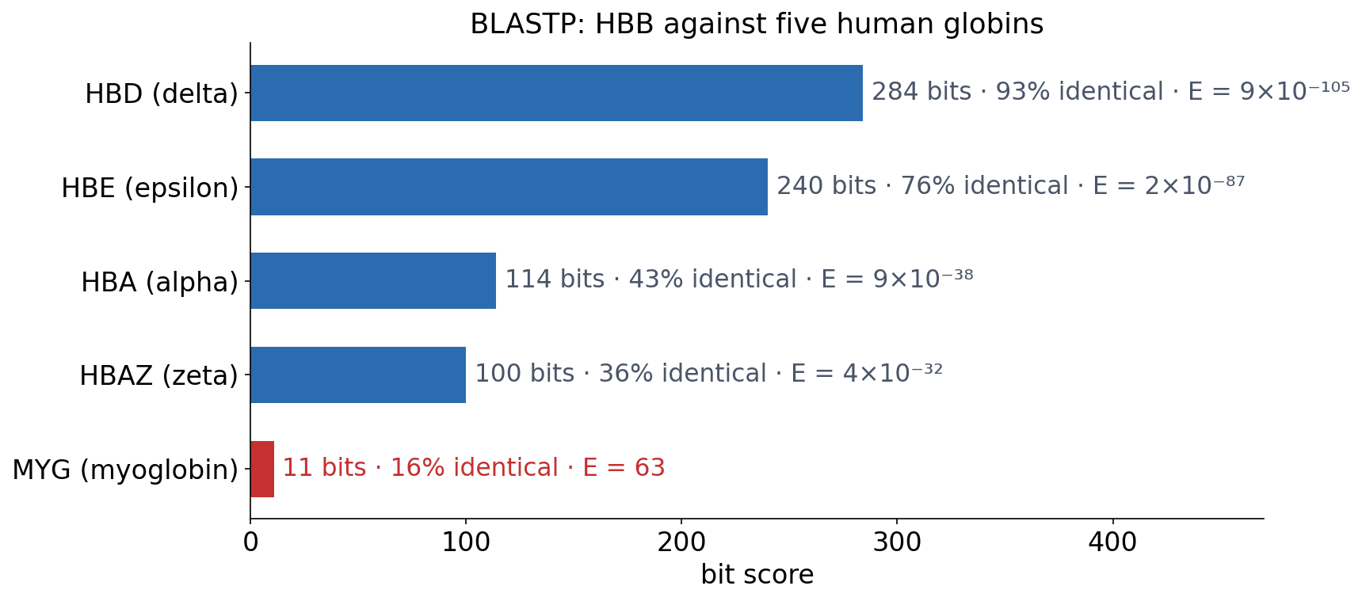
4 · EVALUATION
Reading real output: HBB against its relatives
▪ Four confident hits
▪ Myoglobin: E = 63
▪ A real homolog, yet no evidence?
BLASTP (BLAST+) output in the course notebook; see course.bioinfo.se/session05.html, Table 5.2.
Notes:
Myoglobin shares the globin fold and a real evolutionary origin with haemoglobin, yet the reported alignment is short and weak. Ask the room why before the next slide.

Slide 22
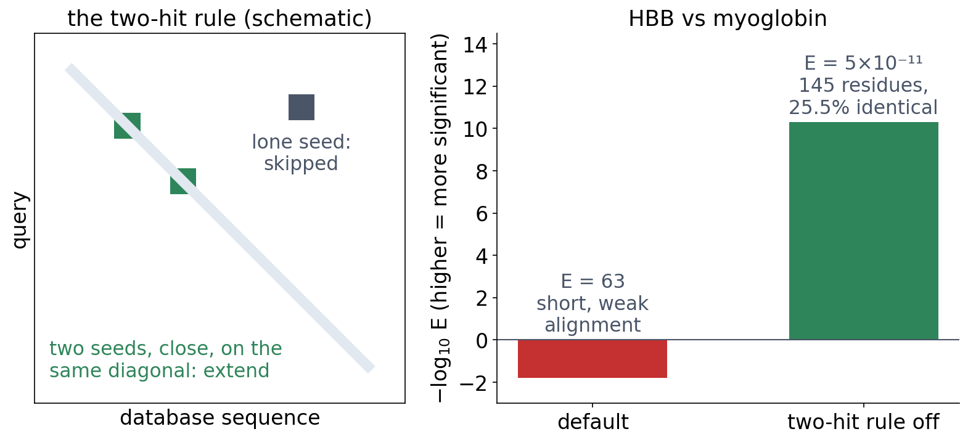
4 · EVALUATION
The price of a heuristic: the two-hit rule
With the default settings no two seeds fell close enough together on the right diagonal, so the good alignment was never extended. Switched off (-window_size 0 in BLAST+), BLAST finds 145 residues at 25.5% identity, E = 5×10⁻¹¹.
Course notebook, 'Stage 3: a real BLAST search, and what its heuristic missed'.
Notes:
BLAST is fast because it skips most of the search, and occasionally it skips the answer, which an optimal Smith-Waterman search would not have missed.

Slide 23
4 · EVALUATION
The same alignment, a bigger database
▪ The same myoglobin alignment
▪ Significant, but only just
▪ Truncated haemoglobins: no pairwise signal
5×10⁻¹¹
against 5
globins
≈ 0.007
against UniProtKB
(≈ 9×10¹⁰ residues)
See course.bioinfo.se/session05.html, 'Stage 3: is this hit significant?'.
Notes:
Relatives that have diverged further than myoglobin, such as the bacterial truncated haemoglobins, give no detectable pairwise signal at all, even with the optimal alignment. Session 6 shows that they still share the globin fold. This is the motivation for Block 2.

Slide 24
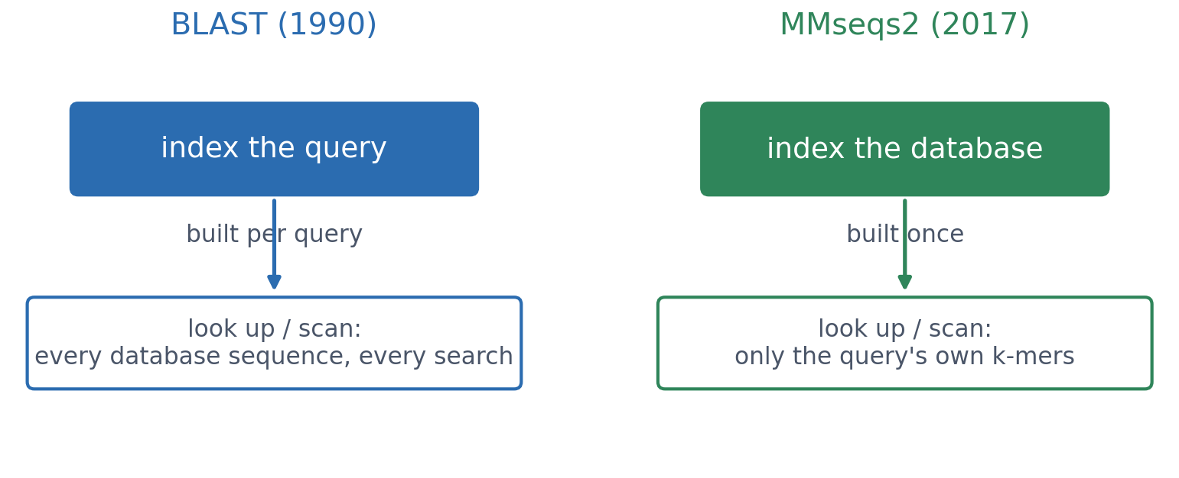
5 · MMSEQS2
BLAST's ideas at today's scale: MMseqs2
BLAST builds a table from the query and reads through every database sequence. MMseqs2 (Steinegger & Söding 2017) indexes the database once, so each query only looks up its own k-mers.
Steinegger & Söding (2017), Nature Biotechnology 35:1026-1028.
Notes:
BLAST was designed in 1990, when protein databases held tens of thousands of sequences. Metagenomic collections now hold billions.

Slide 25
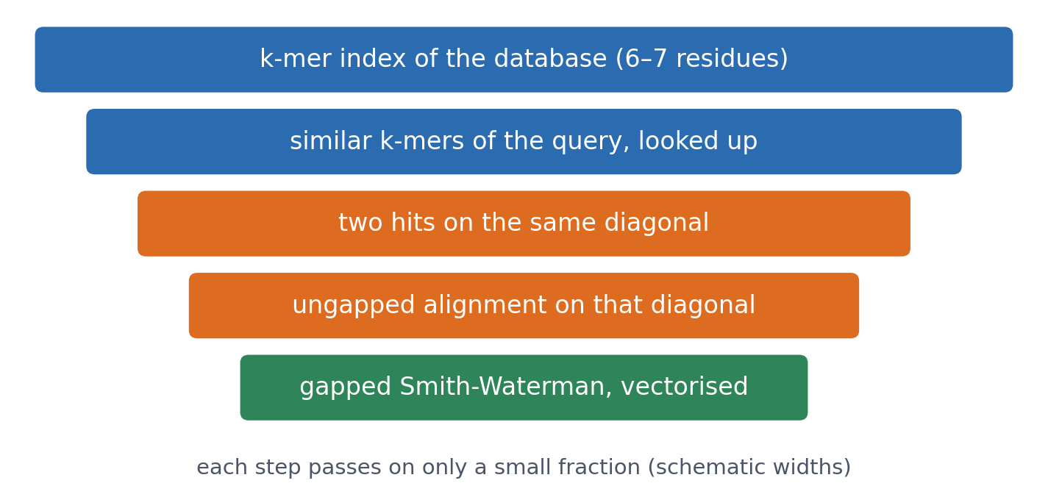
5 · MMSEQS2
A cascade of ever more expensive filters
▪ Often hundreds of times faster
▪ Similar sensitivity
▪ No machine learning
▪ Builds ColabFold's MSAs (Session 12)
See course.bioinfo.se/session05.html, 'BLAST's ideas at modern database scale: MMseqs2'.
Notes:
Two consistent k-mer hits on the same diagonal (the dot-plot idea from Session 4) are much stronger evidence than one. Like PSI-BLAST, MMseqs2 can iterate with a profile. Session 6 meets its structural counterpart, Foldseek.

Slide 26
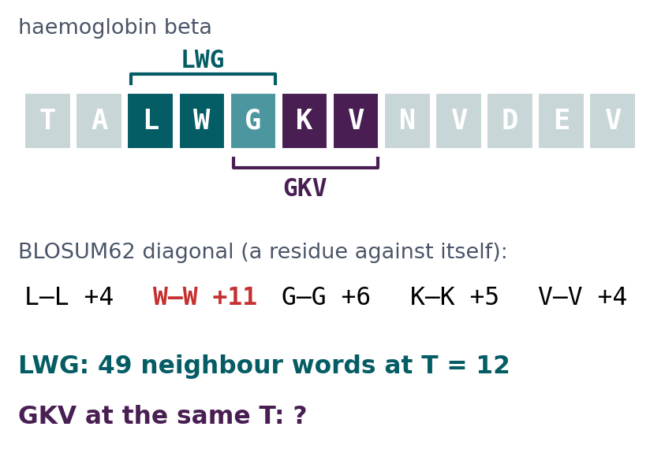
BLOCK 1 · QUIZ
How many neighbour words does GKV have?
Neighbour words: every word scoring at least T = 12 against the query word with BLOSUM62. LWG has 49.
A About as many as LWG
B More: G, K and V have similar residues
C Far fewer: a lower self-score
D None: no word reaches 12
Guess on your own
Scan the code, or go to
quiz.bioinfo.se/live
Notes:
The old discussion problem 1. The figure gives the BLOSUM62 diagonal: let them add up the self-scores before guessing.

Slide 27
BLOCK 1 · QUIZ
How many neighbour words does GKV have?
How did the room answer?
Halt the round when most have answered, then show the results.
Show the results ▸ quiz.bioinfo.se/live/report
Notes:
Halt submission in the Control view, then open the results. Do not say which answer is right.

Slide 28
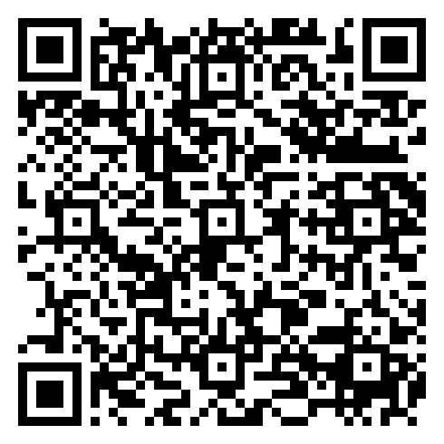
BLOCK 1 · QUIZ
How many neighbour words does GKV have?
Fix it, run it, discuss
Open the notebook: scan the code
Fix the line marked FIX, then run the cells
Did it come out as you guessed? Discuss with your neighbour
The notebook: https://colab.research.google.com/github/ElofssonLab/kb8029-book/blob/main/notebooks/session05-discussion-1.ipynb
Notes:
About 8 minutes. The notebook's word_score adds blosum62[a, a], the query's own diagonal, whatever the other word is: as it is, all 8000 words clear T for both LWG and GKV, the first answer. Fixed with blosum62[a, b]: 49 and 5.

Slide 29
BLOCK 1 · QUIZ
How many neighbour words does GKV have?
Answer again
Same question, after the discussion.
quiz.bioinfo.se/live
Notes:
Open the second round (post) in the Control view.

Slide 30
BLOCK 1 · QUIZ
How many neighbour words does GKV have?
Results, and who explains
Both rounds side by side.
Draw two to explain: one of you says how you reasoned.
Show the results ▸ quiz.bioinfo.se/live/report
To check it with code afterwards: discussion notebook 1 https://colab.research.google.com/github/ElofssonLab/kb8029-book/blob/main/notebooks/session05-discussion-1.ipynb
Notes:
Far fewer: 5. LWG's self-score is 4 + 11 + 6 = 21, nine points above T, so many substituted words still reach 12; GKV's is 6 + 5 + 4 = 15, only three above. Tryptophan's +11 is the highest diagonal score: a rare residue, so a match at W is informative.

Slide 31
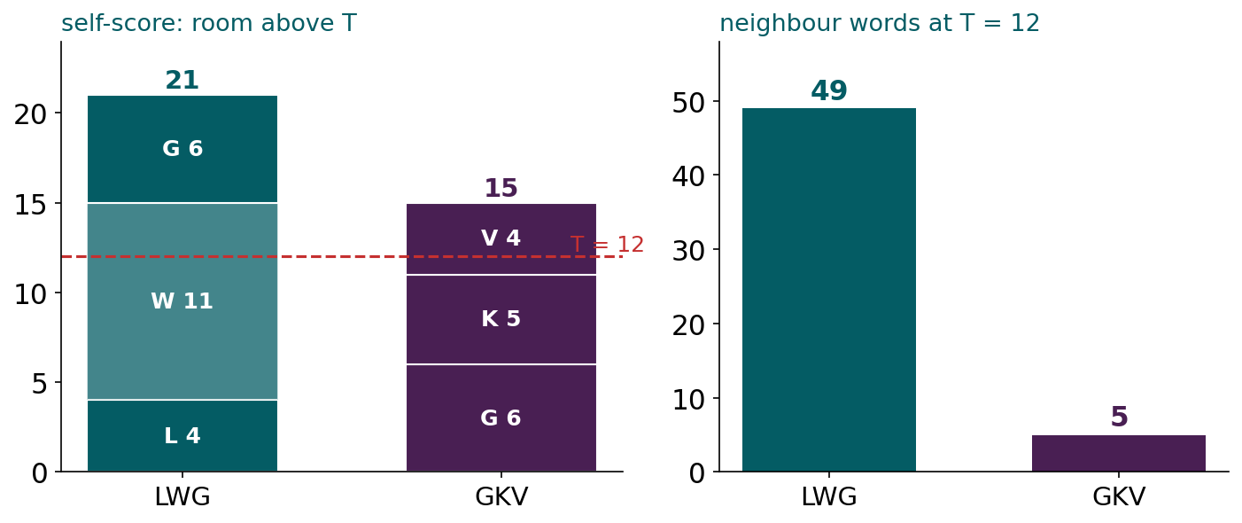
BLOCK 1 · QUIZ
The answer: GKV has only 5 neighbour words
LWG starts from a self-score of 21, mostly from W (+11), so many words with substitutions still reach T = 12. GKV starts from 15. The number of seeds depends on the query itself: rare, high-scoring residues give many; a lower T gives more, and a slower search.

Slide 32
BLOCK 1 DONE
Break

Slide 33
BLOCK 2 · ABOUT 30 MIN
PSI-BLAST and the PSSM

Slide 34
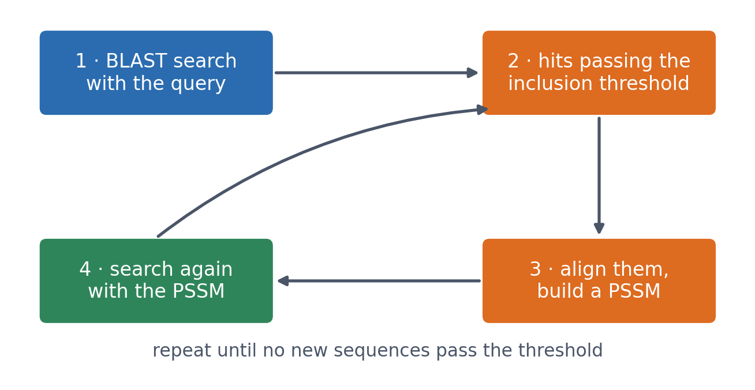
6 · PSI-BLAST
PSI-BLAST: BLAST, iterated with a profile
▪ A scoring matrix for this query
▪ Refined every round
▪ Finds remote homologs
See course.bioinfo.se/session05.html, 'From one sequence to many: PSI-BLAST and the PSSM'.
Notes:
Ordinary BLAST scores everything against one fixed matrix, so a faint but real family signal is lost against a large database. The inclusion threshold (an E-value cutoff) is stricter than the reporting threshold: hits that are displayed but fall short of it do not enter the profile.

Slide 35
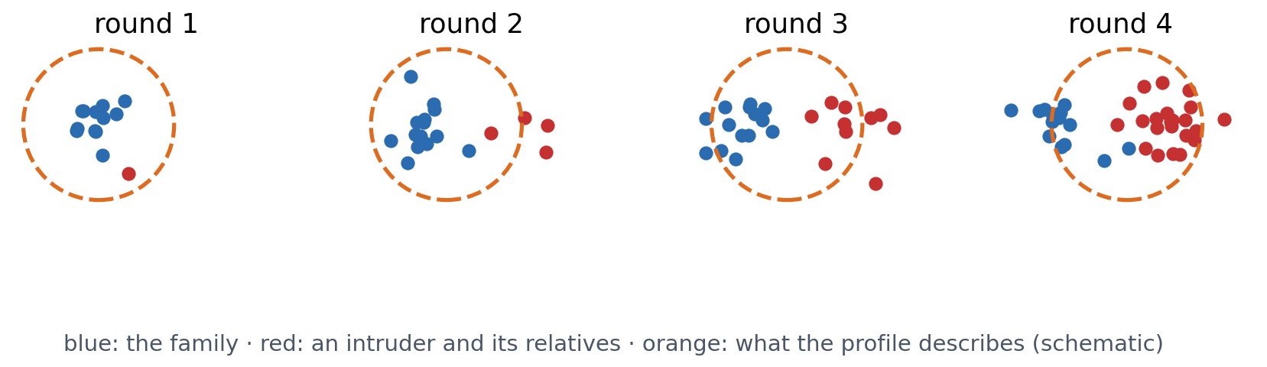
6 · PSI-BLAST
Iteration can go wrong: profile drift
One unrelated sequence passes the inclusion threshold, shifts the next PSSM towards itself, and pulls in more like it. After a few rounds the 'family' can be dominated by proteins unrelated to the query.
See course.bioinfo.se/session05.html, 'Iteration is not automatically better: profile drift'.
Notes:
Often through a shared low-complexity or coiled-coil region rather than real homology. The general lesson returns in the machine-learning half: a model that chooses its own training data can reinforce its own mistakes. In practice: a strict inclusion threshold, look at what entered each round, check surprising late hits independently.

Slide 36
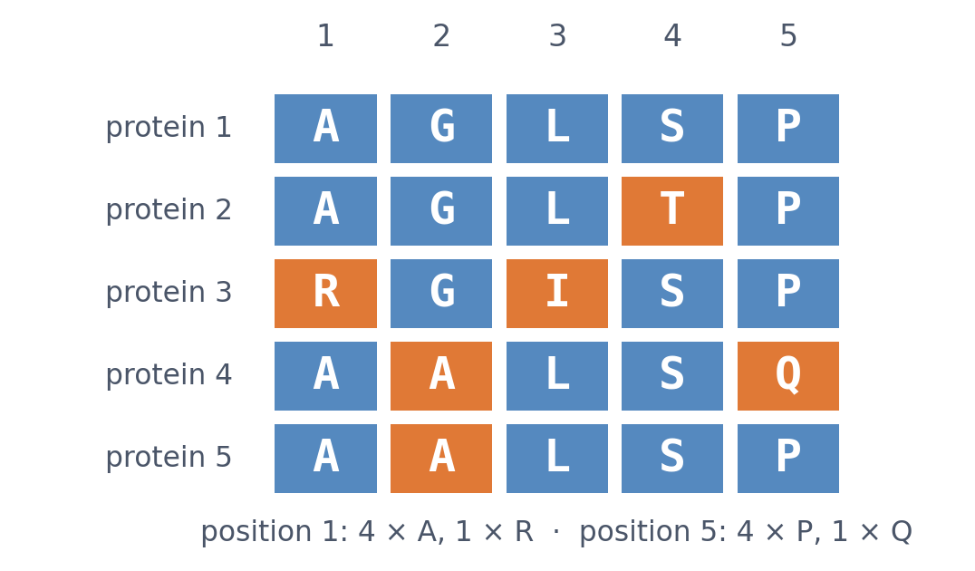
7 · BUILDING A PSSM
Step 1: count each residue at each position
▪ A logo describes a column
▪ A PSSM scores a new sequence
▪ Real tools weight sequences
The toy alignment of course.bioinfo.se/session05.html, 'Building a PSSM, step by step'.
Notes:
This is a teaching model; PSI-BLAST also weights sequences and uses smarter pseudocounts. If a search returns fifty nearly identical mammalian sequences and three distant ones, raw counts would make the profile describe mammals rather than the family, so near-duplicates are removed or down-weighted.

Slide 37
7 · BUILDING A PSSM
Step 2: add pseudocounts, a prior
▪ A residue never seen gets frequency 0
▪ Five sequences: absence may be luck
▪ Prior: every residue is possible
▪ Many sequences swamp the prior
−∞
log-odds of a
zero frequency
+1
added to every
count (teaching model)
See course.bioinfo.se/session05.html, 'Building a PSSM, step by step'.
Notes:
Real tools use smarter priors, for example larger pseudocounts for residues that substitute easily for the observed ones, according to a substitution matrix.

Slide 38
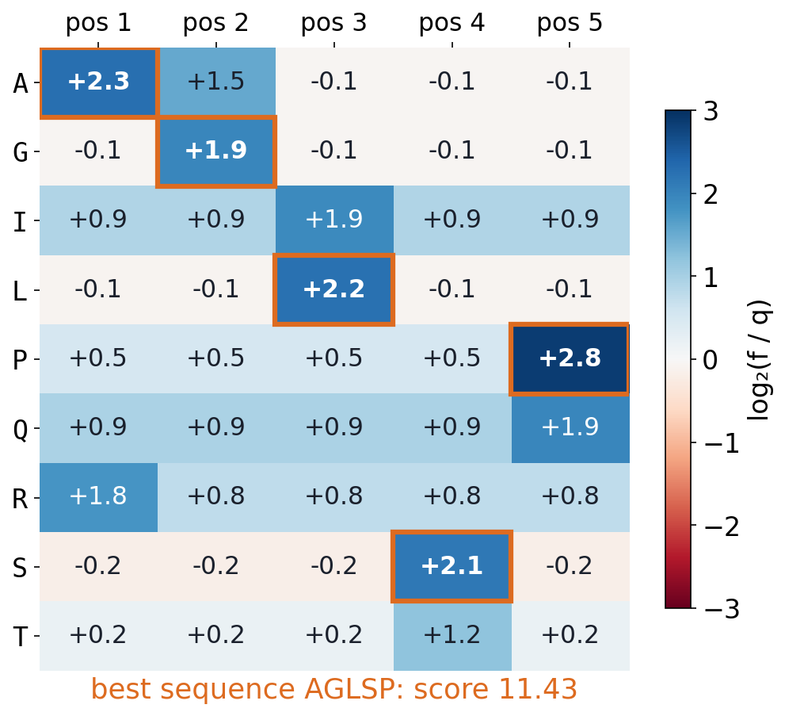
7 · BUILDING A PSSM
Steps 3-4: compare with the background, take log-odds
▪ S = log₂(f / q)
▪ +1: twice as likely as by chance
▪ Best sequence: the consensus
▪ AGLSP, 11.43
PSSM as built in the course notebook (+1 pseudocounts over the residues in the alignment).
Notes:
q is the background frequency of the residue in proteins generally (Ala about 7.4%, Trp about 1.3%). +3 means eight times as likely. The notebook adds the pseudocount only over the nine residue types that appear in its tables, so its numbers differ from the 20-residue example on the next slide; the logic is the same.

Slide 39
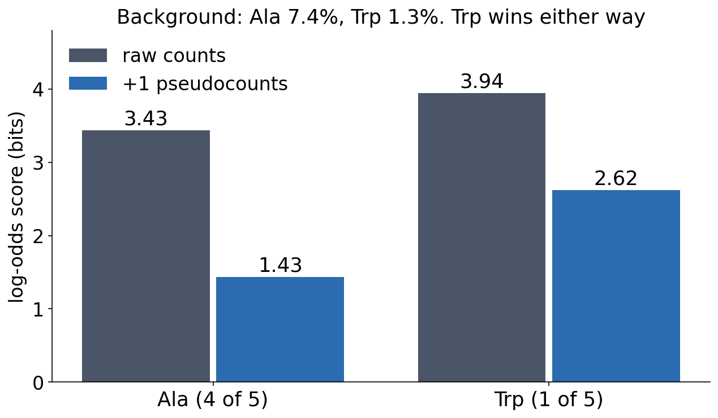
7 · BUILDING A PSSM
Why pseudocounts matter, and what they cannot do
▪ One rare Trp outscores four Ala
▪ +1: both scores more cautious
▪ The ranking stays
▪ Only more sequences can tell
See course.bioinfo.se/session05.html, 'Why pseudocounts really matter'.
Notes:
Raw: log2(0.8/0.074) = 3.43 for alanine and log2(0.2/0.013) = 3.94 for tryptophan, so a single observation outscores four. With +1 pseudocounts over 20 residue types the frequencies become 5/25 and 2/25, and the scores fall to 1.43 and 2.62. Tryptophan still wins: a pseudocount cannot tell a lucky single observation from a real one; only more sequences can.

Slide 40
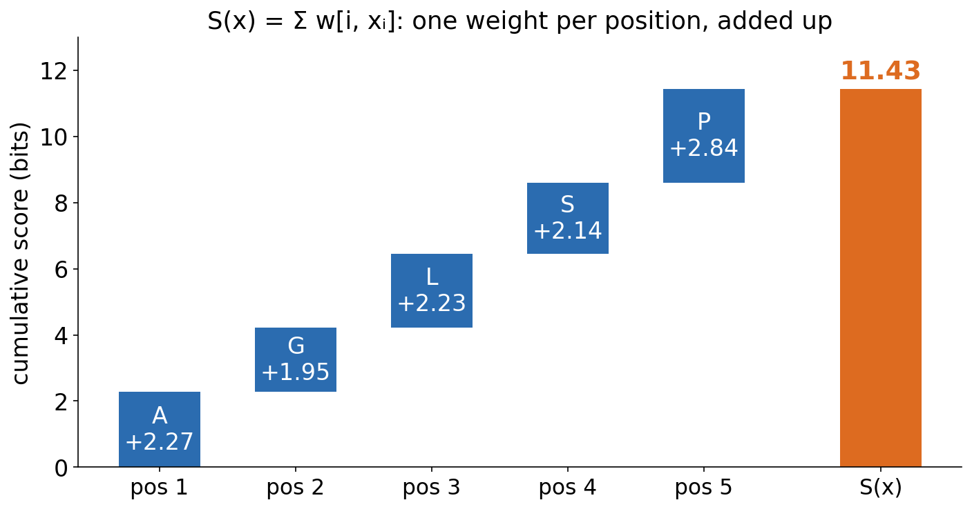
7 · BUILDING A PSSM
A PSSM score is a sum: already a linear model
▪ One weight per position
▪ Look up, then add
▪ Session 7 learns these weights
PSSM of the course notebook; see course.bioinfo.se/session05.html, 'A PSSM is already a linear model'.
Notes:
S(x) = Σ w[i, x_i]: the weighted-sum, or dot-product, idea from Session 1. To align a new sequence to a PSSM, PSI-BLAST uses ordinary gapped dynamic programming (Session 4), with the PSSM row for position i in place of the substitution-matrix row; the gap penalties are the same at every position. That is where Block 3 starts.

Slide 41
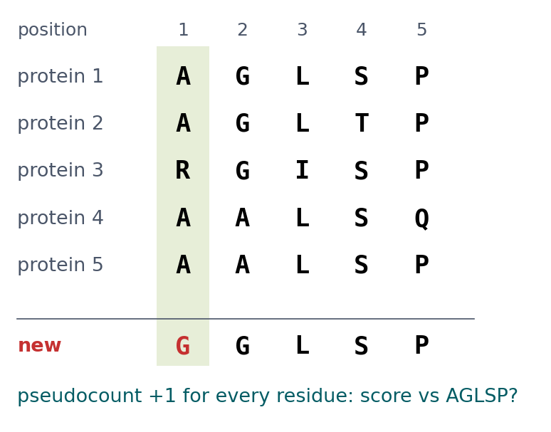
BLOCK 2 · QUIZ
What does an unseen residue do to the score?
PSSM from five aligned proteins, +1 pseudocount for every residue. GGLSP has a G at position 1, where none of the five has one.
A Minus infinity: G was never seen there
B Lower than AGLSP, but finite
C The same: one position hardly matters
D Higher: G is common in the alignment
Guess on your own
Scan the code, or go to
quiz.bioinfo.se/live
Notes:
The alignment of the block (and of the book page). The question says +1 pseudocounts: the first answer is what happens without them.

Slide 42
BLOCK 2 · QUIZ
What does an unseen residue do to the score?
How did the room answer?
Halt the round when most have answered, then show the results.
Show the results ▸ quiz.bioinfo.se/live/report
Notes:
Halt submission in the Control view, then open the results. Do not say which answer is right.

Slide 43

BLOCK 2 · QUIZ
What does an unseen residue do to the score?
Fix it, run it, discuss
Open the notebook: scan the code
Fix the line marked FIX, then run the cells
Did it come out as you guessed? Discuss with your neighbour
The notebook: https://colab.research.google.com/github/ElofssonLab/kb8029-book/blob/main/notebooks/session05-discussion-2.ipynb
Notes:
About 8 minutes. The notebook's FIX line sets the pseudocount to 0: as it is, GGLSP scores −∞ (log2 0), the first answer. Fixed (+1): AGLSP 11.43, RGISP 10.60, GGLSP 9.11; G at position 1 is −0.05.

Slide 44
BLOCK 2 · QUIZ
What does an unseen residue do to the score?
Answer again
Same question, after the discussion.
quiz.bioinfo.se/live
Notes:
Open the second round (post) in the Control view.

Slide 45
BLOCK 2 · QUIZ
What does an unseen residue do to the score?
Results, and who explains
Both rounds side by side.
Draw two to explain: one of you says how you reasoned.
Show the results ▸ quiz.bioinfo.se/live/report
To check it with code afterwards: discussion notebook 2 https://colab.research.google.com/github/ElofssonLab/kb8029-book/blob/main/notebooks/session05-discussion-2.ipynb
Notes:
Lower but finite: 9.11 against 11.43. G's score at position 1 is only −0.05, close to neutral, because 9 pseudocounts outweigh 5 sequences in each column. A pseudocount is a prior; with few sequences it speaks loudly. Real tools weight pseudocounts by background frequencies or substitution scores, and less as the alignment grows.

Slide 46
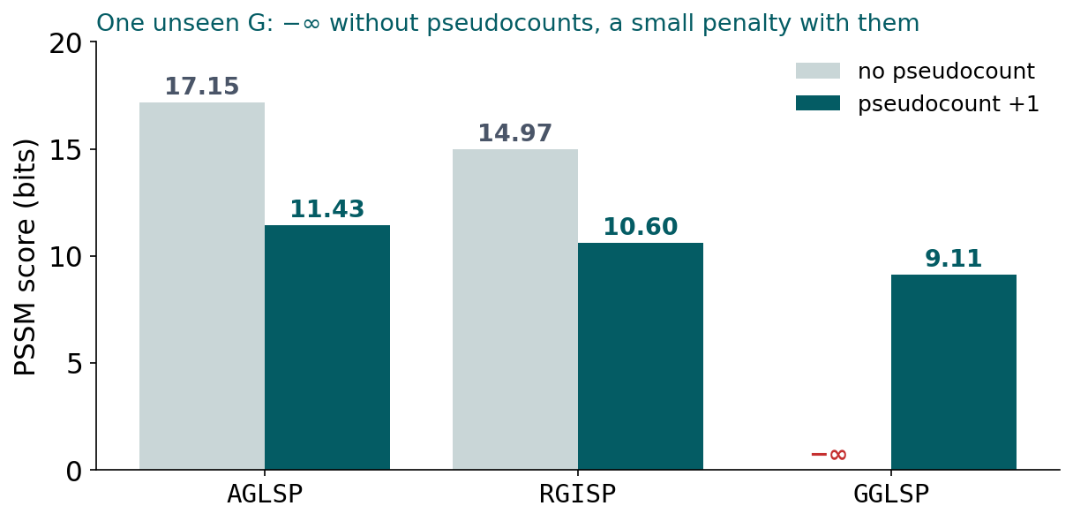
BLOCK 2 · QUIZ
The answer: lower, but finite
Without pseudocounts, an unseen residue has frequency 0 and log-odds −∞: one position rules out the whole sequence. With +1 pseudocounts, GGLSP scores 9.11 against 11.43 for the consensus. Five sequences are too few to conclude that G can never occur at position 1.

Slide 47
BLOCK 2 DONE
Break

Slide 48
BLOCK 3 · ABOUT 30 MIN
Profile hidden Markov models

Slide 49
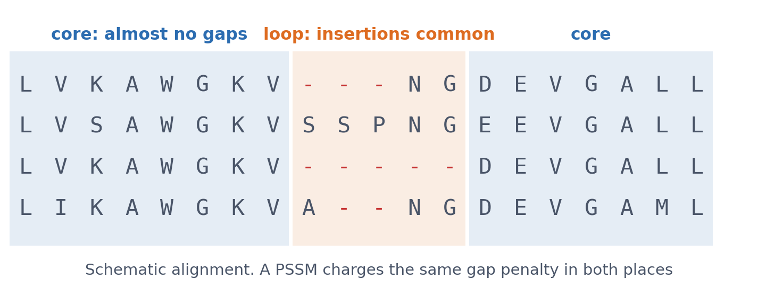
8 · BEYOND A PSSM
A PSSM charges the same gap penalty everywhere
▪ Loops tolerate insertions
▪ The core almost never
▪ A model should know where
See course.bioinfo.se/session05.html, 'Profile Hidden Markov Models'.
Notes:
The alignment is a schematic, not real data. A loop between two helices may tolerate insertions of any length, while the core of the domain almost never has one.

Slide 50
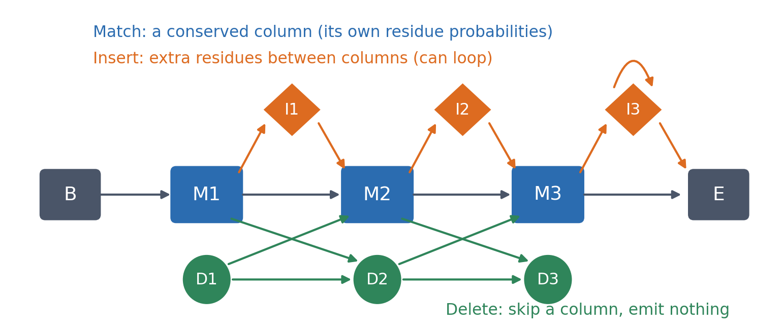
8 · PROFILE HMMS
Match, insert and delete states, one set per position
Match states emit residues like one PSSM column; insert states emit extra residues and can loop; delete states skip a column and emit nothing. Every transition has its own learned probability.
See course.bioinfo.se/session05.html, 'Profile Hidden Markov Models'.
Notes:
Begin and End states bookend the model. Transitions connect consecutive positions (M_i → M_i+1, M_i → I_i, M_i → D_i+1). Because the transition probabilities are learned per position, the model knows where insertions and deletions are common in the family.

Slide 51
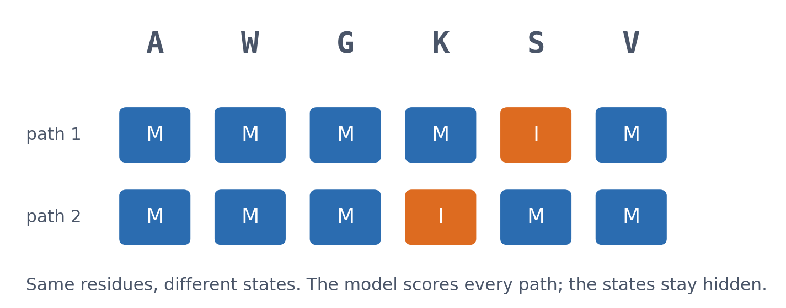
8 · PROFILE HMMS
Why "hidden"?
▪ A residue does not say its state
▪ Inferred from the best path
▪ Emissions + transitions together
See course.bioinfo.se/session05.html, 'Why hidden'.
Notes:
For an observed residue, the model never says directly whether it came from a match or an insert state. That is inferred from the path through the states that best explains the whole sequence. The two paths here are a schematic.

Slide 52
8 · PROFILE HMMS
PSSM or profile HMM?
PSSM
Profile HMM
PSI-BLAST
Pfam, HMMER
▪ Substitution scores per position
▪ Gaps: the same penalties everywhere
▪ Built during the search
▪ Match, insert, delete per position
▪ Knows where gaps are common
▪ Trained on curated families
See course.bioinfo.se/session05.html, 'Profile Hidden Markov Models'.
Notes:
A profile HMM can recognise a new member even when it has a different number of residues in a variable region. This is why profile HMMs, not PSSMs, are behind protein-family databases such as Pfam.

Slide 53
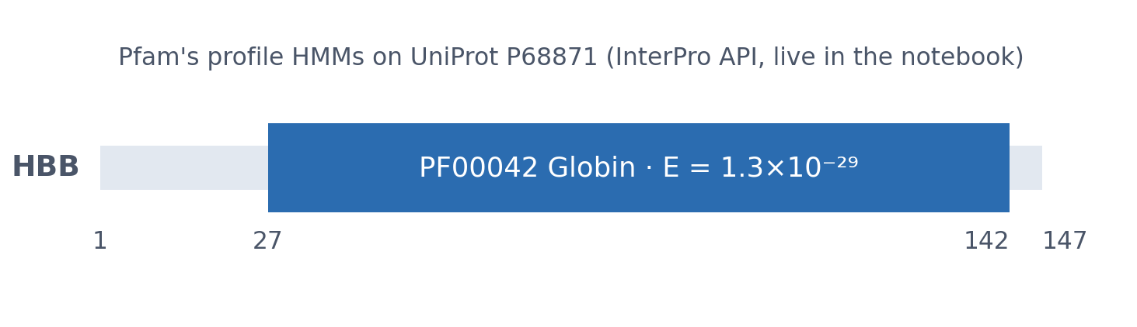
8 · PROFILE HMMS
A real profile-HMM hit on HBB
Pfam's profile HMMs, searched against UniProt P68871 (HBB_HUMAN): PF00042 'Globin' covers residues 27-142 of the 147, with E ≈ 1.3×10⁻²⁹. The same job the toy PSSM did on paper, at production scale.
Live InterPro API call in the course notebook.
Notes:
In a database of this size essentially no match that good is expected by chance. The lab searches HIV-1 Gag-Pol with the same API.

Slide 54
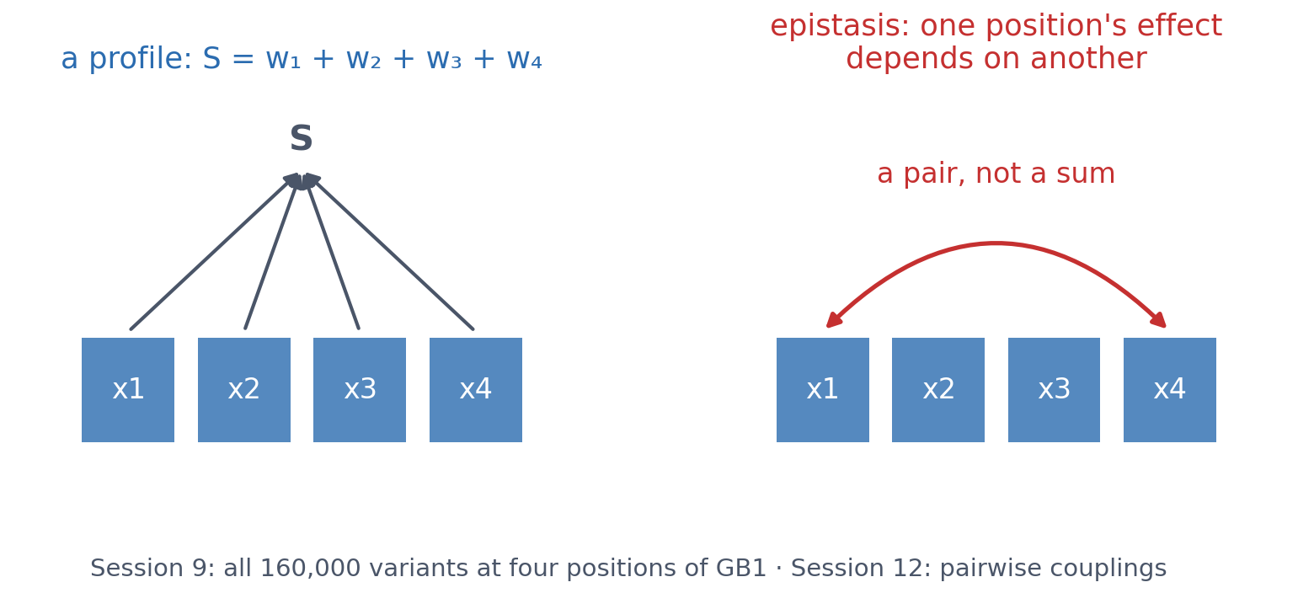
9 · LIMITS
What neither a PSSM nor a profile HMM can represent
Both score a sequence position by position, so each position contributes independently. When the effect of one mutation depends on the residue at another position (epistasis), no profile can capture it.
See course.bioinfo.se/session05.html, 'What neither a PSSM nor a profile HMM can represent'.
Notes:
Session 9 shows a protein where this matters (all 160,000 variants at four positions of GB1), and Session 12 shows how pairwise models fitted to an alignment (direct coupling analysis) add those interactions. Session 7's XOR is the same limitation in its simplest form.

Slide 55
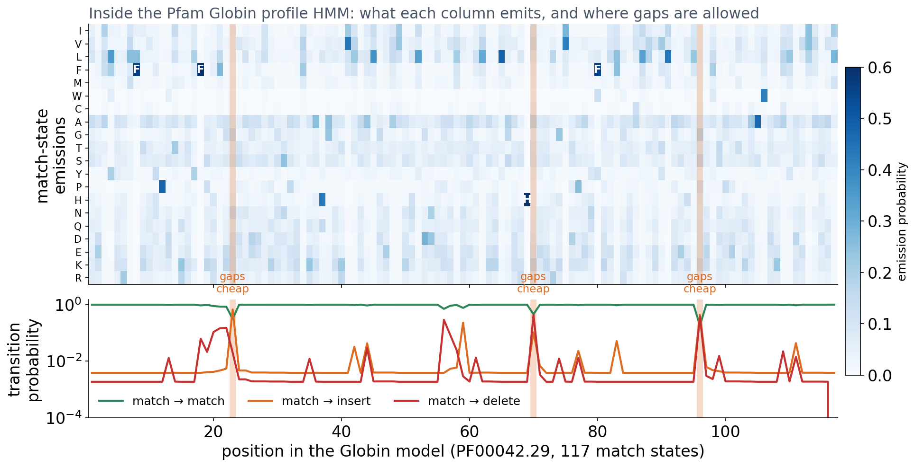
3 · INSIDE A PROFILE HMM
What a real profile HMM looks like inside: Pfam Globin
Top: for each of the 117 match states, the probability of each amino acid; a few columns are almost fixed (one His, three Phe). Bottom: transition probabilities; in most columns a gap is very unlikely, but at a few loop positions inserting or deleting costs almost nothing (orange).
Pfam PF00042 (Globin), fetched from the InterPro API (HMMER3 format, built from 73 seed sequences).
Notes:
This is the same file HMMER uses. Each match state has 20 emission probabilities (stored as -ln p) and seven transition probabilities. The typical match-to-insert probability is about 0.004 and match-to-delete about 0.002, but at a few positions they rise to 0.1-0.7: those are the loops between helices, where globins differ in length. A PSSM cannot express this: it charges the same gap penalty everywhere. Most columns are far from fixed: the HMM records a distribution, not a consensus.

Slide 56
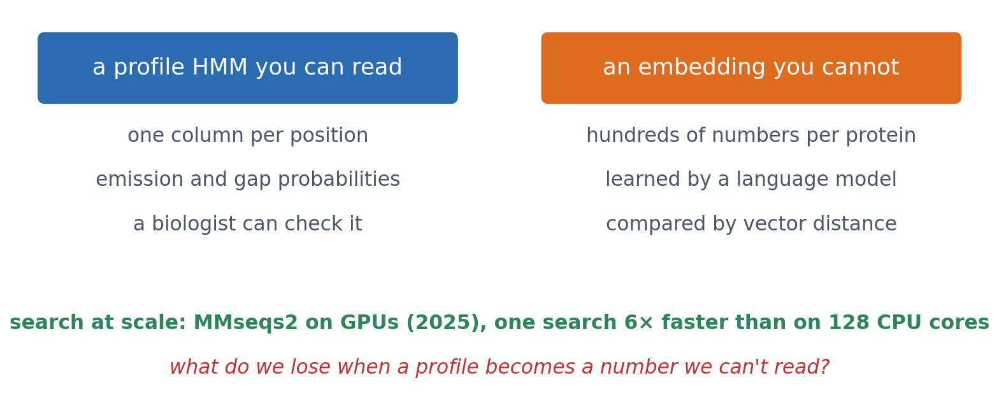
3 · OUTLOOK
From a profile you can read to a vector you cannot
▪ Databases grow faster than CPUs
▪ MMseqs2 on GPUs
▪ Embeddings replace profiles in search
▪ What do we lose when a profile becomes a number we can't read?
Kallenborn et al. (2025), Nature Methods, doi:10.1038/s41592-025-02819-8 (MMseqs2-GPU); embedding search: Session 4's outlook and Session 11.
Notes:
MMseqs2-GPU: single-protein searches 6 times faster than CPU methods on 2 x 64 cores; it speeds up ColabFold's structure prediction 31.8 times over the standard AlphaFold2 pipeline and Foldseek 4-27 times. At the same time, profiles are being replaced by embedding vectors from protein language models (Session 11), compared by vector distance. Question: the HMM on the previous slide can be read and checked column by column. An embedding cannot. What do we gain, and what do we lose?

Slide 57
SUMMARY
More family information, more distant relatives
BLAST: fast, one matrix for every position, E-values tied to the database. PSI-BLAST: a PSSM refined by iteration, with the risk of drift. Profile HMMs: position-specific gaps too, the standard behind Pfam.
See course.bioinfo.se/session05.html, 'What's next'.
Notes:
The lab: identify an unknown gene with NCBI BLAST (a sixth human globin), build a Clustal Omega alignment and PSSM of five globin-family proteins, compare rounds 1 and 3 of an iterated profile search (jackhmmer, the HMM counterpart of PSI-BLAST) against the PDB, and search Pfam for HIV-1 Gag-Pol. Every search runs on EMBL-EBI's servers through web APIs, so the notebook runs on Colab with nothing to install.

Slide 58
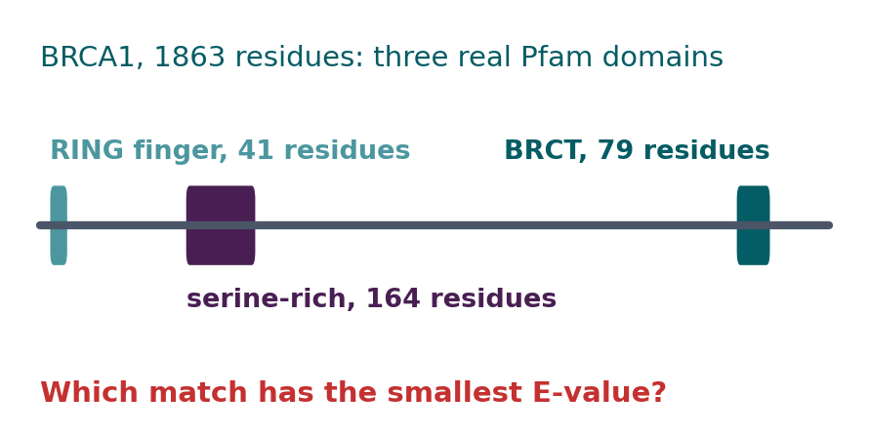
BLOCK 3 · QUIZ
Which BRCA1 domain match is the most significant?
Three real Pfam domains: a RING finger (41 residues), a serine-rich domain (164) and a BRCT domain (79). Which has the smallest E-value?
A The RING finger
B The BRCT domain
C The serine-rich domain
D About the same: all are real
Guess on your own
Scan the code, or go to
quiz.bioinfo.se/live
Notes:
The old discussion problem 3. Smaller E is more significant. Ask them to think about the length of each domain and how diverse each family is.

Slide 59
BLOCK 3 · QUIZ
Which BRCA1 domain match is the most significant?
How did the room answer?
Halt the round when most have answered, then show the results.
Show the results ▸ quiz.bioinfo.se/live/report
Notes:
Halt submission in the Control view, then open the results. Do not say which answer is right.

Slide 60

BLOCK 3 · QUIZ
Which BRCA1 domain match is the most significant?
Fix it, run it, discuss
Open the notebook: scan the code
Fix the line marked FIX, then run the cells
Did it come out as you guessed? Discuss with your neighbour
The notebook: https://colab.research.google.com/github/ElofssonLab/kb8029-book/blob/main/notebooks/session05-discussion-3.ipynb
Notes:
About 8 minutes. The notebook's FIX line sorts by E-value with reverse=True, as if bigger were better, and puts the RING finger first. Fixed: serine-rich (2.8×10⁻⁷⁷), BRCT (4.6×10⁻⁷), RING finger (1.6×10⁻⁶). The data are cached from InterPro; a second cell fetches them live.

Slide 61
BLOCK 3 · QUIZ
Which BRCA1 domain match is the most significant?
Answer again
Same question, after the discussion.
quiz.bioinfo.se/live
Notes:
Open the second round (post) in the Control view.

Slide 62
BLOCK 3 · QUIZ
Which BRCA1 domain match is the most significant?
Results, and who explains
Both rounds side by side.
Draw two to explain: one of you says how you reasoned.
Show the results ▸ quiz.bioinfo.se/live/report
To check it with code afterwards: discussion notebook 3 https://colab.research.google.com/github/ElofssonLab/kb8029-book/blob/main/notebooks/session05-discussion-3.ipynb
Notes:
The serine-rich domain, by 70 orders of magnitude. It is long (164 residues), and its family is closely related BRCA1 orthologues, so the profile is very specific. The RING finger is short and its family diverse. An E-value measures how surprising a match is, not how real the domain is.

Slide 63
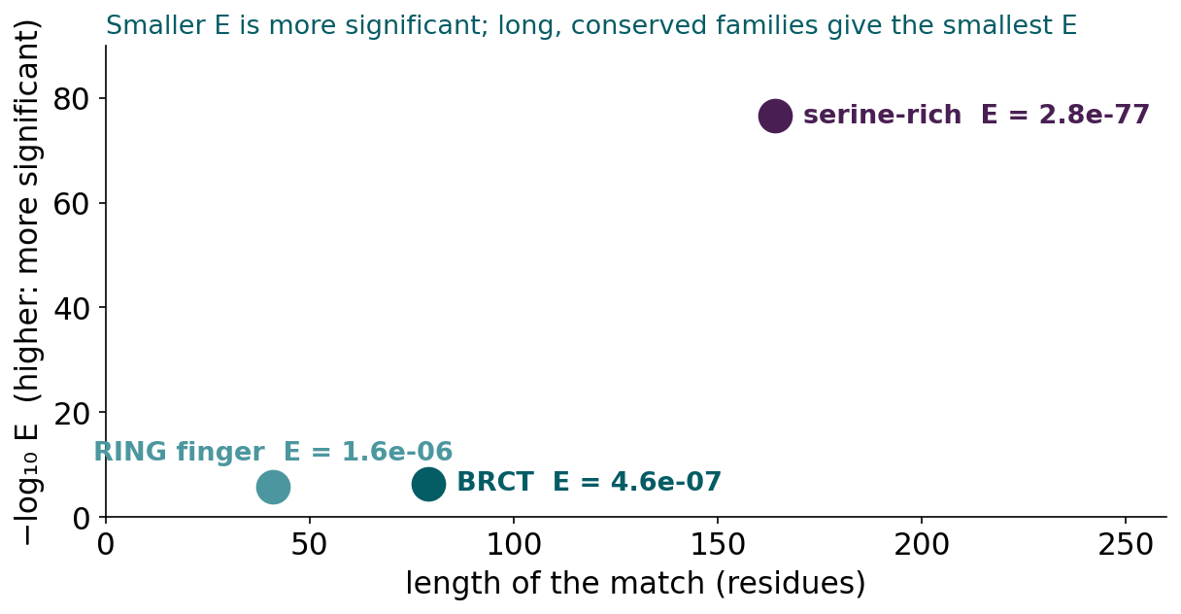
BLOCK 3 · QUIZ
The answer: the serine-rich domain, E = 2.8 × 10⁻⁷⁷
Smaller E is more significant (for a bit score, bigger is better). A long domain adds up score over many positions, and a family of close relatives gives a specific profile. The short RING finger, from a diverse family, gets only 1.6 × 10⁻⁶: weaker evidence from sequence alone, not a sign that the domain is absent.

Slide 64
BEFORE YOU LEAVE
In up to three words: what was the hardest part of today?
Answer now
Scan the code, or go to
quiz.bioinfo.se/live
Notes:
A word cloud: the bigger the word, the more students wrote it. It shows what to repeat next time.

Slide 65
BEFORE YOU LEAVE
The hardest part of today
What the room found hardest
Show the results ▸ quiz.bioinfo.se/live/report

Slide 66
Session 6 next
From sequence to structure: the four levels, hands-on in PyMOL
Then Session 7: a PSSM score S(x) = Σ w[i, xᵢ] is already a linear model
And its weights can be learned, not only derived from alignment statistics

