Slide 1

Session 8: Machine Learning Foundations & Practical PyTorch
KB8029 — Bioinformatics & Deep Learning
Arne Elofsson

Slide 2


BEFORE WE START
Log in to the lecture quiz
Log in to the quiz
Scan the code, or go to quiz.bioinfo.se/live
Log in with your university account
Answering counts as being at the lecture: up to 3 bonus points on the exam
Right or wrong is never graded, only whether you answered. Results are shown without names.
quiz.bioinfo.se/live
Notes:
The quiz is not anonymous, because answering is how attendance is counted: 3 bonus points on the main exam for answering in all 12 lectures, one point less per missed lecture (preliminary). Whether an answer is right or wrong is never used. The projected results never show names; the only names shown are the two drawn to explain their reasoning. Start the session on quiz.bioinfo.se before the lecture: quiz.bioinfo.se/live then leads to it.

Slide 3
BEFORE WE START
Warm-up: what do you know already?
3 quick questions
On the topics of today, one at a time, about 30 seconds each
Answer on your own, and guess if you do not know
It shows me where to start; right or wrong is never graded
Notes:
About 2 minutes in all. Open each question's round, halt it after about 30 seconds and glance at the results; do not explain the answers now, the lecture does that.

Slide 4
WARM-UP · 1 OF 3
Predicting a protein's melting temperature from its sequence is ...
A classification
B regression
C clustering
D unsupervised learning
Answer now
Scan the code, or go to
quiz.bioinfo.se/live
Notes:
Right: regression. The label is a number. Block 1.

Slide 5
WARM-UP · 2 OF 3
95 of 100 proteins are not membrane proteins. A model always says “not membrane”. What is its accuracy?
A 0%
B 5%
C 50%
D 95%
Answer now
Scan the code, or go to
quiz.bioinfo.se/live
Notes:
Right: 95%. High accuracy, no information. Block 2.

Slide 6
WARM-UP · 3 OF 3
In a PyTorch training step, what does loss.backward() do?
A Updates the weights
B Computes the gradients
C Computes the loss
D Sets the gradients to zero
Answer now
Scan the code, or go to
quiz.bioinfo.se/live
Notes:
Right: Computes the gradients. optimizer.step() updates, optimizer.zero_grad() zeroes. Block 3.

Slide 7
BEFORE WE START
What the room knows already
Where we start
Which topics most of you know, and which we take slowly today.
Show the results ▸ quiz.bioinfo.se/live/report
Notes:
Optional: show two or three of the results, the ones that most got wrong.

Slide 8
BEFORE WE START
Your questions before today
What you asked
The questions you sent in on Canvas before the lecture
The most common ones now; the others in the block where they belong
Notes:
About 5 minutes. Read the answers to this session's Canvas survey 'Questions before the lecture' the evening before (it closes at 18:00 the day before the lecture), pick the two or three most common questions, and answer them briefly now or say in which block they come.

Slide 9
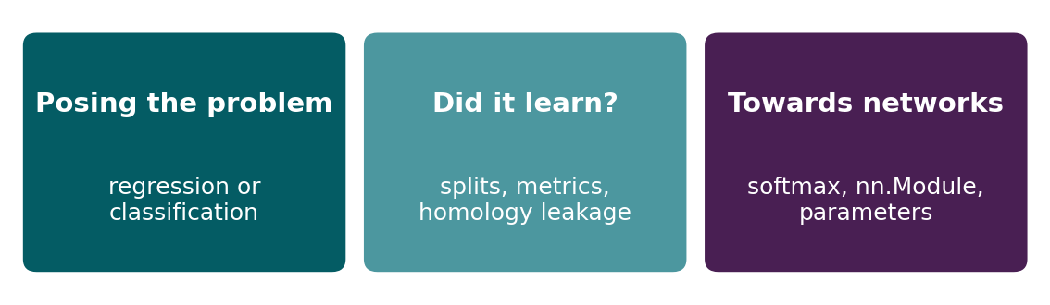
BEFORE WE START
In up to three words: what do you want to learn today?
Answer now
Scan the code, or go to
quiz.bioinfo.se/live
Notes:
A word cloud: the bigger the word, the more students wrote it. Come back to it at the end of the lecture.

Slide 10
BEFORE WE START
What you want to learn today
What the room wants to learn
Show the results ▸ quiz.bioinfo.se/live/report

Slide 11
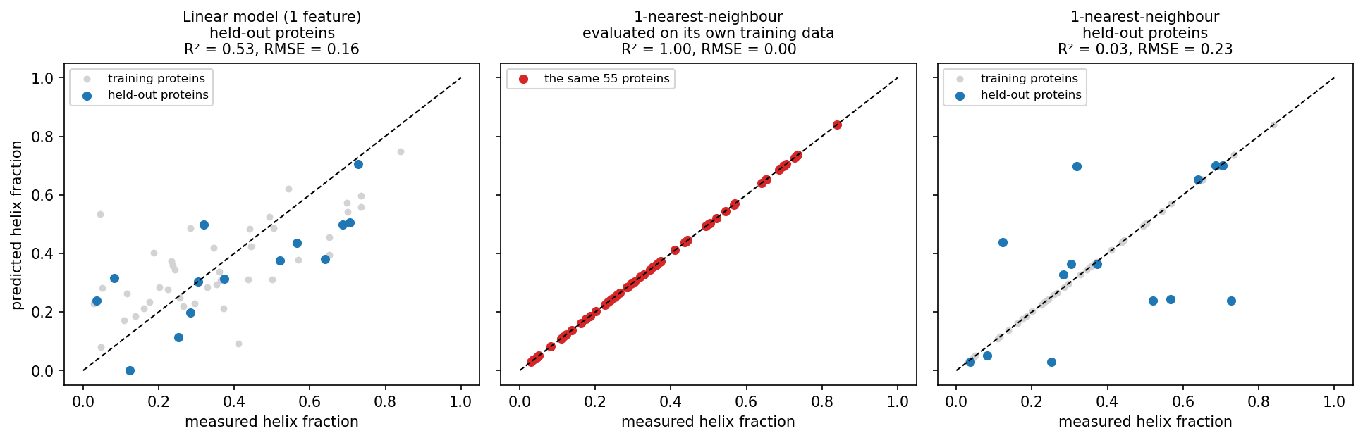
SESSION 8 · THE QUESTION
How do we know a model learned anything useful?
The same kind of model, two answers. Middle: 1-nearest-neighbour evaluated on its own training data looks perfect (R² 1.00). Right: on 14 proteins it has not seen, it is no better than predicting the mean (R² 0.03).
Notebook: session08-ml-foundations-and-pytorch.ipynb, 'Evaluating a regression model'.
Notes:
Session 7 asked what a model can represent. Today asks whether it works on data it has never seen, and how we would know. Ask before revealing the right panel: how well will the perfect model do on new proteins? 1-nearest-neighbour looks up the most similar training protein, so on its own training data every protein finds itself.

Slide 12
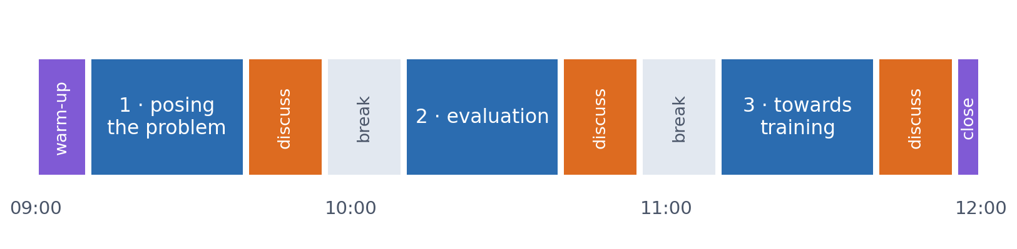
SESSION 8 · THE MORNING
Three blocks: about 30 min talk and 15 min discussion
Block 1: posing the problem (regression or classification). Block 2: evaluation and generalisation, the heart of today. Block 3: towards training networks (activations, softmax, PyTorch).
Times are approximate: a 10 min start (warm-up quiz and your questions), two 15 min breaks and a 5 min close. Each block ends with a quiz question: guess, run the notebook and work out why it behaves as it does, discuss, answer again.

Slide 13
BLOCK 1 · ABOUT 30 MIN
Posing the problem

Slide 14
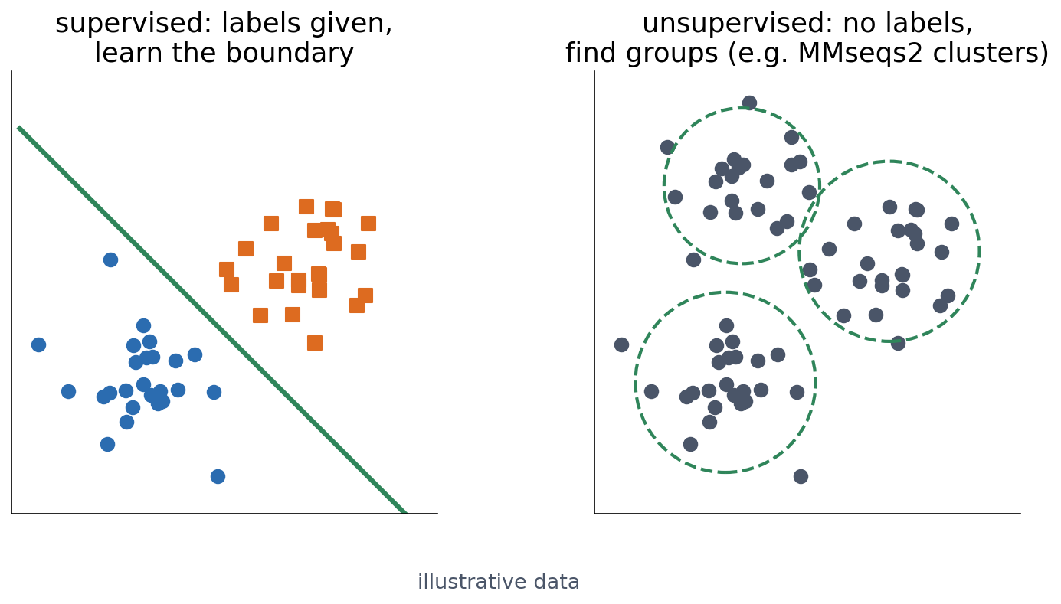
1 · KINDS OF LEARNING
Supervised and unsupervised learning
Supervised: fit a model to labelled examples (a perceptron on known binding sites, Session 7). Unsupervised: find structure without labels (clustering sequences into families). Almost everything we train in this course is supervised.
See course.bioinfo.se/session08.html, 'Supervised and unsupervised learning'.
Notes:
A PSSM (Session 5) sits in between: it is counted from family members, not fitted to labelled positive and negative examples. The MMseqs2 clustering later today is unsupervised.

Slide 15
1 · KINDS OF LEARNING
The label decides: regression or classification
Regression
Classification
the label is a number
the label is a category
▪ Helix fraction
▪ Melting temperature, ΔΔG of a mutation
▪ Expression level, binding affinity (pKd)
▪ Subcellular compartment
▪ Pathogenic or benign? Signal peptide?
▪ Helix / strand / coil per residue
See course.bioinfo.se/session08.html, Table 8.1.

Slide 16
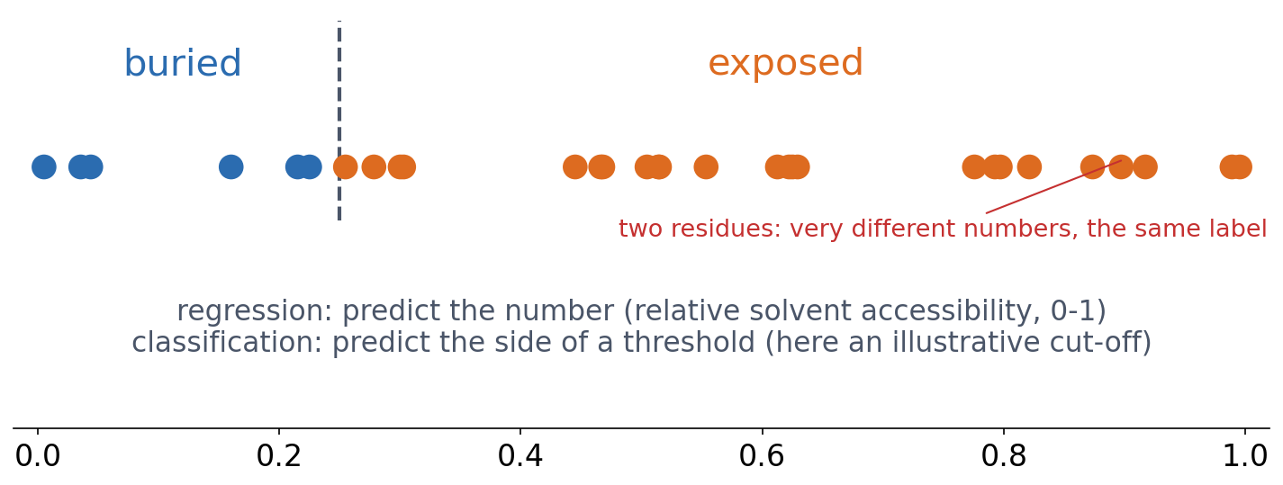
1 · KINDS OF LEARNING
Same biology, posed either way
▪ A threshold turns regression into classification
▪ Easier problem
▪ But information is thrown away
Illustrative values. See course.bioinfo.se/session08.html, 'Regression vs. classification'.

Slide 17
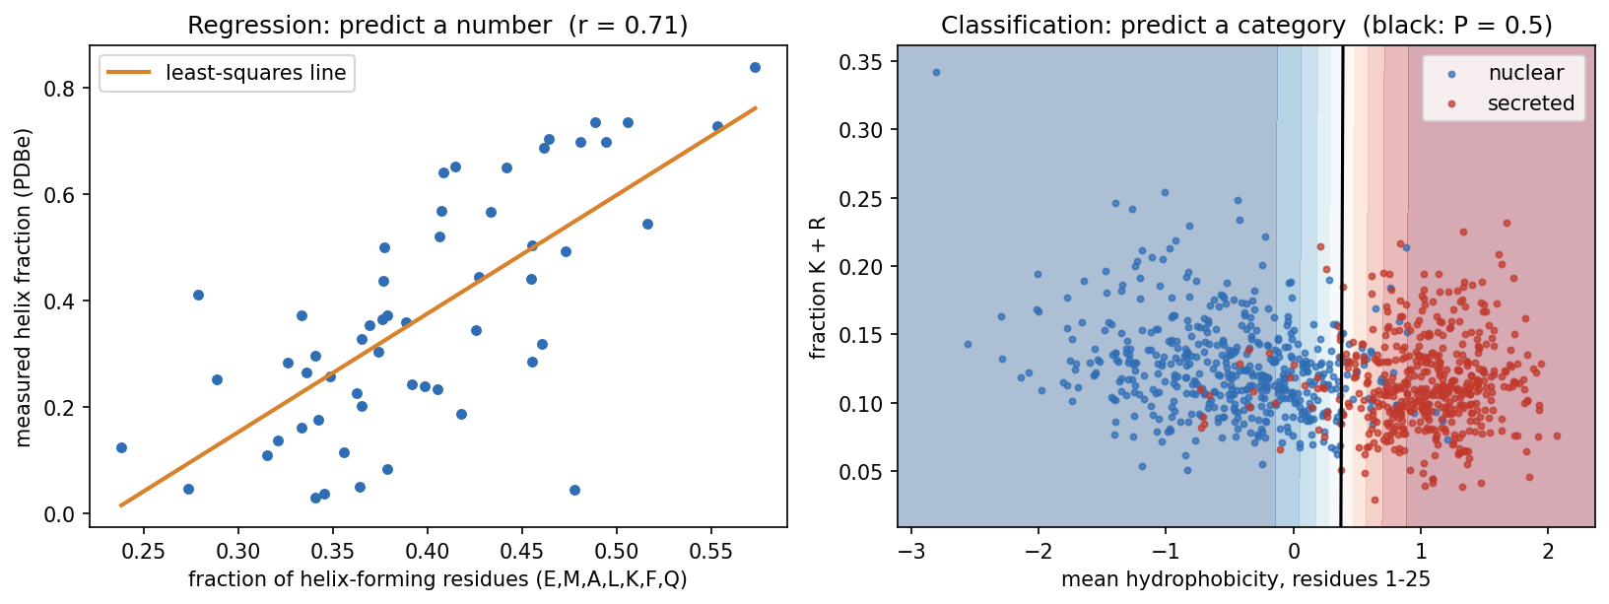
1 · TWO REAL PROBLEMS
A regression and a classification, from real data
Left: helix fraction of 55 PDB entries against helix-former content (r = 0.71). Right: 488 secreted and 497 nuclear proteins by N-terminal hydrophobicity and K+R content; logistic regression draws the boundary at P(secreted) = 0.5.
Data fetched live from PDBe and UniProt; notebook session08-ml-foundations-and-pytorch.ipynb.

Slide 18
1 · TWO REAL PROBLEMS
Signal peptides: overfitting is as old as the field
▪ A hydrophobic N-terminal address: 'send me into the secretory pathway'
▪ 1983: a cleavage-site rule, 92% on its own data, 64% on new data
▪ 1985, McGeoch: two features, boundary drawn by hand
▪ 1991: a network that fitted every training protein, then failed on new ones
▪ Ours: the same two-feature idea, boundary learned, tested on unseen proteins
92%
1983 rule, on
its own 78 sequences
64%
the same rule,
on new data
Nielsen, Tsirigos, Brunak & von Heijne (2019), Protein J 38:200; McGeoch (1985), Virus Res 3:271; Ladunga et al. (1991), Bioinformatics 7:485.
Notes:
A signal peptide is typically 15-30 residues with a hydrophobic core; it sends the chain into the ER (in bacteria, across the inner membrane) and is then cut off. Session 4 shows its motif. McGeoch's features were the length of the uncharged N-terminal stretch and the maximal hydrophobicity: very like ours.

Slide 19
1 · TWO REAL PROBLEMS
The classifier found the signal peptide
▪ Secreted proteins start with a hydrophobic signal peptide
▪ The model found that one feature almost on its own
▪ 93.5% correct on held-out proteins, from two numbers
4.26
weight: N-terminal
hydrophobicity
−0.20
weight:
K+R content
Notebook, 'A classification problem: secreted or nuclear?'.

Slide 20
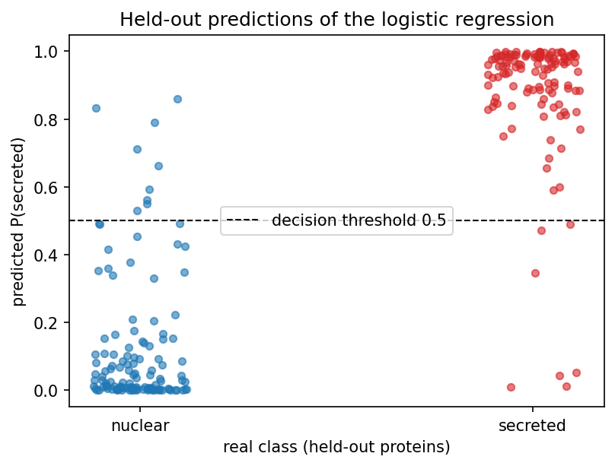
1 · TWO REAL PROBLEMS
Almost every held-out protein falls on the right side
Predicted P(secreted) for each held-out protein, grouped by its real class. The few on the wrong side of 0.5 are the classifier's errors.
Notebook, 'A classification problem: secreted or nuclear?'.

Slide 21
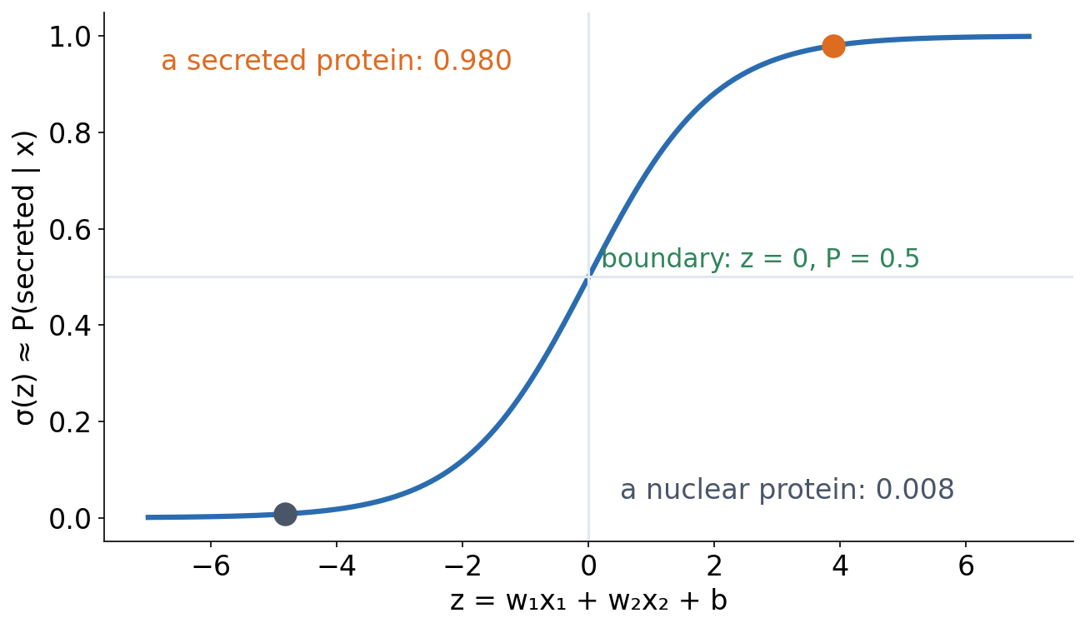
1 · LOGISTIC REGRESSION
Logistic regression: a perceptron with a smooth output
▪ Same weighted sum as Session 7
▪ σ(z) = 1 / (1 + e⁻ᶻ) maps to (0, 1)
▪ Boundary: still a straight line
▪ Smooth, so trainable (Session 9)
See course.bioinfo.se/session08.html, 'Logistic regression: the bridge between the two'.
Notes:
Despite its name, logistic regression is a classifier. Fitted with the log-loss (cross-entropy), its output estimates P(secreted | x). Keep two things apart: the sigmoid is only a mapping into 0-1; logistic regression is a probabilistic model fitted with the likelihood. A sigmoid applied to an arbitrary score is not a probability. Whether the estimates are calibrated (a predicted 0.8 right 80% of the time) must be checked on held-out data.

Slide 22
1 · LOGISTIC REGRESSION
What follows from the choice
Regression
Classification
linear output
sigmoid / softmax output
▪ Loss: mean squared error
▪ Metrics: RMSE, Pearson r, R²
▪ Loss: cross-entropy (Session 1)
▪ Metrics: confusion matrix, precision, recall, F1, MCC, AUROC
See course.bioinfo.se/session08.html, Table 8.2. Losses are Session 9's topic.

Slide 23
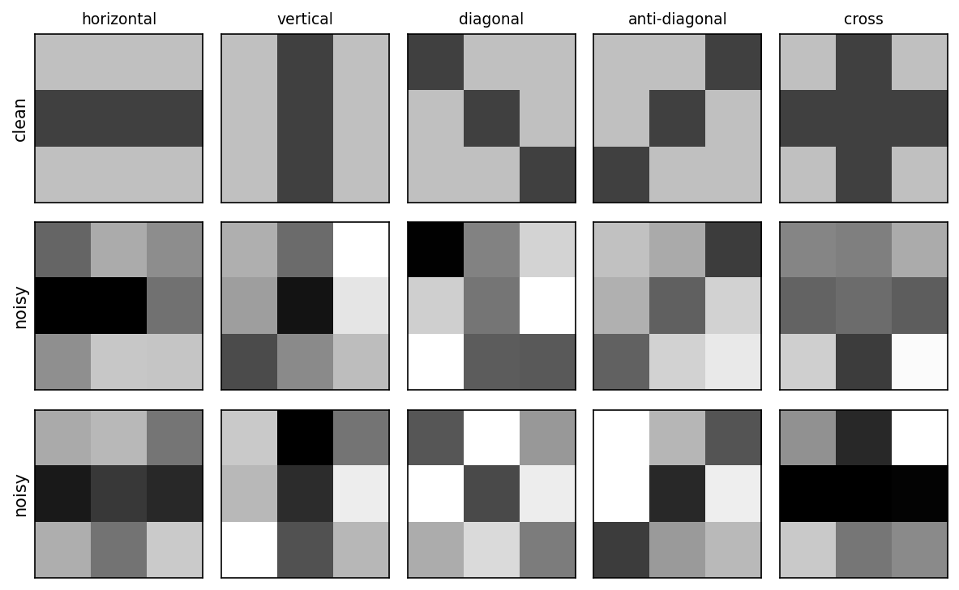
1 · A RUNNING TOY
The smallest image problem: 3×3 pixel patterns
▪ 9 pixels, 5 classes
▪ Clean pattern + noise (σ = 0.8)
▪ 'Cross' shares pixels with two others
Idea from Ekman, Learning Deep Learning, ch. 2.
Notes:
Dark = +1, light = −1. Cross shares its middle row with horizontal and its middle column with vertical, so we expect confusion there. Deep learning's first great breakthrough was image classification (Session 10).

Slide 24
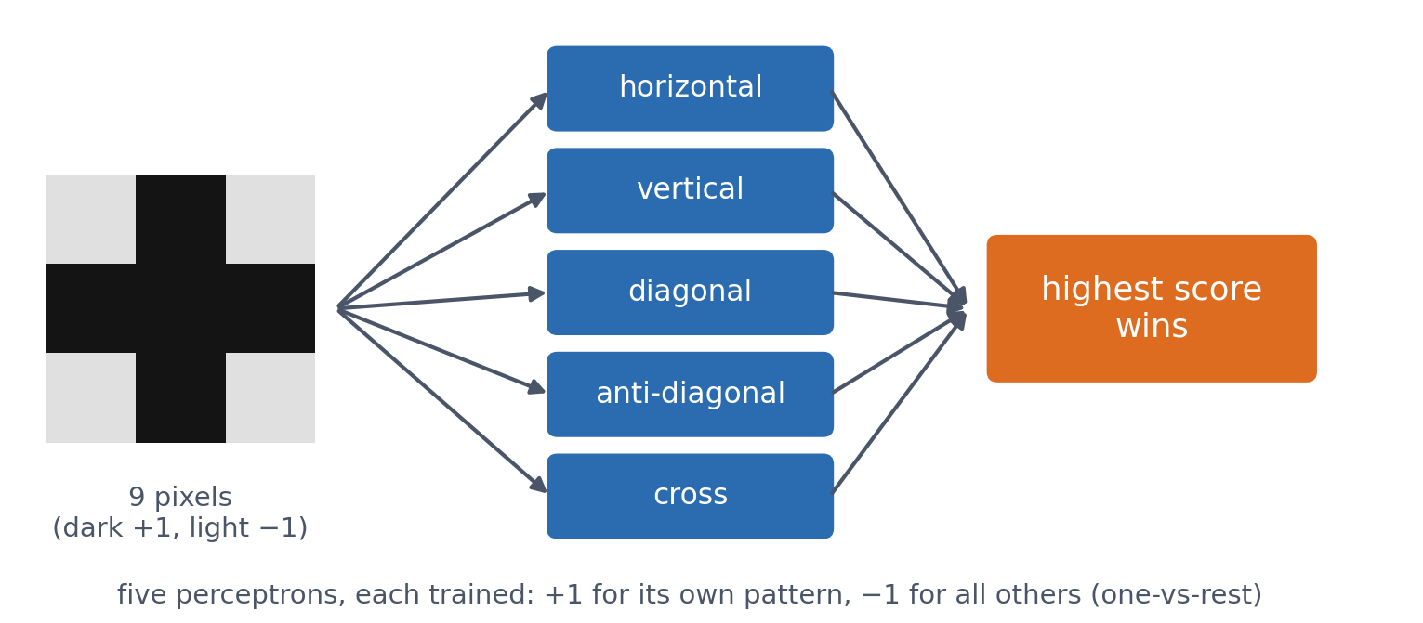
1 · A RUNNING TOY
Five perceptrons, one per pattern
One-vs-rest: each perceptron outputs +1 for its own pattern and −1 for every other; the predicted class is the highest score. No hidden layer, so no backpropagation needed.
See course.bioinfo.se/session08.html, 'A running toy example: 3×3 pixel patterns'.

Slide 25
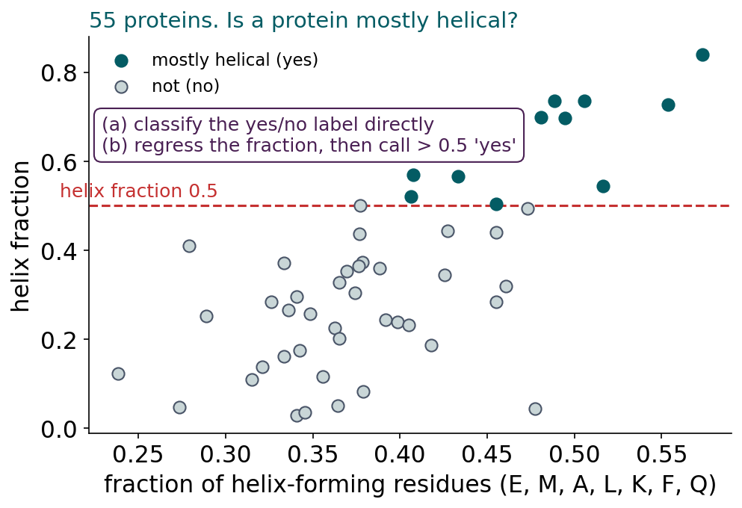
BLOCK 1 · QUIZ
Classify the label, or regress the number?
55 proteins; is each mostly helical (helix fraction > 0.5)? One feature: the share of helix-forming residues. (a) Train a classifier on the yes/no labels, or (b) train a regression on the helix fraction and call > 0.5 'yes'. Which is more accurate?
A (a) Classifier: trained on yes/no
B (b) Regression: keeps more information
C About the same
D Neither: one feature is too little
Guess on your own
Scan the code, or go to
quiz.bioinfo.se/live
Notes:
Read the two routes out loud. Accuracy by 5-fold cross-validation; 16 of the 55 proteins are mostly helical.

Slide 26
BLOCK 1 · QUIZ
Classify the label, or regress the number?
How did the room answer?
Halt the round when most have answered, then show the results.
Show the results ▸ quiz.bioinfo.se/live/report
Notes:
Halt submission in the Control view, then open the results. Do not say which answer is right.

Slide 27
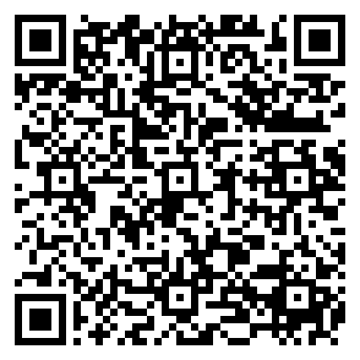
BLOCK 1 · QUIZ
Classify the label, or regress the number?
Fix it, run it, discuss
Open the notebook: scan the code
Fix the line marked FIX, then run the cells
Did it come out as you guessed? Discuss with your neighbour
The notebook: https://colab.research.google.com/github/ElofssonLab/kb8029-book/blob/main/notebooks/session08-discussion-1.ipynb
Notes:
About 8 minutes. As it is, the notebook's classifier calls no protein helical: 0.709 = always 'no' (39/55). The cause is scikit-learn's default regularisation (C = 1) with a feature that only varies between 0.2 and 0.5. Fixed with C = 100 (or a standardised feature), it scores 0.818, the same as the regression.

Slide 28
BLOCK 1 · QUIZ
Classify the label, or regress the number?
Answer again
Same question, after the discussion.
quiz.bioinfo.se/live
Notes:
Open the second round (post) in the Control view.

Slide 29
BLOCK 1 · QUIZ
Classify the label, or regress the number?
Results, and who explains
Both rounds side by side.
Draw two to explain: one of you says how you reasoned.
Show the results ▸ quiz.bioinfo.se/live/report
To check it with code afterwards: discussion notebook 1 https://colab.research.google.com/github/ElofssonLab/kb8029-book/blob/main/notebooks/session08-discussion-1.ipynb
Notes:
About the same: 0.818 and 0.818. The first result, 0.709, was the trivial baseline: always compare with it. In general there is no winner: regression keeps more information if the number is trustworthy; classification optimises the yes/no task. 55 proteins cannot settle it.

Slide 30
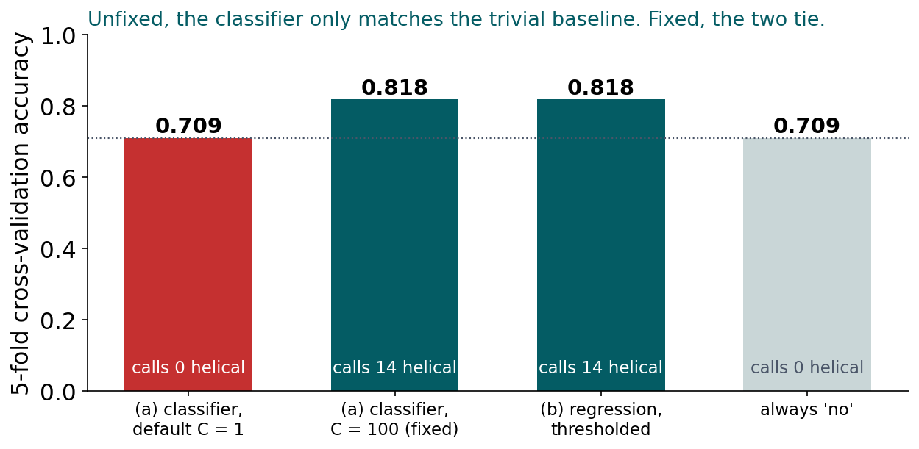
BLOCK 1 · QUIZ
The answer: about the same, once the classifier is fixed
With scikit-learn's default regularisation the classifier never says 'helical': its 0.709 is exactly the score of always answering 'no'. With weaker regularisation (C = 100) it reaches 0.818, the same as the regression. Always compare with the trivial baseline; and on 55 proteins neither approach is better.

Slide 31
BLOCK 1 DONE
Break

Slide 32
BLOCK 2 · ABOUT 30 MIN
How do we know a model learned anything?

Slide 33
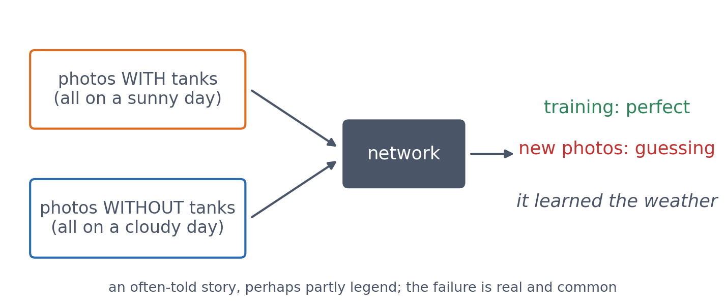
2 · GENERALISATION
Datasets should be representative
The network separated the training photos perfectly and was no better than guessing on new ones: every tank photo was sunny, every empty one cloudy.
See course.bioinfo.se/session08.html, callout 'Datasets should be representative'.

Slide 34
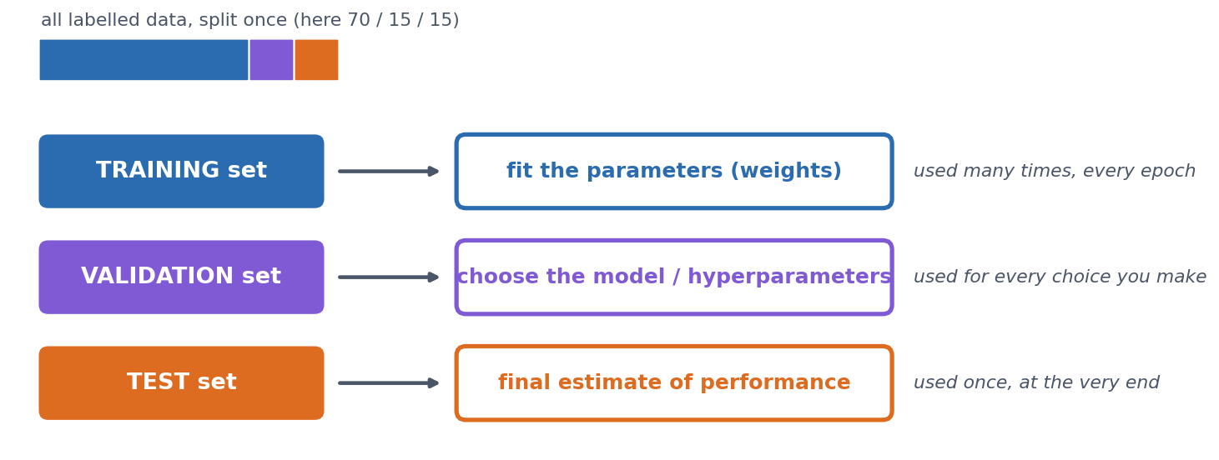
2 · THREE DATA SETS
Why three data sets?
Training: fit the weights. Validation: make choices (epochs, size, features). Test: look once, at the very end; a test set used to guide choices becomes a second validation set.
See course.bioinfo.se/session08.html, 'Why three data sets?'.
Notes:
A model that predicts its training data well but fails on new examples overfits. Every choice tuned on the validation set makes it slightly optimistic.

Slide 35
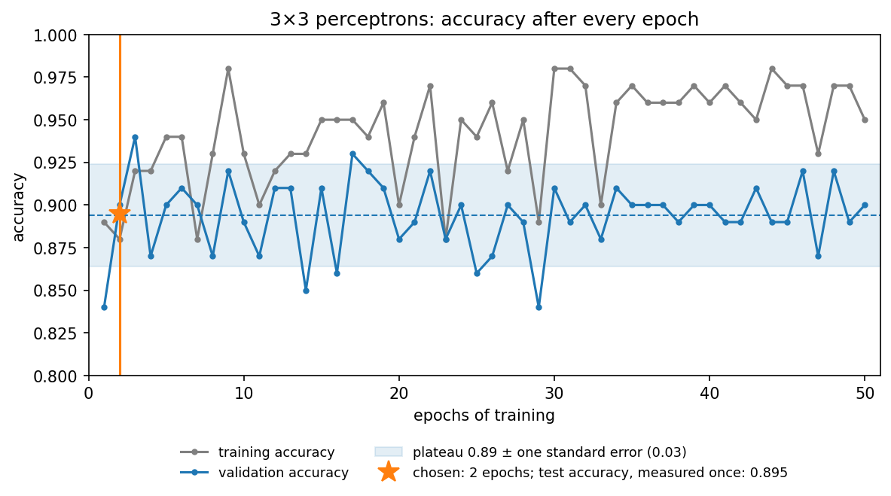
2 · THREE DATA SETS
Choosing the number of epochs on the validation set
Validation accuracy is noisy (±0.03 with 100 examples) around a plateau of 0.89. The best single epoch (3, 0.94) is partly luck. Rule: the earliest epoch clearly on the plateau → 2 epochs. Test, once: 0.895.
Notebook, 'Training, validation and test sets, on the 3×3 problem'.
Notes:
Ask first: which epoch would you pick, and why? Most will say 3. With 100 validation examples one accuracy is uncertain by about 0.03, so the peak at 3 is within the noise, and picking the maximum of 50 noisy numbers is optimistic: selection bias. Using the validation set to choose is fine; reporting its best score as the expected one is not. Training accuracy never settles (0.88-0.98) because the noisy patterns cannot all be separated by straight lines.

Slide 36
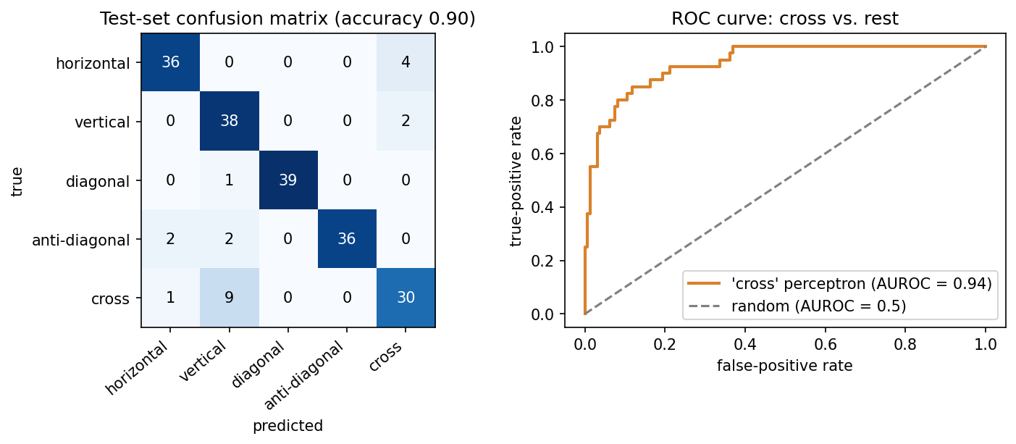
2 · EVALUATING A CLASSIFIER
The confusion matrix shows which mistakes
Left: almost all mistakes involve 'cross': 9 crosses called vertical, 4 horizontals and 2 verticals called cross. Right: sweeping the threshold on the cross perceptron's score traces the ROC curve.
Notebook: session08-ml-foundations-and-pytorch.ipynb.

Slide 37
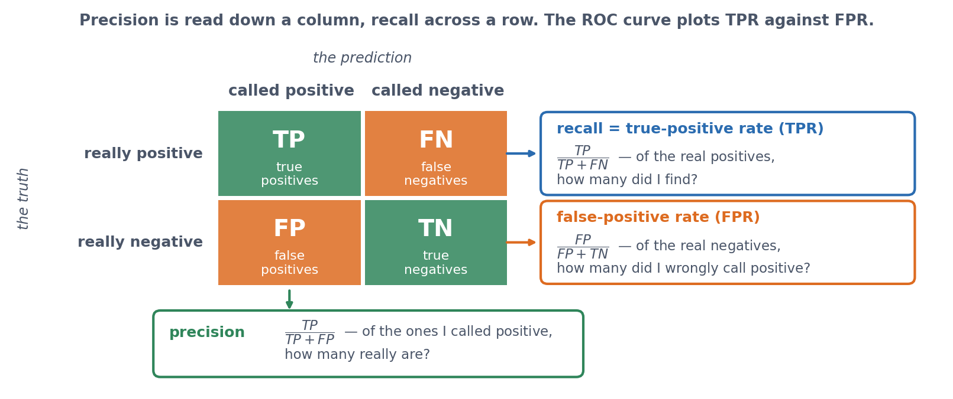
2 · EVALUATING A CLASSIFIER
Four counts, three measures
Rows are the truth, columns the prediction. Precision is read down a column; recall and the false-positive rate across a row.
See course.bioinfo.se/session08.html, 'Evaluating a classifier'.
Notes:
Every prediction falls into one of four boxes, once we pick one class as positive. Which total you divide by is the whole difference between these measures. Recall and the true-positive rate are two names for the same number: TP / (TP + FN). The false-positive rate is the bottom row, FP / (FP + TN). The ROC curve two slides on plots TPR against FPR, so they need to be clear here.

Slide 38
2 · EVALUATING A CLASSIFIER
Precision and recall
▪ precision = TP / (TP + FP)
▪ recall = TP / (TP + FN)
▪ recall = TPR, the true-positive rate
▪ Screening: favour recall
▪ Expensive follow-up: favour precision
0.95
recall,
'vertical'
0.76
precision,
'vertical'
See course.bioinfo.se/session08.html, 'Evaluating a classifier'.
Notes:
Precision: of those I called positive, how many are? Recall: of the true positives, how many did I find? For vertical, recall is high but precision low because many crosses were called vertical. For cross, recall drops to 0.75.

Slide 39
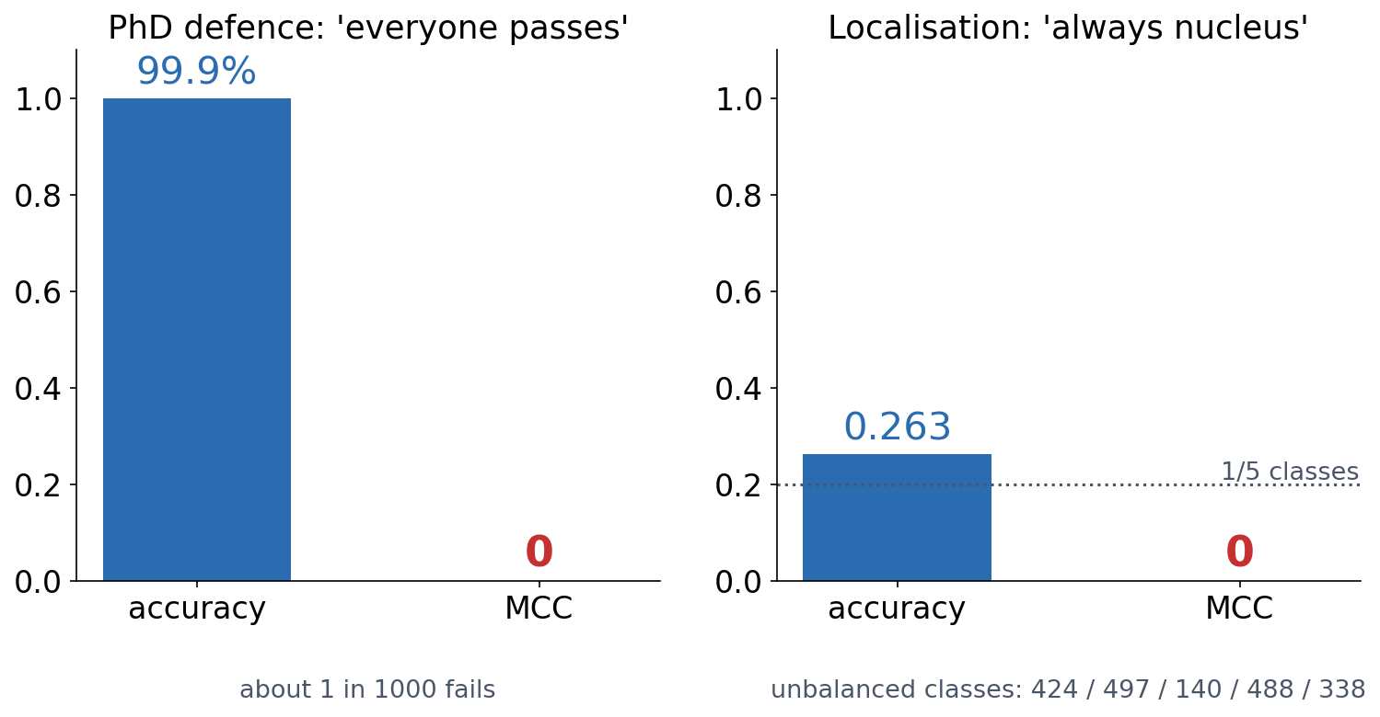
2 · EVALUATING A CLASSIFIER
High accuracy, no information
Predicting that every PhD student passes is right 99.9% of the time. Always answering 'nucleus' on the unbalanced localisation data beats the 1-in-5 guess. Both have an MCC of exactly 0.
See course.bioinfo.se/session08.html, callout 'How useful is accuracy?' and 'Class imbalance first'.
Notes:
Real proteomes are far more unbalanced: for a rare targeting signal, 'always no' can be more than 90% accurate. Always report MCC, or precision and recall, next to accuracy. For the rest of the session the localisation classes are balanced to 140 each (700 proteins).

Slide 40
2 · EVALUATING A CLASSIFIER
One number each: MCC and AUROC
▪ MCC: all four counts, −1 to +1
▪ 0 = chance; honest when classes are unbalanced
▪ AUROC: P(a random positive outscores a random negative)
▪ 0.5 = guessing, 1.0 = perfect ranking
0.871
multi-class MCC,
3×3 test set
0.938
AUROC,
'cross'
See course.bioinfo.se/session08.html, 'Evaluating a classifier' and 'ROC curves'.
Notes:
F1 is the harmonic mean of precision and recall. The binary MCC formula generalises to the whole confusion matrix in scikit-learn. Session 5's E-value cut-off was a point on the same kind of trade-off.

Slide 41
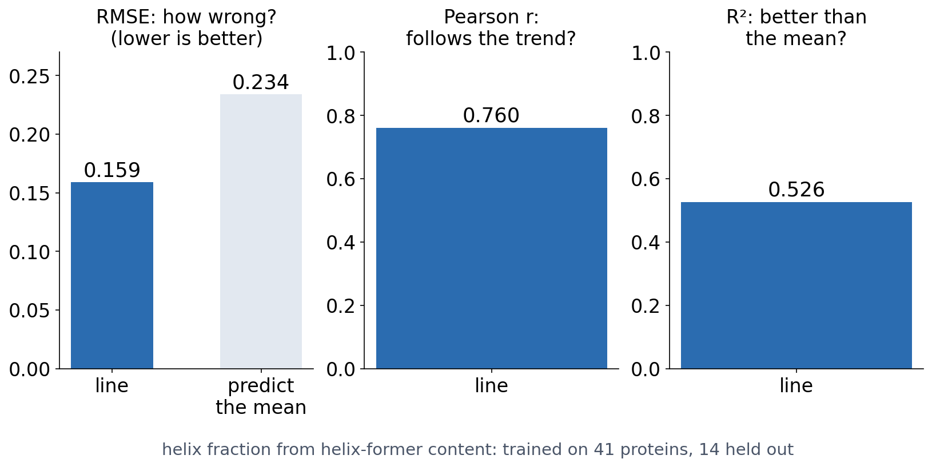
2 · EVALUATING A REGRESSION
Three numbers, three questions
RMSE is in the target's units; predicting the training mean gives 0.234, the baseline to beat. Pearson r measures the trend; R² compares with always predicting the mean (about half the variance explained).
See course.bioinfo.se/session08.html, 'Evaluating a regression model'.

Slide 42
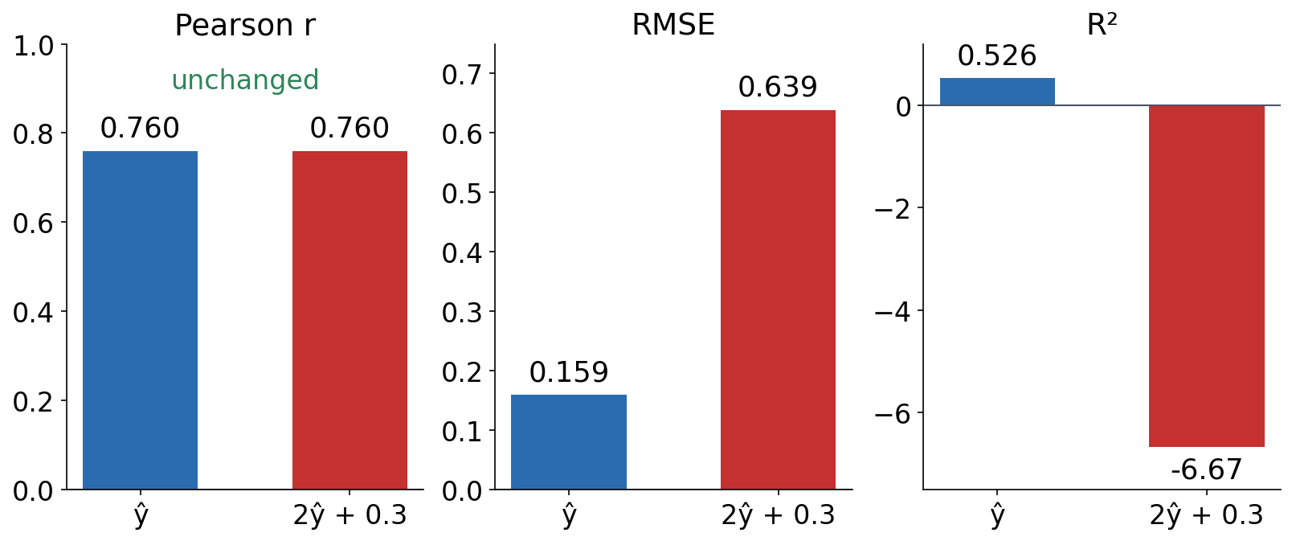
2 · EVALUATING A REGRESSION
Correlation is not accuracy
The same predictions stretched and shifted (2ŷ + 0.3): the correlation does not change at all, while RMSE quadruples and R² falls far below the mean predictor. A common mistake in bioinformatics papers.
Notebook, 'Evaluating a regression model'.
Notes:
Before revealing, ask: if every prediction is doubled and shifted by 0.3, what happens to r? Most expect it to drop. It does not change, because the ordering is unchanged.

Slide 43
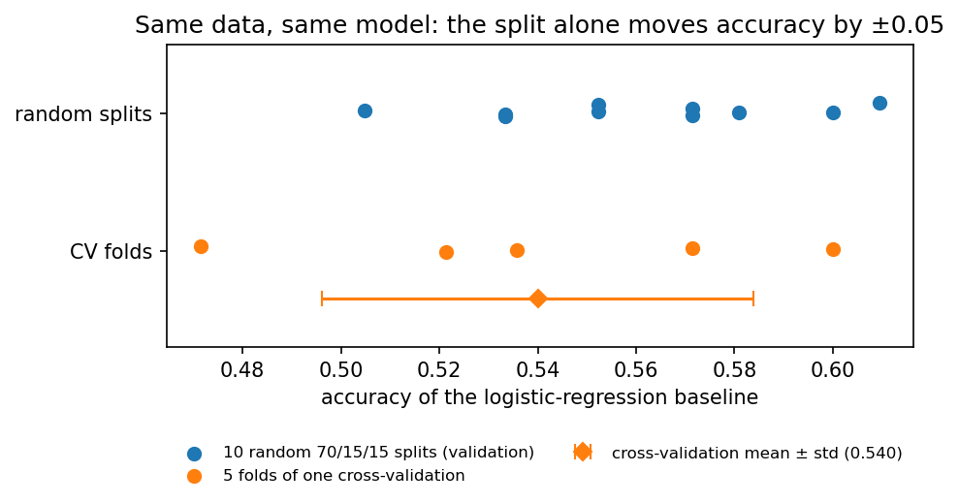
2 · HOW MUCH TO TRUST ONE SPLIT
Same data, same model, different split
▪ 10 random splits: 0.505 to 0.610
▪ 5-fold CV: 0.540 ± 0.044
▪ Every protein validates once
▪ At 5× the computing cost
Localisation: 700 human proteins, 5 classes, first 150 residues one-hot (3000 numbers).
Notes:
Logistic-regression baseline, 70/15/15 splits: mean 0.561, standard deviation 0.031. k-fold cross-validation makes better use of limited data and reduces the dependence on one split, but does not remove sampling variability.

Slide 44
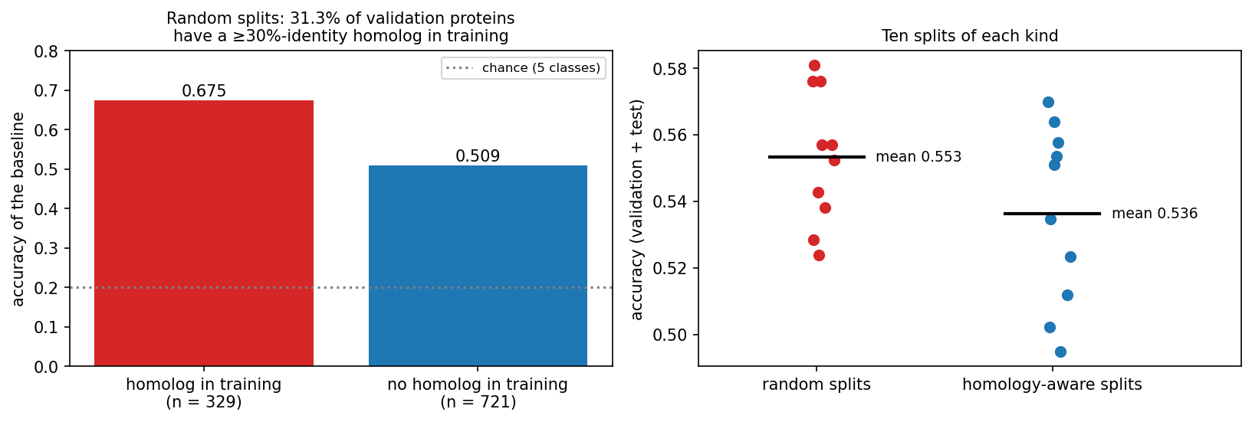
2 · THE BIOLOGICAL TRAP
Homologs on both sides of the split
MMseqs2 at 30% identity: 700 proteins → 551 clusters. In random splits 31.3% of validation proteins have a homolog in training; those are right 67.5% of the time, the rest 50.9%.
Steinegger & Söding (2017), MMseqs2, Nat Biotechnol 35:1026.
Notes:
Proteins come in families that share sequence and, often, localisation. With a family member on each side, the model can exploit family similarity instead of general targeting signals. 75 clusters have more than one member (224 proteins); the largest has 11.

Slide 45
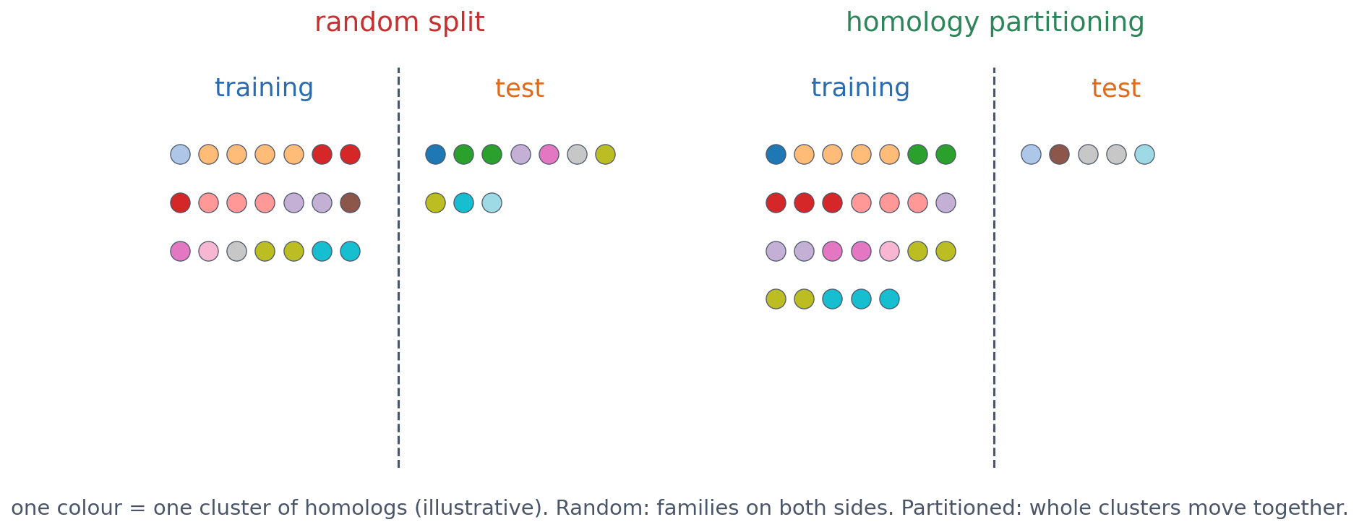
2 · THE BIOLOGICAL TRAP
Homology partitioning: split clusters, not proteins
Cluster first, then put whole clusters into training, validation or test. Over ten splits of each kind, baseline accuracy drops from 0.553 (random) to 0.536 (homology-aware). From today the course uses that split: 486 / 105 / 109 proteins.
Illustrative clusters. Numbers: 10 random and 10 homology-aware splits (notebook).
Notes:
No cluster of ≥30% identity crosses the split: substantially less leakage, though remote homologs below the cut-off can remain. The drop is small here only because 476 of the 700 proteins have no homolog in the set; in redundant data (a whole proteome, the PDB) the gap can be much larger. Sessions 9 and 10 reuse this split.

Slide 46
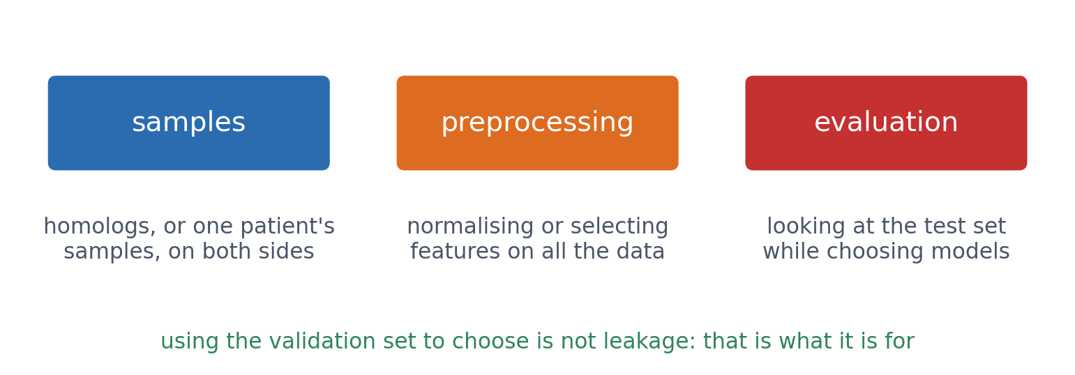
2 · THE BIOLOGICAL TRAP
Other ways test information leaks in
Also: batch effects (all tumours sequenced in one lab), time (tested on proteins annotated before the training data), and unrepresentative data. CASP's truly blind test (Session 6) is the model for honest evaluation.
See course.bioinfo.se/session08.html, 'Other ways biological data leaks'.

Slide 47
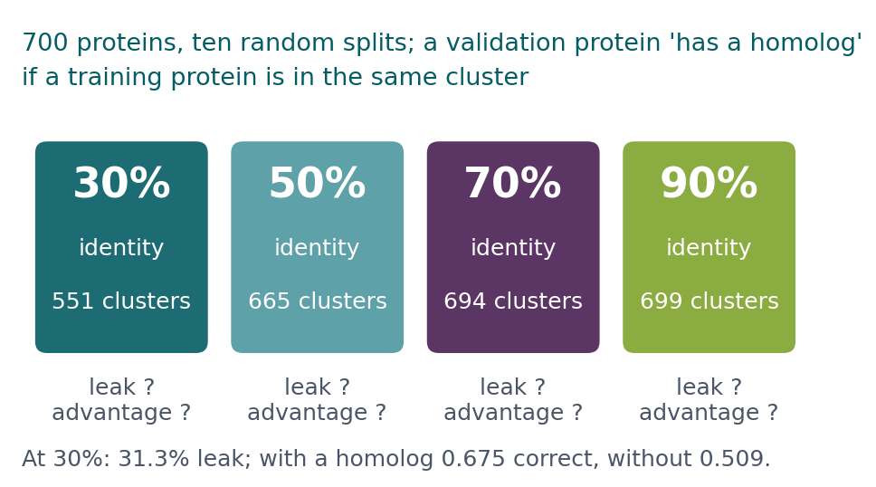
BLOCK 2 · QUIZ
What happens as the identity cutoff rises?
700 proteins clustered at 30%, 50%, 70% and 90% identity. As the cutoff rises: the share of validation proteins with a homolog in training, and their accuracy advantage?
A Both fall; the advantage is gone at 50%
B The share falls, but the advantage grows
C Both stay about the same
D The share rises
Guess on your own
Scan the code, or go to
quiz.bioinfo.se/live
Notes:
At 30%, from the block: 31.3% of validation proteins have a homolog in training, and they are classified correctly 0.675 against 0.509.

Slide 48
BLOCK 2 · QUIZ
What happens as the identity cutoff rises?
How did the room answer?
Halt the round when most have answered, then show the results.
Show the results ▸ quiz.bioinfo.se/live/report
Notes:
Halt submission in the Control view, then open the results. Do not say which answer is right.

Slide 49
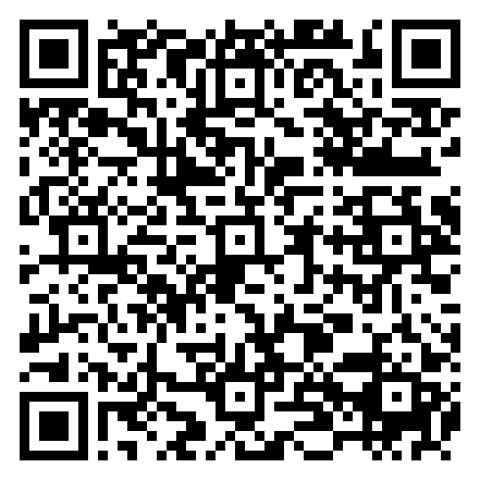
BLOCK 2 · QUIZ
What happens as the identity cutoff rises?
Fix it, run it, discuss
Open the notebook: scan the code
Fix the line marked FIX, then run the cells
Did it come out as you guessed? Discuss with your neighbour
The notebook: https://colab.research.google.com/github/ElofssonLab/kb8029-book/blob/main/notebooks/session08-discussion-2.ipynb
Notes:
About 8 minutes. As it is, in_train is built from the validation proteins' own clusters, so the leak is 100% at every cutoff. Fixed (g[tr]): 31.3%, 7.8%, 0.9%, 0.2%.

Slide 50
BLOCK 2 · QUIZ
What happens as the identity cutoff rises?
Answer again
Same question, after the discussion.
quiz.bioinfo.se/live
Notes:
Open the second round (post) in the Control view.

Slide 51
BLOCK 2 · QUIZ
What happens as the identity cutoff rises?
Results, and who explains
Both rounds side by side.
Draw two to explain: one of you says how you reasoned.
Show the results ▸ quiz.bioinfo.se/live/report
To check it with code afterwards: discussion notebook 2 https://colab.research.google.com/github/ElofssonLab/kb8029-book/blob/main/notebooks/session08-discussion-2.ipynb
Notes:
Both fall. At 50% only 7.8% have a homolog and the advantage has gone (0.537 against 0.563); at 70% and 90% there are too few (9 and 2) to read. This one-hot linear model exploits distant relatives at 30%-50% identity. Whole-sequence models (Sessions 10, 12) can exploit closer ones, so 30% stays the safe choice.

Slide 52
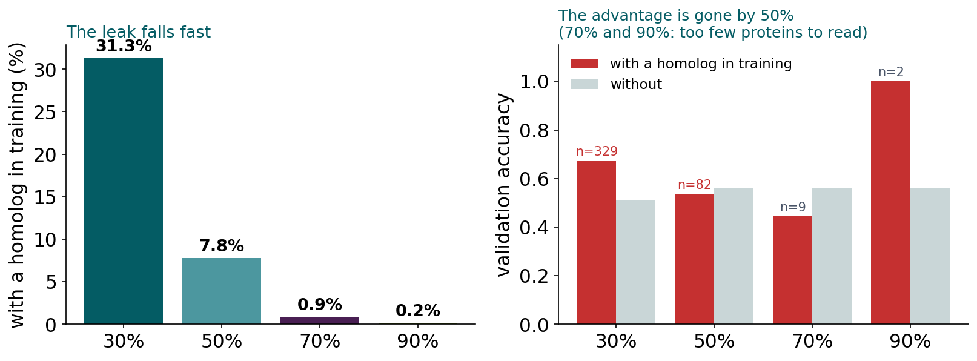
BLOCK 2 · QUIZ
The answer: both fall; above 50% nothing is left to exploit
The share of validation proteins with a homolog in training falls from 31.3% at 30% identity to 7.8% at 50%, and their advantage disappears. At 70% and 90% there are too few such proteins to say anything. For this model the leak comes from distant relatives; that is why datasets are partitioned at 25-30%.

Slide 53
BLOCK 2 DONE
Break

Slide 54
BLOCK 3 · ABOUT 30 MIN
Towards training networks

Slide 55
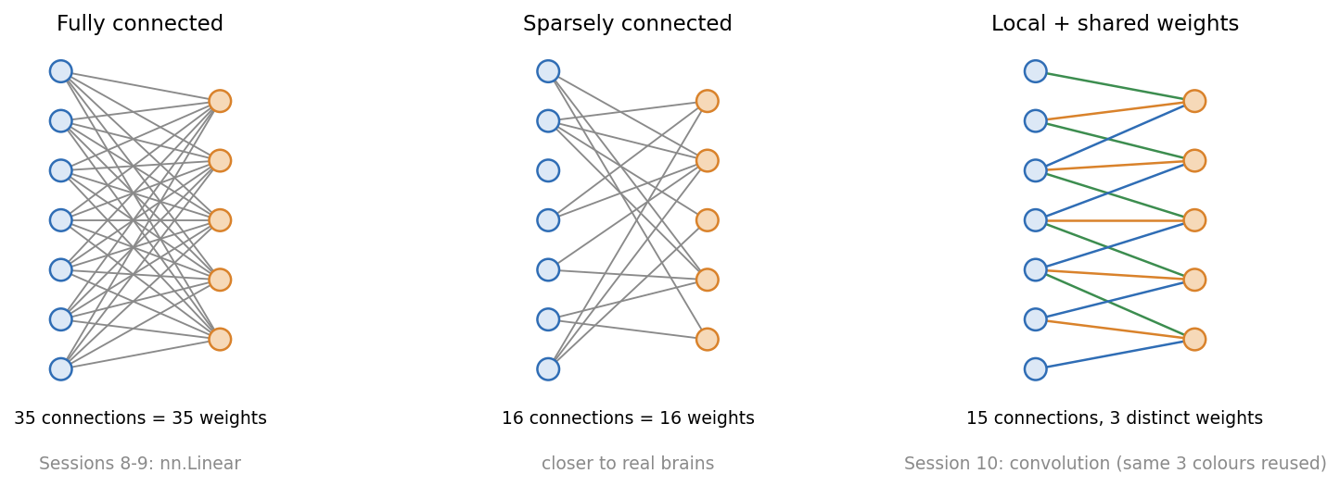
3 · NETWORKS
Connectivity decides the number of weights
Fully connected (nn.Linear, Sessions 8-9): every input to every output, so the size grows with the input. Local with shared weights: convolution, Session 10's key idea.
Figure drawn for this course.

Slide 56
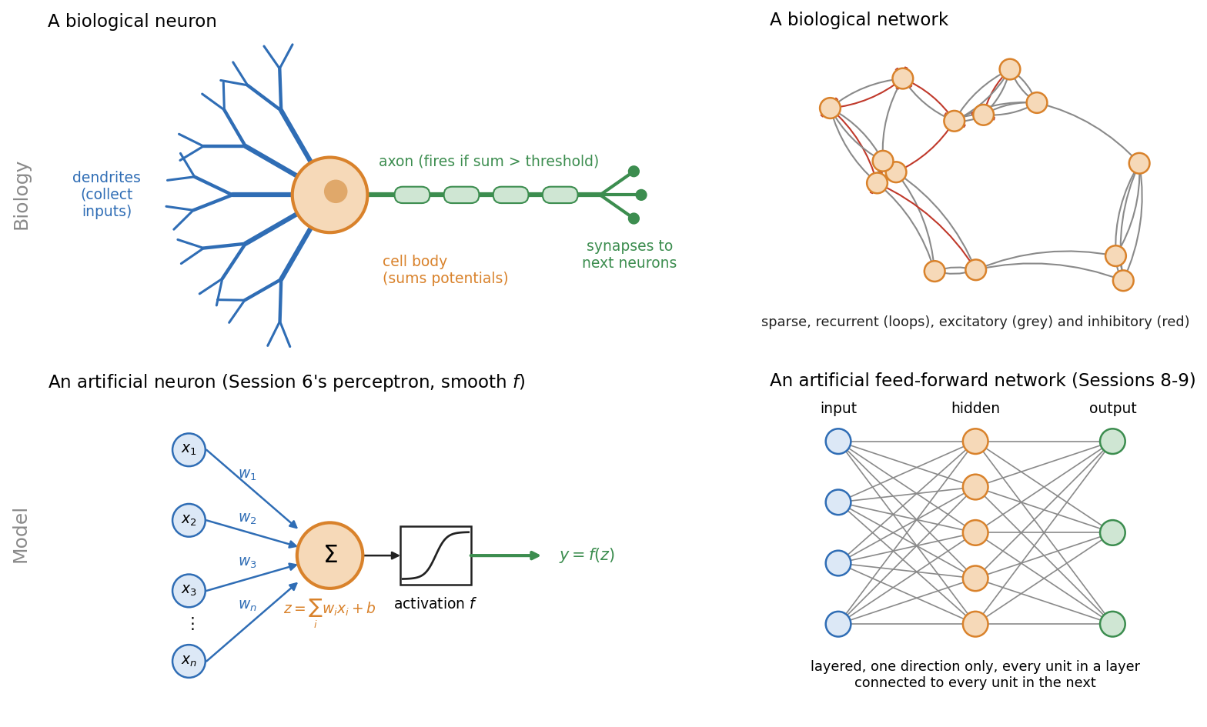
3 · NETWORKS
Biological and artificial networks
Real neurons spike, brains loop back and are sparsely connected. Artificial units output one number, and the networks of Sessions 8-10 are strictly feed-forward.
See course.bioinfo.se/session08.html, optional box 'Biological and artificial networks'.

Slide 57
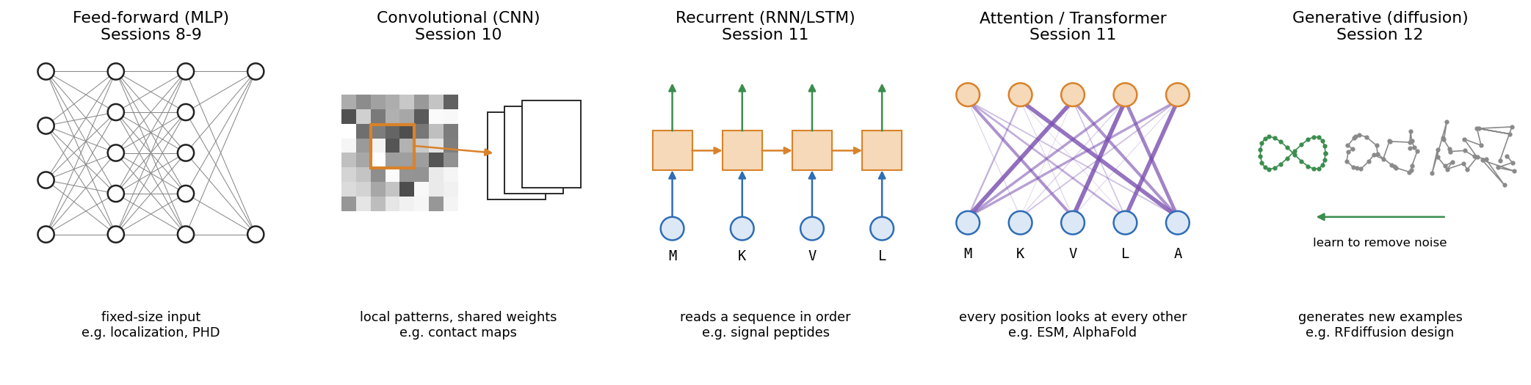
3 · NETWORKS
The architectures still to come
Each builds a different assumption into its wiring: feed-forward (today, PHD), CNNs (contact maps, Session 10), RNNs and transformers (signal peptides, language models, Session 11), AlphaFold and diffusion models (Session 12).
See course.bioinfo.se/session08.html, optional box.

Slide 58
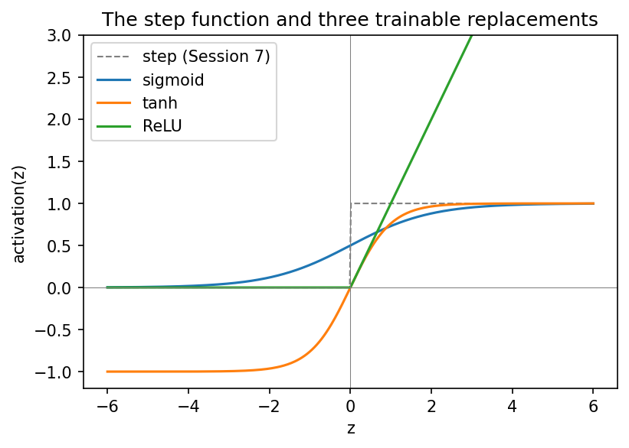
3 · ACTIVATIONS
A step gives gradient descent nothing to follow
▪ Step: derivative 0 almost everywhere
▪ Sigmoid (0, 1): binary outputs
▪ tanh (−1, 1): centred on zero
▪ ReLU: default for hidden layers
See course.bioinfo.se/session08.html, 'From step functions to trainable activations'.
Notes:
Backpropagation (Session 9) is gradient descent applied layer by layer and needs the derivative of every activation. ReLU has a kink at 0, but slope 1 or 0 elsewhere is enough. Why the choice matters in deep networks is Session 9's vanishing-gradient discussion.

Slide 59
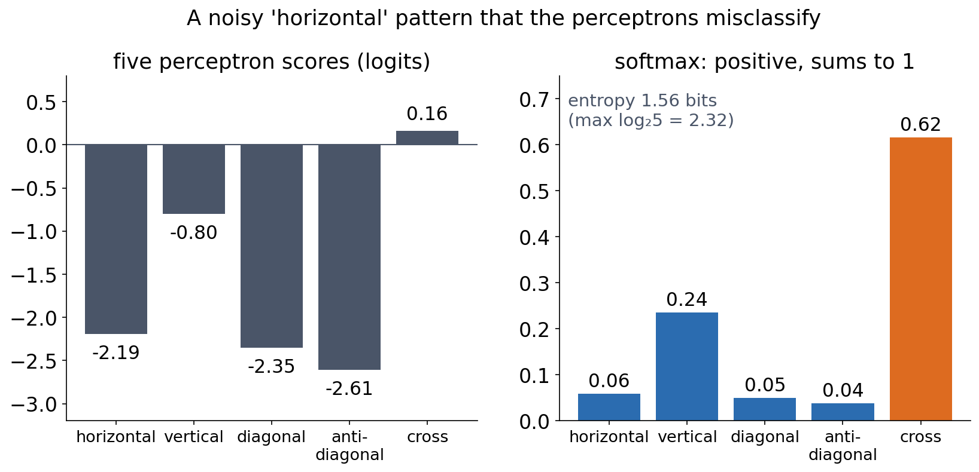
3 · SOFTMAX
Softmax: K scores become a distribution
softmax(z)ₖ = eᶻᵏ / Σⱼ eᶻʲ. It never changes which class wins. These perceptrons were not trained with cross-entropy, so the numbers sum to 1 but are not reliable probabilities.
See course.bioinfo.se/session08.html, 'From binary to multi-class: softmax'.
Notes:
Training with cross-entropy (Session 9) makes softmax outputs interpretable as probability estimates, but calibration must still be checked on held-out data. Entropy: 0 bits for a completely confident model, log2 5 ≈ 2.32 for one that cannot tell the classes apart. For two classes, softmax is equivalent to logistic (sigmoid) classification.

Slide 60
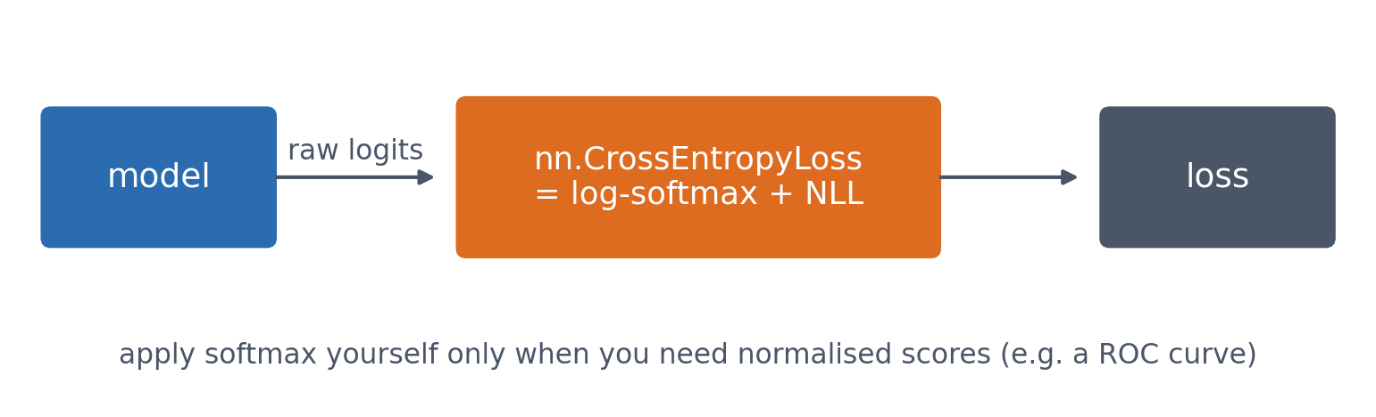
3 · SOFTMAX
In PyTorch the model outputs raw logits
nn.CrossEntropyLoss combines log-softmax with the negative log-likelihood in one numerically stable step, so the model should not apply softmax itself.
See course.bioinfo.se/session08.html, 'From binary to multi-class: softmax'; Session 9.

Slide 61
3 · PYTORCH
A model is a class: nn.Module
▪ Layers as attributes in __init__
▪ forward(): input tensor → output tensor
▪ The whole 3×3 classifier: nn.Linear(9, 5)
▪ Perceptron weights copied in → identical predictions
50
parameters:
5 × 9 + 5
Notebook: session08-ml-foundations-and-pytorch.ipynb. First real use of Session 2's class syntax.

Slide 62
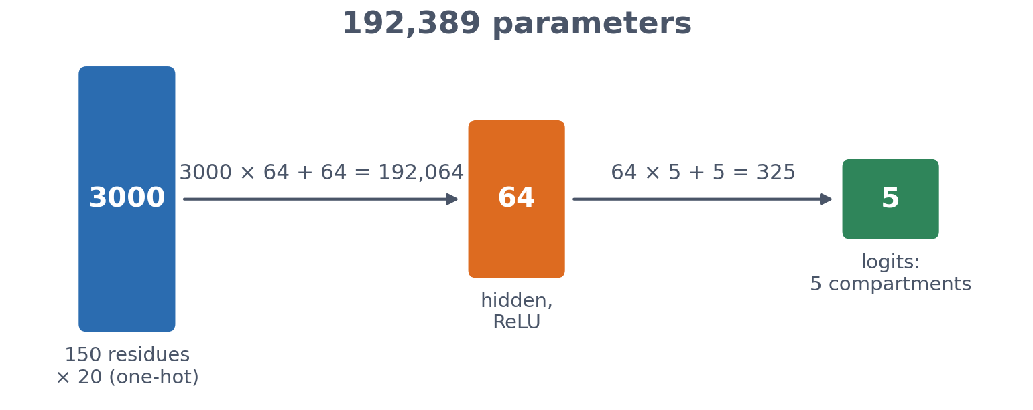
3 · PYTORCH
The localisation network
3000 inputs (150 residues one-hot), a hidden layer of 64 ReLU units, 5 output logits. One forward pass on the homology-aware validation set confirms the shapes: 105 × 3000 in, 105 × 5 out.
Notebook: session08-ml-foundations-and-pytorch.ipynb.

Slide 63
3 · PYTORCH
Untrained, it scores what chance looks like
▪ Random weights, homology-aware validation set
▪ Not trained today
▪ Session 9: backpropagation and the training loop, same metrics, same split
0.181
accuracy
−0.027
MCC
0.474
AUROC
Notebook: session08-ml-foundations-and-pytorch.ipynb.

Slide 64
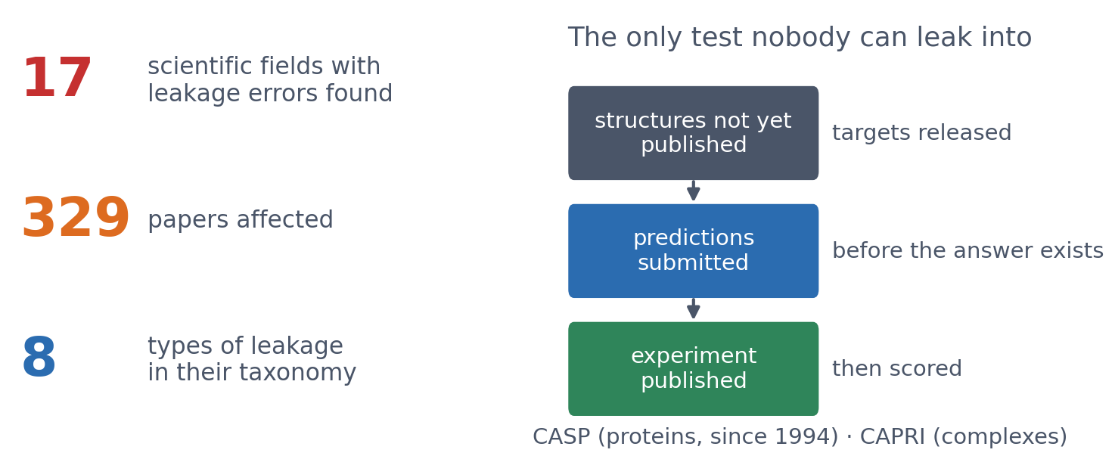
3 · OUTLOOK
Leakage is not just a student mistake
▪ Found across 17 fields of ML-based science
▪ Homologs in benchmarks, too
▪ Blind tests: the gold standard
▪ How would you prove a model trained on millions of proteins never saw your test protein?
Kapoor & Narayanan (2023), Patterns 4:100804; CASP (predictioncenter.org); CAPRI.
Notes:
Kapoor and Narayanan found leakage errors in 17 fields, affecting 329 papers, sometimes with wildly over-optimistic conclusions; they describe 8 types of leakage, from textbook errors (no test set, preprocessing on all the data) to subtle ones. In a re-analysis of civil-war prediction, the advantage of complex ML models over logistic regression disappeared once leakage was fixed. In protein science the typical leak is homology: a test protein with a close relative in training (this session's homology partitioning). Large models make it worse: they are trained on almost everything in UniProt and the PDB, so 'never seen' is hard to prove. Blind tests avoid the problem by construction: CASP releases sequences of structures that are not yet public, collects predictions, and scores them when the experiments are published. Possible answers to the question: only a time split or a blind test proves it; otherwise check sequence identity to the training set (if it is published at all).

Slide 65
SUMMARY
Evaluate on data the model has never seen
Pose the problem from the label. Split three ways and look at the test set once. Report MCC or precision and recall, not only accuracy; RMSE and R², not only correlation. Split proteins by homology, not at random.
See course.bioinfo.se/session08.html.

Slide 66
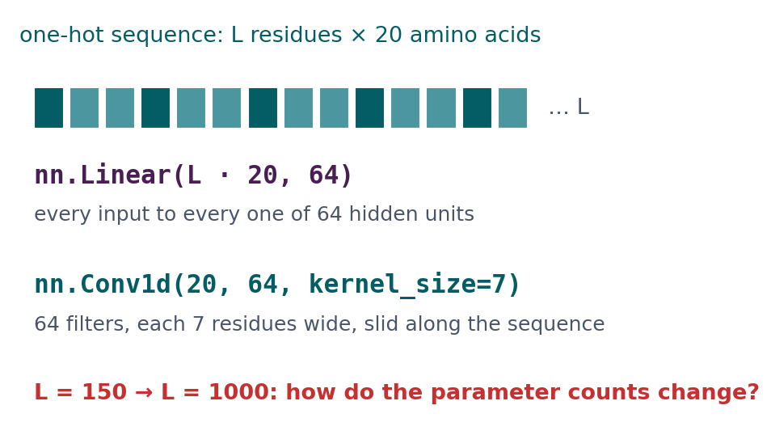
BLOCK 3 · QUIZ
How do the parameter counts change with sequence length?
A one-hot sequence (L × 20) into nn.Linear(L·20, 64) or nn.Conv1d(20, 64, 7). From L = 150 to L = 1000?
A Both grow about seven times
B nn.Linear grows about 7×; nn.Conv1d stays the same
C Both stay the same
D nn.Conv1d grows; nn.Linear stays the same
Guess on your own
Scan the code, or go to
quiz.bioinfo.se/live
Notes:
The dense layer connects every input to every hidden unit; the convolution's filters are 7 residues wide and slide along the sequence.

Slide 67
BLOCK 3 · QUIZ
How do the parameter counts change with sequence length?
How did the room answer?
Halt the round when most have answered, then show the results.
Show the results ▸ quiz.bioinfo.se/live/report
Notes:
Halt submission in the Control view, then open the results. Do not say which answer is right.

Slide 68
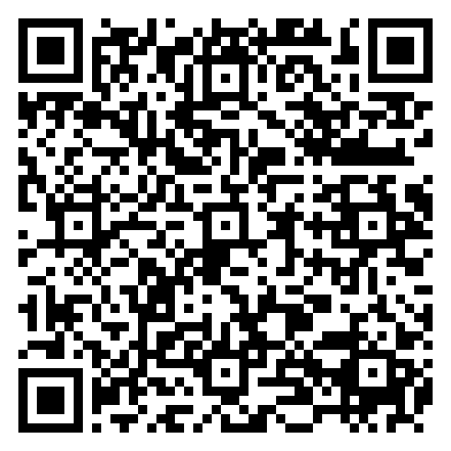
BLOCK 3 · QUIZ
How do the parameter counts change with sequence length?
Fix it, run it, discuss
Open the notebook: scan the code
Fix the line marked FIX, then run the cells
Did it come out as you guessed? Discuss with your neighbour
The notebook: https://colab.research.google.com/github/ElofssonLab/kb8029-book/blob/main/notebooks/session08-discussion-3.ipynb
Notes:
About 8 minutes. As it is, count() counts the parameter tensors (weights and bias: 2), not the numbers in them. Fixed with sum(p.numel() ...): 192,064 and 1,280,064 for nn.Linear; 9,024 for nn.Conv1d at both lengths. Part A (the weight images) is for afterwards.

Slide 69
BLOCK 3 · QUIZ
How do the parameter counts change with sequence length?
Answer again
Same question, after the discussion.
quiz.bioinfo.se/live
Notes:
Open the second round (post) in the Control view.

Slide 70
BLOCK 3 · QUIZ
How do the parameter counts change with sequence length?
Results, and who explains
Both rounds side by side.
Draw two to explain: one of you says how you reasoned.
Show the results ▸ quiz.bioinfo.se/live/report
To check it with code afterwards: discussion notebook 3 https://colab.research.google.com/github/ElofssonLab/kb8029-book/blob/main/notebooks/session08-discussion-3.ipynb
Notes:
nn.Linear: (L·20 + 1)·64, so 192,064 → 1,280,064. nn.Conv1d: (20·7 + 1)·64 = 9,024 at any length, because the same filter is used at every position. It assumes a motif means the same wherever it is (Session 10). With 486 training proteins, the dense layer overfits more (Session 9).

Slide 71
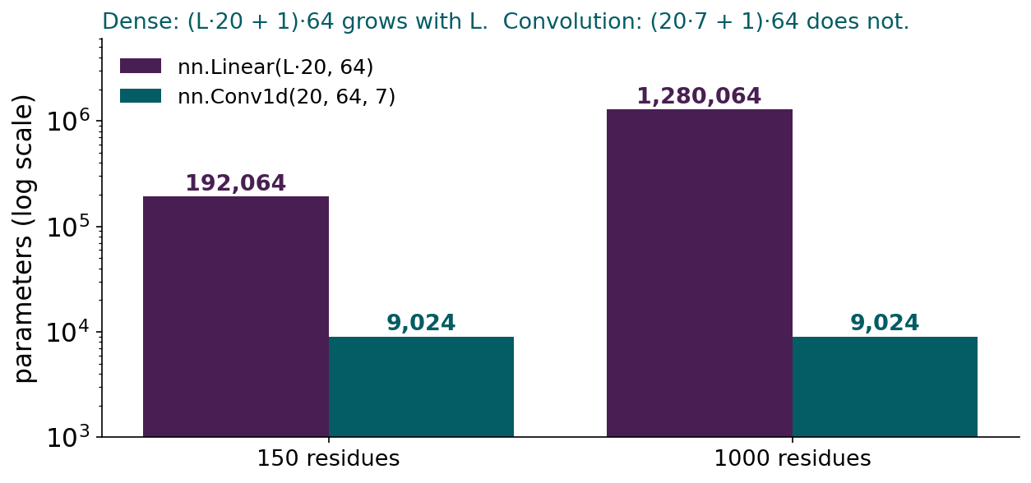
BLOCK 3 · QUIZ
The answer: the dense layer grows with the sequence; the convolution does not
nn.Linear has (L·20 + 1)·64 parameters: 192,064 at 150 residues, 1,280,064 at 1000. nn.Conv1d has (20·7 + 1)·64 = 9,024 at any length, because one set of filters is slid along the whole sequence. That assumption, a motif means the same wherever it is, is Session 10's convolutional network.

Slide 72
BEFORE YOU LEAVE
In up to three words: what was the hardest part of today?
Answer now
Scan the code, or go to
quiz.bioinfo.se/live
Notes:
A word cloud: the bigger the word, the more students wrote it. It shows what to repeat next time.

Slide 73
BEFORE YOU LEAVE
The hardest part of today
What the room found hardest
Show the results ▸ quiz.bioinfo.se/live/report

Slide 74
Session 9 next
This model, trained on the homology-aware split: backpropagation, cross-entropy, regularisation
And an honest comparison against the linear baseline

