Slide 1
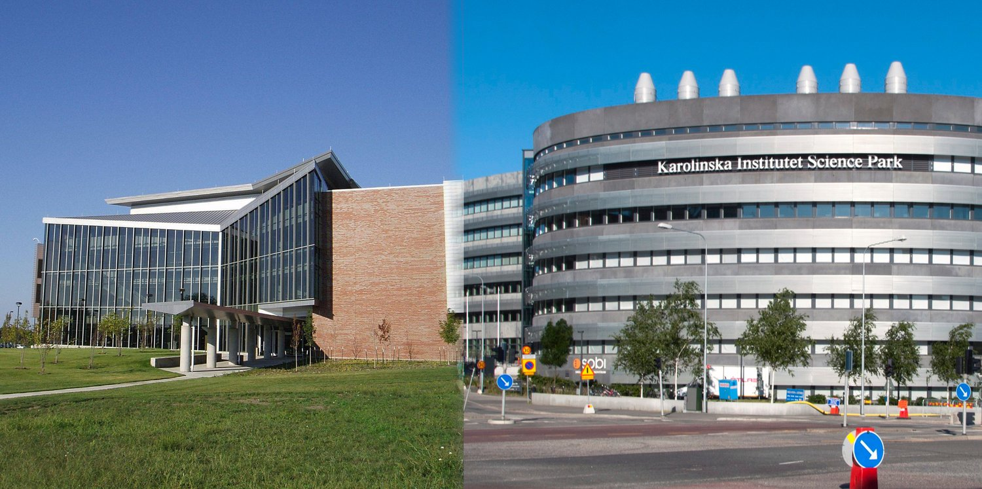


Bioinformatics
KB8029
Petras Kundrotas
Center for Computational Biology
The University of Kansas
Lawrence, Kansas, USA
Protein Bioinformatics
SciLife lab
Department of Biochemistry and Biophysics
Stockholm University
Stockholm, Sweden
pkundro@ku.edu
petras.kundrotas@dbb.su.se
Stockholm University and SciLife Lab, February 26, 2027

Slide 2

Choosing databases and connecting DNA, RNA and protein records
Using identifiers and cross-references and accessing evidence and versions
Command-line/programmatic access and database web pages
Genome browsers: DNA, RNA and protein in one interface
Database searches and AI-assisted discovery
Building queries and checking original sources
Notes:
[On slide entry] The lecture connects three practical questions: which database to use, how to retrieve the relevant information, and how to find and assess the scientific literature supporting it.
[Click 1] The first part introduces biological databases and the relationships between genomic, transcript and protein records. HBB illustrates how a biological question can lead to different records depending on the information needed. Identifiers, cross-references and evidence help us recognise what a record represents and assess the claims it contains.
[Click 2] The second part compares command-line or programmatic access with a database's own web pages and genome browsers. Genome browsers such as UCSC and Ensembl bring genomic, transcript and protein information together within one web interface. Starting from a protein-coding gene, we can inspect its genomic DNA, select a transcript and retrieve its sequence and the corresponding protein sequence without searching a separate database website for each biological level. Different views within the browser retain the gene and selected transcript as the common context. The TP53BP1 example shows how organism, genome assembly and transcript choice affect retrieval. Recording these choices with versioned identifiers makes a result reproducible.
[Click 3] The third part explores literature discovery through bibliographic databases, scholarly search engines and AI-assisted tools. PubMed is our worked example for building queries, checking their interpretation and finding publications and available full text. AI can suggest search terms or related papers and help form an initial overview. We compare those suggestions with a database search, confirm a suggested paper's bibliographic details, and check the relevant passage or result in the original publication. A valid reference and a supported claim are separate checks. AI suggestions may miss relevant work, so we also consider what the search has left out.
Around 10 minutes are reserved for questions submitted during preparation, followed by a 5–10-minute live quiz.

Slide 3
Highlights:
Choosing databases and connecting DNA, RNA and protein records
Using identifiers and cross-references and accessing evidence and versions
Command-line/programmatic access and database web pages
Genome browsers: DNA, RNA and protein in one interface
Database searches and AI-assisted discovery
Building queries and checking original sources
Notes:
[On slide entry] The lecture connects three practical questions: which database to use, how to retrieve the relevant information, and how to find and assess the scientific literature supporting it.
[Click 1] The first part introduces biological databases and the relationships between genomic, transcript and protein records. HBB illustrates how a biological question can lead to different records depending on the information needed. Identifiers, cross-references and evidence help us recognise what a record represents and assess the claims it contains.
[Click 2] The second part compares command-line or programmatic access with a database's own web pages and genome browsers. Genome browsers such as UCSC and Ensembl bring genomic, transcript and protein information together within one web interface. Starting from a protein-coding gene, we can inspect its genomic DNA, select a transcript and retrieve its sequence and the corresponding protein sequence without searching a separate database website for each biological level. Different views within the browser retain the gene and selected transcript as the common context. The TP53BP1 example shows how organism, genome assembly and transcript choice affect retrieval. Recording these choices with versioned identifiers makes a result reproducible.
[Click 3] The third part explores literature discovery through bibliographic databases, scholarly search engines and AI-assisted tools. PubMed is our worked example for building queries, checking their interpretation and finding publications and available full text. AI can suggest search terms or related papers and help form an initial overview. We compare those suggestions with a database search, confirm a suggested paper's bibliographic details, and check the relevant passage or result in the original publication. A valid reference and a supported claim are separate checks. AI suggestions may miss relevant work, so we also consider what the search has left out.
Around 10 minutes are reserved for questions submitted during preparation, followed by a 5–10-minute live quiz.

Slide 4
Highlights:
Databases, records and evidence
Choosing databases and connecting DNA, RNA and protein records
Using identifiers and cross-references and accessing evidence and versions
Command-line/programmatic access and database web pages
Genome browsers: DNA, RNA and protein in one interface
Database searches and AI-assisted discovery
Building queries and checking original sources
Notes:
[On slide entry] The lecture connects three practical questions: which database to use, how to retrieve the relevant information, and how to find and assess the scientific literature supporting it.
[Click 1] The first part introduces biological databases and the relationships between genomic, transcript and protein records. HBB illustrates how a biological question can lead to different records depending on the information needed. Identifiers, cross-references and evidence help us recognise what a record represents and assess the claims it contains.
[Click 2] The second part compares command-line or programmatic access with a database's own web pages and genome browsers. Genome browsers such as UCSC and Ensembl bring genomic, transcript and protein information together within one web interface. Starting from a protein-coding gene, we can inspect its genomic DNA, select a transcript and retrieve its sequence and the corresponding protein sequence without searching a separate database website for each biological level. Different views within the browser retain the gene and selected transcript as the common context. The TP53BP1 example shows how organism, genome assembly and transcript choice affect retrieval. Recording these choices with versioned identifiers makes a result reproducible.
[Click 3] The third part explores literature discovery through bibliographic databases, scholarly search engines and AI-assisted tools. PubMed is our worked example for building queries, checking their interpretation and finding publications and available full text. AI can suggest search terms or related papers and help form an initial overview. We compare those suggestions with a database search, confirm a suggested paper's bibliographic details, and check the relevant passage or result in the original publication. A valid reference and a supported claim are separate checks. AI suggestions may miss relevant work, so we also consider what the search has left out.
Around 10 minutes are reserved for questions submitted during preparation, followed by a 5–10-minute live quiz.

Slide 5
Highlights:
Databases, records and evidence
Choosing databases and connecting DNA, RNA and protein records
Using identifiers and cross-references and accessing evidence and versions
Database access and retrieval
Command-line/programmatic access and database web pages
Genome browsers: DNA, RNA and protein in one interface
Database searches and AI-assisted discovery
Building queries and checking original sources
Notes:
[On slide entry] The lecture connects three practical questions: which database to use, how to retrieve the relevant information, and how to find and assess the scientific literature supporting it.
[Click 1] The first part introduces biological databases and the relationships between genomic, transcript and protein records. HBB illustrates how a biological question can lead to different records depending on the information needed. Identifiers, cross-references and evidence help us recognise what a record represents and assess the claims it contains.
[Click 2] The second part compares command-line or programmatic access with a database's own web pages and genome browsers. Genome browsers such as UCSC and Ensembl bring genomic, transcript and protein information together within one web interface. Starting from a protein-coding gene, we can inspect its genomic DNA, select a transcript and retrieve its sequence and the corresponding protein sequence without searching a separate database website for each biological level. Different views within the browser retain the gene and selected transcript as the common context. The TP53BP1 example shows how organism, genome assembly and transcript choice affect retrieval. Recording these choices with versioned identifiers makes a result reproducible.
[Click 3] The third part explores literature discovery through bibliographic databases, scholarly search engines and AI-assisted tools. PubMed is our worked example for building queries, checking their interpretation and finding publications and available full text. AI can suggest search terms or related papers and help form an initial overview. We compare those suggestions with a database search, confirm a suggested paper's bibliographic details, and check the relevant passage or result in the original publication. A valid reference and a supported claim are separate checks. AI suggestions may miss relevant work, so we also consider what the search has left out.
Around 10 minutes are reserved for questions submitted during preparation, followed by a 5–10-minute live quiz.

Slide 6
Highlights:
Databases, records and evidence
Choosing databases and connecting DNA, RNA and protein records
Using identifiers and cross-references and accessing evidence and versions
Database access and retrieval
Command-line/programmatic access and database web pages
Genome browsers: DNA, RNA and protein in one interface
Reading literature online
Database searches and AI-assisted discovery
Building queries and checking original sources
Notes:
[On slide entry] The lecture connects three practical questions: which database to use, how to retrieve the relevant information, and how to find and assess the scientific literature supporting it.
[Click 1] The first part introduces biological databases and the relationships between genomic, transcript and protein records. HBB illustrates how a biological question can lead to different records depending on the information needed. Identifiers, cross-references and evidence help us recognise what a record represents and assess the claims it contains.
[Click 2] The second part compares command-line or programmatic access with a database's own web pages and genome browsers. Genome browsers such as UCSC and Ensembl bring genomic, transcript and protein information together within one web interface. Starting from a protein-coding gene, we can inspect its genomic DNA, select a transcript and retrieve its sequence and the corresponding protein sequence without searching a separate database website for each biological level. Different views within the browser retain the gene and selected transcript as the common context. The TP53BP1 example shows how organism, genome assembly and transcript choice affect retrieval. Recording these choices with versioned identifiers makes a result reproducible.
[Click 3] The third part explores literature discovery through bibliographic databases, scholarly search engines and AI-assisted tools. PubMed is our worked example for building queries, checking their interpretation and finding publications and available full text. AI can suggest search terms or related papers and help form an initial overview. We compare those suggestions with a database search, confirm a suggested paper's bibliographic details, and check the relevant passage or result in the original publication. A valid reference and a supported claim are separate checks. AI suggestions may miss relevant work, so we also consider what the search has left out.
Around 10 minutes are reserved for questions submitted during preparation, followed by a 5–10-minute live quiz.

Slide 7
Notes:
[Click 1] A database is an organised collection of data. Its organisation allows us to search for records using criteria such as an identifier, an organism or a sequence.
[Click 2] Database management software controls how the data are stored, updated and retrieved. [Click 3] Computer hardware provides storage and computing power. These components support the database service we use. In biology, the name of a resource often refers to the whole service, including its data and access tools.
Biological databases commonly present information as records for genes, transcripts, proteins or structures. A record may contain a sequence, descriptive annotations, links to related records and references. Different claims in the same record can have different types of supporting evidence.
Human beta-globin (HBB) is our shared example. Searching for HBB can lead to a gene, transcript or protein record, depending on the resource and query. Identifiers and cross-references help us recognize and connect these records. [Click 4] A website provides one way to access them. Some resources also offer downloads and programmatic interfaces.

Slide 8
Databases
Notes:
[Click 1] A database is an organised collection of data. Its organisation allows us to search for records using criteria such as an identifier, an organism or a sequence.
[Click 2] Database management software controls how the data are stored, updated and retrieved. [Click 3] Computer hardware provides storage and computing power. These components support the database service we use. In biology, the name of a resource often refers to the whole service, including its data and access tools.
Biological databases commonly present information as records for genes, transcripts, proteins or structures. A record may contain a sequence, descriptive annotations, links to related records and references. Different claims in the same record can have different types of supporting evidence.
Human beta-globin (HBB) is our shared example. Searching for HBB can lead to a gene, transcript or protein record, depending on the resource and query. Identifiers and cross-references help us recognize and connect these records. [Click 4] A website provides one way to access them. Some resources also offer downloads and programmatic interfaces.

Slide 9
Databases
A database is an organised collection of data that supports searching and retrieval.
Notes:
[Click 1] A database is an organised collection of data. Its organisation allows us to search for records using criteria such as an identifier, an organism or a sequence.
[Click 2] Database management software controls how the data are stored, updated and retrieved. [Click 3] Computer hardware provides storage and computing power. These components support the database service we use. In biology, the name of a resource often refers to the whole service, including its data and access tools.
Biological databases commonly present information as records for genes, transcripts, proteins or structures. A record may contain a sequence, descriptive annotations, links to related records and references. Different claims in the same record can have different types of supporting evidence.
Human beta-globin (HBB) is our shared example. Searching for HBB can lead to a gene, transcript or protein record, depending on the resource and query. Identifiers and cross-references help us recognize and connect these records. [Click 4] A website provides one way to access them. Some resources also offer downloads and programmatic interfaces.

Slide 10
Databases
A database is an organised collection of data that supports searching and retrieval.
Database management software stores, updates and retrieves the data.
Notes:
[Click 1] A database is an organised collection of data. Its organisation allows us to search for records using criteria such as an identifier, an organism or a sequence.
[Click 2] Database management software controls how the data are stored, updated and retrieved. [Click 3] Computer hardware provides storage and computing power. These components support the database service we use. In biology, the name of a resource often refers to the whole service, including its data and access tools.
Biological databases commonly present information as records for genes, transcripts, proteins or structures. A record may contain a sequence, descriptive annotations, links to related records and references. Different claims in the same record can have different types of supporting evidence.
Human beta-globin (HBB) is our shared example. Searching for HBB can lead to a gene, transcript or protein record, depending on the resource and query. Identifiers and cross-references help us recognize and connect these records. [Click 4] A website provides one way to access them. Some resources also offer downloads and programmatic interfaces.

Slide 11
Databases
A database is an organised collection of data that supports searching and retrieval.
Database management software stores, updates and retrieves the data.
Hardware provides storage and computing power.
Notes:
[Click 1] A database is an organised collection of data. Its organisation allows us to search for records using criteria such as an identifier, an organism or a sequence.
[Click 2] Database management software controls how the data are stored, updated and retrieved. [Click 3] Computer hardware provides storage and computing power. These components support the database service we use. In biology, the name of a resource often refers to the whole service, including its data and access tools.
Biological databases commonly present information as records for genes, transcripts, proteins or structures. A record may contain a sequence, descriptive annotations, links to related records and references. Different claims in the same record can have different types of supporting evidence.
Human beta-globin (HBB) is our shared example. Searching for HBB can lead to a gene, transcript or protein record, depending on the resource and query. Identifiers and cross-references help us recognize and connect these records. [Click 4] A website provides one way to access them. Some resources also offer downloads and programmatic interfaces.

Slide 12
Databases
A database is an organised collection of data that supports searching and retrieval.
Database management software stores, updates and retrieves the data.
Hardware provides storage and computing power.
A database website provides an interface for searching and viewing records.
Notes:
[Click 1] A database is an organised collection of data. Its organisation allows us to search for records using criteria such as an identifier, an organism or a sequence.
[Click 2] Database management software controls how the data are stored, updated and retrieved. [Click 3] Computer hardware provides storage and computing power. These components support the database service we use. In biology, the name of a resource often refers to the whole service, including its data and access tools.
Biological databases commonly present information as records for genes, transcripts, proteins or structures. A record may contain a sequence, descriptive annotations, links to related records and references. Different claims in the same record can have different types of supporting evidence.
Human beta-globin (HBB) is our shared example. Searching for HBB can lead to a gene, transcript or protein record, depending on the resource and query. Identifiers and cross-references help us recognize and connect these records. [Click 4] A website provides one way to access them. Some resources also offer downloads and programmatic interfaces.

Slide 13
Notes:
[On slide entry] Earlier bioinformatics workflows often began by downloading database releases and searching them locally. Local copies are still practical for some resources. As the largest archives have expanded, however, routinely maintaining full copies has become impractical for most individual laboratories. Storage capacity is only part of the work. Downloads, updates, indexes, backups and the software needed to search the data also have to be maintained.
[Click 1] The table uses decimal units. [Click 2] A character occupies one byte in the ASCII examples. Other encodings can use more than one byte per character. [Click 3] Each step from kB to MB, GB, TB and PB multiplies the number of bytes by 1,000. One TB is 1,000 GB, or one trillion bytes.
[Click 4] The biological examples are dated snapshots. In UniProt release 2026_03, the gzip-compressed annotated-text files contain 700,301,138 bytes for Swiss-Prot, approximately 700 MB, [Click 5] and 121,252,764,508 bytes for TrEMBL, approximately 121 GB. Compressed downloads, extracted files and searchable indexes occupy different amounts of storage.
[Click 6] The PDB Core archive snapshot dated 1 January 2026 was reported as 1,583 GB. Using the decimal units in this slide, this converts to 1.583 TB. This is the published snapshot size, rather than an exact byte count for today's continuously updated archive. It covers the distributed PDB Core archive, with structure files, metadata and experimental data. The separate EMDB archive is not included. Keeping the date and the archive scope beside the number makes the comparison reproducible.
A terabyte-scale archive can fit on an ordinary hard drive. For example, a Seagate Expansion portable 4 TB drive, model STKM4000400, was advertised by Proshop Sweden for SEK 2,198 including VAT on 24 October 2026. The 1.583 TB PDB snapshot would occupy about 40% of its nominal capacity. Two such drives, one for a working copy and one for a separate backup, would cost SEK 4,396. This puts storage for a local PDB snapshot within a modest laboratory equipment budget, although extracted files, indexes and future growth require additional space. A stored backup also needs an appropriate backup procedure.
Larger drives are readily available too. A Seagate Expansion desktop 24 TB drive, model STKP24000400, was advertised by the same retailer for SEK 10,205 including VAT. The contrast with the largest biological archives is substantial. [Click 7] NLM reported that SRA managed more than 50 PB of unique data in April 2026. Even 50 PB would require at least 2,084 hard drives of 24 TB each, before allowing for backups and other storage overhead. At the illustrative retail price above, those drives alone would cost approximately SEK 21.3 million. This is a comparison of raw capacity at individual retail prices, rather than a quotation for a research storage system. Bulk purchasing and institutional infrastructure would change the cost. Servers, spare capacity, redundancy, backups, power, administration and data transfer would add further requirements. SRA's archive-wide unique-data total is also not the size of a single downloadable file set or format.
[Click 8] The practical conclusion depends on the resource. Keeping a local PDB snapshot can be affordable and useful. Full copies of the largest archives require much greater resources. [Click 9] Researchers therefore need to know how to search external databases efficiently, retrieve the records or datasets relevant to a biological question, and record identifiers, versions and retrieval dates. Local subsets and fixed releases remain valuable for analysis and reproducibility.
Public data centers provide the shared infrastructure for the full collections. The next slide shows how three partners collaborate to preserve and distribute nucleotide sequence data.
Sources
PDB Core archive snapshot, 1 January 2026: https://www.rcsb.org/news/695ecade725cd43b223c4f37
PDBe snapshot announcement: https://www.ebi.ac.uk/pdbe/news/time-stamped-copies-pdb-and-emdb-archives-0
UniProt release metadata: https://ftp.uniprot.org/pub/databases/uniprot/current_release/knowledgebase/complete/RELEASE.metalink
UniProt release statistics: https://web.expasy.org/docs/relnotes/relstat.html
NLM SRA Working Group, 21 April 2026: https://www.nlm.nih.gov/od/bor/SRA_NLM_BOR_Meeting_Summary_20260421.pdf
Seagate Expansion 4 TB, Proshop Sweden, price checked 24 October 2026: https://www.proshop.se/Haarddisk-extern/Seagate-Expansion-Extern-Haarddisk-4TB-Svart/2976621
Seagate Expansion desktop 24 TB, Proshop Sweden, price checked 24 October 2026: https://www.proshop.se/Haarddisk-extern/Seagate-Expansion-Desktop-24TB-External-Hard-drive-Black/3250001

Slide 14
Growing data volumes
Notes:
[On slide entry] Earlier bioinformatics workflows often began by downloading database releases and searching them locally. Local copies are still practical for some resources. As the largest archives have expanded, however, routinely maintaining full copies has become impractical for most individual laboratories. Storage capacity is only part of the work. Downloads, updates, indexes, backups and the software needed to search the data also have to be maintained.
[Click 1] The table uses decimal units. [Click 2] A character occupies one byte in the ASCII examples. Other encodings can use more than one byte per character. [Click 3] Each step from kB to MB, GB, TB and PB multiplies the number of bytes by 1,000. One TB is 1,000 GB, or one trillion bytes.
[Click 4] The biological examples are dated snapshots. In UniProt release 2026_03, the gzip-compressed annotated-text files contain 700,301,138 bytes for Swiss-Prot, approximately 700 MB, [Click 5] and 121,252,764,508 bytes for TrEMBL, approximately 121 GB. Compressed downloads, extracted files and searchable indexes occupy different amounts of storage.
[Click 6] The PDB Core archive snapshot dated 1 January 2026 was reported as 1,583 GB. Using the decimal units in this slide, this converts to 1.583 TB. This is the published snapshot size, rather than an exact byte count for today's continuously updated archive. It covers the distributed PDB Core archive, with structure files, metadata and experimental data. The separate EMDB archive is not included. Keeping the date and the archive scope beside the number makes the comparison reproducible.
A terabyte-scale archive can fit on an ordinary hard drive. For example, a Seagate Expansion portable 4 TB drive, model STKM4000400, was advertised by Proshop Sweden for SEK 2,198 including VAT on 24 October 2026. The 1.583 TB PDB snapshot would occupy about 40% of its nominal capacity. Two such drives, one for a working copy and one for a separate backup, would cost SEK 4,396. This puts storage for a local PDB snapshot within a modest laboratory equipment budget, although extracted files, indexes and future growth require additional space. A stored backup also needs an appropriate backup procedure.
Larger drives are readily available too. A Seagate Expansion desktop 24 TB drive, model STKP24000400, was advertised by the same retailer for SEK 10,205 including VAT. The contrast with the largest biological archives is substantial. [Click 7] NLM reported that SRA managed more than 50 PB of unique data in April 2026. Even 50 PB would require at least 2,084 hard drives of 24 TB each, before allowing for backups and other storage overhead. At the illustrative retail price above, those drives alone would cost approximately SEK 21.3 million. This is a comparison of raw capacity at individual retail prices, rather than a quotation for a research storage system. Bulk purchasing and institutional infrastructure would change the cost. Servers, spare capacity, redundancy, backups, power, administration and data transfer would add further requirements. SRA's archive-wide unique-data total is also not the size of a single downloadable file set or format.
[Click 8] The practical conclusion depends on the resource. Keeping a local PDB snapshot can be affordable and useful. Full copies of the largest archives require much greater resources. [Click 9] Researchers therefore need to know how to search external databases efficiently, retrieve the records or datasets relevant to a biological question, and record identifiers, versions and retrieval dates. Local subsets and fixed releases remain valuable for analysis and reproducibility.
Public data centers provide the shared infrastructure for the full collections. The next slide shows how three partners collaborate to preserve and distribute nucleotide sequence data.
Sources
PDB Core archive snapshot, 1 January 2026: https://www.rcsb.org/news/695ecade725cd43b223c4f37
PDBe snapshot announcement: https://www.ebi.ac.uk/pdbe/news/time-stamped-copies-pdb-and-emdb-archives-0
UniProt release metadata: https://ftp.uniprot.org/pub/databases/uniprot/current_release/knowledgebase/complete/RELEASE.metalink
UniProt release statistics: https://web.expasy.org/docs/relnotes/relstat.html
NLM SRA Working Group, 21 April 2026: https://www.nlm.nih.gov/od/bor/SRA_NLM_BOR_Meeting_Summary_20260421.pdf
Seagate Expansion 4 TB, Proshop Sweden, price checked 24 October 2026: https://www.proshop.se/Haarddisk-extern/Seagate-Expansion-Extern-Haarddisk-4TB-Svart/2976621
Seagate Expansion desktop 24 TB, Proshop Sweden, price checked 24 October 2026: https://www.proshop.se/Haarddisk-extern/Seagate-Expansion-Desktop-24TB-External-Hard-drive-Black/3250001

Slide 15
Growing data volumes
Decimal units and dated examples
Unit | Bytes per unit | Symbol | Example | Size
Notes:
[On slide entry] Earlier bioinformatics workflows often began by downloading database releases and searching them locally. Local copies are still practical for some resources. As the largest archives have expanded, however, routinely maintaining full copies has become impractical for most individual laboratories. Storage capacity is only part of the work. Downloads, updates, indexes, backups and the software needed to search the data also have to be maintained.
[Click 1] The table uses decimal units. [Click 2] A character occupies one byte in the ASCII examples. Other encodings can use more than one byte per character. [Click 3] Each step from kB to MB, GB, TB and PB multiplies the number of bytes by 1,000. One TB is 1,000 GB, or one trillion bytes.
[Click 4] The biological examples are dated snapshots. In UniProt release 2026_03, the gzip-compressed annotated-text files contain 700,301,138 bytes for Swiss-Prot, approximately 700 MB, [Click 5] and 121,252,764,508 bytes for TrEMBL, approximately 121 GB. Compressed downloads, extracted files and searchable indexes occupy different amounts of storage.
[Click 6] The PDB Core archive snapshot dated 1 January 2026 was reported as 1,583 GB. Using the decimal units in this slide, this converts to 1.583 TB. This is the published snapshot size, rather than an exact byte count for today's continuously updated archive. It covers the distributed PDB Core archive, with structure files, metadata and experimental data. The separate EMDB archive is not included. Keeping the date and the archive scope beside the number makes the comparison reproducible.
A terabyte-scale archive can fit on an ordinary hard drive. For example, a Seagate Expansion portable 4 TB drive, model STKM4000400, was advertised by Proshop Sweden for SEK 2,198 including VAT on 24 October 2026. The 1.583 TB PDB snapshot would occupy about 40% of its nominal capacity. Two such drives, one for a working copy and one for a separate backup, would cost SEK 4,396. This puts storage for a local PDB snapshot within a modest laboratory equipment budget, although extracted files, indexes and future growth require additional space. A stored backup also needs an appropriate backup procedure.
Larger drives are readily available too. A Seagate Expansion desktop 24 TB drive, model STKP24000400, was advertised by the same retailer for SEK 10,205 including VAT. The contrast with the largest biological archives is substantial. [Click 7] NLM reported that SRA managed more than 50 PB of unique data in April 2026. Even 50 PB would require at least 2,084 hard drives of 24 TB each, before allowing for backups and other storage overhead. At the illustrative retail price above, those drives alone would cost approximately SEK 21.3 million. This is a comparison of raw capacity at individual retail prices, rather than a quotation for a research storage system. Bulk purchasing and institutional infrastructure would change the cost. Servers, spare capacity, redundancy, backups, power, administration and data transfer would add further requirements. SRA's archive-wide unique-data total is also not the size of a single downloadable file set or format.
[Click 8] The practical conclusion depends on the resource. Keeping a local PDB snapshot can be affordable and useful. Full copies of the largest archives require much greater resources. [Click 9] Researchers therefore need to know how to search external databases efficiently, retrieve the records or datasets relevant to a biological question, and record identifiers, versions and retrieval dates. Local subsets and fixed releases remain valuable for analysis and reproducibility.
Public data centers provide the shared infrastructure for the full collections. The next slide shows how three partners collaborate to preserve and distribute nucleotide sequence data.
Sources
PDB Core archive snapshot, 1 January 2026: https://www.rcsb.org/news/695ecade725cd43b223c4f37
PDBe snapshot announcement: https://www.ebi.ac.uk/pdbe/news/time-stamped-copies-pdb-and-emdb-archives-0
UniProt release metadata: https://ftp.uniprot.org/pub/databases/uniprot/current_release/knowledgebase/complete/RELEASE.metalink
UniProt release statistics: https://web.expasy.org/docs/relnotes/relstat.html
NLM SRA Working Group, 21 April 2026: https://www.nlm.nih.gov/od/bor/SRA_NLM_BOR_Meeting_Summary_20260421.pdf
Seagate Expansion 4 TB, Proshop Sweden, price checked 24 October 2026: https://www.proshop.se/Haarddisk-extern/Seagate-Expansion-Extern-Haarddisk-4TB-Svart/2976621
Seagate Expansion desktop 24 TB, Proshop Sweden, price checked 24 October 2026: https://www.proshop.se/Haarddisk-extern/Seagate-Expansion-Desktop-24TB-External-Hard-drive-Black/3250001

Slide 16
Growing data volumes
Decimal units and dated examples
Unit | Bytes per unit | Symbol | Example | Size
Byte | 10⁰ | B | One ASCII character | 1 B
Notes:
[On slide entry] Earlier bioinformatics workflows often began by downloading database releases and searching them locally. Local copies are still practical for some resources. As the largest archives have expanded, however, routinely maintaining full copies has become impractical for most individual laboratories. Storage capacity is only part of the work. Downloads, updates, indexes, backups and the software needed to search the data also have to be maintained.
[Click 1] The table uses decimal units. [Click 2] A character occupies one byte in the ASCII examples. Other encodings can use more than one byte per character. [Click 3] Each step from kB to MB, GB, TB and PB multiplies the number of bytes by 1,000. One TB is 1,000 GB, or one trillion bytes.
[Click 4] The biological examples are dated snapshots. In UniProt release 2026_03, the gzip-compressed annotated-text files contain 700,301,138 bytes for Swiss-Prot, approximately 700 MB, [Click 5] and 121,252,764,508 bytes for TrEMBL, approximately 121 GB. Compressed downloads, extracted files and searchable indexes occupy different amounts of storage.
[Click 6] The PDB Core archive snapshot dated 1 January 2026 was reported as 1,583 GB. Using the decimal units in this slide, this converts to 1.583 TB. This is the published snapshot size, rather than an exact byte count for today's continuously updated archive. It covers the distributed PDB Core archive, with structure files, metadata and experimental data. The separate EMDB archive is not included. Keeping the date and the archive scope beside the number makes the comparison reproducible.
A terabyte-scale archive can fit on an ordinary hard drive. For example, a Seagate Expansion portable 4 TB drive, model STKM4000400, was advertised by Proshop Sweden for SEK 2,198 including VAT on 24 October 2026. The 1.583 TB PDB snapshot would occupy about 40% of its nominal capacity. Two such drives, one for a working copy and one for a separate backup, would cost SEK 4,396. This puts storage for a local PDB snapshot within a modest laboratory equipment budget, although extracted files, indexes and future growth require additional space. A stored backup also needs an appropriate backup procedure.
Larger drives are readily available too. A Seagate Expansion desktop 24 TB drive, model STKP24000400, was advertised by the same retailer for SEK 10,205 including VAT. The contrast with the largest biological archives is substantial. [Click 7] NLM reported that SRA managed more than 50 PB of unique data in April 2026. Even 50 PB would require at least 2,084 hard drives of 24 TB each, before allowing for backups and other storage overhead. At the illustrative retail price above, those drives alone would cost approximately SEK 21.3 million. This is a comparison of raw capacity at individual retail prices, rather than a quotation for a research storage system. Bulk purchasing and institutional infrastructure would change the cost. Servers, spare capacity, redundancy, backups, power, administration and data transfer would add further requirements. SRA's archive-wide unique-data total is also not the size of a single downloadable file set or format.
[Click 8] The practical conclusion depends on the resource. Keeping a local PDB snapshot can be affordable and useful. Full copies of the largest archives require much greater resources. [Click 9] Researchers therefore need to know how to search external databases efficiently, retrieve the records or datasets relevant to a biological question, and record identifiers, versions and retrieval dates. Local subsets and fixed releases remain valuable for analysis and reproducibility.
Public data centers provide the shared infrastructure for the full collections. The next slide shows how three partners collaborate to preserve and distribute nucleotide sequence data.
Sources
PDB Core archive snapshot, 1 January 2026: https://www.rcsb.org/news/695ecade725cd43b223c4f37
PDBe snapshot announcement: https://www.ebi.ac.uk/pdbe/news/time-stamped-copies-pdb-and-emdb-archives-0
UniProt release metadata: https://ftp.uniprot.org/pub/databases/uniprot/current_release/knowledgebase/complete/RELEASE.metalink
UniProt release statistics: https://web.expasy.org/docs/relnotes/relstat.html
NLM SRA Working Group, 21 April 2026: https://www.nlm.nih.gov/od/bor/SRA_NLM_BOR_Meeting_Summary_20260421.pdf
Seagate Expansion 4 TB, Proshop Sweden, price checked 24 October 2026: https://www.proshop.se/Haarddisk-extern/Seagate-Expansion-Extern-Haarddisk-4TB-Svart/2976621
Seagate Expansion desktop 24 TB, Proshop Sweden, price checked 24 October 2026: https://www.proshop.se/Haarddisk-extern/Seagate-Expansion-Desktop-24TB-External-Hard-drive-Black/3250001

Slide 17
Growing data volumes
Decimal units and dated examples
Unit | Bytes per unit | Symbol | Example | Size
Byte | 10⁰ | B | One ASCII character | 1 B
Kilobyte | 10³ | kB | 1,000 ASCII characters | 1 kB
Notes:
[On slide entry] Earlier bioinformatics workflows often began by downloading database releases and searching them locally. Local copies are still practical for some resources. As the largest archives have expanded, however, routinely maintaining full copies has become impractical for most individual laboratories. Storage capacity is only part of the work. Downloads, updates, indexes, backups and the software needed to search the data also have to be maintained.
[Click 1] The table uses decimal units. [Click 2] A character occupies one byte in the ASCII examples. Other encodings can use more than one byte per character. [Click 3] Each step from kB to MB, GB, TB and PB multiplies the number of bytes by 1,000. One TB is 1,000 GB, or one trillion bytes.
[Click 4] The biological examples are dated snapshots. In UniProt release 2026_03, the gzip-compressed annotated-text files contain 700,301,138 bytes for Swiss-Prot, approximately 700 MB, [Click 5] and 121,252,764,508 bytes for TrEMBL, approximately 121 GB. Compressed downloads, extracted files and searchable indexes occupy different amounts of storage.
[Click 6] The PDB Core archive snapshot dated 1 January 2026 was reported as 1,583 GB. Using the decimal units in this slide, this converts to 1.583 TB. This is the published snapshot size, rather than an exact byte count for today's continuously updated archive. It covers the distributed PDB Core archive, with structure files, metadata and experimental data. The separate EMDB archive is not included. Keeping the date and the archive scope beside the number makes the comparison reproducible.
A terabyte-scale archive can fit on an ordinary hard drive. For example, a Seagate Expansion portable 4 TB drive, model STKM4000400, was advertised by Proshop Sweden for SEK 2,198 including VAT on 24 October 2026. The 1.583 TB PDB snapshot would occupy about 40% of its nominal capacity. Two such drives, one for a working copy and one for a separate backup, would cost SEK 4,396. This puts storage for a local PDB snapshot within a modest laboratory equipment budget, although extracted files, indexes and future growth require additional space. A stored backup also needs an appropriate backup procedure.
Larger drives are readily available too. A Seagate Expansion desktop 24 TB drive, model STKP24000400, was advertised by the same retailer for SEK 10,205 including VAT. The contrast with the largest biological archives is substantial. [Click 7] NLM reported that SRA managed more than 50 PB of unique data in April 2026. Even 50 PB would require at least 2,084 hard drives of 24 TB each, before allowing for backups and other storage overhead. At the illustrative retail price above, those drives alone would cost approximately SEK 21.3 million. This is a comparison of raw capacity at individual retail prices, rather than a quotation for a research storage system. Bulk purchasing and institutional infrastructure would change the cost. Servers, spare capacity, redundancy, backups, power, administration and data transfer would add further requirements. SRA's archive-wide unique-data total is also not the size of a single downloadable file set or format.
[Click 8] The practical conclusion depends on the resource. Keeping a local PDB snapshot can be affordable and useful. Full copies of the largest archives require much greater resources. [Click 9] Researchers therefore need to know how to search external databases efficiently, retrieve the records or datasets relevant to a biological question, and record identifiers, versions and retrieval dates. Local subsets and fixed releases remain valuable for analysis and reproducibility.
Public data centers provide the shared infrastructure for the full collections. The next slide shows how three partners collaborate to preserve and distribute nucleotide sequence data.
Sources
PDB Core archive snapshot, 1 January 2026: https://www.rcsb.org/news/695ecade725cd43b223c4f37
PDBe snapshot announcement: https://www.ebi.ac.uk/pdbe/news/time-stamped-copies-pdb-and-emdb-archives-0
UniProt release metadata: https://ftp.uniprot.org/pub/databases/uniprot/current_release/knowledgebase/complete/RELEASE.metalink
UniProt release statistics: https://web.expasy.org/docs/relnotes/relstat.html
NLM SRA Working Group, 21 April 2026: https://www.nlm.nih.gov/od/bor/SRA_NLM_BOR_Meeting_Summary_20260421.pdf
Seagate Expansion 4 TB, Proshop Sweden, price checked 24 October 2026: https://www.proshop.se/Haarddisk-extern/Seagate-Expansion-Extern-Haarddisk-4TB-Svart/2976621
Seagate Expansion desktop 24 TB, Proshop Sweden, price checked 24 October 2026: https://www.proshop.se/Haarddisk-extern/Seagate-Expansion-Desktop-24TB-External-Hard-drive-Black/3250001

Slide 18
Growing data volumes
Decimal units and dated examples
Unit | Bytes per unit | Symbol | Example | Size
Byte | 10⁰ | B | One ASCII character | 1 B
Kilobyte | 10³ | kB | 1,000 ASCII characters | 1 kB
Megabyte | 10⁶ | MB | Swiss-Prot, compressed text (2026_03) | ~700 MB
Notes:
[On slide entry] Earlier bioinformatics workflows often began by downloading database releases and searching them locally. Local copies are still practical for some resources. As the largest archives have expanded, however, routinely maintaining full copies has become impractical for most individual laboratories. Storage capacity is only part of the work. Downloads, updates, indexes, backups and the software needed to search the data also have to be maintained.
[Click 1] The table uses decimal units. [Click 2] A character occupies one byte in the ASCII examples. Other encodings can use more than one byte per character. [Click 3] Each step from kB to MB, GB, TB and PB multiplies the number of bytes by 1,000. One TB is 1,000 GB, or one trillion bytes.
[Click 4] The biological examples are dated snapshots. In UniProt release 2026_03, the gzip-compressed annotated-text files contain 700,301,138 bytes for Swiss-Prot, approximately 700 MB, [Click 5] and 121,252,764,508 bytes for TrEMBL, approximately 121 GB. Compressed downloads, extracted files and searchable indexes occupy different amounts of storage.
[Click 6] The PDB Core archive snapshot dated 1 January 2026 was reported as 1,583 GB. Using the decimal units in this slide, this converts to 1.583 TB. This is the published snapshot size, rather than an exact byte count for today's continuously updated archive. It covers the distributed PDB Core archive, with structure files, metadata and experimental data. The separate EMDB archive is not included. Keeping the date and the archive scope beside the number makes the comparison reproducible.
A terabyte-scale archive can fit on an ordinary hard drive. For example, a Seagate Expansion portable 4 TB drive, model STKM4000400, was advertised by Proshop Sweden for SEK 2,198 including VAT on 24 October 2026. The 1.583 TB PDB snapshot would occupy about 40% of its nominal capacity. Two such drives, one for a working copy and one for a separate backup, would cost SEK 4,396. This puts storage for a local PDB snapshot within a modest laboratory equipment budget, although extracted files, indexes and future growth require additional space. A stored backup also needs an appropriate backup procedure.
Larger drives are readily available too. A Seagate Expansion desktop 24 TB drive, model STKP24000400, was advertised by the same retailer for SEK 10,205 including VAT. The contrast with the largest biological archives is substantial. [Click 7] NLM reported that SRA managed more than 50 PB of unique data in April 2026. Even 50 PB would require at least 2,084 hard drives of 24 TB each, before allowing for backups and other storage overhead. At the illustrative retail price above, those drives alone would cost approximately SEK 21.3 million. This is a comparison of raw capacity at individual retail prices, rather than a quotation for a research storage system. Bulk purchasing and institutional infrastructure would change the cost. Servers, spare capacity, redundancy, backups, power, administration and data transfer would add further requirements. SRA's archive-wide unique-data total is also not the size of a single downloadable file set or format.
[Click 8] The practical conclusion depends on the resource. Keeping a local PDB snapshot can be affordable and useful. Full copies of the largest archives require much greater resources. [Click 9] Researchers therefore need to know how to search external databases efficiently, retrieve the records or datasets relevant to a biological question, and record identifiers, versions and retrieval dates. Local subsets and fixed releases remain valuable for analysis and reproducibility.
Public data centers provide the shared infrastructure for the full collections. The next slide shows how three partners collaborate to preserve and distribute nucleotide sequence data.
Sources
PDB Core archive snapshot, 1 January 2026: https://www.rcsb.org/news/695ecade725cd43b223c4f37
PDBe snapshot announcement: https://www.ebi.ac.uk/pdbe/news/time-stamped-copies-pdb-and-emdb-archives-0
UniProt release metadata: https://ftp.uniprot.org/pub/databases/uniprot/current_release/knowledgebase/complete/RELEASE.metalink
UniProt release statistics: https://web.expasy.org/docs/relnotes/relstat.html
NLM SRA Working Group, 21 April 2026: https://www.nlm.nih.gov/od/bor/SRA_NLM_BOR_Meeting_Summary_20260421.pdf
Seagate Expansion 4 TB, Proshop Sweden, price checked 24 October 2026: https://www.proshop.se/Haarddisk-extern/Seagate-Expansion-Extern-Haarddisk-4TB-Svart/2976621
Seagate Expansion desktop 24 TB, Proshop Sweden, price checked 24 October 2026: https://www.proshop.se/Haarddisk-extern/Seagate-Expansion-Desktop-24TB-External-Hard-drive-Black/3250001

Slide 19
Growing data volumes
Decimal units and dated examples
Unit | Bytes per unit | Symbol | Example | Size
Byte | 10⁰ | B | One ASCII character | 1 B
Kilobyte | 10³ | kB | 1,000 ASCII characters | 1 kB
Megabyte | 10⁶ | MB | Swiss-Prot, compressed text (2026_03) | ~700 MB
Gigabyte | 10⁹ | GB | TrEMBL, compressed text (2026_03) | ~121 GB
Notes:
[On slide entry] Earlier bioinformatics workflows often began by downloading database releases and searching them locally. Local copies are still practical for some resources. As the largest archives have expanded, however, routinely maintaining full copies has become impractical for most individual laboratories. Storage capacity is only part of the work. Downloads, updates, indexes, backups and the software needed to search the data also have to be maintained.
[Click 1] The table uses decimal units. [Click 2] A character occupies one byte in the ASCII examples. Other encodings can use more than one byte per character. [Click 3] Each step from kB to MB, GB, TB and PB multiplies the number of bytes by 1,000. One TB is 1,000 GB, or one trillion bytes.
[Click 4] The biological examples are dated snapshots. In UniProt release 2026_03, the gzip-compressed annotated-text files contain 700,301,138 bytes for Swiss-Prot, approximately 700 MB, [Click 5] and 121,252,764,508 bytes for TrEMBL, approximately 121 GB. Compressed downloads, extracted files and searchable indexes occupy different amounts of storage.
[Click 6] The PDB Core archive snapshot dated 1 January 2026 was reported as 1,583 GB. Using the decimal units in this slide, this converts to 1.583 TB. This is the published snapshot size, rather than an exact byte count for today's continuously updated archive. It covers the distributed PDB Core archive, with structure files, metadata and experimental data. The separate EMDB archive is not included. Keeping the date and the archive scope beside the number makes the comparison reproducible.
A terabyte-scale archive can fit on an ordinary hard drive. For example, a Seagate Expansion portable 4 TB drive, model STKM4000400, was advertised by Proshop Sweden for SEK 2,198 including VAT on 24 October 2026. The 1.583 TB PDB snapshot would occupy about 40% of its nominal capacity. Two such drives, one for a working copy and one for a separate backup, would cost SEK 4,396. This puts storage for a local PDB snapshot within a modest laboratory equipment budget, although extracted files, indexes and future growth require additional space. A stored backup also needs an appropriate backup procedure.
Larger drives are readily available too. A Seagate Expansion desktop 24 TB drive, model STKP24000400, was advertised by the same retailer for SEK 10,205 including VAT. The contrast with the largest biological archives is substantial. [Click 7] NLM reported that SRA managed more than 50 PB of unique data in April 2026. Even 50 PB would require at least 2,084 hard drives of 24 TB each, before allowing for backups and other storage overhead. At the illustrative retail price above, those drives alone would cost approximately SEK 21.3 million. This is a comparison of raw capacity at individual retail prices, rather than a quotation for a research storage system. Bulk purchasing and institutional infrastructure would change the cost. Servers, spare capacity, redundancy, backups, power, administration and data transfer would add further requirements. SRA's archive-wide unique-data total is also not the size of a single downloadable file set or format.
[Click 8] The practical conclusion depends on the resource. Keeping a local PDB snapshot can be affordable and useful. Full copies of the largest archives require much greater resources. [Click 9] Researchers therefore need to know how to search external databases efficiently, retrieve the records or datasets relevant to a biological question, and record identifiers, versions and retrieval dates. Local subsets and fixed releases remain valuable for analysis and reproducibility.
Public data centers provide the shared infrastructure for the full collections. The next slide shows how three partners collaborate to preserve and distribute nucleotide sequence data.
Sources
PDB Core archive snapshot, 1 January 2026: https://www.rcsb.org/news/695ecade725cd43b223c4f37
PDBe snapshot announcement: https://www.ebi.ac.uk/pdbe/news/time-stamped-copies-pdb-and-emdb-archives-0
UniProt release metadata: https://ftp.uniprot.org/pub/databases/uniprot/current_release/knowledgebase/complete/RELEASE.metalink
UniProt release statistics: https://web.expasy.org/docs/relnotes/relstat.html
NLM SRA Working Group, 21 April 2026: https://www.nlm.nih.gov/od/bor/SRA_NLM_BOR_Meeting_Summary_20260421.pdf
Seagate Expansion 4 TB, Proshop Sweden, price checked 24 October 2026: https://www.proshop.se/Haarddisk-extern/Seagate-Expansion-Extern-Haarddisk-4TB-Svart/2976621
Seagate Expansion desktop 24 TB, Proshop Sweden, price checked 24 October 2026: https://www.proshop.se/Haarddisk-extern/Seagate-Expansion-Desktop-24TB-External-Hard-drive-Black/3250001

Slide 20
Growing data volumes
Decimal units and dated examples
Unit | Bytes per unit | Symbol | Example | Size
Byte | 10⁰ | B | One ASCII character | 1 B
Kilobyte | 10³ | kB | 1,000 ASCII characters | 1 kB
Megabyte | 10⁶ | MB | Swiss-Prot, compressed text (2026_03) | ~700 MB
Gigabyte | 10⁹ | GB | TrEMBL, compressed text (2026_03) | ~121 GB
Terabyte | 10¹² | TB | PDB Core snapshot (1 Jan 2026) | ~1.5 TB
Notes:
[On slide entry] Earlier bioinformatics workflows often began by downloading database releases and searching them locally. Local copies are still practical for some resources. As the largest archives have expanded, however, routinely maintaining full copies has become impractical for most individual laboratories. Storage capacity is only part of the work. Downloads, updates, indexes, backups and the software needed to search the data also have to be maintained.
[Click 1] The table uses decimal units. [Click 2] A character occupies one byte in the ASCII examples. Other encodings can use more than one byte per character. [Click 3] Each step from kB to MB, GB, TB and PB multiplies the number of bytes by 1,000. One TB is 1,000 GB, or one trillion bytes.
[Click 4] The biological examples are dated snapshots. In UniProt release 2026_03, the gzip-compressed annotated-text files contain 700,301,138 bytes for Swiss-Prot, approximately 700 MB, [Click 5] and 121,252,764,508 bytes for TrEMBL, approximately 121 GB. Compressed downloads, extracted files and searchable indexes occupy different amounts of storage.
[Click 6] The PDB Core archive snapshot dated 1 January 2026 was reported as 1,583 GB. Using the decimal units in this slide, this converts to 1.583 TB. This is the published snapshot size, rather than an exact byte count for today's continuously updated archive. It covers the distributed PDB Core archive, with structure files, metadata and experimental data. The separate EMDB archive is not included. Keeping the date and the archive scope beside the number makes the comparison reproducible.
A terabyte-scale archive can fit on an ordinary hard drive. For example, a Seagate Expansion portable 4 TB drive, model STKM4000400, was advertised by Proshop Sweden for SEK 2,198 including VAT on 24 October 2026. The 1.583 TB PDB snapshot would occupy about 40% of its nominal capacity. Two such drives, one for a working copy and one for a separate backup, would cost SEK 4,396. This puts storage for a local PDB snapshot within a modest laboratory equipment budget, although extracted files, indexes and future growth require additional space. A stored backup also needs an appropriate backup procedure.
Larger drives are readily available too. A Seagate Expansion desktop 24 TB drive, model STKP24000400, was advertised by the same retailer for SEK 10,205 including VAT. The contrast with the largest biological archives is substantial. [Click 7] NLM reported that SRA managed more than 50 PB of unique data in April 2026. Even 50 PB would require at least 2,084 hard drives of 24 TB each, before allowing for backups and other storage overhead. At the illustrative retail price above, those drives alone would cost approximately SEK 21.3 million. This is a comparison of raw capacity at individual retail prices, rather than a quotation for a research storage system. Bulk purchasing and institutional infrastructure would change the cost. Servers, spare capacity, redundancy, backups, power, administration and data transfer would add further requirements. SRA's archive-wide unique-data total is also not the size of a single downloadable file set or format.
[Click 8] The practical conclusion depends on the resource. Keeping a local PDB snapshot can be affordable and useful. Full copies of the largest archives require much greater resources. [Click 9] Researchers therefore need to know how to search external databases efficiently, retrieve the records or datasets relevant to a biological question, and record identifiers, versions and retrieval dates. Local subsets and fixed releases remain valuable for analysis and reproducibility.
Public data centers provide the shared infrastructure for the full collections. The next slide shows how three partners collaborate to preserve and distribute nucleotide sequence data.
Sources
PDB Core archive snapshot, 1 January 2026: https://www.rcsb.org/news/695ecade725cd43b223c4f37
PDBe snapshot announcement: https://www.ebi.ac.uk/pdbe/news/time-stamped-copies-pdb-and-emdb-archives-0
UniProt release metadata: https://ftp.uniprot.org/pub/databases/uniprot/current_release/knowledgebase/complete/RELEASE.metalink
UniProt release statistics: https://web.expasy.org/docs/relnotes/relstat.html
NLM SRA Working Group, 21 April 2026: https://www.nlm.nih.gov/od/bor/SRA_NLM_BOR_Meeting_Summary_20260421.pdf
Seagate Expansion 4 TB, Proshop Sweden, price checked 24 October 2026: https://www.proshop.se/Haarddisk-extern/Seagate-Expansion-Extern-Haarddisk-4TB-Svart/2976621
Seagate Expansion desktop 24 TB, Proshop Sweden, price checked 24 October 2026: https://www.proshop.se/Haarddisk-extern/Seagate-Expansion-Desktop-24TB-External-Hard-drive-Black/3250001

Slide 21
Growing data volumes
Decimal units and dated examples
Unit | Bytes per unit | Symbol | Example | Size
Byte | 10⁰ | B | One ASCII character | 1 B
Kilobyte | 10³ | kB | 1,000 ASCII characters | 1 kB
Megabyte | 10⁶ | MB | Swiss-Prot, compressed text (2026_03) | ~700 MB
Gigabyte | 10⁹ | GB | TrEMBL, compressed text (2026_03) | ~121 GB
Terabyte | 10¹² | TB | PDB Core snapshot (1 Jan 2026) | ~1.5 TB
Petabyte | 10¹⁵ | PB | SRA unique data (April 2026) | >50 PB
Notes:
[On slide entry] Earlier bioinformatics workflows often began by downloading database releases and searching them locally. Local copies are still practical for some resources. As the largest archives have expanded, however, routinely maintaining full copies has become impractical for most individual laboratories. Storage capacity is only part of the work. Downloads, updates, indexes, backups and the software needed to search the data also have to be maintained.
[Click 1] The table uses decimal units. [Click 2] A character occupies one byte in the ASCII examples. Other encodings can use more than one byte per character. [Click 3] Each step from kB to MB, GB, TB and PB multiplies the number of bytes by 1,000. One TB is 1,000 GB, or one trillion bytes.
[Click 4] The biological examples are dated snapshots. In UniProt release 2026_03, the gzip-compressed annotated-text files contain 700,301,138 bytes for Swiss-Prot, approximately 700 MB, [Click 5] and 121,252,764,508 bytes for TrEMBL, approximately 121 GB. Compressed downloads, extracted files and searchable indexes occupy different amounts of storage.
[Click 6] The PDB Core archive snapshot dated 1 January 2026 was reported as 1,583 GB. Using the decimal units in this slide, this converts to 1.583 TB. This is the published snapshot size, rather than an exact byte count for today's continuously updated archive. It covers the distributed PDB Core archive, with structure files, metadata and experimental data. The separate EMDB archive is not included. Keeping the date and the archive scope beside the number makes the comparison reproducible.
A terabyte-scale archive can fit on an ordinary hard drive. For example, a Seagate Expansion portable 4 TB drive, model STKM4000400, was advertised by Proshop Sweden for SEK 2,198 including VAT on 24 October 2026. The 1.583 TB PDB snapshot would occupy about 40% of its nominal capacity. Two such drives, one for a working copy and one for a separate backup, would cost SEK 4,396. This puts storage for a local PDB snapshot within a modest laboratory equipment budget, although extracted files, indexes and future growth require additional space. A stored backup also needs an appropriate backup procedure.
Larger drives are readily available too. A Seagate Expansion desktop 24 TB drive, model STKP24000400, was advertised by the same retailer for SEK 10,205 including VAT. The contrast with the largest biological archives is substantial. [Click 7] NLM reported that SRA managed more than 50 PB of unique data in April 2026. Even 50 PB would require at least 2,084 hard drives of 24 TB each, before allowing for backups and other storage overhead. At the illustrative retail price above, those drives alone would cost approximately SEK 21.3 million. This is a comparison of raw capacity at individual retail prices, rather than a quotation for a research storage system. Bulk purchasing and institutional infrastructure would change the cost. Servers, spare capacity, redundancy, backups, power, administration and data transfer would add further requirements. SRA's archive-wide unique-data total is also not the size of a single downloadable file set or format.
[Click 8] The practical conclusion depends on the resource. Keeping a local PDB snapshot can be affordable and useful. Full copies of the largest archives require much greater resources. [Click 9] Researchers therefore need to know how to search external databases efficiently, retrieve the records or datasets relevant to a biological question, and record identifiers, versions and retrieval dates. Local subsets and fixed releases remain valuable for analysis and reproducibility.
Public data centers provide the shared infrastructure for the full collections. The next slide shows how three partners collaborate to preserve and distribute nucleotide sequence data.
Sources
PDB Core archive snapshot, 1 January 2026: https://www.rcsb.org/news/695ecade725cd43b223c4f37
PDBe snapshot announcement: https://www.ebi.ac.uk/pdbe/news/time-stamped-copies-pdb-and-emdb-archives-0
UniProt release metadata: https://ftp.uniprot.org/pub/databases/uniprot/current_release/knowledgebase/complete/RELEASE.metalink
UniProt release statistics: https://web.expasy.org/docs/relnotes/relstat.html
NLM SRA Working Group, 21 April 2026: https://www.nlm.nih.gov/od/bor/SRA_NLM_BOR_Meeting_Summary_20260421.pdf
Seagate Expansion 4 TB, Proshop Sweden, price checked 24 October 2026: https://www.proshop.se/Haarddisk-extern/Seagate-Expansion-Extern-Haarddisk-4TB-Svart/2976621
Seagate Expansion desktop 24 TB, Proshop Sweden, price checked 24 October 2026: https://www.proshop.se/Haarddisk-extern/Seagate-Expansion-Desktop-24TB-External-Hard-drive-Black/3250001

Slide 22
Growing data volumes
Decimal units and dated examples
Unit | Bytes per unit | Symbol | Example | Size
Byte | 10⁰ | B | One ASCII character | 1 B
Kilobyte | 10³ | kB | 1,000 ASCII characters | 1 kB
Megabyte | 10⁶ | MB | Swiss-Prot, compressed text (2026_03) | ~700 MB
Gigabyte | 10⁹ | GB | TrEMBL, compressed text (2026_03) | ~121 GB
Terabyte | 10¹² | TB | PDB Core snapshot (1 Jan 2026) | ~1.5 TB
Petabyte | 10¹⁵ | PB | SRA unique data (April 2026) | >50 PB
Full copies of the largest archives are impractical.
Notes:
[On slide entry] Earlier bioinformatics workflows often began by downloading database releases and searching them locally. Local copies are still practical for some resources. As the largest archives have expanded, however, routinely maintaining full copies has become impractical for most individual laboratories. Storage capacity is only part of the work. Downloads, updates, indexes, backups and the software needed to search the data also have to be maintained.
[Click 1] The table uses decimal units. [Click 2] A character occupies one byte in the ASCII examples. Other encodings can use more than one byte per character. [Click 3] Each step from kB to MB, GB, TB and PB multiplies the number of bytes by 1,000. One TB is 1,000 GB, or one trillion bytes.
[Click 4] The biological examples are dated snapshots. In UniProt release 2026_03, the gzip-compressed annotated-text files contain 700,301,138 bytes for Swiss-Prot, approximately 700 MB, [Click 5] and 121,252,764,508 bytes for TrEMBL, approximately 121 GB. Compressed downloads, extracted files and searchable indexes occupy different amounts of storage.
[Click 6] The PDB Core archive snapshot dated 1 January 2026 was reported as 1,583 GB. Using the decimal units in this slide, this converts to 1.583 TB. This is the published snapshot size, rather than an exact byte count for today's continuously updated archive. It covers the distributed PDB Core archive, with structure files, metadata and experimental data. The separate EMDB archive is not included. Keeping the date and the archive scope beside the number makes the comparison reproducible.
A terabyte-scale archive can fit on an ordinary hard drive. For example, a Seagate Expansion portable 4 TB drive, model STKM4000400, was advertised by Proshop Sweden for SEK 2,198 including VAT on 24 October 2026. The 1.583 TB PDB snapshot would occupy about 40% of its nominal capacity. Two such drives, one for a working copy and one for a separate backup, would cost SEK 4,396. This puts storage for a local PDB snapshot within a modest laboratory equipment budget, although extracted files, indexes and future growth require additional space. A stored backup also needs an appropriate backup procedure.
Larger drives are readily available too. A Seagate Expansion desktop 24 TB drive, model STKP24000400, was advertised by the same retailer for SEK 10,205 including VAT. The contrast with the largest biological archives is substantial. [Click 7] NLM reported that SRA managed more than 50 PB of unique data in April 2026. Even 50 PB would require at least 2,084 hard drives of 24 TB each, before allowing for backups and other storage overhead. At the illustrative retail price above, those drives alone would cost approximately SEK 21.3 million. This is a comparison of raw capacity at individual retail prices, rather than a quotation for a research storage system. Bulk purchasing and institutional infrastructure would change the cost. Servers, spare capacity, redundancy, backups, power, administration and data transfer would add further requirements. SRA's archive-wide unique-data total is also not the size of a single downloadable file set or format.
[Click 8] The practical conclusion depends on the resource. Keeping a local PDB snapshot can be affordable and useful. Full copies of the largest archives require much greater resources. [Click 9] Researchers therefore need to know how to search external databases efficiently, retrieve the records or datasets relevant to a biological question, and record identifiers, versions and retrieval dates. Local subsets and fixed releases remain valuable for analysis and reproducibility.
Public data centers provide the shared infrastructure for the full collections. The next slide shows how three partners collaborate to preserve and distribute nucleotide sequence data.
Sources
PDB Core archive snapshot, 1 January 2026: https://www.rcsb.org/news/695ecade725cd43b223c4f37
PDBe snapshot announcement: https://www.ebi.ac.uk/pdbe/news/time-stamped-copies-pdb-and-emdb-archives-0
UniProt release metadata: https://ftp.uniprot.org/pub/databases/uniprot/current_release/knowledgebase/complete/RELEASE.metalink
UniProt release statistics: https://web.expasy.org/docs/relnotes/relstat.html
NLM SRA Working Group, 21 April 2026: https://www.nlm.nih.gov/od/bor/SRA_NLM_BOR_Meeting_Summary_20260421.pdf
Seagate Expansion 4 TB, Proshop Sweden, price checked 24 October 2026: https://www.proshop.se/Haarddisk-extern/Seagate-Expansion-Extern-Haarddisk-4TB-Svart/2976621
Seagate Expansion desktop 24 TB, Proshop Sweden, price checked 24 October 2026: https://www.proshop.se/Haarddisk-extern/Seagate-Expansion-Desktop-24TB-External-Hard-drive-Black/3250001

Slide 23
Growing data volumes
Decimal units and dated examples
Unit | Bytes per unit | Symbol | Example | Size
Byte | 10⁰ | B | One ASCII character | 1 B
Kilobyte | 10³ | kB | 1,000 ASCII characters | 1 kB
Megabyte | 10⁶ | MB | Swiss-Prot, compressed text (2026_03) | ~700 MB
Gigabyte | 10⁹ | GB | TrEMBL, compressed text (2026_03) | ~121 GB
Terabyte | 10¹² | TB | PDB Core snapshot (1 Jan 2026) | ~1.5 TB
Petabyte | 10¹⁵ | PB | SRA unique data (April 2026) | >50 PB
Full copies of the largest archives are impractical.
Use shared databases efficiently.
Notes:
[On slide entry] Earlier bioinformatics workflows often began by downloading database releases and searching them locally. Local copies are still practical for some resources. As the largest archives have expanded, however, routinely maintaining full copies has become impractical for most individual laboratories. Storage capacity is only part of the work. Downloads, updates, indexes, backups and the software needed to search the data also have to be maintained.
[Click 1] The table uses decimal units. [Click 2] A character occupies one byte in the ASCII examples. Other encodings can use more than one byte per character. [Click 3] Each step from kB to MB, GB, TB and PB multiplies the number of bytes by 1,000. One TB is 1,000 GB, or one trillion bytes.
[Click 4] The biological examples are dated snapshots. In UniProt release 2026_03, the gzip-compressed annotated-text files contain 700,301,138 bytes for Swiss-Prot, approximately 700 MB, [Click 5] and 121,252,764,508 bytes for TrEMBL, approximately 121 GB. Compressed downloads, extracted files and searchable indexes occupy different amounts of storage.
[Click 6] The PDB Core archive snapshot dated 1 January 2026 was reported as 1,583 GB. Using the decimal units in this slide, this converts to 1.583 TB. This is the published snapshot size, rather than an exact byte count for today's continuously updated archive. It covers the distributed PDB Core archive, with structure files, metadata and experimental data. The separate EMDB archive is not included. Keeping the date and the archive scope beside the number makes the comparison reproducible.
A terabyte-scale archive can fit on an ordinary hard drive. For example, a Seagate Expansion portable 4 TB drive, model STKM4000400, was advertised by Proshop Sweden for SEK 2,198 including VAT on 24 October 2026. The 1.583 TB PDB snapshot would occupy about 40% of its nominal capacity. Two such drives, one for a working copy and one for a separate backup, would cost SEK 4,396. This puts storage for a local PDB snapshot within a modest laboratory equipment budget, although extracted files, indexes and future growth require additional space. A stored backup also needs an appropriate backup procedure.
Larger drives are readily available too. A Seagate Expansion desktop 24 TB drive, model STKP24000400, was advertised by the same retailer for SEK 10,205 including VAT. The contrast with the largest biological archives is substantial. [Click 7] NLM reported that SRA managed more than 50 PB of unique data in April 2026. Even 50 PB would require at least 2,084 hard drives of 24 TB each, before allowing for backups and other storage overhead. At the illustrative retail price above, those drives alone would cost approximately SEK 21.3 million. This is a comparison of raw capacity at individual retail prices, rather than a quotation for a research storage system. Bulk purchasing and institutional infrastructure would change the cost. Servers, spare capacity, redundancy, backups, power, administration and data transfer would add further requirements. SRA's archive-wide unique-data total is also not the size of a single downloadable file set or format.
[Click 8] The practical conclusion depends on the resource. Keeping a local PDB snapshot can be affordable and useful. Full copies of the largest archives require much greater resources. [Click 9] Researchers therefore need to know how to search external databases efficiently, retrieve the records or datasets relevant to a biological question, and record identifiers, versions and retrieval dates. Local subsets and fixed releases remain valuable for analysis and reproducibility.
Public data centers provide the shared infrastructure for the full collections. The next slide shows how three partners collaborate to preserve and distribute nucleotide sequence data.
Sources
PDB Core archive snapshot, 1 January 2026: https://www.rcsb.org/news/695ecade725cd43b223c4f37
PDBe snapshot announcement: https://www.ebi.ac.uk/pdbe/news/time-stamped-copies-pdb-and-emdb-archives-0
UniProt release metadata: https://ftp.uniprot.org/pub/databases/uniprot/current_release/knowledgebase/complete/RELEASE.metalink
UniProt release statistics: https://web.expasy.org/docs/relnotes/relstat.html
NLM SRA Working Group, 21 April 2026: https://www.nlm.nih.gov/od/bor/SRA_NLM_BOR_Meeting_Summary_20260421.pdf
Seagate Expansion 4 TB, Proshop Sweden, price checked 24 October 2026: https://www.proshop.se/Haarddisk-extern/Seagate-Expansion-Extern-Haarddisk-4TB-Svart/2976621
Seagate Expansion desktop 24 TB, Proshop Sweden, price checked 24 October 2026: https://www.proshop.se/Haarddisk-extern/Seagate-Expansion-Desktop-24TB-External-Hard-drive-Black/3250001

Slide 24





Bethesda, Maryland,
USA
National Inst Genetics,
Mishima, Japan
Hinxton, Cambridge,
UK
Notes:
[On slide entry] The previous slide raises a practical question: who maintains the complete collections of sequence data that researchers use? A laboratory can keep local copies of some resources, and fixed
snapshots are useful for reproducible analysis. Maintaining the largest archives, with regular updates and reliable access for many users, requires much greater resources. Public bioinformatics
institutions provide this shared infrastructure. The International Nucleotide Sequence Database Collaboration, or INSDC, is an example of how they coordinate that work across countries.
[Click 1] The map shows three institutions and the sequence archives they operate. [Click 2] In Bethesda, Maryland, the US National Center for Biotechnology Information, NCBI, operates GenBank. NCBI is part of
the National Library of Medicine at the National Institutes of Health. [Click 3] In Hinxton, near Cambridge in the UK, the European Bioinformatics Institute, EMBL-EBI, operates the European Nucleotide Archive, ENA.
[Click 4] In Mishima, Japan, the National Institute of Genetics operates the DNA Data Bank of Japan, DDBJ. The institution and its archive are different things: NCBI, for example, provides many resources in addition to
GenBank.
Together, the partners preserve nucleotide sequence information at several stages of a sequencing project. This includes raw reads, assembled sequences and the annotations describing features within those sequences. Associated metadata explain the biological source and the experimental context. These descriptions matter because a sequence becomes much more useful when we know which organism or sample it came from and how it was generated. Different archive components handle different kinds of sequence data.
A researcher normally submits a dataset to one appropriate INSDC partner. There is no need to submit the same sequence independently to all three. The receiving archive processes the submission and assigns identifiers that can be cited in a publication. The link between a paper and its archived data allows another researcher to retrieve the material behind the published analysis and consider using it for a new question.
[Click 5] The arrows between the institutions represent the exchange of publicly released records and their updates. This exchange takes place daily, and a shared sequence record retains its accession number across GenBank, ENA and DDBJ. The collaboration therefore provides alternative services through which researchers can reach shared data. Newly released or updated records can take different amounts of time to appear in website searches and analysis tools, so daily exchange should not be interpreted as an instantaneous update of every interface.
Finding the same record through all three partners does not provide three independent experimental confirmations of its contents. It is the same submitted record, shared through the collaboration. This distinction is important when evaluating evidence: the number of websites displaying a claim does not tell us how many experiments support it. To assess a particular annotation, we need to inspect its source, references and supporting evidence.
[Click 6] The partners also agree on annotation conventions. Common feature names and rules help software interpret information such as the position of a coding sequence. These standards make records easier to exchange and use together. Submission checks can identify problems with the data or their descriptions, but an archived annotation may still contain a prediction or a claim made by the submitter. Acceptance into an archive does not establish every biological interpretation in the record.
Shared records and standards coexist with different search interfaces and output formats. The same accession can lead to differently arranged pages, and each service may offer additional tools. A FASTA download is convenient when we need the sequence for an alignment. If we also need feature locations, annotations or references, we should retrieve a fuller record or an appropriate structured output. Choosing an access route therefore starts with deciding what information the biological question requires.
Public availability also has a release condition. A submission may remain confidential until its agreed release date, and some sensitive human datasets require controlled access. The public INSDC exchange concerns data that have been released for open access. An archive can preserve the submitted sequence and its accompanying description without containing every later paper or every conclusion about that sequence. Literature searching remains a separate part of finding out what is known.
When following HBB through the course, we will encounter both shared archival records and records from resources such as RefSeq and UniProt. Those resources organize and interpret information for different purposes, and their records have their own identifiers. An INSDC accession identifies a particular archival record. Explicit cross-references help us connect that record to other records concerning the gene, transcript or protein.
The practical lesson is to combine shared infrastructure with careful record handling. Use a website, download service or programmatic interface suited to the task. Check the organism and the type of record, then record its accession, sequence version where available, and retrieval date. These details let another researcher find the data used in an analysis even when websites and databases continue to change.

Slide 25
Shared sequence archives
International Nucleotide Sequence Database Collaboration (INSDC)
Bethesda, Maryland,
USA
National Inst Genetics,
Mishima, Japan
Hinxton, Cambridge,
UK
Notes:
[On slide entry] The previous slide raises a practical question: who maintains the complete collections of sequence data that researchers use? A laboratory can keep local copies of some resources, and fixed
snapshots are useful for reproducible analysis. Maintaining the largest archives, with regular updates and reliable access for many users, requires much greater resources. Public bioinformatics
institutions provide this shared infrastructure. The International Nucleotide Sequence Database Collaboration, or INSDC, is an example of how they coordinate that work across countries.
[Click 1] The map shows three institutions and the sequence archives they operate. [Click 2] In Bethesda, Maryland, the US National Center for Biotechnology Information, NCBI, operates GenBank. NCBI is part of
the National Library of Medicine at the National Institutes of Health. [Click 3] In Hinxton, near Cambridge in the UK, the European Bioinformatics Institute, EMBL-EBI, operates the European Nucleotide Archive, ENA.
[Click 4] In Mishima, Japan, the National Institute of Genetics operates the DNA Data Bank of Japan, DDBJ. The institution and its archive are different things: NCBI, for example, provides many resources in addition to
GenBank.
Together, the partners preserve nucleotide sequence information at several stages of a sequencing project. This includes raw reads, assembled sequences and the annotations describing features within those sequences. Associated metadata explain the biological source and the experimental context. These descriptions matter because a sequence becomes much more useful when we know which organism or sample it came from and how it was generated. Different archive components handle different kinds of sequence data.
A researcher normally submits a dataset to one appropriate INSDC partner. There is no need to submit the same sequence independently to all three. The receiving archive processes the submission and assigns identifiers that can be cited in a publication. The link between a paper and its archived data allows another researcher to retrieve the material behind the published analysis and consider using it for a new question.
[Click 5] The arrows between the institutions represent the exchange of publicly released records and their updates. This exchange takes place daily, and a shared sequence record retains its accession number across GenBank, ENA and DDBJ. The collaboration therefore provides alternative services through which researchers can reach shared data. Newly released or updated records can take different amounts of time to appear in website searches and analysis tools, so daily exchange should not be interpreted as an instantaneous update of every interface.
Finding the same record through all three partners does not provide three independent experimental confirmations of its contents. It is the same submitted record, shared through the collaboration. This distinction is important when evaluating evidence: the number of websites displaying a claim does not tell us how many experiments support it. To assess a particular annotation, we need to inspect its source, references and supporting evidence.
[Click 6] The partners also agree on annotation conventions. Common feature names and rules help software interpret information such as the position of a coding sequence. These standards make records easier to exchange and use together. Submission checks can identify problems with the data or their descriptions, but an archived annotation may still contain a prediction or a claim made by the submitter. Acceptance into an archive does not establish every biological interpretation in the record.
Shared records and standards coexist with different search interfaces and output formats. The same accession can lead to differently arranged pages, and each service may offer additional tools. A FASTA download is convenient when we need the sequence for an alignment. If we also need feature locations, annotations or references, we should retrieve a fuller record or an appropriate structured output. Choosing an access route therefore starts with deciding what information the biological question requires.
Public availability also has a release condition. A submission may remain confidential until its agreed release date, and some sensitive human datasets require controlled access. The public INSDC exchange concerns data that have been released for open access. An archive can preserve the submitted sequence and its accompanying description without containing every later paper or every conclusion about that sequence. Literature searching remains a separate part of finding out what is known.
When following HBB through the course, we will encounter both shared archival records and records from resources such as RefSeq and UniProt. Those resources organize and interpret information for different purposes, and their records have their own identifiers. An INSDC accession identifies a particular archival record. Explicit cross-references help us connect that record to other records concerning the gene, transcript or protein.
The practical lesson is to combine shared infrastructure with careful record handling. Use a website, download service or programmatic interface suited to the task. Check the organism and the type of record, then record its accession, sequence version where available, and retrieval date. These details let another researcher find the data used in an analysis even when websites and databases continue to change.

Slide 26
Shared sequence archives
International Nucleotide Sequence Database Collaboration (INSDC)
Bethesda, Maryland,
USA
National Inst Genetics,
Mishima, Japan
Hinxton, Cambridge,
UK
Shared accessions and daily data exchange
Notes:
[On slide entry] The previous slide raises a practical question: who maintains the complete collections of sequence data that researchers use? A laboratory can keep local copies of some resources, and fixed
snapshots are useful for reproducible analysis. Maintaining the largest archives, with regular updates and reliable access for many users, requires much greater resources. Public bioinformatics
institutions provide this shared infrastructure. The International Nucleotide Sequence Database Collaboration, or INSDC, is an example of how they coordinate that work across countries.
[Click 1] The map shows three institutions and the sequence archives they operate. [Click 2] In Bethesda, Maryland, the US National Center for Biotechnology Information, NCBI, operates GenBank. NCBI is part of
the National Library of Medicine at the National Institutes of Health. [Click 3] In Hinxton, near Cambridge in the UK, the European Bioinformatics Institute, EMBL-EBI, operates the European Nucleotide Archive, ENA.
[Click 4] In Mishima, Japan, the National Institute of Genetics operates the DNA Data Bank of Japan, DDBJ. The institution and its archive are different things: NCBI, for example, provides many resources in addition to
GenBank.
Together, the partners preserve nucleotide sequence information at several stages of a sequencing project. This includes raw reads, assembled sequences and the annotations describing features within those sequences. Associated metadata explain the biological source and the experimental context. These descriptions matter because a sequence becomes much more useful when we know which organism or sample it came from and how it was generated. Different archive components handle different kinds of sequence data.
A researcher normally submits a dataset to one appropriate INSDC partner. There is no need to submit the same sequence independently to all three. The receiving archive processes the submission and assigns identifiers that can be cited in a publication. The link between a paper and its archived data allows another researcher to retrieve the material behind the published analysis and consider using it for a new question.
[Click 5] The arrows between the institutions represent the exchange of publicly released records and their updates. This exchange takes place daily, and a shared sequence record retains its accession number across GenBank, ENA and DDBJ. The collaboration therefore provides alternative services through which researchers can reach shared data. Newly released or updated records can take different amounts of time to appear in website searches and analysis tools, so daily exchange should not be interpreted as an instantaneous update of every interface.
Finding the same record through all three partners does not provide three independent experimental confirmations of its contents. It is the same submitted record, shared through the collaboration. This distinction is important when evaluating evidence: the number of websites displaying a claim does not tell us how many experiments support it. To assess a particular annotation, we need to inspect its source, references and supporting evidence.
[Click 6] The partners also agree on annotation conventions. Common feature names and rules help software interpret information such as the position of a coding sequence. These standards make records easier to exchange and use together. Submission checks can identify problems with the data or their descriptions, but an archived annotation may still contain a prediction or a claim made by the submitter. Acceptance into an archive does not establish every biological interpretation in the record.
Shared records and standards coexist with different search interfaces and output formats. The same accession can lead to differently arranged pages, and each service may offer additional tools. A FASTA download is convenient when we need the sequence for an alignment. If we also need feature locations, annotations or references, we should retrieve a fuller record or an appropriate structured output. Choosing an access route therefore starts with deciding what information the biological question requires.
Public availability also has a release condition. A submission may remain confidential until its agreed release date, and some sensitive human datasets require controlled access. The public INSDC exchange concerns data that have been released for open access. An archive can preserve the submitted sequence and its accompanying description without containing every later paper or every conclusion about that sequence. Literature searching remains a separate part of finding out what is known.
When following HBB through the course, we will encounter both shared archival records and records from resources such as RefSeq and UniProt. Those resources organize and interpret information for different purposes, and their records have their own identifiers. An INSDC accession identifies a particular archival record. Explicit cross-references help us connect that record to other records concerning the gene, transcript or protein.
The practical lesson is to combine shared infrastructure with careful record handling. Use a website, download service or programmatic interface suited to the task. Check the organism and the type of record, then record its accession, sequence version where available, and retrieval date. These details let another researcher find the data used in an analysis even when websites and databases continue to change.

Slide 27
Shared sequence archives
International Nucleotide Sequence Database Collaboration (INSDC)
Bethesda, Maryland,
USA
National Inst Genetics,
Mishima, Japan
Hinxton, Cambridge,
UK
Shared accessions and daily data exchange
Common standards, different search interfaces
Notes:
[On slide entry] The previous slide raises a practical question: who maintains the complete collections of sequence data that researchers use? A laboratory can keep local copies of some resources, and fixed
snapshots are useful for reproducible analysis. Maintaining the largest archives, with regular updates and reliable access for many users, requires much greater resources. Public bioinformatics
institutions provide this shared infrastructure. The International Nucleotide Sequence Database Collaboration, or INSDC, is an example of how they coordinate that work across countries.
[Click 1] The map shows three institutions and the sequence archives they operate. [Click 2] In Bethesda, Maryland, the US National Center for Biotechnology Information, NCBI, operates GenBank. NCBI is part of
the National Library of Medicine at the National Institutes of Health. [Click 3] In Hinxton, near Cambridge in the UK, the European Bioinformatics Institute, EMBL-EBI, operates the European Nucleotide Archive, ENA.
[Click 4] In Mishima, Japan, the National Institute of Genetics operates the DNA Data Bank of Japan, DDBJ. The institution and its archive are different things: NCBI, for example, provides many resources in addition to
GenBank.
Together, the partners preserve nucleotide sequence information at several stages of a sequencing project. This includes raw reads, assembled sequences and the annotations describing features within those sequences. Associated metadata explain the biological source and the experimental context. These descriptions matter because a sequence becomes much more useful when we know which organism or sample it came from and how it was generated. Different archive components handle different kinds of sequence data.
A researcher normally submits a dataset to one appropriate INSDC partner. There is no need to submit the same sequence independently to all three. The receiving archive processes the submission and assigns identifiers that can be cited in a publication. The link between a paper and its archived data allows another researcher to retrieve the material behind the published analysis and consider using it for a new question.
[Click 5] The arrows between the institutions represent the exchange of publicly released records and their updates. This exchange takes place daily, and a shared sequence record retains its accession number across GenBank, ENA and DDBJ. The collaboration therefore provides alternative services through which researchers can reach shared data. Newly released or updated records can take different amounts of time to appear in website searches and analysis tools, so daily exchange should not be interpreted as an instantaneous update of every interface.
Finding the same record through all three partners does not provide three independent experimental confirmations of its contents. It is the same submitted record, shared through the collaboration. This distinction is important when evaluating evidence: the number of websites displaying a claim does not tell us how many experiments support it. To assess a particular annotation, we need to inspect its source, references and supporting evidence.
[Click 6] The partners also agree on annotation conventions. Common feature names and rules help software interpret information such as the position of a coding sequence. These standards make records easier to exchange and use together. Submission checks can identify problems with the data or their descriptions, but an archived annotation may still contain a prediction or a claim made by the submitter. Acceptance into an archive does not establish every biological interpretation in the record.
Shared records and standards coexist with different search interfaces and output formats. The same accession can lead to differently arranged pages, and each service may offer additional tools. A FASTA download is convenient when we need the sequence for an alignment. If we also need feature locations, annotations or references, we should retrieve a fuller record or an appropriate structured output. Choosing an access route therefore starts with deciding what information the biological question requires.
Public availability also has a release condition. A submission may remain confidential until its agreed release date, and some sensitive human datasets require controlled access. The public INSDC exchange concerns data that have been released for open access. An archive can preserve the submitted sequence and its accompanying description without containing every later paper or every conclusion about that sequence. Literature searching remains a separate part of finding out what is known.
When following HBB through the course, we will encounter both shared archival records and records from resources such as RefSeq and UniProt. Those resources organize and interpret information for different purposes, and their records have their own identifiers. An INSDC accession identifies a particular archival record. Explicit cross-references help us connect that record to other records concerning the gene, transcript or protein.
The practical lesson is to combine shared infrastructure with careful record handling. Use a website, download service or programmatic interface suited to the task. Check the organism and the type of record, then record its accession, sequence version where available, and retrieval date. These details let another researcher find the data used in an analysis even when websites and databases continue to change.

Slide 28

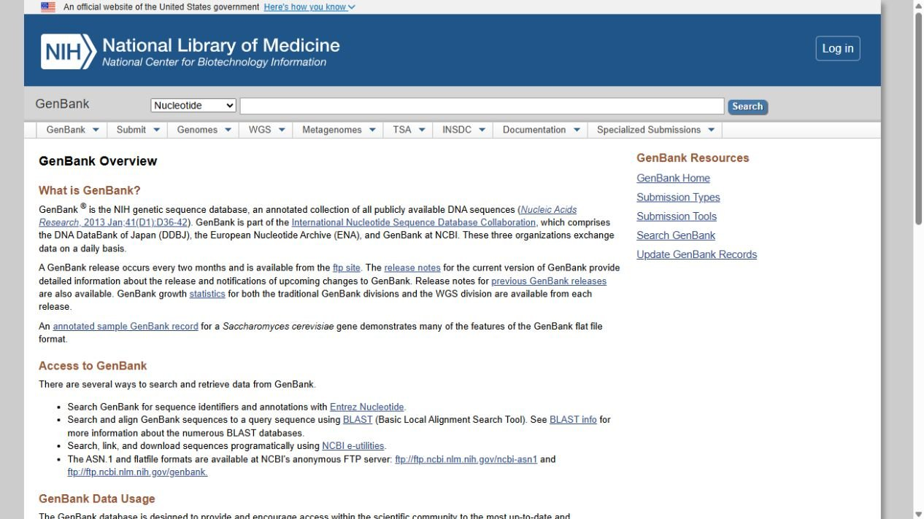
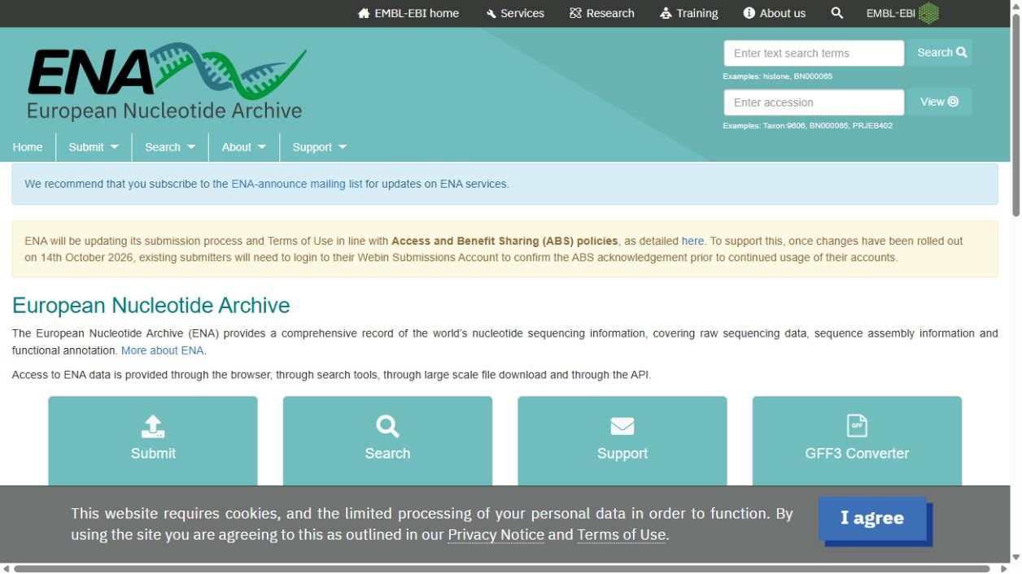
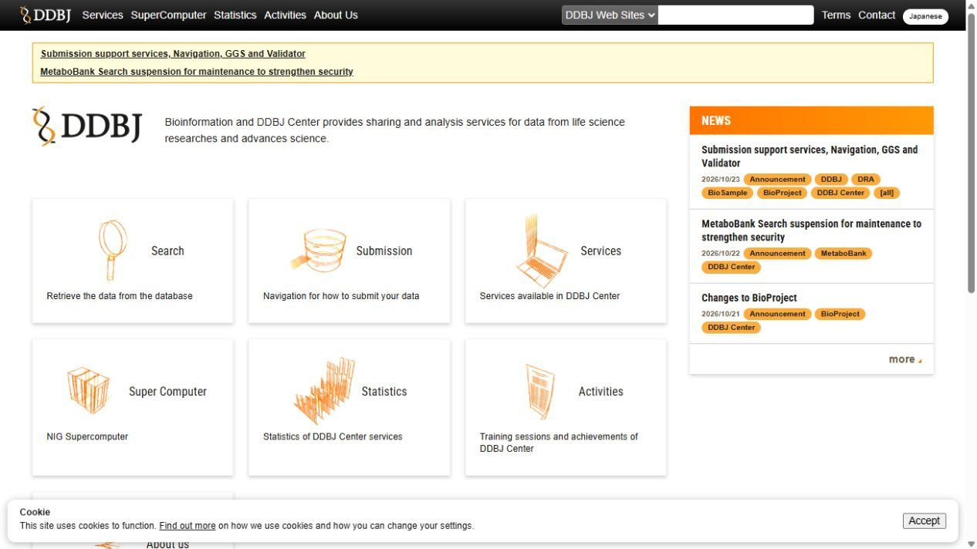

Shared sequence archives
NCBI (USA)
EMBL-EBI (UK)
DDBJ (Japan)
ncbi.nlm.nih.gov/genbank
ebi.ac.uk/ena/browser
ddbj.nig.ac.jp
Read archives
Assembled sequences
and annotations
BioProject / Study
BioSample / Sample
SRA / ENA reads / DRA
Reads and quality data
GenBank / ENA / DDBJ
Project description
Biological material
Notes:
[On slide entry] NCBI in the USA, EMBL-EBI in the UK and DDBJ in Japan provide different interfaces to shared public INSDC sequence records. [Click 1] Their pages and retrieval tools differ, but a shared archival record can be reached through any partner. The webpage snapshots illustrate those different entry points rather than search results for one sequence.
[Click 2] The partners exchange public sequence records and updates daily. The Daily exchange labels refer to that coordination; they do not imply that every institutional resource or every screen is identical.
The lower boxes represent different but linked types of records that describe the sequence data, their biological source and the research project. These biological concepts correspond across the partners, but their names and web pages differ. ENA includes both read data and assembled/annotated sequences, so the boxes do not represent four separately named databases at every partner. Consider a hypothetical study investigating HBB variants associated with beta-thalassaemia. HBB encodes the beta chain of haemoglobin. The examples below illustrate how records could be connected; they do not describe an identified participant study.
Read archives contain raw or minimally processed sequencing reads, their associated quality information and linked descriptions of the sequencing experiment. The partner names are NCBI Sequence Read Archive (SRA), reads within EMBL-EBI ENA, and DDBJ Sequence Read Archive (DRA). In the hypothetical study, these could be reads generated by targeted sequencing of HBB. They preserve the underlying measurements, allowing other researchers to inspect the evidence for a reported variant or repeat an analysis. Base-quality scores express confidence in individual base calls; they do not establish that every biological interpretation is correct. Some studies analyse reads by comparison with an existing reference and do not produce a separately deposited assembly.
Assembled sequences and annotations contain reconstructed nucleotide sequences, ranging from individual regions to complete chromosomes, together with features such as genes, exons and coding regions. The corresponding resources are GenBank at NCBI, assembled/annotated sequence records within ENA at EMBL-EBI, and the DDBJ annotated/assembled sequence archive in Japan. The archive stores deposited sequences and annotations; it does not itself assemble the reads. In our example, researchers might reconstruct an HBB region and deposit that sequence with its annotations. Existing HBB reference sequences, accessible through NCBI Gene 3043, provide comparison and biological context. Those reference sequences are distinct from sequences generated from the study participants; curated resources such as NCBI RefSeq are also distinct from the shared INSDC submission archives. An annotation may reflect a prediction or experimental evidence, so its supporting evidence still needs checking.
BioProject / Study describes the investigation and organizes its related datasets. NCBI and DDBJ use BioProject; ENA uses Study / Project. Its scope is broader than a short statement of purpose: information can include the project title, objectives, biological scope, planned or generated data types, submitting organization, funding, publications and links to associated records. These details are not all mandatory or equally complete. For our example, it could group multiple participant samples and their sequencing datasets under the shared question about HBB variation and beta-thalassaemia. The project record supplies context and links rather than containing the sequence files itself.
BioSample / Sample describes the biological source material. NCBI and DDBJ use BioSample; ENA uses Sample records, also represented in the EMBL-EBI BioSamples service. Here, a sample record could describe genomic DNA extracted from a participant's blood, with relevant information about the human source, specimen type, collection and phenotype. Blood-derived genomic DNA comes from nucleated cells, not mature red blood cells. The sample record helps explain what was sequenced; sequencing-machine and library details belong to linked experiment records.
[Clicks 3–6: submit once; show NCBI, ENA or DDBJ, then clear the arrow] For a given dataset, researchers submit to one appropriate partner. Separate submissions of the same data to all three sites are unnecessary.
Finding a shared record through three websites does not provide three independent pieces of experimental evidence. For reuse, inspect provenance, sample and experiment metadata, sequence quality, annotation evidence and relevant publications. Record accessions and sequence versions, the resource and access route used, and the retrieval date.
Sources:
https://www.ncbi.nlm.nih.gov/genbank/collab/
https://www.ncbi.nlm.nih.gov/genbank/submit/
https://www.ncbi.nlm.nih.gov/gene/3043
https://www.ebi.ac.uk/training/online/courses/ena-quick-tour/what-is-ena/how-is-ena-structured/
https://ena-browser-docs.readthedocs.io/en/latest/browser/ena-record.html
https://www.ncbi.nlm.nih.gov/sra/docs/submitformats/
https://www.ncbi.nlm.nih.gov/books/NBK54015/
https://www.ncbi.nlm.nih.gov/books/NBK50679/
https://www.ddbj.nig.ac.jp/submission-e.html
https://www.ddbj.nig.ac.jp/dra/
Webpage snapshots captured 26 October 2026:
https://www.ncbi.nlm.nih.gov/genbank/
https://www.ebi.ac.uk/ena/browser/home
https://www.ddbj.nig.ac.jp/index-e.html
Researcher illustration: AI-generated.

Slide 29
Shared sequence archives
Access data through any partner.
NCBI (USA)
EMBL-EBI (UK)
DDBJ (Japan)
ncbi.nlm.nih.gov/genbank
ebi.ac.uk/ena/browser
ddbj.nig.ac.jp
Read archives
Assembled sequences
and annotations
BioProject / Study
BioSample / Sample
SRA / ENA reads / DRA
Reads and quality data
GenBank / ENA / DDBJ
Project description
Biological material
Notes:
[On slide entry] NCBI in the USA, EMBL-EBI in the UK and DDBJ in Japan provide different interfaces to shared public INSDC sequence records. [Click 1] Their pages and retrieval tools differ, but a shared archival record can be reached through any partner. The webpage snapshots illustrate those different entry points rather than search results for one sequence.
[Click 2] The partners exchange public sequence records and updates daily. The Daily exchange labels refer to that coordination; they do not imply that every institutional resource or every screen is identical.
The lower boxes represent different but linked types of records that describe the sequence data, their biological source and the research project. These biological concepts correspond across the partners, but their names and web pages differ. ENA includes both read data and assembled/annotated sequences, so the boxes do not represent four separately named databases at every partner. Consider a hypothetical study investigating HBB variants associated with beta-thalassaemia. HBB encodes the beta chain of haemoglobin. The examples below illustrate how records could be connected; they do not describe an identified participant study.
Read archives contain raw or minimally processed sequencing reads, their associated quality information and linked descriptions of the sequencing experiment. The partner names are NCBI Sequence Read Archive (SRA), reads within EMBL-EBI ENA, and DDBJ Sequence Read Archive (DRA). In the hypothetical study, these could be reads generated by targeted sequencing of HBB. They preserve the underlying measurements, allowing other researchers to inspect the evidence for a reported variant or repeat an analysis. Base-quality scores express confidence in individual base calls; they do not establish that every biological interpretation is correct. Some studies analyse reads by comparison with an existing reference and do not produce a separately deposited assembly.
Assembled sequences and annotations contain reconstructed nucleotide sequences, ranging from individual regions to complete chromosomes, together with features such as genes, exons and coding regions. The corresponding resources are GenBank at NCBI, assembled/annotated sequence records within ENA at EMBL-EBI, and the DDBJ annotated/assembled sequence archive in Japan. The archive stores deposited sequences and annotations; it does not itself assemble the reads. In our example, researchers might reconstruct an HBB region and deposit that sequence with its annotations. Existing HBB reference sequences, accessible through NCBI Gene 3043, provide comparison and biological context. Those reference sequences are distinct from sequences generated from the study participants; curated resources such as NCBI RefSeq are also distinct from the shared INSDC submission archives. An annotation may reflect a prediction or experimental evidence, so its supporting evidence still needs checking.
BioProject / Study describes the investigation and organizes its related datasets. NCBI and DDBJ use BioProject; ENA uses Study / Project. Its scope is broader than a short statement of purpose: information can include the project title, objectives, biological scope, planned or generated data types, submitting organization, funding, publications and links to associated records. These details are not all mandatory or equally complete. For our example, it could group multiple participant samples and their sequencing datasets under the shared question about HBB variation and beta-thalassaemia. The project record supplies context and links rather than containing the sequence files itself.
BioSample / Sample describes the biological source material. NCBI and DDBJ use BioSample; ENA uses Sample records, also represented in the EMBL-EBI BioSamples service. Here, a sample record could describe genomic DNA extracted from a participant's blood, with relevant information about the human source, specimen type, collection and phenotype. Blood-derived genomic DNA comes from nucleated cells, not mature red blood cells. The sample record helps explain what was sequenced; sequencing-machine and library details belong to linked experiment records.
[Clicks 3–6: submit once; show NCBI, ENA or DDBJ, then clear the arrow] For a given dataset, researchers submit to one appropriate partner. Separate submissions of the same data to all three sites are unnecessary.
Finding a shared record through three websites does not provide three independent pieces of experimental evidence. For reuse, inspect provenance, sample and experiment metadata, sequence quality, annotation evidence and relevant publications. Record accessions and sequence versions, the resource and access route used, and the retrieval date.
Sources:
https://www.ncbi.nlm.nih.gov/genbank/collab/
https://www.ncbi.nlm.nih.gov/genbank/submit/
https://www.ncbi.nlm.nih.gov/gene/3043
https://www.ebi.ac.uk/training/online/courses/ena-quick-tour/what-is-ena/how-is-ena-structured/
https://ena-browser-docs.readthedocs.io/en/latest/browser/ena-record.html
https://www.ncbi.nlm.nih.gov/sra/docs/submitformats/
https://www.ncbi.nlm.nih.gov/books/NBK54015/
https://www.ncbi.nlm.nih.gov/books/NBK50679/
https://www.ddbj.nig.ac.jp/submission-e.html
https://www.ddbj.nig.ac.jp/dra/
Webpage snapshots captured 26 October 2026:
https://www.ncbi.nlm.nih.gov/genbank/
https://www.ebi.ac.uk/ena/browser/home
https://www.ddbj.nig.ac.jp/index-e.html
Researcher illustration: AI-generated.

Slide 30
Shared sequence archives
Access data through any partner.
NCBI (USA)
EMBL-EBI (UK)
DDBJ (Japan)
ncbi.nlm.nih.gov/genbank
ebi.ac.uk/ena/browser
ddbj.nig.ac.jp
Daily exchange
Daily exchange
Connected records
Read archives
Assembled sequences
and annotations
BioProject / Study
BioSample / Sample
SRA / ENA reads / DRA
Reads and quality data
GenBank / ENA / DDBJ
Project description
Biological material
Notes:
[On slide entry] NCBI in the USA, EMBL-EBI in the UK and DDBJ in Japan provide different interfaces to shared public INSDC sequence records. [Click 1] Their pages and retrieval tools differ, but a shared archival record can be reached through any partner. The webpage snapshots illustrate those different entry points rather than search results for one sequence.
[Click 2] The partners exchange public sequence records and updates daily. The Daily exchange labels refer to that coordination; they do not imply that every institutional resource or every screen is identical.
The lower boxes represent different but linked types of records that describe the sequence data, their biological source and the research project. These biological concepts correspond across the partners, but their names and web pages differ. ENA includes both read data and assembled/annotated sequences, so the boxes do not represent four separately named databases at every partner. Consider a hypothetical study investigating HBB variants associated with beta-thalassaemia. HBB encodes the beta chain of haemoglobin. The examples below illustrate how records could be connected; they do not describe an identified participant study.
Read archives contain raw or minimally processed sequencing reads, their associated quality information and linked descriptions of the sequencing experiment. The partner names are NCBI Sequence Read Archive (SRA), reads within EMBL-EBI ENA, and DDBJ Sequence Read Archive (DRA). In the hypothetical study, these could be reads generated by targeted sequencing of HBB. They preserve the underlying measurements, allowing other researchers to inspect the evidence for a reported variant or repeat an analysis. Base-quality scores express confidence in individual base calls; they do not establish that every biological interpretation is correct. Some studies analyse reads by comparison with an existing reference and do not produce a separately deposited assembly.
Assembled sequences and annotations contain reconstructed nucleotide sequences, ranging from individual regions to complete chromosomes, together with features such as genes, exons and coding regions. The corresponding resources are GenBank at NCBI, assembled/annotated sequence records within ENA at EMBL-EBI, and the DDBJ annotated/assembled sequence archive in Japan. The archive stores deposited sequences and annotations; it does not itself assemble the reads. In our example, researchers might reconstruct an HBB region and deposit that sequence with its annotations. Existing HBB reference sequences, accessible through NCBI Gene 3043, provide comparison and biological context. Those reference sequences are distinct from sequences generated from the study participants; curated resources such as NCBI RefSeq are also distinct from the shared INSDC submission archives. An annotation may reflect a prediction or experimental evidence, so its supporting evidence still needs checking.
BioProject / Study describes the investigation and organizes its related datasets. NCBI and DDBJ use BioProject; ENA uses Study / Project. Its scope is broader than a short statement of purpose: information can include the project title, objectives, biological scope, planned or generated data types, submitting organization, funding, publications and links to associated records. These details are not all mandatory or equally complete. For our example, it could group multiple participant samples and their sequencing datasets under the shared question about HBB variation and beta-thalassaemia. The project record supplies context and links rather than containing the sequence files itself.
BioSample / Sample describes the biological source material. NCBI and DDBJ use BioSample; ENA uses Sample records, also represented in the EMBL-EBI BioSamples service. Here, a sample record could describe genomic DNA extracted from a participant's blood, with relevant information about the human source, specimen type, collection and phenotype. Blood-derived genomic DNA comes from nucleated cells, not mature red blood cells. The sample record helps explain what was sequenced; sequencing-machine and library details belong to linked experiment records.
[Clicks 3–6: submit once; show NCBI, ENA or DDBJ, then clear the arrow] For a given dataset, researchers submit to one appropriate partner. Separate submissions of the same data to all three sites are unnecessary.
Finding a shared record through three websites does not provide three independent pieces of experimental evidence. For reuse, inspect provenance, sample and experiment metadata, sequence quality, annotation evidence and relevant publications. Record accessions and sequence versions, the resource and access route used, and the retrieval date.
Sources:
https://www.ncbi.nlm.nih.gov/genbank/collab/
https://www.ncbi.nlm.nih.gov/genbank/submit/
https://www.ncbi.nlm.nih.gov/gene/3043
https://www.ebi.ac.uk/training/online/courses/ena-quick-tour/what-is-ena/how-is-ena-structured/
https://ena-browser-docs.readthedocs.io/en/latest/browser/ena-record.html
https://www.ncbi.nlm.nih.gov/sra/docs/submitformats/
https://www.ncbi.nlm.nih.gov/books/NBK54015/
https://www.ncbi.nlm.nih.gov/books/NBK50679/
https://www.ddbj.nig.ac.jp/submission-e.html
https://www.ddbj.nig.ac.jp/dra/
Webpage snapshots captured 26 October 2026:
https://www.ncbi.nlm.nih.gov/genbank/
https://www.ebi.ac.uk/ena/browser/home
https://www.ddbj.nig.ac.jp/index-e.html
Researcher illustration: AI-generated.

Slide 31
Shared sequence archives
Access data through any partner.
Submit data to only one.
NCBI (USA)
EMBL-EBI (UK)
DDBJ (Japan)
ncbi.nlm.nih.gov/genbank
ebi.ac.uk/ena/browser
ddbj.nig.ac.jp
Daily exchange
Daily exchange
Connected records
Read archives
Assembled sequences
and annotations
BioProject / Study
BioSample / Sample
SRA / ENA reads / DRA
Reads and quality data
GenBank / ENA / DDBJ
Project description
Biological material
Notes:
[On slide entry] NCBI in the USA, EMBL-EBI in the UK and DDBJ in Japan provide different interfaces to shared public INSDC sequence records. [Click 1] Their pages and retrieval tools differ, but a shared archival record can be reached through any partner. The webpage snapshots illustrate those different entry points rather than search results for one sequence.
[Click 2] The partners exchange public sequence records and updates daily. The Daily exchange labels refer to that coordination; they do not imply that every institutional resource or every screen is identical.
The lower boxes represent different but linked types of records that describe the sequence data, their biological source and the research project. These biological concepts correspond across the partners, but their names and web pages differ. ENA includes both read data and assembled/annotated sequences, so the boxes do not represent four separately named databases at every partner. Consider a hypothetical study investigating HBB variants associated with beta-thalassaemia. HBB encodes the beta chain of haemoglobin. The examples below illustrate how records could be connected; they do not describe an identified participant study.
Read archives contain raw or minimally processed sequencing reads, their associated quality information and linked descriptions of the sequencing experiment. The partner names are NCBI Sequence Read Archive (SRA), reads within EMBL-EBI ENA, and DDBJ Sequence Read Archive (DRA). In the hypothetical study, these could be reads generated by targeted sequencing of HBB. They preserve the underlying measurements, allowing other researchers to inspect the evidence for a reported variant or repeat an analysis. Base-quality scores express confidence in individual base calls; they do not establish that every biological interpretation is correct. Some studies analyse reads by comparison with an existing reference and do not produce a separately deposited assembly.
Assembled sequences and annotations contain reconstructed nucleotide sequences, ranging from individual regions to complete chromosomes, together with features such as genes, exons and coding regions. The corresponding resources are GenBank at NCBI, assembled/annotated sequence records within ENA at EMBL-EBI, and the DDBJ annotated/assembled sequence archive in Japan. The archive stores deposited sequences and annotations; it does not itself assemble the reads. In our example, researchers might reconstruct an HBB region and deposit that sequence with its annotations. Existing HBB reference sequences, accessible through NCBI Gene 3043, provide comparison and biological context. Those reference sequences are distinct from sequences generated from the study participants; curated resources such as NCBI RefSeq are also distinct from the shared INSDC submission archives. An annotation may reflect a prediction or experimental evidence, so its supporting evidence still needs checking.
BioProject / Study describes the investigation and organizes its related datasets. NCBI and DDBJ use BioProject; ENA uses Study / Project. Its scope is broader than a short statement of purpose: information can include the project title, objectives, biological scope, planned or generated data types, submitting organization, funding, publications and links to associated records. These details are not all mandatory or equally complete. For our example, it could group multiple participant samples and their sequencing datasets under the shared question about HBB variation and beta-thalassaemia. The project record supplies context and links rather than containing the sequence files itself.
BioSample / Sample describes the biological source material. NCBI and DDBJ use BioSample; ENA uses Sample records, also represented in the EMBL-EBI BioSamples service. Here, a sample record could describe genomic DNA extracted from a participant's blood, with relevant information about the human source, specimen type, collection and phenotype. Blood-derived genomic DNA comes from nucleated cells, not mature red blood cells. The sample record helps explain what was sequenced; sequencing-machine and library details belong to linked experiment records.
[Clicks 3–6: submit once; show NCBI, ENA or DDBJ, then clear the arrow] For a given dataset, researchers submit to one appropriate partner. Separate submissions of the same data to all three sites are unnecessary.
Finding a shared record through three websites does not provide three independent pieces of experimental evidence. For reuse, inspect provenance, sample and experiment metadata, sequence quality, annotation evidence and relevant publications. Record accessions and sequence versions, the resource and access route used, and the retrieval date.
Sources:
https://www.ncbi.nlm.nih.gov/genbank/collab/
https://www.ncbi.nlm.nih.gov/genbank/submit/
https://www.ncbi.nlm.nih.gov/gene/3043
https://www.ebi.ac.uk/training/online/courses/ena-quick-tour/what-is-ena/how-is-ena-structured/
https://ena-browser-docs.readthedocs.io/en/latest/browser/ena-record.html
https://www.ncbi.nlm.nih.gov/sra/docs/submitformats/
https://www.ncbi.nlm.nih.gov/books/NBK54015/
https://www.ncbi.nlm.nih.gov/books/NBK50679/
https://www.ddbj.nig.ac.jp/submission-e.html
https://www.ddbj.nig.ac.jp/dra/
Webpage snapshots captured 26 October 2026:
https://www.ncbi.nlm.nih.gov/genbank/
https://www.ebi.ac.uk/ena/browser/home
https://www.ddbj.nig.ac.jp/index-e.html
Researcher illustration: AI-generated.

Slide 32



Shared sequence archives
NCBI (USA)
Retired 17 June 2022
NCBI (USA)
Trace Archive
Historical data (by Apr 2023)
SRA
DDBJ (Japan)
New submissions
DDBJ (Japan)
Trace Archive, DTA
DRA
EMBL-EBI (UK)
EMBL-EBI (UK)
European
Trace Archive
Integrated in May 2010
ENA
Notes:
[On slide entry] This slide will demonstrate the importance of understanding general principles of database organization rather than learning a list of particular databases, because archives can merge and access routes may change.
[Click 1] Trace Archive was established in 2001 during the expansion of large genome projects. It preserved individual sequencing reads used to reconstruct longer DNA sequences. It stored chromatograms—the instrument signals displayed as coloured peaks—together with the DNA sequences inferred from those signals. It also stored quality scores, which estimate confidence in each identified base, and metadata describing the sample and experiment. Later, high-throughput sequencing produced much larger datasets, prompting development of newer read archives. NCBI released SRA in 2008. The two archives coexisted for years, and SRA now also accepts capillary sequencing data. [1–3,5]
[Click 2] At NCBI, declining use and ageing computer systems led to retirement of the separate Trace Archive on 17 June 2022. Its data were moved to SRA. The arrow illustrates how older data can remain accessible after their original website or service closes. [4,5]
[Click 3] The Japanese example shows two different routes. DDBJ’s Trace Archive, DTA, had closed by 12 April 2023, although its exact shutdown day is undocumented. Older trace data can now be retrieved through SRA, while newly generated capillary sequencing data can be submitted to DRA. The two arrows distinguish finding previously stored data from depositing new data. [2,6]
[Click 4] The European partner followed an earlier route. In May 2010, it brought its nucleotide sequence collection, Trace Archive and SRA together within ENA. In February 2017, it stopped providing trace searches and viewing through the ENA website, while direct file downloads remained available at that time. Bringing collections together and closing a particular search interface were separate events. [7,8]
A surviving example is sequencing dataset SRR9451988. Its record describes historical capillary reads from an HBB-labelled DNA library and identifies the organism as olive baboon, Papio anubis. It also records the data’s conversion from Trace Archive. This illustrates why we should check the record rather than rely on a familiar gene name. [9]
When following an older publication, retain its record identifiers, consult current access instructions and check what evidence is available. DNA sequences and quality scores may remain accessible even when the original signal recordings are unavailable. [5]
References
[1] NCBI News, Summer 2006: Trace Archive history.
https://www.ncbi.nlm.nih.gov/books/NBK2592/bin/Summer2006.pdf
[2] DDBJ Trace Archive: description and current access routes.
https://www.ddbj.nig.ac.jp/dta/index-e.html
[3] NCBI: About the Sequence Read Archive.
https://www.ncbi.nlm.nih.gov/sra/docs/
[4] NCBI: Trace Archive retirement announcement.
https://ncbiinsights.ncbi.nlm.nih.gov/2021/12/17/trace-archive-retirement/
[5] NCBI: Access Trace Data.
https://www.ncbi.nlm.nih.gov/sra/docs/trace-data/
[6] DDBJ: website revision documenting closure, dated 12 April 2023.
https://github.com/ddbj/www/commit/22ae1138cfda4e6010ddc287493c4ad82d43344f
[7] EMBL-EBI Scientific Report 2010: ENA integration.
https://www.embl.org/files/wp-content/uploads/EMBL-EBI_Scientific_Report-2010.pdf
[8] EMBL-EBI: Changes to the Trace Archive at ENA.
https://www.ebi.ac.uk/about/news/updates-from-data-resources/changes-trace-archive-ena/
[9] NCBI: experiment SRX6217698, linked to run SRR9451988.
https://www.ncbi.nlm.nih.gov/sra/SRX6217698

Slide 33
Shared sequence archives
Archives merge and access routes change.
NCBI (USA)
Retired 17 June 2022
NCBI (USA)
Trace Archive
Historical data (by Apr 2023)
SRA
DDBJ (Japan)
New submissions
DDBJ (Japan)
Trace Archive, DTA
DRA
EMBL-EBI (UK)
EMBL-EBI (UK)
European
Trace Archive
Integrated in May 2010
ENA
Notes:
[On slide entry] This slide will demonstrate the importance of understanding general principles of database organization rather than learning a list of particular databases, because archives can merge and access routes may change.
[Click 1] Trace Archive was established in 2001 during the expansion of large genome projects. It preserved individual sequencing reads used to reconstruct longer DNA sequences. It stored chromatograms—the instrument signals displayed as coloured peaks—together with the DNA sequences inferred from those signals. It also stored quality scores, which estimate confidence in each identified base, and metadata describing the sample and experiment. Later, high-throughput sequencing produced much larger datasets, prompting development of newer read archives. NCBI released SRA in 2008. The two archives coexisted for years, and SRA now also accepts capillary sequencing data. [1–3,5]
[Click 2] At NCBI, declining use and ageing computer systems led to retirement of the separate Trace Archive on 17 June 2022. Its data were moved to SRA. The arrow illustrates how older data can remain accessible after their original website or service closes. [4,5]
[Click 3] The Japanese example shows two different routes. DDBJ’s Trace Archive, DTA, had closed by 12 April 2023, although its exact shutdown day is undocumented. Older trace data can now be retrieved through SRA, while newly generated capillary sequencing data can be submitted to DRA. The two arrows distinguish finding previously stored data from depositing new data. [2,6]
[Click 4] The European partner followed an earlier route. In May 2010, it brought its nucleotide sequence collection, Trace Archive and SRA together within ENA. In February 2017, it stopped providing trace searches and viewing through the ENA website, while direct file downloads remained available at that time. Bringing collections together and closing a particular search interface were separate events. [7,8]
A surviving example is sequencing dataset SRR9451988. Its record describes historical capillary reads from an HBB-labelled DNA library and identifies the organism as olive baboon, Papio anubis. It also records the data’s conversion from Trace Archive. This illustrates why we should check the record rather than rely on a familiar gene name. [9]
When following an older publication, retain its record identifiers, consult current access instructions and check what evidence is available. DNA sequences and quality scores may remain accessible even when the original signal recordings are unavailable. [5]
References
[1] NCBI News, Summer 2006: Trace Archive history.
https://www.ncbi.nlm.nih.gov/books/NBK2592/bin/Summer2006.pdf
[2] DDBJ Trace Archive: description and current access routes.
https://www.ddbj.nig.ac.jp/dta/index-e.html
[3] NCBI: About the Sequence Read Archive.
https://www.ncbi.nlm.nih.gov/sra/docs/
[4] NCBI: Trace Archive retirement announcement.
https://ncbiinsights.ncbi.nlm.nih.gov/2021/12/17/trace-archive-retirement/
[5] NCBI: Access Trace Data.
https://www.ncbi.nlm.nih.gov/sra/docs/trace-data/
[6] DDBJ: website revision documenting closure, dated 12 April 2023.
https://github.com/ddbj/www/commit/22ae1138cfda4e6010ddc287493c4ad82d43344f
[7] EMBL-EBI Scientific Report 2010: ENA integration.
https://www.embl.org/files/wp-content/uploads/EMBL-EBI_Scientific_Report-2010.pdf
[8] EMBL-EBI: Changes to the Trace Archive at ENA.
https://www.ebi.ac.uk/about/news/updates-from-data-resources/changes-trace-archive-ena/
[9] NCBI: experiment SRX6217698, linked to run SRR9451988.
https://www.ncbi.nlm.nih.gov/sra/SRX6217698

Slide 34
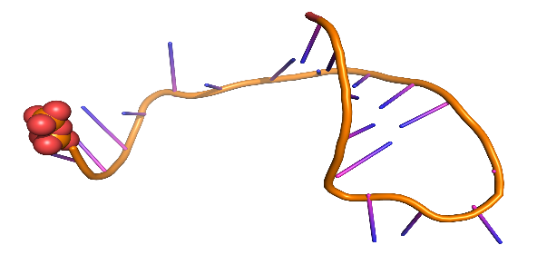
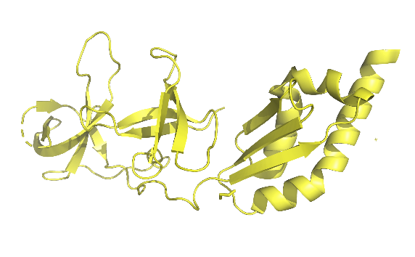
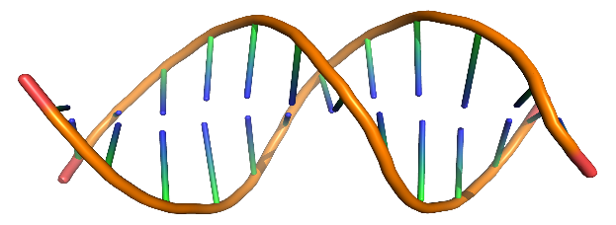







DNA
Transcription
mRNA
Translation
Protein
DNA-level data
RNA-level data
Protein-level data
Genomic sequences
and gene context
Cross-references
RefSeq
mRNAsequences
Cross-references
Sequence and structure Function and interactions
Noncoding RNA sequences
RNA families
Notes:
[On slide entry] The previous slides described how archives share data and how their access routes can change. We now consider which biological information we need: genomic DNA, an RNA transcript or a protein.
[Click 1] The upper diagram shows the familiar route for a protein-coding gene. This diagram therefore provides a simplified framework for the information considered here. [1]
[Click 2] The lower boxes give examples of database information. Genomic records describe DNA sequences and features such as genes.
[Click 3] Transcription copies sequence information from DNA into RNA. Many other RNAs function without being translated. Transcript records describe RNA products.
The three RNA rows pair each resource with the information it provides. RefSeq illustrates reference mRNA sequences. Its broader collection also contains noncoding transcripts, genomic DNA and protein records. RNAcentral integrates noncoding RNA sequences. Rfam groups structured noncoding RNAs and regulatory RNA elements into families. A sequence record and a family record answer different questions, so these resources complement one another. [2–4]
[Click 4] Translation uses the coding region of an mRNA to produce a polypeptide. Protein records describe amino-acid sequences and connect them to information about structure, function and interactions.
The protein examples include molecular interactions as well as sequence, structure and function. IntAct provides interaction records with information about their sources and experimental context. We still need to inspect the evidence for the particular interaction or claim. [6]
The double-headed arrows indicate connections between related records that we can explore across biological levels. They do not guarantee that every resource provides a direct link in both directions.
Human HBB provides our common example. Its gene is linked to an mRNA that encodes the beta-globin chain of haemoglobin. These related biological objects have different records, connected through annotations and cross-references. We will examine their identifiers later. More generally, a gene can have several transcripts and protein products, so its symbol alone does not specify the sequence to retrieve. [5]
A resource or genome browser can bring several biological levels together. The biological level does not determine the strength of the evidence: observations, predictions and curated interpretations can occur at every level. The following slides examine the information available at each level.
References and short introductions (checked 28 October 2026)
[1] NCBI Bookshelf: How Cells Read the Genome: From DNA to Protein.
https://www.ncbi.nlm.nih.gov/books/NBK21050/
[2] NCBI: About RefSeq.
https://www.ncbi.nlm.nih.gov/refseq/about/
[3] RNAcentral: About RNAcentral.
https://www.rnacentral.org/about-us
EMBL-EBI Training: What is RNAcentral?
https://www.ebi.ac.uk/training/online/courses/rnacentral/what-is-rnacentral/
[4] Rfam: About Rfam.
https://docs.rfam.org/en/latest/about-rfam.html
EMBL-EBI Training: What is Rfam?
https://www.ebi.ac.uk/training/online/courses/rfam-quick-tour/what-is-rfam/
[5] NCBI Gene: Human HBB.
https://www.ncbi.nlm.nih.gov/gene/3043
[6] EMBL-EBI Training: What is IntAct?
https://www.ebi.ac.uk/training/online/courses/intact-quick-tour/what-is-intact/

Slide 35
DNA, RNA and protein data
DNA
Transcription
mRNA
Translation
Protein
DNA-level data
RNA-level data
Protein-level data
Genomic sequences
and gene context
Cross-references
RefSeq
mRNAsequences
Cross-references
Sequence and structure Function and interactions
Noncoding RNA sequences
RNA families
Notes:
[On slide entry] The previous slides described how archives share data and how their access routes can change. We now consider which biological information we need: genomic DNA, an RNA transcript or a protein.
[Click 1] The upper diagram shows the familiar route for a protein-coding gene. This diagram therefore provides a simplified framework for the information considered here. [1]
[Click 2] The lower boxes give examples of database information. Genomic records describe DNA sequences and features such as genes.
[Click 3] Transcription copies sequence information from DNA into RNA. Many other RNAs function without being translated. Transcript records describe RNA products.
The three RNA rows pair each resource with the information it provides. RefSeq illustrates reference mRNA sequences. Its broader collection also contains noncoding transcripts, genomic DNA and protein records. RNAcentral integrates noncoding RNA sequences. Rfam groups structured noncoding RNAs and regulatory RNA elements into families. A sequence record and a family record answer different questions, so these resources complement one another. [2–4]
[Click 4] Translation uses the coding region of an mRNA to produce a polypeptide. Protein records describe amino-acid sequences and connect them to information about structure, function and interactions.
The protein examples include molecular interactions as well as sequence, structure and function. IntAct provides interaction records with information about their sources and experimental context. We still need to inspect the evidence for the particular interaction or claim. [6]
The double-headed arrows indicate connections between related records that we can explore across biological levels. They do not guarantee that every resource provides a direct link in both directions.
Human HBB provides our common example. Its gene is linked to an mRNA that encodes the beta-globin chain of haemoglobin. These related biological objects have different records, connected through annotations and cross-references. We will examine their identifiers later. More generally, a gene can have several transcripts and protein products, so its symbol alone does not specify the sequence to retrieve. [5]
A resource or genome browser can bring several biological levels together. The biological level does not determine the strength of the evidence: observations, predictions and curated interpretations can occur at every level. The following slides examine the information available at each level.
References and short introductions (checked 28 October 2026)
[1] NCBI Bookshelf: How Cells Read the Genome: From DNA to Protein.
https://www.ncbi.nlm.nih.gov/books/NBK21050/
[2] NCBI: About RefSeq.
https://www.ncbi.nlm.nih.gov/refseq/about/
[3] RNAcentral: About RNAcentral.
https://www.rnacentral.org/about-us
EMBL-EBI Training: What is RNAcentral?
https://www.ebi.ac.uk/training/online/courses/rnacentral/what-is-rnacentral/
[4] Rfam: About Rfam.
https://docs.rfam.org/en/latest/about-rfam.html
EMBL-EBI Training: What is Rfam?
https://www.ebi.ac.uk/training/online/courses/rfam-quick-tour/what-is-rfam/
[5] NCBI Gene: Human HBB.
https://www.ncbi.nlm.nih.gov/gene/3043
[6] EMBL-EBI Training: What is IntAct?
https://www.ebi.ac.uk/training/online/courses/intact-quick-tour/what-is-intact/

Slide 36
DNA, RNA and protein data
Central dogma of biology
DNA
Transcription
mRNA
Translation
Protein
Linked database records
DNA-level data
RNA-level data
Protein-level data
Genomic sequences
and gene context
Cross-references
RefSeq
mRNAsequences
Cross-references
Sequence and structure Function and interactions
Noncoding RNA sequences
RNA families
Notes:
[On slide entry] The previous slides described how archives share data and how their access routes can change. We now consider which biological information we need: genomic DNA, an RNA transcript or a protein.
[Click 1] The upper diagram shows the familiar route for a protein-coding gene. This diagram therefore provides a simplified framework for the information considered here. [1]
[Click 2] The lower boxes give examples of database information. Genomic records describe DNA sequences and features such as genes.
[Click 3] Transcription copies sequence information from DNA into RNA. Many other RNAs function without being translated. Transcript records describe RNA products.
The three RNA rows pair each resource with the information it provides. RefSeq illustrates reference mRNA sequences. Its broader collection also contains noncoding transcripts, genomic DNA and protein records. RNAcentral integrates noncoding RNA sequences. Rfam groups structured noncoding RNAs and regulatory RNA elements into families. A sequence record and a family record answer different questions, so these resources complement one another. [2–4]
[Click 4] Translation uses the coding region of an mRNA to produce a polypeptide. Protein records describe amino-acid sequences and connect them to information about structure, function and interactions.
The protein examples include molecular interactions as well as sequence, structure and function. IntAct provides interaction records with information about their sources and experimental context. We still need to inspect the evidence for the particular interaction or claim. [6]
The double-headed arrows indicate connections between related records that we can explore across biological levels. They do not guarantee that every resource provides a direct link in both directions.
Human HBB provides our common example. Its gene is linked to an mRNA that encodes the beta-globin chain of haemoglobin. These related biological objects have different records, connected through annotations and cross-references. We will examine their identifiers later. More generally, a gene can have several transcripts and protein products, so its symbol alone does not specify the sequence to retrieve. [5]
A resource or genome browser can bring several biological levels together. The biological level does not determine the strength of the evidence: observations, predictions and curated interpretations can occur at every level. The following slides examine the information available at each level.
References and short introductions (checked 28 October 2026)
[1] NCBI Bookshelf: How Cells Read the Genome: From DNA to Protein.
https://www.ncbi.nlm.nih.gov/books/NBK21050/
[2] NCBI: About RefSeq.
https://www.ncbi.nlm.nih.gov/refseq/about/
[3] RNAcentral: About RNAcentral.
https://www.rnacentral.org/about-us
EMBL-EBI Training: What is RNAcentral?
https://www.ebi.ac.uk/training/online/courses/rnacentral/what-is-rnacentral/
[4] Rfam: About Rfam.
https://docs.rfam.org/en/latest/about-rfam.html
EMBL-EBI Training: What is Rfam?
https://www.ebi.ac.uk/training/online/courses/rfam-quick-tour/what-is-rfam/
[5] NCBI Gene: Human HBB.
https://www.ncbi.nlm.nih.gov/gene/3043
[6] EMBL-EBI Training: What is IntAct?
https://www.ebi.ac.uk/training/online/courses/intact-quick-tour/what-is-intact/

Slide 37
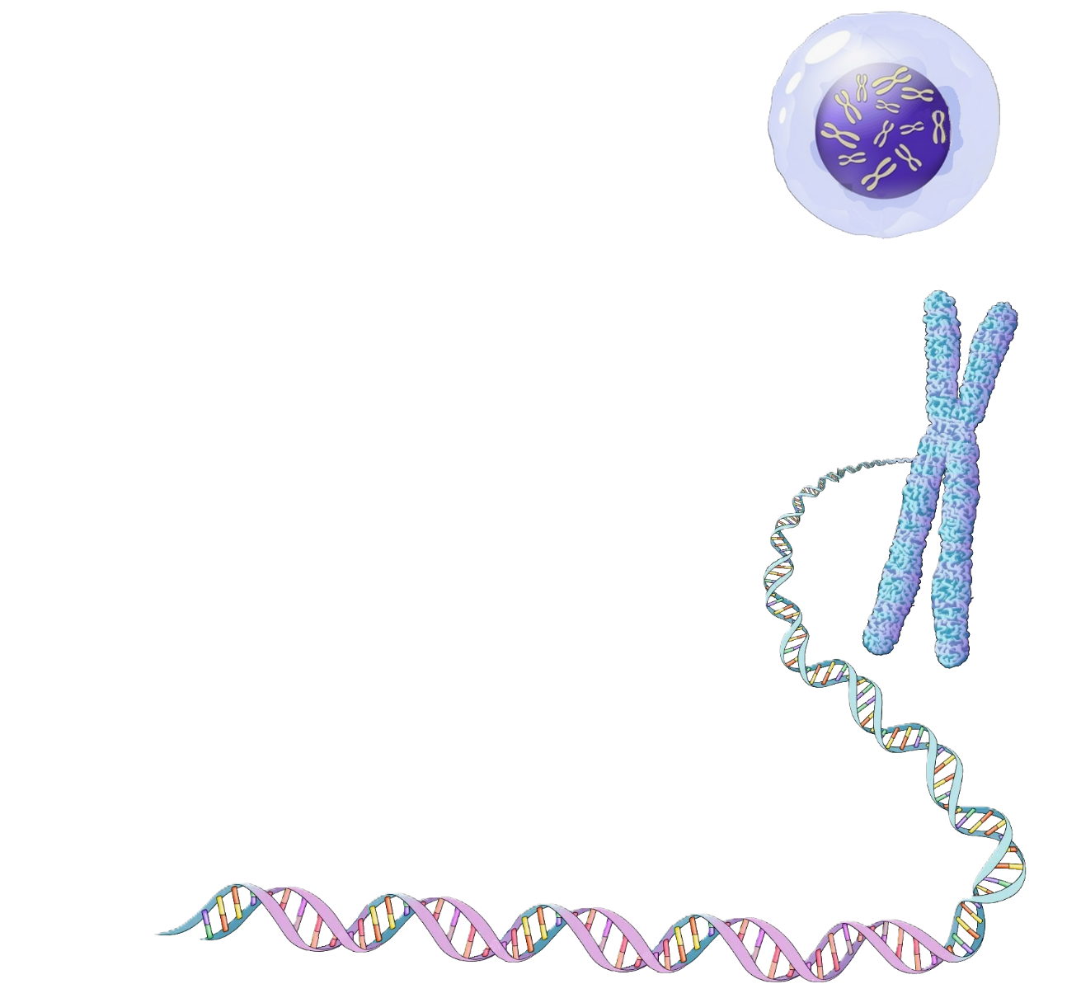


Cell
Nucleus
Genome
Chromosome
HBB on chromosome 11
DNA
segment
NCBI Gene
Intron1
Intron2
Exon1
Exon2
Exon3
Gene
GenBank
ENA
DDBJ Annotated/
Assembled sequences
Notes:
[On slide entry] This slide follows four connected views of genomic DNA: a genome assembly, a chromosome overview, a selected DNA region and an individual gene. Each view highlights a different aspect of the same biological material.
[Click 1] Genome. A genome assembly is a reconstructed representation of a genome’s DNA sequence. Its completeness depends on the available data and assembly quality. NCBI glossary
[Click 2] Chromosome overview. We now focus on one chromosome. Numbered positions along its reference DNA sequence provide a coordinate system for locating information. Genome browsers, such as NCBI Genome Data Viewer and Ensembl, let us start with a chromosome overview and zoom into a selected region. Different information layers remain aligned to the same positions. NCBI Genome Data Viewer
[Click 3] Selected DNA region. The enlarged helix represents a selected part of that chromosome. This segment may contain one gene, several genes, parts of genes and DNA between them. It can include both protein-coding and noncoding sequences. Some noncoding DNA regulates gene activity, while other noncoding regions have no known function. NHGRI: Non-coding DNA
Examining a wider region becomes important when our question concerns how a gene works in its genomic surroundings. Regulatory sequences can influence when, where and how strongly a gene is expressed, and some lie outside the gene they control. Larger DNA changes, such as deletions or duplications, may affect several genes or their regulatory sequences. Looking only at one coding sequence could therefore miss relevant information. Research on changes affecting multiple genes
Human HBB provides a concrete example. It belongs to the beta-globin gene cluster on chromosome 11. A noncoding regulatory region, called the beta-globin locus control region, helps control the activity of several genes in this cluster. Examining HBB’s coding sequence alone would miss this regulatory context. The simplified picture shows one gene, but a wider browser view allows us to investigate its neighbourhood. NCBI: Beta-globin locus control region
[Click 4] Gene. We can then focus on HBB itself. It encodes the beta subunit of haemoglobin and contains three exons separated by two introns. Its genomic DNA includes both. During RNA processing, the introns are removed and the exons joined to form mature mRNA. Exons can also contain untranslated sequence, so a protein-coding gene is not entirely protein-coding DNA. The diagram is schematic and follows gene order because HBB lies on the reverse strand. NCBI: HBB, Ensembl: Sequence views
[Click 5] GenBank and ENA provide access to sequence records, which may cover a whole chromosome or a smaller region. [Click 6] Genome browsers and gene resources connect these sequences to annotations and related records. Their coverage overlaps, which explains the repeated logos. The region we retrieve should match the biological question. Record the genome assembly and annotation source, and check the evidence supporting any proposed function or regulatory relationship.
Sources links:
Genome assemblies: https://www.ncbi.nlm.nih.gov/datasets/docs/v2/glossary/
Chromosome browsing: https://www.ncbi.nlm.nih.gov/gdv/
Noncoding DNA: https://www.genome.gov/genetics-glossary/Non-Coding-DNA
DNA changes affecting multiple genes: https://pmc.ncbi.nlm.nih.gov/articles/PMC8647827/
Beta-globin locus control region: https://www.ncbi.nlm.nih.gov/gene/109580095
Human HBB: https://www.ncbi.nlm.nih.gov/gene/3043
Genomic and transcript sequences: https://static.ensembl.org/info/website/tutorials/sequence.html
GenBank: https://www.ncbi.nlm.nih.gov/genbank/
ENA: https://www.ebi.ac.uk/ena/browser/about

Slide 38
DNA-level data
Cell
Nucleus
Genome
Chromosome
HBB on chromosome 11
DNA
segment
NCBI Gene
Intron1
Intron2
Exon1
Exon2
Exon3
Gene
GenBank
ENA
DDBJ Annotated/
Assembled sequences
Notes:
[On slide entry] This slide follows four connected views of genomic DNA: a genome assembly, a chromosome overview, a selected DNA region and an individual gene. Each view highlights a different aspect of the same biological material.
[Click 1] Genome. A genome assembly is a reconstructed representation of a genome’s DNA sequence. Its completeness depends on the available data and assembly quality. NCBI glossary
[Click 2] Chromosome overview. We now focus on one chromosome. Numbered positions along its reference DNA sequence provide a coordinate system for locating information. Genome browsers, such as NCBI Genome Data Viewer and Ensembl, let us start with a chromosome overview and zoom into a selected region. Different information layers remain aligned to the same positions. NCBI Genome Data Viewer
[Click 3] Selected DNA region. The enlarged helix represents a selected part of that chromosome. This segment may contain one gene, several genes, parts of genes and DNA between them. It can include both protein-coding and noncoding sequences. Some noncoding DNA regulates gene activity, while other noncoding regions have no known function. NHGRI: Non-coding DNA
Examining a wider region becomes important when our question concerns how a gene works in its genomic surroundings. Regulatory sequences can influence when, where and how strongly a gene is expressed, and some lie outside the gene they control. Larger DNA changes, such as deletions or duplications, may affect several genes or their regulatory sequences. Looking only at one coding sequence could therefore miss relevant information. Research on changes affecting multiple genes
Human HBB provides a concrete example. It belongs to the beta-globin gene cluster on chromosome 11. A noncoding regulatory region, called the beta-globin locus control region, helps control the activity of several genes in this cluster. Examining HBB’s coding sequence alone would miss this regulatory context. The simplified picture shows one gene, but a wider browser view allows us to investigate its neighbourhood. NCBI: Beta-globin locus control region
[Click 4] Gene. We can then focus on HBB itself. It encodes the beta subunit of haemoglobin and contains three exons separated by two introns. Its genomic DNA includes both. During RNA processing, the introns are removed and the exons joined to form mature mRNA. Exons can also contain untranslated sequence, so a protein-coding gene is not entirely protein-coding DNA. The diagram is schematic and follows gene order because HBB lies on the reverse strand. NCBI: HBB, Ensembl: Sequence views
[Click 5] GenBank and ENA provide access to sequence records, which may cover a whole chromosome or a smaller region. [Click 6] Genome browsers and gene resources connect these sequences to annotations and related records. Their coverage overlaps, which explains the repeated logos. The region we retrieve should match the biological question. Record the genome assembly and annotation source, and check the evidence supporting any proposed function or regulatory relationship.
Sources links:
Genome assemblies: https://www.ncbi.nlm.nih.gov/datasets/docs/v2/glossary/
Chromosome browsing: https://www.ncbi.nlm.nih.gov/gdv/
Noncoding DNA: https://www.genome.gov/genetics-glossary/Non-Coding-DNA
DNA changes affecting multiple genes: https://pmc.ncbi.nlm.nih.gov/articles/PMC8647827/
Beta-globin locus control region: https://www.ncbi.nlm.nih.gov/gene/109580095
Human HBB: https://www.ncbi.nlm.nih.gov/gene/3043
Genomic and transcript sequences: https://static.ensembl.org/info/website/tutorials/sequence.html
GenBank: https://www.ncbi.nlm.nih.gov/genbank/
ENA: https://www.ebi.ac.uk/ena/browser/about

Slide 39
DNA-level data
Cell
Genome
Nucleus
Genome assemblies and their annotations
Genome
Chromosome
HBB on chromosome 11
DNA
segment
NCBI Gene
Intron1
Intron2
Exon1
Exon2
Exon3
Gene
GenBank
ENA
DDBJ Annotated/
Assembled sequences
Notes:
[On slide entry] This slide follows four connected views of genomic DNA: a genome assembly, a chromosome overview, a selected DNA region and an individual gene. Each view highlights a different aspect of the same biological material.
[Click 1] Genome. A genome assembly is a reconstructed representation of a genome’s DNA sequence. Its completeness depends on the available data and assembly quality. NCBI glossary
[Click 2] Chromosome overview. We now focus on one chromosome. Numbered positions along its reference DNA sequence provide a coordinate system for locating information. Genome browsers, such as NCBI Genome Data Viewer and Ensembl, let us start with a chromosome overview and zoom into a selected region. Different information layers remain aligned to the same positions. NCBI Genome Data Viewer
[Click 3] Selected DNA region. The enlarged helix represents a selected part of that chromosome. This segment may contain one gene, several genes, parts of genes and DNA between them. It can include both protein-coding and noncoding sequences. Some noncoding DNA regulates gene activity, while other noncoding regions have no known function. NHGRI: Non-coding DNA
Examining a wider region becomes important when our question concerns how a gene works in its genomic surroundings. Regulatory sequences can influence when, where and how strongly a gene is expressed, and some lie outside the gene they control. Larger DNA changes, such as deletions or duplications, may affect several genes or their regulatory sequences. Looking only at one coding sequence could therefore miss relevant information. Research on changes affecting multiple genes
Human HBB provides a concrete example. It belongs to the beta-globin gene cluster on chromosome 11. A noncoding regulatory region, called the beta-globin locus control region, helps control the activity of several genes in this cluster. Examining HBB’s coding sequence alone would miss this regulatory context. The simplified picture shows one gene, but a wider browser view allows us to investigate its neighbourhood. NCBI: Beta-globin locus control region
[Click 4] Gene. We can then focus on HBB itself. It encodes the beta subunit of haemoglobin and contains three exons separated by two introns. Its genomic DNA includes both. During RNA processing, the introns are removed and the exons joined to form mature mRNA. Exons can also contain untranslated sequence, so a protein-coding gene is not entirely protein-coding DNA. The diagram is schematic and follows gene order because HBB lies on the reverse strand. NCBI: HBB, Ensembl: Sequence views
[Click 5] GenBank and ENA provide access to sequence records, which may cover a whole chromosome or a smaller region. [Click 6] Genome browsers and gene resources connect these sequences to annotations and related records. Their coverage overlaps, which explains the repeated logos. The region we retrieve should match the biological question. Record the genome assembly and annotation source, and check the evidence supporting any proposed function or regulatory relationship.
Sources links:
Genome assemblies: https://www.ncbi.nlm.nih.gov/datasets/docs/v2/glossary/
Chromosome browsing: https://www.ncbi.nlm.nih.gov/gdv/
Noncoding DNA: https://www.genome.gov/genetics-glossary/Non-Coding-DNA
DNA changes affecting multiple genes: https://pmc.ncbi.nlm.nih.gov/articles/PMC8647827/
Beta-globin locus control region: https://www.ncbi.nlm.nih.gov/gene/109580095
Human HBB: https://www.ncbi.nlm.nih.gov/gene/3043
Genomic and transcript sequences: https://static.ensembl.org/info/website/tutorials/sequence.html
GenBank: https://www.ncbi.nlm.nih.gov/genbank/
ENA: https://www.ebi.ac.uk/ena/browser/about

Slide 40
DNA-level data
Cell
Genome
Nucleus
Genome assemblies and their annotations
Genome
Chromosome overview
Chromosome
Chromosome sequences and mapped information
HBB on chromosome 11
DNA
segment
NCBI Gene
Intron1
Intron2
Exon1
Exon2
Exon3
Gene
GenBank
ENA
DDBJ Annotated/
Assembled sequences
Notes:
[On slide entry] This slide follows four connected views of genomic DNA: a genome assembly, a chromosome overview, a selected DNA region and an individual gene. Each view highlights a different aspect of the same biological material.
[Click 1] Genome. A genome assembly is a reconstructed representation of a genome’s DNA sequence. Its completeness depends on the available data and assembly quality. NCBI glossary
[Click 2] Chromosome overview. We now focus on one chromosome. Numbered positions along its reference DNA sequence provide a coordinate system for locating information. Genome browsers, such as NCBI Genome Data Viewer and Ensembl, let us start with a chromosome overview and zoom into a selected region. Different information layers remain aligned to the same positions. NCBI Genome Data Viewer
[Click 3] Selected DNA region. The enlarged helix represents a selected part of that chromosome. This segment may contain one gene, several genes, parts of genes and DNA between them. It can include both protein-coding and noncoding sequences. Some noncoding DNA regulates gene activity, while other noncoding regions have no known function. NHGRI: Non-coding DNA
Examining a wider region becomes important when our question concerns how a gene works in its genomic surroundings. Regulatory sequences can influence when, where and how strongly a gene is expressed, and some lie outside the gene they control. Larger DNA changes, such as deletions or duplications, may affect several genes or their regulatory sequences. Looking only at one coding sequence could therefore miss relevant information. Research on changes affecting multiple genes
Human HBB provides a concrete example. It belongs to the beta-globin gene cluster on chromosome 11. A noncoding regulatory region, called the beta-globin locus control region, helps control the activity of several genes in this cluster. Examining HBB’s coding sequence alone would miss this regulatory context. The simplified picture shows one gene, but a wider browser view allows us to investigate its neighbourhood. NCBI: Beta-globin locus control region
[Click 4] Gene. We can then focus on HBB itself. It encodes the beta subunit of haemoglobin and contains three exons separated by two introns. Its genomic DNA includes both. During RNA processing, the introns are removed and the exons joined to form mature mRNA. Exons can also contain untranslated sequence, so a protein-coding gene is not entirely protein-coding DNA. The diagram is schematic and follows gene order because HBB lies on the reverse strand. NCBI: HBB, Ensembl: Sequence views
[Click 5] GenBank and ENA provide access to sequence records, which may cover a whole chromosome or a smaller region. [Click 6] Genome browsers and gene resources connect these sequences to annotations and related records. Their coverage overlaps, which explains the repeated logos. The region we retrieve should match the biological question. Record the genome assembly and annotation source, and check the evidence supporting any proposed function or regulatory relationship.
Sources links:
Genome assemblies: https://www.ncbi.nlm.nih.gov/datasets/docs/v2/glossary/
Chromosome browsing: https://www.ncbi.nlm.nih.gov/gdv/
Noncoding DNA: https://www.genome.gov/genetics-glossary/Non-Coding-DNA
DNA changes affecting multiple genes: https://pmc.ncbi.nlm.nih.gov/articles/PMC8647827/
Beta-globin locus control region: https://www.ncbi.nlm.nih.gov/gene/109580095
Human HBB: https://www.ncbi.nlm.nih.gov/gene/3043
Genomic and transcript sequences: https://static.ensembl.org/info/website/tutorials/sequence.html
GenBank: https://www.ncbi.nlm.nih.gov/genbank/
ENA: https://www.ebi.ac.uk/ena/browser/about

Slide 41
DNA-level data
Cell
Genome
Nucleus
Genome assemblies and their annotations
Genome
Chromosome overview
Chromosome
Chromosome sequences and mapped information
Selected DNA region
Genes and non-coding DNA within a region
HBB on chromosome 11
DNA
segment
NCBI Gene
Intron1
Intron2
Exon1
Exon2
Exon3
Gene
GenBank
ENA
DDBJ Annotated/
Assembled sequences
Notes:
[On slide entry] This slide follows four connected views of genomic DNA: a genome assembly, a chromosome overview, a selected DNA region and an individual gene. Each view highlights a different aspect of the same biological material.
[Click 1] Genome. A genome assembly is a reconstructed representation of a genome’s DNA sequence. Its completeness depends on the available data and assembly quality. NCBI glossary
[Click 2] Chromosome overview. We now focus on one chromosome. Numbered positions along its reference DNA sequence provide a coordinate system for locating information. Genome browsers, such as NCBI Genome Data Viewer and Ensembl, let us start with a chromosome overview and zoom into a selected region. Different information layers remain aligned to the same positions. NCBI Genome Data Viewer
[Click 3] Selected DNA region. The enlarged helix represents a selected part of that chromosome. This segment may contain one gene, several genes, parts of genes and DNA between them. It can include both protein-coding and noncoding sequences. Some noncoding DNA regulates gene activity, while other noncoding regions have no known function. NHGRI: Non-coding DNA
Examining a wider region becomes important when our question concerns how a gene works in its genomic surroundings. Regulatory sequences can influence when, where and how strongly a gene is expressed, and some lie outside the gene they control. Larger DNA changes, such as deletions or duplications, may affect several genes or their regulatory sequences. Looking only at one coding sequence could therefore miss relevant information. Research on changes affecting multiple genes
Human HBB provides a concrete example. It belongs to the beta-globin gene cluster on chromosome 11. A noncoding regulatory region, called the beta-globin locus control region, helps control the activity of several genes in this cluster. Examining HBB’s coding sequence alone would miss this regulatory context. The simplified picture shows one gene, but a wider browser view allows us to investigate its neighbourhood. NCBI: Beta-globin locus control region
[Click 4] Gene. We can then focus on HBB itself. It encodes the beta subunit of haemoglobin and contains three exons separated by two introns. Its genomic DNA includes both. During RNA processing, the introns are removed and the exons joined to form mature mRNA. Exons can also contain untranslated sequence, so a protein-coding gene is not entirely protein-coding DNA. The diagram is schematic and follows gene order because HBB lies on the reverse strand. NCBI: HBB, Ensembl: Sequence views
[Click 5] GenBank and ENA provide access to sequence records, which may cover a whole chromosome or a smaller region. [Click 6] Genome browsers and gene resources connect these sequences to annotations and related records. Their coverage overlaps, which explains the repeated logos. The region we retrieve should match the biological question. Record the genome assembly and annotation source, and check the evidence supporting any proposed function or regulatory relationship.
Sources links:
Genome assemblies: https://www.ncbi.nlm.nih.gov/datasets/docs/v2/glossary/
Chromosome browsing: https://www.ncbi.nlm.nih.gov/gdv/
Noncoding DNA: https://www.genome.gov/genetics-glossary/Non-Coding-DNA
DNA changes affecting multiple genes: https://pmc.ncbi.nlm.nih.gov/articles/PMC8647827/
Beta-globin locus control region: https://www.ncbi.nlm.nih.gov/gene/109580095
Human HBB: https://www.ncbi.nlm.nih.gov/gene/3043
Genomic and transcript sequences: https://static.ensembl.org/info/website/tutorials/sequence.html
GenBank: https://www.ncbi.nlm.nih.gov/genbank/
ENA: https://www.ebi.ac.uk/ena/browser/about

Slide 42
DNA-level data
Cell
Genome
Nucleus
Genome assemblies and their annotations
Genome
Chromosome overview
Chromosome
Chromosome sequences and mapped information
Selected DNA region
Genes and non-coding DNA within a region
HBB on chromosome 11
DNA
segment
Gene
NCBI Gene
Intron1
Intron2
Gene structure and links to RNA and proteins
Exon1
Exon2
Exon3
Gene
GenBank
ENA
DDBJ Annotated/
Assembled sequences
Notes:
[On slide entry] This slide follows four connected views of genomic DNA: a genome assembly, a chromosome overview, a selected DNA region and an individual gene. Each view highlights a different aspect of the same biological material.
[Click 1] Genome. A genome assembly is a reconstructed representation of a genome’s DNA sequence. Its completeness depends on the available data and assembly quality. NCBI glossary
[Click 2] Chromosome overview. We now focus on one chromosome. Numbered positions along its reference DNA sequence provide a coordinate system for locating information. Genome browsers, such as NCBI Genome Data Viewer and Ensembl, let us start with a chromosome overview and zoom into a selected region. Different information layers remain aligned to the same positions. NCBI Genome Data Viewer
[Click 3] Selected DNA region. The enlarged helix represents a selected part of that chromosome. This segment may contain one gene, several genes, parts of genes and DNA between them. It can include both protein-coding and noncoding sequences. Some noncoding DNA regulates gene activity, while other noncoding regions have no known function. NHGRI: Non-coding DNA
Examining a wider region becomes important when our question concerns how a gene works in its genomic surroundings. Regulatory sequences can influence when, where and how strongly a gene is expressed, and some lie outside the gene they control. Larger DNA changes, such as deletions or duplications, may affect several genes or their regulatory sequences. Looking only at one coding sequence could therefore miss relevant information. Research on changes affecting multiple genes
Human HBB provides a concrete example. It belongs to the beta-globin gene cluster on chromosome 11. A noncoding regulatory region, called the beta-globin locus control region, helps control the activity of several genes in this cluster. Examining HBB’s coding sequence alone would miss this regulatory context. The simplified picture shows one gene, but a wider browser view allows us to investigate its neighbourhood. NCBI: Beta-globin locus control region
[Click 4] Gene. We can then focus on HBB itself. It encodes the beta subunit of haemoglobin and contains three exons separated by two introns. Its genomic DNA includes both. During RNA processing, the introns are removed and the exons joined to form mature mRNA. Exons can also contain untranslated sequence, so a protein-coding gene is not entirely protein-coding DNA. The diagram is schematic and follows gene order because HBB lies on the reverse strand. NCBI: HBB, Ensembl: Sequence views
[Click 5] GenBank and ENA provide access to sequence records, which may cover a whole chromosome or a smaller region. [Click 6] Genome browsers and gene resources connect these sequences to annotations and related records. Their coverage overlaps, which explains the repeated logos. The region we retrieve should match the biological question. Record the genome assembly and annotation source, and check the evidence supporting any proposed function or regulatory relationship.
Sources links:
Genome assemblies: https://www.ncbi.nlm.nih.gov/datasets/docs/v2/glossary/
Chromosome browsing: https://www.ncbi.nlm.nih.gov/gdv/
Noncoding DNA: https://www.genome.gov/genetics-glossary/Non-Coding-DNA
DNA changes affecting multiple genes: https://pmc.ncbi.nlm.nih.gov/articles/PMC8647827/
Beta-globin locus control region: https://www.ncbi.nlm.nih.gov/gene/109580095
Human HBB: https://www.ncbi.nlm.nih.gov/gene/3043
Genomic and transcript sequences: https://static.ensembl.org/info/website/tutorials/sequence.html
GenBank: https://www.ncbi.nlm.nih.gov/genbank/
ENA: https://www.ebi.ac.uk/ena/browser/about

Slide 43







5′
3′
Exon1
Exon2
Exon3
Ensembl
RNAcentral
Expression
Atlas
GEO
GEA
RNA notation
5′
A
G
C
U
U
C
G
A
3′
DNA notation
5′
A
G
C
T
T
C
G
A
3′
Notes:
[On slide entry] RNA-level resources provide sequence records and information about the biological roles of RNA.
[Click 1] A transcript record describes an RNA sequence and its relationship to a gene. RefSeq and Ensembl provide annotated transcript sequences, including their exon composition and alternative forms. The mature-RNA illustration shows exon segments joined after splicing. Its three-exon arrangement is illustrative, rather than a rule for all transcripts. Because annotations may combine experimental evidence, prediction and curation, we should check the evidence supporting the particular record. [1]
Submitted transcript sequences are also accessible through the three INSDC partners: GenBank at NCBI, ENA at EMBL-EBI, and DDBJ Annotated/Assembled Sequences in Japan. Despite its name, the DNA Data Bank of Japan also stores RNA sequence information. These shared archives preserve submitted sequences, while RefSeq and Ensembl provide additional reference sequences and annotations. [1, 2]
[Click 2] Noncoding RNAs are also transcription products, but they function without encoding proteins. The tRNA illustration shows a familiar example: tRNAs carry amino acids to the ribosome. RNAcentral brings together noncoding RNA sequences and annotations from specialist resources. Rfam groups related RNAs into families using sequence and structural information. These resources help us connect an RNA sequence to its possible function, while checking whether an annotation or structure has experimental support. [3]
[Click 3] A sequence record tells us which RNA form we are examining. Expression data tell us where that RNA is detected and how abundant it is. Cells carrying the same gene can contain very different amounts of its RNA, so finding a transcript record does not establish its expression in a particular tissue. Some expression datasets report RNA abundance for a gene as a whole without distinguishing its transcript variants.
At the DNA level, we describe the template from which RNA is produced. Gene expression uses information in that template to produce RNA and, for coding genes, proteins. DNA remains the template during transcription, which is why we do not introduce a separate DNA-expression category. DNA copy number describes DNA quantity, while regulatory features such as methylation help explain how expression is controlled. At the RNA level, both the identity of the product and its abundance matter. [4]
GEO and Japan’s Genomic Expression Archive, or GEA, preserve expression studies with sample descriptions and associated data. For RNA-sequencing studies submitted through DDBJ, the raw reads are stored in DRA, while GEA holds the processed data and experimental descriptions. Expression Atlas organizes selected studies into curated expression results. Before comparing values, we need to check the samples, methods and units. The expression illustration is schematic, rather than experimental data for a particular gene or organ. [2, 5]
RNA abundance also differs from protein abundance. Translation and protein degradation affect the amount of protein that accumulates, so abundant mRNA does not necessarily mean abundant protein. Expression Atlas includes protein measurements as well as RNA measurements. [5]
[Click 4] The RNA-notation row uses U, while the DNA-notation row writes the same illustrative RNA sequence with T instead. This convention can apply to noncoding RNAs as well as mRNAs. The record’s molecule type and annotation identify what the sequence represents. Using T does not by itself mean that the sequence is genomic DNA or that a physical cDNA copy was made in the laboratory. DDBJ explicitly uses this convention for RNA sequences. [6]
We can now examine how different transcription starts, splicing patterns and RNA processing sites can produce several transcript sequences from one gene.
References:
[1] RefSeq: transcript records and annotation
https://www.ncbi.nlm.nih.gov/refseq/about/
[2] DDBJ: sequence archives, GEA and DRA
https://www.ddbj.nig.ac.jp/submission-e.html
[3] RNAcentral and its specialist resources
https://rnacentral.org/about-us
[4] NHGRI: gene expression
https://www.genome.gov/genetics-glossary/Gene-Expression
[5] Expression Atlas
https://www.ebi.ac.uk/gxa/about.html
[6] DDBJ: nucleotide sequence conventions
https://www.ddbj.nig.ac.jp/ddbj/sequence-e.html

Slide 44
RNA-level data
5′
3′
Exon1
Exon2
Exon3
Ensembl
RNAcentral
Expression
Atlas
GEO
GEA
RNA notation
5′
A
G
C
U
U
C
G
A
3′
DNA notation
5′
A
G
C
T
T
C
G
A
3′
Notes:
[On slide entry] RNA-level resources provide sequence records and information about the biological roles of RNA.
[Click 1] A transcript record describes an RNA sequence and its relationship to a gene. RefSeq and Ensembl provide annotated transcript sequences, including their exon composition and alternative forms. The mature-RNA illustration shows exon segments joined after splicing. Its three-exon arrangement is illustrative, rather than a rule for all transcripts. Because annotations may combine experimental evidence, prediction and curation, we should check the evidence supporting the particular record. [1]
Submitted transcript sequences are also accessible through the three INSDC partners: GenBank at NCBI, ENA at EMBL-EBI, and DDBJ Annotated/Assembled Sequences in Japan. Despite its name, the DNA Data Bank of Japan also stores RNA sequence information. These shared archives preserve submitted sequences, while RefSeq and Ensembl provide additional reference sequences and annotations. [1, 2]
[Click 2] Noncoding RNAs are also transcription products, but they function without encoding proteins. The tRNA illustration shows a familiar example: tRNAs carry amino acids to the ribosome. RNAcentral brings together noncoding RNA sequences and annotations from specialist resources. Rfam groups related RNAs into families using sequence and structural information. These resources help us connect an RNA sequence to its possible function, while checking whether an annotation or structure has experimental support. [3]
[Click 3] A sequence record tells us which RNA form we are examining. Expression data tell us where that RNA is detected and how abundant it is. Cells carrying the same gene can contain very different amounts of its RNA, so finding a transcript record does not establish its expression in a particular tissue. Some expression datasets report RNA abundance for a gene as a whole without distinguishing its transcript variants.
At the DNA level, we describe the template from which RNA is produced. Gene expression uses information in that template to produce RNA and, for coding genes, proteins. DNA remains the template during transcription, which is why we do not introduce a separate DNA-expression category. DNA copy number describes DNA quantity, while regulatory features such as methylation help explain how expression is controlled. At the RNA level, both the identity of the product and its abundance matter. [4]
GEO and Japan’s Genomic Expression Archive, or GEA, preserve expression studies with sample descriptions and associated data. For RNA-sequencing studies submitted through DDBJ, the raw reads are stored in DRA, while GEA holds the processed data and experimental descriptions. Expression Atlas organizes selected studies into curated expression results. Before comparing values, we need to check the samples, methods and units. The expression illustration is schematic, rather than experimental data for a particular gene or organ. [2, 5]
RNA abundance also differs from protein abundance. Translation and protein degradation affect the amount of protein that accumulates, so abundant mRNA does not necessarily mean abundant protein. Expression Atlas includes protein measurements as well as RNA measurements. [5]
[Click 4] The RNA-notation row uses U, while the DNA-notation row writes the same illustrative RNA sequence with T instead. This convention can apply to noncoding RNAs as well as mRNAs. The record’s molecule type and annotation identify what the sequence represents. Using T does not by itself mean that the sequence is genomic DNA or that a physical cDNA copy was made in the laboratory. DDBJ explicitly uses this convention for RNA sequences. [6]
We can now examine how different transcription starts, splicing patterns and RNA processing sites can produce several transcript sequences from one gene.
References:
[1] RefSeq: transcript records and annotation
https://www.ncbi.nlm.nih.gov/refseq/about/
[2] DDBJ: sequence archives, GEA and DRA
https://www.ddbj.nig.ac.jp/submission-e.html
[3] RNAcentral and its specialist resources
https://rnacentral.org/about-us
[4] NHGRI: gene expression
https://www.genome.gov/genetics-glossary/Gene-Expression
[5] Expression Atlas
https://www.ebi.ac.uk/gxa/about.html
[6] DDBJ: nucleotide sequence conventions
https://www.ddbj.nig.ac.jp/ddbj/sequence-e.html

Slide 45
RNA-level data
RNA transcripts
5′
3′
Exon1
Exon2
Exon3
Sequences, exon composition and transcript variants
Ensembl
RNAcentral
Expression
Atlas
GEO
GEA
RNA notation
5′
A
G
C
U
U
C
G
A
3′
DNA notation
5′
A
G
C
T
T
C
G
A
3′
Notes:
[On slide entry] RNA-level resources provide sequence records and information about the biological roles of RNA.
[Click 1] A transcript record describes an RNA sequence and its relationship to a gene. RefSeq and Ensembl provide annotated transcript sequences, including their exon composition and alternative forms. The mature-RNA illustration shows exon segments joined after splicing. Its three-exon arrangement is illustrative, rather than a rule for all transcripts. Because annotations may combine experimental evidence, prediction and curation, we should check the evidence supporting the particular record. [1]
Submitted transcript sequences are also accessible through the three INSDC partners: GenBank at NCBI, ENA at EMBL-EBI, and DDBJ Annotated/Assembled Sequences in Japan. Despite its name, the DNA Data Bank of Japan also stores RNA sequence information. These shared archives preserve submitted sequences, while RefSeq and Ensembl provide additional reference sequences and annotations. [1, 2]
[Click 2] Noncoding RNAs are also transcription products, but they function without encoding proteins. The tRNA illustration shows a familiar example: tRNAs carry amino acids to the ribosome. RNAcentral brings together noncoding RNA sequences and annotations from specialist resources. Rfam groups related RNAs into families using sequence and structural information. These resources help us connect an RNA sequence to its possible function, while checking whether an annotation or structure has experimental support. [3]
[Click 3] A sequence record tells us which RNA form we are examining. Expression data tell us where that RNA is detected and how abundant it is. Cells carrying the same gene can contain very different amounts of its RNA, so finding a transcript record does not establish its expression in a particular tissue. Some expression datasets report RNA abundance for a gene as a whole without distinguishing its transcript variants.
At the DNA level, we describe the template from which RNA is produced. Gene expression uses information in that template to produce RNA and, for coding genes, proteins. DNA remains the template during transcription, which is why we do not introduce a separate DNA-expression category. DNA copy number describes DNA quantity, while regulatory features such as methylation help explain how expression is controlled. At the RNA level, both the identity of the product and its abundance matter. [4]
GEO and Japan’s Genomic Expression Archive, or GEA, preserve expression studies with sample descriptions and associated data. For RNA-sequencing studies submitted through DDBJ, the raw reads are stored in DRA, while GEA holds the processed data and experimental descriptions. Expression Atlas organizes selected studies into curated expression results. Before comparing values, we need to check the samples, methods and units. The expression illustration is schematic, rather than experimental data for a particular gene or organ. [2, 5]
RNA abundance also differs from protein abundance. Translation and protein degradation affect the amount of protein that accumulates, so abundant mRNA does not necessarily mean abundant protein. Expression Atlas includes protein measurements as well as RNA measurements. [5]
[Click 4] The RNA-notation row uses U, while the DNA-notation row writes the same illustrative RNA sequence with T instead. This convention can apply to noncoding RNAs as well as mRNAs. The record’s molecule type and annotation identify what the sequence represents. Using T does not by itself mean that the sequence is genomic DNA or that a physical cDNA copy was made in the laboratory. DDBJ explicitly uses this convention for RNA sequences. [6]
We can now examine how different transcription starts, splicing patterns and RNA processing sites can produce several transcript sequences from one gene.
References:
[1] RefSeq: transcript records and annotation
https://www.ncbi.nlm.nih.gov/refseq/about/
[2] DDBJ: sequence archives, GEA and DRA
https://www.ddbj.nig.ac.jp/submission-e.html
[3] RNAcentral and its specialist resources
https://rnacentral.org/about-us
[4] NHGRI: gene expression
https://www.genome.gov/genetics-glossary/Gene-Expression
[5] Expression Atlas
https://www.ebi.ac.uk/gxa/about.html
[6] DDBJ: nucleotide sequence conventions
https://www.ddbj.nig.ac.jp/ddbj/sequence-e.html

Slide 46
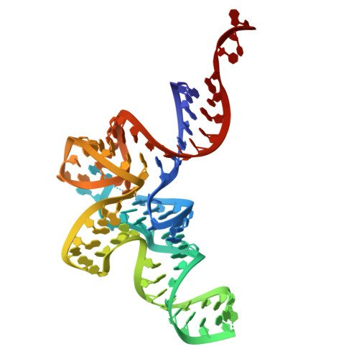
RNA-level data
RNA transcripts
5′
3′
Exon1
Exon2
Exon3
Sequences, exon composition and transcript variants
Ensembl
Noncoding RNAs
RNAcentral
RNA sequences, families and structure
Expression
Atlas
GEO
GEA
RNA notation
5′
A
G
C
U
U
C
G
A
3′
DNA notation
5′
A
G
C
T
T
C
G
A
3′
Notes:
[On slide entry] RNA-level resources provide sequence records and information about the biological roles of RNA.
[Click 1] A transcript record describes an RNA sequence and its relationship to a gene. RefSeq and Ensembl provide annotated transcript sequences, including their exon composition and alternative forms. The mature-RNA illustration shows exon segments joined after splicing. Its three-exon arrangement is illustrative, rather than a rule for all transcripts. Because annotations may combine experimental evidence, prediction and curation, we should check the evidence supporting the particular record. [1]
Submitted transcript sequences are also accessible through the three INSDC partners: GenBank at NCBI, ENA at EMBL-EBI, and DDBJ Annotated/Assembled Sequences in Japan. Despite its name, the DNA Data Bank of Japan also stores RNA sequence information. These shared archives preserve submitted sequences, while RefSeq and Ensembl provide additional reference sequences and annotations. [1, 2]
[Click 2] Noncoding RNAs are also transcription products, but they function without encoding proteins. The tRNA illustration shows a familiar example: tRNAs carry amino acids to the ribosome. RNAcentral brings together noncoding RNA sequences and annotations from specialist resources. Rfam groups related RNAs into families using sequence and structural information. These resources help us connect an RNA sequence to its possible function, while checking whether an annotation or structure has experimental support. [3]
[Click 3] A sequence record tells us which RNA form we are examining. Expression data tell us where that RNA is detected and how abundant it is. Cells carrying the same gene can contain very different amounts of its RNA, so finding a transcript record does not establish its expression in a particular tissue. Some expression datasets report RNA abundance for a gene as a whole without distinguishing its transcript variants.
At the DNA level, we describe the template from which RNA is produced. Gene expression uses information in that template to produce RNA and, for coding genes, proteins. DNA remains the template during transcription, which is why we do not introduce a separate DNA-expression category. DNA copy number describes DNA quantity, while regulatory features such as methylation help explain how expression is controlled. At the RNA level, both the identity of the product and its abundance matter. [4]
GEO and Japan’s Genomic Expression Archive, or GEA, preserve expression studies with sample descriptions and associated data. For RNA-sequencing studies submitted through DDBJ, the raw reads are stored in DRA, while GEA holds the processed data and experimental descriptions. Expression Atlas organizes selected studies into curated expression results. Before comparing values, we need to check the samples, methods and units. The expression illustration is schematic, rather than experimental data for a particular gene or organ. [2, 5]
RNA abundance also differs from protein abundance. Translation and protein degradation affect the amount of protein that accumulates, so abundant mRNA does not necessarily mean abundant protein. Expression Atlas includes protein measurements as well as RNA measurements. [5]
[Click 4] The RNA-notation row uses U, while the DNA-notation row writes the same illustrative RNA sequence with T instead. This convention can apply to noncoding RNAs as well as mRNAs. The record’s molecule type and annotation identify what the sequence represents. Using T does not by itself mean that the sequence is genomic DNA or that a physical cDNA copy was made in the laboratory. DDBJ explicitly uses this convention for RNA sequences. [6]
We can now examine how different transcription starts, splicing patterns and RNA processing sites can produce several transcript sequences from one gene.
References:
[1] RefSeq: transcript records and annotation
https://www.ncbi.nlm.nih.gov/refseq/about/
[2] DDBJ: sequence archives, GEA and DRA
https://www.ddbj.nig.ac.jp/submission-e.html
[3] RNAcentral and its specialist resources
https://rnacentral.org/about-us
[4] NHGRI: gene expression
https://www.genome.gov/genetics-glossary/Gene-Expression
[5] Expression Atlas
https://www.ebi.ac.uk/gxa/about.html
[6] DDBJ: nucleotide sequence conventions
https://www.ddbj.nig.ac.jp/ddbj/sequence-e.html

Slide 47
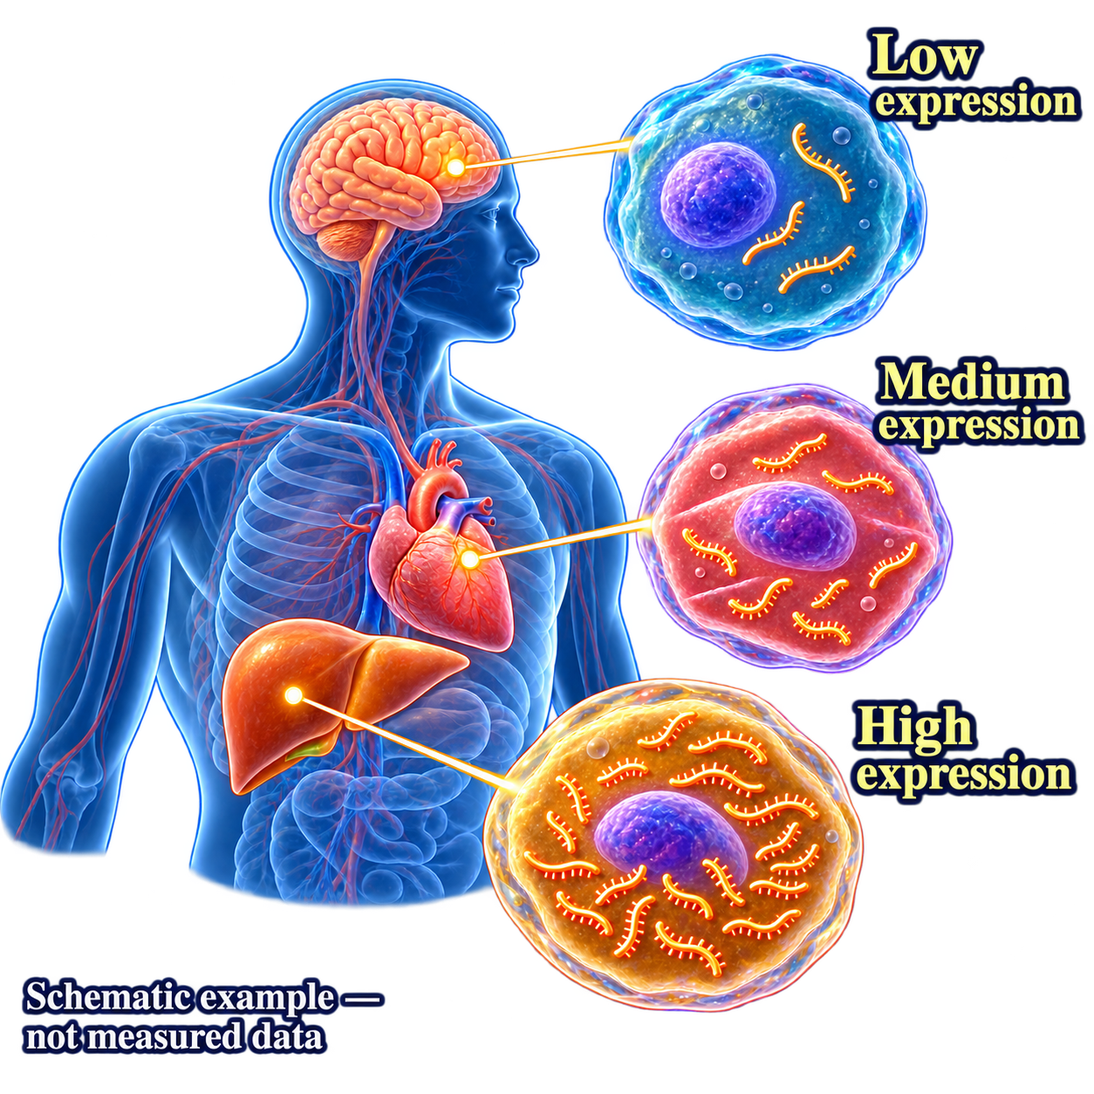
RNA-level data
RNA transcripts
5′
3′
Exon1
Exon2
Exon3
Sequences, exon composition and transcript variants
Ensembl
Noncoding RNAs
RNAcentral
RNA sequences, families and structure
RNA expression
Expression
Atlas
Where RNA is detected and how abundant it is
GEO
GEA
RNA notation
5′
A
G
C
U
U
C
G
A
3′
DNA notation
5′
A
G
C
T
T
C
G
A
3′
Notes:
[On slide entry] RNA-level resources provide sequence records and information about the biological roles of RNA.
[Click 1] A transcript record describes an RNA sequence and its relationship to a gene. RefSeq and Ensembl provide annotated transcript sequences, including their exon composition and alternative forms. The mature-RNA illustration shows exon segments joined after splicing. Its three-exon arrangement is illustrative, rather than a rule for all transcripts. Because annotations may combine experimental evidence, prediction and curation, we should check the evidence supporting the particular record. [1]
Submitted transcript sequences are also accessible through the three INSDC partners: GenBank at NCBI, ENA at EMBL-EBI, and DDBJ Annotated/Assembled Sequences in Japan. Despite its name, the DNA Data Bank of Japan also stores RNA sequence information. These shared archives preserve submitted sequences, while RefSeq and Ensembl provide additional reference sequences and annotations. [1, 2]
[Click 2] Noncoding RNAs are also transcription products, but they function without encoding proteins. The tRNA illustration shows a familiar example: tRNAs carry amino acids to the ribosome. RNAcentral brings together noncoding RNA sequences and annotations from specialist resources. Rfam groups related RNAs into families using sequence and structural information. These resources help us connect an RNA sequence to its possible function, while checking whether an annotation or structure has experimental support. [3]
[Click 3] A sequence record tells us which RNA form we are examining. Expression data tell us where that RNA is detected and how abundant it is. Cells carrying the same gene can contain very different amounts of its RNA, so finding a transcript record does not establish its expression in a particular tissue. Some expression datasets report RNA abundance for a gene as a whole without distinguishing its transcript variants.
At the DNA level, we describe the template from which RNA is produced. Gene expression uses information in that template to produce RNA and, for coding genes, proteins. DNA remains the template during transcription, which is why we do not introduce a separate DNA-expression category. DNA copy number describes DNA quantity, while regulatory features such as methylation help explain how expression is controlled. At the RNA level, both the identity of the product and its abundance matter. [4]
GEO and Japan’s Genomic Expression Archive, or GEA, preserve expression studies with sample descriptions and associated data. For RNA-sequencing studies submitted through DDBJ, the raw reads are stored in DRA, while GEA holds the processed data and experimental descriptions. Expression Atlas organizes selected studies into curated expression results. Before comparing values, we need to check the samples, methods and units. The expression illustration is schematic, rather than experimental data for a particular gene or organ. [2, 5]
RNA abundance also differs from protein abundance. Translation and protein degradation affect the amount of protein that accumulates, so abundant mRNA does not necessarily mean abundant protein. Expression Atlas includes protein measurements as well as RNA measurements. [5]
[Click 4] The RNA-notation row uses U, while the DNA-notation row writes the same illustrative RNA sequence with T instead. This convention can apply to noncoding RNAs as well as mRNAs. The record’s molecule type and annotation identify what the sequence represents. Using T does not by itself mean that the sequence is genomic DNA or that a physical cDNA copy was made in the laboratory. DDBJ explicitly uses this convention for RNA sequences. [6]
We can now examine how different transcription starts, splicing patterns and RNA processing sites can produce several transcript sequences from one gene.
References:
[1] RefSeq: transcript records and annotation
https://www.ncbi.nlm.nih.gov/refseq/about/
[2] DDBJ: sequence archives, GEA and DRA
https://www.ddbj.nig.ac.jp/submission-e.html
[3] RNAcentral and its specialist resources
https://rnacentral.org/about-us
[4] NHGRI: gene expression
https://www.genome.gov/genetics-glossary/Gene-Expression
[5] Expression Atlas
https://www.ebi.ac.uk/gxa/about.html
[6] DDBJ: nucleotide sequence conventions
https://www.ddbj.nig.ac.jp/ddbj/sequence-e.html

Slide 48
RNA-level data
RNA transcripts
5′
3′
Exon1
Exon2
Exon3
Sequences, exon composition and transcript variants
Ensembl
Noncoding RNAs
RNAcentral
RNA sequences, families and structure
RNA expression
Expression
Atlas
Where RNA is detected and how abundant it is
GEO
GEA
Same RNA sequence, two writing conventions
RNA notation
5′
A
G
C
U
U
C
G
A
3′
DNA notation
5′
A
G
C
T
T
C
G
A
3′
Notes:
[On slide entry] RNA-level resources provide sequence records and information about the biological roles of RNA.
[Click 1] A transcript record describes an RNA sequence and its relationship to a gene. RefSeq and Ensembl provide annotated transcript sequences, including their exon composition and alternative forms. The mature-RNA illustration shows exon segments joined after splicing. Its three-exon arrangement is illustrative, rather than a rule for all transcripts. Because annotations may combine experimental evidence, prediction and curation, we should check the evidence supporting the particular record. [1]
Submitted transcript sequences are also accessible through the three INSDC partners: GenBank at NCBI, ENA at EMBL-EBI, and DDBJ Annotated/Assembled Sequences in Japan. Despite its name, the DNA Data Bank of Japan also stores RNA sequence information. These shared archives preserve submitted sequences, while RefSeq and Ensembl provide additional reference sequences and annotations. [1, 2]
[Click 2] Noncoding RNAs are also transcription products, but they function without encoding proteins. The tRNA illustration shows a familiar example: tRNAs carry amino acids to the ribosome. RNAcentral brings together noncoding RNA sequences and annotations from specialist resources. Rfam groups related RNAs into families using sequence and structural information. These resources help us connect an RNA sequence to its possible function, while checking whether an annotation or structure has experimental support. [3]
[Click 3] A sequence record tells us which RNA form we are examining. Expression data tell us where that RNA is detected and how abundant it is. Cells carrying the same gene can contain very different amounts of its RNA, so finding a transcript record does not establish its expression in a particular tissue. Some expression datasets report RNA abundance for a gene as a whole without distinguishing its transcript variants.
At the DNA level, we describe the template from which RNA is produced. Gene expression uses information in that template to produce RNA and, for coding genes, proteins. DNA remains the template during transcription, which is why we do not introduce a separate DNA-expression category. DNA copy number describes DNA quantity, while regulatory features such as methylation help explain how expression is controlled. At the RNA level, both the identity of the product and its abundance matter. [4]
GEO and Japan’s Genomic Expression Archive, or GEA, preserve expression studies with sample descriptions and associated data. For RNA-sequencing studies submitted through DDBJ, the raw reads are stored in DRA, while GEA holds the processed data and experimental descriptions. Expression Atlas organizes selected studies into curated expression results. Before comparing values, we need to check the samples, methods and units. The expression illustration is schematic, rather than experimental data for a particular gene or organ. [2, 5]
RNA abundance also differs from protein abundance. Translation and protein degradation affect the amount of protein that accumulates, so abundant mRNA does not necessarily mean abundant protein. Expression Atlas includes protein measurements as well as RNA measurements. [5]
[Click 4] The RNA-notation row uses U, while the DNA-notation row writes the same illustrative RNA sequence with T instead. This convention can apply to noncoding RNAs as well as mRNAs. The record’s molecule type and annotation identify what the sequence represents. Using T does not by itself mean that the sequence is genomic DNA or that a physical cDNA copy was made in the laboratory. DDBJ explicitly uses this convention for RNA sequences. [6]
We can now examine how different transcription starts, splicing patterns and RNA processing sites can produce several transcript sequences from one gene.
References:
[1] RefSeq: transcript records and annotation
https://www.ncbi.nlm.nih.gov/refseq/about/
[2] DDBJ: sequence archives, GEA and DRA
https://www.ddbj.nig.ac.jp/submission-e.html
[3] RNAcentral and its specialist resources
https://rnacentral.org/about-us
[4] NHGRI: gene expression
https://www.genome.gov/genetics-glossary/Gene-Expression
[5] Expression Atlas
https://www.ebi.ac.uk/gxa/about.html
[6] DDBJ: nucleotide sequence conventions
https://www.ddbj.nig.ac.jp/ddbj/sequence-e.html

Slide 49
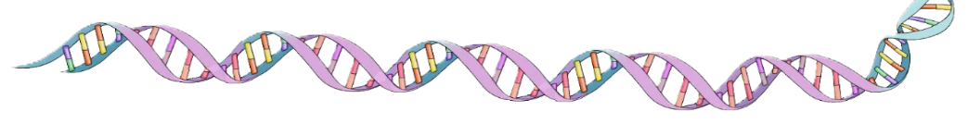
RNA-level data
5′
3′
Exon1
Exon2
Exon3
5′
3′
Exon1
Exon3
Exon2
Intron
Intron
Exon1
Exon2
Exon3
5′
3′
Exon1
Exon3
Gene
5′
3′
Exon1
Exon2
Exon3
Notes:
[On slide entry] The previous slide introduced resources for RNA sequences and expression data. Here we see why searching for one gene can return several transcript sequences.
[Click 1] The exemplar gene diagram contains three exons separated by introns. [Click 2] In the baseline example, splicing removes the introns and joins all three exons. This transcript provides a
reference for comparing the other forms.
[Click 3] Transcription can begin at different sites, producing RNAs with different 5′ ends.
[Click 4] Alternative splicing changes which sequences remain in the mature RNA. Here, exon 2 is skipped, while exons 1 and 3 retain their genomic order.
[Click 5] Alternative cleavage and polyadenylation produce different 3′ ends. These mechanisms can occur in combination, so the diagram illustrates possibilities rather than a fixed number
of transcripts per gene. [1]
Different transcripts do not necessarily produce different proteins. Changes can affect untranslated regions while leaving the protein sequence unchanged
[Click 6] For database work, a gene name may therefore be insufficient to specify the RNA sequence we need. To check whether two transcripts originate from the same gene, follow their links
to the gene records. Transcripts from the same gene link to the same gene identifier. Make this comparison within the same organism, database and annotation release.
For example, different Ensembl transcript identifiers beginning with ENST can link to the same gene identifier beginning with ENSG. The shared gene link establishes their annotated
relationship, while their separate transcript identifiers distinguish the RNA forms. Before selecting a sequence, check its annotation and supporting evidence, and record its identifier
and version. [2]
References:
[1] Mechanisms generating transcript diversity
https://pmc.ncbi.nlm.nih.gov/articles/PMC1435940/
[2] Ensembl identifiers and versions
https://www.ensembl.org/info/genome/stable_ids/index.html
8:46 AM

Slide 50
RNA-level data
One gene, several RNA transcripts
5′
3′
Exon1
Exon2
Exon3
5′
3′
Exon1
Exon3
Exon2
Intron
Intron
Exon1
Exon2
Exon3
5′
3′
Exon1
Exon3
Gene
5′
3′
Exon1
Exon2
Exon3
Notes:
[On slide entry] The previous slide introduced resources for RNA sequences and expression data. Here we see why searching for one gene can return several transcript sequences.
[Click 1] The exemplar gene diagram contains three exons separated by introns. [Click 2] In the baseline example, splicing removes the introns and joins all three exons. This transcript provides a
reference for comparing the other forms.
[Click 3] Transcription can begin at different sites, producing RNAs with different 5′ ends.
[Click 4] Alternative splicing changes which sequences remain in the mature RNA. Here, exon 2 is skipped, while exons 1 and 3 retain their genomic order.
[Click 5] Alternative cleavage and polyadenylation produce different 3′ ends. These mechanisms can occur in combination, so the diagram illustrates possibilities rather than a fixed number
of transcripts per gene. [1]
Different transcripts do not necessarily produce different proteins. Changes can affect untranslated regions while leaving the protein sequence unchanged
[Click 6] For database work, a gene name may therefore be insufficient to specify the RNA sequence we need. To check whether two transcripts originate from the same gene, follow their links
to the gene records. Transcripts from the same gene link to the same gene identifier. Make this comparison within the same organism, database and annotation release.
For example, different Ensembl transcript identifiers beginning with ENST can link to the same gene identifier beginning with ENSG. The shared gene link establishes their annotated
relationship, while their separate transcript identifiers distinguish the RNA forms. Before selecting a sequence, check its annotation and supporting evidence, and record its identifier
and version. [2]
References:
[1] Mechanisms generating transcript diversity
https://pmc.ncbi.nlm.nih.gov/articles/PMC1435940/
[2] Ensembl identifiers and versions
https://www.ensembl.org/info/genome/stable_ids/index.html
8:46 AM

Slide 51
RNA-level data
One gene, several RNA transcripts
5′
3′
Baseline transcript
Exon1
Exon2
Exon3
5′
3′
Exon1
Exon3
Exon2
Intron
Intron
Exon1
Exon2
Exon3
5′
3′
Exon1
Exon3
Gene
5′
3′
Exon1
Exon2
Exon3
Notes:
[On slide entry] The previous slide introduced resources for RNA sequences and expression data. Here we see why searching for one gene can return several transcript sequences.
[Click 1] The exemplar gene diagram contains three exons separated by introns. [Click 2] In the baseline example, splicing removes the introns and joins all three exons. This transcript provides a
reference for comparing the other forms.
[Click 3] Transcription can begin at different sites, producing RNAs with different 5′ ends.
[Click 4] Alternative splicing changes which sequences remain in the mature RNA. Here, exon 2 is skipped, while exons 1 and 3 retain their genomic order.
[Click 5] Alternative cleavage and polyadenylation produce different 3′ ends. These mechanisms can occur in combination, so the diagram illustrates possibilities rather than a fixed number
of transcripts per gene. [1]
Different transcripts do not necessarily produce different proteins. Changes can affect untranslated regions while leaving the protein sequence unchanged
[Click 6] For database work, a gene name may therefore be insufficient to specify the RNA sequence we need. To check whether two transcripts originate from the same gene, follow their links
to the gene records. Transcripts from the same gene link to the same gene identifier. Make this comparison within the same organism, database and annotation release.
For example, different Ensembl transcript identifiers beginning with ENST can link to the same gene identifier beginning with ENSG. The shared gene link establishes their annotated
relationship, while their separate transcript identifiers distinguish the RNA forms. Before selecting a sequence, check its annotation and supporting evidence, and record its identifier
and version. [2]
References:
[1] Mechanisms generating transcript diversity
https://pmc.ncbi.nlm.nih.gov/articles/PMC1435940/
[2] Ensembl identifiers and versions
https://www.ensembl.org/info/genome/stable_ids/index.html
8:46 AM

Slide 52
RNA-level data
One gene, several RNA transcripts
5′
3′
Baseline transcript
Exon1
Exon2
Exon3
5′
3′
Transcription start at different sites
Exon1
Exon3
Exon2
Intron
Intron
Exon1
Exon2
Exon3
5′
3′
Exon1
Exon3
Gene
5′
3′
Exon1
Exon2
Exon3
Notes:
[On slide entry] The previous slide introduced resources for RNA sequences and expression data. Here we see why searching for one gene can return several transcript sequences.
[Click 1] The exemplar gene diagram contains three exons separated by introns. [Click 2] In the baseline example, splicing removes the introns and joins all three exons. This transcript provides a
reference for comparing the other forms.
[Click 3] Transcription can begin at different sites, producing RNAs with different 5′ ends.
[Click 4] Alternative splicing changes which sequences remain in the mature RNA. Here, exon 2 is skipped, while exons 1 and 3 retain their genomic order.
[Click 5] Alternative cleavage and polyadenylation produce different 3′ ends. These mechanisms can occur in combination, so the diagram illustrates possibilities rather than a fixed number
of transcripts per gene. [1]
Different transcripts do not necessarily produce different proteins. Changes can affect untranslated regions while leaving the protein sequence unchanged
[Click 6] For database work, a gene name may therefore be insufficient to specify the RNA sequence we need. To check whether two transcripts originate from the same gene, follow their links
to the gene records. Transcripts from the same gene link to the same gene identifier. Make this comparison within the same organism, database and annotation release.
For example, different Ensembl transcript identifiers beginning with ENST can link to the same gene identifier beginning with ENSG. The shared gene link establishes their annotated
relationship, while their separate transcript identifiers distinguish the RNA forms. Before selecting a sequence, check its annotation and supporting evidence, and record its identifier
and version. [2]
References:
[1] Mechanisms generating transcript diversity
https://pmc.ncbi.nlm.nih.gov/articles/PMC1435940/
[2] Ensembl identifiers and versions
https://www.ensembl.org/info/genome/stable_ids/index.html
8:46 AM

Slide 53
RNA-level data
One gene, several RNA transcripts
5′
3′
Baseline transcript
Exon1
Exon2
Exon3
5′
3′
Transcription start at different sites
Exon1
Exon3
Exon2
Intron
Intron
Exon1
Exon2
Exon3
5′
3′
Alternative splicing
Exon1
Exon3
Gene
5′
3′
Exon1
Exon2
Exon3
Notes:
[On slide entry] The previous slide introduced resources for RNA sequences and expression data. Here we see why searching for one gene can return several transcript sequences.
[Click 1] The exemplar gene diagram contains three exons separated by introns. [Click 2] In the baseline example, splicing removes the introns and joins all three exons. This transcript provides a
reference for comparing the other forms.
[Click 3] Transcription can begin at different sites, producing RNAs with different 5′ ends.
[Click 4] Alternative splicing changes which sequences remain in the mature RNA. Here, exon 2 is skipped, while exons 1 and 3 retain their genomic order.
[Click 5] Alternative cleavage and polyadenylation produce different 3′ ends. These mechanisms can occur in combination, so the diagram illustrates possibilities rather than a fixed number
of transcripts per gene. [1]
Different transcripts do not necessarily produce different proteins. Changes can affect untranslated regions while leaving the protein sequence unchanged
[Click 6] For database work, a gene name may therefore be insufficient to specify the RNA sequence we need. To check whether two transcripts originate from the same gene, follow their links
to the gene records. Transcripts from the same gene link to the same gene identifier. Make this comparison within the same organism, database and annotation release.
For example, different Ensembl transcript identifiers beginning with ENST can link to the same gene identifier beginning with ENSG. The shared gene link establishes their annotated
relationship, while their separate transcript identifiers distinguish the RNA forms. Before selecting a sequence, check its annotation and supporting evidence, and record its identifier
and version. [2]
References:
[1] Mechanisms generating transcript diversity
https://pmc.ncbi.nlm.nih.gov/articles/PMC1435940/
[2] Ensembl identifiers and versions
https://www.ensembl.org/info/genome/stable_ids/index.html
8:46 AM

Slide 54
RNA-level data
One gene, several RNA transcripts
5′
3′
Baseline transcript
Exon1
Exon2
Exon3
5′
3′
Transcription start at different sites
Exon1
Exon3
Exon2
Intron
Intron
Exon1
Exon2
Exon3
5′
3′
Alternative splicing
Exon1
Exon3
Gene
5′
3′
Alternative cleavage/polyadenylation sites
Exon1
Exon2
Exon3
Notes:
[On slide entry] The previous slide introduced resources for RNA sequences and expression data. Here we see why searching for one gene can return several transcript sequences.
[Click 1] The exemplar gene diagram contains three exons separated by introns. [Click 2] In the baseline example, splicing removes the introns and joins all three exons. This transcript provides a
reference for comparing the other forms.
[Click 3] Transcription can begin at different sites, producing RNAs with different 5′ ends.
[Click 4] Alternative splicing changes which sequences remain in the mature RNA. Here, exon 2 is skipped, while exons 1 and 3 retain their genomic order.
[Click 5] Alternative cleavage and polyadenylation produce different 3′ ends. These mechanisms can occur in combination, so the diagram illustrates possibilities rather than a fixed number
of transcripts per gene. [1]
Different transcripts do not necessarily produce different proteins. Changes can affect untranslated regions while leaving the protein sequence unchanged
[Click 6] For database work, a gene name may therefore be insufficient to specify the RNA sequence we need. To check whether two transcripts originate from the same gene, follow their links
to the gene records. Transcripts from the same gene link to the same gene identifier. Make this comparison within the same organism, database and annotation release.
For example, different Ensembl transcript identifiers beginning with ENST can link to the same gene identifier beginning with ENSG. The shared gene link establishes their annotated
relationship, while their separate transcript identifiers distinguish the RNA forms. Before selecting a sequence, check its annotation and supporting evidence, and record its identifier
and version. [2]
References:
[1] Mechanisms generating transcript diversity
https://pmc.ncbi.nlm.nih.gov/articles/PMC1435940/
[2] Ensembl identifiers and versions
https://www.ensembl.org/info/genome/stable_ids/index.html
8:46 AM

Slide 55
RNA-level data
One gene, several RNA transcripts
5′
3′
Baseline transcript
Exon1
Exon2
Exon3
5′
3′
Transcription start at different sites
Exon1
Exon3
Exon2
Intron
Intron
Exon1
Exon2
Exon3
5′
3′
Alternative splicing
Exon1
Exon3
Gene
5′
3′
Alternative cleavage/polyadenylation sites
Exon1
Exon2
Exon3
Two transcripts, same gene?
Transcripts originating from the same gene share a linked gene identifier.
Notes:
[On slide entry] The previous slide introduced resources for RNA sequences and expression data. Here we see why searching for one gene can return several transcript sequences.
[Click 1] The exemplar gene diagram contains three exons separated by introns. [Click 2] In the baseline example, splicing removes the introns and joins all three exons. This transcript provides a
reference for comparing the other forms.
[Click 3] Transcription can begin at different sites, producing RNAs with different 5′ ends.
[Click 4] Alternative splicing changes which sequences remain in the mature RNA. Here, exon 2 is skipped, while exons 1 and 3 retain their genomic order.
[Click 5] Alternative cleavage and polyadenylation produce different 3′ ends. These mechanisms can occur in combination, so the diagram illustrates possibilities rather than a fixed number
of transcripts per gene. [1]
Different transcripts do not necessarily produce different proteins. Changes can affect untranslated regions while leaving the protein sequence unchanged
[Click 6] For database work, a gene name may therefore be insufficient to specify the RNA sequence we need. To check whether two transcripts originate from the same gene, follow their links
to the gene records. Transcripts from the same gene link to the same gene identifier. Make this comparison within the same organism, database and annotation release.
For example, different Ensembl transcript identifiers beginning with ENST can link to the same gene identifier beginning with ENSG. The shared gene link establishes their annotated
relationship, while their separate transcript identifiers distinguish the RNA forms. Before selecting a sequence, check its annotation and supporting evidence, and record its identifier
and version. [2]
References:
[1] Mechanisms generating transcript diversity
https://pmc.ncbi.nlm.nih.gov/articles/PMC1435940/
[2] Ensembl identifiers and versions
https://www.ensembl.org/info/genome/stable_ids/index.html
8:46 AM

Slide 56


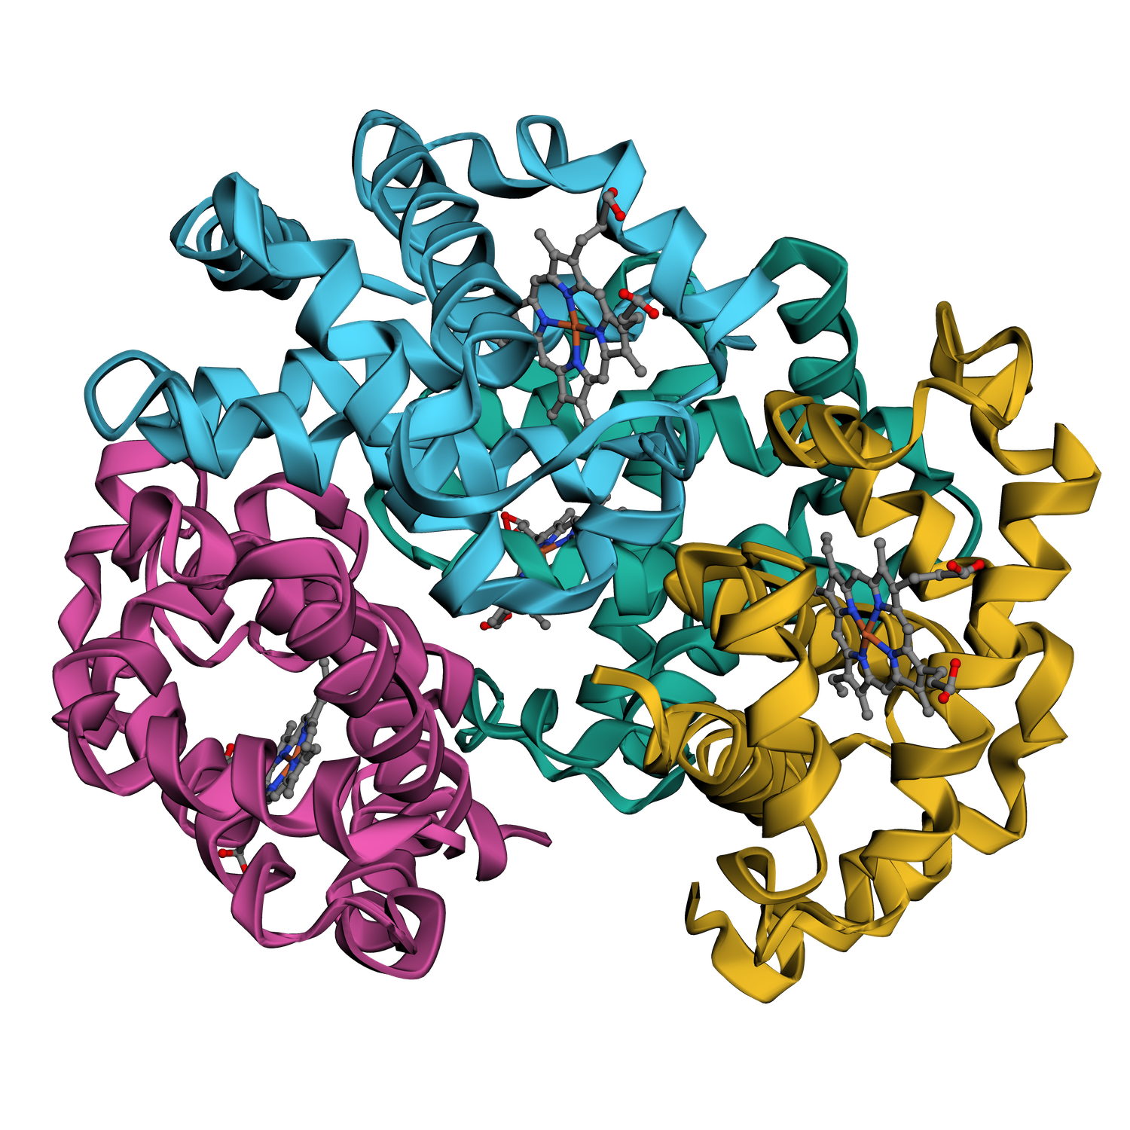






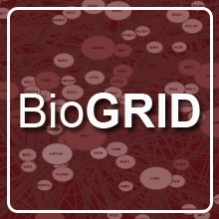
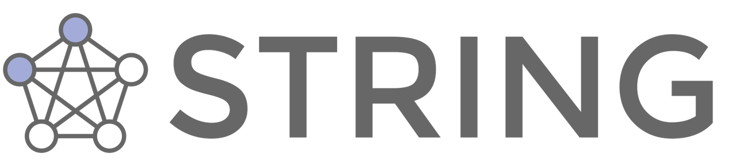

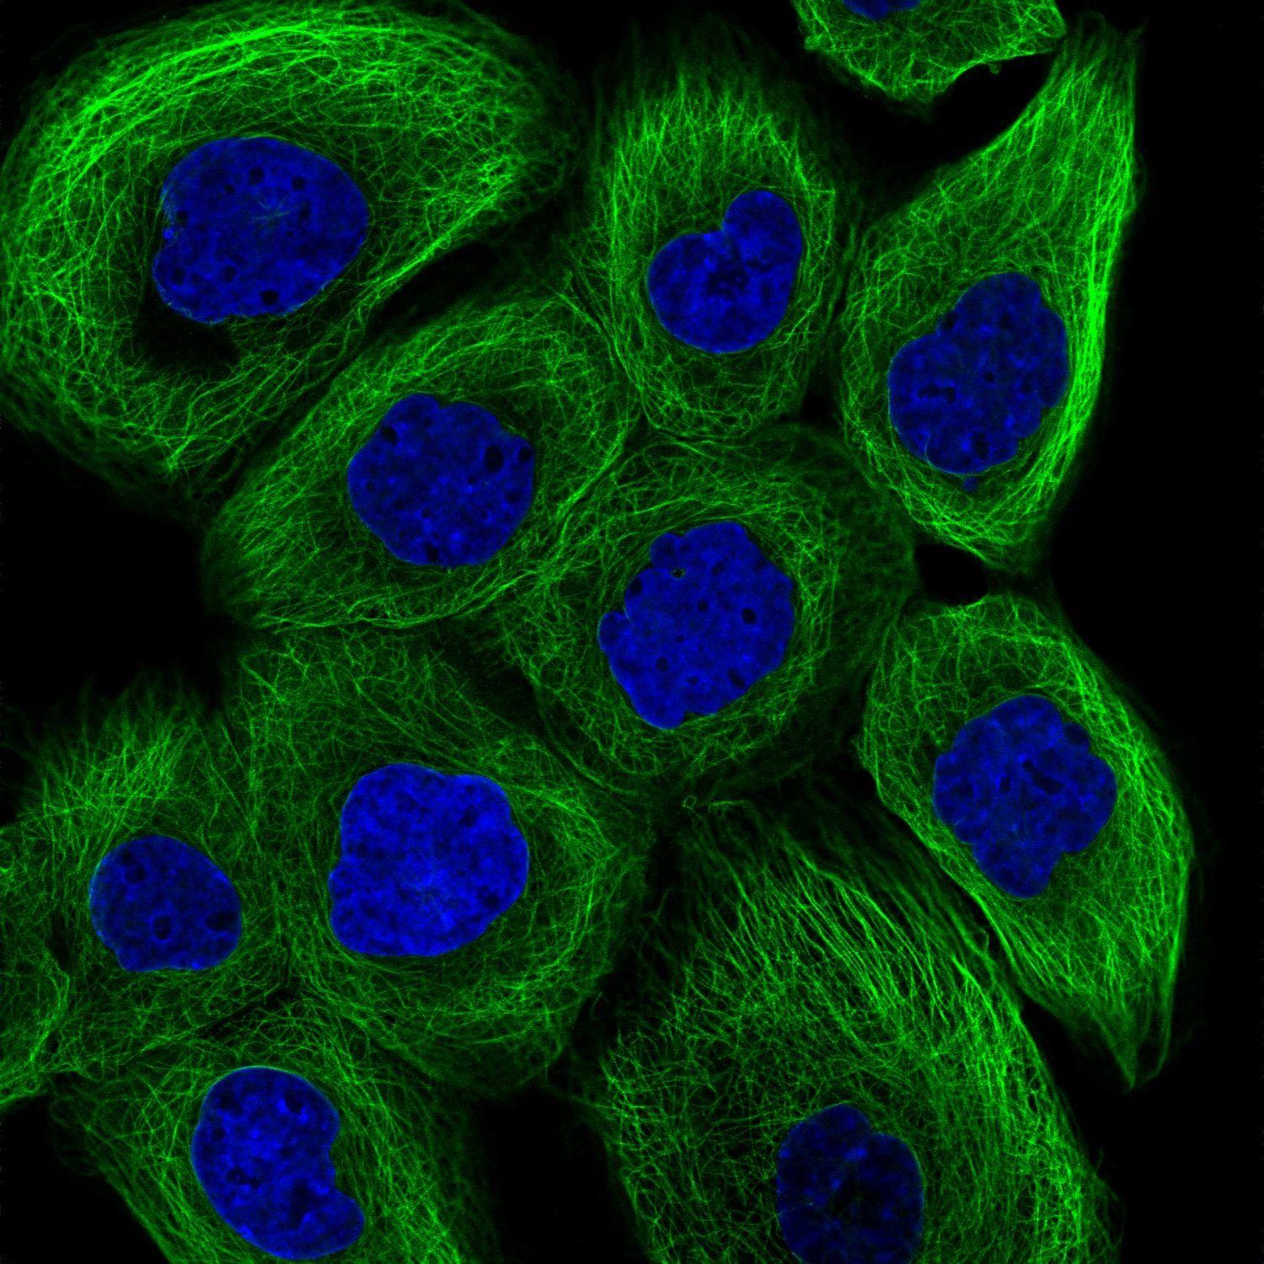
M
V
H
L
T
P
E
E
K
S
A
V
T
A
L
W
G
K
V
N
β-globin sequence
AlphaFold
Haemoglobin (PDB)
A
B
C
Domain map: schematic
HBA2
HBZ
HBB
BioGRID
HBD
HBA1
HBB network (STRING)
Green: tubulin; blue: nuclei
Notes:
[On slide entry] The preceding slides showed how genes relate to RNA transcripts. Protein records describe the resulting amino-acid sequences and connect them to information about structure, biological function and cellular context.
[Click 1] Different transcripts do not necessarily encode different proteins. The β-globin sequence illustrates sequence information available through resources such as UniProtKB and NCBI Protein, including annotated variants and links to related records.
[Click 2] The haemoglobin picture illustrates three-dimensional structure. RCSB PDB, PDBe and Japan’s PDBj provide different interfaces to the shared PDB archive. These structural models are based on experimental measurements. AlphaFold provides predicted models, so similar-looking pictures can have different supporting evidence.
[Click 3] The coloured domain map is a generic schematic. Domains are recognizable structural or functional units within proteins. Pfam and InterPro help identify conserved regions, classify protein families and annotate functional sites. SCOP (Structural Classification of Proteins) classifies domains with known three-dimensional structures according to their structural similarities and evolutionary relationships.
[Click 4] The HBB network illustrates relationships between proteins. BioGRID and IntAct provide curated experimental interaction data, while STRING integrates several sources of evidence for protein associations. A connection can indicate a shared biological role without demonstrating direct binding. Genetic interactions describe the effects of combined gene perturbations, rather than necessarily showing physical contact between proteins.
[Click 5] Protein abundance and location provide additional biological context. The microscopy image shows green tubulin fibres around blue nuclei, illustrating protein localization. The Human Protein Atlas also provides information about protein abundance across tissues and cells. Protein abundance can differ from RNA abundance because translation and protein degradation affect protein levels.
The databases shown are examples, not an exhaustive list. These categories provide a general framework for understanding protein databases. Specialist resources concentrate on particular aspects, while broader resources combine several and link to complementary records. The aim is to recognize what information a database provides and how its claims are supported, rather than memorize a list of names.

Slide 57
Protein-level data
M
V
H
L
T
P
E
E
K
S
A
V
T
A
L
W
G
K
V
N
β-globin sequence
AlphaFold
Haemoglobin (PDB)
A
B
C
Domain map: schematic
HBA2
HBZ
HBB
BioGRID
HBD
HBA1
HBB network (STRING)
Green: tubulin; blue: nuclei
Notes:
[On slide entry] The preceding slides showed how genes relate to RNA transcripts. Protein records describe the resulting amino-acid sequences and connect them to information about structure, biological function and cellular context.
[Click 1] Different transcripts do not necessarily encode different proteins. The β-globin sequence illustrates sequence information available through resources such as UniProtKB and NCBI Protein, including annotated variants and links to related records.
[Click 2] The haemoglobin picture illustrates three-dimensional structure. RCSB PDB, PDBe and Japan’s PDBj provide different interfaces to the shared PDB archive. These structural models are based on experimental measurements. AlphaFold provides predicted models, so similar-looking pictures can have different supporting evidence.
[Click 3] The coloured domain map is a generic schematic. Domains are recognizable structural or functional units within proteins. Pfam and InterPro help identify conserved regions, classify protein families and annotate functional sites. SCOP (Structural Classification of Proteins) classifies domains with known three-dimensional structures according to their structural similarities and evolutionary relationships.
[Click 4] The HBB network illustrates relationships between proteins. BioGRID and IntAct provide curated experimental interaction data, while STRING integrates several sources of evidence for protein associations. A connection can indicate a shared biological role without demonstrating direct binding. Genetic interactions describe the effects of combined gene perturbations, rather than necessarily showing physical contact between proteins.
[Click 5] Protein abundance and location provide additional biological context. The microscopy image shows green tubulin fibres around blue nuclei, illustrating protein localization. The Human Protein Atlas also provides information about protein abundance across tissues and cells. Protein abundance can differ from RNA abundance because translation and protein degradation affect protein levels.
The databases shown are examples, not an exhaustive list. These categories provide a general framework for understanding protein databases. Specialist resources concentrate on particular aspects, while broader resources combine several and link to complementary records. The aim is to recognize what information a database provides and how its claims are supported, rather than memorize a list of names.

Slide 58
Protein-level data
Amino-acid sequence
M
V
H
L
T
P
E
E
K
S
Sequences and annotated variants
A
V
T
A
L
W
G
K
V
N
β-globin sequence
AlphaFold
Haemoglobin (PDB)
A
B
C
Domain map: schematic
HBA2
HBZ
HBB
BioGRID
HBD
HBA1
HBB network (STRING)
Green: tubulin; blue: nuclei
Notes:
[On slide entry] The preceding slides showed how genes relate to RNA transcripts. Protein records describe the resulting amino-acid sequences and connect them to information about structure, biological function and cellular context.
[Click 1] Different transcripts do not necessarily encode different proteins. The β-globin sequence illustrates sequence information available through resources such as UniProtKB and NCBI Protein, including annotated variants and links to related records.
[Click 2] The haemoglobin picture illustrates three-dimensional structure. RCSB PDB, PDBe and Japan’s PDBj provide different interfaces to the shared PDB archive. These structural models are based on experimental measurements. AlphaFold provides predicted models, so similar-looking pictures can have different supporting evidence.
[Click 3] The coloured domain map is a generic schematic. Domains are recognizable structural or functional units within proteins. Pfam and InterPro help identify conserved regions, classify protein families and annotate functional sites. SCOP (Structural Classification of Proteins) classifies domains with known three-dimensional structures according to their structural similarities and evolutionary relationships.
[Click 4] The HBB network illustrates relationships between proteins. BioGRID and IntAct provide curated experimental interaction data, while STRING integrates several sources of evidence for protein associations. A connection can indicate a shared biological role without demonstrating direct binding. Genetic interactions describe the effects of combined gene perturbations, rather than necessarily showing physical contact between proteins.
[Click 5] Protein abundance and location provide additional biological context. The microscopy image shows green tubulin fibres around blue nuclei, illustrating protein localization. The Human Protein Atlas also provides information about protein abundance across tissues and cells. Protein abundance can differ from RNA abundance because translation and protein degradation affect protein levels.
The databases shown are examples, not an exhaustive list. These categories provide a general framework for understanding protein databases. Specialist resources concentrate on particular aspects, while broader resources combine several and link to complementary records. The aim is to recognize what information a database provides and how its claims are supported, rather than memorize a list of names.

Slide 59
Protein-level data
Amino-acid sequence
M
V
H
L
T
P
E
E
K
S
Sequences and annotated variants
A
V
T
A
L
W
G
K
V
N
β-globin sequence
Three-dimensional structure
Experimental (PDB) or predicted (AlphaFold)
AlphaFold
Haemoglobin (PDB)
A
B
C
Domain map: schematic
HBA2
HBZ
HBB
BioGRID
HBD
HBA1
HBB network (STRING)
Green: tubulin; blue: nuclei
Notes:
[On slide entry] The preceding slides showed how genes relate to RNA transcripts. Protein records describe the resulting amino-acid sequences and connect them to information about structure, biological function and cellular context.
[Click 1] Different transcripts do not necessarily encode different proteins. The β-globin sequence illustrates sequence information available through resources such as UniProtKB and NCBI Protein, including annotated variants and links to related records.
[Click 2] The haemoglobin picture illustrates three-dimensional structure. RCSB PDB, PDBe and Japan’s PDBj provide different interfaces to the shared PDB archive. These structural models are based on experimental measurements. AlphaFold provides predicted models, so similar-looking pictures can have different supporting evidence.
[Click 3] The coloured domain map is a generic schematic. Domains are recognizable structural or functional units within proteins. Pfam and InterPro help identify conserved regions, classify protein families and annotate functional sites. SCOP (Structural Classification of Proteins) classifies domains with known three-dimensional structures according to their structural similarities and evolutionary relationships.
[Click 4] The HBB network illustrates relationships between proteins. BioGRID and IntAct provide curated experimental interaction data, while STRING integrates several sources of evidence for protein associations. A connection can indicate a shared biological role without demonstrating direct binding. Genetic interactions describe the effects of combined gene perturbations, rather than necessarily showing physical contact between proteins.
[Click 5] Protein abundance and location provide additional biological context. The microscopy image shows green tubulin fibres around blue nuclei, illustrating protein localization. The Human Protein Atlas also provides information about protein abundance across tissues and cells. Protein abundance can differ from RNA abundance because translation and protein degradation affect protein levels.
The databases shown are examples, not an exhaustive list. These categories provide a general framework for understanding protein databases. Specialist resources concentrate on particular aspects, while broader resources combine several and link to complementary records. The aim is to recognize what information a database provides and how its claims are supported, rather than memorize a list of names.

Slide 60
Protein-level data
Amino-acid sequence
M
V
H
L
T
P
E
E
K
S
Sequences and annotated variants
A
V
T
A
L
W
G
K
V
N
β-globin sequence
Three-dimensional structure
Experimental (PDB) or predicted (AlphaFold)
AlphaFold
Haemoglobin (PDB)
Domains and families
A
B
C
Conserved regions and functional sites
Domain map: schematic
HBA2
HBZ
HBB
BioGRID
HBD
HBA1
HBB network (STRING)
Green: tubulin; blue: nuclei
Notes:
[On slide entry] The preceding slides showed how genes relate to RNA transcripts. Protein records describe the resulting amino-acid sequences and connect them to information about structure, biological function and cellular context.
[Click 1] Different transcripts do not necessarily encode different proteins. The β-globin sequence illustrates sequence information available through resources such as UniProtKB and NCBI Protein, including annotated variants and links to related records.
[Click 2] The haemoglobin picture illustrates three-dimensional structure. RCSB PDB, PDBe and Japan’s PDBj provide different interfaces to the shared PDB archive. These structural models are based on experimental measurements. AlphaFold provides predicted models, so similar-looking pictures can have different supporting evidence.
[Click 3] The coloured domain map is a generic schematic. Domains are recognizable structural or functional units within proteins. Pfam and InterPro help identify conserved regions, classify protein families and annotate functional sites. SCOP (Structural Classification of Proteins) classifies domains with known three-dimensional structures according to their structural similarities and evolutionary relationships.
[Click 4] The HBB network illustrates relationships between proteins. BioGRID and IntAct provide curated experimental interaction data, while STRING integrates several sources of evidence for protein associations. A connection can indicate a shared biological role without demonstrating direct binding. Genetic interactions describe the effects of combined gene perturbations, rather than necessarily showing physical contact between proteins.
[Click 5] Protein abundance and location provide additional biological context. The microscopy image shows green tubulin fibres around blue nuclei, illustrating protein localization. The Human Protein Atlas also provides information about protein abundance across tissues and cells. Protein abundance can differ from RNA abundance because translation and protein degradation affect protein levels.
The databases shown are examples, not an exhaustive list. These categories provide a general framework for understanding protein databases. Specialist resources concentrate on particular aspects, while broader resources combine several and link to complementary records. The aim is to recognize what information a database provides and how its claims are supported, rather than memorize a list of names.

Slide 61
Protein-level data
Amino-acid sequence
M
V
H
L
T
P
E
E
K
S
Sequences and annotated variants
A
V
T
A
L
W
G
K
V
N
β-globin sequence
Three-dimensional structure
Experimental (PDB) or predicted (AlphaFold)
AlphaFold
Haemoglobin (PDB)
Domains and families
A
B
C
Conserved regions and functional sites
Domain map: schematic
HBA2
HBZ
Interactions and associations
HBB
BioGRID
HBD
HBA1
Physical / genetic interactions and functional links
HBB network (STRING)
Green: tubulin; blue: nuclei
Notes:
[On slide entry] The preceding slides showed how genes relate to RNA transcripts. Protein records describe the resulting amino-acid sequences and connect them to information about structure, biological function and cellular context.
[Click 1] Different transcripts do not necessarily encode different proteins. The β-globin sequence illustrates sequence information available through resources such as UniProtKB and NCBI Protein, including annotated variants and links to related records.
[Click 2] The haemoglobin picture illustrates three-dimensional structure. RCSB PDB, PDBe and Japan’s PDBj provide different interfaces to the shared PDB archive. These structural models are based on experimental measurements. AlphaFold provides predicted models, so similar-looking pictures can have different supporting evidence.
[Click 3] The coloured domain map is a generic schematic. Domains are recognizable structural or functional units within proteins. Pfam and InterPro help identify conserved regions, classify protein families and annotate functional sites. SCOP (Structural Classification of Proteins) classifies domains with known three-dimensional structures according to their structural similarities and evolutionary relationships.
[Click 4] The HBB network illustrates relationships between proteins. BioGRID and IntAct provide curated experimental interaction data, while STRING integrates several sources of evidence for protein associations. A connection can indicate a shared biological role without demonstrating direct binding. Genetic interactions describe the effects of combined gene perturbations, rather than necessarily showing physical contact between proteins.
[Click 5] Protein abundance and location provide additional biological context. The microscopy image shows green tubulin fibres around blue nuclei, illustrating protein localization. The Human Protein Atlas also provides information about protein abundance across tissues and cells. Protein abundance can differ from RNA abundance because translation and protein degradation affect protein levels.
The databases shown are examples, not an exhaustive list. These categories provide a general framework for understanding protein databases. Specialist resources concentrate on particular aspects, while broader resources combine several and link to complementary records. The aim is to recognize what information a database provides and how its claims are supported, rather than memorize a list of names.

Slide 62
Protein-level data
Amino-acid sequence
M
V
H
L
T
P
E
E
K
S
Sequences and annotated variants
A
V
T
A
L
W
G
K
V
N
β-globin sequence
Three-dimensional structure
Experimental (PDB) or predicted (AlphaFold)
AlphaFold
Haemoglobin (PDB)
Domains and families
A
B
C
Conserved regions and functional sites
Domain map: schematic
HBA2
HBZ
Interactions and associations
HBB
BioGRID
HBD
HBA1
Physical / genetic interactions and functional links
HBB network (STRING)
Abundance and location
Where a protein occurs and how much is detected
Green: tubulin; blue: nuclei
Notes:
[On slide entry] The preceding slides showed how genes relate to RNA transcripts. Protein records describe the resulting amino-acid sequences and connect them to information about structure, biological function and cellular context.
[Click 1] Different transcripts do not necessarily encode different proteins. The β-globin sequence illustrates sequence information available through resources such as UniProtKB and NCBI Protein, including annotated variants and links to related records.
[Click 2] The haemoglobin picture illustrates three-dimensional structure. RCSB PDB, PDBe and Japan’s PDBj provide different interfaces to the shared PDB archive. These structural models are based on experimental measurements. AlphaFold provides predicted models, so similar-looking pictures can have different supporting evidence.
[Click 3] The coloured domain map is a generic schematic. Domains are recognizable structural or functional units within proteins. Pfam and InterPro help identify conserved regions, classify protein families and annotate functional sites. SCOP (Structural Classification of Proteins) classifies domains with known three-dimensional structures according to their structural similarities and evolutionary relationships.
[Click 4] The HBB network illustrates relationships between proteins. BioGRID and IntAct provide curated experimental interaction data, while STRING integrates several sources of evidence for protein associations. A connection can indicate a shared biological role without demonstrating direct binding. Genetic interactions describe the effects of combined gene perturbations, rather than necessarily showing physical contact between proteins.
[Click 5] Protein abundance and location provide additional biological context. The microscopy image shows green tubulin fibres around blue nuclei, illustrating protein localization. The Human Protein Atlas also provides information about protein abundance across tissues and cells. Protein abundance can differ from RNA abundance because translation and protein degradation affect protein levels.
The databases shown are examples, not an exhaustive list. These categories provide a general framework for understanding protein databases. Specialist resources concentrate on particular aspects, while broader resources combine several and link to complementary records. The aim is to recognize what information a database provides and how its claims are supported, rather than memorize a list of names.

Slide 63
Notes:
[On slide entry] The previous slides introduced information at DNA, RNA and protein levels. We now consider how that information enters database records.
[Click 1] Experiments generate the measurements and observations that form the starting point for subsequent analysis. Here, raw data means the original experimental output retained for that analysis. Instruments and acquisition software may already have performed some processing, so “raw” does not necessarily mean completely untouched.
Sequencing signals are physical measurements used to determine a nucleotide sequence. Depending on the technology, these may be changes in fluorescence or electrical current. Software interprets the signals to assign nucleotide letters. Thus, the familiar sequence written as A, C, G and T already represents an interpretation of experimental measurements. NHGRI: DNA sequencing
Experimental images, such as microscopy images, record spatial information. They can show the appearance of cells or the distribution of fluorescent signals. Further analysis may identify individual cells, measure their dimensions or quantify fluorescence. The recorded image and the measurements extracted from it represent different stages of the investigation.
Instrument readings include measurements such as absorbance, fluorescence intensity or mass spectra. Their interpretation requires information about the units, instrument settings and experimental controls. Images and sequencing signals are also instrument outputs, so these examples overlap rather than form strictly separate categories.
Phenotypic observations describe observable characteristics, such as cell shape, growth or behaviour. Researchers may record them as images, counts, measurements or descriptive scores. A phenotype documents what was observed, while explaining its molecular cause requires additional evidence. NHGRI: Phenotype
These outputs become useful when accompanied by their experimental context: the organism, sample, conditions and methods. For example, sequencing data associated with HBB must be linked to the sample from which they originated. This is why archives connect data files to sample descriptions and project records. Together, the data and their context allow researchers to interpret, check and reanalyse the experiment. EMBL-EBI: ENA organisation
[Click 2] Analysis turns these observations into interpretable results and can predict additional properties. Software assembles sequence reads into longer sequences and translates coding regions into amino-acid sequences. Computational translation gives a protein sequence but does not establish that the protein was detected experimentally. Analysis can also assign domains and produce three-dimensional structural models. Some structural models are fitted to experimental measurements; others are computational predictions. Both involve analysis, but their supporting evidence differs. [1]
[Click 3] Curation evaluates and connects this information. Curators assess whether experiments or analyses support annotations—the descriptions of features and biological properties attached to a record. They link related records, for example connecting a protein to its transcript or an annotation to its source publication. Comparing findings across studies helps identify consistent results and differences caused by methods or experimental conditions. Curators then create or update annotations, documenting uncertainty where necessary. [2]
A reviewed record can therefore combine experimentally supported findings and computational interpretations. For HBB, its sequence, domain assignment and structural information may have different supporting sources. We should check the evidence for the claim we intend to use. Next, identifiers will help us specify the relevant records precisely and follow their connections.
References for the notes:
RCSB PDB-101, Methods for Determining Structure: https://pdb101.rcsb.org/learn/guide-to-understanding-pdb-data/methods-for-determining-structure
EMBL-EBI Training, Manual curation: https://www.ebi.ac.uk/training/online/courses/uniprot-exploring-protein-sequence-and-functional-info/where-does-the-data-come-from/functional-information/manual-curation/

Slide 64
Behind database records
Notes:
[On slide entry] The previous slides introduced information at DNA, RNA and protein levels. We now consider how that information enters database records.
[Click 1] Experiments generate the measurements and observations that form the starting point for subsequent analysis. Here, raw data means the original experimental output retained for that analysis. Instruments and acquisition software may already have performed some processing, so “raw” does not necessarily mean completely untouched.
Sequencing signals are physical measurements used to determine a nucleotide sequence. Depending on the technology, these may be changes in fluorescence or electrical current. Software interprets the signals to assign nucleotide letters. Thus, the familiar sequence written as A, C, G and T already represents an interpretation of experimental measurements. NHGRI: DNA sequencing
Experimental images, such as microscopy images, record spatial information. They can show the appearance of cells or the distribution of fluorescent signals. Further analysis may identify individual cells, measure their dimensions or quantify fluorescence. The recorded image and the measurements extracted from it represent different stages of the investigation.
Instrument readings include measurements such as absorbance, fluorescence intensity or mass spectra. Their interpretation requires information about the units, instrument settings and experimental controls. Images and sequencing signals are also instrument outputs, so these examples overlap rather than form strictly separate categories.
Phenotypic observations describe observable characteristics, such as cell shape, growth or behaviour. Researchers may record them as images, counts, measurements or descriptive scores. A phenotype documents what was observed, while explaining its molecular cause requires additional evidence. NHGRI: Phenotype
These outputs become useful when accompanied by their experimental context: the organism, sample, conditions and methods. For example, sequencing data associated with HBB must be linked to the sample from which they originated. This is why archives connect data files to sample descriptions and project records. Together, the data and their context allow researchers to interpret, check and reanalyse the experiment. EMBL-EBI: ENA organisation
[Click 2] Analysis turns these observations into interpretable results and can predict additional properties. Software assembles sequence reads into longer sequences and translates coding regions into amino-acid sequences. Computational translation gives a protein sequence but does not establish that the protein was detected experimentally. Analysis can also assign domains and produce three-dimensional structural models. Some structural models are fitted to experimental measurements; others are computational predictions. Both involve analysis, but their supporting evidence differs. [1]
[Click 3] Curation evaluates and connects this information. Curators assess whether experiments or analyses support annotations—the descriptions of features and biological properties attached to a record. They link related records, for example connecting a protein to its transcript or an annotation to its source publication. Comparing findings across studies helps identify consistent results and differences caused by methods or experimental conditions. Curators then create or update annotations, documenting uncertainty where necessary. [2]
A reviewed record can therefore combine experimentally supported findings and computational interpretations. For HBB, its sequence, domain assignment and structural information may have different supporting sources. We should check the evidence for the claim we intend to use. Next, identifiers will help us specify the relevant records precisely and follow their connections.
References for the notes:
RCSB PDB-101, Methods for Determining Structure: https://pdb101.rcsb.org/learn/guide-to-understanding-pdb-data/methods-for-determining-structure
EMBL-EBI Training, Manual curation: https://www.ebi.ac.uk/training/online/courses/uniprot-exploring-protein-sequence-and-functional-info/where-does-the-data-come-from/functional-information/manual-curation/

Slide 65
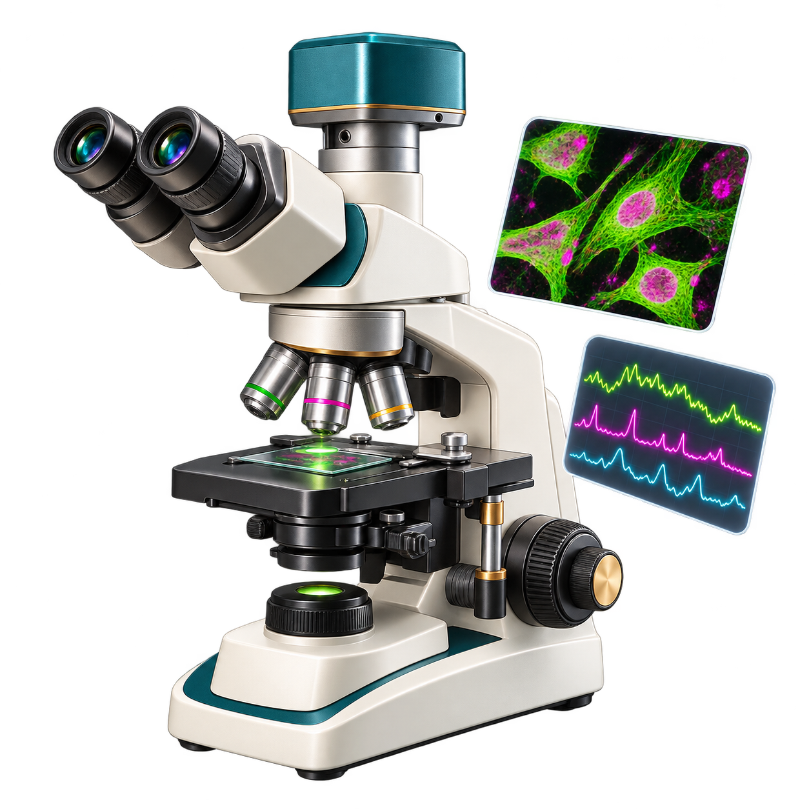
Behind database records
Experiments generate raw data
Sequencing signals
Experimental images
Instrument readings
Phenotypic observations
Notes:
[On slide entry] The previous slides introduced information at DNA, RNA and protein levels. We now consider how that information enters database records.
[Click 1] Experiments generate the measurements and observations that form the starting point for subsequent analysis. Here, raw data means the original experimental output retained for that analysis. Instruments and acquisition software may already have performed some processing, so “raw” does not necessarily mean completely untouched.
Sequencing signals are physical measurements used to determine a nucleotide sequence. Depending on the technology, these may be changes in fluorescence or electrical current. Software interprets the signals to assign nucleotide letters. Thus, the familiar sequence written as A, C, G and T already represents an interpretation of experimental measurements. NHGRI: DNA sequencing
Experimental images, such as microscopy images, record spatial information. They can show the appearance of cells or the distribution of fluorescent signals. Further analysis may identify individual cells, measure their dimensions or quantify fluorescence. The recorded image and the measurements extracted from it represent different stages of the investigation.
Instrument readings include measurements such as absorbance, fluorescence intensity or mass spectra. Their interpretation requires information about the units, instrument settings and experimental controls. Images and sequencing signals are also instrument outputs, so these examples overlap rather than form strictly separate categories.
Phenotypic observations describe observable characteristics, such as cell shape, growth or behaviour. Researchers may record them as images, counts, measurements or descriptive scores. A phenotype documents what was observed, while explaining its molecular cause requires additional evidence. NHGRI: Phenotype
These outputs become useful when accompanied by their experimental context: the organism, sample, conditions and methods. For example, sequencing data associated with HBB must be linked to the sample from which they originated. This is why archives connect data files to sample descriptions and project records. Together, the data and their context allow researchers to interpret, check and reanalyse the experiment. EMBL-EBI: ENA organisation
[Click 2] Analysis turns these observations into interpretable results and can predict additional properties. Software assembles sequence reads into longer sequences and translates coding regions into amino-acid sequences. Computational translation gives a protein sequence but does not establish that the protein was detected experimentally. Analysis can also assign domains and produce three-dimensional structural models. Some structural models are fitted to experimental measurements; others are computational predictions. Both involve analysis, but their supporting evidence differs. [1]
[Click 3] Curation evaluates and connects this information. Curators assess whether experiments or analyses support annotations—the descriptions of features and biological properties attached to a record. They link related records, for example connecting a protein to its transcript or an annotation to its source publication. Comparing findings across studies helps identify consistent results and differences caused by methods or experimental conditions. Curators then create or update annotations, documenting uncertainty where necessary. [2]
A reviewed record can therefore combine experimentally supported findings and computational interpretations. For HBB, its sequence, domain assignment and structural information may have different supporting sources. We should check the evidence for the claim we intend to use. Next, identifiers will help us specify the relevant records precisely and follow their connections.
References for the notes:
RCSB PDB-101, Methods for Determining Structure: https://pdb101.rcsb.org/learn/guide-to-understanding-pdb-data/methods-for-determining-structure
EMBL-EBI Training, Manual curation: https://www.ebi.ac.uk/training/online/courses/uniprot-exploring-protein-sequence-and-functional-info/where-does-the-data-come-from/functional-information/manual-curation/

Slide 66
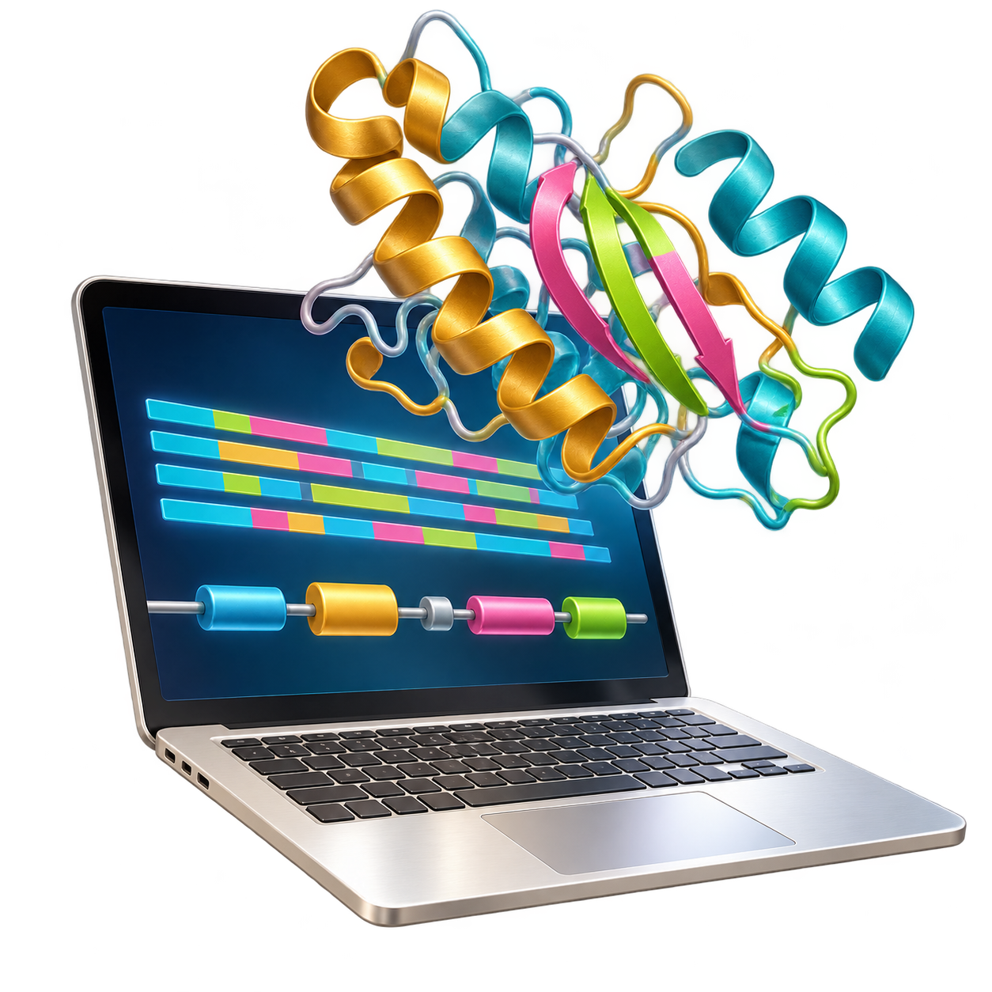
Behind database records
Experiments generate raw data
Sequencing signals
Experimental images
Instrument readings
Phenotypic observations
Analysis produces results and predictions
Assembled sequences
Translated protein sequences
Domain assignments
Three-dimensional structures
Notes:
[On slide entry] The previous slides introduced information at DNA, RNA and protein levels. We now consider how that information enters database records.
[Click 1] Experiments generate the measurements and observations that form the starting point for subsequent analysis. Here, raw data means the original experimental output retained for that analysis. Instruments and acquisition software may already have performed some processing, so “raw” does not necessarily mean completely untouched.
Sequencing signals are physical measurements used to determine a nucleotide sequence. Depending on the technology, these may be changes in fluorescence or electrical current. Software interprets the signals to assign nucleotide letters. Thus, the familiar sequence written as A, C, G and T already represents an interpretation of experimental measurements. NHGRI: DNA sequencing
Experimental images, such as microscopy images, record spatial information. They can show the appearance of cells or the distribution of fluorescent signals. Further analysis may identify individual cells, measure their dimensions or quantify fluorescence. The recorded image and the measurements extracted from it represent different stages of the investigation.
Instrument readings include measurements such as absorbance, fluorescence intensity or mass spectra. Their interpretation requires information about the units, instrument settings and experimental controls. Images and sequencing signals are also instrument outputs, so these examples overlap rather than form strictly separate categories.
Phenotypic observations describe observable characteristics, such as cell shape, growth or behaviour. Researchers may record them as images, counts, measurements or descriptive scores. A phenotype documents what was observed, while explaining its molecular cause requires additional evidence. NHGRI: Phenotype
These outputs become useful when accompanied by their experimental context: the organism, sample, conditions and methods. For example, sequencing data associated with HBB must be linked to the sample from which they originated. This is why archives connect data files to sample descriptions and project records. Together, the data and their context allow researchers to interpret, check and reanalyse the experiment. EMBL-EBI: ENA organisation
[Click 2] Analysis turns these observations into interpretable results and can predict additional properties. Software assembles sequence reads into longer sequences and translates coding regions into amino-acid sequences. Computational translation gives a protein sequence but does not establish that the protein was detected experimentally. Analysis can also assign domains and produce three-dimensional structural models. Some structural models are fitted to experimental measurements; others are computational predictions. Both involve analysis, but their supporting evidence differs. [1]
[Click 3] Curation evaluates and connects this information. Curators assess whether experiments or analyses support annotations—the descriptions of features and biological properties attached to a record. They link related records, for example connecting a protein to its transcript or an annotation to its source publication. Comparing findings across studies helps identify consistent results and differences caused by methods or experimental conditions. Curators then create or update annotations, documenting uncertainty where necessary. [2]
A reviewed record can therefore combine experimentally supported findings and computational interpretations. For HBB, its sequence, domain assignment and structural information may have different supporting sources. We should check the evidence for the claim we intend to use. Next, identifiers will help us specify the relevant records precisely and follow their connections.
References for the notes:
RCSB PDB-101, Methods for Determining Structure: https://pdb101.rcsb.org/learn/guide-to-understanding-pdb-data/methods-for-determining-structure
EMBL-EBI Training, Manual curation: https://www.ebi.ac.uk/training/online/courses/uniprot-exploring-protein-sequence-and-functional-info/where-does-the-data-come-from/functional-information/manual-curation/

Slide 67

Behind database records
Experiments generate raw data
Sequencing signals
Experimental images
Instrument readings
Phenotypic observations
Analysis produces results and predictions
Assembled sequences
Translated protein sequences
Domain assignments
Three-dimensional structures
Curation evaluates and connects the information
Assess supporting evidence
Create and update annotations
Compare findings across studies
Link related records
Notes:
[On slide entry] The previous slides introduced information at DNA, RNA and protein levels. We now consider how that information enters database records.
[Click 1] Experiments generate the measurements and observations that form the starting point for subsequent analysis. Here, raw data means the original experimental output retained for that analysis. Instruments and acquisition software may already have performed some processing, so “raw” does not necessarily mean completely untouched.
Sequencing signals are physical measurements used to determine a nucleotide sequence. Depending on the technology, these may be changes in fluorescence or electrical current. Software interprets the signals to assign nucleotide letters. Thus, the familiar sequence written as A, C, G and T already represents an interpretation of experimental measurements. NHGRI: DNA sequencing
Experimental images, such as microscopy images, record spatial information. They can show the appearance of cells or the distribution of fluorescent signals. Further analysis may identify individual cells, measure their dimensions or quantify fluorescence. The recorded image and the measurements extracted from it represent different stages of the investigation.
Instrument readings include measurements such as absorbance, fluorescence intensity or mass spectra. Their interpretation requires information about the units, instrument settings and experimental controls. Images and sequencing signals are also instrument outputs, so these examples overlap rather than form strictly separate categories.
Phenotypic observations describe observable characteristics, such as cell shape, growth or behaviour. Researchers may record them as images, counts, measurements or descriptive scores. A phenotype documents what was observed, while explaining its molecular cause requires additional evidence. NHGRI: Phenotype
These outputs become useful when accompanied by their experimental context: the organism, sample, conditions and methods. For example, sequencing data associated with HBB must be linked to the sample from which they originated. This is why archives connect data files to sample descriptions and project records. Together, the data and their context allow researchers to interpret, check and reanalyse the experiment. EMBL-EBI: ENA organisation
[Click 2] Analysis turns these observations into interpretable results and can predict additional properties. Software assembles sequence reads into longer sequences and translates coding regions into amino-acid sequences. Computational translation gives a protein sequence but does not establish that the protein was detected experimentally. Analysis can also assign domains and produce three-dimensional structural models. Some structural models are fitted to experimental measurements; others are computational predictions. Both involve analysis, but their supporting evidence differs. [1]
[Click 3] Curation evaluates and connects this information. Curators assess whether experiments or analyses support annotations—the descriptions of features and biological properties attached to a record. They link related records, for example connecting a protein to its transcript or an annotation to its source publication. Comparing findings across studies helps identify consistent results and differences caused by methods or experimental conditions. Curators then create or update annotations, documenting uncertainty where necessary. [2]
A reviewed record can therefore combine experimentally supported findings and computational interpretations. For HBB, its sequence, domain assignment and structural information may have different supporting sources. We should check the evidence for the claim we intend to use. Next, identifiers will help us specify the relevant records precisely and follow their connections.
References for the notes:
RCSB PDB-101, Methods for Determining Structure: https://pdb101.rcsb.org/learn/guide-to-understanding-pdb-data/methods-for-determining-structure
EMBL-EBI Training, Manual curation: https://www.ebi.ac.uk/training/online/courses/uniprot-exploring-protein-sequence-and-functional-info/where-does-the-data-come-from/functional-information/manual-curation/

Slide 68
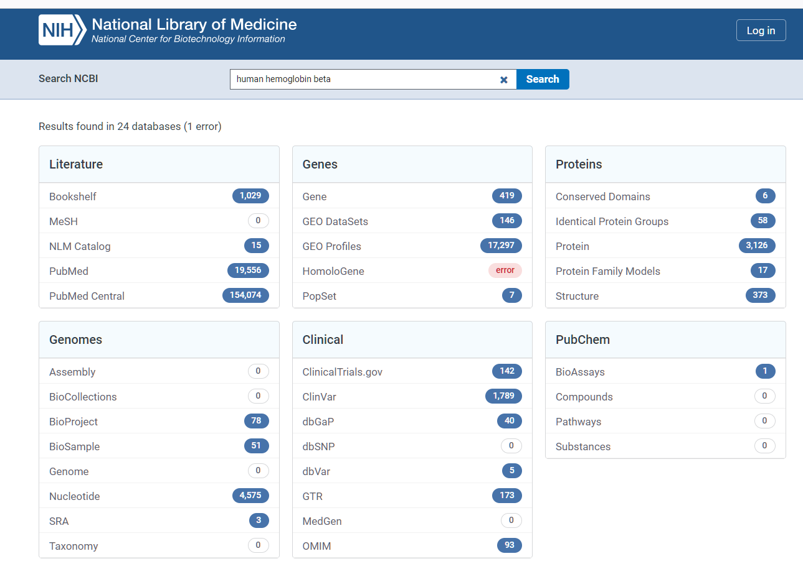
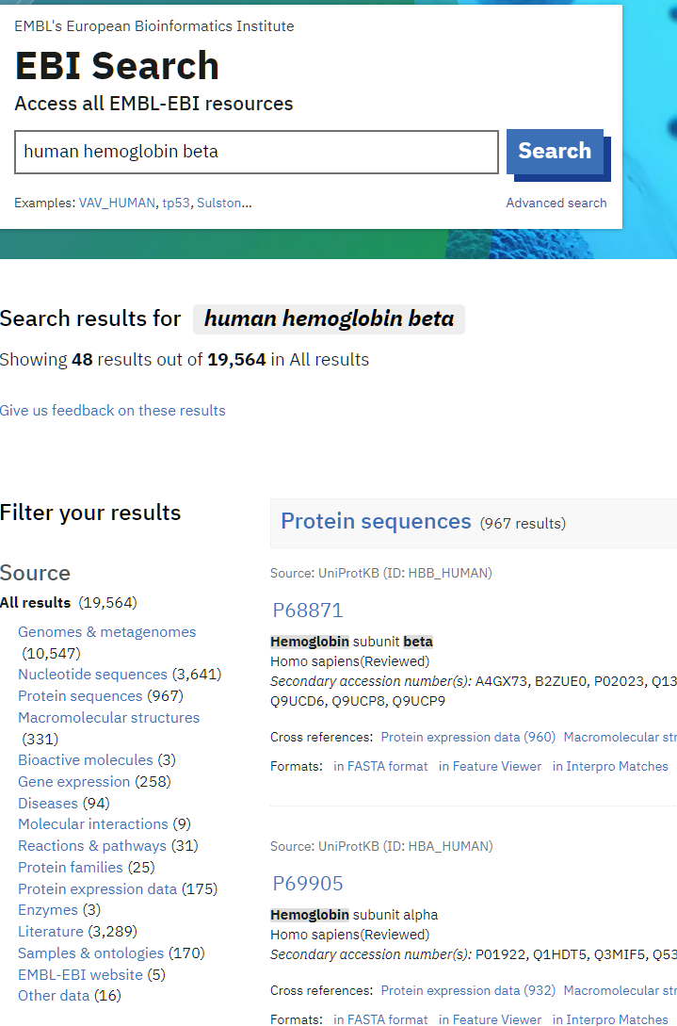
NCBI
EMBL-EBI
Notes:
[On slide entry] We’ve seen how experiments, analysis and curation contribute different kinds of information to database records. Now suppose we need to find some of that information for a particular protein. [Click 1] A biological name gives us a starting point.
[Click 2] Here we enter human hemoglobin beta in two search portals. [Click 3] The left magnifier shows the query in NCBI, and the right one shows the same words in EMBL-EBI. Both searches give us places to look. To decide where to go next, we need to see how each portal groups its results.

Slide 69
Search by name
NCBI
EMBL-EBI
Notes:
[On slide entry] We’ve seen how experiments, analysis and curation contribute different kinds of information to database records. Now suppose we need to find some of that information for a particular protein. [Click 1] A biological name gives us a starting point.
[Click 2] Here we enter human hemoglobin beta in two search portals. [Click 3] The left magnifier shows the query in NCBI, and the right one shows the same words in EMBL-EBI. Both searches give us places to look. To decide where to go next, we need to see how each portal groups its results.

Slide 70
Search by name
One biological name, different databases
NCBI
EMBL-EBI
Notes:
[On slide entry] We’ve seen how experiments, analysis and curation contribute different kinds of information to database records. Now suppose we need to find some of that information for a particular protein. [Click 1] A biological name gives us a starting point.
[Click 2] Here we enter human hemoglobin beta in two search portals. [Click 3] The left magnifier shows the query in NCBI, and the right one shows the same words in EMBL-EBI. Both searches give us places to look. To decide where to go next, we need to see how each portal groups its results.

Slide 71
Search by name
One biological name, different databases
NCBI
EMBL-EBI
Notes:
[On slide entry] We’ve seen how experiments, analysis and curation contribute different kinds of information to database records. Now suppose we need to find some of that information for a particular protein. [Click 1] A biological name gives us a starting point.
[Click 2] Here we enter human hemoglobin beta in two search portals. [Click 3] The left magnifier shows the query in NCBI, and the right one shows the same words in EMBL-EBI. Both searches give us places to look. To decide where to go next, we need to see how each portal groups its results.

Slide 72
Search by name
NCBI
EMBL-EBI
Notes:
[On slide entry] With the full results pages in view, notice the categories. NCBI groups matches under headings such as Literature, Genes, Genomes and Proteins. EMBL-EBI lists categories including Nucleotide sequences, Protein sequences and Macromolecular structures.
The same words can lead to a paper about haemoglobin, a sequence record or a structure. Which result is useful depends on our question. Suppose we want to examine the DNA around the gene that encodes beta-globin. Where would we look?

Slide 73
Search by name
One search, several kinds of records
NCBI
EMBL-EBI
Notes:
[On slide entry] With the full results pages in view, notice the categories. NCBI groups matches under headings such as Literature, Genes, Genomes and Proteins. EMBL-EBI lists categories including Nucleotide sequences, Protein sequences and Macromolecular structures.
The same words can lead to a paper about haemoglobin, a sequence record or a structure. Which result is useful depends on our question. Suppose we want to examine the DNA around the gene that encodes beta-globin. Where would we look?

Slide 74
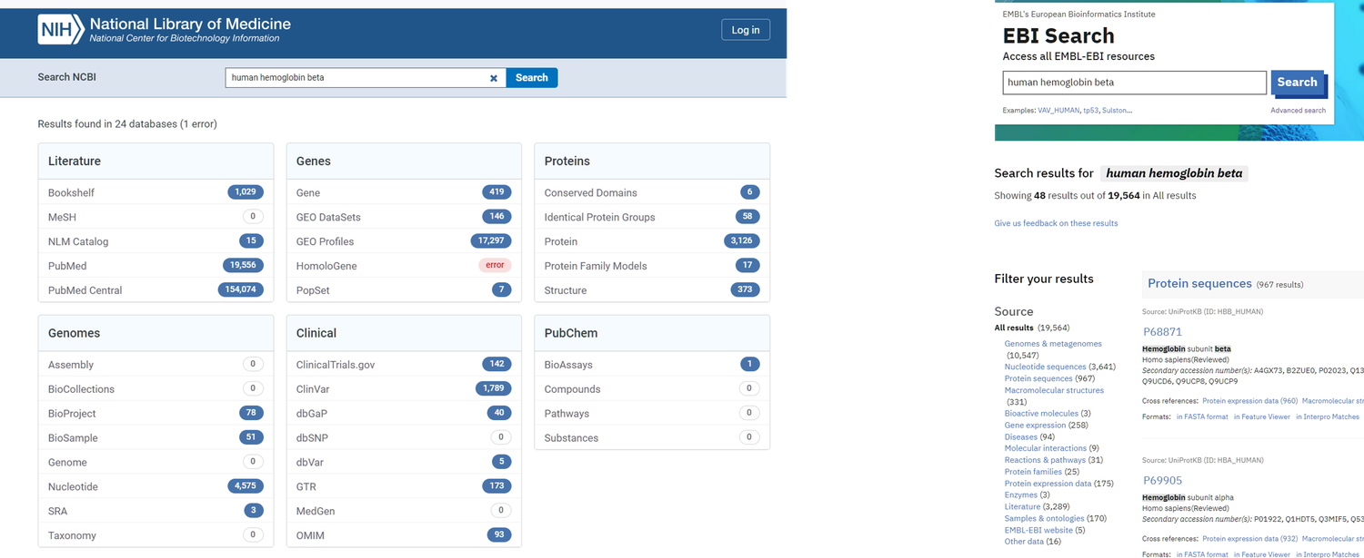
Search by name
NCBI
EMBL-EBI
Notes:
[On slide entry] The magnifier shows NCBI’s Genomes group. Nucleotide is a starting point for finding genomic DNA. It also contains transcript sequences, so we need to open the candidate record and check what sequence it describes.
The other entries help answer different questions. SRA provides sequencing reads, while BioProject describes the study and BioSample describes the material used. This connects to the earlier discussion of how sequence data and their experimental context are stored in separate, linked records.
NCBI DNA and RNA guide
https://www.ncbi.nlm.nih.gov/sites/guide/dna-rna/
Nucleotide — DNA and RNA sequence records
https://www.ncbi.nlm.nih.gov/nuccore/
Sequence Read Archive (SRA) — sequencing reads
https://www.ncbi.nlm.nih.gov/sra/
BioProject — study records
https://www.ncbi.nlm.nih.gov/bioproject/
BioSample — descriptions of biological samples
https://www.ncbi.nlm.nih.gov/biosample/

Slide 75
Search by name
Nucleotide sequences and their sources
NCBI
EMBL-EBI
Notes:
[On slide entry] The magnifier shows NCBI’s Genomes group. Nucleotide is a starting point for finding genomic DNA. It also contains transcript sequences, so we need to open the candidate record and check what sequence it describes.
The other entries help answer different questions. SRA provides sequencing reads, while BioProject describes the study and BioSample describes the material used. This connects to the earlier discussion of how sequence data and their experimental context are stored in separate, linked records.
NCBI DNA and RNA guide
https://www.ncbi.nlm.nih.gov/sites/guide/dna-rna/
Nucleotide — DNA and RNA sequence records
https://www.ncbi.nlm.nih.gov/nuccore/
Sequence Read Archive (SRA) — sequencing reads
https://www.ncbi.nlm.nih.gov/sra/
BioProject — study records
https://www.ncbi.nlm.nih.gov/bioproject/
BioSample — descriptions of biological samples
https://www.ncbi.nlm.nih.gov/biosample/

Slide 76
Search by name
NCBI
EMBL-EBI
Notes:
[On slide entry / Morph] If the question is where the beta-globin gene is located or which transcripts are associated with it, NCBI Gene is a useful starting point. A gene record gives us an overview and links to related records for the sequences themselves.
The Genes group also includes GEO DataSets. We would use it to look for studies that measured expression, for example to investigate which tissues express the gene. The two resources help us answer different questions about the same gene.
NCBI Genes & Expression guide
https://www.ncbi.nlm.nih.gov/guide/genes-expression/
NCBI Gene — gene records
https://www.ncbi.nlm.nih.gov/gene/
GEO DataSets — gene expression and functional genomics studies
https://www.ncbi.nlm.nih.gov/gds/

Slide 77
Search by name
Gene records and expression studies
NCBI
EMBL-EBI
Notes:
[On slide entry / Morph] If the question is where the beta-globin gene is located or which transcripts are associated with it, NCBI Gene is a useful starting point. A gene record gives us an overview and links to related records for the sequences themselves.
The Genes group also includes GEO DataSets. We would use it to look for studies that measured expression, for example to investigate which tissues express the gene. The two resources help us answer different questions about the same gene.
NCBI Genes & Expression guide
https://www.ncbi.nlm.nih.gov/guide/genes-expression/
NCBI Gene — gene records
https://www.ncbi.nlm.nih.gov/gene/
GEO DataSets — gene expression and functional genomics studies
https://www.ncbi.nlm.nih.gov/gds/

Slide 78
Search by name
NCBI
EMBL-EBI
Notes:
[On slide entry / Morph] Once we turn to the protein, the question still determines where we search.
If we need the amino-acid sequence of beta-globin for an alignment, we start with Protein.
Conserved Domains and Protein Family Models help us examine conserved regions and family membership.
Structure is a starting point for seeing how haemoglobin’s subunits fit together in three dimensions.
Choosing the protein level narrows the kind of information we are looking for. We then choose the collection that provides the particular information we need.
NCBI protein resources guide
https://www.ncbi.nlm.nih.gov/home/proteins/
Protein — amino-acid sequence records
https://www.ncbi.nlm.nih.gov/protein/
Conserved Domains (CDD)
https://www.ncbi.nlm.nih.gov/cdd/
Protein Family Models
https://www.ncbi.nlm.nih.gov/protfam/
Structure — three-dimensional biomolecular structures
https://www.ncbi.nlm.nih.gov/structure/

Slide 79
Search by name
Different questions about a protein
NCBI
EMBL-EBI
Notes:
[On slide entry / Morph] Once we turn to the protein, the question still determines where we search.
If we need the amino-acid sequence of beta-globin for an alignment, we start with Protein.
Conserved Domains and Protein Family Models help us examine conserved regions and family membership.
Structure is a starting point for seeing how haemoglobin’s subunits fit together in three dimensions.
Choosing the protein level narrows the kind of information we are looking for. We then choose the collection that provides the particular information we need.
NCBI protein resources guide
https://www.ncbi.nlm.nih.gov/home/proteins/
Protein — amino-acid sequence records
https://www.ncbi.nlm.nih.gov/protein/
Conserved Domains (CDD)
https://www.ncbi.nlm.nih.gov/cdd/
Protein Family Models
https://www.ncbi.nlm.nih.gov/protfam/
Structure — three-dimensional biomolecular structures
https://www.ncbi.nlm.nih.gov/structure/

Slide 80
Search by name
NCBI
EMBL-EBI
Notes:
[On slide entry / Morph] The same approach works in EMBL-EBI. The category list on the left helps us focus on sequences, structures, expression data or other information. On the right, the protein results include both haemoglobin beta and alpha subunits. To select the beta-globin entry, we check the protein name and organism.

Slide 81
Search by name
Choosing and checking a result
NCBI
EMBL-EBI
Notes:
[On slide entry / Morph] The same approach works in EMBL-EBI. The category list on the left helps us focus on sequences, structures, expression data or other information. On the right, the protein results include both haemoglobin beta and alpha subunits. To select the beta-globin entry, we check the protein name and organism.

Slide 82
Search by name
Notes:
[On slide entry] The broad search showed us several kinds of result.
[Click 1] Suppose our question is about the human gene that encodes beta-globin. We select Gene at NCBI and use the same query, human hemoglobin beta.
Left screenshot shows 419 Gene hits. Selecting Gene brings us to that collection, where we can examine the individual records.
Search across NCBI resources
https://www.ncbi.nlm.nih.gov/search/
Search within NCBI Gene
https://www.ncbi.nlm.nih.gov/gene/

Slide 83
Search by name
Search within selected resource
NCBI Gene
Notes:
[On slide entry] The broad search showed us several kinds of result.
[Click 1] Suppose our question is about the human gene that encodes beta-globin. We select Gene at NCBI and use the same query, human hemoglobin beta.
Left screenshot shows 419 Gene hits. Selecting Gene brings us to that collection, where we can examine the individual records.
Search across NCBI resources
https://www.ncbi.nlm.nih.gov/search/
Search within NCBI Gene
https://www.ncbi.nlm.nih.gov/gene/

Slide 84
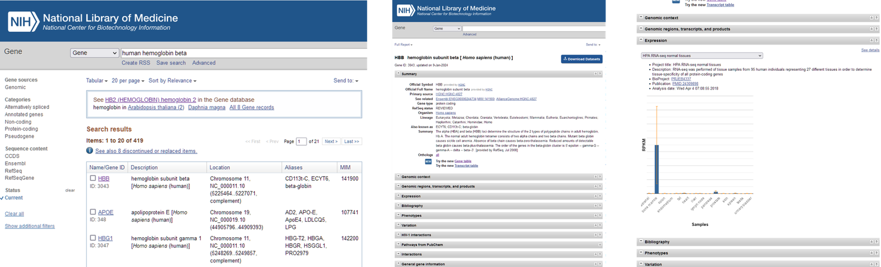
Search by name
Search within selected resource
NCBI Gene
Notes:
[On slide entry] The broad search showed us several kinds of result.
[Click 1] Suppose our question is about the human gene that encodes beta-globin. We select Gene at NCBI and use the same query, human hemoglobin beta.
Left screenshot shows 419 Gene hits. Selecting Gene brings us to that collection, where we can examine the individual records.
Search across NCBI resources
https://www.ncbi.nlm.nih.gov/search/
Search within NCBI Gene
https://www.ncbi.nlm.nih.gov/gene/

Slide 85

Search by name
NCBI Gene
Notes:
[On slide entry / Morph] The first row in this example describes hemoglobin subunit beta in Homo sapiens. Further down, there is also a human hemoglobin subunit gamma 1 record.
The organism alone is therefore insufficient to choose between them. We check the description as well, then open the record for the human beta subunit gene.
Human haemoglobin subunit beta gene, NCBI Gene ID 3043
https://www.ncbi.nlm.nih.gov/gene/3043

Slide 86
Search by name
Check the name and organism
NCBI Gene
Notes:
[On slide entry / Morph] The first row in this example describes hemoglobin subunit beta in Homo sapiens. Further down, there is also a human hemoglobin subunit gamma 1 record.
The organism alone is therefore insufficient to choose between them. We check the description as well, then open the record for the human beta subunit gene.
Human haemoglobin subunit beta gene, NCBI Gene ID 3043
https://www.ncbi.nlm.nih.gov/gene/3043

Slide 87
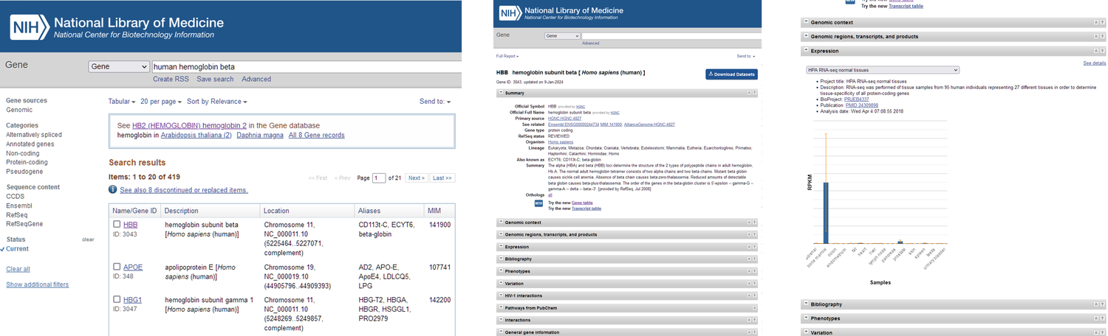
Search by name
NCBI Gene
Notes:
[On slide entry / Morph] The summary confirms which gene and organism the record describes. The sections below it let us pursue different questions.
Genomic context shows where the gene lies.
Genomic regions, transcripts, and products gives us access to related sequence records.
If our question is how much RNA from this gene was detected in different tissues, we open Expression.
Human haemoglobin subunit beta gene, NCBI Gene ID 3043
https://www.ncbi.nlm.nih.gov/gene/3043

Slide 88
Search by name
Explore the gene record
NCBI Gene
Notes:
[On slide entry / Morph] The summary confirms which gene and organism the record describes. The sections below it let us pursue different questions.
Genomic context shows where the gene lies.
Genomic regions, transcripts, and products gives us access to related sequence records.
If our question is how much RNA from this gene was detected in different tissues, we open Expression.
Human haemoglobin subunit beta gene, NCBI Gene ID 3043
https://www.ncbi.nlm.nih.gov/gene/3043

Slide 89
Search by name
NCBI Gene
Notes:
[On slide entry / Morph] The Expression section displays results from a Human Protein Atlas RNA-sequencing study.
The bars compare estimated RNA abundance across the tissues sampled, using the normalized measure shown on the vertical axis, RPKM.
Above the chart, the BioProject and publication links tell us where the data came from and how the study was carried out.
We can use the same descriptive query in UniProtKB when our question is about the beta-globin protein and its function.
Human Protein Atlas RNA-seq study, BioProject PRJEB4337
https://www.ncbi.nlm.nih.gov/bioproject/PRJEB4337
Study publication, Fagerberg et al., PMID 24309898
https://pubmed.ncbi.nlm.nih.gov/24309898/

Slide 90
Search by name
Trace expression data to the study
NCBI Gene
Notes:
[On slide entry / Morph] The Expression section displays results from a Human Protein Atlas RNA-sequencing study.
The bars compare estimated RNA abundance across the tissues sampled, using the normalized measure shown on the vertical axis, RPKM.
Above the chart, the BioProject and publication links tell us where the data came from and how the study was carried out.
We can use the same descriptive query in UniProtKB when our question is about the beta-globin protein and its function.
Human Protein Atlas RNA-seq study, BioProject PRJEB4337
https://www.ncbi.nlm.nih.gov/bioproject/PRJEB4337
Study publication, Fagerberg et al., PMID 24309898
https://pubmed.ncbi.nlm.nih.gov/24309898/

Slide 91
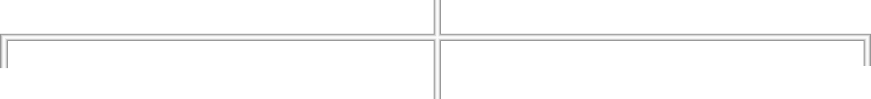





UniRef
UniRef 100
UniRef 90
UniRef 50
Reviewed
Unreviewed
Notes:
[On slide entry] We’ve seen how a gene record can lead us to RNA expression data. To find out what the beta-globin protein does, we turn to UniProt, the Universal Protein Resource. The diagram shows three databases that help us answer different questions about proteins.
[Click 1] UniProtKB brings together protein sequences and annotations about their function, structure and other properties. Its Swiss-Prot section contains entries reviewed by curators. TrEMBL contains entries with automatic annotations that have yet to undergo manual review. Review status tells us how the entry was curated. To assess a particular statement about a protein’s function, we can follow the evidence attached to that statement.
[Click 2] UniParc is a sequence archive. It stores each distinct protein sequence once and links it to the source records where that sequence has appeared. This helps us trace where a sequence came from and follow its history.
[Click 3] UniRef groups protein sequences into clusters. The numbers in UniRef100, UniRef90 and UniRef50 refer to sequence identity levels used for clustering. These groupings are useful when we want to work with a representative set of sequences.
[Click 4] For our next search, we want to find the human beta-globin entry and read about its function. That’s why UniProtKB is highlighted. We’ll search it using the same words as before, human hemoglobin beta.
EMBL-EBI overview of the UniProt databases
https://www.ebi.ac.uk/training/online/courses/uniprot-quick-tour/the-uniprot-databases/
UniProt Archive (UniParc)
https://www.uniprot.org/help/uniparc
UniProt Reference Clusters (UniRef)
https://www.uniprot.org/help/uniref

Slide 92
Universal Protein Resource
Resource content
UniRef
UniRef 100
UniRef 90
UniRef 50
Reviewed
Unreviewed
Notes:
[On slide entry] We’ve seen how a gene record can lead us to RNA expression data. To find out what the beta-globin protein does, we turn to UniProt, the Universal Protein Resource. The diagram shows three databases that help us answer different questions about proteins.
[Click 1] UniProtKB brings together protein sequences and annotations about their function, structure and other properties. Its Swiss-Prot section contains entries reviewed by curators. TrEMBL contains entries with automatic annotations that have yet to undergo manual review. Review status tells us how the entry was curated. To assess a particular statement about a protein’s function, we can follow the evidence attached to that statement.
[Click 2] UniParc is a sequence archive. It stores each distinct protein sequence once and links it to the source records where that sequence has appeared. This helps us trace where a sequence came from and follow its history.
[Click 3] UniRef groups protein sequences into clusters. The numbers in UniRef100, UniRef90 and UniRef50 refer to sequence identity levels used for clustering. These groupings are useful when we want to work with a representative set of sequences.
[Click 4] For our next search, we want to find the human beta-globin entry and read about its function. That’s why UniProtKB is highlighted. We’ll search it using the same words as before, human hemoglobin beta.
EMBL-EBI overview of the UniProt databases
https://www.ebi.ac.uk/training/online/courses/uniprot-quick-tour/the-uniprot-databases/
UniProt Archive (UniParc)
https://www.uniprot.org/help/uniparc
UniProt Reference Clusters (UniRef)
https://www.uniprot.org/help/uniref

Slide 93
Universal Protein Resource
Resource content
UniRef
UniRef 100
UniRef 90
UniRef 50
Reviewed
Unreviewed
Notes:
[On slide entry] We’ve seen how a gene record can lead us to RNA expression data. To find out what the beta-globin protein does, we turn to UniProt, the Universal Protein Resource. The diagram shows three databases that help us answer different questions about proteins.
[Click 1] UniProtKB brings together protein sequences and annotations about their function, structure and other properties. Its Swiss-Prot section contains entries reviewed by curators. TrEMBL contains entries with automatic annotations that have yet to undergo manual review. Review status tells us how the entry was curated. To assess a particular statement about a protein’s function, we can follow the evidence attached to that statement.
[Click 2] UniParc is a sequence archive. It stores each distinct protein sequence once and links it to the source records where that sequence has appeared. This helps us trace where a sequence came from and follow its history.
[Click 3] UniRef groups protein sequences into clusters. The numbers in UniRef100, UniRef90 and UniRef50 refer to sequence identity levels used for clustering. These groupings are useful when we want to work with a representative set of sequences.
[Click 4] For our next search, we want to find the human beta-globin entry and read about its function. That’s why UniProtKB is highlighted. We’ll search it using the same words as before, human hemoglobin beta.
EMBL-EBI overview of the UniProt databases
https://www.ebi.ac.uk/training/online/courses/uniprot-quick-tour/the-uniprot-databases/
UniProt Archive (UniParc)
https://www.uniprot.org/help/uniparc
UniProt Reference Clusters (UniRef)
https://www.uniprot.org/help/uniref

Slide 94
Notes:
[On slide entry] The UniProt diagram showed us which collection to use when we want a protein sequence and information about its function.
Here we select UniProtKB next to the search field and enter human hemoglobin beta, the same words we used at NCBI.
The collection we select determines what kind of records we can retrieve.
Here, each row is a protein entry.
The table gives us fields such as the protein name and organism, which we can use to decide which entry to open.
UniProt website — select UniProtKB and enter human hemoglobin beta
https://www.uniprot.org/

Slide 95
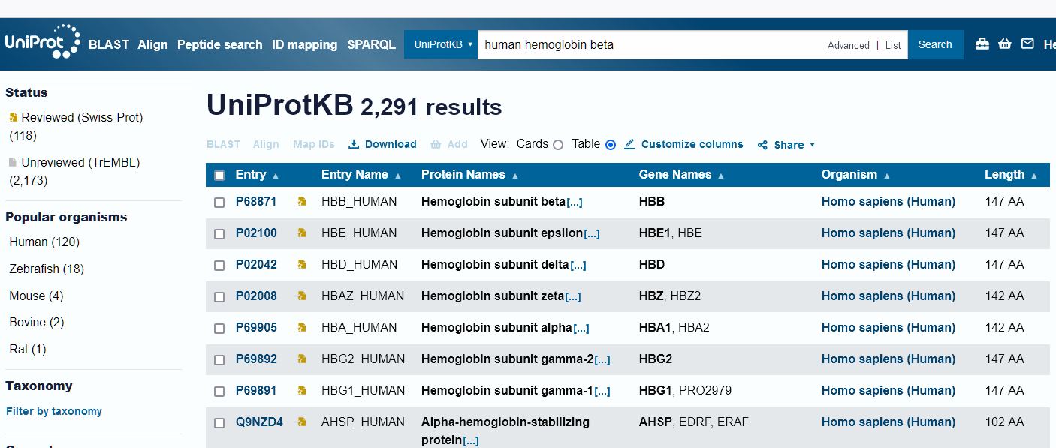
Search by name
Search within UniProtKB
UniProtKB
Notes:
[On slide entry] The UniProt diagram showed us which collection to use when we want a protein sequence and information about its function.
Here we select UniProtKB next to the search field and enter human hemoglobin beta, the same words we used at NCBI.
The collection we select determines what kind of records we can retrieve.
Here, each row is a protein entry.
The table gives us fields such as the protein name and organism, which we can use to decide which entry to open.
UniProt website — select UniProtKB and enter human hemoglobin beta
https://www.uniprot.org/

Slide 96
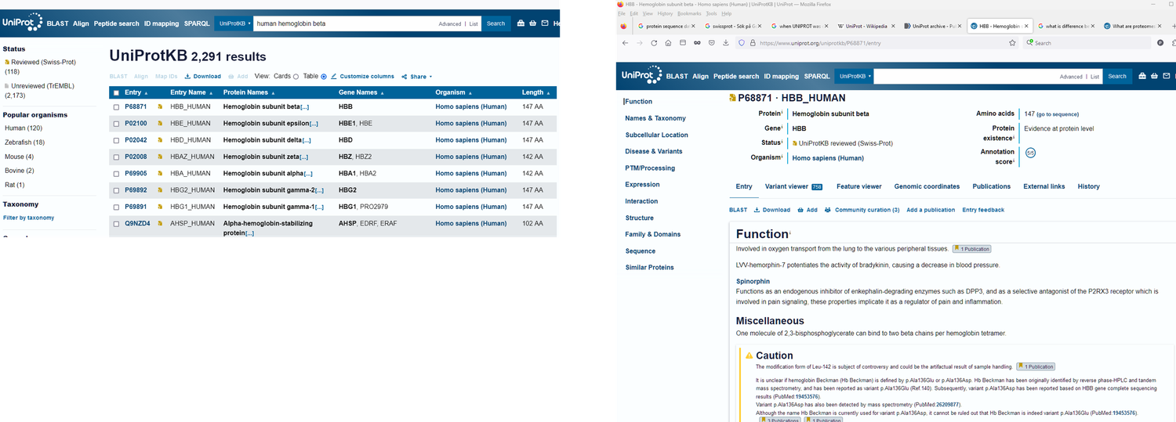
Search by name
UniProtKB
Notes:
[On slide entry / Morph] The query contains the word human, and the sidebar still shows matches for organisms such as zebrafish and mouse.
To restrict the list to human proteins, select Human under Popular organisms.
The Status filter lets us choose reviewed or unreviewed entries. For this example, we want to see an entry that has undergone manual curation, so Reviewed (Swiss-Prot) is useful.
[Click 1: reveal the selected beta-globin entry] Several human haemoglobin subunits can still appear after filtering, so we also need to read the protein names.
EMBL-EBI guide to searching UniProtKB
https://www.ebi.ac.uk/training/online/courses/uniprot-exploring-protein-sequence-and-functional-info/how-to-search-uniprot/

Slide 97
Search by name
Filter by organism and review status
UniProtKB
Notes:
[On slide entry / Morph] The query contains the word human, and the sidebar still shows matches for organisms such as zebrafish and mouse.
To restrict the list to human proteins, select Human under Popular organisms.
The Status filter lets us choose reviewed or unreviewed entries. For this example, we want to see an entry that has undergone manual curation, so Reviewed (Swiss-Prot) is useful.
[Click 1: reveal the selected beta-globin entry] Several human haemoglobin subunits can still appear after filtering, so we also need to read the protein names.
EMBL-EBI guide to searching UniProtKB
https://www.ebi.ac.uk/training/online/courses/uniprot-exploring-protein-sequence-and-functional-info/how-to-search-uniprot/

Slide 98
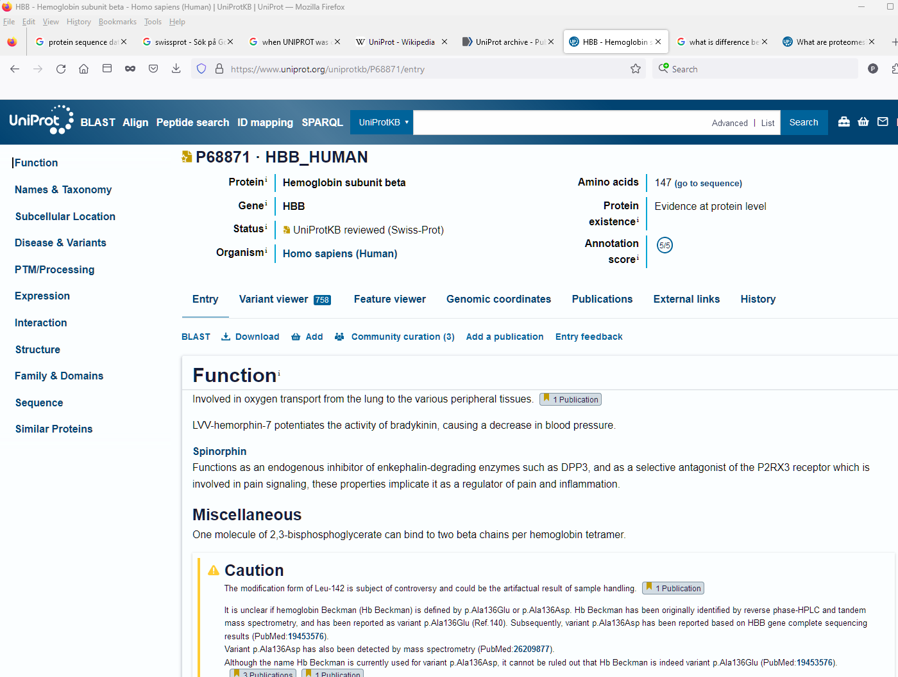
Search by name
Filter by organism and review status
UniProtKB
Notes:
[On slide entry / Morph] The query contains the word human, and the sidebar still shows matches for organisms such as zebrafish and mouse.
To restrict the list to human proteins, select Human under Popular organisms.
The Status filter lets us choose reviewed or unreviewed entries. For this example, we want to see an entry that has undergone manual curation, so Reviewed (Swiss-Prot) is useful.
[Click 1: reveal the selected beta-globin entry] Several human haemoglobin subunits can still appear after filtering, so we also need to read the protein names.
EMBL-EBI guide to searching UniProtKB
https://www.ebi.ac.uk/training/online/courses/uniprot-exploring-protein-sequence-and-functional-info/how-to-search-uniprot/

Slide 99
Search by name
UniProtKB
Notes:
[On slide entry / Morph] In the results table, look for Hemoglobin subunit beta and Homo sapiens in the same row.
Other rows describe human haemoglobin subunits, such as epsilon and delta, so checking the organism only gets us part of the way.
Once we open the beta-globin entry, we can verify both fields again in the enlarged header.
The header also shows Reviewed (Swiss-Prot), which confirms the review status of the entry we selected.
Human haemoglobin subunit beta — UniProtKB entry P68871
https://www.uniprot.org/uniprotkb/P68871/entry

Slide 100
Search by name
Check the protein name and organism
UniProtKB
Notes:
[On slide entry / Morph] In the results table, look for Hemoglobin subunit beta and Homo sapiens in the same row.
Other rows describe human haemoglobin subunits, such as epsilon and delta, so checking the organism only gets us part of the way.
Once we open the beta-globin entry, we can verify both fields again in the enlarged header.
The header also shows Reviewed (Swiss-Prot), which confirms the review status of the entry we selected.
Human haemoglobin subunit beta — UniProtKB entry P68871
https://www.uniprot.org/uniprotkb/P68871/entry

Slide 101
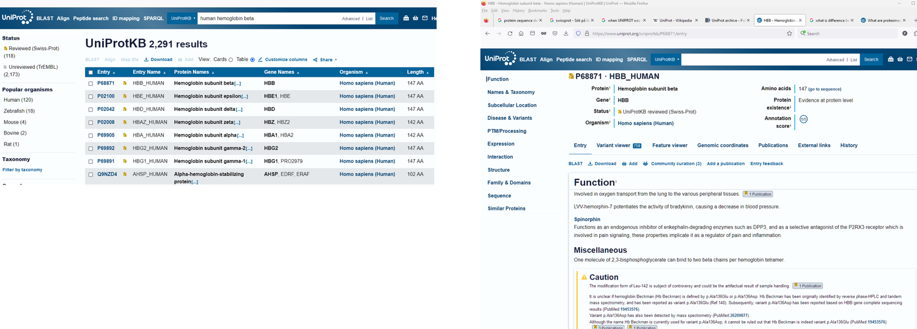
Search by name
UniProtKB
Notes:
[On slide entry / Morph] We came to this entry to find out what beta-globin does.
In Function, the first annotation describes its role in oxygen transport.
The 1 Publication label beside that statement leads to a paper on Hb Vigo, a beta-globin variant. When we follow the link, we can see what the authors studied and how their findings relate to the statement in UniProtKB.
This is an example of the distinction we discussed earlier between finding a record and checking the evidence for a particular claim.
So far, we’ve used a descriptive name to find gene and protein records. Next, we’ll use the approved gene symbol to look up the human gene across resources.
UniProtKB entry P68871 — open the Function section
https://www.uniprot.org/uniprotkb/P68871/entry
Publication linked to the oxygen transport annotation — PMID 28066926
https://pubmed.ncbi.nlm.nih.gov/28066926/

Slide 102
Search by name
Check the function and its evidence
UniProtKB
Notes:
[On slide entry / Morph] We came to this entry to find out what beta-globin does.
In Function, the first annotation describes its role in oxygen transport.
The 1 Publication label beside that statement leads to a paper on Hb Vigo, a beta-globin variant. When we follow the link, we can see what the authors studied and how their findings relate to the statement in UniProtKB.
This is an example of the distinction we discussed earlier between finding a record and checking the evidence for a particular claim.
So far, we’ve used a descriptive name to find gene and protein records. Next, we’ll use the approved gene symbol to look up the human gene across resources.
UniProtKB entry P68871 — open the Function section
https://www.uniprot.org/uniprotkb/P68871/entry
Publication linked to the oxygen transport annotation — PMID 28066926
https://pubmed.ncbi.nlm.nih.gov/28066926/

Slide 103
Notes:
[On slide entry] In the preceding slides we searched by name, then checked the identity and function of the human beta-globin protein in UniProtKB. [Click 1] We now use HBB, the approved symbol for the human gene that encodes it, to connect records across databases.
HGNC stands for HUGO Gene Nomenclature Committee. It approves and maintains a standard symbol and descriptive name for each human gene it names. That shared vocabulary helps researchers refer to the same gene in papers and search for it in different resources.
[Click 2] The report also points to related records in other databases.
[Click 3] The magnifier shows HBB, the approved name hemoglobin subunit beta, and HGNC:4827. The HGNC ID identifies this nomenclature record and stays stable if the approved name or symbol changes.
About HGNC: https://www.genenames.org/about/
HGNC HBB symbol report: https://www.genenames.org/data/gene-symbol-report/#!/hgnc_id/HGNC:4827

Slide 104
Search by official symbol
Notes:
[On slide entry] In the preceding slides we searched by name, then checked the identity and function of the human beta-globin protein in UniProtKB. [Click 1] We now use HBB, the approved symbol for the human gene that encodes it, to connect records across databases.
HGNC stands for HUGO Gene Nomenclature Committee. It approves and maintains a standard symbol and descriptive name for each human gene it names. That shared vocabulary helps researchers refer to the same gene in papers and search for it in different resources.
[Click 2] The report also points to related records in other databases.
[Click 3] The magnifier shows HBB, the approved name hemoglobin subunit beta, and HGNC:4827. The HGNC ID identifies this nomenclature record and stays stable if the approved name or symbol changes.
About HGNC: https://www.genenames.org/about/
HGNC HBB symbol report: https://www.genenames.org/data/gene-symbol-report/#!/hgnc_id/HGNC:4827

Slide 105
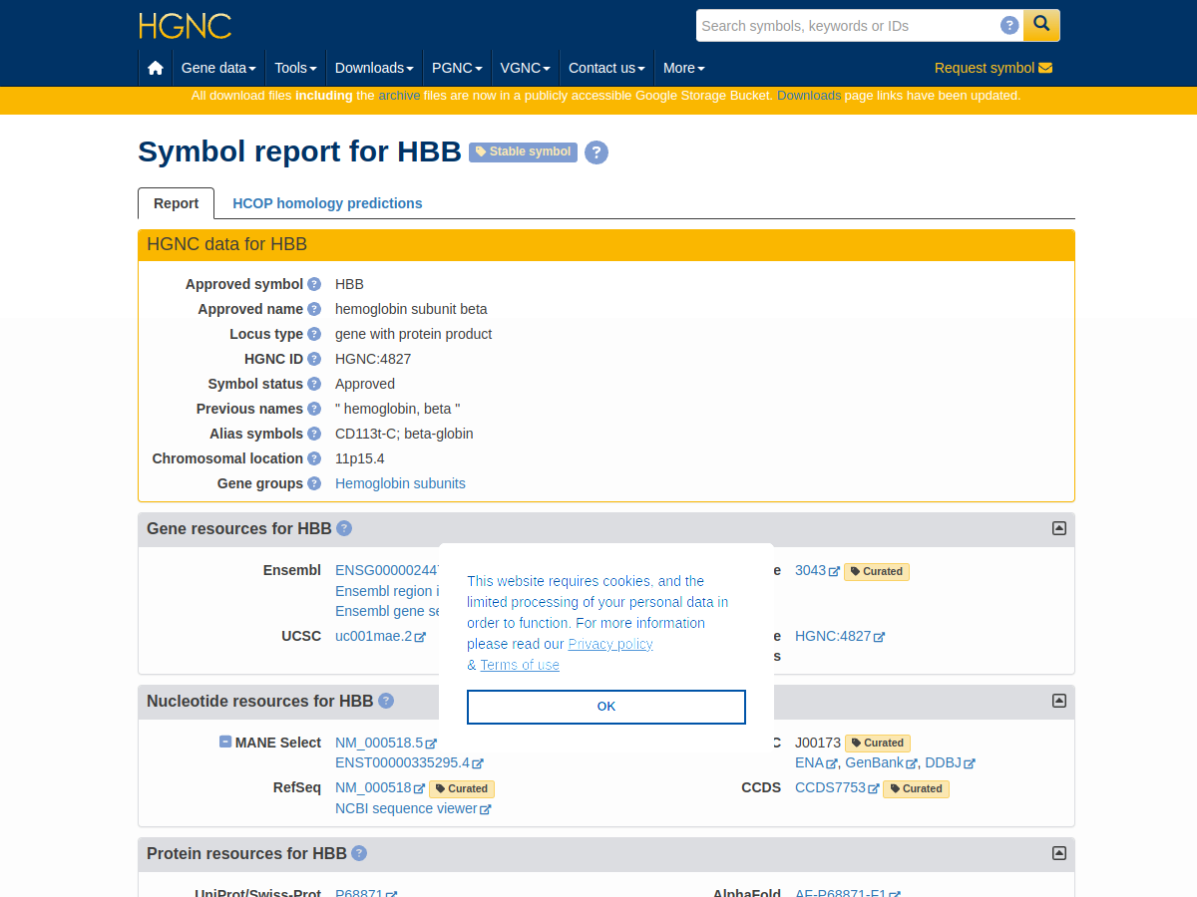
Search by official symbol
One symbol, different record IDs
Official gene symbol (HBB)
Notes:
[On slide entry] In the preceding slides we searched by name, then checked the identity and function of the human beta-globin protein in UniProtKB. [Click 1] We now use HBB, the approved symbol for the human gene that encodes it, to connect records across databases.
HGNC stands for HUGO Gene Nomenclature Committee. It approves and maintains a standard symbol and descriptive name for each human gene it names. That shared vocabulary helps researchers refer to the same gene in papers and search for it in different resources.
[Click 2] The report also points to related records in other databases.
[Click 3] The magnifier shows HBB, the approved name hemoglobin subunit beta, and HGNC:4827. The HGNC ID identifies this nomenclature record and stays stable if the approved name or symbol changes.
About HGNC: https://www.genenames.org/about/
HGNC HBB symbol report: https://www.genenames.org/data/gene-symbol-report/#!/hgnc_id/HGNC:4827

Slide 106
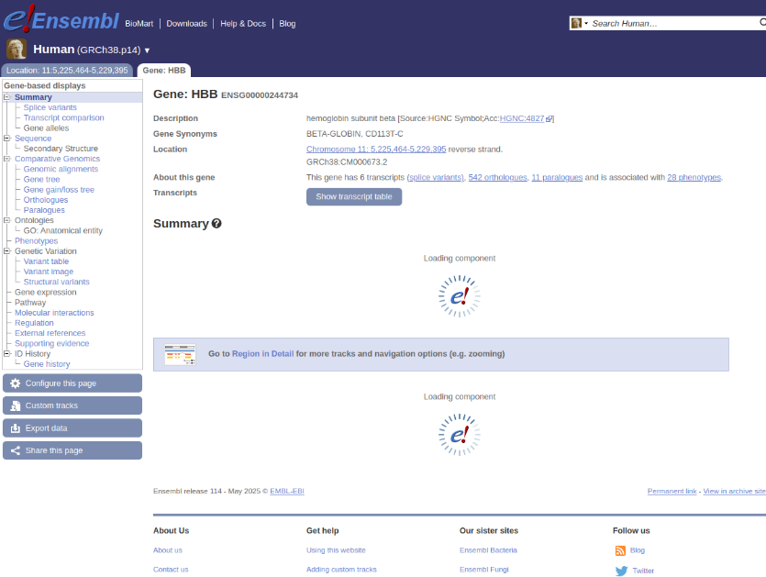
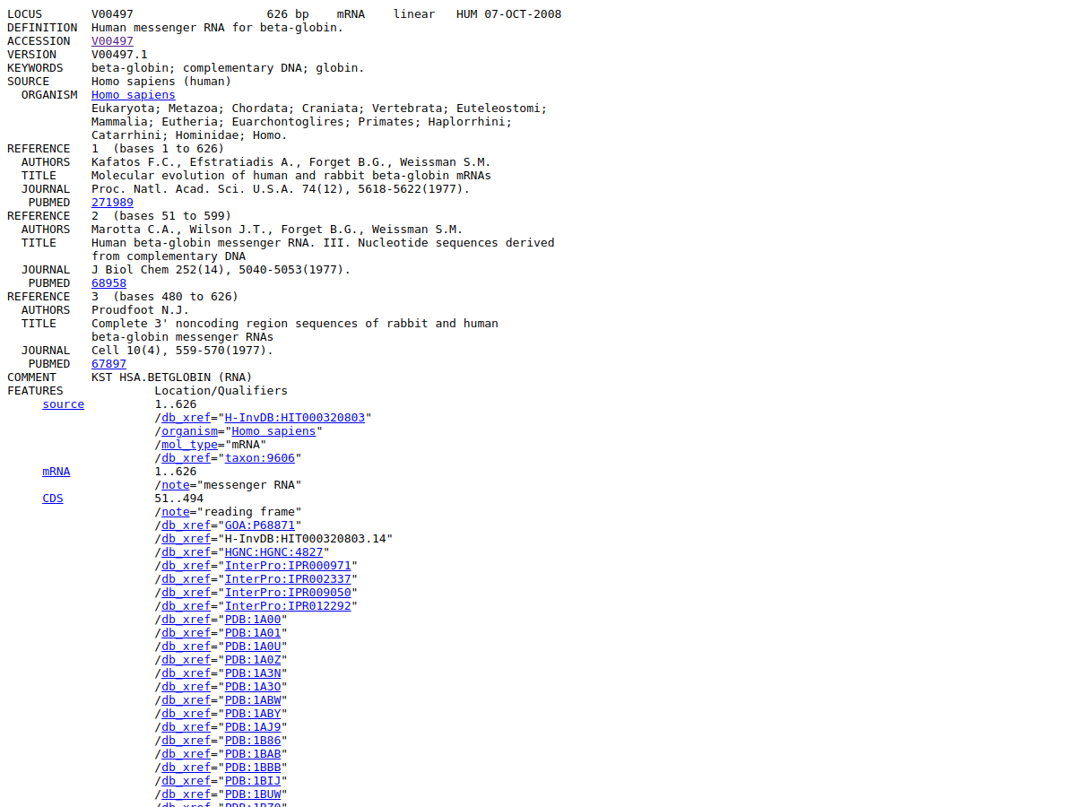
Search by official symbol
One symbol, different record IDs
Official gene symbol (HBB)
NCBI
EMBL-EBI
DDBJ
Notes:
[On slide entry] In the preceding slides we searched by name, then checked the identity and function of the human beta-globin protein in UniProtKB. [Click 1] We now use HBB, the approved symbol for the human gene that encodes it, to connect records across databases.
HGNC stands for HUGO Gene Nomenclature Committee. It approves and maintains a standard symbol and descriptive name for each human gene it names. That shared vocabulary helps researchers refer to the same gene in papers and search for it in different resources.
[Click 2] The report also points to related records in other databases.
[Click 3] The magnifier shows HBB, the approved name hemoglobin subunit beta, and HGNC:4827. The HGNC ID identifies this nomenclature record and stays stable if the approved name or symbol changes.
About HGNC: https://www.genenames.org/about/
HGNC HBB symbol report: https://www.genenames.org/data/gene-symbol-report/#!/hgnc_id/HGNC:4827

Slide 107
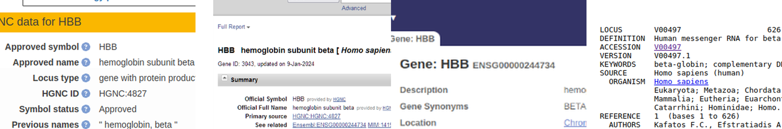
Search by official symbol
One symbol, different record IDs
Official gene symbol (HBB)
NCBI
EMBL-EBI
DDBJ
Notes:
[On slide entry] In the preceding slides we searched by name, then checked the identity and function of the human beta-globin protein in UniProtKB. [Click 1] We now use HBB, the approved symbol for the human gene that encodes it, to connect records across databases.
HGNC stands for HUGO Gene Nomenclature Committee. It approves and maintains a standard symbol and descriptive name for each human gene it names. That shared vocabulary helps researchers refer to the same gene in papers and search for it in different resources.
[Click 2] The report also points to related records in other databases.
[Click 3] The magnifier shows HBB, the approved name hemoglobin subunit beta, and HGNC:4827. The HGNC ID identifies this nomenclature record and stays stable if the approved name or symbol changes.
About HGNC: https://www.genenames.org/about/
HGNC HBB symbol report: https://www.genenames.org/data/gene-symbol-report/#!/hgnc_id/HGNC:4827

Slide 108
Search by official symbol
One symbol, different record IDs
Official gene symbol (HBB)
NCBI
EMBL-EBI
DDBJ
Notes:
[On slide entry / Morph] This is the NCBI Gene record we found earlier by narrowing a search by name. The entry is headed HBB, hemoglobin subunit beta, with Homo sapiens as the organism. The highlighted number, 3043, is the identifier for this particular NCBI Gene record.
The Summary credits HGNC as the source of the approved symbol and name and links to HGNC:4827. It also links to the Ensembl gene record. These cross-references let us confirm that the resources are describing the same gene, even though each has its own identifier.
NCBI Gene record: https://www.ncbi.nlm.nih.gov/gene/3043

Slide 109
Search by official symbol
One symbol, different record IDs
Official gene symbol (HBB)
NCBI
EMBL-EBI
DDBJ
Notes:
[On slide entry / Morph] Ensembl uses HBB for the same human gene and assigns its gene record the identifier ENSG00000244734. The ENSG prefix marks an Ensembl gene identifier. Compare this with NCBI Gene ID 3043. Both provide a direct route to their respective gene records.
The description in the full Ensembl screenshot cites HGNC:4827, which ties it back to the nomenclature record. This view also gives the location of HBB on chromosome 11 in the GRCh38 assembly and links to the annotated transcripts. The screenshot comes from Ensembl release 114, so use the live record to check current annotation.
Ensembl gene record: https://www.ensembl.org/id/ENSG00000244734
Ensembl release 114 screenshot: https://may2025.archive.ensembl.org/Homo_sapiens/Gene/Summary?g=ENSG00000244734

Slide 110
Search by official symbol
One symbol, different record IDs
Official gene symbol (HBB)
NCBI
EMBL-EBI
DDBJ
Notes:
[On slide entry / Morph] The final magnifier highlights V00497.1 in DDBJ GetEntry. Check the record header and definition. They describe a submitted human beta-globin mRNA sequence. The ACCESSION line gives V00497, and the VERSION line gives V00497.1. The suffix .1 specifies the first sequence version.
The notebook retrieves this same INSDC record through NCBI Nucleotide and ENA. The partners share the submitted sequence and accession, even though they display the record in different formats. Compare that with the NCBI Gene and Ensembl examples, where different identifiers point to two gene records for human HBB.
Before using an identifier, check its resource and the kind of record it retrieves. For this example, the record header tells us that the sequence is mRNA.
DDBJ GetEntry: https://getentry.ddbj.nig.ac.jp/getentry/na/V00497/?filetype=html

Slide 111



From a symbol to a record
Nomenclature
Gene record
Gene record
Genomic sequence
ClinVar variant
Submitted mRNA
Approved human gene symbol
HBB
Ensembl transcript
Ensembl protein
Haemoglobin complex
Globin family
Protein function
Globin domain
Notes:
[On slide entry] Suppose a colleague asks us to repeat an analysis and tells us, “I used HBB.” We recognize the human hemoglobin subunit beta gene, but we still need to know exactly which data went into the analysis. The name gives us a starting point. Our search then opens a whole collection of related records.
[Click 1: gene, genomic and variant records] Some describe the human gene in different resources. HGNC maintains its approved name and symbol under HGNC:4827, while NCBI Gene uses 3043 and Ensembl uses ENSG00000244734, as it was shown in the previous slides. Other records describe particular genomic sequences, [Click 2: transcript and Ensembl protein records] transcripts, proteins, variants, [Click 3: RefSeq protein, function, structure and family records] structures or families associated with HBB. The collection grows because large number of resources organize different kinds of information around the same biological subject.
[Click 4: moving identifiers and confused student] At first, that can feel confusing. Yet each identifier gives us a way to point precisely to a record
References
https://www.ncbi.nlm.nih.gov/gene/3043
https://www.ncbi.nlm.nih.gov/books/NBK50679/

Slide 112
From a symbol to a record
Nomenclature
Gene record
Gene record
Genomic sequence
ClinVar variant
HGNC:4827
3043
ENSG00000244734
NG_059281.1
VCV000015495.3
Submitted mRNA
Approved human gene symbol
HBB
Ensembl transcript
Ensembl protein
Haemoglobin complex
Globin family
Protein function
Globin domain
Notes:
[On slide entry] Suppose a colleague asks us to repeat an analysis and tells us, “I used HBB.” We recognize the human hemoglobin subunit beta gene, but we still need to know exactly which data went into the analysis. The name gives us a starting point. Our search then opens a whole collection of related records.
[Click 1: gene, genomic and variant records] Some describe the human gene in different resources. HGNC maintains its approved name and symbol under HGNC:4827, while NCBI Gene uses 3043 and Ensembl uses ENSG00000244734, as it was shown in the previous slides. Other records describe particular genomic sequences, [Click 2: transcript and Ensembl protein records] transcripts, proteins, variants, [Click 3: RefSeq protein, function, structure and family records] structures or families associated with HBB. The collection grows because large number of resources organize different kinds of information around the same biological subject.
[Click 4: moving identifiers and confused student] At first, that can feel confusing. Yet each identifier gives us a way to point precisely to a record
References
https://www.ncbi.nlm.nih.gov/gene/3043
https://www.ncbi.nlm.nih.gov/books/NBK50679/

Slide 113
From a symbol to a record
Nomenclature
Gene record
Gene record
Genomic sequence
ClinVar variant
HGNC:4827
3043
ENSG00000244734
NG_059281.1
VCV000015495.3
Reference mRNA
Submitted mRNA
NM_000518.5
Approved human gene symbol
V00497.1
HBB
Ensembl transcript
Ensembl protein
ENST00000335295.4
ENSP00000333994.3
Haemoglobin complex
Globin family
Protein function
Globin domain
Notes:
[On slide entry] Suppose a colleague asks us to repeat an analysis and tells us, “I used HBB.” We recognize the human hemoglobin subunit beta gene, but we still need to know exactly which data went into the analysis. The name gives us a starting point. Our search then opens a whole collection of related records.
[Click 1: gene, genomic and variant records] Some describe the human gene in different resources. HGNC maintains its approved name and symbol under HGNC:4827, while NCBI Gene uses 3043 and Ensembl uses ENSG00000244734, as it was shown in the previous slides. Other records describe particular genomic sequences, [Click 2: transcript and Ensembl protein records] transcripts, proteins, variants, [Click 3: RefSeq protein, function, structure and family records] structures or families associated with HBB. The collection grows because large number of resources organize different kinds of information around the same biological subject.
[Click 4: moving identifiers and confused student] At first, that can feel confusing. Yet each identifier gives us a way to point precisely to a record
References
https://www.ncbi.nlm.nih.gov/gene/3043
https://www.ncbi.nlm.nih.gov/books/NBK50679/

Slide 114
From a symbol to a record
Nomenclature
Gene record
Gene record
Genomic sequence
ClinVar variant
HGNC:4827
3043
ENSG00000244734
NG_059281.1
VCV000015495.3
Reference mRNA
Submitted mRNA
NM_000518.5
Approved human gene symbol
V00497.1
HBB
Ensembl transcript
Ensembl protein
ENST00000335295.4
ENSP00000333994.3
RefSeq protein
Haemoglobin complex
Globin family
NP_000509.1
Protein function
2HHB
IPR000971
Globin domain
P68871
PF00042
Notes:
[On slide entry] Suppose a colleague asks us to repeat an analysis and tells us, “I used HBB.” We recognize the human hemoglobin subunit beta gene, but we still need to know exactly which data went into the analysis. The name gives us a starting point. Our search then opens a whole collection of related records.
[Click 1: gene, genomic and variant records] Some describe the human gene in different resources. HGNC maintains its approved name and symbol under HGNC:4827, while NCBI Gene uses 3043 and Ensembl uses ENSG00000244734, as it was shown in the previous slides. Other records describe particular genomic sequences, [Click 2: transcript and Ensembl protein records] transcripts, proteins, variants, [Click 3: RefSeq protein, function, structure and family records] structures or families associated with HBB. The collection grows because large number of resources organize different kinds of information around the same biological subject.
[Click 4: moving identifiers and confused student] At first, that can feel confusing. Yet each identifier gives us a way to point precisely to a record
References
https://www.ncbi.nlm.nih.gov/gene/3043
https://www.ncbi.nlm.nih.gov/books/NBK50679/

Slide 115
From a symbol to a record
Nomenclature
Gene record
Gene record
Genomic sequence
ClinVar variant
HGNC:4827
ENSG00000244734
VCV000015495.3
What kind of sequence?
Which version did we use?
3043
NG_059281.1
Submitted mRNA
Approved human gene symbol
V00497.1
RefSeq mRNA
HBB
RefSeq protein
NM_000518.5
NP_000509.1
Ensembl transcript
hemoglobin subunit beta
Ensembl protein
ENST00000335295.4
ENSP00000333994.3
Save the full accession and version to retrieve the same sequence.
Haemoglobin complex
Globin family
Protein function
2HHB
IPR000971
Globin domain
P68871
PF00042
Notes:
[On slide entry / Morph] Our colleague’s note saying “I used HBB” has led us to many related records. To reproduce the analysis, we now need to answer two questions.
What kind of sequence? Studying a transcript requires an mRNA sequence, while examining amino-acid changes requires a protein sequence. In RefSeq, the prefix helps distinguish these. NM_000518.5 identifies an HBB mRNA record, and NP_000509.1 identifies its protein product.
UniProt uses another convention. P68871 identifies the human beta-globin entry. For proteins with several isoforms, a numbered suffix specifies the isoform. For example, P04150-2 identifies an isoform of the glucocorticoid receptor. The suffix -2 identifies a protein isoform and has a different meaning from RefSeq’s sequence-version suffix .5. UniProt explains this convention at https://www.uniprot.org/help/alternative_products.
Naturally occurring sequence variants can have identifiers beginning with VAR_. For example, VAR_002863 identifies the sickle-cell haemoglobin variant annotated within the HBB entry. Processed protein chains and peptides can have PRO_ identifiers. PRO_0000052976 identifies the mature beta-globin chain after removal of its initial methionine. These identifiers point to particular features within the protein entry. The HBB record is available at https://www.uniprot.org/uniprotkb/P68871/entry.
Post-translational modifications, such as phosphorylation, are generally recorded by specifying the modification type and its position in the protein sequence. Identifying the modified form therefore requires the protein accession together with the relevant modification and position. UniProt describes these annotations at https://www.uniprot.org/help/mod_res.
Which version did we use? Suppose our colleague confirms that the analysis used the HBB mRNA. In NM_000518.5, the suffix .5 specifies sequence version 5. The protein has its own update history, recorded independently in NP_000509.1. These conventions are explained at https://www.ncbi.nlm.nih.gov/books/NBK50679/.
We can now replace “I used HBB” with a precise description of the input. The biological name helped us find relevant records. The complete identifiers and version information allow another researcher to establish exactly what we analyzed.

Slide 116
Notes:
[On slide entry] We have seen that a biological name can lead to many records. [Click 1] Once we know the resource, an identifier’s first letters or final characters can help us recognize what a record contains and specify the particular sequence or protein form we need. These are selected examples. Every resource defines its own conventions.
[Click 2] RefSeq uses NM_ for mRNA records and NP_ for protein records. The HBB mRNA NM_000518.5 is sequence version 5. Its protein product NP_000509.1 has an independent sequence version. For reproducibility, retain the full accession and version.
[Click 3] For the human Ensembl records shown here, ENSG identifies a gene, ENST a transcript and ENSP a protein. Other organisms can have additional species letters. The number after a dot is the version of that Ensembl object. Ensembl applies different update rules to genes, transcripts and proteins, so a gene version should not be interpreted as the number of changes to its DNA sequence.
[Click 4] In the international read archives, SRR, ERR and DRR identify sequencing runs originating at NCBI, EMBL-EBI and DDBJ respectively. INSDC partners exchange these records, so the prefix indicates the originating archive rather than the only website where the data can be accessed. SRR390728 is a real RNA-sequencing run used here as a general example.
[Click 5] GEO uses GSE for a Series, which groups related samples in a study, and GSM for a Sample record. GSE10072 and GSM254625 are real expression-study examples. They are included to illustrate GEO’s identifier conventions and are separate from our HBB example.
[Click 6] UniProtKB uses an accession followed by a dash and a number to identify a protein isoform. UniProt records sequence and entry versions separately from its accession and isoform suffix. For reproducibility, we should save the accession, the relevant isoform or variant information, and the version information associated with the downloaded record. UniProt’s entry history is explained at https://www.uniprot.org/help/entry_history. P04150-2 identifies an isoform of the human glucocorticoid receptor. The -2 specifies the isoform. UniProt stores sequence-version information separately. The HBB entry P68871 currently has no curated isoform listing.
[Click 7] UniProtKB also assigns feature identifiers within protein entries. In the HBB entry, VAR_002863 identifies the natural variant associated with sickle-cell haemoglobin. PRO_0000052976 identifies the mature beta-globin chain after removal of the initiator methionine. Post-translational modifications are generally described by modification type and residue position within the entry. They do not have a general accession-suffix convention.
[Click 8] Rfam uses RF for RNA families. RF00005 is the tRNA family and illustrates noncoding RNA information. Pfam uses PF for protein families or domains. PF00042 is the globin domain found in beta-globin and other globin proteins. These family identifiers describe groups of related sequences.
[Click 9] The patterns are useful clues once the resource is known. Read the record description and check the organism, evidence and relevant version information before using the data.
RefSeq https://www.ncbi.nlm.nih.gov/books/NBK50679/
Ensembl identifier and version rules https://www.ensembl.org/info/genome/stable_ids/index.html
INSDC read accession prefixes https://www.ddbj.nig.ac.jp/news/en/2021-11-24-e.html
Example sequencing run https://www.ebi.ac.uk/ena/browser/view/SRR390728
GEO accession types https://www.ncbi.nlm.nih.gov/geo/info/geo_paccess.html
GEO example study https://www.ncbi.nlm.nih.gov/geo/query/acc.cgi?acc=GSE10072
GEO example sample https://www.ncbi.nlm.nih.gov/geo/query/acc.cgi?acc=GSM254625
UniProt isoform identifiers https://www.uniprot.org/help/alternative_products
UniProt feature identifiers https://www.uniprot.org/help/sequence_annotation#annotation_id
UniProt HBB https://www.uniprot.org/uniprotkb/P68871/entry
UniProt modified residues https://www.uniprot.org/help/mod_res
Rfam tRNA family https://rfam.org/family/RF00005
Pfam globin family/domain https://www.ebi.ac.uk/interpro/entry/pfam/PF00042/

Slide 117
Clues in the code
Notes:
[On slide entry] We have seen that a biological name can lead to many records. [Click 1] Once we know the resource, an identifier’s first letters or final characters can help us recognize what a record contains and specify the particular sequence or protein form we need. These are selected examples. Every resource defines its own conventions.
[Click 2] RefSeq uses NM_ for mRNA records and NP_ for protein records. The HBB mRNA NM_000518.5 is sequence version 5. Its protein product NP_000509.1 has an independent sequence version. For reproducibility, retain the full accession and version.
[Click 3] For the human Ensembl records shown here, ENSG identifies a gene, ENST a transcript and ENSP a protein. Other organisms can have additional species letters. The number after a dot is the version of that Ensembl object. Ensembl applies different update rules to genes, transcripts and proteins, so a gene version should not be interpreted as the number of changes to its DNA sequence.
[Click 4] In the international read archives, SRR, ERR and DRR identify sequencing runs originating at NCBI, EMBL-EBI and DDBJ respectively. INSDC partners exchange these records, so the prefix indicates the originating archive rather than the only website where the data can be accessed. SRR390728 is a real RNA-sequencing run used here as a general example.
[Click 5] GEO uses GSE for a Series, which groups related samples in a study, and GSM for a Sample record. GSE10072 and GSM254625 are real expression-study examples. They are included to illustrate GEO’s identifier conventions and are separate from our HBB example.
[Click 6] UniProtKB uses an accession followed by a dash and a number to identify a protein isoform. UniProt records sequence and entry versions separately from its accession and isoform suffix. For reproducibility, we should save the accession, the relevant isoform or variant information, and the version information associated with the downloaded record. UniProt’s entry history is explained at https://www.uniprot.org/help/entry_history. P04150-2 identifies an isoform of the human glucocorticoid receptor. The -2 specifies the isoform. UniProt stores sequence-version information separately. The HBB entry P68871 currently has no curated isoform listing.
[Click 7] UniProtKB also assigns feature identifiers within protein entries. In the HBB entry, VAR_002863 identifies the natural variant associated with sickle-cell haemoglobin. PRO_0000052976 identifies the mature beta-globin chain after removal of the initiator methionine. Post-translational modifications are generally described by modification type and residue position within the entry. They do not have a general accession-suffix convention.
[Click 8] Rfam uses RF for RNA families. RF00005 is the tRNA family and illustrates noncoding RNA information. Pfam uses PF for protein families or domains. PF00042 is the globin domain found in beta-globin and other globin proteins. These family identifiers describe groups of related sequences.
[Click 9] The patterns are useful clues once the resource is known. Read the record description and check the organism, evidence and relevant version information before using the data.
RefSeq https://www.ncbi.nlm.nih.gov/books/NBK50679/
Ensembl identifier and version rules https://www.ensembl.org/info/genome/stable_ids/index.html
INSDC read accession prefixes https://www.ddbj.nig.ac.jp/news/en/2021-11-24-e.html
Example sequencing run https://www.ebi.ac.uk/ena/browser/view/SRR390728
GEO accession types https://www.ncbi.nlm.nih.gov/geo/info/geo_paccess.html
GEO example study https://www.ncbi.nlm.nih.gov/geo/query/acc.cgi?acc=GSE10072
GEO example sample https://www.ncbi.nlm.nih.gov/geo/query/acc.cgi?acc=GSM254625
UniProt isoform identifiers https://www.uniprot.org/help/alternative_products
UniProt feature identifiers https://www.uniprot.org/help/sequence_annotation#annotation_id
UniProt HBB https://www.uniprot.org/uniprotkb/P68871/entry
UniProt modified residues https://www.uniprot.org/help/mod_res
Rfam tRNA family https://rfam.org/family/RF00005
Pfam globin family/domain https://www.ebi.ac.uk/interpro/entry/pfam/PF00042/

Slide 118
Clues in the code
Prefixes and suffixes carry clues
Resource | Pattern or example | What the pattern tells us
Notes:
[On slide entry] We have seen that a biological name can lead to many records. [Click 1] Once we know the resource, an identifier’s first letters or final characters can help us recognize what a record contains and specify the particular sequence or protein form we need. These are selected examples. Every resource defines its own conventions.
[Click 2] RefSeq uses NM_ for mRNA records and NP_ for protein records. The HBB mRNA NM_000518.5 is sequence version 5. Its protein product NP_000509.1 has an independent sequence version. For reproducibility, retain the full accession and version.
[Click 3] For the human Ensembl records shown here, ENSG identifies a gene, ENST a transcript and ENSP a protein. Other organisms can have additional species letters. The number after a dot is the version of that Ensembl object. Ensembl applies different update rules to genes, transcripts and proteins, so a gene version should not be interpreted as the number of changes to its DNA sequence.
[Click 4] In the international read archives, SRR, ERR and DRR identify sequencing runs originating at NCBI, EMBL-EBI and DDBJ respectively. INSDC partners exchange these records, so the prefix indicates the originating archive rather than the only website where the data can be accessed. SRR390728 is a real RNA-sequencing run used here as a general example.
[Click 5] GEO uses GSE for a Series, which groups related samples in a study, and GSM for a Sample record. GSE10072 and GSM254625 are real expression-study examples. They are included to illustrate GEO’s identifier conventions and are separate from our HBB example.
[Click 6] UniProtKB uses an accession followed by a dash and a number to identify a protein isoform. UniProt records sequence and entry versions separately from its accession and isoform suffix. For reproducibility, we should save the accession, the relevant isoform or variant information, and the version information associated with the downloaded record. UniProt’s entry history is explained at https://www.uniprot.org/help/entry_history. P04150-2 identifies an isoform of the human glucocorticoid receptor. The -2 specifies the isoform. UniProt stores sequence-version information separately. The HBB entry P68871 currently has no curated isoform listing.
[Click 7] UniProtKB also assigns feature identifiers within protein entries. In the HBB entry, VAR_002863 identifies the natural variant associated with sickle-cell haemoglobin. PRO_0000052976 identifies the mature beta-globin chain after removal of the initiator methionine. Post-translational modifications are generally described by modification type and residue position within the entry. They do not have a general accession-suffix convention.
[Click 8] Rfam uses RF for RNA families. RF00005 is the tRNA family and illustrates noncoding RNA information. Pfam uses PF for protein families or domains. PF00042 is the globin domain found in beta-globin and other globin proteins. These family identifiers describe groups of related sequences.
[Click 9] The patterns are useful clues once the resource is known. Read the record description and check the organism, evidence and relevant version information before using the data.
RefSeq https://www.ncbi.nlm.nih.gov/books/NBK50679/
Ensembl identifier and version rules https://www.ensembl.org/info/genome/stable_ids/index.html
INSDC read accession prefixes https://www.ddbj.nig.ac.jp/news/en/2021-11-24-e.html
Example sequencing run https://www.ebi.ac.uk/ena/browser/view/SRR390728
GEO accession types https://www.ncbi.nlm.nih.gov/geo/info/geo_paccess.html
GEO example study https://www.ncbi.nlm.nih.gov/geo/query/acc.cgi?acc=GSE10072
GEO example sample https://www.ncbi.nlm.nih.gov/geo/query/acc.cgi?acc=GSM254625
UniProt isoform identifiers https://www.uniprot.org/help/alternative_products
UniProt feature identifiers https://www.uniprot.org/help/sequence_annotation#annotation_id
UniProt HBB https://www.uniprot.org/uniprotkb/P68871/entry
UniProt modified residues https://www.uniprot.org/help/mod_res
Rfam tRNA family https://rfam.org/family/RF00005
Pfam globin family/domain https://www.ebi.ac.uk/interpro/entry/pfam/PF00042/

Slide 119
Clues in the code
Prefixes and suffixes carry clues
Resource | Pattern or example | What the pattern tells us
RefSeq | NM_000518.5 NP_000509.1 | NM_ mRNA, NP_ protein .5 sequence version 5
Notes:
[On slide entry] We have seen that a biological name can lead to many records. [Click 1] Once we know the resource, an identifier’s first letters or final characters can help us recognize what a record contains and specify the particular sequence or protein form we need. These are selected examples. Every resource defines its own conventions.
[Click 2] RefSeq uses NM_ for mRNA records and NP_ for protein records. The HBB mRNA NM_000518.5 is sequence version 5. Its protein product NP_000509.1 has an independent sequence version. For reproducibility, retain the full accession and version.
[Click 3] For the human Ensembl records shown here, ENSG identifies a gene, ENST a transcript and ENSP a protein. Other organisms can have additional species letters. The number after a dot is the version of that Ensembl object. Ensembl applies different update rules to genes, transcripts and proteins, so a gene version should not be interpreted as the number of changes to its DNA sequence.
[Click 4] In the international read archives, SRR, ERR and DRR identify sequencing runs originating at NCBI, EMBL-EBI and DDBJ respectively. INSDC partners exchange these records, so the prefix indicates the originating archive rather than the only website where the data can be accessed. SRR390728 is a real RNA-sequencing run used here as a general example.
[Click 5] GEO uses GSE for a Series, which groups related samples in a study, and GSM for a Sample record. GSE10072 and GSM254625 are real expression-study examples. They are included to illustrate GEO’s identifier conventions and are separate from our HBB example.
[Click 6] UniProtKB uses an accession followed by a dash and a number to identify a protein isoform. UniProt records sequence and entry versions separately from its accession and isoform suffix. For reproducibility, we should save the accession, the relevant isoform or variant information, and the version information associated with the downloaded record. UniProt’s entry history is explained at https://www.uniprot.org/help/entry_history. P04150-2 identifies an isoform of the human glucocorticoid receptor. The -2 specifies the isoform. UniProt stores sequence-version information separately. The HBB entry P68871 currently has no curated isoform listing.
[Click 7] UniProtKB also assigns feature identifiers within protein entries. In the HBB entry, VAR_002863 identifies the natural variant associated with sickle-cell haemoglobin. PRO_0000052976 identifies the mature beta-globin chain after removal of the initiator methionine. Post-translational modifications are generally described by modification type and residue position within the entry. They do not have a general accession-suffix convention.
[Click 8] Rfam uses RF for RNA families. RF00005 is the tRNA family and illustrates noncoding RNA information. Pfam uses PF for protein families or domains. PF00042 is the globin domain found in beta-globin and other globin proteins. These family identifiers describe groups of related sequences.
[Click 9] The patterns are useful clues once the resource is known. Read the record description and check the organism, evidence and relevant version information before using the data.
RefSeq https://www.ncbi.nlm.nih.gov/books/NBK50679/
Ensembl identifier and version rules https://www.ensembl.org/info/genome/stable_ids/index.html
INSDC read accession prefixes https://www.ddbj.nig.ac.jp/news/en/2021-11-24-e.html
Example sequencing run https://www.ebi.ac.uk/ena/browser/view/SRR390728
GEO accession types https://www.ncbi.nlm.nih.gov/geo/info/geo_paccess.html
GEO example study https://www.ncbi.nlm.nih.gov/geo/query/acc.cgi?acc=GSE10072
GEO example sample https://www.ncbi.nlm.nih.gov/geo/query/acc.cgi?acc=GSM254625
UniProt isoform identifiers https://www.uniprot.org/help/alternative_products
UniProt feature identifiers https://www.uniprot.org/help/sequence_annotation#annotation_id
UniProt HBB https://www.uniprot.org/uniprotkb/P68871/entry
UniProt modified residues https://www.uniprot.org/help/mod_res
Rfam tRNA family https://rfam.org/family/RF00005
Pfam globin family/domain https://www.ebi.ac.uk/interpro/entry/pfam/PF00042/

Slide 120
Clues in the code
Prefixes and suffixes carry clues
Resource | Pattern or example | What the pattern tells us
RefSeq | NM_000518.5 NP_000509.1 | NM_ mRNA, NP_ protein .5 sequence version 5
Ensembl (human) | ENSG… / ENST… / ENSP… ENST00000335295.4 | Gene / transcript / protein .4 version of this transcript
Notes:
[On slide entry] We have seen that a biological name can lead to many records. [Click 1] Once we know the resource, an identifier’s first letters or final characters can help us recognize what a record contains and specify the particular sequence or protein form we need. These are selected examples. Every resource defines its own conventions.
[Click 2] RefSeq uses NM_ for mRNA records and NP_ for protein records. The HBB mRNA NM_000518.5 is sequence version 5. Its protein product NP_000509.1 has an independent sequence version. For reproducibility, retain the full accession and version.
[Click 3] For the human Ensembl records shown here, ENSG identifies a gene, ENST a transcript and ENSP a protein. Other organisms can have additional species letters. The number after a dot is the version of that Ensembl object. Ensembl applies different update rules to genes, transcripts and proteins, so a gene version should not be interpreted as the number of changes to its DNA sequence.
[Click 4] In the international read archives, SRR, ERR and DRR identify sequencing runs originating at NCBI, EMBL-EBI and DDBJ respectively. INSDC partners exchange these records, so the prefix indicates the originating archive rather than the only website where the data can be accessed. SRR390728 is a real RNA-sequencing run used here as a general example.
[Click 5] GEO uses GSE for a Series, which groups related samples in a study, and GSM for a Sample record. GSE10072 and GSM254625 are real expression-study examples. They are included to illustrate GEO’s identifier conventions and are separate from our HBB example.
[Click 6] UniProtKB uses an accession followed by a dash and a number to identify a protein isoform. UniProt records sequence and entry versions separately from its accession and isoform suffix. For reproducibility, we should save the accession, the relevant isoform or variant information, and the version information associated with the downloaded record. UniProt’s entry history is explained at https://www.uniprot.org/help/entry_history. P04150-2 identifies an isoform of the human glucocorticoid receptor. The -2 specifies the isoform. UniProt stores sequence-version information separately. The HBB entry P68871 currently has no curated isoform listing.
[Click 7] UniProtKB also assigns feature identifiers within protein entries. In the HBB entry, VAR_002863 identifies the natural variant associated with sickle-cell haemoglobin. PRO_0000052976 identifies the mature beta-globin chain after removal of the initiator methionine. Post-translational modifications are generally described by modification type and residue position within the entry. They do not have a general accession-suffix convention.
[Click 8] Rfam uses RF for RNA families. RF00005 is the tRNA family and illustrates noncoding RNA information. Pfam uses PF for protein families or domains. PF00042 is the globin domain found in beta-globin and other globin proteins. These family identifiers describe groups of related sequences.
[Click 9] The patterns are useful clues once the resource is known. Read the record description and check the organism, evidence and relevant version information before using the data.
RefSeq https://www.ncbi.nlm.nih.gov/books/NBK50679/
Ensembl identifier and version rules https://www.ensembl.org/info/genome/stable_ids/index.html
INSDC read accession prefixes https://www.ddbj.nig.ac.jp/news/en/2021-11-24-e.html
Example sequencing run https://www.ebi.ac.uk/ena/browser/view/SRR390728
GEO accession types https://www.ncbi.nlm.nih.gov/geo/info/geo_paccess.html
GEO example study https://www.ncbi.nlm.nih.gov/geo/query/acc.cgi?acc=GSE10072
GEO example sample https://www.ncbi.nlm.nih.gov/geo/query/acc.cgi?acc=GSM254625
UniProt isoform identifiers https://www.uniprot.org/help/alternative_products
UniProt feature identifiers https://www.uniprot.org/help/sequence_annotation#annotation_id
UniProt HBB https://www.uniprot.org/uniprotkb/P68871/entry
UniProt modified residues https://www.uniprot.org/help/mod_res
Rfam tRNA family https://rfam.org/family/RF00005
Pfam globin family/domain https://www.ebi.ac.uk/interpro/entry/pfam/PF00042/

Slide 121
Clues in the code
Prefixes and suffixes carry clues
Resource | Pattern or example | What the pattern tells us
RefSeq | NM_000518.5 NP_000509.1 | NM_ mRNA, NP_ protein .5 sequence version 5
Ensembl (human) | ENSG… / ENST… / ENSP… ENST00000335295.4 | Gene / transcript / protein .4 version of this transcript
INSDC read runs | SRR… / ERR… / DRR… Example SRR390728 | Sequencing run Prefix shows the originating archive
Notes:
[On slide entry] We have seen that a biological name can lead to many records. [Click 1] Once we know the resource, an identifier’s first letters or final characters can help us recognize what a record contains and specify the particular sequence or protein form we need. These are selected examples. Every resource defines its own conventions.
[Click 2] RefSeq uses NM_ for mRNA records and NP_ for protein records. The HBB mRNA NM_000518.5 is sequence version 5. Its protein product NP_000509.1 has an independent sequence version. For reproducibility, retain the full accession and version.
[Click 3] For the human Ensembl records shown here, ENSG identifies a gene, ENST a transcript and ENSP a protein. Other organisms can have additional species letters. The number after a dot is the version of that Ensembl object. Ensembl applies different update rules to genes, transcripts and proteins, so a gene version should not be interpreted as the number of changes to its DNA sequence.
[Click 4] In the international read archives, SRR, ERR and DRR identify sequencing runs originating at NCBI, EMBL-EBI and DDBJ respectively. INSDC partners exchange these records, so the prefix indicates the originating archive rather than the only website where the data can be accessed. SRR390728 is a real RNA-sequencing run used here as a general example.
[Click 5] GEO uses GSE for a Series, which groups related samples in a study, and GSM for a Sample record. GSE10072 and GSM254625 are real expression-study examples. They are included to illustrate GEO’s identifier conventions and are separate from our HBB example.
[Click 6] UniProtKB uses an accession followed by a dash and a number to identify a protein isoform. UniProt records sequence and entry versions separately from its accession and isoform suffix. For reproducibility, we should save the accession, the relevant isoform or variant information, and the version information associated with the downloaded record. UniProt’s entry history is explained at https://www.uniprot.org/help/entry_history. P04150-2 identifies an isoform of the human glucocorticoid receptor. The -2 specifies the isoform. UniProt stores sequence-version information separately. The HBB entry P68871 currently has no curated isoform listing.
[Click 7] UniProtKB also assigns feature identifiers within protein entries. In the HBB entry, VAR_002863 identifies the natural variant associated with sickle-cell haemoglobin. PRO_0000052976 identifies the mature beta-globin chain after removal of the initiator methionine. Post-translational modifications are generally described by modification type and residue position within the entry. They do not have a general accession-suffix convention.
[Click 8] Rfam uses RF for RNA families. RF00005 is the tRNA family and illustrates noncoding RNA information. Pfam uses PF for protein families or domains. PF00042 is the globin domain found in beta-globin and other globin proteins. These family identifiers describe groups of related sequences.
[Click 9] The patterns are useful clues once the resource is known. Read the record description and check the organism, evidence and relevant version information before using the data.
RefSeq https://www.ncbi.nlm.nih.gov/books/NBK50679/
Ensembl identifier and version rules https://www.ensembl.org/info/genome/stable_ids/index.html
INSDC read accession prefixes https://www.ddbj.nig.ac.jp/news/en/2021-11-24-e.html
Example sequencing run https://www.ebi.ac.uk/ena/browser/view/SRR390728
GEO accession types https://www.ncbi.nlm.nih.gov/geo/info/geo_paccess.html
GEO example study https://www.ncbi.nlm.nih.gov/geo/query/acc.cgi?acc=GSE10072
GEO example sample https://www.ncbi.nlm.nih.gov/geo/query/acc.cgi?acc=GSM254625
UniProt isoform identifiers https://www.uniprot.org/help/alternative_products
UniProt feature identifiers https://www.uniprot.org/help/sequence_annotation#annotation_id
UniProt HBB https://www.uniprot.org/uniprotkb/P68871/entry
UniProt modified residues https://www.uniprot.org/help/mod_res
Rfam tRNA family https://rfam.org/family/RF00005
Pfam globin family/domain https://www.ebi.ac.uk/interpro/entry/pfam/PF00042/

Slide 122
Clues in the code
Prefixes and suffixes carry clues
Resource | Pattern or example | What the pattern tells us
RefSeq | NM_000518.5 NP_000509.1 | NM_ mRNA, NP_ protein .5 sequence version 5
Ensembl (human) | ENSG… / ENST… / ENSP… ENST00000335295.4 | Gene / transcript / protein .4 version of this transcript
INSDC read runs | SRR… / ERR… / DRR… Example SRR390728 | Sequencing run Prefix shows the originating archive
GEO | GSE… / GSM… GSE10072 / GSM254625 | GSE study series GSM sample
Notes:
[On slide entry] We have seen that a biological name can lead to many records. [Click 1] Once we know the resource, an identifier’s first letters or final characters can help us recognize what a record contains and specify the particular sequence or protein form we need. These are selected examples. Every resource defines its own conventions.
[Click 2] RefSeq uses NM_ for mRNA records and NP_ for protein records. The HBB mRNA NM_000518.5 is sequence version 5. Its protein product NP_000509.1 has an independent sequence version. For reproducibility, retain the full accession and version.
[Click 3] For the human Ensembl records shown here, ENSG identifies a gene, ENST a transcript and ENSP a protein. Other organisms can have additional species letters. The number after a dot is the version of that Ensembl object. Ensembl applies different update rules to genes, transcripts and proteins, so a gene version should not be interpreted as the number of changes to its DNA sequence.
[Click 4] In the international read archives, SRR, ERR and DRR identify sequencing runs originating at NCBI, EMBL-EBI and DDBJ respectively. INSDC partners exchange these records, so the prefix indicates the originating archive rather than the only website where the data can be accessed. SRR390728 is a real RNA-sequencing run used here as a general example.
[Click 5] GEO uses GSE for a Series, which groups related samples in a study, and GSM for a Sample record. GSE10072 and GSM254625 are real expression-study examples. They are included to illustrate GEO’s identifier conventions and are separate from our HBB example.
[Click 6] UniProtKB uses an accession followed by a dash and a number to identify a protein isoform. UniProt records sequence and entry versions separately from its accession and isoform suffix. For reproducibility, we should save the accession, the relevant isoform or variant information, and the version information associated with the downloaded record. UniProt’s entry history is explained at https://www.uniprot.org/help/entry_history. P04150-2 identifies an isoform of the human glucocorticoid receptor. The -2 specifies the isoform. UniProt stores sequence-version information separately. The HBB entry P68871 currently has no curated isoform listing.
[Click 7] UniProtKB also assigns feature identifiers within protein entries. In the HBB entry, VAR_002863 identifies the natural variant associated with sickle-cell haemoglobin. PRO_0000052976 identifies the mature beta-globin chain after removal of the initiator methionine. Post-translational modifications are generally described by modification type and residue position within the entry. They do not have a general accession-suffix convention.
[Click 8] Rfam uses RF for RNA families. RF00005 is the tRNA family and illustrates noncoding RNA information. Pfam uses PF for protein families or domains. PF00042 is the globin domain found in beta-globin and other globin proteins. These family identifiers describe groups of related sequences.
[Click 9] The patterns are useful clues once the resource is known. Read the record description and check the organism, evidence and relevant version information before using the data.
RefSeq https://www.ncbi.nlm.nih.gov/books/NBK50679/
Ensembl identifier and version rules https://www.ensembl.org/info/genome/stable_ids/index.html
INSDC read accession prefixes https://www.ddbj.nig.ac.jp/news/en/2021-11-24-e.html
Example sequencing run https://www.ebi.ac.uk/ena/browser/view/SRR390728
GEO accession types https://www.ncbi.nlm.nih.gov/geo/info/geo_paccess.html
GEO example study https://www.ncbi.nlm.nih.gov/geo/query/acc.cgi?acc=GSE10072
GEO example sample https://www.ncbi.nlm.nih.gov/geo/query/acc.cgi?acc=GSM254625
UniProt isoform identifiers https://www.uniprot.org/help/alternative_products
UniProt feature identifiers https://www.uniprot.org/help/sequence_annotation#annotation_id
UniProt HBB https://www.uniprot.org/uniprotkb/P68871/entry
UniProt modified residues https://www.uniprot.org/help/mod_res
Rfam tRNA family https://rfam.org/family/RF00005
Pfam globin family/domain https://www.ebi.ac.uk/interpro/entry/pfam/PF00042/

Slide 123
Clues in the code
Prefixes and suffixes carry clues
Resource | Pattern or example | What the pattern tells us
RefSeq | NM_000518.5 NP_000509.1 | NM_ mRNA, NP_ protein .5 sequence version 5
Ensembl (human) | ENSG… / ENST… / ENSP… ENST00000335295.4 | Gene / transcript / protein .4 version of this transcript
INSDC read runs | SRR… / ERR… / DRR… Example SRR390728 | Sequencing run Prefix shows the originating archive
GEO | GSE… / GSM… GSE10072 / GSM254625 | GSE study series GSM sample
UniProtKB isoforms | P04150-2 | -2 identifies a protein isoform
Notes:
[On slide entry] We have seen that a biological name can lead to many records. [Click 1] Once we know the resource, an identifier’s first letters or final characters can help us recognize what a record contains and specify the particular sequence or protein form we need. These are selected examples. Every resource defines its own conventions.
[Click 2] RefSeq uses NM_ for mRNA records and NP_ for protein records. The HBB mRNA NM_000518.5 is sequence version 5. Its protein product NP_000509.1 has an independent sequence version. For reproducibility, retain the full accession and version.
[Click 3] For the human Ensembl records shown here, ENSG identifies a gene, ENST a transcript and ENSP a protein. Other organisms can have additional species letters. The number after a dot is the version of that Ensembl object. Ensembl applies different update rules to genes, transcripts and proteins, so a gene version should not be interpreted as the number of changes to its DNA sequence.
[Click 4] In the international read archives, SRR, ERR and DRR identify sequencing runs originating at NCBI, EMBL-EBI and DDBJ respectively. INSDC partners exchange these records, so the prefix indicates the originating archive rather than the only website where the data can be accessed. SRR390728 is a real RNA-sequencing run used here as a general example.
[Click 5] GEO uses GSE for a Series, which groups related samples in a study, and GSM for a Sample record. GSE10072 and GSM254625 are real expression-study examples. They are included to illustrate GEO’s identifier conventions and are separate from our HBB example.
[Click 6] UniProtKB uses an accession followed by a dash and a number to identify a protein isoform. UniProt records sequence and entry versions separately from its accession and isoform suffix. For reproducibility, we should save the accession, the relevant isoform or variant information, and the version information associated with the downloaded record. UniProt’s entry history is explained at https://www.uniprot.org/help/entry_history. P04150-2 identifies an isoform of the human glucocorticoid receptor. The -2 specifies the isoform. UniProt stores sequence-version information separately. The HBB entry P68871 currently has no curated isoform listing.
[Click 7] UniProtKB also assigns feature identifiers within protein entries. In the HBB entry, VAR_002863 identifies the natural variant associated with sickle-cell haemoglobin. PRO_0000052976 identifies the mature beta-globin chain after removal of the initiator methionine. Post-translational modifications are generally described by modification type and residue position within the entry. They do not have a general accession-suffix convention.
[Click 8] Rfam uses RF for RNA families. RF00005 is the tRNA family and illustrates noncoding RNA information. Pfam uses PF for protein families or domains. PF00042 is the globin domain found in beta-globin and other globin proteins. These family identifiers describe groups of related sequences.
[Click 9] The patterns are useful clues once the resource is known. Read the record description and check the organism, evidence and relevant version information before using the data.
RefSeq https://www.ncbi.nlm.nih.gov/books/NBK50679/
Ensembl identifier and version rules https://www.ensembl.org/info/genome/stable_ids/index.html
INSDC read accession prefixes https://www.ddbj.nig.ac.jp/news/en/2021-11-24-e.html
Example sequencing run https://www.ebi.ac.uk/ena/browser/view/SRR390728
GEO accession types https://www.ncbi.nlm.nih.gov/geo/info/geo_paccess.html
GEO example study https://www.ncbi.nlm.nih.gov/geo/query/acc.cgi?acc=GSE10072
GEO example sample https://www.ncbi.nlm.nih.gov/geo/query/acc.cgi?acc=GSM254625
UniProt isoform identifiers https://www.uniprot.org/help/alternative_products
UniProt feature identifiers https://www.uniprot.org/help/sequence_annotation#annotation_id
UniProt HBB https://www.uniprot.org/uniprotkb/P68871/entry
UniProt modified residues https://www.uniprot.org/help/mod_res
Rfam tRNA family https://rfam.org/family/RF00005
Pfam globin family/domain https://www.ebi.ac.uk/interpro/entry/pfam/PF00042/

Slide 124
Clues in the code
Prefixes and suffixes carry clues
Resource | Pattern or example | What the pattern tells us
RefSeq | NM_000518.5 NP_000509.1 | NM_ mRNA, NP_ protein .5 sequence version 5
Ensembl (human) | ENSG… / ENST… / ENSP… ENST00000335295.4 | Gene / transcript / protein .4 version of this transcript
INSDC read runs | SRR… / ERR… / DRR… Example SRR390728 | Sequencing run Prefix shows the originating archive
GEO | GSE… / GSM… GSE10072 / GSM254625 | GSE study series GSM sample
UniProtKB isoforms | P04150-2 | -2 identifies a protein isoform
UniProtKB features | VAR_002863 PRO_0000052976 | VAR_ natural sequence variant PRO_ processed chain or peptide
Notes:
[On slide entry] We have seen that a biological name can lead to many records. [Click 1] Once we know the resource, an identifier’s first letters or final characters can help us recognize what a record contains and specify the particular sequence or protein form we need. These are selected examples. Every resource defines its own conventions.
[Click 2] RefSeq uses NM_ for mRNA records and NP_ for protein records. The HBB mRNA NM_000518.5 is sequence version 5. Its protein product NP_000509.1 has an independent sequence version. For reproducibility, retain the full accession and version.
[Click 3] For the human Ensembl records shown here, ENSG identifies a gene, ENST a transcript and ENSP a protein. Other organisms can have additional species letters. The number after a dot is the version of that Ensembl object. Ensembl applies different update rules to genes, transcripts and proteins, so a gene version should not be interpreted as the number of changes to its DNA sequence.
[Click 4] In the international read archives, SRR, ERR and DRR identify sequencing runs originating at NCBI, EMBL-EBI and DDBJ respectively. INSDC partners exchange these records, so the prefix indicates the originating archive rather than the only website where the data can be accessed. SRR390728 is a real RNA-sequencing run used here as a general example.
[Click 5] GEO uses GSE for a Series, which groups related samples in a study, and GSM for a Sample record. GSE10072 and GSM254625 are real expression-study examples. They are included to illustrate GEO’s identifier conventions and are separate from our HBB example.
[Click 6] UniProtKB uses an accession followed by a dash and a number to identify a protein isoform. UniProt records sequence and entry versions separately from its accession and isoform suffix. For reproducibility, we should save the accession, the relevant isoform or variant information, and the version information associated with the downloaded record. UniProt’s entry history is explained at https://www.uniprot.org/help/entry_history. P04150-2 identifies an isoform of the human glucocorticoid receptor. The -2 specifies the isoform. UniProt stores sequence-version information separately. The HBB entry P68871 currently has no curated isoform listing.
[Click 7] UniProtKB also assigns feature identifiers within protein entries. In the HBB entry, VAR_002863 identifies the natural variant associated with sickle-cell haemoglobin. PRO_0000052976 identifies the mature beta-globin chain after removal of the initiator methionine. Post-translational modifications are generally described by modification type and residue position within the entry. They do not have a general accession-suffix convention.
[Click 8] Rfam uses RF for RNA families. RF00005 is the tRNA family and illustrates noncoding RNA information. Pfam uses PF for protein families or domains. PF00042 is the globin domain found in beta-globin and other globin proteins. These family identifiers describe groups of related sequences.
[Click 9] The patterns are useful clues once the resource is known. Read the record description and check the organism, evidence and relevant version information before using the data.
RefSeq https://www.ncbi.nlm.nih.gov/books/NBK50679/
Ensembl identifier and version rules https://www.ensembl.org/info/genome/stable_ids/index.html
INSDC read accession prefixes https://www.ddbj.nig.ac.jp/news/en/2021-11-24-e.html
Example sequencing run https://www.ebi.ac.uk/ena/browser/view/SRR390728
GEO accession types https://www.ncbi.nlm.nih.gov/geo/info/geo_paccess.html
GEO example study https://www.ncbi.nlm.nih.gov/geo/query/acc.cgi?acc=GSE10072
GEO example sample https://www.ncbi.nlm.nih.gov/geo/query/acc.cgi?acc=GSM254625
UniProt isoform identifiers https://www.uniprot.org/help/alternative_products
UniProt feature identifiers https://www.uniprot.org/help/sequence_annotation#annotation_id
UniProt HBB https://www.uniprot.org/uniprotkb/P68871/entry
UniProt modified residues https://www.uniprot.org/help/mod_res
Rfam tRNA family https://rfam.org/family/RF00005
Pfam globin family/domain https://www.ebi.ac.uk/interpro/entry/pfam/PF00042/

Slide 125
Clues in the code
Prefixes and suffixes carry clues
Resource | Pattern or example | What the pattern tells us
RefSeq | NM_000518.5 NP_000509.1 | NM_ mRNA, NP_ protein .5 sequence version 5
Ensembl (human) | ENSG… / ENST… / ENSP… ENST00000335295.4 | Gene / transcript / protein .4 version of this transcript
INSDC read runs | SRR… / ERR… / DRR… Example SRR390728 | Sequencing run Prefix shows the originating archive
GEO | GSE… / GSM… GSE10072 / GSM254625 | GSE study series GSM sample
UniProtKB isoforms | P04150-2 | -2 identifies a protein isoform
UniProtKB features | VAR_002863 PRO_0000052976 | VAR_ natural sequence variant PRO_ processed chain or peptide
Rfam / Pfam | RF00005 / PF00042 | RF RNA family PF protein family or domain
Notes:
[On slide entry] We have seen that a biological name can lead to many records. [Click 1] Once we know the resource, an identifier’s first letters or final characters can help us recognize what a record contains and specify the particular sequence or protein form we need. These are selected examples. Every resource defines its own conventions.
[Click 2] RefSeq uses NM_ for mRNA records and NP_ for protein records. The HBB mRNA NM_000518.5 is sequence version 5. Its protein product NP_000509.1 has an independent sequence version. For reproducibility, retain the full accession and version.
[Click 3] For the human Ensembl records shown here, ENSG identifies a gene, ENST a transcript and ENSP a protein. Other organisms can have additional species letters. The number after a dot is the version of that Ensembl object. Ensembl applies different update rules to genes, transcripts and proteins, so a gene version should not be interpreted as the number of changes to its DNA sequence.
[Click 4] In the international read archives, SRR, ERR and DRR identify sequencing runs originating at NCBI, EMBL-EBI and DDBJ respectively. INSDC partners exchange these records, so the prefix indicates the originating archive rather than the only website where the data can be accessed. SRR390728 is a real RNA-sequencing run used here as a general example.
[Click 5] GEO uses GSE for a Series, which groups related samples in a study, and GSM for a Sample record. GSE10072 and GSM254625 are real expression-study examples. They are included to illustrate GEO’s identifier conventions and are separate from our HBB example.
[Click 6] UniProtKB uses an accession followed by a dash and a number to identify a protein isoform. UniProt records sequence and entry versions separately from its accession and isoform suffix. For reproducibility, we should save the accession, the relevant isoform or variant information, and the version information associated with the downloaded record. UniProt’s entry history is explained at https://www.uniprot.org/help/entry_history. P04150-2 identifies an isoform of the human glucocorticoid receptor. The -2 specifies the isoform. UniProt stores sequence-version information separately. The HBB entry P68871 currently has no curated isoform listing.
[Click 7] UniProtKB also assigns feature identifiers within protein entries. In the HBB entry, VAR_002863 identifies the natural variant associated with sickle-cell haemoglobin. PRO_0000052976 identifies the mature beta-globin chain after removal of the initiator methionine. Post-translational modifications are generally described by modification type and residue position within the entry. They do not have a general accession-suffix convention.
[Click 8] Rfam uses RF for RNA families. RF00005 is the tRNA family and illustrates noncoding RNA information. Pfam uses PF for protein families or domains. PF00042 is the globin domain found in beta-globin and other globin proteins. These family identifiers describe groups of related sequences.
[Click 9] The patterns are useful clues once the resource is known. Read the record description and check the organism, evidence and relevant version information before using the data.
RefSeq https://www.ncbi.nlm.nih.gov/books/NBK50679/
Ensembl identifier and version rules https://www.ensembl.org/info/genome/stable_ids/index.html
INSDC read accession prefixes https://www.ddbj.nig.ac.jp/news/en/2021-11-24-e.html
Example sequencing run https://www.ebi.ac.uk/ena/browser/view/SRR390728
GEO accession types https://www.ncbi.nlm.nih.gov/geo/info/geo_paccess.html
GEO example study https://www.ncbi.nlm.nih.gov/geo/query/acc.cgi?acc=GSE10072
GEO example sample https://www.ncbi.nlm.nih.gov/geo/query/acc.cgi?acc=GSM254625
UniProt isoform identifiers https://www.uniprot.org/help/alternative_products
UniProt feature identifiers https://www.uniprot.org/help/sequence_annotation#annotation_id
UniProt HBB https://www.uniprot.org/uniprotkb/P68871/entry
UniProt modified residues https://www.uniprot.org/help/mod_res
Rfam tRNA family https://rfam.org/family/RF00005
Pfam globin family/domain https://www.ebi.ac.uk/interpro/entry/pfam/PF00042/

Slide 126
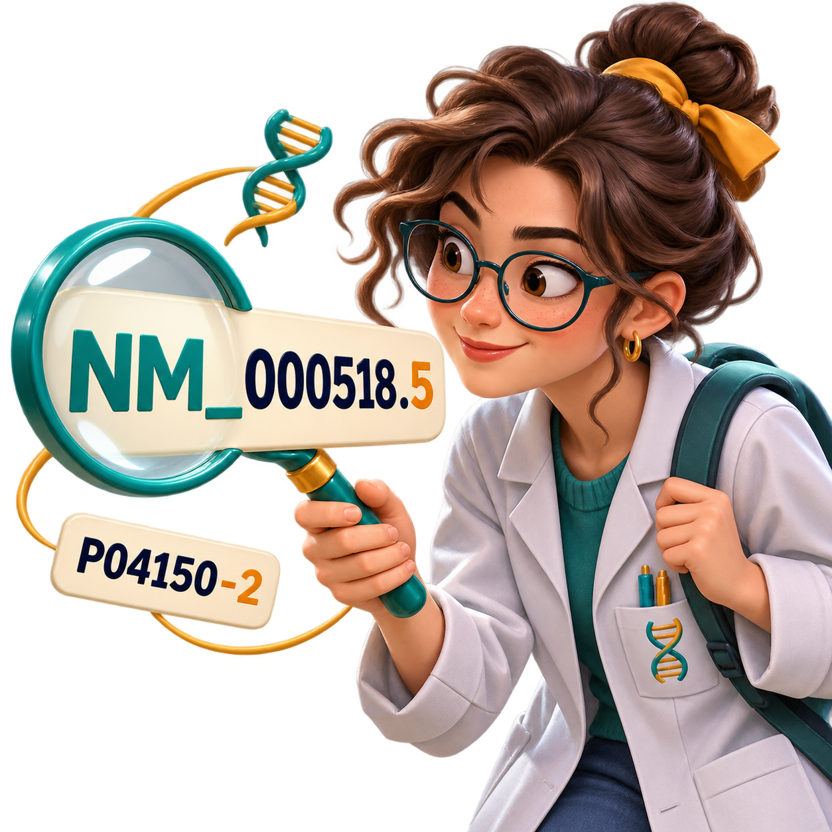
Clues in the code
Prefixes and suffixes carry clues
Resource | Pattern or example | What the pattern tells us
RefSeq | NM_000518.5 NP_000509.1 | NM_ mRNA, NP_ protein .5 sequence version 5
Ensembl (human) | ENSG… / ENST… / ENSP… ENST00000335295.4 | Gene / transcript / protein .4 version of this transcript
INSDC read runs | SRR… / ERR… / DRR… Example SRR390728 | Sequencing run Prefix shows the originating archive
GEO | GSE… / GSM… GSE10072 / GSM254625 | GSE study series GSM sample
UniProtKB isoforms | P04150-2 | -2 identifies a protein isoform
Check theresource’s rules
UniProtKB features | VAR_002863 PRO_0000052976 | VAR_ natural sequence variant PRO_ processed chain or peptide
Rfam / Pfam | RF00005 / PF00042 | RF RNA family PF protein family or domain
Notes:
[On slide entry] We have seen that a biological name can lead to many records. [Click 1] Once we know the resource, an identifier’s first letters or final characters can help us recognize what a record contains and specify the particular sequence or protein form we need. These are selected examples. Every resource defines its own conventions.
[Click 2] RefSeq uses NM_ for mRNA records and NP_ for protein records. The HBB mRNA NM_000518.5 is sequence version 5. Its protein product NP_000509.1 has an independent sequence version. For reproducibility, retain the full accession and version.
[Click 3] For the human Ensembl records shown here, ENSG identifies a gene, ENST a transcript and ENSP a protein. Other organisms can have additional species letters. The number after a dot is the version of that Ensembl object. Ensembl applies different update rules to genes, transcripts and proteins, so a gene version should not be interpreted as the number of changes to its DNA sequence.
[Click 4] In the international read archives, SRR, ERR and DRR identify sequencing runs originating at NCBI, EMBL-EBI and DDBJ respectively. INSDC partners exchange these records, so the prefix indicates the originating archive rather than the only website where the data can be accessed. SRR390728 is a real RNA-sequencing run used here as a general example.
[Click 5] GEO uses GSE for a Series, which groups related samples in a study, and GSM for a Sample record. GSE10072 and GSM254625 are real expression-study examples. They are included to illustrate GEO’s identifier conventions and are separate from our HBB example.
[Click 6] UniProtKB uses an accession followed by a dash and a number to identify a protein isoform. UniProt records sequence and entry versions separately from its accession and isoform suffix. For reproducibility, we should save the accession, the relevant isoform or variant information, and the version information associated with the downloaded record. UniProt’s entry history is explained at https://www.uniprot.org/help/entry_history. P04150-2 identifies an isoform of the human glucocorticoid receptor. The -2 specifies the isoform. UniProt stores sequence-version information separately. The HBB entry P68871 currently has no curated isoform listing.
[Click 7] UniProtKB also assigns feature identifiers within protein entries. In the HBB entry, VAR_002863 identifies the natural variant associated with sickle-cell haemoglobin. PRO_0000052976 identifies the mature beta-globin chain after removal of the initiator methionine. Post-translational modifications are generally described by modification type and residue position within the entry. They do not have a general accession-suffix convention.
[Click 8] Rfam uses RF for RNA families. RF00005 is the tRNA family and illustrates noncoding RNA information. Pfam uses PF for protein families or domains. PF00042 is the globin domain found in beta-globin and other globin proteins. These family identifiers describe groups of related sequences.
[Click 9] The patterns are useful clues once the resource is known. Read the record description and check the organism, evidence and relevant version information before using the data.
RefSeq https://www.ncbi.nlm.nih.gov/books/NBK50679/
Ensembl identifier and version rules https://www.ensembl.org/info/genome/stable_ids/index.html
INSDC read accession prefixes https://www.ddbj.nig.ac.jp/news/en/2021-11-24-e.html
Example sequencing run https://www.ebi.ac.uk/ena/browser/view/SRR390728
GEO accession types https://www.ncbi.nlm.nih.gov/geo/info/geo_paccess.html
GEO example study https://www.ncbi.nlm.nih.gov/geo/query/acc.cgi?acc=GSE10072
GEO example sample https://www.ncbi.nlm.nih.gov/geo/query/acc.cgi?acc=GSM254625
UniProt isoform identifiers https://www.uniprot.org/help/alternative_products
UniProt feature identifiers https://www.uniprot.org/help/sequence_annotation#annotation_id
UniProt HBB https://www.uniprot.org/uniprotkb/P68871/entry
UniProt modified residues https://www.uniprot.org/help/mod_res
Rfam tRNA family https://rfam.org/family/RF00005
Pfam globin family/domain https://www.ebi.ac.uk/interpro/entry/pfam/PF00042/

Slide 127
UniProtKB
P68871
Human beta-globin
Cross-references
NCBI Gene 3043
Human HBB gene
3043
RefSeq NP_000509.1
Reference protein
NP_000509.1
PDB 2HHB
Haemoglobin complex
2HHB
Notes:
[On slide entry] Our colleague has now told us exactly which beta-globin record was used. We can use that record to continue exploring without starting a new name search at every website. [Click 1] A cross-reference is a pointer from a record to related information in another resource. Websites often display it as a clickable identifier.
[Click 2] The source in this example is UniProtKB P68871, the human beta-globin entry. Its cross-references include the three real identifiers shown here. The diagram summarizes those links so that we can focus on where they lead.
[Click 3] Following NCBI Gene ID 3043 takes us to the human HBB gene record. We move from a protein entry to information about the gene that encodes it. [Click 4] RefSeq NP_000509.1 leads to a reference protein sequence corresponding to beta-globin. [Click 5] The PDB link 2HHB leads to an experimentally determined haemoglobin complex containing both alpha- and beta-globin chains.
The links therefore connect relevant information at different levels. They do not all describe the same kind of object. Read the resource name and the relationship before interpreting the destination. Once we find the appropriate record, retain its full identifier and relevant version information for our analysis.
The underlined identifiers on this slide are active links to the actual records.
UniProt explanation of cross-references https://www.uniprot.org/help/cross_references_section
Source UniProtKB entry https://www.uniprot.org/uniprotkb/P68871/entry
NCBI HBB gene https://www.ncbi.nlm.nih.gov/gene/3043
RefSeq protein https://www.ncbi.nlm.nih.gov/protein/NP_000509.1
PDB haemoglobin complex https://www.rcsb.org/structure/2HHB

Slide 128
Links across resources
UniProtKB
P68871
Human beta-globin
Cross-references
NCBI Gene 3043
Human HBB gene
3043
RefSeq NP_000509.1
Reference protein
NP_000509.1
PDB 2HHB
Haemoglobin complex
2HHB
Notes:
[On slide entry] Our colleague has now told us exactly which beta-globin record was used. We can use that record to continue exploring without starting a new name search at every website. [Click 1] A cross-reference is a pointer from a record to related information in another resource. Websites often display it as a clickable identifier.
[Click 2] The source in this example is UniProtKB P68871, the human beta-globin entry. Its cross-references include the three real identifiers shown here. The diagram summarizes those links so that we can focus on where they lead.
[Click 3] Following NCBI Gene ID 3043 takes us to the human HBB gene record. We move from a protein entry to information about the gene that encodes it. [Click 4] RefSeq NP_000509.1 leads to a reference protein sequence corresponding to beta-globin. [Click 5] The PDB link 2HHB leads to an experimentally determined haemoglobin complex containing both alpha- and beta-globin chains.
The links therefore connect relevant information at different levels. They do not all describe the same kind of object. Read the resource name and the relationship before interpreting the destination. Once we find the appropriate record, retain its full identifier and relevant version information for our analysis.
The underlined identifiers on this slide are active links to the actual records.
UniProt explanation of cross-references https://www.uniprot.org/help/cross_references_section
Source UniProtKB entry https://www.uniprot.org/uniprotkb/P68871/entry
NCBI HBB gene https://www.ncbi.nlm.nih.gov/gene/3043
RefSeq protein https://www.ncbi.nlm.nih.gov/protein/NP_000509.1
PDB haemoglobin complex https://www.rcsb.org/structure/2HHB

Slide 129
Links across resources
Linked identifiers are cross-references
They lead to relevant information in another resource.
UniProtKB
P68871
Human beta-globin
Cross-references
NCBI Gene 3043
Human HBB gene
3043
RefSeq NP_000509.1
Reference protein
NP_000509.1
PDB 2HHB
Haemoglobin complex
2HHB
Notes:
[On slide entry] Our colleague has now told us exactly which beta-globin record was used. We can use that record to continue exploring without starting a new name search at every website. [Click 1] A cross-reference is a pointer from a record to related information in another resource. Websites often display it as a clickable identifier.
[Click 2] The source in this example is UniProtKB P68871, the human beta-globin entry. Its cross-references include the three real identifiers shown here. The diagram summarizes those links so that we can focus on where they lead.
[Click 3] Following NCBI Gene ID 3043 takes us to the human HBB gene record. We move from a protein entry to information about the gene that encodes it. [Click 4] RefSeq NP_000509.1 leads to a reference protein sequence corresponding to beta-globin. [Click 5] The PDB link 2HHB leads to an experimentally determined haemoglobin complex containing both alpha- and beta-globin chains.
The links therefore connect relevant information at different levels. They do not all describe the same kind of object. Read the resource name and the relationship before interpreting the destination. Once we find the appropriate record, retain its full identifier and relevant version information for our analysis.
The underlined identifiers on this slide are active links to the actual records.
UniProt explanation of cross-references https://www.uniprot.org/help/cross_references_section
Source UniProtKB entry https://www.uniprot.org/uniprotkb/P68871/entry
NCBI HBB gene https://www.ncbi.nlm.nih.gov/gene/3043
RefSeq protein https://www.ncbi.nlm.nih.gov/protein/NP_000509.1
PDB haemoglobin complex https://www.rcsb.org/structure/2HHB

Slide 130
Notes:
[On slide entry] The previous slides introduced identifiers and cross-references linking records for a gene and its products. We now consider how to access those records.
[Click 1] Database record pages let us search for records, inspect their annotations and evidence, and follow links to related information. The preceding slides have already demonstrated these steps through searches by name and official gene symbol. We will therefore not repeat a detailed walkthrough of this access route here. Instead, we will examine how software can retrieve records automatically and how genome browsers bring information from different biological levels together.
[Click 2] Programmatic access allows a command-line tool or a program, such as a Python script, to request data from a resource, often through an application programming interface, or API. The service returns information in a format that software can process, such as FASTA for sequences or JSON for structured records. This approach can retrieve a single record, automate repeated queries or process many records consistently. Keeping the requests, parameters, record versions, retrieval date and downloaded files helps make the analysis reproducible.
[Click 3] Web-based genome browsers, such as UCSC and Ensembl, organise information around positions in a reference genome. After choosing an organism and genome assembly, we can locate a region, inspect its annotated genes and transcripts, and retrieve genomic, transcript and encoded protein sequences through the same interface. Additional tracks can show information such as variants, regulatory features and expression measurements. This integration lets us explore the relationships between biological levels without independently searching a separate database website for each level.
These are different ways of accessing database information. A resource may provide both web pages and programmatic access. Genome browsers combine graphical genomic views with linked record pages, bringing information from several biological levels together.
Illustrations are conceptual examples of the three interfaces. Original educational artwork generated with OpenAI image generation for this lecture, 5 November 2026.

Slide 131
Routes to database info
Notes:
[On slide entry] The previous slides introduced identifiers and cross-references linking records for a gene and its products. We now consider how to access those records.
[Click 1] Database record pages let us search for records, inspect their annotations and evidence, and follow links to related information. The preceding slides have already demonstrated these steps through searches by name and official gene symbol. We will therefore not repeat a detailed walkthrough of this access route here. Instead, we will examine how software can retrieve records automatically and how genome browsers bring information from different biological levels together.
[Click 2] Programmatic access allows a command-line tool or a program, such as a Python script, to request data from a resource, often through an application programming interface, or API. The service returns information in a format that software can process, such as FASTA for sequences or JSON for structured records. This approach can retrieve a single record, automate repeated queries or process many records consistently. Keeping the requests, parameters, record versions, retrieval date and downloaded files helps make the analysis reproducible.
[Click 3] Web-based genome browsers, such as UCSC and Ensembl, organise information around positions in a reference genome. After choosing an organism and genome assembly, we can locate a region, inspect its annotated genes and transcripts, and retrieve genomic, transcript and encoded protein sequences through the same interface. Additional tracks can show information such as variants, regulatory features and expression measurements. This integration lets us explore the relationships between biological levels without independently searching a separate database website for each level.
These are different ways of accessing database information. A resource may provide both web pages and programmatic access. Genome browsers combine graphical genomic views with linked record pages, bringing information from several biological levels together.
Illustrations are conceptual examples of the three interfaces. Original educational artwork generated with OpenAI image generation for this lecture, 5 November 2026.

Slide 132

Routes to database info
Databaserecord pages
Inspect records andcheck their evidence.
Notes:
[On slide entry] The previous slides introduced identifiers and cross-references linking records for a gene and its products. We now consider how to access those records.
[Click 1] Database record pages let us search for records, inspect their annotations and evidence, and follow links to related information. The preceding slides have already demonstrated these steps through searches by name and official gene symbol. We will therefore not repeat a detailed walkthrough of this access route here. Instead, we will examine how software can retrieve records automatically and how genome browsers bring information from different biological levels together.
[Click 2] Programmatic access allows a command-line tool or a program, such as a Python script, to request data from a resource, often through an application programming interface, or API. The service returns information in a format that software can process, such as FASTA for sequences or JSON for structured records. This approach can retrieve a single record, automate repeated queries or process many records consistently. Keeping the requests, parameters, record versions, retrieval date and downloaded files helps make the analysis reproducible.
[Click 3] Web-based genome browsers, such as UCSC and Ensembl, organise information around positions in a reference genome. After choosing an organism and genome assembly, we can locate a region, inspect its annotated genes and transcripts, and retrieve genomic, transcript and encoded protein sequences through the same interface. Additional tracks can show information such as variants, regulatory features and expression measurements. This integration lets us explore the relationships between biological levels without independently searching a separate database website for each level.
These are different ways of accessing database information. A resource may provide both web pages and programmatic access. Genome browsers combine graphical genomic views with linked record pages, bringing information from several biological levels together.
Illustrations are conceptual examples of the three interfaces. Original educational artwork generated with OpenAI image generation for this lecture, 5 November 2026.

Slide 133
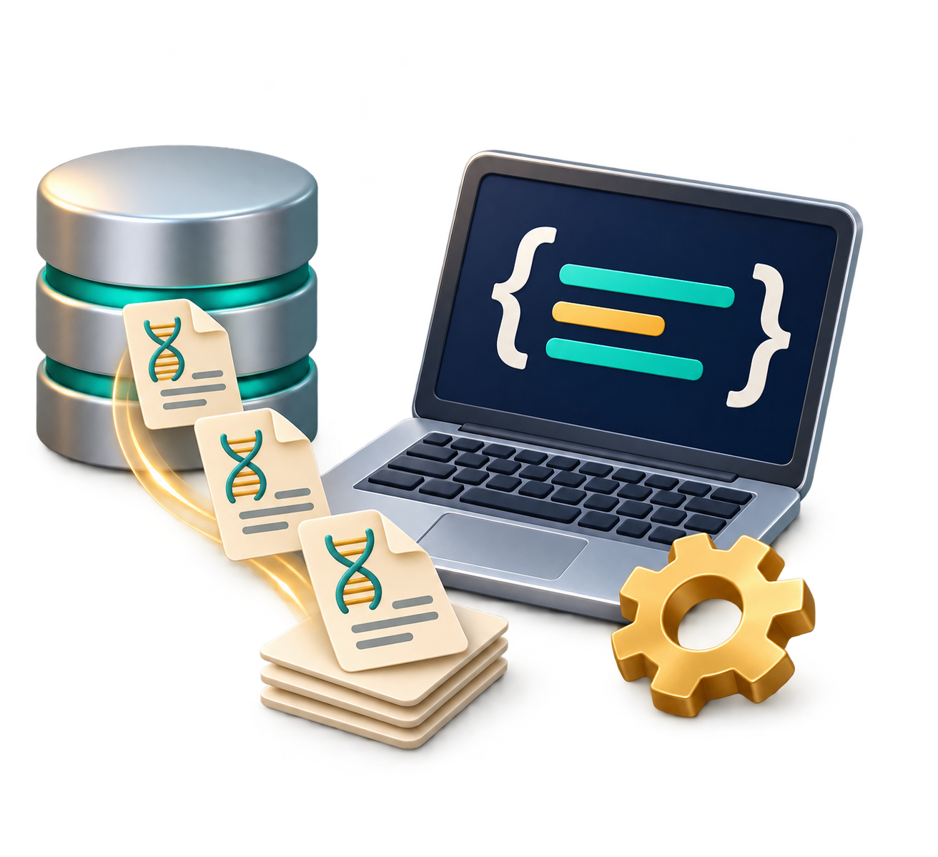
Routes to database info
Databaserecord pages
Programmaticaccess
Inspect records andcheck their evidence.
Automate queries usingcode or command-line
tools.
Notes:
[On slide entry] The previous slides introduced identifiers and cross-references linking records for a gene and its products. We now consider how to access those records.
[Click 1] Database record pages let us search for records, inspect their annotations and evidence, and follow links to related information. The preceding slides have already demonstrated these steps through searches by name and official gene symbol. We will therefore not repeat a detailed walkthrough of this access route here. Instead, we will examine how software can retrieve records automatically and how genome browsers bring information from different biological levels together.
[Click 2] Programmatic access allows a command-line tool or a program, such as a Python script, to request data from a resource, often through an application programming interface, or API. The service returns information in a format that software can process, such as FASTA for sequences or JSON for structured records. This approach can retrieve a single record, automate repeated queries or process many records consistently. Keeping the requests, parameters, record versions, retrieval date and downloaded files helps make the analysis reproducible.
[Click 3] Web-based genome browsers, such as UCSC and Ensembl, organise information around positions in a reference genome. After choosing an organism and genome assembly, we can locate a region, inspect its annotated genes and transcripts, and retrieve genomic, transcript and encoded protein sequences through the same interface. Additional tracks can show information such as variants, regulatory features and expression measurements. This integration lets us explore the relationships between biological levels without independently searching a separate database website for each level.
These are different ways of accessing database information. A resource may provide both web pages and programmatic access. Genome browsers combine graphical genomic views with linked record pages, bringing information from several biological levels together.
Illustrations are conceptual examples of the three interfaces. Original educational artwork generated with OpenAI image generation for this lecture, 5 November 2026.

Slide 134
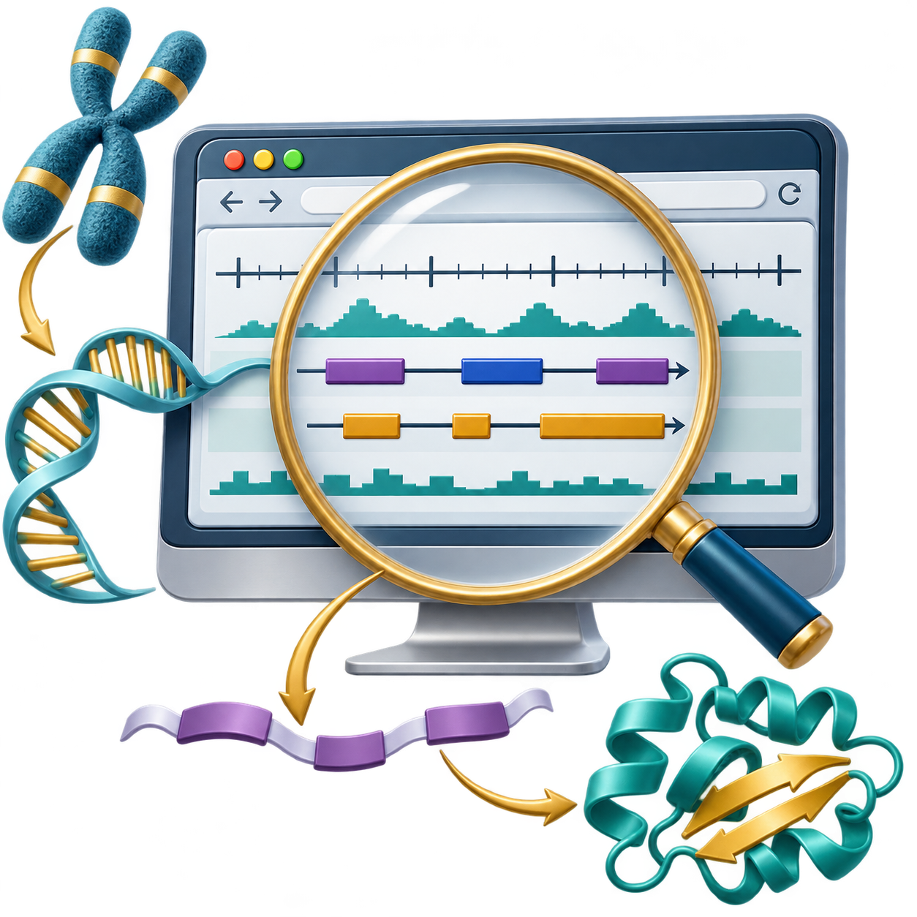
Routes to database info
Databaserecord pages
Programmaticaccess
Genomebrowsers
Inspect records andcheck their evidence.
Automate queries usingcode or command-line
tools.
Explore DNA, transcripts
and proteins through
one web interface
Notes:
[On slide entry] The previous slides introduced identifiers and cross-references linking records for a gene and its products. We now consider how to access those records.
[Click 1] Database record pages let us search for records, inspect their annotations and evidence, and follow links to related information. The preceding slides have already demonstrated these steps through searches by name and official gene symbol. We will therefore not repeat a detailed walkthrough of this access route here. Instead, we will examine how software can retrieve records automatically and how genome browsers bring information from different biological levels together.
[Click 2] Programmatic access allows a command-line tool or a program, such as a Python script, to request data from a resource, often through an application programming interface, or API. The service returns information in a format that software can process, such as FASTA for sequences or JSON for structured records. This approach can retrieve a single record, automate repeated queries or process many records consistently. Keeping the requests, parameters, record versions, retrieval date and downloaded files helps make the analysis reproducible.
[Click 3] Web-based genome browsers, such as UCSC and Ensembl, organise information around positions in a reference genome. After choosing an organism and genome assembly, we can locate a region, inspect its annotated genes and transcripts, and retrieve genomic, transcript and encoded protein sequences through the same interface. Additional tracks can show information such as variants, regulatory features and expression measurements. This integration lets us explore the relationships between biological levels without independently searching a separate database website for each level.
These are different ways of accessing database information. A resource may provide both web pages and programmatic access. Genome browsers combine graphical genomic views with linked record pages, bringing information from several biological levels together.
Illustrations are conceptual examples of the three interfaces. Original educational artwork generated with OpenAI image generation for this lecture, 5 November 2026.

Slide 135
Notes:
[On slide entry] The previous slide introduced three routes to database information. We have already explored database record pages. [Click 1] We now examine programmatic access, beginning with a command-line tool that requests information directly from a database service.
[Click 2] GNU Wget downloads the content returned by a URL and saves it as a file. Here, the address identifies the UniProtKB entry P68871 for human haemoglobin subunit beta, and the ending .fasta requests its sequence in FASTA format. In this example, the command saves a file called P68871.fasta.
[Click 3] The second command, cat P68871.fasta, displays that file. The first line begins with > and identifies the record, protein and organism. The amino-acid sequence follows. This sequence contains 147 amino acids, and SV=2 identifies sequence version 2. The $ symbol represents the terminal prompt and is not part of either command.
[Click 4] “One command, one file” describes this download, but one file does not necessarily mean one record. A different URL could return many sequences or an entire database release. In a FASTA file containing multiple records, each record begins with its own > header.
[Click 5] Downloading gives us the content, but further work may require extracting particular fields, comparing records or combining results. Wget does not interpret biological records itself. Additional tools or code provide that processing. The next example shows how Python can bring retrieval and processing together.
References:
https://www.gnu.org/software/wget/manual/wget.html
https://rest.uniprot.org/uniprotkb/P68871.fasta

Slide 136
Programmatic access
Notes:
[On slide entry] The previous slide introduced three routes to database information. We have already explored database record pages. [Click 1] We now examine programmatic access, beginning with a command-line tool that requests information directly from a database service.
[Click 2] GNU Wget downloads the content returned by a URL and saves it as a file. Here, the address identifies the UniProtKB entry P68871 for human haemoglobin subunit beta, and the ending .fasta requests its sequence in FASTA format. In this example, the command saves a file called P68871.fasta.
[Click 3] The second command, cat P68871.fasta, displays that file. The first line begins with > and identifies the record, protein and organism. The amino-acid sequence follows. This sequence contains 147 amino acids, and SV=2 identifies sequence version 2. The $ symbol represents the terminal prompt and is not part of either command.
[Click 4] “One command, one file” describes this download, but one file does not necessarily mean one record. A different URL could return many sequences or an entire database release. In a FASTA file containing multiple records, each record begins with its own > header.
[Click 5] Downloading gives us the content, but further work may require extracting particular fields, comparing records or combining results. Wget does not interpret biological records itself. Additional tools or code provide that processing. The next example shows how Python can bring retrieval and processing together.
References:
https://www.gnu.org/software/wget/manual/wget.html
https://rest.uniprot.org/uniprotkb/P68871.fasta

Slide 137

Programmatic access
One command, one file
$
Notes:
[On slide entry] The previous slide introduced three routes to database information. We have already explored database record pages. [Click 1] We now examine programmatic access, beginning with a command-line tool that requests information directly from a database service.
[Click 2] GNU Wget downloads the content returned by a URL and saves it as a file. Here, the address identifies the UniProtKB entry P68871 for human haemoglobin subunit beta, and the ending .fasta requests its sequence in FASTA format. In this example, the command saves a file called P68871.fasta.
[Click 3] The second command, cat P68871.fasta, displays that file. The first line begins with > and identifies the record, protein and organism. The amino-acid sequence follows. This sequence contains 147 amino acids, and SV=2 identifies sequence version 2. The $ symbol represents the terminal prompt and is not part of either command.
[Click 4] “One command, one file” describes this download, but one file does not necessarily mean one record. A different URL could return many sequences or an entire database release. In a FASTA file containing multiple records, each record begins with its own > header.
[Click 5] Downloading gives us the content, but further work may require extracting particular fields, comparing records or combining results. Wget does not interpret biological records itself. Additional tools or code provide that processing. The next example shows how Python can bring retrieval and processing together.
References:
https://www.gnu.org/software/wget/manual/wget.html
https://rest.uniprot.org/uniprotkb/P68871.fasta

Slide 138
Programmatic access
One command, one file
$
wget "https://rest.uniprot.org/uniprotkb/P68871.fasta"
Notes:
[On slide entry] The previous slide introduced three routes to database information. We have already explored database record pages. [Click 1] We now examine programmatic access, beginning with a command-line tool that requests information directly from a database service.
[Click 2] GNU Wget downloads the content returned by a URL and saves it as a file. Here, the address identifies the UniProtKB entry P68871 for human haemoglobin subunit beta, and the ending .fasta requests its sequence in FASTA format. In this example, the command saves a file called P68871.fasta.
[Click 3] The second command, cat P68871.fasta, displays that file. The first line begins with > and identifies the record, protein and organism. The amino-acid sequence follows. This sequence contains 147 amino acids, and SV=2 identifies sequence version 2. The $ symbol represents the terminal prompt and is not part of either command.
[Click 4] “One command, one file” describes this download, but one file does not necessarily mean one record. A different URL could return many sequences or an entire database release. In a FASTA file containing multiple records, each record begins with its own > header.
[Click 5] Downloading gives us the content, but further work may require extracting particular fields, comparing records or combining results. Wget does not interpret biological records itself. Additional tools or code provide that processing. The next example shows how Python can bring retrieval and processing together.
References:
https://www.gnu.org/software/wget/manual/wget.html
https://rest.uniprot.org/uniprotkb/P68871.fasta

Slide 139
Programmatic access
One command, one file
$
wget "https://rest.uniprot.org/uniprotkb/P68871.fasta"
$ cat P68871.fasta
>sp|P68871|HBB_HUMAN Hemoglobin subunit beta OS=Homo sapiens OX=9606 GN=HBB PE=1 SV=2
MVHLTPEEKSAVTALWGKVNVDEVGGEALGRLLVVYPWTQRFFESFGDLSTPDAV
MGNPKVKAHGKKVLGAFSDGLAHLDNLKGTFATLSELHCDKLHVDPENFRLLGNVLVCVLAHHFGKEFTPPVQAAYQKVVAGVANALAHKYH
Notes:
[On slide entry] The previous slide introduced three routes to database information. We have already explored database record pages. [Click 1] We now examine programmatic access, beginning with a command-line tool that requests information directly from a database service.
[Click 2] GNU Wget downloads the content returned by a URL and saves it as a file. Here, the address identifies the UniProtKB entry P68871 for human haemoglobin subunit beta, and the ending .fasta requests its sequence in FASTA format. In this example, the command saves a file called P68871.fasta.
[Click 3] The second command, cat P68871.fasta, displays that file. The first line begins with > and identifies the record, protein and organism. The amino-acid sequence follows. This sequence contains 147 amino acids, and SV=2 identifies sequence version 2. The $ symbol represents the terminal prompt and is not part of either command.
[Click 4] “One command, one file” describes this download, but one file does not necessarily mean one record. A different URL could return many sequences or an entire database release. In a FASTA file containing multiple records, each record begins with its own > header.
[Click 5] Downloading gives us the content, but further work may require extracting particular fields, comparing records or combining results. Wget does not interpret biological records itself. Additional tools or code provide that processing. The next example shows how Python can bring retrieval and processing together.
References:
https://www.gnu.org/software/wget/manual/wget.html
https://rest.uniprot.org/uniprotkb/P68871.fasta

Slide 140
Programmatic access
One command, one file
$
wget "https://rest.uniprot.org/uniprotkb/P68871.fasta"
$ cat P68871.fasta
File may contain many records
>sp|P68871|HBB_HUMAN Hemoglobin subunit beta OS=Homo sapiens OX=9606 GN=HBB PE=1 SV=2
MVHLTPEEKSAVTALWGKVNVDEVGGEALGRLLVVYPWTQRFFESFGDLSTPDAV
MGNPKVKAHGKKVLGAFSDGLAHLDNLKGTFATLSELHCDKLHVDPENFRLLGNVLVCVLAHHFGKEFTPPVQAAYQKVVAGVANALAHKYH
Notes:
[On slide entry] The previous slide introduced three routes to database information. We have already explored database record pages. [Click 1] We now examine programmatic access, beginning with a command-line tool that requests information directly from a database service.
[Click 2] GNU Wget downloads the content returned by a URL and saves it as a file. Here, the address identifies the UniProtKB entry P68871 for human haemoglobin subunit beta, and the ending .fasta requests its sequence in FASTA format. In this example, the command saves a file called P68871.fasta.
[Click 3] The second command, cat P68871.fasta, displays that file. The first line begins with > and identifies the record, protein and organism. The amino-acid sequence follows. This sequence contains 147 amino acids, and SV=2 identifies sequence version 2. The $ symbol represents the terminal prompt and is not part of either command.
[Click 4] “One command, one file” describes this download, but one file does not necessarily mean one record. A different URL could return many sequences or an entire database release. In a FASTA file containing multiple records, each record begins with its own > header.
[Click 5] Downloading gives us the content, but further work may require extracting particular fields, comparing records or combining results. Wget does not interpret biological records itself. Additional tools or code provide that processing. The next example shows how Python can bring retrieval and processing together.
References:
https://www.gnu.org/software/wget/manual/wget.html
https://rest.uniprot.org/uniprotkb/P68871.fasta

Slide 141
Programmatic access
One command, one file
$
wget "https://rest.uniprot.org/uniprotkb/P68871.fasta"
$ cat P68871.fasta
File may contain many records
>sp|P68871|HBB_HUMAN Hemoglobin subunit beta OS=Homo sapiens OX=9606 GN=HBB PE=1 SV=2
MVHLTPEEKSAVTALWGKVNVDEVGGEALGRLLVVYPWTQRFFESFGDLSTPDAV
MGNPKVKAHGKKVLGAFSDGLAHLDNLKGTFATLSELHCDKLHVDPENFRLLGNVLVCVLAHHFGKEFTPPVQAAYQKVVAGVANALAHKYH
File processing needs additional tools or code
Notes:
[On slide entry] The previous slide introduced three routes to database information. We have already explored database record pages. [Click 1] We now examine programmatic access, beginning with a command-line tool that requests information directly from a database service.
[Click 2] GNU Wget downloads the content returned by a URL and saves it as a file. Here, the address identifies the UniProtKB entry P68871 for human haemoglobin subunit beta, and the ending .fasta requests its sequence in FASTA format. In this example, the command saves a file called P68871.fasta.
[Click 3] The second command, cat P68871.fasta, displays that file. The first line begins with > and identifies the record, protein and organism. The amino-acid sequence follows. This sequence contains 147 amino acids, and SV=2 identifies sequence version 2. The $ symbol represents the terminal prompt and is not part of either command.
[Click 4] “One command, one file” describes this download, but one file does not necessarily mean one record. A different URL could return many sequences or an entire database release. In a FASTA file containing multiple records, each record begins with its own > header.
[Click 5] Downloading gives us the content, but further work may require extracting particular fields, comparing records or combining results. Wget does not interpret biological records itself. Additional tools or code provide that processing. The next example shows how Python can bring retrieval and processing together.
References:
https://www.gnu.org/software/wget/manual/wget.html
https://rest.uniprot.org/uniprotkb/P68871.fasta

Slide 142
Programmatic access
import requests
url = ("https://rest.uniprot.org/uniprotkb/"
"P68871.json")
r = requests.get(url, timeout=30)
r.raise_for_status()
record = r.json()
print(record["primaryAccession"],
record["organism"]["scientificName"],
record["sequence"]["length"])
Output
P68871 Homo sapiens 147
Notes:
[On slide entry] We have downloaded and displayed a sequence file. Now suppose we want selected information from its database record in a form that we can immediately use in an analysis. [Click 1: script frame] Python allows us to request the data and continue working with the response in the same program.
[Click 2: script] This example retrieves the same UniProtKB entry, P68871, using JSON—a structured text format containing named fields. FASTA and JSON provide different representations of information about the same protein.
Reading the script from the top, we first import the requests library and define the URL. Python joins the two adjacent quoted strings inside parentheses into one address. The requests.get command sends the request. timeout=30 limits waiting for a connection or incoming data, while raise_for_status() checks whether the server reported an HTTP error.
Next, r.json() converts the response into Python data structures. The print statement selects three fields: the primary accession, organism’s scientific name and sequence length. [Click 3: output] These produce the displayed output: P68871, Homo sapiens and 147 amino acids. The funnel illustrates selecting useful information from a larger record.
Here, the response stays in memory, so processing does not require first saving a file to disk. A longer program could check the organism, repeat requests for several accessions, compare results or build a table. These operations require additional code, but the same basic retrieval-and-processing pattern applies.
For reproducibility, retain the request, relevant record versions, retrieval date and original response. We will next turn to genome browsers, where genomic positions and relationships between genes, transcripts and proteins provide a visual context for exploring database information.
References:
https://requests.readthedocs.io/en/latest/user/quickstart/
https://rest.uniprot.org/uniprotkb/P68871.json

Slide 143
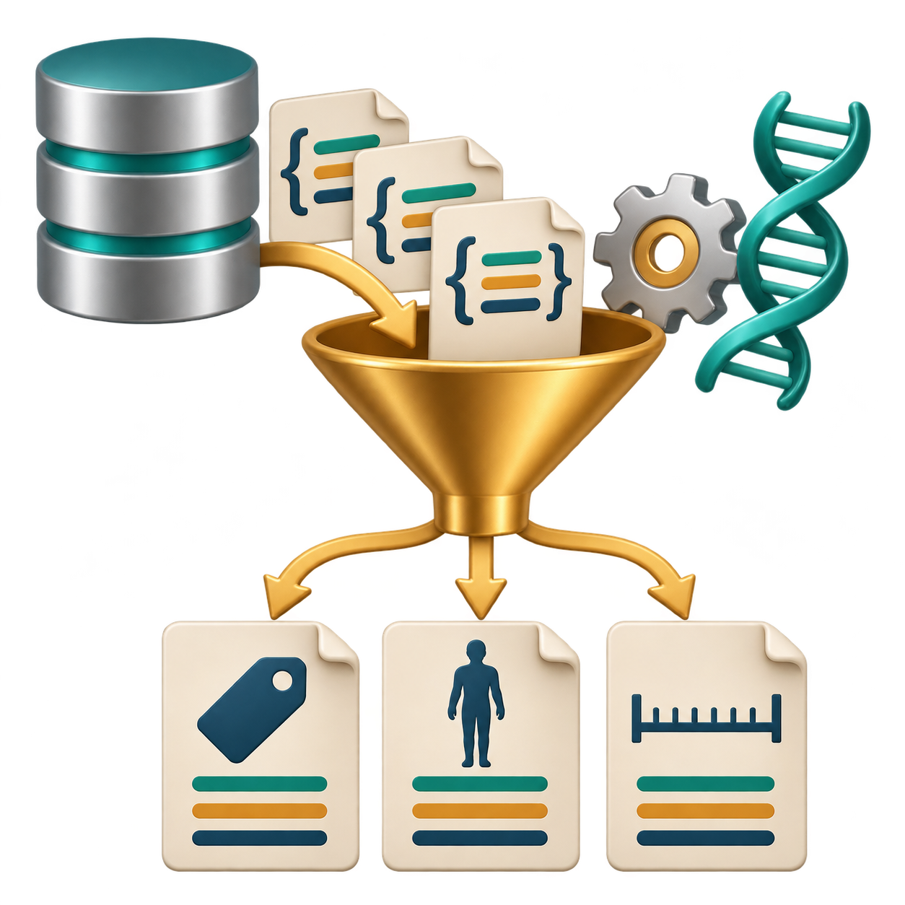
Programmatic access
Download first, process next
import requests
url = ("https://rest.uniprot.org/uniprotkb/"
"P68871.json")
r = requests.get(url, timeout=30)
r.raise_for_status()
record = r.json()
print(record["primaryAccession"],
record["organism"]["scientificName"],
record["sequence"]["length"])
Output
P68871 Homo sapiens 147
Notes:
[On slide entry] We have downloaded and displayed a sequence file. Now suppose we want selected information from its database record in a form that we can immediately use in an analysis. [Click 1: script frame] Python allows us to request the data and continue working with the response in the same program.
[Click 2: script] This example retrieves the same UniProtKB entry, P68871, using JSON—a structured text format containing named fields. FASTA and JSON provide different representations of information about the same protein.
Reading the script from the top, we first import the requests library and define the URL. Python joins the two adjacent quoted strings inside parentheses into one address. The requests.get command sends the request. timeout=30 limits waiting for a connection or incoming data, while raise_for_status() checks whether the server reported an HTTP error.
Next, r.json() converts the response into Python data structures. The print statement selects three fields: the primary accession, organism’s scientific name and sequence length. [Click 3: output] These produce the displayed output: P68871, Homo sapiens and 147 amino acids. The funnel illustrates selecting useful information from a larger record.
Here, the response stays in memory, so processing does not require first saving a file to disk. A longer program could check the organism, repeat requests for several accessions, compare results or build a table. These operations require additional code, but the same basic retrieval-and-processing pattern applies.
For reproducibility, retain the request, relevant record versions, retrieval date and original response. We will next turn to genome browsers, where genomic positions and relationships between genes, transcripts and proteins provide a visual context for exploring database information.
References:
https://requests.readthedocs.io/en/latest/user/quickstart/
https://rest.uniprot.org/uniprotkb/P68871.json

Slide 144
Programmatic access
Download first, process next
Python script
import requests
url = ("https://rest.uniprot.org/uniprotkb/"
"P68871.json")
r = requests.get(url, timeout=30)
r.raise_for_status()
record = r.json()
print(record["primaryAccession"],
record["organism"]["scientificName"],
record["sequence"]["length"])
Output
P68871 Homo sapiens 147
Notes:
[On slide entry] We have downloaded and displayed a sequence file. Now suppose we want selected information from its database record in a form that we can immediately use in an analysis. [Click 1: script frame] Python allows us to request the data and continue working with the response in the same program.
[Click 2: script] This example retrieves the same UniProtKB entry, P68871, using JSON—a structured text format containing named fields. FASTA and JSON provide different representations of information about the same protein.
Reading the script from the top, we first import the requests library and define the URL. Python joins the two adjacent quoted strings inside parentheses into one address. The requests.get command sends the request. timeout=30 limits waiting for a connection or incoming data, while raise_for_status() checks whether the server reported an HTTP error.
Next, r.json() converts the response into Python data structures. The print statement selects three fields: the primary accession, organism’s scientific name and sequence length. [Click 3: output] These produce the displayed output: P68871, Homo sapiens and 147 amino acids. The funnel illustrates selecting useful information from a larger record.
Here, the response stays in memory, so processing does not require first saving a file to disk. A longer program could check the organism, repeat requests for several accessions, compare results or build a table. These operations require additional code, but the same basic retrieval-and-processing pattern applies.
For reproducibility, retain the request, relevant record versions, retrieval date and original response. We will next turn to genome browsers, where genomic positions and relationships between genes, transcripts and proteins provide a visual context for exploring database information.
References:
https://requests.readthedocs.io/en/latest/user/quickstart/
https://rest.uniprot.org/uniprotkb/P68871.json

Slide 145
Programmatic access
Download first, process next
Python script
import requests
url = ("https://rest.uniprot.org/uniprotkb/"
"P68871.json")
r = requests.get(url, timeout=30)
r.raise_for_status()
record = r.json()
print(record["primaryAccession"],
record["organism"]["scientificName"],
record["sequence"]["length"])
Output
P68871 Homo sapiens 147
Notes:
[On slide entry] We have downloaded and displayed a sequence file. Now suppose we want selected information from its database record in a form that we can immediately use in an analysis. [Click 1: script frame] Python allows us to request the data and continue working with the response in the same program.
[Click 2: script] This example retrieves the same UniProtKB entry, P68871, using JSON—a structured text format containing named fields. FASTA and JSON provide different representations of information about the same protein.
Reading the script from the top, we first import the requests library and define the URL. Python joins the two adjacent quoted strings inside parentheses into one address. The requests.get command sends the request. timeout=30 limits waiting for a connection or incoming data, while raise_for_status() checks whether the server reported an HTTP error.
Next, r.json() converts the response into Python data structures. The print statement selects three fields: the primary accession, organism’s scientific name and sequence length. [Click 3: output] These produce the displayed output: P68871, Homo sapiens and 147 amino acids. The funnel illustrates selecting useful information from a larger record.
Here, the response stays in memory, so processing does not require first saving a file to disk. A longer program could check the organism, repeat requests for several accessions, compare results or build a table. These operations require additional code, but the same basic retrieval-and-processing pattern applies.
For reproducibility, retain the request, relevant record versions, retrieval date and original response. We will next turn to genome browsers, where genomic positions and relationships between genes, transcripts and proteins provide a visual context for exploring database information.
References:
https://requests.readthedocs.io/en/latest/user/quickstart/
https://rest.uniprot.org/uniprotkb/P68871.json

Slide 146
Notes:
[On slide entry] We have seen how to retrieve information through database pages, commands and programs. [Click 1] A genome browser adds genomic context: it places information from different sources at positions along a reference genome. Everything in one interface as integration of many selected sources, dependent on assembly, tracks and filters. [Click 2] Each horizontal track displays a particular collection of annotations. Here, we are looking at the human HBB region using GENCODE and NCBI RefSeq annotations. We can compare transcript structures, examine neighbouring features and follow links to related records. First, we need to understand how to read this display.
Browser principles: https://genome.ucsc.edu/goldenPath/help/hgTracksHelp.html

Slide 147
Genome browsers
Notes:
[On slide entry] We have seen how to retrieve information through database pages, commands and programs. [Click 1] A genome browser adds genomic context: it places information from different sources at positions along a reference genome. Everything in one interface as integration of many selected sources, dependent on assembly, tracks and filters. [Click 2] Each horizontal track displays a particular collection of annotations. Here, we are looking at the human HBB region using GENCODE and NCBI RefSeq annotations. We can compare transcript structures, examine neighbouring features and follow links to related records. First, we need to understand how to read this display.
Browser principles: https://genome.ucsc.edu/goldenPath/help/hgTracksHelp.html

Slide 148
Genome browsers
Everything in one interface
Notes:
[On slide entry] We have seen how to retrieve information through database pages, commands and programs. [Click 1] A genome browser adds genomic context: it places information from different sources at positions along a reference genome. Everything in one interface as integration of many selected sources, dependent on assembly, tracks and filters. [Click 2] Each horizontal track displays a particular collection of annotations. Here, we are looking at the human HBB region using GENCODE and NCBI RefSeq annotations. We can compare transcript structures, examine neighbouring features and follow links to related records. First, we need to understand how to read this display.
Browser principles: https://genome.ucsc.edu/goldenPath/help/hgTracksHelp.html

Slide 149
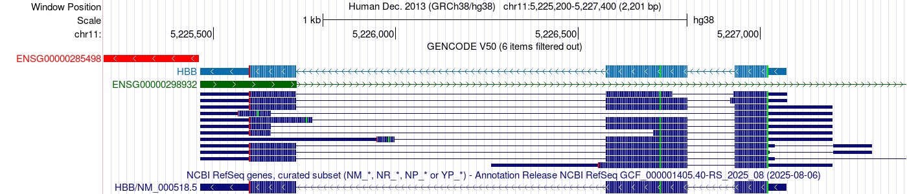
Genome browsers
Everything in one interface
HBB in UCSC Genome Browser: https://genome.ucsc.edu
Notes:
[On slide entry] We have seen how to retrieve information through database pages, commands and programs. [Click 1] A genome browser adds genomic context: it places information from different sources at positions along a reference genome. Everything in one interface as integration of many selected sources, dependent on assembly, tracks and filters. [Click 2] Each horizontal track displays a particular collection of annotations. Here, we are looking at the human HBB region using GENCODE and NCBI RefSeq annotations. We can compare transcript structures, examine neighbouring features and follow links to related records. First, we need to understand how to read this display.
Browser principles: https://genome.ucsc.edu/goldenPath/help/hgTracksHelp.html

Slide 150
Genome browsers
Assembly release date
Assembly name
Chromosome interval
Window length
Assembly organism
HBB in UCSC Genome Browser: https://genome.ucsc.edu
Notes:
[On slide entry / Morph] The header tells us [Click 1: organism] which organism and reference genome we are examining. [Click 2: assembly release date] December 2013 is the assembly’s release date; annotations can be updated later. [Click 3: assembly name] Here, the organism is human, and the assembly is GRCh38, called hg38 at UCSC. [Click 4] The chromosome interval specifies the displayed portion of chromosome 11, from position 5,225,200 to 5,227,400. [Click 5] Including both endpoints, this covers 2,201 bases. When recording a genomic location, keep the assembly's name together with the chromosome coordinates.

Slide 151
Genome browsers
Reference assembly and displayed region
Assembly release date
Assembly name
Chromosome interval
Window length
Assembly organism
HBB in UCSC Genome Browser: https://genome.ucsc.edu
Notes:
[On slide entry / Morph] The header tells us [Click 1: organism] which organism and reference genome we are examining. [Click 2: assembly release date] December 2013 is the assembly’s release date; annotations can be updated later. [Click 3: assembly name] Here, the organism is human, and the assembly is GRCh38, called hg38 at UCSC. [Click 4] The chromosome interval specifies the displayed portion of chromosome 11, from position 5,225,200 to 5,227,400. [Click 5] Including both endpoints, this covers 2,201 bases. When recording a genomic location, keep the assembly's name together with the chromosome coordinates.

Slide 152
Genome browsers
Scale bar (1,000 bases)
Positions along the chromosome 11
HBB in UCSC Genome Browser: https://genome.ucsc.edu
Notes:
[On slide entry] The numbered ruler shows positions along the reference sequence of chromosome 11. [Click 1] Coordinates increase from left to right. [Click 2] The scale bar represents 1,000 bases and helps us judge distances between features. Zooming changes how much DNA fits on the screen, while the underlying sequence stays the same.
GENCODE V50 identifies the source and version of the annotations below the ruler. GENCODE is a project that identifies genes and describes their transcripts, including exon boundaries and protein-coding regions. “V50” means annotation release 50. This is separate from the genome assembly name, GRCh38/hg38. GENCODE release information.
“6 items filtered out” means that six transcript annotations in this region are hidden by the current track filters. They remain available in the database, but the browser displays a selected subset to control the amount of information shown. We should therefore check the track settings before assuming that the visible rows represent every available transcript.
Reference for the track settings and annotation subsets:
https://genome.ucsc.edu/cgi-bin/hgTrackUi?db=hg38&g=knownGene.

Slide 153
Genome browsers
Distances along chromosome 11
Scale bar (1,000 bases)
Positions along the chromosome 11
HBB in UCSC Genome Browser: https://genome.ucsc.edu
Notes:
[On slide entry] The numbered ruler shows positions along the reference sequence of chromosome 11. [Click 1] Coordinates increase from left to right. [Click 2] The scale bar represents 1,000 bases and helps us judge distances between features. Zooming changes how much DNA fits on the screen, while the underlying sequence stays the same.
GENCODE V50 identifies the source and version of the annotations below the ruler. GENCODE is a project that identifies genes and describes their transcripts, including exon boundaries and protein-coding regions. “V50” means annotation release 50. This is separate from the genome assembly name, GRCh38/hg38. GENCODE release information.
“6 items filtered out” means that six transcript annotations in this region are hidden by the current track filters. They remain available in the database, but the browser displays a selected subset to control the amount of information shown. We should therefore check the track settings before assuming that the visible rows represent every available transcript.
Reference for the track settings and annotation subsets:
https://genome.ucsc.edu/cgi-bin/hgTrackUi?db=hg38&g=knownGene.

Slide 154
Genome browsers
Non-coding exon part (UTR)
Coding exon parts
UTR
Introns
HBB in UCSC Genome Browser: https://genome.ucsc.edu
Notes:
[On slide entry] The prominent light-blue HBB row comes from the GENCODE V50 annotation collection. Its transcript identifier is ENST00000335295.4. It describes an mRNA produced from the human HBB gene. GENCODE combines experimental sequence evidence, computational analysis and expert curation to establish transcript structures. The browser maps this transcript model onto the reference chromosome, showing where its exons lie in genomic DNA.
This particular transcript is highlighted because it belongs to MANE Select, a set of representative transcripts whose sequences and structures agree between NCBI RefSeq and Ensembl/GENCODE. It provides a shared reference for describing HBB, while other HBB transcript models remain available. The prominent display identifies its reference role; it does not indicate its expression level. MANE is explained at https://www.ncbi.nlm.nih.gov/refseq/MANE/.
Its three blocks represent exons. [Click 1] Thicker portions contain the sequence that encodes the protein. [Click 2] Thinner portions represent untranslated regions, or UTRs, which remain in the mature RNA but do not encode the protein. [Click 3] The connecting lines mark introns. During RNA processing, splicing removes the introns and joins the exons. An exon can therefore contain coding sequence, untranslated sequence, or both.

Slide 155
Genome browsers
Exons and Introns
Non-coding exon part (UTR)
Coding exon parts
UTR
Introns
HBB in UCSC Genome Browser: https://genome.ucsc.edu
Notes:
[On slide entry] The prominent light-blue HBB row comes from the GENCODE V50 annotation collection. Its transcript identifier is ENST00000335295.4. It describes an mRNA produced from the human HBB gene. GENCODE combines experimental sequence evidence, computational analysis and expert curation to establish transcript structures. The browser maps this transcript model onto the reference chromosome, showing where its exons lie in genomic DNA.
This particular transcript is highlighted because it belongs to MANE Select, a set of representative transcripts whose sequences and structures agree between NCBI RefSeq and Ensembl/GENCODE. It provides a shared reference for describing HBB, while other HBB transcript models remain available. The prominent display identifies its reference role; it does not indicate its expression level. MANE is explained at https://www.ncbi.nlm.nih.gov/refseq/MANE/.
Its three blocks represent exons. [Click 1] Thicker portions contain the sequence that encodes the protein. [Click 2] Thinner portions represent untranslated regions, or UTRs, which remain in the mature RNA but do not encode the protein. [Click 3] The connecting lines mark introns. During RNA processing, splicing removes the introns and joins the exons. An exon can therefore contain coding sequence, untranslated sequence, or both.

Slide 156
Genome browsers
Possible transcript
HBB in UCSC Genome Browser: https://genome.ucsc.edu
Notes:
[On slide entry] The large red feature represents a separate candidate transcript beside HBB. [Click 1] GENCODE classifies it as TEC, meaning “To be Experimentally Confirmed.” Further experimental work is needed to establish its nature. UCSC uses red for this annotation category. This is a reminder that a feature appearing in a database may still be provisional: we should check its description and supporting evidence before drawing biological conclusions.
TEC definition: https://www.gencodegenes.org/pages/biotypes.html.

Slide 157
Genome browsers
Some annotations still need confirmation
Possible transcript
HBB in UCSC Genome Browser: https://genome.ucsc.edu
Notes:
[On slide entry] The large red feature represents a separate candidate transcript beside HBB. [Click 1] GENCODE classifies it as TEC, meaning “To be Experimentally Confirmed.” Further experimental work is needed to establish its nature. UCSC uses red for this annotation category. This is a reminder that a feature appearing in a database may still be provisional: we should check its description and supporting evidence before drawing biological conclusions.
TEC definition: https://www.gencodegenes.org/pages/biotypes.html.

Slide 158
Genome browsers
Next exon outside this window
Non-coding RNA exon on opposite DNA strand
HBB in UCSC Genome Browser: https://genome.ucsc.edu
Notes:
[On slide entry] The green row represents another gene, annotated as producing a long non-coding RNA. [Click 1] It overlaps part of the HBB region but uses the opposite DNA strand. The visible green block is one exon. [Click 2] The long connecting line leads to another exon beyond the right edge of this window. The RNA has no annotated protein product. Its presence shows why genomic context matters: the same region can contain overlapping annotations for different genes. Overlap alone does not establish that this RNA regulates HBB.

Slide 159
Genome browsers
A neighbouring long non-coding RNA
Next exon outside this window
Non-coding RNA exon on opposite DNA strand
HBB in UCSC Genome Browser: https://genome.ucsc.edu
Notes:
[On slide entry] The green row represents another gene, annotated as producing a long non-coding RNA. [Click 1] It overlaps part of the HBB region but uses the opposite DNA strand. The visible green block is one exon. [Click 2] The long connecting line leads to another exon beyond the right edge of this window. The RNA has no annotated protein product. Its presence shows why genomic context matters: the same region can contain overlapping annotations for different genes. Overlap alone does not establish that this RNA regulates HBB.

Slide 160
Genome browsers
Different exon boundaries
Alternative transcripts
Different transcript ends
HBB in UCSC Genome Browser: https://genome.ucsc.edu
Notes:
[On slide entry] The compact dark-blue rows represent additional annotated HBB transcripts. [Click 1: exon boundaries] Comparing the rows reveals differences in exon boundaries and transcript ends. [Click 2: alternative transcript rows] The browser compresses these rows to fit more models into the display. Their smaller height does not indicate lower expression or a physically smaller RNA molecule. [Click 3: transcript ends] Some differences affect untranslated regions and therefore may leave the encoded protein unchanged. This illustrates how one gene can connect to several transcript records, each describing a particular RNA structure.

Slide 161
Genome browsers
One gene, several transcripts
Different exon boundaries
Alternative transcripts
Different transcript ends
HBB in UCSC Genome Browser: https://genome.ucsc.edu
Notes:
[On slide entry] The compact dark-blue rows represent additional annotated HBB transcripts. [Click 1: exon boundaries] Comparing the rows reveals differences in exon boundaries and transcript ends. [Click 2: alternative transcript rows] The browser compresses these rows to fit more models into the display. Their smaller height does not indicate lower expression or a physically smaller RNA molecule. [Click 3: transcript ends] Some differences affect untranslated regions and therefore may leave the encoded protein unchanged. This illustrates how one gene can connect to several transcript records, each describing a particular RNA structure.

Slide 162
Genome browsers
Curated RefSeq annotation
Annotation release identification
HBB in UCSC Genome Browser: https://genome.ucsc.edu
Notes:
[On slide entry] The bottom track shows NCBI RefSeq’s annotation of the same HBB region. Keeping it separate from GENCODE makes the source of each annotation clear. Because both tracks use the same chromosome coordinates, we can directly compare their exon boundaries, coding regions and transcript ends. Similarities and differences between the rows tell us how the two annotation collections describe this gene.
[Click 1] RefSeq Curated is a particular subset of RefSeq. It includes reference mRNA records with NM_ accessions and non-coding RNA records with NR_ accessions. Computationally predicted XM_ and XR_ transcript records appear in a separate subtrack. This gives us a focused view of the curated reference sequences. Each record’s evidence and review status still need to be considered. UCSC explains these categories here: https://genome.ucsc.edu/cgibin/hgTrackUi?db=hg38&g=refSeqComposite.
GENCODE also combines expert curation with computational annotation. The separate RefSeq track therefore introduces another annotation source, with its own records, identifiers and inclusion criteria. Showing both sources helps students understand why databases can contain different transcript sets for the same gene. GENCODE track description.
For HBB, the RefSeq transcript NM_000518.5 matches the highlighted GENCODE transcript ENST00000335295.4. These form a MANE Select pair: the two resources agree on the transcript sequence, exon structure and coding region. This provides a shared reference while preserving each resource’s identifier. We can follow the RefSeq record to retrieve its mRNA sequence and associated protein, and record the accession version so others can identify the sequence we used. MANE is described here: https://www.ncbi.nlm.nih.gov/refseq/MANE/.
Only one HBB transcript appears in this RefSeq Curated release, while GENCODE shows several models. That difference reflects the contents of these annotation collections; it does not establish that HBB produces only one RNA transcript. [Click 2] Finally, the displayed 6 August 2025 date identifies the RefSeq annotation release. Recording the annotation source and release, together with the genome assembly, makes our interpretation reproducible.

Slide 163
Genome browsers
One curated HBB reference transcript
Curated RefSeq annotation
Annotation release identification
HBB in UCSC Genome Browser: https://genome.ucsc.edu
Notes:
[On slide entry] The bottom track shows NCBI RefSeq’s annotation of the same HBB region. Keeping it separate from GENCODE makes the source of each annotation clear. Because both tracks use the same chromosome coordinates, we can directly compare their exon boundaries, coding regions and transcript ends. Similarities and differences between the rows tell us how the two annotation collections describe this gene.
[Click 1] RefSeq Curated is a particular subset of RefSeq. It includes reference mRNA records with NM_ accessions and non-coding RNA records with NR_ accessions. Computationally predicted XM_ and XR_ transcript records appear in a separate subtrack. This gives us a focused view of the curated reference sequences. Each record’s evidence and review status still need to be considered. UCSC explains these categories here: https://genome.ucsc.edu/cgibin/hgTrackUi?db=hg38&g=refSeqComposite.
GENCODE also combines expert curation with computational annotation. The separate RefSeq track therefore introduces another annotation source, with its own records, identifiers and inclusion criteria. Showing both sources helps students understand why databases can contain different transcript sets for the same gene. GENCODE track description.
For HBB, the RefSeq transcript NM_000518.5 matches the highlighted GENCODE transcript ENST00000335295.4. These form a MANE Select pair: the two resources agree on the transcript sequence, exon structure and coding region. This provides a shared reference while preserving each resource’s identifier. We can follow the RefSeq record to retrieve its mRNA sequence and associated protein, and record the accession version so others can identify the sequence we used. MANE is described here: https://www.ncbi.nlm.nih.gov/refseq/MANE/.
Only one HBB transcript appears in this RefSeq Curated release, while GENCODE shows several models. That difference reflects the contents of these annotation collections; it does not establish that HBB produces only one RNA transcript. [Click 2] Finally, the displayed 6 August 2025 date identifies the RefSeq annotation release. Recording the annotation source and release, together with the genome assembly, makes our interpretation reproducible.

Slide 164
Genome browsers
HBB transcription runs to the left
Coordinates increase to the right
HBB in UCSC Genome Browser: https://genome.ucsc.edu
Notes:
[On slide entry] Chromosome coordinates increase towards the right, [Clicks 1–2: reveal HBB direction, then increasing coordinates] but the small arrows in the HBB model point left. They show that HBB lies on the minus strand. Its transcription therefore proceeds towards decreasing chromosome coordinates. In this view, the transcript’s 5′ end is on the right and its 3′ end is on the left. The green RNA model points in the opposite direction because it uses the other strand. Strand information matters when retrieving a sequence in the orientation of the gene or transcript.

Slide 165
Genome browsers
Transcription direction
HBB transcription runs to the left
Coordinates increase to the right
HBB in UCSC Genome Browser: https://genome.ucsc.edu
Notes:
[On slide entry] Chromosome coordinates increase towards the right, [Clicks 1–2: reveal HBB direction, then increasing coordinates] but the small arrows in the HBB model point left. They show that HBB lies on the minus strand. Its transcription therefore proceeds towards decreasing chromosome coordinates. In this view, the transcript’s 5′ end is on the right and its 3′ end is on the left. The green RNA model points in the opposite direction because it uses the other strand. Strand information matters when retrieving a sequence in the orientation of the gene or transcript.

Slide 166
Genome browsers
Thin part: untranslated region
Blue shades: successive codons
Green: start codon (methionine)
HBB in UCSC Genome Browser: https://genome.ucsc.edu
Notes:
[On slide entry / Morph] The magnifier now shows the rightmost HBB exon, which contains the beginning of the transcript. [Click 1] At the boundary with the thicker coding portion, the green mark identifies the start codon, which encodes methionine. [Click 2] The thin portion is the 5′ untranslated region. [Click 3] Alternating blue shades distinguish successive codons within the coding sequence. Green can also mark methionine elsewhere in a protein, so its position at the coding boundary identifies this particular mark as the start.
Codon-colour legend: https://genome.ucsc.edu/goldenPath/help/hgCodonColoring.html.

Slide 167
Genome browsers
Exon structure and codon colours
Thin part: untranslated region
Blue shades: successive codons
Green: start codon (methionine)
HBB in UCSC Genome Browser: https://genome.ucsc.edu
Notes:
[On slide entry / Morph] The magnifier now shows the rightmost HBB exon, which contains the beginning of the transcript. [Click 1] At the boundary with the thicker coding portion, the green mark identifies the start codon, which encodes methionine. [Click 2] The thin portion is the 5′ untranslated region. [Click 3] Alternating blue shades distinguish successive codons within the coding sequence. Green can also mark methionine elsewhere in a protein, so its position at the coding boundary identifies this particular mark as the start.
Codon-colour legend: https://genome.ucsc.edu/goldenPath/help/hgCodonColoring.html.

Slide 168
Genome browsers
Exon structure and codon colours
Red: stop codon
HBB in UCSC Genome Browser: https://genome.ucsc.edu
Notes:
[On slide entry / Morph] Following HBB towards the left brings us to its final exon. The red mark identifies the stop codon, which signals the end of translation. The RNA continues beyond this point into the 3′ untranslated region, visible as the thinner portion to the left. The stop codon therefore marks the end of protein production, rather than the end of the transcript. Notice that this small red coding mark has a different meaning from the large red provisional annotation examined earlier.

Slide 169
Genome browsers
Click this transcript
Notes:
[On slide entry] The stop codon examined earlier marks the end of translation, while the transcript continues into its 3′ untranslated region. This distinction illustrates why asking for “the HBB sequence” is incomplete. We might need the DNA at its chromosome location, the mature transcript, its coding sequence, or the resulting protein.
[Click 1] We will compare these possibilities using one defined annotation: the reviewed human RefSeq transcript NM_000518.5 on GRCh38/hg38. Keeping the model and version fixed lets us explain differences between the outputs. Its genomic span contains 1,608 bases, whereas the wider browser window contains 2,201 bases, including surrounding DNA. The visible window and the selected transcript therefore have different boundaries.

Slide 170
Genome browsers
One transcript, different sequences
Click this transcript
Notes:
[On slide entry] The stop codon examined earlier marks the end of translation, while the transcript continues into its 3′ untranslated region. This distinction illustrates why asking for “the HBB sequence” is incomplete. We might need the DNA at its chromosome location, the mature transcript, its coding sequence, or the resulting protein.
[Click 1] We will compare these possibilities using one defined annotation: the reviewed human RefSeq transcript NM_000518.5 on GRCh38/hg38. Keeping the model and version fixed lets us explain differences between the outputs. Its genomic span contains 1,608 bases, whereas the wider browser window contains 2,201 bases, including surrounding DNA. The visible window and the selected transcript therefore have different boundaries.

Slide 171
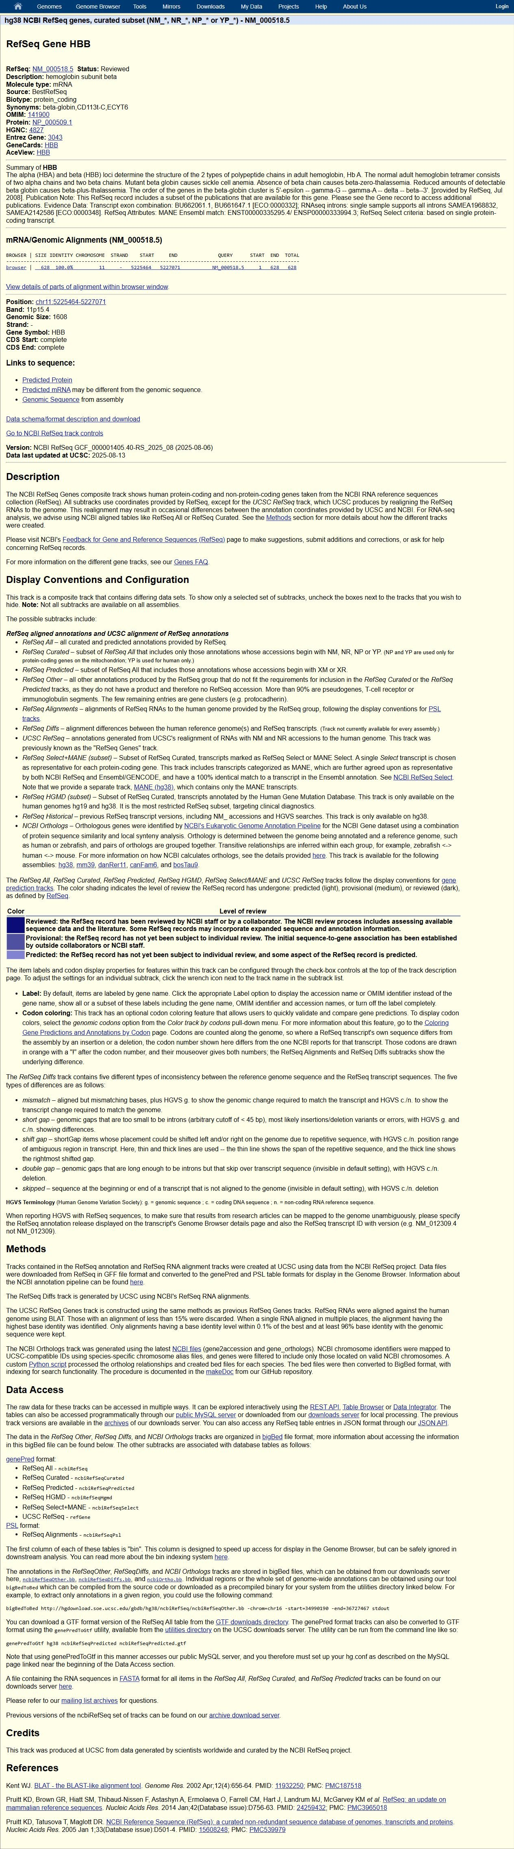
Genome browsers
One transcript, different sequences
Protein (147 amino acids)
>NP_000509.1 length=147
MVHLTPEEKSAVTALWGKVNVDEVGGEALGRLLVVYPWTQRFFESFGDLS
TPDAVMGNPKVKAHGKKVLGAFSDGLAHLDNLKGTFATLSELHCDKLHVD
PENFRLLGNVLVCVLAHHFGKEFTPPVQAAYQKVVAGVANALAHKYH
Full mRNA (628 nucleotides)
>NM_000518.5
acatttgcttctgacacaactgtgttcactagcaacctcaaacagacaccatggtgcatctgac
tcctgaggagaagtctgccgttactgccctgtggggcaaggtgaacgtggatgaagttggtggt
gaggccctgggcaggctgctggtggtctacccttggacccagaggttctttgagtcctttgggg
atctgtccactcctgatgctgttatgggcaaccctaaggtgaaggctcatggcaagaaagtgct
cggtgcctttagtgatggcctggctcacctggacaacctcaagggcacctttgccacactgagt
gagctgcactgtgacaagctgcacgtggatcctgagaacttcaggctcctgggcaacgtgctgg
tctgtgtgctggcccatcactttggcaaagaattcaccccaccagtgcaggctgcctatcagaa
agtggtggctggtgtggctaatgccctggcccacaagtatcactaagctcgctttcttgctgtc
caatttctattaaaggttcctttgttccctaagtccaactactaaactgggggatattatgaag
ggccttgagcatctggattctgcctaataaaaaacatttattttcattgcaa
Notes:
[On slide entry] The transcript and protein records give two immediate answers to our sequence question. [Click 1] The associated protein, NP_000509.1, contains 147 amino acids. [Click 2] NM_000518.5 contains 628 nucleotides: its three exons joined together, including both untranslated regions. Their relationship connects RNA-level and protein-level information, but the full transcript contains regions that do not encode amino acids.
The transcript export uses DNA letters, including T. This common storage convention means that the alphabet alone cannot distinguish a transcript sequence from genomic DNA.
UCSC uses the generic link labels “Predicted mRNA” and “Predicted Protein” here, although the selected RefSeq record has Reviewed status. The accession, record status and evidence annotations establish the identity and provenance of the sequence.

Slide 172
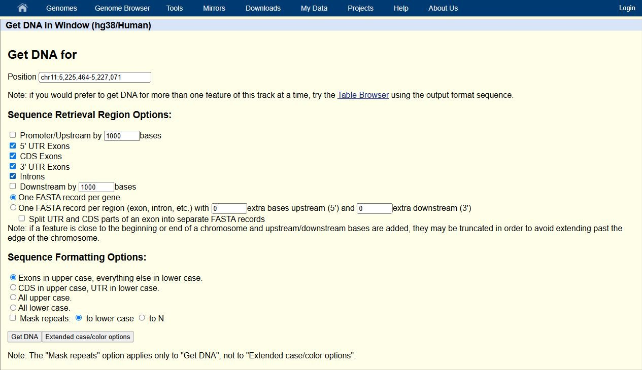

Genome browsers
One transcript, different sequences
Notes:
[On slide entry] To examine HBB at the genomic level, we need to decide which annotated parts the output should contain. The export options connect biological concepts—UTRs, coding regions and introns—to a concrete sequence selection.
Including both UTR options, coding exons and introns retrieves the complete genomic span of this transcript model. Adding upstream or downstream bases would broaden the selection to surrounding DNA and change its length. Combining the selected regions into one FASTA record gives us a continuous sequence for this example.
These choices determine the content of the result. Formatting options determine how that content is displayed. Uppercase exons and lowercase introns can help us recognise the gene’s organisation, while preserving the underlying nucleotide identities.

Slide 173
Genome browsers
One transcript, different sequences
Genomic DNA: 1,608 nt
>hg38_ncbiRefSeqCurated_NM_000518.5
range=chr11:5225464-5227071 5'pad=0 3'pad=0 strand=- repeatMasking=none
ACATTTGCTTCTGACACAACTGTGTTCACTAGCAACCTCAAACAGACACCATGGTGCATCTGACTCCTGAGGAGAAGTCTGCCG
TTACTGCCCTGTGGGGCAAGGTGAACGTGGATGAAGTTGGTGGTGAGGCCCTGGGCAGgttggtatcaaggttacaagacaggt
ttaaggagaccaatagaaactgggcatgtggagacagagaagactcttgggtttctgataggcactgactctctctgcctattg
gtctattttcccacccttagGCTGCTGGTGGTCTACCCTTGGACCCAGAGGTTCTTTGAGTCCTTTGGGGATCTGTCCACTCCT
GATGCTGTTATGGGCAACCCTAAGGTGAAGGCTCATGGCAAGAAAGTGCTCGGTGCCTTTAGTGATGGCCTGGCTCACCTGGAC
AACCTCAAGGGCACCTTTGCCACACTGAGTGAGCTGCACTGTGACAAGCTGCACGTGGATCCTGAGAACTTCAGGgtgagtcta
tgggacgcttgatgttttctttccccttcttttctatggttaagttcatgtcataggaaggggataagtaacagggtacagttt
agaatgggaaacagacgaatgattgcatcagtgtggaagtctcaggatcgttttagtttcttttatttgctgttcataacaatt
gttttcttttgtttaattcttgctttctttttttttcttctccgcaatttttactattatacttaatgccttaacattgtgtat
aacaaaaggaaatatctctgagatacattaagtaacttaaaaaaaaactttacacagtctgcctagtacattactatttggaat
atatgtgtgcttatttgcatattcataatctccctactttattttcttttatttttaattgatacataatcattatacatattt
atgggttaaagtgtaatgttttaatatgtgtacacatattgaccaaatcagggtaattttgcatttgtaattttaaaaaatgct
ttcttcttttaatatacttttttgtttatcttatttctaatactttccctaatctctttctttcagggcaataatgatacaatg
tatcatgcctctttgcaccattctaaagaataacagtgataatttctgggttaaggcaatagcaatatctctgcatataaatat
ttctgcatataaattgtaactgatgtaagaggtttcatattgctaatagcagctacaatccagctaccattctgcttttatttt
atggttgggataaggctggattattctgagtccaagctaggcccttttgctaatcatgttcatacctcttatcttcctcccaca
gCTCCTGGGCAACGTGCTGGTCTGTGTGCTGGCCCATCACTTTGGCAAAGAATTCACCCCACCAGTGCAGGCTGCCTATCAGAA
AGTGGTGGCTGGTGTGGCTAATGCCCTGGCCCACAAGTATCACTAAGCTCGCTTTCTTGCTGTCCAATTTCTATTAAAGGTTCC
TTTGTTCCCTAAGTCCAACTACTAAACTGGGGGATATTATGAAGGGCCTTGAGCATCTGGATTCTGCCTAATAAAAAACATTTA
TTTTCATTGCAA
Notes:
[On slide entry / Morph] The genomic output contains [Click 1] 1,608 nucleotides because it retains both exons and introns. The two introns contribute 130 and 850 bases. Removing these 980 intronic bases leaves the 628 bases present in the reference transcript. The difference in length therefore follows directly from the annotated exon structure.
[Click 2] The uppercase regions include the untranslated portions of exons as well as their coding portions. An exon is not necessarily entirely protein-coding.
HBB lies on the minus strand, so UCSC returns the sequence in the gene’s orientation: the reverse complement of the chromosome’s forward reference sequence. This allows the genomic and transcript sequences to be compared in the same biological direction.

Slide 174
Genome browsers
One transcript, different sequences
Genomic DNA: 1,608 nt
>hg38_ncbiRefSeqCurated_NM_000518.5
range=chr11:5225464-5227071 5'pad=0 3'pad=0 strand=- repeatMasking=none
ACATTTGCTTCTGACACAACTGTGTTCACTAGCAACCTCAAACAGACACCATGGTGCATCTGACTCCTGAGGAGAAGTCTGCCG
TTACTGCCCTGTGGGGCAAGGTGAACGTGGATGAAGTTGGTGGTGAGGCCCTGGGCAGgttggtatcaaggttacaagacaggt
ttaaggagaccaatagaaactgggcatgtggagacagagaagactcttgggtttctgataggcactgactctctctgcctattg
gtctattttcccacccttagGCTGCTGGTGGTCTACCCTTGGACCCAGAGGTTCTTTGAGTCCTTTGGGGATCTGTCCACTCCT
GATGCTGTTATGGGCAACCCTAAGGTGAAGGCTCATGGCAAGAAAGTGCTCGGTGCCTTTAGTGATGGCCTGGCTCACCTGGAC
AACCTCAAGGGCACCTTTGCCACACTGAGTGAGCTGCACTGTGACAAGCTGCACGTGGATCCTGAGAACTTCAGGgtgagtcta
tgggacgcttgatgttttctttccccttcttttctatggttaagttcatgtcataggaaggggataagtaacagggtacagttt
agaatgggaaacagacgaatgattgcatcagtgtggaagtctcaggatcgttttagtttcttttatttgctgttcataacaatt
gttttcttttgtttaattcttgctttctttttttttcttctccgcaatttttactattatacttaatgccttaacattgtgtat
aacaaaaggaaatatctctgagatacattaagtaacttaaaaaaaaactttacacagtctgcctagtacattactatttggaat
atatgtgtgcttatttgcatattcataatctccctactttattttcttttatttttaattgatacataatcattatacatattt
atgggttaaagtgtaatgttttaatatgtgtacacatattgaccaaatcagggtaattttgcatttgtaattttaaaaaatgct
ttcttcttttaatatacttttttgtttatcttatttctaatactttccctaatctctttctttcagggcaataatgatacaatg
tatcatgcctctttgcaccattctaaagaataacagtgataatttctgggttaaggcaatagcaatatctctgcatataaatat
ttctgcatataaattgtaactgatgtaagaggtttcatattgctaatagcagctacaatccagctaccattctgcttttatttt
atggttgggataaggctggattattctgagtccaagctaggcccttttgctaatcatgttcatacctcttatcttcctcccaca
gCTCCTGGGCAACGTGCTGGTCTGTGTGCTGGCCCATCACTTTGGCAAAGAATTCACCCCACCAGTGCAGGCTGCCTATCAGAA
AGTGGTGGCTGGTGTGGCTAATGCCCTGGCCCACAAGTATCACTAAGCTCGCTTTCTTGCTGTCCAATTTCTATTAAAGGTTCC
TTTGTTCCCTAAGTCCAACTACTAAACTGGGGGATATTATGAAGGGCCTTGAGCATCTGGATTCTGCCTAATAAAAAACATTTA
TTTTCATTGCAA
Uppercase: exons Lowercase: introns
Notes:
[On slide entry / Morph] The genomic output contains [Click 1] 1,608 nucleotides because it retains both exons and introns. The two introns contribute 130 and 850 bases. Removing these 980 intronic bases leaves the 628 bases present in the reference transcript. The difference in length therefore follows directly from the annotated exon structure.
[Click 2] The uppercase regions include the untranslated portions of exons as well as their coding portions. An exon is not necessarily entirely protein-coding.
HBB lies on the minus strand, so UCSC returns the sequence in the gene’s orientation: the reverse complement of the chromosome’s forward reference sequence. This allows the genomic and transcript sequences to be compared in the same biological direction.

Slide 175
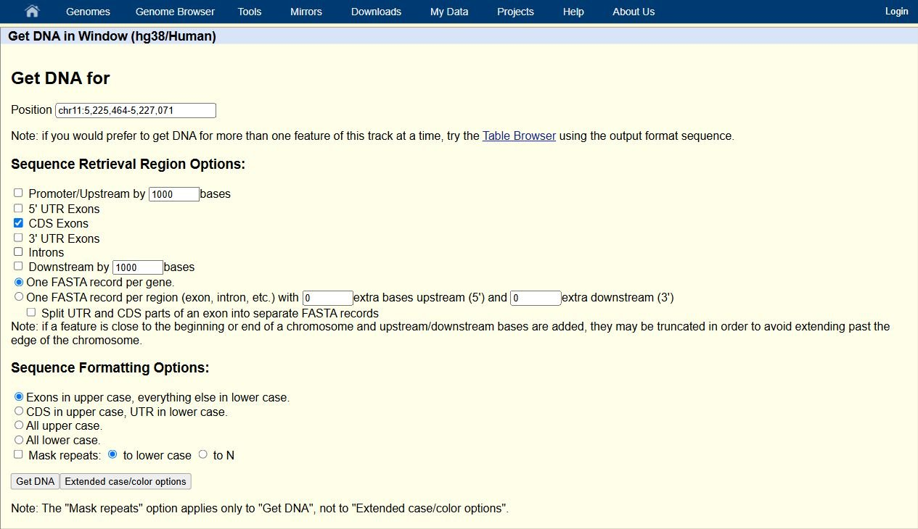
Genome browsers
One transcript, different sequences
Coding sequence: 444 nt
>hg38_ncbiRefSeqCurated_NM_000518.5
range=chr11:5225598-5227021 5'pad=0 3'pad=0 strand=- repeatMasking=none
ATGGTGCATCTGACTCCTGAGGAGAAGTCTGCCGTTACTGCCCTGTGGGGCAAGGTGA
ACGTGGATGAAGTTGGTGGTGAGGCCCTGGGCAGGCTGCTGGTGGTCTACCCTTGGAC
CCAGAGGTTCTTTGAGTCCTTTGGGGATCTGTCCACTCCTGATGCTGTTATGGGCAAC
CCTAAGGTGAAGGCTCATGGCAAGAAAGTGCTCGGTGCCTTTAGTGATGGCCTGGCTC
ACCTGGACAACCTCAAGGGCACCTTTGCCACACTGAGTGAGCTGCACTGTGACAAGCT
GCACGTGGATCCTGAGAACTTCAGGCTCCTGGGCAACGTGCTGGTCTGTGTGCTGGCC
CATCACTTTGGCAAAGAATTCACCCCACCAGTGCAGGCTGCCTATCAGAAAGTGGTGG
CTGGTGTGGCTAATGCCCTGGCCCACAAGTATCACTAA
Notes:
[On slide entry / Morph] The mature transcript still contains sequence outside the protein-coding region. Its 50-nucleotide 5′ UTR precedes the CDS, and its 134-nucleotide 3′ UTR follows it. [Click 1] Excluding these untranslated regions leaves a 444-nucleotide coding sequence.
The CDS begins with ATG and ends with TAA. Its 148 triplets comprise 147 amino acid codons and one terminal stop codon. This explains the 147-amino-acid protein retrieved earlier, including its initiator methionine. The stop codon contributes no amino acid.
The FASTA header gives the outer genomic boundaries of the coding regions. Those boundaries span introns, so subtracting the coordinates would measure a genomic span. The joined output itself contains only the selected coding portions.

Slide 176
Genome browsers
One transcript, different sequences
Coding sequence: 444 nt
>hg38_ncbiRefSeqCurated_NM_000518.5
range=chr11:5225598-5227021 5'pad=0 3'pad=0 strand=- repeatMasking=none
ATGGTGCATCTGACTCCTGAGGAGAAGTCTGCCGTTACTGCCCTGTGGGGCAAGGTGA
ACGTGGATGAAGTTGGTGGTGAGGCCCTGGGCAGGCTGCTGGTGGTCTACCCTTGGAC
CCAGAGGTTCTTTGAGTCCTTTGGGGATCTGTCCACTCCTGATGCTGTTATGGGCAAC
CCTAAGGTGAAGGCTCATGGCAAGAAAGTGCTCGGTGCCTTTAGTGATGGCCTGGCTC
ACCTGGACAACCTCAAGGGCACCTTTGCCACACTGAGTGAGCTGCACTGTGACAAGCT
GCACGTGGATCCTGAGAACTTCAGGCTCCTGGGCAACGTGCTGGTCTGTGTGCTGGCC
CATCACTTTGGCAAAGAATTCACCCCACCAGTGCAGGCTGCCTATCAGAAAGTGGTGG
CTGGTGTGGCTAATGCCCTGGCCCACAAGTATCACTAA
Joined CDS exons, including terminal stop codon
Notes:
[On slide entry / Morph] The mature transcript still contains sequence outside the protein-coding region. Its 50-nucleotide 5′ UTR precedes the CDS, and its 134-nucleotide 3′ UTR follows it. [Click 1] Excluding these untranslated regions leaves a 444-nucleotide coding sequence.
The CDS begins with ATG and ends with TAA. Its 148 triplets comprise 147 amino acid codons and one terminal stop codon. This explains the 147-amino-acid protein retrieved earlier, including its initiator methionine. The stop codon contributes no amino acid.
The FASTA header gives the outer genomic boundaries of the coding regions. Those boundaries span introns, so subtracting the coordinates would measure a genomic span. The joined output itself contains only the selected coding portions.

Slide 177
Genome browsers
One transcript, different sequences
Genomic DNA, 1,608 nt
Full transcript, 628 nt
ACATTTGCTTCTGACACAACTGTGTTCACTAGCAACCTCAAACAGACACCATGGTGCATCTGACTCCTGAGGAGAAGTCTGCCGT
TACTGCCCTGTGGGGCAAGGTGAACGTGGATGAAGTTGGTGGTGAGGCCCTGGGCAGgttggtatcaaggttacaagacaggttt
aaggagaccaatagaaactgggcatgtggagacagagaagactcttgggtttctgataggcactgactctctctgcctattggtc
tattttcccacccttagGCTGCTGGTGGTCTACCCTTGGACCCAGAGGTTCTTTGAGTCCTTTGGGGATCTGTCCACTCCTGATG
CTGTTATGGGCAACCCTAAGGTGAAGGCTCATGGCAAGAAAGTGCTCGGTGCCTTTAGTGATGGCCTGGCTCACCTGGACAACCT
CAAGGGCACCTTTGCCACACTGAGTGAGCTGCACTGTGACAAGCTGCACGTGGATCCTGAGAACTTCAGGgtgagtctatgggac
gcttgatgttttctttccccttcttttctatggttaagttcatgtcataggaaggggataagtaacagggtacagtttagaatgg
gaaacagacgaatgattgcatcagtgtggaagtctcaggatcgttttagtttcttttatttgctgttcataacaattgttttctt
ttgtttaattcttgctttctttttttttcttctccgcaatttttactattatacttaatgccttaacattgtgtataacaaaagg
aaatatctctgagatacattaagtaacttaaaaaaaaactttacacagtctgcctagtacattactatttggaatatatgtgtgc
ttatttgcatattcataatctccctactttattttcttttatttttaattgatacataatcattatacatatttatgggttaaag
tgtaatgttttaatatgtgtacacatattgaccaaatcagggtaattttgcatttgtaattttaaaaaatgctttcttcttttaa
tatacttttttgtttatcttatttctaatactttccctaatctctttctttcagggcaataatgatacaatgtatcatgcctctt
tgcaccattctaaagaataacagtgataatttctgggttaaggcaatagcaatatctctgcatataaatatttctgcatataaat
tgtaactgatgtaagaggtttcatattgctaatagcagctacaatccagctaccattctgcttttattttatggttgggataagg
ctggattattctgagtccaagctaggcccttttgctaatcatgttcatacctcttatcttcctcccacagCTCCTGGGCAACGTG
CTGGTCTGTGTGCTGGCCCATCACTTTGGCAAAGAATTCACCCCACCAGTGCAGGCTGCCTATCAGAAAGTGGTGGCTGGTGTGG
CTAATGCCCTGGCCCACAAGTATCACTAAGCTCGCTTTCTTGCTGTCCAATTTCTATTAAAGGTTCCTTTGTTCCCTAAGTCCAA
CTACTAAACTGGGGGATATTATGAAGGGCCTTGAGCATCTGGATTCTGCCTAATAAAAAACATTTATTTTCATTGCAA
acatttgcttctgacacaactgtgttcactagcaacctcaaacagacaccatggtgcatctgac
tcctgaggagaagtctgccgttactgccctgtggggcaaggtgaacgtggatgaagttggtggt
gaggccctgggcaggctgctggtggtctacccttggacccagaggttctttgagtcctttgggg
atctgtccactcctgatgctgttatgggcaaccctaaggtgaaggctcatggcaagaaagtgct
cggtgcctttagtgatggcctggctcacctggacaacctcaagggcacctttgccacactgagt
gagctgcactgtgacaagctgcacgtggatcctgagaacttcaggctcctgggcaacgtgctgg
tctgtgtgctggcccatcactttggcaaagaattcaccccaccagtgcaggctgcctatcagaa
agtggtggctggtgtggctaatgccctggcccacaagtatcactaagctcgctttcttgctgtc
caatttctattaaaggttcctttgttccctaagtccaactactaaactgggggatattatgaag
ggccttgagcatctggattctgcctaataaaaaacatttattttcattgcaa
Join exons
Select CDS
Coding sequence, 444 nt
Protein, 147 aa
Translate
ATGGTGCATCTGACTCCTGAGGAGAAGTCTGCCGTTACTGCCCTGTGGGGCAAGGTGA
ACGTGGATGAAGTTGGTGGTGAGGCCCTGGGCAGGCTGCTGGTGGTCTACCCTTGGAC
CCAGAGGTTCTTTGAGTCCTTTGGGGATCTGTCCACTCCTGATGCTGTTATGGGCAAC
CCTAAGGTGAAGGCTCATGGCAAGAAAGTGCTCGGTGCCTTTAGTGATGGCCTGGCTC
ACCTGGACAACCTCAAGGGCACCTTTGCCACACTGAGTGAGCTGCACTGTGACAAGCT
GCACGTGGATCCTGAGAACTTCAGGCTCCTGGGCAACGTGCTGGTCTGTGTGCTGGCC
CATCACTTTGGCAAAGAATTCACCCCACCAGTGCAGGCTGCCTATCAGAAAGTGGTGG
CTGGTGTGGCTAATGCCCTGGCCCACAAGTATCACTAA
MVHLTPEEKSAVTALWGKVNVDEVGGEALGRLLVVYPWTQRFFESFGDLS
TPDAVMGNPKVKAHGKKVLGAFSDGLAHLDNLKGTFATLSELHCDKLHVD
PENFRLLGNVLVCVLAHHFGKEFTPPVQAAYQKVVAGVANALAHKYH
Notes:
[On slide entry] The four sequence views now fit together. [Click 1] Genomic DNA preserves the exon–intron organization. [Click 2] The full transcript represents the joined exons and retains both UTRs. [Click 3] The CDS selects the region used for translation, [Click 4] and the protein sequence represents the resulting amino acid chain.
The arrows compare connected sequence representations. In the cell, transcription produces RNA and splicing removes introns from that RNA. Selecting the CDS is a computational choice about which part of the transcript to analyze.
Consequently, the shortest sequence is not automatically the most useful. Investigating an intronic variant requires genomic information. Studying a UTR requires a sequence that retains it. Analyzing the encoded amino acid sequence requires the CDS or protein record.

Slide 178
Genome browsers
Notes:
[As the question appears] We just used this browser to retrieve DNA, RNA and protein sequences from one HBB transcript. Now imagine we want to find a DNA variant and see where it falls in that transcript. Which parts of this busy view would help us?
[Reveal Visible Tracks] The panel shows the two annotation sources we have on screen, GENCODE V50 and NCBI RefSeq. Both are drawn against the same chromosome coordinates. We’ll keep the RefSeq transcript we used for the sequence example so we can compare variant positions with its exons and introns.

Slide 179
Genome browsers
What is visible?
Notes:
[As the question appears] We just used this browser to retrieve DNA, RNA and protein sequences from one HBB transcript. Now imagine we want to find a DNA variant and see where it falls in that transcript. Which parts of this busy view would help us?
[Reveal Visible Tracks] The panel shows the two annotation sources we have on screen, GENCODE V50 and NCBI RefSeq. Both are drawn against the same chromosome coordinates. We’ll keep the RefSeq transcript we used for the sequence example so we can compare variant positions with its exons and introns.

Slide 180
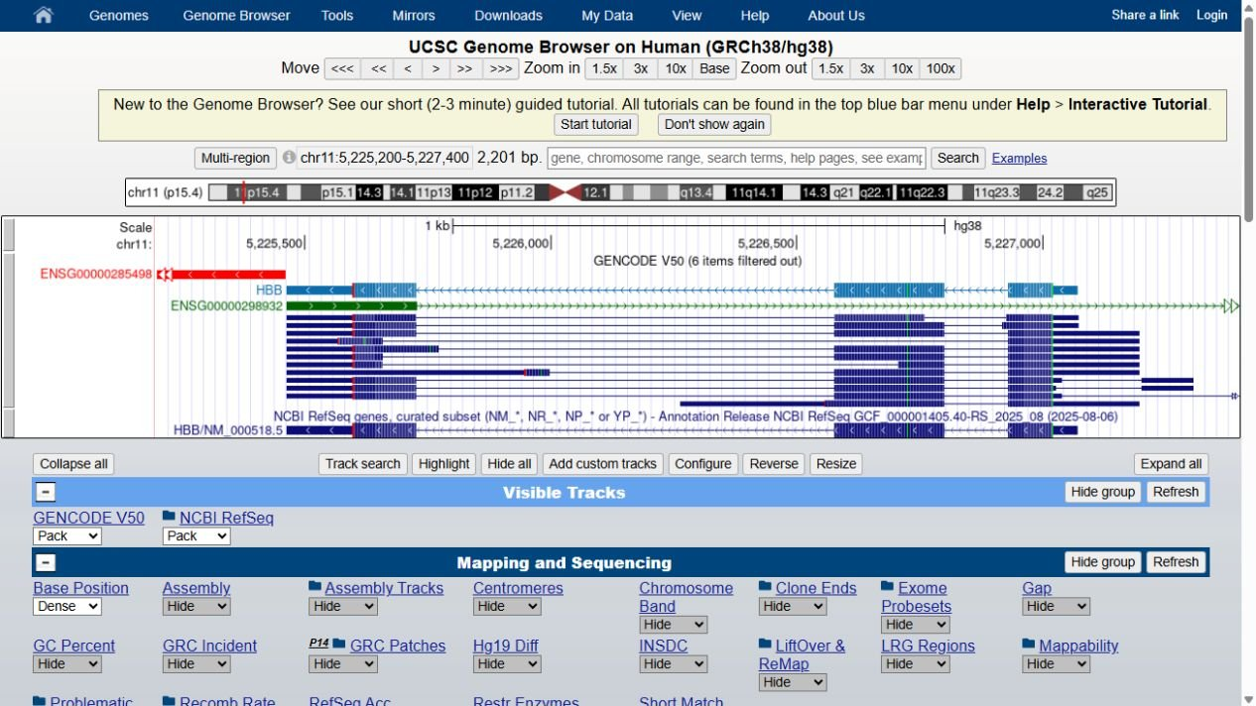
Genome browsers
What is visible?
Notes:
[As the question appears] We just used this browser to retrieve DNA, RNA and protein sequences from one HBB transcript. Now imagine we want to find a DNA variant and see where it falls in that transcript. Which parts of this busy view would help us?
[Reveal Visible Tracks] The panel shows the two annotation sources we have on screen, GENCODE V50 and NCBI RefSeq. Both are drawn against the same chromosome coordinates. We’ll keep the RefSeq transcript we used for the sequence example so we can compare variant positions with its exons and introns.

Slide 181
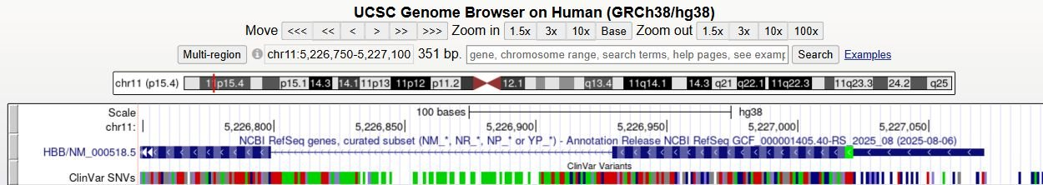
Genome browsers
What is visible?
+ Mapping and Sequencing
+ Expression
+ Genes and Gene Predictions
+ Single Cell RNA-seq
+ Phenotypes, Variants, and Literature
+ Regulation
+ Variation
+ Comparative Genomics
+ Human Pangenome - HPRC
+ Repeats
+ RNA and Transcriptome
Notes:
Slide 58 — Start with one transcript
[On entry] We’ve zoomed in on HBB and kept just the NCBI RefSeq track visible. The thick blue blocks mark coding regions, and the thin line between them marks an intron. This gives us a reference for reading any new track we add.
[Reveal the collapsed categories] The categories below are where we find other layers. For example, we could open Expression to look for RNA abundance. Our question is about variants with reported clinical interpretations, so we’ll open Phenotypes, Variants, and Literature. UCSC Genome Browser tutorial

Slide 182
Genome browsers
What is visible?
ClinVar Variants
Pack
▾
− Phenotypes, Variants, and Literature
Track controls schematic
ClinVar Variants
Pack
▾
Track display mode
Subtracks
ClinVar SNVs
Dense
▾
ClinVar CNVs
Hide
▾
ClinVar interp
Hide
▾
Notes:
Slide 59 — Add the short-variant track
[On entry, all elements visible] We’ll add ClinVar Variants and keep only its short-variant subtrack, labelled ClinVar SNVs. The schematic shows the parent track set to Pack and the short-variant subtrack set to Dense, so it appears as one compact row. We can now look straight up from a variant mark to see where it falls relative to the HBB transcript. UCSC ClinVar track settings

Slide 183
Genome browsers
An intronic variant:
A coding variant:
Notes:
Slide 60 — Where does the variant lie?
[Reveal the question] Before we ask what a variant does, let’s work out where it falls. Compare each mark in the ClinVar row with the transcript directly above it.
[Reveal the left arrow] The first arrow points to the intronic region. Look up from it and you meet the thin line between exons.
[Reveal the right arrow] The second arrow points into a thick coding block. A change here can alter a codon. What could a change in an intron do, given that the intron is normally removed from the RNA?

Slide 184
Genome browsers
Where does the variant lie?
An intronic variant:
A coding variant:
Notes:
Slide 60 — Where does the variant lie?
[Reveal the question] Before we ask what a variant does, let’s work out where it falls. Compare each mark in the ClinVar row with the transcript directly above it.
[Reveal the left arrow] The first arrow points to the intronic region. Look up from it and you meet the thin line between exons.
[Reveal the right arrow] The second arrow points into a thick coding block. A change here can alter a codon. What could a change in an intron do, given that the intron is normally removed from the RNA?

Slide 185
Genome browsers
at DNA position 5,227,002 A changes to T
at DNA position 5,226,820 G changes to A
Notes:
[Reveal the question, then the coding view] Let’s zoom in, starting with the coding example. Once we can see the individual bases, we can follow the change from DNA to protein.
[Highlight A → T, then reveal the codon and amino acid in turn] In HBB transcript notation this is c.20A>T. It changes GAG to GTG, so valine replaces glutamate at position 7 of beta-globin. Haemoglobin containing this altered beta-globin is called haemoglobin S, or HbS. ClinVar HbS record
[Reveal the intronic view and highlight G → A] Now look at c.93-21G>A, 21 bases before exon 2. This change creates a new site that the cell can use when it splices the RNA.
[Reveal the 19 bases, then the stop codon] When the cell uses that new site, the last 19 bases of intron 1 stay in the mature mRNA. They introduce a premature stop codon. Some transcripts still splice normally, but the affected copy produces less functional beta-globin. How do we know those 19 bases really stay in the RNA? Experimental study of HBB splicing
The ruler gives GRCh38 chromosome 11 coordinates, but the nucleotide changes shown here use HBB’s minus-strand orientation. NM_000518.5:c.20A>T corresponds to NC_000011.10:g.5227002T>A, and NM_000518.5:c.93-21G>A corresponds to NC_000011.10:g.5226820C>T. Complementing both alleles describes the same biological variant.

Slide 186
Genome browsers
What is consequence of a variant?
at DNA position 5,227,002 A changes to T
at DNA position 5,226,820 G changes to A
Notes:
[Reveal the question, then the coding view] Let’s zoom in, starting with the coding example. Once we can see the individual bases, we can follow the change from DNA to protein.
[Highlight A → T, then reveal the codon and amino acid in turn] In HBB transcript notation this is c.20A>T. It changes GAG to GTG, so valine replaces glutamate at position 7 of beta-globin. Haemoglobin containing this altered beta-globin is called haemoglobin S, or HbS. ClinVar HbS record
[Reveal the intronic view and highlight G → A] Now look at c.93-21G>A, 21 bases before exon 2. This change creates a new site that the cell can use when it splices the RNA.
[Reveal the 19 bases, then the stop codon] When the cell uses that new site, the last 19 bases of intron 1 stay in the mature mRNA. They introduce a premature stop codon. Some transcripts still splice normally, but the affected copy produces less functional beta-globin. How do we know those 19 bases really stay in the RNA? Experimental study of HBB splicing
The ruler gives GRCh38 chromosome 11 coordinates, but the nucleotide changes shown here use HBB’s minus-strand orientation. NM_000518.5:c.20A>T corresponds to NC_000011.10:g.5227002T>A, and NM_000518.5:c.93-21G>A corresponds to NC_000011.10:g.5226820C>T. Complementing both alleles describes the same biological variant.

Slide 187
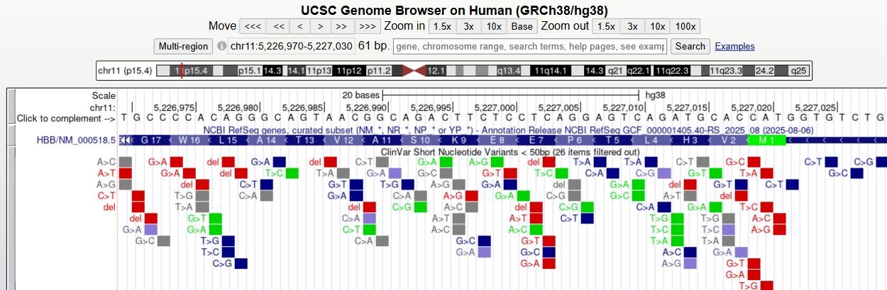
Genome browsers
What is consequence of a variant?
Coding variant
at DNA position 5,227,002 A changes to T
at DNA position 5,226,820 G changes to A
Notes:
[Reveal the question, then the coding view] Let’s zoom in, starting with the coding example. Once we can see the individual bases, we can follow the change from DNA to protein.
[Highlight A → T, then reveal the codon and amino acid in turn] In HBB transcript notation this is c.20A>T. It changes GAG to GTG, so valine replaces glutamate at position 7 of beta-globin. Haemoglobin containing this altered beta-globin is called haemoglobin S, or HbS. ClinVar HbS record
[Reveal the intronic view and highlight G → A] Now look at c.93-21G>A, 21 bases before exon 2. This change creates a new site that the cell can use when it splices the RNA.
[Reveal the 19 bases, then the stop codon] When the cell uses that new site, the last 19 bases of intron 1 stay in the mature mRNA. They introduce a premature stop codon. Some transcripts still splice normally, but the affected copy produces less functional beta-globin. How do we know those 19 bases really stay in the RNA? Experimental study of HBB splicing
The ruler gives GRCh38 chromosome 11 coordinates, but the nucleotide changes shown here use HBB’s minus-strand orientation. NM_000518.5:c.20A>T corresponds to NC_000011.10:g.5227002T>A, and NM_000518.5:c.93-21G>A corresponds to NC_000011.10:g.5226820C>T. Complementing both alleles describes the same biological variant.

Slide 188
Genome browsers
What is consequence of a variant?
Coding variant
at DNA position 5,227,002 A changes to T
at DNA position 5,226,820 G changes to A
Notes:
[Reveal the question, then the coding view] Let’s zoom in, starting with the coding example. Once we can see the individual bases, we can follow the change from DNA to protein.
[Highlight A → T, then reveal the codon and amino acid in turn] In HBB transcript notation this is c.20A>T. It changes GAG to GTG, so valine replaces glutamate at position 7 of beta-globin. Haemoglobin containing this altered beta-globin is called haemoglobin S, or HbS. ClinVar HbS record
[Reveal the intronic view and highlight G → A] Now look at c.93-21G>A, 21 bases before exon 2. This change creates a new site that the cell can use when it splices the RNA.
[Reveal the 19 bases, then the stop codon] When the cell uses that new site, the last 19 bases of intron 1 stay in the mature mRNA. They introduce a premature stop codon. Some transcripts still splice normally, but the affected copy produces less functional beta-globin. How do we know those 19 bases really stay in the RNA? Experimental study of HBB splicing
The ruler gives GRCh38 chromosome 11 coordinates, but the nucleotide changes shown here use HBB’s minus-strand orientation. NM_000518.5:c.20A>T corresponds to NC_000011.10:g.5227002T>A, and NM_000518.5:c.93-21G>A corresponds to NC_000011.10:g.5226820C>T. Complementing both alleles describes the same biological variant.

Slide 189
Genome browsers
What is consequence of a variant?
Coding variant
at DNA position 5,227,002 A changes to T
at DNA position 5,226,820 G changes to A
GAG becomes GTG
Notes:
[Reveal the question, then the coding view] Let’s zoom in, starting with the coding example. Once we can see the individual bases, we can follow the change from DNA to protein.
[Highlight A → T, then reveal the codon and amino acid in turn] In HBB transcript notation this is c.20A>T. It changes GAG to GTG, so valine replaces glutamate at position 7 of beta-globin. Haemoglobin containing this altered beta-globin is called haemoglobin S, or HbS. ClinVar HbS record
[Reveal the intronic view and highlight G → A] Now look at c.93-21G>A, 21 bases before exon 2. This change creates a new site that the cell can use when it splices the RNA.
[Reveal the 19 bases, then the stop codon] When the cell uses that new site, the last 19 bases of intron 1 stay in the mature mRNA. They introduce a premature stop codon. Some transcripts still splice normally, but the affected copy produces less functional beta-globin. How do we know those 19 bases really stay in the RNA? Experimental study of HBB splicing
The ruler gives GRCh38 chromosome 11 coordinates, but the nucleotide changes shown here use HBB’s minus-strand orientation. NM_000518.5:c.20A>T corresponds to NC_000011.10:g.5227002T>A, and NM_000518.5:c.93-21G>A corresponds to NC_000011.10:g.5226820C>T. Complementing both alleles describes the same biological variant.

Slide 190
Genome browsers
What is consequence of a variant?
Coding variant
at DNA position 5,227,002 A changes to T
at DNA position 5,226,820 G changes to A
GAG becomes GTG
GLU7 in beta-globin becomes Val
Notes:
[Reveal the question, then the coding view] Let’s zoom in, starting with the coding example. Once we can see the individual bases, we can follow the change from DNA to protein.
[Highlight A → T, then reveal the codon and amino acid in turn] In HBB transcript notation this is c.20A>T. It changes GAG to GTG, so valine replaces glutamate at position 7 of beta-globin. Haemoglobin containing this altered beta-globin is called haemoglobin S, or HbS. ClinVar HbS record
[Reveal the intronic view and highlight G → A] Now look at c.93-21G>A, 21 bases before exon 2. This change creates a new site that the cell can use when it splices the RNA.
[Reveal the 19 bases, then the stop codon] When the cell uses that new site, the last 19 bases of intron 1 stay in the mature mRNA. They introduce a premature stop codon. Some transcripts still splice normally, but the affected copy produces less functional beta-globin. How do we know those 19 bases really stay in the RNA? Experimental study of HBB splicing
The ruler gives GRCh38 chromosome 11 coordinates, but the nucleotide changes shown here use HBB’s minus-strand orientation. NM_000518.5:c.20A>T corresponds to NC_000011.10:g.5227002T>A, and NM_000518.5:c.93-21G>A corresponds to NC_000011.10:g.5226820C>T. Complementing both alleles describes the same biological variant.

Slide 191
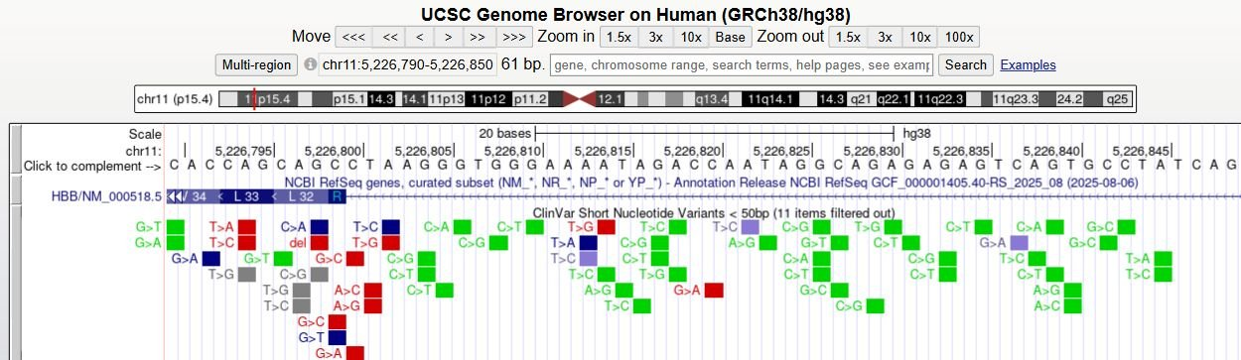
Genome browsers
What is consequence of a variant?
Coding variant
Intronic variant
at DNA position 5,227,002 A changes to T
at DNA position 5,226,820 G changes to A
GAG becomes GTG
GLU7 in beta-globin becomes Val
Notes:
[Reveal the question, then the coding view] Let’s zoom in, starting with the coding example. Once we can see the individual bases, we can follow the change from DNA to protein.
[Highlight A → T, then reveal the codon and amino acid in turn] In HBB transcript notation this is c.20A>T. It changes GAG to GTG, so valine replaces glutamate at position 7 of beta-globin. Haemoglobin containing this altered beta-globin is called haemoglobin S, or HbS. ClinVar HbS record
[Reveal the intronic view and highlight G → A] Now look at c.93-21G>A, 21 bases before exon 2. This change creates a new site that the cell can use when it splices the RNA.
[Reveal the 19 bases, then the stop codon] When the cell uses that new site, the last 19 bases of intron 1 stay in the mature mRNA. They introduce a premature stop codon. Some transcripts still splice normally, but the affected copy produces less functional beta-globin. How do we know those 19 bases really stay in the RNA? Experimental study of HBB splicing
The ruler gives GRCh38 chromosome 11 coordinates, but the nucleotide changes shown here use HBB’s minus-strand orientation. NM_000518.5:c.20A>T corresponds to NC_000011.10:g.5227002T>A, and NM_000518.5:c.93-21G>A corresponds to NC_000011.10:g.5226820C>T. Complementing both alleles describes the same biological variant.

Slide 192
Genome browsers
What is consequence of a variant?
Coding variant
Intronic variant
at DNA position 5,227,002 A changes to T
at DNA position 5,226,820 G changes to A
GAG becomes GTG
Leaves 19 intronic bases in mRNA
GLU7 in beta-globin becomes Val
Notes:
[Reveal the question, then the coding view] Let’s zoom in, starting with the coding example. Once we can see the individual bases, we can follow the change from DNA to protein.
[Highlight A → T, then reveal the codon and amino acid in turn] In HBB transcript notation this is c.20A>T. It changes GAG to GTG, so valine replaces glutamate at position 7 of beta-globin. Haemoglobin containing this altered beta-globin is called haemoglobin S, or HbS. ClinVar HbS record
[Reveal the intronic view and highlight G → A] Now look at c.93-21G>A, 21 bases before exon 2. This change creates a new site that the cell can use when it splices the RNA.
[Reveal the 19 bases, then the stop codon] When the cell uses that new site, the last 19 bases of intron 1 stay in the mature mRNA. They introduce a premature stop codon. Some transcripts still splice normally, but the affected copy produces less functional beta-globin. How do we know those 19 bases really stay in the RNA? Experimental study of HBB splicing
The ruler gives GRCh38 chromosome 11 coordinates, but the nucleotide changes shown here use HBB’s minus-strand orientation. NM_000518.5:c.20A>T corresponds to NC_000011.10:g.5227002T>A, and NM_000518.5:c.93-21G>A corresponds to NC_000011.10:g.5226820C>T. Complementing both alleles describes the same biological variant.

Slide 193
Genome browsers
What is consequence of a variant?
Coding variant
Intronic variant
at DNA position 5,227,002 A changes to T
at DNA position 5,226,820 G changes to A
GAG becomes GTG
Leaves 19 intronic bases in mRNA
GLU7 in beta-globin becomes Val
Premature stop codon
Notes:
[Reveal the question, then the coding view] Let’s zoom in, starting with the coding example. Once we can see the individual bases, we can follow the change from DNA to protein.
[Highlight A → T, then reveal the codon and amino acid in turn] In HBB transcript notation this is c.20A>T. It changes GAG to GTG, so valine replaces glutamate at position 7 of beta-globin. Haemoglobin containing this altered beta-globin is called haemoglobin S, or HbS. ClinVar HbS record
[Reveal the intronic view and highlight G → A] Now look at c.93-21G>A, 21 bases before exon 2. This change creates a new site that the cell can use when it splices the RNA.
[Reveal the 19 bases, then the stop codon] When the cell uses that new site, the last 19 bases of intron 1 stay in the mature mRNA. They introduce a premature stop codon. Some transcripts still splice normally, but the affected copy produces less functional beta-globin. How do we know those 19 bases really stay in the RNA? Experimental study of HBB splicing
The ruler gives GRCh38 chromosome 11 coordinates, but the nucleotide changes shown here use HBB’s minus-strand orientation. NM_000518.5:c.20A>T corresponds to NC_000011.10:g.5227002T>A, and NM_000518.5:c.93-21G>A corresponds to NC_000011.10:g.5226820C>T. Complementing both alleles describes the same biological variant.

Slide 194
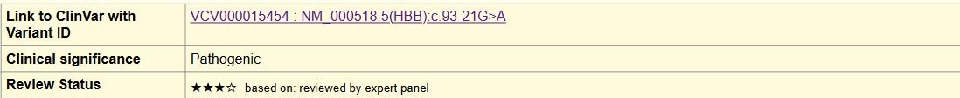
Genome browsers
Coding variant
Intronic variant
UCSC feature details
ClinVar record
Supporting submissions
and cited studies
Notes:
[Reveal the heading] The genome browser helped us locate the variant. To see how its effect was established, we can follow the link back to the source record.
[Reveal the callout] This is what UCSC shows when we open the intronic variant’s details. The accession VCV000015454 links to ClinVar. There we can confirm the exact change, see which condition it was assessed for, and read the supporting submissions and cited studies. In this case, researchers examined RNA and found the extra intronic sequence we just discussed. We’ll now switch to Ensembl and see how another genome browser organises the same kinds of information. ClinVar record · Original RNA study

Slide 195
Genome browsers
Follow the evidence
Coding variant
Intronic variant
UCSC feature details
ClinVar record
Supporting submissions
and cited studies
Notes:
[Reveal the heading] The genome browser helped us locate the variant. To see how its effect was established, we can follow the link back to the source record.
[Reveal the callout] This is what UCSC shows when we open the intronic variant’s details. The accession VCV000015454 links to ClinVar. There we can confirm the exact change, see which condition it was assessed for, and read the supporting submissions and cited studies. In this case, researchers examined RNA and found the extra intronic sequence we just discussed. We’ll now switch to Ensembl and see how another genome browser organises the same kinds of information. ClinVar record · Original RNA study

Slide 196
Genome browsers
Genome assembly
Chromosome region
Exons separated by introns
Possible transcript
Non-coding RNA exon on opposite DNA strand
Notes:
On opening
We used UCSC to explore human HBB. Let’s open the same region in Ensembl and see which clues help us find our bearings.
Browser view appears. Before interpreting the tracks, let’s check where we are.
Genome assembly. The top label tells us which reference sequence we’re using. Here it’s the human assembly GRCh38.p14.
Chromosome region. The coordinates tell us which stretch of chromosome 11 is on screen. This is the viewing window around HBB.
HBB track. Now we can read the gene structure. The blocks mark exons, and the lines between them mark introns. The small chevrons point left because HBB is transcribed from the reverse strand.
Noncoding RNA on the opposite strand. The same stretch of chromosome can carry annotations on both strands. Here an exon from a noncoding RNA overlaps part of the HBB region, and its track points the other way.
Possible transcript. The bottom track shows a separate candidate transcript nearby. To find the transcripts that belong to HBB, let’s open the HBB gene record itself.

Slide 197
Genome browsers
What can we find in Ensembl?
Genome assembly
Chromosome region
Exons separated by introns
Possible transcript
Non-coding RNA exon on opposite DNA strand
Notes:
On opening
We used UCSC to explore human HBB. Let’s open the same region in Ensembl and see which clues help us find our bearings.
Browser view appears. Before interpreting the tracks, let’s check where we are.
Genome assembly. The top label tells us which reference sequence we’re using. Here it’s the human assembly GRCh38.p14.
Chromosome region. The coordinates tell us which stretch of chromosome 11 is on screen. This is the viewing window around HBB.
HBB track. Now we can read the gene structure. The blocks mark exons, and the lines between them mark introns. The small chevrons point left because HBB is transcribed from the reverse strand.
Noncoding RNA on the opposite strand. The same stretch of chromosome can carry annotations on both strands. Here an exon from a noncoding RNA overlaps part of the HBB region, and its track points the other way.
Possible transcript. The bottom track shows a separate candidate transcript nearby. To find the transcripts that belong to HBB, let’s open the HBB gene record itself.

Slide 198
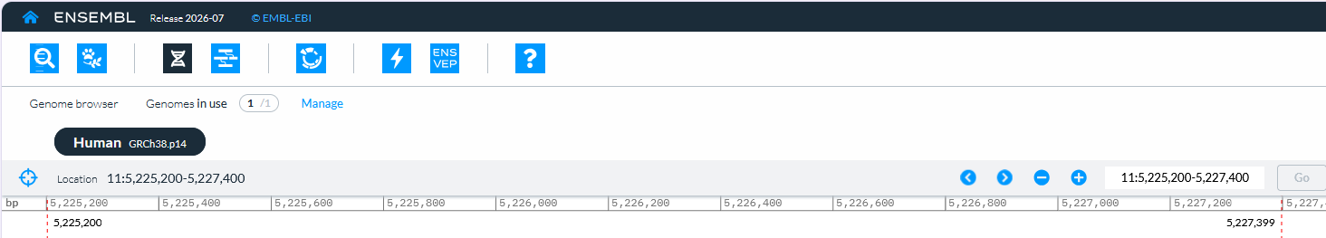
Genome browsers
What can we find in Ensembl?
Genome assembly
Chromosome region
Exons separated by introns
Possible transcript
Non-coding RNA exon on opposite DNA strand
https://www.ensembl.org/genome-browser/GCA_000001405.29?focus=location:11:5225200-5227400&location=11:5225200-5227400
Notes:
On opening
We used UCSC to explore human HBB. Let’s open the same region in Ensembl and see which clues help us find our bearings.
Browser view appears. Before interpreting the tracks, let’s check where we are.
Genome assembly. The top label tells us which reference sequence we’re using. Here it’s the human assembly GRCh38.p14.
Chromosome region. The coordinates tell us which stretch of chromosome 11 is on screen. This is the viewing window around HBB.
HBB track. Now we can read the gene structure. The blocks mark exons, and the lines between them mark introns. The small chevrons point left because HBB is transcribed from the reverse strand.
Noncoding RNA on the opposite strand. The same stretch of chromosome can carry annotations on both strands. Here an exon from a noncoding RNA overlaps part of the HBB region, and its track points the other way.
Possible transcript. The bottom track shows a separate candidate transcript nearby. To find the transcripts that belong to HBB, let’s open the HBB gene record itself.

Slide 199
Genome browsers
What can we find in Ensembl?
Genome assembly
Chromosome region
Exons separated by introns
Possible transcript
Non-coding RNA exon on opposite DNA strand
https://www.ensembl.org/genome-browser/GCA_000001405.29?focus=location:11:5225200-5227400&location=11:5225200-5227400
Notes:
On opening
We used UCSC to explore human HBB. Let’s open the same region in Ensembl and see which clues help us find our bearings.
Browser view appears. Before interpreting the tracks, let’s check where we are.
Genome assembly. The top label tells us which reference sequence we’re using. Here it’s the human assembly GRCh38.p14.
Chromosome region. The coordinates tell us which stretch of chromosome 11 is on screen. This is the viewing window around HBB.
HBB track. Now we can read the gene structure. The blocks mark exons, and the lines between them mark introns. The small chevrons point left because HBB is transcribed from the reverse strand.
Noncoding RNA on the opposite strand. The same stretch of chromosome can carry annotations on both strands. Here an exon from a noncoding RNA overlaps part of the HBB region, and its track points the other way.
Possible transcript. The bottom track shows a separate candidate transcript nearby. To find the transcripts that belong to HBB, let’s open the HBB gene record itself.

Slide 200
Genome browsers
What can we find in Ensembl?
Genome assembly
Chromosome region
Exons separated by introns
Possible transcript
Non-coding RNA exon on opposite DNA strand
https://www.ensembl.org/genome-browser/GCA_000001405.29?focus=location:11:5225200-5227400&location=11:5225200-5227400
Notes:
On opening
We used UCSC to explore human HBB. Let’s open the same region in Ensembl and see which clues help us find our bearings.
Browser view appears. Before interpreting the tracks, let’s check where we are.
Genome assembly. The top label tells us which reference sequence we’re using. Here it’s the human assembly GRCh38.p14.
Chromosome region. The coordinates tell us which stretch of chromosome 11 is on screen. This is the viewing window around HBB.
HBB track. Now we can read the gene structure. The blocks mark exons, and the lines between them mark introns. The small chevrons point left because HBB is transcribed from the reverse strand.
Noncoding RNA on the opposite strand. The same stretch of chromosome can carry annotations on both strands. Here an exon from a noncoding RNA overlaps part of the HBB region, and its track points the other way.
Possible transcript. The bottom track shows a separate candidate transcript nearby. To find the transcripts that belong to HBB, let’s open the HBB gene record itself.

Slide 201
Genome browsers
What can we find in Ensembl?
Genome assembly
Chromosome region
Exons separated by introns
Possible transcript
Non-coding RNA exon on opposite DNA strand
https://www.ensembl.org/genome-browser/GCA_000001405.29?focus=location:11:5225200-5227400&location=11:5225200-5227400
Notes:
On opening
We used UCSC to explore human HBB. Let’s open the same region in Ensembl and see which clues help us find our bearings.
Browser view appears. Before interpreting the tracks, let’s check where we are.
Genome assembly. The top label tells us which reference sequence we’re using. Here it’s the human assembly GRCh38.p14.
Chromosome region. The coordinates tell us which stretch of chromosome 11 is on screen. This is the viewing window around HBB.
HBB track. Now we can read the gene structure. The blocks mark exons, and the lines between them mark introns. The small chevrons point left because HBB is transcribed from the reverse strand.
Noncoding RNA on the opposite strand. The same stretch of chromosome can carry annotations on both strands. Here an exon from a noncoding RNA overlaps part of the HBB region, and its track points the other way.
Possible transcript. The bottom track shows a separate candidate transcript nearby. To find the transcripts that belong to HBB, let’s open the HBB gene record itself.

Slide 202
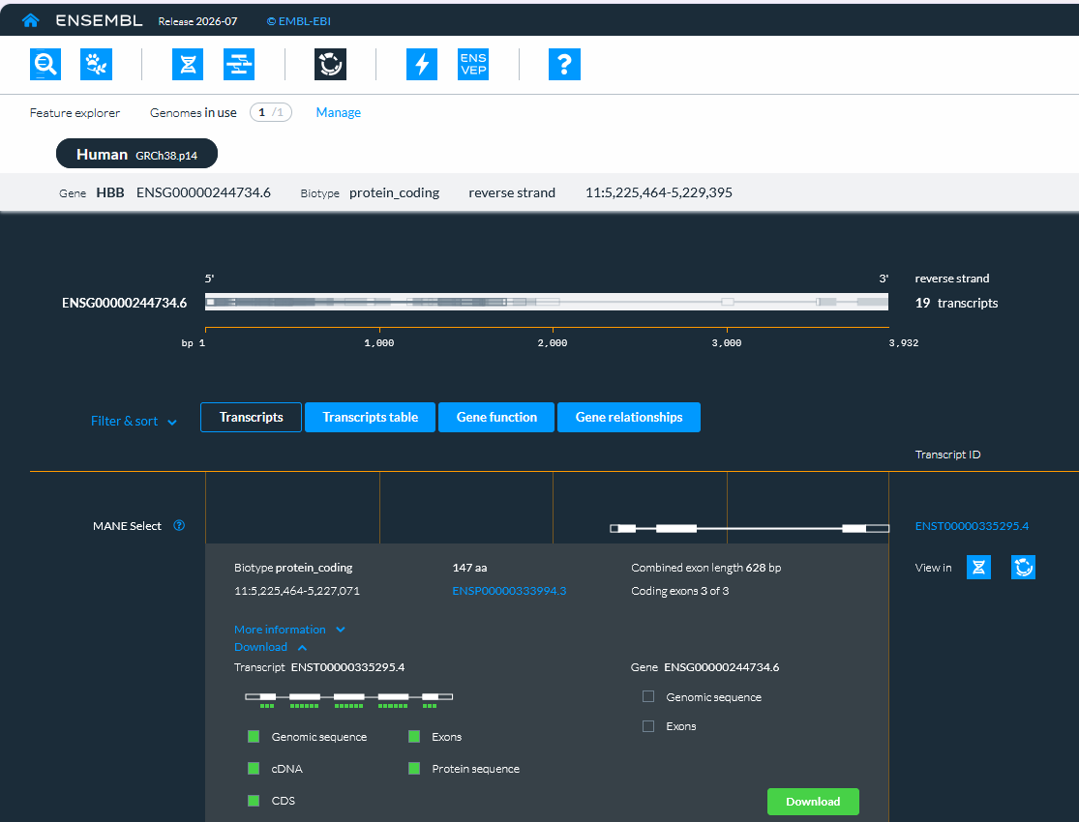
Genome browsers
Three separate exons
142, 223 and 263 bases
Enter gene
Whole-gene DNA
3,932 bases
Genomic DNA for that transcript
1,608 bases
Spliced transcript
628 bases
Coding sequence
444 bases
Beta-globin protein
147 amino acids
https://www.ensembl.org/feature-explorer/GCA_000001405.29/gene:ENSG00000244734?view=transcripts
Notes:
On opening
Suppose someone asks you to download the HBB sequence. Which sequence would you give them?
Feature Explorer appears. Here is the HBB gene record. We’ve expanded the matched reference transcript, the Ensembl counterpart of the transcript we used in UCSC, and opened Download.
Magnifier appears. The menu has two columns, one for the gene and one for the selected transcript. Both offer Genomic sequence, so check the column before choosing.
Whole-gene DNA. If we want the full annotated HBB region, we choose genomic sequence in the gene column. That gives us 3,932 bases.
Transcript span. If our question concerns only the genomic region covered by this transcript, we choose genomic sequence in the transcript column. That gives us 1,608 bases, including the introns between its exons.
Spliced transcript. What if we want the mature RNA sequence? Choose cDNA. The exons are joined, both untranslated ends are retained, and the 628 bases are written with DNA letters.
Three separate exons. To examine each exon individually, choose Exons. Their lengths are 142, 223 and 263 bases. Add them together and you get the length of the spliced transcript.
Coding sequence. If we want the part that specifies beta-globin, choose CDS. This gives us 444 bases from the start codon through the stop codon.
Beta-globin protein. The protein download gives us 147 amino acids. The last codon of the coding sequence tells the ribosome to stop. It adds no amino acid.
Transition to PubMed
Once we’ve selected the sequence we need, the green Download button exports it as FASTA. If we want to know how a particular change in that sequence affects haemoglobin, we can look for the studies that investigated it. That takes us to PubMed.

Slide 203
Genome browsers
One gene, many sequences
Three separate exons
142, 223 and 263 bases
Enter gene
Whole-gene DNA
3,932 bases
Genomic DNA for that transcript
1,608 bases
Spliced transcript
628 bases
Coding sequence
444 bases
Beta-globin protein
147 amino acids
https://www.ensembl.org/feature-explorer/GCA_000001405.29/gene:ENSG00000244734?view=transcripts
Notes:
On opening
Suppose someone asks you to download the HBB sequence. Which sequence would you give them?
Feature Explorer appears. Here is the HBB gene record. We’ve expanded the matched reference transcript, the Ensembl counterpart of the transcript we used in UCSC, and opened Download.
Magnifier appears. The menu has two columns, one for the gene and one for the selected transcript. Both offer Genomic sequence, so check the column before choosing.
Whole-gene DNA. If we want the full annotated HBB region, we choose genomic sequence in the gene column. That gives us 3,932 bases.
Transcript span. If our question concerns only the genomic region covered by this transcript, we choose genomic sequence in the transcript column. That gives us 1,608 bases, including the introns between its exons.
Spliced transcript. What if we want the mature RNA sequence? Choose cDNA. The exons are joined, both untranslated ends are retained, and the 628 bases are written with DNA letters.
Three separate exons. To examine each exon individually, choose Exons. Their lengths are 142, 223 and 263 bases. Add them together and you get the length of the spliced transcript.
Coding sequence. If we want the part that specifies beta-globin, choose CDS. This gives us 444 bases from the start codon through the stop codon.
Beta-globin protein. The protein download gives us 147 amino acids. The last codon of the coding sequence tells the ribosome to stop. It adds no amino acid.
Transition to PubMed
Once we’ve selected the sequence we need, the green Download button exports it as FASTA. If we want to know how a particular change in that sequence affects haemoglobin, we can look for the studies that investigated it. That takes us to PubMed.

Slide 204
Genome browsers
One gene, many sequences
Three separate exons
142, 223 and 263 bases
Enter gene
Whole-gene DNA
3,932 bases
Genomic DNA for that transcript
1,608 bases
Spliced transcript
628 bases
Coding sequence
444 bases
Beta-globin protein
147 amino acids
https://www.ensembl.org/feature-explorer/GCA_000001405.29/gene:ENSG00000244734?view=transcripts
Notes:
On opening
Suppose someone asks you to download the HBB sequence. Which sequence would you give them?
Feature Explorer appears. Here is the HBB gene record. We’ve expanded the matched reference transcript, the Ensembl counterpart of the transcript we used in UCSC, and opened Download.
Magnifier appears. The menu has two columns, one for the gene and one for the selected transcript. Both offer Genomic sequence, so check the column before choosing.
Whole-gene DNA. If we want the full annotated HBB region, we choose genomic sequence in the gene column. That gives us 3,932 bases.
Transcript span. If our question concerns only the genomic region covered by this transcript, we choose genomic sequence in the transcript column. That gives us 1,608 bases, including the introns between its exons.
Spliced transcript. What if we want the mature RNA sequence? Choose cDNA. The exons are joined, both untranslated ends are retained, and the 628 bases are written with DNA letters.
Three separate exons. To examine each exon individually, choose Exons. Their lengths are 142, 223 and 263 bases. Add them together and you get the length of the spliced transcript.
Coding sequence. If we want the part that specifies beta-globin, choose CDS. This gives us 444 bases from the start codon through the stop codon.
Beta-globin protein. The protein download gives us 147 amino acids. The last codon of the coding sequence tells the ribosome to stop. It adds no amino acid.
Transition to PubMed
Once we’ve selected the sequence we need, the green Download button exports it as FASTA. If we want to know how a particular change in that sequence affects haemoglobin, we can look for the studies that investigated it. That takes us to PubMed.

Slide 205
Notes:
[On slide entry] Having explored how biological databases organise and connect information, we now turn to the scientific literature to understand how that information was obtained and what evidence supports it.
We have followed biological information from DNA to RNA and protein and seen how identifiers and cross-references connect records across resources. Those records bring together several kinds of information. A sequence may have been assembled from experimental reads, a domain assigned by computational analysis, and a statement about function added through curation. The publications linked to these records help us trace those statements back to the methods, observations and reasoning behind them.
Our human HBB example gives us a question to follow. A database record describes a variant that affects RNA splicing. We can locate the change, retrieve the surrounding sequence and see which transcript it overlaps. We then want to know how researchers established its effect. Did they measure RNA from patient-derived cells? Which forms of the transcript did they detect, and under what conditions? These questions guide our literature search.
[Click 1] One route begins in a literature database.
[Click 2] AI-based discovery offers another starting point, especially when we are unfamiliar with the terminology.
[Click 3] We translate the biological question into search concepts, then choose terms that authors and indexers might have used. The official gene symbol, a protein name and an older name for the variant may all lead us to relevant work. Combining terms and using phrases helps shape the search. PubMed provides a convenient example for exploring these choices.
[Click 4] The results introduce another decision. A review may explain the field, while an original study may describe the experiment we need. Filtering helps us examine a manageable set of papers, and opening the full article lets us look beyond the abstract to the methods, figures and results. [Click 5] A useful paper can also give us better vocabulary. Its indexed subject headings may lead to related studies that our first query missed.
[Click 6] We can describe our question in ordinary language and ask for candidate studies, alternative terms or related questions. For HBB, this might help connect the current variant description to the historical name used in older publications. [Click 7] Each suggestion gives us a lead to investigate. We can match its title and identifier to the publication record, then examine the result supporting the proposed claim.
[Click 8] The final step brings us back to the importance of evidence throughout this lecture. An AI search may invent a citation, misrepresent a real study or overlook relevant papers. Even a convincing summary can leave out the experimental conditions that limit a finding. Whether we arrived through a database query, a cross-reference or an AI suggestion, we still need to ask what the researchers measured and how well that observation supports the claim we want to use.
Full article: https://pmc.ncbi.nlm.nih.gov/articles/PMC7555009/
Artwork generated with the built-in ImageGen tool. Eight transparent scientific illustrations show a scholarly database, two query tiles within gold quotation marks, an open paper and filter, subject headings linked to papers, a processor linked to papers, candidate articles, a checked figure, and a broken citation link.

Slide 206
Finding evidence online
We located an HBB splice variant. Which study measured its effect?
Notes:
[On slide entry] Having explored how biological databases organise and connect information, we now turn to the scientific literature to understand how that information was obtained and what evidence supports it.
We have followed biological information from DNA to RNA and protein and seen how identifiers and cross-references connect records across resources. Those records bring together several kinds of information. A sequence may have been assembled from experimental reads, a domain assigned by computational analysis, and a statement about function added through curation. The publications linked to these records help us trace those statements back to the methods, observations and reasoning behind them.
Our human HBB example gives us a question to follow. A database record describes a variant that affects RNA splicing. We can locate the change, retrieve the surrounding sequence and see which transcript it overlaps. We then want to know how researchers established its effect. Did they measure RNA from patient-derived cells? Which forms of the transcript did they detect, and under what conditions? These questions guide our literature search.
[Click 1] One route begins in a literature database.
[Click 2] AI-based discovery offers another starting point, especially when we are unfamiliar with the terminology.
[Click 3] We translate the biological question into search concepts, then choose terms that authors and indexers might have used. The official gene symbol, a protein name and an older name for the variant may all lead us to relevant work. Combining terms and using phrases helps shape the search. PubMed provides a convenient example for exploring these choices.
[Click 4] The results introduce another decision. A review may explain the field, while an original study may describe the experiment we need. Filtering helps us examine a manageable set of papers, and opening the full article lets us look beyond the abstract to the methods, figures and results. [Click 5] A useful paper can also give us better vocabulary. Its indexed subject headings may lead to related studies that our first query missed.
[Click 6] We can describe our question in ordinary language and ask for candidate studies, alternative terms or related questions. For HBB, this might help connect the current variant description to the historical name used in older publications. [Click 7] Each suggestion gives us a lead to investigate. We can match its title and identifier to the publication record, then examine the result supporting the proposed claim.
[Click 8] The final step brings us back to the importance of evidence throughout this lecture. An AI search may invent a citation, misrepresent a real study or overlook relevant papers. Even a convincing summary can leave out the experimental conditions that limit a finding. Whether we arrived through a database query, a cross-reference or an AI suggestion, we still need to ask what the researchers measured and how well that observation supports the claim we want to use.
Full article: https://pmc.ncbi.nlm.nih.gov/articles/PMC7555009/
Artwork generated with the built-in ImageGen tool. Eight transparent scientific illustrations show a scholarly database, two query tiles within gold quotation marks, an open paper and filter, subject headings linked to papers, a processor linked to papers, candidate articles, a checked figure, and a broken citation link.

Slide 207

Finding evidence online
We located an HBB splice variant. Which study measured its effect?
Literature databases
Notes:
[On slide entry] Having explored how biological databases organise and connect information, we now turn to the scientific literature to understand how that information was obtained and what evidence supports it.
We have followed biological information from DNA to RNA and protein and seen how identifiers and cross-references connect records across resources. Those records bring together several kinds of information. A sequence may have been assembled from experimental reads, a domain assigned by computational analysis, and a statement about function added through curation. The publications linked to these records help us trace those statements back to the methods, observations and reasoning behind them.
Our human HBB example gives us a question to follow. A database record describes a variant that affects RNA splicing. We can locate the change, retrieve the surrounding sequence and see which transcript it overlaps. We then want to know how researchers established its effect. Did they measure RNA from patient-derived cells? Which forms of the transcript did they detect, and under what conditions? These questions guide our literature search.
[Click 1] One route begins in a literature database.
[Click 2] AI-based discovery offers another starting point, especially when we are unfamiliar with the terminology.
[Click 3] We translate the biological question into search concepts, then choose terms that authors and indexers might have used. The official gene symbol, a protein name and an older name for the variant may all lead us to relevant work. Combining terms and using phrases helps shape the search. PubMed provides a convenient example for exploring these choices.
[Click 4] The results introduce another decision. A review may explain the field, while an original study may describe the experiment we need. Filtering helps us examine a manageable set of papers, and opening the full article lets us look beyond the abstract to the methods, figures and results. [Click 5] A useful paper can also give us better vocabulary. Its indexed subject headings may lead to related studies that our first query missed.
[Click 6] We can describe our question in ordinary language and ask for candidate studies, alternative terms or related questions. For HBB, this might help connect the current variant description to the historical name used in older publications. [Click 7] Each suggestion gives us a lead to investigate. We can match its title and identifier to the publication record, then examine the result supporting the proposed claim.
[Click 8] The final step brings us back to the importance of evidence throughout this lecture. An AI search may invent a citation, misrepresent a real study or overlook relevant papers. Even a convincing summary can leave out the experimental conditions that limit a finding. Whether we arrived through a database query, a cross-reference or an AI suggestion, we still need to ask what the researchers measured and how well that observation supports the claim we want to use.
Full article: https://pmc.ncbi.nlm.nih.gov/articles/PMC7555009/
Artwork generated with the built-in ImageGen tool. Eight transparent scientific illustrations show a scholarly database, two query tiles within gold quotation marks, an open paper and filter, subject headings linked to papers, a processor linked to papers, candidate articles, a checked figure, and a broken citation link.

Slide 208

Finding evidence online
We located an HBB splice variant. Which study measured its effect?
Literature databases
AI-based discovery
Notes:
[On slide entry] Having explored how biological databases organise and connect information, we now turn to the scientific literature to understand how that information was obtained and what evidence supports it.
We have followed biological information from DNA to RNA and protein and seen how identifiers and cross-references connect records across resources. Those records bring together several kinds of information. A sequence may have been assembled from experimental reads, a domain assigned by computational analysis, and a statement about function added through curation. The publications linked to these records help us trace those statements back to the methods, observations and reasoning behind them.
Our human HBB example gives us a question to follow. A database record describes a variant that affects RNA splicing. We can locate the change, retrieve the surrounding sequence and see which transcript it overlaps. We then want to know how researchers established its effect. Did they measure RNA from patient-derived cells? Which forms of the transcript did they detect, and under what conditions? These questions guide our literature search.
[Click 1] One route begins in a literature database.
[Click 2] AI-based discovery offers another starting point, especially when we are unfamiliar with the terminology.
[Click 3] We translate the biological question into search concepts, then choose terms that authors and indexers might have used. The official gene symbol, a protein name and an older name for the variant may all lead us to relevant work. Combining terms and using phrases helps shape the search. PubMed provides a convenient example for exploring these choices.
[Click 4] The results introduce another decision. A review may explain the field, while an original study may describe the experiment we need. Filtering helps us examine a manageable set of papers, and opening the full article lets us look beyond the abstract to the methods, figures and results. [Click 5] A useful paper can also give us better vocabulary. Its indexed subject headings may lead to related studies that our first query missed.
[Click 6] We can describe our question in ordinary language and ask for candidate studies, alternative terms or related questions. For HBB, this might help connect the current variant description to the historical name used in older publications. [Click 7] Each suggestion gives us a lead to investigate. We can match its title and identifier to the publication record, then examine the result supporting the proposed claim.
[Click 8] The final step brings us back to the importance of evidence throughout this lecture. An AI search may invent a citation, misrepresent a real study or overlook relevant papers. Even a convincing summary can leave out the experimental conditions that limit a finding. Whether we arrived through a database query, a cross-reference or an AI suggestion, we still need to ask what the researchers measured and how well that observation supports the claim we want to use.
Full article: https://pmc.ncbi.nlm.nih.gov/articles/PMC7555009/
Artwork generated with the built-in ImageGen tool. Eight transparent scientific illustrations show a scholarly database, two query tiles within gold quotation marks, an open paper and filter, subject headings linked to papers, a processor linked to papers, candidate articles, a checked figure, and a broken citation link.

Slide 209
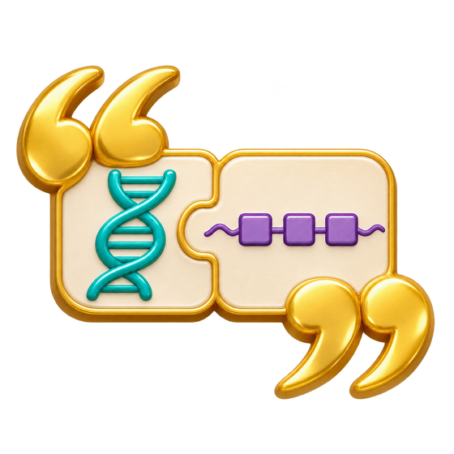
Finding evidence online
We located an HBB splice variant. Which study measured its effect?
Literature databases
AI-based discovery
Build efficient queries
Notes:
[On slide entry] Having explored how biological databases organise and connect information, we now turn to the scientific literature to understand how that information was obtained and what evidence supports it.
We have followed biological information from DNA to RNA and protein and seen how identifiers and cross-references connect records across resources. Those records bring together several kinds of information. A sequence may have been assembled from experimental reads, a domain assigned by computational analysis, and a statement about function added through curation. The publications linked to these records help us trace those statements back to the methods, observations and reasoning behind them.
Our human HBB example gives us a question to follow. A database record describes a variant that affects RNA splicing. We can locate the change, retrieve the surrounding sequence and see which transcript it overlaps. We then want to know how researchers established its effect. Did they measure RNA from patient-derived cells? Which forms of the transcript did they detect, and under what conditions? These questions guide our literature search.
[Click 1] One route begins in a literature database.
[Click 2] AI-based discovery offers another starting point, especially when we are unfamiliar with the terminology.
[Click 3] We translate the biological question into search concepts, then choose terms that authors and indexers might have used. The official gene symbol, a protein name and an older name for the variant may all lead us to relevant work. Combining terms and using phrases helps shape the search. PubMed provides a convenient example for exploring these choices.
[Click 4] The results introduce another decision. A review may explain the field, while an original study may describe the experiment we need. Filtering helps us examine a manageable set of papers, and opening the full article lets us look beyond the abstract to the methods, figures and results. [Click 5] A useful paper can also give us better vocabulary. Its indexed subject headings may lead to related studies that our first query missed.
[Click 6] We can describe our question in ordinary language and ask for candidate studies, alternative terms or related questions. For HBB, this might help connect the current variant description to the historical name used in older publications. [Click 7] Each suggestion gives us a lead to investigate. We can match its title and identifier to the publication record, then examine the result supporting the proposed claim.
[Click 8] The final step brings us back to the importance of evidence throughout this lecture. An AI search may invent a citation, misrepresent a real study or overlook relevant papers. Even a convincing summary can leave out the experimental conditions that limit a finding. Whether we arrived through a database query, a cross-reference or an AI suggestion, we still need to ask what the researchers measured and how well that observation supports the claim we want to use.
Full article: https://pmc.ncbi.nlm.nih.gov/articles/PMC7555009/
Artwork generated with the built-in ImageGen tool. Eight transparent scientific illustrations show a scholarly database, two query tiles within gold quotation marks, an open paper and filter, subject headings linked to papers, a processor linked to papers, candidate articles, a checked figure, and a broken citation link.

Slide 210

Finding evidence online
We located an HBB splice variant. Which study measured its effect?
Literature databases
AI-based discovery
Build efficient queries
Filter and open papers
Notes:
[On slide entry] Having explored how biological databases organise and connect information, we now turn to the scientific literature to understand how that information was obtained and what evidence supports it.
We have followed biological information from DNA to RNA and protein and seen how identifiers and cross-references connect records across resources. Those records bring together several kinds of information. A sequence may have been assembled from experimental reads, a domain assigned by computational analysis, and a statement about function added through curation. The publications linked to these records help us trace those statements back to the methods, observations and reasoning behind them.
Our human HBB example gives us a question to follow. A database record describes a variant that affects RNA splicing. We can locate the change, retrieve the surrounding sequence and see which transcript it overlaps. We then want to know how researchers established its effect. Did they measure RNA from patient-derived cells? Which forms of the transcript did they detect, and under what conditions? These questions guide our literature search.
[Click 1] One route begins in a literature database.
[Click 2] AI-based discovery offers another starting point, especially when we are unfamiliar with the terminology.
[Click 3] We translate the biological question into search concepts, then choose terms that authors and indexers might have used. The official gene symbol, a protein name and an older name for the variant may all lead us to relevant work. Combining terms and using phrases helps shape the search. PubMed provides a convenient example for exploring these choices.
[Click 4] The results introduce another decision. A review may explain the field, while an original study may describe the experiment we need. Filtering helps us examine a manageable set of papers, and opening the full article lets us look beyond the abstract to the methods, figures and results. [Click 5] A useful paper can also give us better vocabulary. Its indexed subject headings may lead to related studies that our first query missed.
[Click 6] We can describe our question in ordinary language and ask for candidate studies, alternative terms or related questions. For HBB, this might help connect the current variant description to the historical name used in older publications. [Click 7] Each suggestion gives us a lead to investigate. We can match its title and identifier to the publication record, then examine the result supporting the proposed claim.
[Click 8] The final step brings us back to the importance of evidence throughout this lecture. An AI search may invent a citation, misrepresent a real study or overlook relevant papers. Even a convincing summary can leave out the experimental conditions that limit a finding. Whether we arrived through a database query, a cross-reference or an AI suggestion, we still need to ask what the researchers measured and how well that observation supports the claim we want to use.
Full article: https://pmc.ncbi.nlm.nih.gov/articles/PMC7555009/
Artwork generated with the built-in ImageGen tool. Eight transparent scientific illustrations show a scholarly database, two query tiles within gold quotation marks, an open paper and filter, subject headings linked to papers, a processor linked to papers, candidate articles, a checked figure, and a broken citation link.

Slide 211

Finding evidence online
We located an HBB splice variant. Which study measured its effect?
Literature databases
AI-based discovery
Build efficient queries
Filter and open papers
Follow subject headings
Notes:
[On slide entry] Having explored how biological databases organise and connect information, we now turn to the scientific literature to understand how that information was obtained and what evidence supports it.
We have followed biological information from DNA to RNA and protein and seen how identifiers and cross-references connect records across resources. Those records bring together several kinds of information. A sequence may have been assembled from experimental reads, a domain assigned by computational analysis, and a statement about function added through curation. The publications linked to these records help us trace those statements back to the methods, observations and reasoning behind them.
Our human HBB example gives us a question to follow. A database record describes a variant that affects RNA splicing. We can locate the change, retrieve the surrounding sequence and see which transcript it overlaps. We then want to know how researchers established its effect. Did they measure RNA from patient-derived cells? Which forms of the transcript did they detect, and under what conditions? These questions guide our literature search.
[Click 1] One route begins in a literature database.
[Click 2] AI-based discovery offers another starting point, especially when we are unfamiliar with the terminology.
[Click 3] We translate the biological question into search concepts, then choose terms that authors and indexers might have used. The official gene symbol, a protein name and an older name for the variant may all lead us to relevant work. Combining terms and using phrases helps shape the search. PubMed provides a convenient example for exploring these choices.
[Click 4] The results introduce another decision. A review may explain the field, while an original study may describe the experiment we need. Filtering helps us examine a manageable set of papers, and opening the full article lets us look beyond the abstract to the methods, figures and results. [Click 5] A useful paper can also give us better vocabulary. Its indexed subject headings may lead to related studies that our first query missed.
[Click 6] We can describe our question in ordinary language and ask for candidate studies, alternative terms or related questions. For HBB, this might help connect the current variant description to the historical name used in older publications. [Click 7] Each suggestion gives us a lead to investigate. We can match its title and identifier to the publication record, then examine the result supporting the proposed claim.
[Click 8] The final step brings us back to the importance of evidence throughout this lecture. An AI search may invent a citation, misrepresent a real study or overlook relevant papers. Even a convincing summary can leave out the experimental conditions that limit a finding. Whether we arrived through a database query, a cross-reference or an AI suggestion, we still need to ask what the researchers measured and how well that observation supports the claim we want to use.
Full article: https://pmc.ncbi.nlm.nih.gov/articles/PMC7555009/
Artwork generated with the built-in ImageGen tool. Eight transparent scientific illustrations show a scholarly database, two query tiles within gold quotation marks, an open paper and filter, subject headings linked to papers, a processor linked to papers, candidate articles, a checked figure, and a broken citation link.

Slide 212

Finding evidence online
We located an HBB splice variant. Which study measured its effect?
Literature databases
AI-based discovery
Build efficient queries
Find candidate studies
Filter and open papers
Follow subject headings
Notes:
[On slide entry] Having explored how biological databases organise and connect information, we now turn to the scientific literature to understand how that information was obtained and what evidence supports it.
We have followed biological information from DNA to RNA and protein and seen how identifiers and cross-references connect records across resources. Those records bring together several kinds of information. A sequence may have been assembled from experimental reads, a domain assigned by computational analysis, and a statement about function added through curation. The publications linked to these records help us trace those statements back to the methods, observations and reasoning behind them.
Our human HBB example gives us a question to follow. A database record describes a variant that affects RNA splicing. We can locate the change, retrieve the surrounding sequence and see which transcript it overlaps. We then want to know how researchers established its effect. Did they measure RNA from patient-derived cells? Which forms of the transcript did they detect, and under what conditions? These questions guide our literature search.
[Click 1] One route begins in a literature database.
[Click 2] AI-based discovery offers another starting point, especially when we are unfamiliar with the terminology.
[Click 3] We translate the biological question into search concepts, then choose terms that authors and indexers might have used. The official gene symbol, a protein name and an older name for the variant may all lead us to relevant work. Combining terms and using phrases helps shape the search. PubMed provides a convenient example for exploring these choices.
[Click 4] The results introduce another decision. A review may explain the field, while an original study may describe the experiment we need. Filtering helps us examine a manageable set of papers, and opening the full article lets us look beyond the abstract to the methods, figures and results. [Click 5] A useful paper can also give us better vocabulary. Its indexed subject headings may lead to related studies that our first query missed.
[Click 6] We can describe our question in ordinary language and ask for candidate studies, alternative terms or related questions. For HBB, this might help connect the current variant description to the historical name used in older publications. [Click 7] Each suggestion gives us a lead to investigate. We can match its title and identifier to the publication record, then examine the result supporting the proposed claim.
[Click 8] The final step brings us back to the importance of evidence throughout this lecture. An AI search may invent a citation, misrepresent a real study or overlook relevant papers. Even a convincing summary can leave out the experimental conditions that limit a finding. Whether we arrived through a database query, a cross-reference or an AI suggestion, we still need to ask what the researchers measured and how well that observation supports the claim we want to use.
Full article: https://pmc.ncbi.nlm.nih.gov/articles/PMC7555009/
Artwork generated with the built-in ImageGen tool. Eight transparent scientific illustrations show a scholarly database, two query tiles within gold quotation marks, an open paper and filter, subject headings linked to papers, a processor linked to papers, candidate articles, a checked figure, and a broken citation link.

Slide 213

Finding evidence online
We located an HBB splice variant. Which study measured its effect?
Literature databases
AI-based discovery
Build efficient queries
Find candidate studies
Filter and open papers
Check claims in the paper
Follow subject headings
Notes:
[On slide entry] Having explored how biological databases organise and connect information, we now turn to the scientific literature to understand how that information was obtained and what evidence supports it.
We have followed biological information from DNA to RNA and protein and seen how identifiers and cross-references connect records across resources. Those records bring together several kinds of information. A sequence may have been assembled from experimental reads, a domain assigned by computational analysis, and a statement about function added through curation. The publications linked to these records help us trace those statements back to the methods, observations and reasoning behind them.
Our human HBB example gives us a question to follow. A database record describes a variant that affects RNA splicing. We can locate the change, retrieve the surrounding sequence and see which transcript it overlaps. We then want to know how researchers established its effect. Did they measure RNA from patient-derived cells? Which forms of the transcript did they detect, and under what conditions? These questions guide our literature search.
[Click 1] One route begins in a literature database.
[Click 2] AI-based discovery offers another starting point, especially when we are unfamiliar with the terminology.
[Click 3] We translate the biological question into search concepts, then choose terms that authors and indexers might have used. The official gene symbol, a protein name and an older name for the variant may all lead us to relevant work. Combining terms and using phrases helps shape the search. PubMed provides a convenient example for exploring these choices.
[Click 4] The results introduce another decision. A review may explain the field, while an original study may describe the experiment we need. Filtering helps us examine a manageable set of papers, and opening the full article lets us look beyond the abstract to the methods, figures and results. [Click 5] A useful paper can also give us better vocabulary. Its indexed subject headings may lead to related studies that our first query missed.
[Click 6] We can describe our question in ordinary language and ask for candidate studies, alternative terms or related questions. For HBB, this might help connect the current variant description to the historical name used in older publications. [Click 7] Each suggestion gives us a lead to investigate. We can match its title and identifier to the publication record, then examine the result supporting the proposed claim.
[Click 8] The final step brings us back to the importance of evidence throughout this lecture. An AI search may invent a citation, misrepresent a real study or overlook relevant papers. Even a convincing summary can leave out the experimental conditions that limit a finding. Whether we arrived through a database query, a cross-reference or an AI suggestion, we still need to ask what the researchers measured and how well that observation supports the claim we want to use.
Full article: https://pmc.ncbi.nlm.nih.gov/articles/PMC7555009/
Artwork generated with the built-in ImageGen tool. Eight transparent scientific illustrations show a scholarly database, two query tiles within gold quotation marks, an open paper and filter, subject headings linked to papers, a processor linked to papers, candidate articles, a checked figure, and a broken citation link.

Slide 214

Finding evidence online
We located an HBB splice variant. Which study measured its effect?
Literature databases
AI-based discovery
Build efficient queries
Find candidate studies
Filter and open papers
Check claims in the paper
Follow subject headings
Spot AI search pitfalls
Notes:
[On slide entry] Having explored how biological databases organise and connect information, we now turn to the scientific literature to understand how that information was obtained and what evidence supports it.
We have followed biological information from DNA to RNA and protein and seen how identifiers and cross-references connect records across resources. Those records bring together several kinds of information. A sequence may have been assembled from experimental reads, a domain assigned by computational analysis, and a statement about function added through curation. The publications linked to these records help us trace those statements back to the methods, observations and reasoning behind them.
Our human HBB example gives us a question to follow. A database record describes a variant that affects RNA splicing. We can locate the change, retrieve the surrounding sequence and see which transcript it overlaps. We then want to know how researchers established its effect. Did they measure RNA from patient-derived cells? Which forms of the transcript did they detect, and under what conditions? These questions guide our literature search.
[Click 1] One route begins in a literature database.
[Click 2] AI-based discovery offers another starting point, especially when we are unfamiliar with the terminology.
[Click 3] We translate the biological question into search concepts, then choose terms that authors and indexers might have used. The official gene symbol, a protein name and an older name for the variant may all lead us to relevant work. Combining terms and using phrases helps shape the search. PubMed provides a convenient example for exploring these choices.
[Click 4] The results introduce another decision. A review may explain the field, while an original study may describe the experiment we need. Filtering helps us examine a manageable set of papers, and opening the full article lets us look beyond the abstract to the methods, figures and results. [Click 5] A useful paper can also give us better vocabulary. Its indexed subject headings may lead to related studies that our first query missed.
[Click 6] We can describe our question in ordinary language and ask for candidate studies, alternative terms or related questions. For HBB, this might help connect the current variant description to the historical name used in older publications. [Click 7] Each suggestion gives us a lead to investigate. We can match its title and identifier to the publication record, then examine the result supporting the proposed claim.
[Click 8] The final step brings us back to the importance of evidence throughout this lecture. An AI search may invent a citation, misrepresent a real study or overlook relevant papers. Even a convincing summary can leave out the experimental conditions that limit a finding. Whether we arrived through a database query, a cross-reference or an AI suggestion, we still need to ask what the researchers measured and how well that observation supports the claim we want to use.
Full article: https://pmc.ncbi.nlm.nih.gov/articles/PMC7555009/
Artwork generated with the built-in ImageGen tool. Eight transparent scientific illustrations show a scholarly database, two query tiles within gold quotation marks, an open paper and filter, subject headings linked to papers, a processor linked to papers, candidate articles, a checked figure, and a broken citation link.

Slide 215
X
Y
X
Y
X
Y
Notes:
[On slide entry] A literature search begins with the biological concepts in the question. [Click 1] Logical operators determine how we combine the sets of records that match those concepts. Here the terms are entered as shown, without field tags or additional filters, so PubMed uses its default interpretation.
[Click 2] The X and Y columns report the complete individual searches. Cyan and yellow distinguish their sets in the diagrams. Their totals include shared records. Pink identifies the records retained by the combined search. The ellipses are schematic and do not represent the relative numbers of PubMed records.
AND keeps the overlap. Searching HBB returns 2,899 records and searching review returns 5,111,910. Combining them with AND gives 241 records matching both. At this stage review is a search term, rather than a guarantee that every result is a review article. The next slide will make that distinction explicit.
[Click 3] OR helps collect alternative wording. HBB and the phrase beta-globin give 2,899 and 8,884 records separately, while their union contains 11,067 distinct records. A record matching both appears once. Names and symbols help broaden a search, although beta-globin can also retrieve research from other species.
[Click 4] NOT removes the overlap from the first search. HBB AND thalassemia gives 939 records. Of these, 76 also match review. Excluding them leaves 863 records. The total number matching review is much larger, but only the shared records can be removed from the starting set. This exclusion does not guarantee that every remaining record reports original research.
The numbers depend on how PubMed interprets the terms. We have first isolated the Boolean operations. We can now ask where a term should match, or whether we want a particular kind of article. Counts were retrieved on 11 November 2026 without additional filters.
HBB (2,899 records)
https://pubmed.ncbi.nlm.nih.gov/?term=HBB
review (5,111,910 records)
https://pubmed.ncbi.nlm.nih.gov/?term=review
HBB AND review (241 records)
https://pubmed.ncbi.nlm.nih.gov/?term=HBB%20AND%20review
"beta-globin" (8,884 records)
https://pubmed.ncbi.nlm.nih.gov/?term=%22beta-globin%22
HBB OR "beta-globin" (11,067 records)
https://pubmed.ncbi.nlm.nih.gov/?term=HBB%20OR%20%22beta-globin%22
HBB AND thalassemia (939 records)
https://pubmed.ncbi.nlm.nih.gov/?term=HBB%20AND%20thalassemia
(HBB AND thalassemia) AND review (76 records)
https://pubmed.ncbi.nlm.nih.gov/?term=%28HBB%20AND%20thalassemia%29%20AND%20review
(HBB AND thalassemia) NOT review (863 records)
https://pubmed.ncbi.nlm.nih.gov/?term=%28HBB%20AND%20thalassemia%29%20NOT%20review
PubMed search guide
https://pubmed.ncbi.nlm.nih.gov/help/#boolean-operators
https://pubmed.ncbi.nlm.nih.gov/help/#using-search-field-tags
https://pubmed.ncbi.nlm.nih.gov/help/#viewing-the-search-details

Slide 216
Building efficient queries
X
Y
X
Y
X
Y
Notes:
[On slide entry] A literature search begins with the biological concepts in the question. [Click 1] Logical operators determine how we combine the sets of records that match those concepts. Here the terms are entered as shown, without field tags or additional filters, so PubMed uses its default interpretation.
[Click 2] The X and Y columns report the complete individual searches. Cyan and yellow distinguish their sets in the diagrams. Their totals include shared records. Pink identifies the records retained by the combined search. The ellipses are schematic and do not represent the relative numbers of PubMed records.
AND keeps the overlap. Searching HBB returns 2,899 records and searching review returns 5,111,910. Combining them with AND gives 241 records matching both. At this stage review is a search term, rather than a guarantee that every result is a review article. The next slide will make that distinction explicit.
[Click 3] OR helps collect alternative wording. HBB and the phrase beta-globin give 2,899 and 8,884 records separately, while their union contains 11,067 distinct records. A record matching both appears once. Names and symbols help broaden a search, although beta-globin can also retrieve research from other species.
[Click 4] NOT removes the overlap from the first search. HBB AND thalassemia gives 939 records. Of these, 76 also match review. Excluding them leaves 863 records. The total number matching review is much larger, but only the shared records can be removed from the starting set. This exclusion does not guarantee that every remaining record reports original research.
The numbers depend on how PubMed interprets the terms. We have first isolated the Boolean operations. We can now ask where a term should match, or whether we want a particular kind of article. Counts were retrieved on 11 November 2026 without additional filters.
HBB (2,899 records)
https://pubmed.ncbi.nlm.nih.gov/?term=HBB
review (5,111,910 records)
https://pubmed.ncbi.nlm.nih.gov/?term=review
HBB AND review (241 records)
https://pubmed.ncbi.nlm.nih.gov/?term=HBB%20AND%20review
"beta-globin" (8,884 records)
https://pubmed.ncbi.nlm.nih.gov/?term=%22beta-globin%22
HBB OR "beta-globin" (11,067 records)
https://pubmed.ncbi.nlm.nih.gov/?term=HBB%20OR%20%22beta-globin%22
HBB AND thalassemia (939 records)
https://pubmed.ncbi.nlm.nih.gov/?term=HBB%20AND%20thalassemia
(HBB AND thalassemia) AND review (76 records)
https://pubmed.ncbi.nlm.nih.gov/?term=%28HBB%20AND%20thalassemia%29%20AND%20review
(HBB AND thalassemia) NOT review (863 records)
https://pubmed.ncbi.nlm.nih.gov/?term=%28HBB%20AND%20thalassemia%29%20NOT%20review
PubMed search guide
https://pubmed.ncbi.nlm.nih.gov/help/#boolean-operators
https://pubmed.ncbi.nlm.nih.gov/help/#using-search-field-tags
https://pubmed.ncbi.nlm.nih.gov/help/#viewing-the-search-details

Slide 217
Building efficient queries
Logical operators
Operator | Schematic matches | X query | Y query | PubMed hits for
 |  |  |  | X search | Y search | Combined
X
Y
X
Y
X
Y
Notes:
[On slide entry] A literature search begins with the biological concepts in the question. [Click 1] Logical operators determine how we combine the sets of records that match those concepts. Here the terms are entered as shown, without field tags or additional filters, so PubMed uses its default interpretation.
[Click 2] The X and Y columns report the complete individual searches. Cyan and yellow distinguish their sets in the diagrams. Their totals include shared records. Pink identifies the records retained by the combined search. The ellipses are schematic and do not represent the relative numbers of PubMed records.
AND keeps the overlap. Searching HBB returns 2,899 records and searching review returns 5,111,910. Combining them with AND gives 241 records matching both. At this stage review is a search term, rather than a guarantee that every result is a review article. The next slide will make that distinction explicit.
[Click 3] OR helps collect alternative wording. HBB and the phrase beta-globin give 2,899 and 8,884 records separately, while their union contains 11,067 distinct records. A record matching both appears once. Names and symbols help broaden a search, although beta-globin can also retrieve research from other species.
[Click 4] NOT removes the overlap from the first search. HBB AND thalassemia gives 939 records. Of these, 76 also match review. Excluding them leaves 863 records. The total number matching review is much larger, but only the shared records can be removed from the starting set. This exclusion does not guarantee that every remaining record reports original research.
The numbers depend on how PubMed interprets the terms. We have first isolated the Boolean operations. We can now ask where a term should match, or whether we want a particular kind of article. Counts were retrieved on 11 November 2026 without additional filters.
HBB (2,899 records)
https://pubmed.ncbi.nlm.nih.gov/?term=HBB
review (5,111,910 records)
https://pubmed.ncbi.nlm.nih.gov/?term=review
HBB AND review (241 records)
https://pubmed.ncbi.nlm.nih.gov/?term=HBB%20AND%20review
"beta-globin" (8,884 records)
https://pubmed.ncbi.nlm.nih.gov/?term=%22beta-globin%22
HBB OR "beta-globin" (11,067 records)
https://pubmed.ncbi.nlm.nih.gov/?term=HBB%20OR%20%22beta-globin%22
HBB AND thalassemia (939 records)
https://pubmed.ncbi.nlm.nih.gov/?term=HBB%20AND%20thalassemia
(HBB AND thalassemia) AND review (76 records)
https://pubmed.ncbi.nlm.nih.gov/?term=%28HBB%20AND%20thalassemia%29%20AND%20review
(HBB AND thalassemia) NOT review (863 records)
https://pubmed.ncbi.nlm.nih.gov/?term=%28HBB%20AND%20thalassemia%29%20NOT%20review
PubMed search guide
https://pubmed.ncbi.nlm.nih.gov/help/#boolean-operators
https://pubmed.ncbi.nlm.nih.gov/help/#using-search-field-tags
https://pubmed.ncbi.nlm.nih.gov/help/#viewing-the-search-details

Slide 218
Building efficient queries
Logical operators
Operator | Schematic matches | X query | Y query | PubMed hits for
 |  |  |  | X search | Y search | Combined
AND |  | HBB | review | 2,899 | 5,111,910 | 241
X
Y
X
Y
X
Y
Notes:
[On slide entry] A literature search begins with the biological concepts in the question. [Click 1] Logical operators determine how we combine the sets of records that match those concepts. Here the terms are entered as shown, without field tags or additional filters, so PubMed uses its default interpretation.
[Click 2] The X and Y columns report the complete individual searches. Cyan and yellow distinguish their sets in the diagrams. Their totals include shared records. Pink identifies the records retained by the combined search. The ellipses are schematic and do not represent the relative numbers of PubMed records.
AND keeps the overlap. Searching HBB returns 2,899 records and searching review returns 5,111,910. Combining them with AND gives 241 records matching both. At this stage review is a search term, rather than a guarantee that every result is a review article. The next slide will make that distinction explicit.
[Click 3] OR helps collect alternative wording. HBB and the phrase beta-globin give 2,899 and 8,884 records separately, while their union contains 11,067 distinct records. A record matching both appears once. Names and symbols help broaden a search, although beta-globin can also retrieve research from other species.
[Click 4] NOT removes the overlap from the first search. HBB AND thalassemia gives 939 records. Of these, 76 also match review. Excluding them leaves 863 records. The total number matching review is much larger, but only the shared records can be removed from the starting set. This exclusion does not guarantee that every remaining record reports original research.
The numbers depend on how PubMed interprets the terms. We have first isolated the Boolean operations. We can now ask where a term should match, or whether we want a particular kind of article. Counts were retrieved on 11 November 2026 without additional filters.
HBB (2,899 records)
https://pubmed.ncbi.nlm.nih.gov/?term=HBB
review (5,111,910 records)
https://pubmed.ncbi.nlm.nih.gov/?term=review
HBB AND review (241 records)
https://pubmed.ncbi.nlm.nih.gov/?term=HBB%20AND%20review
"beta-globin" (8,884 records)
https://pubmed.ncbi.nlm.nih.gov/?term=%22beta-globin%22
HBB OR "beta-globin" (11,067 records)
https://pubmed.ncbi.nlm.nih.gov/?term=HBB%20OR%20%22beta-globin%22
HBB AND thalassemia (939 records)
https://pubmed.ncbi.nlm.nih.gov/?term=HBB%20AND%20thalassemia
(HBB AND thalassemia) AND review (76 records)
https://pubmed.ncbi.nlm.nih.gov/?term=%28HBB%20AND%20thalassemia%29%20AND%20review
(HBB AND thalassemia) NOT review (863 records)
https://pubmed.ncbi.nlm.nih.gov/?term=%28HBB%20AND%20thalassemia%29%20NOT%20review
PubMed search guide
https://pubmed.ncbi.nlm.nih.gov/help/#boolean-operators
https://pubmed.ncbi.nlm.nih.gov/help/#using-search-field-tags
https://pubmed.ncbi.nlm.nih.gov/help/#viewing-the-search-details

Slide 219
Building efficient queries
Logical operators
Operator | Schematic matches | X query | Y query | PubMed hits for
 |  |  |  | X search | Y search | Combined
AND |  | HBB | review | 2,899 | 5,111,910 | 241
X
Y
OR |  | HBB | "beta-globin" | 2,899 | 8,884 | 11,067
X
Y
X
Y
Notes:
[On slide entry] A literature search begins with the biological concepts in the question. [Click 1] Logical operators determine how we combine the sets of records that match those concepts. Here the terms are entered as shown, without field tags or additional filters, so PubMed uses its default interpretation.
[Click 2] The X and Y columns report the complete individual searches. Cyan and yellow distinguish their sets in the diagrams. Their totals include shared records. Pink identifies the records retained by the combined search. The ellipses are schematic and do not represent the relative numbers of PubMed records.
AND keeps the overlap. Searching HBB returns 2,899 records and searching review returns 5,111,910. Combining them with AND gives 241 records matching both. At this stage review is a search term, rather than a guarantee that every result is a review article. The next slide will make that distinction explicit.
[Click 3] OR helps collect alternative wording. HBB and the phrase beta-globin give 2,899 and 8,884 records separately, while their union contains 11,067 distinct records. A record matching both appears once. Names and symbols help broaden a search, although beta-globin can also retrieve research from other species.
[Click 4] NOT removes the overlap from the first search. HBB AND thalassemia gives 939 records. Of these, 76 also match review. Excluding them leaves 863 records. The total number matching review is much larger, but only the shared records can be removed from the starting set. This exclusion does not guarantee that every remaining record reports original research.
The numbers depend on how PubMed interprets the terms. We have first isolated the Boolean operations. We can now ask where a term should match, or whether we want a particular kind of article. Counts were retrieved on 11 November 2026 without additional filters.
HBB (2,899 records)
https://pubmed.ncbi.nlm.nih.gov/?term=HBB
review (5,111,910 records)
https://pubmed.ncbi.nlm.nih.gov/?term=review
HBB AND review (241 records)
https://pubmed.ncbi.nlm.nih.gov/?term=HBB%20AND%20review
"beta-globin" (8,884 records)
https://pubmed.ncbi.nlm.nih.gov/?term=%22beta-globin%22
HBB OR "beta-globin" (11,067 records)
https://pubmed.ncbi.nlm.nih.gov/?term=HBB%20OR%20%22beta-globin%22
HBB AND thalassemia (939 records)
https://pubmed.ncbi.nlm.nih.gov/?term=HBB%20AND%20thalassemia
(HBB AND thalassemia) AND review (76 records)
https://pubmed.ncbi.nlm.nih.gov/?term=%28HBB%20AND%20thalassemia%29%20AND%20review
(HBB AND thalassemia) NOT review (863 records)
https://pubmed.ncbi.nlm.nih.gov/?term=%28HBB%20AND%20thalassemia%29%20NOT%20review
PubMed search guide
https://pubmed.ncbi.nlm.nih.gov/help/#boolean-operators
https://pubmed.ncbi.nlm.nih.gov/help/#using-search-field-tags
https://pubmed.ncbi.nlm.nih.gov/help/#viewing-the-search-details

Slide 220
Building efficient queries
Logical operators
Operator | Schematic matches | X query | Y query | PubMed hits for
 |  |  |  | X search | Y search | Combined
AND |  | HBB | review | 2,899 | 5,111,910 | 241
X
Y
OR |  | HBB | "beta-globin" | 2,899 | 8,884 | 11,067
X
Y
NOT |  | (HBB AND thalassemia) | review | 939 | 5,111,910 | 863
X
Y
PubMed counts: 11 Nov 2026
Notes:
[On slide entry] A literature search begins with the biological concepts in the question. [Click 1] Logical operators determine how we combine the sets of records that match those concepts. Here the terms are entered as shown, without field tags or additional filters, so PubMed uses its default interpretation.
[Click 2] The X and Y columns report the complete individual searches. Cyan and yellow distinguish their sets in the diagrams. Their totals include shared records. Pink identifies the records retained by the combined search. The ellipses are schematic and do not represent the relative numbers of PubMed records.
AND keeps the overlap. Searching HBB returns 2,899 records and searching review returns 5,111,910. Combining them with AND gives 241 records matching both. At this stage review is a search term, rather than a guarantee that every result is a review article. The next slide will make that distinction explicit.
[Click 3] OR helps collect alternative wording. HBB and the phrase beta-globin give 2,899 and 8,884 records separately, while their union contains 11,067 distinct records. A record matching both appears once. Names and symbols help broaden a search, although beta-globin can also retrieve research from other species.
[Click 4] NOT removes the overlap from the first search. HBB AND thalassemia gives 939 records. Of these, 76 also match review. Excluding them leaves 863 records. The total number matching review is much larger, but only the shared records can be removed from the starting set. This exclusion does not guarantee that every remaining record reports original research.
The numbers depend on how PubMed interprets the terms. We have first isolated the Boolean operations. We can now ask where a term should match, or whether we want a particular kind of article. Counts were retrieved on 11 November 2026 without additional filters.
HBB (2,899 records)
https://pubmed.ncbi.nlm.nih.gov/?term=HBB
review (5,111,910 records)
https://pubmed.ncbi.nlm.nih.gov/?term=review
HBB AND review (241 records)
https://pubmed.ncbi.nlm.nih.gov/?term=HBB%20AND%20review
"beta-globin" (8,884 records)
https://pubmed.ncbi.nlm.nih.gov/?term=%22beta-globin%22
HBB OR "beta-globin" (11,067 records)
https://pubmed.ncbi.nlm.nih.gov/?term=HBB%20OR%20%22beta-globin%22
HBB AND thalassemia (939 records)
https://pubmed.ncbi.nlm.nih.gov/?term=HBB%20AND%20thalassemia
(HBB AND thalassemia) AND review (76 records)
https://pubmed.ncbi.nlm.nih.gov/?term=%28HBB%20AND%20thalassemia%29%20AND%20review
(HBB AND thalassemia) NOT review (863 records)
https://pubmed.ncbi.nlm.nih.gov/?term=%28HBB%20AND%20thalassemia%29%20NOT%20review
PubMed search guide
https://pubmed.ncbi.nlm.nih.gov/help/#boolean-operators
https://pubmed.ncbi.nlm.nih.gov/help/#using-search-field-tags
https://pubmed.ncbi.nlm.nih.gov/help/#viewing-the-search-details

Slide 221
Building efficient queries
PubMed counts: 11 Nov 2026
Notes:
[On slide entry] The previous slide showed how to combine searches. We now specify the fields in which a term should match. An unrestricted PubMed search covers searchable citation information and may use automatic term mapping. It does not search the full text of every article.
[Click 1] For HBB, the default search gives 2,899 records. Adding [tiab] gives 2,701. This field is named Title/Abstract and also covers collection titles, other abstracts and author keywords. It limits where HBB must occur rather than selecting papers by their quality.
[Click 2] For review, the distinction concerns the kind of article. The default term gives 5,111,910 records because PubMed interprets it through several routes, including the Review publication type, a subject heading about reviews and matching words. Using review[pt] specifically selects the Review publication type and gives 4,100,845 records. Recently added records may not yet have all indexing information.
[Click 3] The same choices change the Boolean examples. The AND combination falls from 241 to 148 records. [Click 4] The OR combination changes from 11,067 to 10,869. The beta-globin input itself remains at 8,884 in these searches, so adding a field tag does not always change a count.
[Click 5] The NOT comparison needs particular care because both the initial set and the excluded set change. The unrestricted starting set has 939 records and excludes 76, leaving 863. The restricted starting set has 844 and excludes 53, leaving 791. Restricting the excluded set alone can restore records, so a NOT search does not follow a simple rule that every additional restriction must reduce the result.
A smaller result list is useful only if it better matches the biological question. Field tags can also change automatic term mapping. Search Details in Advanced Search reveals the actual interpretation. The exact query, search date and deliberate filters should be retained when the search needs to be reproducible. Counts were retrieved on 11 November 2026.
HBB[tiab] (2,701 records)
https://pubmed.ncbi.nlm.nih.gov/?term=HBB%5Btiab%5D
review[pt] (4,100,845 records)
https://pubmed.ncbi.nlm.nih.gov/?term=review%5Bpt%5D
HBB[tiab] AND review[pt] (148 records)
https://pubmed.ncbi.nlm.nih.gov/?term=HBB%5Btiab%5D%20AND%20review%5Bpt%5D
"beta-globin"[tiab] (8,884 records)
https://pubmed.ncbi.nlm.nih.gov/?term=%22beta-globin%22%5Btiab%5D
HBB[tiab] OR "beta-globin"[tiab] (10,869 records)
https://pubmed.ncbi.nlm.nih.gov/?term=HBB%5Btiab%5D%20OR%20%22beta-globin%22%5Btiab%5D
HBB[tiab] AND thalassemia[tiab] (844 records)
https://pubmed.ncbi.nlm.nih.gov/?term=HBB%5Btiab%5D%20AND%20thalassemia%5Btiab%5D
(HBB[tiab] AND thalassemia[tiab]) AND review[pt] (53 records)
https://pubmed.ncbi.nlm.nih.gov/?term=%28HBB%5Btiab%5D%20AND%20thalassemia%5Btiab%5D%29%20AND%20review%5Bpt%5D
(HBB[tiab] AND thalassemia[tiab]) NOT review[pt] (791 records)
https://pubmed.ncbi.nlm.nih.gov/?term=%28HBB%5Btiab%5D%20AND%20thalassemia%5Btiab%5D%29%20NOT%20review%5Bpt%5D
PubMed search guide
https://pubmed.ncbi.nlm.nih.gov/help/#boolean-operators
https://pubmed.ncbi.nlm.nih.gov/help/#using-search-field-tags
https://pubmed.ncbi.nlm.nih.gov/help/#viewing-the-search-details

Slide 222
Building efficient queries
Restricting search space
Example | Unrestricted query | Hits | Restricted query | Hits
PubMed counts: 11 Nov 2026
Notes:
[On slide entry] The previous slide showed how to combine searches. We now specify the fields in which a term should match. An unrestricted PubMed search covers searchable citation information and may use automatic term mapping. It does not search the full text of every article.
[Click 1] For HBB, the default search gives 2,899 records. Adding [tiab] gives 2,701. This field is named Title/Abstract and also covers collection titles, other abstracts and author keywords. It limits where HBB must occur rather than selecting papers by their quality.
[Click 2] For review, the distinction concerns the kind of article. The default term gives 5,111,910 records because PubMed interprets it through several routes, including the Review publication type, a subject heading about reviews and matching words. Using review[pt] specifically selects the Review publication type and gives 4,100,845 records. Recently added records may not yet have all indexing information.
[Click 3] The same choices change the Boolean examples. The AND combination falls from 241 to 148 records. [Click 4] The OR combination changes from 11,067 to 10,869. The beta-globin input itself remains at 8,884 in these searches, so adding a field tag does not always change a count.
[Click 5] The NOT comparison needs particular care because both the initial set and the excluded set change. The unrestricted starting set has 939 records and excludes 76, leaving 863. The restricted starting set has 844 and excludes 53, leaving 791. Restricting the excluded set alone can restore records, so a NOT search does not follow a simple rule that every additional restriction must reduce the result.
A smaller result list is useful only if it better matches the biological question. Field tags can also change automatic term mapping. Search Details in Advanced Search reveals the actual interpretation. The exact query, search date and deliberate filters should be retained when the search needs to be reproducible. Counts were retrieved on 11 November 2026.
HBB[tiab] (2,701 records)
https://pubmed.ncbi.nlm.nih.gov/?term=HBB%5Btiab%5D
review[pt] (4,100,845 records)
https://pubmed.ncbi.nlm.nih.gov/?term=review%5Bpt%5D
HBB[tiab] AND review[pt] (148 records)
https://pubmed.ncbi.nlm.nih.gov/?term=HBB%5Btiab%5D%20AND%20review%5Bpt%5D
"beta-globin"[tiab] (8,884 records)
https://pubmed.ncbi.nlm.nih.gov/?term=%22beta-globin%22%5Btiab%5D
HBB[tiab] OR "beta-globin"[tiab] (10,869 records)
https://pubmed.ncbi.nlm.nih.gov/?term=HBB%5Btiab%5D%20OR%20%22beta-globin%22%5Btiab%5D
HBB[tiab] AND thalassemia[tiab] (844 records)
https://pubmed.ncbi.nlm.nih.gov/?term=HBB%5Btiab%5D%20AND%20thalassemia%5Btiab%5D
(HBB[tiab] AND thalassemia[tiab]) AND review[pt] (53 records)
https://pubmed.ncbi.nlm.nih.gov/?term=%28HBB%5Btiab%5D%20AND%20thalassemia%5Btiab%5D%29%20AND%20review%5Bpt%5D
(HBB[tiab] AND thalassemia[tiab]) NOT review[pt] (791 records)
https://pubmed.ncbi.nlm.nih.gov/?term=%28HBB%5Btiab%5D%20AND%20thalassemia%5Btiab%5D%29%20NOT%20review%5Bpt%5D
PubMed search guide
https://pubmed.ncbi.nlm.nih.gov/help/#boolean-operators
https://pubmed.ncbi.nlm.nih.gov/help/#using-search-field-tags
https://pubmed.ncbi.nlm.nih.gov/help/#viewing-the-search-details

Slide 223
Building efficient queries
Restricting search space
Example | Unrestricted query | Hits | Restricted query | Hits
Gene | HBB | 2,899 | HBB[tiab] | 2,701
[tiab] Title, abstract and author keywords
[pt] Publication type
PubMed counts: 11 Nov 2026
Notes:
[On slide entry] The previous slide showed how to combine searches. We now specify the fields in which a term should match. An unrestricted PubMed search covers searchable citation information and may use automatic term mapping. It does not search the full text of every article.
[Click 1] For HBB, the default search gives 2,899 records. Adding [tiab] gives 2,701. This field is named Title/Abstract and also covers collection titles, other abstracts and author keywords. It limits where HBB must occur rather than selecting papers by their quality.
[Click 2] For review, the distinction concerns the kind of article. The default term gives 5,111,910 records because PubMed interprets it through several routes, including the Review publication type, a subject heading about reviews and matching words. Using review[pt] specifically selects the Review publication type and gives 4,100,845 records. Recently added records may not yet have all indexing information.
[Click 3] The same choices change the Boolean examples. The AND combination falls from 241 to 148 records. [Click 4] The OR combination changes from 11,067 to 10,869. The beta-globin input itself remains at 8,884 in these searches, so adding a field tag does not always change a count.
[Click 5] The NOT comparison needs particular care because both the initial set and the excluded set change. The unrestricted starting set has 939 records and excludes 76, leaving 863. The restricted starting set has 844 and excludes 53, leaving 791. Restricting the excluded set alone can restore records, so a NOT search does not follow a simple rule that every additional restriction must reduce the result.
A smaller result list is useful only if it better matches the biological question. Field tags can also change automatic term mapping. Search Details in Advanced Search reveals the actual interpretation. The exact query, search date and deliberate filters should be retained when the search needs to be reproducible. Counts were retrieved on 11 November 2026.
HBB[tiab] (2,701 records)
https://pubmed.ncbi.nlm.nih.gov/?term=HBB%5Btiab%5D
review[pt] (4,100,845 records)
https://pubmed.ncbi.nlm.nih.gov/?term=review%5Bpt%5D
HBB[tiab] AND review[pt] (148 records)
https://pubmed.ncbi.nlm.nih.gov/?term=HBB%5Btiab%5D%20AND%20review%5Bpt%5D
"beta-globin"[tiab] (8,884 records)
https://pubmed.ncbi.nlm.nih.gov/?term=%22beta-globin%22%5Btiab%5D
HBB[tiab] OR "beta-globin"[tiab] (10,869 records)
https://pubmed.ncbi.nlm.nih.gov/?term=HBB%5Btiab%5D%20OR%20%22beta-globin%22%5Btiab%5D
HBB[tiab] AND thalassemia[tiab] (844 records)
https://pubmed.ncbi.nlm.nih.gov/?term=HBB%5Btiab%5D%20AND%20thalassemia%5Btiab%5D
(HBB[tiab] AND thalassemia[tiab]) AND review[pt] (53 records)
https://pubmed.ncbi.nlm.nih.gov/?term=%28HBB%5Btiab%5D%20AND%20thalassemia%5Btiab%5D%29%20AND%20review%5Bpt%5D
(HBB[tiab] AND thalassemia[tiab]) NOT review[pt] (791 records)
https://pubmed.ncbi.nlm.nih.gov/?term=%28HBB%5Btiab%5D%20AND%20thalassemia%5Btiab%5D%29%20NOT%20review%5Bpt%5D
PubMed search guide
https://pubmed.ncbi.nlm.nih.gov/help/#boolean-operators
https://pubmed.ncbi.nlm.nih.gov/help/#using-search-field-tags
https://pubmed.ncbi.nlm.nih.gov/help/#viewing-the-search-details

Slide 224
Building efficient queries
Restricting search space
Example | Unrestricted query | Hits | Restricted query | Hits
Gene | HBB | 2,899 | HBB[tiab] | 2,701
Article type | review | 5,111,910 | review[pt] | 4,100,845
[tiab] Title, abstract and author keywords
[pt] Publication type
PubMed counts: 11 Nov 2026
Notes:
[On slide entry] The previous slide showed how to combine searches. We now specify the fields in which a term should match. An unrestricted PubMed search covers searchable citation information and may use automatic term mapping. It does not search the full text of every article.
[Click 1] For HBB, the default search gives 2,899 records. Adding [tiab] gives 2,701. This field is named Title/Abstract and also covers collection titles, other abstracts and author keywords. It limits where HBB must occur rather than selecting papers by their quality.
[Click 2] For review, the distinction concerns the kind of article. The default term gives 5,111,910 records because PubMed interprets it through several routes, including the Review publication type, a subject heading about reviews and matching words. Using review[pt] specifically selects the Review publication type and gives 4,100,845 records. Recently added records may not yet have all indexing information.
[Click 3] The same choices change the Boolean examples. The AND combination falls from 241 to 148 records. [Click 4] The OR combination changes from 11,067 to 10,869. The beta-globin input itself remains at 8,884 in these searches, so adding a field tag does not always change a count.
[Click 5] The NOT comparison needs particular care because both the initial set and the excluded set change. The unrestricted starting set has 939 records and excludes 76, leaving 863. The restricted starting set has 844 and excludes 53, leaving 791. Restricting the excluded set alone can restore records, so a NOT search does not follow a simple rule that every additional restriction must reduce the result.
A smaller result list is useful only if it better matches the biological question. Field tags can also change automatic term mapping. Search Details in Advanced Search reveals the actual interpretation. The exact query, search date and deliberate filters should be retained when the search needs to be reproducible. Counts were retrieved on 11 November 2026.
HBB[tiab] (2,701 records)
https://pubmed.ncbi.nlm.nih.gov/?term=HBB%5Btiab%5D
review[pt] (4,100,845 records)
https://pubmed.ncbi.nlm.nih.gov/?term=review%5Bpt%5D
HBB[tiab] AND review[pt] (148 records)
https://pubmed.ncbi.nlm.nih.gov/?term=HBB%5Btiab%5D%20AND%20review%5Bpt%5D
"beta-globin"[tiab] (8,884 records)
https://pubmed.ncbi.nlm.nih.gov/?term=%22beta-globin%22%5Btiab%5D
HBB[tiab] OR "beta-globin"[tiab] (10,869 records)
https://pubmed.ncbi.nlm.nih.gov/?term=HBB%5Btiab%5D%20OR%20%22beta-globin%22%5Btiab%5D
HBB[tiab] AND thalassemia[tiab] (844 records)
https://pubmed.ncbi.nlm.nih.gov/?term=HBB%5Btiab%5D%20AND%20thalassemia%5Btiab%5D
(HBB[tiab] AND thalassemia[tiab]) AND review[pt] (53 records)
https://pubmed.ncbi.nlm.nih.gov/?term=%28HBB%5Btiab%5D%20AND%20thalassemia%5Btiab%5D%29%20AND%20review%5Bpt%5D
(HBB[tiab] AND thalassemia[tiab]) NOT review[pt] (791 records)
https://pubmed.ncbi.nlm.nih.gov/?term=%28HBB%5Btiab%5D%20AND%20thalassemia%5Btiab%5D%29%20NOT%20review%5Bpt%5D
PubMed search guide
https://pubmed.ncbi.nlm.nih.gov/help/#boolean-operators
https://pubmed.ncbi.nlm.nih.gov/help/#using-search-field-tags
https://pubmed.ncbi.nlm.nih.gov/help/#viewing-the-search-details

Slide 225
Building efficient queries
Restricting search space
Example | Unrestricted query | Hits | Restricted query | Hits
Gene | HBB | 2,899 | HBB[tiab] | 2,701
Article type | review | 5,111,910 | review[pt] | 4,100,845
AND | HBB AND review | 241 | HBB[tiab] AND review[pt] | 148
[tiab] Title, abstract and author keywords
[pt] Publication type
PubMed counts: 11 Nov 2026
Notes:
[On slide entry] The previous slide showed how to combine searches. We now specify the fields in which a term should match. An unrestricted PubMed search covers searchable citation information and may use automatic term mapping. It does not search the full text of every article.
[Click 1] For HBB, the default search gives 2,899 records. Adding [tiab] gives 2,701. This field is named Title/Abstract and also covers collection titles, other abstracts and author keywords. It limits where HBB must occur rather than selecting papers by their quality.
[Click 2] For review, the distinction concerns the kind of article. The default term gives 5,111,910 records because PubMed interprets it through several routes, including the Review publication type, a subject heading about reviews and matching words. Using review[pt] specifically selects the Review publication type and gives 4,100,845 records. Recently added records may not yet have all indexing information.
[Click 3] The same choices change the Boolean examples. The AND combination falls from 241 to 148 records. [Click 4] The OR combination changes from 11,067 to 10,869. The beta-globin input itself remains at 8,884 in these searches, so adding a field tag does not always change a count.
[Click 5] The NOT comparison needs particular care because both the initial set and the excluded set change. The unrestricted starting set has 939 records and excludes 76, leaving 863. The restricted starting set has 844 and excludes 53, leaving 791. Restricting the excluded set alone can restore records, so a NOT search does not follow a simple rule that every additional restriction must reduce the result.
A smaller result list is useful only if it better matches the biological question. Field tags can also change automatic term mapping. Search Details in Advanced Search reveals the actual interpretation. The exact query, search date and deliberate filters should be retained when the search needs to be reproducible. Counts were retrieved on 11 November 2026.
HBB[tiab] (2,701 records)
https://pubmed.ncbi.nlm.nih.gov/?term=HBB%5Btiab%5D
review[pt] (4,100,845 records)
https://pubmed.ncbi.nlm.nih.gov/?term=review%5Bpt%5D
HBB[tiab] AND review[pt] (148 records)
https://pubmed.ncbi.nlm.nih.gov/?term=HBB%5Btiab%5D%20AND%20review%5Bpt%5D
"beta-globin"[tiab] (8,884 records)
https://pubmed.ncbi.nlm.nih.gov/?term=%22beta-globin%22%5Btiab%5D
HBB[tiab] OR "beta-globin"[tiab] (10,869 records)
https://pubmed.ncbi.nlm.nih.gov/?term=HBB%5Btiab%5D%20OR%20%22beta-globin%22%5Btiab%5D
HBB[tiab] AND thalassemia[tiab] (844 records)
https://pubmed.ncbi.nlm.nih.gov/?term=HBB%5Btiab%5D%20AND%20thalassemia%5Btiab%5D
(HBB[tiab] AND thalassemia[tiab]) AND review[pt] (53 records)
https://pubmed.ncbi.nlm.nih.gov/?term=%28HBB%5Btiab%5D%20AND%20thalassemia%5Btiab%5D%29%20AND%20review%5Bpt%5D
(HBB[tiab] AND thalassemia[tiab]) NOT review[pt] (791 records)
https://pubmed.ncbi.nlm.nih.gov/?term=%28HBB%5Btiab%5D%20AND%20thalassemia%5Btiab%5D%29%20NOT%20review%5Bpt%5D
PubMed search guide
https://pubmed.ncbi.nlm.nih.gov/help/#boolean-operators
https://pubmed.ncbi.nlm.nih.gov/help/#using-search-field-tags
https://pubmed.ncbi.nlm.nih.gov/help/#viewing-the-search-details

Slide 226
Building efficient queries
Restricting search space
Example | Unrestricted query | Hits | Restricted query | Hits
Gene | HBB | 2,899 | HBB[tiab] | 2,701
Article type | review | 5,111,910 | review[pt] | 4,100,845
AND | HBB AND review | 241 | HBB[tiab] AND review[pt] | 148
OR | HBB OR "beta-globin" | 11,067 | HBB[tiab] OR "beta-globin"[tiab] | 10,869
[tiab] Title, abstract and author keywords
[pt] Publication type
PubMed counts: 11 Nov 2026
Notes:
[On slide entry] The previous slide showed how to combine searches. We now specify the fields in which a term should match. An unrestricted PubMed search covers searchable citation information and may use automatic term mapping. It does not search the full text of every article.
[Click 1] For HBB, the default search gives 2,899 records. Adding [tiab] gives 2,701. This field is named Title/Abstract and also covers collection titles, other abstracts and author keywords. It limits where HBB must occur rather than selecting papers by their quality.
[Click 2] For review, the distinction concerns the kind of article. The default term gives 5,111,910 records because PubMed interprets it through several routes, including the Review publication type, a subject heading about reviews and matching words. Using review[pt] specifically selects the Review publication type and gives 4,100,845 records. Recently added records may not yet have all indexing information.
[Click 3] The same choices change the Boolean examples. The AND combination falls from 241 to 148 records. [Click 4] The OR combination changes from 11,067 to 10,869. The beta-globin input itself remains at 8,884 in these searches, so adding a field tag does not always change a count.
[Click 5] The NOT comparison needs particular care because both the initial set and the excluded set change. The unrestricted starting set has 939 records and excludes 76, leaving 863. The restricted starting set has 844 and excludes 53, leaving 791. Restricting the excluded set alone can restore records, so a NOT search does not follow a simple rule that every additional restriction must reduce the result.
A smaller result list is useful only if it better matches the biological question. Field tags can also change automatic term mapping. Search Details in Advanced Search reveals the actual interpretation. The exact query, search date and deliberate filters should be retained when the search needs to be reproducible. Counts were retrieved on 11 November 2026.
HBB[tiab] (2,701 records)
https://pubmed.ncbi.nlm.nih.gov/?term=HBB%5Btiab%5D
review[pt] (4,100,845 records)
https://pubmed.ncbi.nlm.nih.gov/?term=review%5Bpt%5D
HBB[tiab] AND review[pt] (148 records)
https://pubmed.ncbi.nlm.nih.gov/?term=HBB%5Btiab%5D%20AND%20review%5Bpt%5D
"beta-globin"[tiab] (8,884 records)
https://pubmed.ncbi.nlm.nih.gov/?term=%22beta-globin%22%5Btiab%5D
HBB[tiab] OR "beta-globin"[tiab] (10,869 records)
https://pubmed.ncbi.nlm.nih.gov/?term=HBB%5Btiab%5D%20OR%20%22beta-globin%22%5Btiab%5D
HBB[tiab] AND thalassemia[tiab] (844 records)
https://pubmed.ncbi.nlm.nih.gov/?term=HBB%5Btiab%5D%20AND%20thalassemia%5Btiab%5D
(HBB[tiab] AND thalassemia[tiab]) AND review[pt] (53 records)
https://pubmed.ncbi.nlm.nih.gov/?term=%28HBB%5Btiab%5D%20AND%20thalassemia%5Btiab%5D%29%20AND%20review%5Bpt%5D
(HBB[tiab] AND thalassemia[tiab]) NOT review[pt] (791 records)
https://pubmed.ncbi.nlm.nih.gov/?term=%28HBB%5Btiab%5D%20AND%20thalassemia%5Btiab%5D%29%20NOT%20review%5Bpt%5D
PubMed search guide
https://pubmed.ncbi.nlm.nih.gov/help/#boolean-operators
https://pubmed.ncbi.nlm.nih.gov/help/#using-search-field-tags
https://pubmed.ncbi.nlm.nih.gov/help/#viewing-the-search-details

Slide 227
Building efficient queries
Restricting search space
Example | Unrestricted query | Hits | Restricted query | Hits
Gene | HBB | 2,899 | HBB[tiab] | 2,701
Article type | review | 5,111,910 | review[pt] | 4,100,845
AND | HBB AND review | 241 | HBB[tiab] AND review[pt] | 148
OR | HBB OR "beta-globin" | 11,067 | HBB[tiab] OR "beta-globin"[tiab] | 10,869
NOT | (HBB AND thalassemia) NOT review | 863 | (HBB[tiab] AND thalassemia[tiab]) NOT review[pt] | 791
[tiab] Title, abstract and author keywords
[pt] Publication type
PubMed counts: 11 Nov 2026
Notes:
[On slide entry] The previous slide showed how to combine searches. We now specify the fields in which a term should match. An unrestricted PubMed search covers searchable citation information and may use automatic term mapping. It does not search the full text of every article.
[Click 1] For HBB, the default search gives 2,899 records. Adding [tiab] gives 2,701. This field is named Title/Abstract and also covers collection titles, other abstracts and author keywords. It limits where HBB must occur rather than selecting papers by their quality.
[Click 2] For review, the distinction concerns the kind of article. The default term gives 5,111,910 records because PubMed interprets it through several routes, including the Review publication type, a subject heading about reviews and matching words. Using review[pt] specifically selects the Review publication type and gives 4,100,845 records. Recently added records may not yet have all indexing information.
[Click 3] The same choices change the Boolean examples. The AND combination falls from 241 to 148 records. [Click 4] The OR combination changes from 11,067 to 10,869. The beta-globin input itself remains at 8,884 in these searches, so adding a field tag does not always change a count.
[Click 5] The NOT comparison needs particular care because both the initial set and the excluded set change. The unrestricted starting set has 939 records and excludes 76, leaving 863. The restricted starting set has 844 and excludes 53, leaving 791. Restricting the excluded set alone can restore records, so a NOT search does not follow a simple rule that every additional restriction must reduce the result.
A smaller result list is useful only if it better matches the biological question. Field tags can also change automatic term mapping. Search Details in Advanced Search reveals the actual interpretation. The exact query, search date and deliberate filters should be retained when the search needs to be reproducible. Counts were retrieved on 11 November 2026.
HBB[tiab] (2,701 records)
https://pubmed.ncbi.nlm.nih.gov/?term=HBB%5Btiab%5D
review[pt] (4,100,845 records)
https://pubmed.ncbi.nlm.nih.gov/?term=review%5Bpt%5D
HBB[tiab] AND review[pt] (148 records)
https://pubmed.ncbi.nlm.nih.gov/?term=HBB%5Btiab%5D%20AND%20review%5Bpt%5D
"beta-globin"[tiab] (8,884 records)
https://pubmed.ncbi.nlm.nih.gov/?term=%22beta-globin%22%5Btiab%5D
HBB[tiab] OR "beta-globin"[tiab] (10,869 records)
https://pubmed.ncbi.nlm.nih.gov/?term=HBB%5Btiab%5D%20OR%20%22beta-globin%22%5Btiab%5D
HBB[tiab] AND thalassemia[tiab] (844 records)
https://pubmed.ncbi.nlm.nih.gov/?term=HBB%5Btiab%5D%20AND%20thalassemia%5Btiab%5D
(HBB[tiab] AND thalassemia[tiab]) AND review[pt] (53 records)
https://pubmed.ncbi.nlm.nih.gov/?term=%28HBB%5Btiab%5D%20AND%20thalassemia%5Btiab%5D%29%20AND%20review%5Bpt%5D
(HBB[tiab] AND thalassemia[tiab]) NOT review[pt] (791 records)
https://pubmed.ncbi.nlm.nih.gov/?term=%28HBB%5Btiab%5D%20AND%20thalassemia%5Btiab%5D%29%20NOT%20review%5Bpt%5D
PubMed search guide
https://pubmed.ncbi.nlm.nih.gov/help/#boolean-operators
https://pubmed.ncbi.nlm.nih.gov/help/#using-search-field-tags
https://pubmed.ncbi.nlm.nih.gov/help/#viewing-the-search-details

Slide 228

Query
beta
globin
AND
other text
beta
globin
other text
beta
globin
other text
beta
other text
beta AND globin
other text
globin
other text
beta
beta
24,779 PubMed records
other text
globin
other text
beta
other text
beta
globin
other text
beta
globin
other text
“
”
beta
globin
other text
beta
"beta globin"
8,885 PubMed records
Notes:
[On slide entry] Logical operators combine separate search concepts. Quotation marks ask for an ordered phrase. Here both searches use only beta and globin, the two words shown throughout the coloured strips. HBB encodes beta-globin, so this example continues our biological theme. The searches are not limited to the human HBB gene and can include related globin research from other organisms.
[Click 1] The upper query, beta AND globin, treats the two terms as separate concepts. [Click 2] The green and gold pieces show that words may be adjacent, repeated, reversed or separated by other text. Pink means other searchable text. These are schematic illustrations, not excerpts from actual papers. In a real PubMed search, Automatic Term Mapping also expands unquoted terms to indexing terms and related forms. This unrestricted search returned 24,779 records on 11 November 2026.
[Click 3] The lower query, "beta globin", asks PubMed to recognise those two words as a phrase in that order. [Click 4] The two lower strips preserve their adjacency, even when there is other text elsewhere. This search returned 8,885 records. Both example queries were recognised without warnings. The smaller total reflects both phrase matching and disabled Automatic Term Mapping for the quoted phrase. It cannot be explained solely by whether the two literal words are next to each other.
Phrase searches can make wording more precise, but a smaller set is not automatically a better one. Relevant papers can use a different expression. The record and its evidence still need to answer the biological question. PubMed searches citation and indexing fields rather than the complete text of every article. Its phrase index also matters. When a requested phrase is unavailable, PubMed may ignore quotation marks and display a warning. Search Details shows how it interpreted the query.
References and exact searches, retrieved 11 November 2026 at approximately 22:07 UTC
Separate terms: beta AND globin, 24,779 records
https://pubmed.ncbi.nlm.nih.gov/?term=beta+AND+globin
Quoted phrase: "beta globin", 8,885 records
https://pubmed.ncbi.nlm.nih.gov/?term=%22beta+globin%22
Official PubMed phrase guidance
https://pubmed.ncbi.nlm.nih.gov/help/#searching-for-a-phrase
Search Details
https://pubmed.ncbi.nlm.nih.gov/help/#viewing-the-search-details
HBB and beta-globin
https://medlineplus.gov/genetics/gene/hbb/

Slide 229
Building efficient queries
Quotation marks
Query
beta
globin
AND
other text
beta
globin
other text
beta
globin
other text
beta
other text
beta AND globin
other text
globin
other text
beta
beta
24,779 PubMed records
other text
globin
other text
beta
other text
beta
globin
other text
beta
globin
other text
“
”
beta
globin
other text
beta
"beta globin"
8,885 PubMed records
Notes:
[On slide entry] Logical operators combine separate search concepts. Quotation marks ask for an ordered phrase. Here both searches use only beta and globin, the two words shown throughout the coloured strips. HBB encodes beta-globin, so this example continues our biological theme. The searches are not limited to the human HBB gene and can include related globin research from other organisms.
[Click 1] The upper query, beta AND globin, treats the two terms as separate concepts. [Click 2] The green and gold pieces show that words may be adjacent, repeated, reversed or separated by other text. Pink means other searchable text. These are schematic illustrations, not excerpts from actual papers. In a real PubMed search, Automatic Term Mapping also expands unquoted terms to indexing terms and related forms. This unrestricted search returned 24,779 records on 11 November 2026.
[Click 3] The lower query, "beta globin", asks PubMed to recognise those two words as a phrase in that order. [Click 4] The two lower strips preserve their adjacency, even when there is other text elsewhere. This search returned 8,885 records. Both example queries were recognised without warnings. The smaller total reflects both phrase matching and disabled Automatic Term Mapping for the quoted phrase. It cannot be explained solely by whether the two literal words are next to each other.
Phrase searches can make wording more precise, but a smaller set is not automatically a better one. Relevant papers can use a different expression. The record and its evidence still need to answer the biological question. PubMed searches citation and indexing fields rather than the complete text of every article. Its phrase index also matters. When a requested phrase is unavailable, PubMed may ignore quotation marks and display a warning. Search Details shows how it interpreted the query.
References and exact searches, retrieved 11 November 2026 at approximately 22:07 UTC
Separate terms: beta AND globin, 24,779 records
https://pubmed.ncbi.nlm.nih.gov/?term=beta+AND+globin
Quoted phrase: "beta globin", 8,885 records
https://pubmed.ncbi.nlm.nih.gov/?term=%22beta+globin%22
Official PubMed phrase guidance
https://pubmed.ncbi.nlm.nih.gov/help/#searching-for-a-phrase
Search Details
https://pubmed.ncbi.nlm.nih.gov/help/#viewing-the-search-details
HBB and beta-globin
https://medlineplus.gov/genetics/gene/hbb/

Slide 230
Building efficient queries
Quotation marks
Query
beta
globin
AND
other text
beta
globin
other text
beta
globin
other text
beta
other text
beta AND globin
other text
globin
other text
beta
beta
24,779 PubMed records
other text
globin
other text
beta
other text
beta
globin
other text
beta
globin
other text
“
”
beta
globin
other text
beta
"beta globin"
8,885 PubMed records
PubMed, 11 Nov 2026. Counts change as the database updates.
Notes:
[On slide entry] Logical operators combine separate search concepts. Quotation marks ask for an ordered phrase. Here both searches use only beta and globin, the two words shown throughout the coloured strips. HBB encodes beta-globin, so this example continues our biological theme. The searches are not limited to the human HBB gene and can include related globin research from other organisms.
[Click 1] The upper query, beta AND globin, treats the two terms as separate concepts. [Click 2] The green and gold pieces show that words may be adjacent, repeated, reversed or separated by other text. Pink means other searchable text. These are schematic illustrations, not excerpts from actual papers. In a real PubMed search, Automatic Term Mapping also expands unquoted terms to indexing terms and related forms. This unrestricted search returned 24,779 records on 11 November 2026.
[Click 3] The lower query, "beta globin", asks PubMed to recognise those two words as a phrase in that order. [Click 4] The two lower strips preserve their adjacency, even when there is other text elsewhere. This search returned 8,885 records. Both example queries were recognised without warnings. The smaller total reflects both phrase matching and disabled Automatic Term Mapping for the quoted phrase. It cannot be explained solely by whether the two literal words are next to each other.
Phrase searches can make wording more precise, but a smaller set is not automatically a better one. Relevant papers can use a different expression. The record and its evidence still need to answer the biological question. PubMed searches citation and indexing fields rather than the complete text of every article. Its phrase index also matters. When a requested phrase is unavailable, PubMed may ignore quotation marks and display a warning. Search Details shows how it interpreted the query.
References and exact searches, retrieved 11 November 2026 at approximately 22:07 UTC
Separate terms: beta AND globin, 24,779 records
https://pubmed.ncbi.nlm.nih.gov/?term=beta+AND+globin
Quoted phrase: "beta globin", 8,885 records
https://pubmed.ncbi.nlm.nih.gov/?term=%22beta+globin%22
Official PubMed phrase guidance
https://pubmed.ncbi.nlm.nih.gov/help/#searching-for-a-phrase
Search Details
https://pubmed.ncbi.nlm.nih.gov/help/#viewing-the-search-details
HBB and beta-globin
https://medlineplus.gov/genetics/gene/hbb/

Slide 231
Building efficient queries
Quotation marks
Query
Schematic text matches
beta
globin
AND
other text
beta
globin
other text
beta
globin
other text
beta
other text
beta AND globin
other text
globin
other text
beta
beta
24,779 PubMed records
other text
globin
other text
beta
other text
beta
globin
other text
beta
globin
other text
“
”
beta
globin
other text
beta
"beta globin"
8,885 PubMed records
PubMed, 11 Nov 2026. Counts change as the database updates.
Notes:
[On slide entry] Logical operators combine separate search concepts. Quotation marks ask for an ordered phrase. Here both searches use only beta and globin, the two words shown throughout the coloured strips. HBB encodes beta-globin, so this example continues our biological theme. The searches are not limited to the human HBB gene and can include related globin research from other organisms.
[Click 1] The upper query, beta AND globin, treats the two terms as separate concepts. [Click 2] The green and gold pieces show that words may be adjacent, repeated, reversed or separated by other text. Pink means other searchable text. These are schematic illustrations, not excerpts from actual papers. In a real PubMed search, Automatic Term Mapping also expands unquoted terms to indexing terms and related forms. This unrestricted search returned 24,779 records on 11 November 2026.
[Click 3] The lower query, "beta globin", asks PubMed to recognise those two words as a phrase in that order. [Click 4] The two lower strips preserve their adjacency, even when there is other text elsewhere. This search returned 8,885 records. Both example queries were recognised without warnings. The smaller total reflects both phrase matching and disabled Automatic Term Mapping for the quoted phrase. It cannot be explained solely by whether the two literal words are next to each other.
Phrase searches can make wording more precise, but a smaller set is not automatically a better one. Relevant papers can use a different expression. The record and its evidence still need to answer the biological question. PubMed searches citation and indexing fields rather than the complete text of every article. Its phrase index also matters. When a requested phrase is unavailable, PubMed may ignore quotation marks and display a warning. Search Details shows how it interpreted the query.
References and exact searches, retrieved 11 November 2026 at approximately 22:07 UTC
Separate terms: beta AND globin, 24,779 records
https://pubmed.ncbi.nlm.nih.gov/?term=beta+AND+globin
Quoted phrase: "beta globin", 8,885 records
https://pubmed.ncbi.nlm.nih.gov/?term=%22beta+globin%22
Official PubMed phrase guidance
https://pubmed.ncbi.nlm.nih.gov/help/#searching-for-a-phrase
Search Details
https://pubmed.ncbi.nlm.nih.gov/help/#viewing-the-search-details
HBB and beta-globin
https://medlineplus.gov/genetics/gene/hbb/

Slide 232
Building efficient queries
Quotation marks
Query
Schematic text matches
beta
globin
AND
other text
beta
globin
other text
beta
globin
other text
beta
other text
beta AND globin
other text
globin
other text
beta
beta
24,779 PubMed records
other text
globin
other text
beta
other text
Quotation marks keep the words together, in this order
beta
globin
other text
beta
globin
other text
“
”
beta
globin
other text
beta
"beta globin"
8,885 PubMed records
PubMed, 11 Nov 2026. Counts change as the database updates.
Notes:
[On slide entry] Logical operators combine separate search concepts. Quotation marks ask for an ordered phrase. Here both searches use only beta and globin, the two words shown throughout the coloured strips. HBB encodes beta-globin, so this example continues our biological theme. The searches are not limited to the human HBB gene and can include related globin research from other organisms.
[Click 1] The upper query, beta AND globin, treats the two terms as separate concepts. [Click 2] The green and gold pieces show that words may be adjacent, repeated, reversed or separated by other text. Pink means other searchable text. These are schematic illustrations, not excerpts from actual papers. In a real PubMed search, Automatic Term Mapping also expands unquoted terms to indexing terms and related forms. This unrestricted search returned 24,779 records on 11 November 2026.
[Click 3] The lower query, "beta globin", asks PubMed to recognise those two words as a phrase in that order. [Click 4] The two lower strips preserve their adjacency, even when there is other text elsewhere. This search returned 8,885 records. Both example queries were recognised without warnings. The smaller total reflects both phrase matching and disabled Automatic Term Mapping for the quoted phrase. It cannot be explained solely by whether the two literal words are next to each other.
Phrase searches can make wording more precise, but a smaller set is not automatically a better one. Relevant papers can use a different expression. The record and its evidence still need to answer the biological question. PubMed searches citation and indexing fields rather than the complete text of every article. Its phrase index also matters. When a requested phrase is unavailable, PubMed may ignore quotation marks and display a warning. Search Details shows how it interpreted the query.
References and exact searches, retrieved 11 November 2026 at approximately 22:07 UTC
Separate terms: beta AND globin, 24,779 records
https://pubmed.ncbi.nlm.nih.gov/?term=beta+AND+globin
Quoted phrase: "beta globin", 8,885 records
https://pubmed.ncbi.nlm.nih.gov/?term=%22beta+globin%22
Official PubMed phrase guidance
https://pubmed.ncbi.nlm.nih.gov/help/#searching-for-a-phrase
Search Details
https://pubmed.ncbi.nlm.nih.gov/help/#viewing-the-search-details
HBB and beta-globin
https://medlineplus.gov/genetics/gene/hbb/

Slide 233
Building efficient queries
A
B
C
A
B
C
A
B
C
A
B
C
PubMed, 11 Nov 2026. Counts change as the database updates.
Notes:
[On slide entry] Quotation marks keep words together as a phrase. [Click 1] Parentheses group search conditions. [Click 2] The upper pair shows how regrouping can narrow a search; the lower pair shows that it can also broaden one. Within each pair, the terms and operators stay in the same order. Between the pairs, the order of AND and OR changes.
[Click 3] The upper pair begins with HBB AND thalassemia OR beta globin. PubMed reads Boolean operators from left to right, so it first combines HBB AND thalassemia, then adds all beta globin matches through OR. Every beta globin match qualifies, along with HBB matches connected to thalassemia. This search returns 9,357 records. In the diagrams, A means HBB, B means the beta globin phrase, and C means thalassemia. Pink marks the qualifying regions.
[Click 4] The next row groups thalassemia OR beta globin after AND. HBB becomes mandatory for every result, together with at least one of the other two concepts. The count falls to 1,189, about 87% fewer. Only the parts of the HBB set overlapping the other concepts remain pink. This is the narrowing students may expect when a query becomes more specific.
[Click 5] The lower pair shows why parentheses do not always make a search smaller. Without parentheses, its query requires a thalassemia match together with HBB or beta globin, giving 3,636 records. [Click 6] Moving the parentheses to beta globin AND thalassemia makes that disease condition apply only to the beta globin branch. Any HBB match can now qualify. The entire HBB set becomes pink, and the count increases to 5,596.
Parentheses control which conditions belong together. Their effect depends on their position and the operators. A smaller result set is not automatically more useful: requiring HBB can exclude relevant papers that use only the name beta-globin. The useful grouping depends on the biological question. Databases may also use a different default order of operations, so an unparenthesized query can behave differently elsewhere.
These unrestricted PubMed searches used no extra filters. Thalassemia was automatically expanded to indexing terms and spelling variants. The beta globin phrase was recognised without warnings. Diagram areas are schematic and do not represent the actual sizes of the sets. Counts were verified on 11 November 2026 and will change as the database updates.
Exact searches and references
Upper default, 9,357 records
https://pubmed.ncbi.nlm.nih.gov/?term=HBB+AND+thalassemia+OR+%22beta+globin%22
Upper regrouped, 1,189 records
https://pubmed.ncbi.nlm.nih.gov/?term=HBB+AND+%28thalassemia+OR+%22beta+globin%22%29
Lower default, 3,636 records
https://pubmed.ncbi.nlm.nih.gov/?term=HBB+OR+%22beta+globin%22+AND+thalassemia
Lower regrouped, 5,596 records
https://pubmed.ncbi.nlm.nih.gov/?term=HBB+OR+%28%22beta+globin%22+AND+thalassemia%29
PubMed grouping and default order
https://pubmed.ncbi.nlm.nih.gov/help/#combining-search-terms-with-boolean-operators-and-or-not
Example of a different default order, CORDIS
https://cordis.europa.eu/about/search

Slide 234
Building efficient queries
Use parentheses with care
A
B
C
A
B
C
A
B
C
A
B
C
PubMed, 11 Nov 2026. Counts change as the database updates.
Notes:
[On slide entry] Quotation marks keep words together as a phrase. [Click 1] Parentheses group search conditions. [Click 2] The upper pair shows how regrouping can narrow a search; the lower pair shows that it can also broaden one. Within each pair, the terms and operators stay in the same order. Between the pairs, the order of AND and OR changes.
[Click 3] The upper pair begins with HBB AND thalassemia OR beta globin. PubMed reads Boolean operators from left to right, so it first combines HBB AND thalassemia, then adds all beta globin matches through OR. Every beta globin match qualifies, along with HBB matches connected to thalassemia. This search returns 9,357 records. In the diagrams, A means HBB, B means the beta globin phrase, and C means thalassemia. Pink marks the qualifying regions.
[Click 4] The next row groups thalassemia OR beta globin after AND. HBB becomes mandatory for every result, together with at least one of the other two concepts. The count falls to 1,189, about 87% fewer. Only the parts of the HBB set overlapping the other concepts remain pink. This is the narrowing students may expect when a query becomes more specific.
[Click 5] The lower pair shows why parentheses do not always make a search smaller. Without parentheses, its query requires a thalassemia match together with HBB or beta globin, giving 3,636 records. [Click 6] Moving the parentheses to beta globin AND thalassemia makes that disease condition apply only to the beta globin branch. Any HBB match can now qualify. The entire HBB set becomes pink, and the count increases to 5,596.
Parentheses control which conditions belong together. Their effect depends on their position and the operators. A smaller result set is not automatically more useful: requiring HBB can exclude relevant papers that use only the name beta-globin. The useful grouping depends on the biological question. Databases may also use a different default order of operations, so an unparenthesized query can behave differently elsewhere.
These unrestricted PubMed searches used no extra filters. Thalassemia was automatically expanded to indexing terms and spelling variants. The beta globin phrase was recognised without warnings. Diagram areas are schematic and do not represent the actual sizes of the sets. Counts were verified on 11 November 2026 and will change as the database updates.
Exact searches and references
Upper default, 9,357 records
https://pubmed.ncbi.nlm.nih.gov/?term=HBB+AND+thalassemia+OR+%22beta+globin%22
Upper regrouped, 1,189 records
https://pubmed.ncbi.nlm.nih.gov/?term=HBB+AND+%28thalassemia+OR+%22beta+globin%22%29
Lower default, 3,636 records
https://pubmed.ncbi.nlm.nih.gov/?term=HBB+OR+%22beta+globin%22+AND+thalassemia
Lower regrouped, 5,596 records
https://pubmed.ncbi.nlm.nih.gov/?term=HBB+OR+%28%22beta+globin%22+AND+thalassemia%29
PubMed grouping and default order
https://pubmed.ncbi.nlm.nih.gov/help/#combining-search-terms-with-boolean-operators-and-or-not
Example of a different default order, CORDIS
https://cordis.europa.eu/about/search

Slide 235
Building efficient queries
Use parentheses with care
Query | Schematic matches | Interpretation | PubMed hits
A
B
C
A
B
C
A
B
C
A
B
C
A: HBB B: "beta globin" C: thalassemia Pink: matching records
PubMed, 11 Nov 2026. Counts change as the database updates.
Notes:
[On slide entry] Quotation marks keep words together as a phrase. [Click 1] Parentheses group search conditions. [Click 2] The upper pair shows how regrouping can narrow a search; the lower pair shows that it can also broaden one. Within each pair, the terms and operators stay in the same order. Between the pairs, the order of AND and OR changes.
[Click 3] The upper pair begins with HBB AND thalassemia OR beta globin. PubMed reads Boolean operators from left to right, so it first combines HBB AND thalassemia, then adds all beta globin matches through OR. Every beta globin match qualifies, along with HBB matches connected to thalassemia. This search returns 9,357 records. In the diagrams, A means HBB, B means the beta globin phrase, and C means thalassemia. Pink marks the qualifying regions.
[Click 4] The next row groups thalassemia OR beta globin after AND. HBB becomes mandatory for every result, together with at least one of the other two concepts. The count falls to 1,189, about 87% fewer. Only the parts of the HBB set overlapping the other concepts remain pink. This is the narrowing students may expect when a query becomes more specific.
[Click 5] The lower pair shows why parentheses do not always make a search smaller. Without parentheses, its query requires a thalassemia match together with HBB or beta globin, giving 3,636 records. [Click 6] Moving the parentheses to beta globin AND thalassemia makes that disease condition apply only to the beta globin branch. Any HBB match can now qualify. The entire HBB set becomes pink, and the count increases to 5,596.
Parentheses control which conditions belong together. Their effect depends on their position and the operators. A smaller result set is not automatically more useful: requiring HBB can exclude relevant papers that use only the name beta-globin. The useful grouping depends on the biological question. Databases may also use a different default order of operations, so an unparenthesized query can behave differently elsewhere.
These unrestricted PubMed searches used no extra filters. Thalassemia was automatically expanded to indexing terms and spelling variants. The beta globin phrase was recognised without warnings. Diagram areas are schematic and do not represent the actual sizes of the sets. Counts were verified on 11 November 2026 and will change as the database updates.
Exact searches and references
Upper default, 9,357 records
https://pubmed.ncbi.nlm.nih.gov/?term=HBB+AND+thalassemia+OR+%22beta+globin%22
Upper regrouped, 1,189 records
https://pubmed.ncbi.nlm.nih.gov/?term=HBB+AND+%28thalassemia+OR+%22beta+globin%22%29
Lower default, 3,636 records
https://pubmed.ncbi.nlm.nih.gov/?term=HBB+OR+%22beta+globin%22+AND+thalassemia
Lower regrouped, 5,596 records
https://pubmed.ncbi.nlm.nih.gov/?term=HBB+OR+%28%22beta+globin%22+AND+thalassemia%29
PubMed grouping and default order
https://pubmed.ncbi.nlm.nih.gov/help/#combining-search-terms-with-boolean-operators-and-or-not
Example of a different default order, CORDIS
https://cordis.europa.eu/about/search

Slide 236
Building efficient queries
Use parentheses with care
Query | Schematic matches | Interpretation | PubMed hits
HBB AND thalassemia OR "beta globin" |  | “beta globin” alone is sufficient; HBB must be combined with thalassemia | 9,357
A
B
C
A
B
C
A
B
C
A
B
C
A: HBB B: "beta globin" C: thalassemia Pink: matching records
PubMed, 11 Nov 2026. Counts change as the database updates.
Notes:
[On slide entry] Quotation marks keep words together as a phrase. [Click 1] Parentheses group search conditions. [Click 2] The upper pair shows how regrouping can narrow a search; the lower pair shows that it can also broaden one. Within each pair, the terms and operators stay in the same order. Between the pairs, the order of AND and OR changes.
[Click 3] The upper pair begins with HBB AND thalassemia OR beta globin. PubMed reads Boolean operators from left to right, so it first combines HBB AND thalassemia, then adds all beta globin matches through OR. Every beta globin match qualifies, along with HBB matches connected to thalassemia. This search returns 9,357 records. In the diagrams, A means HBB, B means the beta globin phrase, and C means thalassemia. Pink marks the qualifying regions.
[Click 4] The next row groups thalassemia OR beta globin after AND. HBB becomes mandatory for every result, together with at least one of the other two concepts. The count falls to 1,189, about 87% fewer. Only the parts of the HBB set overlapping the other concepts remain pink. This is the narrowing students may expect when a query becomes more specific.
[Click 5] The lower pair shows why parentheses do not always make a search smaller. Without parentheses, its query requires a thalassemia match together with HBB or beta globin, giving 3,636 records. [Click 6] Moving the parentheses to beta globin AND thalassemia makes that disease condition apply only to the beta globin branch. Any HBB match can now qualify. The entire HBB set becomes pink, and the count increases to 5,596.
Parentheses control which conditions belong together. Their effect depends on their position and the operators. A smaller result set is not automatically more useful: requiring HBB can exclude relevant papers that use only the name beta-globin. The useful grouping depends on the biological question. Databases may also use a different default order of operations, so an unparenthesized query can behave differently elsewhere.
These unrestricted PubMed searches used no extra filters. Thalassemia was automatically expanded to indexing terms and spelling variants. The beta globin phrase was recognised without warnings. Diagram areas are schematic and do not represent the actual sizes of the sets. Counts were verified on 11 November 2026 and will change as the database updates.
Exact searches and references
Upper default, 9,357 records
https://pubmed.ncbi.nlm.nih.gov/?term=HBB+AND+thalassemia+OR+%22beta+globin%22
Upper regrouped, 1,189 records
https://pubmed.ncbi.nlm.nih.gov/?term=HBB+AND+%28thalassemia+OR+%22beta+globin%22%29
Lower default, 3,636 records
https://pubmed.ncbi.nlm.nih.gov/?term=HBB+OR+%22beta+globin%22+AND+thalassemia
Lower regrouped, 5,596 records
https://pubmed.ncbi.nlm.nih.gov/?term=HBB+OR+%28%22beta+globin%22+AND+thalassemia%29
PubMed grouping and default order
https://pubmed.ncbi.nlm.nih.gov/help/#combining-search-terms-with-boolean-operators-and-or-not
Example of a different default order, CORDIS
https://cordis.europa.eu/about/search

Slide 237
Building efficient queries
Use parentheses with care
Query | Schematic matches | Interpretation | PubMed hits
HBB AND thalassemia OR "beta globin" |  | “beta globin” alone is sufficient; HBB must be combined with thalassemia | 9,357
A
B
C
HBB AND (thalassemia OR "beta globin") |  | requires HBB and at least one of the other two term | 1,189
A
B
C
A
B
C
A
B
C
A: HBB B: "beta globin" C: thalassemia Pink: matching records
PubMed, 11 Nov 2026. Counts change as the database updates.
Notes:
[On slide entry] Quotation marks keep words together as a phrase. [Click 1] Parentheses group search conditions. [Click 2] The upper pair shows how regrouping can narrow a search; the lower pair shows that it can also broaden one. Within each pair, the terms and operators stay in the same order. Between the pairs, the order of AND and OR changes.
[Click 3] The upper pair begins with HBB AND thalassemia OR beta globin. PubMed reads Boolean operators from left to right, so it first combines HBB AND thalassemia, then adds all beta globin matches through OR. Every beta globin match qualifies, along with HBB matches connected to thalassemia. This search returns 9,357 records. In the diagrams, A means HBB, B means the beta globin phrase, and C means thalassemia. Pink marks the qualifying regions.
[Click 4] The next row groups thalassemia OR beta globin after AND. HBB becomes mandatory for every result, together with at least one of the other two concepts. The count falls to 1,189, about 87% fewer. Only the parts of the HBB set overlapping the other concepts remain pink. This is the narrowing students may expect when a query becomes more specific.
[Click 5] The lower pair shows why parentheses do not always make a search smaller. Without parentheses, its query requires a thalassemia match together with HBB or beta globin, giving 3,636 records. [Click 6] Moving the parentheses to beta globin AND thalassemia makes that disease condition apply only to the beta globin branch. Any HBB match can now qualify. The entire HBB set becomes pink, and the count increases to 5,596.
Parentheses control which conditions belong together. Their effect depends on their position and the operators. A smaller result set is not automatically more useful: requiring HBB can exclude relevant papers that use only the name beta-globin. The useful grouping depends on the biological question. Databases may also use a different default order of operations, so an unparenthesized query can behave differently elsewhere.
These unrestricted PubMed searches used no extra filters. Thalassemia was automatically expanded to indexing terms and spelling variants. The beta globin phrase was recognised without warnings. Diagram areas are schematic and do not represent the actual sizes of the sets. Counts were verified on 11 November 2026 and will change as the database updates.
Exact searches and references
Upper default, 9,357 records
https://pubmed.ncbi.nlm.nih.gov/?term=HBB+AND+thalassemia+OR+%22beta+globin%22
Upper regrouped, 1,189 records
https://pubmed.ncbi.nlm.nih.gov/?term=HBB+AND+%28thalassemia+OR+%22beta+globin%22%29
Lower default, 3,636 records
https://pubmed.ncbi.nlm.nih.gov/?term=HBB+OR+%22beta+globin%22+AND+thalassemia
Lower regrouped, 5,596 records
https://pubmed.ncbi.nlm.nih.gov/?term=HBB+OR+%28%22beta+globin%22+AND+thalassemia%29
PubMed grouping and default order
https://pubmed.ncbi.nlm.nih.gov/help/#combining-search-terms-with-boolean-operators-and-or-not
Example of a different default order, CORDIS
https://cordis.europa.eu/about/search

Slide 238
Building efficient queries
Use parentheses with care
Query | Schematic matches | Interpretation | PubMed hits
HBB AND thalassemia OR "beta globin" |  | “beta globin” alone is sufficient; HBB must be combined with thalassemia | 9,357
A
B
C
HBB AND (thalassemia OR "beta globin") |  | requires HBB and at least one of the other two term | 1,189
A
B
C
HBB OR "beta globin" AND thalassemia |  | Requires thalassemia, together with at least one of the two names. | 3,636
A
B
C
A
B
C
A: HBB B: "beta globin" C: thalassemia Pink: matching records
PubMed, 11 Nov 2026. Counts change as the database updates.
Notes:
[On slide entry] Quotation marks keep words together as a phrase. [Click 1] Parentheses group search conditions. [Click 2] The upper pair shows how regrouping can narrow a search; the lower pair shows that it can also broaden one. Within each pair, the terms and operators stay in the same order. Between the pairs, the order of AND and OR changes.
[Click 3] The upper pair begins with HBB AND thalassemia OR beta globin. PubMed reads Boolean operators from left to right, so it first combines HBB AND thalassemia, then adds all beta globin matches through OR. Every beta globin match qualifies, along with HBB matches connected to thalassemia. This search returns 9,357 records. In the diagrams, A means HBB, B means the beta globin phrase, and C means thalassemia. Pink marks the qualifying regions.
[Click 4] The next row groups thalassemia OR beta globin after AND. HBB becomes mandatory for every result, together with at least one of the other two concepts. The count falls to 1,189, about 87% fewer. Only the parts of the HBB set overlapping the other concepts remain pink. This is the narrowing students may expect when a query becomes more specific.
[Click 5] The lower pair shows why parentheses do not always make a search smaller. Without parentheses, its query requires a thalassemia match together with HBB or beta globin, giving 3,636 records. [Click 6] Moving the parentheses to beta globin AND thalassemia makes that disease condition apply only to the beta globin branch. Any HBB match can now qualify. The entire HBB set becomes pink, and the count increases to 5,596.
Parentheses control which conditions belong together. Their effect depends on their position and the operators. A smaller result set is not automatically more useful: requiring HBB can exclude relevant papers that use only the name beta-globin. The useful grouping depends on the biological question. Databases may also use a different default order of operations, so an unparenthesized query can behave differently elsewhere.
These unrestricted PubMed searches used no extra filters. Thalassemia was automatically expanded to indexing terms and spelling variants. The beta globin phrase was recognised without warnings. Diagram areas are schematic and do not represent the actual sizes of the sets. Counts were verified on 11 November 2026 and will change as the database updates.
Exact searches and references
Upper default, 9,357 records
https://pubmed.ncbi.nlm.nih.gov/?term=HBB+AND+thalassemia+OR+%22beta+globin%22
Upper regrouped, 1,189 records
https://pubmed.ncbi.nlm.nih.gov/?term=HBB+AND+%28thalassemia+OR+%22beta+globin%22%29
Lower default, 3,636 records
https://pubmed.ncbi.nlm.nih.gov/?term=HBB+OR+%22beta+globin%22+AND+thalassemia
Lower regrouped, 5,596 records
https://pubmed.ncbi.nlm.nih.gov/?term=HBB+OR+%28%22beta+globin%22+AND+thalassemia%29
PubMed grouping and default order
https://pubmed.ncbi.nlm.nih.gov/help/#combining-search-terms-with-boolean-operators-and-or-not
Example of a different default order, CORDIS
https://cordis.europa.eu/about/search

Slide 239
Building efficient queries
Use parentheses with care
Query | Schematic matches | Interpretation | PubMed hits
HBB AND thalassemia OR "beta globin" |  | “beta globin” alone is sufficient; HBB must be combined with thalassemia | 9,357
A
B
C
HBB AND (thalassemia OR "beta globin") |  | requires HBB and at least one of the other two term | 1,189
A
B
C
HBB OR "beta globin" AND thalassemia |  | Requires thalassemia, together with at least one of the two names. | 3,636
A
B
C
HBB OR ("beta globin" AND thalassemia) |  | HBB alone is sufficient; “beta globin” must be combined with thalassemia | 5,596
A
B
C
A: HBB B: "beta globin" C: thalassemia Pink: matching records
PubMed, 11 Nov 2026. Counts change as the database updates.
Notes:
[On slide entry] Quotation marks keep words together as a phrase. [Click 1] Parentheses group search conditions. [Click 2] The upper pair shows how regrouping can narrow a search; the lower pair shows that it can also broaden one. Within each pair, the terms and operators stay in the same order. Between the pairs, the order of AND and OR changes.
[Click 3] The upper pair begins with HBB AND thalassemia OR beta globin. PubMed reads Boolean operators from left to right, so it first combines HBB AND thalassemia, then adds all beta globin matches through OR. Every beta globin match qualifies, along with HBB matches connected to thalassemia. This search returns 9,357 records. In the diagrams, A means HBB, B means the beta globin phrase, and C means thalassemia. Pink marks the qualifying regions.
[Click 4] The next row groups thalassemia OR beta globin after AND. HBB becomes mandatory for every result, together with at least one of the other two concepts. The count falls to 1,189, about 87% fewer. Only the parts of the HBB set overlapping the other concepts remain pink. This is the narrowing students may expect when a query becomes more specific.
[Click 5] The lower pair shows why parentheses do not always make a search smaller. Without parentheses, its query requires a thalassemia match together with HBB or beta globin, giving 3,636 records. [Click 6] Moving the parentheses to beta globin AND thalassemia makes that disease condition apply only to the beta globin branch. Any HBB match can now qualify. The entire HBB set becomes pink, and the count increases to 5,596.
Parentheses control which conditions belong together. Their effect depends on their position and the operators. A smaller result set is not automatically more useful: requiring HBB can exclude relevant papers that use only the name beta-globin. The useful grouping depends on the biological question. Databases may also use a different default order of operations, so an unparenthesized query can behave differently elsewhere.
These unrestricted PubMed searches used no extra filters. Thalassemia was automatically expanded to indexing terms and spelling variants. The beta globin phrase was recognised without warnings. Diagram areas are schematic and do not represent the actual sizes of the sets. Counts were verified on 11 November 2026 and will change as the database updates.
Exact searches and references
Upper default, 9,357 records
https://pubmed.ncbi.nlm.nih.gov/?term=HBB+AND+thalassemia+OR+%22beta+globin%22
Upper regrouped, 1,189 records
https://pubmed.ncbi.nlm.nih.gov/?term=HBB+AND+%28thalassemia+OR+%22beta+globin%22%29
Lower default, 3,636 records
https://pubmed.ncbi.nlm.nih.gov/?term=HBB+OR+%22beta+globin%22+AND+thalassemia
Lower regrouped, 5,596 records
https://pubmed.ncbi.nlm.nih.gov/?term=HBB+OR+%28%22beta+globin%22+AND+thalassemia%29
PubMed grouping and default order
https://pubmed.ncbi.nlm.nih.gov/help/#combining-search-terms-with-boolean-operators-and-or-not
Example of a different default order, CORDIS
https://cordis.europa.eu/about/search

Slide 240
Building efficient queries
PubMed, 11 Nov 2026. Counts change as the database updates.
Notes:
[On slide entry] Parentheses group search conditions. [Click 1] A wildcard represents characters within a word. In PubMed, an asterisk can stand for zero or more characters. Placing it at the end of a stem is called truncation. For example, globin* can match globin and globins.
Thalassemia and thalassaemia use different spellings. Their adjectives, thalassemic and thalassaemic, also differ. All four forms start with thalass. The query thalass* uses that shared beginning and allows PubMed to match the different endings. The slide shows examples, and the same pattern can match plurals such as thalassemias.
[Click 2] Both searches require an HBB match and search the same PubMed fields. [Click 3] The quotation marks in the first search specify the single word thalassemia. [Click 4] The second search uses the wildcard to include several forms of the disease term. The quoted search returned 919 records and the wildcard search returned 941.
PubMed applies Automatic Term Mapping to many unquoted searches. For example, the ordinary query HBB AND thalassemia returned 940 records after PubMed added spelling variants and a subject heading. Quotation marks and wildcards bypass this mapping for the disease term. The two unquoted result counts happen to be close, but the matching rules differ. Search Details shows how PubMed interpreted a query.
The choice of stem controls which words can match. A short stem can pull in unrelated words, so inspect the results. PubMed requires at least four characters before the first asterisk. Check the wildcard rules for the database you use. The counts were checked on 11 November 2026 at 23:34 UTC and can change as PubMed updates.
Exact word search
https://pubmed.ncbi.nlm.nih.gov/?term=HBB+AND+%22thalassemia%22
Wildcard search
https://pubmed.ncbi.nlm.nih.gov/?term=HBB+AND+thalass%2A
Unquoted search
https://pubmed.ncbi.nlm.nih.gov/?term=HBB+AND+thalassemia
PubMed guidance on wildcards and truncation
https://pubmed.ncbi.nlm.nih.gov/help/#wildcards-and-truncation
PubMed Search Details
https://pubmed.ncbi.nlm.nih.gov/help/#viewing-the-search-details

Slide 241
Building efficient queries
Wildcards for word variants
An asterisk (*) can stand for zero or more characters
PubMed, 11 Nov 2026. Counts change as the database updates.
Notes:
[On slide entry] Parentheses group search conditions. [Click 1] A wildcard represents characters within a word. In PubMed, an asterisk can stand for zero or more characters. Placing it at the end of a stem is called truncation. For example, globin* can match globin and globins.
Thalassemia and thalassaemia use different spellings. Their adjectives, thalassemic and thalassaemic, also differ. All four forms start with thalass. The query thalass* uses that shared beginning and allows PubMed to match the different endings. The slide shows examples, and the same pattern can match plurals such as thalassemias.
[Click 2] Both searches require an HBB match and search the same PubMed fields. [Click 3] The quotation marks in the first search specify the single word thalassemia. [Click 4] The second search uses the wildcard to include several forms of the disease term. The quoted search returned 919 records and the wildcard search returned 941.
PubMed applies Automatic Term Mapping to many unquoted searches. For example, the ordinary query HBB AND thalassemia returned 940 records after PubMed added spelling variants and a subject heading. Quotation marks and wildcards bypass this mapping for the disease term. The two unquoted result counts happen to be close, but the matching rules differ. Search Details shows how PubMed interpreted a query.
The choice of stem controls which words can match. A short stem can pull in unrelated words, so inspect the results. PubMed requires at least four characters before the first asterisk. Check the wildcard rules for the database you use. The counts were checked on 11 November 2026 at 23:34 UTC and can change as PubMed updates.
Exact word search
https://pubmed.ncbi.nlm.nih.gov/?term=HBB+AND+%22thalassemia%22
Wildcard search
https://pubmed.ncbi.nlm.nih.gov/?term=HBB+AND+thalass%2A
Unquoted search
https://pubmed.ncbi.nlm.nih.gov/?term=HBB+AND+thalassemia
PubMed guidance on wildcards and truncation
https://pubmed.ncbi.nlm.nih.gov/help/#wildcards-and-truncation
PubMed Search Details
https://pubmed.ncbi.nlm.nih.gov/help/#viewing-the-search-details

Slide 242
Building efficient queries
Wildcards for word variants
An asterisk (*) can stand for zero or more characters
Search | Query | Matching word examples | PubMed hits
PubMed, 11 Nov 2026. Counts change as the database updates.
Notes:
[On slide entry] Parentheses group search conditions. [Click 1] A wildcard represents characters within a word. In PubMed, an asterisk can stand for zero or more characters. Placing it at the end of a stem is called truncation. For example, globin* can match globin and globins.
Thalassemia and thalassaemia use different spellings. Their adjectives, thalassemic and thalassaemic, also differ. All four forms start with thalass. The query thalass* uses that shared beginning and allows PubMed to match the different endings. The slide shows examples, and the same pattern can match plurals such as thalassemias.
[Click 2] Both searches require an HBB match and search the same PubMed fields. [Click 3] The quotation marks in the first search specify the single word thalassemia. [Click 4] The second search uses the wildcard to include several forms of the disease term. The quoted search returned 919 records and the wildcard search returned 941.
PubMed applies Automatic Term Mapping to many unquoted searches. For example, the ordinary query HBB AND thalassemia returned 940 records after PubMed added spelling variants and a subject heading. Quotation marks and wildcards bypass this mapping for the disease term. The two unquoted result counts happen to be close, but the matching rules differ. Search Details shows how PubMed interpreted a query.
The choice of stem controls which words can match. A short stem can pull in unrelated words, so inspect the results. PubMed requires at least four characters before the first asterisk. Check the wildcard rules for the database you use. The counts were checked on 11 November 2026 at 23:34 UTC and can change as PubMed updates.
Exact word search
https://pubmed.ncbi.nlm.nih.gov/?term=HBB+AND+%22thalassemia%22
Wildcard search
https://pubmed.ncbi.nlm.nih.gov/?term=HBB+AND+thalass%2A
Unquoted search
https://pubmed.ncbi.nlm.nih.gov/?term=HBB+AND+thalassemia
PubMed guidance on wildcards and truncation
https://pubmed.ncbi.nlm.nih.gov/help/#wildcards-and-truncation
PubMed Search Details
https://pubmed.ncbi.nlm.nih.gov/help/#viewing-the-search-details

Slide 243
Building efficient queries
Wildcards for word variants
An asterisk (*) can stand for zero or more characters
Search | Query | Matching word examples | PubMed hits
Exact word | HBB AND "thalassemia" | thalassemia | 919
PubMed, 11 Nov 2026. Counts change as the database updates.
Notes:
[On slide entry] Parentheses group search conditions. [Click 1] A wildcard represents characters within a word. In PubMed, an asterisk can stand for zero or more characters. Placing it at the end of a stem is called truncation. For example, globin* can match globin and globins.
Thalassemia and thalassaemia use different spellings. Their adjectives, thalassemic and thalassaemic, also differ. All four forms start with thalass. The query thalass* uses that shared beginning and allows PubMed to match the different endings. The slide shows examples, and the same pattern can match plurals such as thalassemias.
[Click 2] Both searches require an HBB match and search the same PubMed fields. [Click 3] The quotation marks in the first search specify the single word thalassemia. [Click 4] The second search uses the wildcard to include several forms of the disease term. The quoted search returned 919 records and the wildcard search returned 941.
PubMed applies Automatic Term Mapping to many unquoted searches. For example, the ordinary query HBB AND thalassemia returned 940 records after PubMed added spelling variants and a subject heading. Quotation marks and wildcards bypass this mapping for the disease term. The two unquoted result counts happen to be close, but the matching rules differ. Search Details shows how PubMed interpreted a query.
The choice of stem controls which words can match. A short stem can pull in unrelated words, so inspect the results. PubMed requires at least four characters before the first asterisk. Check the wildcard rules for the database you use. The counts were checked on 11 November 2026 at 23:34 UTC and can change as PubMed updates.
Exact word search
https://pubmed.ncbi.nlm.nih.gov/?term=HBB+AND+%22thalassemia%22
Wildcard search
https://pubmed.ncbi.nlm.nih.gov/?term=HBB+AND+thalass%2A
Unquoted search
https://pubmed.ncbi.nlm.nih.gov/?term=HBB+AND+thalassemia
PubMed guidance on wildcards and truncation
https://pubmed.ncbi.nlm.nih.gov/help/#wildcards-and-truncation
PubMed Search Details
https://pubmed.ncbi.nlm.nih.gov/help/#viewing-the-search-details

Slide 244
Building efficient queries
Wildcards for word variants
An asterisk (*) can stand for zero or more characters
Search | Query | Matching word examples | PubMed hits
Exact word | HBB AND "thalassemia" | thalassemia | 919
Wildcard | HBB AND thalass* | thalassemia, thalassaemia thalassemic, thalassaemic | 941
PubMed, 11 Nov 2026. Counts change as the database updates.
Notes:
[On slide entry] Parentheses group search conditions. [Click 1] A wildcard represents characters within a word. In PubMed, an asterisk can stand for zero or more characters. Placing it at the end of a stem is called truncation. For example, globin* can match globin and globins.
Thalassemia and thalassaemia use different spellings. Their adjectives, thalassemic and thalassaemic, also differ. All four forms start with thalass. The query thalass* uses that shared beginning and allows PubMed to match the different endings. The slide shows examples, and the same pattern can match plurals such as thalassemias.
[Click 2] Both searches require an HBB match and search the same PubMed fields. [Click 3] The quotation marks in the first search specify the single word thalassemia. [Click 4] The second search uses the wildcard to include several forms of the disease term. The quoted search returned 919 records and the wildcard search returned 941.
PubMed applies Automatic Term Mapping to many unquoted searches. For example, the ordinary query HBB AND thalassemia returned 940 records after PubMed added spelling variants and a subject heading. Quotation marks and wildcards bypass this mapping for the disease term. The two unquoted result counts happen to be close, but the matching rules differ. Search Details shows how PubMed interpreted a query.
The choice of stem controls which words can match. A short stem can pull in unrelated words, so inspect the results. PubMed requires at least four characters before the first asterisk. Check the wildcard rules for the database you use. The counts were checked on 11 November 2026 at 23:34 UTC and can change as PubMed updates.
Exact word search
https://pubmed.ncbi.nlm.nih.gov/?term=HBB+AND+%22thalassemia%22
Wildcard search
https://pubmed.ncbi.nlm.nih.gov/?term=HBB+AND+thalass%2A
Unquoted search
https://pubmed.ncbi.nlm.nih.gov/?term=HBB+AND+thalassemia
PubMed guidance on wildcards and truncation
https://pubmed.ncbi.nlm.nih.gov/help/#wildcards-and-truncation
PubMed Search Details
https://pubmed.ncbi.nlm.nih.gov/help/#viewing-the-search-details

Slide 245
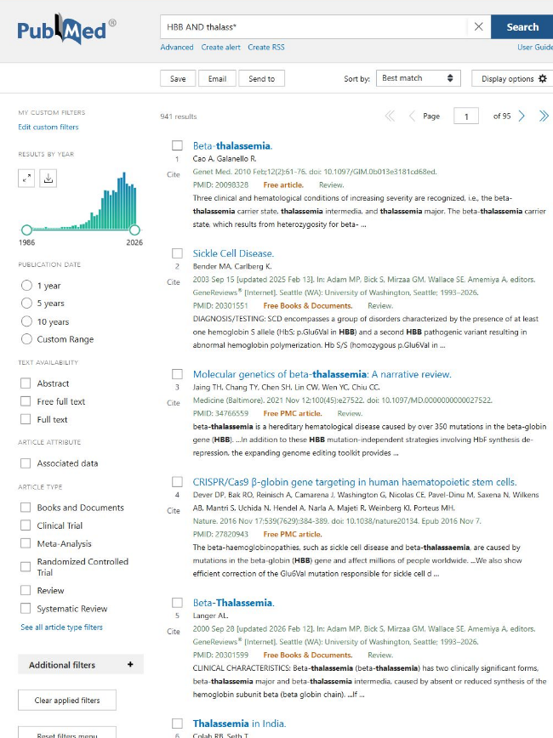
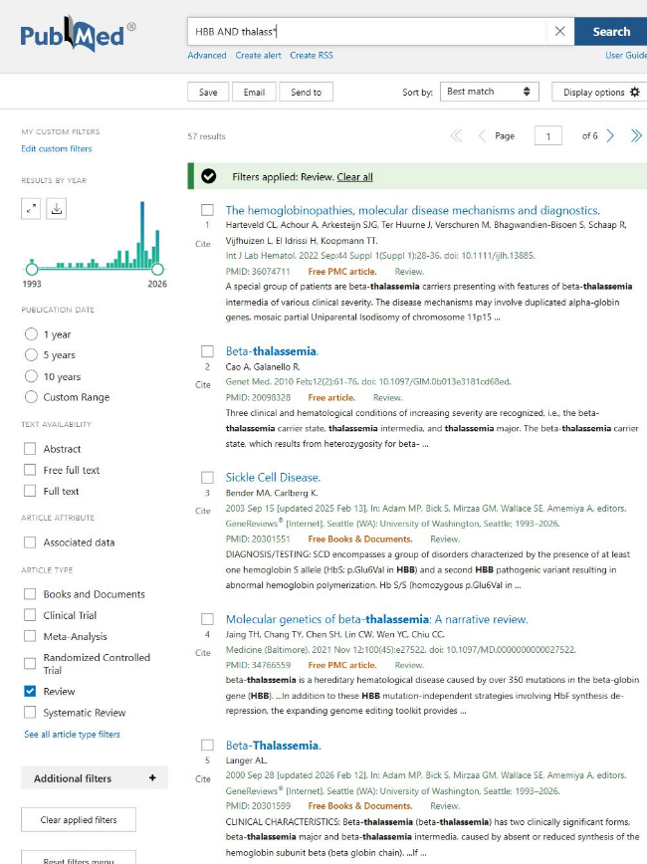
Literature databases
Query
Filtered results
Notes:
[Click 1] The wildcard search carried forward from the previous slide is HBB AND thalass*. [Click 2] For a background overview, select Review under Article type. [Click 3] The captured results show the active Review filter and 57 matching records. A different purpose can call for another article type or publication period. The filters work on the database’s record metadata. The example uses PubMed, and the same decision about what kind of paper to read applies in other literature databases.
Source material for this slide
https://pubmed.ncbi.nlm.nih.gov/?term=HBB+AND+thalass%2A
https://pubmed.ncbi.nlm.nih.gov/?term=HBB+AND+thalass%2A&filter=pubt.review&sort=relevance
https://pubmed.ncbi.nlm.nih.gov/help/#article-type-filters
Browser screenshots captured from the live PubMed and PubMed Central websites on 11 November 2026. The oval enlarges the highlighted page detail and dims surrounding text.

Slide 246
Literature databases
Filter and open papers
Query
Filtered results
Notes:
[Click 1] The wildcard search carried forward from the previous slide is HBB AND thalass*. [Click 2] For a background overview, select Review under Article type. [Click 3] The captured results show the active Review filter and 57 matching records. A different purpose can call for another article type or publication period. The filters work on the database’s record metadata. The example uses PubMed, and the same decision about what kind of paper to read applies in other literature databases.
Source material for this slide
https://pubmed.ncbi.nlm.nih.gov/?term=HBB+AND+thalass%2A
https://pubmed.ncbi.nlm.nih.gov/?term=HBB+AND+thalass%2A&filter=pubt.review&sort=relevance
https://pubmed.ncbi.nlm.nih.gov/help/#article-type-filters
Browser screenshots captured from the live PubMed and PubMed Central websites on 11 November 2026. The oval enlarges the highlighted page detail and dims surrounding text.

Slide 247
Literature databases
Filter and open papers
Query
Filtered results
Notes:
[Click 1] The wildcard search carried forward from the previous slide is HBB AND thalass*. [Click 2] For a background overview, select Review under Article type. [Click 3] The captured results show the active Review filter and 57 matching records. A different purpose can call for another article type or publication period. The filters work on the database’s record metadata. The example uses PubMed, and the same decision about what kind of paper to read applies in other literature databases.
Source material for this slide
https://pubmed.ncbi.nlm.nih.gov/?term=HBB+AND+thalass%2A
https://pubmed.ncbi.nlm.nih.gov/?term=HBB+AND+thalass%2A&filter=pubt.review&sort=relevance
https://pubmed.ncbi.nlm.nih.gov/help/#article-type-filters
Browser screenshots captured from the live PubMed and PubMed Central websites on 11 November 2026. The oval enlarges the highlighted page detail and dims surrounding text.

Slide 248
Literature databases
Filter and open papers
Query
Filtered results
Notes:
[On slide entry / Morph] Read the titles with the original question in mind. Jaing and colleagues’ 2021 narrative review is a match for an overview of the molecular genetics of beta-thalassemia. Its abstract connects the disease to HBB, which helps confirm that the result is relevant to the question. Select the title to open the citation record.
Source material for this slide
https://pubmed.ncbi.nlm.nih.gov/?term=HBB+AND+thalass%2A&filter=pubt.review&sort=relevance
https://pubmed.ncbi.nlm.nih.gov/34766559/
Browser screenshots captured from the live PubMed and PubMed Central websites on 11 November 2026. The oval enlarges the highlighted page detail and dims surrounding text.

Slide 249
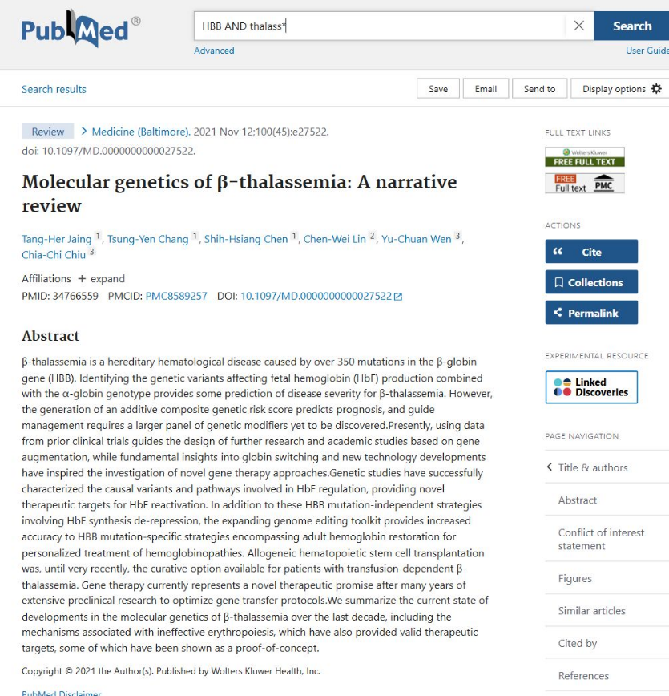
Literature databases
Filter and open papers
Query
Filtered results
Article record
Notes:
[On slide entry / Morph] The record brings together the title, authors, publication information and abstract. Under Full text links, PubMed lists access routes to the article. For this review, the Free PMC article link leads to the copy in PubMed Central. The publisher link offers another route. A library subscription may provide access for other papers.
Source material for this slide
https://pubmed.ncbi.nlm.nih.gov/34766559/
https://pmc.ncbi.nlm.nih.gov/articles/PMC8589257/
https://pubmed.ncbi.nlm.nih.gov/help/#finding-the-full-text-article
Browser screenshots captured from the live PubMed and PubMed Central websites on 11 November 2026. The oval enlarges the highlighted page detail and dims surrounding text.

Slide 250

Literature databases
Filter and open papers
Query
Filtered results
Full articles
Notes:
[On slide entry / Morph] We have reached the full article. The opening page repeats the title and authors, then provides the full discussion, figures and references. At this point we can follow up the part of the review that answers our question or trace its claims to the cited studies. The citation record also gives us another way to continue the search through its assigned subjects.
Source material for this slide
https://pmc.ncbi.nlm.nih.gov/articles/PMC8589257/
https://doi.org/10.1097/MD.0000000000027522
Browser screenshots captured from the live PubMed and PubMed Central websites on 11 November 2026. The oval enlarges the highlighted page detail and dims surrounding text.

Slide 251
Literature databases
Notes:
[On slide entry / Morph] Returning to the same PubMed citation, [Click 1] scroll down to MeSH terms. [Click 2] These subject headings describe the topics assigned to this indexed article. The term beta-Thalassemia / genetics expresses the disease and the aspect discussed, even when authors use different wording. The asterisk marks a major topic. MeSH offers another route from a relevant article to a set of papers about its subject. Recent records may appear before subject indexing is complete.
Source material
https://pubmed.ncbi.nlm.nih.gov/34766559/
https://pubmed.ncbi.nlm.nih.gov/help/#mesh-terms
Browser screenshots captured on 11 November 2026.

Slide 252
Literature databases
Follow subject headings
Notes:
[On slide entry / Morph] Returning to the same PubMed citation, [Click 1] scroll down to MeSH terms. [Click 2] These subject headings describe the topics assigned to this indexed article. The term beta-Thalassemia / genetics expresses the disease and the aspect discussed, even when authors use different wording. The asterisk marks a major topic. MeSH offers another route from a relevant article to a set of papers about its subject. Recent records may appear before subject indexing is complete.
Source material
https://pubmed.ncbi.nlm.nih.gov/34766559/
https://pubmed.ncbi.nlm.nih.gov/help/#mesh-terms
Browser screenshots captured on 11 November 2026.

Slide 253

Literature databases
Follow subject headings
Article record
Notes:
[On slide entry / Morph] Returning to the same PubMed citation, [Click 1] scroll down to MeSH terms. [Click 2] These subject headings describe the topics assigned to this indexed article. The term beta-Thalassemia / genetics expresses the disease and the aspect discussed, even when authors use different wording. The asterisk marks a major topic. MeSH offers another route from a relevant article to a set of papers about its subject. Recent records may appear before subject indexing is complete.
Source material
https://pubmed.ncbi.nlm.nih.gov/34766559/
https://pubmed.ncbi.nlm.nih.gov/help/#mesh-terms
Browser screenshots captured on 11 November 2026.

Slide 254
Literature databases
Follow subject headings
Article record
Notes:
[On slide entry / Morph] Returning to the same PubMed citation, [Click 1] scroll down to MeSH terms. [Click 2] These subject headings describe the topics assigned to this indexed article. The term beta-Thalassemia / genetics expresses the disease and the aspect discussed, even when authors use different wording. The asterisk marks a major topic. MeSH offers another route from a relevant article to a set of papers about its subject. Recent records may appear before subject indexing is complete.
Source material
https://pubmed.ncbi.nlm.nih.gov/34766559/
https://pubmed.ncbi.nlm.nih.gov/help/#mesh-terms
Browser screenshots captured on 11 November 2026.

Slide 255

Literature databases
Follow subject headings
Article record
Subject heading
Notes:
[On slide entry / Morph] Select the entry beta-Thalassemia* / genetics and choose Search in PubMed. The genetics qualifier specifies the aspect of the subject, and the asterisk in the MeSH display marks a major topic. The link starts a search for that indexed topic. In the generated query, MAJR is the field tag for a MeSH major topic.
Source material for this slide
https://pubmed.ncbi.nlm.nih.gov/34766559/#mesh-terms
https://pubmed.ncbi.nlm.nih.gov/?sort=date&sort_order=desc&term=%22beta-Thalassemia%2Fgenetics%22%5BMAJR%5D
https://www.nlm.nih.gov/oet/ed/pubmed/mesh/mod02/03-300.html
Browser screenshots captured from the live PubMed and PubMed Central websites on 11 November 2026. The oval enlarges the highlighted page detail and dims surrounding text.

Slide 256

Literature databases
Follow subject headings
Article record
Subject heading
New results
Notes:
[On slide entry / Morph] Following Search in PubMed creates a query from the selected MeSH heading. Here the query is "beta-Thalassemia/genetics"[MAJR], which retrieves articles indexed with the genetics of beta-thalassemia as a major topic. The Review filter from the earlier search remains active. The live page therefore shows 216 results and explicitly states Filters applied: Review. Always inspect the active filters when moving between searches.
This route uses the subject description attached to a paper that we have already checked for relevance. The new list can lead to other useful reviews, and their references and subject headings can extend the search further.
Source material
https://pubmed.ncbi.nlm.nih.gov/?term=%22beta-Thalassemia%2Fgenetics%22%5BMAJR%5D&sort=date&sort_order=desc&filter=pubt.review
https://pubmed.ncbi.nlm.nih.gov/help/#mesh-terms
Browser screenshots captured on 11 November 2026. Result counts change as PubMed updates.

Slide 257
ChatGPT
+ New chat
⌄
Search chats
Your chats
HBB splicing
Ask anything
↑
Abridged ChatGPT example
Notes:
[On slide entry] We have explored biological records and followed literature searches to research papers. [Click 1] We can also begin by expressing our uncertainty as a biological question. [Click 2] Here, we want to understand how a change inside an HBB intron could affect the RNA produced from that gene.
We will develop this question through one conversation. Each follow-up will ask for something more specific, until we have papers and experimental findings that we can investigate ourselves. The replies shown here are abridged examples prepared for the lecture.

Slide 258
AI-based discovery
ChatGPT
+ New chat
⌄
Search chats
Your chats
HBB splicing
Ask anything
↑
Abridged ChatGPT example
Notes:
[On slide entry] We have explored biological records and followed literature searches to research papers. [Click 1] We can also begin by expressing our uncertainty as a biological question. [Click 2] Here, we want to understand how a change inside an HBB intron could affect the RNA produced from that gene.
We will develop this question through one conversation. Each follow-up will ask for something more specific, until we have papers and experimental findings that we can investigate ourselves. The replies shown here are abridged examples prepared for the lecture.

Slide 259
AI-based discovery
Find candidate studies
ChatGPT
+ New chat
⌄
Search chats
Your chats
HBB splicing
Ask anything
↑
Abridged ChatGPT example
Notes:
[On slide entry] We have explored biological records and followed literature searches to research papers. [Click 1] We can also begin by expressing our uncertainty as a biological question. [Click 2] Here, we want to understand how a change inside an HBB intron could affect the RNA produced from that gene.
We will develop this question through one conversation. Each follow-up will ask for something more specific, until we have papers and experimental findings that we can investigate ourselves. The replies shown here are abridged examples prepared for the lecture.

Slide 260
AI-based discovery
Find candidate studies
Generic biological question
ChatGPT
+ New chat
⌄
Search chats
Your chats
HBB splicing
Ask anything
↑
Abridged ChatGPT example
Notes:
[On slide entry] We have explored biological records and followed literature searches to research papers. [Click 1] We can also begin by expressing our uncertainty as a biological question. [Click 2] Here, we want to understand how a change inside an HBB intron could affect the RNA produced from that gene.
We will develop this question through one conversation. Each follow-up will ask for something more specific, until we have papers and experimental findings that we can investigate ourselves. The replies shown here are abridged examples prepared for the lecture.

Slide 261
AI-based discovery
Find candidate studies
Generic biological question
ChatGPT
+ New chat
⌄
Search chats
Your chats
HBB splicing
↑
Abridged ChatGPT example
Notes:
[On slide entry] Our starting question is broad. We know which gene interests us and which biological process we want to understand, but we have yet to choose a particular variant or experiment.
Think about what would answer this question for you. An explanation of splicing might help us understand the mechanism. A research paper could show what happened when scientists tested a particular change. We will first see how the AI interprets the question as it stands.

Slide 262
AI-based discovery
Find candidate studies
Generic biological question
ChatGPT
+ New chat
⌄
Search chats
Your chats
HBB splicing
How do intronic variants affect RNA splicing in human HBB?
↑
Abridged ChatGPT example
Notes:
[On slide entry] Our starting question is broad. We know which gene interests us and which biological process we want to understand, but we have yet to choose a particular variant or experiment.
Think about what would answer this question for you. An explanation of splicing might help us understand the mechanism. A research paper could show what happened when scientists tested a particular change. We will first see how the AI interprets the question as it stands.

Slide 263
AI-based discovery
Find candidate studies
Generic biological question
ChatGPT
+ New chat
⌄
Search chats
How do intronic variants affect RNA splicing in human HBB?
Your chats
ChatGPT
HBB splicing
HBB splicing
Ask anything
↑
Abridged ChatGPT example
Notes:
[On slide entry] The reply follows one possible route from an intronic change to a biological consequence. A change in a splice signal can alter where the RNA is cut and joined. Part of an intron may then remain in the mature RNA, potentially reducing the production of functional β-globin.
This gives us a mechanism to investigate. Our next question is where researchers have measured such an effect. We can make that need explicit in the conversation and ask for experimental studies.

Slide 264
AI-based discovery
Find candidate studies
Generic biological question
ChatGPT
+ New chat
⌄
Search chats
How do intronic variants affect RNA splicing in human HBB?
Your chats
ChatGPT
HBB splicing
HBB splicing
An intronic variant can weaken a usual splice signal or create a new one. If the spliceosome uses a site inside an HBB intron, part of the intron can remain in the mature RNA. In some cases, this reduces production of functional β-globin.
Ask anything
↑
Abridged ChatGPT example
Notes:
[On slide entry] The reply follows one possible route from an intronic change to a biological consequence. A change in a splice signal can alter where the RNA is cut and joined. Part of an intron may then remain in the mature RNA, potentially reducing the production of functional β-globin.
This gives us a mechanism to investigate. Our next question is where researchers have measured such an effect. We can make that need explicit in the conversation and ask for experimental studies.

Slide 265
AI-based discovery
Find candidate studies
ChatGPT
+ New chat
⌄
Search chats
How do intronic variants affect RNA splicing in human HBB?
Your chats
ChatGPT
HBB splicing
HBB splicing
An intronic variant can weaken a usual splice signal or create a new one. If the spliceosome uses a site inside an HBB intron, part of the intron can remain in the mature RNA. In some cases, this reduces production of functional β-globin.
↑
Abridged ChatGPT example
Notes:
[On slide entry] We now ask for two primary studies. These are papers in which the authors report experiments or data that address the question.
Keeping the same conversation lets us build on the biological context already established. We have changed what we want the answer to provide. Instead of a general explanation alone, we are asking for examples that identify a study, a biological change and an observation. The limit of two papers gives us a manageable starting point for reading.

Slide 266
AI-based discovery
Find candidate studies
Ask for primary studies
ChatGPT
+ New chat
⌄
Search chats
How do intronic variants affect RNA splicing in human HBB?
Your chats
ChatGPT
HBB splicing
HBB splicing
An intronic variant can weaken a usual splice signal or create a new one. If the spliceosome uses a site inside an HBB intron, part of the intron can remain in the mature RNA. In some cases, this reduces production of functional β-globin.
Find two primary studies that measured how intronic variants affect human HBB splicing.
↑
Abridged ChatGPT example
Notes:
[On slide entry] We now ask for two primary studies. These are papers in which the authors report experiments or data that address the question.
Keeping the same conversation lets us build on the biological context already established. We have changed what we want the answer to provide. Instead of a general explanation alone, we are asking for examples that identify a study, a biological change and an observation. The limit of two papers gives us a manageable starting point for reading.

Slide 267
AI-based discovery
Find candidate studies
Ask for primary studies
ChatGPT
+ New chat
⌄
Search chats
Find two primary studies that measured how intronic variants affect human HBB splicing.
Your chats
ChatGPT
HBB splicing
HBB splicing
Ask anything
↑
Abridged ChatGPT example
Notes:
[On slide entry] Reimer’s study gives us a specific intronic variant to follow. The researchers tested how IVS-110 changed the splicing of human HBB RNA in a cell model. We can now ask what they compared and how they detected the change.
Nualkaew’s study approaches a related question from another direction. It examines whether an intervention could restore some correctly spliced RNA in cultured patient-derived cells carrying IVS2-654. We now have two candidates involving different variants and experimental settings. Their short descriptions help us decide which paper fits the question we want to pursue.

Slide 268
AI-based discovery
Find candidate studies
Ask for primary studies
ChatGPT
+ New chat
⌄
Search chats
Find two primary studies that measured how intronic variants affect human HBB splicing.
Your chats
ChatGPT
HBB splicing
HBB splicing
Reimer et al. (2021)
Tested how the IVS-110 variant changed splicing of human HBB RNA in a cell model.
Nualkaew et al. (2019)
Tested whether normal HBB splicing could be partly restored in cultured patient-derived cells carrying IVS2-654.
Ask anything
↑
Abridged ChatGPT example
Notes:
[On slide entry] Reimer’s study gives us a specific intronic variant to follow. The researchers tested how IVS-110 changed the splicing of human HBB RNA in a cell model. We can now ask what they compared and how they detected the change.
Nualkaew’s study approaches a related question from another direction. It examines whether an intervention could restore some correctly spliced RNA in cultured patient-derived cells carrying IVS2-654. We now have two candidates involving different variants and experimental settings. Their short descriptions help us decide which paper fits the question we want to pursue.

Slide 269
AI-based discovery
Find candidate studies
ChatGPT
+ New chat
⌄
Search chats
Find two primary studies that measured how intronic variants affect human HBB splicing.
Your chats
ChatGPT
HBB splicing
HBB splicing
Reimer et al. (2021)
Tested how the IVS-110 variant changed splicing of human HBB RNA in a cell model.
Nualkaew et al. (2019)
Tested whether normal HBB splicing could be partly restored in cultured patient-derived cells carrying IVS2-654.
↑
Abridged ChatGPT example
Notes:
[On slide entry] A paper name gives us a lead. We now want enough detail to follow that lead efficiently.
The PMID gives us a precise way to locate the PubMed record. Asking what the researchers measured helps us understand which observation supports the claim. Asking for a figure gives us a place to begin reading inside the paper. These details turn a brief recommendation into a set of concrete checks we can make ourselves.

Slide 270
AI-based discovery
Find candidate studies
Ask for supporting evidence
ChatGPT
+ New chat
⌄
Search chats
Find two primary studies that measured how intronic variants affect human HBB splicing.
Your chats
ChatGPT
HBB splicing
HBB splicing
Reimer et al. (2021)
Tested how the IVS-110 variant changed splicing of human HBB RNA in a cell model.
Nualkaew et al. (2019)
Tested whether normal HBB splicing could be partly restored in cultured patient-derived cells carrying IVS2-654.
For each study, give the PMID, what the researchers measured, and the figure that supports the finding.
↑
Abridged ChatGPT example
Notes:
[On slide entry] A paper name gives us a lead. We now want enough detail to follow that lead efficiently.
The PMID gives us a precise way to locate the PubMed record. Asking what the researchers measured helps us understand which observation supports the claim. Asking for a figure gives us a place to begin reading inside the paper. These details turn a brief recommendation into a set of concrete checks we can make ourselves.

Slide 271
AI-based discovery
Find candidate studies
Ask for supporting evidence
ChatGPT
+ New chat
⌄
Search chats
For each study, give the PMID, what the researchers measured, and the figure that supports the finding.
Your chats
ChatGPT
HBB splicing
HBB splicing
Ask anything
↑
Abridged ChatGPT example
Notes:
[On slide entry] For Reimer, the added details connect the claim to long-read RNA sequencing. Figure 7A identifies the alternative splice site created by IVS-110, while Figure 7B compares the RNA splicing patterns in the usual and variant HBB constructs. Reimer et al., Figure 7
For Nualkaew, the relevant measurement is correctly spliced HBB RNA, assessed by RT-PCR in cultured patient-derived cells. Figure 3A–B shows partial restoration after the intervention. We can follow the PMID to the paper and inspect whether the experiment supports the wording of the reply. Nualkaew et al., Figure 3
Notice how the answer became more specific as we clarified our purpose. That brings us back to the final search principles—define what you need, then refine the query until the result gives you something you can investigate.

Slide 272
AI-based discovery
Find candidate studies
Ask for supporting evidence
ChatGPT
+ New chat
⌄
Search chats
For each study, give the PMID, what the researchers measured, and the figure that supports the finding.
Your chats
ChatGPT
HBB splicing
HBB splicing
Reimer et al. (2021) PMID 33440169
Long-read RNA sequencing compared usual and IVS-110 HBB minigenes. Fig. 7A–B shows the alternative site and compares splicing patterns.
Nualkaew et al. (2019) PMID 31113996
RT-PCR measured correctly spliced HBB RNA in cells carrying IVS2-654. Fig. 3A–B shows partial restoration after an intervention.
Ask anything
↑
Abridged ChatGPT example
Notes:
[On slide entry] For Reimer, the added details connect the claim to long-read RNA sequencing. Figure 7A identifies the alternative splice site created by IVS-110, while Figure 7B compares the RNA splicing patterns in the usual and variant HBB constructs. Reimer et al., Figure 7
For Nualkaew, the relevant measurement is correctly spliced HBB RNA, assessed by RT-PCR in cultured patient-derived cells. Figure 3A–B shows partial restoration after the intervention. We can follow the PMID to the paper and inspect whether the experiment supports the wording of the reply. Nualkaew et al., Figure 3
Notice how the answer became more specific as we clarified our purpose. That brings us back to the final search principles—define what you need, then refine the query until the result gives you something you can investigate.

Slide 273
AI-based discovery
Notes:
[On slide entry] Our AI search has produced a promising candidate, [Click 1] the study by Nualkaew and colleagues identified by PMID 31113996. The short AI summary suggests that an intervention partially restored HBB splicing. We now follow the citation to find out whether the published evidence supports that statement.
[Click 2] The PubMed record lets us [Click 3] match the title, authors and year to the suggested citation. The PMID identifies this article precisely. The abstract helps us establish its relevance to HBB splicing, while the full paper provides the experimental details behind the summary.
[Click 4] The free full-text PMC link opens the article in PubMed Central. We can read the Results and inspect Figure 3, which the AI answer named. Finding the article and checking the biological claim are separate steps. We have now reached the source needed for the second step.
PubMed record and original paper
https://pubmed.ncbi.nlm.nih.gov/31113996/
https://pmc.ncbi.nlm.nih.gov/articles/PMC6529457/
The PubMed image is an actual browser screenshot captured 12 November 2026, cropped without changing page content. The clickable screenshot opens the record. The handwritten full-text label opens the paper.

Slide 274
AI-based discovery
Check claims in the paper
Notes:
[On slide entry] Our AI search has produced a promising candidate, [Click 1] the study by Nualkaew and colleagues identified by PMID 31113996. The short AI summary suggests that an intervention partially restored HBB splicing. We now follow the citation to find out whether the published evidence supports that statement.
[Click 2] The PubMed record lets us [Click 3] match the title, authors and year to the suggested citation. The PMID identifies this article precisely. The abstract helps us establish its relevance to HBB splicing, while the full paper provides the experimental details behind the summary.
[Click 4] The free full-text PMC link opens the article in PubMed Central. We can read the Results and inspect Figure 3, which the AI answer named. Finding the article and checking the biological claim are separate steps. We have now reached the source needed for the second step.
PubMed record and original paper
https://pubmed.ncbi.nlm.nih.gov/31113996/
https://pmc.ncbi.nlm.nih.gov/articles/PMC6529457/
The PubMed image is an actual browser screenshot captured 12 November 2026, cropped without changing page content. The clickable screenshot opens the record. The handwritten full-text label opens the paper.

Slide 275
AI-based discovery
Check claims in the paper
Follow the citation
(Nualkaew et al. (2019), PMID 31113996)
AI summary: partially restored HBB splicing in cultured cells
Notes:
[On slide entry] Our AI search has produced a promising candidate, [Click 1] the study by Nualkaew and colleagues identified by PMID 31113996. The short AI summary suggests that an intervention partially restored HBB splicing. We now follow the citation to find out whether the published evidence supports that statement.
[Click 2] The PubMed record lets us [Click 3] match the title, authors and year to the suggested citation. The PMID identifies this article precisely. The abstract helps us establish its relevance to HBB splicing, while the full paper provides the experimental details behind the summary.
[Click 4] The free full-text PMC link opens the article in PubMed Central. We can read the Results and inspect Figure 3, which the AI answer named. Finding the article and checking the biological claim are separate steps. We have now reached the source needed for the second step.
PubMed record and original paper
https://pubmed.ncbi.nlm.nih.gov/31113996/
https://pmc.ncbi.nlm.nih.gov/articles/PMC6529457/
The PubMed image is an actual browser screenshot captured 12 November 2026, cropped without changing page content. The clickable screenshot opens the record. The handwritten full-text label opens the paper.

Slide 276

AI-based discovery
Check claims in the paper
Follow the citation
(Nualkaew et al. (2019), PMID 31113996)
AI summary: partially restored HBB splicing in cultured cells
Notes:
[On slide entry] Our AI search has produced a promising candidate, [Click 1] the study by Nualkaew and colleagues identified by PMID 31113996. The short AI summary suggests that an intervention partially restored HBB splicing. We now follow the citation to find out whether the published evidence supports that statement.
[Click 2] The PubMed record lets us [Click 3] match the title, authors and year to the suggested citation. The PMID identifies this article precisely. The abstract helps us establish its relevance to HBB splicing, while the full paper provides the experimental details behind the summary.
[Click 4] The free full-text PMC link opens the article in PubMed Central. We can read the Results and inspect Figure 3, which the AI answer named. Finding the article and checking the biological claim are separate steps. We have now reached the source needed for the second step.
PubMed record and original paper
https://pubmed.ncbi.nlm.nih.gov/31113996/
https://pmc.ncbi.nlm.nih.gov/articles/PMC6529457/
The PubMed image is an actual browser screenshot captured 12 November 2026, cropped without changing page content. The clickable screenshot opens the record. The handwritten full-text label opens the paper.

Slide 277
AI-based discovery
Check claims in the paper
Follow the citation
(Nualkaew et al. (2019), PMID 31113996)
AI summary: partially restored HBB splicing in cultured cells
Match title, authors and year
Notes:
[On slide entry] Our AI search has produced a promising candidate, [Click 1] the study by Nualkaew and colleagues identified by PMID 31113996. The short AI summary suggests that an intervention partially restored HBB splicing. We now follow the citation to find out whether the published evidence supports that statement.
[Click 2] The PubMed record lets us [Click 3] match the title, authors and year to the suggested citation. The PMID identifies this article precisely. The abstract helps us establish its relevance to HBB splicing, while the full paper provides the experimental details behind the summary.
[Click 4] The free full-text PMC link opens the article in PubMed Central. We can read the Results and inspect Figure 3, which the AI answer named. Finding the article and checking the biological claim are separate steps. We have now reached the source needed for the second step.
PubMed record and original paper
https://pubmed.ncbi.nlm.nih.gov/31113996/
https://pmc.ncbi.nlm.nih.gov/articles/PMC6529457/
The PubMed image is an actual browser screenshot captured 12 November 2026, cropped without changing page content. The clickable screenshot opens the record. The handwritten full-text label opens the paper.

Slide 278
AI-based discovery
Check claims in the paper
Follow the citation
(Nualkaew et al. (2019), PMID 31113996)
AI summary: partially restored HBB splicing in cultured cells
Match title, authors and year
Open the free full text
Notes:
[On slide entry] Our AI search has produced a promising candidate, [Click 1] the study by Nualkaew and colleagues identified by PMID 31113996. The short AI summary suggests that an intervention partially restored HBB splicing. We now follow the citation to find out whether the published evidence supports that statement.
[Click 2] The PubMed record lets us [Click 3] match the title, authors and year to the suggested citation. The PMID identifies this article precisely. The abstract helps us establish its relevance to HBB splicing, while the full paper provides the experimental details behind the summary.
[Click 4] The free full-text PMC link opens the article in PubMed Central. We can read the Results and inspect Figure 3, which the AI answer named. Finding the article and checking the biological claim are separate steps. We have now reached the source needed for the second step.
PubMed record and original paper
https://pubmed.ncbi.nlm.nih.gov/31113996/
https://pmc.ncbi.nlm.nih.gov/articles/PMC6529457/
The PubMed image is an actual browser screenshot captured 12 November 2026, cropped without changing page content. The clickable screenshot opens the record. The handwritten full-text label opens the paper.

Slide 279
AI-based discovery
Check claims in the paper
Notes:
[On slide entry] Figure 3 contains several measurements. [Click 1] The overview shows that panels A and B concern RNA splicing, while C and D concern haemoglobin A. [Click 2] Because our immediate claim concerns RNA processing, we enlarge A and B and read the experiment at that level first.
Panel A shows products obtained by reverse-transcribing RNA and amplifying the resulting DNA. [Click 3] The shorter product labelled Correct (284) represents correctly spliced RNA. The longer Aberrant (359) product represents abnormal splicing. The numbers are the printed PCR-product lengths. The comparison helps us identify the kind of RNA detected after the intervention.
[Click 4] Panel B gives the quantitative comparison with untreated and control cultures. The Results text reports a mean of 8.25 ± 2.7% correctly spliced beta-globin RNA on day 10. This percentage describes the RNA measurement, rather than the proportion of cells corrected. Panel A includes 29% under one representative lane. We therefore take the overall mean from panel B together with the Results text, instead of treating the representative gel as the summary of all samples.
[Click 5] The same figure examines haemoglobin A by chromatography in C and D, reporting 7.04 ± 1.69% on day 14. RNA splicing and haemoglobin production are related biological outcomes, but each needs its own measurement. We can now ask which experimental setting and intervention produced these results.
Original Figure 3 and Results
https://pmc.ncbi.nlm.nih.gov/articles/PMC6529457/#Fig3
https://doi.org/10.1038/s41598-019-43964-3
Figure by Nualkaew et al. (2019), licensed CC BY 4.0. The overview is unchanged. The enlargements crop the original A and B panels. Arrows and outlines are teaching annotations.
https://creativecommons.org/licenses/by/4.0/

Slide 280
AI-based discovery
Check claims in the paper
Find the measurement
Notes:
[On slide entry] Figure 3 contains several measurements. [Click 1] The overview shows that panels A and B concern RNA splicing, while C and D concern haemoglobin A. [Click 2] Because our immediate claim concerns RNA processing, we enlarge A and B and read the experiment at that level first.
Panel A shows products obtained by reverse-transcribing RNA and amplifying the resulting DNA. [Click 3] The shorter product labelled Correct (284) represents correctly spliced RNA. The longer Aberrant (359) product represents abnormal splicing. The numbers are the printed PCR-product lengths. The comparison helps us identify the kind of RNA detected after the intervention.
[Click 4] Panel B gives the quantitative comparison with untreated and control cultures. The Results text reports a mean of 8.25 ± 2.7% correctly spliced beta-globin RNA on day 10. This percentage describes the RNA measurement, rather than the proportion of cells corrected. Panel A includes 29% under one representative lane. We therefore take the overall mean from panel B together with the Results text, instead of treating the representative gel as the summary of all samples.
[Click 5] The same figure examines haemoglobin A by chromatography in C and D, reporting 7.04 ± 1.69% on day 14. RNA splicing and haemoglobin production are related biological outcomes, but each needs its own measurement. We can now ask which experimental setting and intervention produced these results.
Original Figure 3 and Results
https://pmc.ncbi.nlm.nih.gov/articles/PMC6529457/#Fig3
https://doi.org/10.1038/s41598-019-43964-3
Figure by Nualkaew et al. (2019), licensed CC BY 4.0. The overview is unchanged. The enlargements crop the original A and B panels. Arrows and outlines are teaching annotations.
https://creativecommons.org/licenses/by/4.0/

Slide 281

AI-based discovery
Check claims in the paper
Find the measurement
Nualkaew et al. (2019), Figure 3. CC BY 4.0.
Notes:
[On slide entry] Figure 3 contains several measurements. [Click 1] The overview shows that panels A and B concern RNA splicing, while C and D concern haemoglobin A. [Click 2] Because our immediate claim concerns RNA processing, we enlarge A and B and read the experiment at that level first.
Panel A shows products obtained by reverse-transcribing RNA and amplifying the resulting DNA. [Click 3] The shorter product labelled Correct (284) represents correctly spliced RNA. The longer Aberrant (359) product represents abnormal splicing. The numbers are the printed PCR-product lengths. The comparison helps us identify the kind of RNA detected after the intervention.
[Click 4] Panel B gives the quantitative comparison with untreated and control cultures. The Results text reports a mean of 8.25 ± 2.7% correctly spliced beta-globin RNA on day 10. This percentage describes the RNA measurement, rather than the proportion of cells corrected. Panel A includes 29% under one representative lane. We therefore take the overall mean from panel B together with the Results text, instead of treating the representative gel as the summary of all samples.
[Click 5] The same figure examines haemoglobin A by chromatography in C and D, reporting 7.04 ± 1.69% on day 14. RNA splicing and haemoglobin production are related biological outcomes, but each needs its own measurement. We can now ask which experimental setting and intervention produced these results.
Original Figure 3 and Results
https://pmc.ncbi.nlm.nih.gov/articles/PMC6529457/#Fig3
https://doi.org/10.1038/s41598-019-43964-3
Figure by Nualkaew et al. (2019), licensed CC BY 4.0. The overview is unchanged. The enlargements crop the original A and B panels. Arrows and outlines are teaching annotations.
https://creativecommons.org/licenses/by/4.0/

Slide 282


AI-based discovery
Check claims in the paper
Find the measurement
Nualkaew et al. (2019), Figure 3. CC BY 4.0.
Notes:
[On slide entry] Figure 3 contains several measurements. [Click 1] The overview shows that panels A and B concern RNA splicing, while C and D concern haemoglobin A. [Click 2] Because our immediate claim concerns RNA processing, we enlarge A and B and read the experiment at that level first.
Panel A shows products obtained by reverse-transcribing RNA and amplifying the resulting DNA. [Click 3] The shorter product labelled Correct (284) represents correctly spliced RNA. The longer Aberrant (359) product represents abnormal splicing. The numbers are the printed PCR-product lengths. The comparison helps us identify the kind of RNA detected after the intervention.
[Click 4] Panel B gives the quantitative comparison with untreated and control cultures. The Results text reports a mean of 8.25 ± 2.7% correctly spliced beta-globin RNA on day 10. This percentage describes the RNA measurement, rather than the proportion of cells corrected. Panel A includes 29% under one representative lane. We therefore take the overall mean from panel B together with the Results text, instead of treating the representative gel as the summary of all samples.
[Click 5] The same figure examines haemoglobin A by chromatography in C and D, reporting 7.04 ± 1.69% on day 14. RNA splicing and haemoglobin production are related biological outcomes, but each needs its own measurement. We can now ask which experimental setting and intervention produced these results.
Original Figure 3 and Results
https://pmc.ncbi.nlm.nih.gov/articles/PMC6529457/#Fig3
https://doi.org/10.1038/s41598-019-43964-3
Figure by Nualkaew et al. (2019), licensed CC BY 4.0. The overview is unchanged. The enlargements crop the original A and B panels. Arrows and outlines are teaching annotations.
https://creativecommons.org/licenses/by/4.0/

Slide 283
AI-based discovery
Check claims in the paper
Find the measurement
Shorter product: correctly spliced RNA
Nualkaew et al. (2019), Figure 3. CC BY 4.0.
Notes:
[On slide entry] Figure 3 contains several measurements. [Click 1] The overview shows that panels A and B concern RNA splicing, while C and D concern haemoglobin A. [Click 2] Because our immediate claim concerns RNA processing, we enlarge A and B and read the experiment at that level first.
Panel A shows products obtained by reverse-transcribing RNA and amplifying the resulting DNA. [Click 3] The shorter product labelled Correct (284) represents correctly spliced RNA. The longer Aberrant (359) product represents abnormal splicing. The numbers are the printed PCR-product lengths. The comparison helps us identify the kind of RNA detected after the intervention.
[Click 4] Panel B gives the quantitative comparison with untreated and control cultures. The Results text reports a mean of 8.25 ± 2.7% correctly spliced beta-globin RNA on day 10. This percentage describes the RNA measurement, rather than the proportion of cells corrected. Panel A includes 29% under one representative lane. We therefore take the overall mean from panel B together with the Results text, instead of treating the representative gel as the summary of all samples.
[Click 5] The same figure examines haemoglobin A by chromatography in C and D, reporting 7.04 ± 1.69% on day 14. RNA splicing and haemoglobin production are related biological outcomes, but each needs its own measurement. We can now ask which experimental setting and intervention produced these results.
Original Figure 3 and Results
https://pmc.ncbi.nlm.nih.gov/articles/PMC6529457/#Fig3
https://doi.org/10.1038/s41598-019-43964-3
Figure by Nualkaew et al. (2019), licensed CC BY 4.0. The overview is unchanged. The enlargements crop the original A and B panels. Arrows and outlines are teaching annotations.
https://creativecommons.org/licenses/by/4.0/

Slide 284
AI-based discovery
Check claims in the paper
Find the measurement
Shorter product: correctly spliced RNA
Mean 8.25% correctly spliced RNA
Nualkaew et al. (2019), Figure 3. CC BY 4.0.
Notes:
[On slide entry] Figure 3 contains several measurements. [Click 1] The overview shows that panels A and B concern RNA splicing, while C and D concern haemoglobin A. [Click 2] Because our immediate claim concerns RNA processing, we enlarge A and B and read the experiment at that level first.
Panel A shows products obtained by reverse-transcribing RNA and amplifying the resulting DNA. [Click 3] The shorter product labelled Correct (284) represents correctly spliced RNA. The longer Aberrant (359) product represents abnormal splicing. The numbers are the printed PCR-product lengths. The comparison helps us identify the kind of RNA detected after the intervention.
[Click 4] Panel B gives the quantitative comparison with untreated and control cultures. The Results text reports a mean of 8.25 ± 2.7% correctly spliced beta-globin RNA on day 10. This percentage describes the RNA measurement, rather than the proportion of cells corrected. Panel A includes 29% under one representative lane. We therefore take the overall mean from panel B together with the Results text, instead of treating the representative gel as the summary of all samples.
[Click 5] The same figure examines haemoglobin A by chromatography in C and D, reporting 7.04 ± 1.69% on day 14. RNA splicing and haemoglobin production are related biological outcomes, but each needs its own measurement. We can now ask which experimental setting and intervention produced these results.
Original Figure 3 and Results
https://pmc.ncbi.nlm.nih.gov/articles/PMC6529457/#Fig3
https://doi.org/10.1038/s41598-019-43964-3
Figure by Nualkaew et al. (2019), licensed CC BY 4.0. The overview is unchanged. The enlargements crop the original A and B panels. Arrows and outlines are teaching annotations.
https://creativecommons.org/licenses/by/4.0/

Slide 285
AI-based discovery
Check claims in the paper
Find the measurement
Shorter product: correctly spliced RNA
Mean 8.25% correctly spliced RNA
A–B test RNA splicing. C–D test haemoglobin A separately.
Nualkaew et al. (2019), Figure 3. CC BY 4.0.
Notes:
[On slide entry] Figure 3 contains several measurements. [Click 1] The overview shows that panels A and B concern RNA splicing, while C and D concern haemoglobin A. [Click 2] Because our immediate claim concerns RNA processing, we enlarge A and B and read the experiment at that level first.
Panel A shows products obtained by reverse-transcribing RNA and amplifying the resulting DNA. [Click 3] The shorter product labelled Correct (284) represents correctly spliced RNA. The longer Aberrant (359) product represents abnormal splicing. The numbers are the printed PCR-product lengths. The comparison helps us identify the kind of RNA detected after the intervention.
[Click 4] Panel B gives the quantitative comparison with untreated and control cultures. The Results text reports a mean of 8.25 ± 2.7% correctly spliced beta-globin RNA on day 10. This percentage describes the RNA measurement, rather than the proportion of cells corrected. Panel A includes 29% under one representative lane. We therefore take the overall mean from panel B together with the Results text, instead of treating the representative gel as the summary of all samples.
[Click 5] The same figure examines haemoglobin A by chromatography in C and D, reporting 7.04 ± 1.69% on day 14. RNA splicing and haemoglobin production are related biological outcomes, but each needs its own measurement. We can now ask which experimental setting and intervention produced these results.
Original Figure 3 and Results
https://pmc.ncbi.nlm.nih.gov/articles/PMC6529457/#Fig3
https://doi.org/10.1038/s41598-019-43964-3
Figure by Nualkaew et al. (2019), licensed CC BY 4.0. The overview is unchanged. The enlargements crop the original A and B panels. Arrows and outlines are teaching annotations.
https://creativecommons.org/licenses/by/4.0/

Slide 286
AI-based discovery
Check claims in the paper
Notes:
[On slide entry] The model matters as much as the result. [Click 1] These experiments used cultured erythroid cells derived from patients with beta-IVS2-654-thalassaemia/HbE. Erythroid cells develop towards red blood cells. The experiment therefore gives us evidence for a particular HBB variant in patient-derived cells grown in culture. It does not show what happened after treating patients.
[Click 2] The researchers delivered engineered U7.BP+623 RNA using a lentiviral vector. The engineered RNA targets signals involved in abnormal splicing and helps redirect RNA processing towards the usual splice pattern. The paper compares these cultures with untreated cells, a vector control and a scrambled-sequence control. Those comparisons help us judge whether the observed change is associated with the particular intervention.
[Click 3] Treated cultures showed partial restoration of correctly spliced beta-globin RNA, with a reported mean of 8.25 ± 2.7%. Haemoglobin A production provides a separate protein-level result. For our RNA claim, the model, intervention and RNA measurement give us enough detail to write a precise conclusion.
[Click 4] Our checked statement now says that an engineered U7 RNA intervention partly restored correctly spliced HBB RNA in cultured patient-derived cells carrying IVS2-654. The experiment supports that statement within this setting. Clinical effectiveness would require additional evidence. AI helped us find the candidate study, while reading the original experiment let us define the result and its limits. This distinction becomes especially useful when we consider the pitfalls of AI-assisted searches next.
https://pmc.ncbi.nlm.nih.gov/articles/PMC6529457/#Fig3
https://doi.org/10.1038/s41598-019-43964-3

Slide 287
AI-based discovery
Check claims in the paper
State what the experiment supports
Notes:
[On slide entry] The model matters as much as the result. [Click 1] These experiments used cultured erythroid cells derived from patients with beta-IVS2-654-thalassaemia/HbE. Erythroid cells develop towards red blood cells. The experiment therefore gives us evidence for a particular HBB variant in patient-derived cells grown in culture. It does not show what happened after treating patients.
[Click 2] The researchers delivered engineered U7.BP+623 RNA using a lentiviral vector. The engineered RNA targets signals involved in abnormal splicing and helps redirect RNA processing towards the usual splice pattern. The paper compares these cultures with untreated cells, a vector control and a scrambled-sequence control. Those comparisons help us judge whether the observed change is associated with the particular intervention.
[Click 3] Treated cultures showed partial restoration of correctly spliced beta-globin RNA, with a reported mean of 8.25 ± 2.7%. Haemoglobin A production provides a separate protein-level result. For our RNA claim, the model, intervention and RNA measurement give us enough detail to write a precise conclusion.
[Click 4] Our checked statement now says that an engineered U7 RNA intervention partly restored correctly spliced HBB RNA in cultured patient-derived cells carrying IVS2-654. The experiment supports that statement within this setting. Clinical effectiveness would require additional evidence. AI helped us find the candidate study, while reading the original experiment let us define the result and its limits. This distinction becomes especially useful when we consider the pitfalls of AI-assisted searches next.
https://pmc.ncbi.nlm.nih.gov/articles/PMC6529457/#Fig3
https://doi.org/10.1038/s41598-019-43964-3

Slide 288
AI-based discovery
Check claims in the paper
State what the experiment supports
Cells in culture
Patient-derived erythroid cells carrying IVS2-654
Notes:
[On slide entry] The model matters as much as the result. [Click 1] These experiments used cultured erythroid cells derived from patients with beta-IVS2-654-thalassaemia/HbE. Erythroid cells develop towards red blood cells. The experiment therefore gives us evidence for a particular HBB variant in patient-derived cells grown in culture. It does not show what happened after treating patients.
[Click 2] The researchers delivered engineered U7.BP+623 RNA using a lentiviral vector. The engineered RNA targets signals involved in abnormal splicing and helps redirect RNA processing towards the usual splice pattern. The paper compares these cultures with untreated cells, a vector control and a scrambled-sequence control. Those comparisons help us judge whether the observed change is associated with the particular intervention.
[Click 3] Treated cultures showed partial restoration of correctly spliced beta-globin RNA, with a reported mean of 8.25 ± 2.7%. Haemoglobin A production provides a separate protein-level result. For our RNA claim, the model, intervention and RNA measurement give us enough detail to write a precise conclusion.
[Click 4] Our checked statement now says that an engineered U7 RNA intervention partly restored correctly spliced HBB RNA in cultured patient-derived cells carrying IVS2-654. The experiment supports that statement within this setting. Clinical effectiveness would require additional evidence. AI helped us find the candidate study, while reading the original experiment let us define the result and its limits. This distinction becomes especially useful when we consider the pitfalls of AI-assisted searches next.
https://pmc.ncbi.nlm.nih.gov/articles/PMC6529457/#Fig3
https://doi.org/10.1038/s41598-019-43964-3

Slide 289
AI-based discovery
Check claims in the paper
State what the experiment supports
Cells in culture
Patient-derived erythroid cells carrying IVS2-654
Engineered U7 RNA
U7.BP+623, delivered using a lentiviral vector
Notes:
[On slide entry] The model matters as much as the result. [Click 1] These experiments used cultured erythroid cells derived from patients with beta-IVS2-654-thalassaemia/HbE. Erythroid cells develop towards red blood cells. The experiment therefore gives us evidence for a particular HBB variant in patient-derived cells grown in culture. It does not show what happened after treating patients.
[Click 2] The researchers delivered engineered U7.BP+623 RNA using a lentiviral vector. The engineered RNA targets signals involved in abnormal splicing and helps redirect RNA processing towards the usual splice pattern. The paper compares these cultures with untreated cells, a vector control and a scrambled-sequence control. Those comparisons help us judge whether the observed change is associated with the particular intervention.
[Click 3] Treated cultures showed partial restoration of correctly spliced beta-globin RNA, with a reported mean of 8.25 ± 2.7%. Haemoglobin A production provides a separate protein-level result. For our RNA claim, the model, intervention and RNA measurement give us enough detail to write a precise conclusion.
[Click 4] Our checked statement now says that an engineered U7 RNA intervention partly restored correctly spliced HBB RNA in cultured patient-derived cells carrying IVS2-654. The experiment supports that statement within this setting. Clinical effectiveness would require additional evidence. AI helped us find the candidate study, while reading the original experiment let us define the result and its limits. This distinction becomes especially useful when we consider the pitfalls of AI-assisted searches next.
https://pmc.ncbi.nlm.nih.gov/articles/PMC6529457/#Fig3
https://doi.org/10.1038/s41598-019-43964-3

Slide 290
AI-based discovery
Check claims in the paper
State what the experiment supports
Cells in culture
Patient-derived erythroid cells carrying IVS2-654
Engineered U7 RNA
U7.BP+623, delivered using a lentiviral vector
Partial restoration
Mean 8.25% correctly spliced β-globin RNA
Notes:
[On slide entry] The model matters as much as the result. [Click 1] These experiments used cultured erythroid cells derived from patients with beta-IVS2-654-thalassaemia/HbE. Erythroid cells develop towards red blood cells. The experiment therefore gives us evidence for a particular HBB variant in patient-derived cells grown in culture. It does not show what happened after treating patients.
[Click 2] The researchers delivered engineered U7.BP+623 RNA using a lentiviral vector. The engineered RNA targets signals involved in abnormal splicing and helps redirect RNA processing towards the usual splice pattern. The paper compares these cultures with untreated cells, a vector control and a scrambled-sequence control. Those comparisons help us judge whether the observed change is associated with the particular intervention.
[Click 3] Treated cultures showed partial restoration of correctly spliced beta-globin RNA, with a reported mean of 8.25 ± 2.7%. Haemoglobin A production provides a separate protein-level result. For our RNA claim, the model, intervention and RNA measurement give us enough detail to write a precise conclusion.
[Click 4] Our checked statement now says that an engineered U7 RNA intervention partly restored correctly spliced HBB RNA in cultured patient-derived cells carrying IVS2-654. The experiment supports that statement within this setting. Clinical effectiveness would require additional evidence. AI helped us find the candidate study, while reading the original experiment let us define the result and its limits. This distinction becomes especially useful when we consider the pitfalls of AI-assisted searches next.
https://pmc.ncbi.nlm.nih.gov/articles/PMC6529457/#Fig3
https://doi.org/10.1038/s41598-019-43964-3

Slide 291
AI-based discovery
Check claims in the paper
State what the experiment supports
Cells in culture
Patient-derived erythroid cells carrying IVS2-654
Engineered U7 RNA
U7.BP+623, delivered using a lentiviral vector
Partial restoration
Mean 8.25% correctly spliced β-globin RNA
In cultured patient-derived cells carrying IVS2-654, an engineered U7 RNA intervention partly restored correctly spliced HBB RNA.
Nualkaew et al. (2019), Results and Figure 3A–B
Notes:
[On slide entry] The model matters as much as the result. [Click 1] These experiments used cultured erythroid cells derived from patients with beta-IVS2-654-thalassaemia/HbE. Erythroid cells develop towards red blood cells. The experiment therefore gives us evidence for a particular HBB variant in patient-derived cells grown in culture. It does not show what happened after treating patients.
[Click 2] The researchers delivered engineered U7.BP+623 RNA using a lentiviral vector. The engineered RNA targets signals involved in abnormal splicing and helps redirect RNA processing towards the usual splice pattern. The paper compares these cultures with untreated cells, a vector control and a scrambled-sequence control. Those comparisons help us judge whether the observed change is associated with the particular intervention.
[Click 3] Treated cultures showed partial restoration of correctly spliced beta-globin RNA, with a reported mean of 8.25 ± 2.7%. Haemoglobin A production provides a separate protein-level result. For our RNA claim, the model, intervention and RNA measurement give us enough detail to write a precise conclusion.
[Click 4] Our checked statement now says that an engineered U7 RNA intervention partly restored correctly spliced HBB RNA in cultured patient-derived cells carrying IVS2-654. The experiment supports that statement within this setting. Clinical effectiveness would require additional evidence. AI helped us find the candidate study, while reading the original experiment let us define the result and its limits. This distinction becomes especially useful when we consider the pitfalls of AI-assisted searches next.
https://pmc.ncbi.nlm.nih.gov/articles/PMC6529457/#Fig3
https://doi.org/10.1038/s41598-019-43964-3

Slide 292
AI-based discovery
Notes:
[On slide entry] Our previous examples followed real papers into their evidence. Here we step back to an earlier question, whether the suggested paper exists at all. [Click 1] This historical example comes from a published study of ChatGPT-3.5, rather than from the HBB conversation. The researchers generated the response on 12 April 2023. The left image is their original ChatGPT screenshot. The enlargement preserves the wording of its first reference.
The citation has the details that normally make a reference easy to trace. [Click 2] It names authors and gives a relevant title, [Click 3] a journal, a publication year, a volume and issue, pages [Click 4] and a PubMed identifier. Those attributes create an impression of precision. We should now test whether they describe a publication we can actually locate.
The reference in the image is Chen et al. (2021), A systematic review of the relationship between sunscreen use and the prevention of melanoma and non-melanoma skin cancer, European Journal of Dermatology 31(1), 1-9, PMID 33635047. The original answer supplied no DOI. We preserve it exactly, without adding a DOI or changing the topic to HBB.
The study explicitly identifies this Chen reference as fabricated. Its researchers independently searched Medline, Google Scholar and the Directory of Open Access Journals. We will first check the title, author and year in PubMed, then follow the supplied identifier. This is a documented historical failure, not an estimate of error rates in current AI systems.
Original output, classification, methods and licence
https://pmc.ncbi.nlm.nih.gov/articles/PMC10277170/#FIG1
https://doi.org/10.7759/cureus.39238
https://creativecommons.org/licenses/by/4.0/

Slide 293
AI-based discovery
Spot AI search pitfalls
Notes:
[On slide entry] Our previous examples followed real papers into their evidence. Here we step back to an earlier question, whether the suggested paper exists at all. [Click 1] This historical example comes from a published study of ChatGPT-3.5, rather than from the HBB conversation. The researchers generated the response on 12 April 2023. The left image is their original ChatGPT screenshot. The enlargement preserves the wording of its first reference.
The citation has the details that normally make a reference easy to trace. [Click 2] It names authors and gives a relevant title, [Click 3] a journal, a publication year, a volume and issue, pages [Click 4] and a PubMed identifier. Those attributes create an impression of precision. We should now test whether they describe a publication we can actually locate.
The reference in the image is Chen et al. (2021), A systematic review of the relationship between sunscreen use and the prevention of melanoma and non-melanoma skin cancer, European Journal of Dermatology 31(1), 1-9, PMID 33635047. The original answer supplied no DOI. We preserve it exactly, without adding a DOI or changing the topic to HBB.
The study explicitly identifies this Chen reference as fabricated. Its researchers independently searched Medline, Google Scholar and the Directory of Open Access Journals. We will first check the title, author and year in PubMed, then follow the supplied identifier. This is a documented historical failure, not an estimate of error rates in current AI systems.
Original output, classification, methods and licence
https://pmc.ncbi.nlm.nih.gov/articles/PMC10277170/#FIG1
https://doi.org/10.7759/cureus.39238
https://creativecommons.org/licenses/by/4.0/

Slide 294


AI-based discovery
Spot AI search pitfalls
Would you trust this reference?
Actual ChatGPT-3.5 output, 12 April 2023
Bhattacharyya et al. (2023), Figure 1. CC BY 4.0.
Notes:
[On slide entry] Our previous examples followed real papers into their evidence. Here we step back to an earlier question, whether the suggested paper exists at all. [Click 1] This historical example comes from a published study of ChatGPT-3.5, rather than from the HBB conversation. The researchers generated the response on 12 April 2023. The left image is their original ChatGPT screenshot. The enlargement preserves the wording of its first reference.
The citation has the details that normally make a reference easy to trace. [Click 2] It names authors and gives a relevant title, [Click 3] a journal, a publication year, a volume and issue, pages [Click 4] and a PubMed identifier. Those attributes create an impression of precision. We should now test whether they describe a publication we can actually locate.
The reference in the image is Chen et al. (2021), A systematic review of the relationship between sunscreen use and the prevention of melanoma and non-melanoma skin cancer, European Journal of Dermatology 31(1), 1-9, PMID 33635047. The original answer supplied no DOI. We preserve it exactly, without adding a DOI or changing the topic to HBB.
The study explicitly identifies this Chen reference as fabricated. Its researchers independently searched Medline, Google Scholar and the Directory of Open Access Journals. We will first check the title, author and year in PubMed, then follow the supplied identifier. This is a documented historical failure, not an estimate of error rates in current AI systems.
Original output, classification, methods and licence
https://pmc.ncbi.nlm.nih.gov/articles/PMC10277170/#FIG1
https://doi.org/10.7759/cureus.39238
https://creativecommons.org/licenses/by/4.0/

Slide 295
AI-based discovery
Spot AI search pitfalls
Would you trust this reference?
Authors and a plausible title
Actual ChatGPT-3.5 output, 12 April 2023
Bhattacharyya et al. (2023), Figure 1. CC BY 4.0.
Notes:
[On slide entry] Our previous examples followed real papers into their evidence. Here we step back to an earlier question, whether the suggested paper exists at all. [Click 1] This historical example comes from a published study of ChatGPT-3.5, rather than from the HBB conversation. The researchers generated the response on 12 April 2023. The left image is their original ChatGPT screenshot. The enlargement preserves the wording of its first reference.
The citation has the details that normally make a reference easy to trace. [Click 2] It names authors and gives a relevant title, [Click 3] a journal, a publication year, a volume and issue, pages [Click 4] and a PubMed identifier. Those attributes create an impression of precision. We should now test whether they describe a publication we can actually locate.
The reference in the image is Chen et al. (2021), A systematic review of the relationship between sunscreen use and the prevention of melanoma and non-melanoma skin cancer, European Journal of Dermatology 31(1), 1-9, PMID 33635047. The original answer supplied no DOI. We preserve it exactly, without adding a DOI or changing the topic to HBB.
The study explicitly identifies this Chen reference as fabricated. Its researchers independently searched Medline, Google Scholar and the Directory of Open Access Journals. We will first check the title, author and year in PubMed, then follow the supplied identifier. This is a documented historical failure, not an estimate of error rates in current AI systems.
Original output, classification, methods and licence
https://pmc.ncbi.nlm.nih.gov/articles/PMC10277170/#FIG1
https://doi.org/10.7759/cureus.39238
https://creativecommons.org/licenses/by/4.0/

Slide 296
AI-based discovery
Spot AI search pitfalls
Would you trust this reference?
Authors and a plausible title
Journal, year, volume and pages
Actual ChatGPT-3.5 output, 12 April 2023
Bhattacharyya et al. (2023), Figure 1. CC BY 4.0.
Notes:
[On slide entry] Our previous examples followed real papers into their evidence. Here we step back to an earlier question, whether the suggested paper exists at all. [Click 1] This historical example comes from a published study of ChatGPT-3.5, rather than from the HBB conversation. The researchers generated the response on 12 April 2023. The left image is their original ChatGPT screenshot. The enlargement preserves the wording of its first reference.
The citation has the details that normally make a reference easy to trace. [Click 2] It names authors and gives a relevant title, [Click 3] a journal, a publication year, a volume and issue, pages [Click 4] and a PubMed identifier. Those attributes create an impression of precision. We should now test whether they describe a publication we can actually locate.
The reference in the image is Chen et al. (2021), A systematic review of the relationship between sunscreen use and the prevention of melanoma and non-melanoma skin cancer, European Journal of Dermatology 31(1), 1-9, PMID 33635047. The original answer supplied no DOI. We preserve it exactly, without adding a DOI or changing the topic to HBB.
The study explicitly identifies this Chen reference as fabricated. Its researchers independently searched Medline, Google Scholar and the Directory of Open Access Journals. We will first check the title, author and year in PubMed, then follow the supplied identifier. This is a documented historical failure, not an estimate of error rates in current AI systems.
Original output, classification, methods and licence
https://pmc.ncbi.nlm.nih.gov/articles/PMC10277170/#FIG1
https://doi.org/10.7759/cureus.39238
https://creativecommons.org/licenses/by/4.0/

Slide 297
AI-based discovery
Spot AI search pitfalls
Would you trust this reference?
Authors and a plausible title
Journal, year, volume and pages
PMID
Actual ChatGPT-3.5 output, 12 April 2023
Bhattacharyya et al. (2023), Figure 1. CC BY 4.0.
Notes:
[On slide entry] Our previous examples followed real papers into their evidence. Here we step back to an earlier question, whether the suggested paper exists at all. [Click 1] This historical example comes from a published study of ChatGPT-3.5, rather than from the HBB conversation. The researchers generated the response on 12 April 2023. The left image is their original ChatGPT screenshot. The enlargement preserves the wording of its first reference.
The citation has the details that normally make a reference easy to trace. [Click 2] It names authors and gives a relevant title, [Click 3] a journal, a publication year, a volume and issue, pages [Click 4] and a PubMed identifier. Those attributes create an impression of precision. We should now test whether they describe a publication we can actually locate.
The reference in the image is Chen et al. (2021), A systematic review of the relationship between sunscreen use and the prevention of melanoma and non-melanoma skin cancer, European Journal of Dermatology 31(1), 1-9, PMID 33635047. The original answer supplied no DOI. We preserve it exactly, without adding a DOI or changing the topic to HBB.
The study explicitly identifies this Chen reference as fabricated. Its researchers independently searched Medline, Google Scholar and the Directory of Open Access Journals. We will first check the title, author and year in PubMed, then follow the supplied identifier. This is a documented historical failure, not an estimate of error rates in current AI systems.
Original output, classification, methods and licence
https://pmc.ncbi.nlm.nih.gov/articles/PMC10277170/#FIG1
https://doi.org/10.7759/cureus.39238
https://creativecommons.org/licenses/by/4.0/

Slide 298
AI-based discovery
Spot AI search pitfalls
Notes:
[Click 1] We take three details directly from the citation, the title word sunscreen, the first author Chen AC and the publication year 2021. This fielded PubMed search asks for a record containing sunscreen in its title, that author and that publication year. [Click 2] It returns no results. The screenshot is a real search result captured on 12 November 2026, with no additional sidebar filters selected.
An unrestricted search using the whole suggested title returned related papers, but no matching Chen review. PubMed searches concepts as well as citation wording. Related results therefore need to be compared with the authors, title, journal and year before we accept one as the cited paper. The more specific search shown here makes that citation check visible.
This failure is a warning. A missing PubMed record alone cannot establish that every possible publication is nonexistent. Indexing coverage, incorrect citation details and spelling can affect retrieval. The published audit provides independent evidence that this reference is fabricated. Our next check follows the identifier that the AI supplied, which should identify one particular record.
Exact live query
https://pubmed.ncbi.nlm.nih.gov/?term=sunscreen%5BTitle%5D+AND+Chen+AC%5BAuthor%5D+AND+2021%5BDate+-+Publication%5D
Original fabricated reference and independent published classification
https://pmc.ncbi.nlm.nih.gov/articles/PMC10277170/#FIG1

Slide 299
AI-based discovery
Spot AI search pitfalls
Can we find the cited review?
Notes:
[Click 1] We take three details directly from the citation, the title word sunscreen, the first author Chen AC and the publication year 2021. This fielded PubMed search asks for a record containing sunscreen in its title, that author and that publication year. [Click 2] It returns no results. The screenshot is a real search result captured on 12 November 2026, with no additional sidebar filters selected.
An unrestricted search using the whole suggested title returned related papers, but no matching Chen review. PubMed searches concepts as well as citation wording. Related results therefore need to be compared with the authors, title, journal and year before we accept one as the cited paper. The more specific search shown here makes that citation check visible.
This failure is a warning. A missing PubMed record alone cannot establish that every possible publication is nonexistent. Indexing coverage, incorrect citation details and spelling can affect retrieval. The published audit provides independent evidence that this reference is fabricated. Our next check follows the identifier that the AI supplied, which should identify one particular record.
Exact live query
https://pubmed.ncbi.nlm.nih.gov/?term=sunscreen%5BTitle%5D+AND+Chen+AC%5BAuthor%5D+AND+2021%5BDate+-+Publication%5D
Original fabricated reference and independent published classification
https://pmc.ncbi.nlm.nih.gov/articles/PMC10277170/#FIG1

Slide 300

AI-based discovery
Spot AI search pitfalls
Can we find the cited review?
Title contains sunscreen; author Chen AC; publication year 2021
Notes:
[Click 1] We take three details directly from the citation, the title word sunscreen, the first author Chen AC and the publication year 2021. This fielded PubMed search asks for a record containing sunscreen in its title, that author and that publication year. [Click 2] It returns no results. The screenshot is a real search result captured on 12 November 2026, with no additional sidebar filters selected.
An unrestricted search using the whole suggested title returned related papers, but no matching Chen review. PubMed searches concepts as well as citation wording. Related results therefore need to be compared with the authors, title, journal and year before we accept one as the cited paper. The more specific search shown here makes that citation check visible.
This failure is a warning. A missing PubMed record alone cannot establish that every possible publication is nonexistent. Indexing coverage, incorrect citation details and spelling can affect retrieval. The published audit provides independent evidence that this reference is fabricated. Our next check follows the identifier that the AI supplied, which should identify one particular record.
Exact live query
https://pubmed.ncbi.nlm.nih.gov/?term=sunscreen%5BTitle%5D+AND+Chen+AC%5BAuthor%5D+AND+2021%5BDate+-+Publication%5D
Original fabricated reference and independent published classification
https://pmc.ncbi.nlm.nih.gov/articles/PMC10277170/#FIG1

Slide 301
AI-based discovery
Spot AI search pitfalls
Can we find the cited review?
Title contains sunscreen; author Chen AC; publication year 2021
No matching reference
Notes:
[Click 1] We take three details directly from the citation, the title word sunscreen, the first author Chen AC and the publication year 2021. This fielded PubMed search asks for a record containing sunscreen in its title, that author and that publication year. [Click 2] It returns no results. The screenshot is a real search result captured on 12 November 2026, with no additional sidebar filters selected.
An unrestricted search using the whole suggested title returned related papers, but no matching Chen review. PubMed searches concepts as well as citation wording. Related results therefore need to be compared with the authors, title, journal and year before we accept one as the cited paper. The more specific search shown here makes that citation check visible.
This failure is a warning. A missing PubMed record alone cannot establish that every possible publication is nonexistent. Indexing coverage, incorrect citation details and spelling can affect retrieval. The published audit provides independent evidence that this reference is fabricated. Our next check follows the identifier that the AI supplied, which should identify one particular record.
Exact live query
https://pubmed.ncbi.nlm.nih.gov/?term=sunscreen%5BTitle%5D+AND+Chen+AC%5BAuthor%5D+AND+2021%5BDate+-+Publication%5D
Original fabricated reference and independent published classification
https://pmc.ncbi.nlm.nih.gov/articles/PMC10277170/#FIG1

Slide 302
AI-based discovery
Spot AI search pitfalls
Notes:
[Click 1] The supplied PMID does exist. It opens a paper by Wang and colleagues about materials used to enrich histidine-rich proteins, published in ACS Applied Materials and Interfaces. [Click 2] Its title, authors and journal differ from the sunscreen review in the AI answer. [Click 3] A functioning identifier therefore needs to be matched to the surrounding citation details.
This check provides a concrete inconsistency, beyond the unsuccessful search. The authors of the published audit classify the supposed Chen review as fabricated after independent searches across several resources. Together, the documented classification and the observable PMID mismatch show why a complete-looking citation cannot serve as evidence by itself.
We have now encountered the most basic failure, a suggested publication that does not exist. When a paper does exist, another check follows. We still need to establish whether its experiment supports the statement we want to make. This connects the reference check to our earlier reading of the HBB studies.
Actual record associated with the supplied PMID
https://pubmed.ncbi.nlm.nih.gov/33635047/
https://doi.org/10.1021/acsami.0c19734
Published classification of the fabricated Chen reference
https://pmc.ncbi.nlm.nih.gov/articles/PMC10277170/#FIG1
https://doi.org/10.7759/cureus.39238
PubMed screenshots captured 12 November 2026. The source images preserve the page text. Native outlines and arrows are teaching annotations.

Slide 303
AI-based discovery
Spot AI search pitfalls
Where does the PMID lead?
Notes:
[Click 1] The supplied PMID does exist. It opens a paper by Wang and colleagues about materials used to enrich histidine-rich proteins, published in ACS Applied Materials and Interfaces. [Click 2] Its title, authors and journal differ from the sunscreen review in the AI answer. [Click 3] A functioning identifier therefore needs to be matched to the surrounding citation details.
This check provides a concrete inconsistency, beyond the unsuccessful search. The authors of the published audit classify the supposed Chen review as fabricated after independent searches across several resources. Together, the documented classification and the observable PMID mismatch show why a complete-looking citation cannot serve as evidence by itself.
We have now encountered the most basic failure, a suggested publication that does not exist. When a paper does exist, another check follows. We still need to establish whether its experiment supports the statement we want to make. This connects the reference check to our earlier reading of the HBB studies.
Actual record associated with the supplied PMID
https://pubmed.ncbi.nlm.nih.gov/33635047/
https://doi.org/10.1021/acsami.0c19734
Published classification of the fabricated Chen reference
https://pmc.ncbi.nlm.nih.gov/articles/PMC10277170/#FIG1
https://doi.org/10.7759/cureus.39238
PubMed screenshots captured 12 November 2026. The source images preserve the page text. Native outlines and arrows are teaching annotations.

Slide 304

AI-based discovery
Spot AI search pitfalls
Where does the PMID lead?
The citation supplies PMID 33635047
Notes:
[Click 1] The supplied PMID does exist. It opens a paper by Wang and colleagues about materials used to enrich histidine-rich proteins, published in ACS Applied Materials and Interfaces. [Click 2] Its title, authors and journal differ from the sunscreen review in the AI answer. [Click 3] A functioning identifier therefore needs to be matched to the surrounding citation details.
This check provides a concrete inconsistency, beyond the unsuccessful search. The authors of the published audit classify the supposed Chen review as fabricated after independent searches across several resources. Together, the documented classification and the observable PMID mismatch show why a complete-looking citation cannot serve as evidence by itself.
We have now encountered the most basic failure, a suggested publication that does not exist. When a paper does exist, another check follows. We still need to establish whether its experiment supports the statement we want to make. This connects the reference check to our earlier reading of the HBB studies.
Actual record associated with the supplied PMID
https://pubmed.ncbi.nlm.nih.gov/33635047/
https://doi.org/10.1021/acsami.0c19734
Published classification of the fabricated Chen reference
https://pmc.ncbi.nlm.nih.gov/articles/PMC10277170/#FIG1
https://doi.org/10.7759/cureus.39238
PubMed screenshots captured 12 November 2026. The source images preserve the page text. Native outlines and arrows are teaching annotations.

Slide 305
AI-based discovery
Spot AI search pitfalls
Where does the PMID lead?
The citation supplies PMID 33635047
Notes:
[Click 1] The supplied PMID does exist. It opens a paper by Wang and colleagues about materials used to enrich histidine-rich proteins, published in ACS Applied Materials and Interfaces. [Click 2] Its title, authors and journal differ from the sunscreen review in the AI answer. [Click 3] A functioning identifier therefore needs to be matched to the surrounding citation details.
This check provides a concrete inconsistency, beyond the unsuccessful search. The authors of the published audit classify the supposed Chen review as fabricated after independent searches across several resources. Together, the documented classification and the observable PMID mismatch show why a complete-looking citation cannot serve as evidence by itself.
We have now encountered the most basic failure, a suggested publication that does not exist. When a paper does exist, another check follows. We still need to establish whether its experiment supports the statement we want to make. This connects the reference check to our earlier reading of the HBB studies.
Actual record associated with the supplied PMID
https://pubmed.ncbi.nlm.nih.gov/33635047/
https://doi.org/10.1021/acsami.0c19734
Published classification of the fabricated Chen reference
https://pmc.ncbi.nlm.nih.gov/articles/PMC10277170/#FIG1
https://doi.org/10.7759/cureus.39238
PubMed screenshots captured 12 November 2026. The source images preserve the page text. Native outlines and arrows are teaching annotations.

Slide 306
AI-based discovery
Spot AI search pitfalls
Where does the PMID lead?
The citation supplies PMID 33635047
This PMID identifies a different paper
Notes:
[Click 1] The supplied PMID does exist. It opens a paper by Wang and colleagues about materials used to enrich histidine-rich proteins, published in ACS Applied Materials and Interfaces. [Click 2] Its title, authors and journal differ from the sunscreen review in the AI answer. [Click 3] A functioning identifier therefore needs to be matched to the surrounding citation details.
This check provides a concrete inconsistency, beyond the unsuccessful search. The authors of the published audit classify the supposed Chen review as fabricated after independent searches across several resources. Together, the documented classification and the observable PMID mismatch show why a complete-looking citation cannot serve as evidence by itself.
We have now encountered the most basic failure, a suggested publication that does not exist. When a paper does exist, another check follows. We still need to establish whether its experiment supports the statement we want to make. This connects the reference check to our earlier reading of the HBB studies.
Actual record associated with the supplied PMID
https://pubmed.ncbi.nlm.nih.gov/33635047/
https://doi.org/10.1021/acsami.0c19734
Published classification of the fabricated Chen reference
https://pmc.ncbi.nlm.nih.gov/articles/PMC10277170/#FIG1
https://doi.org/10.7759/cureus.39238
PubMed screenshots captured 12 November 2026. The source images preserve the page text. Native outlines and arrows are teaching annotations.

Slide 307
AI-based discovery
Spot AI search pitfalls
Notes:
[On slide entry] The fabricated reference we have just examined contained the details we normally use to locate a publication. Its convincing appearance did not establish that those details belonged together. [Click 1] A model can generate citation-shaped text without first retrieving the corresponding record.
Some requests make this problem harder to detect. [Click 2] Asking for exactly ten papers with complete bibliographic details may demand more information than the model can verify. [Click 3] A question can also assume that supporting evidence exists, encouraging an answer built around that assumption.
[Click 4] Even when sources are retrieved, incomplete information or confusion between publications can produce an incorrect citation. An author list, a plausible title and a real identifier can appear together while referring to different works. Search access helps provide evidence, but the model still has to interpret and report it correctly.
These are possible failure mechanisms, rather than a diagnosis of the historical example. An ordinary, reasonable prompt can also produce faulty references. A demanding prompt does not inevitably cause fabrication. An appropriate response may acknowledge uncertainty, supply fewer references or explain that exact details require verification.
Background on retrieval and model errors
https://developers.openai.com/api/docs/guides/optimizing-llm-accuracy
Documented historical fabricated-reference example
https://pmc.ncbi.nlm.nih.gov/articles/PMC10277170/#FIG1

Slide 308
AI-based discovery
Spot AI search pitfalls
Why can references go wrong?
Notes:
[On slide entry] The fabricated reference we have just examined contained the details we normally use to locate a publication. Its convincing appearance did not establish that those details belonged together. [Click 1] A model can generate citation-shaped text without first retrieving the corresponding record.
Some requests make this problem harder to detect. [Click 2] Asking for exactly ten papers with complete bibliographic details may demand more information than the model can verify. [Click 3] A question can also assume that supporting evidence exists, encouraging an answer built around that assumption.
[Click 4] Even when sources are retrieved, incomplete information or confusion between publications can produce an incorrect citation. An author list, a plausible title and a real identifier can appear together while referring to different works. Search access helps provide evidence, but the model still has to interpret and report it correctly.
These are possible failure mechanisms, rather than a diagnosis of the historical example. An ordinary, reasonable prompt can also produce faulty references. A demanding prompt does not inevitably cause fabrication. An appropriate response may acknowledge uncertainty, supply fewer references or explain that exact details require verification.
Background on retrieval and model errors
https://developers.openai.com/api/docs/guides/optimizing-llm-accuracy
Documented historical fabricated-reference example
https://pmc.ncbi.nlm.nih.gov/articles/PMC10277170/#FIG1

Slide 309
AI-based discovery
Spot AI search pitfalls
Why can references go wrong?
Generating without checking records
A plausible citation can appear without a matching publication.
Notes:
[On slide entry] The fabricated reference we have just examined contained the details we normally use to locate a publication. Its convincing appearance did not establish that those details belonged together. [Click 1] A model can generate citation-shaped text without first retrieving the corresponding record.
Some requests make this problem harder to detect. [Click 2] Asking for exactly ten papers with complete bibliographic details may demand more information than the model can verify. [Click 3] A question can also assume that supporting evidence exists, encouraging an answer built around that assumption.
[Click 4] Even when sources are retrieved, incomplete information or confusion between publications can produce an incorrect citation. An author list, a plausible title and a real identifier can appear together while referring to different works. Search access helps provide evidence, but the model still has to interpret and report it correctly.
These are possible failure mechanisms, rather than a diagnosis of the historical example. An ordinary, reasonable prompt can also produce faulty references. A demanding prompt does not inevitably cause fabrication. An appropriate response may acknowledge uncertainty, supply fewer references or explain that exact details require verification.
Background on retrieval and model errors
https://developers.openai.com/api/docs/guides/optimizing-llm-accuracy
Documented historical fabricated-reference example
https://pmc.ncbi.nlm.nih.gov/articles/PMC10277170/#FIG1

Slide 310
AI-based discovery
Spot AI search pitfalls
Why can references go wrong?
Generating without checking records
A plausible citation can appear without a matching publication.
Pressure to complete the list
A fixed quota and full metadata may exceed the available evidence.
Notes:
[On slide entry] The fabricated reference we have just examined contained the details we normally use to locate a publication. Its convincing appearance did not establish that those details belonged together. [Click 1] A model can generate citation-shaped text without first retrieving the corresponding record.
Some requests make this problem harder to detect. [Click 2] Asking for exactly ten papers with complete bibliographic details may demand more information than the model can verify. [Click 3] A question can also assume that supporting evidence exists, encouraging an answer built around that assumption.
[Click 4] Even when sources are retrieved, incomplete information or confusion between publications can produce an incorrect citation. An author list, a plausible title and a real identifier can appear together while referring to different works. Search access helps provide evidence, but the model still has to interpret and report it correctly.
These are possible failure mechanisms, rather than a diagnosis of the historical example. An ordinary, reasonable prompt can also produce faulty references. A demanding prompt does not inevitably cause fabrication. An appropriate response may acknowledge uncertainty, supply fewer references or explain that exact details require verification.
Background on retrieval and model errors
https://developers.openai.com/api/docs/guides/optimizing-llm-accuracy
Documented historical fabricated-reference example
https://pmc.ncbi.nlm.nih.gov/articles/PMC10277170/#FIG1

Slide 311
AI-based discovery
Spot AI search pitfalls
Why can references go wrong?
Generating without checking records
A plausible citation can appear without a matching publication.
Pressure to complete the list
A fixed quota and full metadata may exceed the available evidence.
Assumptions in the question
The request may assume that supporting studies already exist.
Notes:
[On slide entry] The fabricated reference we have just examined contained the details we normally use to locate a publication. Its convincing appearance did not establish that those details belonged together. [Click 1] A model can generate citation-shaped text without first retrieving the corresponding record.
Some requests make this problem harder to detect. [Click 2] Asking for exactly ten papers with complete bibliographic details may demand more information than the model can verify. [Click 3] A question can also assume that supporting evidence exists, encouraging an answer built around that assumption.
[Click 4] Even when sources are retrieved, incomplete information or confusion between publications can produce an incorrect citation. An author list, a plausible title and a real identifier can appear together while referring to different works. Search access helps provide evidence, but the model still has to interpret and report it correctly.
These are possible failure mechanisms, rather than a diagnosis of the historical example. An ordinary, reasonable prompt can also produce faulty references. A demanding prompt does not inevitably cause fabrication. An appropriate response may acknowledge uncertainty, supply fewer references or explain that exact details require verification.
Background on retrieval and model errors
https://developers.openai.com/api/docs/guides/optimizing-llm-accuracy
Documented historical fabricated-reference example
https://pmc.ncbi.nlm.nih.gov/articles/PMC10277170/#FIG1

Slide 312
AI-based discovery
Spot AI search pitfalls
Why can references go wrong?
Generating without checking records
A plausible citation can appear without a matching publication.
Pressure to complete the list
A fixed quota and full metadata may exceed the available evidence.
Assumptions in the question
The request may assume that supporting studies already exist.
Incomplete or mixed source details
Authors, titles and identifiers can be incorrectly combined.
Notes:
[On slide entry] The fabricated reference we have just examined contained the details we normally use to locate a publication. Its convincing appearance did not establish that those details belonged together. [Click 1] A model can generate citation-shaped text without first retrieving the corresponding record.
Some requests make this problem harder to detect. [Click 2] Asking for exactly ten papers with complete bibliographic details may demand more information than the model can verify. [Click 3] A question can also assume that supporting evidence exists, encouraging an answer built around that assumption.
[Click 4] Even when sources are retrieved, incomplete information or confusion between publications can produce an incorrect citation. An author list, a plausible title and a real identifier can appear together while referring to different works. Search access helps provide evidence, but the model still has to interpret and report it correctly.
These are possible failure mechanisms, rather than a diagnosis of the historical example. An ordinary, reasonable prompt can also produce faulty references. A demanding prompt does not inevitably cause fabrication. An appropriate response may acknowledge uncertainty, supply fewer references or explain that exact details require verification.
Background on retrieval and model errors
https://developers.openai.com/api/docs/guides/optimizing-llm-accuracy
Documented historical fabricated-reference example
https://pmc.ncbi.nlm.nih.gov/articles/PMC10277170/#FIG1

Slide 313
AI-based discovery
Spot AI search pitfalls
Notes:
[On slide entry] Both requests concern the same biological question, the effects of intronic human HBB variants on RNA splicing. [Click 1] The first prioritizes a complete-looking bibliography and requires a particular number of papers. [Click 2] It asks for exact identifiers while giving no explicit place to acknowledge missing information.
[Click 3] The revised request makes verification part of the task. It accepts a shorter list and asks the model to distinguish checked details from uncertain ones. Direct links give us a route back to the records, where we can compare the title, authors and identifiers ourselves. [Click 4] These changes support a more transparent answer, but they do not guarantee accuracy. The model may also say that it cannot verify a reference.
The biological scope remains the same. What changes is the requested handling of evidence. A fair comparison of prompt wording would keep the model and available tools unchanged. Search access can then be varied separately. If wording and search access both change at once, we cannot attribute a different outcome to one of them.
The two prompts are teaching examples. They are not presented as a controlled experiment in which one produced fabricated papers and the other eliminated them. Whatever the configuration, the person using a citation needs to check the corresponding record and the claim it is used to support.
Guidance on explicit uncertainty and supplying relevant sources
https://developers.openai.com/cookbook/examples/chatgpt/chatgpt_prompt_guide/chatgpt_prompt_guide
Search-tool availability and use
https://developers.openai.com/api/docs/guides/tools-web-search

Slide 314
AI-based discovery
Spot AI search pitfalls
Ask for references that can be checked
Notes:
[On slide entry] Both requests concern the same biological question, the effects of intronic human HBB variants on RNA splicing. [Click 1] The first prioritizes a complete-looking bibliography and requires a particular number of papers. [Click 2] It asks for exact identifiers while giving no explicit place to acknowledge missing information.
[Click 3] The revised request makes verification part of the task. It accepts a shorter list and asks the model to distinguish checked details from uncertain ones. Direct links give us a route back to the records, where we can compare the title, authors and identifiers ourselves. [Click 4] These changes support a more transparent answer, but they do not guarantee accuracy. The model may also say that it cannot verify a reference.
The biological scope remains the same. What changes is the requested handling of evidence. A fair comparison of prompt wording would keep the model and available tools unchanged. Search access can then be varied separately. If wording and search access both change at once, we cannot attribute a different outcome to one of them.
The two prompts are teaching examples. They are not presented as a controlled experiment in which one produced fabricated papers and the other eliminated them. Whatever the configuration, the person using a citation needs to check the corresponding record and the claim it is used to support.
Guidance on explicit uncertainty and supplying relevant sources
https://developers.openai.com/cookbook/examples/chatgpt/chatgpt_prompt_guide/chatgpt_prompt_guide
Search-tool availability and use
https://developers.openai.com/api/docs/guides/tools-web-search

Slide 315
AI-based discovery
Spot AI search pitfalls
Ask for references that can be checked
Problematic prompt
Notes:
[On slide entry] Both requests concern the same biological question, the effects of intronic human HBB variants on RNA splicing. [Click 1] The first prioritizes a complete-looking bibliography and requires a particular number of papers. [Click 2] It asks for exact identifiers while giving no explicit place to acknowledge missing information.
[Click 3] The revised request makes verification part of the task. It accepts a shorter list and asks the model to distinguish checked details from uncertain ones. Direct links give us a route back to the records, where we can compare the title, authors and identifiers ourselves. [Click 4] These changes support a more transparent answer, but they do not guarantee accuracy. The model may also say that it cannot verify a reference.
The biological scope remains the same. What changes is the requested handling of evidence. A fair comparison of prompt wording would keep the model and available tools unchanged. Search access can then be varied separately. If wording and search access both change at once, we cannot attribute a different outcome to one of them.
The two prompts are teaching examples. They are not presented as a controlled experiment in which one produced fabricated papers and the other eliminated them. Whatever the configuration, the person using a citation needs to check the corresponding record and the claim it is used to support.
Guidance on explicit uncertainty and supplying relevant sources
https://developers.openai.com/cookbook/examples/chatgpt/chatgpt_prompt_guide/chatgpt_prompt_guide
Search-tool availability and use
https://developers.openai.com/api/docs/guides/tools-web-search

Slide 316
AI-based discovery
Spot AI search pitfalls
Ask for references that can be checked
Problematic prompt
From your existing knowledge, list exactly ten primary studies on intronic human HBB variants and RNA splicing. Include complete citations, DOIs and PMIDs. Return only the bibliography.
Notes:
[On slide entry] Both requests concern the same biological question, the effects of intronic human HBB variants on RNA splicing. [Click 1] The first prioritizes a complete-looking bibliography and requires a particular number of papers. [Click 2] It asks for exact identifiers while giving no explicit place to acknowledge missing information.
[Click 3] The revised request makes verification part of the task. It accepts a shorter list and asks the model to distinguish checked details from uncertain ones. Direct links give us a route back to the records, where we can compare the title, authors and identifiers ourselves. [Click 4] These changes support a more transparent answer, but they do not guarantee accuracy. The model may also say that it cannot verify a reference.
The biological scope remains the same. What changes is the requested handling of evidence. A fair comparison of prompt wording would keep the model and available tools unchanged. Search access can then be varied separately. If wording and search access both change at once, we cannot attribute a different outcome to one of them.
The two prompts are teaching examples. They are not presented as a controlled experiment in which one produced fabricated papers and the other eliminated them. Whatever the configuration, the person using a citation needs to check the corresponding record and the claim it is used to support.
Guidance on explicit uncertainty and supplying relevant sources
https://developers.openai.com/cookbook/examples/chatgpt/chatgpt_prompt_guide/chatgpt_prompt_guide
Search-tool availability and use
https://developers.openai.com/api/docs/guides/tools-web-search

Slide 317
AI-based discovery
Spot AI search pitfalls
Ask for references that can be checked
Problematic prompt
Improved prompt
From your existing knowledge, list exactly ten primary studies on intronic human HBB variants and RNA splicing. Include complete citations, DOIs and PMIDs. Return only the bibliography.
Search for up to ten primary studies on intronic human HBB variants and RNA splicing. Include only references verified against PubMed or publisher records. Give direct links and identify unverified details. Fewer papers are acceptable.
Notes:
[On slide entry] Both requests concern the same biological question, the effects of intronic human HBB variants on RNA splicing. [Click 1] The first prioritizes a complete-looking bibliography and requires a particular number of papers. [Click 2] It asks for exact identifiers while giving no explicit place to acknowledge missing information.
[Click 3] The revised request makes verification part of the task. It accepts a shorter list and asks the model to distinguish checked details from uncertain ones. Direct links give us a route back to the records, where we can compare the title, authors and identifiers ourselves. [Click 4] These changes support a more transparent answer, but they do not guarantee accuracy. The model may also say that it cannot verify a reference.
The biological scope remains the same. What changes is the requested handling of evidence. A fair comparison of prompt wording would keep the model and available tools unchanged. Search access can then be varied separately. If wording and search access both change at once, we cannot attribute a different outcome to one of them.
The two prompts are teaching examples. They are not presented as a controlled experiment in which one produced fabricated papers and the other eliminated them. Whatever the configuration, the person using a citation needs to check the corresponding record and the claim it is used to support.
Guidance on explicit uncertainty and supplying relevant sources
https://developers.openai.com/cookbook/examples/chatgpt/chatgpt_prompt_guide/chatgpt_prompt_guide
Search-tool availability and use
https://developers.openai.com/api/docs/guides/tools-web-search

Slide 318
AI-based discovery
Spot AI search pitfalls
Ask for references that can be checked
Problematic prompt
Improved prompt
From your existing knowledge, list exactly ten primary studies on intronic human HBB variants and RNA splicing. Include complete citations, DOIs and PMIDs. Return only the bibliography.
Search for up to ten primary studies on intronic human HBB variants and RNA splicing. Include only references verified against PubMed or publisher records. Give direct links and identify unverified details. Fewer papers are acceptable.
A better prompt helps. The references still need checking.
Notes:
[On slide entry] Both requests concern the same biological question, the effects of intronic human HBB variants on RNA splicing. [Click 1] The first prioritizes a complete-looking bibliography and requires a particular number of papers. [Click 2] It asks for exact identifiers while giving no explicit place to acknowledge missing information.
[Click 3] The revised request makes verification part of the task. It accepts a shorter list and asks the model to distinguish checked details from uncertain ones. Direct links give us a route back to the records, where we can compare the title, authors and identifiers ourselves. [Click 4] These changes support a more transparent answer, but they do not guarantee accuracy. The model may also say that it cannot verify a reference.
The biological scope remains the same. What changes is the requested handling of evidence. A fair comparison of prompt wording would keep the model and available tools unchanged. Search access can then be varied separately. If wording and search access both change at once, we cannot attribute a different outcome to one of them.
The two prompts are teaching examples. They are not presented as a controlled experiment in which one produced fabricated papers and the other eliminated them. Whatever the configuration, the person using a citation needs to check the corresponding record and the claim it is used to support.
Guidance on explicit uncertainty and supplying relevant sources
https://developers.openai.com/cookbook/examples/chatgpt/chatgpt_prompt_guide/chatgpt_prompt_guide
Search-tool availability and use
https://developers.openai.com/api/docs/guides/tools-web-search

Slide 319
AI-based discovery
Spot AI search pitfalls
Albumin
33.2%
Saline
20.4%
Notes:
[On slide entry] In the previous examples, we saw how an AI answer could present a convincing reference to a paper that did not exist. The author names, title and journal gave the answer an appearance of authority, but searching for the publication exposed the problem. That gives us an essential first check: does the reference exist? [Click 1] Here, we move to a more difficult situation. The paper exists, we can find it in PubMed, and its publication details are correct. Yet the answer still gives us the wrong understanding of its findings.
This example comes from a published evaluation of ChatGPT’s summaries of medical literature. In a test conducted on 11 May 2023, ChatGPT 3.5 was asked to summarize a named paper about saline and albumin in patients with traumatic brain injury. The article text was not supplied, and the model had no internet access. [Click 2] Its response included the statement shown here: “no significant difference in mortality between saline and albumin.” This is a recorded AI response, rather than an error invented for our demonstration. Weinberg and colleagues, 2024.
Taken on its own, that statement sounds straightforward: neither fluid appeared to produce a different mortality outcome. A student relying on this summary could therefore leave with the impression that the paper found little reason to distinguish between the treatments.
[Click 3] Opening the original paper changes that interpretation. The researchers followed patients with traumatic brain injury who had participated in the earlier randomized SAFE trial. At 24 months, mortality was 33.2% in the albumin group and 20.4% in the saline group, with P = 0.003. The authors reported an association between albumin treatment and higher mortality in this patient group. [Click 4] The AI answer therefore removed the paper’s central finding; this was much more consequential than rounding a percentage incorrectly. Original study, 2007.
The evaluators identified a revealing mixture of information: the answer combined details from the earlier, broader SAFE trial with the later traumatic-brain-injury follow-up. Related publications had become blended into one account. This illustrates why recognizing a topic is insufficient: the population, analysis and conclusion must belong to the particular paper being discussed. Published analysis of the error.
The date and conditions matter. This historical example does not measure the reliability of current AI tools, and it does not demonstrate a failure to interpret an uploaded full-text article. It shows what happened when a model generated a summary from a title without retrieving the source. For students, the practical distinction is between an answer that sounds familiar with a paper and an answer whose claims can be traced to its actual contents.
The same principle applies to our HBB literature searches. We would want to establish whether a finding concerns one particular variant or several, what experimental system was used, and which result supports the explanation of altered splicing. A real paper about the right gene can still be used to support a claim that extends beyond what its experiments establish.
The two examples therefore belong together. With a fabricated reference, we cannot reach the claimed evidence. With a real reference and an inaccurate summary, the evidence is available, but the answer represents it incorrectly. Finding the publication completes the first check. Comparing the claim with the relevant passage, table or figure completes the next.

Slide 320
AI-based discovery
Spot AI search pitfalls
A real paper, the wrong conclusion
Saline or albumin in patients with traumatic brain injury (NEJM, 2007. PMID 17761591)
Albumin
33.2%
Saline
20.4%
Notes:
[On slide entry] In the previous examples, we saw how an AI answer could present a convincing reference to a paper that did not exist. The author names, title and journal gave the answer an appearance of authority, but searching for the publication exposed the problem. That gives us an essential first check: does the reference exist? [Click 1] Here, we move to a more difficult situation. The paper exists, we can find it in PubMed, and its publication details are correct. Yet the answer still gives us the wrong understanding of its findings.
This example comes from a published evaluation of ChatGPT’s summaries of medical literature. In a test conducted on 11 May 2023, ChatGPT 3.5 was asked to summarize a named paper about saline and albumin in patients with traumatic brain injury. The article text was not supplied, and the model had no internet access. [Click 2] Its response included the statement shown here: “no significant difference in mortality between saline and albumin.” This is a recorded AI response, rather than an error invented for our demonstration. Weinberg and colleagues, 2024.
Taken on its own, that statement sounds straightforward: neither fluid appeared to produce a different mortality outcome. A student relying on this summary could therefore leave with the impression that the paper found little reason to distinguish between the treatments.
[Click 3] Opening the original paper changes that interpretation. The researchers followed patients with traumatic brain injury who had participated in the earlier randomized SAFE trial. At 24 months, mortality was 33.2% in the albumin group and 20.4% in the saline group, with P = 0.003. The authors reported an association between albumin treatment and higher mortality in this patient group. [Click 4] The AI answer therefore removed the paper’s central finding; this was much more consequential than rounding a percentage incorrectly. Original study, 2007.
The evaluators identified a revealing mixture of information: the answer combined details from the earlier, broader SAFE trial with the later traumatic-brain-injury follow-up. Related publications had become blended into one account. This illustrates why recognizing a topic is insufficient: the population, analysis and conclusion must belong to the particular paper being discussed. Published analysis of the error.
The date and conditions matter. This historical example does not measure the reliability of current AI tools, and it does not demonstrate a failure to interpret an uploaded full-text article. It shows what happened when a model generated a summary from a title without retrieving the source. For students, the practical distinction is between an answer that sounds familiar with a paper and an answer whose claims can be traced to its actual contents.
The same principle applies to our HBB literature searches. We would want to establish whether a finding concerns one particular variant or several, what experimental system was used, and which result supports the explanation of altered splicing. A real paper about the right gene can still be used to support a claim that extends beyond what its experiments establish.
The two examples therefore belong together. With a fabricated reference, we cannot reach the claimed evidence. With a real reference and an inaccurate summary, the evidence is available, but the answer represents it incorrectly. Finding the publication completes the first check. Comparing the claim with the relevant passage, table or figure completes the next.

Slide 321
AI-based discovery
Spot AI search pitfalls
A real paper, the wrong conclusion
Saline or albumin in patients with traumatic brain injury (NEJM, 2007. PMID 17761591)
ChatGPT's summary
“no significant difference
in mortality between
saline and albumin”
Albumin
33.2%
Saline
20.4%
Recorded in Weinberg et al. (2024)
Notes:
[On slide entry] In the previous examples, we saw how an AI answer could present a convincing reference to a paper that did not exist. The author names, title and journal gave the answer an appearance of authority, but searching for the publication exposed the problem. That gives us an essential first check: does the reference exist? [Click 1] Here, we move to a more difficult situation. The paper exists, we can find it in PubMed, and its publication details are correct. Yet the answer still gives us the wrong understanding of its findings.
This example comes from a published evaluation of ChatGPT’s summaries of medical literature. In a test conducted on 11 May 2023, ChatGPT 3.5 was asked to summarize a named paper about saline and albumin in patients with traumatic brain injury. The article text was not supplied, and the model had no internet access. [Click 2] Its response included the statement shown here: “no significant difference in mortality between saline and albumin.” This is a recorded AI response, rather than an error invented for our demonstration. Weinberg and colleagues, 2024.
Taken on its own, that statement sounds straightforward: neither fluid appeared to produce a different mortality outcome. A student relying on this summary could therefore leave with the impression that the paper found little reason to distinguish between the treatments.
[Click 3] Opening the original paper changes that interpretation. The researchers followed patients with traumatic brain injury who had participated in the earlier randomized SAFE trial. At 24 months, mortality was 33.2% in the albumin group and 20.4% in the saline group, with P = 0.003. The authors reported an association between albumin treatment and higher mortality in this patient group. [Click 4] The AI answer therefore removed the paper’s central finding; this was much more consequential than rounding a percentage incorrectly. Original study, 2007.
The evaluators identified a revealing mixture of information: the answer combined details from the earlier, broader SAFE trial with the later traumatic-brain-injury follow-up. Related publications had become blended into one account. This illustrates why recognizing a topic is insufficient: the population, analysis and conclusion must belong to the particular paper being discussed. Published analysis of the error.
The date and conditions matter. This historical example does not measure the reliability of current AI tools, and it does not demonstrate a failure to interpret an uploaded full-text article. It shows what happened when a model generated a summary from a title without retrieving the source. For students, the practical distinction is between an answer that sounds familiar with a paper and an answer whose claims can be traced to its actual contents.
The same principle applies to our HBB literature searches. We would want to establish whether a finding concerns one particular variant or several, what experimental system was used, and which result supports the explanation of altered splicing. A real paper about the right gene can still be used to support a claim that extends beyond what its experiments establish.
The two examples therefore belong together. With a fabricated reference, we cannot reach the claimed evidence. With a real reference and an inaccurate summary, the evidence is available, but the answer represents it incorrectly. Finding the publication completes the first check. Comparing the claim with the relevant passage, table or figure completes the next.

Slide 322
AI-based discovery
Spot AI search pitfalls
A real paper, the wrong conclusion
Saline or albumin in patients with traumatic brain injury (NEJM, 2007. PMID 17761591)
ChatGPT's summary
The paper's result
“no significant difference
in mortality between
saline and albumin”
Mortality at 24 months
Albumin
33.2%
Saline
20.4%
Recorded in Weinberg et al. (2024)
P = 0.003
Notes:
[On slide entry] In the previous examples, we saw how an AI answer could present a convincing reference to a paper that did not exist. The author names, title and journal gave the answer an appearance of authority, but searching for the publication exposed the problem. That gives us an essential first check: does the reference exist? [Click 1] Here, we move to a more difficult situation. The paper exists, we can find it in PubMed, and its publication details are correct. Yet the answer still gives us the wrong understanding of its findings.
This example comes from a published evaluation of ChatGPT’s summaries of medical literature. In a test conducted on 11 May 2023, ChatGPT 3.5 was asked to summarize a named paper about saline and albumin in patients with traumatic brain injury. The article text was not supplied, and the model had no internet access. [Click 2] Its response included the statement shown here: “no significant difference in mortality between saline and albumin.” This is a recorded AI response, rather than an error invented for our demonstration. Weinberg and colleagues, 2024.
Taken on its own, that statement sounds straightforward: neither fluid appeared to produce a different mortality outcome. A student relying on this summary could therefore leave with the impression that the paper found little reason to distinguish between the treatments.
[Click 3] Opening the original paper changes that interpretation. The researchers followed patients with traumatic brain injury who had participated in the earlier randomized SAFE trial. At 24 months, mortality was 33.2% in the albumin group and 20.4% in the saline group, with P = 0.003. The authors reported an association between albumin treatment and higher mortality in this patient group. [Click 4] The AI answer therefore removed the paper’s central finding; this was much more consequential than rounding a percentage incorrectly. Original study, 2007.
The evaluators identified a revealing mixture of information: the answer combined details from the earlier, broader SAFE trial with the later traumatic-brain-injury follow-up. Related publications had become blended into one account. This illustrates why recognizing a topic is insufficient: the population, analysis and conclusion must belong to the particular paper being discussed. Published analysis of the error.
The date and conditions matter. This historical example does not measure the reliability of current AI tools, and it does not demonstrate a failure to interpret an uploaded full-text article. It shows what happened when a model generated a summary from a title without retrieving the source. For students, the practical distinction is between an answer that sounds familiar with a paper and an answer whose claims can be traced to its actual contents.
The same principle applies to our HBB literature searches. We would want to establish whether a finding concerns one particular variant or several, what experimental system was used, and which result supports the explanation of altered splicing. A real paper about the right gene can still be used to support a claim that extends beyond what its experiments establish.
The two examples therefore belong together. With a fabricated reference, we cannot reach the claimed evidence. With a real reference and an inaccurate summary, the evidence is available, but the answer represents it incorrectly. Finding the publication completes the first check. Comparing the claim with the relevant passage, table or figure completes the next.

Slide 323
AI-based discovery
Spot AI search pitfalls
A real paper, the wrong conclusion
Saline or albumin in patients with traumatic brain injury (NEJM, 2007. PMID 17761591)
ChatGPT's summary
The paper's result
“no significant difference
in mortality between
saline and albumin”
Mortality at 24 months
Albumin
33.2%
Saline
20.4%
Recorded in Weinberg et al. (2024)
P = 0.003
The summary lost the study's finding of higher mortality.
Notes:
[On slide entry] In the previous examples, we saw how an AI answer could present a convincing reference to a paper that did not exist. The author names, title and journal gave the answer an appearance of authority, but searching for the publication exposed the problem. That gives us an essential first check: does the reference exist? [Click 1] Here, we move to a more difficult situation. The paper exists, we can find it in PubMed, and its publication details are correct. Yet the answer still gives us the wrong understanding of its findings.
This example comes from a published evaluation of ChatGPT’s summaries of medical literature. In a test conducted on 11 May 2023, ChatGPT 3.5 was asked to summarize a named paper about saline and albumin in patients with traumatic brain injury. The article text was not supplied, and the model had no internet access. [Click 2] Its response included the statement shown here: “no significant difference in mortality between saline and albumin.” This is a recorded AI response, rather than an error invented for our demonstration. Weinberg and colleagues, 2024.
Taken on its own, that statement sounds straightforward: neither fluid appeared to produce a different mortality outcome. A student relying on this summary could therefore leave with the impression that the paper found little reason to distinguish between the treatments.
[Click 3] Opening the original paper changes that interpretation. The researchers followed patients with traumatic brain injury who had participated in the earlier randomized SAFE trial. At 24 months, mortality was 33.2% in the albumin group and 20.4% in the saline group, with P = 0.003. The authors reported an association between albumin treatment and higher mortality in this patient group. [Click 4] The AI answer therefore removed the paper’s central finding; this was much more consequential than rounding a percentage incorrectly. Original study, 2007.
The evaluators identified a revealing mixture of information: the answer combined details from the earlier, broader SAFE trial with the later traumatic-brain-injury follow-up. Related publications had become blended into one account. This illustrates why recognizing a topic is insufficient: the population, analysis and conclusion must belong to the particular paper being discussed. Published analysis of the error.
The date and conditions matter. This historical example does not measure the reliability of current AI tools, and it does not demonstrate a failure to interpret an uploaded full-text article. It shows what happened when a model generated a summary from a title without retrieving the source. For students, the practical distinction is between an answer that sounds familiar with a paper and an answer whose claims can be traced to its actual contents.
The same principle applies to our HBB literature searches. We would want to establish whether a finding concerns one particular variant or several, what experimental system was used, and which result supports the explanation of altered splicing. A real paper about the right gene can still be used to support a claim that extends beyond what its experiments establish.
The two examples therefore belong together. With a fabricated reference, we cannot reach the claimed evidence. With a real reference and an inaccurate summary, the evidence is available, but the answer represents it incorrectly. Finding the publication completes the first check. Comparing the claim with the relevant passage, table or figure completes the next.

Slide 324
Notes:
[On slide entry] We began with a biological question: where can we find information about something such as human haemoglobin? [Click 1] During the lecture, that apparently simple question opened several different doors. A gene sequence, an RNA transcript, a protein structure and an expression measurement describe related aspects of biology, but they answer different questions. Choosing the information we need is therefore the first step towards choosing a useful resource.
[Click 2] These resources form a connected network. Information may be shared between international archives, enriched by other databases and linked to experimental studies. Their names and interfaces can change, but the underlying principles remain useful: identify the biological object, establish what the record describes and follow its connections. Recognizing those principles is more valuable than memorizing a long list of database names.
Our HBB example also showed why biological names and database identifiers have different roles. A name or symbol gives us a starting point for discovery across resources. An identifier specifies a record within a particular resource or identifier system, while a version can help establish exactly which sequence was used. INSDC partners, for example, share accessions. Cross-references allow us to move between related records while keeping track of what each one represents.
[Click 3] How we retrieve the information depends on the task. A record page may be sufficient for examining one entry. Programmatic access helps with repeated retrieval and processing. A genome browser brings several layers of information into a shared genomic context, allowing us to explore sequences, transcripts, variants and other features together. We can combine these approaches as the question develops.
[Click 4] Finding information, however, does not finish the investigation. Some database content comes from experiments, some from computational analysis, and some from expert interpretation. Literature searches help us investigate the evidence behind those records. AI tools can help us discover candidate studies and explore explanations, but the final examples showed why a fluent answer and a convincing citation still require checking. We need to establish both that the paper exists and that it supports the claim attributed to it.
The skill to take into the laboratory is therefore a connected way of working: begin with a clear question, retrieve an appropriate record, follow relevant links and examine the supporting evidence. The resulting answer should make clear where the information came from, what it establishes and what remains uncertain.

Slide 325
From questions to evidence
Notes:
[On slide entry] We began with a biological question: where can we find information about something such as human haemoglobin? [Click 1] During the lecture, that apparently simple question opened several different doors. A gene sequence, an RNA transcript, a protein structure and an expression measurement describe related aspects of biology, but they answer different questions. Choosing the information we need is therefore the first step towards choosing a useful resource.
[Click 2] These resources form a connected network. Information may be shared between international archives, enriched by other databases and linked to experimental studies. Their names and interfaces can change, but the underlying principles remain useful: identify the biological object, establish what the record describes and follow its connections. Recognizing those principles is more valuable than memorizing a long list of database names.
Our HBB example also showed why biological names and database identifiers have different roles. A name or symbol gives us a starting point for discovery across resources. An identifier specifies a record within a particular resource or identifier system, while a version can help establish exactly which sequence was used. INSDC partners, for example, share accessions. Cross-references allow us to move between related records while keeping track of what each one represents.
[Click 3] How we retrieve the information depends on the task. A record page may be sufficient for examining one entry. Programmatic access helps with repeated retrieval and processing. A genome browser brings several layers of information into a shared genomic context, allowing us to explore sequences, transcripts, variants and other features together. We can combine these approaches as the question develops.
[Click 4] Finding information, however, does not finish the investigation. Some database content comes from experiments, some from computational analysis, and some from expert interpretation. Literature searches help us investigate the evidence behind those records. AI tools can help us discover candidate studies and explore explanations, but the final examples showed why a fluent answer and a convincing citation still require checking. We need to establish both that the paper exists and that it supports the claim attributed to it.
The skill to take into the laboratory is therefore a connected way of working: begin with a clear question, retrieve an appropriate record, follow relevant links and examine the supporting evidence. The resulting answer should make clear where the information came from, what it establishes and what remains uncertain.

Slide 326


From questions to evidence
Let the question guide the search
Choose the relevant biological level and type of information.
Notes:
[On slide entry] We began with a biological question: where can we find information about something such as human haemoglobin? [Click 1] During the lecture, that apparently simple question opened several different doors. A gene sequence, an RNA transcript, a protein structure and an expression measurement describe related aspects of biology, but they answer different questions. Choosing the information we need is therefore the first step towards choosing a useful resource.
[Click 2] These resources form a connected network. Information may be shared between international archives, enriched by other databases and linked to experimental studies. Their names and interfaces can change, but the underlying principles remain useful: identify the biological object, establish what the record describes and follow its connections. Recognizing those principles is more valuable than memorizing a long list of database names.
Our HBB example also showed why biological names and database identifiers have different roles. A name or symbol gives us a starting point for discovery across resources. An identifier specifies a record within a particular resource or identifier system, while a version can help establish exactly which sequence was used. INSDC partners, for example, share accessions. Cross-references allow us to move between related records while keeping track of what each one represents.
[Click 3] How we retrieve the information depends on the task. A record page may be sufficient for examining one entry. Programmatic access helps with repeated retrieval and processing. A genome browser brings several layers of information into a shared genomic context, allowing us to explore sequences, transcripts, variants and other features together. We can combine these approaches as the question develops.
[Click 4] Finding information, however, does not finish the investigation. Some database content comes from experiments, some from computational analysis, and some from expert interpretation. Literature searches help us investigate the evidence behind those records. AI tools can help us discover candidate studies and explore explanations, but the final examples showed why a fluent answer and a convincing citation still require checking. We need to establish both that the paper exists and that it supports the claim attributed to it.
The skill to take into the laboratory is therefore a connected way of working: begin with a clear question, retrieve an appropriate record, follow relevant links and examine the supporting evidence. The resulting answer should make clear where the information came from, what it establishes and what remains uncertain.

Slide 327

From questions to evidence
Let the question guide the search
Choose the relevant biological level and type of information.
Connect the records
Use names for discovery, identifiers and cross-references for precision.
Notes:
[On slide entry] We began with a biological question: where can we find information about something such as human haemoglobin? [Click 1] During the lecture, that apparently simple question opened several different doors. A gene sequence, an RNA transcript, a protein structure and an expression measurement describe related aspects of biology, but they answer different questions. Choosing the information we need is therefore the first step towards choosing a useful resource.
[Click 2] These resources form a connected network. Information may be shared between international archives, enriched by other databases and linked to experimental studies. Their names and interfaces can change, but the underlying principles remain useful: identify the biological object, establish what the record describes and follow its connections. Recognizing those principles is more valuable than memorizing a long list of database names.
Our HBB example also showed why biological names and database identifiers have different roles. A name or symbol gives us a starting point for discovery across resources. An identifier specifies a record within a particular resource or identifier system, while a version can help establish exactly which sequence was used. INSDC partners, for example, share accessions. Cross-references allow us to move between related records while keeping track of what each one represents.
[Click 3] How we retrieve the information depends on the task. A record page may be sufficient for examining one entry. Programmatic access helps with repeated retrieval and processing. A genome browser brings several layers of information into a shared genomic context, allowing us to explore sequences, transcripts, variants and other features together. We can combine these approaches as the question develops.
[Click 4] Finding information, however, does not finish the investigation. Some database content comes from experiments, some from computational analysis, and some from expert interpretation. Literature searches help us investigate the evidence behind those records. AI tools can help us discover candidate studies and explore explanations, but the final examples showed why a fluent answer and a convincing citation still require checking. We need to establish both that the paper exists and that it supports the claim attributed to it.
The skill to take into the laboratory is therefore a connected way of working: begin with a clear question, retrieve an appropriate record, follow relevant links and examine the supporting evidence. The resulting answer should make clear where the information came from, what it establishes and what remains uncertain.

Slide 328

From questions to evidence
Let the question guide the search
Choose the relevant biological level and type of information.
Connect the records
Use names for discovery, identifiers and cross-references for precision.
Choose a suitable access route
Record pages, programmatic access and genome browsers.
Notes:
[On slide entry] We began with a biological question: where can we find information about something such as human haemoglobin? [Click 1] During the lecture, that apparently simple question opened several different doors. A gene sequence, an RNA transcript, a protein structure and an expression measurement describe related aspects of biology, but they answer different questions. Choosing the information we need is therefore the first step towards choosing a useful resource.
[Click 2] These resources form a connected network. Information may be shared between international archives, enriched by other databases and linked to experimental studies. Their names and interfaces can change, but the underlying principles remain useful: identify the biological object, establish what the record describes and follow its connections. Recognizing those principles is more valuable than memorizing a long list of database names.
Our HBB example also showed why biological names and database identifiers have different roles. A name or symbol gives us a starting point for discovery across resources. An identifier specifies a record within a particular resource or identifier system, while a version can help establish exactly which sequence was used. INSDC partners, for example, share accessions. Cross-references allow us to move between related records while keeping track of what each one represents.
[Click 3] How we retrieve the information depends on the task. A record page may be sufficient for examining one entry. Programmatic access helps with repeated retrieval and processing. A genome browser brings several layers of information into a shared genomic context, allowing us to explore sequences, transcripts, variants and other features together. We can combine these approaches as the question develops.
[Click 4] Finding information, however, does not finish the investigation. Some database content comes from experiments, some from computational analysis, and some from expert interpretation. Literature searches help us investigate the evidence behind those records. AI tools can help us discover candidate studies and explore explanations, but the final examples showed why a fluent answer and a convincing citation still require checking. We need to establish both that the paper exists and that it supports the claim attributed to it.
The skill to take into the laboratory is therefore a connected way of working: begin with a clear question, retrieve an appropriate record, follow relevant links and examine the supporting evidence. The resulting answer should make clear where the information came from, what it establishes and what remains uncertain.

Slide 329

From questions to evidence
Let the question guide the search
Choose the relevant biological level and type of information.
Connect the records
Use names for discovery, identifiers and cross-references for precision.
Choose a suitable access route
Record pages, programmatic access and genome browsers.
Check what supports the answer
Distinguish observations, predictions and interpretations.
Verify AI-generated claims.
Notes:
[On slide entry] We began with a biological question: where can we find information about something such as human haemoglobin? [Click 1] During the lecture, that apparently simple question opened several different doors. A gene sequence, an RNA transcript, a protein structure and an expression measurement describe related aspects of biology, but they answer different questions. Choosing the information we need is therefore the first step towards choosing a useful resource.
[Click 2] These resources form a connected network. Information may be shared between international archives, enriched by other databases and linked to experimental studies. Their names and interfaces can change, but the underlying principles remain useful: identify the biological object, establish what the record describes and follow its connections. Recognizing those principles is more valuable than memorizing a long list of database names.
Our HBB example also showed why biological names and database identifiers have different roles. A name or symbol gives us a starting point for discovery across resources. An identifier specifies a record within a particular resource or identifier system, while a version can help establish exactly which sequence was used. INSDC partners, for example, share accessions. Cross-references allow us to move between related records while keeping track of what each one represents.
[Click 3] How we retrieve the information depends on the task. A record page may be sufficient for examining one entry. Programmatic access helps with repeated retrieval and processing. A genome browser brings several layers of information into a shared genomic context, allowing us to explore sequences, transcripts, variants and other features together. We can combine these approaches as the question develops.
[Click 4] Finding information, however, does not finish the investigation. Some database content comes from experiments, some from computational analysis, and some from expert interpretation. Literature searches help us investigate the evidence behind those records. AI tools can help us discover candidate studies and explore explanations, but the final examples showed why a fluent answer and a convincing citation still require checking. We need to establish both that the paper exists and that it supports the claim attributed to it.
The skill to take into the laboratory is therefore a connected way of working: begin with a clear question, retrieve an appropriate record, follow relevant links and examine the supporting evidence. The resulting answer should make clear where the information came from, what it establishes and what remains uncertain.

