Slide 1
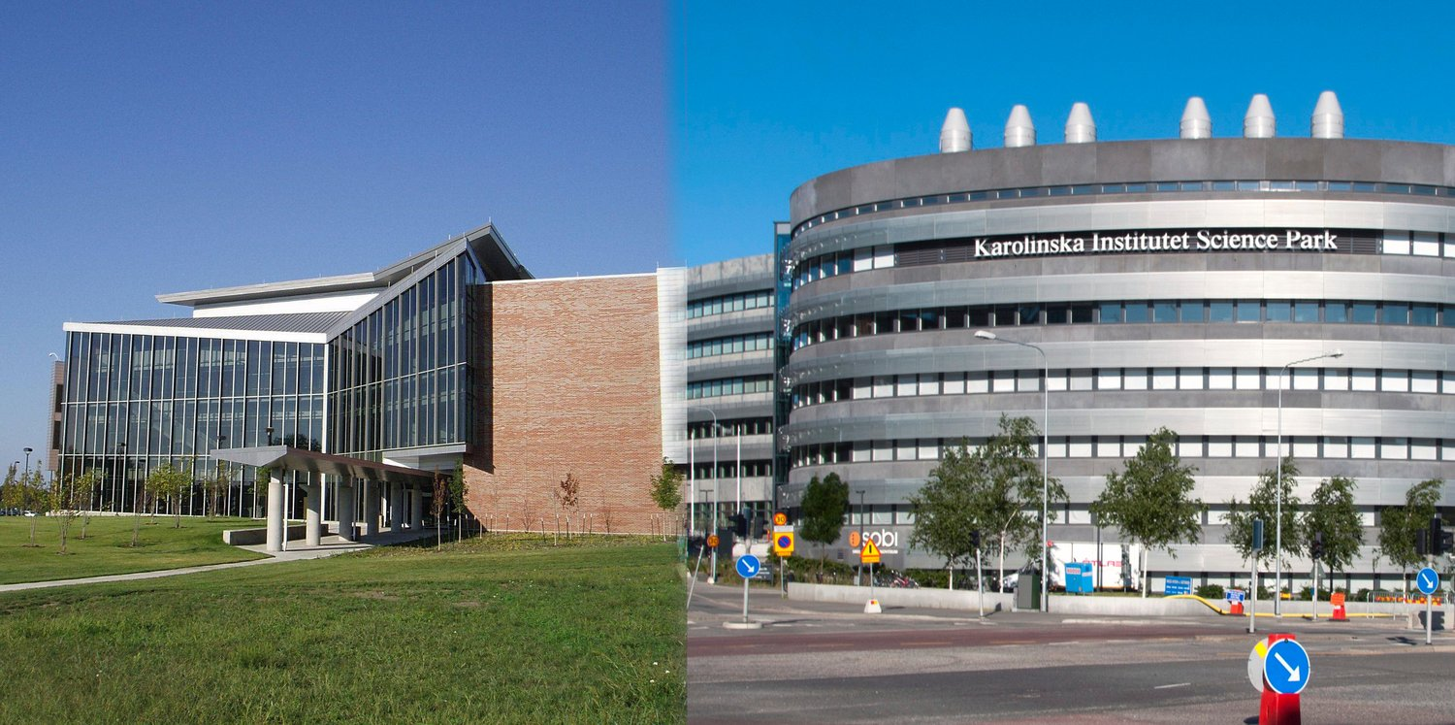

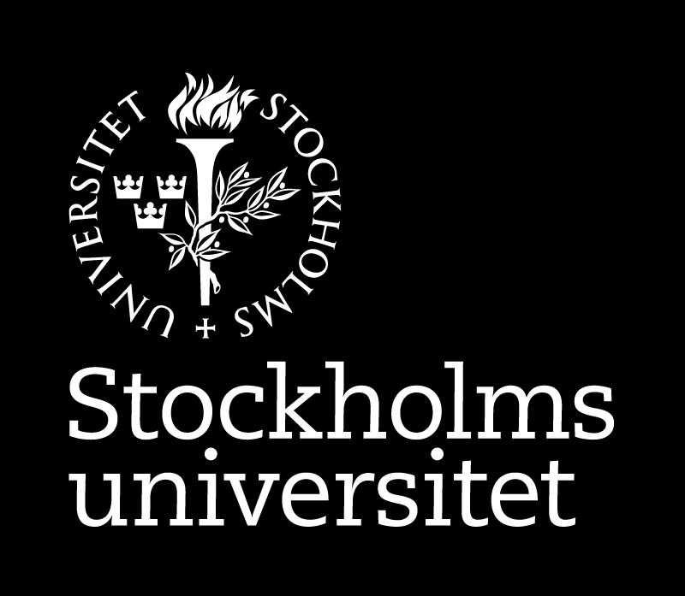
Bioinformatics
KB8029
Petras Kundrotas
Center for Computational Biology
The University of Kansas
Lawrence, Kansas, USA
Protein Bioinformatics
SciLife lab
Department of Biochemistry and Biophysics
Stockholm University
Stockholm, Sweden
pkundro@ku.edu
Stockholm University and SciLife Lab, February 27, 2026

Slide 2

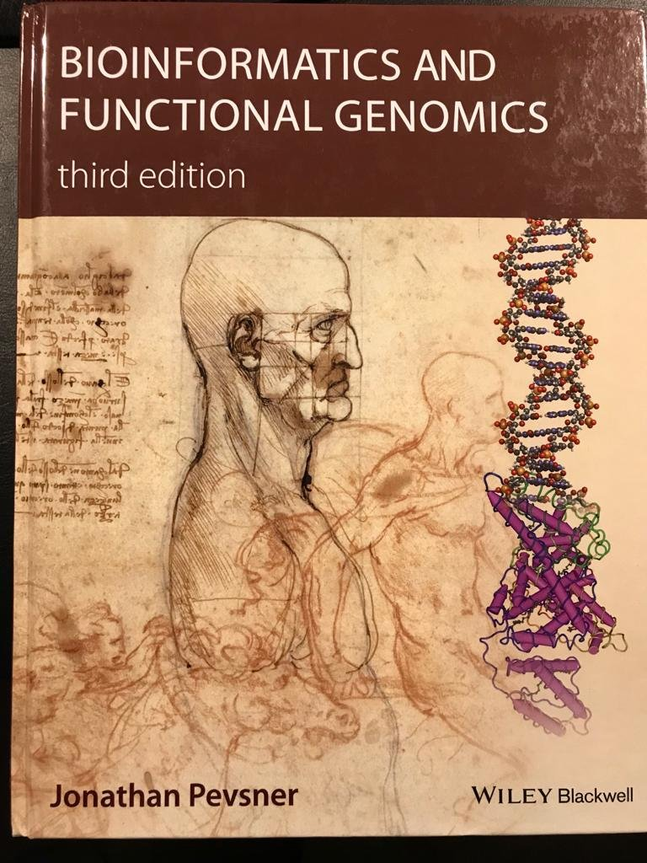
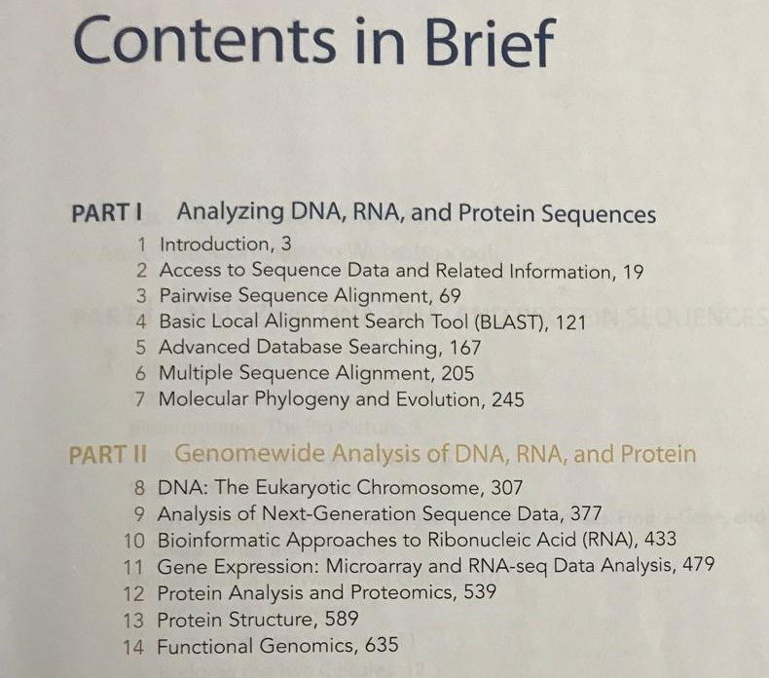
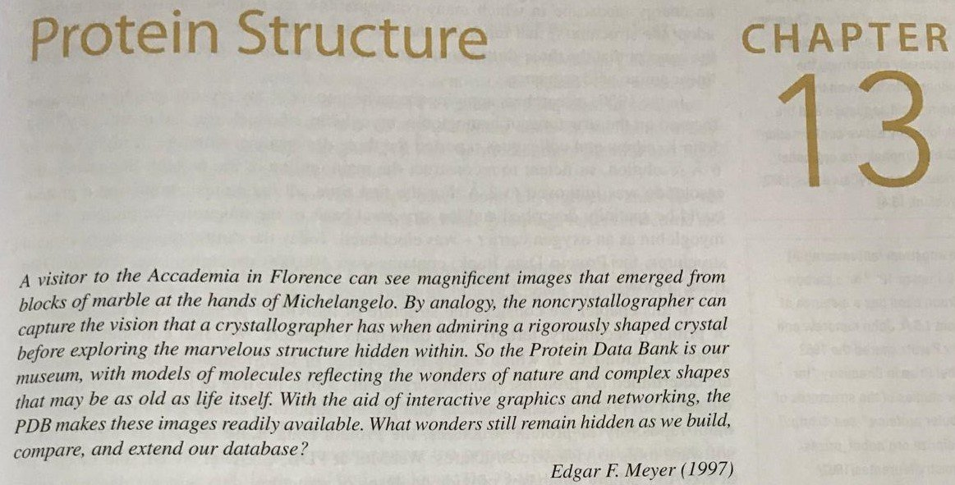
Notes:
Pevsner book describes protein structure in Chapter 13 as shown here. Some material in this lecture will be taken from that chapter. Also, some quiz questions will be based on the book as well.
Thus, you need to read this chapter. However, there will be additional material in the lecture not covered in the book and some quiz and, eventually, exam questions will be based solely on the material from these slides.

Slide 3
Protein Structure
Notes:
Pevsner book describes protein structure in Chapter 13 as shown here. Some material in this lecture will be taken from that chapter. Also, some quiz questions will be based on the book as well.
Thus, you need to read this chapter. However, there will be additional material in the lecture not covered in the book and some quiz and, eventually, exam questions will be based solely on the material from these slides.

Slide 4
Protein Structure
Plus, some additional material
Notes:
Pevsner book describes protein structure in Chapter 13 as shown here. Some material in this lecture will be taken from that chapter. Also, some quiz questions will be based on the book as well.
Thus, you need to read this chapter. However, there will be additional material in the lecture not covered in the book and some quiz and, eventually, exam questions will be based solely on the material from these slides.

Slide 5
Backbone and side chains
Amino acids and their properties (primary structure)
Secondary structure elements
Tertiary and quaternary structure
tertiary structure
quaternary structure
tertiary structure
quaternary structure
Protein domains
Main databases
Notes:
Classically, all the lectures on protein structures start from telling the story about four levels of protein structures. I will not break that tradition, just that I would like to put more emphasis on how proteins (and their assemblies) are formed. That is why I called this part of the lection “From atoms to proteins”, where I would like to present how atoms form those bricks of life (how often proteins are called) and along that way, different levels of the structure (primary, secondary, tertiary and quaternary) will be introduced.
Since protein atoms can be arranged in many ways, there is need in some quantities that will indicate how different (or similar) structures are. And in the second part of the lecture, I will present a brief (far from comprehensive, of course) overview of the most popular similarity measures. This will be done separately for for tertiary and quaternary structures, as those two types of structures require different approaches.
In the third part of the lecture, main emphasis will be done on generic overview of how 3-dimensional arrangements of protein atoms can be inferred from computer simulations. This overview will be rather sketchy as this subject is worth of a separate course. I will show differences and similarities in computational approaches for modelling tertiary (i.e. individual proteins) and quaternary (i.e. protein assemblies) structures. Later in the course, you will have detailed account on most modern way of structural modelling by means of various flavours of artificial intelligence (AI) models, and thus here I will present pre-AI methods, which still can be useful in appropriate circumstances.
And finally, I will present several widely used classifications of protein tertiary structures. Classifications of quaternary structures are still under development and thus I will not touch that subject. I also will mention main databases for storing protein structural information. Those databases were already mentioned in the course’s first lecture, and you will have opportunity to play with them during the Lab.

Slide 6
Highlights:
Backbone and side chains
Amino acids and their properties (primary structure)
Secondary structure elements
Tertiary and quaternary structure
tertiary structure
quaternary structure
tertiary structure
quaternary structure
Protein domains
Main databases
Notes:
Classically, all the lectures on protein structures start from telling the story about four levels of protein structures. I will not break that tradition, just that I would like to put more emphasis on how proteins (and their assemblies) are formed. That is why I called this part of the lection “From atoms to proteins”, where I would like to present how atoms form those bricks of life (how often proteins are called) and along that way, different levels of the structure (primary, secondary, tertiary and quaternary) will be introduced.
Since protein atoms can be arranged in many ways, there is need in some quantities that will indicate how different (or similar) structures are. And in the second part of the lecture, I will present a brief (far from comprehensive, of course) overview of the most popular similarity measures. This will be done separately for for tertiary and quaternary structures, as those two types of structures require different approaches.
In the third part of the lecture, main emphasis will be done on generic overview of how 3-dimensional arrangements of protein atoms can be inferred from computer simulations. This overview will be rather sketchy as this subject is worth of a separate course. I will show differences and similarities in computational approaches for modelling tertiary (i.e. individual proteins) and quaternary (i.e. protein assemblies) structures. Later in the course, you will have detailed account on most modern way of structural modelling by means of various flavours of artificial intelligence (AI) models, and thus here I will present pre-AI methods, which still can be useful in appropriate circumstances.
And finally, I will present several widely used classifications of protein tertiary structures. Classifications of quaternary structures are still under development and thus I will not touch that subject. I also will mention main databases for storing protein structural information. Those databases were already mentioned in the course’s first lecture, and you will have opportunity to play with them during the Lab.

Slide 7
Highlights:
From atoms to proteins
Backbone and side chains
Amino acids and their properties (primary structure)
Secondary structure elements
Tertiary and quaternary structure
tertiary structure
quaternary structure
tertiary structure
quaternary structure
Protein domains
Main databases
Notes:
Classically, all the lectures on protein structures start from telling the story about four levels of protein structures. I will not break that tradition, just that I would like to put more emphasis on how proteins (and their assemblies) are formed. That is why I called this part of the lection “From atoms to proteins”, where I would like to present how atoms form those bricks of life (how often proteins are called) and along that way, different levels of the structure (primary, secondary, tertiary and quaternary) will be introduced.
Since protein atoms can be arranged in many ways, there is need in some quantities that will indicate how different (or similar) structures are. And in the second part of the lecture, I will present a brief (far from comprehensive, of course) overview of the most popular similarity measures. This will be done separately for for tertiary and quaternary structures, as those two types of structures require different approaches.
In the third part of the lecture, main emphasis will be done on generic overview of how 3-dimensional arrangements of protein atoms can be inferred from computer simulations. This overview will be rather sketchy as this subject is worth of a separate course. I will show differences and similarities in computational approaches for modelling tertiary (i.e. individual proteins) and quaternary (i.e. protein assemblies) structures. Later in the course, you will have detailed account on most modern way of structural modelling by means of various flavours of artificial intelligence (AI) models, and thus here I will present pre-AI methods, which still can be useful in appropriate circumstances.
And finally, I will present several widely used classifications of protein tertiary structures. Classifications of quaternary structures are still under development and thus I will not touch that subject. I also will mention main databases for storing protein structural information. Those databases were already mentioned in the course’s first lecture, and you will have opportunity to play with them during the Lab.

Slide 8
Highlights:
From atoms to proteins
Backbone and side chains
Amino acids and their properties (primary structure)
Secondary structure elements
Tertiary and quaternary structure
Comparing
tertiary structure
quaternary structure
tertiary structure
quaternary structure
Protein domains
Main databases
Notes:
Classically, all the lectures on protein structures start from telling the story about four levels of protein structures. I will not break that tradition, just that I would like to put more emphasis on how proteins (and their assemblies) are formed. That is why I called this part of the lection “From atoms to proteins”, where I would like to present how atoms form those bricks of life (how often proteins are called) and along that way, different levels of the structure (primary, secondary, tertiary and quaternary) will be introduced.
Since protein atoms can be arranged in many ways, there is need in some quantities that will indicate how different (or similar) structures are. And in the second part of the lecture, I will present a brief (far from comprehensive, of course) overview of the most popular similarity measures. This will be done separately for for tertiary and quaternary structures, as those two types of structures require different approaches.
In the third part of the lecture, main emphasis will be done on generic overview of how 3-dimensional arrangements of protein atoms can be inferred from computer simulations. This overview will be rather sketchy as this subject is worth of a separate course. I will show differences and similarities in computational approaches for modelling tertiary (i.e. individual proteins) and quaternary (i.e. protein assemblies) structures. Later in the course, you will have detailed account on most modern way of structural modelling by means of various flavours of artificial intelligence (AI) models, and thus here I will present pre-AI methods, which still can be useful in appropriate circumstances.
And finally, I will present several widely used classifications of protein tertiary structures. Classifications of quaternary structures are still under development and thus I will not touch that subject. I also will mention main databases for storing protein structural information. Those databases were already mentioned in the course’s first lecture, and you will have opportunity to play with them during the Lab.

Slide 9
Highlights:
From atoms to proteins
Backbone and side chains
Amino acids and their properties (primary structure)
Secondary structure elements
Tertiary and quaternary structure
Comparing
tertiary structure
quaternary structure
Predicting
tertiary structure
quaternary structure
Protein domains
Main databases
Notes:
Classically, all the lectures on protein structures start from telling the story about four levels of protein structures. I will not break that tradition, just that I would like to put more emphasis on how proteins (and their assemblies) are formed. That is why I called this part of the lection “From atoms to proteins”, where I would like to present how atoms form those bricks of life (how often proteins are called) and along that way, different levels of the structure (primary, secondary, tertiary and quaternary) will be introduced.
Since protein atoms can be arranged in many ways, there is need in some quantities that will indicate how different (or similar) structures are. And in the second part of the lecture, I will present a brief (far from comprehensive, of course) overview of the most popular similarity measures. This will be done separately for for tertiary and quaternary structures, as those two types of structures require different approaches.
In the third part of the lecture, main emphasis will be done on generic overview of how 3-dimensional arrangements of protein atoms can be inferred from computer simulations. This overview will be rather sketchy as this subject is worth of a separate course. I will show differences and similarities in computational approaches for modelling tertiary (i.e. individual proteins) and quaternary (i.e. protein assemblies) structures. Later in the course, you will have detailed account on most modern way of structural modelling by means of various flavours of artificial intelligence (AI) models, and thus here I will present pre-AI methods, which still can be useful in appropriate circumstances.
And finally, I will present several widely used classifications of protein tertiary structures. Classifications of quaternary structures are still under development and thus I will not touch that subject. I also will mention main databases for storing protein structural information. Those databases were already mentioned in the course’s first lecture, and you will have opportunity to play with them during the Lab.

Slide 10
Highlights:
From atoms to proteins
Backbone and side chains
Amino acids and their properties (primary structure)
Secondary structure elements
Tertiary and quaternary structure
Comparing
tertiary structure
quaternary structure
Predicting
tertiary structure
quaternary structure
Classifying and storing
Protein domains
Main databases
Notes:
Classically, all the lectures on protein structures start from telling the story about four levels of protein structures. I will not break that tradition, just that I would like to put more emphasis on how proteins (and their assemblies) are formed. That is why I called this part of the lection “From atoms to proteins”, where I would like to present how atoms form those bricks of life (how often proteins are called) and along that way, different levels of the structure (primary, secondary, tertiary and quaternary) will be introduced.
Since protein atoms can be arranged in many ways, there is need in some quantities that will indicate how different (or similar) structures are. And in the second part of the lecture, I will present a brief (far from comprehensive, of course) overview of the most popular similarity measures. This will be done separately for for tertiary and quaternary structures, as those two types of structures require different approaches.
In the third part of the lecture, main emphasis will be done on generic overview of how 3-dimensional arrangements of protein atoms can be inferred from computer simulations. This overview will be rather sketchy as this subject is worth of a separate course. I will show differences and similarities in computational approaches for modelling tertiary (i.e. individual proteins) and quaternary (i.e. protein assemblies) structures. Later in the course, you will have detailed account on most modern way of structural modelling by means of various flavours of artificial intelligence (AI) models, and thus here I will present pre-AI methods, which still can be useful in appropriate circumstances.
And finally, I will present several widely used classifications of protein tertiary structures. Classifications of quaternary structures are still under development and thus I will not touch that subject. I also will mention main databases for storing protein structural information. Those databases were already mentioned in the course’s first lecture, and you will have opportunity to play with them during the Lab.

Slide 11
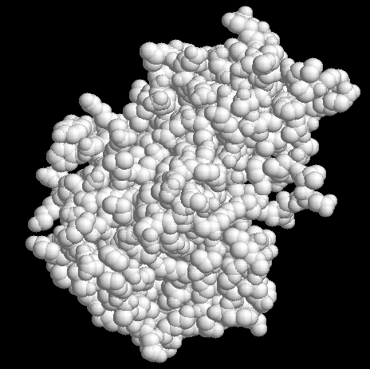
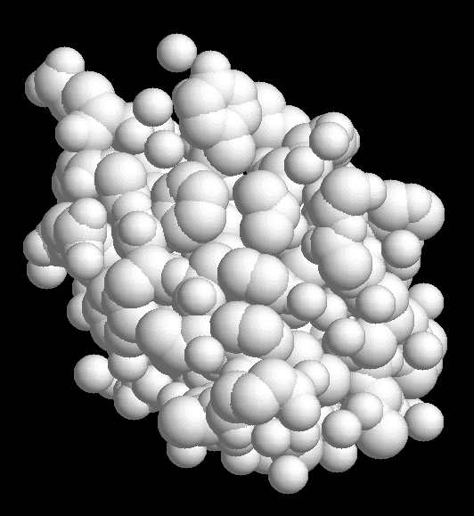
Alcohol dehydrogenase
Insulin
65 Å
34 Å
Notes:
Let’s start with defining what proteins are. Intuitively, proteins are large molecules. For example, two proteins shown here, alcohol dehydrogenase and insulin consists of 2643 and 411 atoms, respectively and have dimensions ~ 65 and ~34 Å3, correspondingly.

Slide 12
Proteins
Alcohol dehydrogenase
Insulin
65 Å
34 Å
Notes:
Let’s start with defining what proteins are. Intuitively, proteins are large molecules. For example, two proteins shown here, alcohol dehydrogenase and insulin consists of 2643 and 411 atoms, respectively and have dimensions ~ 65 and ~34 Å3, correspondingly.

Slide 13
Proteins
are large molecules
Alcohol dehydrogenase
Insulin
65 Å
34 Å
Notes:
Let’s start with defining what proteins are. Intuitively, proteins are large molecules. For example, two proteins shown here, alcohol dehydrogenase and insulin consists of 2643 and 411 atoms, respectively and have dimensions ~ 65 and ~34 Å3, correspondingly.

Slide 14
Proteins
are large molecules
Alcohol dehydrogenase
Insulin
65 Å
34 Å
2643 atoms
411 atoms
Notes:
Let’s start with defining what proteins are. Intuitively, proteins are large molecules. For example, two proteins shown here, alcohol dehydrogenase and insulin consists of 2643 and 411 atoms, respectively and have dimensions ~ 65 and ~34 Å3, correspondingly.

Slide 15
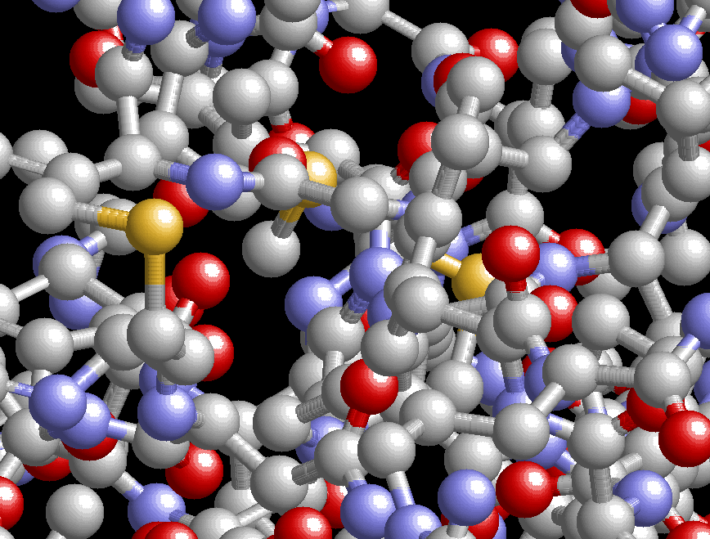
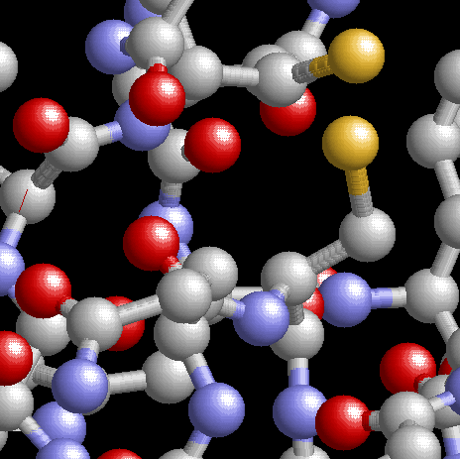
Proteins
are large molecules
Alcohol dehydrogenase
Insulin
2643 atoms
411 atoms
Notes:
However, if we zoom in the structures and color atoms by their type, we can see that there are only few atom types present.

Slide 16
Notes:
Despite seemingly complicated structure of protein molecules, they, in fact, consists of only five types of atoms. Carbon and nitrogen can form long polymer chains and nitrogen, oxygen and hydrogen can form hydrogen bonds and bear charge which is one of the essential factors for stabilizing three-dimensional arrangements of protein atoms, as you will see in the next slides. And finally, sulfur atoms that can form strong disulfide bonds that are also important for structure formation.
For the sake of simplicity, the structure of a protein is often shown without hydrogens. To emphasize that, the term “heavy atoms” is used to denote all atoms, but hydrogens. In the protein structure.

Slide 17
Atoms in Proteins
Notes:
Despite seemingly complicated structure of protein molecules, they, in fact, consists of only five types of atoms. Carbon and nitrogen can form long polymer chains and nitrogen, oxygen and hydrogen can form hydrogen bonds and bear charge which is one of the essential factors for stabilizing three-dimensional arrangements of protein atoms, as you will see in the next slides. And finally, sulfur atoms that can form strong disulfide bonds that are also important for structure formation.
For the sake of simplicity, the structure of a protein is often shown without hydrogens. To emphasize that, the term “heavy atoms” is used to denote all atoms, but hydrogens. In the protein structure.

Slide 18
Atoms in Proteins
Carbon
Form long polymer chains
Nitrogen
Notes:
Despite seemingly complicated structure of protein molecules, they, in fact, consists of only five types of atoms. Carbon and nitrogen can form long polymer chains and nitrogen, oxygen and hydrogen can form hydrogen bonds and bear charge which is one of the essential factors for stabilizing three-dimensional arrangements of protein atoms, as you will see in the next slides. And finally, sulfur atoms that can form strong disulfide bonds that are also important for structure formation.
For the sake of simplicity, the structure of a protein is often shown without hydrogens. To emphasize that, the term “heavy atoms” is used to denote all atoms, but hydrogens. In the protein structure.

Slide 19
Atoms in Proteins
Carbon
Form long polymer chains
Nitrogen
Oxygen
Form hydrogen bond and bear a charge
Hydrogen
Notes:
Despite seemingly complicated structure of protein molecules, they, in fact, consists of only five types of atoms. Carbon and nitrogen can form long polymer chains and nitrogen, oxygen and hydrogen can form hydrogen bonds and bear charge which is one of the essential factors for stabilizing three-dimensional arrangements of protein atoms, as you will see in the next slides. And finally, sulfur atoms that can form strong disulfide bonds that are also important for structure formation.
For the sake of simplicity, the structure of a protein is often shown without hydrogens. To emphasize that, the term “heavy atoms” is used to denote all atoms, but hydrogens. In the protein structure.

Slide 20
Atoms in Proteins
Carbon
Form long polymer chains
Nitrogen
Oxygen
Form hydrogen bond and bear a charge
Hydrogen
Sulfur
Form disulfide bond
Notes:
Despite seemingly complicated structure of protein molecules, they, in fact, consists of only five types of atoms. Carbon and nitrogen can form long polymer chains and nitrogen, oxygen and hydrogen can form hydrogen bonds and bear charge which is one of the essential factors for stabilizing three-dimensional arrangements of protein atoms, as you will see in the next slides. And finally, sulfur atoms that can form strong disulfide bonds that are also important for structure formation.
For the sake of simplicity, the structure of a protein is often shown without hydrogens. To emphasize that, the term “heavy atoms” is used to denote all atoms, but hydrogens. In the protein structure.

Slide 21
Notes:
So, first of all, proteins are flexible polymer chains.

Slide 22
Backbone
Notes:
So, first of all, proteins are flexible polymer chains.

Slide 23
Backbone
Proteins are flexible polymer chains
Notes:
So, first of all, proteins are flexible polymer chains.

Slide 24
Backbone
Proteins are flexible polymer chains
H
O
N
H
C
C
C
N
O
H
Notes:
Here word polymer is emphasized.
And lower picture shows fragment of that chain. The fragment from N to C atom (called as residue) can be repeated, in principle, infinite number of times, thus creating chains as long as needed for a protein to function. That long chain is called backbone of a protein.
Note that term “residue” often is considered as synonym to “amino acid”, which is not completely true. As you noticed from the picture there is a bond going from Ca atom. In this slide I did not put anything there just to emphasize repeatable fragment of protein chain. However, there are also atoms attached to the Ca atom (called side chains), which will be discussed in the following slides and repeatable portion of backbone together with side chain is called amino acid.

Slide 25
Backbone
polymer
Proteins are flexible polymer chains
H
O
N
H
C
C
C
N
O
H
Notes:
Here word polymer is emphasized.
And lower picture shows fragment of that chain. The fragment from N to C atom (called as residue) can be repeated, in principle, infinite number of times, thus creating chains as long as needed for a protein to function. That long chain is called backbone of a protein.
Note that term “residue” often is considered as synonym to “amino acid”, which is not completely true. As you noticed from the picture there is a bond going from Ca atom. In this slide I did not put anything there just to emphasize repeatable fragment of protein chain. However, there are also atoms attached to the Ca atom (called side chains), which will be discussed in the following slides and repeatable portion of backbone together with side chain is called amino acid.

Slide 26
Backbone
polymer
Proteins are flexible polymer chains
Generic structure
H
O
N
H
C
C
C
N
O
H
Notes:
Here word polymer is emphasized.
And lower picture shows fragment of that chain. The fragment from N to C atom (called as residue) can be repeated, in principle, infinite number of times, thus creating chains as long as needed for a protein to function. That long chain is called backbone of a protein.
Note that term “residue” often is considered as synonym to “amino acid”, which is not completely true. As you noticed from the picture there is a bond going from Ca atom. In this slide I did not put anything there just to emphasize repeatable fragment of protein chain. However, there are also atoms attached to the Ca atom (called side chains), which will be discussed in the following slides and repeatable portion of backbone together with side chain is called amino acid.

Slide 27
Backbone
Proteins are flexible polymer chains
Generic structure
H
O
N
H
C
C


C
N
O
H
Notes:
Now, I would like to emphasize word flexible. It means that atoms can rotate about two angles ψ and φ, as indicated by circular arrow on the fragment.
Those angles are called dihedral angles and animation on the right demonstrates how position of an atom in backbone (nitrogen in this example) can change with respect to the three atoms located before it in the backbone (in this example, nitrogen and two carbon atoms from the previous residue.
The rotation around C-N bond (third possible dihedral angle ω) is difficult due to peculiarities in electron distribution in that bond (interested students may consult any quantum chemistry book here) and thus usually is not considered. Note, that only two possible value of that angle are present in the nature: mostly widespread 180°, trans conformation and much less frequently encountered (in ~0.3% of cases) 0°, cis conformation.

Slide 28
Backbone
Proteins are flexible polymer chains
flexible
Generic structure
H
O
N
H
C
C


C
N
O
H
Notes:
Now, I would like to emphasize word flexible. It means that atoms can rotate about two angles ψ and φ, as indicated by circular arrow on the fragment.
Those angles are called dihedral angles and animation on the right demonstrates how position of an atom in backbone (nitrogen in this example) can change with respect to the three atoms located before it in the backbone (in this example, nitrogen and two carbon atoms from the previous residue.
The rotation around C-N bond (third possible dihedral angle ω) is difficult due to peculiarities in electron distribution in that bond (interested students may consult any quantum chemistry book here) and thus usually is not considered. Note, that only two possible value of that angle are present in the nature: mostly widespread 180°, trans conformation and much less frequently encountered (in ~0.3% of cases) 0°, cis conformation.

Slide 29
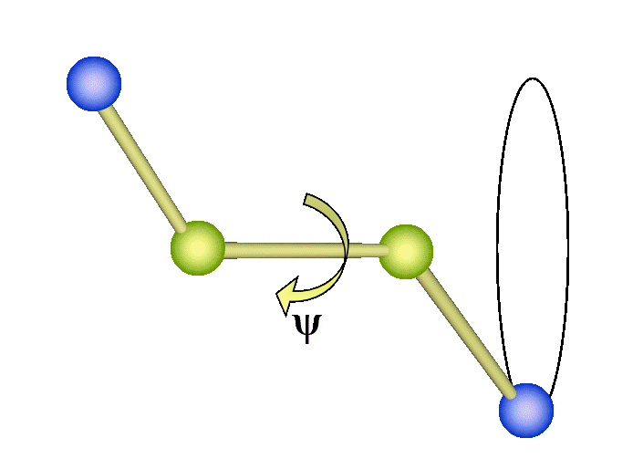
Backbone
Proteins are flexible polymer chains
flexible
Generic structure
Dihedral angle
H
O
N
H
C
C


C
N
O
H
Notes:
Now, I would like to emphasize word flexible. It means that atoms can rotate about two angles ψ and φ, as indicated by circular arrow on the fragment.
Those angles are called dihedral angles and animation on the right demonstrates how position of an atom in backbone (nitrogen in this example) can change with respect to the three atoms located before it in the backbone (in this example, nitrogen and two carbon atoms from the previous residue.
The rotation around C-N bond (third possible dihedral angle ω) is difficult due to peculiarities in electron distribution in that bond (interested students may consult any quantum chemistry book here) and thus usually is not considered. Note, that only two possible value of that angle are present in the nature: mostly widespread 180°, trans conformation and much less frequently encountered (in ~0.3% of cases) 0°, cis conformation.

Slide 30

Backbone
Proteins are flexible polymer chains
flexible
Generic structure
Dihedral angle
H
O
N
H
C
C


C
N
O
H
Notes:
Now, I would like to emphasize word flexible. It means that atoms can rotate about two angles ψ and φ, as indicated by circular arrow on the fragment.
Those angles are called dihedral angles and animation on the right demonstrates how position of an atom in backbone (nitrogen in this example) can change with respect to the three atoms located before it in the backbone (in this example, nitrogen and two carbon atoms from the previous residue.
The rotation around C-N bond (third possible dihedral angle ω) is difficult due to peculiarities in electron distribution in that bond (interested students may consult any quantum chemistry book here) and thus usually is not considered. Note, that only two possible value of that angle are present in the nature: mostly widespread 180°, trans conformation and much less frequently encountered (in ~0.3% of cases) 0°, cis conformation.

Slide 31
Notes:
In this slide, I show again the same two proteins, alcohol dehydrogenase and insulin, but in backbone representation. But “pure” backbone will not make it protein, it is just a “skeleton”, necessary but not sufficient part of the protein structure.

Slide 32
Proteins
Backbone
Notes:
In this slide, I show again the same two proteins, alcohol dehydrogenase and insulin, but in backbone representation. But “pure” backbone will not make it protein, it is just a “skeleton”, necessary but not sufficient part of the protein structure.

Slide 33
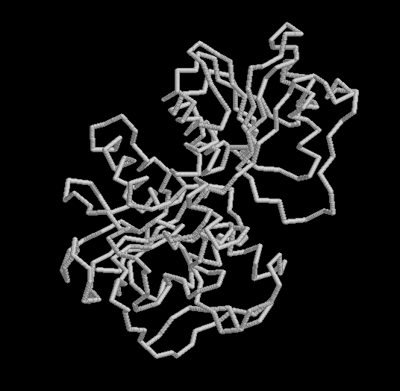
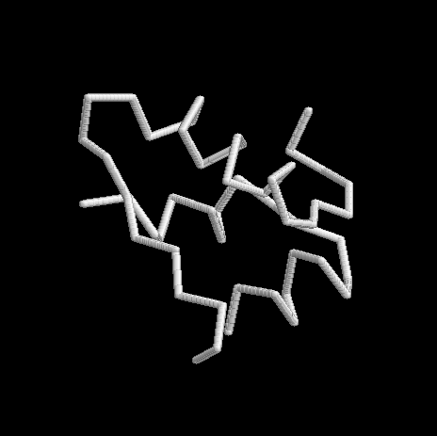
Proteins
Backbone
Alcohol dehydrogenase
Insulin
Notes:
In this slide, I show again the same two proteins, alcohol dehydrogenase and insulin, but in backbone representation. But “pure” backbone will not make it protein, it is just a “skeleton”, necessary but not sufficient part of the protein structure.

Slide 34
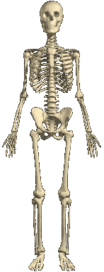
Proteins
Backbone
Alcohol dehydrogenase
Insulin
Backbone is just a skeleton of a protein
Notes:
In this slide, I show again the same two proteins, alcohol dehydrogenase and insulin, but in backbone representation. But “pure” backbone will not make it protein, it is just a “skeleton”, necessary but not sufficient part of the protein structure.

Slide 35
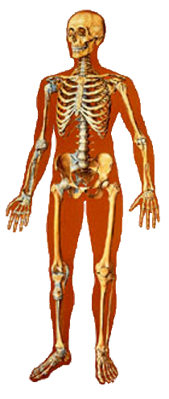
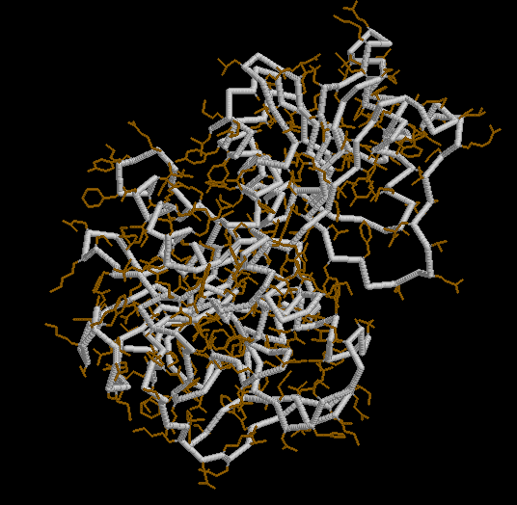
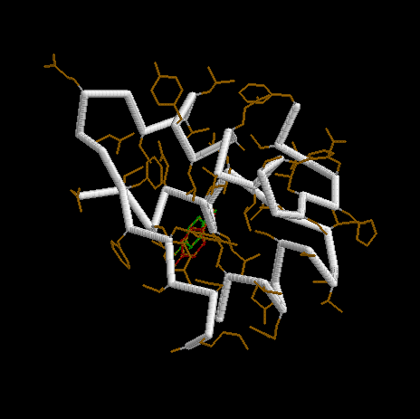
Proteins
Backbone and side chains
Alcohol dehydrogenase
Insulin
Side chains are “flesh on the bones”
Notes:
However, adding side chains, shown here as thin solid lines, adds “flesh to the bones” and polypeptide chain becomes a protein, i.e., large macromolecule performing certain function(s) in a living organism.

Slide 36
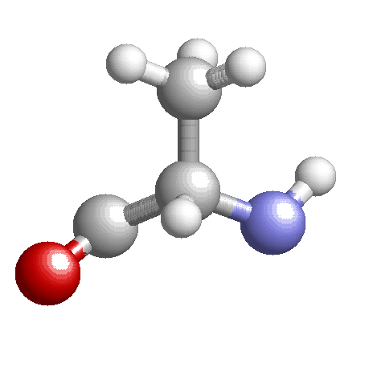
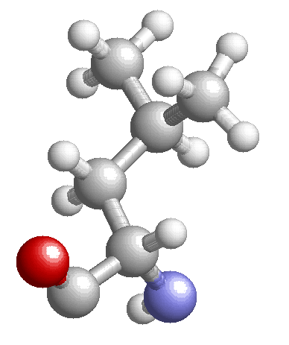
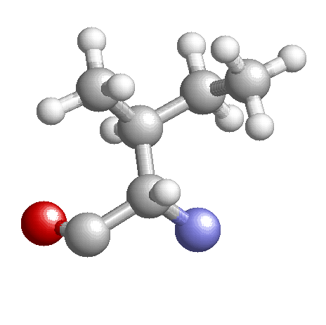
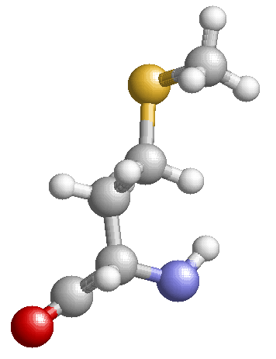
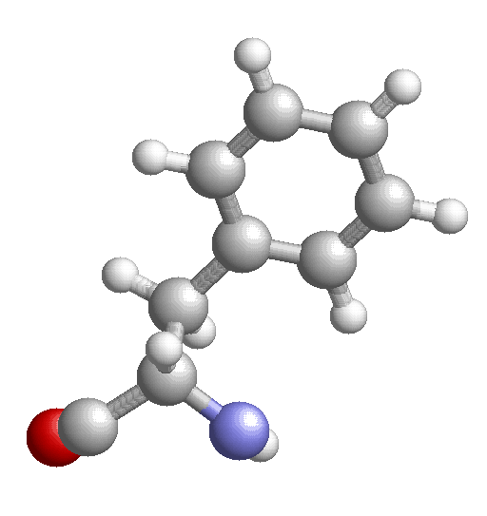
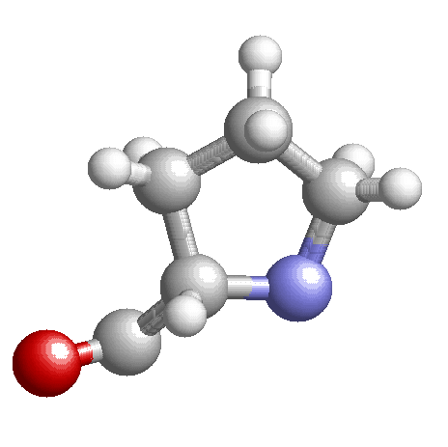
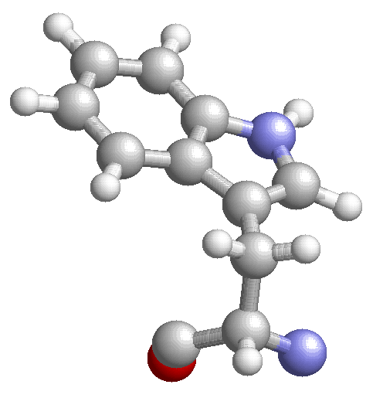
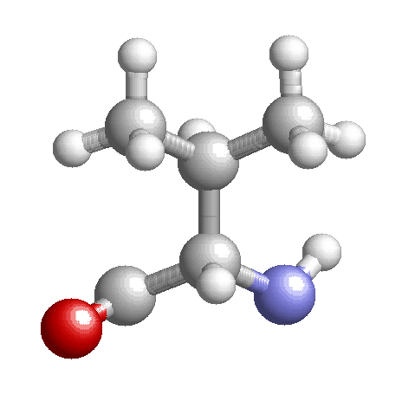
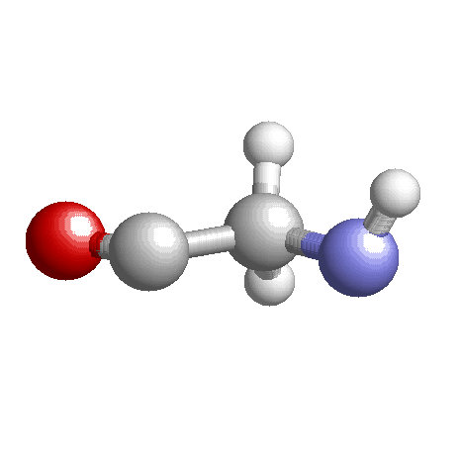
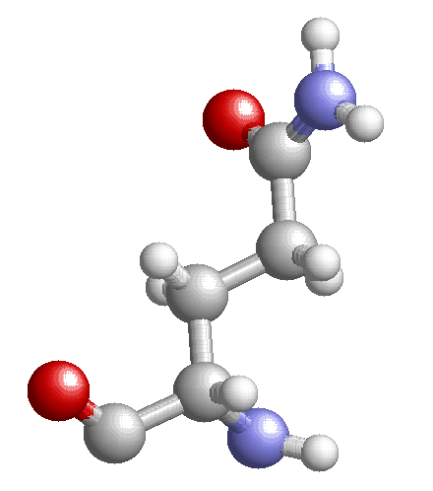
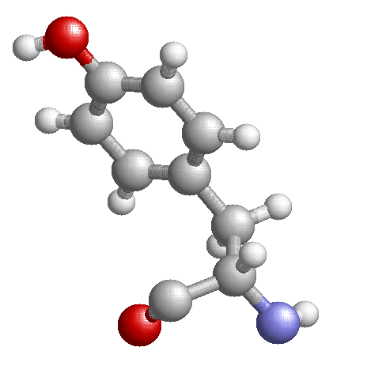
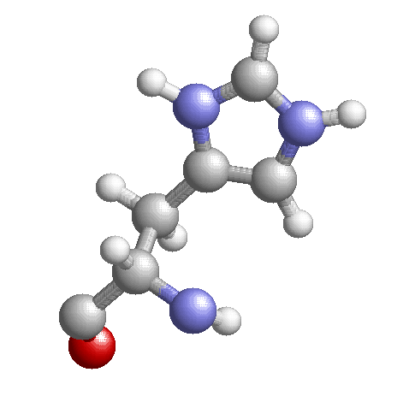
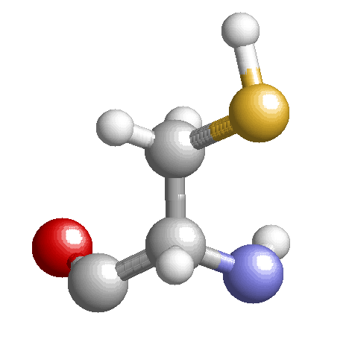
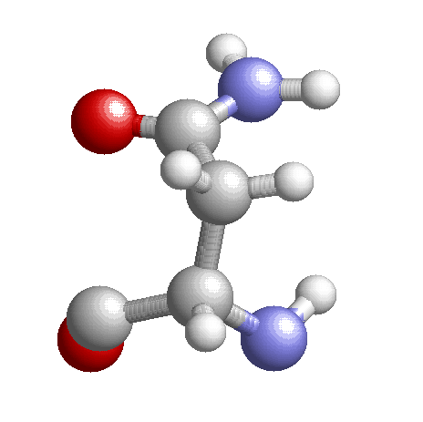
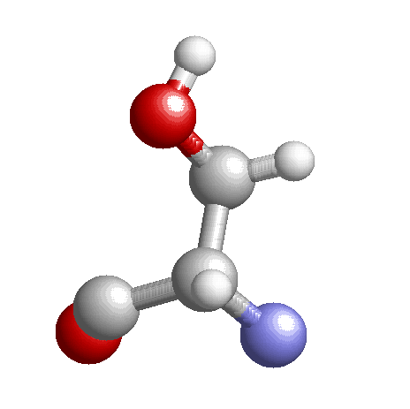
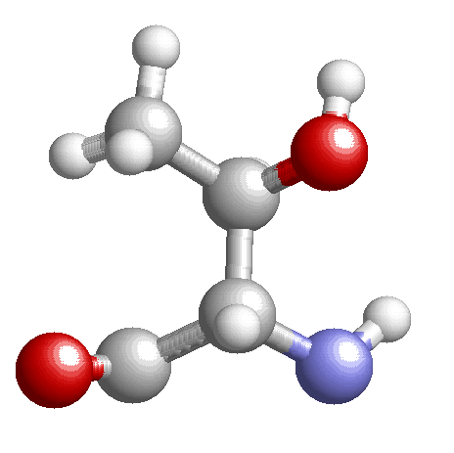
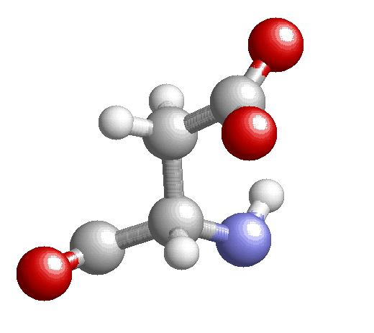
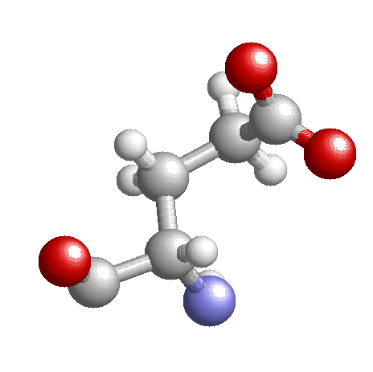
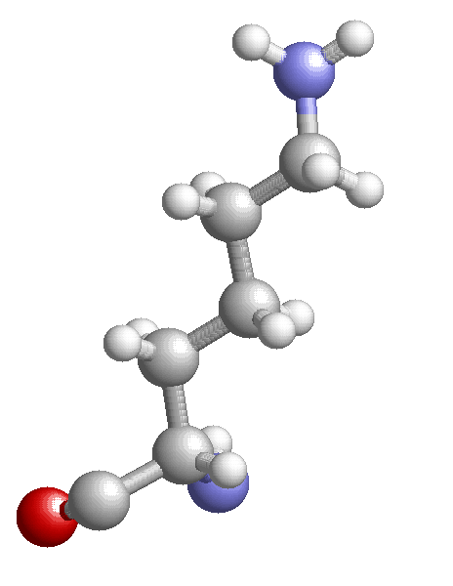
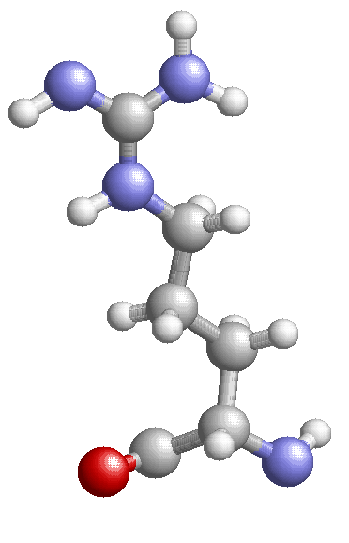
Alanine (ALA, A)
Leucine (LEU, L)
Isoleucine (ILE, I)
Methionine (MET, M)
Phenylalanine (PHE, F)
Proline (PRO, P)
Tryptophan (TRP, W)
Valine (VAL, V)
Glycine (GLY, G)
Asparagine (ASN, N)
Glutamine (GLN, Q)
Serine (SER, S)
Threonine (THR, T)
Tyrosine (TYR, Y)
Histidine (HIS, H)
Cysteine (CYS, C)
Aspartic acid (ASP, D)
Glutamic acid (GLU, E)
Lysine (LYS, K)
Arginine (ARG, R)
Notes:
This slide summarizes three types of the amino acids presented in the proteins along with all-atoms (including hydrogens) structures of the backbone and the side chains. Each amino acid has full name, 3-letters and 1-letter abbreviations, given direct below corresponding amino acid. The hydrophobic side chains consist predominantly of carbon atoms only as those atoms due to their symmetric electron cloud, are not able to form hydrogen bonds. There are two exceptions only, sulfur in MET and nitrogen in TRP, but again sulfur surrounded by other atoms (carbons in this case) and nitrogen within the atomic rings cannot from hydrogen bonds. On the contrary, polar and charged side chains contain nitrogen and oxygen that can form oxygen-nitrogen hydrogen bonds. Following four slides (hidden in the presentation view, but available in editing mode) give, for interested students, a detailed account of those amino acid types and here I would like just to mention following.

Slide 37
Side chains
Alanine (ALA, A)
Leucine (LEU, L)
Isoleucine (ILE, I)
Methionine (MET, M)
Phenylalanine (PHE, F)
Proline (PRO, P)
Tryptophan (TRP, W)
Valine (VAL, V)
Glycine (GLY, G)
Asparagine (ASN, N)
Glutamine (GLN, Q)
Serine (SER, S)
Threonine (THR, T)
Tyrosine (TYR, Y)
Histidine (HIS, H)
Cysteine (CYS, C)
Aspartic acid (ASP, D)
Glutamic acid (GLU, E)
Lysine (LYS, K)
Arginine (ARG, R)
Notes:
This slide summarizes three types of the amino acids presented in the proteins along with all-atoms (including hydrogens) structures of the backbone and the side chains. Each amino acid has full name, 3-letters and 1-letter abbreviations, given direct below corresponding amino acid. The hydrophobic side chains consist predominantly of carbon atoms only as those atoms due to their symmetric electron cloud, are not able to form hydrogen bonds. There are two exceptions only, sulfur in MET and nitrogen in TRP, but again sulfur surrounded by other atoms (carbons in this case) and nitrogen within the atomic rings cannot from hydrogen bonds. On the contrary, polar and charged side chains contain nitrogen and oxygen that can form oxygen-nitrogen hydrogen bonds. Following four slides (hidden in the presentation view, but available in editing mode) give, for interested students, a detailed account of those amino acid types and here I would like just to mention following.

Slide 38
Side chains
Hydrophobic amino acids
Alanine (ALA, A)
Leucine (LEU, L)
Isoleucine (ILE, I)
Methionine (MET, M)
Phenylalanine (PHE, F)
Proline (PRO, P)
Tryptophan (TRP, W)
Valine (VAL, V)
Glycine (GLY, G)
Asparagine (ASN, N)
Glutamine (GLN, Q)
Serine (SER, S)
Threonine (THR, T)
Tyrosine (TYR, Y)
Histidine (HIS, H)
Cysteine (CYS, C)
Aspartic acid (ASP, D)
Glutamic acid (GLU, E)
Lysine (LYS, K)
Arginine (ARG, R)
Notes:
This slide summarizes three types of the amino acids presented in the proteins along with all-atoms (including hydrogens) structures of the backbone and the side chains. Each amino acid has full name, 3-letters and 1-letter abbreviations, given direct below corresponding amino acid. The hydrophobic side chains consist predominantly of carbon atoms only as those atoms due to their symmetric electron cloud, are not able to form hydrogen bonds. There are two exceptions only, sulfur in MET and nitrogen in TRP, but again sulfur surrounded by other atoms (carbons in this case) and nitrogen within the atomic rings cannot from hydrogen bonds. On the contrary, polar and charged side chains contain nitrogen and oxygen that can form oxygen-nitrogen hydrogen bonds. Following four slides (hidden in the presentation view, but available in editing mode) give, for interested students, a detailed account of those amino acid types and here I would like just to mention following.

Slide 39
Side chains
Hydrophobic amino acids
Alanine (ALA, A)
Leucine (LEU, L)
Isoleucine (ILE, I)
Methionine (MET, M)
Phenylalanine (PHE, F)
Proline (PRO, P)
Tryptophan (TRP, W)
Valine (VAL, V)
Glycine (GLY, G)
Polar amino acids
Asparagine (ASN, N)
Glutamine (GLN, Q)
Serine (SER, S)
Threonine (THR, T)
Tyrosine (TYR, Y)
Histidine (HIS, H)
Cysteine (CYS, C)
Aspartic acid (ASP, D)
Glutamic acid (GLU, E)
Lysine (LYS, K)
Arginine (ARG, R)
Notes:
This slide summarizes three types of the amino acids presented in the proteins along with all-atoms (including hydrogens) structures of the backbone and the side chains. Each amino acid has full name, 3-letters and 1-letter abbreviations, given direct below corresponding amino acid. The hydrophobic side chains consist predominantly of carbon atoms only as those atoms due to their symmetric electron cloud, are not able to form hydrogen bonds. There are two exceptions only, sulfur in MET and nitrogen in TRP, but again sulfur surrounded by other atoms (carbons in this case) and nitrogen within the atomic rings cannot from hydrogen bonds. On the contrary, polar and charged side chains contain nitrogen and oxygen that can form oxygen-nitrogen hydrogen bonds. Following four slides (hidden in the presentation view, but available in editing mode) give, for interested students, a detailed account of those amino acid types and here I would like just to mention following.

Slide 40
Side chains
Hydrophobic amino acids
Alanine (ALA, A)
Leucine (LEU, L)
Isoleucine (ILE, I)
Methionine (MET, M)
Phenylalanine (PHE, F)
Proline (PRO, P)
Tryptophan (TRP, W)
Valine (VAL, V)
Glycine (GLY, G)
Polar amino acids
Asparagine (ASN, N)
Glutamine (GLN, Q)
Serine (SER, S)
Threonine (THR, T)
Tyrosine (TYR, Y)
Histidine (HIS, H)
Cysteine (CYS, C)
Charged (titratable) amino acids
Aspartic acid (ASP, D)
Glutamic acid (GLU, E)
Lysine (LYS, K)
Arginine (ARG, R)
Notes:
This slide summarizes three types of the amino acids presented in the proteins along with all-atoms (including hydrogens) structures of the backbone and the side chains. Each amino acid has full name, 3-letters and 1-letter abbreviations, given direct below corresponding amino acid. The hydrophobic side chains consist predominantly of carbon atoms only as those atoms due to their symmetric electron cloud, are not able to form hydrogen bonds. There are two exceptions only, sulfur in MET and nitrogen in TRP, but again sulfur surrounded by other atoms (carbons in this case) and nitrogen within the atomic rings cannot from hydrogen bonds. On the contrary, polar and charged side chains contain nitrogen and oxygen that can form oxygen-nitrogen hydrogen bonds. Following four slides (hidden in the presentation view, but available in editing mode) give, for interested students, a detailed account of those amino acid types and here I would like just to mention following.

Slide 41
Hydrophobic side chains
Incapable of forming hydrogen bond
Alanine
(ALA, A)
Leucine
(LEU, L)
Isoleucine
(ILE,I)
Valine
(VAL, V)
Methionine
(MET, M)
Proline
(PRO, P)
Phenylalanine
(PHE, F)
Tryptophan
(TRP, W)
Glycine
(GLY, G)

Slide 42
Polar side chains
Capable of forming hydrogen bond
Glutamine (GLU, Q)
Asparagine (ASN, N)
Histidine (HIS, H)
Serine (SER, S)
Tyrosine (TYR, Y)
Threonine (THR, T)
Cysteine (CYS, C)

Slide 43
Charged side chains
May bear charge
Acidic residues (negative charge)
Basic residues (positive charge)
Not protonated form
neutral
charged
Aspartic acid
(ASP, D)
Glutamic acid
(GLU, E)
Lysine (LYS, K)
Arginine (ARG, R)

Slide 44
Charged side chains
May bear charge
Acidic residues (negative charge)
Basic residues (positive charge)
Protonated form
charged
neutral
Aspartic acid
(ASP, D)
Glutamic acid
(GLU, E)
Lysine (LYS, K)
Arginine (ARG, R)

Slide 45
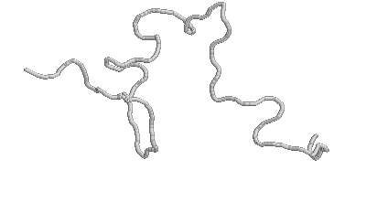
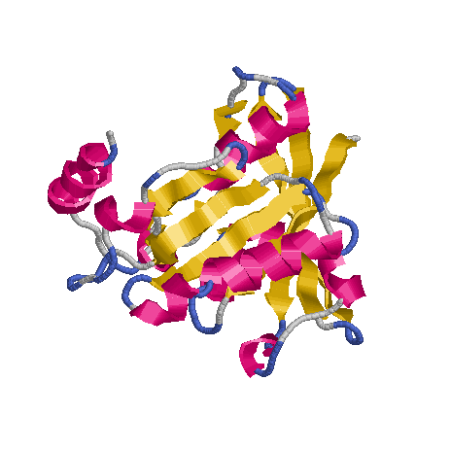
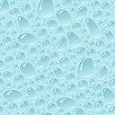
+
+
...
+
Polypeptide chain
Water
Protein
Notes:
When amino acids are connected, they form a polypeptide chain that may as long as needed. Order of amino acids is called primary structure of a protein. It should be noted, however, that the polypeptide chain cannon perform biological function (i.e. to be a protein) unless placed in the water. And this is a water who makes a “magic” by transforming a flexible polypeptide chains into structures we see, for instance, in Pymol.

Slide 46
Primary structure
Order of amino acids in polypeptide chain
+
+
...
Amino acids
Flexible polypeptide chain (not a protein yet)
+
Polypeptide chain
Water
Protein
Notes:
When amino acids are connected, they form a polypeptide chain that may as long as needed. Order of amino acids is called primary structure of a protein. It should be noted, however, that the polypeptide chain cannon perform biological function (i.e. to be a protein) unless placed in the water. And this is a water who makes a “magic” by transforming a flexible polypeptide chains into structures we see, for instance, in Pymol.

Slide 47
Primary structure
Order of amino acids in polypeptide chain
+
+
...
Amino acids
Flexible polypeptide chain (not a protein yet)
Polypeptide chain in water becomes a protein
+
Polypeptide chain
Water
Protein
Notes:
When amino acids are connected, they form a polypeptide chain that may as long as needed. Order of amino acids is called primary structure of a protein. It should be noted, however, that the polypeptide chain cannon perform biological function (i.e. to be a protein) unless placed in the water. And this is a water who makes a “magic” by transforming a flexible polypeptide chains into structures we see, for instance, in Pymol.

Slide 48
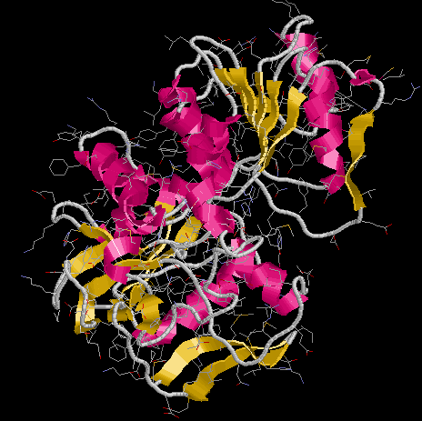
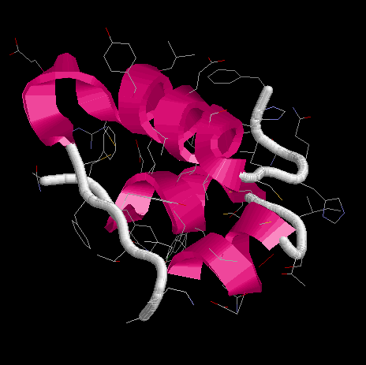
Alcohol dehydrogenase
Insulin
Notes:
As we enable cartoon representation of protein structures in Pymol, we can see that some parts of the structure are displayed differently. Those are rigid elements of the structure called alpha helices and beta strands as shown here.

Slide 49
Secondary structure
Rigid elements of protein structure
Alcohol dehydrogenase
Insulin
Notes:
As we enable cartoon representation of protein structures in Pymol, we can see that some parts of the structure are displayed differently. Those are rigid elements of the structure called alpha helices and beta strands as shown here.

Slide 50
Secondary structure
Rigid elements of protein structure
Alcohol dehydrogenase
Insulin
alpha helices
Notes:
As we enable cartoon representation of protein structures in Pymol, we can see that some parts of the structure are displayed differently. Those are rigid elements of the structure called alpha helices and beta strands as shown here.

Slide 51
Secondary structure
Rigid elements of protein structure
Alcohol dehydrogenase
Insulin
beta strands
alpha helices
Notes:
As we enable cartoon representation of protein structures in Pymol, we can see that some parts of the structure are displayed differently. Those are rigid elements of the structure called alpha helices and beta strands as shown here.

Slide 52
Secondary structure
Notes:
Let’s tale a closer look at those structural element. This slide shows so called alpha helix (pictured in all structure visualization programs as a spiral), a part of the structure stabilized by hydrogen bonds between backbone nitrogen and oxygen atoms, separated by four residues. Note that oxygens and nitrogens of the side chains do not participate in stabilizing alpha helices.

Slide 53
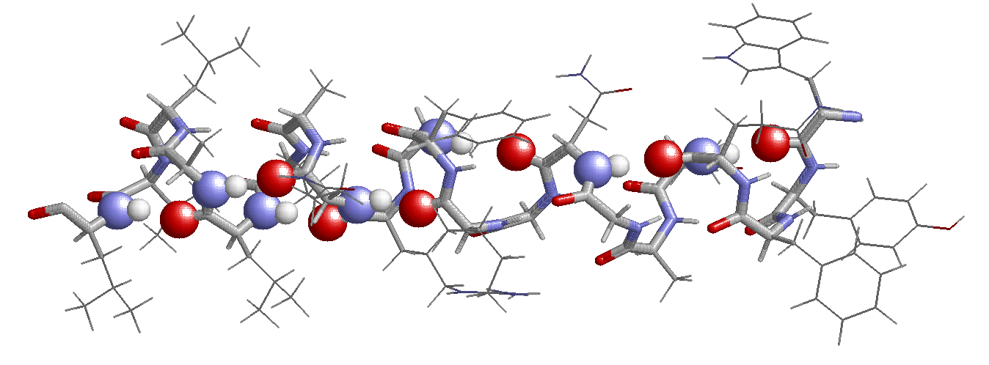
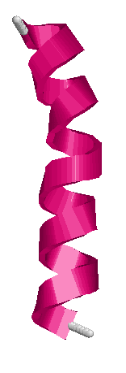
Secondary structure
alpha helices
Hydrogen
bonds
Stabilized by hydrogen bonds between NH and O atoms of the backbone separated by 4 residues
Side chains do not participate in stabilizing helix
Notes:
Let’s tale a closer look at those structural element. This slide shows so called alpha helix (pictured in all structure visualization programs as a spiral), a part of the structure stabilized by hydrogen bonds between backbone nitrogen and oxygen atoms, separated by four residues. Note that oxygens and nitrogens of the side chains do not participate in stabilizing alpha helices.

Slide 54
Secondary structure
Notes:
Another rigid element of the protein structure is part of the backbone in so called extended conformation where all backbone dihedral angles are ~180° . Such a part is known as beta strand and pictured by all visualization programs as a thick flat arrow as shown in this slide. Those strands, however, do not exist alone and form so called beta sheets, which are again stabilized by hydrogen bonds between backbone nitrogen and oxygen atoms. This time atoms forming the hydrogen bond are located in the neighboring strands and it is not important how many residues are in-between them. And again, oxygen and nitrogen atoms of the side chains do not participate in stabilizing beta sheets.

Slide 55
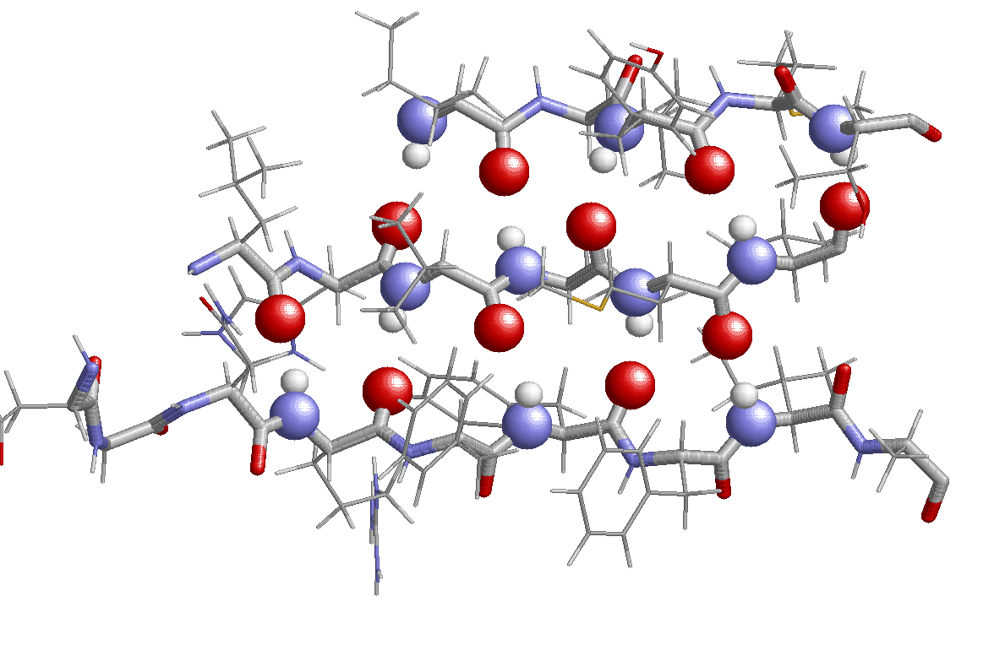
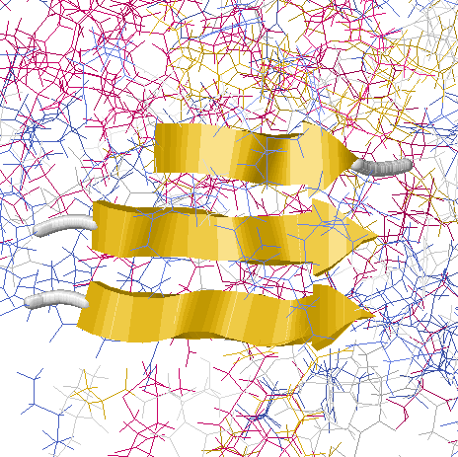
Secondary structure
beta strands and sheets
Hydrogen
bonds
Strands do not exist alone and form sheets
Stabilized by hydrogen bonds between N and O atoms in the neighboring strands
Side chains do not participate in stabilizing sheets
Notes:
Another rigid element of the protein structure is part of the backbone in so called extended conformation where all backbone dihedral angles are ~180° . Such a part is known as beta strand and pictured by all visualization programs as a thick flat arrow as shown in this slide. Those strands, however, do not exist alone and form so called beta sheets, which are again stabilized by hydrogen bonds between backbone nitrogen and oxygen atoms. This time atoms forming the hydrogen bond are located in the neighboring strands and it is not important how many residues are in-between them. And again, oxygen and nitrogen atoms of the side chains do not participate in stabilizing beta sheets.

Slide 56
Alcohol dehydrogenase
Insulin
Notes:
Those secondary structure elements (SSE) are connected into a single polypeptide chain and have a location in space with respect to each other, which is specific for a protein, as shown in this slide for two proteins. That mutual arrangement is space is called tertiary structure of a protein and it comprises single polypeptide chain. That structure is stabilized by hydrophobic effect and non-covalent interactions between atoms of both backbone and side chains. Next two hidden slides provide for interested students a brief overview of those stabilizing factors

Slide 57
Tertiary structure
Mutual arrangement of secondary structure elements
Alcohol dehydrogenase
Insulin
Stabilized by hydrophobic effect
Stabilized by non-covalent bonds between atoms of both backbone and side chains
Notes:
Those secondary structure elements (SSE) are connected into a single polypeptide chain and have a location in space with respect to each other, which is specific for a protein, as shown in this slide for two proteins. That mutual arrangement is space is called tertiary structure of a protein and it comprises single polypeptide chain. That structure is stabilized by hydrophobic effect and non-covalent interactions between atoms of both backbone and side chains. Next two hidden slides provide for interested students a brief overview of those stabilizing factors

Slide 58
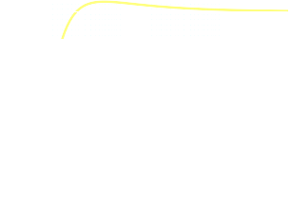
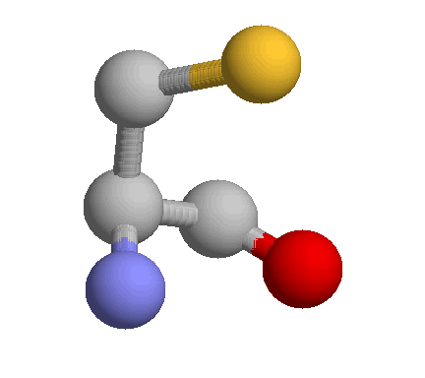
Non-covalent interactions
van der Waals interactions
Attractive long-range part
Repulsive short-range part
Electrostatic interactions
van der Waals radius
Salt bridge
Hydrogen bonding
+
-
Dipole-dipole interactions
Disulfide bond
Notes:
There are four main types of non-covalent atom-atom interactions: van der Waals, electrostatic, hydrogen and disulfide bonds.
Attractive long-range part of VW interactions originates from quantum mechanical fluctuations of the dipole moments of the atoms
Short-term repulsive part comes from repulsion of overlapping electron clouds, electrostatic repulsion of nuclei and pauli exclusion principle
Salt bridge are formed between charged residues in their charged form (see slides before), lysine or arginine from one side (positive charge) and aspartic or glutamic acids (negative charge from another.
Hydrogen bonds are interactions between dipoles which are formed by asymmetric distributions of electron charges between nitrogen and oxygen of backbone and polar side chains.
Disulfide bonds are strong bonds (almost as covalent bonds) formed by two sulfur atoms. That bond is specific for cysteine residues only (sulfur of Methionine is not able to form disulfide bridges).

Slide 59
Hydrophobic effect
Proteins function in water
Pure water
One hydrophobic atom
Two hydrophobic atoms
Hydrophobic
“bond”
Hydrogen
bonds
Notes:
Water molecules form hydrogen bonds between themselves, which makes water a unique liquid from physics-chemical prospectives. One of those features, important for protein functioning, is so-called hydrophobic effect. Since carbon atoms are not able to form hydrogen bonds, water molecules re-arrange themselves to “surround” and “”isolate” that “hostile intruder”. If there two (or more) such atoms, that rearrangement leads to the absence of watr molecules between those atoms and it is said sometimes that those atoms form a hydrophobic “bond”. Hydrophobic effect is a driving force for protein folding.

Slide 60
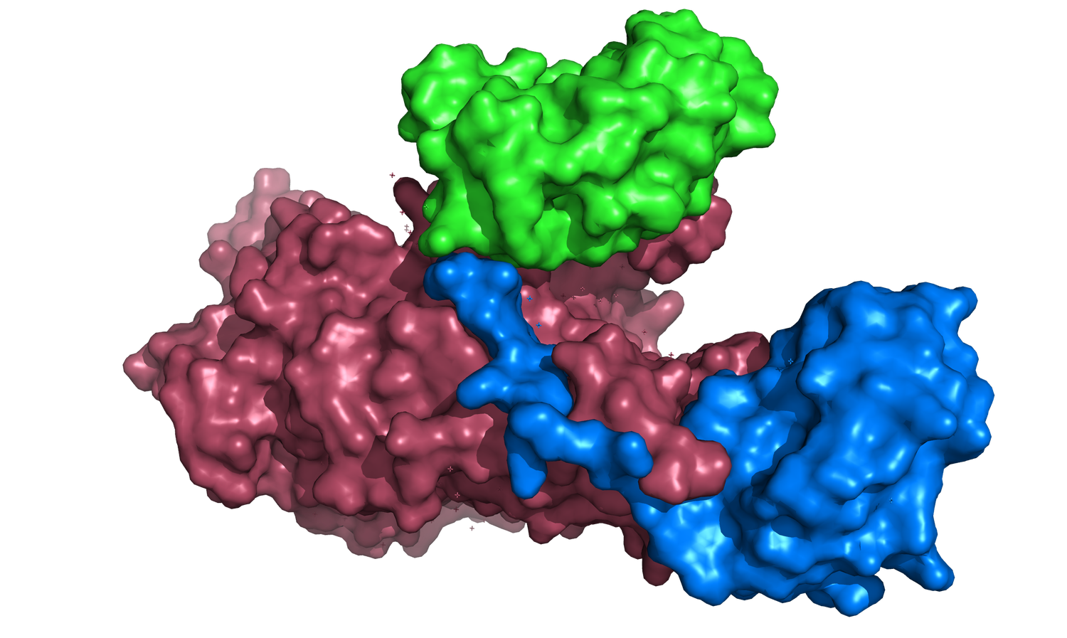
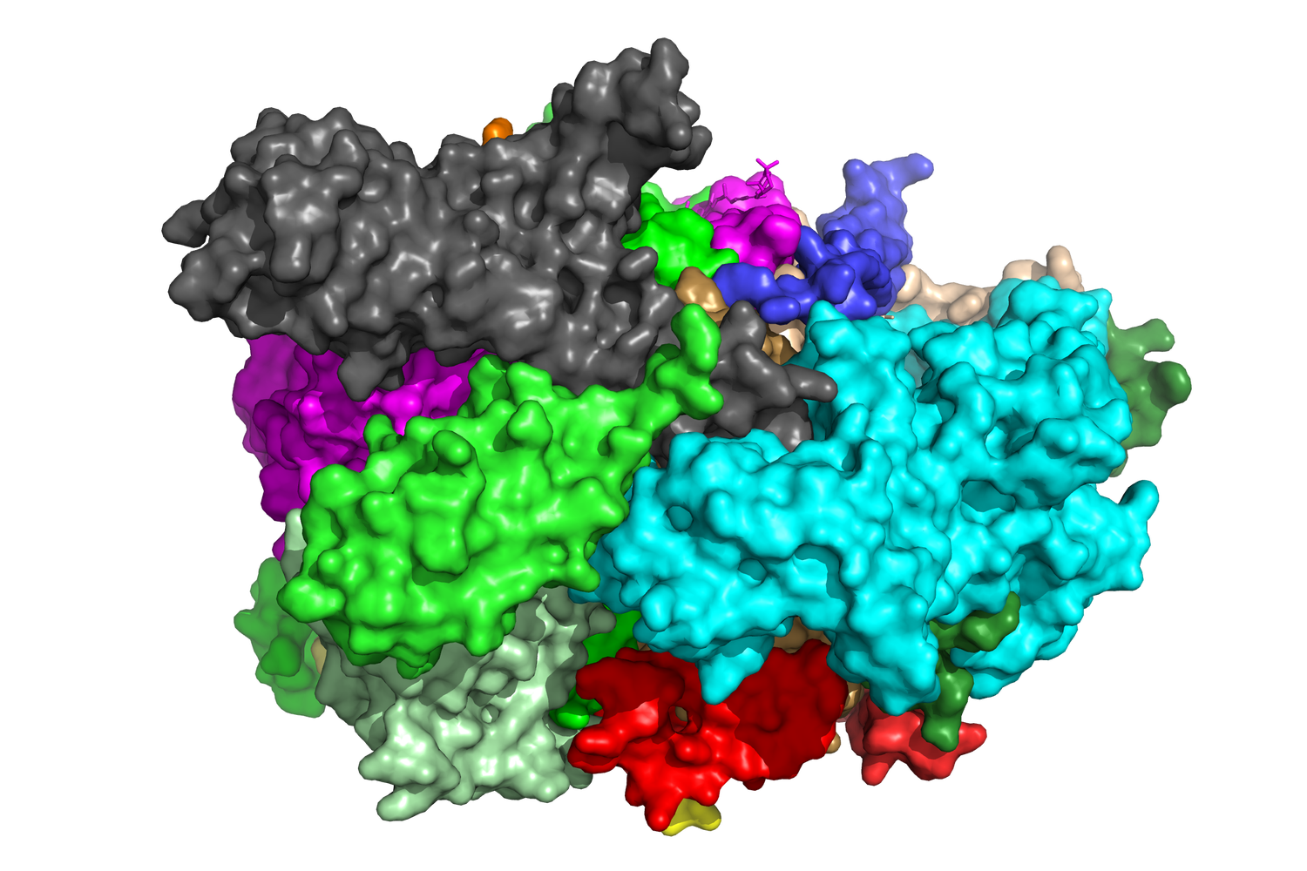
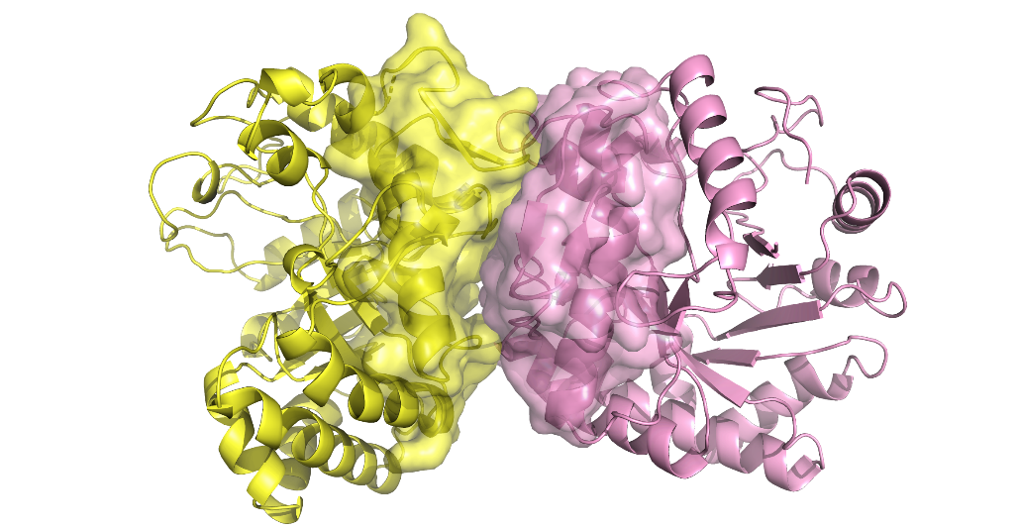
dimer
trimer
20-mer
…
…
Notes:
Proteins can form complexes with two, three and more chains (some experimentally resolved structures contain hundreds of chains) and description of how tertiary structures of individual proteins are arranged with respect to each other in space, are called quaternary structure, the highest level of protein structure. This structure again is stabilized by hydrophobic effect as it energetically unfavorable to have water trapped between hydrophobic patces of protein surfaces, as well as by non-covalent interaction between atoms belonging to different polypeptide chains.

Slide 61
Quaternary structure
Mutual arrangement of protein molecules
dimer
trimer
20-mer
…
…
Stabilized by hydrophobic effect
Stabilized by non-covalent bonds between atoms from different chains
Notes:
Proteins can form complexes with two, three and more chains (some experimentally resolved structures contain hundreds of chains) and description of how tertiary structures of individual proteins are arranged with respect to each other in space, are called quaternary structure, the highest level of protein structure. This structure again is stabilized by hydrophobic effect as it energetically unfavorable to have water trapped between hydrophobic patces of protein surfaces, as well as by non-covalent interaction between atoms belonging to different polypeptide chains.

Slide 62

Protein structure
Primary
Secondary
Tertiary
Quaternary
MGLSDGEWQLVLNVWGKVEADIPGHGQEVLIR
LFKGHPETLEKFDKFKHLKSEDEMKASEDLKK
HGATVLTALGGILKKKGHHEAEIKPLAQSHAT
KHKIPVKYLEFISECIIQVLQSKHPGDFGADA
QGAMNKALELFRKDMASNYKELGFQG
+
+
...
amino acid
sequence
alpha-helices &
beta strands/sheets
spatial arrangement of secondary structure elements (single protein)
spatial arrangement of single proteins
Notes:
And this slide is a “classical” slide summarizing different levels of protein structures.

Slide 63
Protein structure
Summary
Primary
Secondary
Tertiary
Quaternary
MGLSDGEWQLVLNVWGKVEADIPGHGQEVLIR
LFKGHPETLEKFDKFKHLKSEDEMKASEDLKK
HGATVLTALGGILKKKGHHEAEIKPLAQSHAT
KHKIPVKYLEFISECIIQVLQSKHPGDFGADA
QGAMNKALELFRKDMASNYKELGFQG
+
+
...
amino acid
sequence
alpha-helices &
beta strands/sheets
spatial arrangement of secondary structure elements (single protein)
spatial arrangement of single proteins
Notes:
And this slide is a “classical” slide summarizing different levels of protein structures.

Slide 64


Structural databases
Protein Data Bank (PDB)
Number of entries
Alpha Fold model database
Notes:
The main depository of experimentally determined protein structures is Protein Data Bank (PDB) and AlphaFold database of Protein models. Those databases were already mentioned in the first lecture of the course and here I would like only to show some PDB statistics for number of entries, total and deposited annually (yellow bars in the plots). Note that the plot on the right displays the same data as on the left, just y scal is a logarithmic one, which useful when one wants to display on one plot quantities, values of which differ by orders of magnitude…

Slide 65


Structural databases
Protein Data Bank (PDB)
Breakdown of PDB entries by experimental techniques
Notes:
Structures in PDB mainly are determined by three methods, X-ray crystallography, Nuclear Magnetic Resonance (NMR) and Electron Microscopy (EM). And here I want to display an interesting fact that during last 20 years, EM technique is getting more and more popular. Due to this methodology, PDB now contains entire structures of huge macromolecular assemblies, like ribosomal machines or viral capsids, at atomic resolution.

Slide 66
Comparing Tertiary Structures
Rigid body transformation
Various measures of structure similarity
Root Mean Square Distance
TM-score
Global Distance Test, GDT score
Notes:
Very often, one need to compare one or several protein structures and in this part of the lecture, I will talk about mostly used measures of comparing protein structures, separately for tertiary and quaternary structures, although some measures can be used to compare structures on both levels. However, Before moving on to the description itself, I would like to spent some time on the topic, frequently overlooked in such courses, namely, how to change location of the objects in three-dimensional space as calculation of many comparison (but not all of them) metrics require such transformation. It is called rigid-body transformation. After that, I will present two metrics mostly used for comparing tertiary structures (although they can be used with some modification to compare quaternary structures as well). RMSD and TM-score that are dependent on rigid-body transformation of protein molecules, while GDT score does not.

Slide 67

Rigid-body transformation
Old coordinates
New coordinates
Z_{old} = (x_{old}, y_{old}, z_{old})
Z_{new} = (x_{new}, y_{new}, z_{new})
Notes:
Rigid-body transformation is moving object in the three-dimensional space without changing positions of its constituents. In the case of proteins, it means moving tertiary structure as a whole without changing positions of the secondary structure elements. In language of mathematics, the rigid-body transformation is a function which can be applied to all triplets of Cartesian coordinates of protein atoms in one (“old”) position to get another set of Cartesian coordinates in another (“new”) position.

Slide 68





Rigid-body transformation
Old coordinates
New coordinates
Z_{old} = (x_{old}, y_{old}, z_{old})
Z_{new} = (x_{new}, y_{new}, z_{new})
Matrix-vector form:
3D vector of new coordinates
3D vector of old coordinates
3D translation vector
3x3 rotation matrix
Notes:
The rigid-body transformation usually consists of two parts, translation of the center of the mass of a protein along some direction (mathematically called translation vector) and rotation of a protein around that center in a new position (mathematically described by 3x3 rotation matrix). Mathematical expression for that function in its compact form is given here…

Slide 69


Rigid-body transformation
Old coordinates
New coordinates
Z_{old} = (x_{old}, y_{old}, z_{old})
Z_{new} = (x_{new}, y_{new}, z_{new})
Matrix-vector form:
Output of programs
Output of programs
3D vector of new coordinates
3D vector of old coordinates
3D translation vector
3x3 rotation matrix
Notes:
… those translation vector and rotation matrix are very often are shown in output of popular spatial transformation programs…

Slide 70




Rigid-body transformation
Old coordinates
New coordinates
Z_{old} = (x_{old}, y_{old}, z_{old})
Z_{new} = (x_{new}, y_{new}, z_{new})
Matrix-vector form:
Output of programs
Output of programs
Rotation matrix
3D vector of new coordinates
3D vector of old coordinates
3D translation vector
3x3 rotation matrix
Translation vector
Notes:
… like one shown here (that is output of TM-align program).

Slide 71

Rigid-body transformation
Old coordinates
New coordinates
Z_{old} = (x_{old}, y_{old}, z_{old})
Z_{new} = (x_{new}, y_{new}, z_{new})
Matrix-vector form:
Output of programs
Output of programs
3D vector of new coordinates
3D vector of old coordinates
3D translation vector
3x3 rotation matrix
Algebraic form:
Notes:
This slide shows the same transformation in its algebraic from, which can be directly coded into any computer program. Next slide is optional (thus hidden in the general presentation) and describes more compact way of describing rigid-body rotation.

Slide 72


Rigid-body transformation
Old coordinates
New coordinates
Z_{old} = (x_{old}, y_{old}, z_{old})
Z_{new} = (x_{new}, y_{new}, z_{new})
z_{old}
β
y_{new}
Classical Euler angles (α, β, γ):
z_{new}
y_{old}
Rotation matrix in terms of classical Euler angles
(first by α, second by β, third by γ,
in a right-hand system):
x_{new}
x_{old}
α
γ
N
Notes:
This (optional) slide shows another, more compact, way of describing rigid body rotation using just three numbers instead of 9 as in previous slide. Those are so called Euler angles and their relation to the rotation matrix shown previously, is displayed here.

Slide 73



!
Distance between corresponding points
?
d(a_{i},b_{i})
d(a_{i},b_{i})
Notes:
This slide present probably, the most used and straightforward measure to compare two structures (mainly on the tertiary level and with some precautions on quaternary level as well). When it is known which atom in protein A correspond to which atom pf protein B, one can calculate so called root-mean-square distance between those corresponding atoms. However, there is a problem here, namely those distances depend on position of proteins in space, like shown for two cases when proteins are far from each other and superimposed on each other. Thus, you never calculate RMSD for protein coordinates in their original positions, but you need fist to transform those coordinates to find an optimal alignment. How to find that alignment is out of the scope for that course and here I will only mention that optimal alignment minimizes RMSD. For instance, if two structures are absolutely identical, RMSD for optimally aligned structures will be zero. Next optional slide shows what structural alignment means.

Slide 74

Comparing Tertiary Structures
Root-mean-square distance (RMSD)
!
Distance between corresponding points
?
d(a_{i},b_{i})
d(a_{i},b_{i})
Notes:
This slide present probably, the most used and straightforward measure to compare two structures (mainly on the tertiary level and with some precautions on quaternary level as well). When it is known which atom in protein A correspond to which atom pf protein B, one can calculate so called root-mean-square distance between those corresponding atoms. However, there is a problem here, namely those distances depend on position of proteins in space, like shown for two cases when proteins are far from each other and superimposed on each other. Thus, you never calculate RMSD for protein coordinates in their original positions, but you need fist to transform those coordinates to find an optimal alignment. How to find that alignment is out of the scope for that course and here I will only mention that optimal alignment minimizes RMSD. For instance, if two structures are absolutely identical, RMSD for optimally aligned structures will be zero. Next optional slide shows what structural alignment means.

Slide 75
Comparing Tertiary Structures
Root-mean-square distance (RMSD)
!
Distance between corresponding points
?
d(a_{i},b_{i})
d(a_{i},b_{i})
Not in original A and B positions!
Align A and B to minimize RMSD!
Notes:
This slide present probably, the most used and straightforward measure to compare two structures (mainly on the tertiary level and with some precautions on quaternary level as well). When it is known which atom in protein A correspond to which atom pf protein B, one can calculate so called root-mean-square distance between those corresponding atoms. However, there is a problem here, namely those distances depend on position of proteins in space, like shown for two cases when proteins are far from each other and superimposed on each other. Thus, you never calculate RMSD for protein coordinates in their original positions, but you need fist to transform those coordinates to find an optimal alignment. How to find that alignment is out of the scope for that course and here I will only mention that optimal alignment minimizes RMSD. For instance, if two structures are absolutely identical, RMSD for optimally aligned structures will be zero. Next optional slide shows what structural alignment means.

Slide 76

Alignment of Structures
Re-arranging structures in space to infer regions of similarity
1LH1, leghemoglobin
from yellow lupin
1URV, cytoglobin
from human
Notes:
Structure is more conserved than sequences
There is no such thing as structural homology.

Slide 77


Comparing Tertiary Structures
Why
and not average
distance
?
2 Å
1 Å
3 Å
2 Å
RMSD represents sample standard deviation
Notes:
With that slide, I would like to demonstrate often overlooked consideration that RMSD is not the same as average distance. I think this slide is self-explanatory, but I will be happy to answer questions (if any) during discussion.

Slide 78


Comparing Tertiary Structures
TM-score (TM-align, MM-align, I-align)
Length of the optimal alignment
Length of the target protein
Distance between i-th pair of aligned residues
0
0.2
0.4
0.6
0.8
1
TM-score
Random alignment
Similar fold
Identical
structures
Zhang & Skolnick (2005) Nucleic Acids Res., 33:2302-2309
Notes:
This slide shows another widely used measure of structure similarity, so called TM-score. It is used for comparison of tertiary structures and is output of very popular program TM-align. Modifications of this score produced by slightly different programs (MM-align and I-align) are used to measure similarity of quaternary structure and interface structural fragments. Details of how this score is calculated is out of the scope for this course, but, in general outline, TM-align first generates optimized residue-to-residue alignment based on structural similarity using dynamic programming iterations and then calculates distances between atoms in that superimposition and then normalizes them into a score which ranges from zero to one, as shown in formula here. Interested students can read the original paper from 2005.

Slide 79

Comparing Tertiary Structures
Global Distance Test, GDT_TS score
Superimposition-independent measure of similarity between two protein structures with known amino acid correspondences (e.g. identical amino acid sequences)
Fraction of conserved distances between atoms of reference and model structures
Threshold for
considering distances
Conserved distance
for threshold 2 Å
Non-conserved distance
for threshold 2 Å
Zemla A et al. (1999) Proteins, 37(S3):22–29.
Notes:
This slide presents a measure of structural similarity which is not dependent on superimposition, so called global distance test. There are also scores called local distance test (lddt), but essence of those scores is the same, as described below, just distances are calculated oved different set of atoms.
This score is based on fraction of conserved distances in the model with respect to the reference structure. This slide illustrates this concept for two distances, one of which is conserved, and another is not. Note that determination whether distance is conserved or not is a subjective decision. For instance, the distance Q118CG – V160CB shown in this example is conserved for threshold 2 Å, but will be not conserved if that threshold will be reduced to 1 Å.Therefore those scores are usually calculated at different thresholds and final score is average over those thresholds. Agail exact procedure for GDT_TS score calculations is out of the scope for this cource, but interested student cal read the original paper shown in the bottom of the slide for details.

Slide 80
Comparing Tertiary Structures
Global Distance Test, GDT_TS score
Superimposition-independent measure of similarity between two protein structures with known amino acid correspondences (e.g. identical amino acid sequences)
Fraction of conserved distances between atoms of reference and model structures
0
20
40
60
80
100
GDT_TS
Random alignment
Similar fold
Identical
structures
Zemla A et al. (1999) Proteins, 37(S3):22–29.
Notes:
This slide shows range of this score and meaning of different values.

Slide 81


Comparing Quaternary Structures
Position of ligand
in the complex 2
Similar proteins
Obvious correspondence between residues
Receptors
Dissimilar proteins
Position of ligand
in the complex 1
Vague correspondence between residues
Notes:
As it was already mentioned, measures used to compare tertiary structures can be to some extent also applied to compare quaternary structures if one considers all polypeptide chains in a protein assembly as one combined chain. However, then it is difficult to distinguish what contribution into similarity measure comes from differences in tertiary structures and from differences in location of one protein with respect to another. Thus, I want to demonstrate some measures applicable only for comparison of the quaternary structures and here I would like to distinguish two cases, with obvious correspondence of residues between two structures (i.e. when comparing two docking models, both of which consists of identical monomers) and when such correspondence is cannot be easily elucidated.
.

Slide 82
Comparing Quaternary Structures
Similar proteins
Ligand RMSD, L-RMSD
align entire structure of receptors
Cα of res A
Position of ligand
in the complex 2
Cα of res B
Receptors
Cα of res A
Cα of res B
Position of ligand
in the complex 1
Notes:
For the first case, the most widely used measure is ligand RMSD, or L-RMSD, where the main difference from calculating RMSD between two structures of individual proteins is to align receptors (bigger proteins) but calculate distances between ligand (smaller proteins) atoms/residues.
In other words, first superimposition of the receptor-only structure of the model complex (in this example complex 2) onto receptor-only structure of the reference complex (in this example, complex 1) is needed. That is necessary since those receptors-only structures (even the identical ones) can be in an arbitrary positions in the space far from each other. After such superimposition, one gets a translation vector and a rotation matrix, which further are applied to the ligand-only structure of the model complex. After that RMSD is calculated between atoms of the transformed ligand and ligand in the reference complex. This is called ligand RMSD.

Slide 83
Comparing Quaternary Structures
Similar proteins
Notes:
If only interface amino acids of the reference structure are considered, then one can calculate so called interface RMSD, i-RMSD. Schematic outline of its calculation is shown here. I will be happy to answer questions about that during discussion.

Slide 84
Comparing Quaternary Structures
Similar proteins
A
Interface RMSD, i-RMSD
Interface residues in
the reference structure
Notes:
If only interface amino acids of the reference structure are considered, then one can calculate so called interface RMSD, i-RMSD. Schematic outline of its calculation is shown here. I will be happy to answer questions about that during discussion.

Slide 85
Comparing Quaternary Structures
Similar proteins
A
Interface RMSD, i-RMSD
B
Interface residues in
the reference structure
The same residues as in A
in the docking model
Notes:
If only interface amino acids of the reference structure are considered, then one can calculate so called interface RMSD, i-RMSD. Schematic outline of its calculation is shown here. I will be happy to answer questions about that during discussion.

Slide 86
Comparing Quaternary Structures
Similar proteins
A
Interface RMSD, i-RMSD
B
“Alignment”
of residues from B
on residues from A:
Superimpose center of mass
Interface residues in
the reference structure
The same residues as in A
in the docking model
Rotate to minimize distances
Notes:
If only interface amino acids of the reference structure are considered, then one can calculate so called interface RMSD, i-RMSD. Schematic outline of its calculation is shown here. I will be happy to answer questions about that during discussion.

Slide 87



Comparing Quaternary Structures
Similar proteins
Native complex
Docking model
Fraction of native contacts
Fraction of non-native contacts
Lensink and Wodak (2013), Proteins, 81, 2082-2095
CAPRI criteria
Quality category | Condition
High | f_{nat} ≥ 0.5 and (L-RMSD ≤ 1.0 Å or i-RMSD ≤ 1.0 Å)
Medium | f_{nat} ≥ 0.3 and (1.0 < L-RMSD ≤ 5.0 Å or 1.0 < i-RMSD ≤ 2.0 Å)
Acceptable | f_{nat} ≥ 0.1 and (5.0 < L-RMSD ≤ 10.0 Å or 2.0 < i-RMSD ≤ 4.0 Å)
Incorrect | f_{nat} < 0.1 and (L-RMSD > 10.0 Å and i-RMSD > 4.0 Å)
Notes:
As for superimposition independent quantities I would like to present fractions of native , fnat, and of non-native, fop, contacts. Schematic outline of their calculations is shown here. Note that during different numbers in denominators in formulas for those two quantities, their sum is not equal 1, which at first is counterintuitive. Bottom of this slide displays classification of the comparison between two quaternary structures using all three quantities shown before. High-quality category means that structures nearly identical and incorrect category signifies large differences in the positions of the ligands with respect to the receptors.

Slide 88


Comparing Quaternary Structures
Similar proteins
dockQ score
Combines three CAPRI criteria (f_{nat}, L-RMSD, and i-RMSD) into a single score
MOAL dataset
Quality category | Condition
High | dockQ > 0.80
Medium | 0.49 < dockQ < 0.80
Acceptable | 0.23 < dockQ < 0.49
Incorrect | dockQ < 0.23
dockQ bins
Basu and Wallner (2016), PLoS ONE, 11, e0161879
Notes:
And finally, I would like to present a DockQ score was developed to simplify rather complicated CAPRI criteria by empirically combining them into a single number. I presented this quantity since you are going to use it during discussion of AI-based modelling of protein complexes.

Slide 89


Comparing Quaternary Structures
Dissimilar proteins
Interaction RMSD, iRMSD
1ATN
L₁= 260 aa
3PEU
L₂= 188 aa
R₁= 373 aa
R₂=297 aa
Aloy et al ., JMB (2003), 332: 989-998
Notes:
Now, I show how similarity (or dissimilarity) in quaternary structure can be assessed in the case of complexes consisting of different proteins, like two exemplar complexes shown here.

Slide 90
Comparing Quaternary Structures
Dissimilar proteins
Interaction RMSD, iRMSD
L₁
L₂
2_{L}
6_{L}
3_{L}
1_{L}
0_{L}
5_{L}
2_{R}
4_{L}
6_{R}
3_{R}
1_{R}
0_{R}
5_{R}
4_{R}
R₁
R₂
Aloy et al ., JMB (2003), 332: 989-998
Notes:
First step is to represent one of the complexes that are compared by set of 14 points, 7 points for the receptor, 7 points for the ligand. Points 0_R and 0_L are centres of mass of the receptor and ligand respectively, other points are equidistant (by several Å) points in X,Y and Z directions. Coordinates of those points are derived from the coordinates of 0_R or 0_L by simply adding/subtracting specified number to/from x, y or z coordinate of 0_R or 0_L.

Slide 91
Comparing Quaternary Structures
Dissimilar proteins
Interaction RMSD, iRMSD
Step 1
L₁
L₂
2_{L}
6_{L}
2_{LR}
3_{L}
1_{L}
6_{LR}
0_{L}
5_{L}
1_{LR}
2_{R}
4_{L}
3_{LR}
0_{LR}
Aligning R₂ to R₁
5_{LR}
6_{R}
2_{RR}
4_{LR}
3_{R}
1_{R}
6_{RR}
0_{R}
5_{R}
3_{RR}
1_{RR}
4_{R}
0_{RR}
5_{RR}
4_{RR}
R₁
R₂
Record positions of points 0L-6R and 0L-6L after alignment
Aloy et al ., JMB (2003), 332: 989-998
Notes:
After optimally aligning R2 to R1, those 14 points get certain positions in space denoted by the second subindex R.

Slide 92
Comparing Quaternary Structures
Dissimilar proteins
Interaction RMSD, iRMSD
Step 2
L₁
L₂
2_{LL}
2_{L}
6_{LL}
6_{L}
1_{LL}
3_{L}
1_{L}
3_{LL}
0_{LL}
0_{L}
5_{LL}
5_{L}
4_{LL}
2_{R}
4_{L}
2_{RL}
Aligning L₂ to L₁
6_{RL}
6_{R}
3_{RL}
1_{RL}
3_{R}
1_{R}
0_{RL}
0_{R}
5_{RL}
5_{R}
4_{RL}
4_{R}
R₁
R₂
Record positions of points 0L-6R and 0L-6L after alignment
Aloy et al ., JMB (2003), 332: 989-998
Notes:
After optimally aligning L2 to L1, those 14 points get another positions in space denoted by the second subindex L.

Slide 93
Comparing Quaternary Structures
Dissimilar proteins
Interaction RMSD, iRMSD
Step 3
2_{LL}
6_{LL}
L₁
L₂
1_{LL}
2_{L}
3_{LL}
0_{LL}
5_{LL}
6_{L}
4_{LL}
2_{RL}
3_{L}
1_{L}
6_{RL}
0_{L}
5_{L}
3_{RL}
1_{RL}
2_{R}
4_{L}
0_{RL}
3_{LR}
2_{LR}
6_{R}
5_{RL}
3_{RL}
2_{RR}
5_{LR}
6_{LR}
4_{RL}
0_{LR}
3_{R}
1_{R}
1_{LR}
0_{R}
5_{RR}
6_{RR}
4_{LR}
5_{R}
0_{RR}
4_{R}
4_{RR}
1_{RR}
R₁
R₂
0_{RL}
0_{RR} ,
0_{LL}
0_{LR}
iRMSD:
RMSD between two sets of recorded positions
6_{RL}
6_{RR} ,
6_{LL}
6_{LR}
Aloy et al ., JMB (2003), 332: 989-998
Notes:
Interaction RMSD is calculated then between those two sets of positions for the 14 points (14 points with the second subindex R and 14 points with the second subindex L). Next optional slide shows correspondence between interaction RMSD and ligand (interface) RMSD.

Slide 94


Comparing Quaternary Structures
iRMSD vs L-RMSD/i-RMSD
Kundrotas et.al., (unpublished)
Notes:
This graphs show correlation between two types of RMSDs obtained on some limited set of CAPRI targets.

Slide 95
Modeling Tertiary Structure
De novo (ab initio)
Comparative (homology and threading)
Evolutionary (contacts)
Artificial Intelligence
Notes:
Despite seemingly large number of experimentally detected structures in PDB (see earlier slides), there are tremendously larger number of existing proteins and there is prevailing opinion that function of a protein is largely determined by its three-dimensional structure. Thus, it is necessary to model structures of the proteins that elude experimental determination. Traditionally and for a long time, methods for modeling structures of single proteins (here I called it modeling tertiary structure) were roughly divided into two categories, shown on the top of the slide.
Later (~2000), third kind of methods emerged, which predicts physical contacts between protein amino acids based on evolutionary information inferred from multiple sequence alignment.
And finally, very recently (2020), multiple efforts resulted in the arrival of AI (Artificial Intelligence)-based methods, which predicts tertiary structure with unprecedent accuracy level. This gave rise to claims that protein modeling problem is solved and indeed database of Alpha Fold (one of the most famous AI modelling tool) models currently contains ~ 600,000,000 models of single proteins. Later in the course, you will in details go through those AI-based modeling tools and in this lecture, I will focus on the pre-AI methods, namely two top listed on this slide (evolutionary or contacts-based methods you will also learn later in the course as those methods are essential part of AI-based methods). Also, I would like to note that all three “legacy” methods are, in one or another way, included in the AI pipelines and thus, at least, sketchy understanding of how those methods work, will also help in understanding AI-based methods.

Slide 96
Modeling Tertiary Structure
De novo (ab initio, free)
Main assumptions
Non-covalent interactions between atoms of a protein are essential for determining protein tertiary structure
Protein fold into a structure with the lowest free energy (energy funnel)
Advantages
Most rigorous description of protein folding
Pitfalls
Can be applied to small proteins only (<100 aa)
Notes:
This is just sketchy description of ab initio modeling.

Slide 97
Modeling Tertiary Structure
Comparative (homology, template-based, threading)
Main assumption
Two sequences are similar
Their structures are similar too
Advantages
Computationally inexpensive
Possibility of large-scale calculations
Pitfalls
Existence of templates (previously determined structures
Completely new structures (folds) cannot be modeled
Notes:
Here is the sketchy description of the template-based modeling, essence of which is to use previously experimentally determined structures with similar sequences. Very often in the textbooks, there is distinction between homology modeling when sequences of target and template proteins are homologous and threading when those sequences are similar, but not homologous. Here, I joined those two approaches in a single template-based methods

Slide 98


Modeling Quaternary Structure
Predicting protein-protein interactions is a dual problem
Do sequences A and B interact ?
What is 3D structure of AB complex ?
IF?
HOW?
Notes:
Before going to an overview of methods used to predict quaternary structure, I would like to note that loose usage of term “predicting protein-protein interactions” may lead to misconception as it has two meanings as demonstrated in this slide. In this lecture, I will present essences of computational algorithms related to the second part of the problem, how proteins interact or to predict 3D structure of protein-protein complex. This is usually called protein docking.

Slide 99
Modeling Quaternary Structure
Template free (ab initio) docking
Template-based docking
Sequence-based similarity
Structure-based similarity
Deep-learning (Artificial Intelligence)-based docking
Notes:
Following modelling of tertiary structures, modelling of quaternary structures can also be roughly divided into three main types: template free (or ab initio), template-based and deep learning (or artificial Intelligence) methods. Difference in template-based methods from methods used for tertiary structure prediction is that similarity between target and templates can be here inferred on two levels, sequence and structure. AI-based methods will be surveyed later in the course and here I will only present a sketchy overview of template free and template-based methods.

Slide 100
Modeling Quaternary Structure
Notes:
In template free docking one starts with the structures of two proteins, generates as many docking decoys as possible and then chooses one (or several) decoys as final models.

Slide 101


Modeling Quaternary Structure
Template free (ab initio) docking
Receptor
Ligand
Notes:
In template free docking one starts with the structures of two proteins, generates as many docking decoys as possible and then chooses one (or several) decoys as final models.

Slide 102

Modeling Quaternary Structure
Template free (ab initio) docking
Receptor
Docking decoys
Generate decoys
Center of mass
of the ligand
Ligand
Notes:
In template free docking one starts with the structures of two proteins, generates as many docking decoys as possible and then chooses one (or several) decoys as final models.

Slide 103

Modeling Quaternary Structure
Template free (ab initio) docking
Receptor
Docking decoys
Docking model
Generate decoys
Choose decoy
Center of mass
of the ligand
Ligand
Notes:
In template free docking one starts with the structures of two proteins, generates as many docking decoys as possible and then chooses one (or several) decoys as final models.

Slide 104

Modeling Quaternary Structure
Docking by sequence similarity
Single proteins
Two sequences are similar (homologous)
Their structures are similar too
Protein-protein complexes
Two interacting sequences A and B are similar to two other sequences
A′ and B′ forming a complex
Structure of AB complex is similar to structure of A′ B′ complex.
140
120
100
80
60
40
20
Low
Medium
High
0%
25%
60%
100%
Interaction RMSD, Å
Target-template sequence identity
0 20 40 60 80 100
min seq. identity, %
Aloy et al ., JMB (2003), 332, 989; Curr Opin Struct Biol, (2002) 15, 15-22
Notes:
This slide demonstrates main assumption behind template-based docking.

Slide 105



Modeling Quaternary Structure
Docking by sequence similarity
Alignment
protocol
2-chain target complex
…QDLARIDQFLD… monomer A
…ISGAQVERLLQ… monomer B
Alignment
protocol
Alignment(s) for the monomer A
AATRQDLARIDQF-------LDAL……
YGGAENEQLMEDYEKLASDLLEWI……
SQQHDMFRDRQAFSEHTWKMLLSV……
……………
Alignment(s) for the monomer B
LEISGAQVERLLQAPLIDQPKAMLEV……
DQVRSLME--NSDRCQDIRNLAFLGI……
GNKERLVPLGEEA----VYWLETYLE……
…………
Search program
List of common templates
Purging criteria
Modeling software
List of “good” templates
Modeling software
Join pdb files
Model of monomer A
based on a template X
Model of the monomer B
based on a template X
Model of complex AB
based on a template X
Notes:
This is a schematic algorithm for template-based docking with sequence similarity. I would like to attract your attention that this is so called “fold-and-dock” approach where tertiary and quaternary structures are modeled simultaneously.

Slide 106


Modeling Quaternary Structure
Template free docking
Docking by sequence similarity
2 sequences
…QDLARIDQFLD… monomer A
…ISGAQVERLLQ… monomer B
Docking by structure similarity
Model of complex AB
based on a template X
Model of complex AB
based on a template X
Sinha, Kundrotas & Vakser (2010) Proteins, 78:3235
Notes:
Finally, this is schematic representation of template-based docking with structure similarity. And this is fold-then-dock approach where modeling of tertiary and quaternary structures are independent of each other.

Slide 107


Classifying Tertiary Structures
Domains
Connecting helix
Domain 2
Forms a compact three-dimensional structure
May fold independently from the rest of structure
Domain 1
Performs distinct function
Domain arrangements may differ
Notes:
In the final part of my lecture, I will talk about main structure classification schemes and underlying databases. But first I would like to present what is protein domains (this slide)…

Slide 108


Classifying Tertiary Structures
Motifs
Simple combinations of secondary structure elements that frequently occur in protein structure
β-hairpin
Zinc finger
Many others
Notes:
… and protein structural motifs (this slide).

Slide 109
Classifying Tertiary Structures
Generic classification scheme
Class
Overall composition of secondary structure elements within a domain
Fold
Number, arrangement, and connectivity (or topology) of secondary structure elements
Superfamily
Domains with similar folds and usually similar functions with no detectable sequence similarity
Family
Domains within a superfamily with significant sequence similarity
Notes:
That is commonly used scheme of classification of protein structures

Slide 110
Classifying Tertiary Structures
Older databases
SCOP
http://scop.mrc-lmb.cam.ac.uk/legacy/
Last update June 2009
38221 PDB entries; 110,800 domains
CATH
https://www.cathdb.info/
Last update July 2019
150,238 PDB entries; 500,238 domains
Notes:
This is some older databases, which are still frequently mentioned in the literature.

Slide 111
Classifying Tertiary Structures
Newer databases
ECOD
http://prodata.swmed.edu/ecod/
Last update October 2020
168,734 PDB entries; 789,634 domains
Notes:
And this is newer databases of structural classification of experimentally determined protein structures with recent extension for AlphaFold models.

Slide 112
Classifying Tertiary Structures
ECOD classification hierarchy
Architecture (20)
Overall composition of secondary structure elements within a domain
X-groups (2460)
Domains with similar structure but lacking convincing evidence for homology
H-groups (3715)
Domains with established evidence for common ancestry (homology)
T-groups (3950)
Domains with similar topological connections
F-groups (15689)
Domains with significant sequence similarity
Notes:
This is classification scheme for that newer database

Slide 114
Topics covered

Slide 115
Topics covered
Different levels of protein structures

Slide 116
Topics covered
Different levels of protein structures
How to compare protein structures

Slide 117
Topics covered
Different levels of protein structures
How to compare protein structures
How to predict protein structures

Slide 118
Topics covered
Different levels of protein structures
How to compare protein structures
How to predict protein structures
How to classify protein structures

