Slide 1
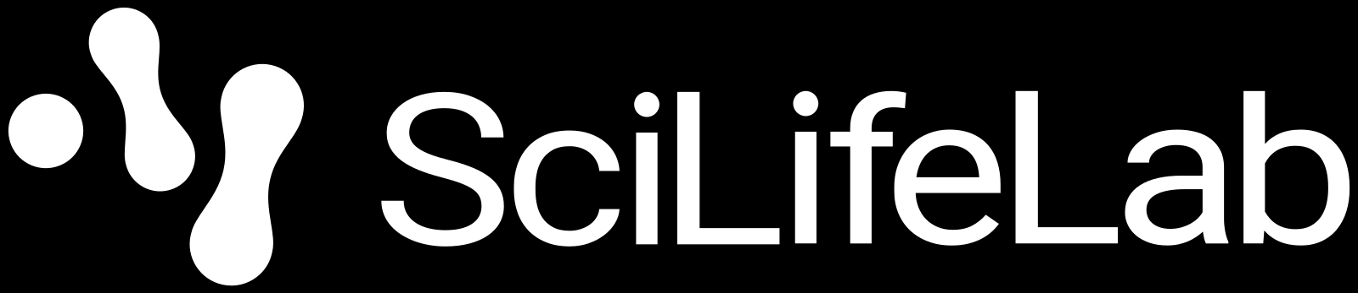
Session 0: Introduction to the Course
KB8029 — Bioinformatics & Deep Learning
Arne Elofsson and Petras Kundrotas

Slide 2

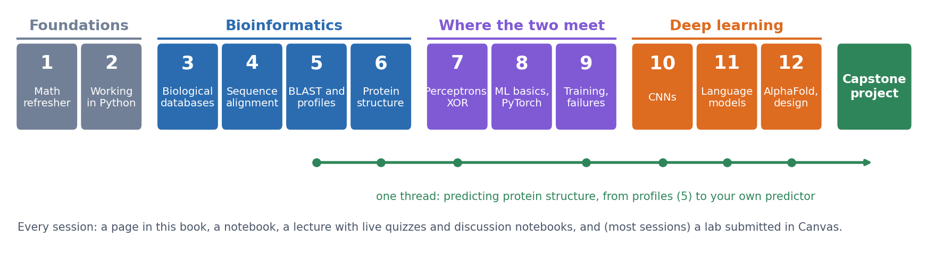
THE COURSE
Bioinformatics and machine learning, taught together
Sessions 1-2: the maths and Python we need. 3-6: classical bioinformatics and protein structure. 7-9: the two meet. 10-12: modern deep learning, up to AlphaFold. One thread, predicting protein structure, ends in your capstone project.
See course.bioinfo.se, 'Session 0: Introduction to the Course'.
Notes:
The key message: a profile score from Session 5 is already a simple neural network (Session 7). The bioinformatics motivates the machine learning, and the machine learning is applied to the same biological problems.

Slide 3
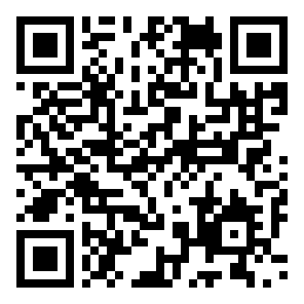
THE COURSE
Open, new, and not perfect: tell us
▪ All pages, notebooks and labs are open access
▪ New this year: there will be errors and unclear parts
▪ Found one? Tell us, we appreciate it
▪ Feedback form, with your university login; anonymous if you like
▪ Or a GitHub issue (public), or email arne@bioinfo.se
Feedback form: bioinfo.se/internal/kb8029-feedback (also linked at the bottom of every course page) https://bioinfo.se/internal/kb8029-feedback/
Notes:
The course material is written from scratch and openly licensed (CC BY-SA), so anyone can read and reuse it. It is the first year of this version: say plainly that it is not perfect, and that we appreciate every error, unclear passage or broken notebook they report. The form needs a university login (to keep spam out); feedback can be sent anonymously and never affects grades. GitHub issues on github.com/ElofssonLab/kb8029-book are a public alternative (not anonymous), handy for errors and broken notebooks; anyone else can email arne@bioinfo.se with the subject 'KB8029 feedback'. Questions about the content still go to the Canvas forum, where everyone sees the answer; the official course evaluation at the end is separate.

Slide 4
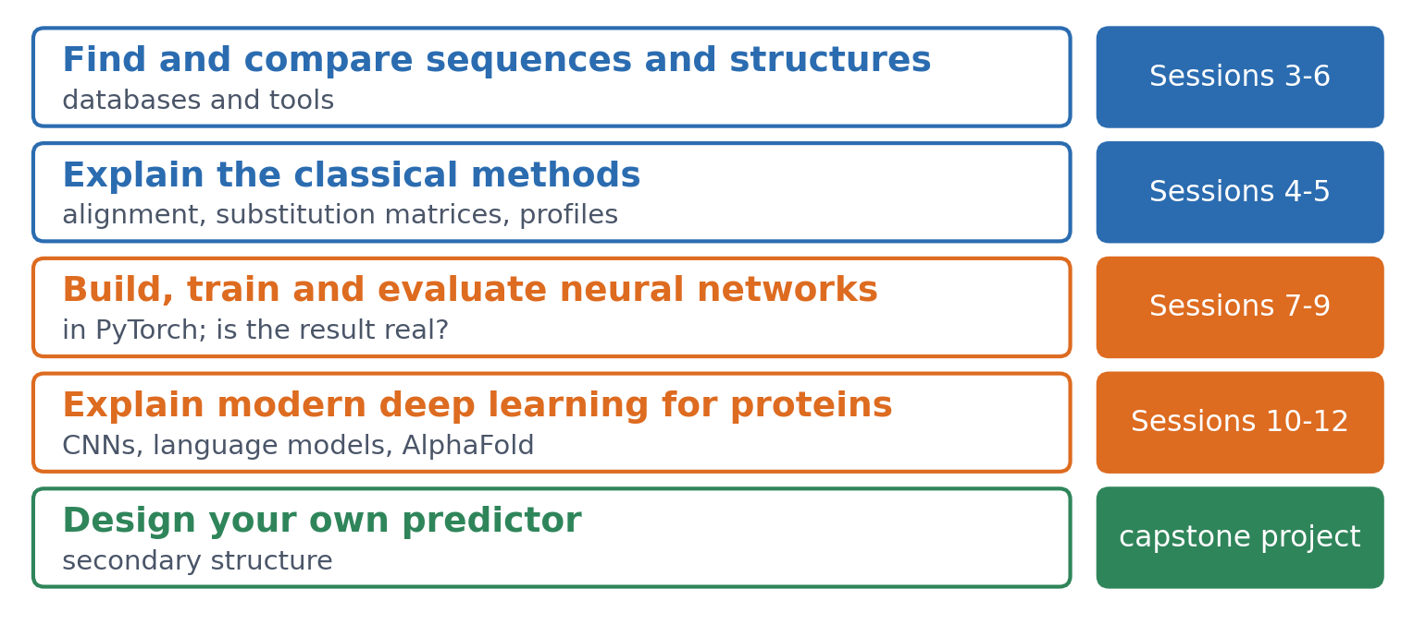
THE COURSE
By the end of the course you can
The last one is the capstone project: your own secondary-structure predictor.
Full plan: course.bioinfo.se/schedule.html https://course.bioinfo.se/schedule.html
Notes:
Find, retrieve and compare sequences and structures with the main databases and tools. Explain how alignment, substitution matrices, profiles and database searches work. Build, train and evaluate neural networks in PyTorch, and judge whether a result is real. Explain CNNs, protein language models and AlphaFold. Design, train and evaluate your own secondary-structure predictor.

Slide 5
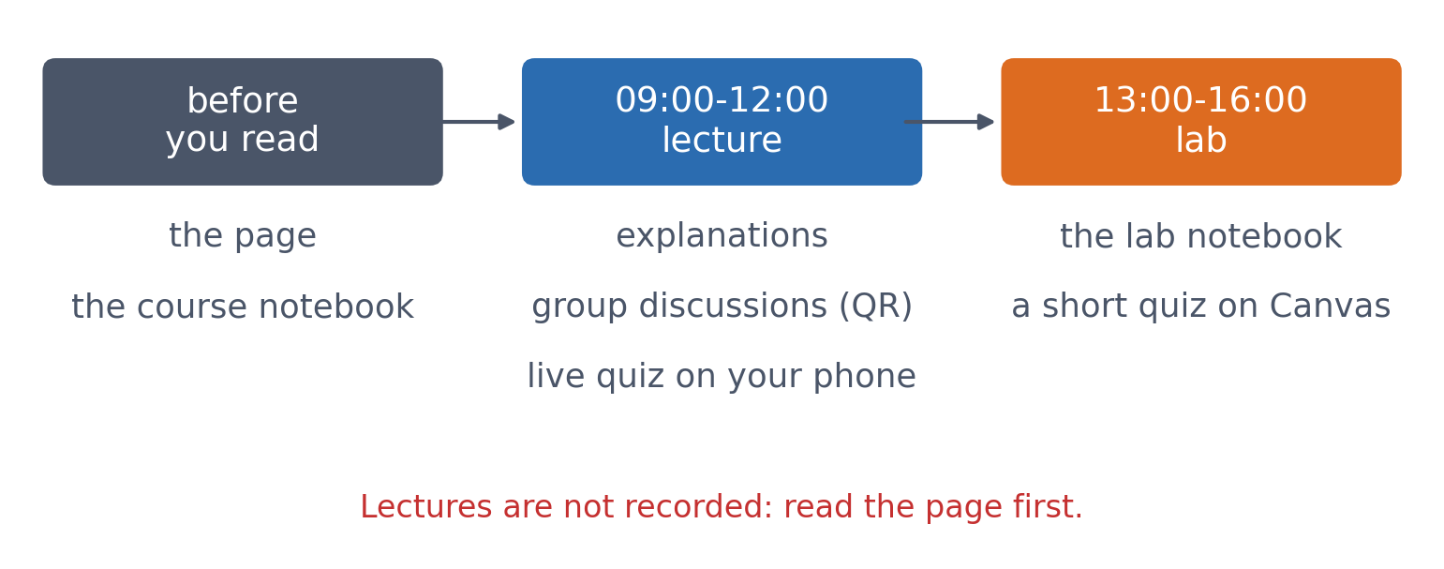
HOW IT WORKS
Every session has the same parts
The page and its course notebook (with an 'Open in Colab' badge) before the lecture; the lab notebook (opened in VS Code) and its Canvas quiz in the afternoon.
See 'How a session works' on the Session 0 page.
Notes:
Read the page before the lecture: the lectures assume you have seen the material once and use the time for the parts that are hard to learn alone. Most sessions have a lab; Session 1 does not.

Slide 6
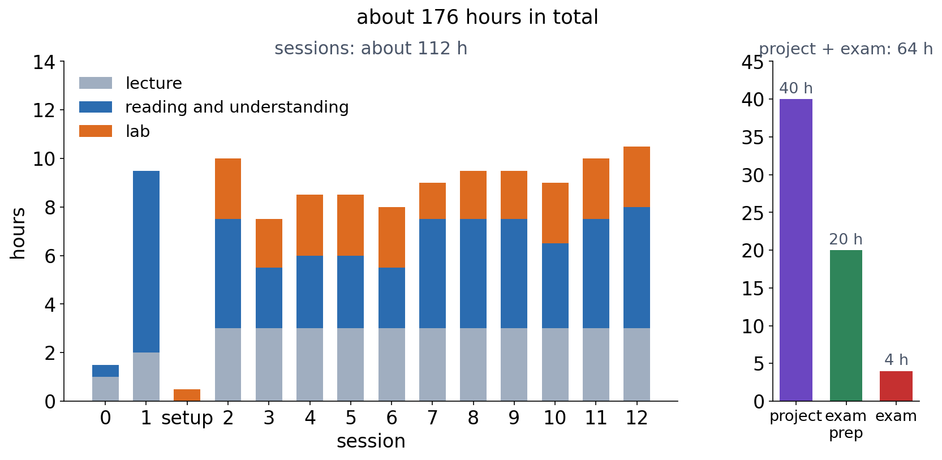
HOW IT WORKS
About 176 hours: four weeks and two days, full time
▪ Each session: lecture, reading, lab (8-10.5 h)
▪ Lab: fits the 3-hour afternoon
▪ Project 40 h, exam preparation 20 h, exam 4 h
See course.bioinfo.se/course-info.html#workload. https://course.bioinfo.se/course-info.html#workload
Notes:
These are estimates from the amount of material, not measurements, and they depend a lot on your background. Most students need about two to two and a half hours for a lab. Optional videos, boxes and lab extras are not included.

Slide 7
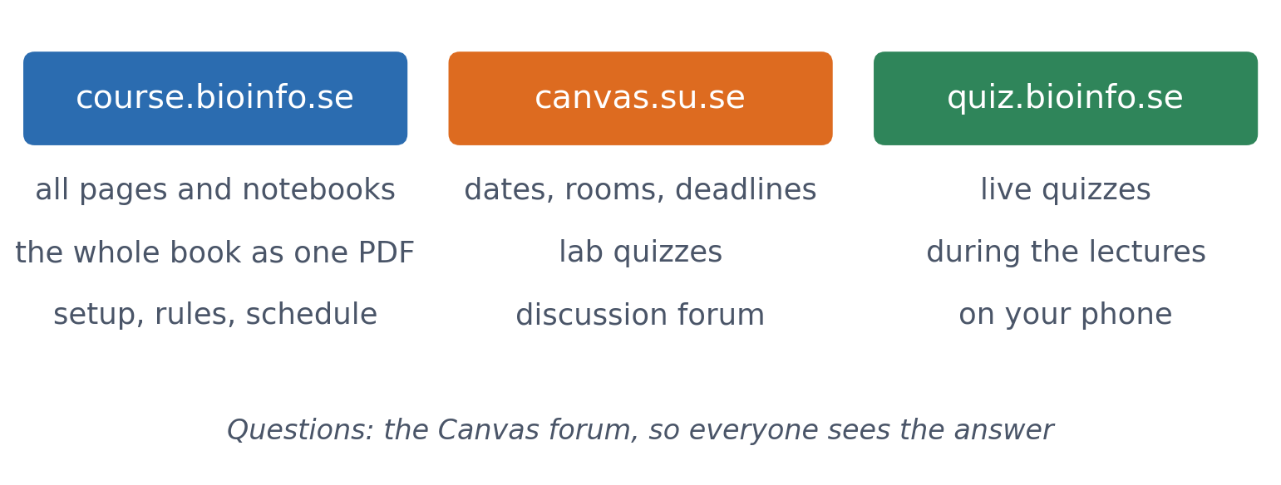
HOW IT WORKS
Where to find everything
The Setup page (VS Code and Colab) and the Course Information page (grading, lab rules, plagiarism) are on course.bioinfo.se.
Links on the Session 0 page, 'Where to find everything'. https://course.bioinfo.se/

Slide 8
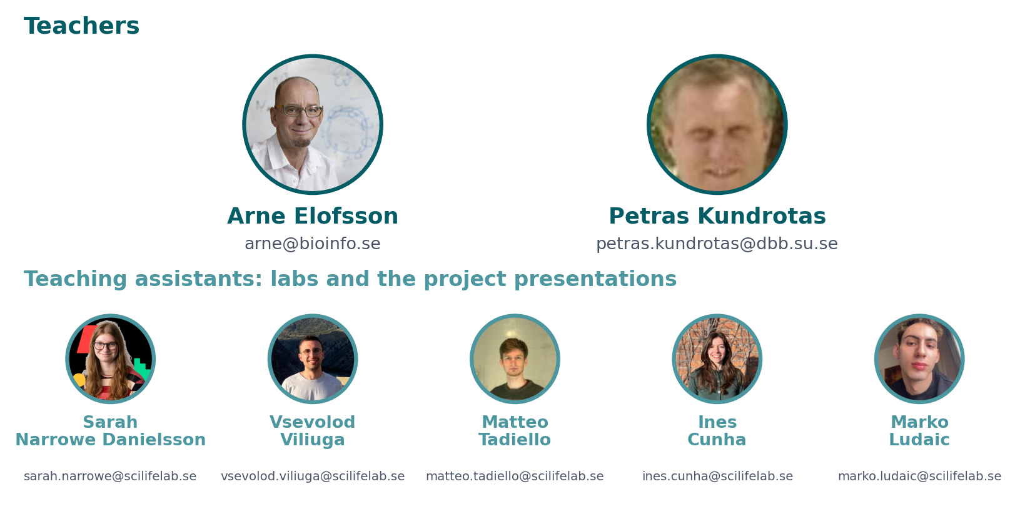
THIS YEAR
Teachers and teaching assistants
Course questions: the Canvas forum, so that everyone sees the answer. Personal matters: email a teacher. Lab help: during the lab hours.
Contact details also on Canvas, 'Teachers and contact'. Drawn from tools/canvas/people.csv.
Notes:
The teaching assistants run the labs and the oral presentations of the capstone project. The schedule shows which TAs are at each lab; the one listed first is responsible for that lab.

Slide 9
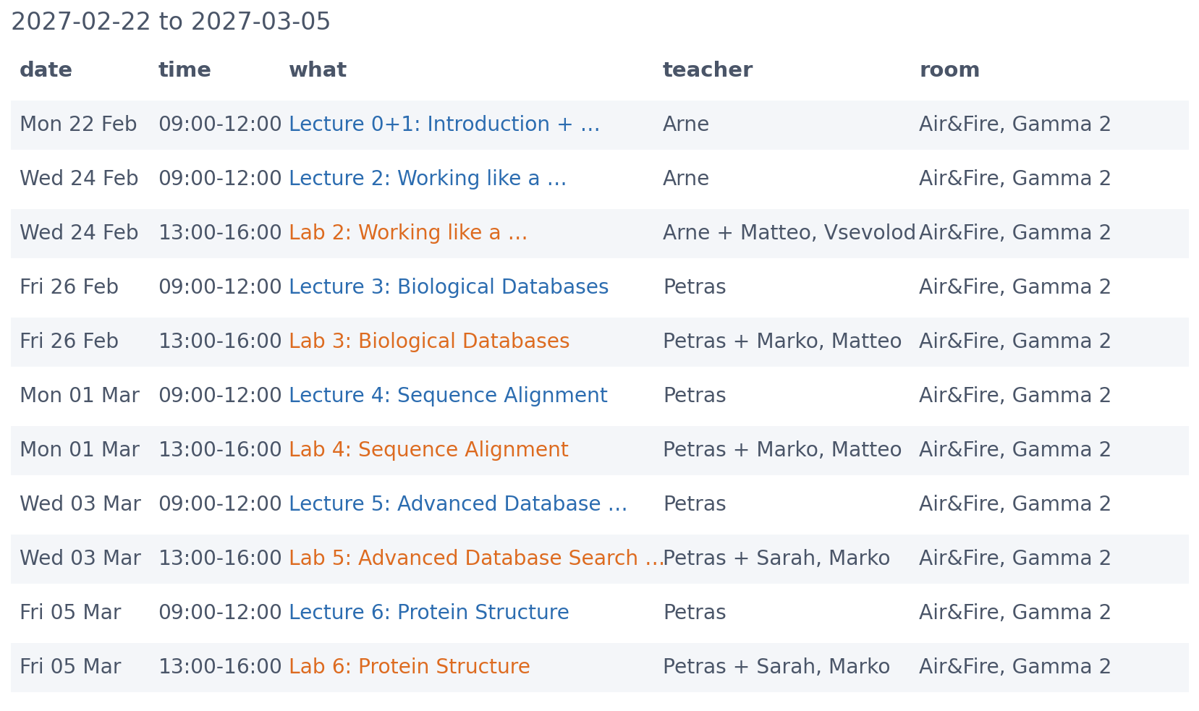
THIS YEAR
Schedule, part 1: lectures 09-12, labs 13-16
The current plan, including who teaches what; the Canvas calendar and Schedule page always have the latest version.
Drawn from tools/canvas/schedule.csv, the same file as the Canvas calendar.

Slide 10
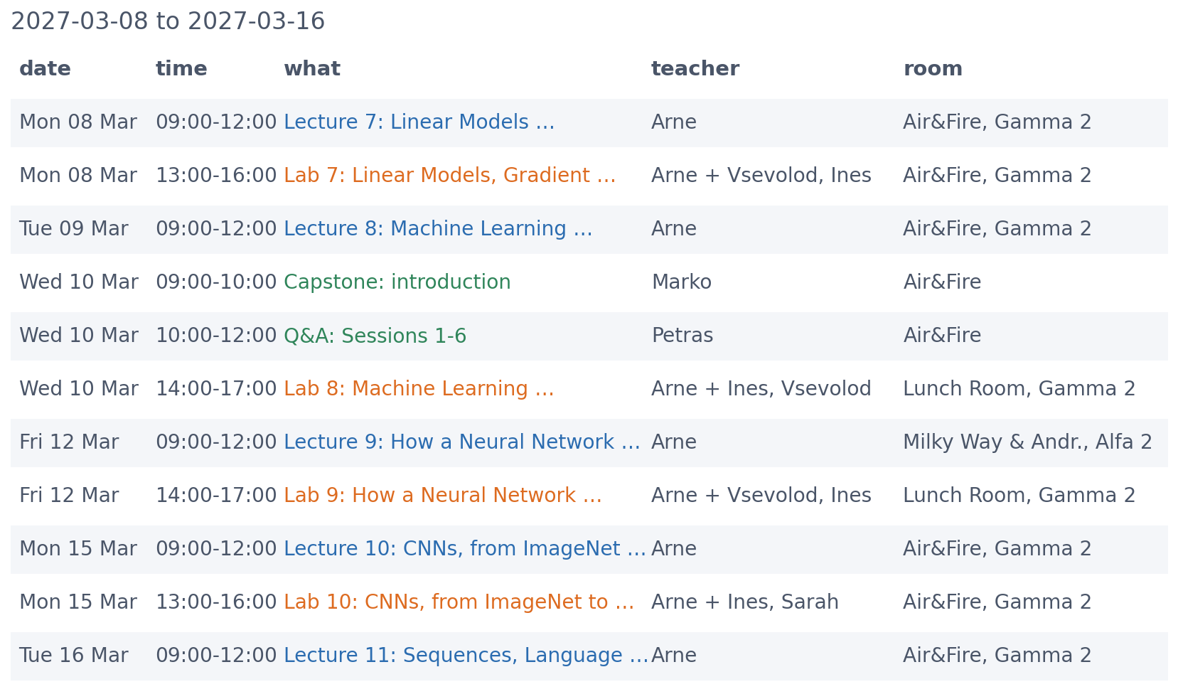
THIS YEAR
Schedule, part 2
Not every week follows the Monday-Wednesday-Friday pattern, and some labs and lectures are in other rooms.
Drawn from tools/canvas/schedule.csv, the same file as the Canvas calendar.

Slide 11
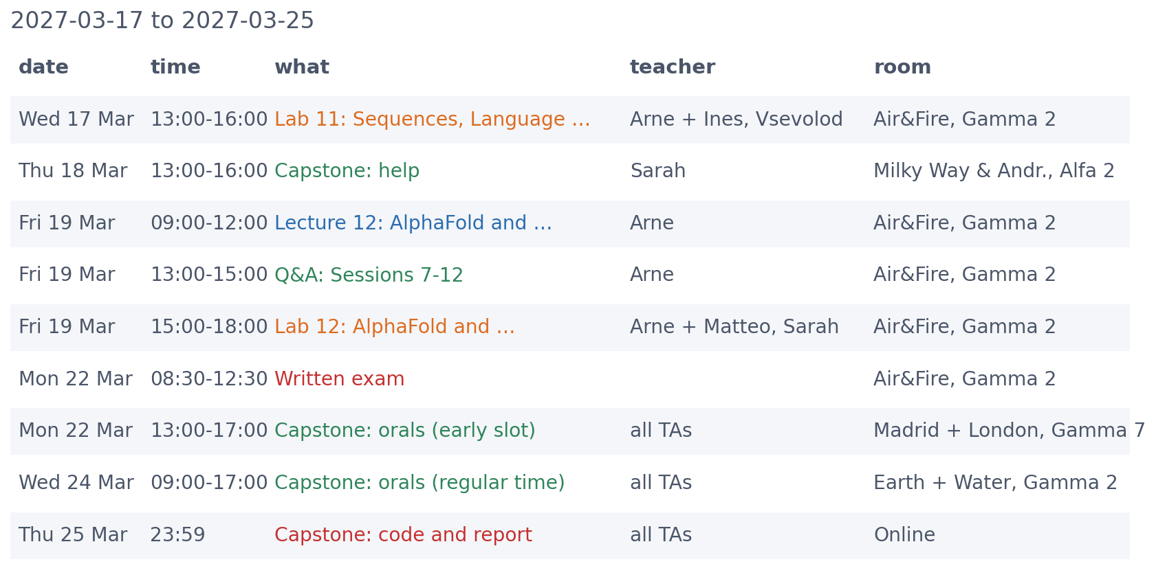
THIS YEAR
Schedule, part 3: the exam and the project
The teaching assistants of each lab are added to the schedule when decided.
Drawn from tools/canvas/schedule.csv, the same file as the Canvas calendar.

Slide 12
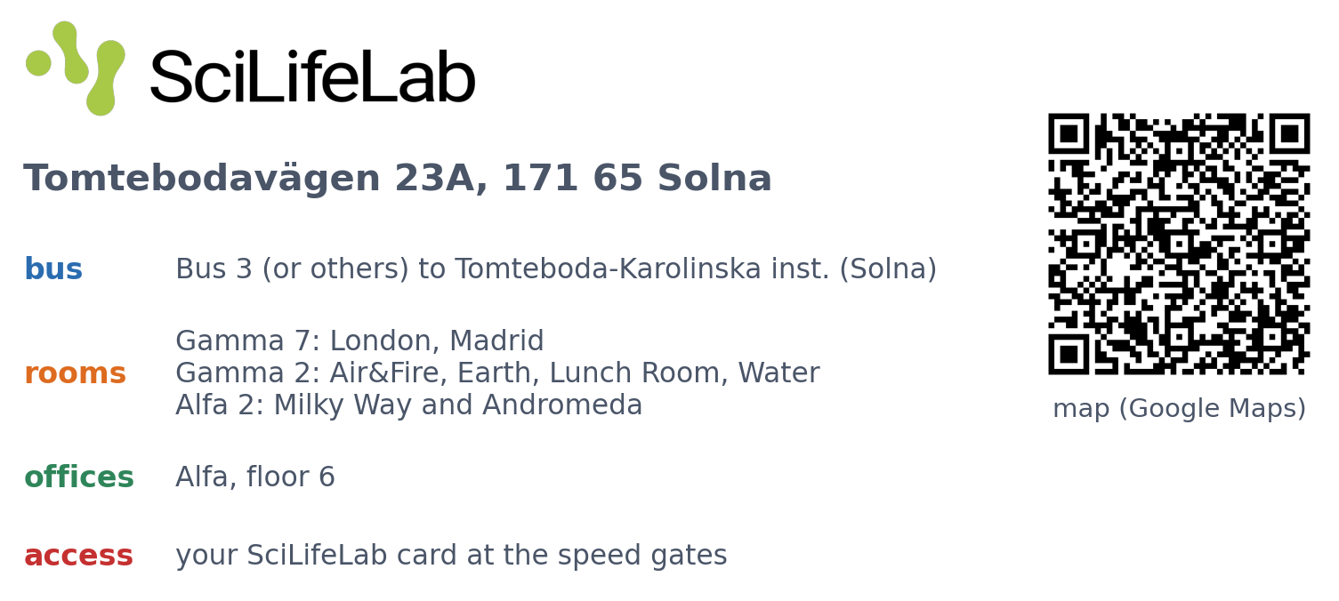
PRACTICALITIES
Getting to SciLifeLab
Scan the code for the map. Directions: bioinfo.se/contact.
Address and directions from bioinfo.se/contact; rooms from the schedule. https://bioinfo.se/contact/

Slide 13
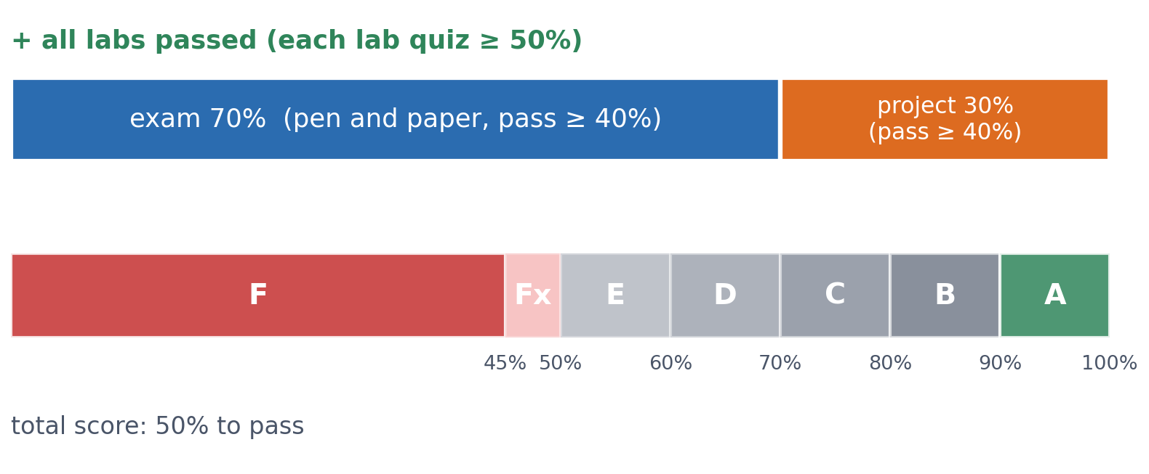
RULES
Labs, project, exam
Labs: a short Canvas quiz and an anonymous feedback survey each, due the evening before the next lecture. Project: your own secondary-structure predictor (notebook, report, oral code presentation to a TA). Exam: pen and paper, up to five single-sided pages of your own notes. Bonus exam points, up to 3 each: questions sent in before the lectures, the live quiz in every lecture, and labs on time.
Details: course.bioinfo.se/course-info.html https://course.bioinfo.se/course-info.html
Notes:
Labs can be done as soon as they are published. Bonus points on the main exam (not on a re-exam), up to 9 in all: 3 for each of three things, one point less for each one missed or late. Questions before the lecture: from Session 2 on, a question or a topic on Canvas by 18:00 the day before the lecture; the most common are answered at the start. The live quiz: answered (logged in) in all 12 lectures; right or wrong answers are never graded, only whether they answered. Labs on time: the lab quiz passed and the anonymous feedback survey filled in by the due date (the evening before the next lecture); a late lab still has to be passed. The feedback survey asks for concrete improvements to the material, and Canvas does not show who wrote what. There is no retake to improve a passing grade.

Slide 14
RULES
Your work must be your own
Encouraged
Not allowed
talk and learn
plagiarism
▪ Discussing methods with other students
▪ AI tools as a 'science buddy'
▪ Asking when you are unsure, before you submit
▪ Submitting others' answers, code or text
▪ AI-written labs or reports
▪ AI tools at the exam
See course.bioinfo.se/course-info.html, 'Plagiarism' and 'AI tools'.
Notes:
All written reports are checked for plagiarism, and plagiarism can lead to suspension. Session 2's 'How to use chatbots' section shows how to use AI tools well.

Slide 15
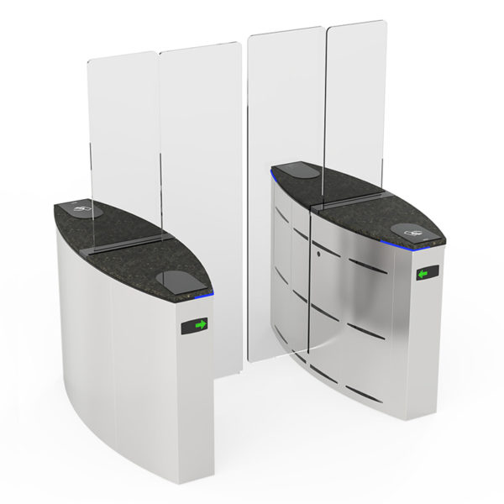
PRACTICALITIES
At SciLifeLab: the speed gates
▪ Your card, every time, in and out
▪ One person at a time
▪ A visitor: card twice, a few seconds apart
▪ Never force your way through a gate
Session 0 page, 'At SciLifeLab'. You need a SciLifeLab access card: when and where to collect it is on Canvas or by email.

Slide 16
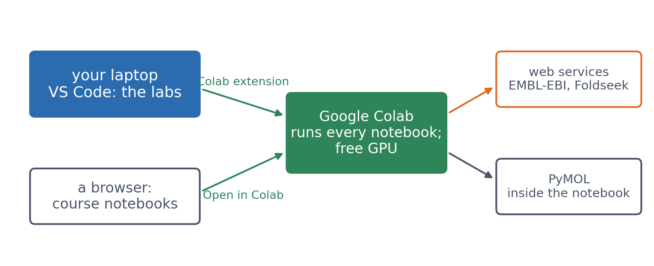
PRACTICALITIES
Computers
▪ Every notebook runs on Colab
▪ Labs: in VS Code, running on Colab
▪ No suitable laptop? Tell us today
Step by step: course.bioinfo.se/setup.html https://course.bioinfo.se/setup.html
Notes:
Every notebook and lab runs on Google Colab. The labs are opened in VS Code (the 'Open in VS Code' link, after cloning the course notebooks once) and run on Colab through the Google Colab extension; the course notebooks can also be opened in Colab in the browser. Colab gives free access to a GPU; release it when you are done. Even PyMOL in Session 6 runs inside a notebook, so nothing else has to be installed.

Slide 17
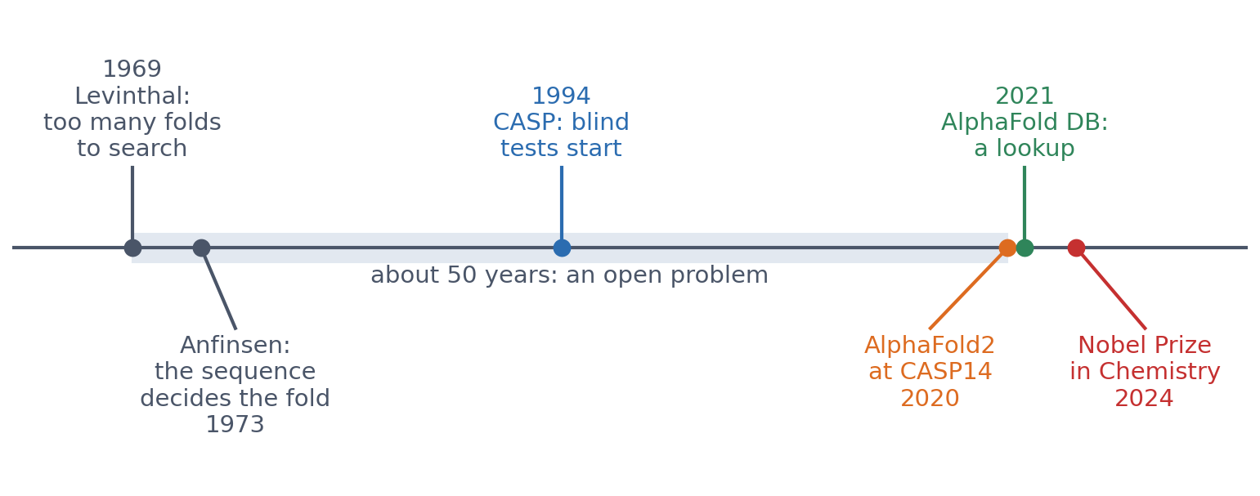
OUTLOOK
From a 50-year problem to a database lookup
▪ 1960s-1970s: the fold is in the sequence
▪ 1994-2018: steady, slow progress at CASP
▪ 2020-2021: AlphaFold2, then a database
▪ What will your field look like when you finish your PhD?
Levinthal 1969; Anfinsen 1973, Science 181:223; predictioncenter.org (CASP); Jumper et al. 2021, Nature 596:583; nobelprize.org (2024).
Notes:
The course follows this arc. Anfinsen showed that a protein's sequence determines its fold; Levinthal pointed out that a protein cannot find its fold by trying every conformation. CASP has run blind tests every two years since 1994. AlphaFold2 reached atomic accuracy at CASP14 in 2020, the AlphaFold Protein Structure Database opened in 2021, and the 2024 Nobel Prize in Chemistry went to David Baker and to Demis Hassabis and John Jumper. Ask the room: which problem in your own field could change this fast, and what would you then need to know?

Slide 18
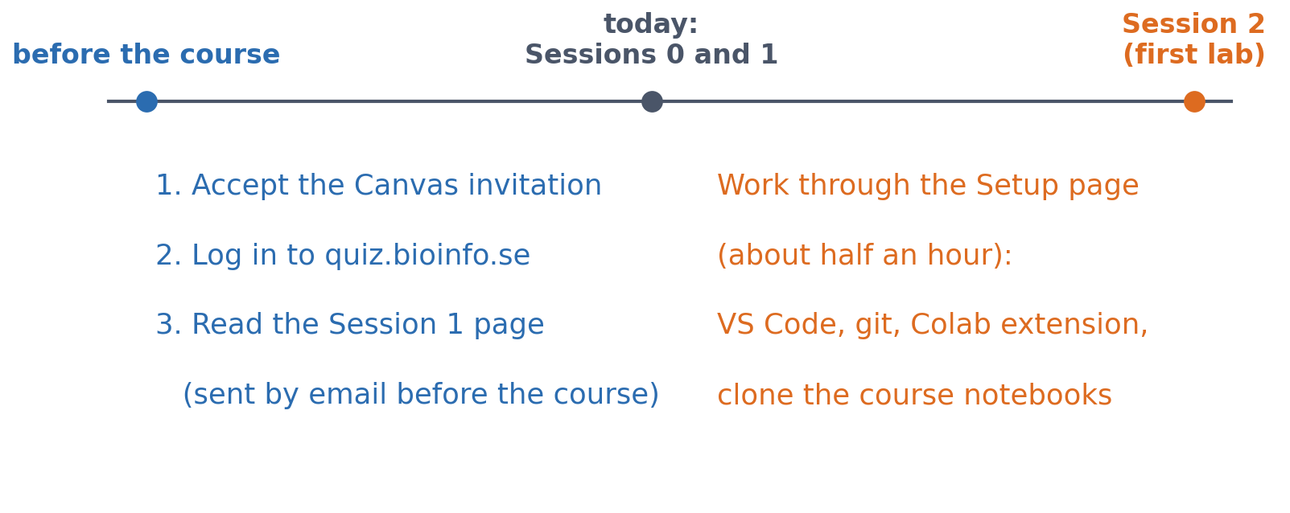
NEXT STEPS
What was due before today, and before Session 2
Sessions 0 and 1 are this morning, so the three items on the left were emailed before the course started. Session 2 has the first lab, on Colab: sort out the setup (about half an hour) before it, not during it.
course.bioinfo.se/session00.html, 'Before the first lecture' and 'Before Session 2'.
Notes:
If there is time left today, start the setup together: install git and the Google Colab extension in VS Code, clone the course notebooks, run a lab notebook on Colab, and log in to the quiz site.

Slide 19
Session 1 next
Vectors and matrices, derivatives and gradients, probability, likelihood and entropy
Read the page before the lecture

