Slide 1

Session 1: Math Prerequisites
KB8029 — Bioinformatics & Deep Learning
Arne Elofsson

Slide 2


BEFORE WE START
Log in to the lecture quiz
Log in to the quiz
Scan the code, or go to quiz.bioinfo.se/live
Log in with your university account
Answering counts as being at the lecture: up to 3 bonus points on the exam
Right or wrong is never graded, only whether you answered. Results are shown without names.
quiz.bioinfo.se/live
Notes:
The quiz is not anonymous, because answering is how attendance is counted: 3 bonus points on the main exam for answering in all 12 lectures, one point less per missed lecture (preliminary). Whether an answer is right or wrong is never used. The projected results never show names; the only names shown are the two drawn to explain their reasoning. Start the session on quiz.bioinfo.se before the lecture: quiz.bioinfo.se/live then leads to it.

Slide 3
BEFORE WE START
Warm-up: what do you know already?
3 quick questions
On the topics of today, one at a time, about 30 seconds each
Answer on your own, and guess if you do not know
It shows me where to start; right or wrong is never graded
Notes:
About 2 minutes in all. Open each question's round, halt it after about 30 seconds and glance at the results; do not explain the answers now, the lecture does that.

Slide 4
WARM-UP · 1 OF 3
A is a 3 × 2 matrix and v is a vector of 2 numbers. What is A v?
A A vector of 3 numbers
B A vector of 2 numbers
C A 3 × 2 matrix
D Not defined
Answer now
Scan the code, or go to
quiz.bioinfo.se/live
Notes:
Right: A vector of 3 numbers. One dot product per row of A. Block 1.

Slide 5
WARM-UP · 2 OF 3
What is the derivative of eˣ?
A x eˣ⁻¹
B eˣ
C ln x
D 1/x
Answer now
Scan the code, or go to
quiz.bioinfo.se/live
Notes:
Right: eˣ. Block 2.

Slide 6
WARM-UP · 3 OF 3
What is log₂ 8?
A 3
B 4
C 2.08
D 16
Answer now
Scan the code, or go to
quiz.bioinfo.se/live
Notes:
Right: 3. 2.08 is ln 8. Block 3: log-odds and entropy in bits.

Slide 7
BEFORE WE START
What the room knows already
Where we start
Which topics most of you know, and which we take slowly today.
Show the results ▸ quiz.bioinfo.se/live/report
Notes:
Optional: show two or three of the results, the ones that most got wrong.

Slide 8
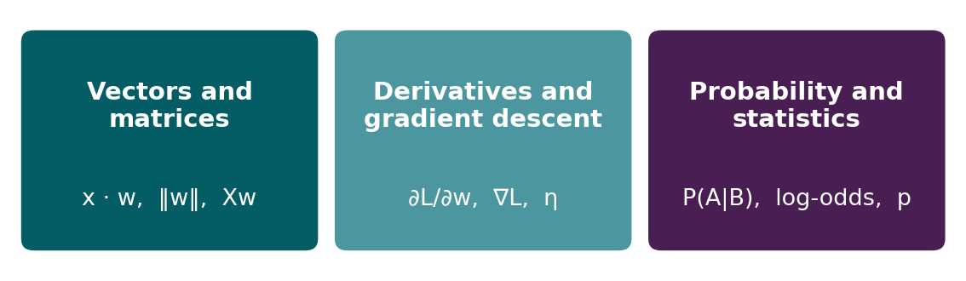
BEFORE WE START
In up to three words: what do you want to learn today?
Answer now
Scan the code, or go to
quiz.bioinfo.se/live
Notes:
A word cloud: the bigger the word, the more students wrote it. Come back to it at the end of the lecture.

Slide 9
BEFORE WE START
What you want to learn today
What the room wants to learn
Show the results ▸ quiz.bioinfo.se/live/report

Slide 10
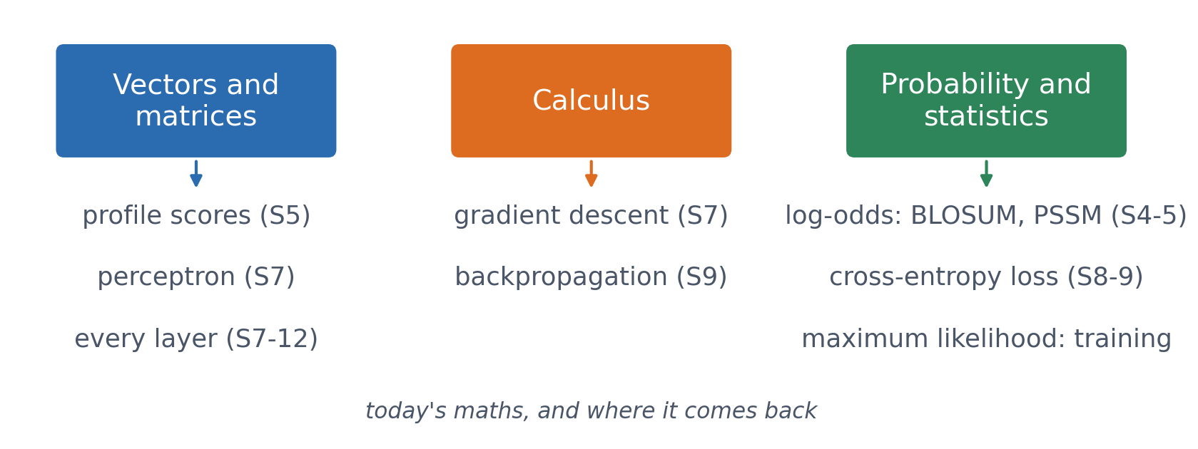
SESSION 1 · THE MAP
The mathematical vocabulary of the course
Not all the mathematics you might need: the ideas this course uses, worked through with real numbers, each with a pointer to where it returns.
See course.bioinfo.se/session01.html. This session has no lab; the first lab is in Session 2.
Notes:
Most of this will be familiar. The aim is to bring everyone up to the same pace, and to show where each idea comes back: the dot product is a profile score and a perceptron, the gradient trains every model, and log-probabilities give log-odds scores and the cross-entropy loss.

Slide 11
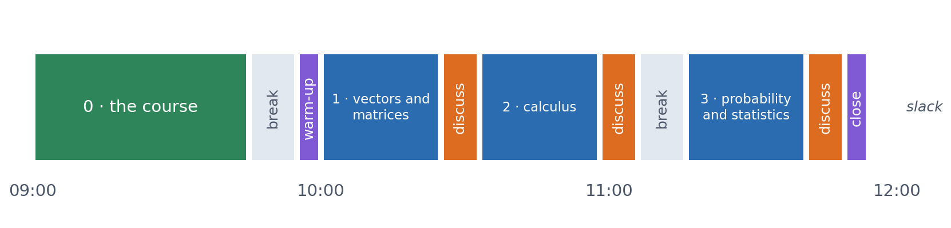
SESSION 1 · THE MORNING
Three blocks: about 25 min talk and 8 min discussion
Block 1: vectors and matrices. Block 2: derivatives, gradients and gradient descent. Block 3: probability, likelihood, entropy and p-values.
Sessions 0 and 1 share one morning, 09:00-12:00, so Session 1 has about two hours, not three. Times are approximate: a 5 min start (warm-up quiz and your questions), one 10 min break and a 5 min close. Each block ends with a quiz question: guess, run the notebook and work out why it behaves as it does, discuss, answer again.

Slide 12
BLOCK 1 · ABOUT 25 MIN
Vectors and matrices

Slide 13
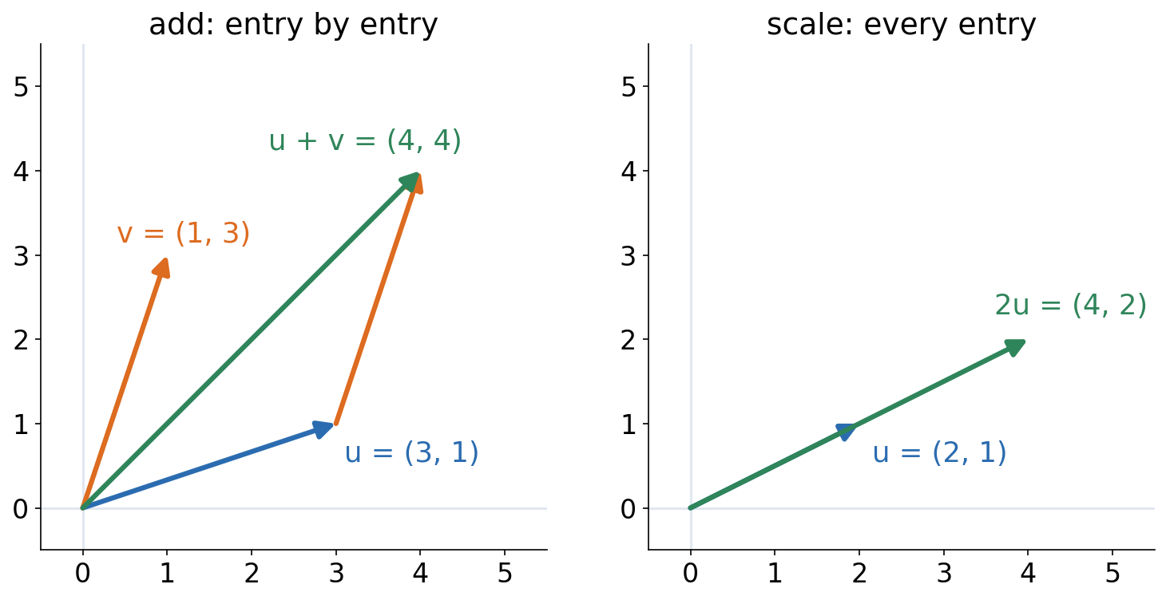
1 · VECTORS
A vector is an ordered list of numbers
▪ Add: entry by entry
▪ Scale: every entry
▪ Dimension = number of entries
See course.bioinfo.se/session01.html, 'Vectors' and 'Dimensions and shapes'.
Notes:
The 20 amino-acid fractions of a protein are a 20-dimensional vector. The geometric picture (an arrow with a direction and a length) is the one the rest of the session builds on.

Slide 14
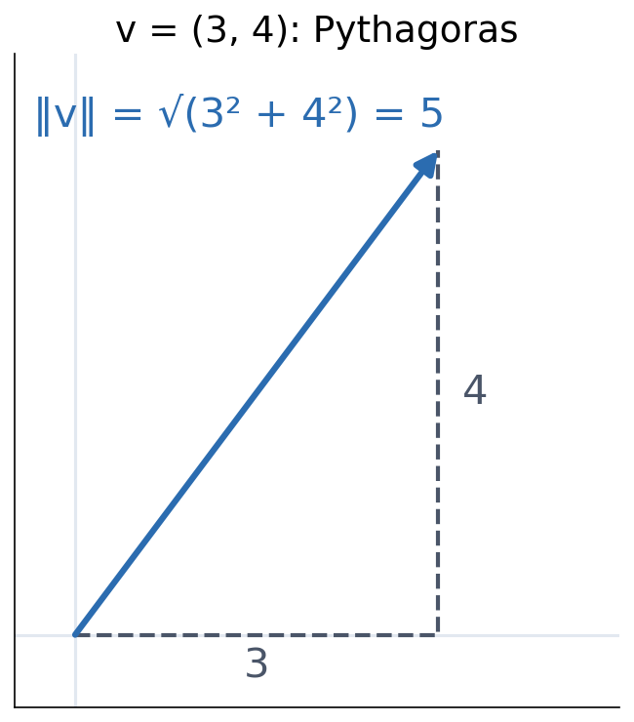
1 · VECTORS
The length of a vector
▪ ‖v‖ = √(v₁² + … + vₙ²)
▪ Pythagoras in n dimensions
▪ Also called the norm
See course.bioinfo.se/session01.html, 'Vectors'.
Notes:
For a number, |x| is its distance from zero; the norm generalises that. Worked example: v = (3, 4) gives sqrt(9 + 16) = 5, the hypotenuse of a 3-4-5 triangle.

Slide 15
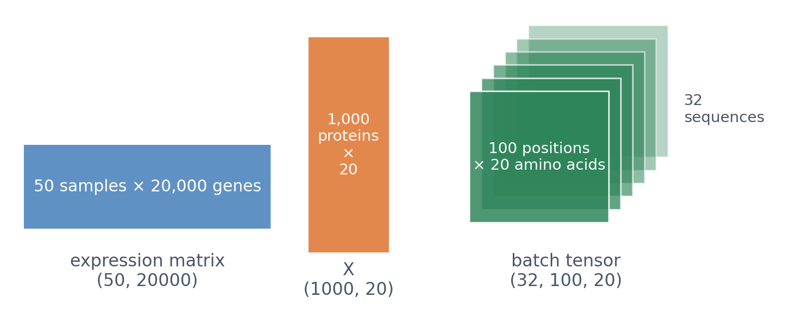
1 · SHAPES
Always know the shape of every matrix
A matrix with n rows and m columns has shape (n, m). In biology a matrix is a data table: one row per sample or protein, one column per feature. A tensor continues to three or more dimensions.
See course.bioinfo.se/session01.html, 'Dimensions and shapes'. Tensors properly: Session 2.
Notes:
Gene expression: 50 samples × 20,000 genes. Protein features: 1,000 proteins × 20 amino-acid fractions. A batch of 32 one-hot encoded sequences of length 100 is (32, 100, 20). Knowing the shapes fixes most errors in this course's code.

Slide 16
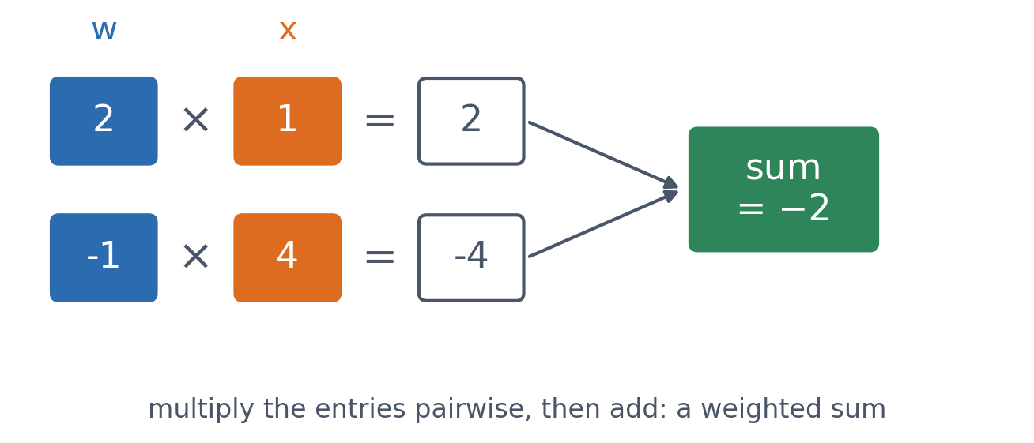
1 · THE DOT PRODUCT
The dot product: multiply, then add
▪ w · x = w₁x₁ + … + wₙxₙ
▪ A weighted sum
▪ (2, −1) · (1, 4) = −2
See course.bioinfo.se/session01.html, 'The dot product'.
Notes:
Each x_i contributes to the total in proportion to its weight w_i. Worked example: (2)(1) + (-1)(4) = 2 - 4 = -2.

Slide 17
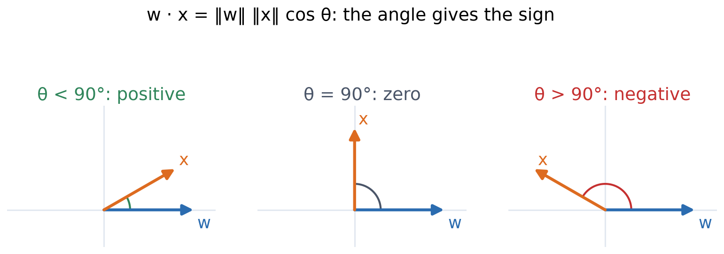
1 · THE DOT PRODUCT
The geometric meaning: the angle gives the sign
Positive when the vectors point broadly the same way, zero when they are perpendicular, negative when they point broadly opposite ways.
See course.bioinfo.se/session01.html, 'The dot product'.

Slide 18
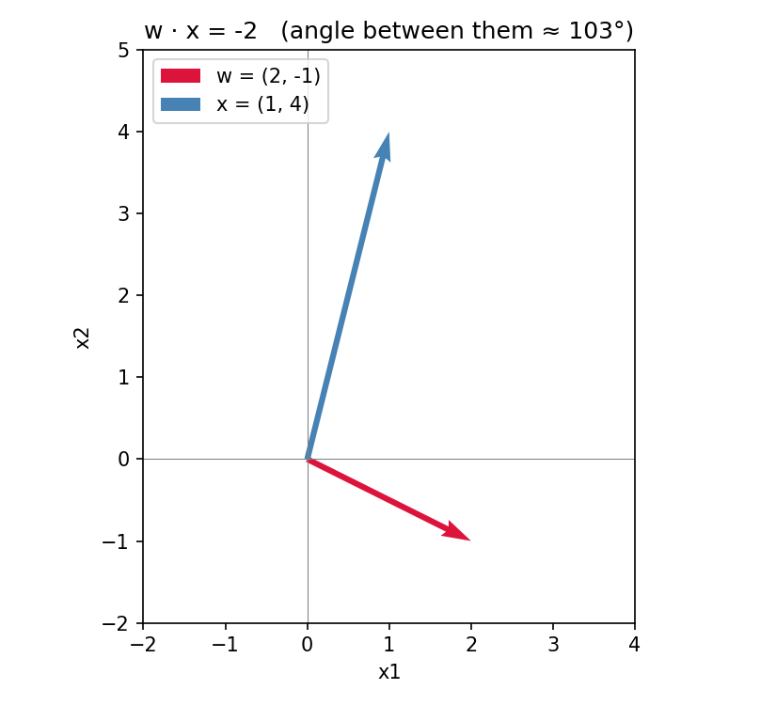
1 · THE DOT PRODUCT
(2, −1) and (1, 4) are about 103° apart
▪ Just past perpendicular
▪ So w · x < 0
▪ No arithmetic needed for the sign
See course.bioinfo.se/session01.html, 'The dot product'.

Slide 19
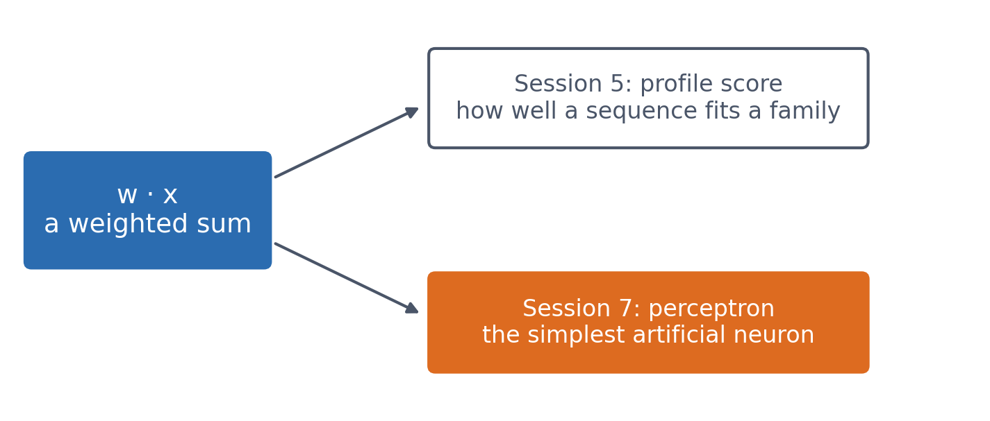
1 · THE DOT PRODUCT
Why it matters: one weighted sum, twice
A profile score multiplies each position's value by a position-specific weight and adds them up. A perceptron computes the same dot product. When you get there, only the interpretation is new.
See course.bioinfo.se/session01.html, 'The dot product'.

Slide 20
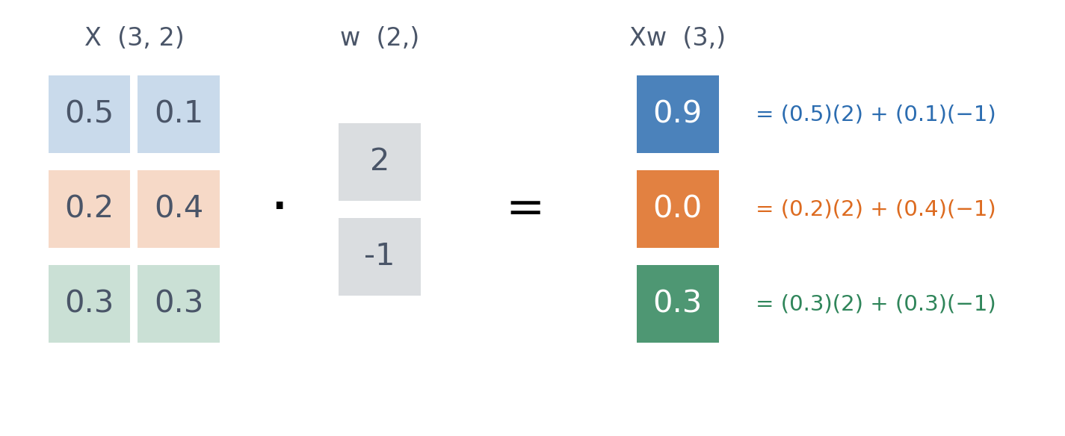
1 · MATRICES
A matrix-vector product is one dot product per row
Three proteins, two features (hydrophobic and charged fractions), w = (2, −1). One product gives all three scores, with no loop: this is how classifiers score every example at once.
See course.bioinfo.se/session01.html, 'Matrix multiplication'.
Notes:
With 1,000 proteins and 20 features, X is (1000, 20), w is (20,), and Xw is (1000,): 1,000 scores in one product. Session 7's perceptron and Session 8's classifiers are written this way.

Slide 21
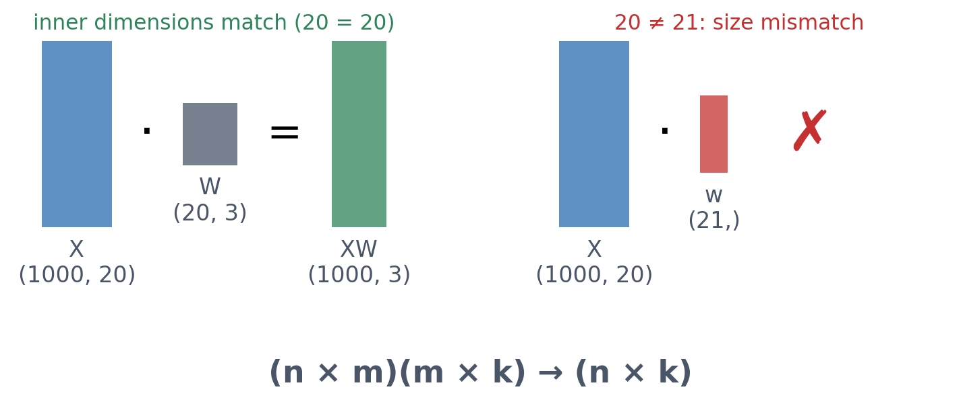
1 · MATRICES
Inner dimensions must match
Three classes: W is (20, 3), and XW gives three scores per protein. A weight vector of length 21 cannot be multiplied: the most common error in this course's code.
See course.bioinfo.se/session01.html, 'Matrix multiplication'.
Notes:
PyTorch's error message: size mismatch, got input (1000), mat (1000x20), vec (21). Reading the shapes is how you fix it.

Slide 22
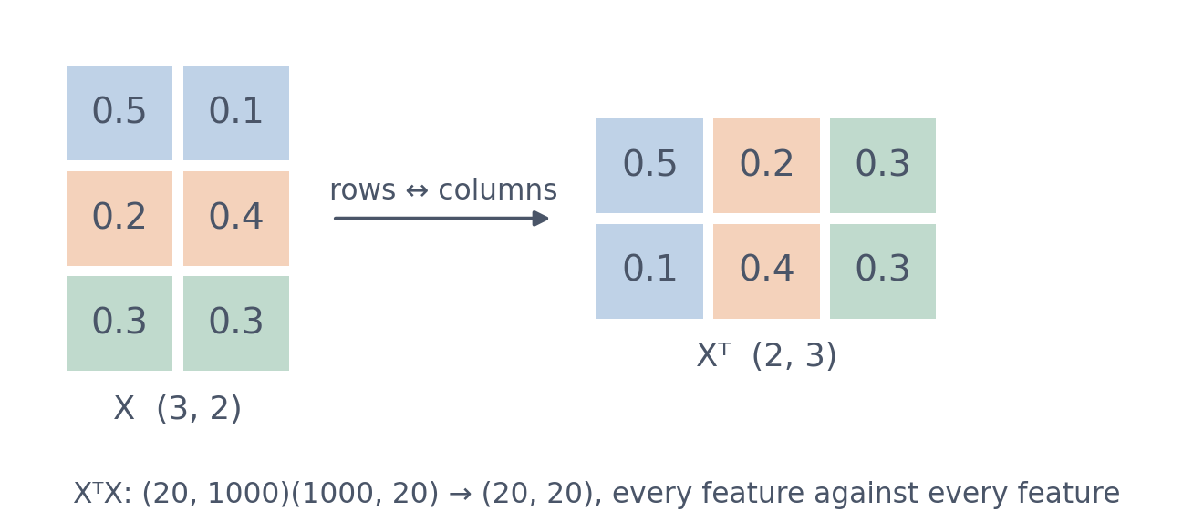
1 · MATRICES
The transpose swaps rows and columns
▪ wᵀx: the dot product
▪ XᵀX: a (20, 20) matrix
▪ (AB)ᵀ = BᵀAᵀ
See course.bioinfo.se/session01.html, 'Matrix multiplication'.
Notes:
w^T x is (1 × m)(m × 1) → one number. For centred data, X^T X / (n - 1) is the covariance matrix of the features, the matrix PCA works on. Check (AB)^T = B^T A^T with the shapes: AB is (n × k), so its transpose is (k × n), and only B^T A^T, (k × m)(m × n), gives that.

Slide 23
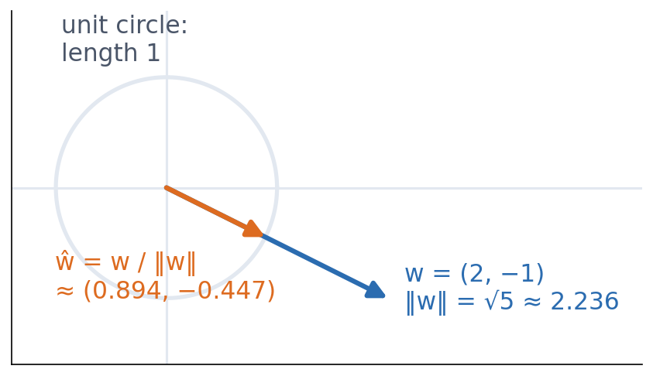
1 · NORMALISATION
Normalising keeps only the direction
▪ ŵ = w / ‖w‖
▪ Length exactly 1
▪ Unit · unit = cosine similarity
See course.bioinfo.se/session01.html, 'Normalisation'.
Notes:
w = (2, -1), ‖w‖ = √5 ≈ 2.236, so ŵ ≈ (0.894, -0.447). Normalising removes the ‖w‖ factor from w·x = ‖w‖‖x‖cos θ and leaves the angle. The Frobenius norm of a matrix is the same length formula over all its entries. The first discussion problem is about exactly this.

Slide 24
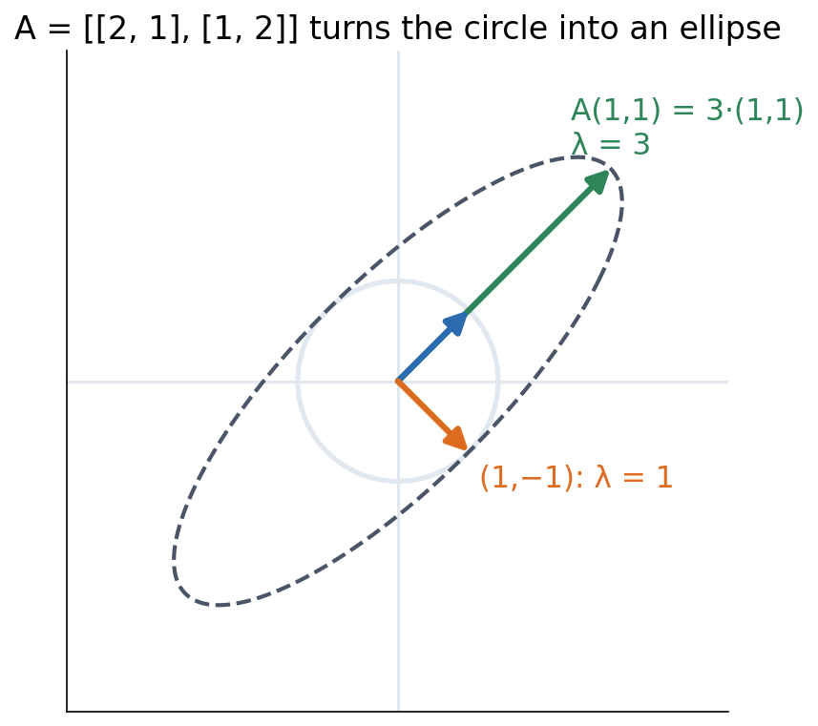
1 · EIGENVECTORS
Eigenvectors keep their direction
▪ Av = λv
▪ Check, don't solve
▪ PCA: eigenvectors of the covariance matrix
See course.bioinfo.se/session01.html, 'Eigenvectors and PCA, intuitively'.
Notes:
A(1, 1) = (3, 3) = 3 × (1, 1), so λ = 3; (1, -1) has λ = 1. Every other vector is turned towards the (1, 1) axis. PCA finds the directions of greatest variance; the eigenvalues say how much variance each explains. The computer does it (np.linalg.eigh). Optional on the page: the cross product, used for structures in Sessions 6 and 12.

Slide 25
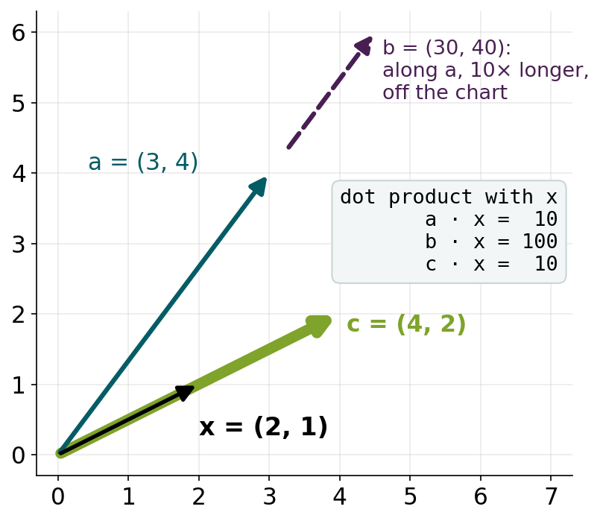
BLOCK 1 · QUIZ
Which vector points most in the direction of x?
Smallest angle with x = (2, 1). The figure shows each vector and its dot product with x.
A b: ten times larger dot product
B a and b equally: same direction
C c: points exactly along x
D a and c equally: same dot product
Guess on your own
Scan the code, or go to
quiz.bioinfo.se/live
Notes:
Vectors a = (3, 4) and c = (4, 2) both have dot product 10 with x = (2, 1); b = (30, 40) has 100. The question is about direction (the angle), not about the size of the dot product. Let them guess on their own; do not hint.

Slide 26
BLOCK 1 · QUIZ
Which vector points most in the direction of x?
How did the room answer?
Halt the round when most have answered, then show the results.
Show the results ▸ quiz.bioinfo.se/live/report
Notes:
Halt submission in the Control view, then open the results. Do not say which answer is right.

Slide 27

BLOCK 1 · QUIZ
Which vector points most in the direction of x?
Fix it, run it, discuss
Open the notebook: scan the code
Fix the line marked FIX, then run the cells
Did it come out as you guessed? Discuss with your neighbour
The notebook: https://colab.research.google.com/github/ElofssonLab/kb8029-book/blob/main/notebooks/session01-discussion-1.ipynb
Notes:
About 8 minutes. The notebook's FIX line prints the dot product as if it were cos θ, so b looks best (100). Fixed by dividing by both lengths: c gives 1.000, a and b 0.894.

Slide 28
BLOCK 1 · QUIZ
Which vector points most in the direction of x?
Answer again
Same question, after the discussion.
quiz.bioinfo.se/live
Notes:
Open the second round (post) in the Control view.

Slide 29
BLOCK 1 · QUIZ
Which vector points most in the direction of x?
Results, and who explains
Both rounds side by side.
Draw two to explain: one of you says how you reasoned.
Show the results ▸ quiz.bioinfo.se/live/report
To check it with code afterwards: discussion notebook 1 https://colab.research.google.com/github/ElofssonLab/kb8029-book/blob/main/notebooks/session01-discussion-1.ipynb
Notes:
c is right: cos θ = 1 for c and 0.89 for a and b. The next slide shows it.

Slide 30
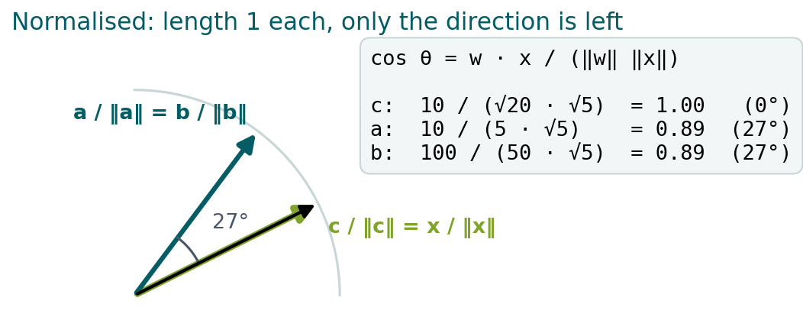
BLOCK 1 · QUIZ
The answer: c points along x
Normalising (dividing by the length) leaves only the direction. b is a made ten times longer, so its dot product is ten times larger at the same angle; a and c have the same dot product but point differently. The dot product mixes length and direction: w · x = ‖w‖ ‖x‖ cos θ.

Slide 31
BLOCK 1 DONE
Break

Slide 32
BLOCK 2 · ABOUT 25 MIN
Calculus for machine learning

Slide 33
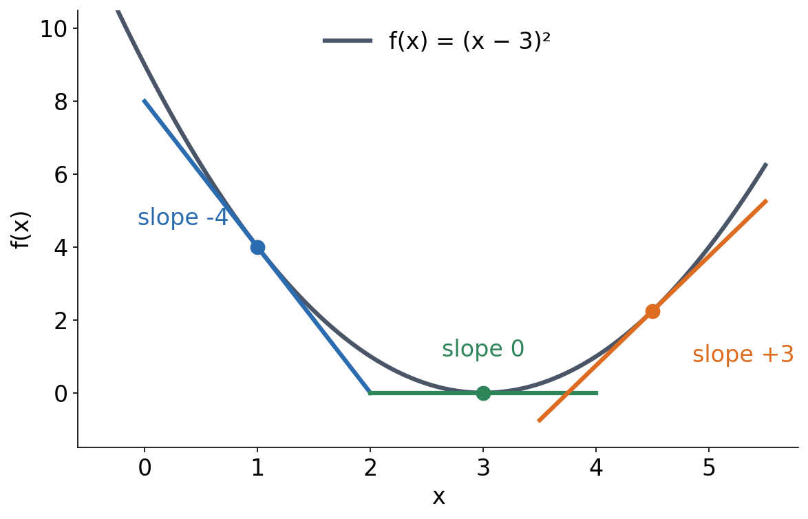
2 · DERIVATIVES
A derivative is the slope of the tangent
▪ How fast the output changes
▪ Zero at the minimum
▪ f′(x) = 2(x − 3) here
See course.bioinfo.se/session01.html, 'Derivatives'.
Notes:
The slopes at x = 1, 3 and 4.5 are -4, 0 and +3. A derivative is zero where the function is momentarily flat: a peak, a trough, or a flat inflection point. This function returns in gradient descent below.

Slide 34
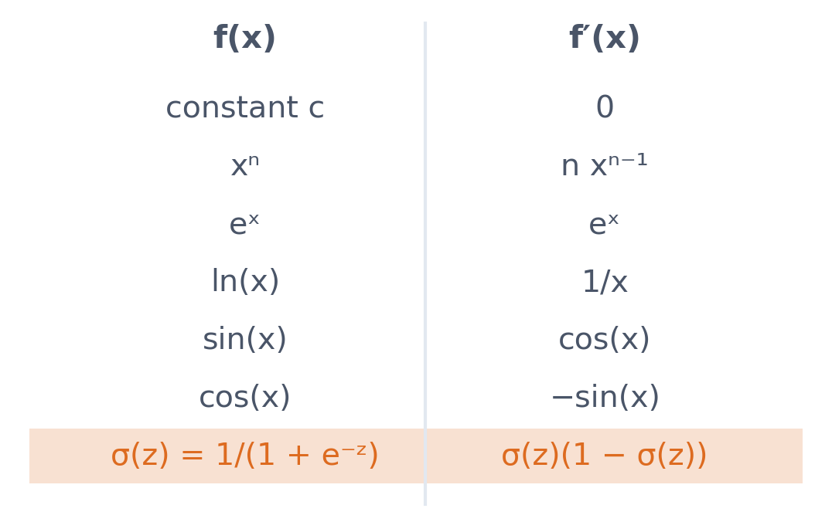
2 · DERIVATIVES
The derivatives used throughout the course
▪ Worth memorising
▪ The sigmoid's derivative uses σ itself
▪ Backpropagation needs it (Session 9)
See course.bioinfo.se/session01.html, Table 1.1.
Notes:
σ(z) has already been computed on the forward pass, so its derivative σ(z)(1 - σ(z)) costs nothing extra.

Slide 35
2 · DERIVATIVES
One row matters more than the others
▪ σ(z) = 1/(1 + e⁻ᶻ) → σ′(z) = σ(z)(1 − σ(z))
▪ Written in σ(z), not in e⁻ᶻ
▪ σ(z) is already computed on the way forward
▪ So the derivative costs nothing extra
▪ Session 9 needs it for every sigmoid unit
Table 2 on course.bioinfo.se/session01.html.
Notes:
This is the only derivative in the table that is worth dwelling on. Backpropagation evaluates it once per unit per example, and the fact that it reuses the forward value is why it is cheap. Memorise the form, not a derivation.

Slide 36
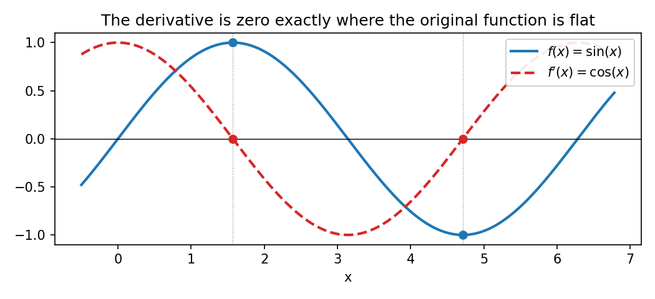
2 · DERIVATIVES
Peaks and troughs: where the derivative is zero
f(x) = sin(x) (solid) and f′(x) = cos(x) (dashed). Wherever sin(x) has a peak or a trough, cos(x) crosses zero.
See course.bioinfo.se/session01.html, 'Derivatives'.

Slide 37
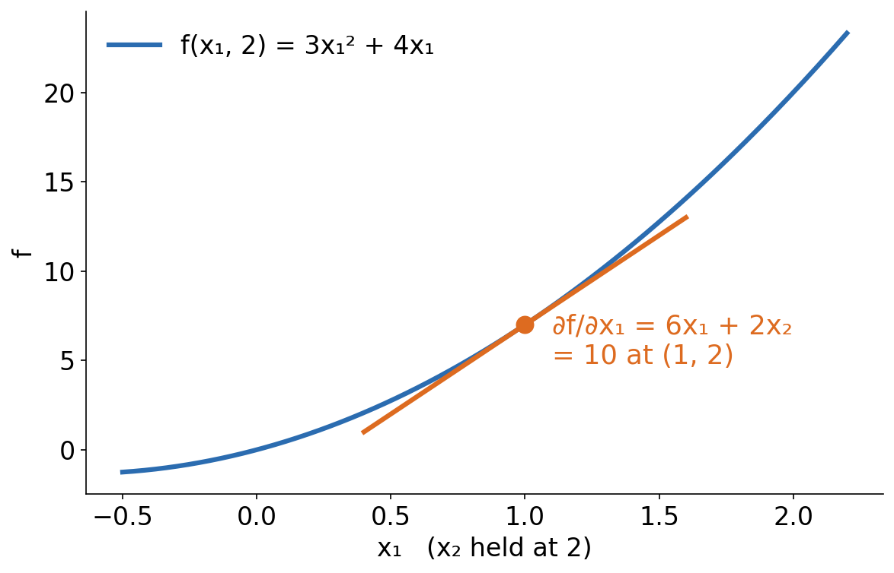
2 · PARTIAL DERIVATIVES
A partial derivative: hold the others fixed
▪ f(x₁, x₂) = 3x₁² + 2x₁x₂
▪ ∂f/∂x₁ = 6x₁ + 2x₂
▪ ∂f/∂x₂ = 2x₁
See course.bioinfo.se/session01.html, 'Partial derivatives and the gradient'.
Notes:
For ∂f/∂x₁, x₂ is a constant, so 2x₁x₂ differentiates like 2x₂·x₁, giving 2x₂. For ∂f/∂x₂, 3x₁² contributes nothing and 2x₁x₂ gives 2x₁. At (1, 2): 10 and 2. The figure is the slice x₂ = 2.

Slide 38
2 · THE GRADIENT
A worked gradient, in full
▪ f(x₁, x₂) = 3x₁² + 2x₁x₂
▪ ∂f/∂x₁ = 6x₁ + 2x₂ (x₂ held constant)
▪ ∂f/∂x₂ = 2x₁ (3x₁² contributes nothing)
▪ ∇f(1, 2) = (10, 2)
See course.bioinfo.se/session01.html, 'Partial derivatives and the gradient'.
Notes:
Do this one on the board rather than reading it. The trap every year is the second line: with x1 held constant, 3x1^2 is a constant and differentiates to zero. Length and direction of (10, 2) then give the steepest-ascent direction and how steep it is.

Slide 39
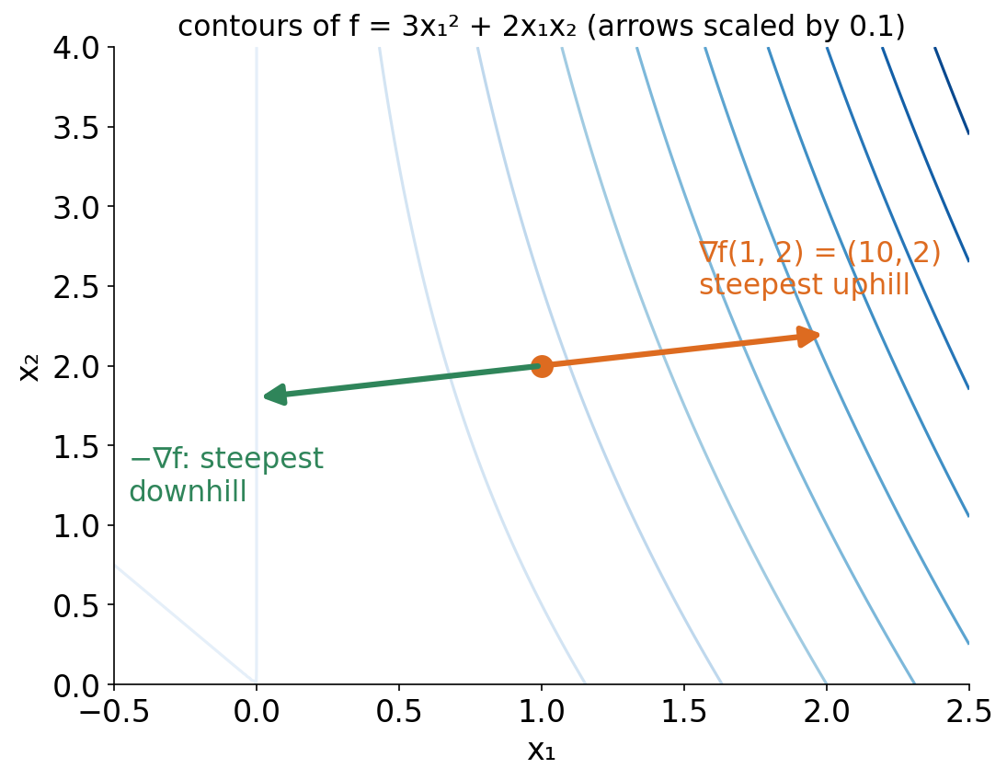
2 · THE GRADIENT
The gradient points uphill
▪ ∇f = (∂f/∂x₁, …, ∂f/∂xₙ)
▪ ∇f(1, 2) = (10, 2)
▪ Direction: steepest uphill
▪ Length: how steep
See course.bioinfo.se/session01.html, 'Partial derivatives and the gradient'.
Notes:
Point yourself in the opposite direction and you head downhill as fast as possible: that is gradient descent.

Slide 40
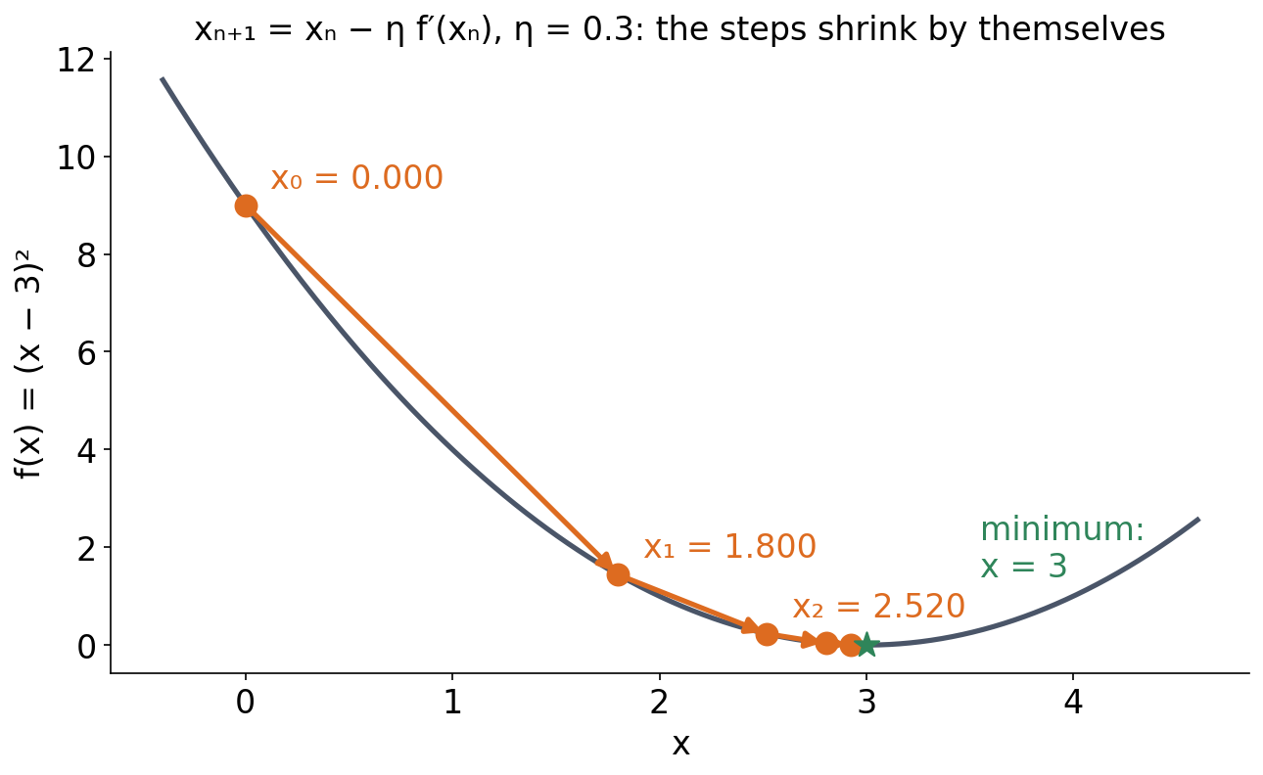
2 · GRADIENT DESCENT
Gradient descent, one step at a time
▪ xₙ₊₁ = xₙ − η f′(xₙ)
▪ 0 → 1.800 → 2.520 → 2.808
▪ Closes in on x = 3
▪ The steps shrink by themselves
See course.bioinfo.se/session01.html, Table 1.2.
Notes:
f(x) = (x - 3)^2, f'(x) = 2(x - 3), η = 0.3, x0 = 0. Step 0: f' = -6.00, x1 = 1.800. Step 1: f' = -2.40, x2 = 2.520. Step 2: f' = -0.96, x3 = 2.808. Step 3: x4 = 2.923. The derivative shrinks near the minimum, so nobody has to decrease η by hand. From Session 7 on, the same update runs on many weights at once, with the gradient vector.

Slide 41
2 · GRADIENT DESCENT
The same four steps, as arithmetic
▪ f(x) = (x − 3)², f′(x) = 2(x − 3), x₀ = 0, η = 0.3
▪ n = 0: x = 0.000, f′ = −6.00 → 1.800
▪ n = 1: x = 1.800, f′ = −2.40 → 2.520
▪ n = 2: x = 2.520, f′ = −0.96 → 2.808
▪ n = 3: x = 2.808, f′ = −0.384 → 2.923
▪ Closing in on 3, with η untouched
Table 3 on course.bioinfo.se/session01.html.
Notes:
The steps are long where the curve is steep and short near the minimum, although eta never changes. Session 7 shows the identical arithmetic inside a model, and the Block 2 quiz asks what happens when eta is far too large.

Slide 42
2 · GRADIENT DESCENT
From one derivative to a million
▪ Here: one variable, one derivative
▪ In a real model: every weight updated at once
▪ The gradient vector replaces the single f′
▪ Same rule, one subtraction per weight
▪ You will see this loop from Session 7 onwards
See course.bioinfo.se/session01.html, 'Gradient descent'.
Notes:
The bridge out of this block. Nothing new has to be learned to go from this toy function to training a network: the update rule is identical, applied to a vector. What is still missing is how to get the gradient of a deep composition, which is the chain rule on the next slide.

Slide 43
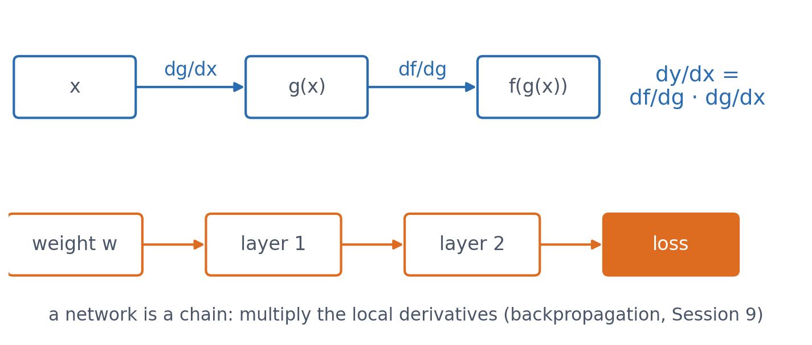
2 · THE CHAIN RULE
The chain rule: multiply the derivatives along the chain
For y = f(g(x)), dy/dx = df/dg · dg/dx. A network's output is a function of a function of a function of its weights, so the chain rule gives the gradient of every weight.
See course.bioinfo.se/session01.html, 'The chain rule'; backpropagation in Session 9.
Notes:
This looks unremarkable, but it is the one idea backpropagation is built from: multiply together the derivatives of every function a weight passes through on the way to the loss.

Slide 44
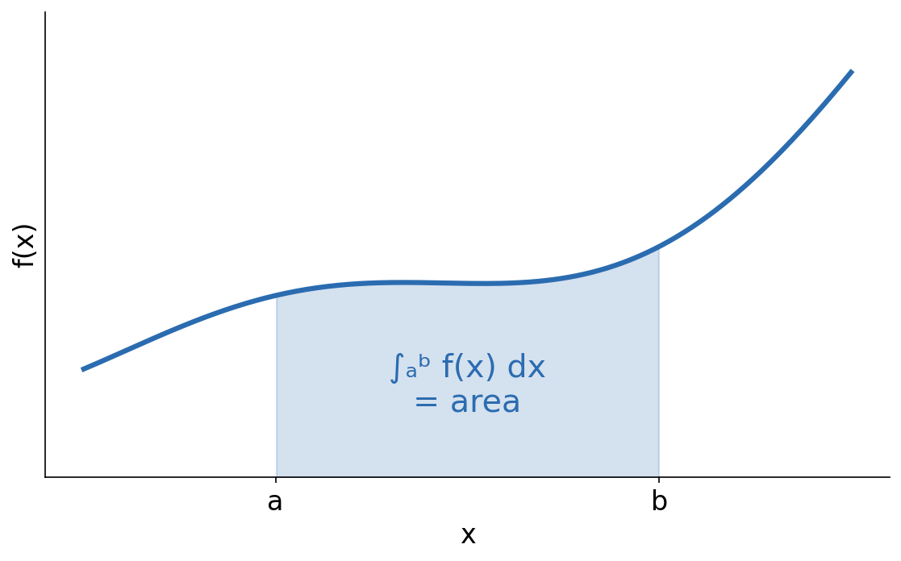
2 · OPTIONAL
An integral is the area under the curve
▪ Differentiation run backwards
▪ AUROC is an area (Session 8)
▪ Optional box on the page
See course.bioinfo.se/session01.html, 'Optional: integrals, briefly'.
Notes:
The indefinite integral recovers a function up to a constant C, since the derivative of a constant is zero. Worked example on the page: integrating f'(x) = 2(x - 3) gives back (x - 3)^2 plus a constant.

Slide 45
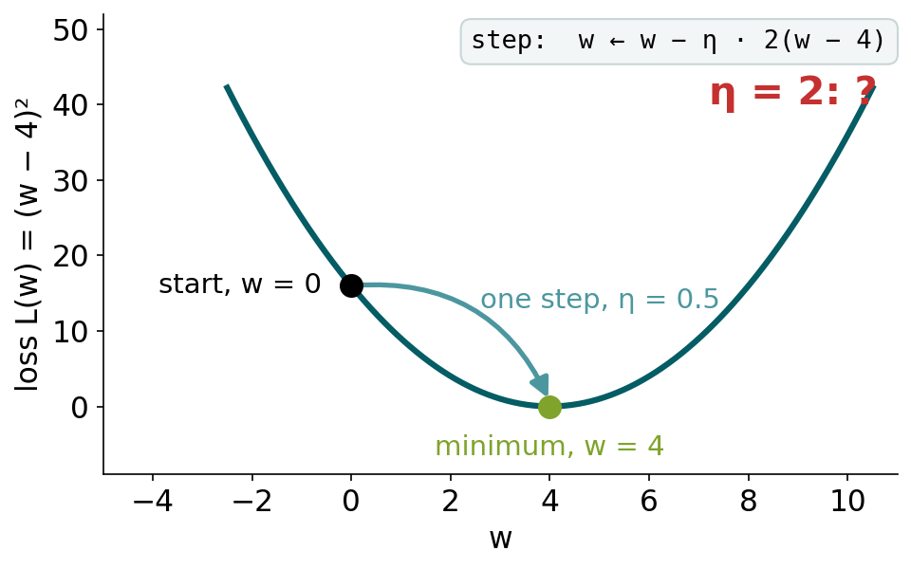
BLOCK 2 · QUIZ
What happens with η = 2?
L(w) = (w − 4)², start at w = 0. With η = 0.5, one step lands exactly on the minimum.
A Lands on the minimum in one step
B Overshoots a little, then settles at w = 4
C Overshoots further each step, on alternating sides
D Overshoots once to w = 8 and stays there
Guess on your own
Scan the code, or go to
quiz.bioinfo.se/live
Notes:
L(w) = (w − 4)², start at w = 0. With η = 0.5 the step w ← w − η·2(w − 4) lands exactly on 4. Ask what η = 2 does.

Slide 46
BLOCK 2 · QUIZ
What happens with η = 2?
How did the room answer?
Halt the round when most have answered, then show the results.
Show the results ▸ quiz.bioinfo.se/live/report
Notes:
Halt submission in the Control view, then open the results. Do not say which answer is right.

Slide 47

BLOCK 2 · QUIZ
What happens with η = 2?
Fix it, run it, discuss
Open the notebook: scan the code
Fix the line marked FIX, then run the cells
Did it come out as you guessed? Discuss with your neighbour
The notebook: https://colab.research.google.com/github/ElofssonLab/kb8029-book/blob/main/notebooks/session01-discussion-2.ipynb
Notes:
About 8 minutes. The notebook's derivative lacks the factor 2 (w − 4 instead of 2(w − 4)): as it is, η = 0.5 only gets halfway each step, and η = 2 jumps between 0 and 8 for ever, the fourth answer. Fixed: η = 0.5 lands on 4 in one step, η = 2 gives 0, 16, −32, 112.

Slide 48
BLOCK 2 · QUIZ
What happens with η = 2?
Answer again
Same question, after the discussion.
quiz.bioinfo.se/live
Notes:
Open the second round (post) in the Control view.

Slide 49
BLOCK 2 · QUIZ
What happens with η = 2?
Results, and who explains
Both rounds side by side.
Draw two to explain: one of you says how you reasoned.
Show the results ▸ quiz.bioinfo.se/live/report
To check it with code afterwards: discussion notebook 2 https://colab.research.google.com/github/ElofssonLab/kb8029-book/blob/main/notebooks/session01-discussion-2.ipynb
Notes:
Third answer. The step is w ← w − 2η(w − 4): with η = 0.5, 2η = 1 cancels the distance to 4 in one step. With η = 2 the distance is multiplied by 1 − 2η = −3 every step: 0 → 16 → −32 → 112. Too large a learning rate diverges.

Slide 50
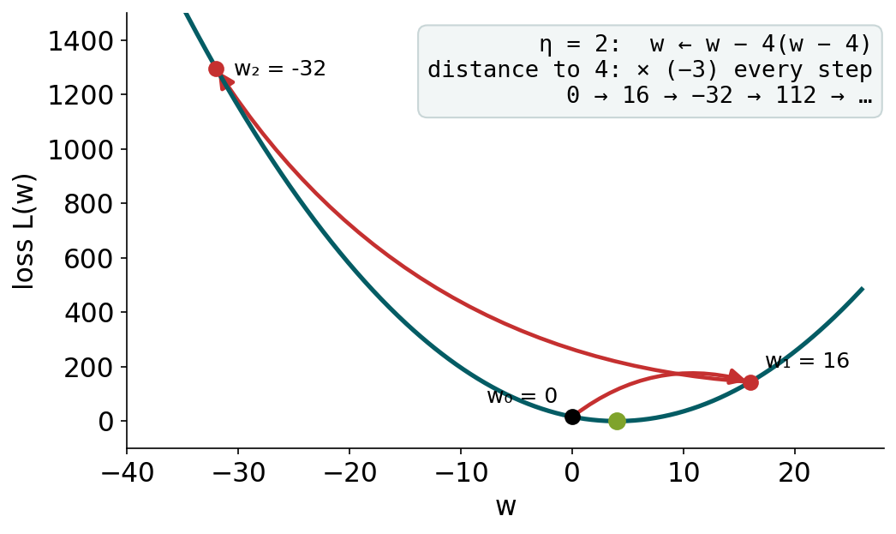
BLOCK 2 · QUIZ
The answer: η = 2 moves away from the minimum
Each step multiplies the distance to the minimum by 1 − 2η. With η = 0.5 that is 0: one step lands on w = 4. With η = 2 it is −3: every step lands three times further away, on the other side. Too large a learning rate diverges.

Slide 51
BLOCK 2 DONE
Break

Slide 52
BLOCK 3 · ABOUT 25 MIN
Probability and statistics

Slide 53
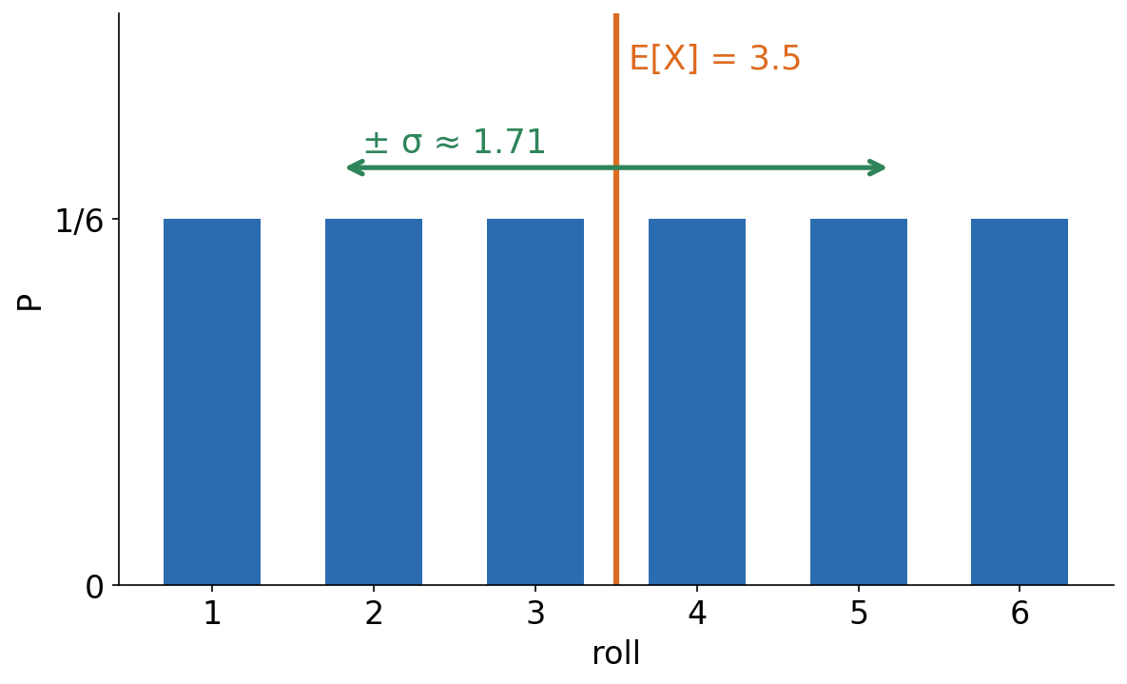
3 · RECAP
Expectation and spread
▪ E[X] = Σ xᵢ P(xᵢ)
▪ Var(X) = E[(X − μ)²]
▪ σ = √Var(X)
See course.bioinfo.se/session01.html, 'A short recap: expectation and variance'.
Notes:
A fair die: E[X] = 3.5, σ ≈ 1.71. For a normal distribution, about 95% of the values lie within 2σ of the mean. The biostatistics course covers probability in general.

Slide 54
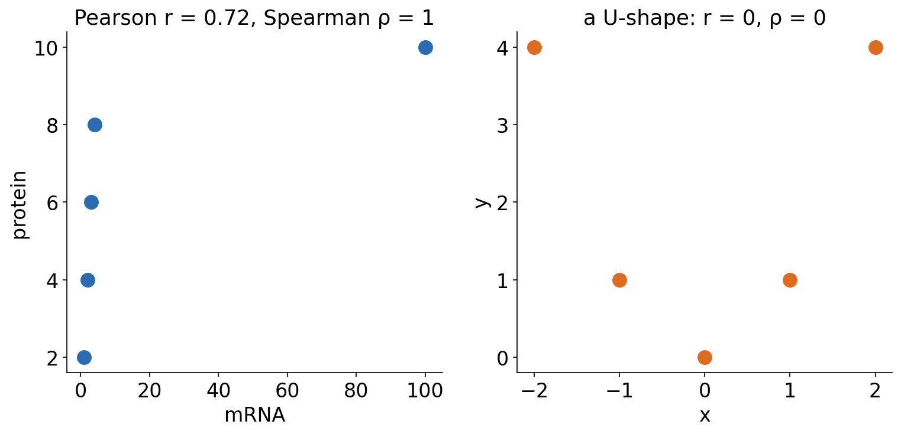
3 · CORRELATION
Pearson and Spearman: a line, or a rising trend?
Left: every increase in mRNA goes with an increase in protein, so Spearman's ρ = 1, but one extreme value pulls Pearson's r down to 0.72. Right: both are 0 for a U-shape. Plot first.
See course.bioinfo.se/session01.html, 'Correlation: Pearson and Spearman'.
Notes:
Pearson's r measures the fit to a straight line; Spearman's ρ is Pearson's r on the ranks. Also: a correlation has a p-value that depends on the number of points (five points is weak evidence), and correlation is not causation. All three cautions are used in Session 2.

Slide 55
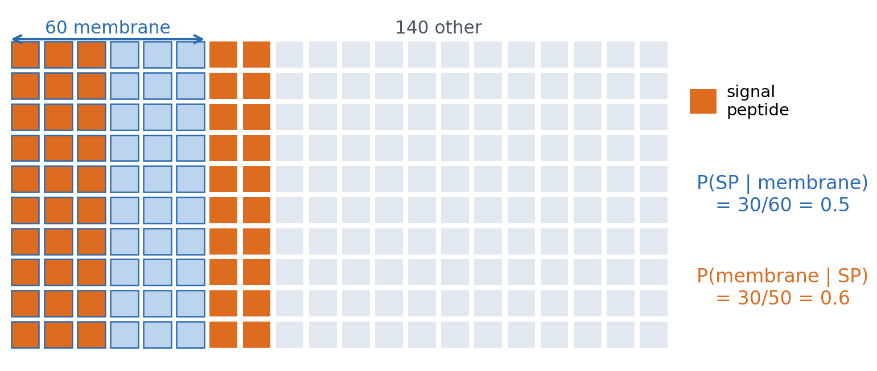
3 · CONDITIONAL PROBABILITY
P(A | B): restrict to the cases where B holds
200 proteins: 60 membrane proteins, 30 of them with a signal peptide, and 20 of the other 140 with one too. The direction matters: 0.5 is not 0.6.
See course.bioinfo.se/session01.html, 'Conditional probability'.
Notes:
P(A | B) = P(A and B) / P(B). Die example: P(even | X > 3) = 2/3, not 1/2. Mixing up the two directions is behind the most common misreading of p-values. A profile gives P(residue | position); a classifier gives P(class | input). The optional box on the page has Bayes' rule, which turns one into the other; the third discussion uses it.

Slide 56
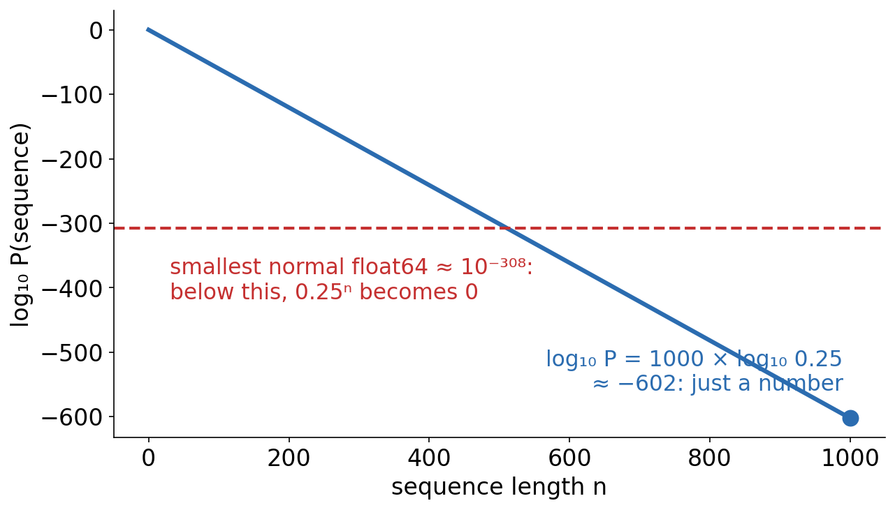
3 · LOGS
Why bioinformatics works with logs
▪ 0.25¹⁰⁰⁰ ≈ 10⁻⁶⁰² rounds to 0
▪ log(xy) = log x + log y
▪ Products become sums
See course.bioinfo.se/session01.html, 'Log probabilities and log-odds'.
Notes:
Any particular 1,000-base sequence under a uniform model has probability 0.25^1000, smaller than the computer normally stores. Its log10 is 1000 × log10(0.25) ≈ -602, an ordinary number. Logarithms to different bases differ only by a constant factor.

Slide 57
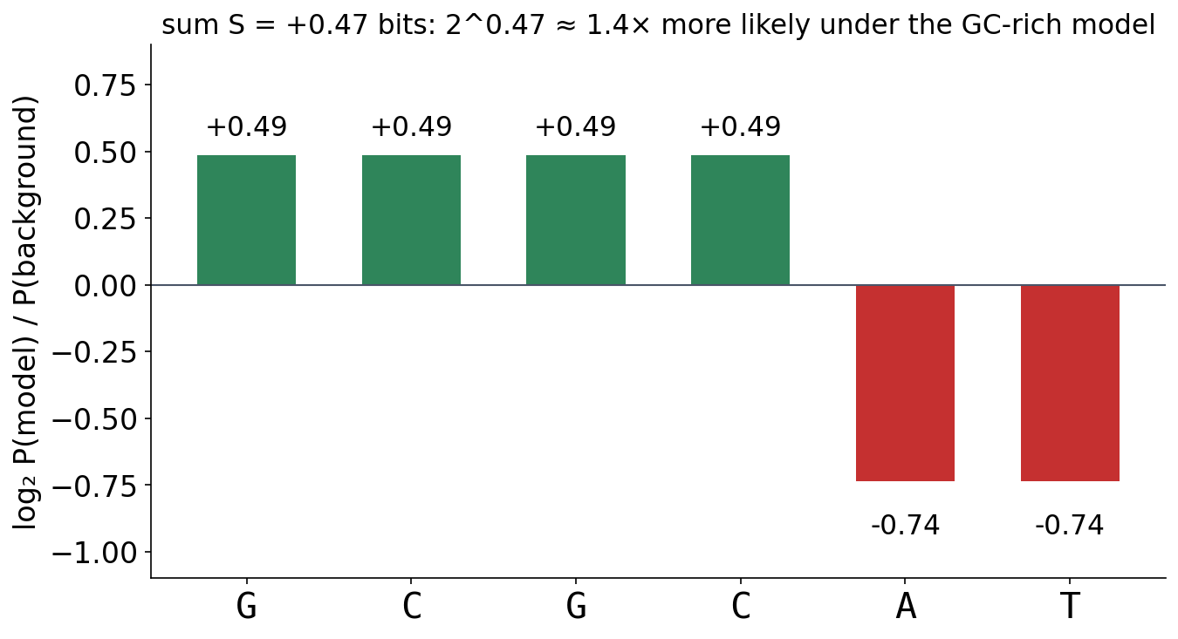
3 · LOG-ODDS
Log-odds: model against background, base by base
▪ Add per-base log ratios
▪ Positive: the model wins
▪ BLOSUM, PSSMs (Sessions 4-5)
See course.bioinfo.se/session01.html, 'Log probabilities and log-odds'.
Notes:
GC-rich model: G and C 0.35 each, A and T 0.15 each; background 0.25. Per base: log2(0.35/0.25) = +0.49, log2(0.15/0.25) = -0.74. GCGCAT: 4 × 0.49 + 2 × (-0.74) ≈ +0.47 bits, so 2^0.47 ≈ 1.4 times more likely under the GC-rich model. This is why substitution scores and profile scores are added along an alignment. Volcano plots use -log10(p) the same way.

Slide 58
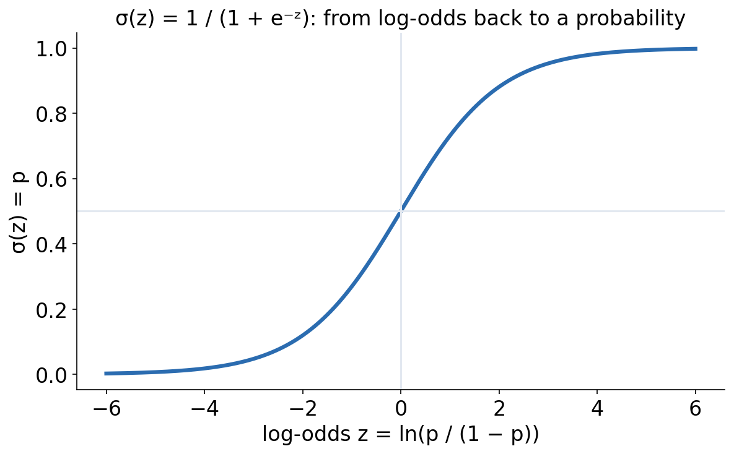
3 · LOG-ODDS
The sigmoid: from log-odds back to a probability
▪ σ(ln(p / (1 − p))) = p
▪ Logistic regression (Session 8)
▪ A calibrated probability only if trained for it
See course.bioinfo.se/session01.html, 'Log probabilities and log-odds'.

Slide 59
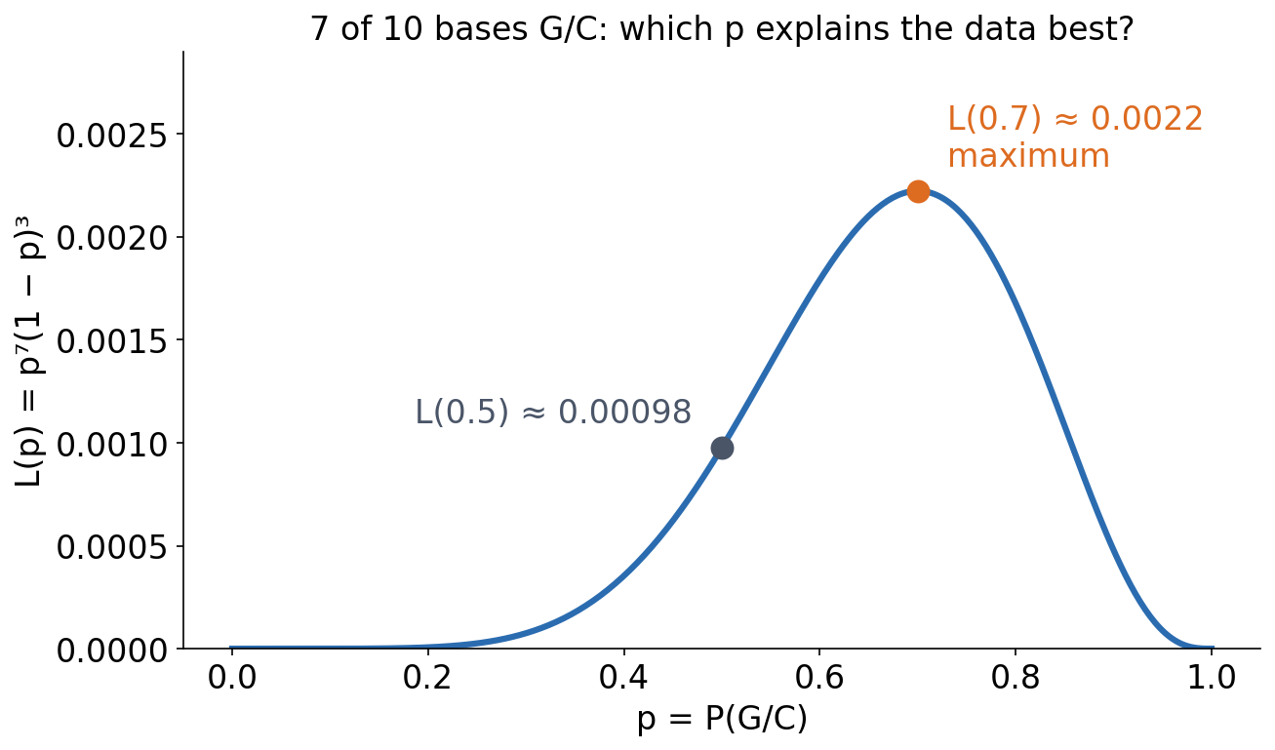
3 · LIKELIHOOD
Likelihood: which parameters explain the data?
▪ L(θ) = P(data | θ)
▪ L(0.7) ≈ 2.3 × L(0.5)
▪ Maximum likelihood: how models are trained
See course.bioinfo.se/session01.html, 'Likelihood'.
Notes:
Ten bases, seven G/C, independent positions: L(p) = p^7 (1-p)^3. L(0.5) ≈ 0.00098, L(0.7) ≈ 0.0022. No p does better than 0.7, the observed fraction. Likelihoods are computed as sums of logs; many loss functions later are negative log-likelihoods.

Slide 60
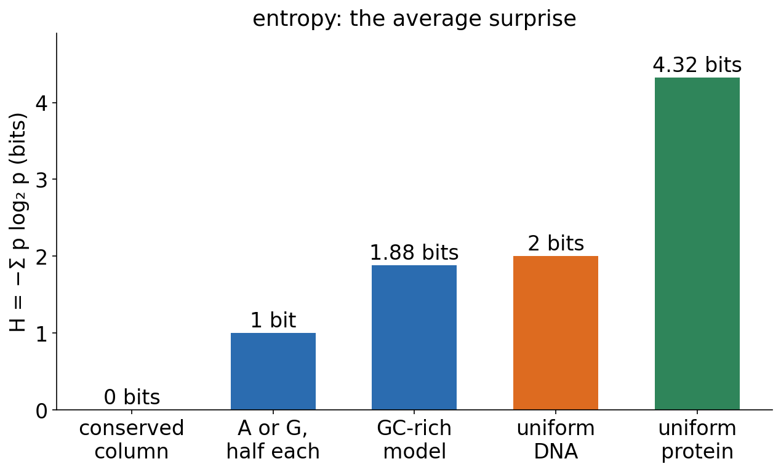
3 · ENTROPY
Entropy: average surprise
▪ Surprise: −log₂ p bits
▪ H = −Σ p log₂ p
▪ Max − H = a logo's stack height (Session 4)
See course.bioinfo.se/session01.html, Table 1.3.
Notes:
A certain outcome carries 0 bits, a fair coin 1 bit, one of four equally likely bases 2 bits. Information content = maximum - H. Session 12's DCA uses maximum entropy. The physical entropy of folding (Session 6) has the same form but is a different quantity.

Slide 61
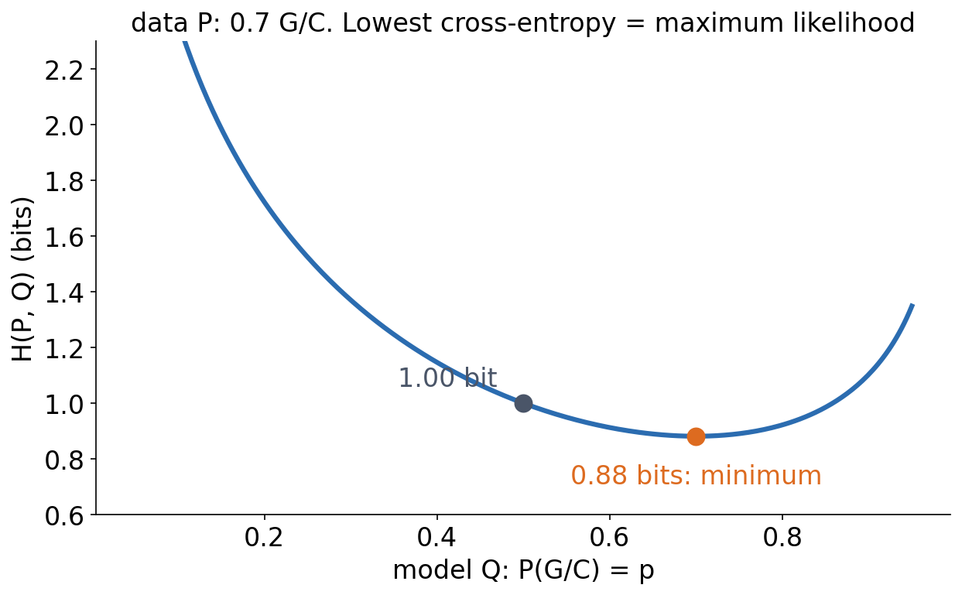
3 · ENTROPY
Cross-entropy is maximum likelihood in disguise
▪ H(P, Q) = −Σ P log₂ Q
▪ Never below H(P)
▪ The classifier loss (Sessions 8-9)
See course.bioinfo.se/session01.html, 'Entropy: average surprise'.
Notes:
Data P: 0.7 G/C. The cross-entropy is 1.00 bit for p = 0.5 and 0.88 bits for p = 0.7, the minimum: exactly the log-likelihood per base with the sign changed (log2 L(0.5) = -10 bits for ten bases, log2 L(0.7) ≈ -8.8). The extra cost H(P,Q) - H(P) is the relative entropy (KL divergence) of Session 4.

Slide 62
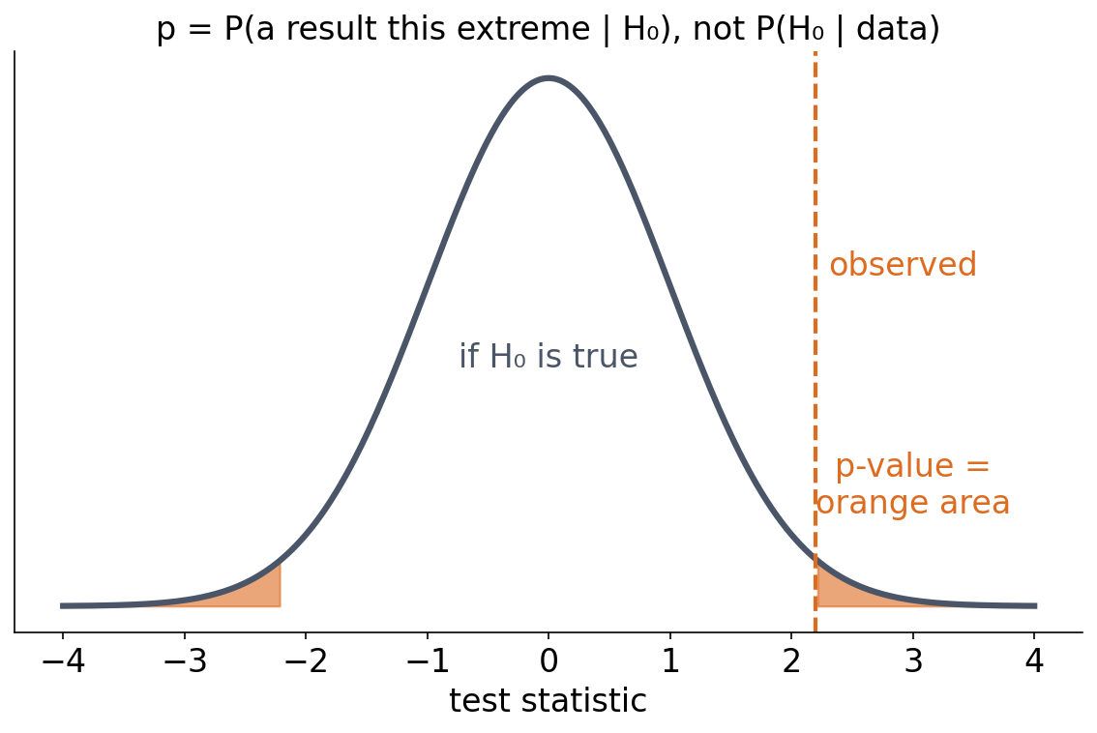
3 · TESTING
A p-value is a tail area under the null
▪ P(data this extreme | H₀)
▪ Not P(H₀ | data)
▪ 0.05 is a convention, not a law
See course.bioinfo.se/session01.html, 'p-values and hypothesis testing'.
Notes:
If H0 is true and the test's assumptions hold, a 0.05 threshold rejects H0 5% of the time. Welch's t-test example: controls (5.1, 4.9, 5.3, 5.0) against treatment (7.2, 6.8, 7.5, 7.0) give t ≈ -11.9 and p ≈ 0.0001.

Slide 63
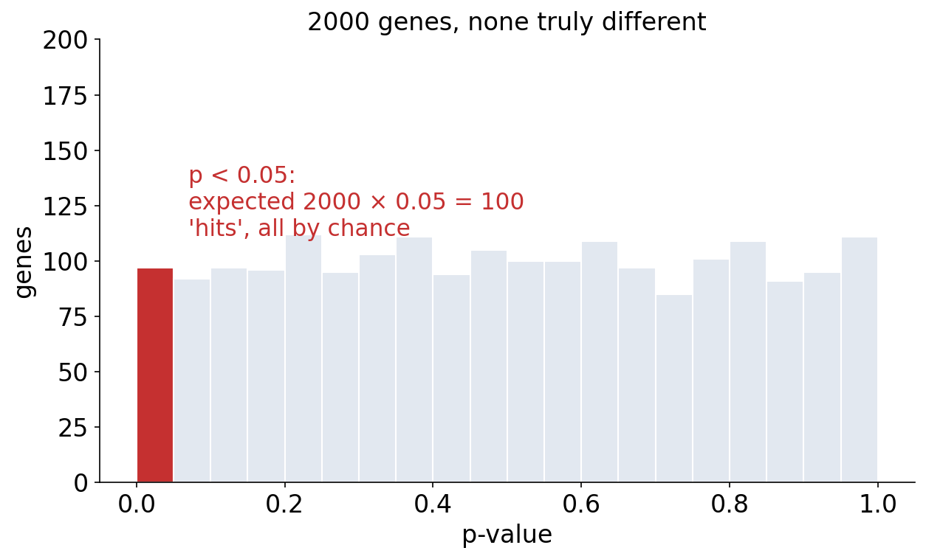
3 · TESTING
Test 2000 genes and chance alone gives about 100 hits
▪ Null p-values are uniform
▪ Bonferroni: often too strict
▪ FDR: Benjamini-Hochberg
See course.bioinfo.se/session01.html, 'The multiple testing problem'. The histogram is one simulation.
Notes:
Bonferroni divides the threshold by the number of tests. The false discovery rate is the expected proportion of false positives among everything called significant; Benjamini-Hochberg controls it under specified assumptions (independent or positively correlated tests).

Slide 64
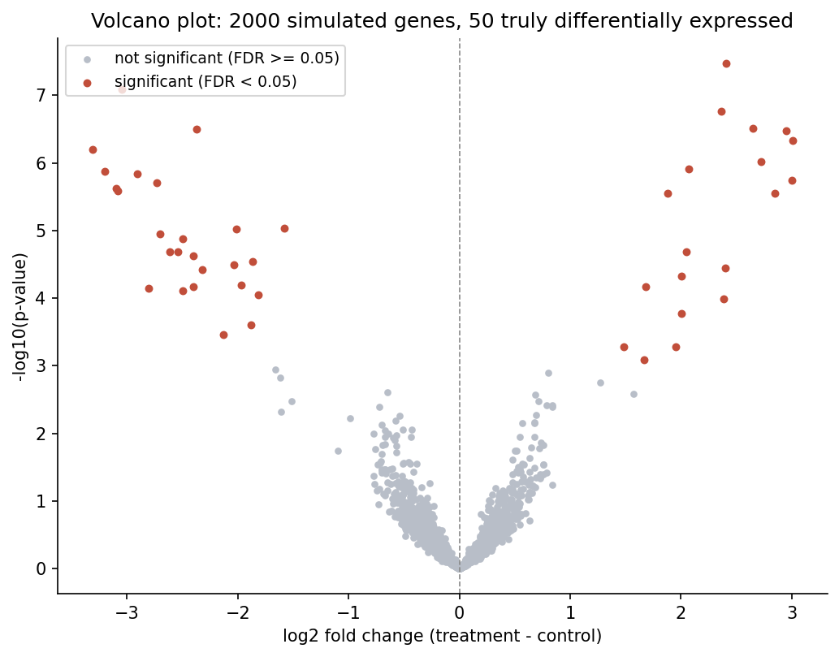
3 · WORKED EXAMPLE
RNA-seq: the volcano plot
▪ x: log₂ fold change (effect)
▪ y: −log₁₀ p (evidence)
▪ Interesting genes: far out and high up
See course.bioinfo.se/session01.html, 'Worked example: RNA-seq differential expression and the volcano plot'.
Notes:
2000 simulated genes, 50 truly differentially expressed, a Welch t-test per gene. The fold change measures the size of the effect independently of its significance.

Slide 65
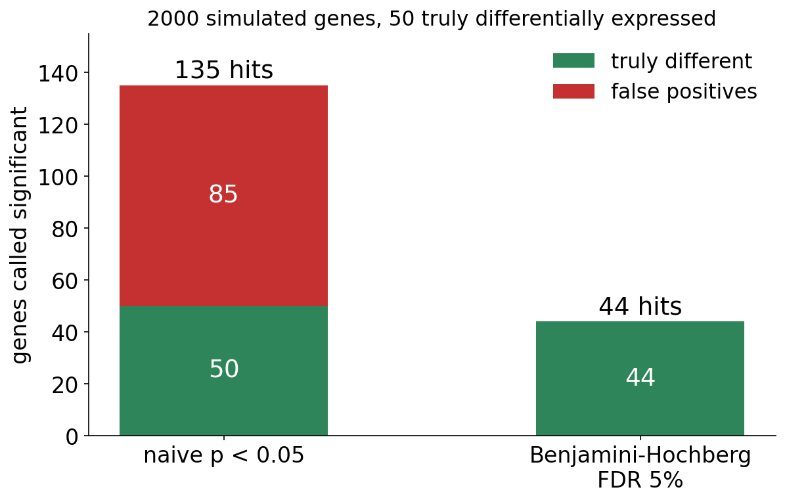
3 · WORKED EXAMPLE
Naive threshold against FDR control
▪ p < 0.05: 135 hits, 85 false
▪ BH at 5%: 44 hits, all real
▪ 5% FDR does not promise zero
See course.bioinfo.se/session01.html, 'Worked example: RNA-seq differential expression and the volcano plot'.
Notes:
The 85 false positives among the 1950 null genes are close to the ~97.5 expected by chance. That none of the 44 BH discoveries is false is a property of this simulation, not a guarantee.

Slide 66
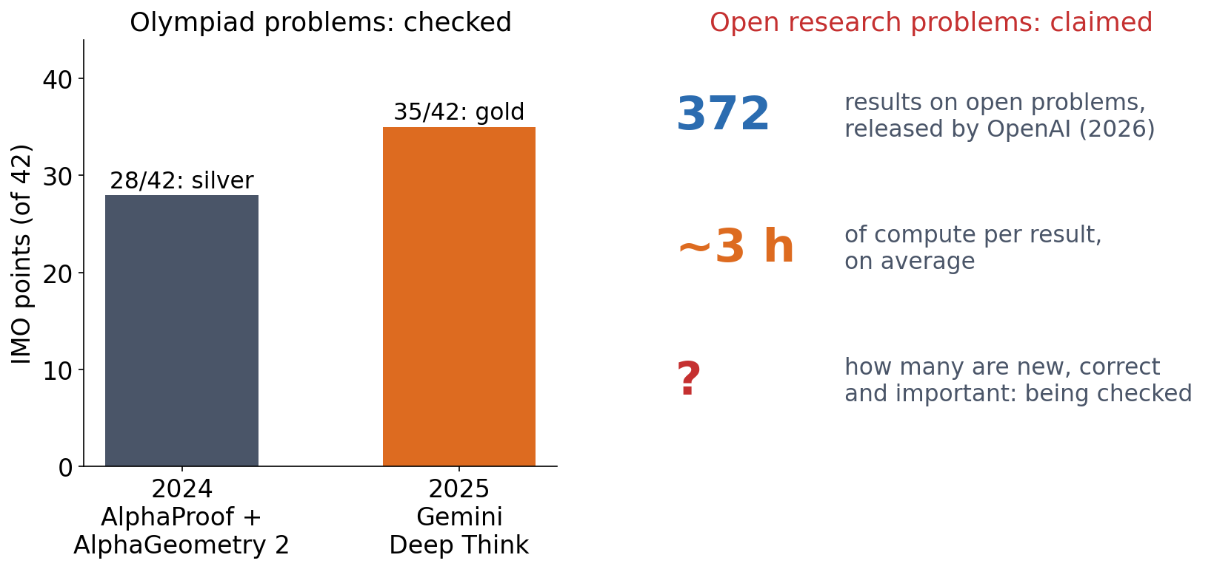
3 · OUTLOOK
AI is doing mathematics: checked results and claims
▪ 2024: olympiad silver; 2025: gold
▪ 2026: 372 claimed results on open problems
▪ Correct, new and important? Being checked
▪ If an AI can do the maths, why learn it?
DeepMind blog, 25 Jul 2024 (AlphaProof, AlphaGeometry 2) and Jul 2025 (Gemini Deep Think); The Decoder on OpenAI's release of 372 results (2026). https://deepmind.google/discover/blog/ai-solves-imo-problems-at-silver-medal-level/
Notes:
IMO 2024: AlphaProof and AlphaGeometry 2 solved four of six problems, 28 of 42 points, one point below gold. IMO 2025: an advanced Gemini Deep Think solved five of six problems in natural language within the time limit, 35 of 42, gold-medal standard, graded by the IMO coordinators; OpenAI reported the same score for an experimental model, graded by itself. In 2026 OpenAI released 372 results 'to solve an open problem or make substantial progress toward one', about three hours of ChatGPT Pro compute each. Present these as claims: many come with Lean formalisations, which check the logic but not whether a result is new or important, and mathematicians are still reading them; reports differ on how many are full solutions. One answer to the question: to judge whether a result is right and whether it answers your question, which is what Sessions 8 and 9 do for models.

Slide 67
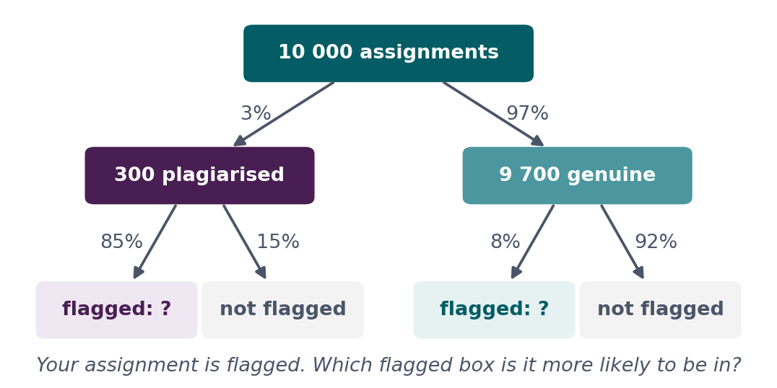
BLOCK 3 · QUIZ
How likely is a flagged assignment plagiarised?
An automatic detector flags 85% of plagiarised and wrongly flags 8% of genuine assignments. 3% of all assignments are plagiarised. Your assignment is flagged.
A About 85%
B About 92%
C About 25%
D About 3%
Guess on your own
Scan the code, or go to
quiz.bioinfo.se/live
Notes:
Flags 85% of plagiarised work and 8% of genuine work; 3% of assignments are plagiarised. The tree shows 10 000 assignments; the flagged counts are left to work out.

Slide 68
BLOCK 3 · QUIZ
How likely is a flagged assignment plagiarised?
How did the room answer?
Halt the round when most have answered, then show the results.
Show the results ▸ quiz.bioinfo.se/live/report
Notes:
Halt submission in the Control view, then open the results. Do not say which answer is right.

Slide 69

BLOCK 3 · QUIZ
How likely is a flagged assignment plagiarised?
Fix it, run it, discuss
Open the notebook: scan the code
Fix the line marked FIX, then run the cells
Did it come out as you guessed? Discuss with your neighbour
The notebook: https://colab.research.google.com/github/ElofssonLab/kb8029-book/blob/main/notebooks/session01-discussion-3.ipynb
Notes:
About 8 minutes. The notebook's FIX line divides the flagged plagiarised assignments by all plagiarised ones, so it prints 0.850: P(flag | plagiarised), the first answer. Fixed (divide by all flagged): 0.247.

Slide 70
BLOCK 3 · QUIZ
How likely is a flagged assignment plagiarised?
Answer again
Same question, after the discussion.
quiz.bioinfo.se/live
Notes:
Open the second round (post) in the Control view.

Slide 71
BLOCK 3 · QUIZ
How likely is a flagged assignment plagiarised?
Results, and who explains
Both rounds side by side.
Draw two to explain: one of you says how you reasoned.
Show the results ▸ quiz.bioinfo.se/live/report
To check it with code afterwards: discussion notebook 3 https://colab.research.google.com/github/ElofssonLab/kb8029-book/blob/main/notebooks/session01-discussion-3.ipynb
Notes:
About 25%. Of 10 000: 300 plagiarised, 255 flagged; 9 700 genuine, 776 flagged. P(plagiarised | flag) = 255 / 1031 ≈ 0.25. The many genuine assignments produce most of the flags. P(flag | plagiarised) = 0.85 and P(plagiarised | flag) = 0.25 are different numbers: the direction of conditioning matters.

Slide 72
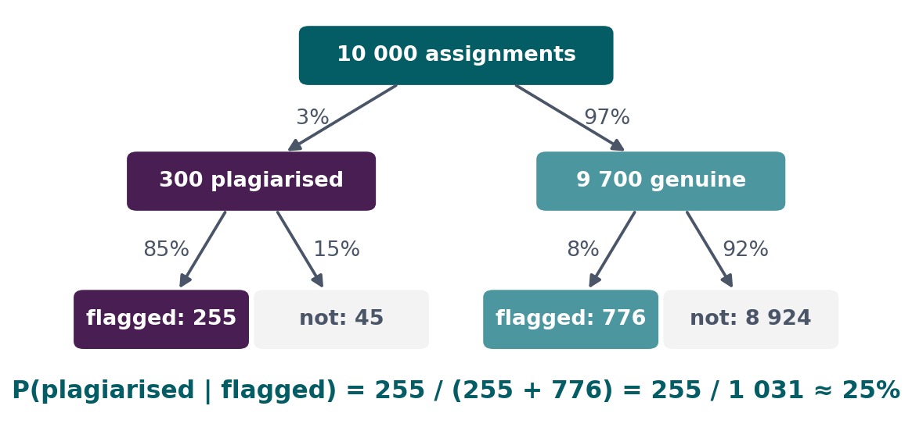
BLOCK 3 · QUIZ
The answer: about 25%
Plagiarism is rare, so the 8% false flags among the many genuine assignments (776) outnumber the true flags among the few plagiarised ones (255). P(flagged | plagiarised) = 85%, but P(plagiarised | flagged) is only about 25%: the direction of conditioning matters.

Slide 73
SUMMARY
Today's maths, and where it comes back
The dot product is a profile score and a perceptron. The gradient and the chain rule train every network. Logs give log-odds scores, and cross-entropy is maximum likelihood.
See course.bioinfo.se/session01.html, 'What's next'.
Notes:
Ask the room for one example per column before showing the caption.

Slide 74
BEFORE YOU LEAVE
In up to three words: what was the hardest part of today?
Answer now
Scan the code, or go to
quiz.bioinfo.se/live
Notes:
A word cloud: the bigger the word, the more students wrote it. It shows what to repeat next time.

Slide 75
BEFORE YOU LEAVE
The hardest part of today
What the room found hardest
Show the results ▸ quiz.bioinfo.se/live/report

Slide 76
BEFORE YOU LEAVE
Feedback on today
The Canvas survey
This session has no lab, so tell us now what to improve: "Sessions 0 and 1: feedback" in Canvas
Concrete suggestions: too long, missing background, errors, unclear slides
Takes about five minutes; Canvas records that you submitted it, not what you wrote
Notes:
Give them five minutes to fill it in before they leave. It is due at 23:59 today.

Slide 77
Session 2 next
Every idea today written in code: Python, NumPy and PyTorch
The dot product becomes one line of PyTorch
Before Session 2: the Setup page (VS Code and Colab)

