Slide 1

Session 2: Working like a computational biologist in Python
KB8029 — Bioinformatics & Deep Learning
Arne Elofsson
Notes:
Students set up VS Code and its Google Colab extension before this session (course.bioinfo.se/setup.html); the notebooks run on Colab, from VS Code or in the browser. Nothing today is new syntax: it is how you work with Python you already know from DA7066.

Slide 2

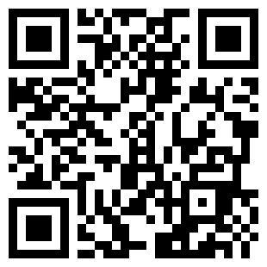
BEFORE WE START
Log in to the lecture quiz
Log in to the quiz
Scan the code, or go to quiz.bioinfo.se/live
Log in with your university account
Answering counts as being at the lecture: up to 3 bonus points on the exam
Right or wrong is never graded, only whether you answered. Results are shown without names.
quiz.bioinfo.se/live
Notes:
The quiz is not anonymous, because answering is how attendance is counted: 3 bonus points on the main exam for answering in all 12 lectures, one point less per missed lecture (preliminary). Whether an answer is right or wrong is never used. The projected results never show names; the only names shown are the two drawn to explain their reasoning. Start the session on quiz.bioinfo.se before the lecture: quiz.bioinfo.se/live then leads to it.

Slide 3
BEFORE WE START
Warm-up: what do you know already?
3 quick questions
On the topics of today, one at a time, about 30 seconds each
Answer on your own, and guess if you do not know
It shows me where to start; right or wrong is never graded
Notes:
About 2 minutes in all. Open each question's round, halt it after about 30 seconds and glance at the results; do not explain the answers now, the lecture does that.

Slide 4
WARM-UP · 1 OF 3
x = [1, 2]; y = x; y.append(3). What is x now?
A [1, 2]
B [1, 2, 3]
C [3]
D An error
Answer now
Scan the code, or go to
quiz.bioinfo.se/live
Notes:
Right: [1, 2, 3]. y is another name for the same list, not a copy. Block 1.

Slide 5
WARM-UP · 2 OF 3
df has one row per gene. What does df["padj"] < 0.05 give?
A The genes with padj below 0.05
B The number of such genes
C True or False for every gene
D An error
Answer now
Scan the code, or go to
quiz.bioinfo.se/live
Notes:
Right: True or False for every gene. A boolean Series; df[df['padj'] < 0.05] then gives the genes. Block 2: selecting and filtering.

Slide 6
WARM-UP · 3 OF 3
Python reports an error on line 12. Where is the mistake?
A On line 12
B On line 12 or earlier
C After line 12
D In a library, not in your code
Answer now
Scan the code, or go to
quiz.bioinfo.se/live
Notes:
Right: On line 12 or earlier. The line in the message is where Python noticed the problem. Block 2's quiz question and block 3.

Slide 7
BEFORE WE START
What the room knows already
Where we start
Which topics most of you know, and which we take slowly today.
Show the results ▸ quiz.bioinfo.se/live/report
Notes:
Optional: show two or three of the results, the ones that most got wrong.

Slide 8
BEFORE WE START
Your questions before today
What you asked
The questions you sent in on Canvas before the lecture
The most common ones now; the others in the block where they belong
Notes:
About 5 minutes. Read the answers to this session's Canvas survey 'Questions before the lecture' the evening before (it closes at 18:00 the day before the lecture), pick the two or three most common questions, and answer them briefly now or say in which block they come.

Slide 9
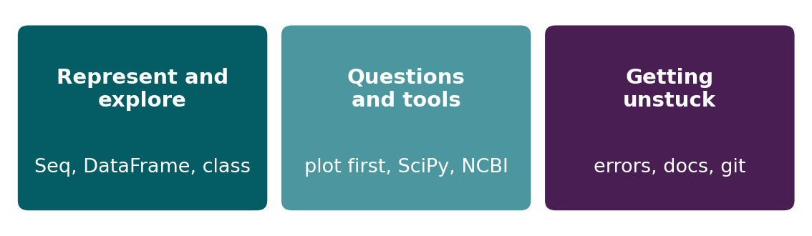
BEFORE WE START
In up to three words: what do you want to learn today?
Answer now
Scan the code, or go to
quiz.bioinfo.se/live
Notes:
A word cloud: the bigger the word, the more students wrote it. Come back to it at the end of the lecture.

Slide 10
BEFORE WE START
What you want to learn today
What the room wants to learn
Show the results ▸ quiz.bioinfo.se/live/report

Slide 11
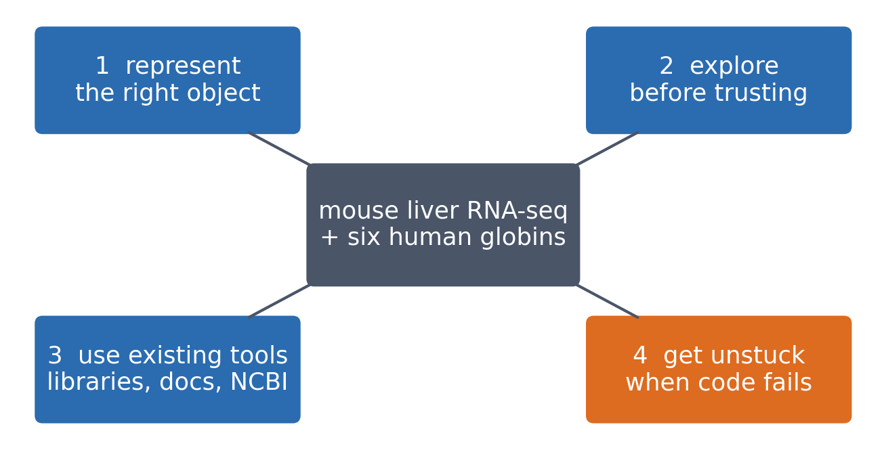
SESSION 2 · THE MAP
Four things a computational biologist does with Python
One real dataset (mouse liver RNA-seq, Becares et al. 2019) and one gene family (the human globins) carry all four ideas through the session.
See course.bioinfo.se/session02.html.
Notes:
Idea 4 gets the live coding in Block 2. Come back to this slide at the end.

Slide 12
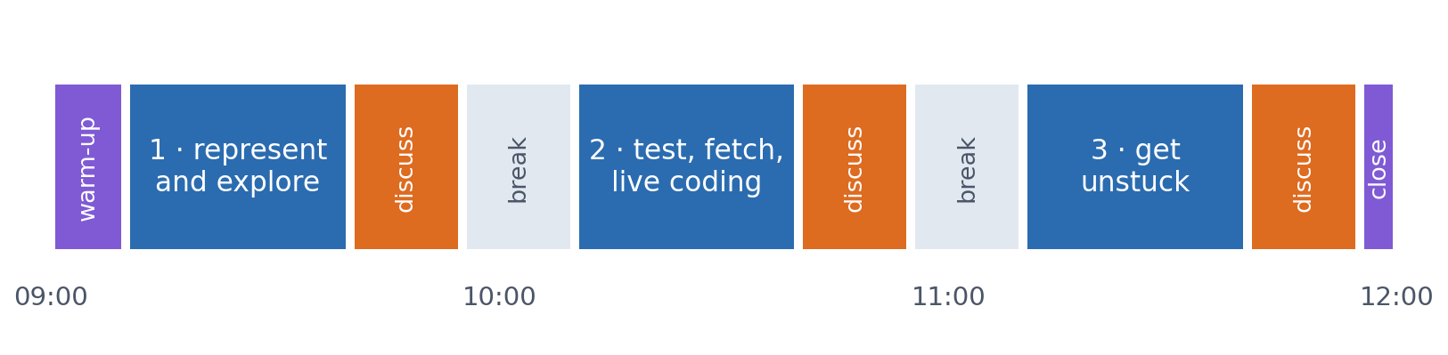
SESSION 2 · THE MORNING
Three blocks: about 30 min talk and 15 min discussion
Block 1: objects, your own classes, sequences and a first look at the RNA-seq table. Block 2: plot first, test second; reading data; live coding with six globins. Block 3: getting unstuck, git, and the lab.
Times are approximate: a 10 min start (warm-up quiz and your questions), two 15 min breaks and a 5 min close. Each block ends with a quiz question: guess, run the notebook and work out why it behaves as it does, discuss, answer again.

Slide 13
BLOCK 1 · ABOUT 30 MIN
Represent and explore

Slide 14
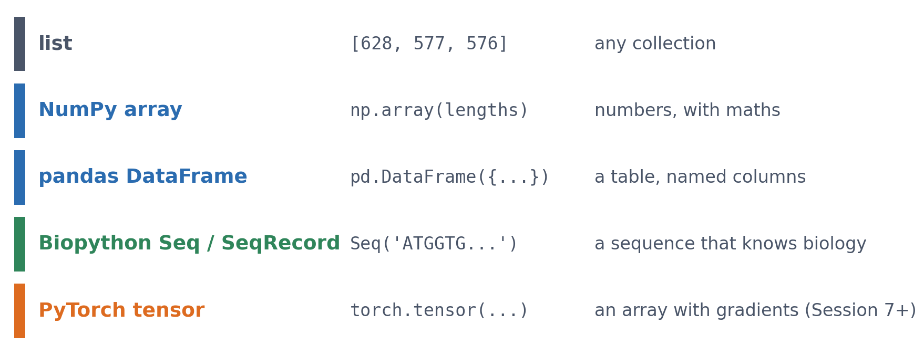
1 · REPRESENT
The right object for the data
The same three transcript lengths in increasingly specialised objects. Each object gives you the operations that make sense for its kind of data.
See course.bioinfo.se/session02.html, 'Scientific Python objects'.

Slide 15
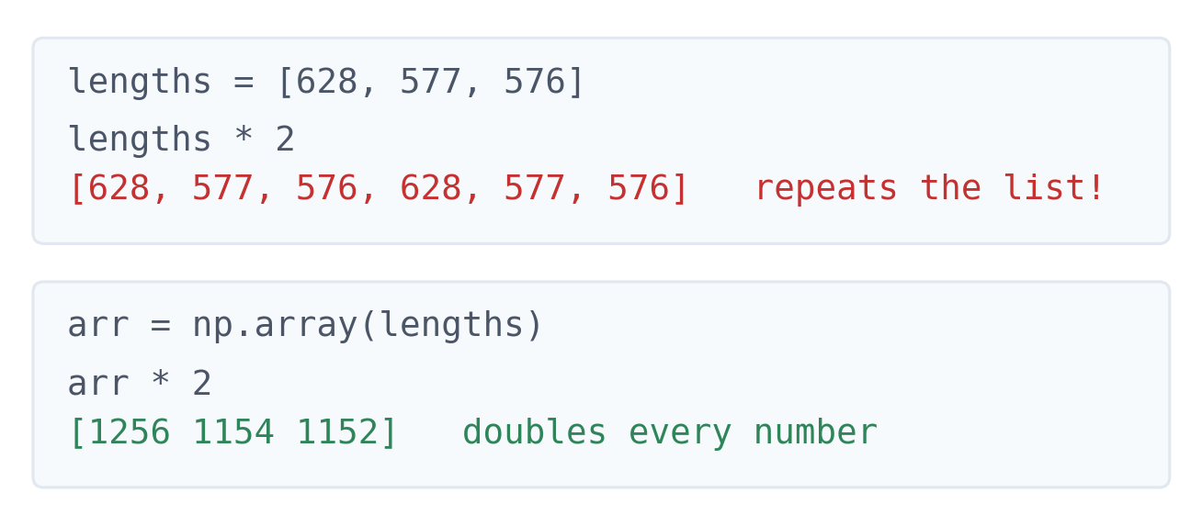
1 · REPRESENT
Same numbers, different object, different answer
▪ A list repeats
▪ An array does the maths
▪ Both run without an error
See course.bioinfo.se/session02.html, 'Scientific Python objects'.
Notes:
Optional 1-minute live demo. A first example of code that runs but does something you did not mean, which is the theme of the whole session.

Slide 16
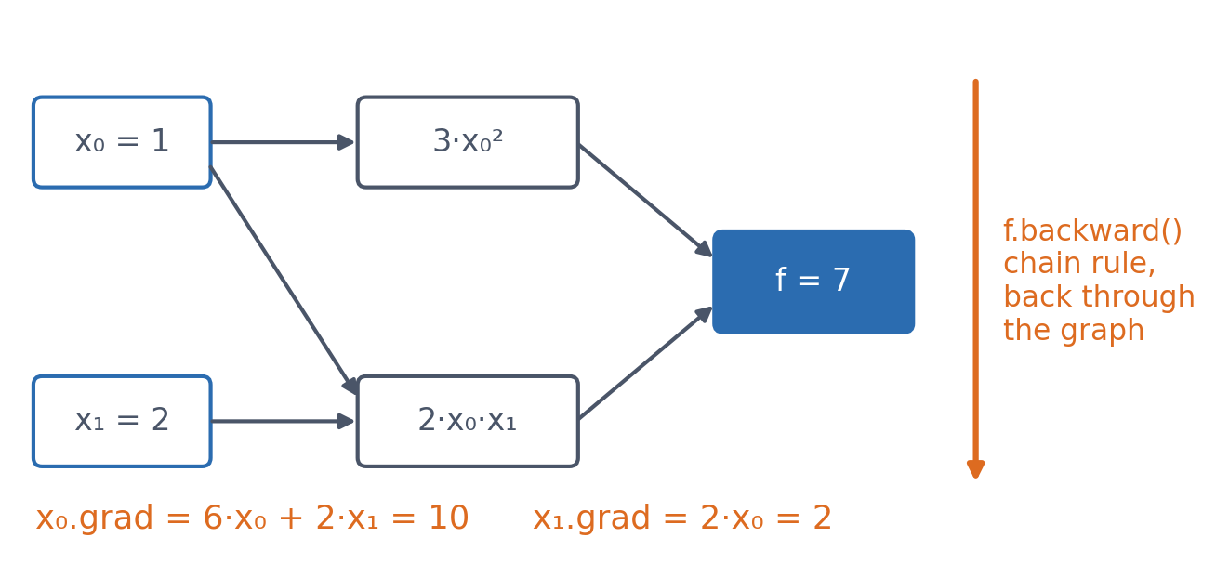
1 · REPRESENT · LOOKING AHEAD
A tensor remembers how it was computed
▪ f.backward(): the chain rule, automatically
▪ Session 1's answer: (10, 2)
▪ From Session 7: no derivatives by hand
See course.bioinfo.se/session02.html, 'Looking ahead: tensors and autograd'.
Notes:
f = 3 x0^2 + 2 x0 x1 at (1, 2). df/dx0 = 6 x0 + 2 x1 = 10, df/dx1 = 2 x0 = 2: Session 1's gradient practice problem. PyTorch records every operation and replays them in reverse.

Slide 17
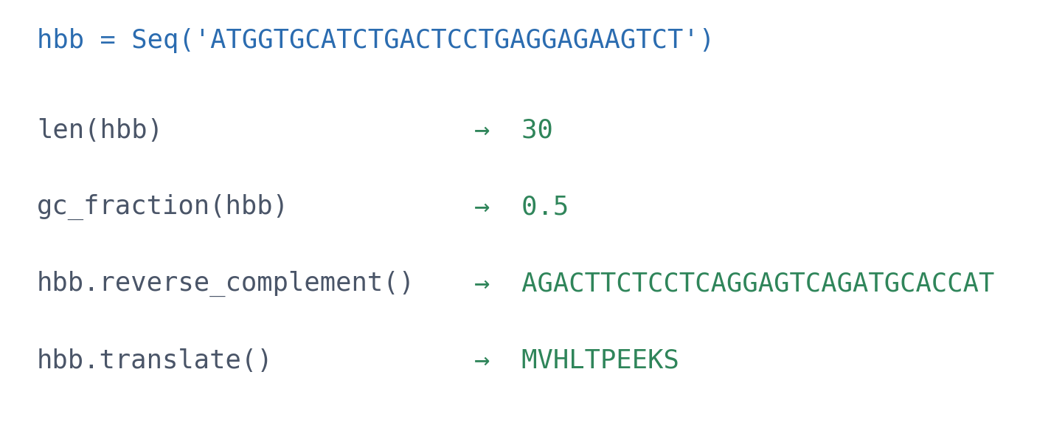
1 · REPRESENT
A Seq knows biology
▪ The first ten codons of HBB
▪ No complement table to write
▪ SeqRecord adds id, description, features
See course.bioinfo.se/session02.html, 'Biological objects'. NM_000518.5.
Notes:
A SeqRecord is an object built from a class Biopython defines: record.seq and record.features are attributes, record.seq.translate() is a method. The next three slides show how to write such a class yourself.

Slide 18
1 · REPRESENT · VOTE
What does hbb[1:].translate() give?
▪ The same sequence, read from its second base
▪ A: MVHLTPEEKS again
▪ B: an error
▪ C: a different peptide
▪ D: nothing
MVHLTPEEKS
hbb.translate()
?
hbb[1:].translate()
See course.bioinfo.se/session02.html, 'Biological objects', and its self-study questions.
Notes:
Let the class vote (hands or quiz tool), then run it live.

Slide 19
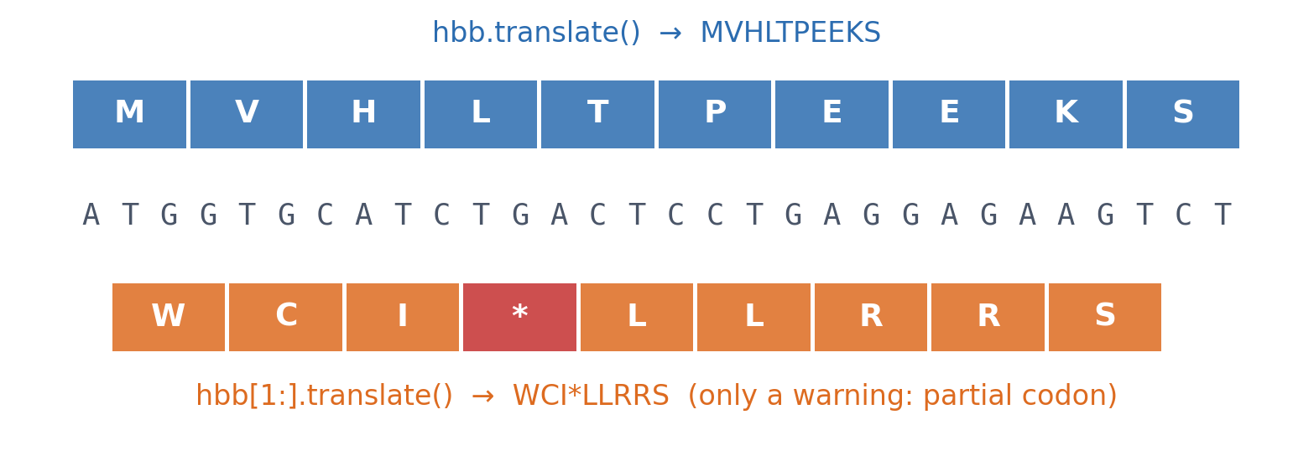
1 · REPRESENT · ANSWER
Biopython translates whatever you give it
Shifted by one base, every codon changes and a stop codon (*) appears. No error, only a warning: nothing stops you translating the wrong frame.
See course.bioinfo.se/session02.html, 'Biological objects'.
Notes:
Answer C. A mistake of the third kind (Block 2): the code runs and the result looks like a peptide.

Slide 20
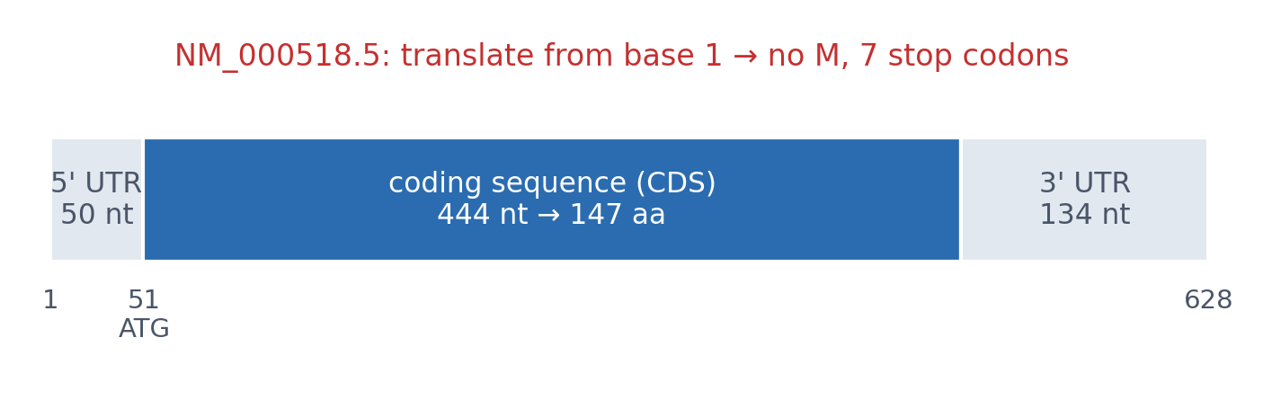
1 · REPRESENT
Translate the coding sequence, not the mRNA
The 628-nt HBB mRNA starts with a 50-nt untranslated region. The record's CDS feature gives the protein: cds.extract(record.seq).translate(to_stop=True) → 147 aa.
See course.bioinfo.se/session02.html, 'Biological objects'; NM_000518.5.
Notes:
This previews the third mistake in the live coding (protein length from mRNA length).

Slide 21
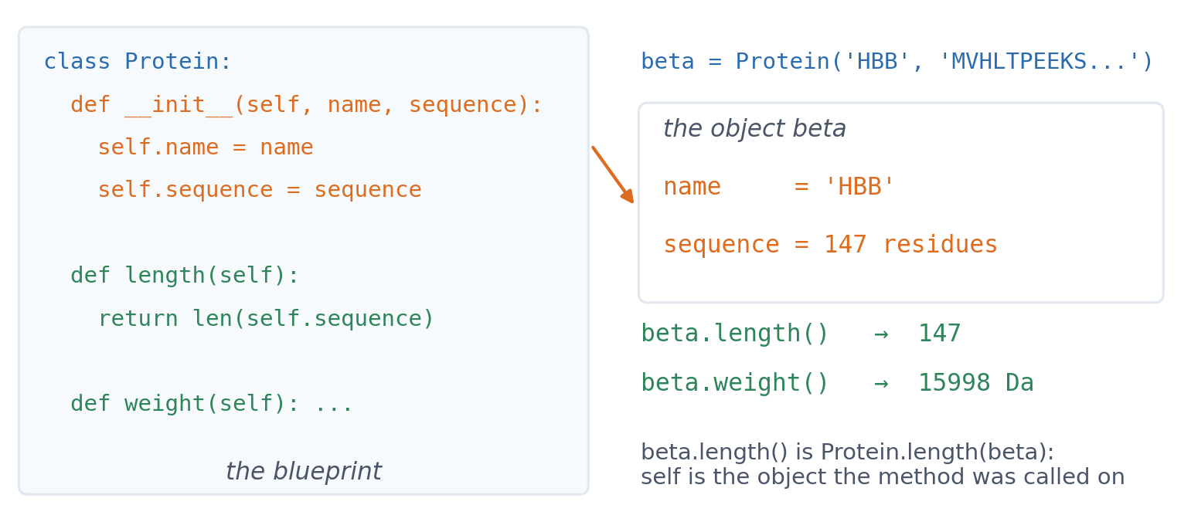
1 · REPRESENT · YOUR OWN OBJECTS
A class is a blueprint for objects
▪ __init__ runs when an object is made
▪ Attributes: the object's data
▪ Methods: functions on that data
▪ self: this object
See course.bioinfo.se/session02.html, 'Your own objects: classes'; course notebook, section 6. HBB: UniProt P68871.
Notes:
Protein('HBB', ...) creates an empty object and passes it to __init__ with the two arguments; __init__ stores them as attributes. beta.length() is the same call as Protein.length(beta). A hundred Protein objects share the methods but each has its own name and sequence. Special methods (two underscores) are called by Python for you: __len__ makes len(beta) work, __repr__ decides what print shows, __call__ makes the object callable. This takes about five minutes of Block 1; the notebook has the full class.

Slide 22
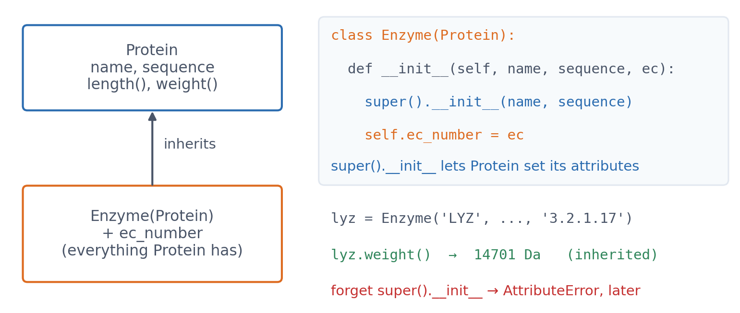
1 · REPRESENT · YOUR OWN OBJECTS
Inheritance: an Enzyme is a Protein
▪ Inherits every method
▪ Adds what is new
▪ super().__init__() first
See course.bioinfo.se/session02.html, 'Your own objects: classes'. Lysozyme: UniProt P61626, mature chain (130 aa).
Notes:
Forgetting super().__init__ is a common bug: the object is created without error, and fails later, when weight() looks for self.sequence (AttributeError). Kind 1 mistake, but far from its cause.

Slide 23
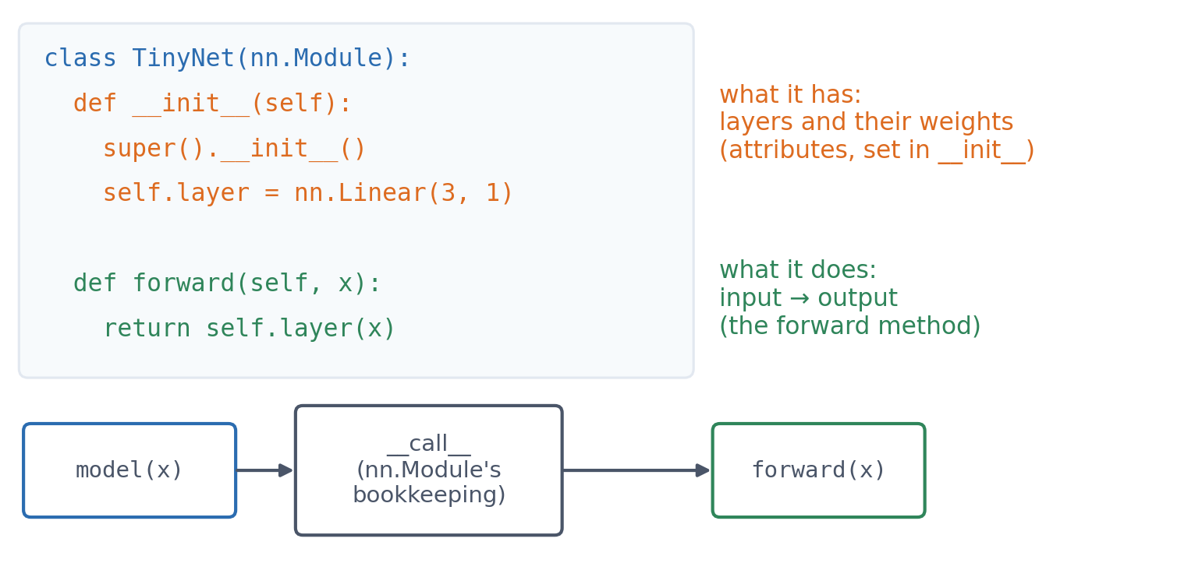
1 · REPRESENT · LOOKING AHEAD
A PyTorch model is a class
▪ __init__: what it has
▪ forward: what it does
▪ model(x) calls forward
▪ Every model from Session 8 on
See course.bioinfo.se/session02.html, 'Your own objects: classes'; course notebook, section 6.
Notes:
Calling an object runs its special method __call__; nn.Module's __call__ does some bookkeeping (hooks) and then calls forward. Because the layers are attributes, nn.Module can find all their weights (model.parameters(): 4 here, 3 weights and a bias), which training in Session 9 relies on.

Slide 24
2 · EXPLORE
A real dataset: mouse liver RNA-seq
▪ Becares et al. 2019, Cell Reports
▪ LXRα-S196A mutant vs wild type, high-fat diet
▪ Already analysed with DESeq2
▪ One row per gene: baseMean, log2 FC, p, padj
3,001
genes
3 + 3
mice per group
See course.bioinfo.se/session02.html, 'Exploring a biological dataset'. Public copy via VolcaNoseR.
Notes:
df = pd.read_csv(url); df.shape is (3001, 9). Then df.columns, df.head(), df.describe(): always the first four things you type on a new table.

Slide 25
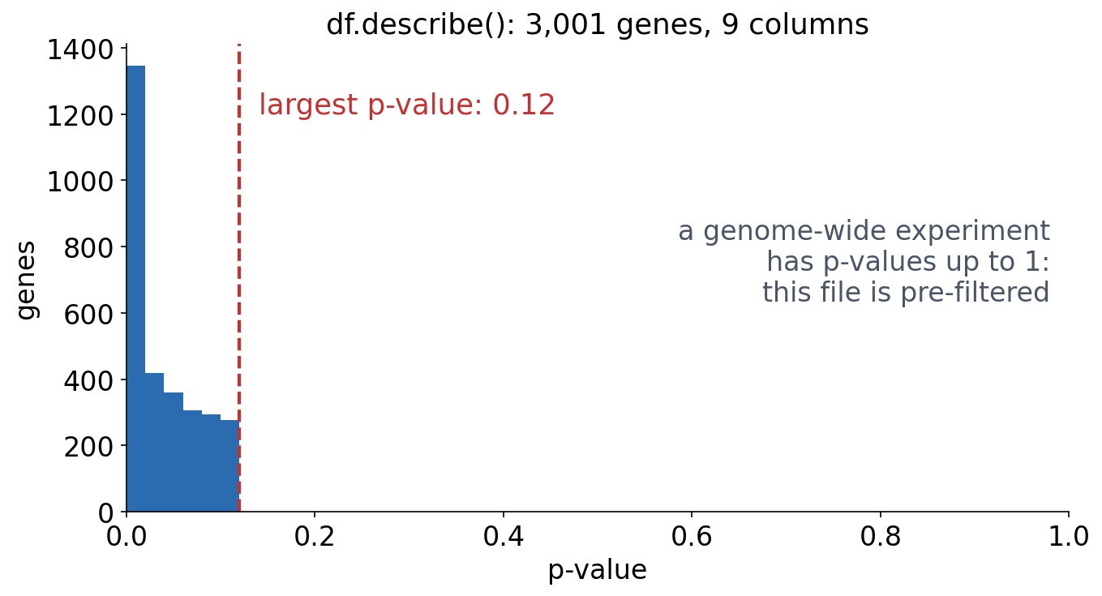
2 · EXPLORE
Summaries tell you how the data were made
▪ No p-value above 0.12
▪ A pre-filtered list, not all genes
▪ Look before you compute
See course.bioinfo.se/session02.html, 'Exploring a biological dataset'.
Notes:
Ask before showing the plot: a genome-wide experiment gives p-values up to 1. What does a maximum of 0.12 tell you? Any claim about all genes from this file would be wrong. The largest adjusted p-value is 0.50.

Slide 26
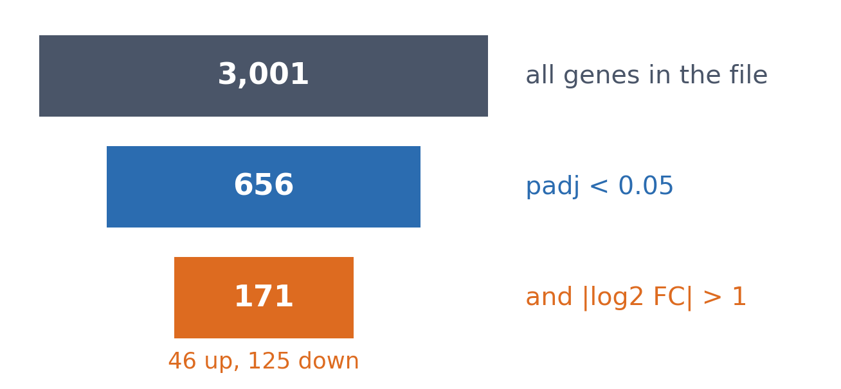
2 · EXPLORE
Selecting and filtering
▪ df[df['padj'] < 0.05]
▪ Combine with &, not and
▪ Keep the parentheses
See course.bioinfo.se/session02.html, 'Exploring a biological dataset'.
Notes:
strong = df[(df['padj'] < 0.05) & (df['log2_FoldChange'].abs() > 1)]. Using 'and' raises 'The truth value of a Series is ambiguous': and needs one True/False, & combines columns element by element.

Slide 27
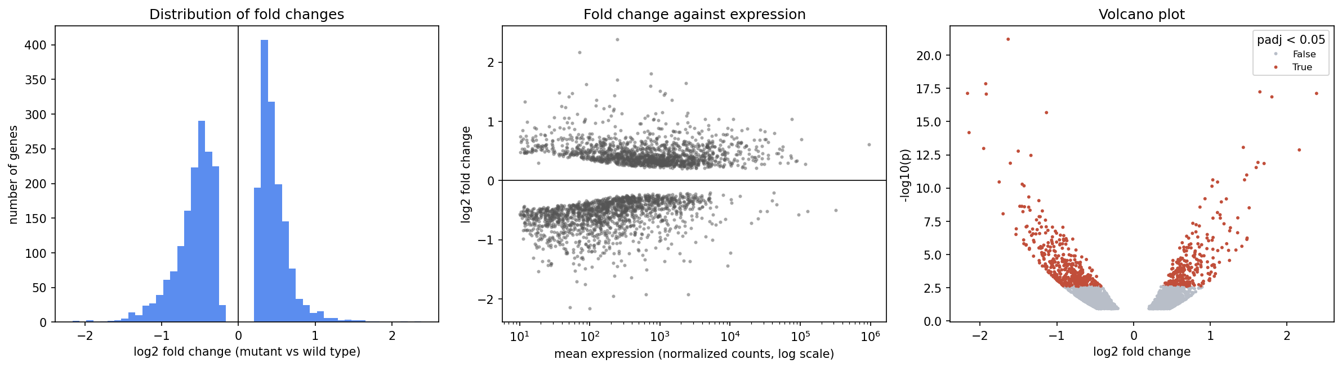
2 · EXPLORE
Seeing the data
Histogram (one variable), scatter on a log axis (two variables), volcano plot coloured by significance with seaborn. The empty band around zero is the pre-filtering again.
Drawn in notebooks/session02-working-in-python.ipynb.
Notes:
Point out the gap around zero in the left and middle panels: genes that barely changed rarely reach p < 0.12. A complete experiment would have its tallest histogram bar at zero.

Slide 28
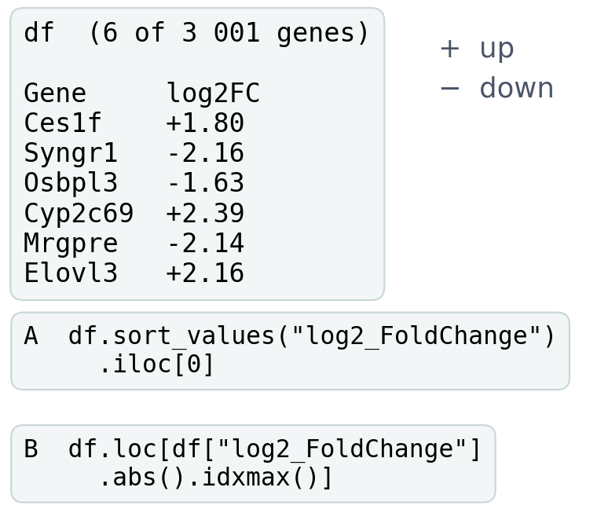
BLOCK 1 · QUIZ
What do the two snippets return?
Looking for the most changed gene. log2_FoldChange: positive is up, negative is down.
A The same gene: both find the largest change
B A: most down; B: largest change, up or down
C A: most up; B: largest change, up or down
D A: most down; B: most up
Guess on your own
Scan the code, or go to
quiz.bioinfo.se/live
Notes:
Both snippets run on the full table (3,001 genes). Let them read the code: sort_values sorts ascending by default, and abs() removes the sign.

Slide 29
BLOCK 1 · QUIZ
What do the two snippets return?
How did the room answer?
Halt the round when most have answered, then show the results.
Show the results ▸ quiz.bioinfo.se/live/report
Notes:
Halt submission in the Control view, then open the results. Do not say which answer is right.

Slide 30
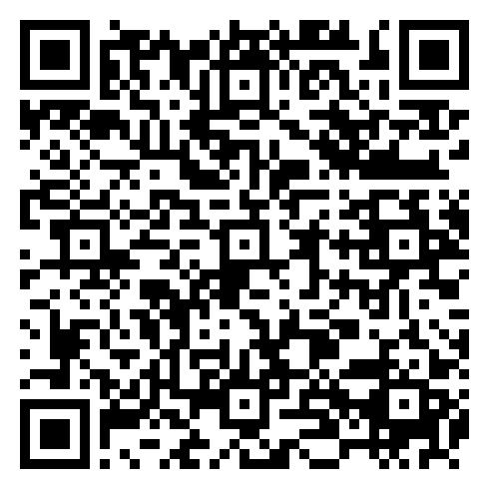
BLOCK 1 · QUIZ
What do the two snippets return?
Fix it, run it, discuss
Open the notebook: scan the code
Fix the line marked FIX, then run the cells
Did it come out as you guessed? Discuss with your neighbour
The notebook: https://colab.research.google.com/github/ElofssonLab/kb8029-book/blob/main/notebooks/session02-discussion-1.ipynb
Notes:
About 8 minutes. Run as it is: A returns Syngr1 (4.5-fold down), B Cyp2c69 (5.2-fold up). The FIX: make A find the largest change with sort_values, e.g. key=abs, ascending=False. Early finishers: the adjusted p-value and the expression level.

Slide 31
BLOCK 1 · QUIZ
What do the two snippets return?
Answer again
Same question, after the discussion.
quiz.bioinfo.se/live
Notes:
Open the second round (post) in the Control view.

Slide 32
BLOCK 1 · QUIZ
What do the two snippets return?
Results, and who explains
Both rounds side by side.
Draw two to explain: one of you says how you reasoned.
Show the results ▸ quiz.bioinfo.se/live/report
To check it with code afterwards: discussion notebook 1 https://colab.research.google.com/github/ElofssonLab/kb8029-book/blob/main/notebooks/session02-discussion-1.ipynb
Notes:
Second answer. A returns Syngr1, 4.5-fold down; B returns Cyp2c69, 5.2-fold up. The most significant gene is a third one, Osbpl3. A mistake of the second kind: the code runs and answers a different question.

Slide 33
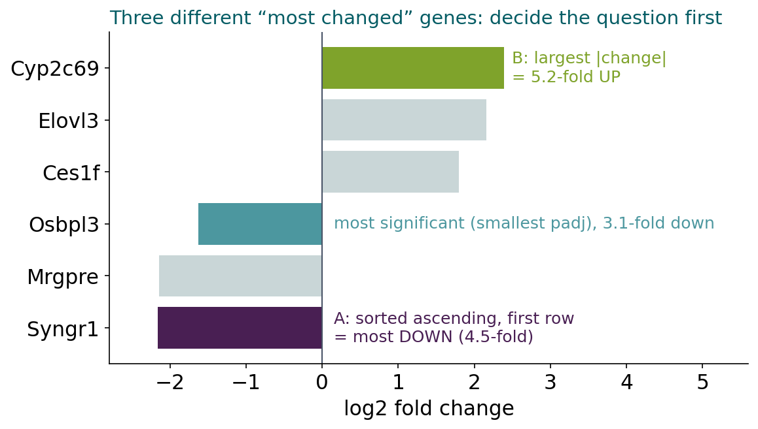
BLOCK 1 · QUIZ
The answer: A finds the most down, B the largest change
sort_values() sorts ascending, so .iloc[0] is the most negative fold change. abs().idxmax() ignores the sign. The most significant gene is a third one, and the largest fold changes come mostly from lowly expressed genes. Decide the biological question first, then write the code.

Slide 34
BLOCK 1 DONE
Break

Slide 35
BLOCK 2 · ABOUT 30 MIN
Plot first, test second; data from somewhere; live coding

Slide 36
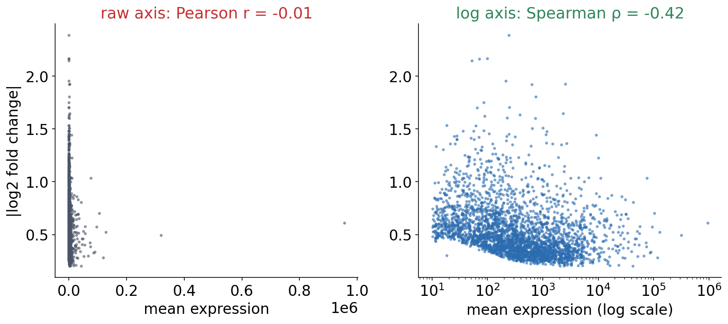
3 · ASK QUANTITATIVE QUESTIONS
Plot first, test second
Is fold change related to expression level? Pearson on the raw numbers says no (r = −0.01, p = 0.43). The log-axis plot says yes, and so do Pearson on log10 expression (r = −0.30) and Spearman (ρ = −0.42, p = 2e-129).
See course.bioinfo.se/session02.html, 'Asking quantitative questions'.
Notes:
On the raw scale a few hugely expressed genes (albumin, 954,964) dominate Pearson's linear correlation. Spearman uses ranks, so the scale does not matter. Why lowly expressed genes change more: few reads, noisier estimates (Session 8).

Slide 37
3 · USE EXISTING TOOLS
Standard questions have standard functions
SciPy
SciPy
scikit-learn
stats.ttest_ind(…, equal_var=False)
cluster.hierarchy.linkage
LinearRegression, MLPClassifier, …
▪ Session 1's Welch t-test
▪ t ≈ −11.9, p ≈ 0.0001
▪ Default equal_var=True: Student's
▪ Merge the closest clusters
▪ Session 4's guide tree
▪ Sessions 7-9 build them by hand
▪ In practice: call the library
See course.bioinfo.se/session02.html, 'Existing tools for standard questions'.
Notes:
The t-test numbers are for Session 1's control (5.1, 4.9, 5.3, 5.0) and treatment (7.2, 6.8, 7.5, 7.0).

Slide 38
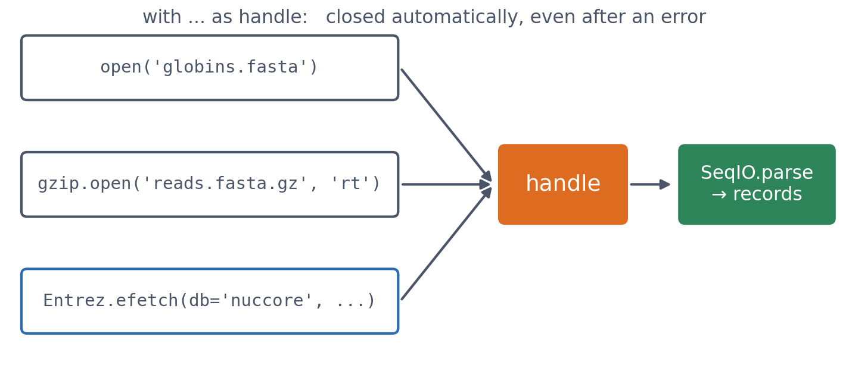
3 · USE EXISTING TOOLS
Files, compressed files and NCBI: one pattern
Every source gives you a handle; SeqIO.parse reads records from it. A .fasta.gz needs no unpacking, and zip/tar archives open with zipfile and tarfile.
See course.bioinfo.se/session02.html, 'Data coming from somewhere'.
Notes:
with Entrez.efetch(db='nuccore', id='NM_000518.5', rettype='gb', retmode='text') as handle: record = SeqIO.read(handle, 'genbank') gives 'Homo sapiens hemoglobin subunit beta (HBB), mRNA', 628 nt. The live coding starts from this call.

Slide 39
3 · USE EXISTING TOOLS
Be polite to NCBI
▪ Set Entrez.email
▪ Fetch many records in one request
▪ Or pause between requests
~3 / s
requests allowed
without an API key
1
request for
50 accessions
See course.bioinfo.se/session02.html, 'Data coming from somewhere'.
Notes:
id=','.join(accessions) fetches all records at once. A fast loop of single requests gets you blocked.

Slide 40
LIVE CODING · ~15 MIN
Six globins, and three kinds of mistakes
Notes:
Script: slides/src/session02-live-coding.py (teachers page). Type, don't paste. Make each mistake for real, let the class see the result, and ask them what is wrong before fixing it.

Slide 41
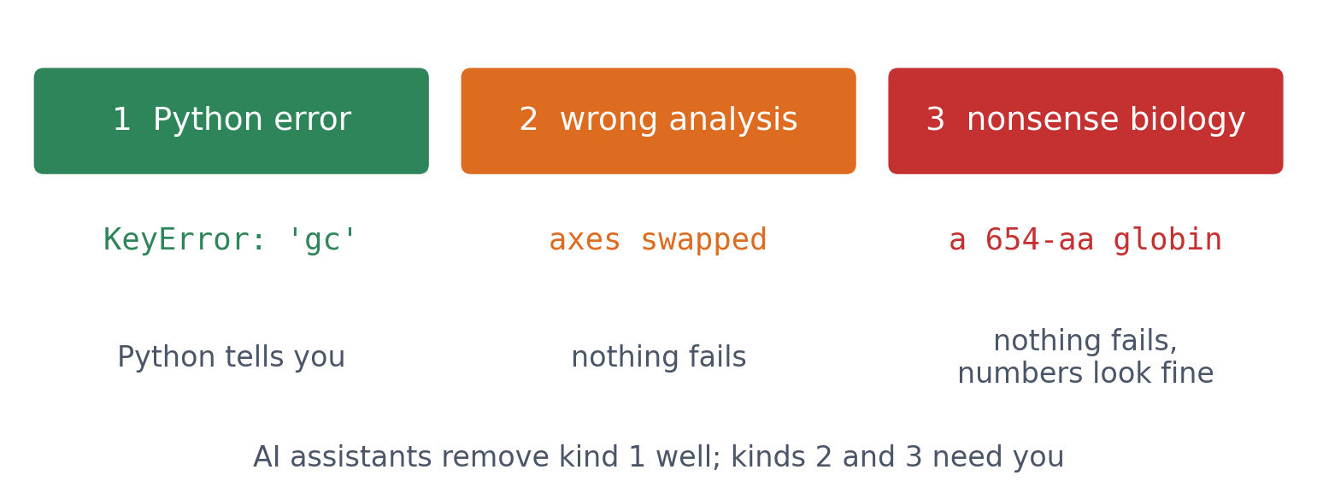
LIVE CODING
Three kinds of mistakes
Watch for all three. Code running without an error does not mean the analysis is correct.
Script: slides/src/session02-live-coding.py.
Notes:
Say this before starting, so the class watches for all three. Ask afterwards which kind was hardest to notice. The answer should be kinds 2 and 3, because nothing complained.

Slide 42
LIVE CODING
The task
Fetch
Tabulate
Plot
Proteins
HBB, HBA1, HBA2, MB, NGB, CYGB
gene, length, gc_content
GC content vs mRNA length
protein length
▪ One Entrez request
▪ A DataFrame
▪ Length on the x-axis
▪ For each gene
Script: slides/src/session02-live-coding.py.
Notes:
Step 1-2: type the Entrez call and build `genes` (script cells 1-2). If there is no network, the script falls back to stored values.
MISTAKE 1 (Python error): type genes["gc"].mean(). KeyError: 'gc'. Read the last line first. Inspect with genes.columns, then fix to genes["gc_content"].
MISTAKE 2 (wrong analysis): the question is 'GC against length', so length belongs on x. Type plt.scatter(genes["gc_content"], genes["length"]) with xlabel 'mRNA length'. It runs. Ask: which gene is on the far right? It should be CYGB (longest). Read the x ticks: 0.5-0.65. That is GC content, so the labels lie. Swap the arguments.
MISTAKE 3 (biologically nonsensical): genes["protein_length"] = genes["length"] // 3 gives CYGB 654 aa, HBB 209 aa. Ask: globins are about 150 aa, so what is wrong? The UTRs. Fix with the CDS feature (script's last cell): 142-190 aa; UTRs 147-1,389 nt.

Slide 43
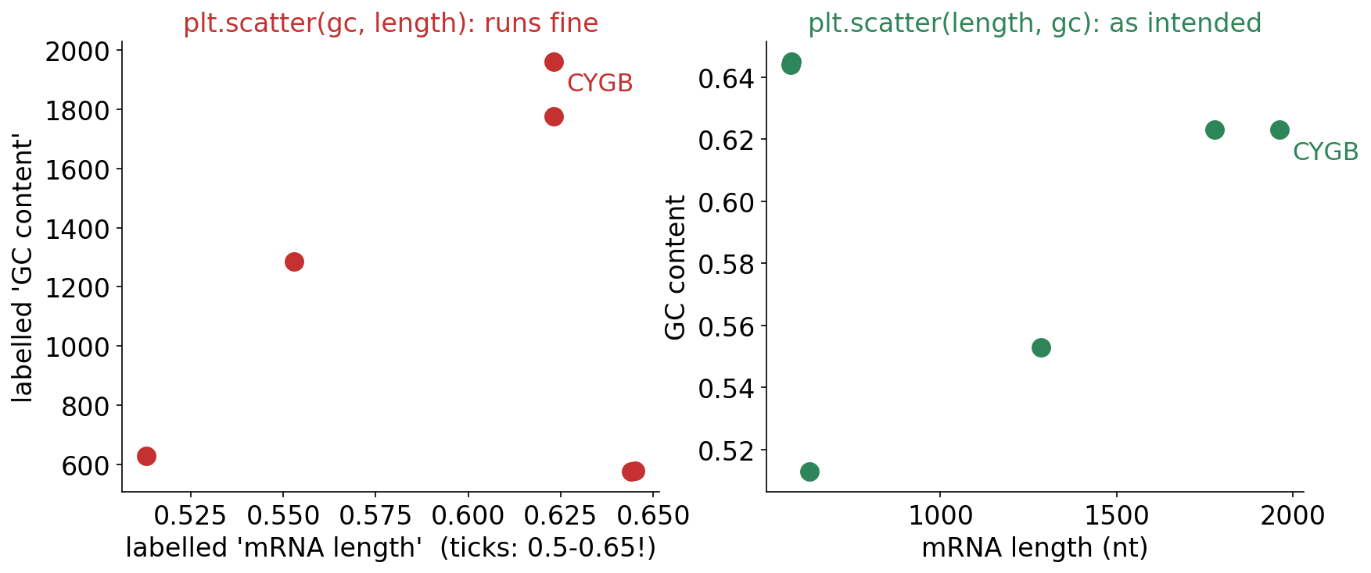
LIVE CODING · MISTAKE 2
It ran fine, and the labels lie
Find one point you know: CYGB has the longest mRNA, so it should be furthest right. Then read the ticks: 0.5-0.65 is GC content, not length.
Script: slides/src/session02-live-coding.py.
Notes:
Show after the demo. Kind 2: correct code, wrong analysis.

Slide 44
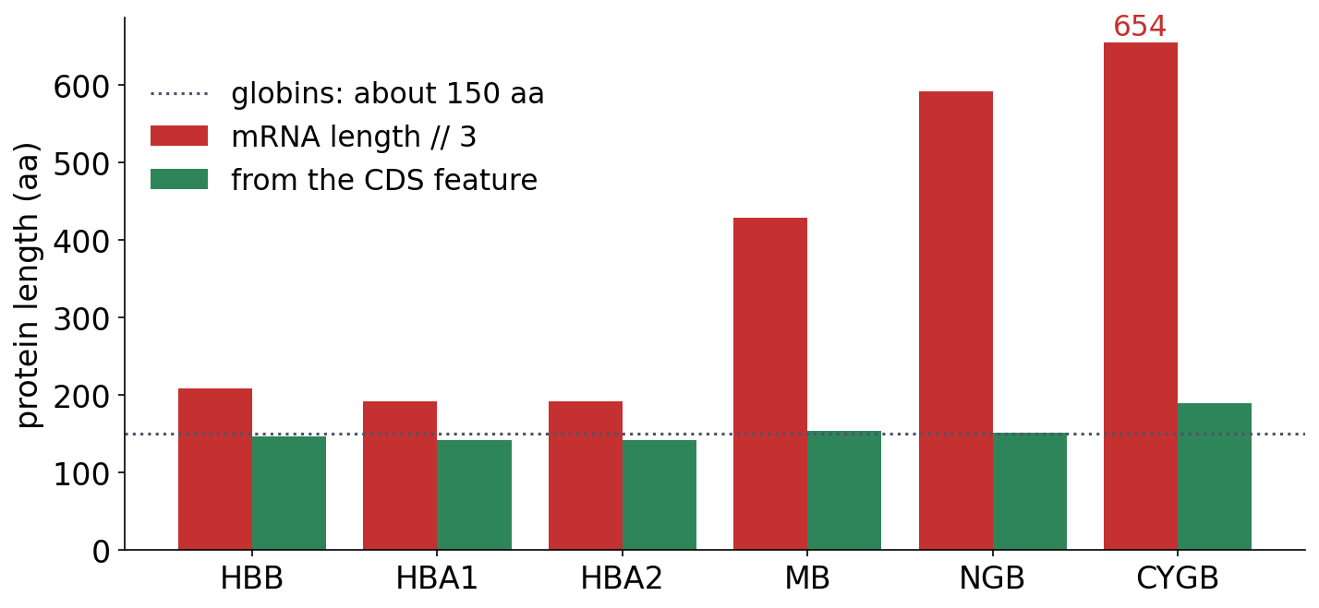
LIVE CODING · MISTAKE 3
A 654-residue globin?
▪ mRNA length // 3: runs fine
▪ Globins are about 150 aa
▪ Fix: the CDS feature
Script: slides/src/session02-live-coding.py; book Table 2.3.
Notes:
Kind 3: biologically nonsensical. Only knowing the biology catches it. The mRNA includes untranslated regions, and only the coding sequence is translated.

Slide 45
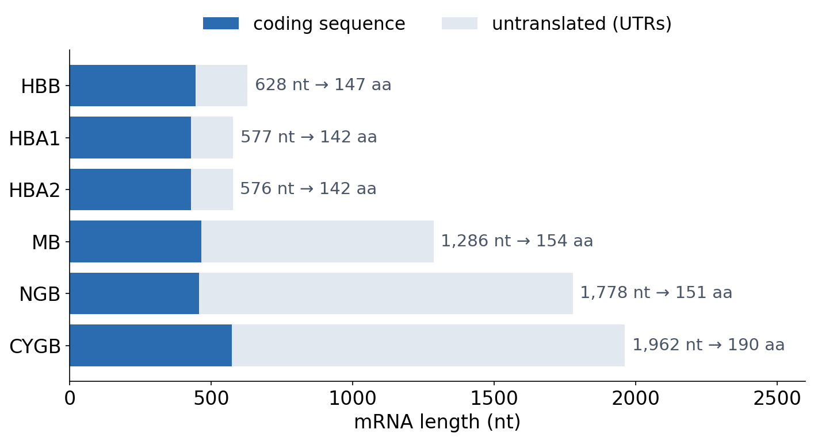
LIVE CODING
The difference is untranslated sequence
▪ Proteins: 142-190 aa
▪ mRNAs: 576-1,962 nt
▪ UTRs: 147-1,389 nt
▪ Length says little about the protein
See course.bioinfo.se/session02.html, 'Mini challenge', Table 2.3.
Notes:
With six genes, Pearson's r between mRNA and protein length is 0.78 but p = 0.07: the next discussion.

Slide 46
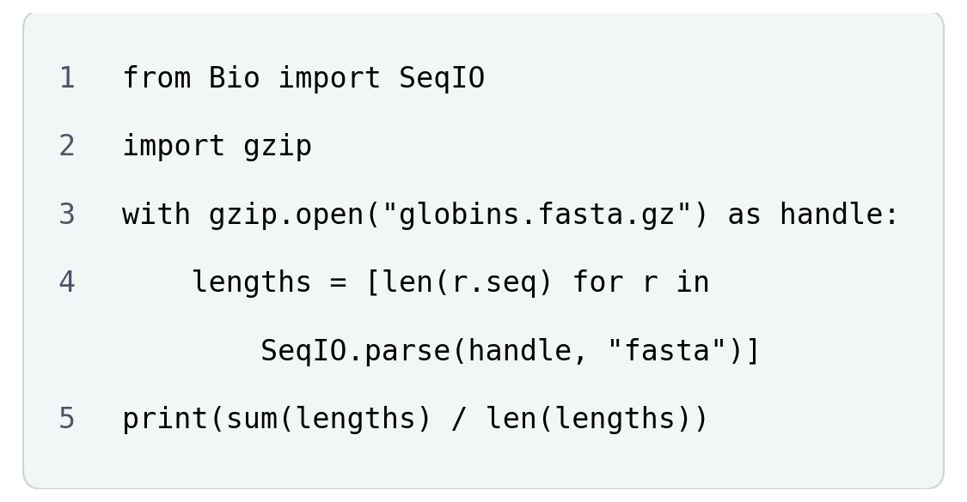
BLOCK 2 · QUIZ
Which line contains the mistake?
The average length of the globins in a compressed FASTA file.
A Line 3
B Line 4
C Line 5
D None: it runs and prints the average
Guess on your own
Scan the code, or go to
quiz.bioinfo.se/live
Notes:
Five lines that read a gzipped FASTA file. Guess first: do not show the error message.

Slide 47
BLOCK 2 · QUIZ
Which line contains the mistake?
How did the room answer?
Halt the round when most have answered, then show the results.
Show the results ▸ quiz.bioinfo.se/live/report
Notes:
Halt submission in the Control view, then open the results. Do not say which answer is right.

Slide 48
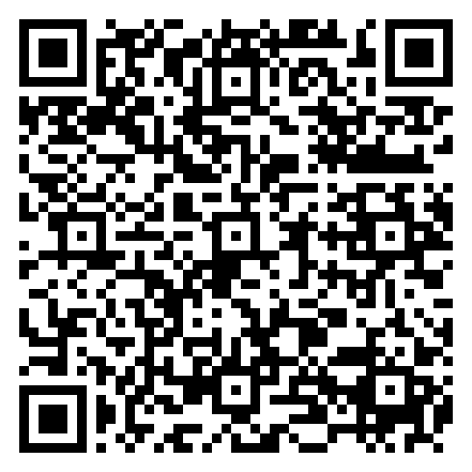
BLOCK 2 · QUIZ
Which line contains the mistake?
Fix it, run it, discuss
Open the notebook: scan the code
Run the code: which line does Python point to?
Fix the mistake and run it again. Discuss with your neighbour
The notebook: https://colab.research.google.com/github/ElofssonLab/kb8029-book/blob/main/notebooks/session02-discussion-2.ipynb
Notes:
About 8 minutes. The traceback points at line 4 (StreamModeError: Fasta files must be opened in text mode); the fix is "rt" on line 3. Fixed, it prints 147.67.

Slide 49
BLOCK 2 · QUIZ
Which line contains the mistake?
Answer again
Same question, after the discussion.
quiz.bioinfo.se/live
Notes:
Open the second round (post) in the Control view.

Slide 50
BLOCK 2 · QUIZ
Which line contains the mistake?
Results, and who explains
Both rounds side by side.
Draw two to explain: one of you says how you reasoned.
Show the results ▸ quiz.bioinfo.se/live/report
To check it with code afterwards: discussion notebook 2 https://colab.research.google.com/github/ElofssonLab/kb8029-book/blob/main/notebooks/session02-discussion-2.ipynb
Notes:
Line 3. gzip.open opens in binary mode by default, so the handle gives bytes; SeqIO.parse on line 4 raises StreamModeError, so the traceback points at line 4. They ran it in the notebook.

Slide 51
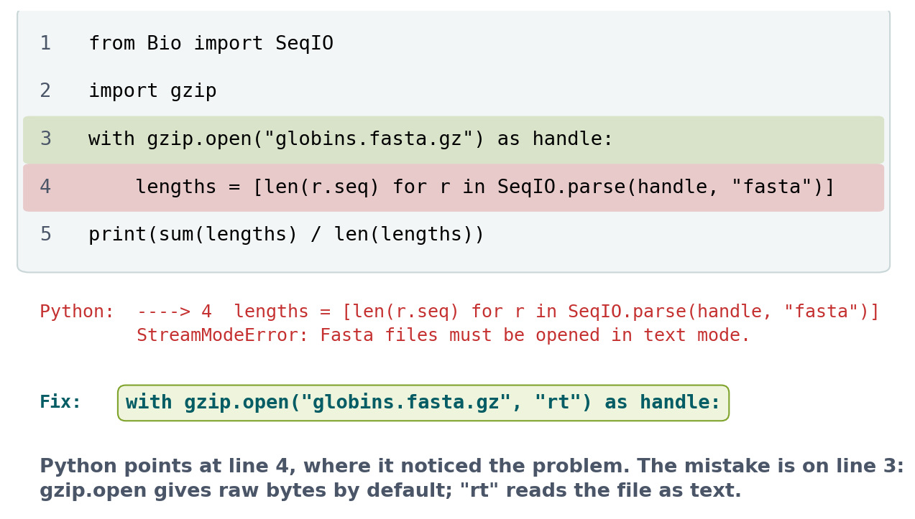
BLOCK 2 · QUIZ
The answer: Python points at line 4, the mistake is on line 3
gzip.open() reads raw bytes unless you ask for text with "rt". Nothing goes wrong until SeqIO.parse tries to read text, on line 4. The line in an error message is where Python noticed the problem: read the last line first, then ask where the object it complains about came from.

Slide 52
BLOCK 2 DONE
Break

Slide 53
BLOCK 3 · ABOUT 30 MIN
When code does not work

Slide 54
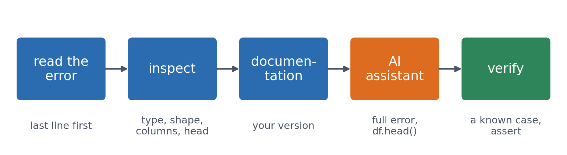
4 · GET UNSTUCK
A routine for getting unstuck
Experienced programmers follow the same five steps. The last one matters most when an AI assistant wrote the code.
See course.bioinfo.se/session02.html, 'When you don't know how to do something'.

Slide 55
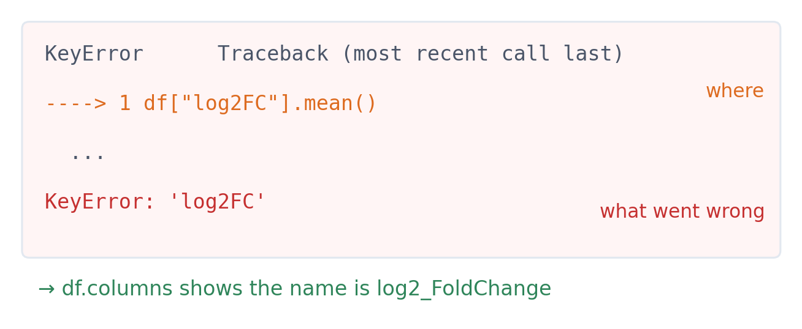
4 · GET UNSTUCK
Read the error from the bottom
▪ Last line: what went wrong
▪ Arrow: where in your code
▪ KeyError on a DataFrame: no such column
See course.bioinfo.se/session02.html, 'When you don't know how to do something'.

Slide 56
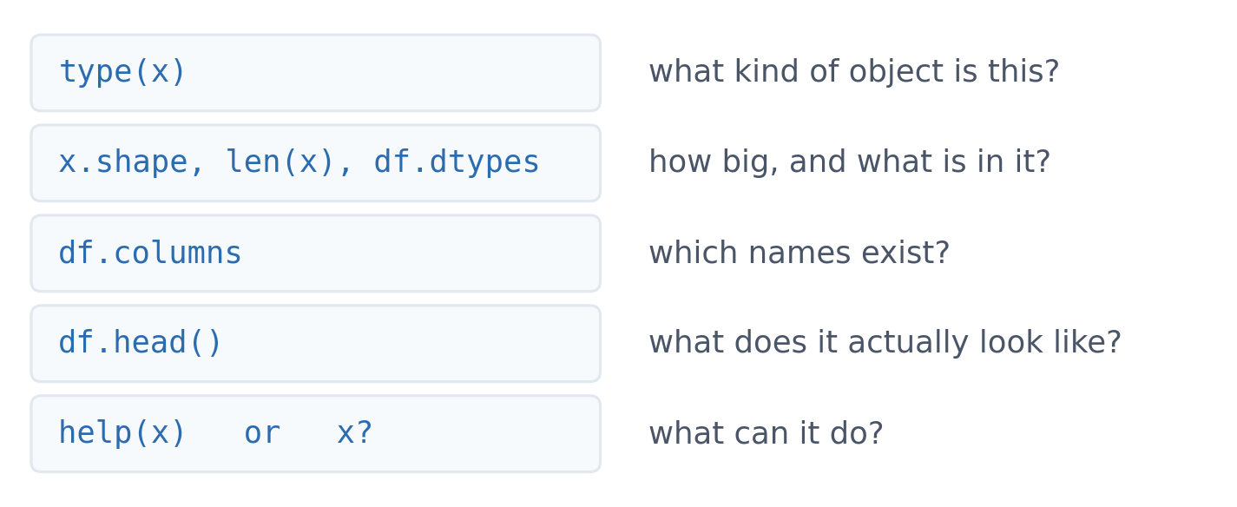
4 · GET UNSTUCK
Inspect instead of guessing
▪ Five tools answer most questions
▪ Look at the object, not at your memory of it
See course.bioinfo.se/session02.html, 'When you don't know how to do something'.

Slide 57
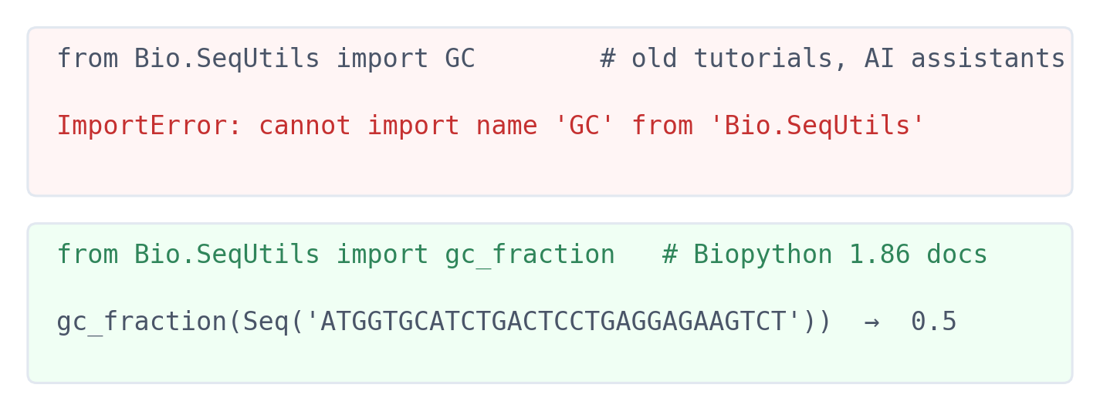
4 · GET UNSTUCK
The documentation is the authority for your version
▪ Old tutorials still say GC
▪ So do AI assistants
▪ The docs name gc_fraction
See course.bioinfo.se/session02.html. Biopython 1.86 when this deck was made.

Slide 58
4 · GET UNSTUCK
Ask an AI assistant well, then verify
Give it
Then verify
what a human helper would need
it can invent or use outdated APIs
▪ The full error message
▪ df.head()
▪ Library versions
▪ What you expected, and what you tried
▪ Run it on a tiny known example
▪ Check shapes and ranges
▪ Look up unknown functions
See course.bioinfo.se/session02.html, 'How to use chatbots'. AI in graded work: the course rules on Canvas.
Notes:
Never ask only 'fix my code'. Say what the code was meant to do, show the data, and ask the assistant to explain its change. The dangerous case is code that runs but computes the wrong thing.

Slide 59
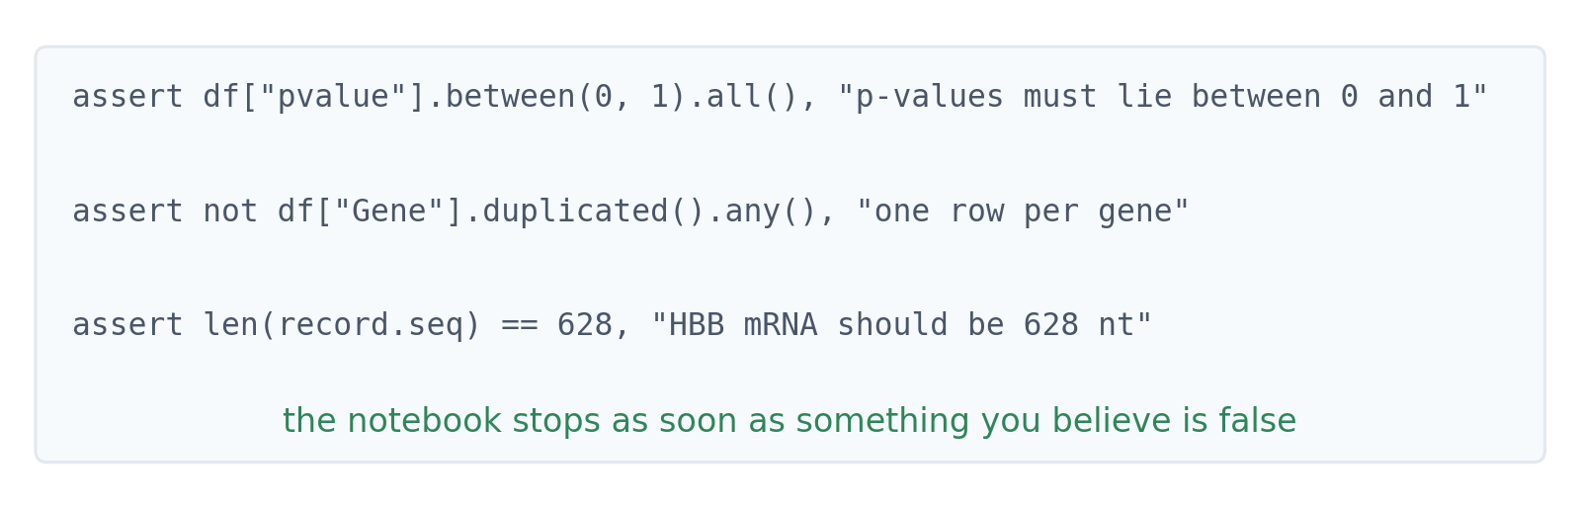
4 · GET UNSTUCK
Test your assumptions in code
An assert turns a belief about your data into a check that stops the notebook when it fails.
See course.bioinfo.se/session02.html, 'When you don't know how to do something'.

Slide 60
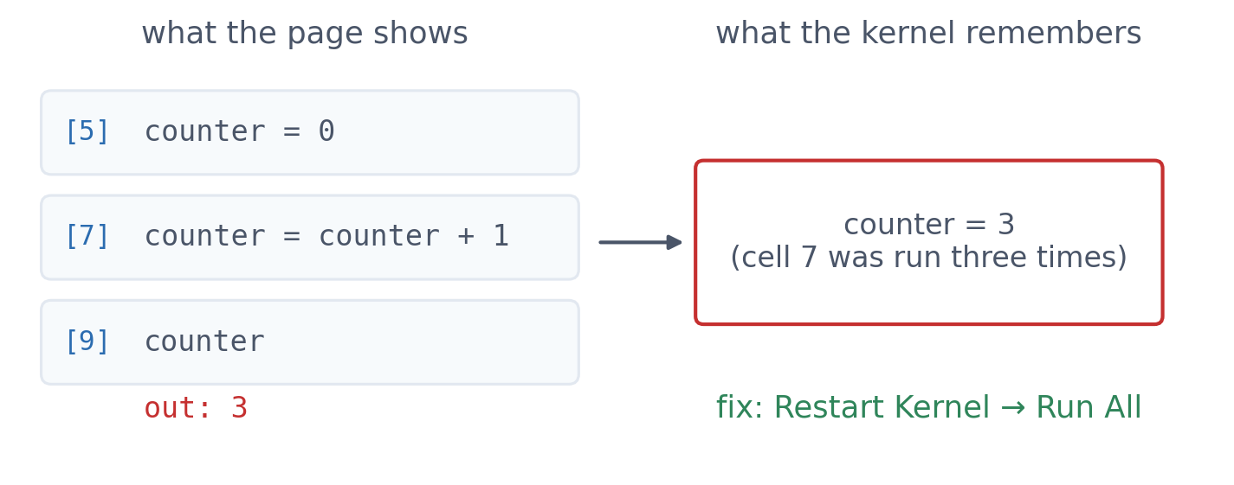
4 · GET UNSTUCK
The notebook trap: stale state
▪ Memory ≠ page
▪ Out of order, re-run, edited
▪ Before sharing: Restart → Run All
See course.bioinfo.se/session02.html, 'Notebooks: what they are and why we use them'.
Notes:
The notebook has the demonstration: a cell that adds 1 to counter gives a new number every time it is re-run, although its code never changes.

Slide 61
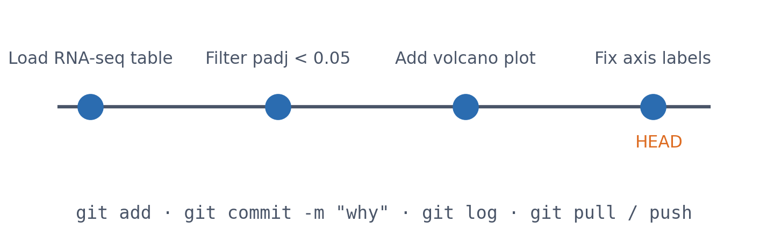
5 · OUTSIDE PYTHON
git: a history of snapshots
Commit small, working steps, with messages that say why. Never commit big data, passwords or keys: list them in .gitignore.
See course.bioinfo.se/session02.html; Software Carpentry, 'Version Control with Git' (CC BY 4.0).
Notes:
git clone https://github.com/ElofssonLab/kb8029-book.git, on your laptop, gives a copy of all course notebooks; open them in VS Code and run them on a Colab machine. git works on the files on your laptop; what a notebook writes while it runs is on the Colab machine.

Slide 62
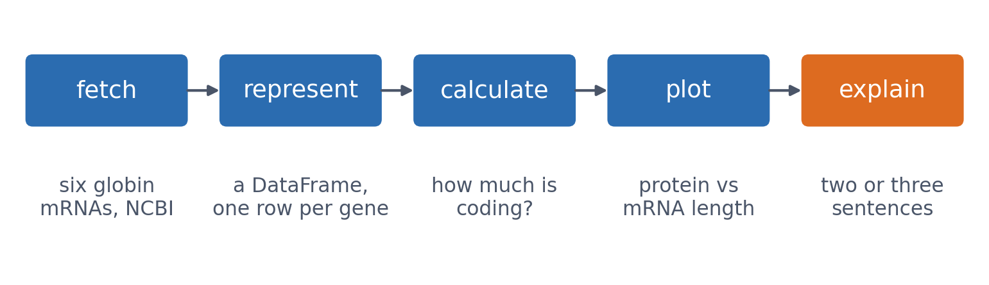
6 · PUTTING IT TOGETHER
Mini challenge: a small analysis, start to finish
The six globins again, now done properly: the result is the UTR figure from the live coding. The worked solution is in the course notebook.
See course.bioinfo.se/session02.html, 'Mini challenge'.
Notes:
Try it before reading the solution. Accessions: NM_000518.5, NM_000558.5, NM_000517.6, NM_001382809.1, NM_021257.4, NM_134268.5.

Slide 63
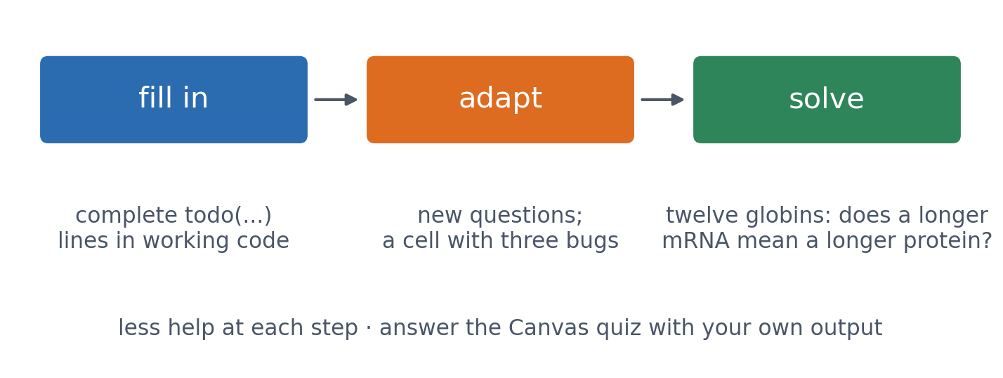
THE LAB
Fill in → adapt → solve
One of the three bugs in the adapt part runs without an error and gives a wrong answer: a mistake of kind 2. Three optional extras follow (leptin with Entrez, seaborn, a Mann-Whitney comparison).
notebooks/session02-lab.ipynb

Slide 64
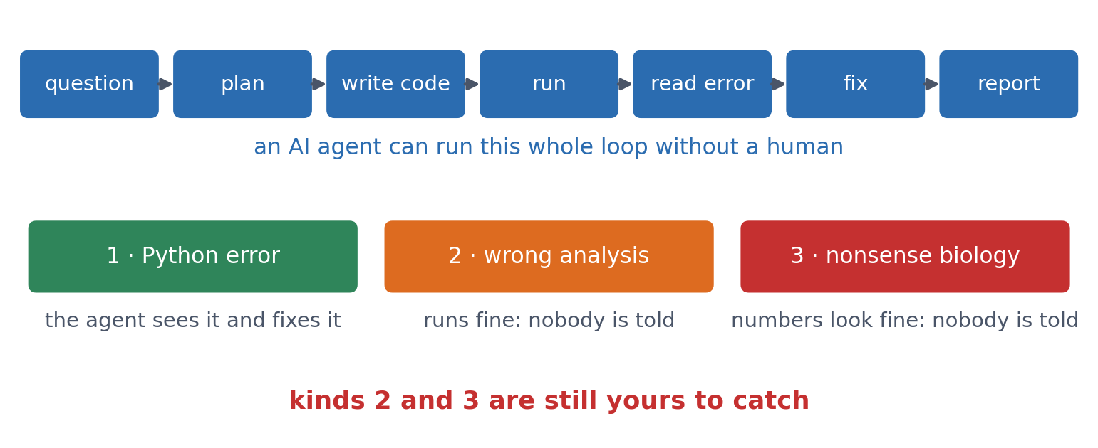
OUTLOOK
AI agents run whole analyses: who checks them?
▪ Agents plan, write, run and fix code
▪ Kind 1 mistakes: fixed for you
▪ Kinds 2 and 3: still yours
▪ Who is responsible for a result that no human looked at?
Example: Biomni, a general-purpose biomedical AI agent, Huang et al. 2025, bioRxiv 10.1101/2025.05.30.656746.
Notes:
AI agents no longer only suggest snippets: given a question they retrieve tools and data, plan, write and run the code, read the errors and try again. Biomni (Stanford, 2025) is one example, built with 150 biomedical tools, 105 software packages and 59 databases. The three kinds of mistakes from the live coding decide what is left for you: a Python error stops the run, so an agent sees and fixes it; a wrong analysis (axes swapped) and nonsense biology (a 654-residue globin) run without errors, so nobody is told. The habits of this session (plot first, test assumptions, check a known case) are exactly the checks an agent's result needs. The course rules still apply: AI-written labs and reports are not allowed.

Slide 65
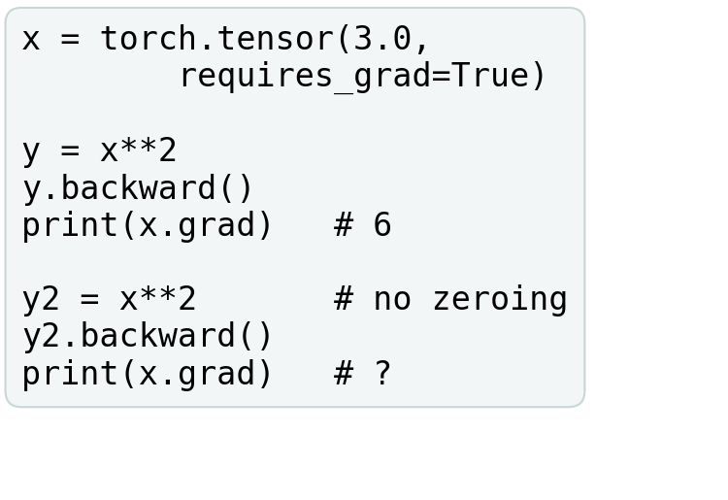
BLOCK 3 · QUIZ
What does x.grad show after a second backward()?
x = 3, y = x². After y.backward(), x.grad is 6. Then y2 = x² and y2.backward(), with no zeroing.
A 6: replaced
B 12: added
C 36: multiplied
D An error: only one backward() allowed
Guess on your own
Scan the code, or go to
quiz.bioinfo.se/live
Notes:
dy/dx = 2x = 6 at x = 3. The question is what PyTorch does with the second gradient.

Slide 66
BLOCK 3 · QUIZ
What does x.grad show after a second backward()?
How did the room answer?
Halt the round when most have answered, then show the results.
Show the results ▸ quiz.bioinfo.se/live/report
Notes:
Halt submission in the Control view, then open the results. Do not say which answer is right.

Slide 67
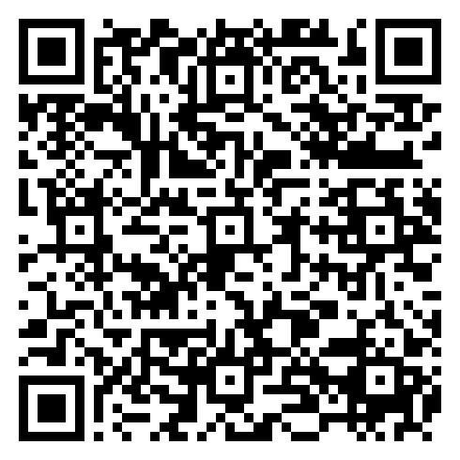
BLOCK 3 · QUIZ
What does x.grad show after a second backward()?
Fix it, run it, discuss
Open the notebook: scan the code
Fix the line marked FIX, then run the cells
Did it come out as you guessed? Discuss with your neighbour
The notebook: https://colab.research.google.com/github/ElofssonLab/kb8029-book/blob/main/notebooks/session02-discussion-3.ipynb
Notes:
About 8 minutes. As it is, the second print shows 12. The FIX: add x.grad.zero_() before the second backward(), and it shows 6. Early finishers: y = x³ gives 27.

Slide 68
BLOCK 3 · QUIZ
What does x.grad show after a second backward()?
Answer again
Same question, after the discussion.
quiz.bioinfo.se/live
Notes:
Open the second round (post) in the Control view.

Slide 69
BLOCK 3 · QUIZ
What does x.grad show after a second backward()?
Results, and who explains
Both rounds side by side.
Draw two to explain: one of you says how you reasoned.
Show the results ▸ quiz.bioinfo.se/live/report
To check it with code afterwards: discussion notebook 3 https://colab.research.google.com/github/ElofssonLab/kb8029-book/blob/main/notebooks/session02-discussion-3.ipynb
Notes:
12. PyTorch accumulates gradients in .grad. Every training loop from Session 7 on starts each step with optimizer.zero_grad().

Slide 70
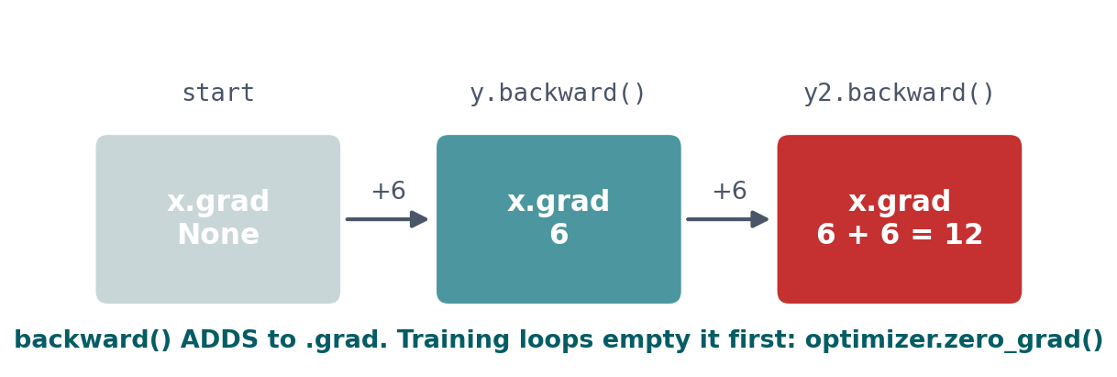
BLOCK 3 · QUIZ
The answer: backward() adds to x.grad
The second backward() computes another 6 and adds it: 6 + 6 = 12. Code that runs and silently gives a wrong number: test your assumptions on a case you can work out by hand. Training loops empty the gradients at every step with optimizer.zero_grad() (Session 7).

Slide 71
SUMMARY
Four ideas, and one rule
Represent with the right object, explore before trusting a number, use existing tools, and get unstuck with a routine. Code running without an error does not mean the analysis is correct.
See course.bioinfo.se/session02.html.

Slide 72
BEFORE YOU LEAVE
In up to three words: what was the hardest part of today?
Answer now
Scan the code, or go to
quiz.bioinfo.se/live
Notes:
A word cloud: the bigger the word, the more students wrote it. It shows what to repeat next time.

Slide 73
BEFORE YOU LEAVE
The hardest part of today
What the room found hardest
Show the results ▸ quiz.bioinfo.se/live/report

Slide 74
Session 3 next
Biological databases: identifiers, curated and predicted records
Following one protein, HBB, through five databases

