Slide 1

Session 3: Biological Databases
KB8029 — Bioinformatics & Deep Learning
Arne Elofsson

Slide 2

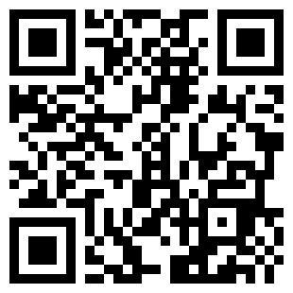
BEFORE WE START
Log in to the lecture quiz
Log in to the quiz
Scan the code, or go to quiz.bioinfo.se/live
Log in with your university account
Answering counts as being at the lecture: up to 3 bonus points on the exam
Right or wrong is never graded, only whether you answered. Results are shown without names.
quiz.bioinfo.se/live
Notes:
The quiz is not anonymous, because answering is how attendance is counted: 3 bonus points on the main exam for answering in all 12 lectures, one point less per missed lecture (preliminary). Whether an answer is right or wrong is never used. The projected results never show names; the only names shown are the two drawn to explain their reasoning. Start the session on quiz.bioinfo.se before the lecture: quiz.bioinfo.se/live then leads to it.

Slide 3
BEFORE WE START
Warm-up: what do you know already?
3 quick questions
On the topics of today, one at a time, about 30 seconds each
Answer on your own, and guess if you do not know
It shows me where to start; right or wrong is never graded
Notes:
About 2 minutes in all. Open each question's round, halt it after about 30 seconds and glance at the results; do not explain the answers now, the lecture does that.

Slide 4
WARM-UP · 1 OF 3
What is an accession number?
A A stable identifier for one database record
B The official name of the gene
C The length of the sequence
D The year the sequence was published
Answer now
Scan the code, or go to
quiz.bioinfo.se/live
Notes:
Right: A stable identifier for one database record. Block 1: know which identifier you are holding.

Slide 5
WARM-UP · 2 OF 3
What does it mean that a database entry is curated?
A It was computed automatically from the sequence
B The authors submitted it themselves
C An expert has checked it against the literature
D It has a 3D structure
Answer now
Scan the code, or go to
quiz.bioinfo.se/live
Notes:
Right: An expert has checked it against the literature. Block 2: who vouches for a record; Swiss-Prot against TrEMBL.

Slide 6
WARM-UP · 3 OF 3
A PubMed search for A AND B, compared with A alone, gives ...
A the same number of articles or fewer
B the same number or more
C exactly half as many
D a number that only depends on B
Answer now
Scan the code, or go to
quiz.bioinfo.se/live
Notes:
Right: the same number of articles or fewer. Block 3: Boolean operators are set operations.

Slide 7
BEFORE WE START
What the room knows already
Where we start
Which topics most of you know, and which we take slowly today.
Show the results ▸ quiz.bioinfo.se/live/report
Notes:
Optional: show two or three of the results, the ones that most got wrong.

Slide 8
BEFORE WE START
Your questions before today
What you asked
The questions you sent in on Canvas before the lecture
The most common ones now; the others in the block where they belong
Notes:
About 5 minutes. Read the answers to this session's Canvas survey 'Questions before the lecture' the evening before (it closes at 18:00 the day before the lecture), pick the two or three most common questions, and answer them briefly now or say in which block they come.

Slide 9
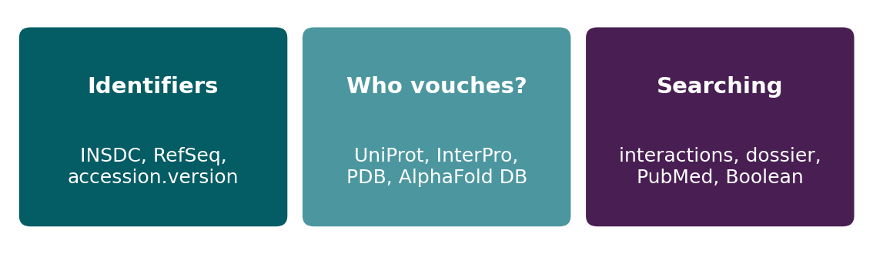
BEFORE WE START
In up to three words: what do you want to learn today?
Answer now
Scan the code, or go to
quiz.bioinfo.se/live
Notes:
A word cloud: the bigger the word, the more students wrote it. Come back to it at the end of the lecture.

Slide 10
BEFORE WE START
What you want to learn today
What the room wants to learn
Show the results ▸ quiz.bioinfo.se/live/report

Slide 11
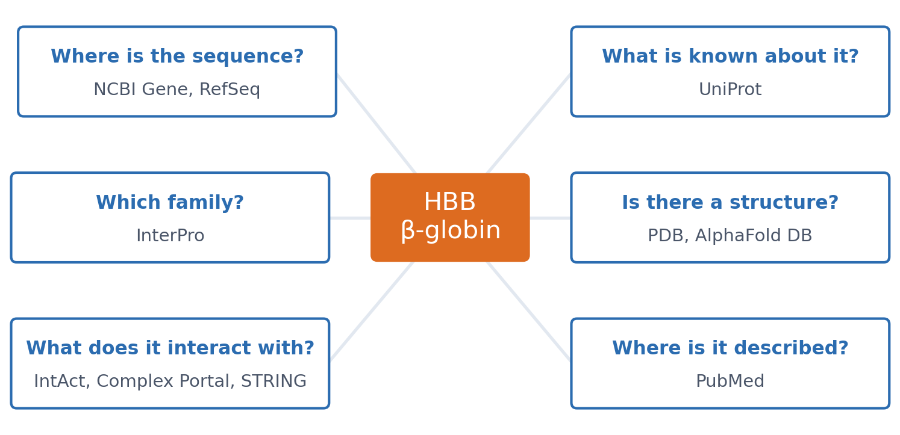
SESSION 3 · THE MAP
One protein, five questions
We follow human β-globin (HBB) through five questions. Each database appears as the answer to one of them, not as an entry in a list to learn.
See course.bioinfo.se/session03.html, 'Learning goals'.
Notes:
Joke from the page: why do databases trust accession numbers more than gene names? Ask the gene Pokemon, renamed Zbtb7 in 2005 after Pokémon's owners objected.

Slide 12
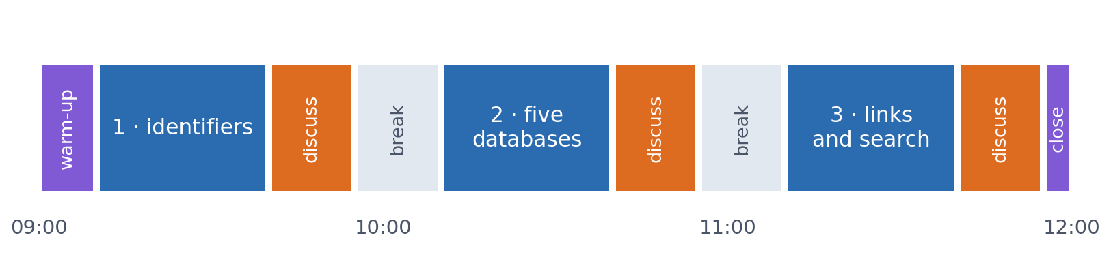
SESSION 3 · THE MORNING
Three blocks: about 30 min talk and 15 min discussion
Block 1: shared databases and the identifiers that link them. Block 2: who vouches for a record, and HBB in UniProt, InterPro, the PDB and AlphaFold DB. Block 3: interactions, the dossier, and searching.
Times are approximate: a 10 min start (warm-up quiz and your questions), two 15 min breaks and a 5 min close. Each block ends with a quiz question: guess, run the notebook and work out why it behaves as it does, discuss, answer again.

Slide 13
BLOCK 1 · ABOUT 30 MIN
Shared databases, and the identifiers that link them

Slide 14
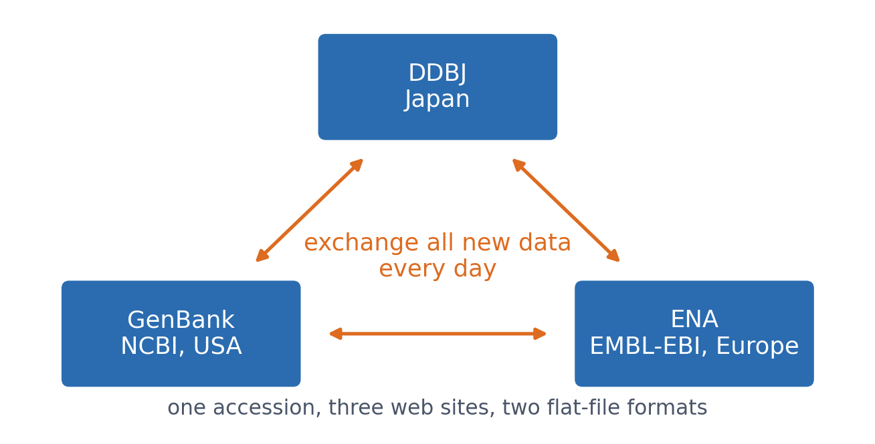
1 · WHY SHARED DATABASES
INSDC: one collaboration, three sites
A sequence submitted to any of the three can be found through all three, under the same accession. Access is free; most journals require deposition before publication.
See course.bioinfo.se/session03.html, 'Why coordinated, worldwide databases'.
Notes:
GenBank and ENA use different flat-file formats and different web pages, but share accessions and annotation standards. Deposition has been required by most journals since the 1990s, which is why a sequence you look up today reflects essentially everything published on it.

Slide 15
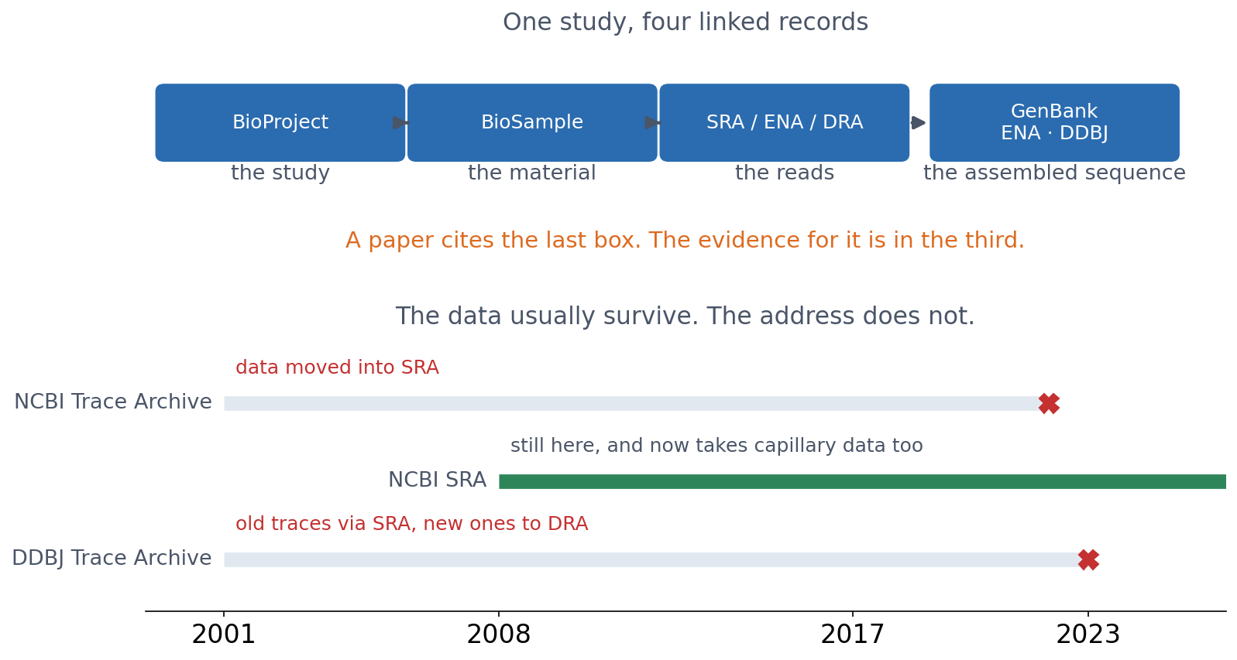
1 · SHARED ARCHIVES
Behind every sequence: the reads, and where they went
A submitted sequence is the end of a chain. The study, the material and the raw reads are separate records, linked to it — and the archives holding them are not permanent addresses.
NCBI Trace Archive retired 17 June 2022, its data moved into SRA; DDBJ's closed in 2023.
Notes:
Two things worth knowing that do not come up anywhere else in this lecture.
The first is that a sequence record is the end of a chain, not the whole of it. The study is a BioProject record, the material a BioSample, the raw reads a run in SRA, ENA or DRA. A paper cites the assembled sequence; the evidence for it is one box to the left. If you ever need to check whether a reported variant is real, that is where you go — the reads, not the consensus.
The second is that archives move. The NCBI Trace Archive ran from 2001, held chromatograms from the big genome projects, and was retired in 2022 with its contents moved into SRA. Japan's closed the year after. Nothing was lost in either case, but every link anyone had published stopped working.
That is the argument for learning how these resources relate rather than memorising a list of them. The data usually survive. The address does not.

Slide 16
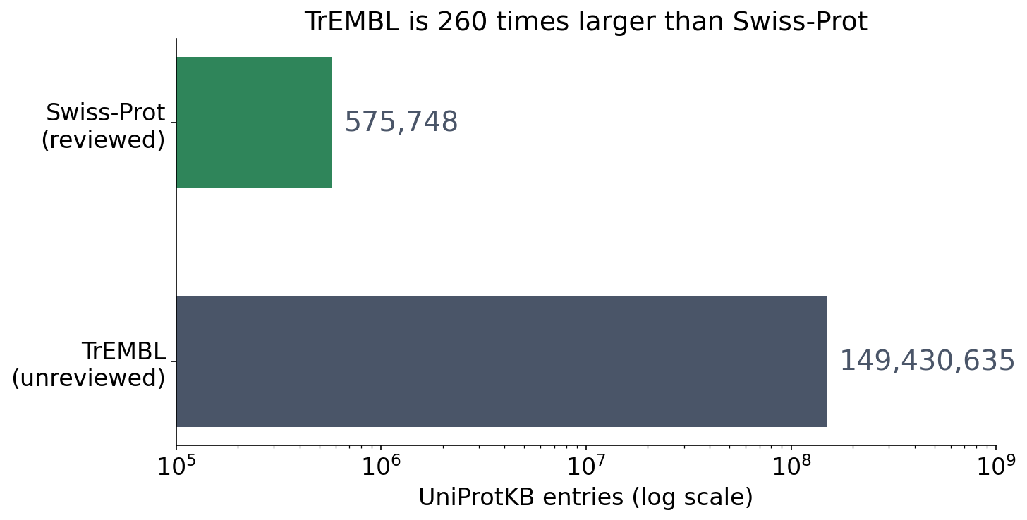
1 · WHY SHARED DATABASES
Too much data for any one lab
▪ TrEMBL: ~149 million entries
▪ A private copy goes stale at once
▪ So the databases are shared
Counts fetched live from the UniProt REST API; see the notebook.
Notes:
Swiss-Prot and TrEMBL return in Block 2 (reviewed vs unreviewed).

Slide 17
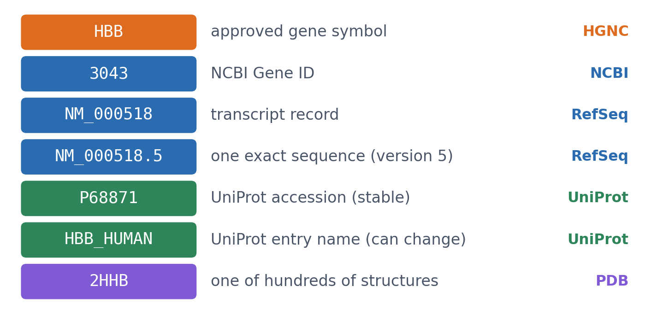
2 · IDENTIFIERS
Know which identifier you are holding
Seven identifiers for one gene and its products. An accession is unique only within its own database.
See course.bioinfo.se/session03.html, Table 3.1.
Notes:
The entry name HBB_HUMAN is a readable label that can change; the accession P68871 is the stable identifier. HBB appears in hundreds of PDB entries; 2HHB is one.

Slide 18
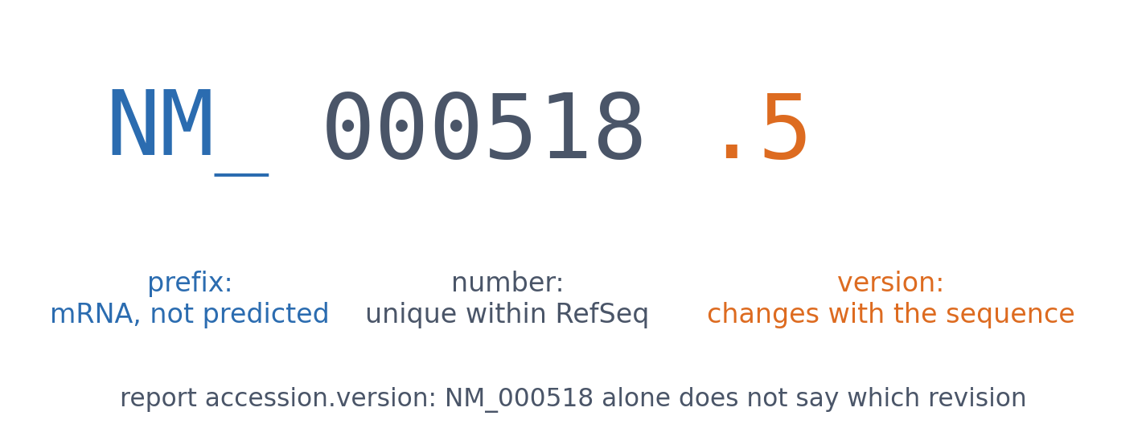
2 · IDENTIFIERS
Anatomy of an accession
NM_000518 is a record; NM_000518.5 is one exact sequence. The version changes whenever the sequence changes.
See course.bioinfo.se/session03.html, 'Identifiers'.

Slide 19
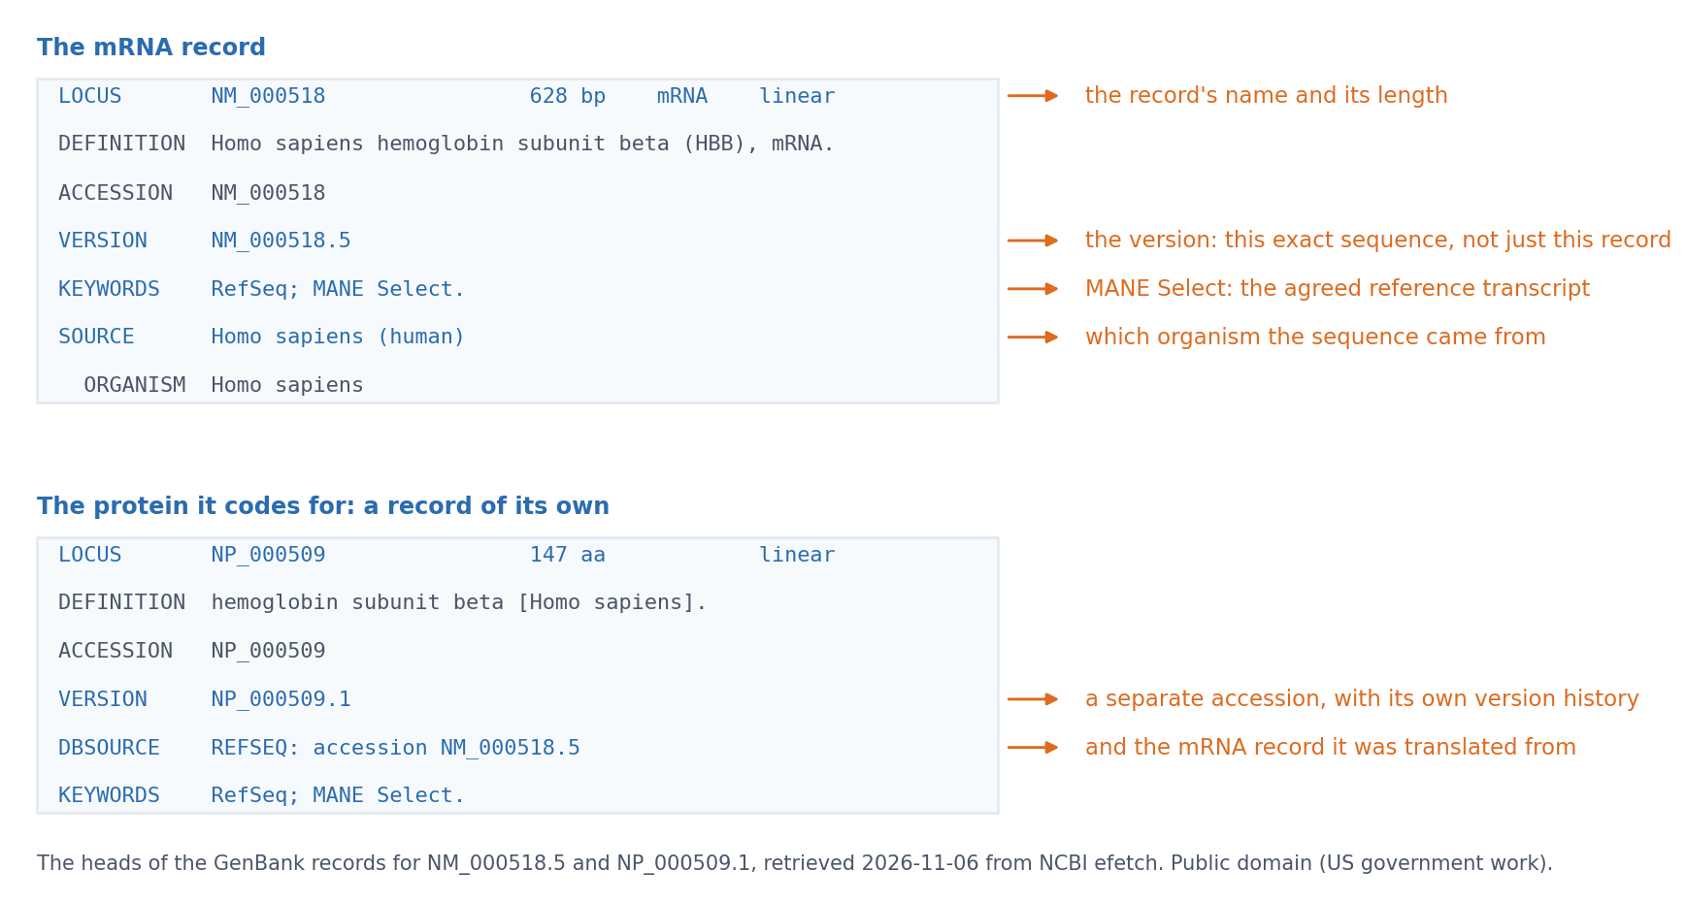
2 · IDENTIFIERS
The same identifier in a real record
The head of NM_000518.5 as NCBI returns it. LOCUS names the record and its length, VERSION fixes the exact sequence, KEYWORDS marks it MANE Select, SOURCE says which organism.
Provenance is printed under the figure itself. The same figure is @fig-s03-record-anatomy in the chapter.
Notes:
This is the first time they see a real record rather than a diagram of one. Read the four fields out loud in order: that is the habit the lab asks for. The figure is fetched, not screenshotted, so re-running the script refreshes it when the record changes.

Slide 20
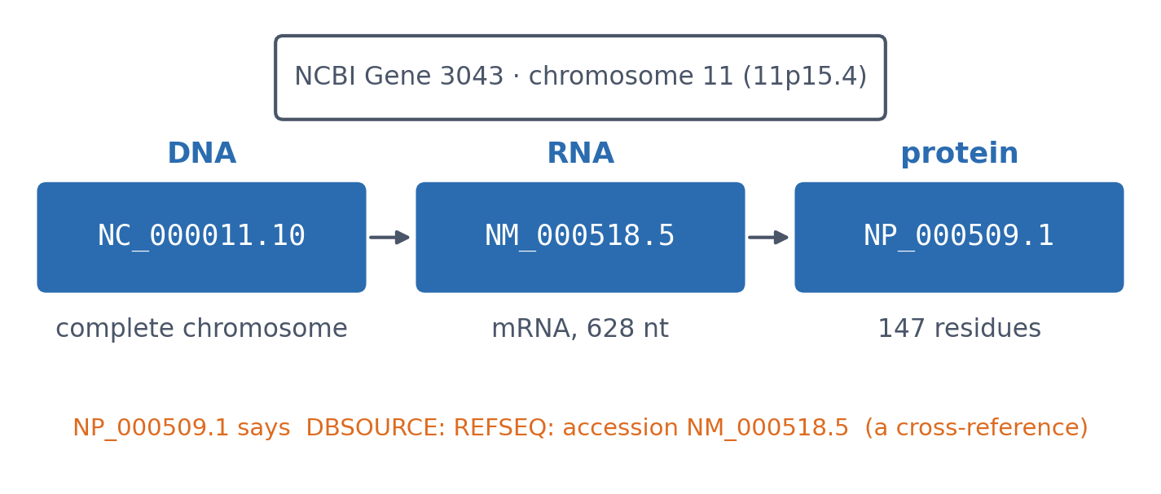
2 · IDENTIFIERS
One gene, three levels, linked by cross-references
Databases follow the central dogma: DNA, RNA and protein each have their own records. Genome browsers (UCSC, Ensembl) show the gene in its chromosomal context.
Records fetched live via Entrez; see the notebook.
Notes:
The raw submitted sequences sit in INSDC; RefSeq and Ensembl give the annotated, non-redundant view. The UniProt entry P68871 lists both NM_000518.5 and NP_000509.1.

Slide 21
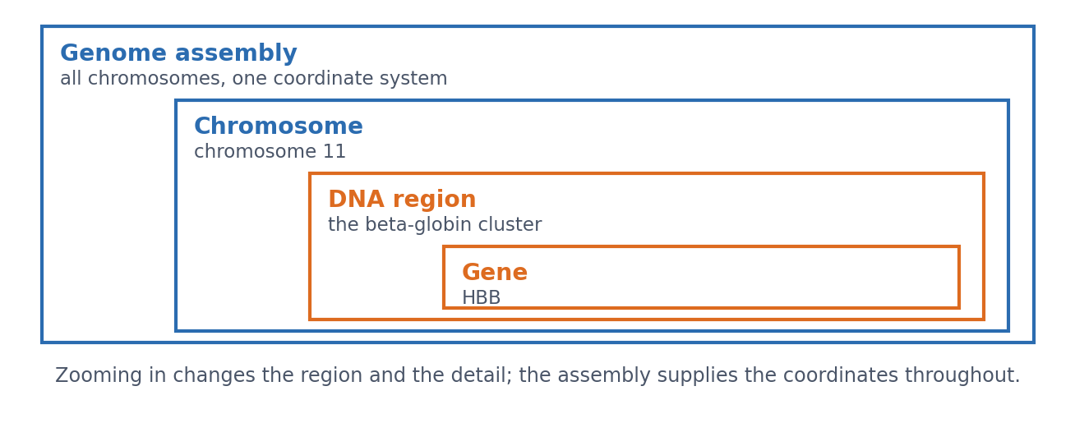
2 · IDENTIFIERS
Assembly, chromosome, region, gene: one DNA, four zoom levels
Not four kinds of thing in a row, but the same DNA at four scales. The assembly supplies the coordinates all the way down.
Drawn by tools/builders/make_session03_book_figures.py; @fig-s03-dna-scales in the chapter.
Notes:
Why the nesting matters: a coordinate is meaningless without the assembly it belongs to, which is the next slide but one.

Slide 22
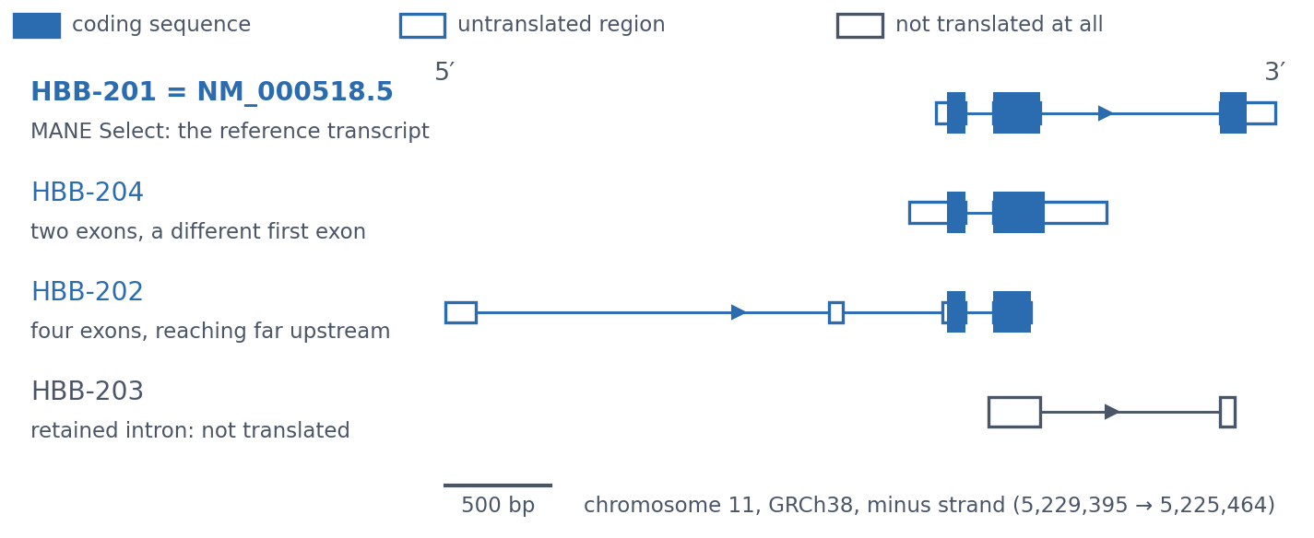
2 · IDENTIFIERS
Four real transcripts of HBB
HBB-201 is the MANE Select transcript, NM_000518.5. The other three differ in their first exon, in how far upstream they reach, and one keeps an intron and is never translated.
Coordinates from Ensembl GRCh38, retrieved 5 November 2026; drawn by tools/builders/make_session03_book_figures.py. @fig-s03-transcript-routes in the chapter.
Notes:
Filled boxes are coding sequence, open boxes untranslated. The point is that one gene symbol can stand for nineteen transcripts in Ensembl, which is why a report names the transcript, not the gene.

Slide 23
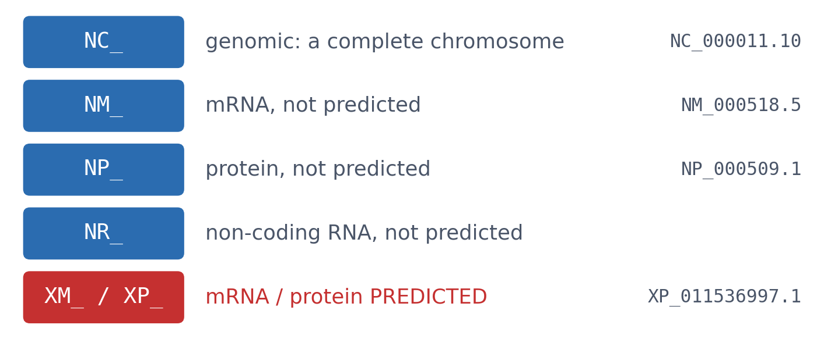
2 · IDENTIFIERS
RefSeq prefixes: level and kind of record
▪ The prefix tells the level
▪ X: predicted
▪ N: not predicted, many curated
See course.bioinfo.se/session03.html, Table 3.2; NCBI RefSeq FAQ.
Notes:
RefSeq is a non-redundant collection built from INSDC data; it is not itself part of INSDC.

Slide 24
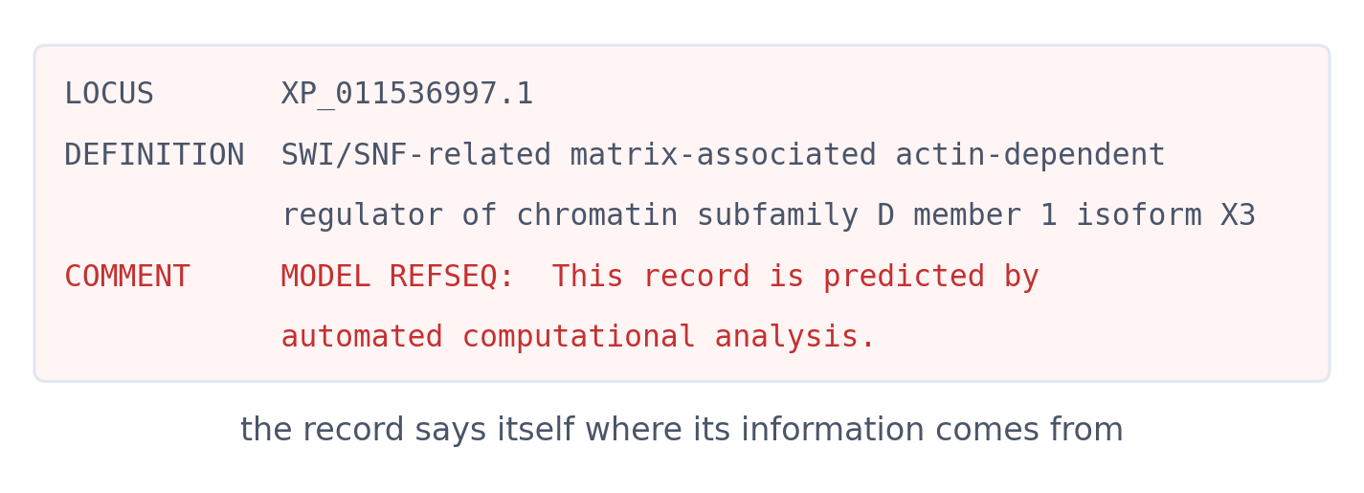
2 · IDENTIFIERS
A predicted record says so itself
XP_011536997.1, fetched live in the notebook. Learn to read where a record's information comes from (Block 2).
NCBI RefSeq via Entrez; see the notebook.

Slide 25
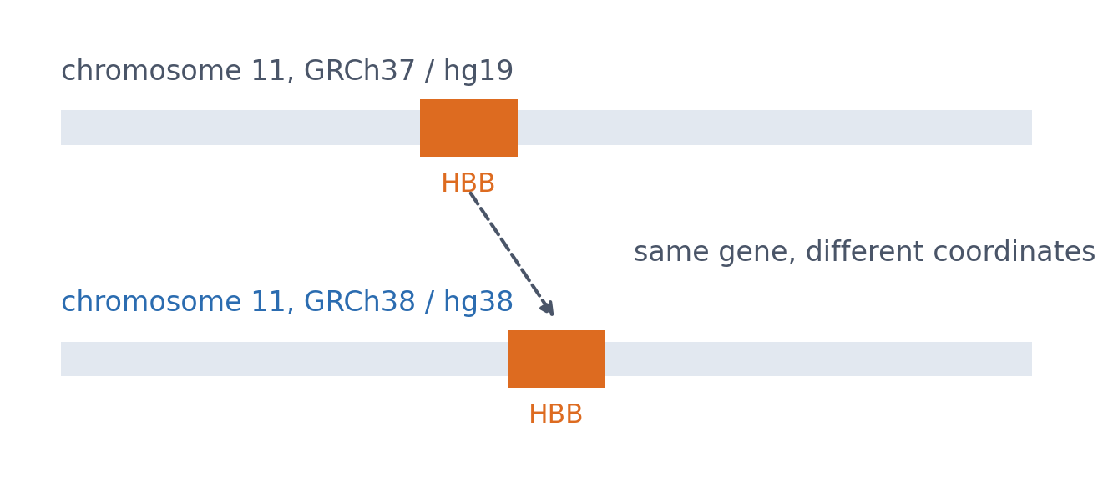
2 · IDENTIFIERS
Coordinates need the genome build
▪ GRCh37/hg19 or GRCh38/hg38?
▪ Same gene, different positions
▪ Always report the build
See course.bioinfo.se/session03.html, 'Identifiers'. The lab compares the two builds.
Notes:
The figure is schematic; the lab shows the real coordinates of a gene in both builds.

Slide 26
2 · IDENTIFIERS
Coordinates need the genome build
▪ GRCh37/hg19 or GRCh38/hg38?
▪ Same gene, different positions
▪ Always report the build
See course.bioinfo.se/session03.html, 'Identifiers'. The lab compares the two builds.
Notes:
The figure is schematic; the lab shows the real coordinates of a gene in both builds.

Slide 27
2 · IDENTIFIERS
Coordinates need the genome build
▪ GRCh37/hg19 or GRCh38/hg38?
▪ Same gene, different positions
▪ Always report the build
See course.bioinfo.se/session03.html, 'Identifiers'. The lab compares the two builds.
Notes:
The figure is schematic; the lab shows the real coordinates of a gene in both builds.

Slide 28
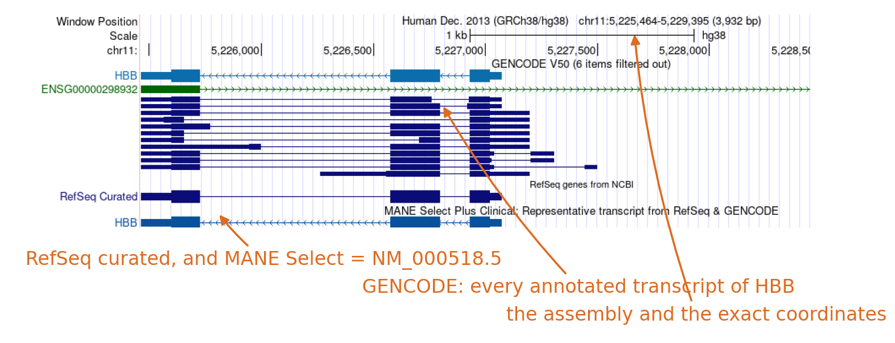
2 · IDENTIFIERS
The same gene in a genome browser
chr11:5,225,464-5,229,395 on GRCh38/hg38. The ruler, every annotated transcript in GENCODE, and the MANE Select row the previous slide named.
UCSC Genome Browser via hgRenderTracks, rendered by tools/builders/make_session03_record_figures.py. The uncropped figure is @fig-s03-ucsc in the chapter.
Notes:
Show that the coordinates in the title bar are exactly what a retrieval log has to record, assembly included. The lab asks them to produce one of these for HBB themselves.

Slide 29
2 · IDENTIFIERS
Two habits
Moving between records
Reporting a sequence
follow a cross-reference
accession.version
▪ Otherwise: stable ID or approved symbol, plus organism
▪ Then check organism and sequence
▪ NM_000518.5, not NM_000518
▪ Coordinates with their build
See course.bioinfo.se/session03.html, 'Identifiers'.

Slide 30
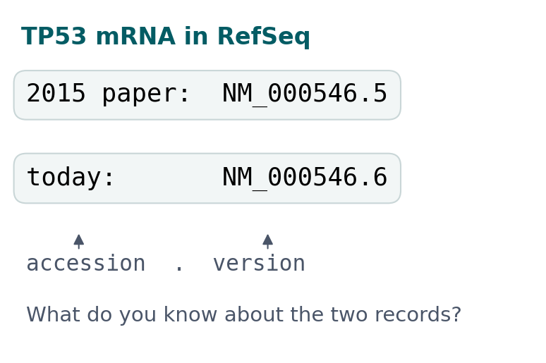
BLOCK 1 · QUIZ
NM_000546.5 and NM_000546.6: what changed?
A 2015 paper used NM_000546.5 (TP53 mRNA). Today RefSeq has NM_000546.6.
A Same sequence: only the annotation changed
B Same gene and record, but the sequence changed
C Two transcript variants of TP53
D Unrelated: a new version is a new record
Guess on your own
Scan the code, or go to
quiz.bioinfo.se/live
Notes:
The accession is the record; the number after the dot is the version of its sequence. Let them guess what a version change means.

Slide 31
BLOCK 1 · QUIZ
NM_000546.5 and NM_000546.6: what changed?
How did the room answer?
Halt the round when most have answered, then show the results.
Show the results ▸ quiz.bioinfo.se/live/report
Notes:
Halt submission in the Control view, then open the results. Do not say which answer is right.

Slide 32
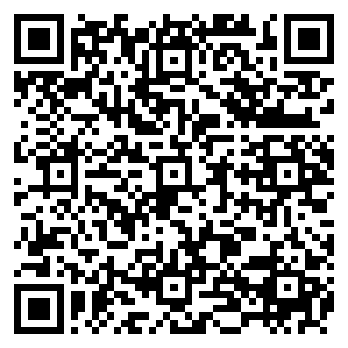
BLOCK 1 · QUIZ
NM_000546.5 and NM_000546.6: what changed?
Fix it, run it, discuss
Open the notebook: scan the code
Fix the line marked FIX, then run the cells
Did it come out as you guessed? Discuss with your neighbour
The notebook: https://colab.research.google.com/github/ElofssonLab/kb8029-book/blob/main/notebooks/session03-discussion-1.ipynb
Notes:
About 8 minutes. The notebook's FIX line compares the accessions without their versions, so it claims the sequences are the same (the first answer). Fixed (seqs[old] == seqs[new]): False, 2591 against 2512 bases. Early finishers find that version 6 lost 60 bases at the 5′ end and 19 at the 3′ end, and that the protein is the same.

Slide 33
BLOCK 1 · QUIZ
NM_000546.5 and NM_000546.6: what changed?
Answer again
Same question, after the discussion.
quiz.bioinfo.se/live
Notes:
Open the second round (post) in the Control view.

Slide 34
BLOCK 1 · QUIZ
NM_000546.5 and NM_000546.6: what changed?
Results, and who explains
Both rounds side by side.
Draw two to explain: one of you says how you reasoned.
Show the results ▸ quiz.bioinfo.se/live/report
To check it with code afterwards: discussion notebook 1 https://colab.research.google.com/github/ElofssonLab/kb8029-book/blob/main/notebooks/session03-discussion-1.ipynb
Notes:
Second answer. The version goes up only when the sequence changes. Version 6 is version 5 with shorter untranslated ends; the coding sequence and the 393-residue protein (NP_000537.3) are the same. Positions in the 2015 paper refer to version 5. Always record accession.version.

Slide 35
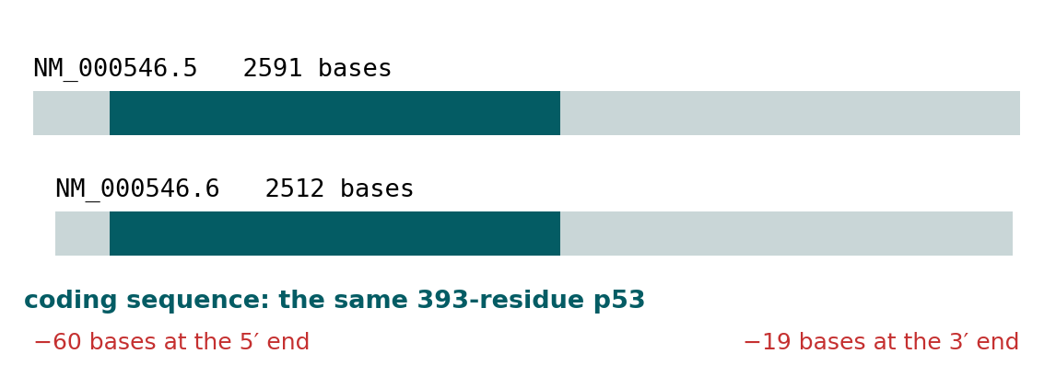
BLOCK 1 · QUIZ
The answer: the same record, a changed sequence
The number after the dot is the sequence version: it goes up only when the sequence changes. Version 6 lost 60 bases at the 5′ end and 19 at the 3′ end; the coding sequence, and so the p53 protein, is the same. A position in the 2015 paper refers to version 5, so always record the full accession.version.

Slide 36
BLOCK 1 DONE
Break

Slide 37
BLOCK 2 · ABOUT 30 MIN
Who vouches for a record? HBB in five databases

Slide 38
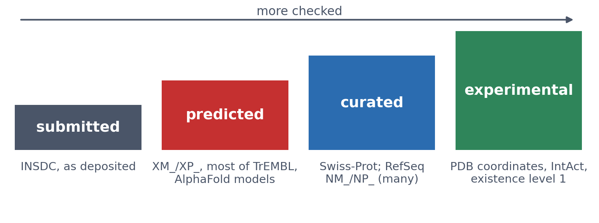
3 · WHERE DOES INFORMATION COME FROM?
Submitted, predicted, curated, experimental
Sources of a claim, not kinds of record: one Swiss-Prot entry mixes curated, experimental and predicted annotation, and a PDB entry is both submitted and experimental.
See course.bioinfo.se/session03.html, 'Where does a record's information come from?'.
Notes:
Databases differ less in what they store than in who vouches for it. Submitted: INSDC as deposited, quality varies, much redundancy. Predicted: a program inferred it. Curated: staff read the evidence and merged records. Experimental: somebody measured it.

Slide 39
3 · TRY IT IN PAIRS (3 MIN)
Who vouches for each claim?
▪ The sequence of XP_011536997.1
▪ The atom positions in 2HHB
▪ The function text in P68871
▪ A sequence as deposited in ENA
See course.bioinfo.se/session03.html, 'Where does a record's information come from?'.
Notes:
Predicted (MODEL REFSEQ); experimental (X-ray, and also submitted); curated (Swiss-Prot); submitted (INSDC). Ask for one claim that mixes two sources: a PDB entry is both submitted and experimental.

Slide 40
3 · TRY IT IN PAIRS (3 MIN)
Who vouches for each claim?
▪ The sequence of XP_011536997.1
▪ The atom positions in 2HHB
▪ The function text in P68871
▪ A sequence as deposited in ENA
See course.bioinfo.se/session03.html, 'Where does a record's information come from?'.
Notes:
Predicted (MODEL REFSEQ); experimental (X-ray, and also submitted); curated (Swiss-Prot); submitted (INSDC). Ask for one claim that mixes two sources: a PDB entry is both submitted and experimental.

Slide 41
3 · TRY IT IN PAIRS (3 MIN)
Who vouches for each claim?
▪ The sequence of XP_011536997.1
▪ The atom positions in 2HHB
▪ The function text in P68871
▪ A sequence as deposited in ENA
See course.bioinfo.se/session03.html, 'Where does a record's information come from?'.
Notes:
Predicted (MODEL REFSEQ); experimental (X-ray, and also submitted); curated (Swiss-Prot); submitted (INSDC). Ask for one claim that mixes two sources: a PDB entry is both submitted and experimental.

Slide 42
3 · TRY IT IN PAIRS (3 MIN)
Who vouches for each claim?
▪ The sequence of XP_011536997.1
▪ The atom positions in 2HHB
▪ The function text in P68871
▪ A sequence as deposited in ENA
See course.bioinfo.se/session03.html, 'Where does a record's information come from?'.
Notes:
Predicted (MODEL REFSEQ); experimental (X-ray, and also submitted); curated (Swiss-Prot); submitted (INSDC). Ask for one claim that mixes two sources: a PDB entry is both submitted and experimental.

Slide 43
3 · UNIPROTKB
Two sections: reviewed and unreviewed
▪ Swiss-Prot: curators check function, domains, literature
▪ TrEMBL: annotated automatically
▪ Not a subset: reviewed entries move to Swiss-Prot
575,748
Swiss-Prot
(reviewed)
149,430,635
TrEMBL
(unreviewed)
Counts fetched live from the UniProt REST API; see the notebook.
Notes:
Swiss-Prot has one entry per protein. Most TrEMBL entries are translations of predicted coding sequences.

Slide 44
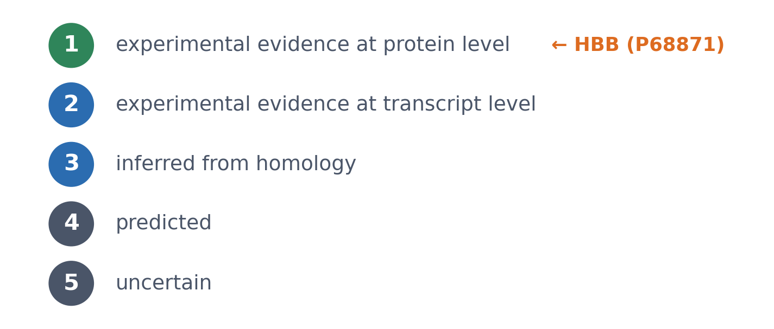
3 · UNIPROTKB
Protein existence: graded evidence
▪ Every entry has a level
▪ From measured to uncertain
▪ HBB: level 1
UniProt; see course.bioinfo.se/session03.html.

Slide 45
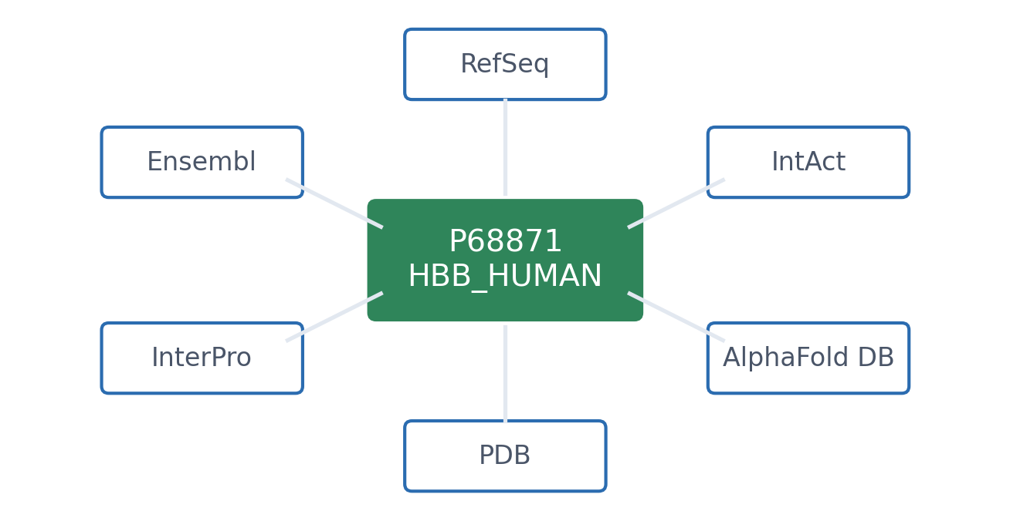
4 · WHAT IS KNOWN ABOUT THE PROTEIN?
UniProt: the best first stop
▪ P68871: Swiss-Prot
▪ Function, disease variants, modifications
▪ Links to everything else
See course.bioinfo.se/session03.html, 'What is known about the protein?'.
Notes:
Disease variants include sickle-cell anaemia. UniParc, a third UniProt component, stores every unique protein sequence once, under an identifier that is never reused: how you recognise that records in different databases hold the same sequence.

Slide 46
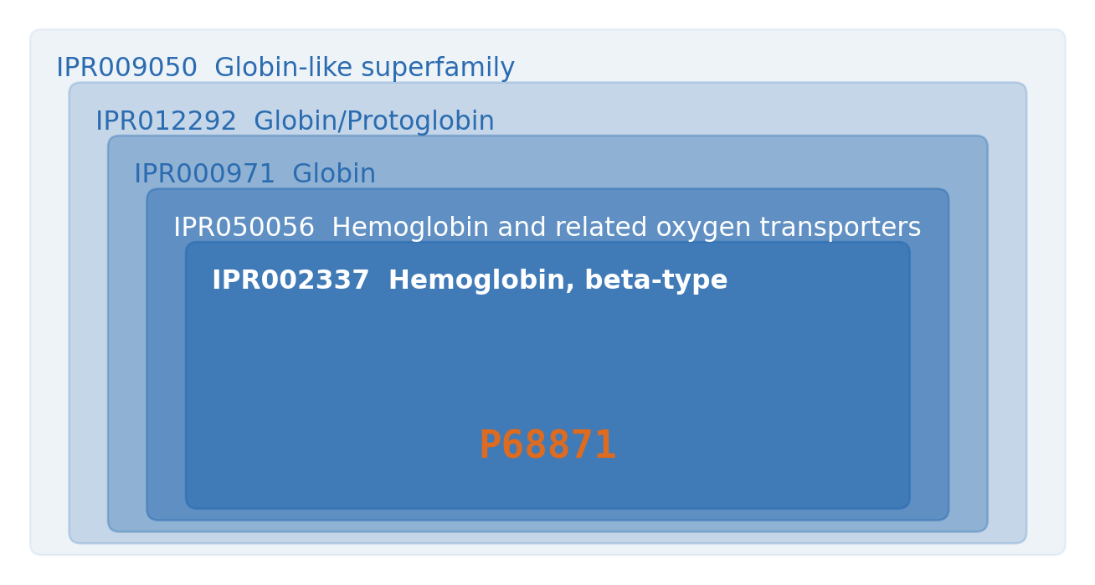
5 · WHICH FAMILY DOES IT BELONG TO?
InterPro: five nested entries for HBB
▪ From superfamily to beta-type
▪ Signatures from a dozen databases
▪ Pfam is now inside InterPro
▪ Mostly profile HMMs (Session 5)
InterPro API; see the notebook and book Table 3.3.
Notes:
Pfam's own website was retired in 2023 and merged into InterPro. For non-coding RNA, Rfam plays the same role with covariance models, which score base pairing together with the sequence. HBB has no Rfam entry; Rfam's tRNA family is RF00005.

Slide 47
5 · WHICH FAMILY DOES IT BELONG TO?
InterPro: five nested entries for HBB
▪ From superfamily to beta-type
▪ Signatures from a dozen databases
▪ Pfam is now inside InterPro
▪ Mostly profile HMMs (Session 5)
InterPro API; see the notebook and book Table 3.3.
Notes:
Pfam's own website was retired in 2023 and merged into InterPro. For non-coding RNA, Rfam plays the same role with covariance models, which score base pairing together with the sequence. HBB has no Rfam entry; Rfam's tRNA family is RF00005.

Slide 48
5 · WHICH FAMILY DOES IT BELONG TO?
InterPro: five nested entries for HBB
▪ From superfamily to beta-type
▪ Signatures from a dozen databases
▪ Pfam is now inside InterPro
▪ Mostly profile HMMs (Session 5)
InterPro API; see the notebook and book Table 3.3.
Notes:
Pfam's own website was retired in 2023 and merged into InterPro. For non-coding RNA, Rfam plays the same role with covariance models, which score base pairing together with the sequence. HBB has no Rfam entry; Rfam's tRNA family is RF00005.

Slide 49
5 · WHICH FAMILY DOES IT BELONG TO?
InterPro: five nested entries for HBB
▪ From superfamily to beta-type
▪ Signatures from a dozen databases
▪ Pfam is now inside InterPro
▪ Mostly profile HMMs (Session 5)
InterPro API; see the notebook and book Table 3.3.
Notes:
Pfam's own website was retired in 2023 and merged into InterPro. For non-coding RNA, Rfam plays the same role with covariance models, which score base pairing together with the sequence. HBB has no Rfam entry; Rfam's tRNA family is RF00005.

Slide 50
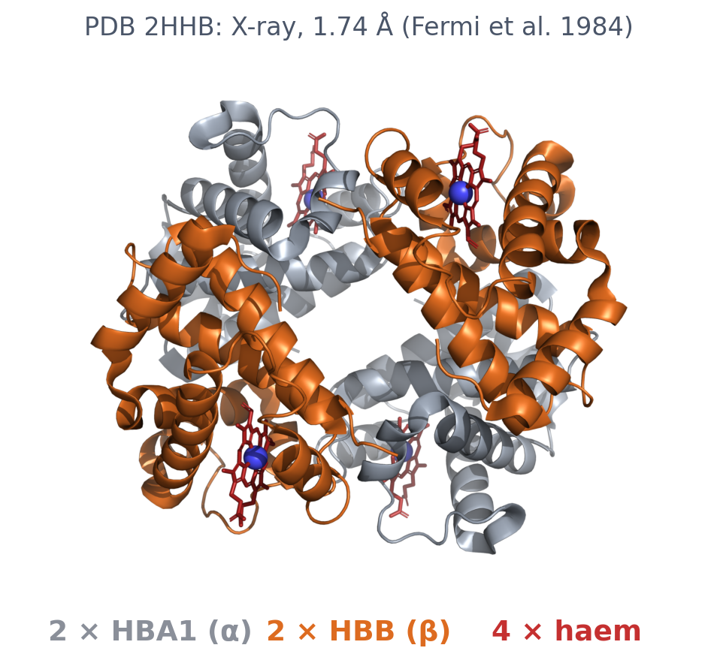
6 · IS THERE A STRUCTURE?
An experiment: PDB 2HHB
▪ Human deoxyhaemoglobin
▪ X-ray diffraction
▪ Resolution 1.74 Å
▪ Smaller = finer detail
PDBe and RCSB APIs; Fermi et al. (1984), J Mol Biol 175:159, PMID 6726807.
Notes:
Resolution describes the experimental data: how much detail the data could resolve. HBB appears in hundreds of PDB entries. Session 6 treats these coordinates as data.

Slide 51
6 · IS THERE A STRUCTURE?
An experiment: PDB 2HHB
▪ Human deoxyhaemoglobin
▪ X-ray diffraction
▪ Resolution 1.74 Å
▪ Smaller = finer detail
PDBe and RCSB APIs; Fermi et al. (1984), J Mol Biol 175:159, PMID 6726807.
Notes:
Resolution describes the experimental data: how much detail the data could resolve. HBB appears in hundreds of PDB entries. Session 6 treats these coordinates as data.

Slide 52
6 · IS THERE A STRUCTURE?
An experiment: PDB 2HHB
▪ Human deoxyhaemoglobin
▪ X-ray diffraction
▪ Resolution 1.74 Å
▪ Smaller = finer detail
PDBe and RCSB APIs; Fermi et al. (1984), J Mol Biol 175:159, PMID 6726807.
Notes:
Resolution describes the experimental data: how much detail the data could resolve. HBB appears in hundreds of PDB entries. Session 6 treats these coordinates as data.

Slide 53
6 · IS THERE A STRUCTURE?
An experiment: PDB 2HHB
▪ Human deoxyhaemoglobin
▪ X-ray diffraction
▪ Resolution 1.74 Å
▪ Smaller = finer detail
PDBe and RCSB APIs; Fermi et al. (1984), J Mol Biol 175:159, PMID 6726807.
Notes:
Resolution describes the experimental data: how much detail the data could resolve. HBB appears in hundreds of PDB entries. Session 6 treats these coordinates as data.

Slide 54
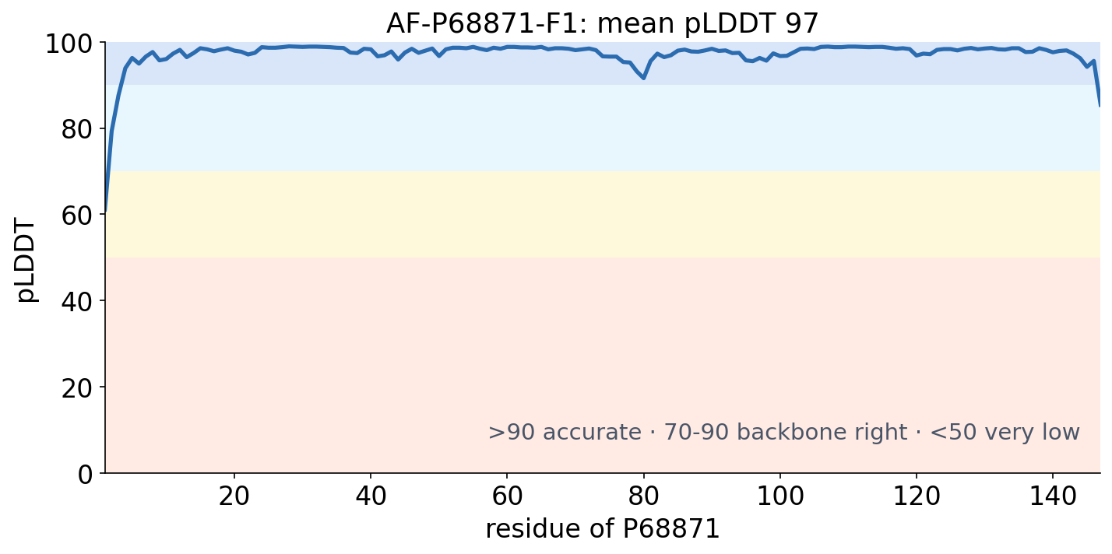
6 · IS THERE A STRUCTURE?
A prediction: AlphaFold DB
▪ AF-P68871-F1
▪ pLDDT: the model's own confidence
▪ Per residue, 0-100
AlphaFold Protein Structure Database (model v6); see the notebook.
Notes:
Above 90: accurate down to the side chains. Above 70: backbone usually right. Below 50: very low confidence, with intrinsic disorder one common reason (Session 12). AlphaFold DB covers essentially every protein in UniProt.

Slide 55
6 · IS THERE A STRUCTURE?
Resolution and pLDDT are different kinds of number
Resolution (PDB)
pLDDT (AlphaFold DB)
2HHB: 1.74 Å
AF-P68871-F1: mean 97
▪ How much detail the experiment saw
▪ In a real molecule
▪ Smaller is better
▪ The model's estimate of itself
▪ Per residue
▪ Larger is better
See course.bioinfo.se/session03.html, 'Is there a structure?'.
Notes:
For HBB, with hundreds of experimental structures, the model adds little. AlphaFold DB matters most for the many proteins with none. Session 12 shows how AlphaFold predicts them.

Slide 56
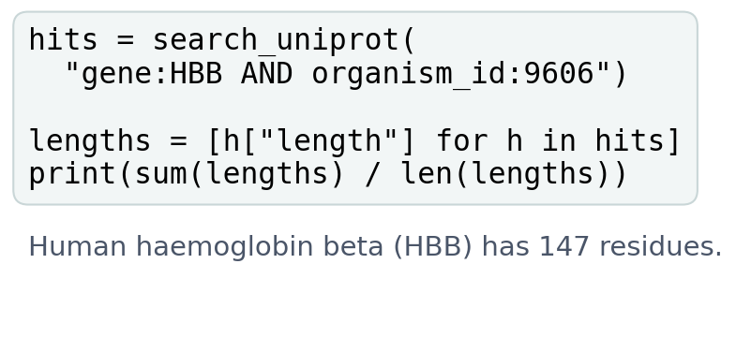
BLOCK 2 · QUIZ
What does the script print?
It searches UniProtKB for gene:HBB AND organism_id:9606 and averages the lengths. HBB has 147 residues.
A 147: every hit is human HBB
B About 80: most hits are unreviewed fragments
C About 290: α and β counted together
D Nothing: one entry per gene
Guess on your own
Scan the code, or go to
quiz.bioinfo.se/live
Notes:
Who vouches for each hit? Let them think about what else a search on the gene name returns.

Slide 57
BLOCK 2 · QUIZ
What does the script print?
How did the room answer?
Halt the round when most have answered, then show the results.
Show the results ▸ quiz.bioinfo.se/live/report
Notes:
Halt submission in the Control view, then open the results. Do not say which answer is right.

Slide 58
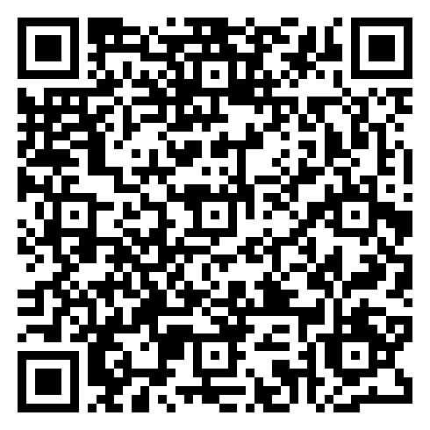
BLOCK 2 · QUIZ
What does the script print?
Fix it, run it, discuss
Open the notebook: scan the code
Fix the line marked FIX, then run the cells
Did it come out as you guessed? Discuss with your neighbour
The notebook: https://colab.research.google.com/github/ElofssonLab/kb8029-book/blob/main/notebooks/session03-discussion-2.ipynb
Notes:
About 8 minutes. On the saved results (14 October 2026), as it is: 18 hits, mean 80.4. The FIX keeps only reviewed entries (table[table['Reviewed'] == 'reviewed']): one hit, P68871, 147. The last cell runs the search live.

Slide 59
BLOCK 2 · QUIZ
What does the script print?
Answer again
Same question, after the discussion.
quiz.bioinfo.se/live
Notes:
Open the second round (post) in the Control view.

Slide 60
BLOCK 2 · QUIZ
What does the script print?
Results, and who explains
Both rounds side by side.
Draw two to explain: one of you says how you reasoned.
Show the results ▸ quiz.bioinfo.se/live/report
To check it with code afterwards: discussion notebook 2 https://colab.research.google.com/github/ElofssonLab/kb8029-book/blob/main/notebooks/session03-discussion-2.ipynb
Notes:
About 80 (80.4). One reviewed Swiss-Prot entry, P68871 (147), and 17 unreviewed TrEMBL entries: fragments, variants and three more copies of the full protein. The search is not wrong, every hit is annotated as human HBB; the question was. Ask for the reviewed entry of the right organism, and look at what came back before computing with it.

Slide 61
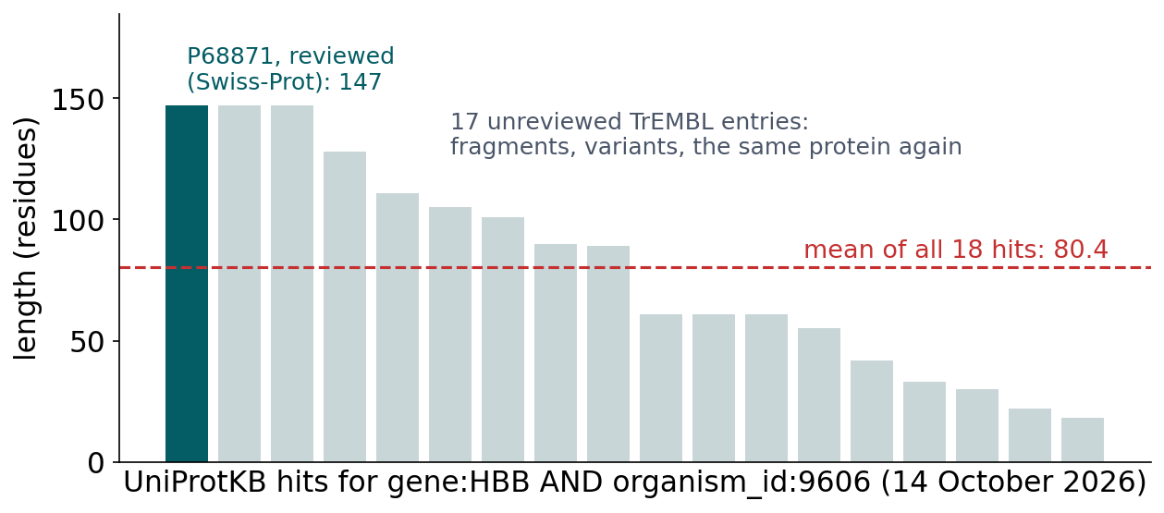
BLOCK 2 · QUIZ
The answer: about 80, because most hits are unreviewed
One reviewed entry (Swiss-Prot P68871, 147 residues) and 17 unreviewed TrEMBL entries, most of them fragments and variants from individual studies. A curator checks one reviewed entry per protein; unreviewed entries are added automatically, one per submitted sequence. Filter with reviewed:true, and look at the hits before you compute with them.

Slide 62
BLOCK 2 DONE
Break

Slide 63
BLOCK 3 · ABOUT 30 MIN
Interactions, the dossier, and searching

Slide 64
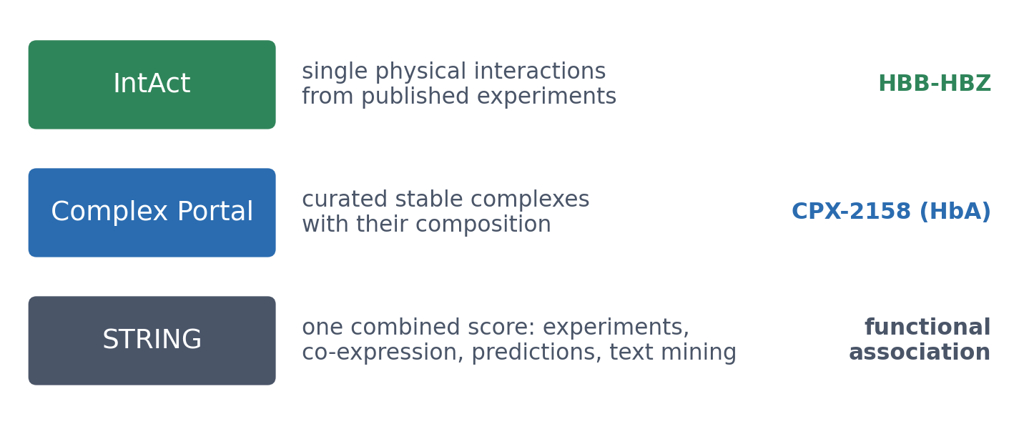
7 · WHAT DOES IT INTERACT WITH?
Interactions: what kind of evidence?
From the most to the least direct evidence. FunCoup (Stockholm University) builds a network like STRING's in a different way.
IntAct, Complex Portal and STRING APIs; see the notebook.
Notes:
IntAct is part of the IMEx consortium. STRING answers a broader question, 'which proteins are functionally associated?', with a mixture of experimental and predicted evidence. A later course in the programme covers FunCoup.

Slide 65
7 · WHAT DOES IT INTERACT WITH?
A curated complex: CPX-2158, haemoglobin HbA
▪ 2 HBA1 + 2 HBB + 4 haem
▪ Curated in Complex Portal
▪ The same object 2HHB shows
Complex Portal API; see the notebook.
Notes:
IntAct lists 20 interaction records for P68871, including HBB-HBZ (haemoglobin subunit zeta).

Slide 66
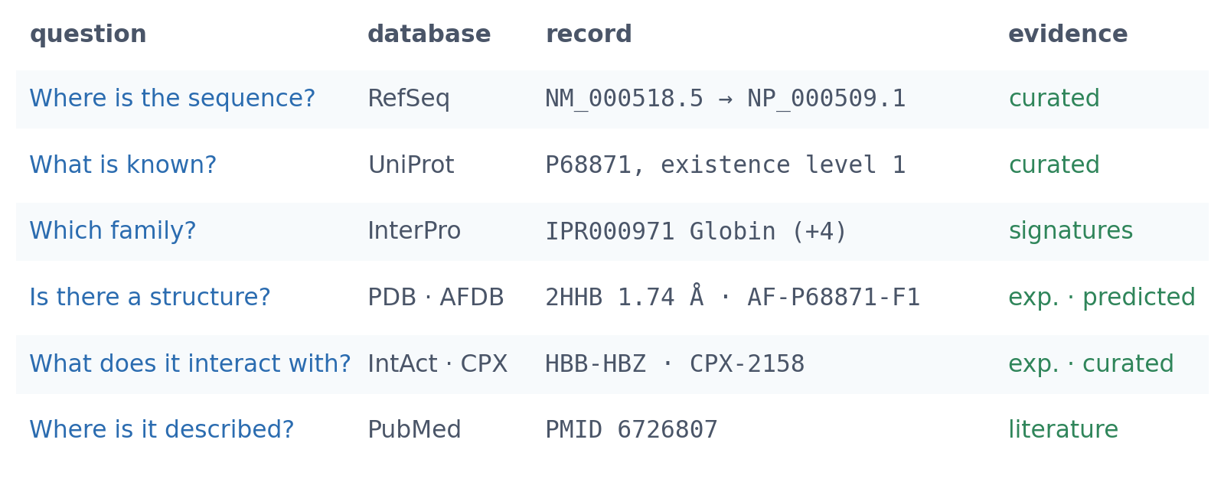
8 · THE DOSSIER
Five questions, five databases, one protein
Each row is a different database's record of the same biology, reached from the previous one by a cross-reference. The notebook fetches every record live.
See course.bioinfo.se/session03.html, Table 3.4.
Notes:
The lab ends with a dossier of the students' own, for human myoglobin.

Slide 67
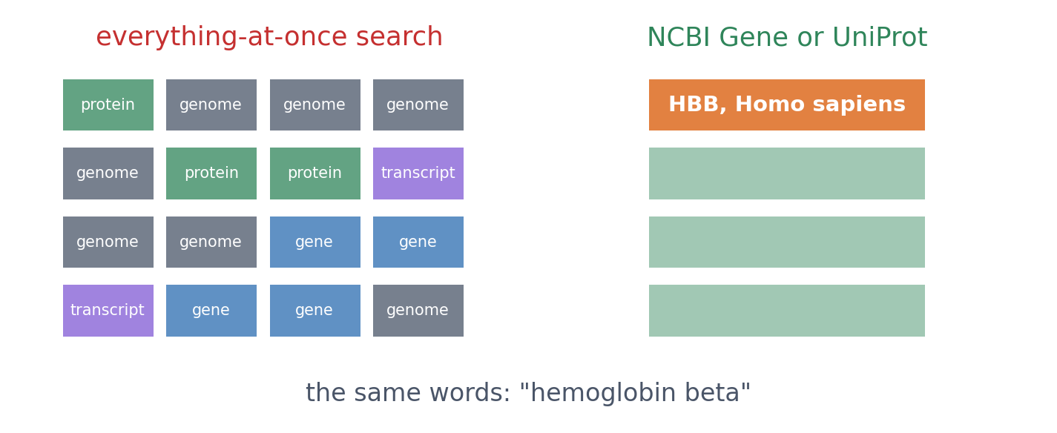
9 · SEARCHING
Know your level, then search
An everything-at-once search mixes genome, gene, transcript and protein records. The same words in NCBI Gene or UniProt give a short list with the record you want near the top.
See course.bioinfo.se/session03.html, 'Searching'. The left panel is schematic.

Slide 68
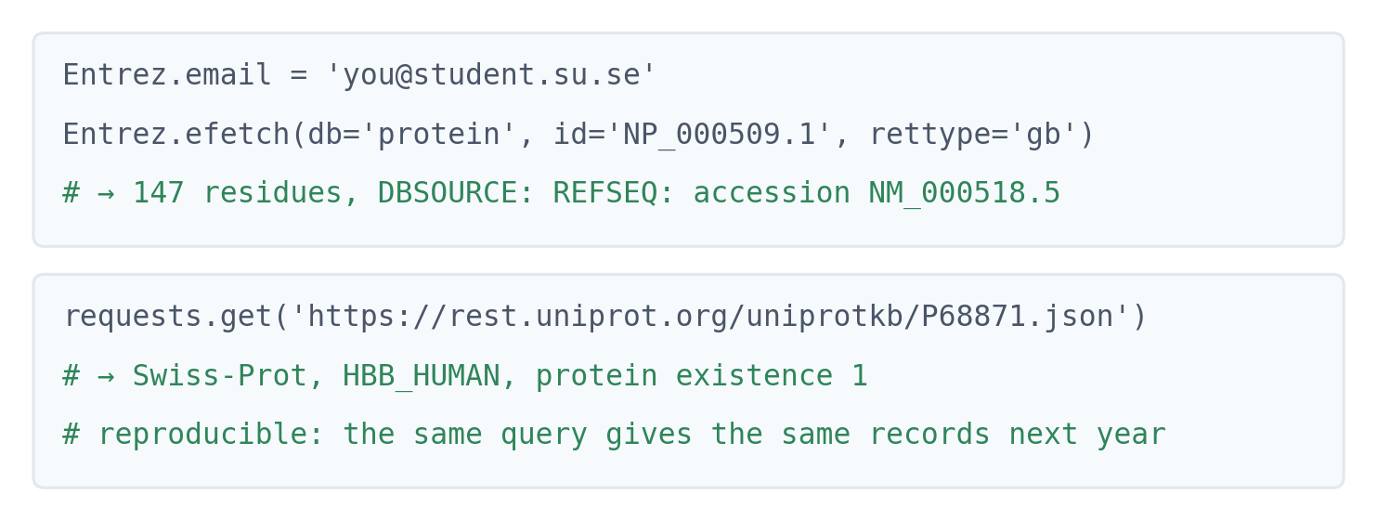
9 · SEARCHING
Searching from code: reproducible and scriptable
NCBI's E-utilities through Bio.Entrez, and the UniProt and PDB REST APIs. The course notebook builds the whole HBB dossier this way.
notebooks/session03-databases-in-code.ipynb

Slide 69
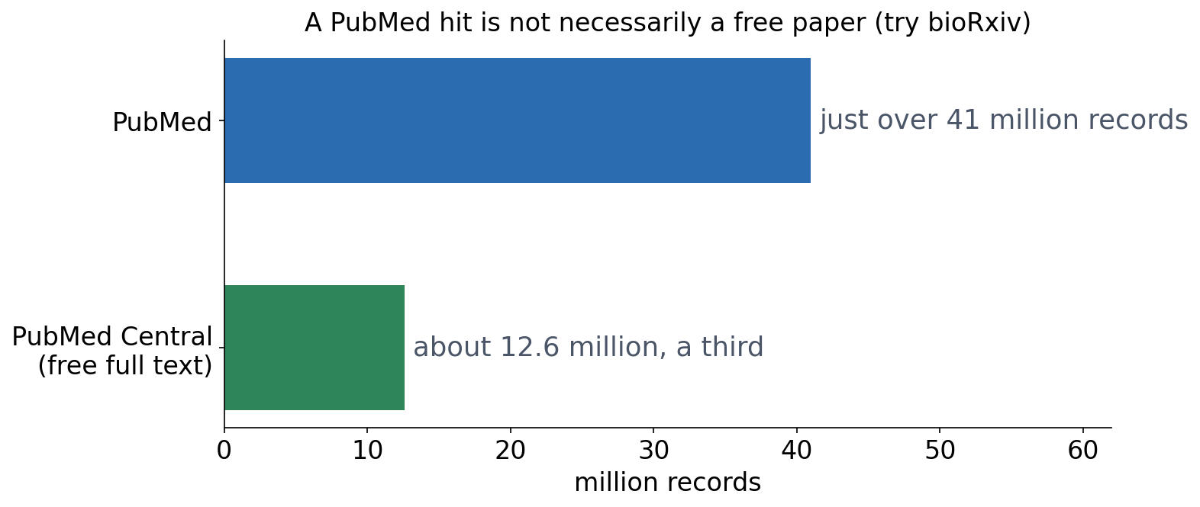
9 · SEARCHING THE LITERATURE
PubMed and PubMed Central
▪ PubMed: built on MEDLINE (1971)
▪ PMC: free full text
▪ No PMC copy? Try bioRxiv
See course.bioinfo.se/session03.html, 'Searching'.

Slide 70
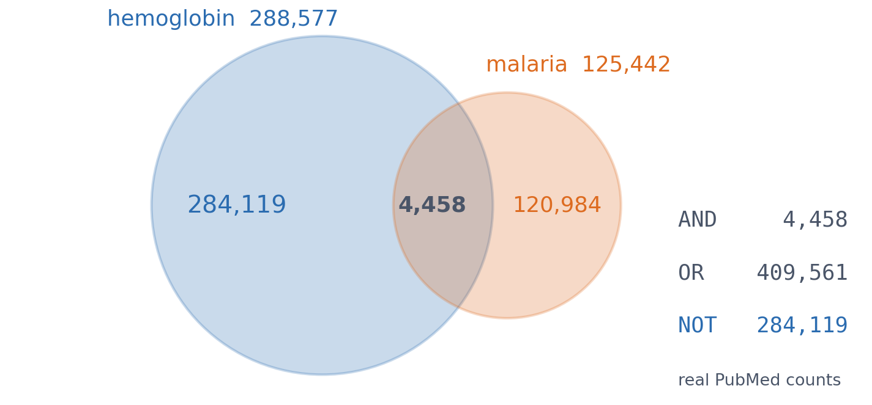
9 · SEARCHING THE LITERATURE
Boolean operators are set operations
▪ AND: the overlap
Live PubMed searches; see the notebook (book Table 3.5).
Notes:
409,561 = 288,577 + 125,442 − 4,458 exactly; 284,119 = 288,577 − 4,458 exactly. The notebook checks the arithmetic in code.

Slide 71
9 · SEARCHING THE LITERATURE
Boolean operators are set operations
▪ AND: the overlap
▪ OR: A + B − overlap
Live PubMed searches; see the notebook (book Table 3.5).
Notes:
409,561 = 288,577 + 125,442 − 4,458 exactly; 284,119 = 288,577 − 4,458 exactly. The notebook checks the arithmetic in code.

Slide 72
9 · SEARCHING THE LITERATURE
Boolean operators are set operations
▪ AND: the overlap
▪ OR: A + B − overlap
▪ NOT: A − overlap
Live PubMed searches; see the notebook (book Table 3.5).
Notes:
409,561 = 288,577 + 125,442 − 4,458 exactly; 284,119 = 288,577 − 4,458 exactly. The notebook checks the arithmetic in code.

Slide 73
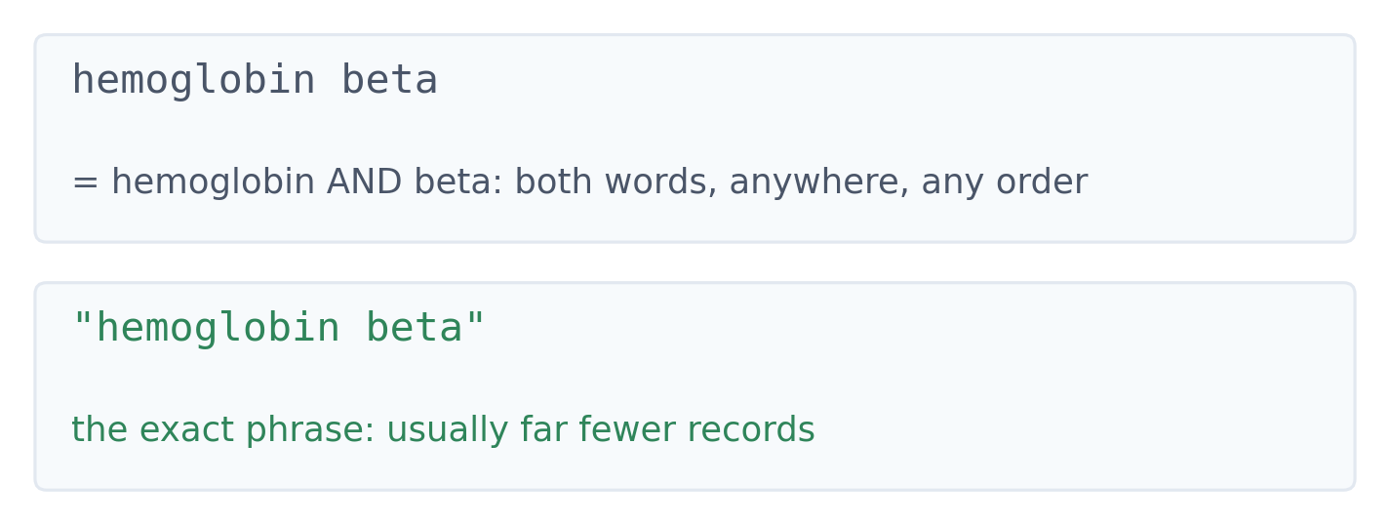
9 · SEARCHING THE LITERATURE
Quotation marks: words or a phrase?
▪ Without quotes: AND
▪ With quotes: the phrase
▪ Predict which gives fewer
See course.bioinfo.se/session03.html, 'Searching'.

Slide 74
9 · SEARCHING THE LITERATURE
Ask AI for leads, then go to the papers
▪ "How do intronic variants affect RNA splicing in human HBB?" — a mechanism to look for, and the words authors use for it
See course.bioinfo.se/session03.html, 'Literature search: finding the evidence'.
Notes:
The point of the ladder is that the last prompt is the only one whose answer you can check. The first two produce prose. Ask for the identifier and the figure and you have something to verify.

Slide 75
9 · SEARCHING THE LITERATURE
Ask AI for leads, then go to the papers
▪ "How do intronic variants affect RNA splicing in human HBB?" — a mechanism to look for, and the words authors use for it
▪ "Find two primary studies that measured it" — now it has to name papers, not explain
See course.bioinfo.se/session03.html, 'Literature search: finding the evidence'.
Notes:
The point of the ladder is that the last prompt is the only one whose answer you can check. The first two produce prose. Ask for the identifier and the figure and you have something to verify.

Slide 76
9 · SEARCHING THE LITERATURE
Ask AI for leads, then go to the papers
▪ "How do intronic variants affect RNA splicing in human HBB?" — a mechanism to look for, and the words authors use for it
▪ "Find two primary studies that measured it" — now it has to name papers, not explain
▪ "For each: the PMID, what was measured, and the figure that shows it" — an identifier to check, and a place to start reading
See course.bioinfo.se/session03.html, 'Literature search: finding the evidence'.
Notes:
The point of the ladder is that the last prompt is the only one whose answer you can check. The first two produce prose. Ask for the identifier and the figure and you have something to verify.

Slide 77
9 · SEARCHING THE LITERATURE
Ask AI for leads, then go to the papers
▪ "How do intronic variants affect RNA splicing in human HBB?" — a mechanism to look for, and the words authors use for it
▪ "Find two primary studies that measured it" — now it has to name papers, not explain
▪ "For each: the PMID, what was measured, and the figure that shows it" — an identifier to check, and a place to start reading
▪ What the assistant actually had matters: learned text, a retrieved record, or a paper you supplied in the conversation
See course.bioinfo.se/session03.html, 'Literature search: finding the evidence'.
Notes:
The point of the ladder is that the last prompt is the only one whose answer you can check. The first two produce prose. Ask for the identifier and the figure and you have something to verify.

Slide 78
9 · SEARCHING THE LITERATURE
Two checks, not one
Is this the paper?
Is the claim supported?
▪ Title, authors, year match
▪ DOI or PMID resolves to that record
▪ A working link proves nothing about the sentence beside it
▪ Find the result, not the abstract
▪ Which cells, which comparison, what was measured
▪ The figure legend, Results and Methods belong together
See course.bioinfo.se/session03.html, 'Put the claim beside the evidence'.
Notes:
Students routinely do the first check and stop. The second is where the reading actually happens, and it is the one that catches a real paper with an invented conclusion attached.

Slide 79
9 · SEARCHING THE LITERATURE
Both checks have failed in print
▪ A citation that does not exist
Both cases are documented in the published literature; see the chapter for the links.
Notes:
Neither example is about a model being stupid. Both are fluent, plausible answers. The sunscreen one is the better teaching case because the identifier resolves: a student who checks that the link works concludes the reference is fine.

Slide 80
9 · SEARCHING THE LITERATURE
Both checks have failed in print
▪ A citation that does not exist
• Bhattacharyya and colleagues published ChatGPT output from April 2023: a 2021 sunscreen review by Chen et al., journal and all, carrying PMID 33635047
Both cases are documented in the published literature; see the chapter for the links.
Notes:
Neither example is about a model being stupid. Both are fluent, plausible answers. The sunscreen one is the better teaching case because the identifier resolves: a student who checks that the link works concludes the reference is fine.

Slide 81
9 · SEARCHING THE LITERATURE
Both checks have failed in print
▪ A citation that does not exist
• Bhattacharyya and colleagues published ChatGPT output from April 2023: a 2021 sunscreen review by Chen et al., journal and all, carrying PMID 33635047
• That PMID is real. It belongs to a paper on iron-oxide microspheres for enriching histidine-rich proteins
Both cases are documented in the published literature; see the chapter for the links.
Notes:
Neither example is about a model being stupid. Both are fluent, plausible answers. The sunscreen one is the better teaching case because the identifier resolves: a student who checks that the link works concludes the reference is fine.

Slide 82
9 · SEARCHING THE LITERATURE
Both checks have failed in print
▪ A citation that does not exist
• Bhattacharyya and colleagues published ChatGPT output from April 2023: a 2021 sunscreen review by Chen et al., journal and all, carrying PMID 33635047
• That PMID is real. It belongs to a paper on iron-oxide microspheres for enriching histidine-rich proteins
▪ A real paper with the wrong conclusion
Both cases are documented in the published literature; see the chapter for the links.
Notes:
Neither example is about a model being stupid. Both are fluent, plausible answers. The sunscreen one is the better teaching case because the identifier resolves: a student who checks that the link works concludes the reference is fine.

Slide 83
9 · SEARCHING THE LITERATURE
Both checks have failed in print
▪ A citation that does not exist
• Bhattacharyya and colleagues published ChatGPT output from April 2023: a 2021 sunscreen review by Chen et al., journal and all, carrying PMID 33635047
• That PMID is real. It belongs to a paper on iron-oxide microspheres for enriching histidine-rich proteins
▪ A real paper with the wrong conclusion
• Weinberg and colleagues asked for a summary of a named trial of saline and albumin in traumatic brain injury; the answer said there was no difference in mortality
Both cases are documented in the published literature; see the chapter for the links.
Notes:
Neither example is about a model being stupid. Both are fluent, plausible answers. The sunscreen one is the better teaching case because the identifier resolves: a student who checks that the link works concludes the reference is fine.

Slide 84
9 · SEARCHING THE LITERATURE
Both checks have failed in print
▪ A citation that does not exist
• Bhattacharyya and colleagues published ChatGPT output from April 2023: a 2021 sunscreen review by Chen et al., journal and all, carrying PMID 33635047
• That PMID is real. It belongs to a paper on iron-oxide microspheres for enriching histidine-rich proteins
▪ A real paper with the wrong conclusion
• Weinberg and colleagues asked for a summary of a named trial of saline and albumin in traumatic brain injury; the answer said there was no difference in mortality
• The paper reports 33.2% against 20.4% at 24 months, P = 0.003 — the finding had been removed
Both cases are documented in the published literature; see the chapter for the links.
Notes:
Neither example is about a model being stupid. Both are fluent, plausible answers. The sunscreen one is the better teaching case because the identifier resolves: a student who checks that the link works concludes the reference is fine.

Slide 85
9 · SEARCHING THE LITERATURE
Keep the conclusion inside the experiment
▪ Nualkaew et al. 2019, PMID 31113996: an engineered U7 snRNA against the IVS2-654 splice defect
▪ Cultured erythroid cells from patients, against untreated, vector and scrambled controls
▪ RT-PCR, Figure 3A-B: a mean of 8.25% correctly spliced beta-globin RNA at day 10
▪ That is RNA in that culture — not the share of cells corrected, and not a cure
See course.bioinfo.se/session03.html, 'Find the measurement behind the claim'.
Notes:
Worth saying out loud: the model defines where the result applies, the intervention what changed, the comparison how to read it, and the measurement what was seen. Drop any one and the sentence grows.

Slide 86
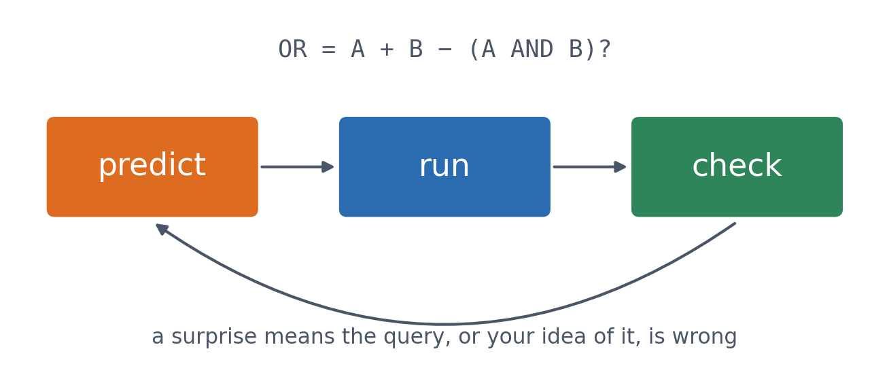
9 · SEARCHING
A habit for every database
▪ Predict the count
▪ Run the query
▪ Check that it makes sense
See course.bioinfo.se/session03.html, 'Searching'.

Slide 87
OTHER RESOURCES WORTH KNOWING
Not needed in this course, but you will meet them
Variants
Cancer genomics
Systems
dbSNP, ClinVar, EVA
TCGA, COSMIC
PRIDE, Reactome, BioModels
▪ GWAS Catalog
▪ OMIM for Mendelian disease
▪ Via NCI's Genomic Data Commons
▪ Somatic mutations
▪ Proteomics data
▪ Pathways and models
See course.bioinfo.se/session03.html, 'Other resources worth knowing' (optional box).

Slide 88
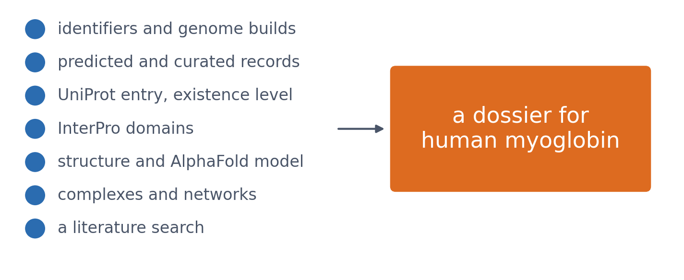
THE LAB
Your own dossier: human myoglobin
The same path on other genes and proteins, ending with a dossier in which you also say what kind of information each record holds.
The Session 3 lab quiz on Canvas (labs/session03-databases.text2qti.md).

Slide 89
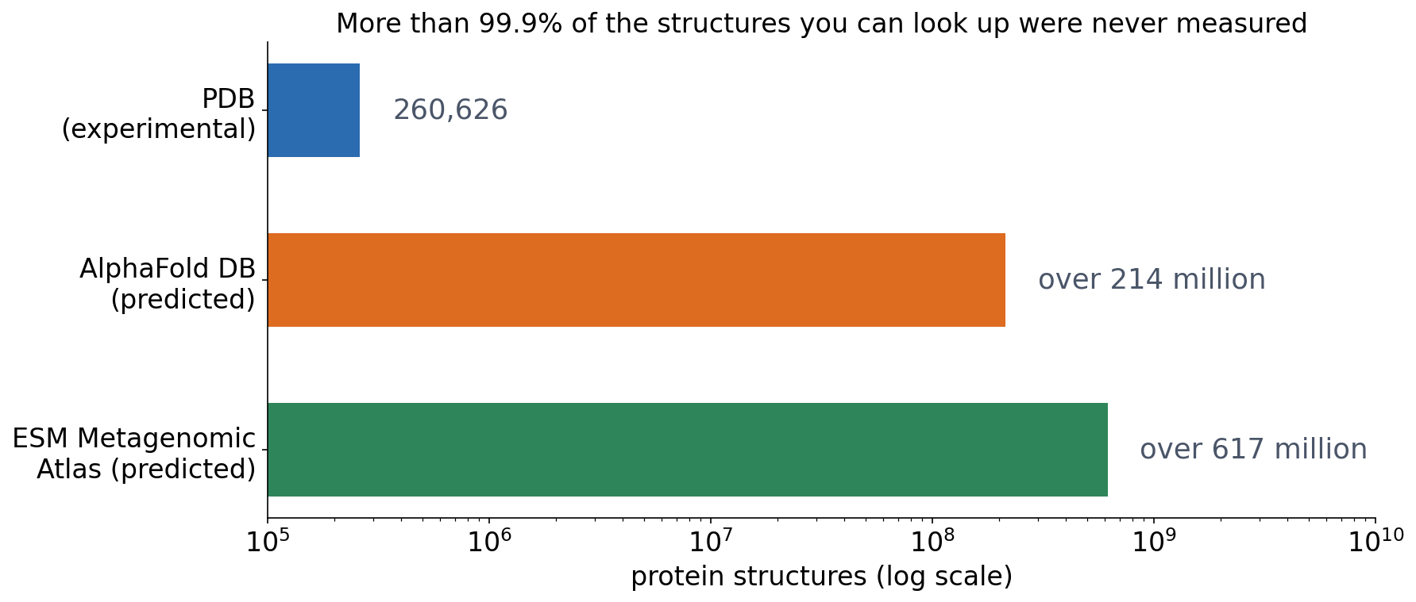
3 · OUTLOOK
From measured to predicted
▪ PDB: about 260,000 measured
▪ AlphaFold DB: over 214 million predicted
RCSB PDB search API, experimental entries, 9 Oct 2026; Varadi et al. 2024, NAR 52:D368; Lin et al. 2023, Science 379:1123. https://alphafold.ebi.ac.uk/
Notes:
Session 3's question was who vouches for each claim: submitted, predicted, curated or experimental. For structures, the answer has flipped: more than 99.9% of the structures you can look up were never measured. 260,626 experimental entries in the PDB (RCSB search, 9 October 2026), over 214 million AlphaFold models (AlphaFold DB, 2024) and over 617 million ESMFold models of metagenomic proteins, more than 225 million of them with high confidence. Answer: the model's own confidence (pLDDT, Session 12), and the experiments it was trained on. Predicted records are useful, but they should be labelled as predicted, as UniProt and the AlphaFold DB do.

Slide 90
3 · OUTLOOK
From measured to predicted
▪ PDB: about 260,000 measured
▪ AlphaFold DB: over 214 million predicted
▪ ESM Atlas: over 617 million predicted
RCSB PDB search API, experimental entries, 9 Oct 2026; Varadi et al. 2024, NAR 52:D368; Lin et al. 2023, Science 379:1123. https://alphafold.ebi.ac.uk/
Notes:
Session 3's question was who vouches for each claim: submitted, predicted, curated or experimental. For structures, the answer has flipped: more than 99.9% of the structures you can look up were never measured. 260,626 experimental entries in the PDB (RCSB search, 9 October 2026), over 214 million AlphaFold models (AlphaFold DB, 2024) and over 617 million ESMFold models of metagenomic proteins, more than 225 million of them with high confidence. Answer: the model's own confidence (pLDDT, Session 12), and the experiments it was trained on. Predicted records are useful, but they should be labelled as predicted, as UniProt and the AlphaFold DB do.

Slide 91
3 · OUTLOOK
From measured to predicted
▪ PDB: about 260,000 measured
▪ AlphaFold DB: over 214 million predicted
▪ ESM Atlas: over 617 million predicted
▪ Who vouches for a predicted record?
RCSB PDB search API, experimental entries, 9 Oct 2026; Varadi et al. 2024, NAR 52:D368; Lin et al. 2023, Science 379:1123. https://alphafold.ebi.ac.uk/
Notes:
Session 3's question was who vouches for each claim: submitted, predicted, curated or experimental. For structures, the answer has flipped: more than 99.9% of the structures you can look up were never measured. 260,626 experimental entries in the PDB (RCSB search, 9 October 2026), over 214 million AlphaFold models (AlphaFold DB, 2024) and over 617 million ESMFold models of metagenomic proteins, more than 225 million of them with high confidence. Answer: the model's own confidence (pLDDT, Session 12), and the experiments it was trained on. Predicted records are useful, but they should be labelled as predicted, as UniProt and the AlphaFold DB do.

Slide 92
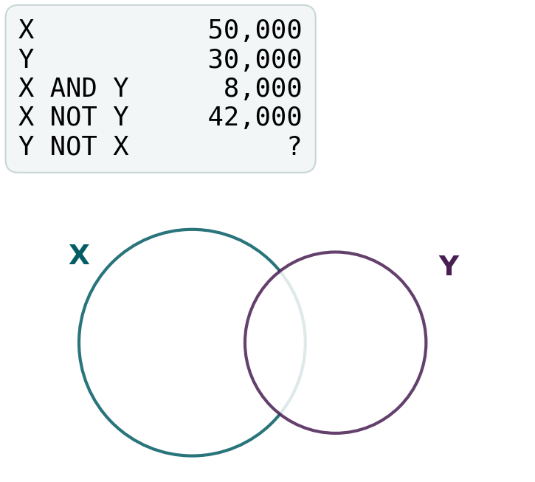
BLOCK 3 · QUIZ
How many articles does Y NOT X give?
PubMed: X gives 50,000, Y 30,000, X AND Y 8,000, and X NOT Y 42,000.
A 42,000: NOT works both ways alike
B 22,000
C 72,000
D 38,000
Guess on your own
Scan the code, or go to
quiz.bioinfo.se/live
Notes:
The old block 3 discussion problem, with X NOT Y given. Draw the two circles if they ask.

Slide 93
BLOCK 3 · QUIZ
How many articles does Y NOT X give?
How did the room answer?
Halt the round when most have answered, then show the results.
Show the results ▸ quiz.bioinfo.se/live/report
Notes:
Halt submission in the Control view, then open the results. Do not say which answer is right.

Slide 94
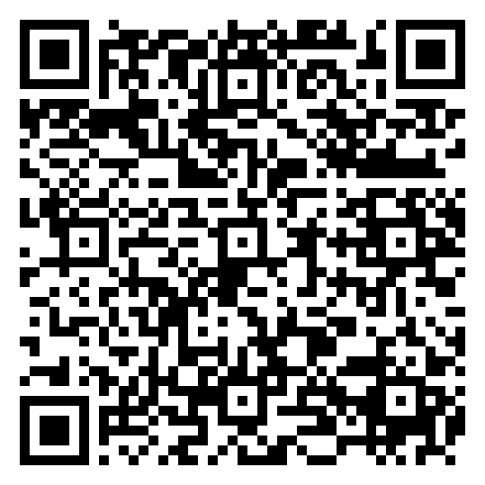
BLOCK 3 · QUIZ
How many articles does Y NOT X give?
Fix it, run it, discuss
Open the notebook: scan the code
Fix the line marked FIX, then run the cells
Did it come out as you guessed? Discuss with your neighbour
The notebook: https://colab.research.google.com/github/ElofssonLab/kb8029-book/blob/main/notebooks/session03-discussion-3.ipynb
Notes:
About 8 minutes. The FIX line was copied from the line above and still starts from X, so it predicts 42,000 (the first answer). Fixed (y - x_and_y): 22,000. The second cell checks the arithmetic on real PubMed counts for CRISPR and cancer: they match exactly.

Slide 95
BLOCK 3 · QUIZ
How many articles does Y NOT X give?
Answer again
Same question, after the discussion.
quiz.bioinfo.se/live
Notes:
Open the second round (post) in the Control view.

Slide 96
BLOCK 3 · QUIZ
How many articles does Y NOT X give?
Results, and who explains
Both rounds side by side.
Draw two to explain: one of you says how you reasoned.
Show the results ▸ quiz.bioinfo.se/live/report
To check it with code afterwards: discussion notebook 3 https://colab.research.google.com/github/ElofssonLab/kb8029-book/blob/main/notebooks/session03-discussion-3.ipynb
Notes:
22,000. NOT keeps one set and removes the overlap: Y NOT X = 30,000 − 8,000. X and Y have different sizes, so the two NOTs differ. 72,000 is X OR Y (the overlap counted once); 38,000 adds the overlap instead of removing it.

Slide 97
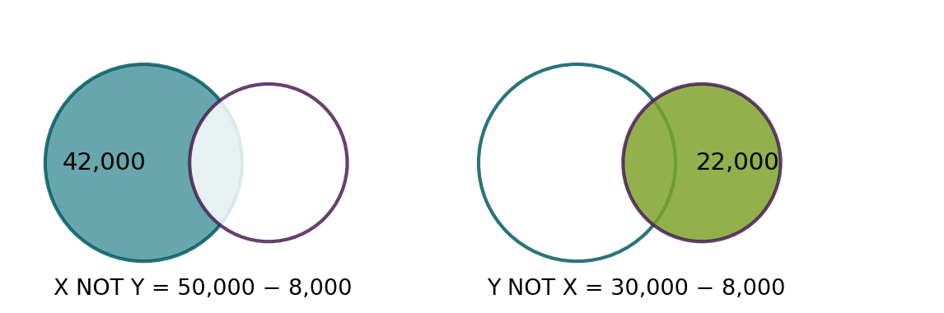
BLOCK 3 · QUIZ
The answer: 22,000, because NOT is not symmetric
Boolean operators are set operations on the lists of matching articles. NOT starts from one set and removes the overlap, so X NOT Y = 50,000 − 8,000 and Y NOT X = 30,000 − 8,000. OR counts the overlap once: 72,000. Real PubMed counts follow the same arithmetic exactly.

Slide 98
SUMMARY
Know the identifier, know who vouches for it
Follow cross-references between records, report accession.version, ask where each claim comes from (submitted, predicted, curated, experimental), and predict a search before you run it.
See course.bioinfo.se/session03.html.

Slide 99
BEFORE YOU LEAVE
In up to three words: what was the hardest part of today?
Answer now
Scan the code, or go to
quiz.bioinfo.se/live
Notes:
A word cloud: the bigger the word, the more students wrote it. It shows what to repeat next time.

Slide 100
BEFORE YOU LEAVE
The hardest part of today
What the room found hardest
Show the results ▸ quiz.bioinfo.se/live/report

Slide 101
Session 4 next
You can now retrieve two related real sequences by accession
Next: how do you line them up, and score how similar they are?
Sequence alignment: dynamic programming, PAM/BLOSUM, dot plots

