Slide 1

Session 6: Protein Structure
KB8029 — Bioinformatics & Deep Learning
Arne Elofsson

Slide 2
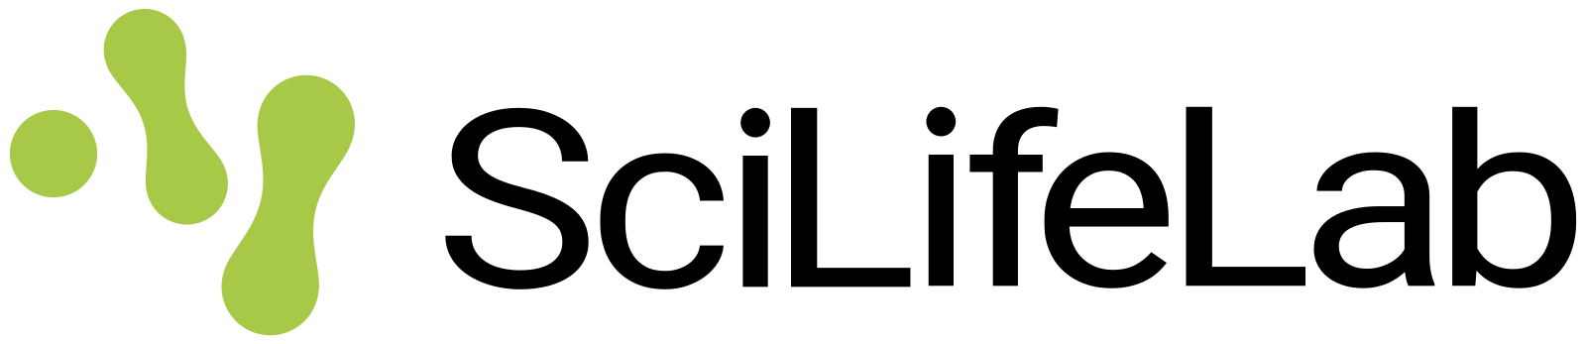
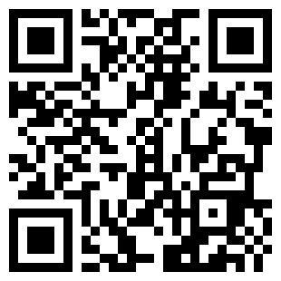
BEFORE WE START
Log in to the lecture quiz
Log in to the quiz
Scan the code, or go to quiz.bioinfo.se/live
Log in with your university account
Answering counts as being at the lecture: up to 3 bonus points on the exam
Right or wrong is never graded, only whether you answered. Results are shown without names.
quiz.bioinfo.se/live
Notes:
The quiz is not anonymous, because answering is how attendance is counted: 3 bonus points on the main exam for answering in all 12 lectures, one point less per missed lecture (preliminary). Whether an answer is right or wrong is never used. The projected results never show names; the only names shown are the two drawn to explain their reasoning. Start the session on quiz.bioinfo.se before the lecture: quiz.bioinfo.se/live then leads to it.

Slide 3
BEFORE WE START
Warm-up: what do you know already?
3 quick questions
On the topics of today, one at a time, about 30 seconds each
Answer on your own, and guess if you do not know
It shows me where to start; right or wrong is never graded
Notes:
About 2 minutes in all. Open each question's round, halt it after about 30 seconds and glance at the results; do not explain the answers now, the lecture does that.

Slide 4
WARM-UP · 1 OF 3
An α-helix is held together mainly by ...
A Disulphide bonds
B Backbone hydrogen bonds, residue i to i + 4
C Salt bridges between side chains
D Hydrogen bonds between neighbouring strands
Answer now
Scan the code, or go to
quiz.bioinfo.se/live
Notes:
Right: Backbone hydrogen bonds, residue i to i + 4. C=O of residue i to N–H of residue i + 4. Block 1: helix, strand, coil.

Slide 5
WARM-UP · 2 OF 3
What does a protein's contact map show?
A Which residues are close to each other in 3D
B Which proteins interact in the cell
C The hydrophobicity along the sequence
D Where in the cell the protein is found
Answer now
Scan the code, or go to
quiz.bioinfo.se/live
Notes:
Right: Which residues are close to each other in 3D. Block 1: a structure as a matrix. Block 3: residues in contact mutate together.

Slide 6
WARM-UP · 3 OF 3
During evolution, which usually changes more slowly?
A The sequence
B Both change equally fast
C The structure
D Neither changes
Answer now
Scan the code, or go to
quiz.bioinfo.se/live
Notes:
Right: The structure. Block 2: sequence identity fades, the fold stays.

Slide 7
BEFORE WE START
What the room knows already
Where we start
Which topics most of you know, and which we take slowly today.
Show the results ▸ quiz.bioinfo.se/live/report
Notes:
Optional: show two or three of the results, the ones that most got wrong.

Slide 8
BEFORE WE START
Your questions before today
What you asked
The questions you sent in on Canvas before the lecture
The most common ones now; the others in the block where they belong
Notes:
About 5 minutes. Read the answers to this session's Canvas survey 'Questions before the lecture' the evening before (it closes at 18:00 the day before the lecture), pick the two or three most common questions, and answer them briefly now or say in which block they come.

Slide 9
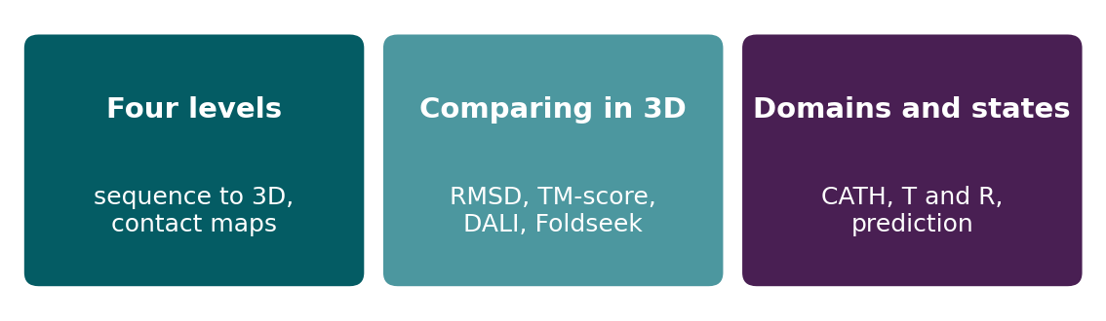
BEFORE WE START
In up to three words: what do you want to learn today?
Answer now
Scan the code, or go to
quiz.bioinfo.se/live
Notes:
A word cloud: the bigger the word, the more students wrote it. Come back to it at the end of the lecture.

Slide 10
BEFORE WE START
What you want to learn today
What the room wants to learn
Show the results ▸ quiz.bioinfo.se/live/report

Slide 11
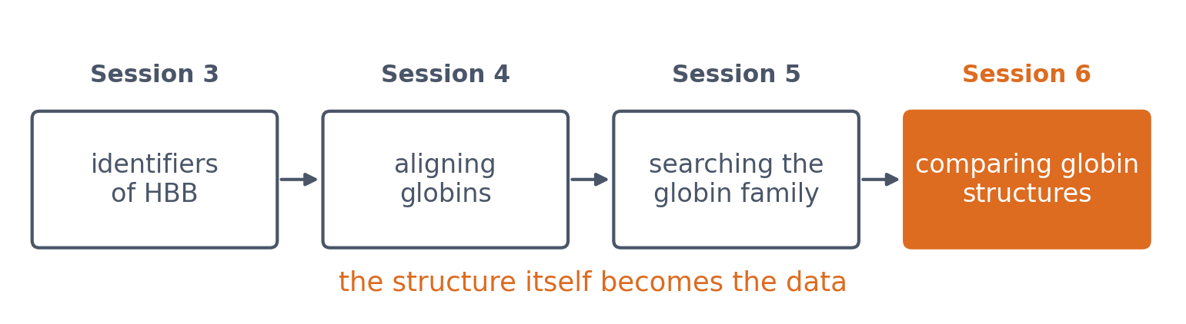
SESSION 6 · THE MAP
What does a sequence encode in 3D?
▪ Today the structure is the data
▪ Coordinates → distances, domains, interfaces
▪ Sessions 7-12: can a computer predict it?
See course.bioinfo.se/session06.html, 'Learning goals'.
Notes:
Session 3 found structures only as database records (a PDB entry, an AlphaFold model). Today the coordinates themselves are the data: we turn them into distances, secondary structure, domains and interfaces, and compare them with other structures. The globin thread continues: identifiers (S3), alignment (S4), family search (S5), structures (today). Opening joke from the page: haemoglobin walks into a bar; the bartender says 'You look tense.' 'Give me some oxygen and I'll relax.' It returns in Block 3 (T and R states).

Slide 12
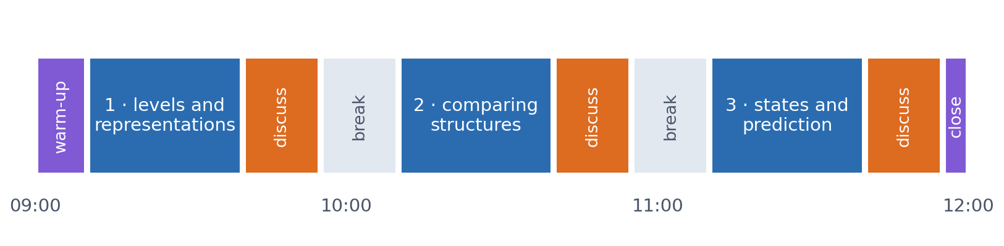
SESSION 6 · THE MORNING
Three blocks: about 30 min talk and 15 min discussion
Block 1: the four levels of structure and how to represent a structure. Block 2: comparing structures (alignment, RMSD, TM-score, DALI, Foldseek). Block 3: domains, conformational states, and structure as a prediction target.
Times are approximate: a 10 min start (warm-up quiz and your questions), two 15 min breaks and a 5 min close. Each block ends with a quiz question: guess, run the notebook and work out why it behaves as it does, discuss, answer again.

Slide 13
BLOCK 1 · ABOUT 30 MIN
Sequence becomes structure

Slide 14
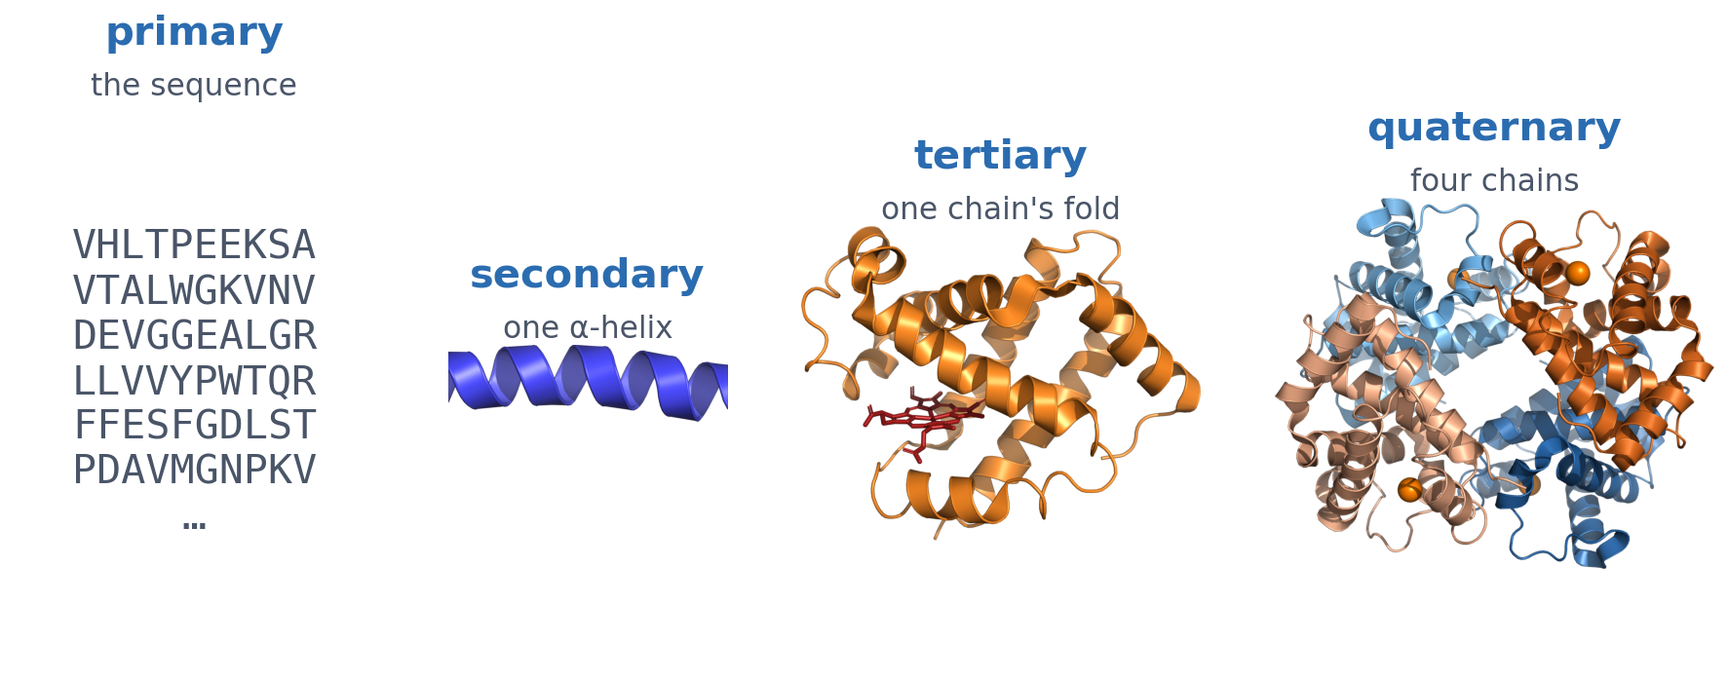
1 · FOUR LEVELS
Four levels of structure, all in haemoglobin
Primary: the amino-acid sequence. Secondary: local backbone shapes (α-helix, β-strand, coil). Tertiary: the 3D fold of one chain. Quaternary: several chains packed together. Rendered from PDB 2HHB with PyMOL.
See course.bioinfo.se/session06.html, 'Four levels, four computational tasks'.

Slide 15
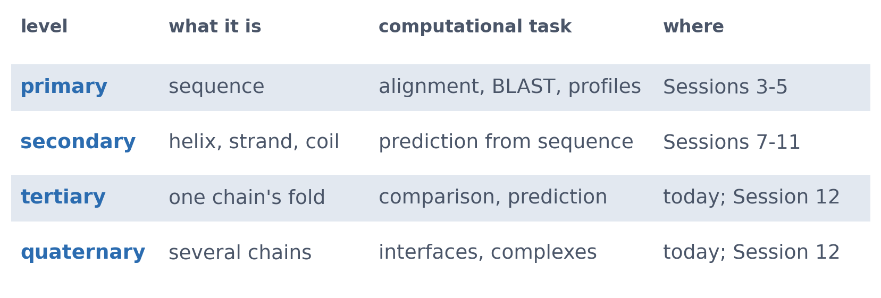
1 · FOUR LEVELS
Each level comes with its own computational task
The course follows the levels in order: sequences (Sessions 3-5), secondary structure (Sessions 7-11), folds and complexes (today and Session 12).
See course.bioinfo.se/session06.html, Table 6.1.

Slide 16
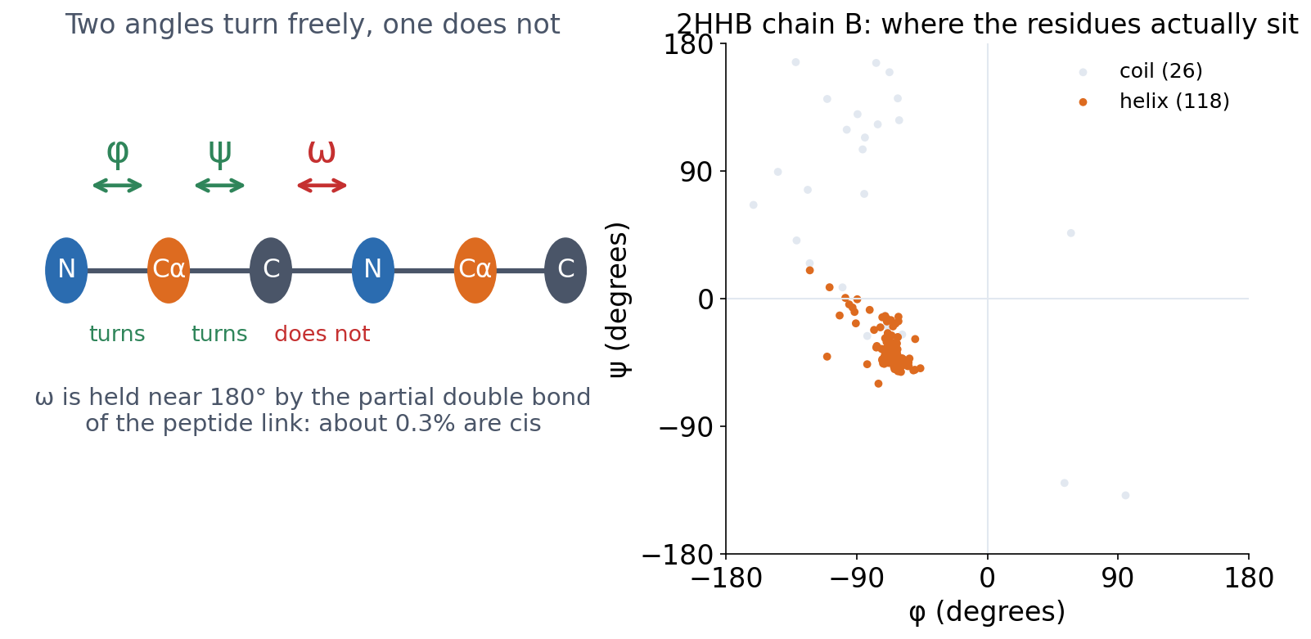
1 · FOUR LEVELS
Flexible means two angles, not three
φ turns about N–Cα, ψ about Cα–C. ω, about the peptide bond itself, barely turns at all. Right: every residue of 2HHB chain B at its measured φ and ψ, coloured by the secondary structure PyMOL assigns it.
Angles read from 2HHB with PyMOL; drawn by tools/builders/make_session06_slide_figures.py.
Notes:
This is what the word flexible actually means, and it is more limited than it sounds. The backbone has three dihedral angles per residue, but only two of them turn. The third, omega, is about the peptide bond, and that bond has partial double-bond character, so it is effectively locked near 180 degrees -- the trans form. About three residues in a thousand are cis instead, and those are worth noticing when you meet them, usually before a proline.
So a conformation is two numbers per residue. That is the whole search space, and it is why a Ramachandran plot is two-dimensional.
The right-hand panel is not a textbook diagram: it is this chain, measured. The helix residues fall in one tight cluster, which is what a helix is -- the same pair of angles, repeated. The coil residues scatter. There are no strands at all, which agrees with the 80.8 per cent helix and zero per cent strand we get from dss later in the lecture.

Slide 17
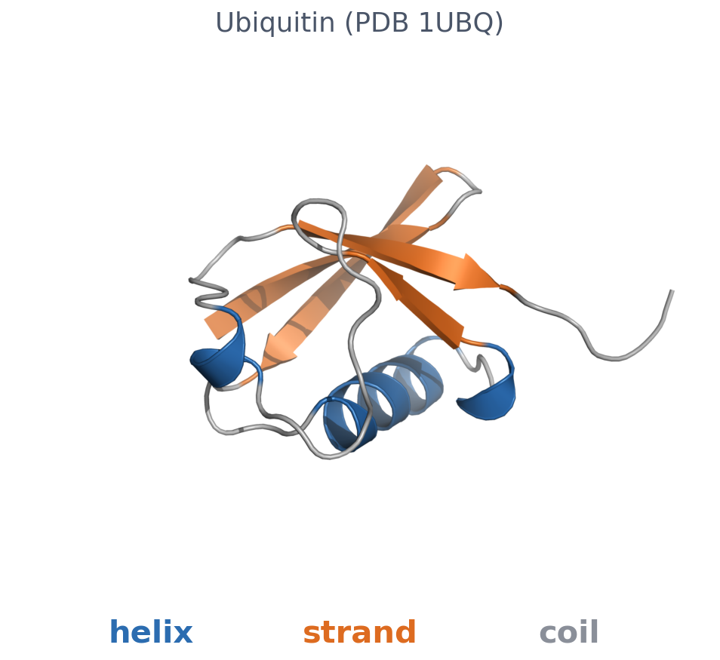
1 · FOUR LEVELS
Helix, strand, coil
▪ Helix: H-bonds between residues i and i+4
▪ Strand: H-bonded edge to edge in a sheet
▪ Coil: everything else
▪ DSSP assigns them from coordinates
Ubiquitin (PDB 1UBQ), rendered with PyMOL.
Notes:
The hydrogen bonds are between backbone N-H and C=O groups. Ubiquitin is shown because it has all three classes; haemoglobin has no strands. Programs such as DSSP (and PyMOL's dss) assign the labels from a solved structure.

Slide 18
1 · FOUR LEVELS
Helix, strand, coil
▪ Helix: H-bonds between residues i and i+4
▪ Strand: H-bonded edge to edge in a sheet
▪ Coil: everything else
▪ DSSP assigns them from coordinates
Ubiquitin (PDB 1UBQ), rendered with PyMOL.
Notes:
The hydrogen bonds are between backbone N-H and C=O groups. Ubiquitin is shown because it has all three classes; haemoglobin has no strands. Programs such as DSSP (and PyMOL's dss) assign the labels from a solved structure.

Slide 19
1 · FOUR LEVELS
Helix, strand, coil
▪ Helix: H-bonds between residues i and i+4
▪ Strand: H-bonded edge to edge in a sheet
▪ Coil: everything else
▪ DSSP assigns them from coordinates
Ubiquitin (PDB 1UBQ), rendered with PyMOL.
Notes:
The hydrogen bonds are between backbone N-H and C=O groups. Ubiquitin is shown because it has all three classes; haemoglobin has no strands. Programs such as DSSP (and PyMOL's dss) assign the labels from a solved structure.

Slide 20
1 · FOUR LEVELS
Helix, strand, coil
▪ Helix: H-bonds between residues i and i+4
▪ Strand: H-bonded edge to edge in a sheet
▪ Coil: everything else
▪ DSSP assigns them from coordinates
Ubiquitin (PDB 1UBQ), rendered with PyMOL.
Notes:
The hydrogen bonds are between backbone N-H and C=O groups. Ubiquitin is shown because it has all three classes; haemoglobin has no strands. Programs such as DSSP (and PyMOL's dss) assign the labels from a solved structure.

Slide 21
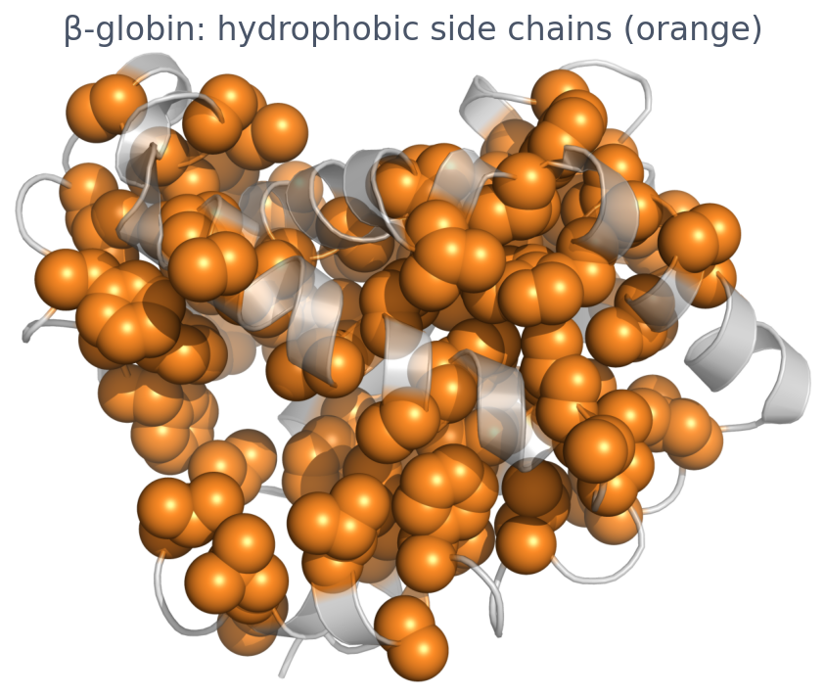
1 · FOUR LEVELS
The fold hides its hydrophobic side chains
▪ Hydrophobic effect: non-polar side chains away from water
▪ Plus H-bonds, electrostatics, van der Waals
▪ Many proteins work in complexes
β-globin (2HHB chain B); Ala, Val, Ile, Leu, Met, Phe, Trp, Cys as spheres.
Notes:
The fold is held together mainly by the hydrophobic effect. Many proteins work as a single chain; others assemble into complexes of two to hundreds of chains.

Slide 22
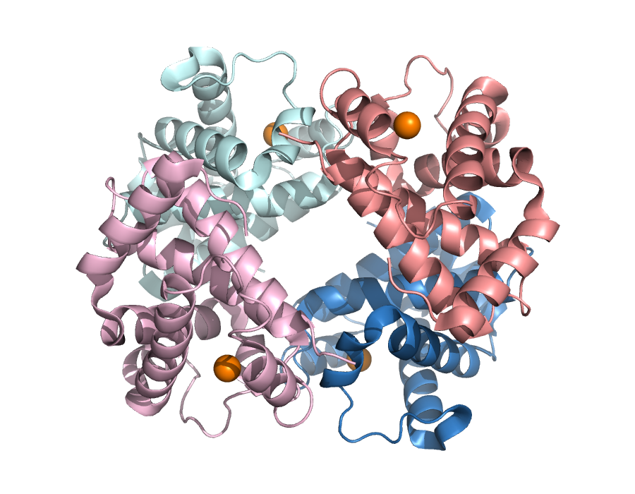
1 · FOUR LEVELS
Haemoglobin: two α and two β chains
▪ α: 141 residues; β (HBB): 146
▪ One haem per chain (orange: iron)
▪ One β chain: 80.8% helix, 0% strand
PDB 2HHB, rendered with PyMOL; numbers from session06-protein-structure-in-code.ipynb.
Notes:
PyMOL's dss: 118 of 146 residues helical. The PDB entry's own annotation, used in Session 7, gives 117, because the two methods differ slightly in where a helix ends. α chains blue/cyan, β chains salmon/pink.

Slide 23
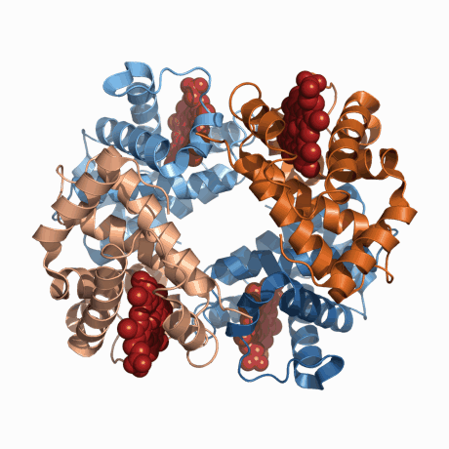
1 · FOUR LEVELS
Haemoglobin, turning
Two α chains (blue) and two β chains (tan), with the four haem groups as red spheres. One revolution, ten degrees a frame.
2HHB, drawn by tools/builders/make_session06_slide_figures.py. Animated in PowerPoint and LibreOffice; the PDF keeps the first frame.
Notes:
Worth letting this run for a few seconds without talking over it. A still of a protein is a projection, and a projection hides the one thing a structure is for: what is near what. Turning it shows the two kinds of chain packing against each other, the central cavity opening and closing as it goes round, and the four haem groups passing in and out of view -- each one buried in its own subunit rather than at the interfaces. Nobody has to open PyMOL to see it.

Slide 24
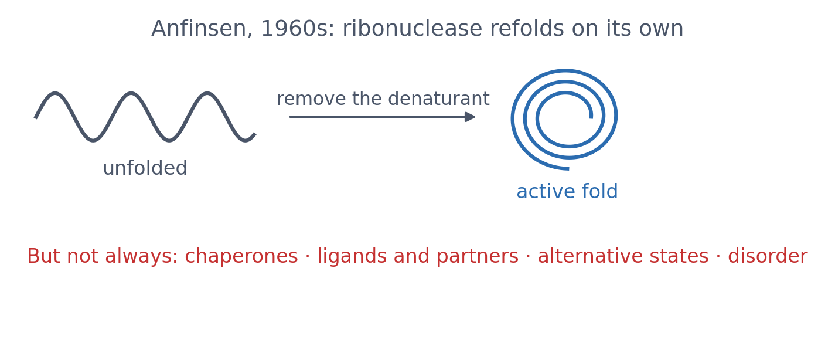
1 · SEQUENCE AND STRUCTURE
Does the sequence determine the structure?
▪ Often yes
▪ That makes prediction possible
▪ Not a law for every protein
See course.bioinfo.se/session06.html, 'Does the sequence determine the structure?'.
Notes:
In the 1960s Anfinsen showed that unfolded ribonuclease refolds into its active shape on its own once the denaturant is removed. For many small globular proteins the sequence specifies the native fold under the right conditions. Exceptions: proteins that need chaperones, ligands, cofactors or partners, proteins that switch states (haemoglobin, Block 3), intrinsically disordered regions.

Slide 25
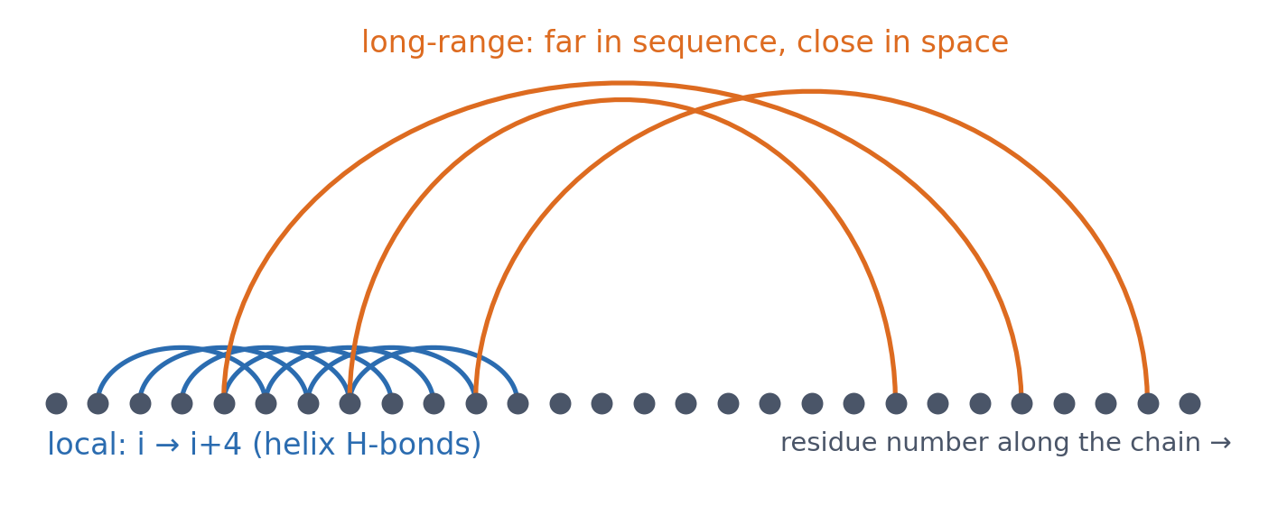
1 · SEQUENCE AND STRUCTURE
Local is easy, long-range is hard
▪ Local: secondary structure
▪ Long-range: the tertiary fold
▪ A window of sequence sees only local
See course.bioinfo.se/session06.html, 'Does the sequence determine the structure?'.
Notes:
Local structure can partly be guessed from a short window of sequence (Session 7). Long-range contacts, between residues far apart in sequence but close in space, cannot, which is why tertiary-structure prediction is so much harder.

Slide 26
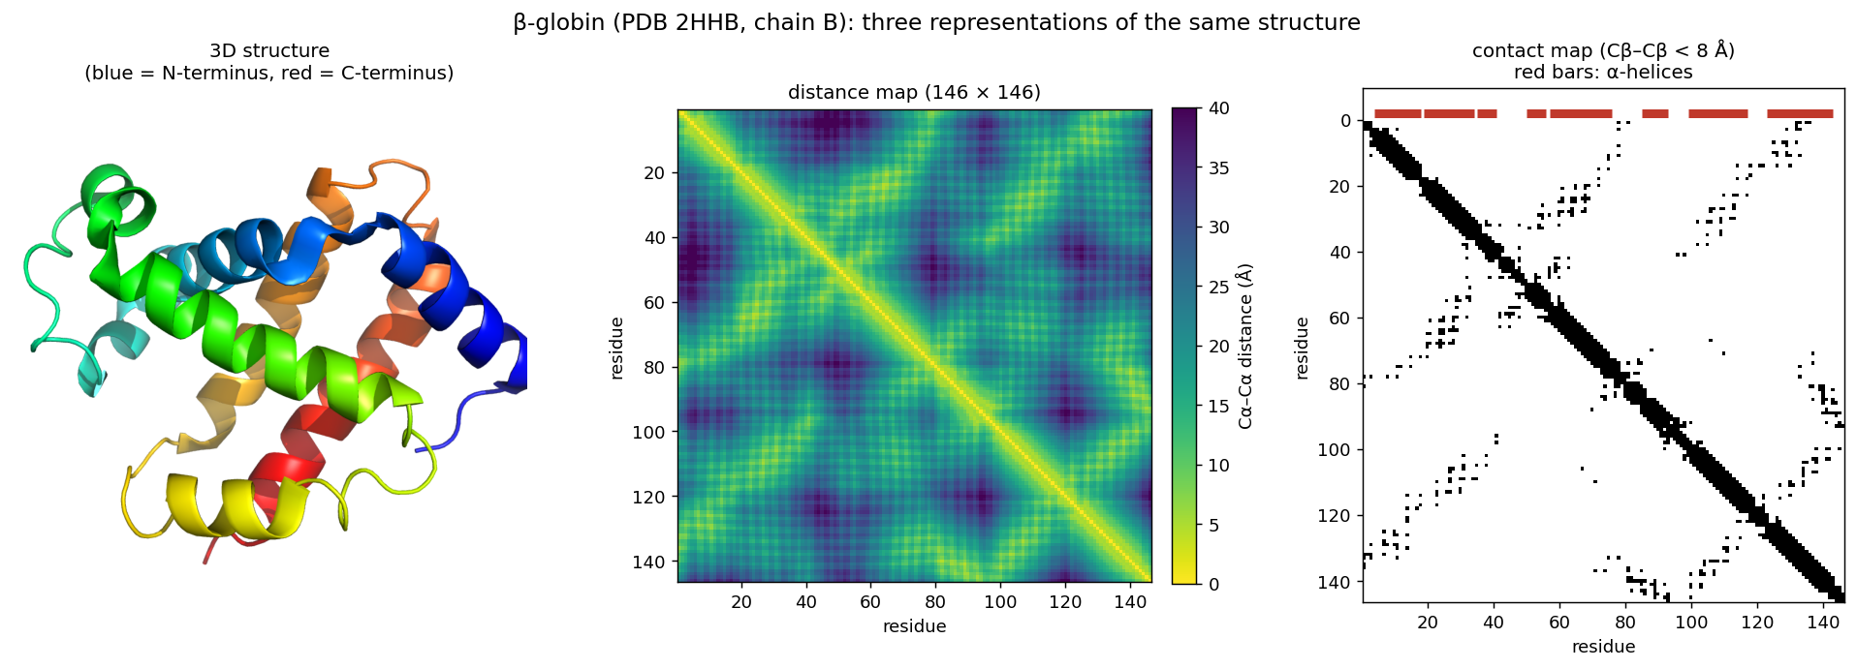
1 · REPRESENTATIONS
A structure as a matrix: distance and contact maps
β-globin as a structure, a distance map and a contact map (Cβ within 8 Å). Diagonal band: each helix touching itself (local). Off-diagonal stripes: helices packed together (long-range). The maps do not change when the protein is rotated.
tools/builders/make_session06_figures.py; notebook.
Notes:
The notebook counts 197 contacts between residues at least 6 apart in sequence. The L × L map returns in Session 10 (it looks like an image, so CNNs can predict it) and Session 12 (coevolution, contact prediction, AlphaFold's pair representation).

Slide 27
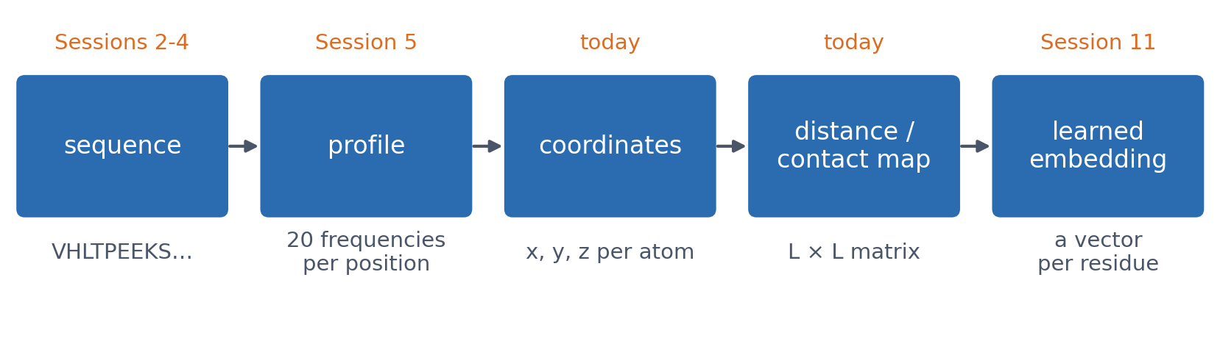
1 · REPRESENTATIONS
One protein, many representations
Each representation makes different patterns easy to see. Later in the course it also decides which patterns a model can easily learn.
See course.bioinfo.se/session06.html, callout 'Representations'.

Slide 28
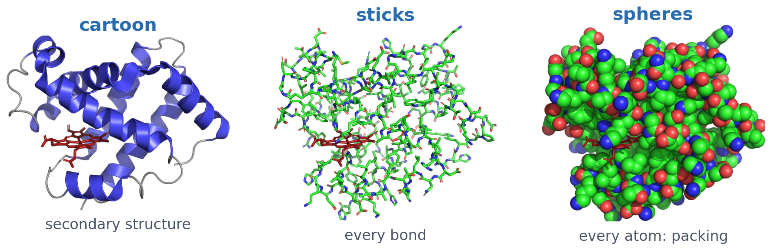
1 · LOOKING AT STRUCTURES
PyMOL: three ways to draw the same chain
Cartoon shows the secondary structure, sticks every bond (for a side chain or a ligand), spheres every atom (for packing). The lab uses PyMOL hands-on; the notebook drives it from Python.
β-globin (2HHB chain B), haem in red.
Notes:
PyMOL and ChimeraX are the two most widely used viewers; open-source PyMOL is free. It also measures distances and angles directly from the coordinates.

Slide 29
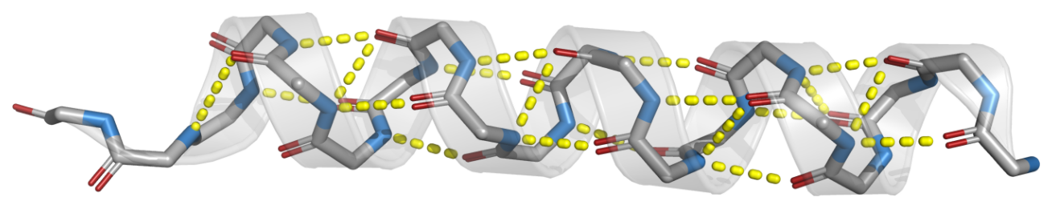
1 · LOOKING AT STRUCTURES
Hydrogen bonds: measured, not drawn
The α-helix is held by N–H···O=C bonds from residue i to residue i+4. PyMOL finds them from the coordinates with a 3.5 Å cutoff; every dash here is a real distance in 2HHB.
2HHB chain B, residues 125–144 (the H helix). Drawn by tools/builders/make_session06_slide_figures.py.
Notes:
This is the picture the structure chapter needs, and it is worth saying how it was made. Nobody placed these bonds. PyMOL applied its polar-contact rules to the deposited coordinates and drew what it found, so if the cutoff is wrong, or the wrong residues were chosen, the fix is one line and a rerun.

Slide 30
1 · LOOKING AT STRUCTURES
The whole figure is eight lines
fetch 2hhb, async=0
create helix, 2hhb and chain B and resi 125-144
show cartoon, helix
show sticks, helix and name N+CA+C+O
# N-H to O=C, i to i+4, within 3.5 Angstrom
dist hb, helix and name N, helix and name O, 3.5, mode=2
set dash_color, yellow
The same commands the figure builder runs; `pymol -cq script.pml` reproduces the picture.
Notes:
Worth labouring the point for a minute, because it is a habit rather than a tool. A figure drawn by hand -- ovals for atoms, extruded cylinders for bonds -- cannot be checked against anything, and correcting it means moving shapes one at a time. A figure made by a script carries its own provenance: the PDB entry, the residues, the cutoff are all visible, and a reviewer can disagree with any of them. Students should produce figures this way from the lab onwards.

Slide 31
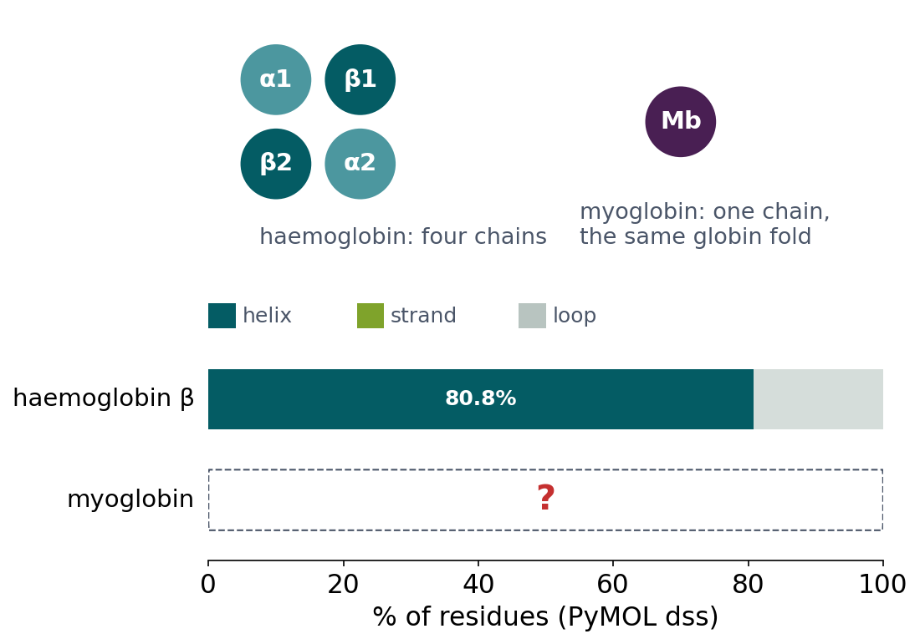
BLOCK 1 · QUIZ
What does dss find for myoglobin?
Haemoglobin β: 80.8% helix, 0% strand, but it works only as four chains. Myoglobin: the same fold, one chain.
A About 80% helix, 0% strand: the same
B About 50% helix: some helices unfold
C About 40% helix, 30% strand
D Hardly any helix or strand: mostly loop
Guess on your own
Scan the code, or go to
quiz.bioinfo.se/live
Notes:
Myoglobin (1MBN, Kendrew 1958) has no quaternary structure. Does working alone change the secondary structure? Let them guess before running anything.

Slide 32
BLOCK 1 · QUIZ
What does dss find for myoglobin?
How did the room answer?
Halt the round when most have answered, then show the results.
Show the results ▸ quiz.bioinfo.se/live/report
Notes:
Halt submission in the Control view, then open the results. Do not say which answer is right.

Slide 33
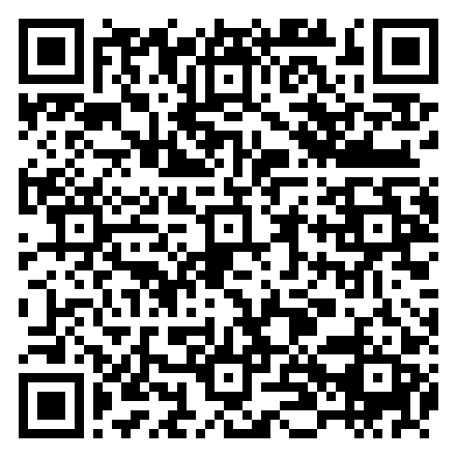
BLOCK 1 · QUIZ
What does dss find for myoglobin?
Fix it, run it, discuss
Open the notebook: scan the code
Fix the line marked FIX, then run the cells
Did it come out as you guessed? Discuss with your neighbour
The notebook: https://colab.research.google.com/github/ElofssonLab/kb8029-book/blob/main/notebooks/session06-discussion-1.ipynb
Notes:
About 8 minutes. The notebook's FIX line compares PyMOL's labels with a lowercase "h"; PyMOL writes "H", so as it is it prints 0.0% helix, 0.0% strand (the fourth answer). Fixed: 79.7% helix, 0.0% strand (122 of 153 residues).

Slide 34
BLOCK 1 · QUIZ
What does dss find for myoglobin?
Answer again
Same question, after the discussion.
quiz.bioinfo.se/live
Notes:
Open the second round (post) in the Control view.

Slide 35
BLOCK 1 · QUIZ
What does dss find for myoglobin?
Results, and who explains
Both rounds side by side.
Draw two to explain: one of you says how you reasoned.
Show the results ▸ quiz.bioinfo.se/live/report
To check it with code afterwards: discussion notebook 1 https://colab.research.google.com/github/ElofssonLab/kb8029-book/blob/main/notebooks/session06-discussion-1.ipynb
Notes:
The first answer: 79.7% helix, 0% strand. Secondary and tertiary structure belong to one folded chain; quaternary structure is a separate level on top. Why four chains, then? Cooperativity: binding in the lungs, release in the tissues (the T to R shift of block 3).

Slide 36
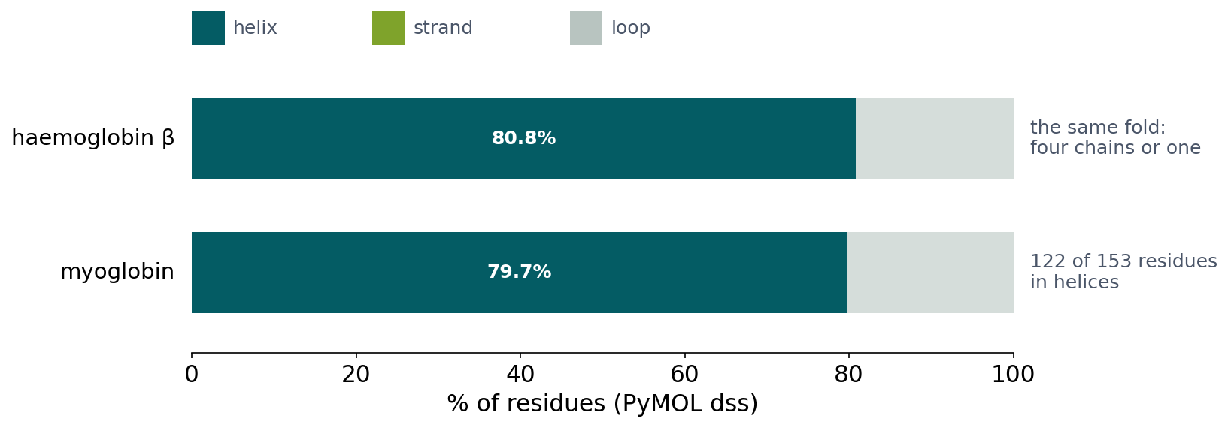
BLOCK 1 · QUIZ
The answer: the same fold, alone or in a tetramer
Myoglobin is 79.7% helix and 0% strand, haemoglobin's β chain 80.8% and 0%. Secondary and tertiary structure are properties of one folded chain; quaternary structure is a separate level on top. Haemoglobin needs four chains for cooperative oxygen binding, not for its fold. And a result of exactly zero is worth a second look.

Slide 37
BLOCK 1 DONE
Break

Slide 38
BLOCK 2 · ABOUT 30 MIN
Comparing proteins in 3D

Slide 39
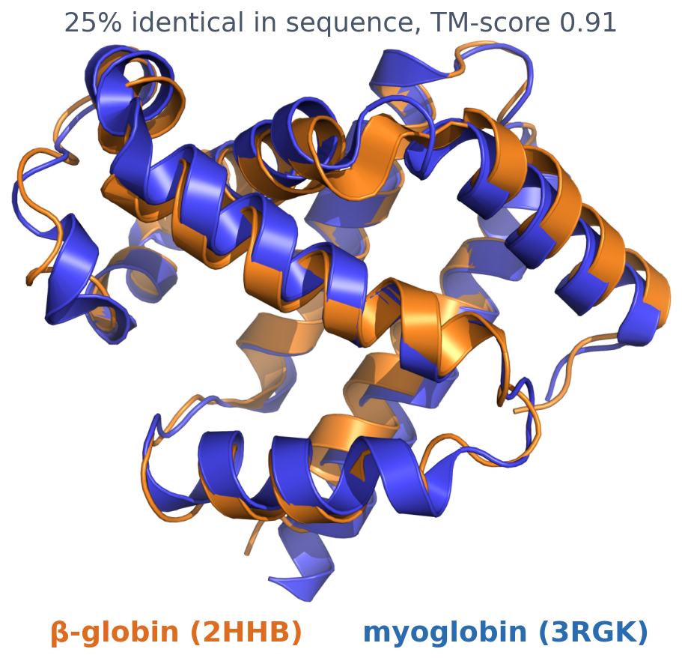
2 · STRUCTURE ALIGNMENT
A structure alignment pairs residues by their place in 3D
▪ Sequence alignment: from substitution scores
▪ Structure alignment: from coordinates
▪ Both are hypotheses about correspondence
Superposition with PyMOL; TM-score from the notebook (TM-align, tmtools).
Notes:
Session 4 defined an alignment as a hypothesis about which residues correspond. A structure alignment decides it by asking which residues occupy the same position in the two folds.

Slide 40
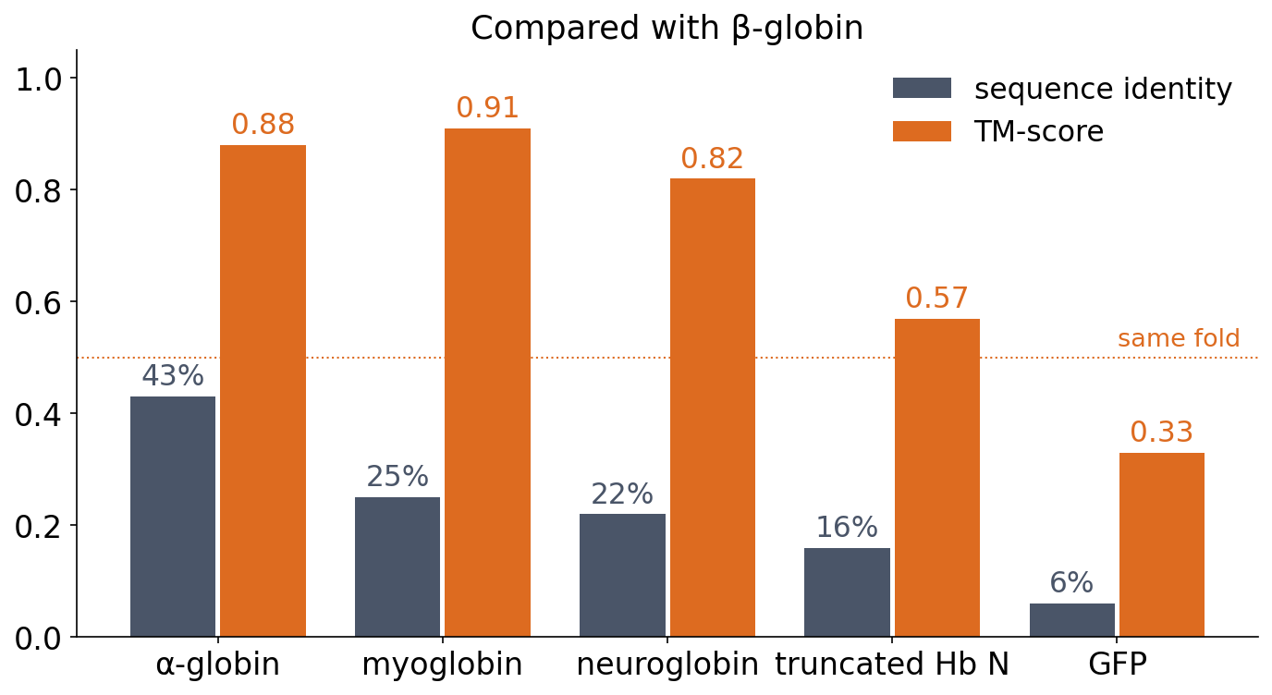
2 · STRUCTURE ALIGNMENT
Sequence identity fades, the fold stays
▪ Five proteins vs β-globin
▪ Identity 43% → 6%
▪ TM-score stays above 0.5 for all globins
Notebook: Smith-Waterman/BLOSUM62 and TM-align (tmtools). TM-scores normalised by the length of β-globin.
Notes:
α-globin 43% / 0.88, myoglobin 25% / 0.91, neuroglobin 22% / 0.82, truncated haemoglobin N (M. tuberculosis) 16% / 0.57, GFP (unrelated fold) 6% / 0.33. Identity is measured over the structurally aligned residues.

Slide 41
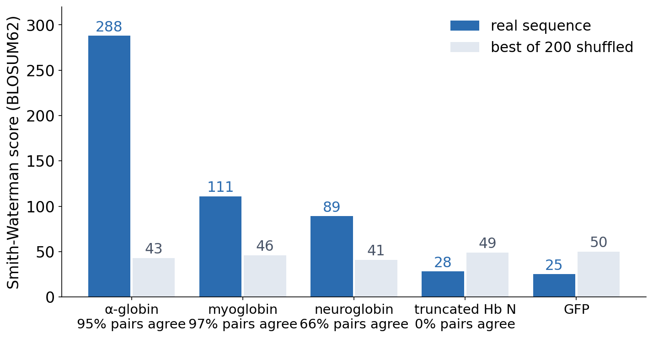
2 · STRUCTURE ALIGNMENT
When sequence signal is gone, structure still finds the relative
▪ Truncated Hb: no better than shuffled
▪ 0% of its pairs right
▪ Structure is more conserved than sequence
Notebook: best Smith-Waterman score against the best of 200 alignments to shuffled sequences.
Notes:
For α-globin and myoglobin the sequence alignment has a strong signal and pairs nearly the same residues as the structure alignment (95%, 97%). For neuroglobin the signal is clear but a third of the pairs are wrong, because the gaps are in the wrong places (66%). For the bacterial truncated haemoglobin the sequence score (28) is below the shuffled maximum (49), yet the structure alignment finds the globin fold over more than 100 residues. Session 5: BLAST with default settings missed myoglobin.

Slide 42
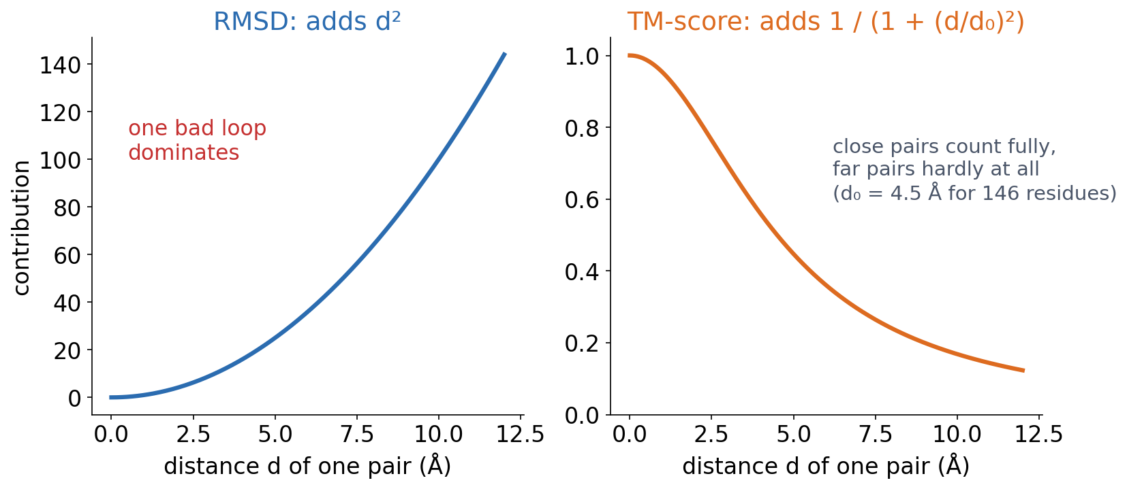
2 · MEASURING SIMILARITY
RMSD and TM-score weight a bad pair differently
RMSD: the root-mean-square distance between corresponding atoms after superposition; it grows with length, one misplaced loop inflates it, and it means little without the number of aligned residues. TM-score: weights each pair by how close it is and normalises by length, from 0 to 1.
See course.bioinfo.se/session06.html, 'Measuring structural similarity: RMSD and TM-score'.
Notes:
d0 = 1.24 (L - 15)^(1/3) - 1.8 is the standard TM-score distance scale; for β-globin's 146 residues it is about 4.5 Å. Notebook RMSDs: α-globin 1.4 Å, myoglobin 1.5, neuroglobin 2.0, truncated Hb 3.2, GFP 5.1.

Slide 43
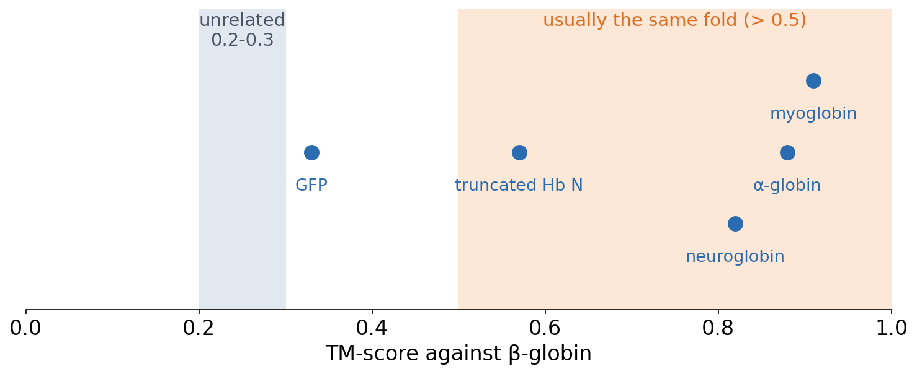
2 · MEASURING SIMILARITY
Reading a TM-score
Unrelated proteins typically score 0.2-0.3; above about 0.5 usually means the same fold. A rule of thumb, not a law: scores in between need other evidence.
TM-scores from the notebook.

Slide 44
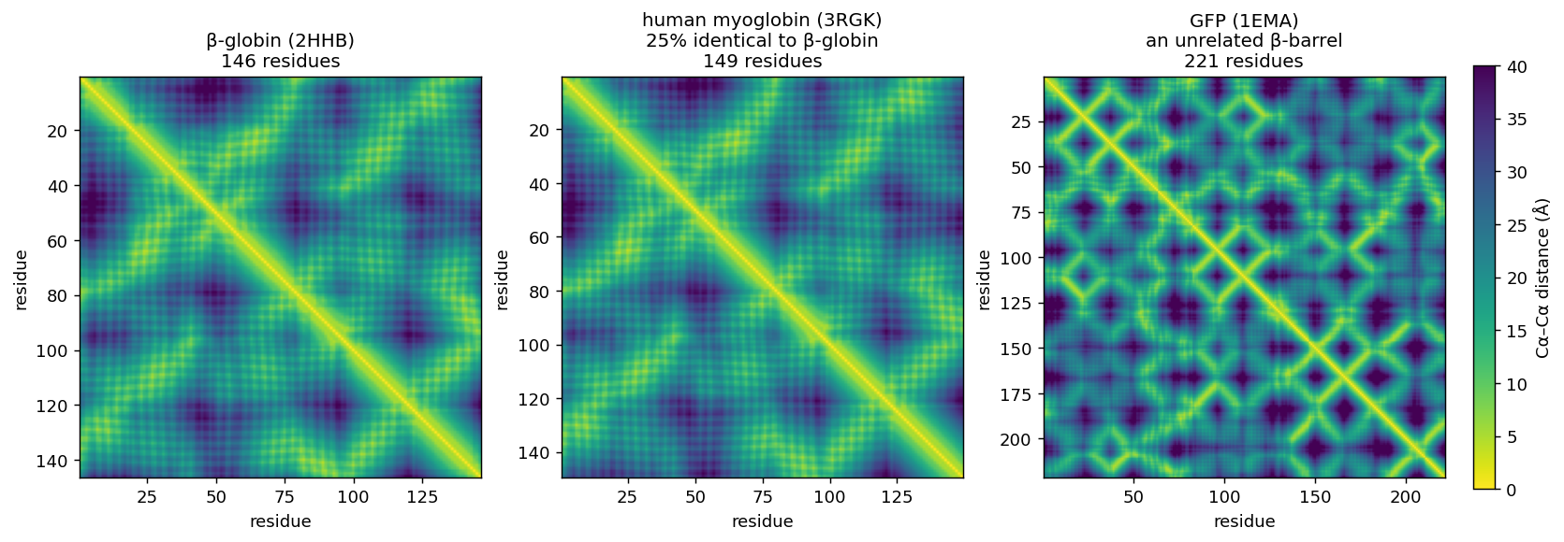
2 · DALI
DALI: comparing patterns of internal distances
β-globin and myoglobin (25% identical) give almost the same distance map; GFP's β-barrel does not. Sequence alignment compares residues; DALI compares residue-residue geometry.
Holm & Sander (1993). Figure: tools/builders/make_session06_figures.py.
Notes:
DALI and TM-align (Zhang & Skolnick, 2005) are accurate and still used for careful pairwise comparisons, but far too slow to search hundreds of millions of structures.

Slide 45
2 · FOLDSEEK
Searching by sequence, searching by structure
Sequence (Session 5)
Structure (today)
BLAST, MMseqs2
Foldseek
▪ Search with the amino-acid sequence
▪ Billions of sequences
▪ Search with a 'structural sequence'
▪ Hundreds of millions of structures in minutes
van Kempen, Steinegger et al. (2024), Nature Biotechnology 42:243-246.
Notes:
Foldseek comes from the same group as MMseqs2 and is tens of thousands of times faster than TM-align at comparable sensitivity.

Slide 46
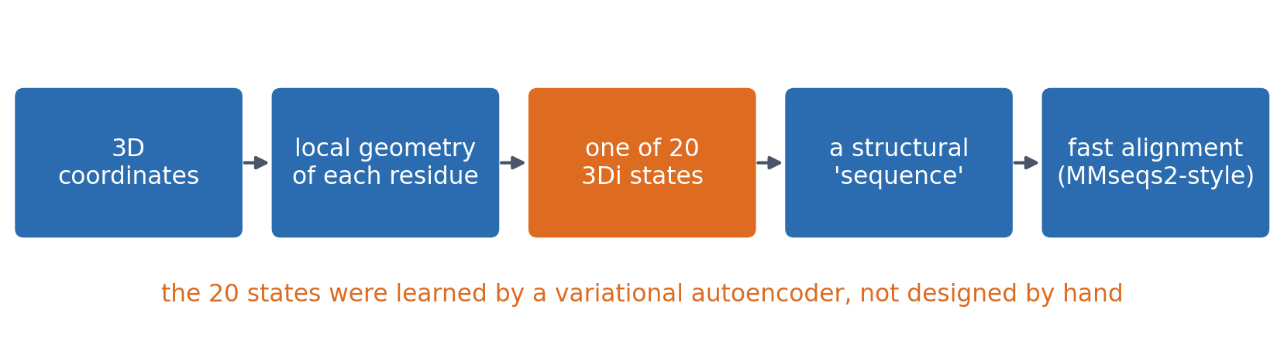
2 · FOLDSEEK
Foldseek turns a structure into a string
Each residue's local 3D environment becomes one of 20 '3Di' letters. The structure is then searched with fast sequence-alignment machinery instead of expensive superposition.
See course.bioinfo.se/session06.html, 'Foldseek' and the callout 'Machine-learning preview'.
Notes:
Machine-learning preview: nobody designed the 20 states by hand. A variational autoencoder, trained on pairs of structurally aligned residues, found recurring 3D environments that are conserved between related structures. In Session 5 humans chose the representation (amino acids) and the scoring (BLOSUM62); in Foldseek, machine learning helped choose the representation. Sessions 7-12 build that machinery.

Slide 47
2 · FOLDSEEK
A worked comparison with Foldseek
▪ Same protein, two states: T (2HHB) vs R (1HHO)
▪ α vs β globin (43% identical): TM 0.90-0.91
▪ 2HHB vs GFP: no hits, even with a loose threshold
0.98
TM-score
T vs R
0.7 Å
RMSD
T vs R
Foldseek run locally on 2HHB, 1HHO and 1EMA (course.bioinfo.se/session06.html).
Notes:
Matching α to α or β to β chains between the two states gives TM 0.98 and RMSD 0.7 Å, about as similar as two independently solved structures get. α against β globin: RMSD 1.7-1.8 Å.

Slide 48
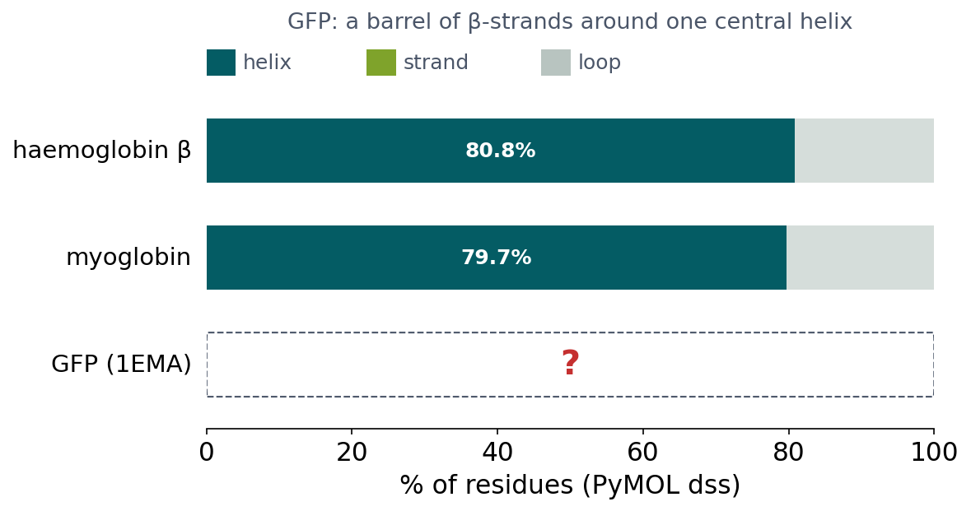
BLOCK 2 · QUIZ
What does dss find for GFP?
The globins: about 80% helix, 0% strand. GFP (1EMA): a barrel of β-strands around one central helix.
A About 80% helix, 0% strand, like the globins
B About 50% helix, 50% strand
C About 10% helix, 54% strand
D About 0% helix, 100% strand
Guess on your own
Scan the code, or go to
quiz.bioinfo.se/live
Notes:
After two globins, it is tempting to think most proteins are mostly helix. The figure gives a hint: a barrel of strands, one helix.

Slide 49
BLOCK 2 · QUIZ
What does dss find for GFP?
How did the room answer?
Halt the round when most have answered, then show the results.
Show the results ▸ quiz.bioinfo.se/live/report
Notes:
Halt submission in the Control view, then open the results. Do not say which answer is right.

Slide 50
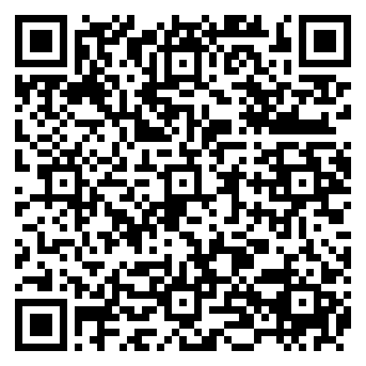
BLOCK 2 · QUIZ
What does dss find for GFP?
Fix it, run it, discuss
Open the notebook: scan the code
Fix the line marked FIX, then run the cells
Did it come out as you guessed? Discuss with your neighbour
The notebook: https://colab.research.google.com/github/ElofssonLab/kb8029-book/blob/main/notebooks/session06-discussion-2.ipynb
Notes:
About 8 minutes. The GFP part of the cell was copied from the myoglobin part, and the FIX line still reads the labels of "mb": as it is, GFP gets myoglobin's 79.7% helix, 0% strand (the first answer). Fixed ("gfp and polymer and name CA"): 9.8% helix, 53.8% strand.

Slide 51
BLOCK 2 · QUIZ
What does dss find for GFP?
Answer again
Same question, after the discussion.
quiz.bioinfo.se/live
Notes:
Open the second round (post) in the Control view.

Slide 52
BLOCK 2 · QUIZ
What does dss find for GFP?
Results, and who explains
Both rounds side by side.
Draw two to explain: one of you says how you reasoned.
Show the results ▸ quiz.bioinfo.se/live/report
To check it with code afterwards: discussion notebook 2 https://colab.research.google.com/github/ElofssonLab/kb8029-book/blob/main/notebooks/session06-discussion-2.ipynb
Notes:
The third answer: 9.8% helix, 53.8% strand (22 and 121 of 225 residues), almost the mirror image of the globins. No fixed rule such as 'assume mostly helix' works: Session 7's methods have to learn from data.

Slide 53
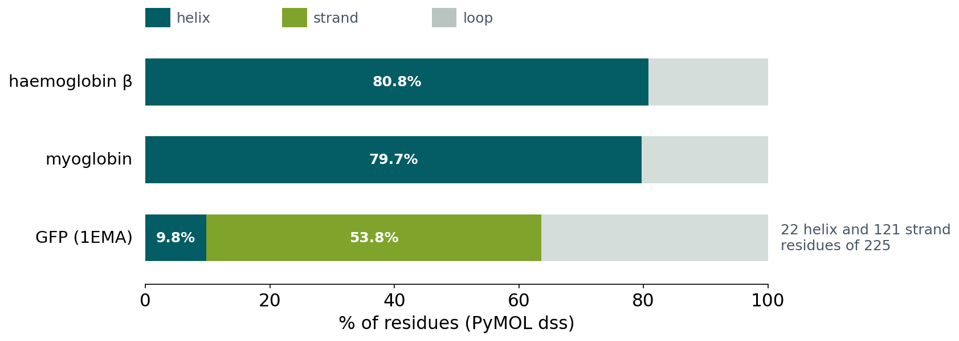
BLOCK 2 · QUIZ
The answer: GFP is mostly strand
GFP is 9.8% helix and 53.8% strand, almost the mirror image of the globins. The globins are an all-α family, not a typical protein, so secondary-structure prediction cannot rely on one fixed rule: it has to learn position-specific patterns (Session 7). A copied block of code that still names the old object is a common mistake; a function called twice avoids it.

Slide 54
BLOCK 2 DONE
Break

Slide 55
BLOCK 3 · ABOUT 30 MIN
Domains, states, and structure as a prediction target

Slide 56
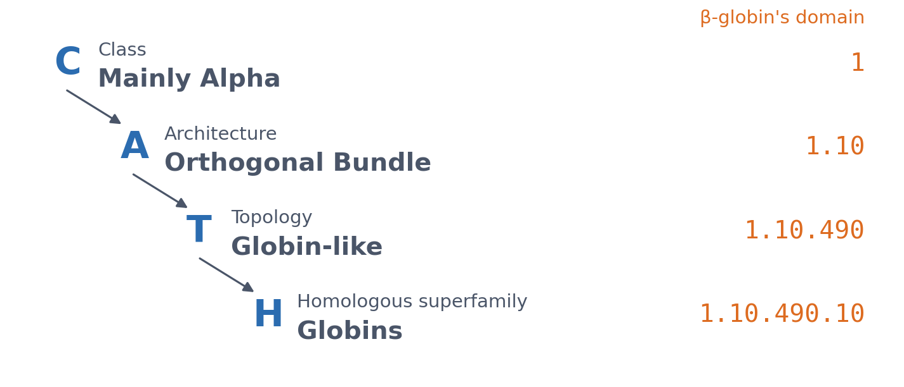
3 · DOMAINS
CATH classifies domains in four levels
▪ Domain: a compact, reusable unit
▪ Grouped by 3D shape
▪ Myoglobin, neuroglobin, truncated Hb: same code
Orengo et al. (1997); live PDBe CATH lookups. GFP: class 2 (Mainly Beta), Beta Barrel.
Notes:
A domain often folds on its own and is reused in many proteins. Sessions 3 and 5 met domains from the sequence side (Pfam profile HMMs); structural classifications group them by shape, which can reveal relationships that sequence misses.

Slide 57
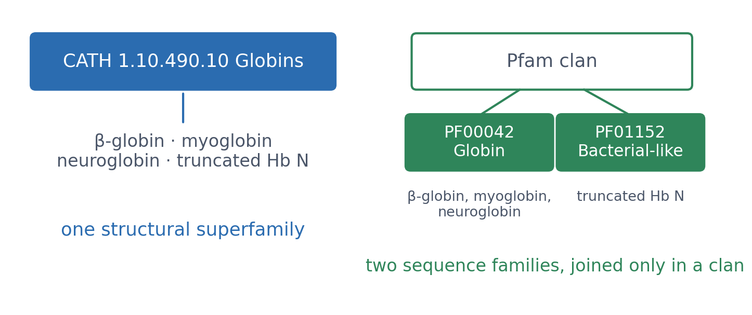
3 · DOMAINS
Structure sees one superfamily, sequence sees two families
CATH puts the truncated haemoglobin in the same superfamily as β-globin. Pfam, working from sequence, needs a separate family (PF01152, 'Bacterial-like globin') and joins it to PF00042 'Globin' only in a clan.
Live PDBe CATH and InterPro lookups (course.bioinfo.se/session06.html).

Slide 58
3 · DOMAINS
Other classifications, other philosophies
SCOP
ECOD
TED
1995
2014
2024
▪ Expert manual curation
▪ Organised by evolutionary relationship
▪ Parsed automatically from the whole AlphaFold Database
Murzin et al. (1995); Cheng et al. (2014); Lau, Bordin et al. (2024).
Notes:
They do not always agree on where one domain ends or how distant superfamilies group together. Knowing that several classifications exist, and why, matters more than picking one.

Slide 59
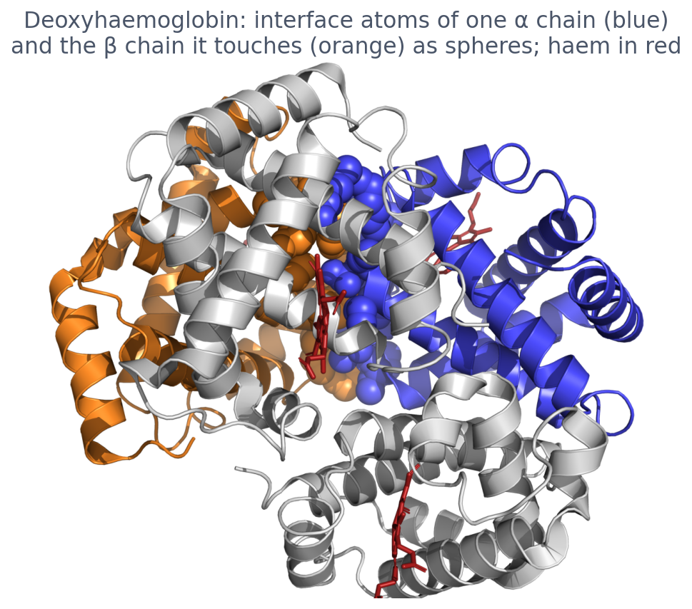
3 · COMPLEXES
Interfaces and ligands: where function happens
▪ Interface: where two chains touch
▪ More hydrophobic, more conserved
▪ Ligands: haem, ions, small molecules
▪ Predicting them: Session 12
Deoxyhaemoglobin (2HHB): atoms within 5 Å of the other chain as spheres, rendered with PyMOL.

Slide 60
3 · COMPLEXES
Interfaces and ligands: where function happens
▪ Interface: where two chains touch
▪ More hydrophobic, more conserved
▪ Ligands: haem, ions, small molecules
▪ Predicting them: Session 12
Deoxyhaemoglobin (2HHB): atoms within 5 Å of the other chain as spheres, rendered with PyMOL.

Slide 61
3 · COMPLEXES
Interfaces and ligands: where function happens
▪ Interface: where two chains touch
▪ More hydrophobic, more conserved
▪ Ligands: haem, ions, small molecules
▪ Predicting them: Session 12
Deoxyhaemoglobin (2HHB): atoms within 5 Å of the other chain as spheres, rendered with PyMOL.

Slide 62
3 · COMPLEXES
Interfaces and ligands: where function happens
▪ Interface: where two chains touch
▪ More hydrophobic, more conserved
▪ Ligands: haem, ions, small molecules
▪ Predicting them: Session 12
Deoxyhaemoglobin (2HHB): atoms within 5 Å of the other chain as spheres, rendered with PyMOL.

Slide 63
3 · COMPLEXES
Docking: three routes to a complex
Shape and physics
Data
Templates
1992
2003
2012
▪ FFT scores every relative translation at once
▪ GRAMM, ZDOCK
▪ HADDOCK: mutations and NMR mark the interface
▪ Build on a related complex of known structure
Katchalski-Katzir et al. (1992); Vakser (1995); Chen, Li & Weng (2003); Dominguez, Boelens & Bonvin (2003); Kundrotas, Zhu, Janin & Vakser (2012).
Notes:
The same three routes as single-chain prediction: physics, data, templates. Katchalski-Katzir put both proteins on a grid and scored shape complementarity for every translation at once with the fast Fourier transform, sampling rotations exhaustively; that became the standard engine. GRAMM used low-resolution grids that tolerate errors in the structures; ZDOCK added electrostatics and desolvation. All of them produce thousands of candidate poses, so the hard part is not generating an answer but ranking the ones you have. Petras Kundrotas, who teaches on this course, is the first author of the templates paper.

Slide 64
3 · COMPLEXES
Judging a complex: each chain right, the pair wrong
▪ Ligand RMSD: superimpose the receptor, measure the other chain
▪ Interface RMSD: only over the residues in contact
▪ Or count contacts: what fraction of the real ones are reproduced
▪ DockQ combines them into one number, 0 to 1
Basu & Wallner (2016), PLoS One 11:e0161879.
Notes:
A complex needs its own measures because both chains can be modelled well and still be put together wrongly, and a global RMSD over everything would average that away. The convention is to superimpose on the larger chain, the receptor, and measure the error on the smaller one. DockQ is the figure usually quoted, which is why interface confidence in Session 12 is reported against it.

Slide 65
3 · COMPLEXES
CAPRI: straightforward with a template, hard without
▪ CAPRI since 2001: docking's CASP
▪ With a template: 'very good to excellent'
▪ Without one: medium or high quality for only 3 of 11 hard targets
▪ What changed that: Session 12
3 / 11
hard targets modelled
well, CASP13 (2018)
2001
first CAPRI
assessment
Janin et al. (2003); Lensink et al. (2019), Proteins 87:1200.
Notes:
Until 2018 CAPRI's verdict was consistent: with a template, docking worked; without one, it mostly did not. This is the docking counterpart of the single-chain story, and the same thing changed it. Session 12 covers AlphaFold-Multimer and FoldDock.

Slide 66
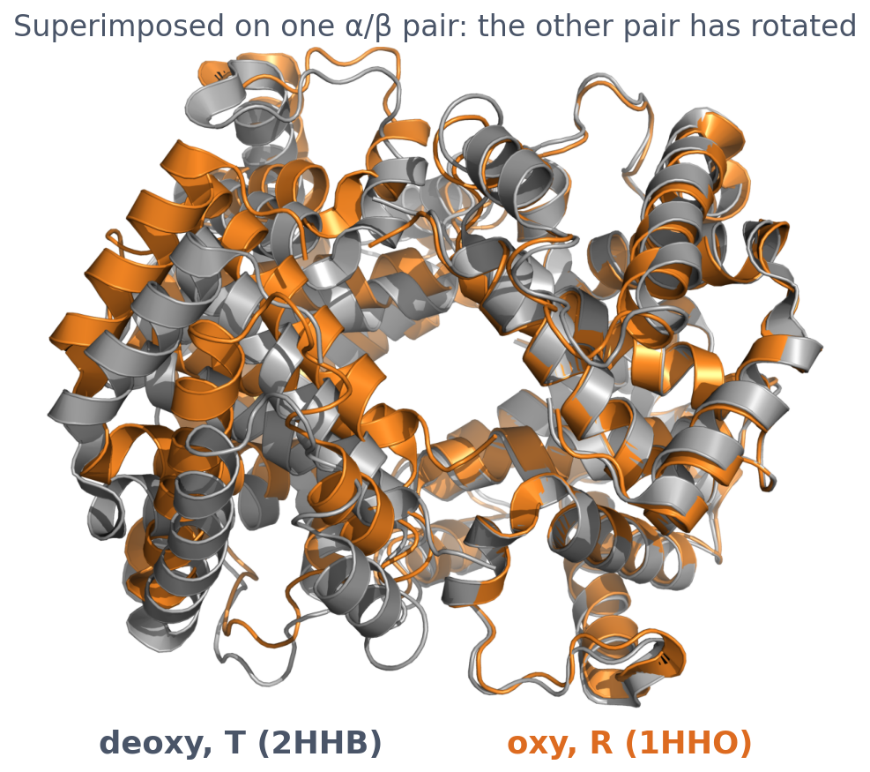
3 · CONFORMATIONAL STATES
One protein, two structures: haemoglobin T and R
▪ Each chain hardly changes (TM 0.98)
▪ The α/β pairs rotate ≈13-15°
▪ β-β Fe-Fe: 39.5 → 34.6 Å
▪ Cooperative oxygen binding
Baldwin & Chothia (1979); notebook (Fe-Fe distances); 1HHO biological assembly.
Notes:
Deoxy (T, tense, 2HHB) and oxy (R, relaxed, 1HHO). The notebook measures the β-β haem iron distance: 39.51 Å in T, 34.62 Å in R, a contraction of 4.89 Å. The quaternary change is how binding at one subunit makes binding at the others easier. The joke from the start: give me some oxygen and I'll relax.

Slide 67
3 · CONFORMATIONAL STATES
One protein, two structures: haemoglobin T and R
▪ Each chain hardly changes (TM 0.98)
▪ The α/β pairs rotate ≈13-15°
▪ β-β Fe-Fe: 39.5 → 34.6 Å
▪ Cooperative oxygen binding
Baldwin & Chothia (1979); notebook (Fe-Fe distances); 1HHO biological assembly.
Notes:
Deoxy (T, tense, 2HHB) and oxy (R, relaxed, 1HHO). The notebook measures the β-β haem iron distance: 39.51 Å in T, 34.62 Å in R, a contraction of 4.89 Å. The quaternary change is how binding at one subunit makes binding at the others easier. The joke from the start: give me some oxygen and I'll relax.

Slide 68
3 · CONFORMATIONAL STATES
One protein, two structures: haemoglobin T and R
▪ Each chain hardly changes (TM 0.98)
▪ The α/β pairs rotate ≈13-15°
▪ β-β Fe-Fe: 39.5 → 34.6 Å
▪ Cooperative oxygen binding
Baldwin & Chothia (1979); notebook (Fe-Fe distances); 1HHO biological assembly.
Notes:
Deoxy (T, tense, 2HHB) and oxy (R, relaxed, 1HHO). The notebook measures the β-β haem iron distance: 39.51 Å in T, 34.62 Å in R, a contraction of 4.89 Å. The quaternary change is how binding at one subunit makes binding at the others easier. The joke from the start: give me some oxygen and I'll relax.

Slide 69
3 · CONFORMATIONAL STATES
One protein, two structures: haemoglobin T and R
▪ Each chain hardly changes (TM 0.98)
▪ The α/β pairs rotate ≈13-15°
▪ β-β Fe-Fe: 39.5 → 34.6 Å
▪ Cooperative oxygen binding
Baldwin & Chothia (1979); notebook (Fe-Fe distances); 1HHO biological assembly.
Notes:
Deoxy (T, tense, 2HHB) and oxy (R, relaxed, 1HHO). The notebook measures the β-β haem iron distance: 39.51 Å in T, 34.62 Å in R, a contraction of 4.89 Å. The quaternary change is how binding at one subunit makes binding at the others easier. The joke from the start: give me some oxygen and I'll relax.

Slide 70
3 · CONFORMATIONAL STATES
A PDB entry is one snapshot, not 'the' structure
▪ States depend on ligands, partners, conditions
▪ Matters whenever a model is compared with 'the' experiment
▪ AlphaFold usually predicts one state (Session 12)
4.9 Å
β-β haem Fe-Fe
contraction, T → R
0.98
TM-score of each
chain, T vs R
Notebook: session06-protein-structure-in-code.ipynb.

Slide 71
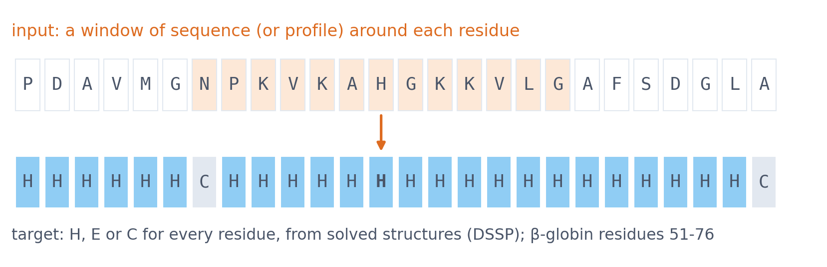
3 · PREDICTION
Secondary structure as a prediction target
Input: the sequence (or its profile), one window per residue. Target: H, E or C for every residue, with labels from solved structures. What could help? The residue itself, its neighbours, and how the position varies among homologs (Session 5).
β-globin residues 51-76 with the PDB entry's secondary structure; window 57-69 around His63 (as in Session 7).
Notes:
Some amino acids favour helices, others strands; proline and glycine break both. Sessions 7-11 build the machinery to learn this mapping; the course returns to it in Sessions 7, 9 and 10 and in the capstone project.

Slide 72
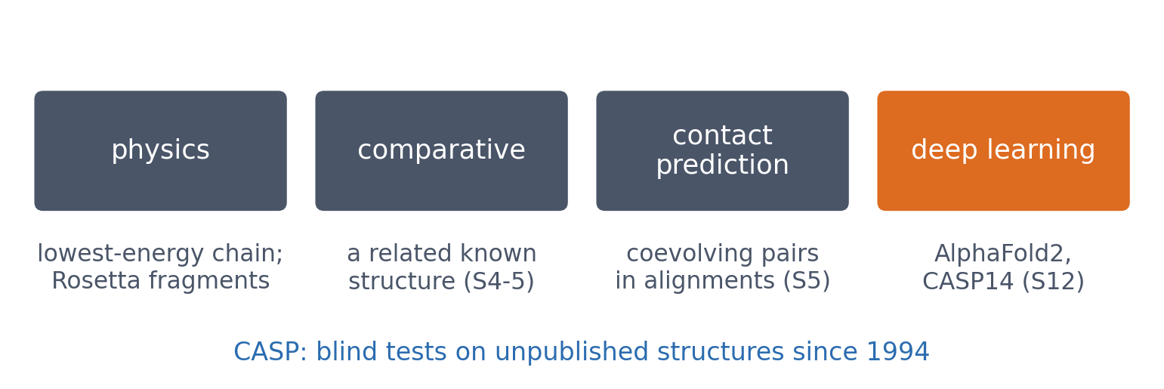
3 · PREDICTION
Four ways to predict a whole fold
Physics is rigorous but expensive; comparative modelling needs a template; coevolution fills in a contact map; deep learning (AlphaFold2, 2020) combined all of it. 2024 Nobel Prize in Chemistry: Baker, Hassabis, Jumper.
See course.bioinfo.se/session06.html, 'Predicting the whole fold'.
Notes:
Rosetta (Baker lab) assembles structures from short fragments of known structures and grew into a tool for protein design. Comparative modelling is reliable when a template exists, useless for a new fold; the alignment table of Block 2 shows why it works.

Slide 73
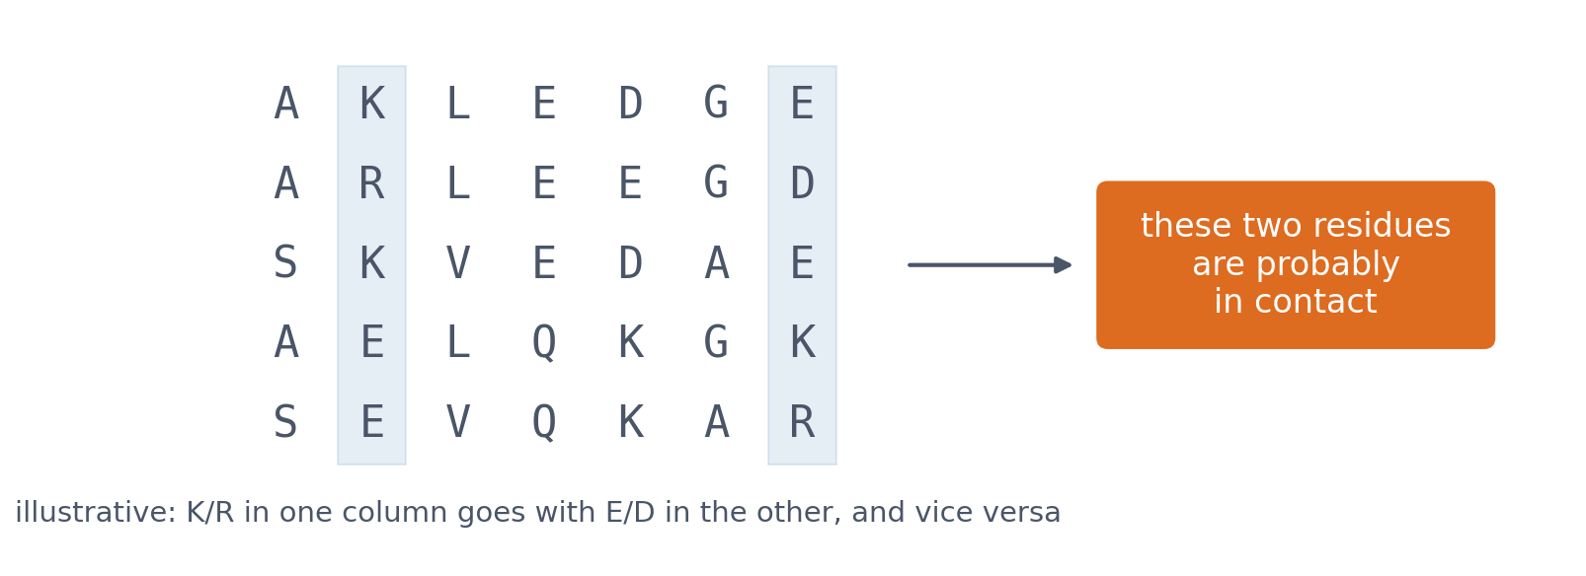
3 · PREDICTION
Residues in contact mutate together
▪ Large alignments reveal coevolving pairs
▪ Coevolving pairs → a contact map
▪ Session 12: AlphaFold
Illustrative alignment, not real sequences. See course.bioinfo.se/session06.html, 'Predicting the whole fold'.
Notes:
If a positive residue at one position faces a negative one at another, a mutation to a negative charge at the first is tolerated only if the second also changes. Seen across thousands of homologs (Session 5), such correlated columns point to residues in contact.

Slide 74
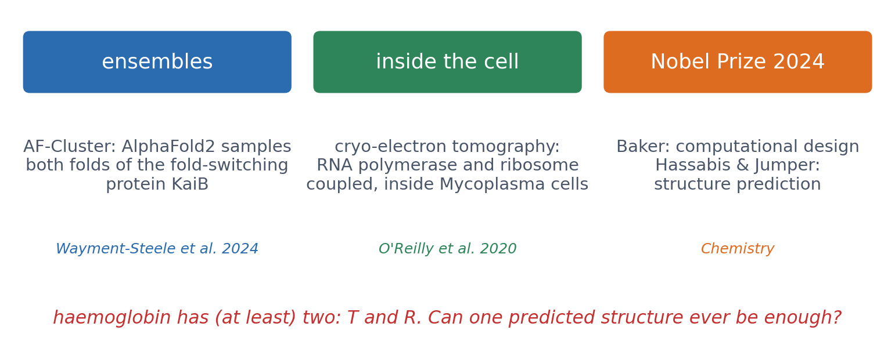
3 · OUTLOOK
One structure becomes many
▪ Proteins move: ensembles, not snapshots
▪ Structures inside cells, by cryo-ET
▪ Nobel Prize in Chemistry 2024
▪ Can one predicted structure ever be enough?
Wayment-Steele et al. (2024), Nature 625:832; O'Reilly et al. (2020), Science 369:554; nobelprize.org (2024).
Notes:
AF-Cluster: clustering the multiple sequence alignment lets AlphaFold2 predict both folds of the fold-switching protein KaiB; NMR confirmed a prediction, and three designed mutations flipped a KaiB variant to the other state. In-cell cryo-electron tomography combined with cross-linking mass spectrometry showed RNA polymerase and the ribosome coupled by NusG and NusA inside Mycoplasma pneumoniae cells. The 2024 Nobel Prize in Chemistry went half to David Baker for computational protein design and half to Demis Hassabis and John Jumper for protein structure prediction. Question: haemoglobin's function is the switch between T and R (this session). What would one predicted structure miss?

Slide 75
3 · OUTLOOK
One structure becomes many
▪ Proteins move: ensembles, not snapshots
▪ Structures inside cells, by cryo-ET
▪ Nobel Prize in Chemistry 2024
▪ Can one predicted structure ever be enough?
Wayment-Steele et al. (2024), Nature 625:832; O'Reilly et al. (2020), Science 369:554; nobelprize.org (2024).
Notes:
AF-Cluster: clustering the multiple sequence alignment lets AlphaFold2 predict both folds of the fold-switching protein KaiB; NMR confirmed a prediction, and three designed mutations flipped a KaiB variant to the other state. In-cell cryo-electron tomography combined with cross-linking mass spectrometry showed RNA polymerase and the ribosome coupled by NusG and NusA inside Mycoplasma pneumoniae cells. The 2024 Nobel Prize in Chemistry went half to David Baker for computational protein design and half to Demis Hassabis and John Jumper for protein structure prediction. Question: haemoglobin's function is the switch between T and R (this session). What would one predicted structure miss?

Slide 76
3 · OUTLOOK
One structure becomes many
▪ Proteins move: ensembles, not snapshots
▪ Structures inside cells, by cryo-ET
▪ Nobel Prize in Chemistry 2024
▪ Can one predicted structure ever be enough?
Wayment-Steele et al. (2024), Nature 625:832; O'Reilly et al. (2020), Science 369:554; nobelprize.org (2024).
Notes:
AF-Cluster: clustering the multiple sequence alignment lets AlphaFold2 predict both folds of the fold-switching protein KaiB; NMR confirmed a prediction, and three designed mutations flipped a KaiB variant to the other state. In-cell cryo-electron tomography combined with cross-linking mass spectrometry showed RNA polymerase and the ribosome coupled by NusG and NusA inside Mycoplasma pneumoniae cells. The 2024 Nobel Prize in Chemistry went half to David Baker for computational protein design and half to Demis Hassabis and John Jumper for protein structure prediction. Question: haemoglobin's function is the switch between T and R (this session). What would one predicted structure miss?

Slide 77
3 · OUTLOOK
One structure becomes many
▪ Proteins move: ensembles, not snapshots
▪ Structures inside cells, by cryo-ET
▪ Nobel Prize in Chemistry 2024
▪ Can one predicted structure ever be enough?
Wayment-Steele et al. (2024), Nature 625:832; O'Reilly et al. (2020), Science 369:554; nobelprize.org (2024).
Notes:
AF-Cluster: clustering the multiple sequence alignment lets AlphaFold2 predict both folds of the fold-switching protein KaiB; NMR confirmed a prediction, and three designed mutations flipped a KaiB variant to the other state. In-cell cryo-electron tomography combined with cross-linking mass spectrometry showed RNA polymerase and the ribosome coupled by NusG and NusA inside Mycoplasma pneumoniae cells. The 2024 Nobel Prize in Chemistry went half to David Baker for computational protein design and half to Demis Hassabis and John Jumper for protein structure prediction. Question: haemoglobin's function is the switch between T and R (this session). What would one predicted structure miss?

Slide 78
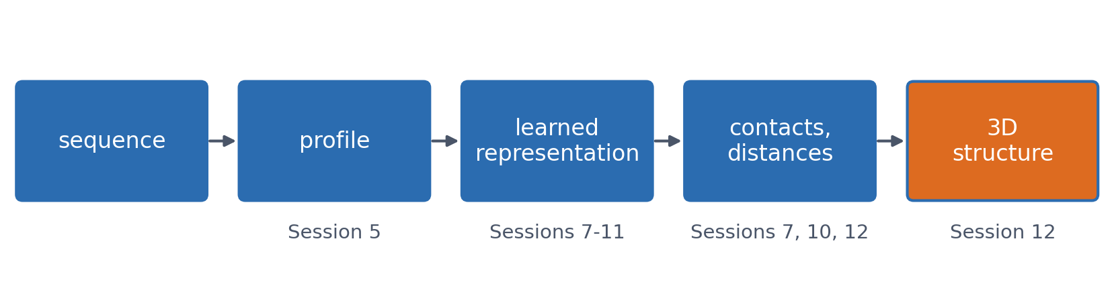
SUMMARY
The course's path from sequence to structure
Today: structures as data, compared by alignment, TM-score, distance maps and Foldseek, and the reminder that one entry is one state. Next: models that learn the steps from sequence to structure.
See course.bioinfo.se/session06.html, 'Predicting the whole fold'.

Slide 79
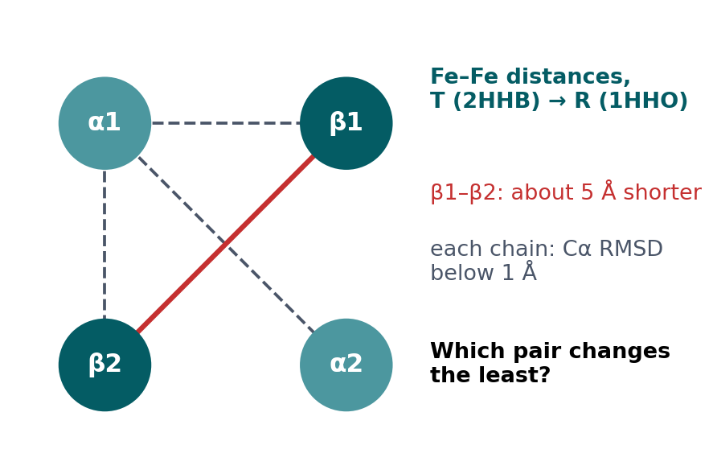
BLOCK 3 · QUIZ
Which iron–iron distance changes the least?
T (2HHB) to R (1HHO): each chain hardly changes shape, but the β1–β2 iron–iron distance shrinks by about 5 Å.
A α1–β1, the "fixed" interface
B α1–β2, the "sliding" interface
C α1–α2
D None: all shrink by about 5 Å
Guess on your own
Scan the code, or go to
quiz.bioinfo.se/live
Notes:
Perutz, and Baldwin and Chothia (1979): α1–β1 is the 'fixed' interface, α1–β2 the 'sliding' one. If the chains do not change shape, how can one distance change by 5 Å?

Slide 80
BLOCK 3 · QUIZ
Which iron–iron distance changes the least?
How did the room answer?
Halt the round when most have answered, then show the results.
Show the results ▸ quiz.bioinfo.se/live/report
Notes:
Halt submission in the Control view, then open the results. Do not say which answer is right.

Slide 81
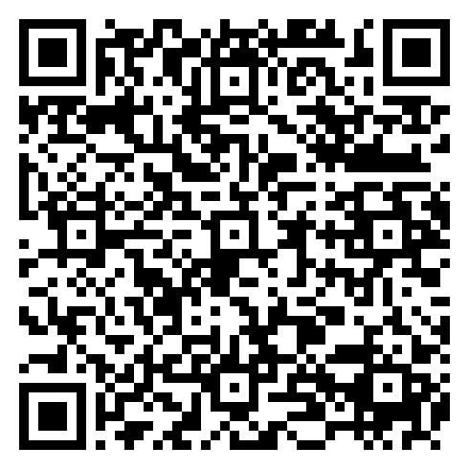
BLOCK 3 · QUIZ
Which iron–iron distance changes the least?
Fix it, run it, discuss
Open the notebook: scan the code
Fix the line marked FIX, then run the cells
Did it come out as you guessed? Discuss with your neighbour
The notebook: https://colab.research.google.com/github/ElofssonLab/kb8029-book/blob/main/notebooks/session06-discussion-3.ipynb
Notes:
About 8 minutes. The R-state file has only chains A and B; the FIX line generates the second α chain from chain B instead of A, so as it is α1–α2 seems to shrink by 8.7 Å and α1–β2 (+1.2 Å) looks like the least change (the second answer). Fixed: α1–β1 −1.8, α1–β2 +1.2, α1–α2 +0.6, β1–β2 −4.9 Å. The second cell superimposes: chains below 1 Å RMSD, the second α/β pair rotated 13°.

Slide 82
BLOCK 3 · QUIZ
Which iron–iron distance changes the least?
Answer again
Same question, after the discussion.
quiz.bioinfo.se/live
Notes:
Open the second round (post) in the Control view.

Slide 83
BLOCK 3 · QUIZ
Which iron–iron distance changes the least?
Results, and who explains
Both rounds side by side.
Draw two to explain: one of you says how you reasoned.
Show the results ▸ quiz.bioinfo.se/live/report
To check it with code afterwards: discussion notebook 3 https://colab.research.google.com/github/ElofssonLab/kb8029-book/blob/main/notebooks/session06-discussion-3.ipynb
Notes:
The third answer: α1–α2 changes by only 0.6 Å. The two α/β pairs rotate about 13° against each other as rigid bodies; a rotation moves atoms by different amounts depending on their distance from the axis. One distance is one projection of the motion of thousands of atoms.

Slide 84
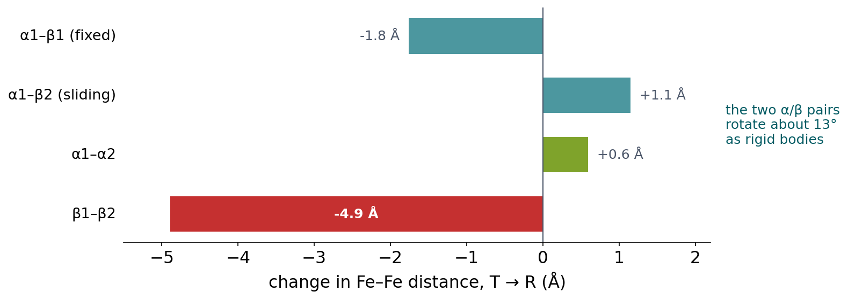
BLOCK 3 · QUIZ
The answer: α1–α2 barely moves; one distance is not the change
From T to R, β1–β2 shrinks by 4.9 Å but α1–α2 changes by only 0.6 Å. The chains hardly change shape: the two α/β pairs rotate about 13° against each other as rigid bodies, and a rotation moves each atom by an amount that depends on its distance from the axis. Describing a conformational change needs the rigid units and their motion, not one distance.

Slide 85
BEFORE YOU LEAVE
In up to three words: what was the hardest part of today?
Answer now
Scan the code, or go to
quiz.bioinfo.se/live
Notes:
A word cloud: the bigger the word, the more students wrote it. It shows what to repeat next time.

Slide 86
BEFORE YOU LEAVE
The hardest part of today
What the room found hardest
Show the results ▸ quiz.bioinfo.se/live/report

Slide 87
Session 7 next
Session 7: the PSSM's weighted sum becomes a perceptron with learned weights
First target: the secondary structure you saw today

