Slide 1

Session 7: Linear Models, Gradient Descent, the XOR Problem & Secondary Structure Prediction
KB8029 — Bioinformatics & Deep Learning
Arne Elofsson

Slide 2


BEFORE WE START
Log in to the lecture quiz
Log in to the quiz
Scan the code, or go to quiz.bioinfo.se/live
Log in with your university account
Answering counts as being at the lecture: up to 3 bonus points on the exam
Right or wrong is never graded, only whether you answered. Results are shown without names.
quiz.bioinfo.se/live
Notes:
The quiz is not anonymous, because answering is how attendance is counted: 3 bonus points on the main exam for answering in all 12 lectures, one point less per missed lecture (preliminary). Whether an answer is right or wrong is never used. The projected results never show names; the only names shown are the two drawn to explain their reasoning. Start the session on quiz.bioinfo.se before the lecture: quiz.bioinfo.se/live then leads to it.

Slide 3
BEFORE WE START
Warm-up: what do you know already?
3 quick questions
On the topics of today, one at a time, about 30 seconds each
Answer on your own, and guess if you do not know
It shows me where to start; right or wrong is never graded
Notes:
About 2 minutes in all. Open each question's round, halt it after about 30 seconds and glance at the results; do not explain the answers now, the lecture does that.

Slide 4
WARM-UP · 1 OF 3
In gradient descent, each step moves the weights ...
A along the gradient: uphill
B against the gradient: downhill
C towards zero
D at random
Answer now
Scan the code, or go to
quiz.bioinfo.se/live
Notes:
Right: against the gradient: downhill. Block 1.

Slide 5
WARM-UP · 2 OF 3
Which logic function is true when exactly one of two inputs is true?
A AND
B OR
C XOR
D NAND
Answer now
Scan the code, or go to
quiz.bioinfo.se/live
Notes:
Right: XOR. Block 2: XOR, which one weighted sum cannot compute.

Slide 6
WARM-UP · 3 OF 3
Which structure is held together by hydrogen bonds from residue i to residue i + 4?
A β-strand
B α-helix
C Coil
D Disulphide bond
Answer now
Scan the code, or go to
quiz.bioinfo.se/live
Notes:
Right: α-helix. Block 3: secondary structure prediction.

Slide 7
BEFORE WE START
What the room knows already
Where we start
Which topics most of you know, and which we take slowly today.
Show the results ▸ quiz.bioinfo.se/live/report
Notes:
Optional: show two or three of the results, the ones that most got wrong.

Slide 8
BEFORE WE START
Your questions before today
What you asked
The questions you sent in on Canvas before the lecture
The most common ones now; the others in the block where they belong
Notes:
About 5 minutes. Read the answers to this session's Canvas survey 'Questions before the lecture' the evening before (it closes at 18:00 the day before the lecture), pick the two or three most common questions, and answer them briefly now or say in which block they come.

Slide 9
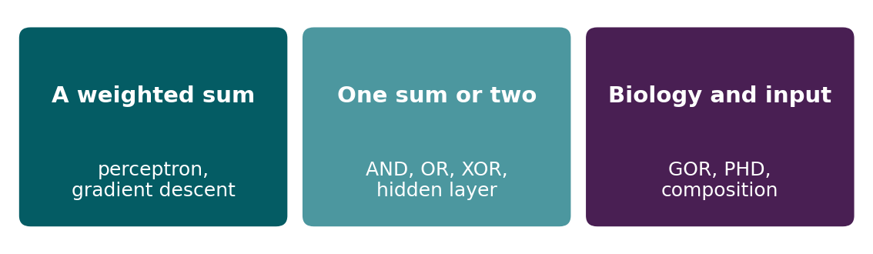
BEFORE WE START
In up to three words: what do you want to learn today?
Answer now
Scan the code, or go to
quiz.bioinfo.se/live
Notes:
A word cloud: the bigger the word, the more students wrote it. Come back to it at the end of the lecture.

Slide 10
BEFORE WE START
What you want to learn today
What the room wants to learn
Show the results ▸ quiz.bioinfo.se/live/report

Slide 11
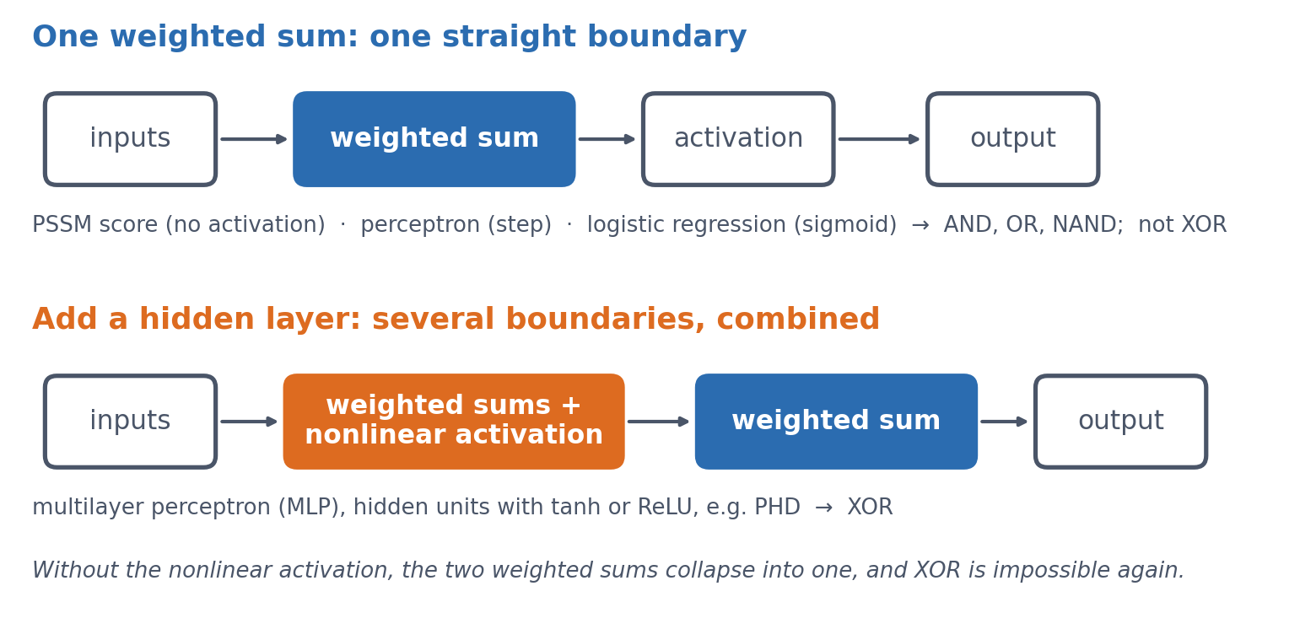
SESSION 7 · THE MAP
Two pictures behind every name today
PSSM, perceptron, linear and logistic regression, sigmoid, tanh, hidden layer, MLP, PHD: each is one of these two pictures.
See course.bioinfo.se/session07.html, 'Two pictures to keep in mind'.
Notes:
Keep this slide short and come back to it at the end. The goal of the session: understand what changed between the two pictures and why that allows XOR. Students do not need to be able to write the PyTorch training loop from memory.

Slide 12
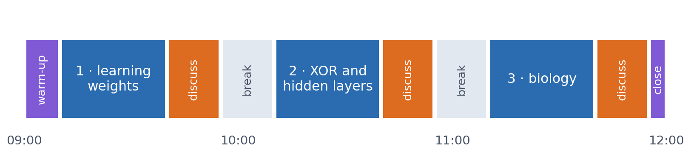
SESSION 7 · THE MORNING
Three blocks: about 30 min talk and 15 min discussion
Block 1: a weighted sum, and how to learn its weights. Block 2: what one weighted sum can and cannot do (XOR), and the hidden layer. Block 3: secondary structure, and why the input matters as much as the model.
Times are approximate: a 10 min start (warm-up quiz and your questions), two 15 min breaks and a 5 min close. Each block ends with a quiz question: guess, run the notebook and work out why it behaves as it does, discuss, answer again.

Slide 13
BLOCK 1 · ABOUT 30 MIN
A weighted sum, learned from examples

Slide 14
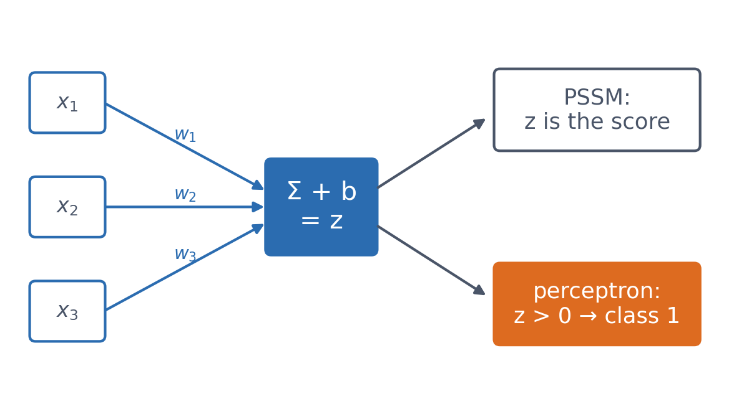
1 · WEIGHTED SUM
You already know the core of a neural network
▪ z = w₁x₁ + … + wₙxₙ + b
▪ The profile score of Session 5
▪ Bias b: moves the threshold
See course.bioinfo.se/session07.html, 'A profile score and a perceptron: the same weighted sum'.
Notes:
A PSSM multiplies each position's value by a position-specific weight and adds them up: a dot product (Session 1). A perceptron computes exactly the same sum and then applies an activation, originally a threshold: output 1 if z > 0, else 0. The bias b shifts the threshold away from zero.

Slide 15
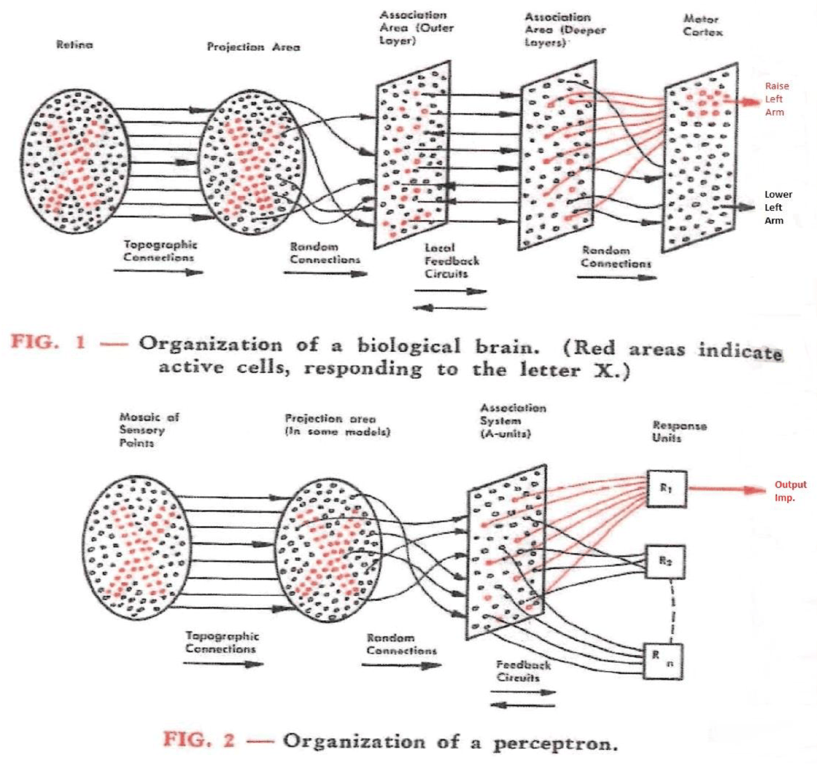
1 · WEIGHTED SUM
Rosenblatt 1958: a perceptron modelled on a neuron
Rosenblatt's own diagram: a brain circuit (top) and the perceptron built to mirror it (bottom). Weights = connection strengths; the cell fires when the weighted sum crosses a threshold.
Rosenblatt (1958), Research Reviews, Office of Naval Research; public domain, via Wikimedia Commons.
Notes:
First simulated on an IBM 704 in 1958; the Mark I Perceptron machine followed in 1960. The brain analogy is loose, and the course only uses the mathematics.

Slide 16
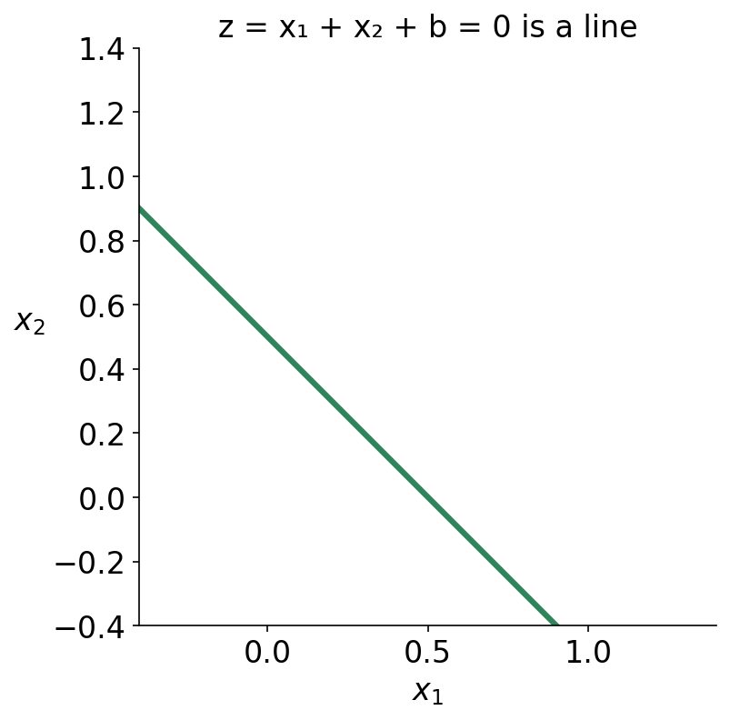
1 · WEIGHTED SUM
z = 0 is a line: the decision boundary
▪ z = w₁x₁ + w₂x₂ + b
▪ Set it to zero and you have a line
See course.bioinfo.se/session07.html, 'A profile score and a perceptron: the same weighted sum'.

Slide 17
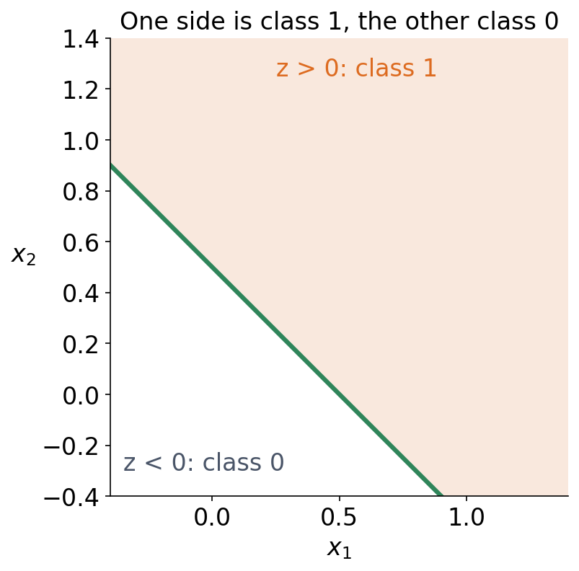
1 · WEIGHTED SUM
z = 0 is a line: the decision boundary
▪ One side: class 1. Other side: class 0
See course.bioinfo.se/session07.html, 'A profile score and a perceptron: the same weighted sum'.

Slide 18
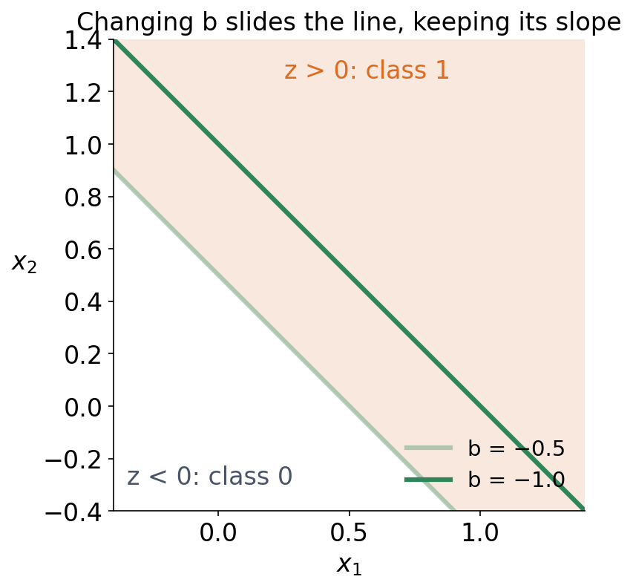
1 · WEIGHTED SUM
z = 0 is a line: the decision boundary
▪ The bias slides the line
▪ The slope does not change
See course.bioinfo.se/session07.html, 'A profile score and a perceptron: the same weighted sum'.

Slide 19
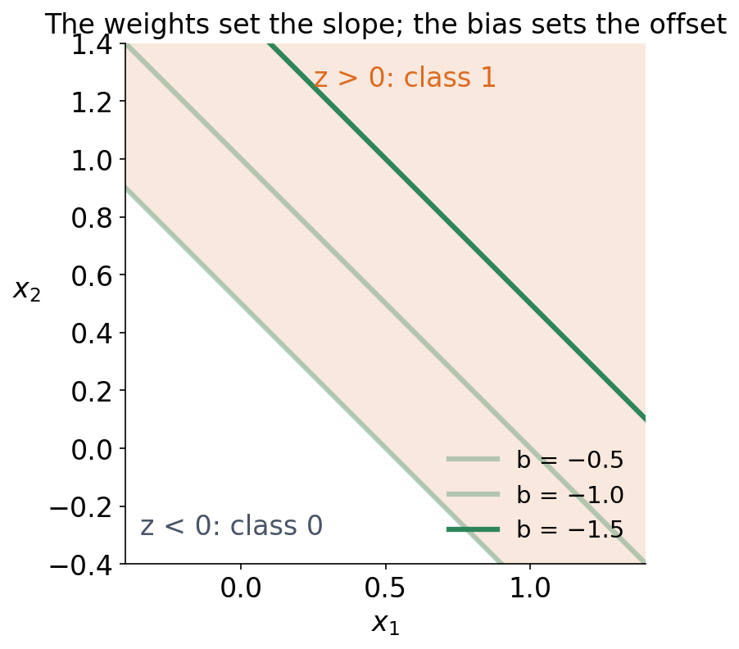
1 · WEIGHTED SUM
z = 0 is a line: the decision boundary
▪ The weights set the slope
▪ The bias slides the line
▪ In more dimensions: a plane
See course.bioinfo.se/session07.html, 'A profile score and a perceptron: the same weighted sum'.
Notes:
Solving w1 x1 + w2 x2 + b = 0 for x2 gives x2 = -(w1/w2) x1 - b/w2, the familiar y = mx + c. The bias plays the role of the intercept, so changing b moves the line sideways without changing its slope.

Slide 20
2 · LEARNING
Two ways to get the weights
Count (Session 5)
Learn (from now on)
PSSM
gradient descent
▪ Count residues in an alignment
▪ Turn counts into log-odds
▪ Needs a trusted alignment
▪ Start with arbitrary weights
▪ Measure the loss on labelled examples
▪ Step every weight downhill
See course.bioinfo.se/session07.html, 'Learning the weights from examples'.
Notes:
Pseudocounts in Session 5 were still counting, only with a correction. Learning needs no alignment, only labelled examples and a loss. The lab does this with raw tensors and autograd, without the nn.Module shortcut of Session 8.

Slide 21
2 · LEARNING
What a loss function measures
▪ How wrong the model is, as one number
▪ Squared error: L(w) = (wx − y)²
▪ Small loss = predictions close to the labels
▪ It must be differentiable — that is the whole requirement
▪ The step activation is not. Hence the sigmoid.
See course.bioinfo.se/session07.html, 'Learning the weights from examples'.
Notes:
The loss is the thing gradient descent walks downhill on, so it has to have a slope everywhere. The perceptron's step function is flat on both sides of zero, so its gradient is zero almost everywhere and gradient descent gets no signal at all. That single sentence is why the last slide of this block exists, and why logistic regression uses a sigmoid.

Slide 22
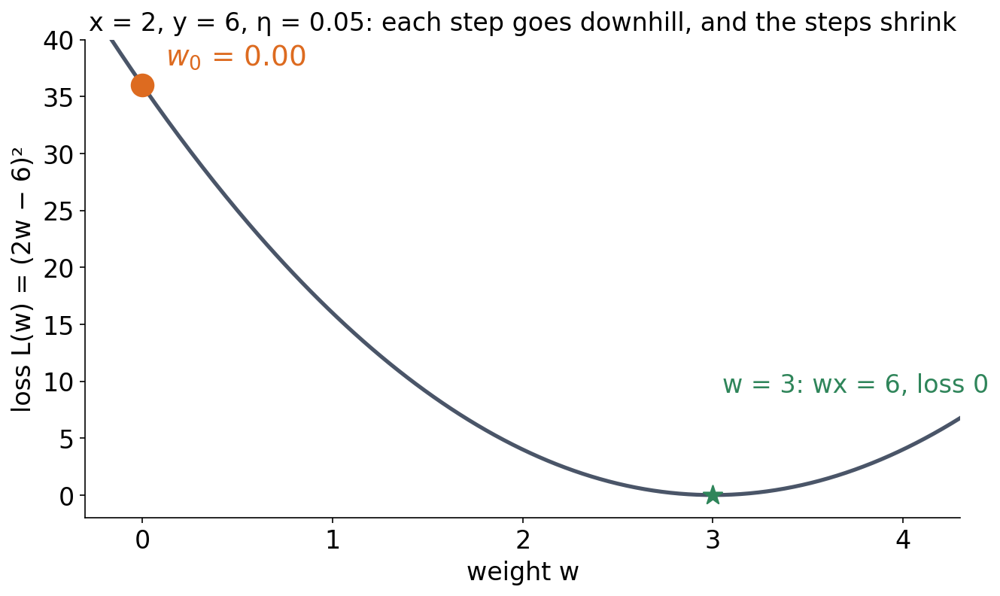
2 · LEARNING
Gradient descent: one weight, one example
▪ dL/dw = 2(wx − y)·x
▪ Start anywhere: w₀ = 0
See course.bioinfo.se/session07.html, the worked example and its table.

Slide 23
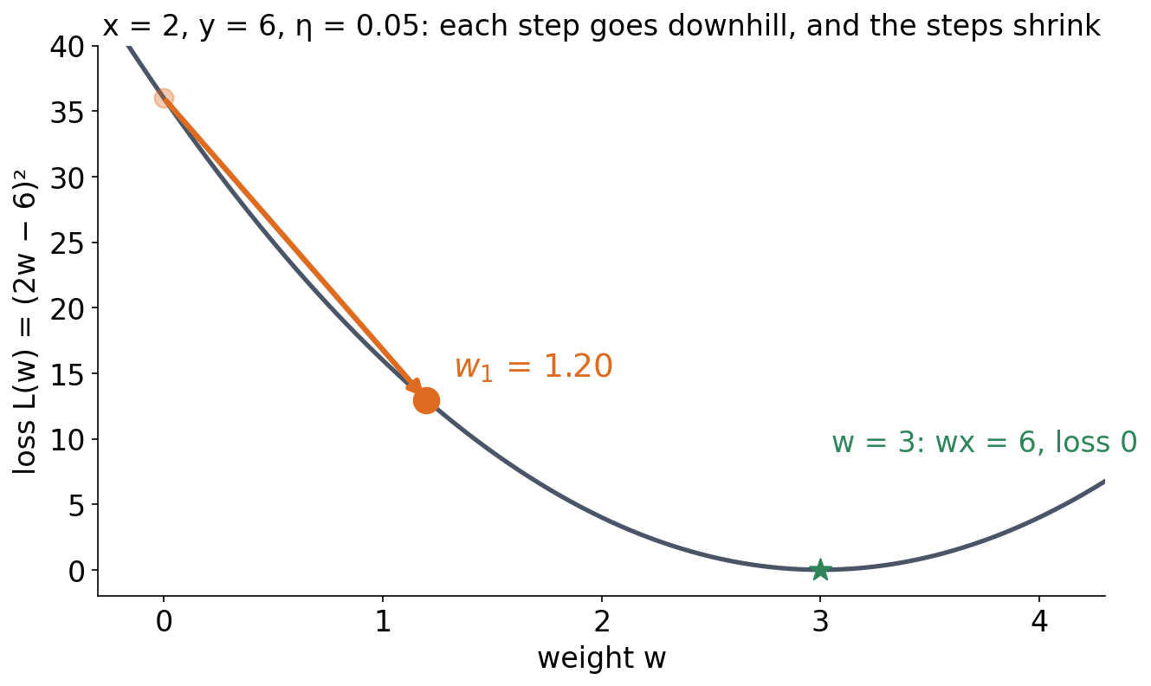
2 · LEARNING
Gradient descent: one weight, one example
▪ dL/dw = 2(wx − y)·x
▪ w₀ = 0 → 1.20
▪ The gradient was −24: a big step
See course.bioinfo.se/session07.html, the worked example and its table.

Slide 24
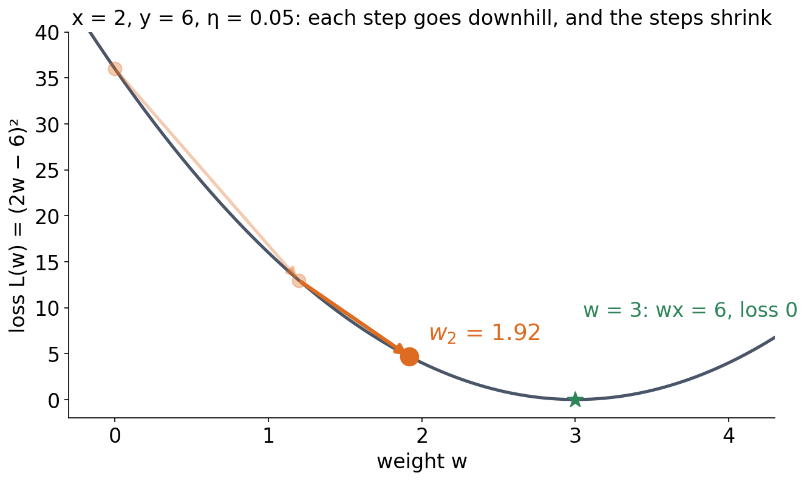
2 · LEARNING
Gradient descent: one weight, one example
▪ dL/dw = 2(wx − y)·x
▪ w₁ = 1.20 → 1.92
▪ The gradient was −14.4: a smaller step
See course.bioinfo.se/session07.html, the worked example and its table.

Slide 25
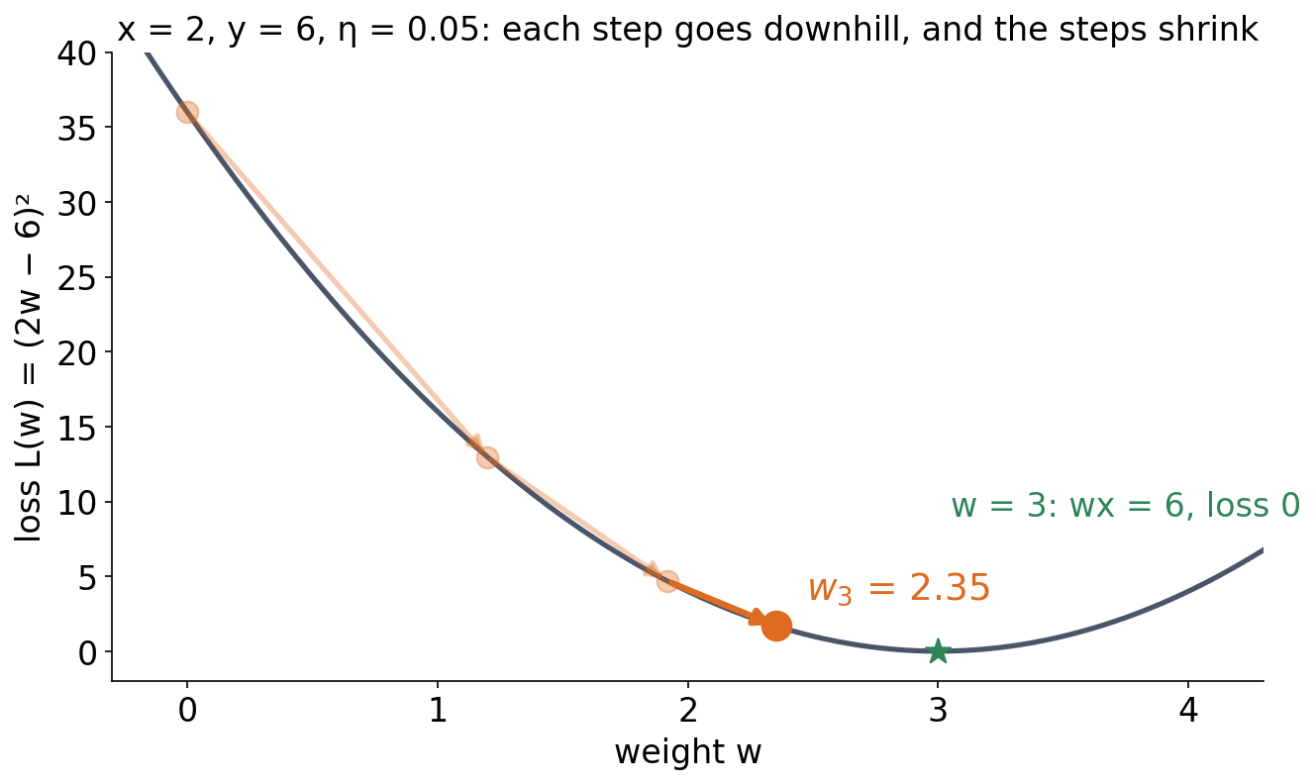
2 · LEARNING
Gradient descent: one weight, one example
▪ dL/dw = 2(wx − y)·x
▪ w₂ = 1.92 → 2.35
▪ Closer to 3, so smaller again
See course.bioinfo.se/session07.html, the worked example and its table.

Slide 26
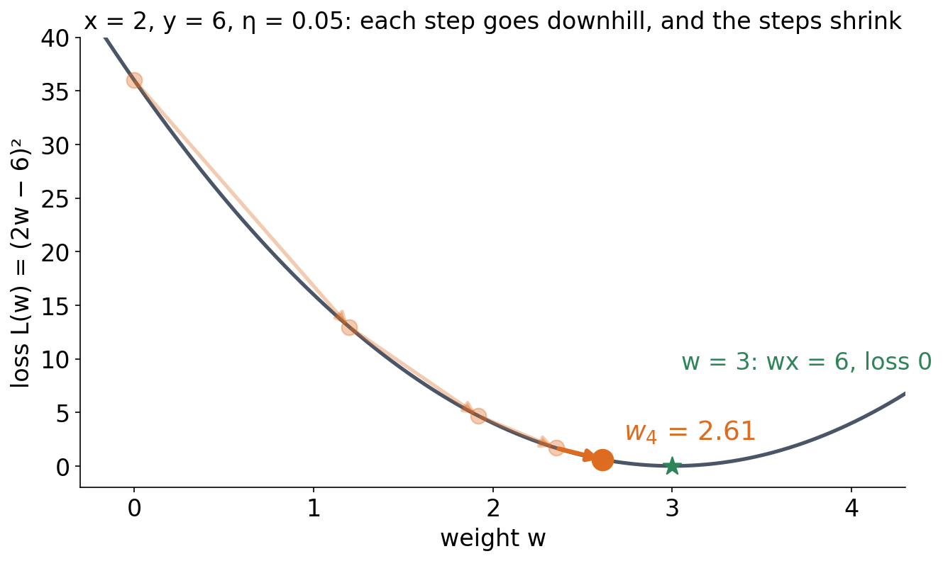
2 · LEARNING
Gradient descent: one weight, one example
▪ dL/dw = 2(wx − y)·x
▪ w₃ = 2.35 → 2.61
▪ η has not changed once
See course.bioinfo.se/session07.html, the worked example and its table.

Slide 27
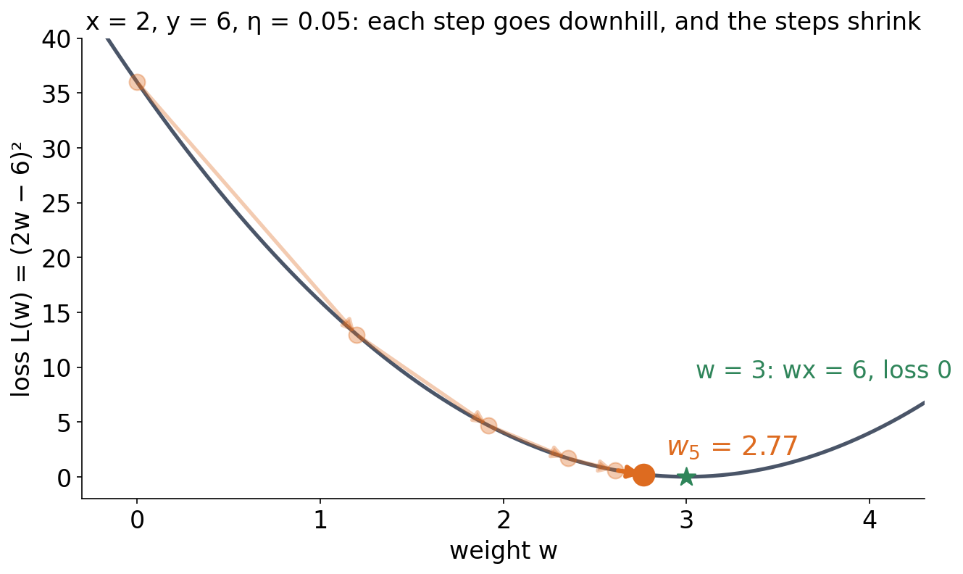
2 · LEARNING
Gradient descent: one weight, one example
▪ dL/dw = 2(wx − y)·x
▪ Heads for w = 3
▪ The steps shrink by themselves
See course.bioinfo.se/session07.html, the worked example and its table.
Notes:
z = wx, w0 = 0, (x, y) = (2, 6), squared-error loss L = (wx - y)^2, learning rate 0.05. Step 0: dL/dw = 2(0 - 6)(2) = -24, so w1 = 0 + 0.05 * 24 = 1.20. Step 1: dL/dw = 2(2.4 - 6)(2) = -14.4, w2 = 1.92. The gradient shrinks as the prediction approaches 6, so the steps shrink without changing eta.

Slide 28
2 · LEARNING
The same three steps, as arithmetic
▪ n = 0: w = 0.00, dL/dw = 2(0 − 6)(2) = −24.0 → 1.20
Table 1 on course.bioinfo.se/session07.html.

Slide 29
2 · LEARNING
The same three steps, as arithmetic
▪ n = 0: w = 0.00, dL/dw = 2(0 − 6)(2) = −24.0 → 1.20
▪ n = 1: w = 1.20, dL/dw = 2(2.4 − 6)(2) = −14.4 → 1.92
Table 1 on course.bioinfo.se/session07.html.

Slide 30
2 · LEARNING
The same three steps, as arithmetic
▪ n = 0: w = 0.00, dL/dw = 2(0 − 6)(2) = −24.0 → 1.20
▪ n = 1: w = 1.20, dL/dw = 2(2.4 − 6)(2) = −14.4 → 1.92
▪ n = 2: w = 1.92, dL/dw = 2(3.84 − 6)(2) = −8.64 → 2.35
Table 1 on course.bioinfo.se/session07.html.

Slide 31
2 · LEARNING
The same three steps, as arithmetic
▪ n = 0: w = 0.00, dL/dw = 2(0 − 6)(2) = −24.0 → 1.20
▪ n = 1: w = 1.20, dL/dw = 2(2.4 − 6)(2) = −14.4 → 1.92
▪ n = 2: w = 1.92, dL/dw = 2(3.84 − 6)(2) = −8.64 → 2.35
▪ The gradient shrinks, so the steps shrink
▪ η stays 0.05 throughout
Table 1 on course.bioinfo.se/session07.html.
Notes:
Walk one row on the board. w_{n+1} = w_n - eta dL/dw, and the minus sign in front of a negative gradient is what moves w upwards. Nobody has to decrease eta by hand: the correction fades out on its own as the prediction approaches 6.

Slide 32
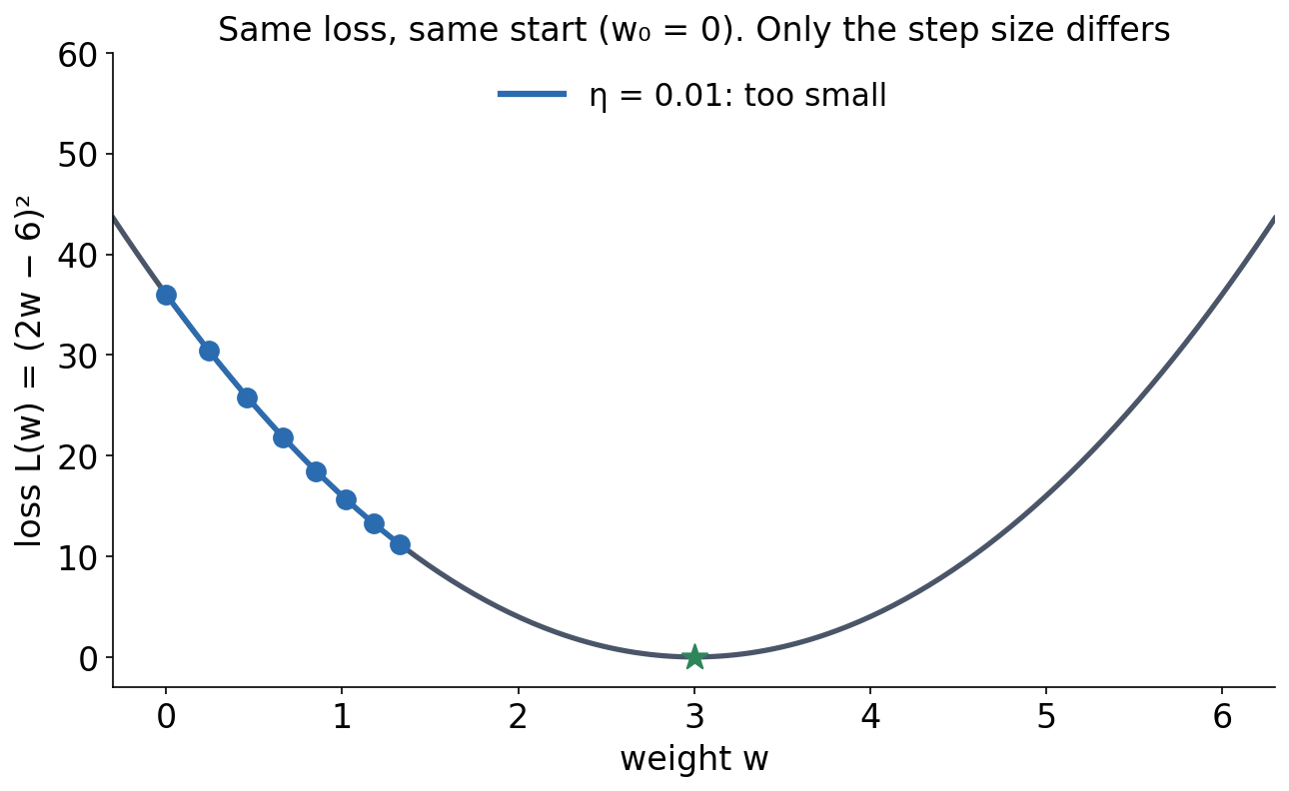
2 · LEARNING
The learning rate decides whether you get there
η = 0.01. Every step multiplies the distance to w = 3 by 0.92, so it gets there eventually — long after the lecture has moved on.
Same example as the previous slide; compare Session 1's second discussion problem.

Slide 33
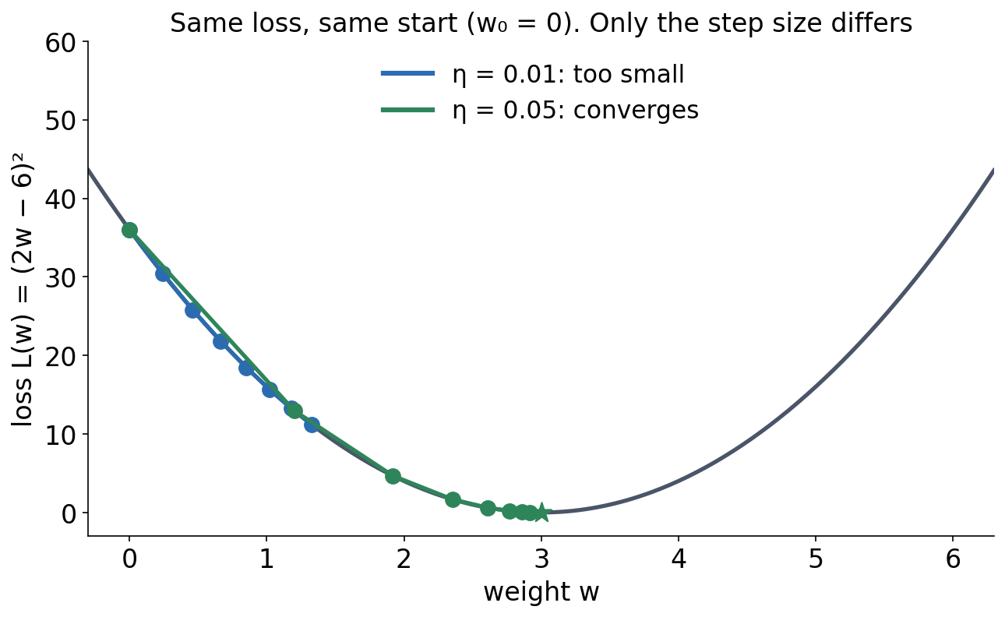
2 · LEARNING
The learning rate decides whether you get there
η = 0.05 multiplies the distance by 0.6: a few steps and it is done. This is the one from the previous slide.
Same example as the previous slide; compare Session 1's second discussion problem.

Slide 34
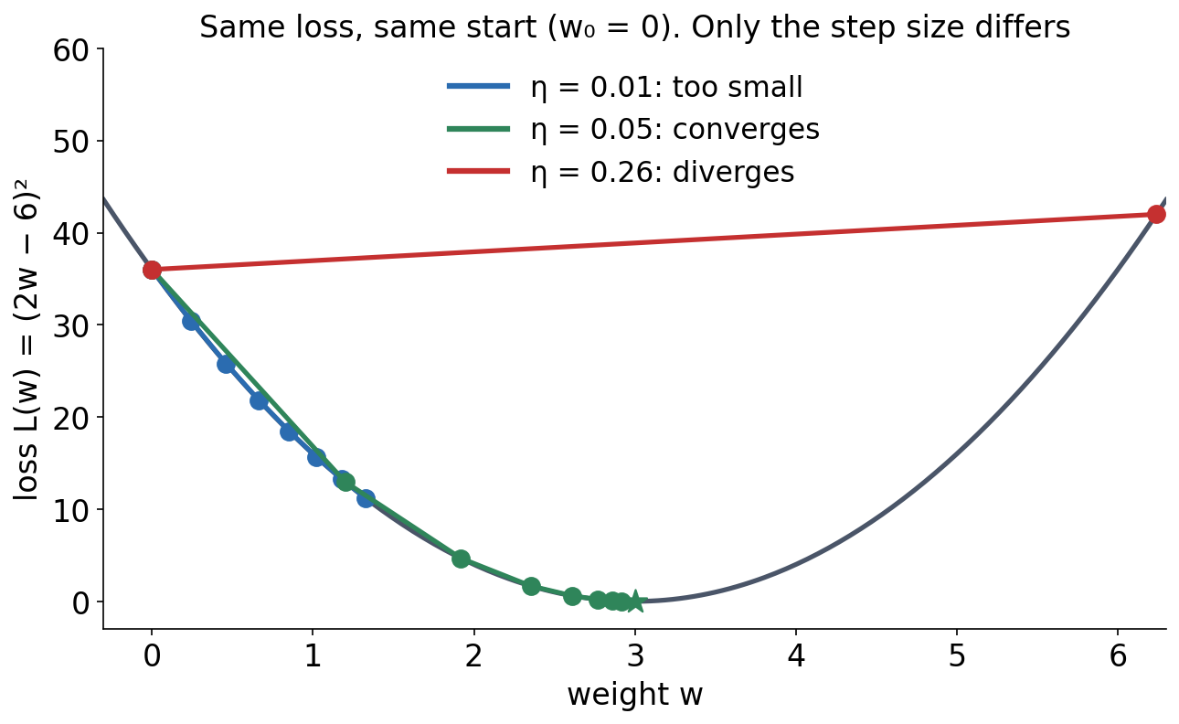
2 · LEARNING
The learning rate decides whether you get there
η = 0.26 multiplies the distance by −1.08. The sign flips, so it overshoots, and the size grows, so it overshoots further every time.
Same example as the previous slide; compare Session 1's second discussion problem.
Notes:
For this loss, each step multiplies the distance to w = 3 by (1 - 8 eta). eta = 0.05 gives 0.6 (converges), 0.01 gives 0.92 (slow), 0.26 gives -1.08: the sign flips (overshoot) and the distance grows (diverges). Ask: what is the largest eta that still converges? (0.25.)

Slide 35
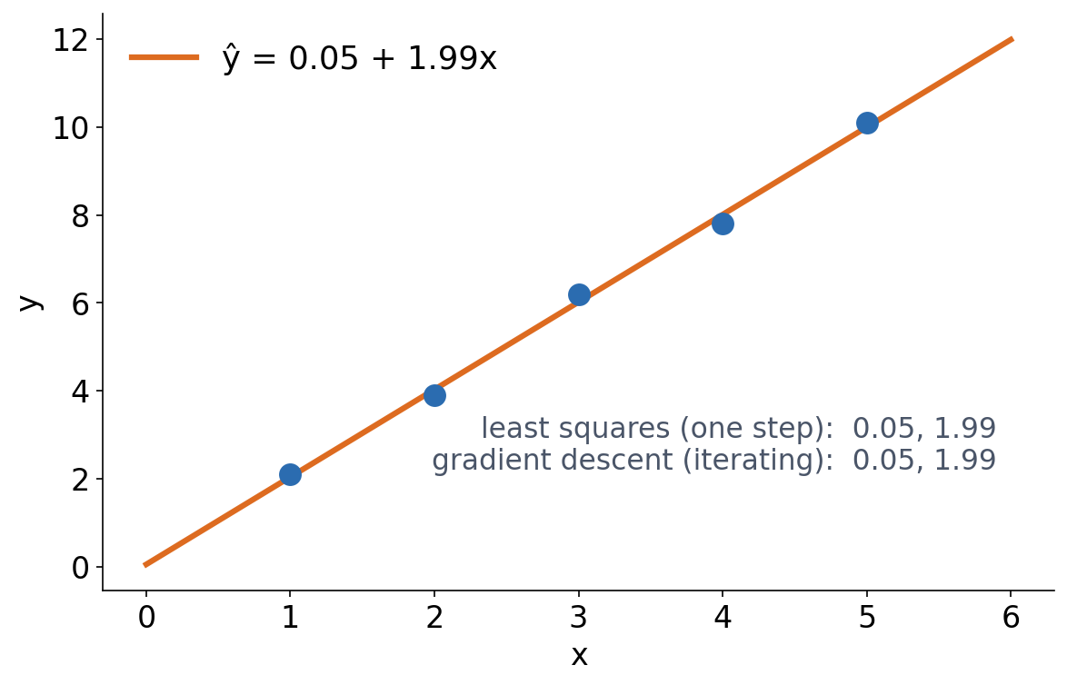
2 · LEARNING
Derived or learned: the same line
▪ Linear regression has a direct solution
▪ Gradient descent reaches the same b₀, b₁
▪ Most models have no direct solution
See course.bioinfo.se/session07.html, 'Deriving vs. learning, on the simplest possible model'.
Notes:
x = 1..5, y = (2.1, 3.9, 6.2, 7.8, 10.1). Least squares gives b0 = 0.05, b1 = 1.99 in one step; gradient descent reaches the same values iteratively. The same contrast as a PSSM (derived from counts) and a perceptron (learned). A perceptron with a classification loss has no closed form, so from now on everything is learned.

Slide 36
2 · LEARNING
One example, or all of them?
▪ The worked example used a single point
▪ Real training averages the loss over many examples
▪ All of them at once: slow but steady
▪ A small random batch: noisier, far faster
▪ SGD, momentum, Adam — Session 9
See course.bioinfo.se/session07.html, 'Learning the weights from examples', and its further reading.
Notes:
Today's mechanics are the same whichever you choose; only how many examples go into one gradient changes. The variants are named here so the words are not new in Session 9, not explained.

Slide 37
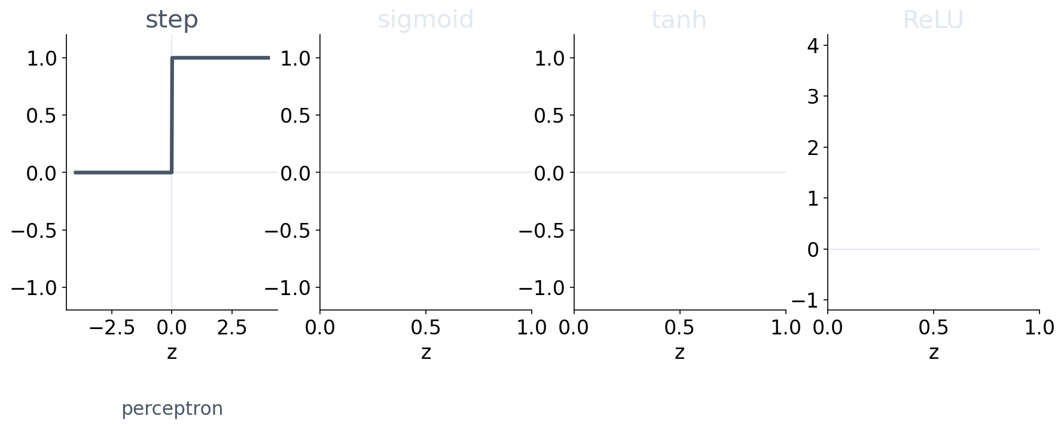
2 · LEARNING
Activation functions: what happens after the sum
▪ Step: 1 if z > 0, else 0 — a class (perceptron)
See course.bioinfo.se/session07.html; logistic regression returns in Session 8.

Slide 38
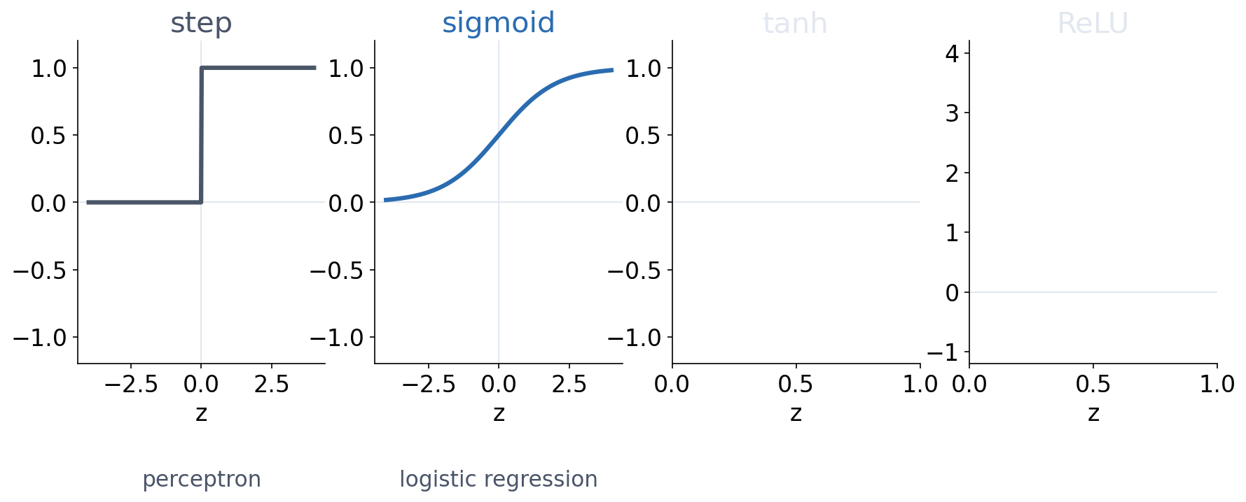
2 · LEARNING
Activation functions: what happens after the sum
▪ Step: 1 if z > 0, else 0 — a class (perceptron)
▪ Sigmoid: a probability (logistic regression)
See course.bioinfo.se/session07.html; logistic regression returns in Session 8.

Slide 39
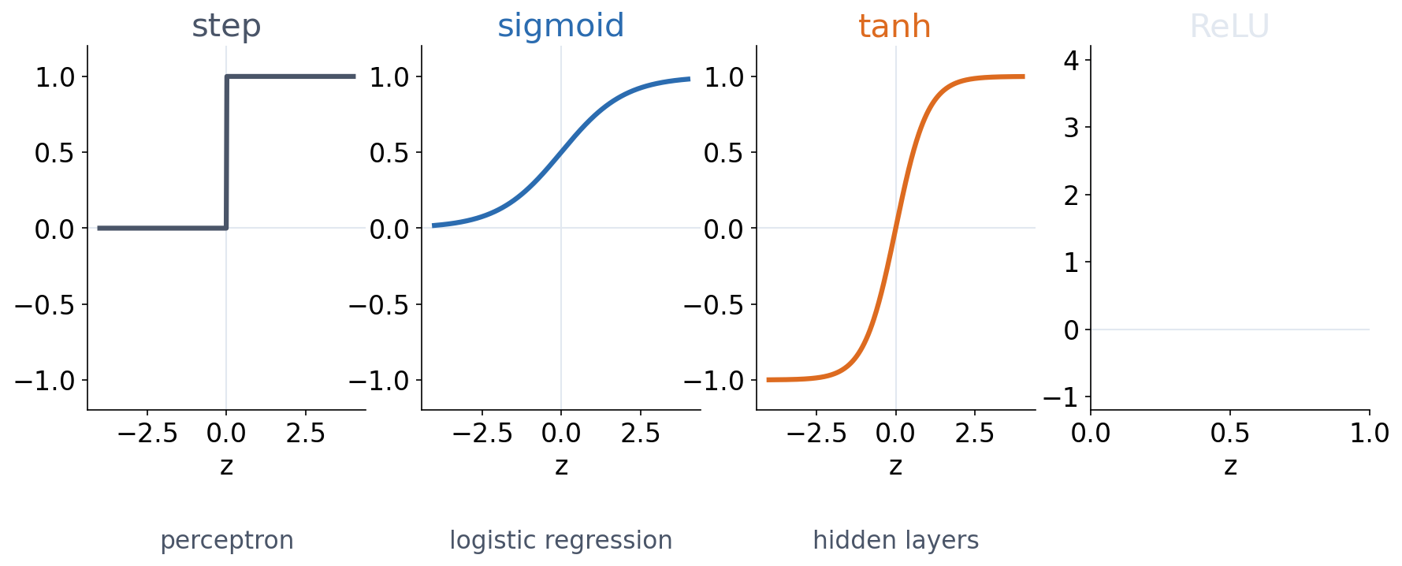
2 · LEARNING
Activation functions: what happens after the sum
▪ Step: 1 if z > 0, else 0 — a class (perceptron)
▪ Sigmoid: a probability (logistic regression)
▪ tanh: like the sigmoid, centred on zero
See course.bioinfo.se/session07.html; logistic regression returns in Session 8.

Slide 40
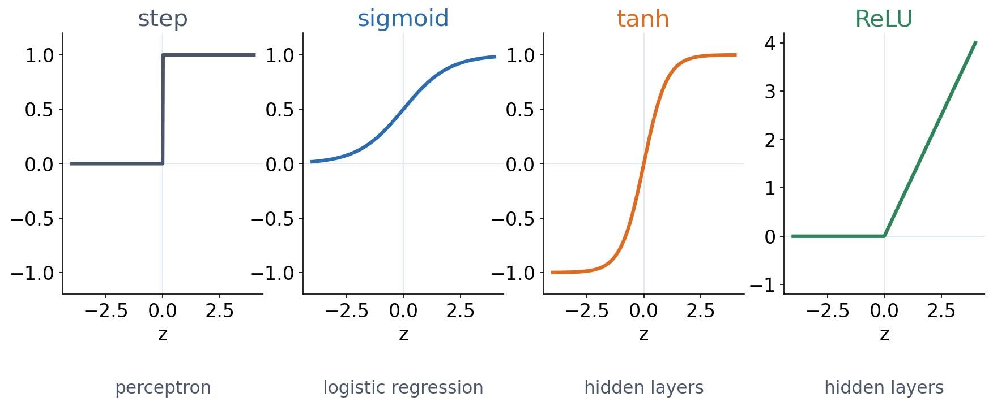
2 · LEARNING
Activation functions: what happens after the sum
▪ Step: 1 if z > 0, else 0 — a class (perceptron)
▪ Sigmoid: a probability (logistic regression)
▪ tanh, ReLU: inside hidden layers (Block 2)
See course.bioinfo.se/session07.html; logistic regression returns in Session 8.
Notes:
The step has zero gradient almost everywhere, so gradient descent cannot train it. Sigmoid is a smooth step, which is why logistic regression and networks use it. Block 2 shows why an activation between layers is essential.

Slide 41
2 · LEARNING
In the lab: raw tensors, on purpose
▪ Autograd from Session 2, nothing above it
▪ No nn.Module, no training-loop helper
▪ Every step of the mechanics stays visible
▪ Session 8 hands you the shortcuts
See course.bioinfo.se/session07.html, 'Learning the weights from examples'.
Notes:
Worth saying out loud before they open the notebook and wonder why the code is so long. The point today is to see the gradient being computed and applied; from Session 8 on they never write it out again.

Slide 42
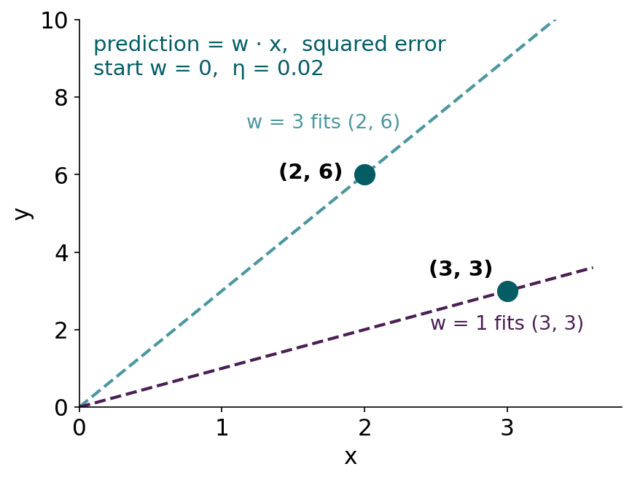
BLOCK 1 · QUIZ
Where does gradient descent take w?
Two examples, (2, 6) and (3, 3); prediction = w · x. Start at w = 0, η = 0.02.
A To w = 3: it fits the first example
B To w = 2: halfway between the two
C To about 1.6: closer to w = 1
D Nowhere: w keeps jumping
Guess on your own
Scan the code, or go to
quiz.bioinfo.se/live
Notes:
The old discussion problem 1. 2w = 6 needs w = 3, 3w = 3 needs w = 1. Let them guess before computing.

Slide 43
BLOCK 1 · QUIZ
Where does gradient descent take w?
How did the room answer?
Halt the round when most have answered, then show the results.
Show the results ▸ quiz.bioinfo.se/live/report
Notes:
Halt submission in the Control view, then open the results. Do not say which answer is right.

Slide 44
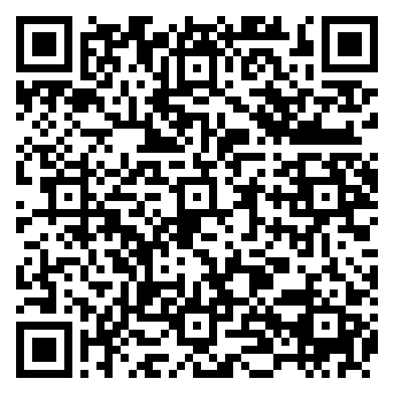
BLOCK 1 · QUIZ
Where does gradient descent take w?
Fix it, run it, discuss
Open the notebook: scan the code
Fix the line marked FIX, then run the cells
Did it come out as you guessed? Discuss with your neighbour
The notebook: https://colab.research.google.com/github/ElofssonLab/kb8029-book/blob/main/notebooks/session07-discussion-1.ipynb
Notes:
About 8 minutes. The notebook's update line has + instead of -: run as it is, w runs away; fixed, it prints 1.62. Questions 1-3 in the notebook are the old discussion questions.

Slide 45
BLOCK 1 · QUIZ
Where does gradient descent take w?
Answer again
Same question, after the discussion.
quiz.bioinfo.se/live
Notes:
Open the second round (post) in the Control view.

Slide 46
BLOCK 1 · QUIZ
Where does gradient descent take w?
Results, and who explains
Both rounds side by side.
Draw two to explain: one of you says how you reasoned.
Show the results ▸ quiz.bioinfo.se/live/report
To check it with code afterwards: discussion notebook 1 https://colab.research.google.com/github/ElofssonLab/kb8029-book/blob/main/notebooks/session07-discussion-1.ipynb
Notes:
About 1.6 (21/13 = 1.62). The losses are 4(w - 3)² and 9(w - 1)²: the example with the larger x is steeper, so the compromise is the average weighted by x², not the plain average 2. First step: gradient -42, w = 0.84.

Slide 47
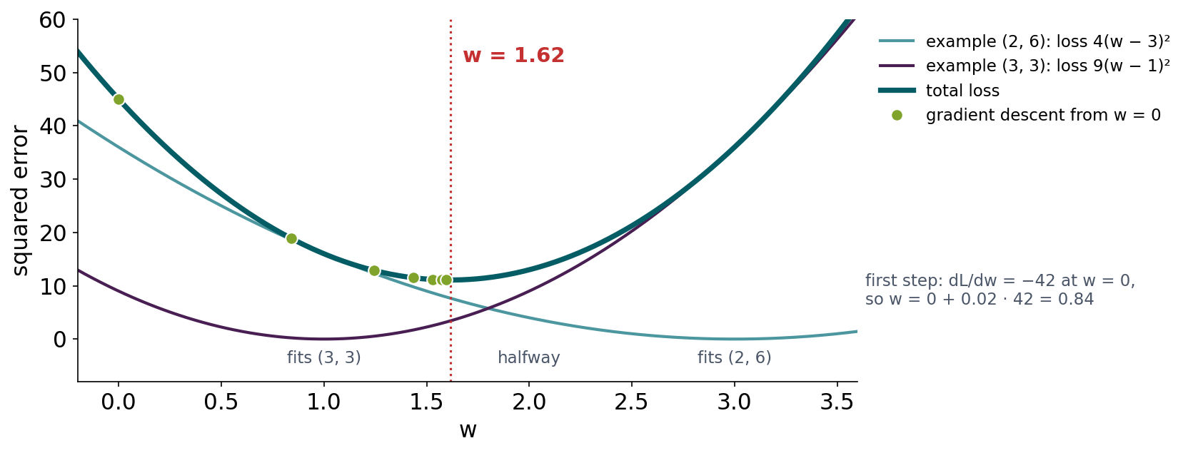
BLOCK 1 · QUIZ
The answer: about 1.6, a compromise that leans to the steeper loss
Total loss 4(w − 3)² + 9(w − 1)². The example (3, 3) has the larger x, so its loss is steeper and pulls harder: w* = (4·3 + 9·1)/13 = 1.62, not the plain average 2. No weight fits both examples, so gradient descent finds the best compromise.

Slide 48
BLOCK 1 DONE
Break

Slide 49
BLOCK 2 · ABOUT 30 MIN
What one weighted sum can and cannot do

Slide 50
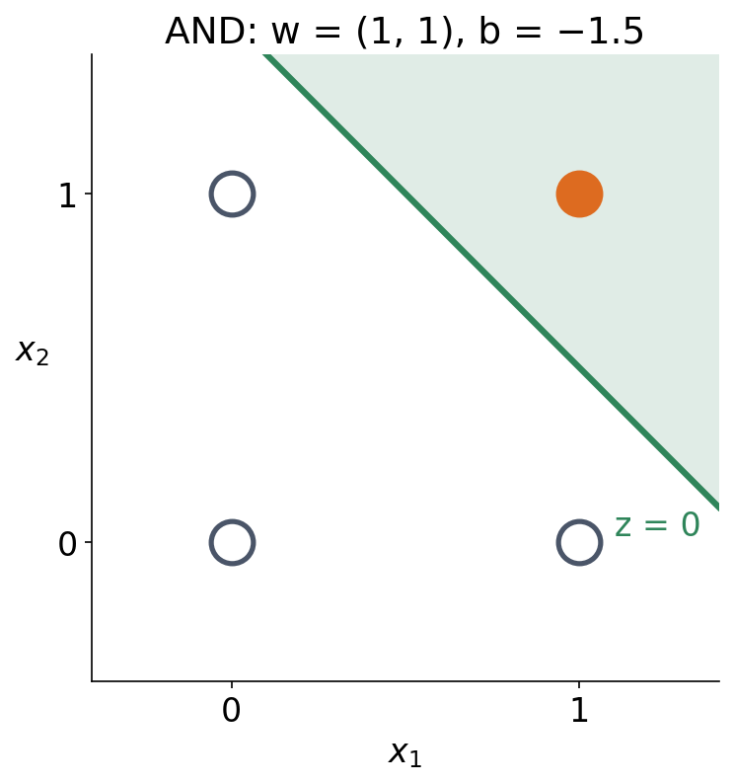
3 · WHAT ONE WEIGHTED SUM CAN DO
AND is one line through the four corners
▪ Output 1 if z > 0, else 0
▪ w = (1, 1), b = −1.5
▪ Only (1, 1) lies on the green side
See course.bioinfo.se/session07.html, 'What one weighted sum can represent'.
Notes:
z at the four corners: -1.5, -0.5, -0.5, +0.5. Only (1,1) gives z > 0. Do not show OR or NAND yet: the next slide asks the students to find OR themselves.

Slide 51
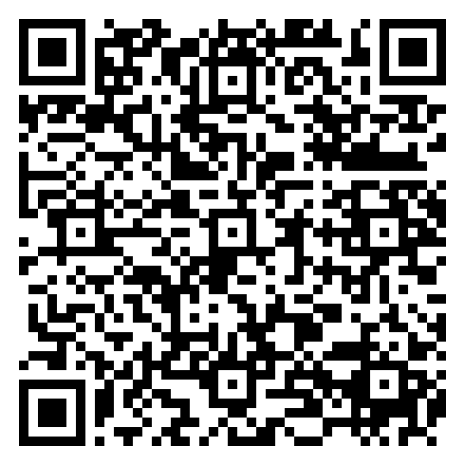
3 · TRY IT IN PAIRS (5 MIN)
Find weights for a perceptron that implements OR
▪ Sign activation: output +1 if z > 0, else −1
▪ 1. Find w₁, w₂, b so z reproduces the OR truth table
▪ 2. Hint: where must the line sit relative to the four corners?
▪ 3. Is your solution the only one that works?
Scan me
Opens in Colab
Discussion notebook 2: https://colab.research.google.com/github/ElofssonLab/kb8029-book/blob/main/notebooks/session07-discussion-2.ipynb
Notes:
Short exercise inside the block, not the block's main discussion. Take one answer from the room, then show the next slide.

Slide 52
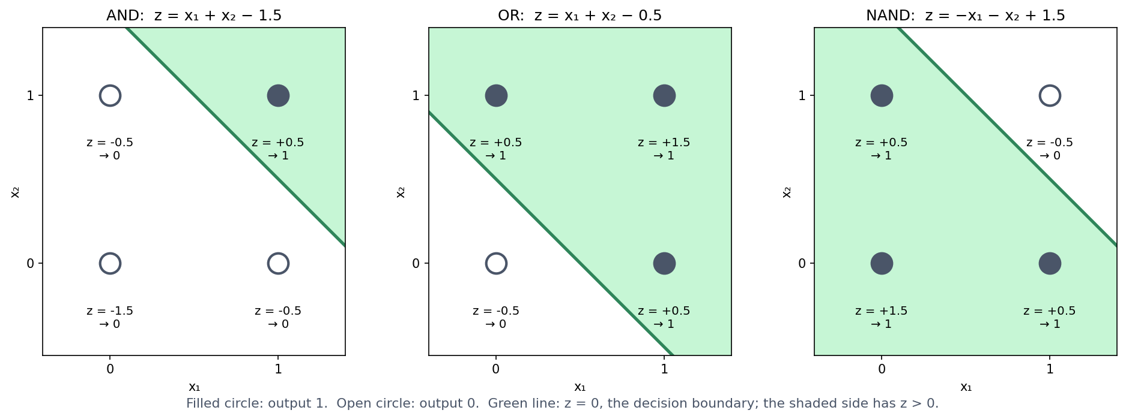
3 · WHAT ONE WEIGHTED SUM CAN DO
AND, OR, NAND: each is one line
Filled: output 1, open: output 0, z under each corner. Green line: z = 0; shaded side: z > 0.
See course.bioinfo.se/session07.html, Section 7.5, and notebook Section 3.
Notes:
Many lines work for each gate: the notebook's grid search finds thousands (two slides on).

Slide 53
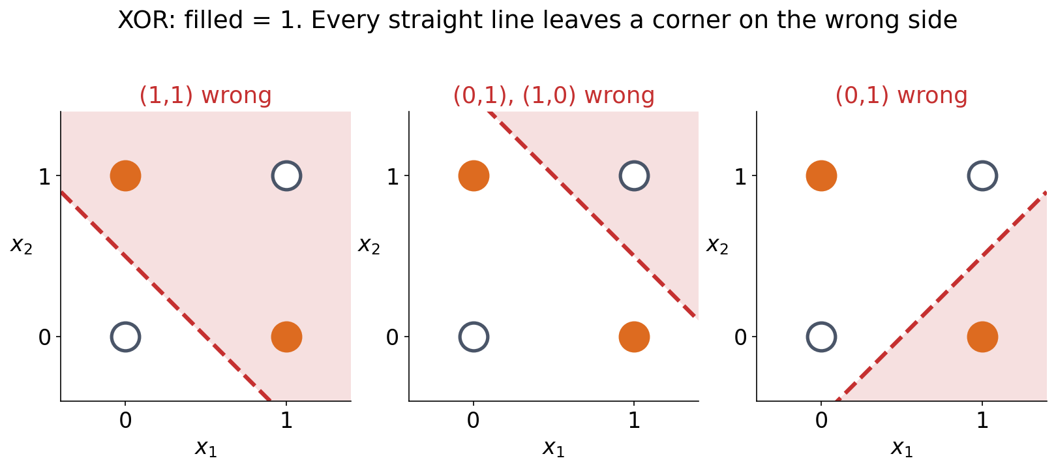
4 · WHAT IT CAN NEVER DO
XOR: try to draw the line
XOR outputs 1 when the inputs differ. Its two 1-corners sit diagonally opposite, and no straight line separates one diagonal from the other.
See course.bioinfo.se/session07.html, 'What one weighted sum can never represent: XOR' (the algebraic proof is optional there).
Notes:
Let the room try for a minute before showing the three failed lines. The optional box on the page has the four-inequality proof: (0,1) and (1,0) need w1 + b > 0 and w2 + b > 0, (0,0) needs b < 0, so w1 + w2 + b > -b > 0 at (1,1), which should be 0.

Slide 54
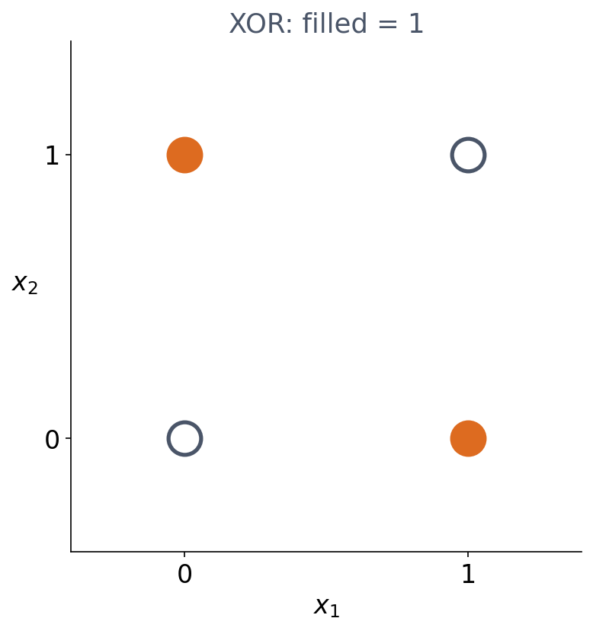
4 · WHAT IT CAN NEVER DO
The notebook tries 226,981 perceptrons
▪ XOR outputs 1 when the inputs differ
▪ The two 1s sit diagonally opposite
Notebook Section 4.

Slide 55
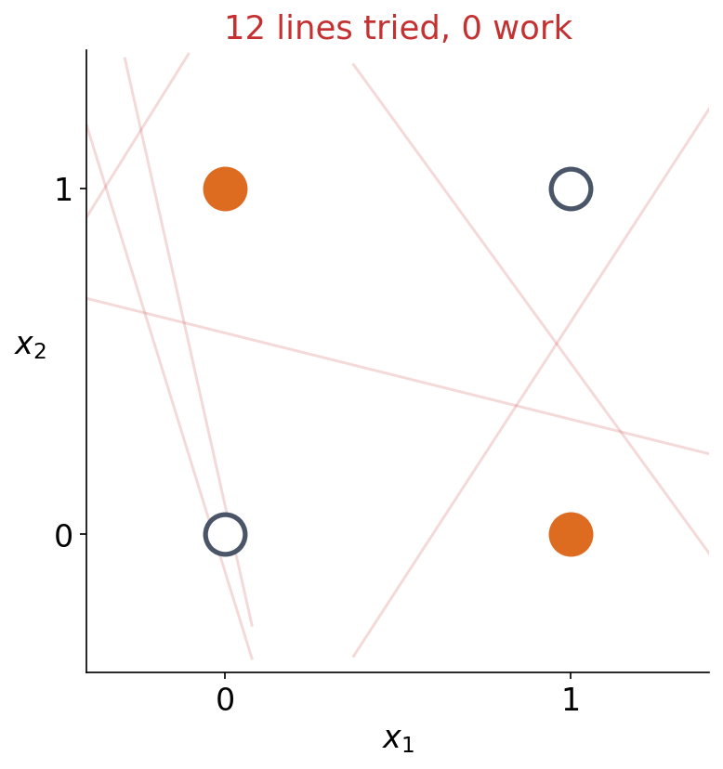
4 · WHAT IT CAN NEVER DO
The notebook tries 226,981 perceptrons
▪ w₁, w₂, b drawn from −3 to 3
▪ 12 lines so far
▪ None of them works
Notebook Section 4.

Slide 56
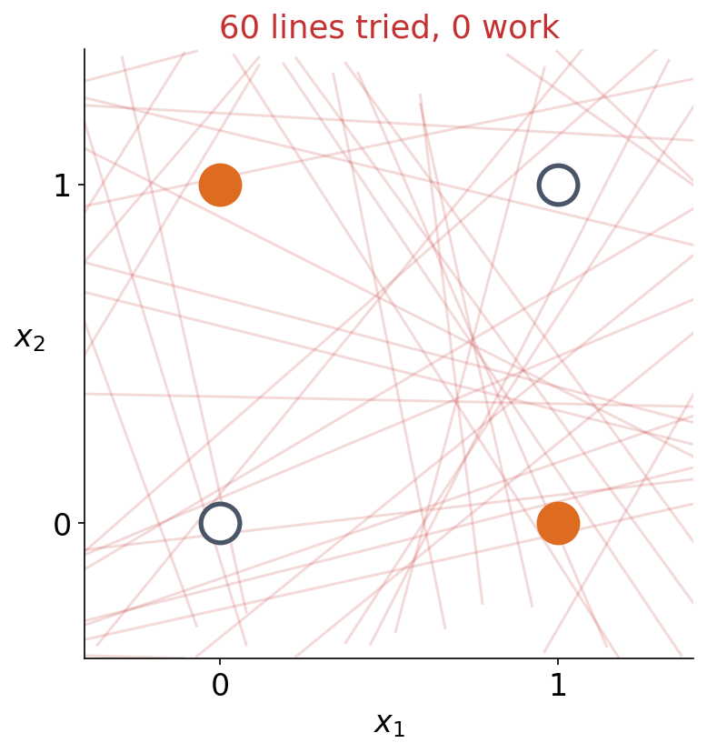
4 · WHAT IT CAN NEVER DO
The notebook tries 226,981 perceptrons
▪ 60 lines
▪ Still none
Notebook Section 4.

Slide 57
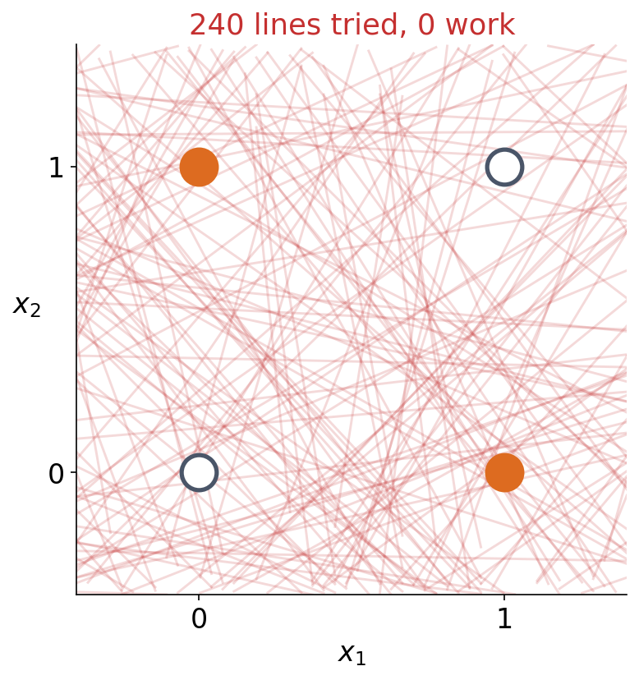
4 · WHAT IT CAN NEVER DO
The notebook tries 226,981 perceptrons
▪ The notebook tries 226,981
▪ Not one of them works
Notebook Section 4.

Slide 58
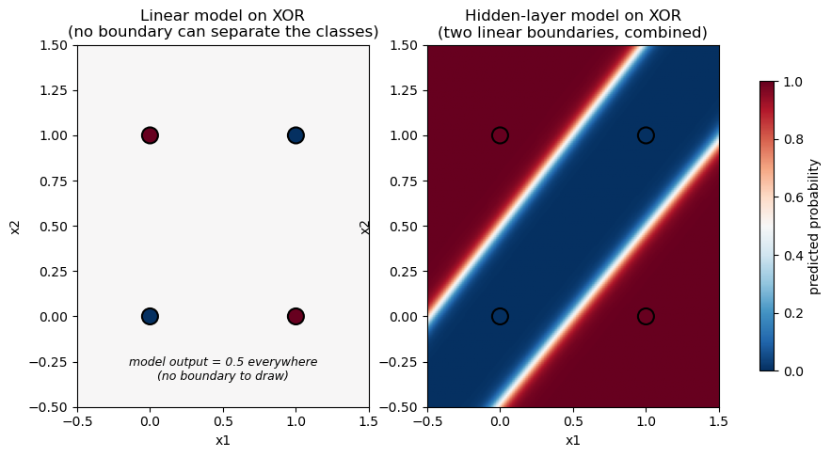
4 · WHAT IT CAN NEVER DO
Gradient descent gives up: 0.5 everywhere
A linear model trained on XOR settles on predicting 0.5 for all four inputs (loss ln 2): any line it draws gets at least one corner wrong.
Notebook Section 4; course.bioinfo.se/session07.html.
Notes:
Final loss 0.6931 = ln 2: exactly the loss of guessing 0.5 for everything. The same training on AND works fine (0.003, 0.113, 0.113, 0.84).

Slide 59
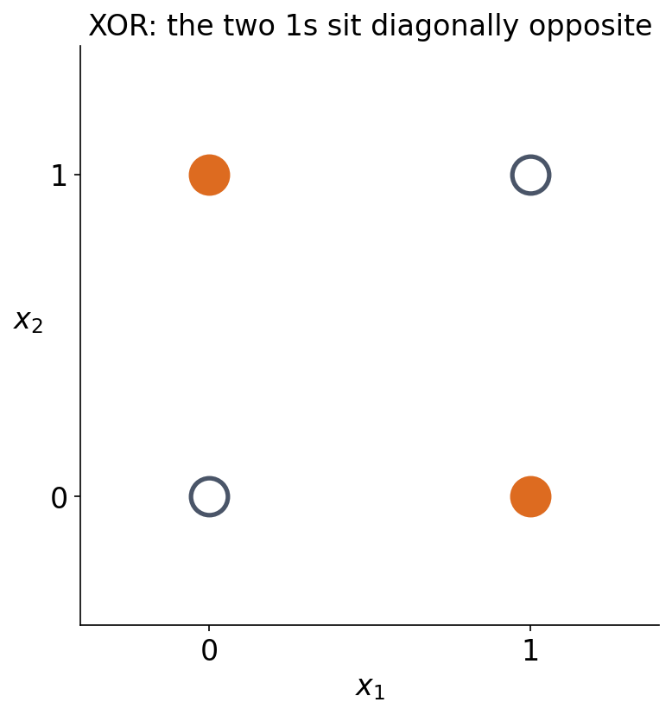
5 · WHY A HIDDEN LAYER HELPS
Two lines make XOR
▪ One line cannot do it
▪ Two can
See course.bioinfo.se/session07.html, 'Why a hidden layer helps'.

Slide 60
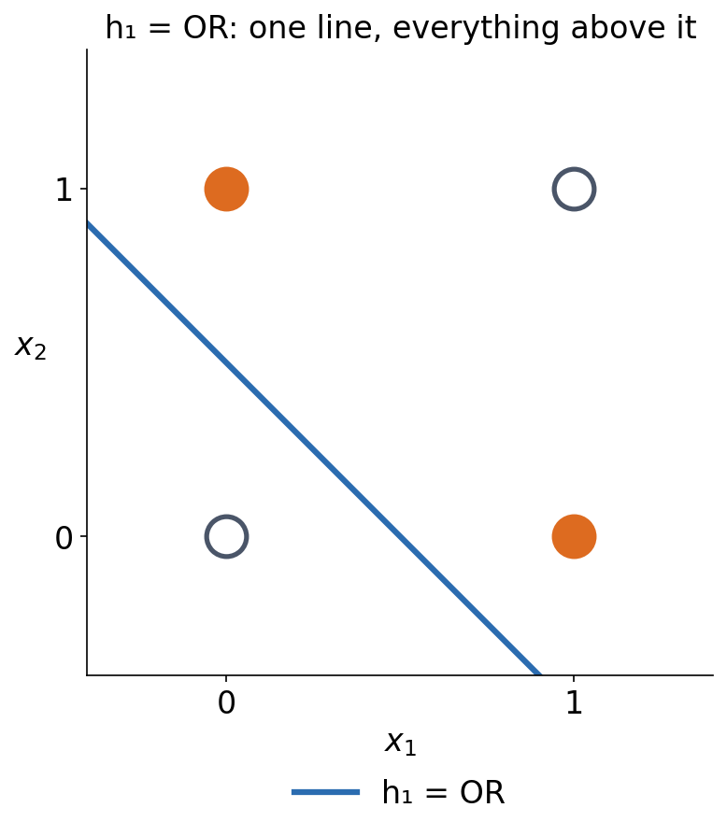
5 · WHY A HIDDEN LAYER HELPS
Two lines make XOR
▪ Hidden unit 1: OR
▪ Fires everywhere except (0,0)
See course.bioinfo.se/session07.html, 'Why a hidden layer helps'.

Slide 61
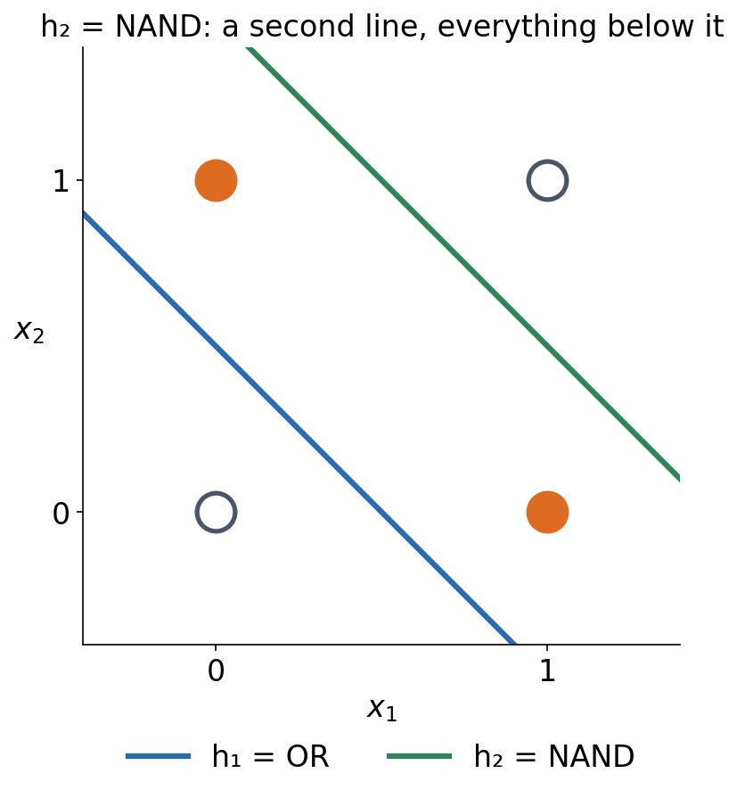
5 · WHY A HIDDEN LAYER HELPS
Two lines make XOR
▪ Hidden unit 1: OR
▪ Hidden unit 2: NAND
▪ Fires everywhere except (1,1)
See course.bioinfo.se/session07.html, 'Why a hidden layer helps'.

Slide 62
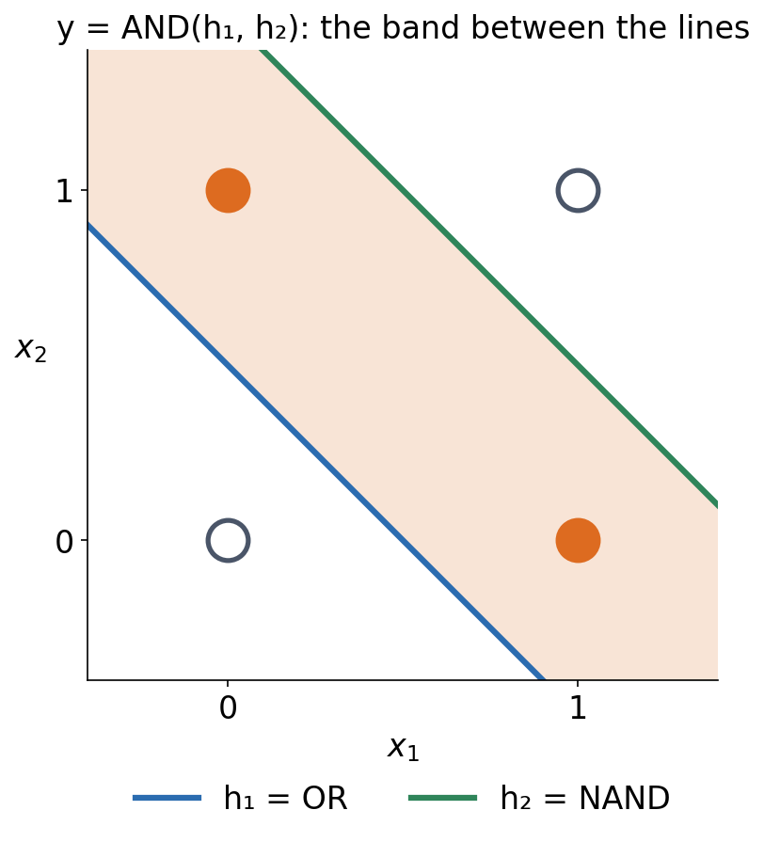
5 · WHY A HIDDEN LAYER HELPS
Two lines make XOR
▪ Hidden unit 1: OR
▪ Hidden unit 2: NAND
▪ Output: AND of the two
▪ 1 only in the band between the lines
See course.bioinfo.se/session07.html, 'Why a hidden layer helps'.
Notes:
Each hidden unit draws one line. The output unit combines them: it fires only where both hidden units fire, which is the band containing (0,1) and (1,0).

Slide 63
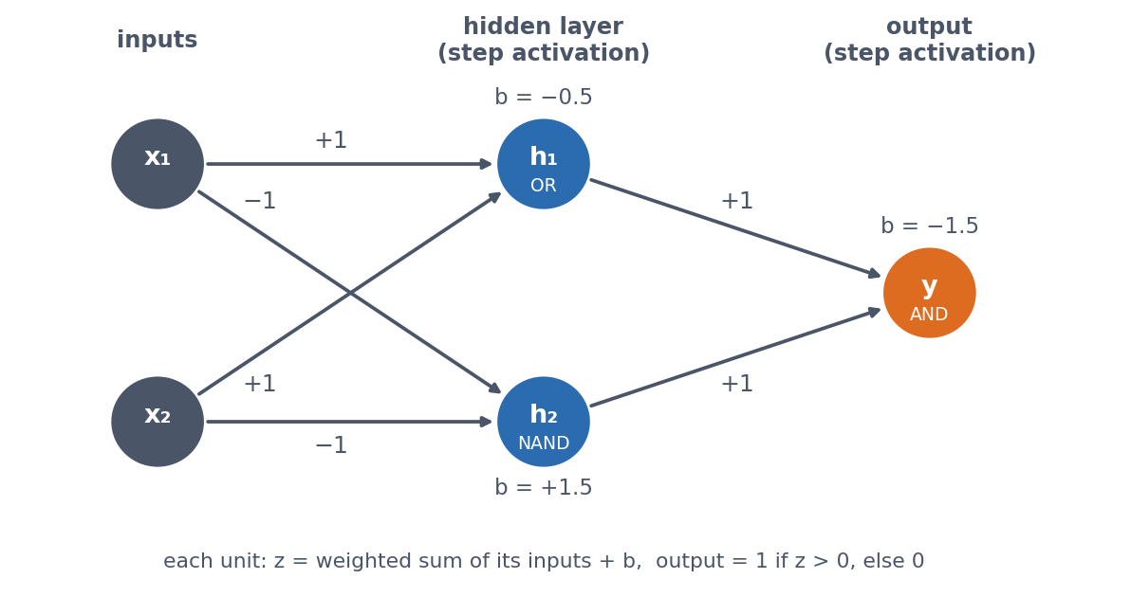
5 · WHY A HIDDEN LAYER HELPS
A two-layer perceptron for XOR
h₁ = OR (+1, +1, bias −0.5), h₂ = NAND (−1, −1, +1.5), y = AND(h₁, h₂) (+1, +1, −1.5). Every unit: weighted sum + bias, then step.
See course.bioinfo.se/session07.html, Section 7.7.

Slide 64
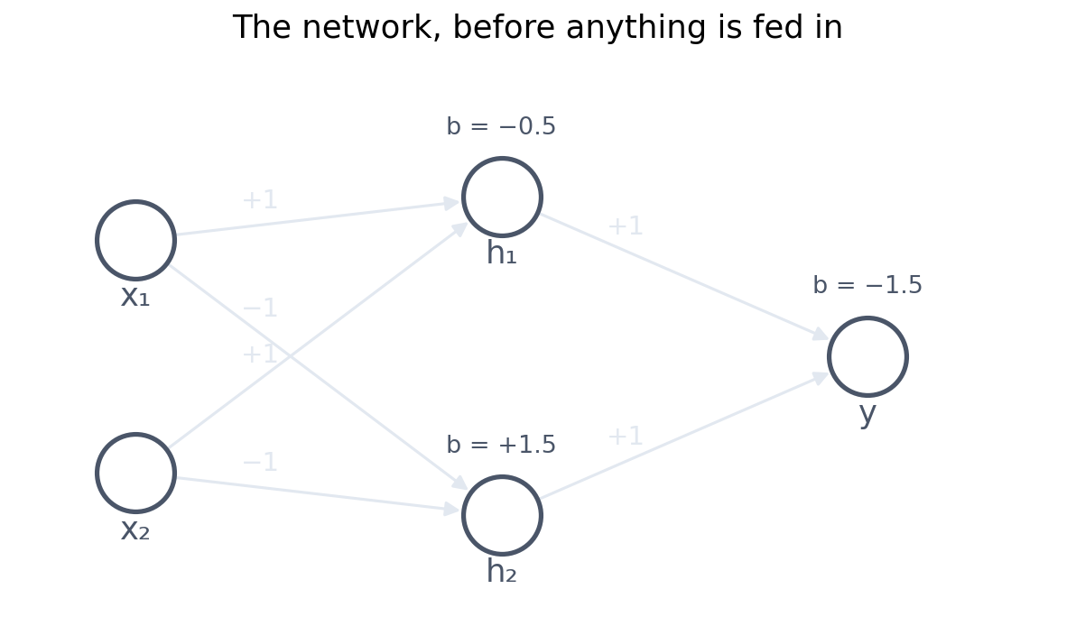
5 · WHY A HIDDEN LAYER HELPS
Step by step through the network
Three units, each one weighted sum plus a bias, then a step. Follow the input (1, 1) through it.
Notebook Section 5 computes this in PyTorch and prints every value.

Slide 65
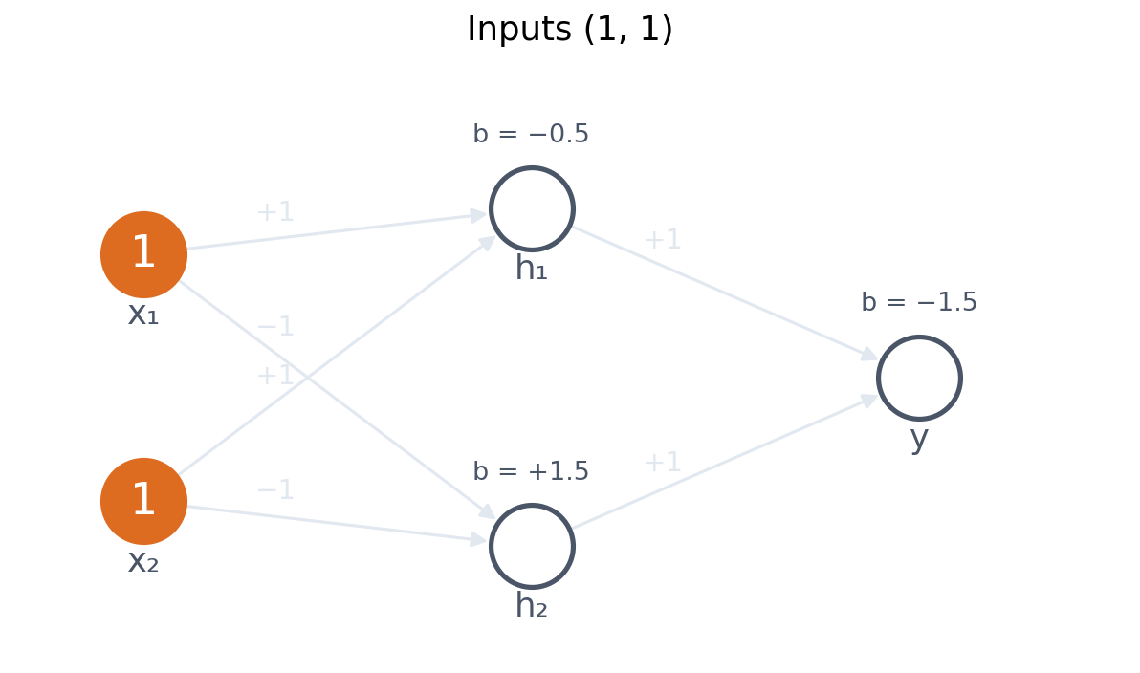
5 · WHY A HIDDEN LAYER HELPS
Step by step through the network
x₁ = 1, x₂ = 1 — the case a single line gets wrong.
Notebook Section 5 computes this in PyTorch and prints every value.

Slide 66
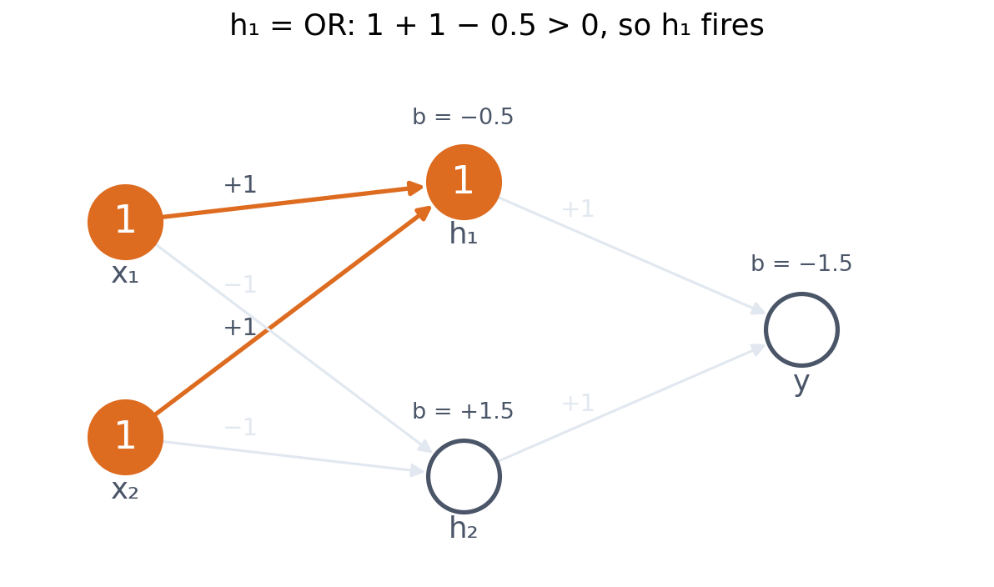
5 · WHY A HIDDEN LAYER HELPS
Step by step through the network
h₁ is the OR unit: 1 + 1 − 0.5 = 1.5, above zero, so it fires.
Notebook Section 5 computes this in PyTorch and prints every value.

Slide 67
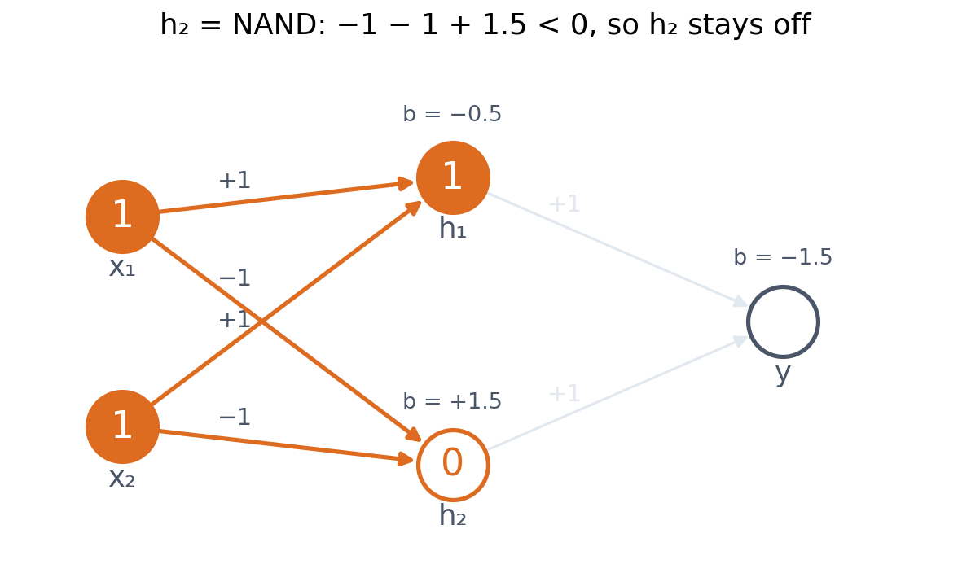
5 · WHY A HIDDEN LAYER HELPS
Step by step through the network
h₂ is the NAND unit: −1 − 1 + 1.5 = −0.5, below zero, so it stays off.
Notebook Section 5 computes this in PyTorch and prints every value.

Slide 68
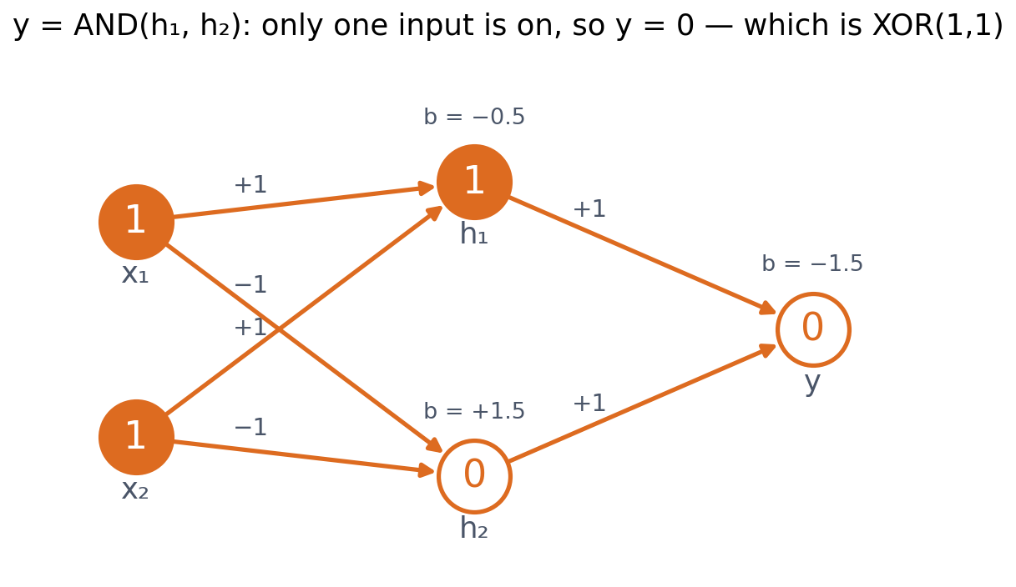
5 · WHY A HIDDEN LAYER HELPS
Step by step through the network
The output unit is AND: it needs both. Only h₁ is on, so y = 0 — and XOR(1, 1) is indeed 0.
Notebook Section 5 computes this in PyTorch and prints every value.
Notes:
Work through (1,1) on the board: both inputs on, OR fires, NAND does not, so the AND unit sees only one active input and stays off. Trained by gradient descent with tanh and sigmoid instead of steps, the notebook's network predicts 0.001, 0.998, 0.998, 0.001.

Slide 69
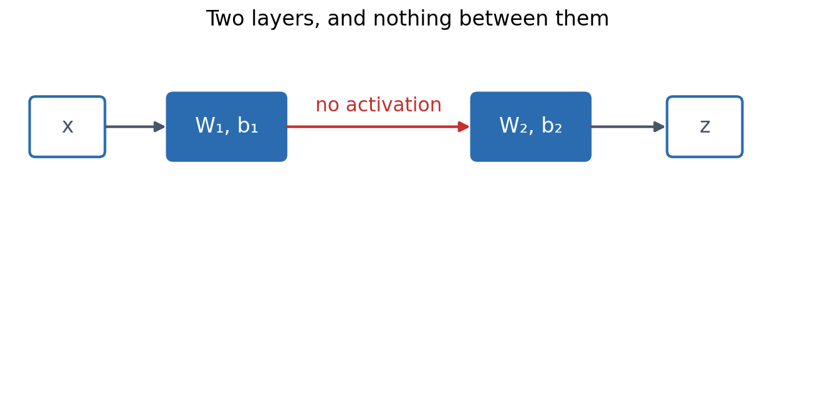
5 · WHY A HIDDEN LAYER HELPS
Without an activation, two layers are one
Two linear layers, with nothing between them.
See course.bioinfo.se/session07.html, 'The activation must be nonlinear'.

Slide 70
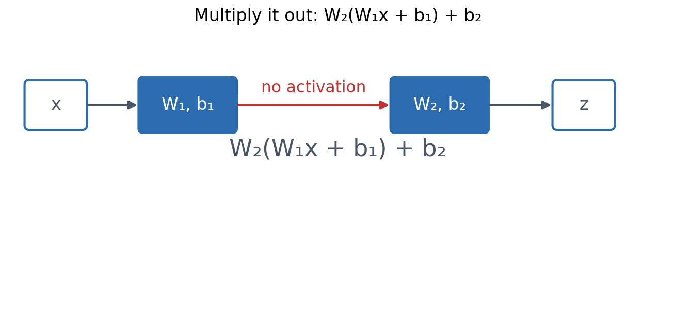
5 · WHY A HIDDEN LAYER HELPS
Without an activation, two layers are one
Write out what the second layer computes from the first.
See course.bioinfo.se/session07.html, 'The activation must be nonlinear'.

Slide 71
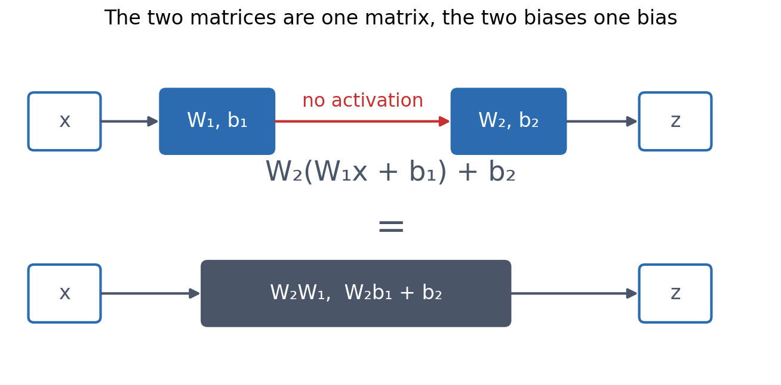
5 · WHY A HIDDEN LAYER HELPS
Without an activation, two layers are one
W₂W₁ is just another matrix, and W₂b₁ + b₂ just another bias.
See course.bioinfo.se/session07.html, 'The activation must be nonlinear'.

Slide 72
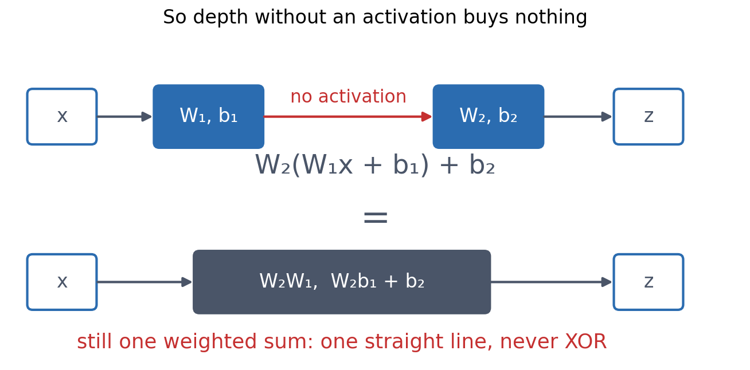
5 · WHY A HIDDEN LAYER HELPS
Without an activation, two layers are one
So two layers without an activation are one layer — one straight boundary, and never XOR. The activation is what prevents this.
See course.bioinfo.se/session07.html, 'The activation must be nonlinear'.
Notes:
Notebook: the same network with tanh removed predicts 0.5 everywhere again, loss ln 2. Any number of linear layers collapses into one.

Slide 73
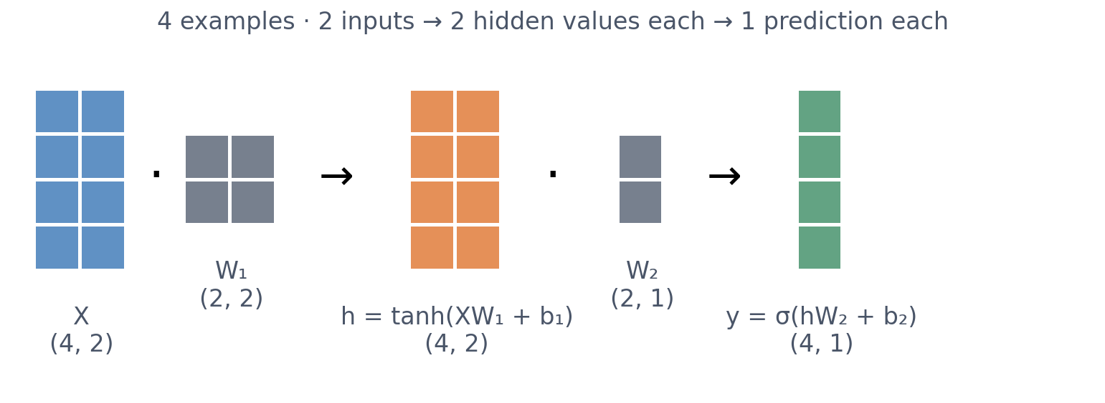
5 · WHY A HIDDEN LAYER HELPS
Shapes in the notebook's XOR network
Follow the shapes (Session 1's rules) and the training loop is this picture in code.
Printed in notebooks/session07-gradient-descent-xor.ipynb.

Slide 74

5 · WHY A HIDDEN LAYER HELPS
A short history
Minsky & Papert proved that single-layer perceptrons cannot solve XOR-like problems. Training through hidden layers became practical with backpropagation (Session 9).
See course.bioinfo.se/session07.html, 'A short history'.
Notes:
The book is widely credited with contributing to the first 'AI winter'. Multi-layer networks were known to be more powerful; the missing piece was a way to train them.

Slide 75

BLOCK 2 · QUIZ
Which logic function does the network compute?
h₁ = ReLU(x₁ + x₂), h₂ = ReLU(x₁ + x₂ − 1), z = h₁ − 2h₂, for x₁, x₂ in {0, 1}.
A AND
B OR
C XOR
D None: untrained weights compute nothing useful
Guess on your own
Scan the code, or go to
quiz.bioinfo.se/live
Notes:
The old discussion problem 3. Four inputs to compute by hand.

Slide 76
BLOCK 2 · QUIZ
Which logic function does the network compute?
How did the room answer?
Halt the round when most have answered, then show the results.
Show the results ▸ quiz.bioinfo.se/live/report
Notes:
Halt submission in the Control view, then open the results. Do not say which answer is right.

Slide 77

BLOCK 2 · QUIZ
Which logic function does the network compute?
Fix it, run it, discuss
Open the notebook: scan the code
Fix the line marked FIX, then run the cells
Did it come out as you guessed? Discuss with your neighbour
The notebook: https://colab.research.google.com/github/ElofssonLab/kb8029-book/blob/main/notebooks/session07-discussion-3.ipynb
Notes:
About 8 minutes. The notebook's relu does nothing (relu = lambda t: t): run as it is, z = 2, 1, 1, 0, which is question 2 (no activation). Fixed with np.maximum(0, t), z = 0, 1, 1, 0: XOR. Ask question 3: could any weights without an activation give XOR?

Slide 78
BLOCK 2 · QUIZ
Which logic function does the network compute?
Answer again
Same question, after the discussion.
quiz.bioinfo.se/live
Notes:
Open the second round (post) in the Control view.

Slide 79
BLOCK 2 · QUIZ
Which logic function does the network compute?
Results, and who explains
Both rounds side by side.
Draw two to explain: one of you says how you reasoned.
Show the results ▸ quiz.bioinfo.se/live/report
To check it with code afterwards: discussion notebook 3 https://colab.research.google.com/github/ElofssonLab/kb8029-book/blob/main/notebooks/session07-discussion-3.ipynb
Notes:
XOR: z = 0, 1, 1, 0. Without the ReLU, z = 2 - x1 - x2 (2, 1, 1, 0). For any weights, W2(W1 x + b1) + b2 = (W2 W1) x + (W2 b1 + b2): one weighted sum, one line, never XOR.

Slide 80

BLOCK 2 · QUIZ
The answer: XOR, and only with the ReLU
With ReLU the network gives 0, 1, 1, 0: XOR. The unfixed notebook had no activation and gave 2, 1, 1, 0. Without an activation, layers multiply out to one weighted sum for any weights, and one weighted sum draws one line: never XOR.

Slide 81
BLOCK 2 DONE
Break

Slide 82
BLOCK 3 · ABOUT 30 MIN
Biology, and why representation matters

Slide 83

6 · BIOLOGICAL ANALOGUES
Bulyk et al. (2002): binding positions are not independent
A toy motif: strong binding with one purine and one pyrimidine. (a) The 16 sites. (b) The logo of the strong sites: each base 2 of 8, 0 bits… (c) …yet the pair decides binding completely. A logo, like a profile, sees one position at a time.
Bulyk, Johnson & Church (2002), Nucleic Acids Res 30:1255. The toy motif is illustrative, not the paper's data.
Notes:
Protein-binding microarrays of Zif268 and its mutants against all 64 central triplets: the effect of one position depends on the others, so neither a consensus nor a position weight matrix describes the specificity. The toy motif (strong binding when one position is a purine and the other a pyrimidine) is the XOR table.

Slide 84

6 · BIOLOGICAL ANALOGUES
Another fix: change the input, not the model
▪ Add x₁x₂ as a third input
▪ XOR = x₁ + x₂ − 2x₁x₂: linear
▪ But someone must know x₁x₂ matters
▪ A hidden layer learns such features
See course.bioinfo.se/session07.html, 'A different fix: change the input'.
Notes:
Weights (1, 1, -2), bias 0 reproduce XOR exactly. For real binding sites or secondary structure nobody knows the useful interaction terms in advance. The general lesson, which returns at the end: the representation of the input can turn an impossible problem into an easy one.

Slide 85

6 · SECONDARY STRUCTURE
Helix, strand, coil: a label for every residue
▪ Helix: H-bonds 4 residues apart
▪ Strand: H-bonded edge to edge in a sheet
▪ Coil: everything else
▪ Predict one of three labels per residue
See course.bioinfo.se/session07.html, 'Secondary structure prediction: PHD'.
Notes:
Secondary structure is the local backbone shape, short of the full 3D fold of Session 6. Ubiquitin is used here because it has all three classes; HBB, the running example, has no strands.

Slide 86

6 · SECONDARY STRUCTURE
GOR (1978): three profiles over a 17-residue window
Each residue in the window adds a value to the helix, strand and coil scores; the largest total wins. Three weighted sums: a linear model, picture 1.
Garnier, Osguthorpe & Robson (1978), J Mol Biol 120:97. Background for the capstone project (optional box on the page).
Notes:
Chou & Fasman (1974) used residue propensities plus nucleation and extension rules, about 50-60%. GOR summed information over a window, about 65%. Both are good baselines for the capstone project. Bar heights are illustrative.

Slide 87

6 · SECONDARY STRUCTURE
Single sequences got stuck at about 65%
▪ Rules, windows, even a neural network
▪ Qian & Sejnowski 1988: 64%
▪ Then PHD: 71%. What changed?
Historical consensus figures (Wikipedia, 'Protein structure prediction'); the papers used different test sets.
Notes:
Qian & Sejnowski trained a network with a hidden layer on single-sequence windows and concluded that no method based only on local sequence information is likely to do much better. The limit was the information in the input. Keep PHD's bar as the cliffhanger.

Slide 88

6 · SECONDARY STRUCTURE
Same ten residues, different structure
QGTAVVVSAA: helix in a malate oxidoreductase (1VL6), strand and coil in an antibody heavy chain (4JB9). A window of local sequence alone cannot decide.
Li et al. (2015), ChSeq, Protein Sci 24:1075; Kabsch & Sander (1984), PNAS 81:1075.
Notes:
Ask: how could any method that only sees this window get both right? Then: what else do we know about each protein? Its family.

Slide 89

6 · SECONDARY STRUCTURE
From letters to numbers: one-hot, and profiles
One residue = 20 numbers with a single 1 (not A = 1, C = 2, which implies a false order). A profile column is the average of the aligned sequences' one-hot vectors.
Profile from the Pfam globin seed alignment (Session 4).
Notes:
13 residues one-hot = 260 inputs. Alternatives worth naming: physicochemical properties, BLOSUM rows, profiles, learned embeddings (Session 11). An embedding layer is a linear layer applied to a one-hot vector: the matrix product picks out one row.

Slide 90
6 · SECONDARY STRUCTURE
PHD (1993): the input was the innovation
▪ A profile from a multiple alignment of homologs, not a single sequence
▪ Structure is more conserved than sequence
▪ The family shows what one sequence hides
+6-8
points from the
alignment alone
70.8%
three-state
accuracy
Rost & Sander (1993), J Mol Biol 232:584-599; Illergård, Ardell & Elofsson (2009).
Notes:
In Rost & Sander's words: 'a new key aspect is the use of evolutionary information in the form of multiple sequence alignments that are used as input in place of single sequences.' Structural cores evolve three to ten times more slowly than sequences, so homologs vary a helix in the ways helices tolerate.

Slide 91

6 · SECONDARY STRUCTURE
PHD: three levels
Level 1: profile window of 13 residues → network → H/E/L. Level 2: level-1 outputs for 17 residues → network (segments of plausible length). Level 3: a jury averages several networks.
Rost & Sander (1993); Session 9 returns to PHD.
Notes:
Each level is picture 2: weighted sums, a nonlinear activation, more weighted sums. Better input (profiles) plus a flexible model (hidden layers) did what additive scores on single sequences could not. PHD also reports a reliability index per residue.

Slide 92

6 · SECONDARY STRUCTURE
HBB: every residue has a label
▪ 2HHB chain B: 117 of 146 residues in helices
▪ No strands
▪ Haem between the helices; His63 above, His92 below
▪ Orange: the 13-residue window around His63
HBB (2HHB, chain B)
helix blue, coil grey
Rendered with PyMOL; secondary structure from the PDB entry.

Slide 93
6 · BIOLOGICAL ANALOGUES
Signal peptides: a weight matrix, then a network
▪ 1986, von Heijne: a weight matrix, −13 to +2
▪ One weighted sum per window: picture 1
▪ 1997, SignalP 1.0: networks on sliding windows
▪ Hidden layer: can combine positions, picture 2
▪ Early networks on a few dozen sequences overfitted (Session 8)
von Heijne (1986), NAR 14:4683; Nielsen et al. (1997), Protein Eng 10:1; history: Nielsen, Tsirigos, Brunak & von Heijne (2019), Protein J 38:200.
Notes:
Session 4 showed the motif. The 1986 matrix slides along the first 40 residues and puts the cleavage site where the sum is highest; like every profile it treats positions independently. SignalP 1.0 used two networks: one scores whether each position is inside a signal peptide (S-score), one recognises the cleavage site (C-score); the two are combined. A hidden layer can learn that a good cleavage site needs a hydrophobic stretch upstream.

Slide 94

7 · THE LAB
Two views of the same protein
Top: per-residue labels and the window PHD reads to label His63. Bottom: the lab's input, 20 amino-acid fractions, and its single target, the helix fraction 0.80.
Secondary structure from EBI's PDBe API; tools/builders/make_session07_hbb_views.py.
Notes:
Ask: which view keeps what you need to label residue 63? Composition keeps counts only; the window keeps order and neighbours. This sets up the lab question.

Slide 95

7 · THE LAB
Representation matters as much as the model
▪ Linear and MLP: a tie
▪ Composition has thrown away order
▪ No model recovers what is not in its input
Lab: 55 proteins from PDBe, 41 for training, 14 held out.
Notes:
Let groups answer 'why a tie?' before showing the right panel. A scrambled sequence has the identical composition vector, so every composition model predicts the same helix fraction for it. XOR plus x1x2, PHD's profiles and the lab all make the same point: the input sets what can be learned (Sessions 10-11).

Slide 96

7 · CAPSTONE PROJECT
Can you do better?
▪ Build your own predictor
▪ Which input: sequence, profile, embedding?
▪ Which model?
▪ Tested on proteins it has never seen?
See the Capstone project page. https://course.bioinfo.se/capstone.html
Notes:
Modern methods combining profiles or protein language models with deep networks reach about 85% on standard benchmarks. Chou-Fasman and GOR are useful baselines; the third question (homology-aware test sets) is the one most students get wrong.

Slide 97

3 · OUTLOOK
Representation beats model, again
▪ Language-model embeddings per residue
▪ A linear model on them: 74-79%
▪ With a small CNN: as good as MSAs
▪ If the input is good enough, how much model do you need?
Elnaggar et al. (2022), IEEE TPAMI 44:7112 (ProtTrans); Rost & Sander (1993). Try it in the capstone project.
Notes:
ProtTrans: logistic regression on ProtBert-BFD embeddings reached Q3 = 74.3-79.3% (CASP12 to NEW364), an 'advanced baseline' with no alignment at all. ProtT5 embeddings with a small CNN reached Q3 = 84.3% on NEW364, the same as NetSurfP-2.0, which uses multiple sequence alignments. PHD's 70.8% is on its own 1993 test set, so the comparison is indicative, not exact. This is today's lesson in its strongest form: the representation of the input matters as much as the model. The capstone project lets you test it yourself.

Slide 98
SUMMARY
What changed between the two pictures, and why does it allow XOR?
Top: one weighted sum draws one straight boundary (AND, OR, NAND; never XOR). Bottom: hidden units with a nonlinear activation draw several boundaries, and the output combines them. Either one can only use what is in its input.
See course.bioinfo.se/session07.html, 'Summary: the two pictures again'.
Notes:
Ask the title question to the room before summarising. If students can answer it, the session has succeeded.

Slide 99

BLOCK 3 · QUIZ
Which methods are picture 2?
Picture 2: a hidden layer with a nonlinear activation. Tick all that apply.
A PSSM
B Perceptron
C Logistic regression
D GOR
E MLP
F PHD
Guess on your own
Scan the code, or go to
quiz.bioinfo.se/live
Notes:
The old block 3 discussion, as a tick-all question. The trap: logistic regression and the perceptron have an activation too, at the output.

Slide 100
BLOCK 3 · QUIZ
Which methods are picture 2?
How did the room answer?
Halt the round when most have answered, then show the results.
Show the results ▸ quiz.bioinfo.se/live/report
Notes:
Halt submission in the Control view, then open the results. Do not say which answer is right.

Slide 101

BLOCK 3 · QUIZ
Which methods are picture 2?
Fix it, run it, discuss
Open the notebook: scan the code
Fix the line marked FIX, then run the cells
Did it come out as you guessed? Discuss with your neighbour
The notebook: https://colab.research.google.com/github/ElofssonLab/kb8029-book/blob/main/notebooks/session07-discussion-4.ipynb
Notes:
About 8 minutes. A binding site where base 2 must pair with base 1 (Bulyk). As it is, the PSSM, perceptron, logistic regression and the MLP without a hidden activation all score about 0.5. With activation="relu", the MLP scores 1.00: only picture 2 learns that two positions depend on each other.

Slide 102
BLOCK 3 · QUIZ
Which methods are picture 2?
Answer again
Same question, after the discussion.
quiz.bioinfo.se/live
Notes:
Open the second round (post) in the Control view.

Slide 103
BLOCK 3 · QUIZ
Which methods are picture 2?
Results, and who explains
Both rounds side by side.
Draw two to explain: one of you says how you reasoned.
Show the results ▸ quiz.bioinfo.se/live/report
To check it with code afterwards: discussion notebook 4 https://colab.research.google.com/github/ElofssonLab/kb8029-book/blob/main/notebooks/session07-discussion-4.ipynb
Notes:
MLP and PHD. PSSM, perceptron, linear and logistic regression and GOR are one weighted sum, with or without an activation at the output. The crucial difference is a nonlinear activation between two weighted sums. And neither picture can use information that is not in its input (the lab).

Slide 104

BLOCK 3 · QUIZ
The answer: MLP and PHD; the others are one weighted sum
An activation at the output (the perceptron's step, logistic regression's sigmoid) does not make a hidden layer. What makes picture 2 is a nonlinear activation between two weighted sums. Either picture can only use what is in its input: the lab's question.

Slide 105
BEFORE YOU LEAVE
In up to three words: what was the hardest part of today?
Answer now
Scan the code, or go to
quiz.bioinfo.se/live
Notes:
A word cloud: the bigger the word, the more students wrote it. It shows what to repeat next time.

Slide 106
BEFORE YOU LEAVE
The hardest part of today
What the room found hardest
Show the results ▸ quiz.bioinfo.se/live/report

Slide 107
Session 8 next
From one yes/no output to multi-class: softmax regression
How do we know whether a model has learned anything useful?

