Slide 1

Session 9: How a Neural Network Learns, and Why Training Fails
KB8029 — Bioinformatics & Deep Learning
Arne Elofsson

Slide 2


BEFORE WE START
Log in to the lecture quiz
Log in to the quiz
Scan the code, or go to quiz.bioinfo.se/live
Log in with your university account
Answering counts as being at the lecture: up to 3 bonus points on the exam
Right or wrong is never graded, only whether you answered. Results are shown without names.
quiz.bioinfo.se/live
Notes:
The quiz is not anonymous, because answering is how attendance is counted: 3 bonus points on the main exam for answering in all 12 lectures, one point less per missed lecture (preliminary). Whether an answer is right or wrong is never used. The projected results never show names; the only names shown are the two drawn to explain their reasoning. Start the session on quiz.bioinfo.se before the lecture: quiz.bioinfo.se/live then leads to it.

Slide 3
BEFORE WE START
Warm-up: what do you know already?
3 quick questions
On the topics of today, one at a time, about 30 seconds each
Answer on your own, and guess if you do not know
It shows me where to start; right or wrong is never graded
Notes:
About 2 minutes in all. Open each question's round, halt it after about 30 seconds and glance at the results; do not explain the answers now, the lecture does that.

Slide 4
WARM-UP · 1 OF 3
The chain rule: if y = f(g(x)), then dy/dx is ...
A f′(x) · g′(x)
B f′(g(x)) · g′(x)
C f′(x) + g′(x)
D f(g′(x))
Answer now
Scan the code, or go to
quiz.bioinfo.se/live
Notes:
Right: f′(g(x)) · g′(x). Block 1: backpropagation is the chain rule, applied layer by layer.

Slide 5
WARM-UP · 2 OF 3
True label 1, prediction p = 0.01. The cross-entropy loss is −ln p. About how large?
A 0.01
B 0.99
C 4.6
D 100
Answer now
Scan the code, or go to
quiz.bioinfo.se/live
Notes:
Right: 4.6. −ln 0.01 = 4.6. Block 1: cross-entropy makes confident mistakes expensive.

Slide 6
WARM-UP · 3 OF 3
Training accuracy 100%, validation accuracy 60%. What is this?
A Underfitting
B Overfitting
C A learning rate that is too small
D A vanishing gradient
Answer now
Scan the code, or go to
quiz.bioinfo.se/live
Notes:
Right: Overfitting. Block 3.

Slide 7
BEFORE WE START
What the room knows already
Where we start
Which topics most of you know, and which we take slowly today.
Show the results ▸ quiz.bioinfo.se/live/report
Notes:
Optional: show two or three of the results, the ones that most got wrong.

Slide 8
BEFORE WE START
Your questions before today
What you asked
The questions you sent in on Canvas before the lecture
The most common ones now; the others in the block where they belong
Notes:
About 5 minutes. Read the answers to this session's Canvas survey 'Questions before the lecture' the evening before (it closes at 18:00 the day before the lecture), pick the two or three most common questions, and answer them briefly now or say in which block they come.

Slide 9
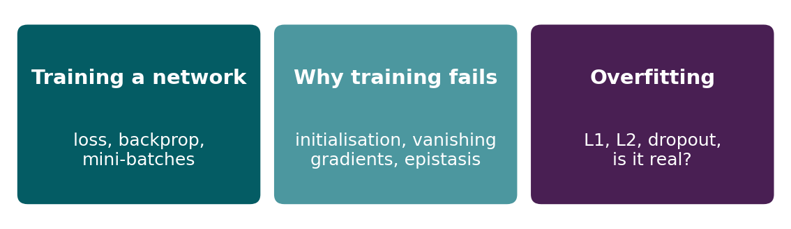
BEFORE WE START
In up to three words: what do you want to learn today?
Answer now
Scan the code, or go to
quiz.bioinfo.se/live
Notes:
A word cloud: the bigger the word, the more students wrote it. Come back to it at the end of the lecture.

Slide 10
BEFORE WE START
What you want to learn today
What the room wants to learn
Show the results ▸ quiz.bioinfo.se/live/report

Slide 11
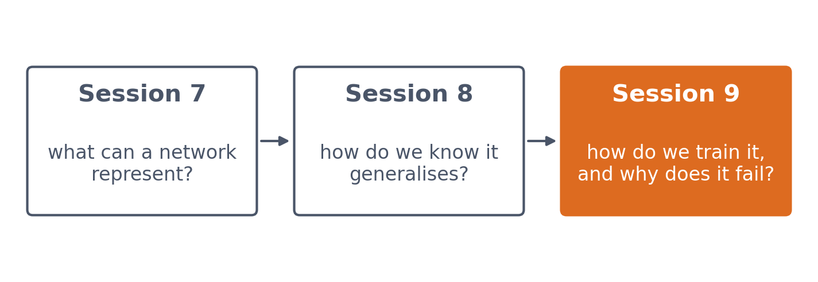
SESSION 9 · THE MAP
Session 8's network had random weights. How do we make it useful?
Sessions 7, 8 and 9 form one progression: what a network can represent, how we know it generalises, and how we actually train it.
See course.bioinfo.se/session09.html.
Notes:
Four datasets today: breast-cancer biopsies (the training loop), the GB1 fitness landscape (why training fails, when a hidden layer pays off), Session 8's localisation data (a network too large for its data) and blood-cell images in the lab.

Slide 12
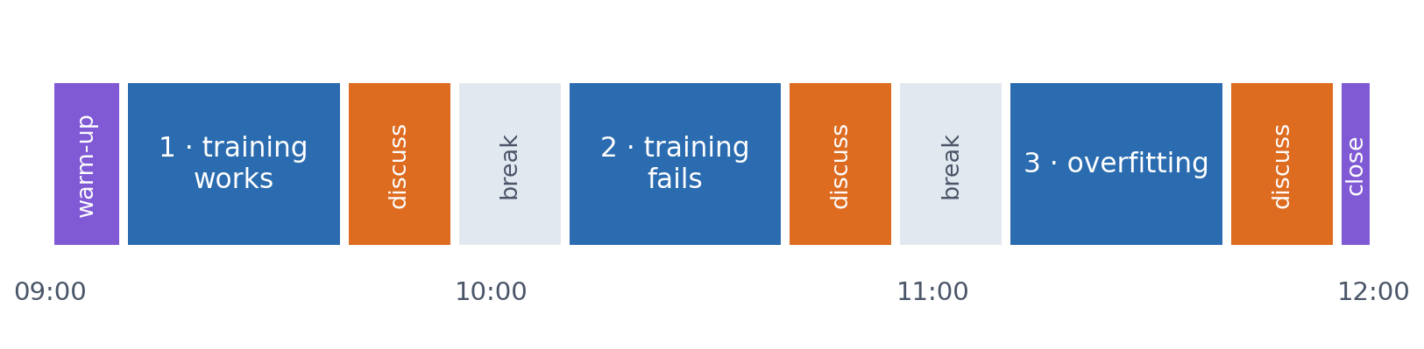
SESSION 9 · THE MORNING
Three blocks: about 30 min talk and 15 min discussion
Block 1: the training loop, backpropagation and the loss. Block 2: why training fails, and when a hidden layer pays off. Block 3: overfitting, regularisation, and whether the improvement is real.
Times are approximate: a 10 min start (warm-up quiz and your questions), two 15 min breaks and a 5 min close. Each block ends with a quiz question: guess, run the notebook and work out why it behaves as it does, discuss, answer again.

Slide 13
BLOCK 1 · ABOUT 30 MIN
From an untrained network to a trained one

Slide 14
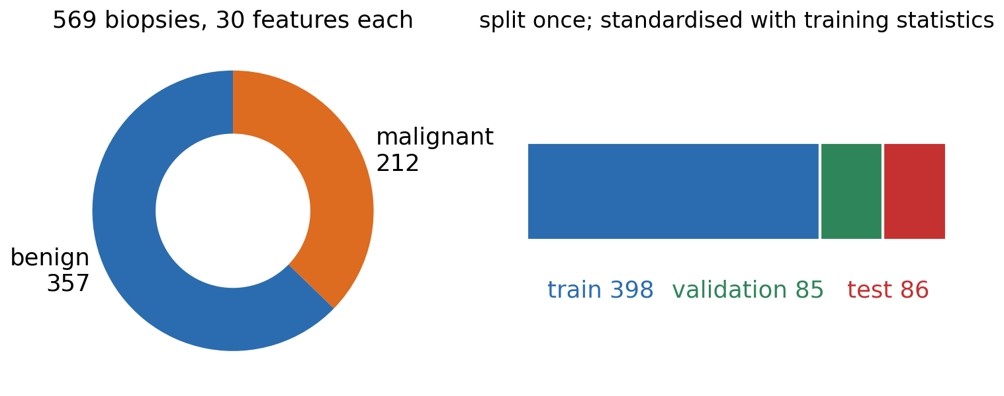
1 · THE TRAINING CYCLE
Breast cancer: 569 biopsies
▪ 30 features per biopsy
▪ Size and shape of the nuclei
▪ Network 30 → 16 → 1
▪ 513 weights
Breast Cancer Wisconsin (Diagnostic), UCI, via scikit-learn; notebook Section 1.
Notes:
Fine-needle biopsies, features measured on microscope images of the cell nuclei (radius, texture, perimeter, smoothness, concavity...). One hidden layer of 16 ReLU units and one output. Features are standardised with statistics from the training set only (Session 8).

Slide 15
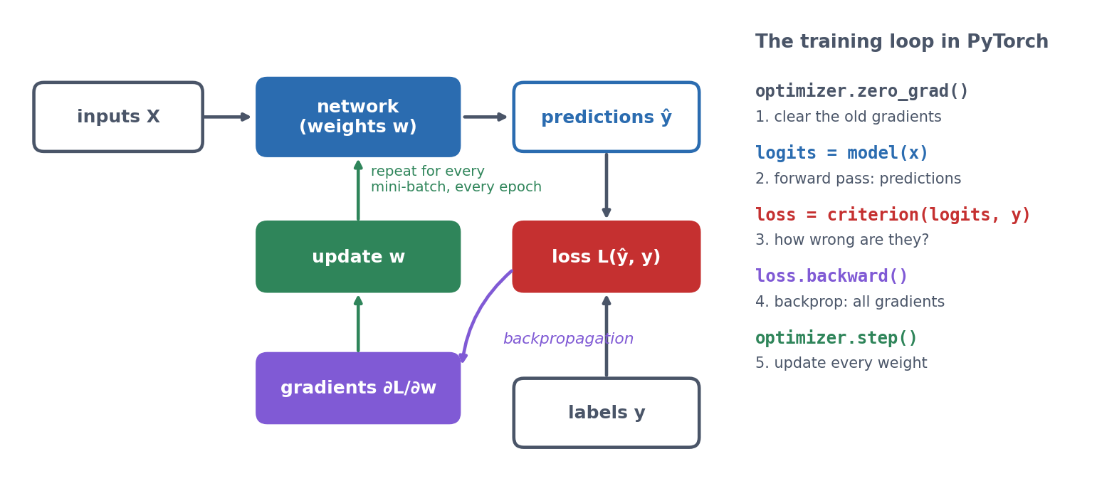
1 · THE TRAINING CYCLE
Predict, measure the loss, compute gradients, update, repeat
The same five lines run for every mini-batch in every epoch. You write this loop yourself in the lab.
See course.bioinfo.se/session09.html, 'From an untrained network to a trained network'.
Notes:
zero_grad clears the old gradients (PyTorch adds them up otherwise), the forward pass gives logits, the criterion measures how wrong they are, backward computes every gradient, step updates every weight.

Slide 16
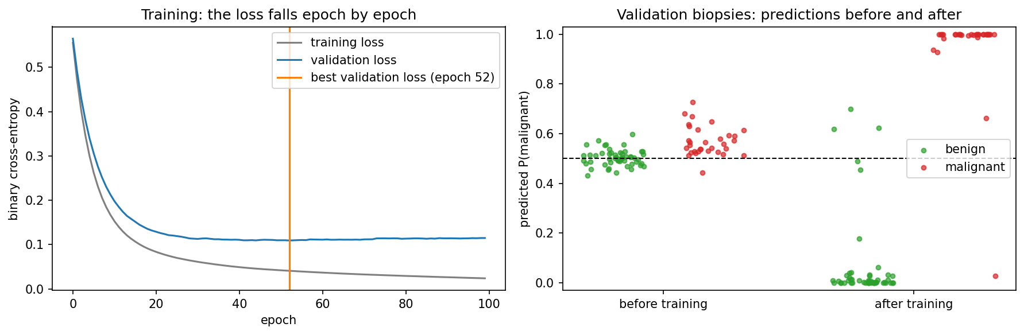
1 · THE TRAINING CYCLE
Training turns guesses into predictions
Left: the loss per epoch; the validation loss is lowest at epoch 52 (early stopping). Right: before training every prediction sits near 0.5; after, benign go to 0 and malignant to 1.
Notebook, Section 1.
Notes:
Before training: validation loss 0.651, accuracy 0.659 (roughly the share of benign biopsies). After: validation loss 0.109, accuracy 0.953. The validation loss stops improving after about 50 epochs while the training loss keeps falling.

Slide 17
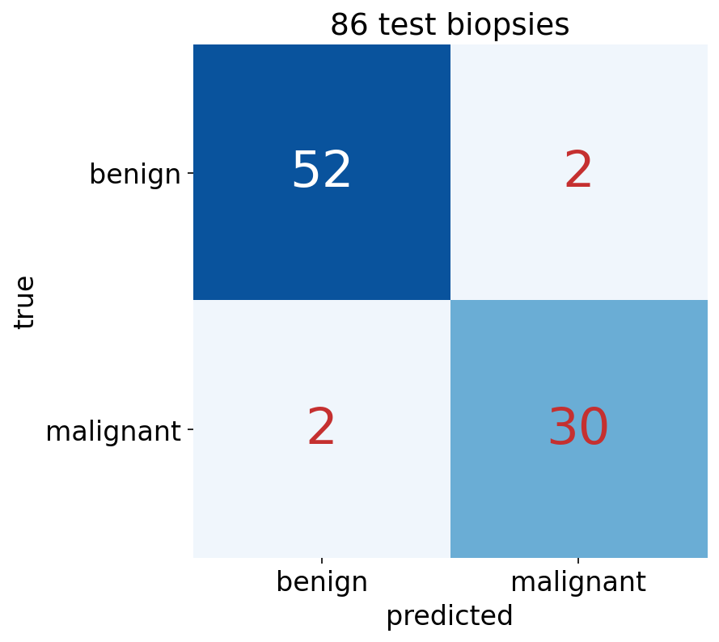
1 · THE TRAINING CYCLE
On the test set: 4 mistakes in 86
▪ Accuracy 0.953
▪ MCC 0.900
▪ AUROC 0.984
▪ 2 false alarms, 2 missed
Notebook, Section 1.

Slide 18
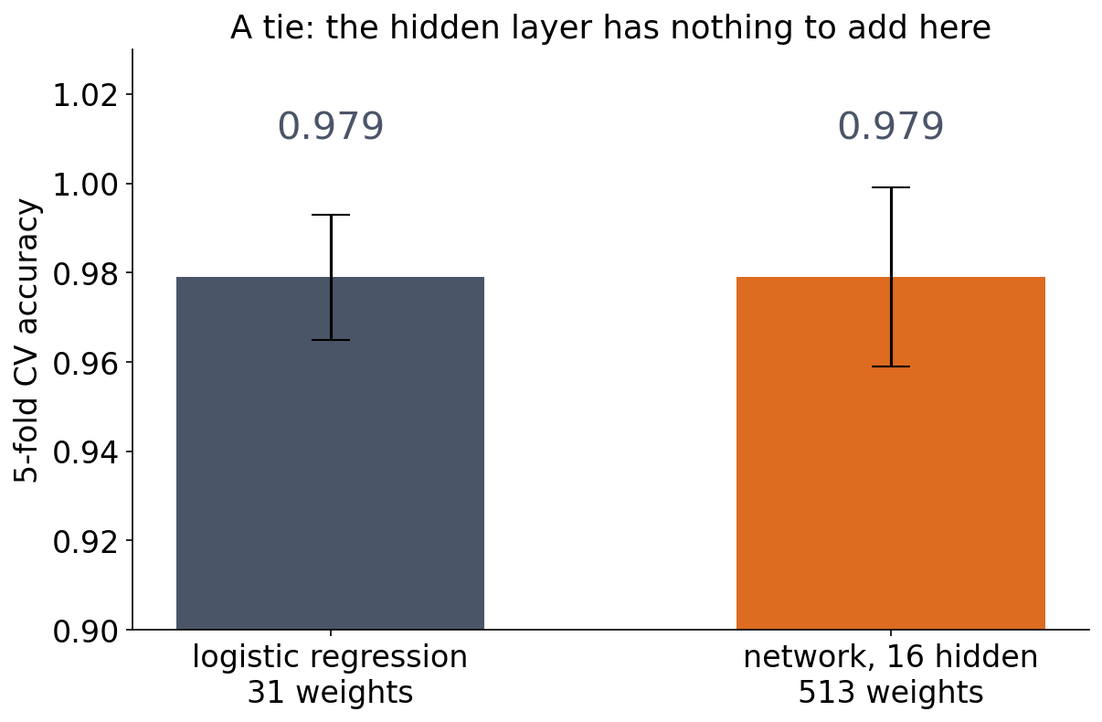
1 · THE TRAINING CYCLE
Was the hidden layer needed? No
▪ Same accuracy with 31 weights
▪ Nearly additive data
▪ Training works; capacity adds nothing
Notebook, Section 1: 5-fold cross-validation.
Notes:
Cross-validation, because one test split of 86 biopsies is too noisy for this comparison (Session 8). Malignant and benign nuclei differ mainly in size and shape, and a weighted sum of those measurements already separates them. Block 2 shows a dataset where the hidden layer does pay off.

Slide 19
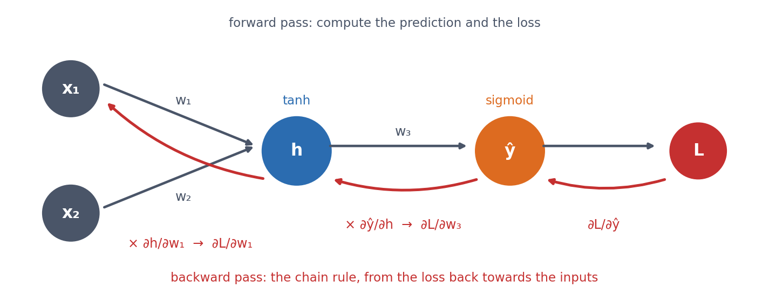
2 · BACKPROPAGATION
How does the network know which weights to change?
The chain rule, from the loss backwards: ∂L/∂ŷ is computed once and reused for w₃, then multiplied by ∂ŷ/∂h and reused for w₁ and w₂.
See course.bioinfo.se/session09.html, 'How backpropagation finds every gradient'.
Notes:
∂L/∂w1 = ∂L/∂ŷ · ∂ŷ/∂h · ∂h/∂w1. Each layer's error signal is computed once and reused for all the weights feeding into it, so computing all gradients costs about as much as one forward pass. Without that reuse, networks with millions of weights could not be trained.

Slide 20
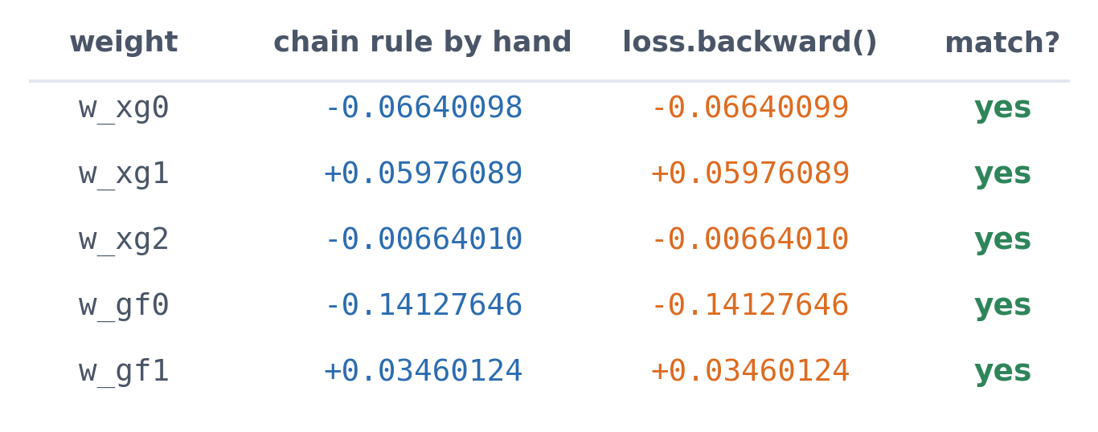
2 · BACKPROPAGATION
By hand and by autograd: the same five gradients
The notebook differentiates the tiny network by hand with the chain rule, then calls loss.backward(). They agree to eight decimal places; from now on autograd does the work.
Notebook, Section 2.

Slide 21
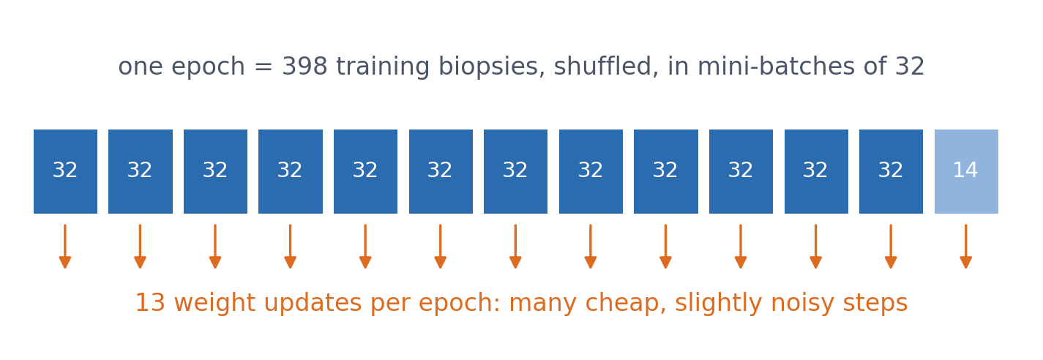
2 · BACKPROPAGATION
Mini-batches: many cheap steps per epoch
▪ Stochastic gradient descent
▪ Shuffle every epoch
▪ Validate after every epoch
See course.bioinfo.se/session09.html; DataLoader with batch size 32.
Notes:
A DataLoader shuffles the training set every epoch and serves it in batches of 32 biopsies; the weights are updated after every batch. Each epoch is many cheap, slightly noisy steps instead of one expensive exact step. After each epoch we measure the validation loss and keep the best weights (early stopping).

Slide 22
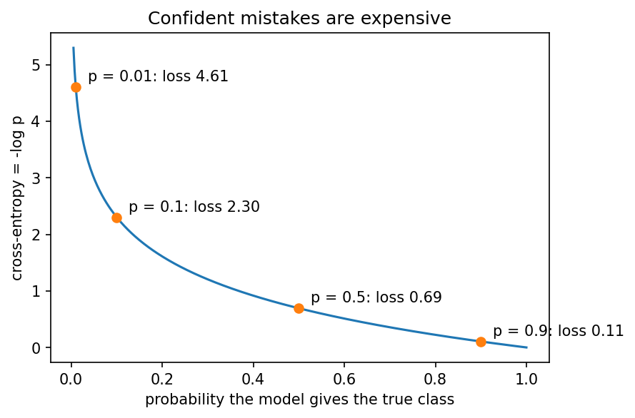
3 · WHICH LOSS?
Cross-entropy: confident mistakes are expensive
▪ CE = −log p(true class)
▪ p = 0.9 costs 0.105
▪ p = 0.01 costs 4.6
▪ Regression: mean squared error
See course.bioinfo.se/session09.html, 'Which loss to minimise'.
Notes:
Cross-entropy is the surprise of Session 1; averaged over a dataset it is the negative log-likelihood, so minimising it is maximum likelihood. In PyTorch, BCEWithLogitsLoss (two classes) and CrossEntropyLoss (more) combine the sigmoid or log-softmax with the loss in one numerically stable step, so the model outputs raw logits (Session 8). Optional: cross-entropy = H(P) + KL(P‖Q).

Slide 23
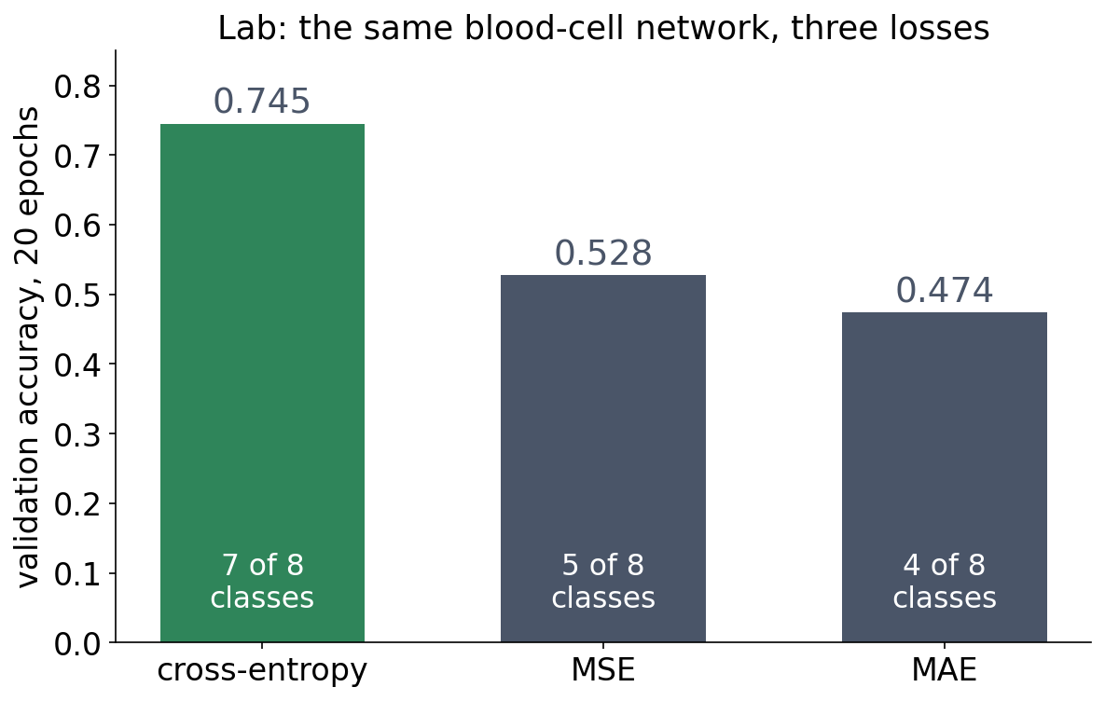
3 · WHICH LOSS?
In the lab: cross-entropy trains best
▪ Same network, same data
▪ MSE and MAE give up on classes
▪ Cross-entropy pushes classes apart
Session 9 lab, executed solution (BloodMNIST, 8 classes).
Notes:
With MSE or MAE the network predicts only five or four of the eight classes after 20 epochs. A confident mistake costs little under MSE, so the gradient pushing classes apart is weak.

Slide 24
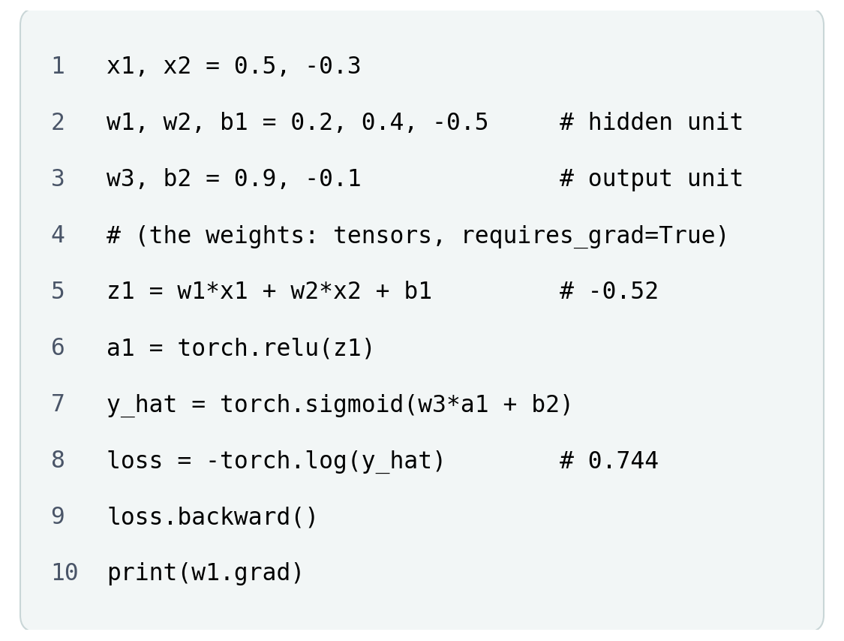
BLOCK 1 · QUIZ
What is w1.grad?
Two inputs, one ReLU hidden unit, one sigmoid output. The hidden unit's input is z1 = −0.52.
A About −0.24: the error flows back to w1
B Exactly 0: ReLU passes nothing back for z < 0
C Small but not zero, as with tanh
D −0.52, the value of z1
Guess on your own
Scan the code, or go to
quiz.bioinfo.se/live
Notes:
The old discussion problem 1: the book's tiny network with ReLU instead of tanh. Let them guess before computing; the loss is 0.744, so the network has something to learn.

Slide 25
BLOCK 1 · QUIZ
What is w1.grad?
How did the room answer?
Halt the round when most have answered, then show the results.
Show the results ▸ quiz.bioinfo.se/live/report
Notes:
Halt submission in the Control view, then open the results. Do not say which answer is right.

Slide 26

BLOCK 1 · QUIZ
What is w1.grad?
Fix it, run it, discuss
Open the notebook: scan the code
Fix the line marked FIX, then run the cells
Did it come out as you guessed? Discuss with your neighbour
The notebook: https://colab.research.google.com/github/ElofssonLab/kb8029-book/blob/main/notebooks/session09-discussion-1.ipynb
Notes:
About 8 minutes. The hand-written backward pass uses relu_deriv = 1.0, so it gets dL/dw1 = −0.236 (the first answer), and autograd disagrees for w1, w2 and b1. Fixed (1.0 if z1 > 0 else 0.0), all five agree: 0 for w1, w2, b1 and w3, −0.525 for b2.

Slide 27
BLOCK 1 · QUIZ
What is w1.grad?
Answer again
Same question, after the discussion.
quiz.bioinfo.se/live
Notes:
Open the second round (post) in the Control view.

Slide 28
BLOCK 1 · QUIZ
What is w1.grad?
Results, and who explains
Both rounds side by side.
Draw two to explain: one of you says how you reasoned.
Show the results ▸ quiz.bioinfo.se/live/report
To check it with code afterwards: discussion notebook 1 https://colab.research.google.com/github/ElofssonLab/kb8029-book/blob/main/notebooks/session09-discussion-1.ipynb
Notes:
Exactly 0. ReLU's derivative is 0 for a negative input, so the error stops at the hidden unit: w1, w2 and b1 do not move however large the loss. Only b2 learns on this example. A unit whose input is negative for every example never learns again: a dead ReLU. Tanh only gets small, never exactly 0.

Slide 29
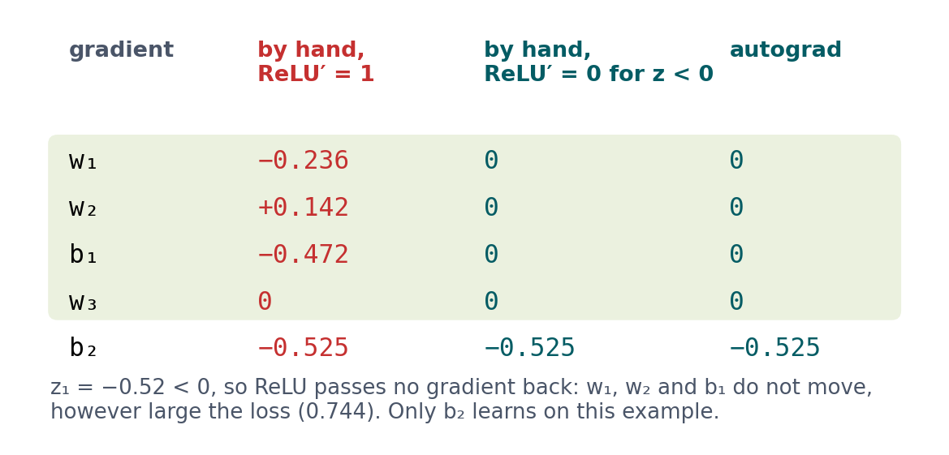
BLOCK 1 · QUIZ
The answer: exactly 0; ReLU passes no gradient for z < 0
The chain rule multiplies by ReLU's local derivative, which is 0 for z₁ < 0. So w₁, w₂ and b₁ get gradient exactly 0, and w₃ too (a₁ = 0); only b₂ learns. The notebook's hand calculation assumed a derivative of 1 and got −0.236: comparing with autograd catches it.

Slide 30
BLOCK 1 DONE
Break

Slide 31
BLOCK 2 · ABOUT 30 MIN
Why training fails, and when a hidden layer pays off

Slide 32
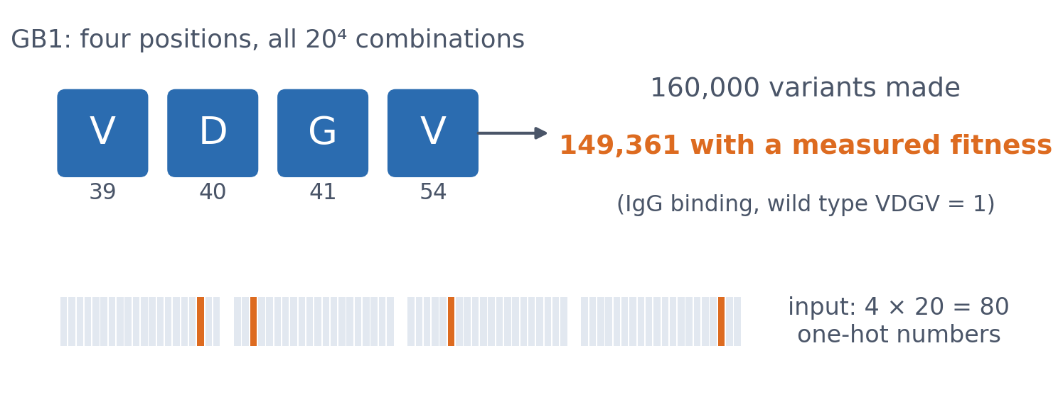
4 · WHY TRAINING FAILS
GB1: a protein fitness landscape
▪ Predict log₁₀ fitness
▪ 20,000 variants for training
▪ Mean predictor: MAE 0.488
▪ Working network: 0.250
Wu et al. (2016) eLife 5:e16965, via FLIP; notebook Section 4.
Notes:
GB1 is a small domain of protein G that binds IgG. Wu et al. made all 20^4 combinations at V39, D40, G41 and V54 and measured binding by deep sequencing. We use 20,000 training, 5,000 validation and 20,000 test variants. Each failure below changes one thing in a working 64/64 network. Rule: change one thing, see what happens, explain why.

Slide 33
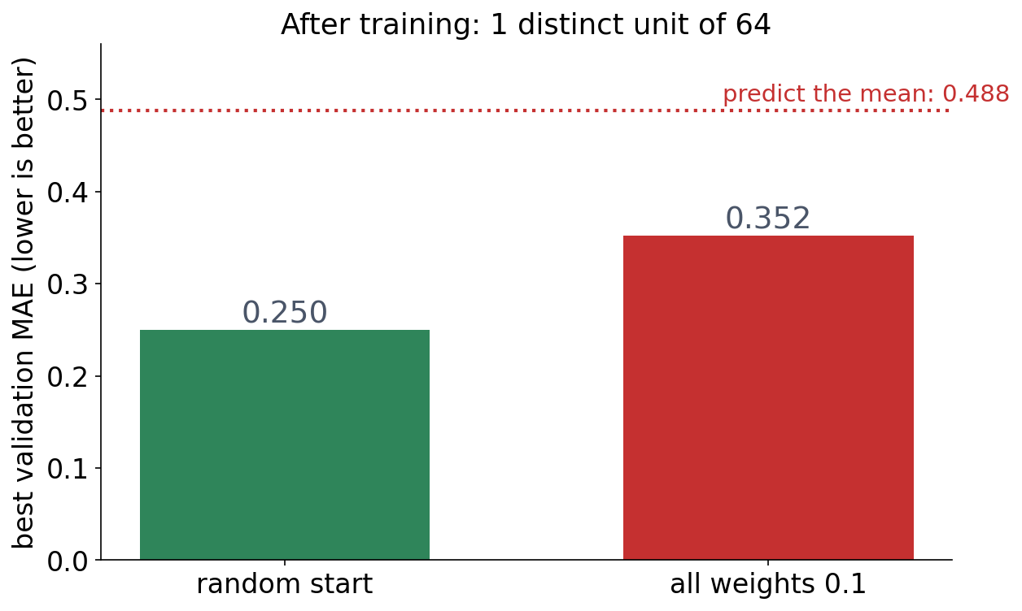
4 · FAILURE 1
Every weight starts the same
▪ Same weights → same gradient
▪ 64 units behave like one
▪ Fix: random initialisation
Notebook, Section 4.
Notes:
Start all weights at 0.1 instead of small random numbers: validation MAE 0.352, little better than the additive model's 0.371. Every hidden unit computes the same thing and receives the same gradient, so they stay identical for ever. Random initialisation breaks the symmetry; PyTorch does it by default.

Slide 34
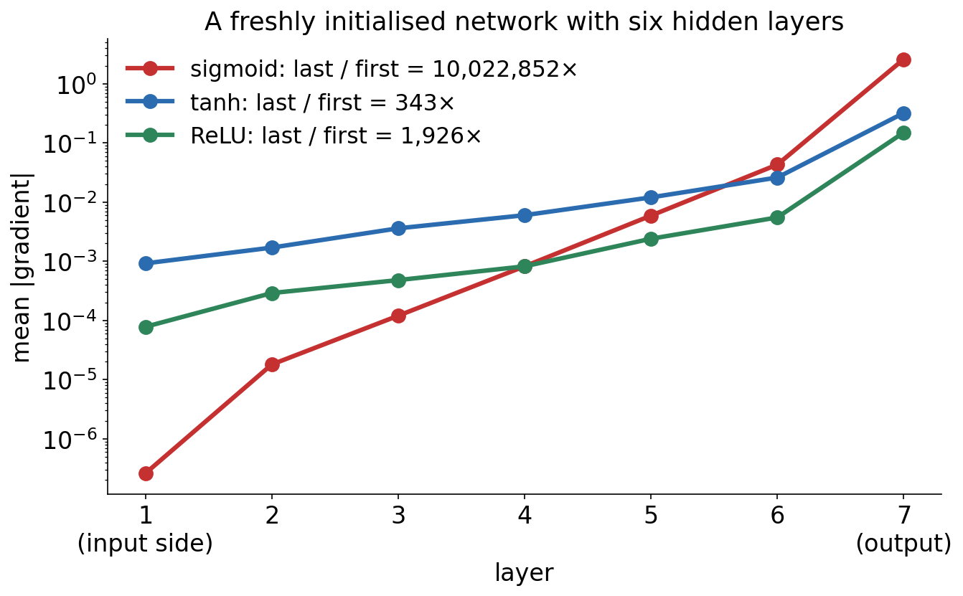
4 · FAILURE 2
Deep sigmoid networks: the gradient vanishes
Backpropagation multiplies one activation derivative per layer. With sigmoid, the first layer of a freshly initialised six-layer network gets ten million times less gradient than the last.
Notebook, Section 4.
Notes:
Sigmoid's derivative is at most 0.25, so even in the best case six layers multiply the gradient by 0.25^6 ≈ 0.00024. Measured: ratio 10,022,852 for sigmoid, 343 for tanh and 1,926 for ReLU. The first layers barely move.

Slide 35
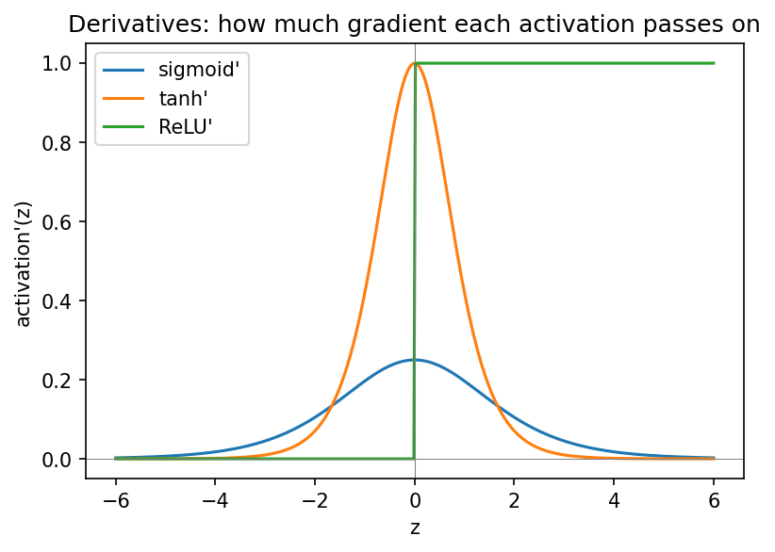
4 · FAILURE 2
How much gradient does each activation pass on?
▪ Sigmoid: at most 0.25
▪ tanh: 1 at 0, vanishes in the tails
▪ ReLU: exactly 0 or 1
Notebook, Section 4.
Notes:
sigmoid'(6) = 0.0025, tanh'(6) = 0.00002. ReLU never shrinks the gradient for positive input, which is why it is the default for hidden layers; its flat side can kill a unit (the first discussion).

Slide 36
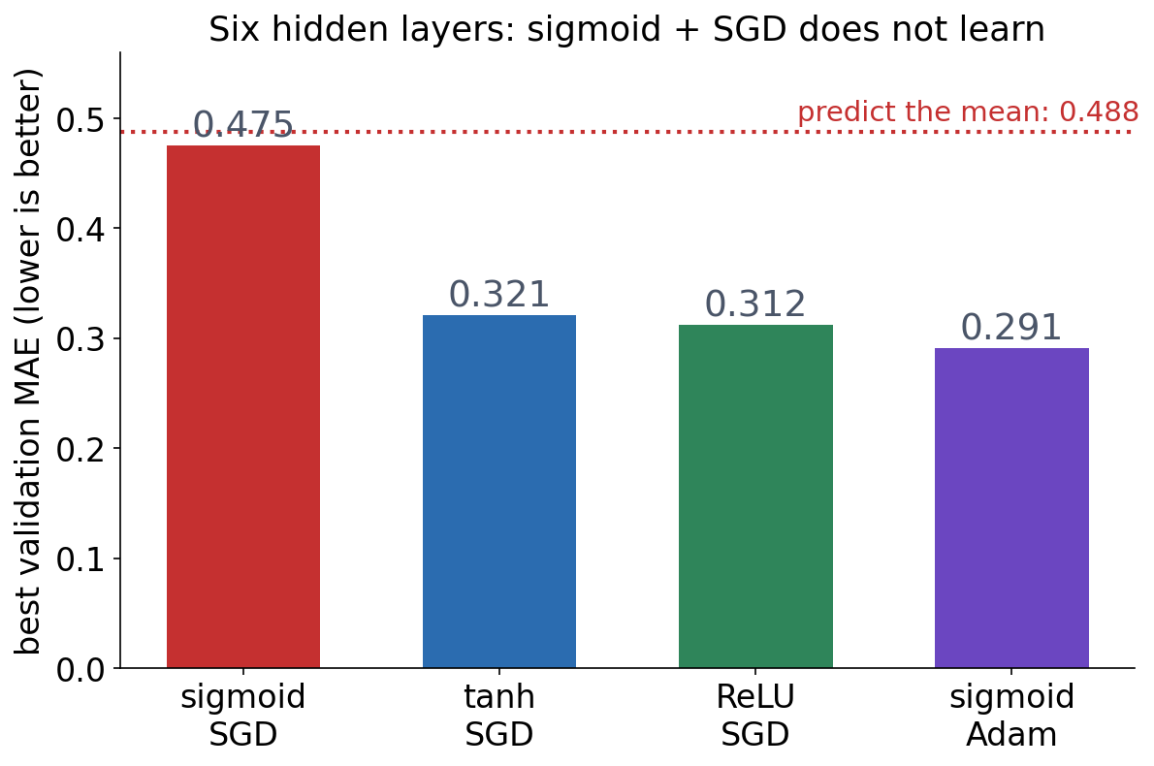
4 · FAILURE 2
Six sigmoid layers do not learn at all
▪ Fix: change what the gradient passes through
▪ ReLU, scaled initialisation
▪ Normalisation, residual connections
▪ Adam: a workaround, not a cure
Notebook, Section 4; Ioffe & Szegedy (2015) for batch normalisation.
Notes:
Sigmoid with SGD stays at about 0.48, the error of predicting the mean. tanh 0.321, ReLU 0.312. Adam gets the sigmoid network to 0.291 by enlarging the tiny steps, but the gradients still vanish. Vanishing gradients return in deep CNNs (Session 10, residual connections), RNNs and Transformers (Session 11).

Slide 37
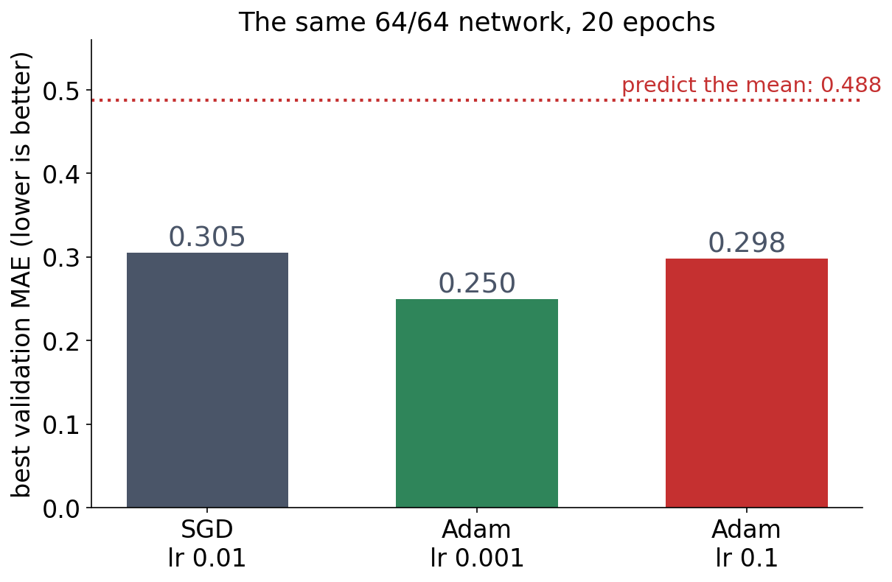
4 · FAILURE 3
The optimiser and the learning rate
▪ Too large: jumps around
▪ Plain SGD: one step size for all
▪ Start with Adam, lr ≈ 10⁻³
▪ Always watch the validation curve
Notebook, Section 4.
Notes:
With Adam and learning rate 0.1 the error jumps around and never gets below 0.298. Plain SGD with lr 0.01 reaches only 0.305 in 20 epochs, against 0.250 for Adam with lr 0.001.

Slide 38
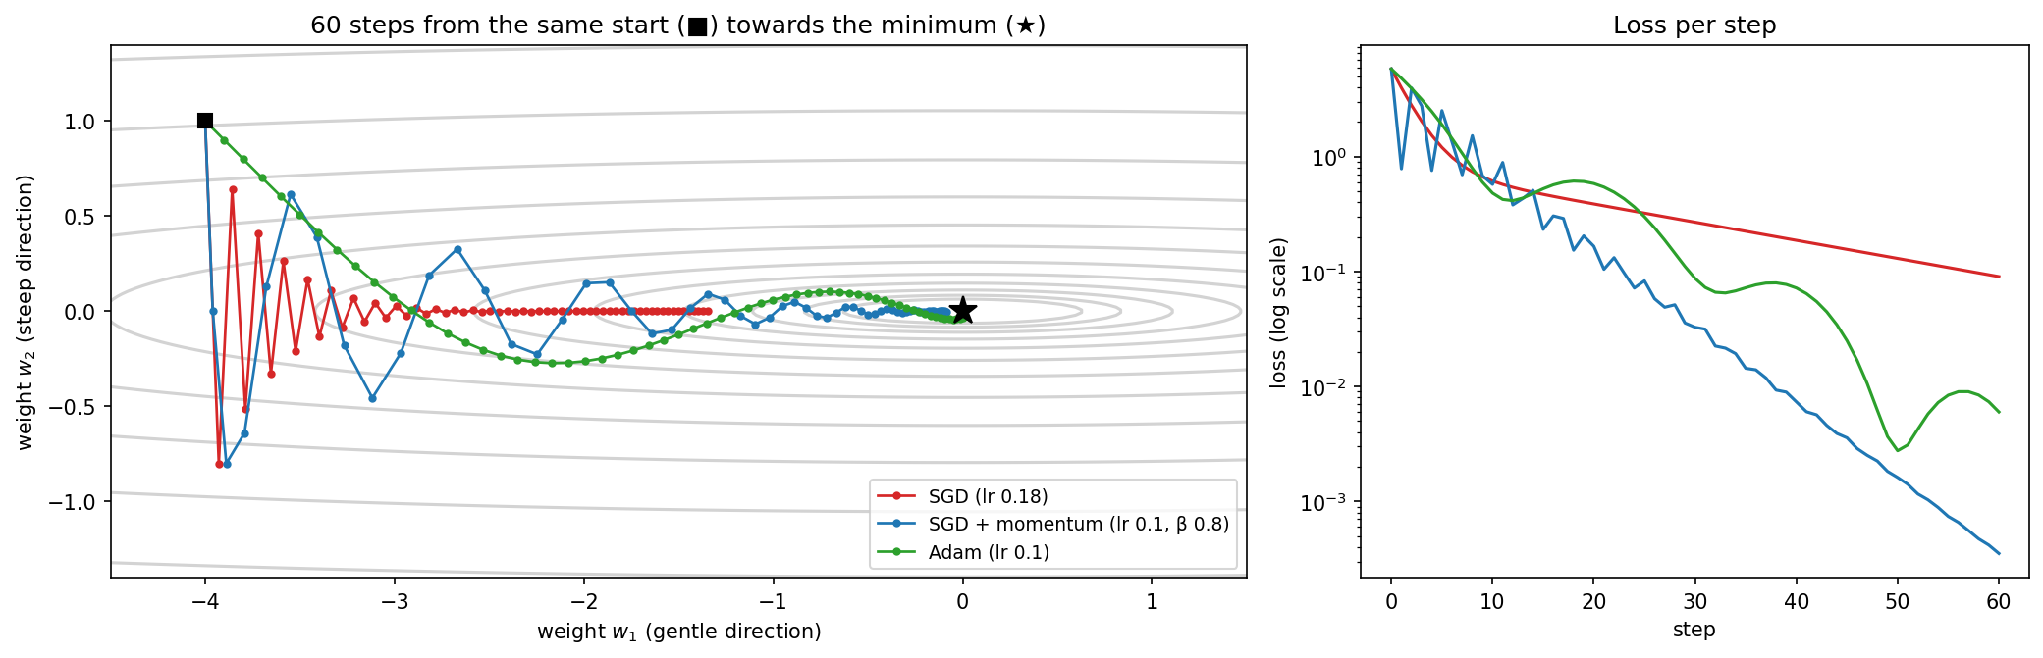
4 · MOMENTUM AND ADAM
Why can an optimiser beat plain SGD?
A valley 100× steeper across than along. SGD zigzags, then crawls (loss 0.09 after 60 steps). Momentum averages recent directions (0.0004). Adam adds a step size per weight (0.006).
Notebook, Section 4; Kingma & Ba (2015).
Notes:
Ask first: which direction does the gradient point in a narrow valley? Mostly across it. Momentum is a heavy ball: directions that agree add up, the zigzag cancels. Adam is a good default, not a universal winner: tuned momentum ends even lower here. Keep vanishing gradients separate: the fixes for those are architectural.

Slide 39
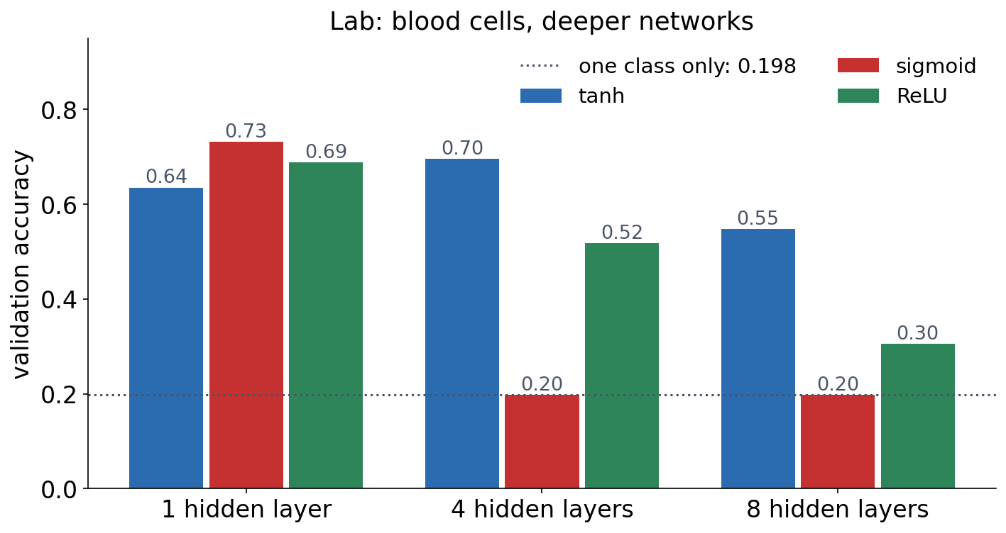
4 · IN THE LAB
The lab repeats the failures on blood cells
With 4 or 8 sigmoid layers the network predicts a single class (0.198). The sigmoid network's first-layer gradient is 2 million times smaller with 8 hidden layers than with 1.
Session 9 lab, executed solution.
Notes:
In the lab, SGD reaches 0.761, SGD with momentum 0.803 and Adam 0.802 with a 128-unit network. Rule: change one thing, see what happens, explain why.

Slide 40
4 · OBSERVATION → WHY → FIX
Three ways training fails
Equal start
Deep sigmoid
Learning rate
units stay identical
gradient vanishes
overshoot or crawl
▪ Same gradient for every unit
▪ Fix: random initialisation
▪ ≤ 0.25 per layer
▪ Fix: ReLU, init, normalisation, residuals
▪ One step size for all weights
▪ Fix: Adam, lr ≈ 10⁻³, watch validation
See course.bioinfo.se/session09.html, 'Why training fails'.

Slide 41
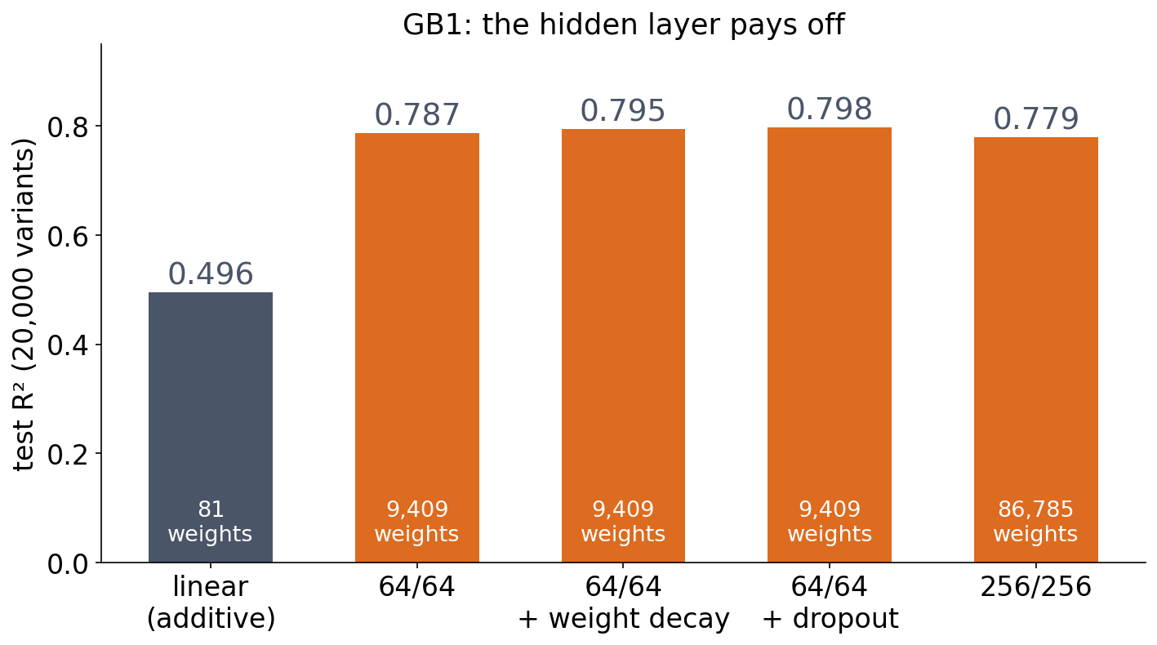
5 · WHEN A HIDDEN LAYER PAYS OFF
GB1: the network explains 79%, the sum 50%
▪ Linear on one-hot = a PSSM
▪ Cannot represent epistasis
▪ Ten times larger: no better
Notebook, Section 5; see the table on course.bioinfo.se/session09.html.
Notes:
A linear model gives every amino acid at every position its own weight and adds them up: an additive model, like a profile (Session 5). Epistasis, where the effect of a mutation depends on the other positions, is Session 7's XOR in a real protein. Weight decay and dropout help a little (0.795, 0.798); 256/256 with 86,785 weights gives 0.779.

Slide 42
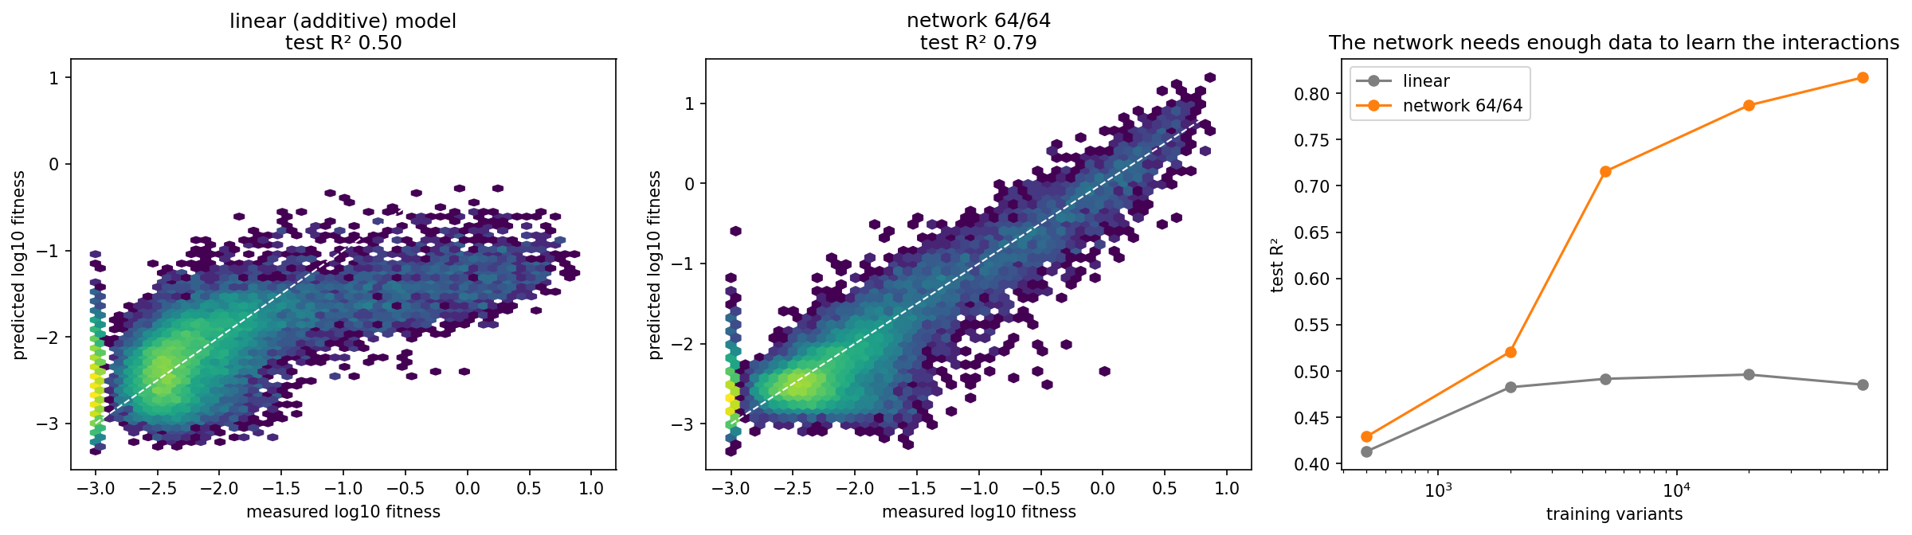
5 · WHEN A HIDDEN LAYER PAYS OFF
The additive model compresses; the network follows the diagonal
Predicted against measured log₁₀ fitness for 20,000 test variants: additive model (left, R² 0.50) and 64/64 network (middle, R² 0.79). Right: test R² against training-set size.
Wu et al. (2016); notebook Section 5.
Notes:
Ask first: what can a sum of per-position weights not represent? The additive model misses the fit variants.

Slide 43
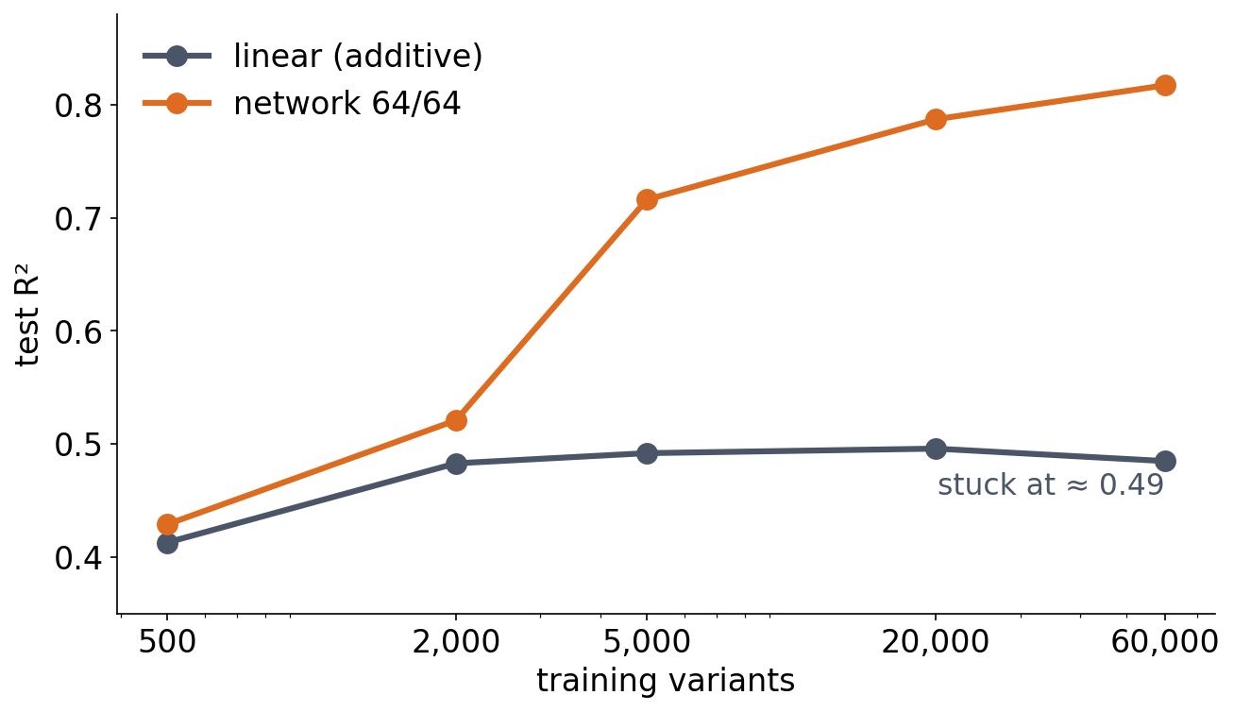
5 · WHEN A HIDDEN LAYER PAYS OFF
The network needs data to learn the interactions
▪ 500 variants: a tie
▪ Thousands: the network pulls away
▪ No data lets a sum represent an interaction
Notebook, Section 5.
Notes:
500 training variants: R² 0.413 (linear) vs 0.429 (network). 5,000: 0.492 vs 0.716. 60,000: 0.485 vs 0.817. This is also the limitation of profiles noted in Session 5; Session 12 returns to it with pairwise models learned from multiple alignments.

Slide 44
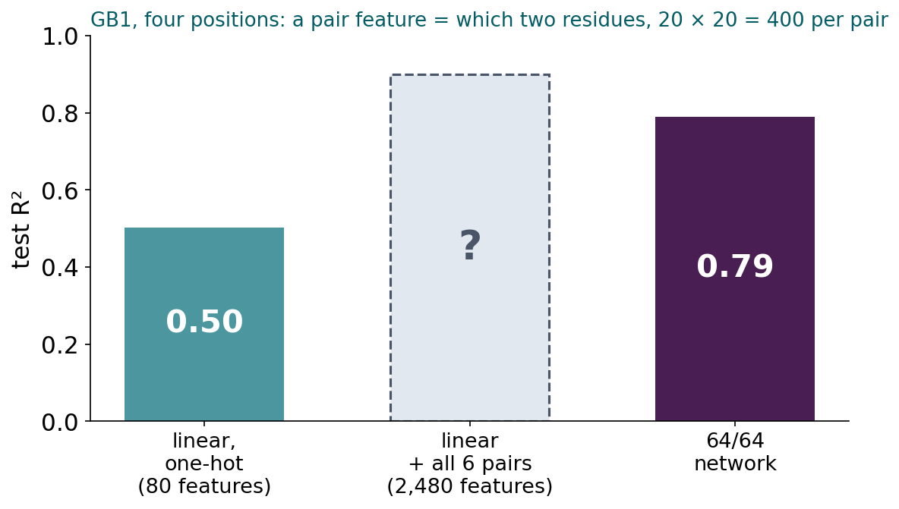
BLOCK 2 · QUIZ
What R² does the linear model reach with pair features?
GB1: linear on one-hot 0.50, 64/64 network 0.79. Add 400 features for each of the six pairs of positions.
A About 0.50: still linear, nothing changes
B About 0.74: most of the way to the network
C About 0.79 or above: matches the network
D Below 0.50: 2,480 features overfit
Guess on your own
Scan the code, or go to
quiz.bioinfo.se/live
Notes:
The old discussion problem 2: test the epistasis explanation the way Session 7 rescued a linear model on XOR, with interaction features. 20,000 training variants, the same split as the page.

Slide 45
BLOCK 2 · QUIZ
What R² does the linear model reach with pair features?
How did the room answer?
Halt the round when most have answered, then show the results.
Show the results ▸ quiz.bioinfo.se/live/report
Notes:
Halt submission in the Control view, then open the results. Do not say which answer is right.

Slide 46

BLOCK 2 · QUIZ
What R² does the linear model reach with pair features?
Fix it, run it, discuss
Open the notebook: scan the code
Fix the line marked FIX, then run the cells
Did it come out as you guessed? Discuss with your neighbour
The notebook: https://colab.research.google.com/github/ElofssonLab/kb8029-book/blob/main/notebooks/session09-discussion-2.ipynb
Notes:
About 8 minutes. The FIX line builds the pair feature from position a with itself (codes[:, a] * 20 + codes[:, a]), which adds nothing to the one-hot: R² stays 0.503, the first answer. Fixed with codes[:, b]: 0.743. Early finishers: one pair at a time (G41 × V54 alone gives 0.647).

Slide 47
BLOCK 2 · QUIZ
What R² does the linear model reach with pair features?
Answer again
Same question, after the discussion.
quiz.bioinfo.se/live
Notes:
Open the second round (post) in the Control view.

Slide 48
BLOCK 2 · QUIZ
What R² does the linear model reach with pair features?
Results, and who explains
Both rounds side by side.
Draw two to explain: one of you says how you reasoned.
Show the results ▸ quiz.bioinfo.se/live/report
To check it with code afterwards: discussion notebook 2 https://colab.research.google.com/github/ElofssonLab/kb8029-book/blob/main/notebooks/session09-discussion-2.ipynb
Notes:
About 0.74 (0.743). Most of the network's advantage is pairwise epistasis. Still a linear model: a weighted sum of fixed features, which now say which combination of residues is present. For 100 residues it would take about 2 million pair features; a hidden layer learns which combinations matter.

Slide 49
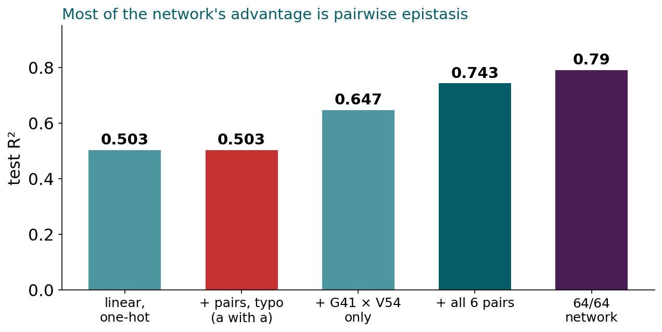
BLOCK 2 · QUIZ
The answer: about 0.74; most of the advantage is pairwise epistasis
Pair features take the linear model from 0.50 to 0.74, most of the way to the network's 0.79; G41 × V54 alone gives 0.65. Listing interactions works for four positions, not for a whole protein: a hidden layer learns the combinations that matter instead of listing them all.

Slide 50
BLOCK 2 DONE
Break

Slide 51
BLOCK 3 · ABOUT 30 MIN
Overfitting, and is the improvement real?

Slide 52
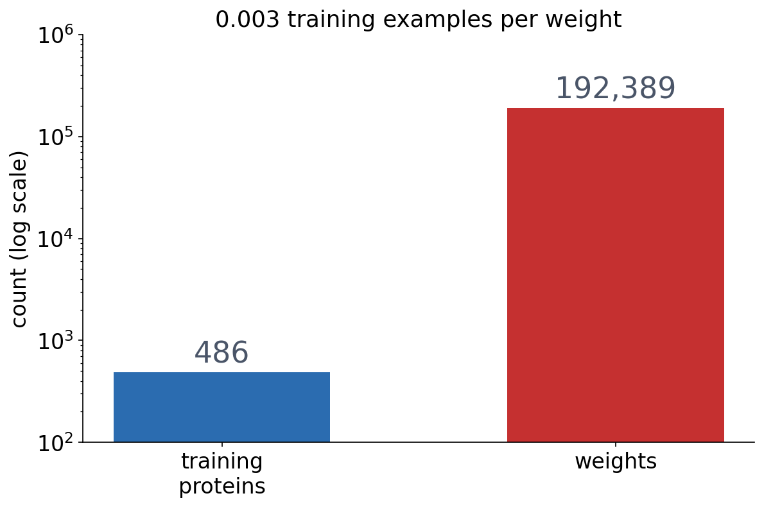
6 · WHY NOT MAKE IT ENORMOUS?
Session 8's localisation network: far more weights than data
▪ 3,000 inputs: 150 residues, one-hot
▪ 64 hidden units, 5 classes
▪ 486 proteins to learn from
Notebook, Section 6; homology-aware split of Session 8.

Slide 53
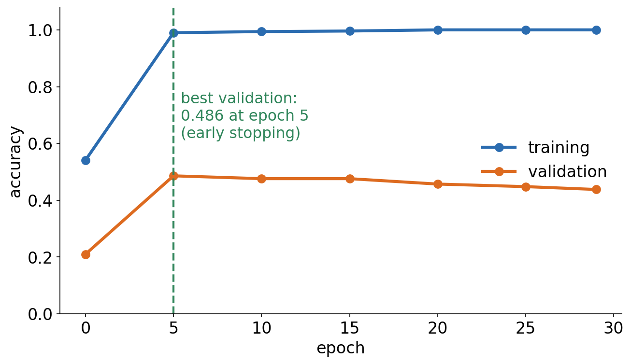
6 · WHY NOT MAKE IT ENORMOUS?
It memorises every training protein
▪ Training accuracy 1.000
▪ Validation peaks at epoch 5
▪ Then falls, to 0.438
▪ Overfitting in its plainest form
Notebook, Section 6.
Notes:
With far more freedom than data, the network learns the idiosyncrasies of the training sequences instead of the general signal.

Slide 54
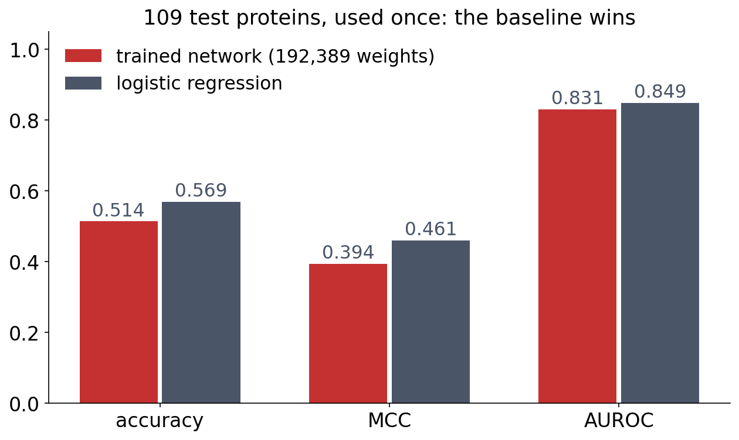
6 · WHY NOT MAKE IT ENORMOUS?
The simple baseline wins
▪ Every number far above chance
▪ Logistic regression is better
▪ Always compare with a baseline
Notebook, Section 6; test set used once.
Notes:
Chance accuracy is 0.20 for five balanced classes. The untrained network of Session 8 had validation accuracy 0.181 and MCC -0.027. Before believing that a bigger model is better, compare it with a simple baseline.

Slide 55
7 · WHAT CAN WE DO ABOUT OVERFITTING?
Five remedies
▪ More data: the most reliable fix
▪ A smaller model or a better architecture
▪ Early stopping
▪ Weight decay (L2) or L1
▪ Dropout
0.486
early stopping
(best validation)
0.476
+ dropout and
weight decay
See course.bioinfo.se/session09.html, 'What can we do about overfitting?'.
Notes:
On the localisation network, dropout and weight decay do not beat early stopping alone. Training accuracy still reaches 1.000 whatever we do, because 192,389 weights can always memorise 486 examples: regularisation is no substitute for data. Session 10's CNN needs 19,237 weights instead of 192,389.

Slide 56
7 · EARLY STOPPING
Two curves, two questions
Training loss: is optimisation working? Validation loss: does more optimisation still help generalisation? Keep the epoch with the best validation loss (here 52), and judge it on the test set once.
See course.bioinfo.se/session09.html, 'Early stopping'.
Notes:
If the training loss does not fall, something in Block 2 is wrong. When the validation loss stops falling while the training loss keeps going down, the network has started to fit the training set rather than the problem. Because the epoch is chosen on validation, only the test set gives an honest estimate.

Slide 57
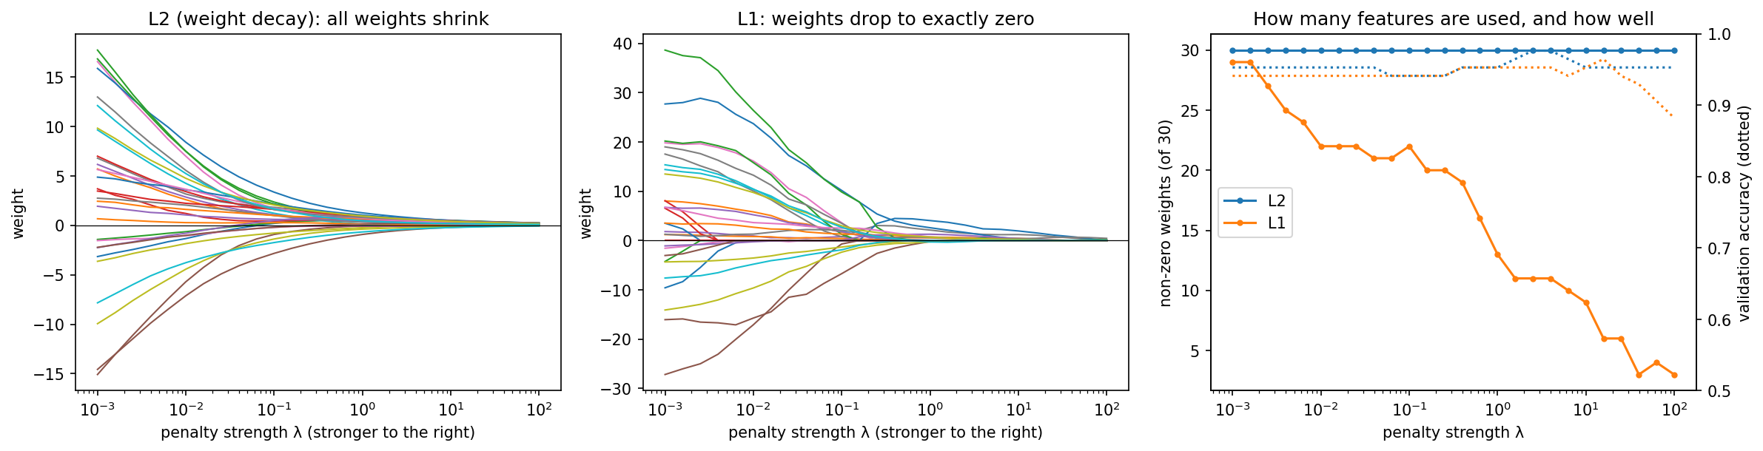
7 · PENALISING LARGE WEIGHTS
L2 shrinks every weight; L1 sets many to exactly zero
Loss + λΣw² (L2, weight decay) or + λΣ|w| (L1), with λ chosen on validation. Logistic regression on the 30 biopsy features; the penalty grows to the right.
Notebook, Section 7.
Notes:
Ask first: which penalty still pulls hard on a weight that is already tiny? L1's pull is constant (λ); L2's (2λw) fades with the weight. L2 shrinks every weight by the same fraction each step, hence 'weight decay', PyTorch's weight_decay argument. For linear regression: ridge (L2), lasso (L1).

Slide 58
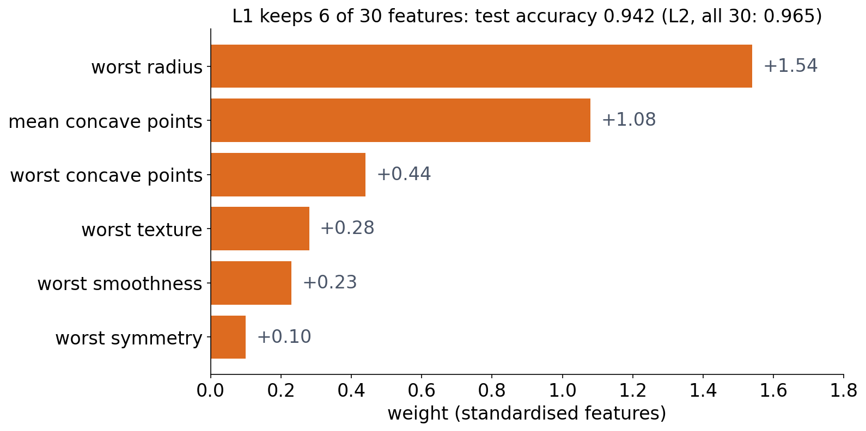
7 · PENALISING LARGE WEIGHTS
L1 gives a model a pathologist can read
▪ 6 features, almost the same accuracy
▪ Many features, few examples: use L1
Notebook, Section 7.
Notes:
Best λ: L2 3.98 (all 30 weights, test 0.965); L1 15.8 (6 of 30, test 0.942). Gene-expression data, with 20,000 genes and a few hundred patients, is the typical case for L1. The third discussion checks the effect by hand.

Slide 59
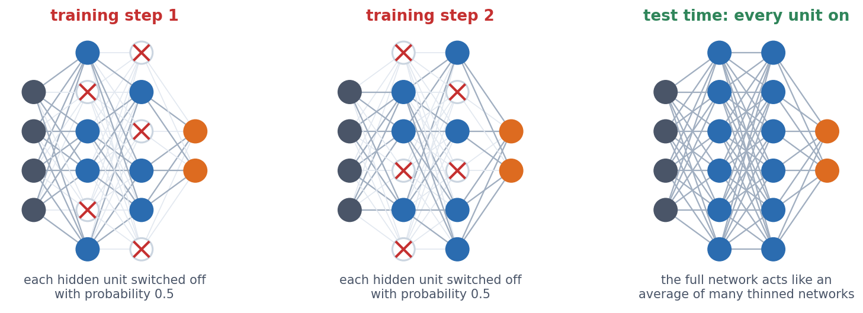
7 · DROPOUT
Dropout: units that cannot rely on their partners
Each hidden unit is switched off with probability p (here 0.5), with a fresh random choice for every mini-batch. At test time every unit is on.
Srivastava et al. (2014), JMLR 15:1929-1958; notebook Section 7.
Notes:
Ask first: why would damaging the network during training help? Without dropout, units can form fragile combinations that fit quirks of the training set; with dropout any partner may be missing next step, so information spreads over many units. On GB1, dropout 0.2 raises the training MAE (0.212 → 0.220) and lowers the test MAE (0.254 → 0.247).

Slide 60
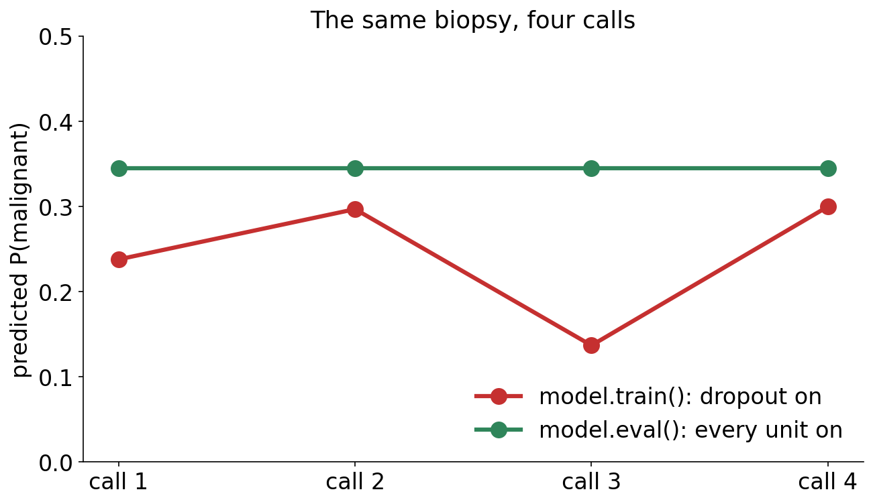
7 · DROPOUT
Forget model.eval() and the answer changes every time
▪ model.train(): dropout on
▪ model.eval(): dropout off
▪ Survivors scaled by 1/(1−p)
Notebook, Section 7.
Notes:
PyTorch scales the surviving units by 1/(1-p) during training, so nothing else needs to change at test time. Every training loop in this course calls both train() and eval().

Slide 61
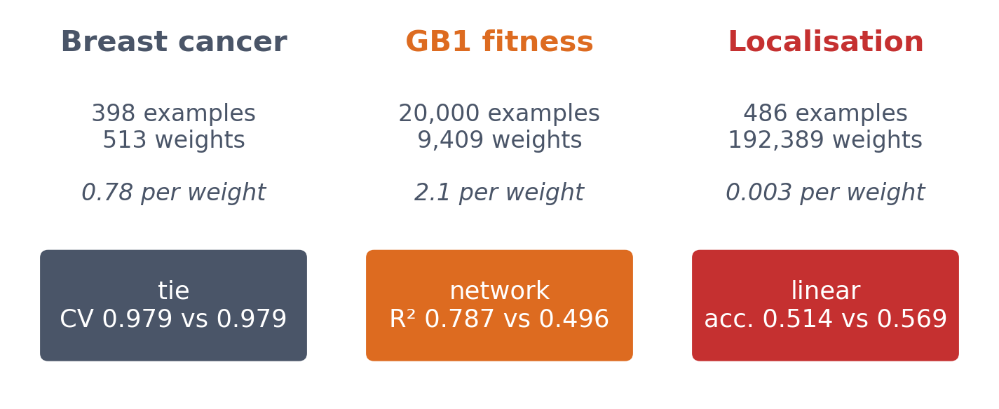
8 · IS THE IMPROVEMENT REAL?
Three datasets, three answers
Breast cancer: nearly additive, so a tie. GB1: non-additive and enough data, so the network wins. Localisation: data scarce relative to the model, so the network memorises and loses.
See course.bioinfo.se/session09.html, 'Is the improvement real?'.
Notes:
Examples per weight is a warning sign, not a strict rule: modern networks often have more weights than examples and still generalise, thanks to architecture, regularisation and the way they are trained. Session 8's rules apply to every comparison: choose on validation, test once, compare with a simple baseline.

Slide 62
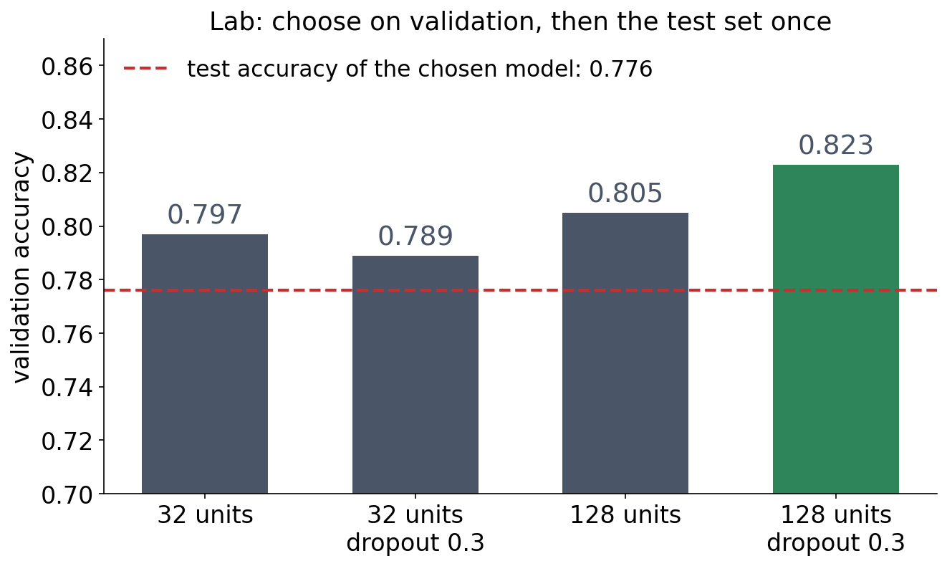
8 · IN THE LAB
Choose on validation, test once
▪ Four settings tried
▪ Best on validation: 0.823
▪ Test, used once: 0.776
Session 9 lab, executed solution (BloodMNIST).
Notes:
The test accuracy is lower than the best validation score because the choice itself was fitted to the validation set. Session 10's lab trains a convolutional network on the same cells.

Slide 63
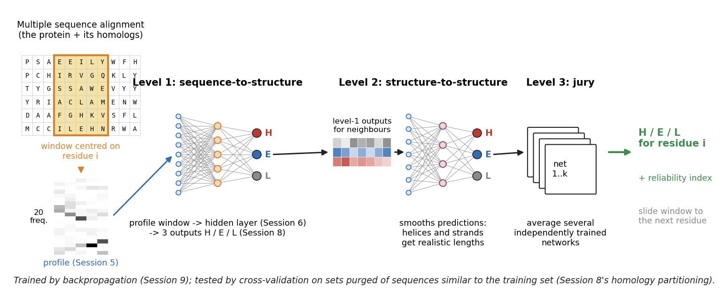
8 · NOW YOU CAN READ IT
PHD is Sessions 5-9 in one network
Profile input (Session 5), hidden layers (Session 7), three outputs (Session 8), trained by backpropagation (this session) and tested on sets purged of similar sequences (Session 8). 70.8% three-state accuracy.
Rost & Sander (1993), J Mol Biol 232:584-599.

Slide 64
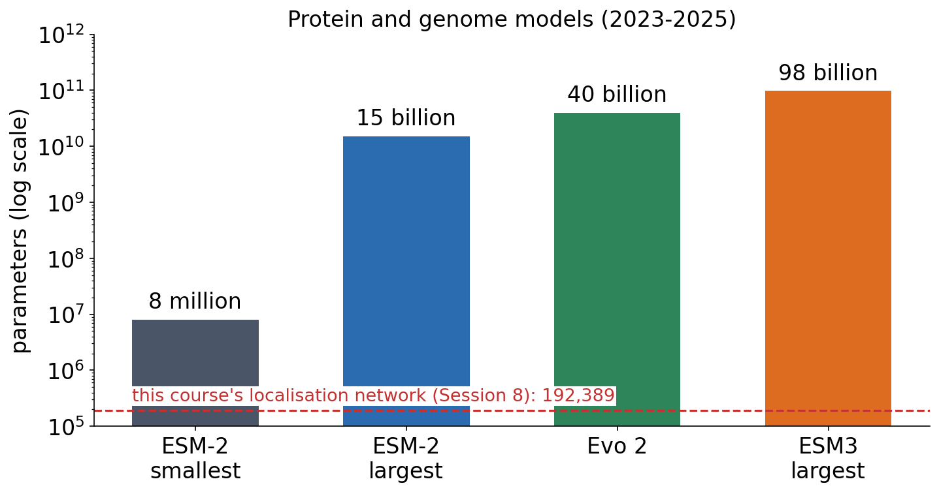
3 · OUTLOOK
Hardly anyone trains from scratch any more
▪ Pretrain one huge model, fine-tune it
▪ Bigger models, more data: lower loss
▪ ESM3: 10²⁴ operations to train
▪ Who can afford the next model, and what does that mean for open science?
Lin et al. (2023), Science 379:1123; Hayes et al. (2025), Science 387:850; Brixi et al. (2026), Nature; Kaplan et al. (2020), arXiv:2001.08361; Hu et al. (2021), LoRA, arXiv:2106.09685.
Notes:
The training loop of this session is the same one used for the largest models; what changed is scale. Kaplan et al. (2020) showed that a language model's loss falls as a power law with model size, data and compute. Protein models followed: ESM-2 from 8 million to 15 billion parameters (structure emerged as it grew), Evo 2 with 40 billion parameters trained on about 9 trillion DNA bases on 2,048 GPUs, ESM3 with 98 billion parameters trained with 1.07 x 10^24 floating-point operations on 2.78 billion proteins. Almost nobody can repeat that, so most work starts from a pretrained model and fine-tunes it, often with LoRA, which trains small low-rank updates instead of all the weights. The overfitting tools of today (early stopping, weight decay, dropout, a validation set) are exactly what fine-tuning on a small biological dataset still needs. Open question: only a few companies and large labs can train such models; open weights (ESM-2, Evo 2) let everyone else use them, closed ones do not.

Slide 65
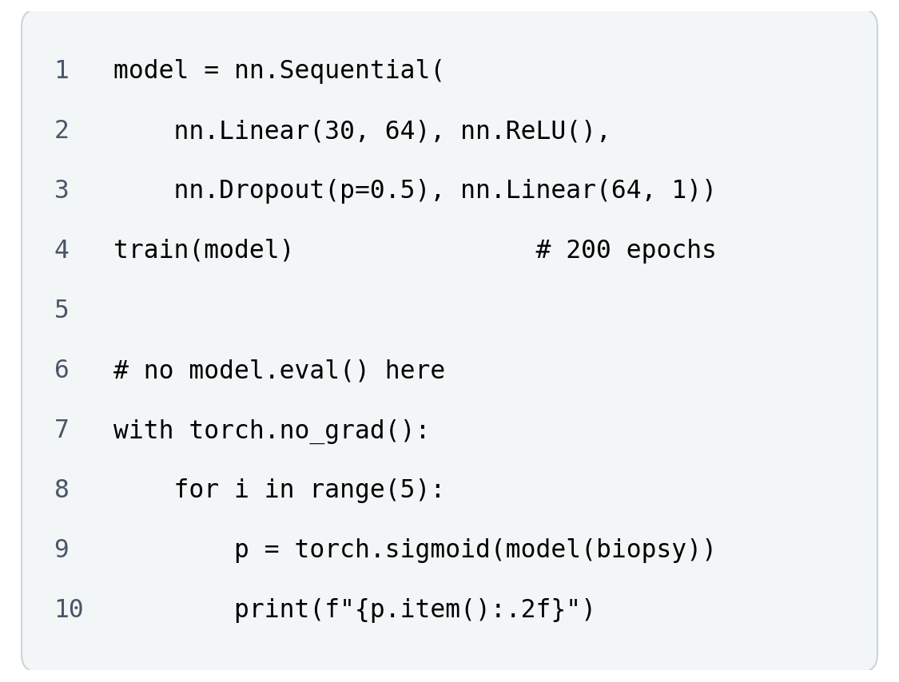
BLOCK 3 · QUIZ
What does the network print without model.eval()?
A trained network with dropout (p = 0.5) predicts the same biopsy five times.
A The same probability five times
B Five different probabilities
C An error: dropout cannot predict
D 0.5 five times: dropout halves outputs
Guess on your own
Scan the code, or go to
quiz.bioinfo.se/live
Notes:
New problem from the dropout slides ('Forget model.eval() and the answer changes every time'). The breast-cancer biopsies of block 1, 30 measurements each. The old L1/L2 problem is now the notebook's 'if you finish early' cell.

Slide 66
BLOCK 3 · QUIZ
What does the network print without model.eval()?
How did the room answer?
Halt the round when most have answered, then show the results.
Show the results ▸ quiz.bioinfo.se/live/report
Notes:
Halt submission in the Control view, then open the results. Do not say which answer is right.

Slide 67

BLOCK 3 · QUIZ
What does the network print without model.eval()?
Fix it, run it, discuss
Open the notebook: scan the code
Fix the line marked FIX, then run the cells
Did it come out as you guessed? Discuss with your neighbour
The notebook: https://colab.research.google.com/github/ElofssonLab/kb8029-book/blob/main/notebooks/session09-discussion-3.ipynb
Notes:
About 8 minutes. As it is (model.train()), test biopsy 6 gets 0.27, 0.57, 0.04, 0.59, 0.31: benign one moment, malignant the next. Fixed with model.eval(): 0.31 five times. Early finishers: Lasso (L1) sets all seven useless weights to exactly 0, Ridge (L2) only shrinks them.

Slide 68
BLOCK 3 · QUIZ
What does the network print without model.eval()?
Answer again
Same question, after the discussion.
quiz.bioinfo.se/live
Notes:
Open the second round (post) in the Control view.

Slide 69
BLOCK 3 · QUIZ
What does the network print without model.eval()?
Results, and who explains
Both rounds side by side.
Draw two to explain: one of you says how you reasoned.
Show the results ▸ quiz.bioinfo.se/live/report
To check it with code afterwards: discussion notebook 3 https://colab.research.google.com/github/ElofssonLab/kb8029-book/blob/main/notebooks/session09-discussion-3.ipynb
Notes:
Five different probabilities. In training mode dropout switches off a different random half of the hidden units at every forward pass. model.eval() switches it off (and batch normalisation to its stored averages). Every training loop in the course calls model.train() before training and model.eval() before evaluating.

Slide 70
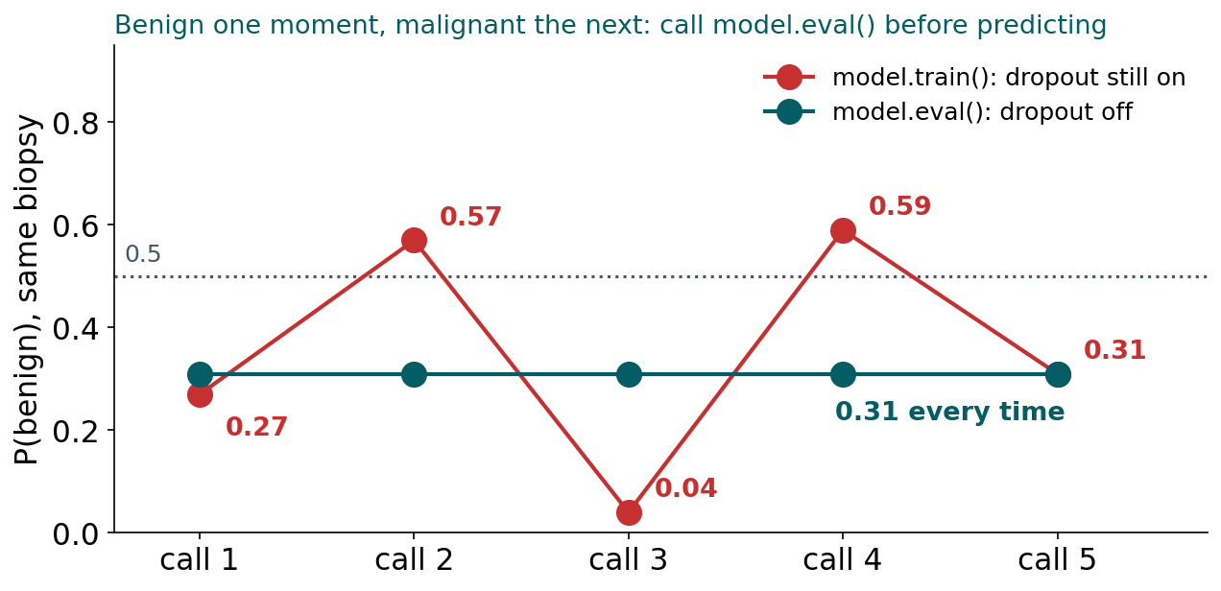
BLOCK 3 · QUIZ
The answer: five different predictions, until model.eval()
In training mode, dropout drops a different random half of the hidden units at every call, so the same biopsy gets five different predictions, on both sides of 0.5. model.eval() switches dropout off: 0.31 every time. Call model.train() before training and model.eval() before evaluating.

Slide 71
BEFORE YOU LEAVE
In up to three words: what was the hardest part of today?
Answer now
Scan the code, or go to
quiz.bioinfo.se/live
Notes:
A word cloud: the bigger the word, the more students wrote it. It shows what to repeat next time.

Slide 72
BEFORE YOU LEAVE
The hardest part of today
What the room found hardest
Show the results ▸ quiz.bioinfo.se/live/report

Slide 73
Session 10 next
A dense layer has a weight for every connection: 192,389 here
But the same motif means the same anywhere in a sequence: convolution

