Slide 1

Session 10: CNNs, from ImageNet to Biology
KB8029 — Bioinformatics & Deep Learning
Arne Elofsson

Slide 2


BEFORE WE START
Log in to the lecture quiz
Log in to the quiz
Scan the code, or go to quiz.bioinfo.se/live
Log in with your university account
Answering counts as being at the lecture: up to 3 bonus points on the exam
Right or wrong is never graded, only whether you answered. Results are shown without names.
quiz.bioinfo.se/live
Notes:
The quiz is not anonymous, because answering is how attendance is counted: 3 bonus points on the main exam for answering in all 12 lectures, one point less per missed lecture (preliminary). Whether an answer is right or wrong is never used. The projected results never show names; the only names shown are the two drawn to explain their reasoning. Start the session on quiz.bioinfo.se before the lecture: quiz.bioinfo.se/live then leads to it.

Slide 3
BEFORE WE START
Warm-up: what do you know already?
3 quick questions
On the topics of today, one at a time, about 30 seconds each
Answer on your own, and guess if you do not know
It shows me where to start; right or wrong is never graded
Notes:
About 2 minutes in all. Open each question's round, halt it after about 30 seconds and glance at the results; do not explain the answers now, the lecture does that.

Slide 4
WARM-UP · 1 OF 3
A 3 × 3 kernel slides over a 6 × 6 image, without padding, one step at a time. How large is the output?
A 6 × 6
B 4 × 4
C 3 × 3
D 2 × 2
Answer now
Scan the code, or go to
quiz.bioinfo.se/live
Notes:
Right: 4 × 4. 6 − 3 + 1 = 4 in each direction. Block 1: without padding, every layer shrinks the image.

Slide 5
WARM-UP · 2 OF 3
A filter, 8 bases wide, slides along one-hot encoded DNA. What is it most like?
A A BLAST alignment
B A phylogenetic tree
C A position weight matrix
D A restriction enzyme
Answer now
Scan the code, or go to
quiz.bioinfo.se/live
Notes:
Right: A position weight matrix. One weight per position and base, summed: a learned PWM. Block 2.

Slide 6
WARM-UP · 3 OF 3
What does transfer learning mean?
A Moving the model from the CPU to a GPU
B Starting from a network trained on another, larger data set
C Copying labels from similar proteins
D Training two networks and averaging them
Answer now
Scan the code, or go to
quiz.bioinfo.se/live
Notes:
Right: Starting from a network trained on another, larger data set. Block 3: the colorectal histology tiles.

Slide 7
BEFORE WE START
What the room knows already
Where we start
Which topics most of you know, and which we take slowly today.
Show the results ▸ quiz.bioinfo.se/live/report
Notes:
Optional: show two or three of the results, the ones that most got wrong.

Slide 8
BEFORE WE START
Your questions before today
What you asked
The questions you sent in on Canvas before the lecture
The most common ones now; the others in the block where they belong
Notes:
About 5 minutes. Read the answers to this session's Canvas survey 'Questions before the lecture' the evening before (it closes at 18:00 the day before the lecture), pick the two or three most common questions, and answer them briefly now or say in which block they come.

Slide 9
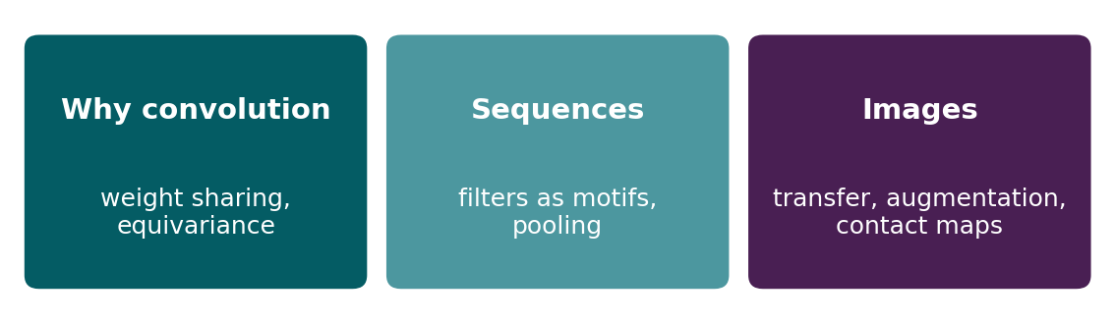
BEFORE WE START
In up to three words: what do you want to learn today?
Answer now
Scan the code, or go to
quiz.bioinfo.se/live
Notes:
A word cloud: the bigger the word, the more students wrote it. Come back to it at the end of the lecture.

Slide 10
BEFORE WE START
What you want to learn today
What the room wants to learn
Show the results ▸ quiz.bioinfo.se/live/report

Slide 11
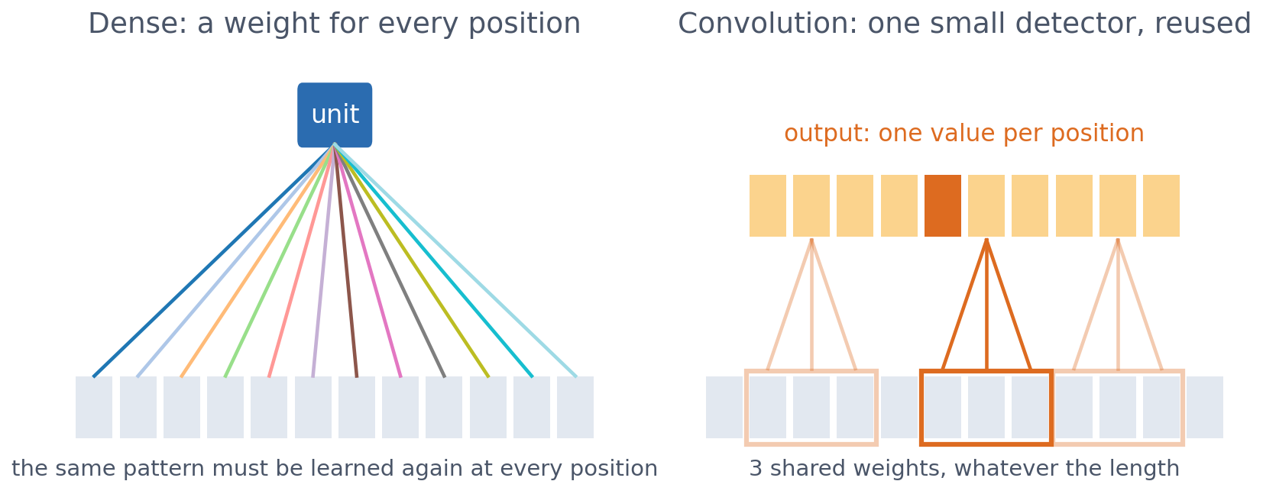
SESSION 10 · THE MAP
One small detector, reused everywhere
A dense layer learns a separate weight for every position. A convolutional layer assumes that nearby inputs belong together and reuses the same small detector at every position.
See course.bioinfo.se/session10.html.
Notes:
This built-in assumption is why CNNs need fewer weights and less data. Keep coming back to it: every result today is this assumption paying off, or failing where it does not hold (position in proteins).

Slide 12
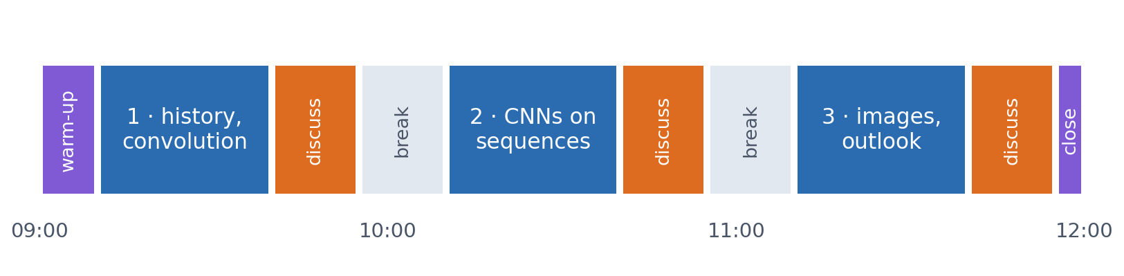
SESSION 10 · THE MORNING
Three blocks: about 30 min talk and 15 min discussion
Block 1: where CNNs and GPUs came from, then why convolution works. Block 2: CNNs on DNA and protein sequences. Block 3: CNNs on images, from cancer histology and contact maps to an outlook: the Human Protein Atlas and Alpha Cell.
Times are approximate: a 10 min start (warm-up quiz and your questions), two 15 min breaks and a 5 min close. Each block ends with a quiz question: guess, run the notebook and work out why it behaves as it does, discuss, answer again.

Slide 13
BLOCK 1 · ABOUT 30 MIN
Where CNNs came from, and why convolution works

Slide 14
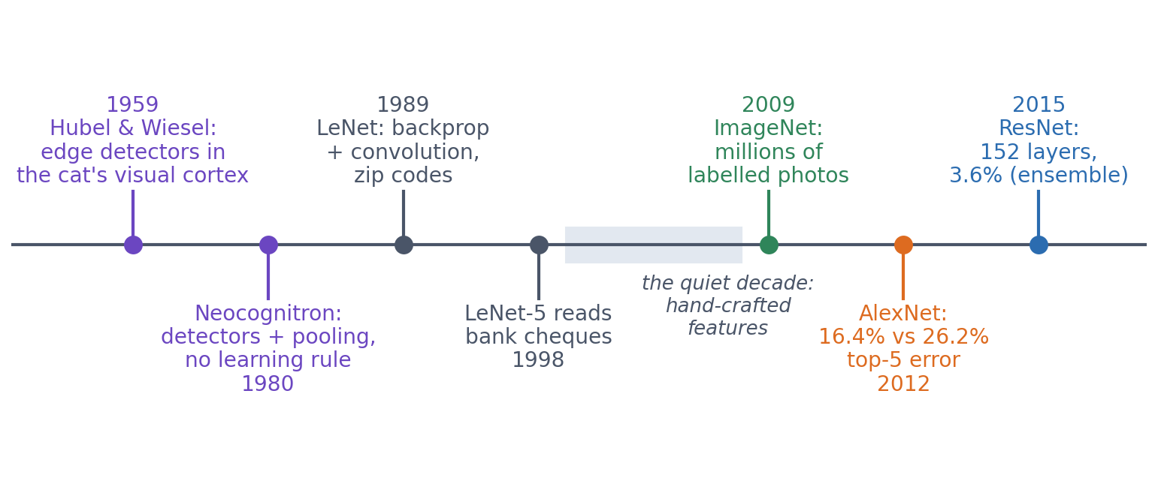
1 · HISTORY
From cat neurons to AlexNet: a 60-year-old idea
The two operations of a CNN, a local detector and pooling, were seen in the visual cortex in 1959 and built into a network in 1980. Backpropagation made them trainable in 1989. Then CNNs waited two decades for data and compute.
Hubel & Wiesel 1962; Fukushima 1980; LeCun et al. 1989, 1998; Deng et al. 2009; Krizhevsky et al. 2012; He et al. 2016. Not to scale in time.
Notes:
Hubel and Wiesel recorded single neurons in the cat's visual cortex (Nobel Prize 1981). Simple cells: an edge at one exact position. Complex cells: the same edge anywhere in a somewhat larger region. These are a convolution filter and pooling. Fukushima's Neocognitron (1980) stacked them; its title promised recognition 'unaffected by shift in position' (invariance, Block 1). It had no good learning rule. LeCun at Bell Labs trained a CNN with backpropagation on zip codes (1989); LeNet-5 (1998) read bank cheques, a large share of all US cheques by the late 1990s. Then the quiet decade: hand-crafted features (edge and corner descriptors) + SVMs won, neural networks were thought hard to train, and datasets of thousands of images were too small. Fei-Fei Li's ImageNet (2009) supplied the data: millions of photos labelled by crowd-workers.

Slide 15
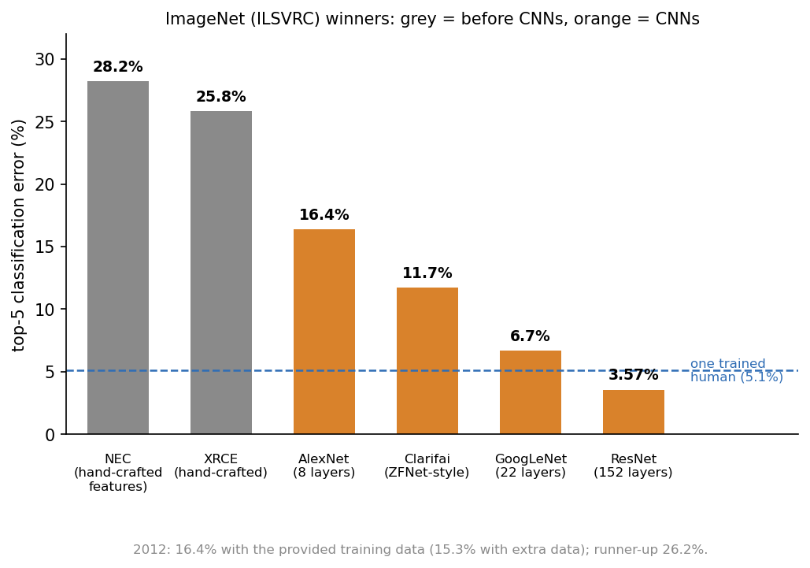
1 · HISTORY
2012: AlexNet wins ImageNet by a mile
▪ Krizhevsky, Sutskever & Hinton, Toronto
▪ 60 million weights, 2 gaming GPUs, 5-6 days
▪ Top-5 error 16.4% vs 26.2%
▪ Old parts: convolution, ReLU, dropout, augmentation
▪ New: the scale of data + GPUs
Russakovsky et al. 2015; Krizhevsky et al. 2012; He et al. 2016.
Notes:
ImageNet challenge: 1.2 million training photos, 1,000 classes, scored by top-5 error (true class not among the five best guesses). The first two winners (2010, 2011) used hand-crafted features: 28% and 26%. Alex Krizhevsky was Hinton's PhD student; Ilya Sutskever later co-founded OpenAI; Hinton shared the 2024 Nobel Prize in Physics with John Hopfield. AlexNet scored 16.4% on the provided training data and 15.3% with extra data; quote 16.4% against the runner-up's 26.2% if asked. The jump of nearly 10 points was the largest the challenge ever saw, and within two years almost every entry was a CNN. Nothing in AlexNet was new on its own: everything except the scale is in Sessions 9-10. Then deeper: VGG (19 layers of 3 × 3, 2014), GoogLeNet (22 layers), and ResNet (152 layers, an ensemble at 3.6% in 2015, below the roughly 5% of a trained human annotator); ResNet comes back in Block 3. Do not let the story become 'CNNs won': in images they led for about five years, then Vision Transformers (Dosovitskiy et al. 2021) matched and passed them with none of convolution's assumptions, and DINOv2 in our own lab is one of those. In biology nothing took over at all. The lesson is the trade-off: a built-in assumption is worth a lot when data is scarce and less as data grows.

Slide 16
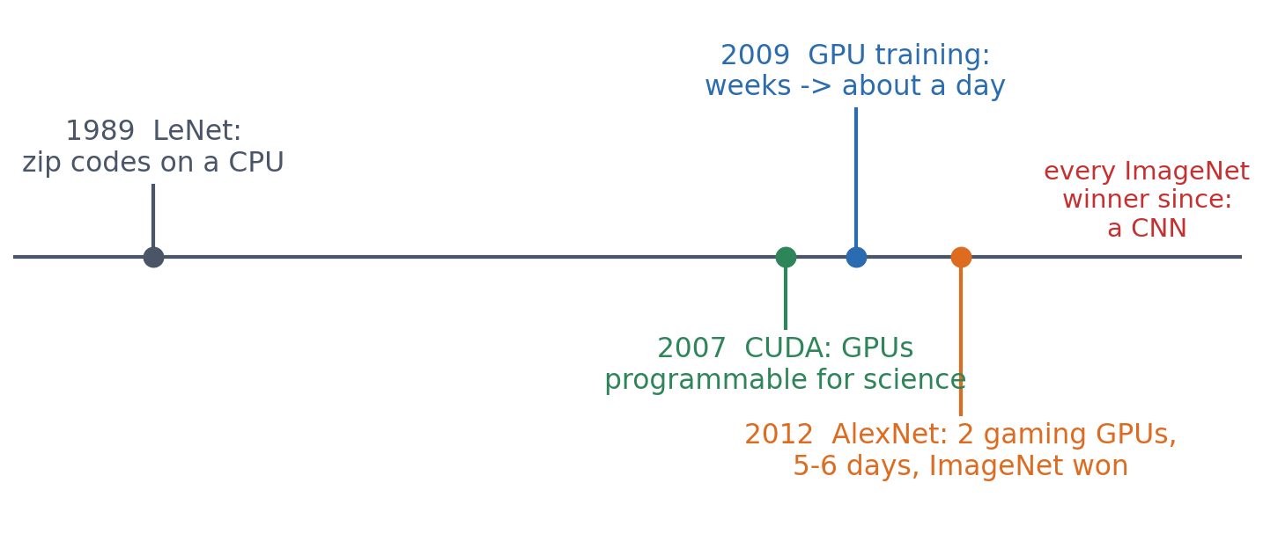
1 · HISTORY
The GPU revolution: from weeks to days
Training a network is mostly huge matrix products, and graphics cards have thousands of simple cores built for exactly that. AlexNet was trained on two gaming GPUs in five to six days; without GPUs there would be no deep CNNs.
Raina, Madhavan & Ng (2009), ICML; Krizhevsky, Sutskever & Hinton (2012), NeurIPS.
Notes:
A convolution or a dense layer is a large number of independent multiply-adds: exactly what graphics cards were built for. NVIDIA's CUDA (2007) made them programmable for general computing. Raina, Madhavan and Ng (2009) cut the training time of a four-layer network with 100 million parameters 'from several weeks to around a single day'. AlexNet (2012) was trained on two GTX 580 GPUs with 3 GB each, for five to six days, and its size was limited by their memory. Today the same idea scales to data centres: this course's own server and Colab's free GPU are the classroom version.

Slide 17
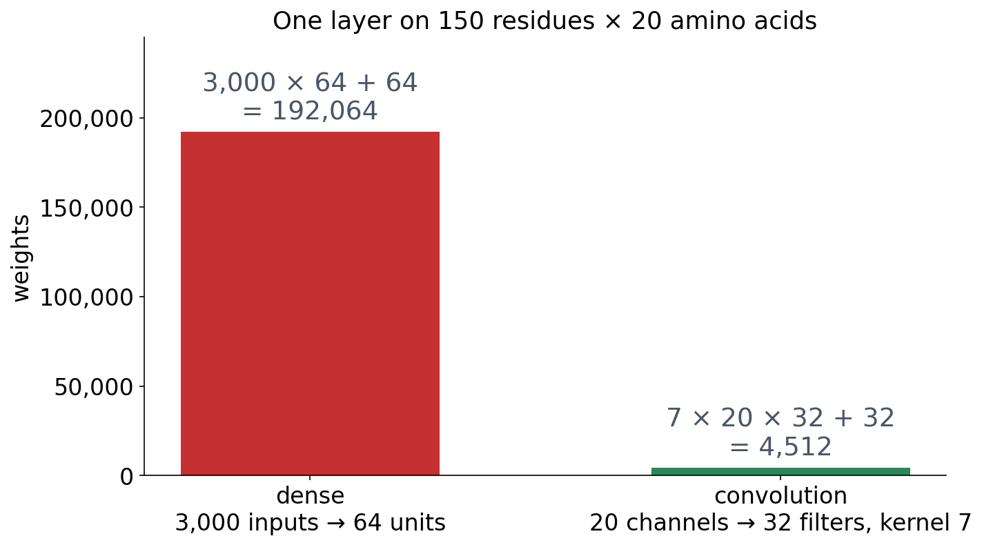
1 · WHY CONVOLUTION?
The problem with dense layers
▪ 40× fewer weights
▪ Same count for any length
▪ A 224 × 224 colour image: 150,000 inputs per unit
See course.bioinfo.se/session10.html, 'A small detector, reused everywhere'.
Notes:
Every model so far gives every input position its own weight: 3,000 per hidden unit for the 150-residue one-hot sequences of Sessions 8-9. The same feature detector must be learned separately at every position, and neighbouring residues are treated as unrelated as distant ones. Whole networks are less simple: in the lab, adding a convolutional layer makes the network smaller, because the next dense layer gets a smaller feature map.

Slide 18
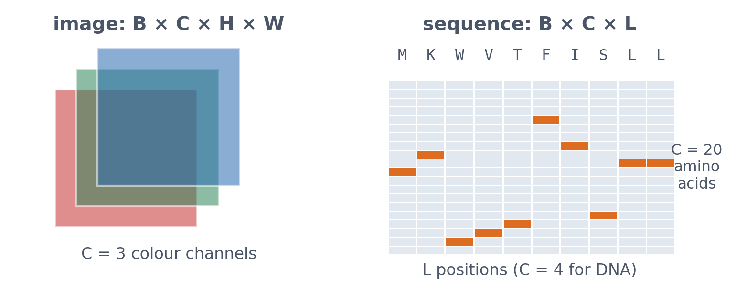
1 · WHY CONVOLUTION?
Shapes: images and sequences
A batch of images is B × C × H × W; a batch of sequences is B × C × L. A size-7 kernel on protein therefore has 20 × 7 weights, one per amino acid per position.
See course.bioinfo.se/session10.html, 'Shapes'.
Notes:
A layer has several kernels (filters); each produces one output channel, one learned feature type.

Slide 19
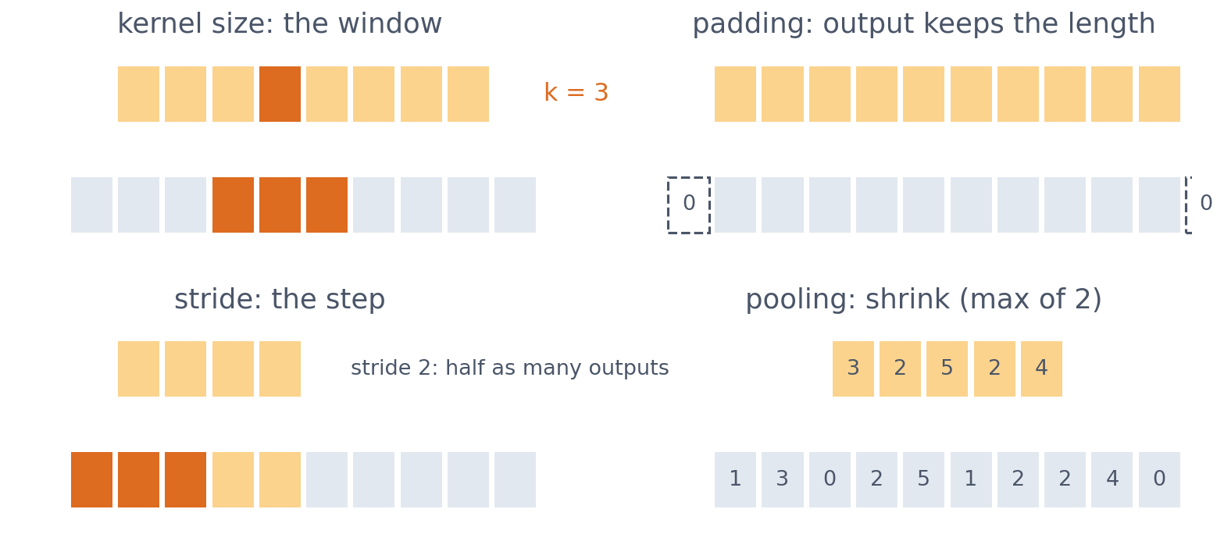
1 · WHY CONVOLUTION?
Four settings of a convolutional layer
Kernel size: the width of the window. Padding: zeros at the edges, so the output keeps the input's length. Stride: how far the kernel moves. Pooling: the maximum or mean of small regions.
See course.bioinfo.se/session10.html, 'Shapes'.

Slide 20
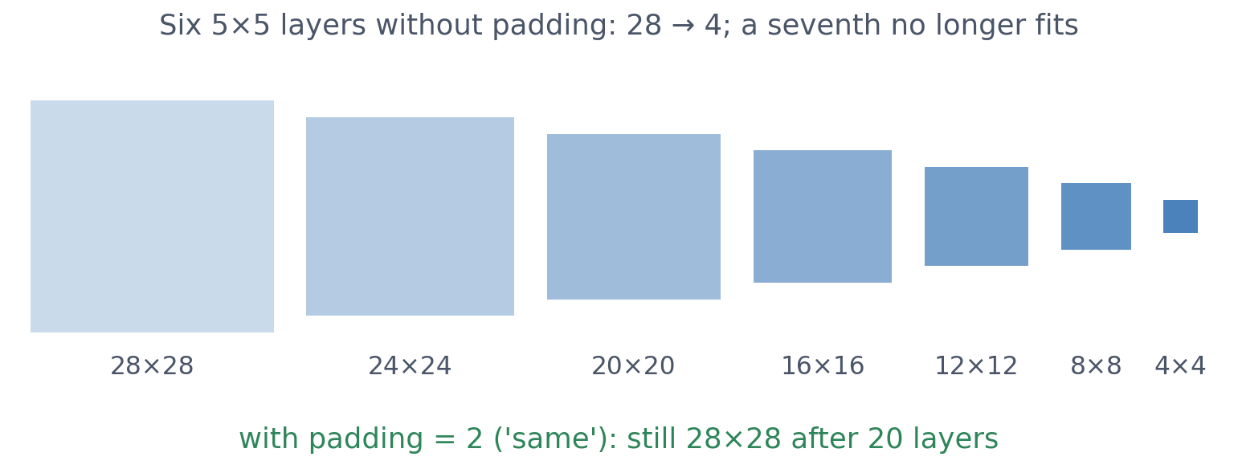
1 · WHY CONVOLUTION?
Without padding, every layer shrinks the image
▪ Kernel 5: lose 4 pixels
▪ Padding keeps the size
▪ Then depth is free
Session 10 lab, executed solution (28 × 28 blood-cell images).

Slide 21
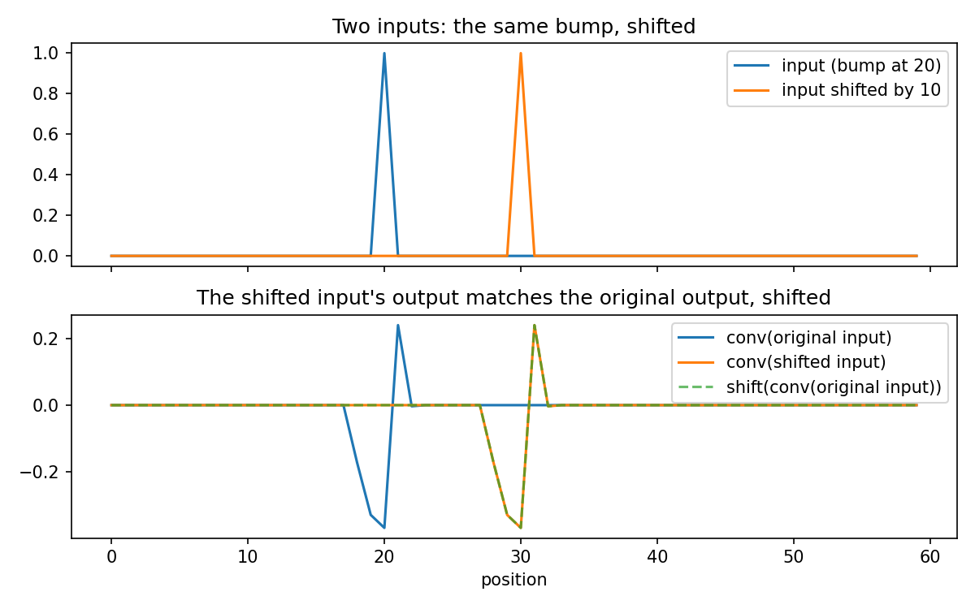
1 · EQUIVARIANCE
Shift the input, and the output shifts
▪ Comes from weight sharing
▪ Holds even untrained
▪ Equivariance ≠ invariance
Course notebook session10-cnns-in-code.ipynb, Part 1.
Notes:
A random, untrained 1D convolution applied to a signal and to the same signal shifted by 10: the shifted input's output is the original output shifted by 10 (difference 0.00 away from the edges). The feature is found, but where it is found still differs.

Slide 22
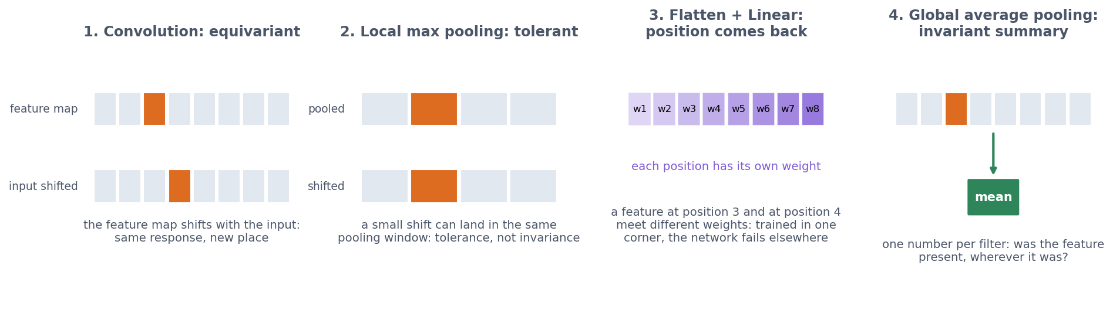
1 · EQUIVARIANCE IS NOT INVARIANCE
Where does position information go?
Convolution: the feature map shifts. Local pooling: tolerance to small shifts. Flatten + Linear: every position gets its own weight again. Global average pooling: one number per filter, wherever the feature was.
See course.bioinfo.se/session10.html, 'Equivariance is not invariance'.
Notes:
Ask first: the convolution is equivariant, so which of these four steps decides whether the whole network cares about position? Rotation is a different matter: nothing in convolution or pooling handles it (Block 3).

Slide 23
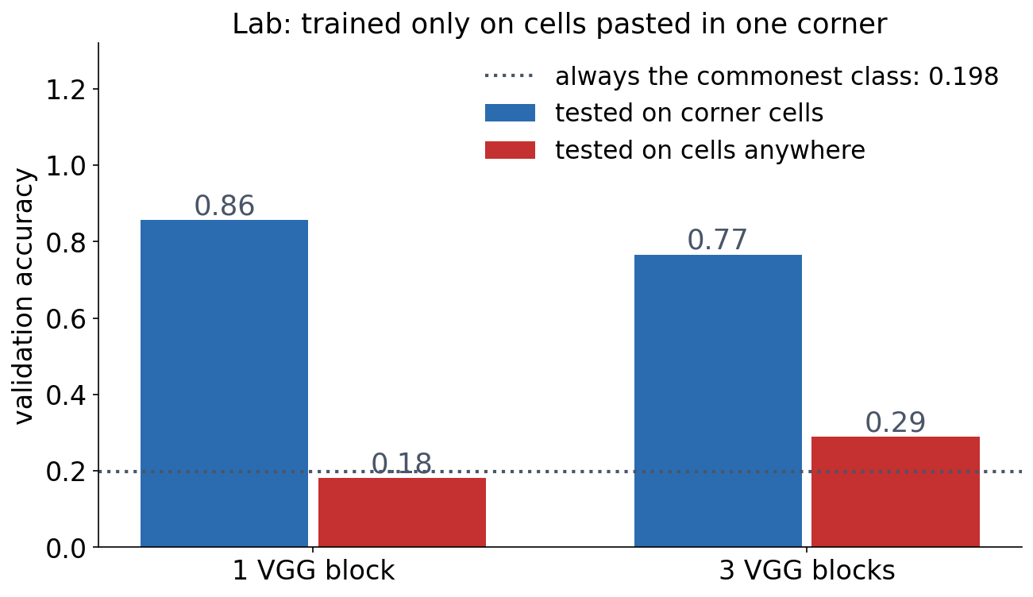
1 · EQUIVARIANCE IS NOT INVARIANCE
Flatten brings position back
▪ Trained on corner cells only
▪ Anywhere else: near chance
▪ Fix: global pooling, or train on all positions
Session 10 lab, executed solution.
Notes:
Ask first: the convolution is equivariant, so why does the corner-trained network fail? Because flatten + linear gives every position of the final feature map its own weight. Trained on cells at random positions, the 3-block network reaches 0.722.

Slide 24
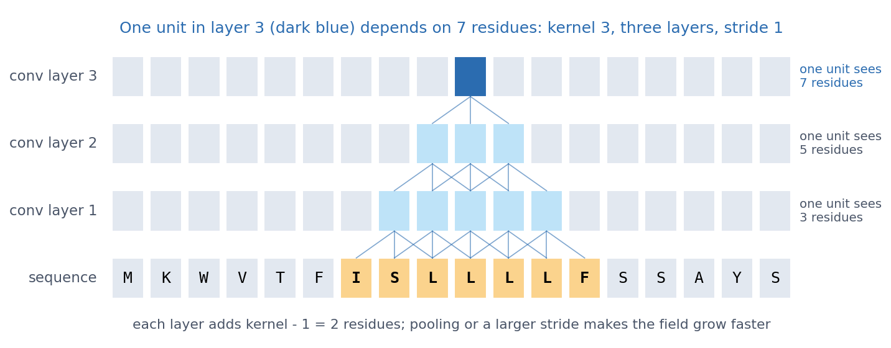
1 · STACKING CONVOLUTIONS
The receptive field grows with depth
Kernel 3, stride 1: a unit in layer 1 sees 3 residues, in layer 2 five, in layer 3 seven. Each layer adds k − 1; pooling and stride make it grow faster.
See course.bioinfo.se/session10.html, 'Stacking convolutions: the receptive field'.
Notes:
This is how deep CNNs build complex patterns from simple ones: edges, shapes and objects in images; motifs and combinations of motifs in DNA and proteins. Block 2's discussion asks how wide the window must be for a signal peptide.

Slide 25
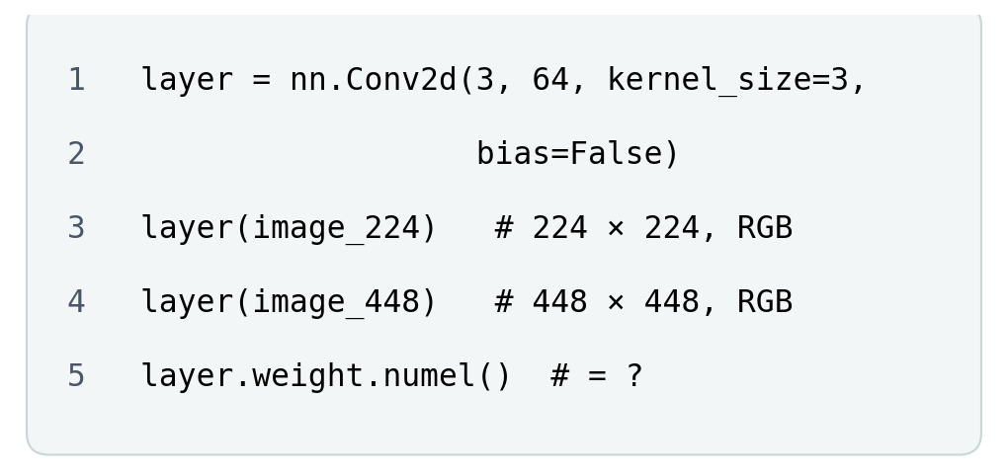
BLOCK 1 · QUIZ
How many weights does the convolutional layer have?
nn.Conv2d(3, 64, kernel_size=3, bias=False), on a 224 × 224 and on a 448 × 448 RGB image.
A 1,728 for both images
B 1,728, then 6,912: four times the pixels
C 9,633,792, then 38,535,168
D 576 for both images
Guess on your own
Scan the code, or go to
quiz.bioinfo.se/live
Notes:
64 filters, each 3 × 3, on 3 input channels. The traps: counting per pixel (a dense layer), or forgetting the input channels (576).

Slide 26
BLOCK 1 · QUIZ
How many weights does the convolutional layer have?
How did the room answer?
Halt the round when most have answered, then show the results.
Show the results ▸ quiz.bioinfo.se/live/report
Notes:
Halt submission in the Control view, then open the results. Do not say which answer is right.

Slide 27

BLOCK 1 · QUIZ
How many weights does the convolutional layer have?
Fix it, run it, discuss
Open the notebook: scan the code
Fix the line marked FIX, then run the cells
Did it come out as you guessed? Discuss with your neighbour
The notebook: https://colab.research.google.com/github/ElofssonLab/kb8029-book/blob/main/notebooks/session10-discussion-1.ipynb
Notes:
About 8 minutes. The notebook's FIX line counts H · W · C_in · C_out, as if every filter looked at the whole image: 9,633,792 and 38,535,168, while PyTorch's own count on the last line says 1,728. Fixed (k · k · C_in · C_out): 1,728 for both. Early finishers: the ratio, and the 2D equivariance check.

Slide 28
BLOCK 1 · QUIZ
How many weights does the convolutional layer have?
Answer again
Same question, after the discussion.
quiz.bioinfo.se/live
Notes:
Open the second round (post) in the Control view.

Slide 29
BLOCK 1 · QUIZ
How many weights does the convolutional layer have?
Results, and who explains
Both rounds side by side.
Draw two to explain: one of you says how you reasoned.
Show the results ▸ quiz.bioinfo.se/live/report
To check it with code afterwards: discussion notebook 1 https://colab.research.google.com/github/ElofssonLab/kb8029-book/blob/main/notebooks/session10-discussion-1.ipynb
Notes:
1,728 for both: 3 · 3 · 3 = 27 weights per filter, times 64. The image size does not enter, because the same kernel is reused at every position. 9.6 million is a dense layer with 64 units; 576 forgets the 3 input channels.

Slide 30
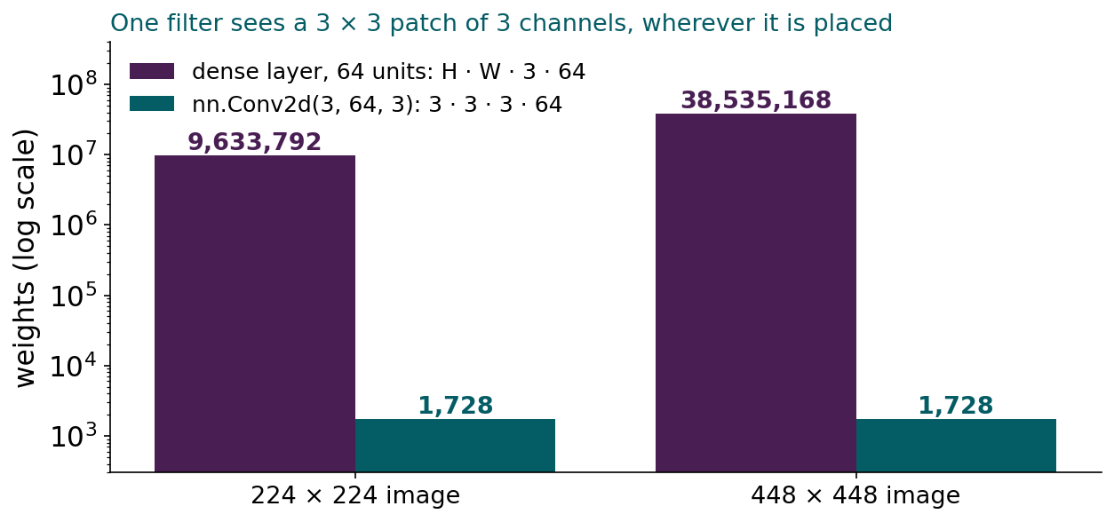
BLOCK 1 · QUIZ
The answer: 1,728 for both images
One filter looks at a 3 × 3 patch of the 3 colour channels, wherever it is placed: 27 weights, and 64 filters make 1,728. The image size never enters. A dense layer with 64 units needs one weight per pixel, channel and unit: 9.6 million, and four times as many when each side doubles.

Slide 31
BLOCK 1 DONE
Break

Slide 32
BLOCK 2 · ABOUT 30 MIN
CNNs on biological sequences

Slide 33
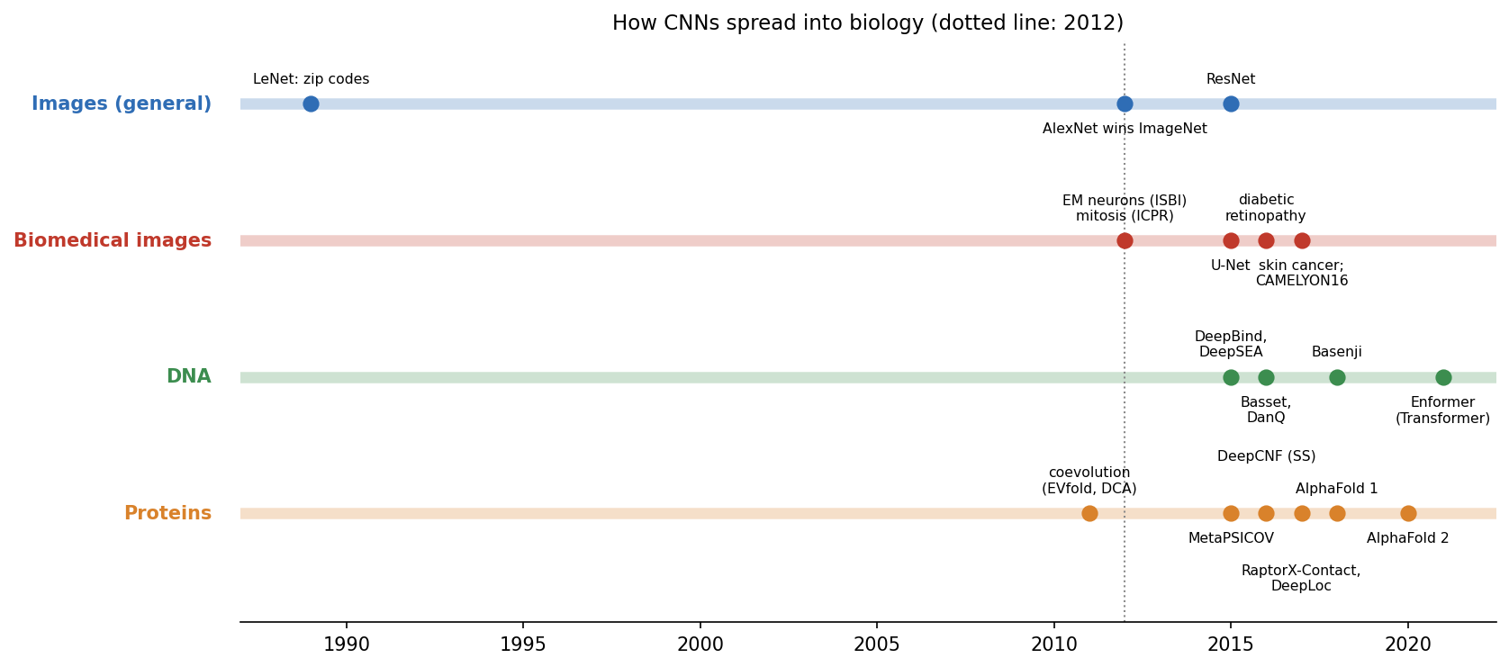
2 · WHERE THIS WENT
How CNNs spread into biology
DeepBind (2015): binding specificities visualised as PWMs. DeepSEA (2015): 1,000 bp of sequence, 919 chromatin features, and scores for non-coding variants. Later networks rediscovered known transcription-factor motifs.
Alipanahi et al. 2015; Zhou & Troyanskaya 2015.
Notes:
DeepSEA scores a non-coding variant by comparing its predictions for the reference and the mutated sequence. Longer-range models needed larger receptive fields and, eventually, Transformers (Session 11). In imaging, U-Net became the standard for segmentation, and ImageNet-pretrained CNNs reached expert level on retina, skin and pathology tasks.

Slide 34
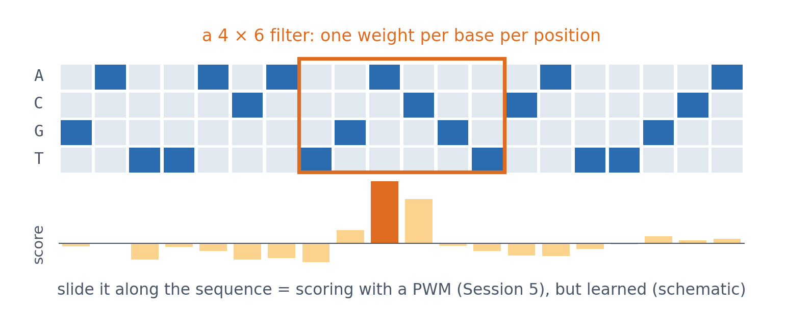
2 · FILTERS BECOME MOTIFS
A filter on DNA is a learned PWM
▪ 4 × k weights
▪ Sliding it = scoring with a PWM
▪ Learned, not counted
See course.bioinfo.se/session10.html, 'Filters become motifs'.
Notes:
A first-layer filter on one-hot DNA has one weight per base per position: exactly a position weight matrix (Session 5), except that it is learned from data instead of counted from aligned sites. The figure is schematic.

Slide 35
2 · FILTERS BECOME MOTIFS
DeepSEA: 1,000 bases in, 919 answers out
▪ Reads 1,000 bp of sequence
▪ Predicts 919 chromatin features at once
▪ A non-coding variant: predict the reference, predict the mutated sequence, compare
▪ Longer range needed larger receptive fields, and eventually Transformers (Session 11)
Zhou & Troyanskaya 2015, Nat Methods 12:931. See course.bioinfo.se/session10.html.
Notes:
This is the move worth remembering: a variant that changes no protein is scored by the difference between two predictions. The quiz bank asks exactly this.

Slide 36
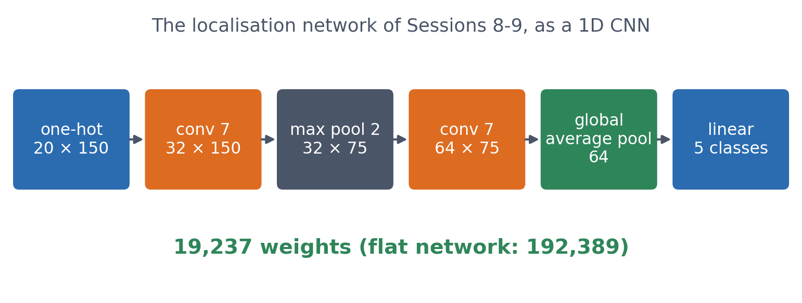
2 · PROTEINS
Our localisation data, as a 1D CNN
▪ Same proteins as Sessions 8-9
▪ Same homology-aware split
▪ A tenth of the weights
Course notebook, Part 2.
Notes:
Two convolutional layers of 7-residue filters (32 then 64 filters), max pooling, global average pooling, and a linear layer to the five classes. Trained and evaluated exactly as in Session 9: 486 / 105 / 109 proteins, MMseqs2 clusters at 30% identity.

Slide 37
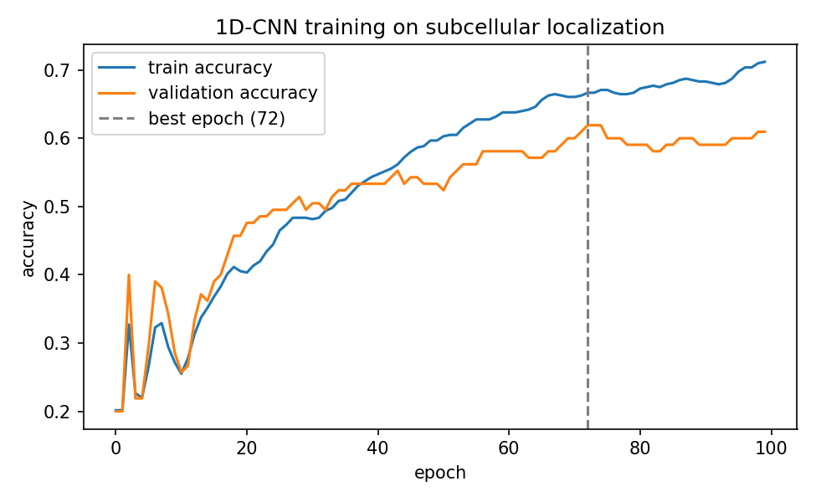
2 · PROTEINS
Training with early stopping
▪ Best validation: 0.619 at epoch 72
▪ No longer memorises
▪ Training accuracy then 0.667
Course notebook, Part 2.
Notes:
Compare Session 9's flat network: training accuracy 1.000 within a few epochs, validation peaking at 0.486 in epoch 5.

Slide 38
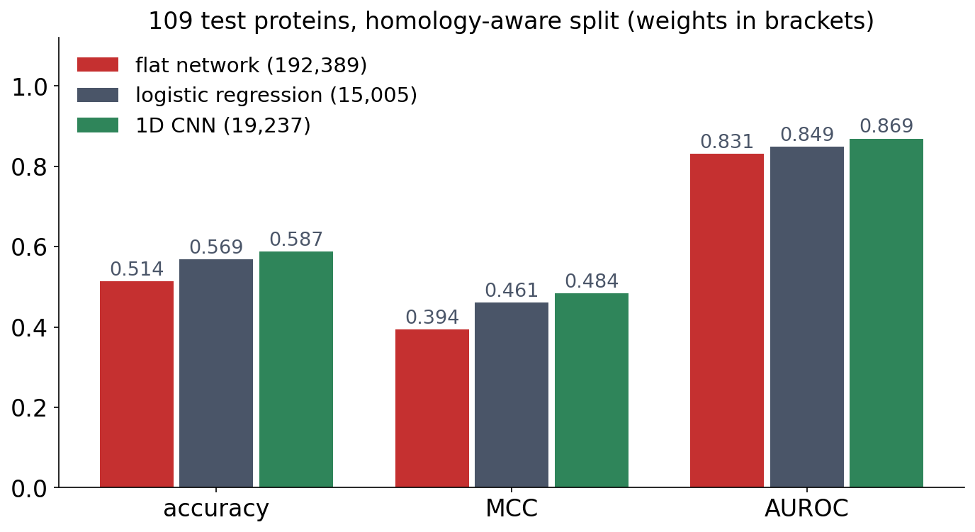
2 · PROTEINS
The CNN beats the flat network on every metric
▪ Built-in assumption, not 192,389 free weights
▪ Margin over logistic regression: noise
Course notebook, Part 2; test set used once.
Notes:
Retraining from other random initial weights gave 0.569-0.587, so the margin over logistic regression is within the noise of a 109-protein test set. The robust finding is the gap to the flat network: same data, a tenth of the weights, better on every metric.

Slide 39
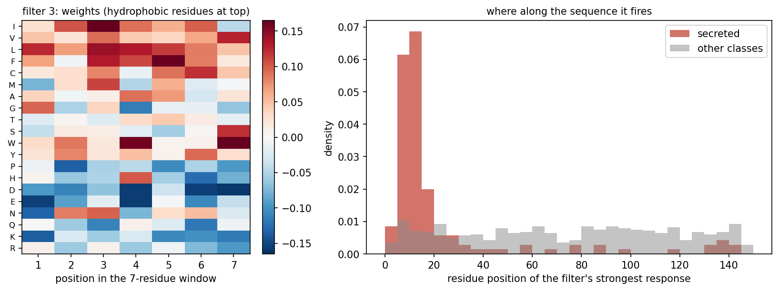
2 · WHAT DID IT LEARN?
Inside the first layer: a learned signal peptide
Left: the weights of the filter most selective for secreted proteins, hydrophobic amino acids at the top. Right: where along the sequence it fires most strongly, in secreted proteins and in the other four classes.
Course notebook, Part 2.
Notes:
Each first-layer filter is a 20 × 7 matrix: a learned PWM over a 7-residue window.

Slide 40
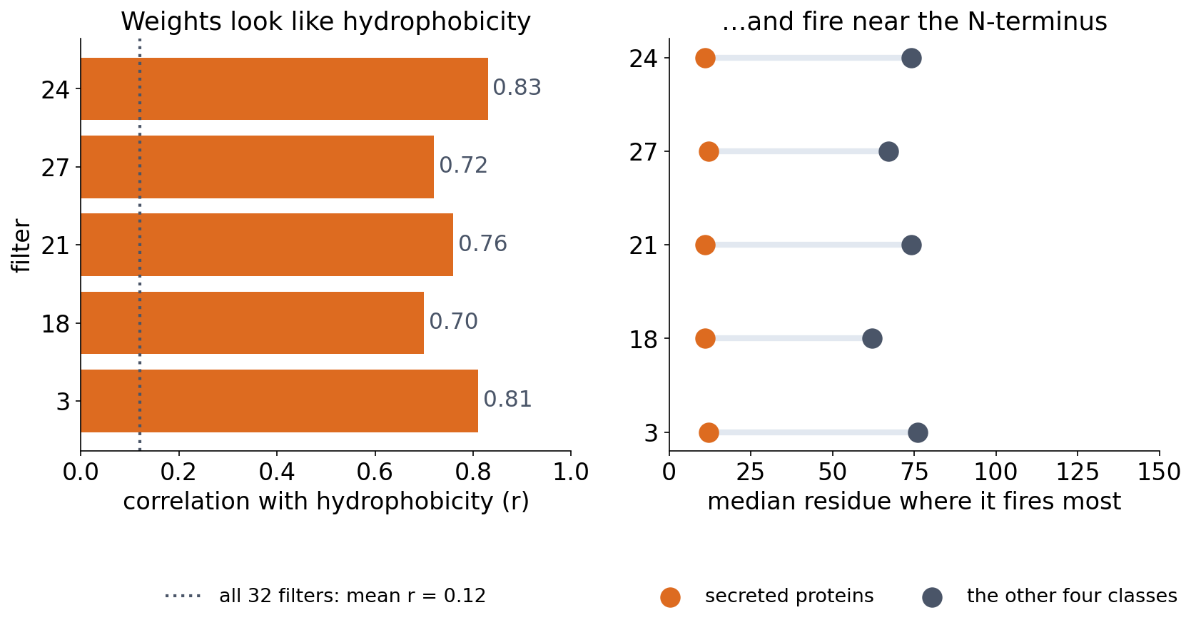
2 · WHAT DID IT LEARN?
Nobody told it about signal peptides
The five filters most selective for secreted proteins: weights correlated with Kyte-Doolittle hydrophobicity (r = 0.70-0.83), firing around residue 11-12 in secreted proteins and 62-76 in the others.
Course notebook, Part 2.
Notes:
Just as the DNA filters rediscovered transcription-factor motifs, our filters found the hydrophobic core of signal peptides on their own. Each unit of the second layer sees 20 residues (7, then 2× pooling and another 7-wide kernel), about the length of a signal peptide.

Slide 41
2 · WHAT DID IT LEARN?
Its second layer sees about a signal peptide
▪ Layer 1: a 7-residue window
▪ Then 2× pooling, then another 7-wide kernel
▪ Each layer-2 unit sees 20 residues
▪ About the length of a signal peptide
▪ Discussion problem 2: how wide must the window be?
See course.bioinfo.se/session10.html, 'Proteins: our own CNN finds the signal peptide'.
Notes:
Block 1's receptive field, arriving at a biological length scale. Worth drawing on the board: 7, then pooling, then 7 again.

Slide 42
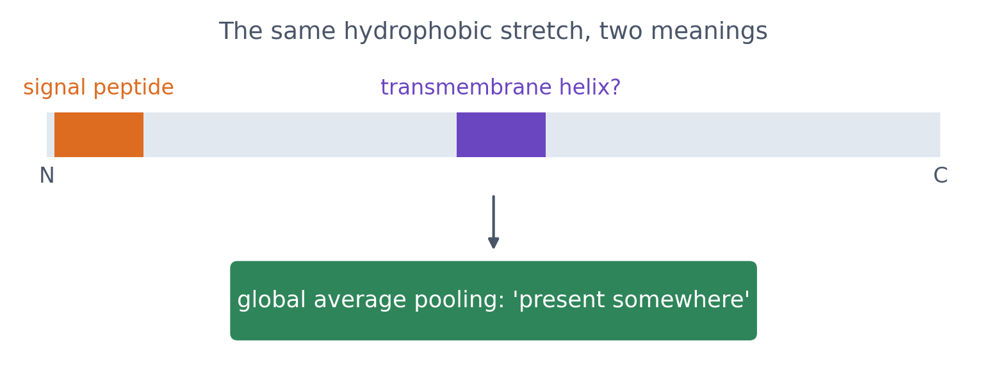
2 · BUT POSITION MATTERS IN PROTEINS
What has global pooling thrown away?
▪ Detected the same everywhere
▪ Not the same meaning everywhere
▪ How would you give position back?
See course.bioinfo.se/session10.html, 'But position matters in proteins'. Schematic.
Notes:
A hydrophobic stretch at the N-terminus is a signal peptide; in the middle it may be a transmembrane helix; some targeting signals sit at the C-terminus. Global average pooling only knows the stretch occurred somewhere. Options: later layers, positional features, position-aware pooling. DeepLoc (2017) puts a bidirectional LSTM with attention after the convolutions (Session 11).

Slide 43
2 · BUT POSITION MATTERS IN PROTEINS
DeepLoc: convolutions first, order afterwards
▪ Convolutional layers find the local patterns
▪ A bidirectional LSTM with attention then reads them in order
▪ The order-aware half restores the position we pooled away
▪ Session 11 builds that half
Almagro Armenteros et al. 2017, Bioinformatics 33:3387.
Notes:
The answer to the question on the previous slide, as the field actually solved it. It also sets up Session 11 rather than leaving the problem open.

Slide 44
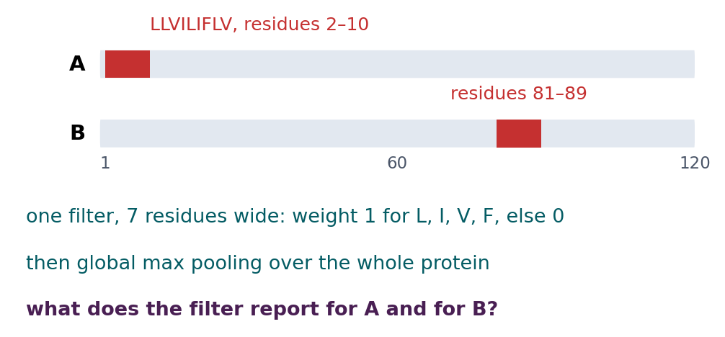
BLOCK 2 · QUIZ
What does the filter report after global pooling?
One filter, 7 residues wide, for L, I, V and F. The same hydrophobic stretch: in A at residues 2–10, in B at 81–89.
A The same value for both
B Higher for A: the stretch is at the N-terminus
C Higher for B: more sequence before it
D Zero for both: pooling removes the signal
Guess on your own
Scan the code, or go to
quiz.bioinfo.se/live
Notes:
The localisation CNN of the main notebook pools each filter globally before the classifier. A hydrophobic stretch at the N-terminus suggests a signal peptide, in the middle perhaps a transmembrane helix.

Slide 45
BLOCK 2 · QUIZ
What does the filter report after global pooling?
How did the room answer?
Halt the round when most have answered, then show the results.
Show the results ▸ quiz.bioinfo.se/live/report
Notes:
Halt submission in the Control view, then open the results. Do not say which answer is right.

Slide 46

BLOCK 2 · QUIZ
What does the filter report after global pooling?
Fix it, run it, discuss
Open the notebook: scan the code
Fix the line marked FIX, then run the cells
Did it come out as you guessed? Discuss with your neighbour
The notebook: https://colab.research.google.com/github/ElofssonLab/kb8029-book/blob/main/notebooks/session10-discussion-2.ipynb
Notes:
About 8 minutes. The FIX line pools only over the first 20 windows: A gives 7.0, B gives 0.0, so it looks as if position were kept (the second answer). Fixed (out.max()): 7.0 for both. Early finishers: mean pooling, how to keep position, and the old kernel-size experiment (about a minute to fetch the data).

Slide 47
BLOCK 2 · QUIZ
What does the filter report after global pooling?
Answer again
Same question, after the discussion.
quiz.bioinfo.se/live
Notes:
Open the second round (post) in the Control view.

Slide 48
BLOCK 2 · QUIZ
What does the filter report after global pooling?
Results, and who explains
Both rounds side by side.
Draw two to explain: one of you says how you reasoned.
Show the results ▸ quiz.bioinfo.se/live/report
To check it with code afterwards: discussion notebook 2 https://colab.research.google.com/github/ElofssonLab/kb8029-book/blob/main/notebooks/session10-discussion-2.ipynb
Notes:
The same value, 7.0 for both: the filter fires at window 1 in A and at window 80 in B, but global pooling keeps only how strongly it fired, not where. The classifier cannot tell a signal peptide from a transmembrane helix by this filter alone.

Slide 49
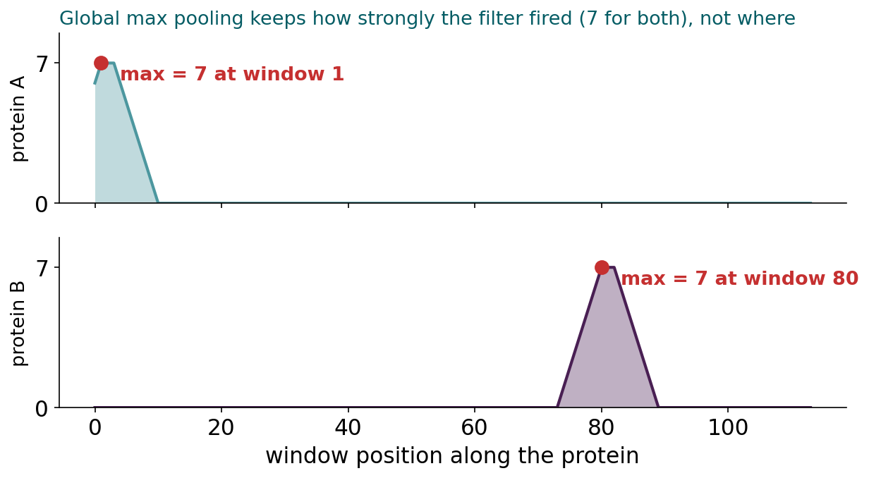
BLOCK 2 · QUIZ
The answer: the same value; pooling forgets where
The filter's response moves with the stretch, and its maximum is 7 in both proteins. Global pooling keeps how strongly a filter fired, not where, although in a protein the position matters: a hydrophobic stretch at the N-terminus suggests a signal peptide, in the middle a transmembrane helix.

Slide 50
BLOCK 2 DONE
Break

Slide 51
BLOCK 3 · ABOUT 30 MIN
CNNs on images: from the clinic to the whole cell

Slide 52
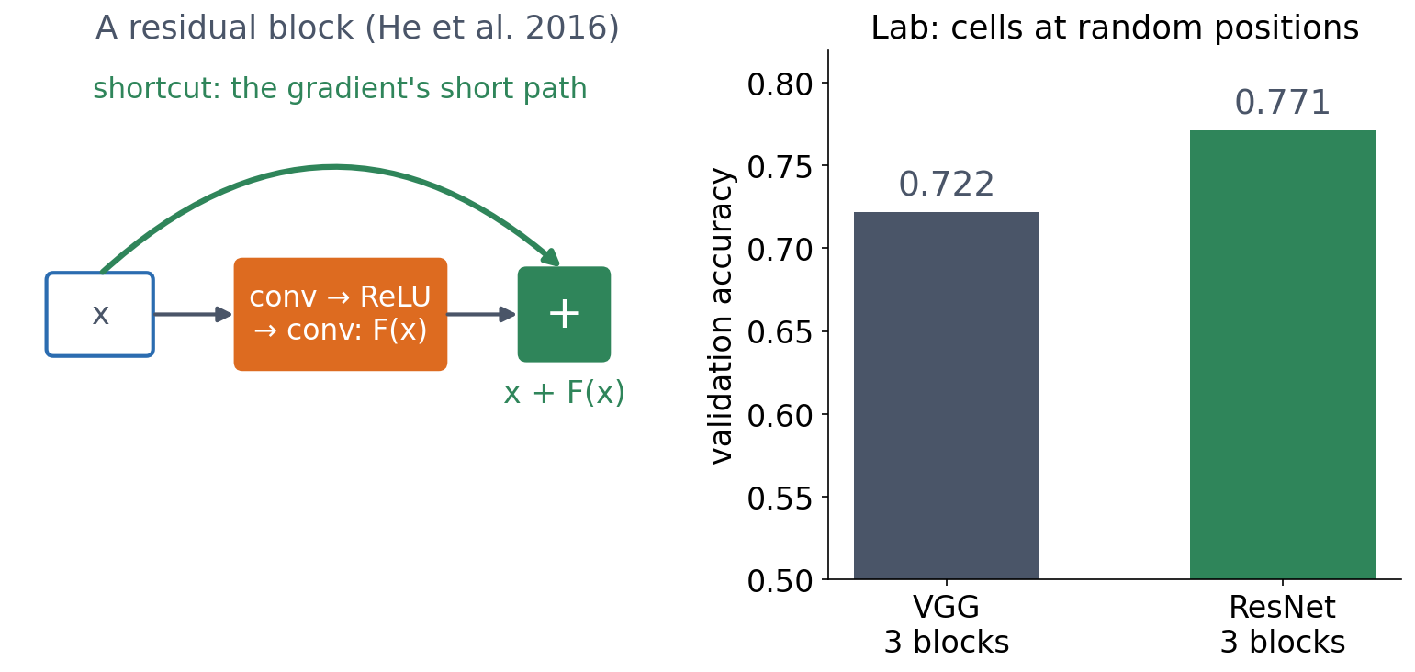
3 · WHAT HAPPENED
ResNet: a short path for the gradient
▪ Each block returns x + F(x)
▪ 100+ layers become trainable
▪ Deep plain networks were not overfitting
He et al. (CVPR 2016); Session 10 lab, optional extra.
Notes:
Deeper plain networks had a higher TRAINING error, so this was not overfitting. He et al. also ruled out vanishing gradients: batch normalisation had dealt with those, and they measured the gradients. The deeper network was simply harder to optimise, even though a solution at least as good must exist (copy the shallower network, do nothing in the extra layers). Each block learns a correction to its input, and the shortcut gives the gradient a path back that does not pass through every layer's derivatives. In the lab, a three-block ResNet (11,968 weights) beats a three-block VGG network (8,720 weights).

Slide 53
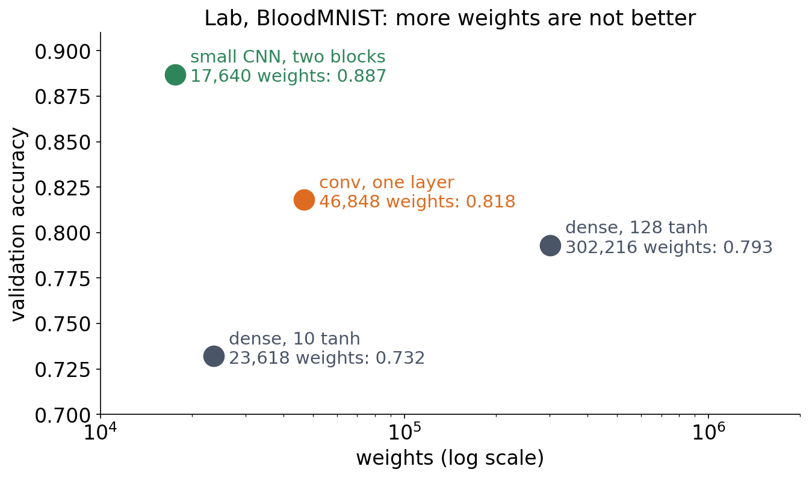
3 · ASSUMPTIONS, NOT SIZE
More weights are not better
▪ Smallest model, best result
▪ Locality and sharing are built in
▪ Session 9's lesson, from the other side
Session 10 lab, executed solution (BloodMNIST).
Notes:
The small CNN with two convolution blocks has 17,640 weights and reaches 0.887; the 128-unit dense network has 302,216 and reaches 0.793. The CNN does not have to learn locality and weight sharing from data.

Slide 54
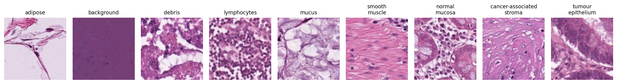
3 · FEW LABELS
Colorectal cancer histology: nine tissue types
H&E-stained tiles (Kather et al. 2019). We pretend to have only 40 labelled tiles per class; validation tiles come from the same 86 slides, test tiles from 50 other patients.
NCT-CRC-HE-100K / CRC-VAL-HE-7K (Kather, Halama & Marx 2018, CC BY 4.0).
Notes:
Ask first: what would a pathologist look at to tell stroma from smooth muscle? Then: why might tiles from the same slide be too easy a test?

Slide 55
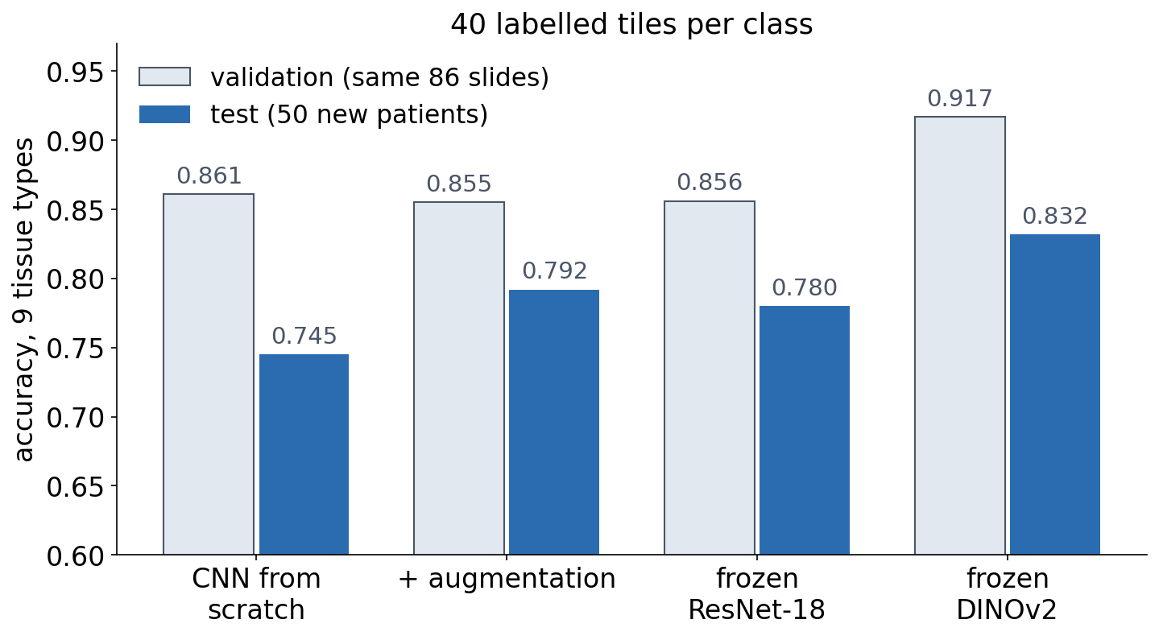
3 · FEW LABELS
Transfer learning beats training from scratch
▪ DINOv2 features: best
▪ The seed alone moves it 6 points
▪ Validation > test: split by patient
Course notebook, Part 1. Test: 900 tiles from 50 patients.
Notes:
From scratch, the CNN (242,697 weights) memorises its 360 training tiles; three seeds give 0.721-0.786. Augmentation helps on average (0.769-0.821), not in every seed. Every model scores higher on validation than on test, because validation tiles share patients, staining runs and scanner with training: Session 8's homology trap again. When examples come in groups, split by group.

Slide 56
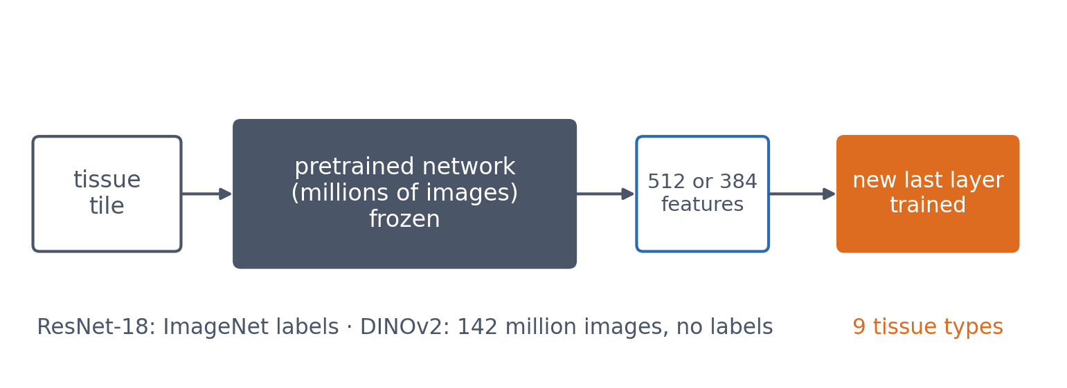
3 · FEW LABELS
Borrow features learned on millions of images
▪ Keep the network frozen
▪ Train only a new last layer
▪ A foundation model (Session 11)
Course notebook, Part 1; Oquab et al. 2023 (DINOv2).
Notes:
ResNet-18 never saw a tissue tile, yet its features match the augmented CNN. DINOv2 was trained on 142 million images without any labels (self-supervised), and its features work best on tissue it has never seen. Session 11 shows the same recipe for proteins.

Slide 57
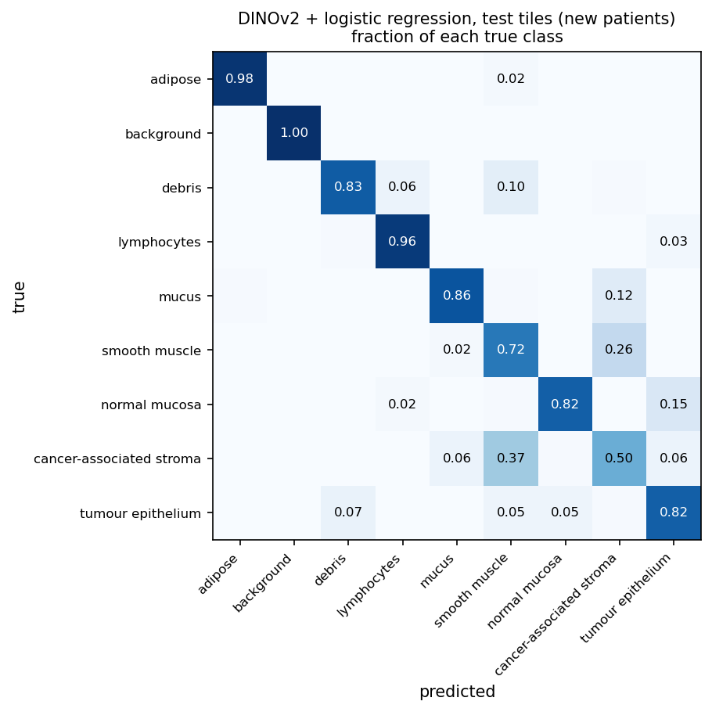
3 · FEW LABELS
Which tissues does it still confuse?
▪ Stroma: 0.50 correct
▪ Mistaken for smooth muscle
▪ Normal mucosa ↔ tumour epithelium
Course notebook, Part 1: DINOv2 + logistic regression, test tiles.
Notes:
Cancer-associated stroma is most often called smooth muscle (0.37), and smooth muscle stroma (0.26); normal mucosa is mistaken for tumour epithelium (0.15). Both pairs are hard for pathologists too.

Slide 58
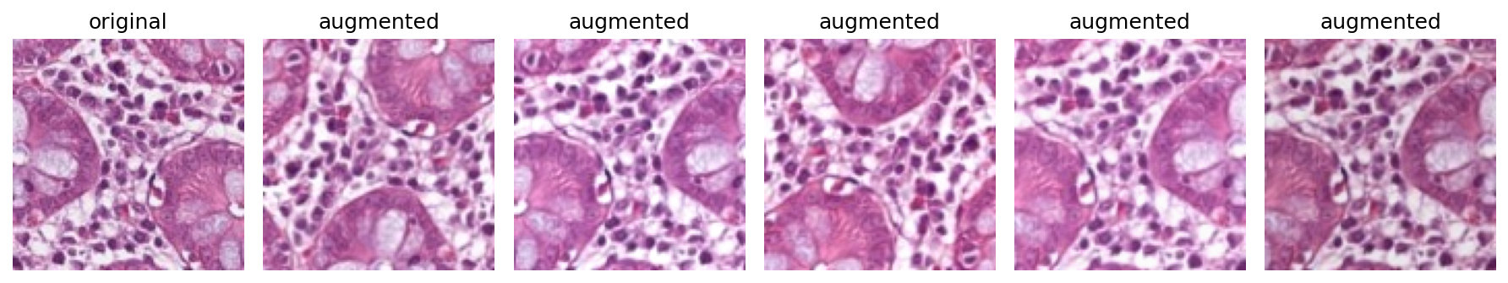
3 · WHICH TRANSFORMATIONS SHOULD NOT MATTER?
Augment only what preserves the label
One training tile and five augmented copies. A tissue section has no 'up', so rotations and mirror images are valid, and small colour changes imitate staining differences. A 6 rotated by 180° is a 9: wrong for digits.
See course.bioinfo.se/session10.html, 'Which transformations should not matter?'.
Notes:
Augmentation is a statement about the biology, not about the network: every epoch the network sees a slightly changed copy of every image with the same label.

Slide 59
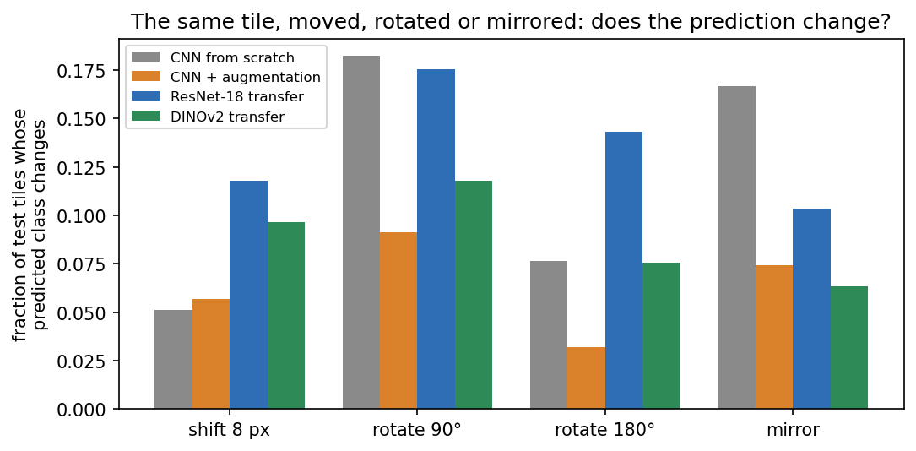
3 · WHICH TRANSFORMATIONS SHOULD NOT MATTER?
Rotation is not built in: it must be learned
▪ Shift 8 px: 5% change
▪ Rotate 90°: 18% change
▪ Rotate 90°, augmented: 9%
Course notebook, Part 1; Veeling et al. 2018.
Notes:
Fraction of the 900 test tiles whose predicted class changes. Mirror: 17% without, 7% with augmentation. The pretrained networks are not rotation-invariant either, since their training photos are almost always upright. This is why pathology pipelines augment with all rotations and flips, and why rotation-equivariant CNNs were developed.

Slide 60
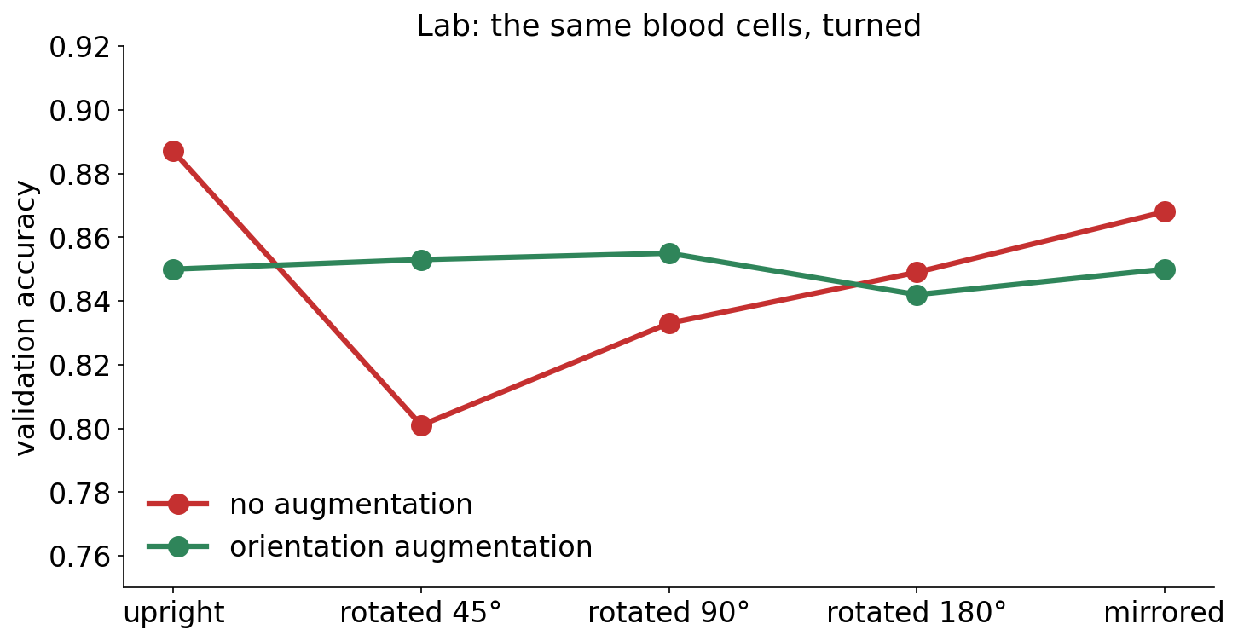
3 · IN THE LAB
Turned blood cells: augmentation evens it out
▪ Without: worst at 45°
▪ With: flat across angles
▪ A little lower upright
Session 10 lab, optional extra 2.

Slide 61
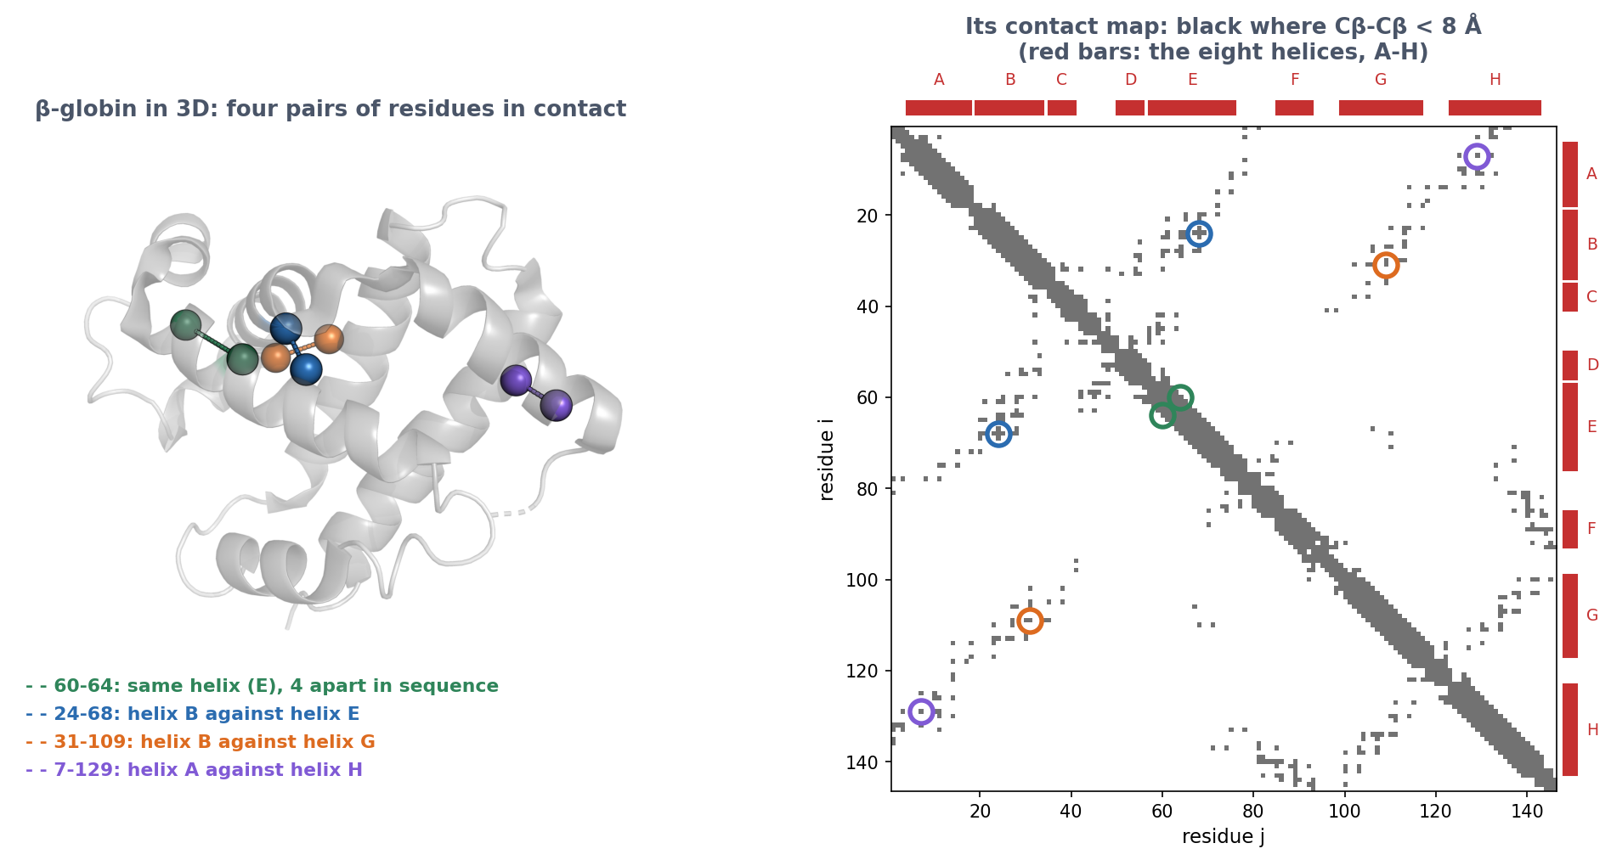
3 · BEYOND PHOTOGRAPHS
A contact map is an image
Row i, column j: black if residues i and j are close (Cβ-Cβ < 8 Å). Each contact appears twice, mirrored in the diagonal. Green: within one helix, next to the diagonal. Blue, orange, purple: helices packed against each other, far from the diagonal. Local patterns → 2D convolutions.
PDB 4HHB chain B, rendered with PyMOL; tools/builders/make_session10_contacts.py.
Notes:
Walk through the four coloured pairs: point at each in 3D, then find it in the map. β-globin, 146 residues: 197 contacts with |i-j| ≥ 6, of which 150 long-range (|i-j| ≥ 24). You first saw this representation in Session 6. Strand pairs give lines along or across the diagonal.

Slide 62
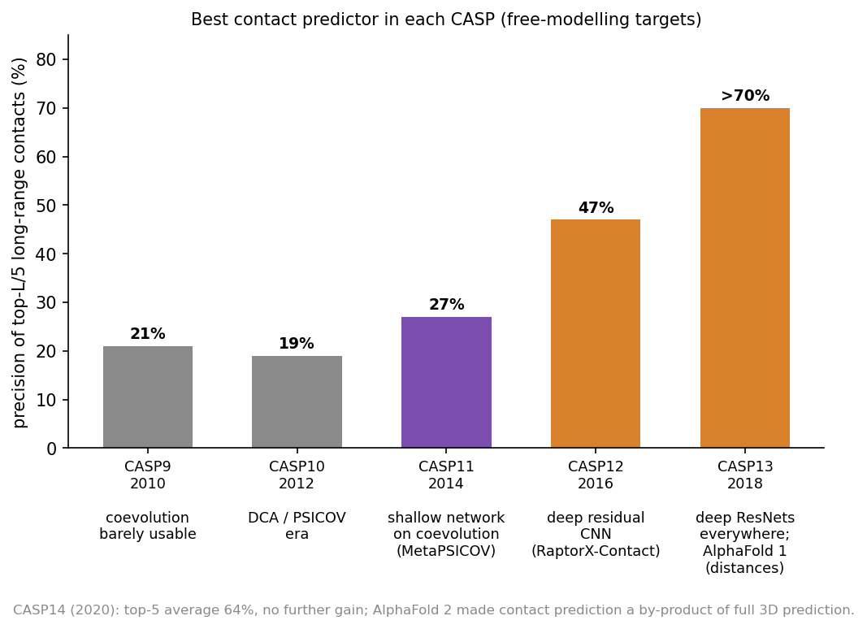
3 · BEYOND PHOTOGRAPHS
Deep CNNs on contact maps transformed structure prediction
Best contact predictor in each CASP. Deep residual CNNs that predict the whole map as an image arrived in 2016 (47%) and passed 70% by 2018. Session 12 tells the rest of the story.
CASP assessments; see Session 12.

Slide 63
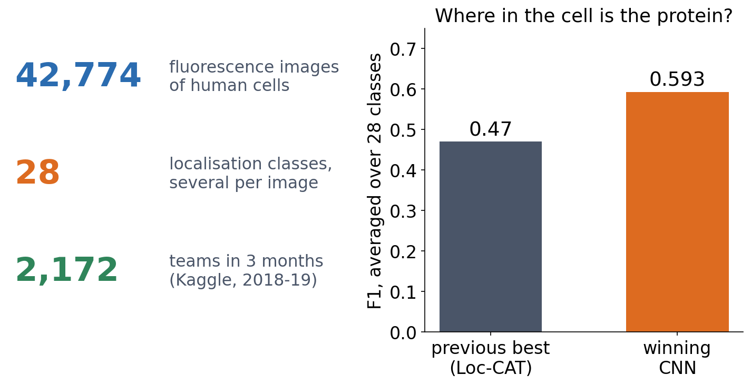
3 · OUTLOOK
Where in the cell is the protein? A CNN competition
▪ Human Protein Atlas images
▪ Several labels per image, rare classes
▪ Best CNNs: 26% better
▪ Still below the experts
Ouyang et al. (2019), Nature Methods 16:1254, 'Analysis of the Human Protein Atlas Image Classification competition'.
Notes:
Organised by Emma Lundberg's group at SciLifeLab on Kaggle. 31,072 training and 11,702 test images; the winning team's F1, averaged over the 28 classes, was 0.593 against 0.47 for the previous best method (Loc-CAT). The difficulties are the ones of this session: highly imbalanced classes and several localisations per image. Expert annotators still did better (precision 0.74, recall 0.69 on similar data). The same images and labels are part of what Alpha Cell builds on.

Slide 64
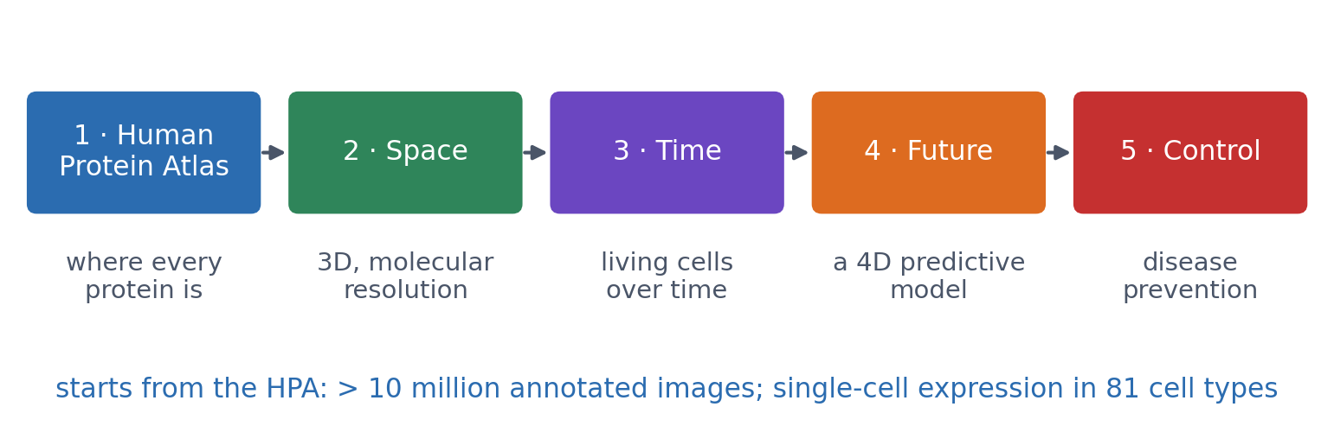
3 · OUTLOOK
Alpha Cell: towards a predictive model of the human cell
▪ SciLifeLab and KTH
▪ Led by Jan Ellenberg and Mathias Uhlén
▪ Knut and Alice Wallenberg Foundation
▪ Starts from the Human Protein Atlas
scilifelab.se/alpha-cell; Human Protein Atlas news, 7 May 2025. https://www.scilifelab.se/alpha-cell/
Notes:
Alpha Cell is SciLifeLab's effort to create predictive models that explain how human cells function, adapt and transition in disease, with USD 36.5 million from the Wallenberg Foundation. The first phase builds on data already in the Human Protein Atlas: more than 10 million manually annotated bioimages, and single-cell gene expression profiles across 81 cell types from 31 human tissues. Later phases add 3D molecular-resolution microscopy (Space), live-cell time series (Time), an integrated 4D predictive model (Future) and translational applications (Control). Image models like the ones in this session are where that starts: from classifying a tile to modelling a cell.

Slide 65
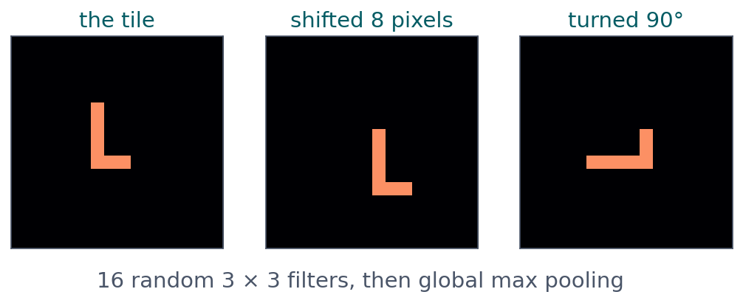
BLOCK 3 · QUIZ
Shift the tile, or turn it?
16 random 3 × 3 filters, then global max pooling. Which change alters the 16 pooled features?
A Only the shift
B Only the turn
C Both
D Neither: a CNN ignores both
Guess on your own
Scan the code, or go to
quiz.bioinfo.se/live
Notes:
In the lecture, turning a tissue tile changed 18% of the predictions, shifting it 5%. Here the same question with one layer and pooling, no training.

Slide 66
BLOCK 3 · QUIZ
Shift the tile, or turn it?
How did the room answer?
Halt the round when most have answered, then show the results.
Show the results ▸ quiz.bioinfo.se/live/report
Notes:
Halt submission in the Control view, then open the results. Do not say which answer is right.

Slide 67

BLOCK 3 · QUIZ
Shift the tile, or turn it?
Fix it, run it, discuss
Open the notebook: scan the code
Fix the line marked FIX, then run the cells
Did it come out as you guessed? Discuss with your neighbour
The notebook: https://colab.research.google.com/github/ElofssonLab/kb8029-book/blob/main/notebooks/session10-discussion-3.ipynb
Notes:
About 8 minutes. The FIX line leaves the 'turned' tile as it is, so both changes come out 0.000 (the fourth answer). Fixed with torch.rot90: the shift still gives 0.000, the turn 0.320. Early finishers: augmentation, and the old contact-map problem (three real proteins).

Slide 68
BLOCK 3 · QUIZ
Shift the tile, or turn it?
Answer again
Same question, after the discussion.
quiz.bioinfo.se/live
Notes:
Open the second round (post) in the Control view.

Slide 69
BLOCK 3 · QUIZ
Shift the tile, or turn it?
Results, and who explains
Both rounds side by side.
Draw two to explain: one of you says how you reasoned.
Show the results ▸ quiz.bioinfo.se/live/report
To check it with code afterwards: discussion notebook 3 https://colab.research.google.com/github/ElofssonLab/kb8029-book/blob/main/notebooks/session10-discussion-3.ipynb
Notes:
Only the turn. Shared filters follow a shift (equivariance) and pooling forgets where (invariance). A 3 × 3 filter for a vertical edge does not respond to a horizontal one, so turning changes the features: rotation invariance must be learned, for example from turned training copies.

Slide 70
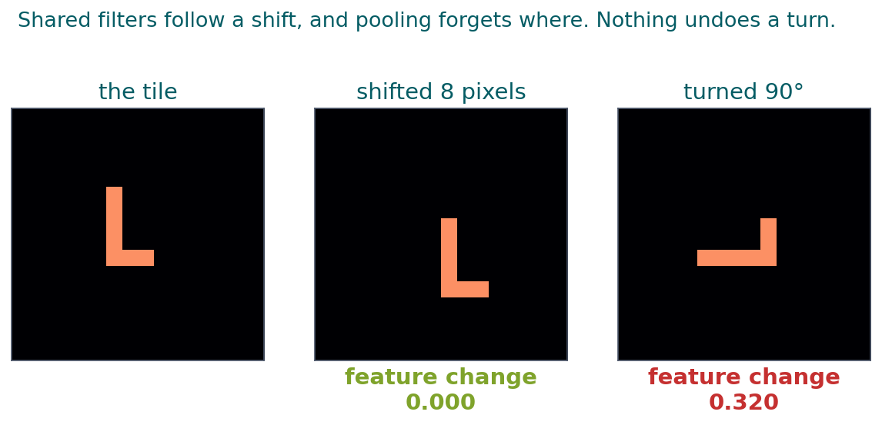
BLOCK 3 · QUIZ
The answer: only the turn changes the features
Shifting moves the object, and the shared filters find the same patterns at the new place; global pooling then forgets where. Nothing in the architecture undoes a turn, so the features change. Rotation invariance has to be learned, for example by augmenting with turned copies, but only where turning keeps the label.

Slide 71
BEFORE YOU LEAVE
In up to three words: what was the hardest part of today?
Answer now
Scan the code, or go to
quiz.bioinfo.se/live
Notes:
A word cloud: the bigger the word, the more students wrote it. It shows what to repeat next time.

Slide 72
BEFORE YOU LEAVE
The hardest part of today
What the room found hardest
Show the results ▸ quiz.bioinfo.se/live/report

Slide 73
Session 11 next
Dense: every position has its own weights. CNN: one local detector, reused
But a CNN sees only its receptive field, and global pooling forgets where
Next: models that read a whole sequence in order: RNNs, language models, Transformers

