Slide 1

Session 11: Sequences, Language Models and SignalP
KB8029 — Bioinformatics & Deep Learning
Arne Elofsson

Slide 2

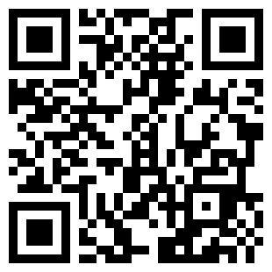
BEFORE WE START
Log in to the lecture quiz
Log in to the quiz
Scan the code, or go to quiz.bioinfo.se/live
Log in with your university account
Answering counts as being at the lecture: up to 3 bonus points on the exam
Right or wrong is never graded, only whether you answered. Results are shown without names.
quiz.bioinfo.se/live
Notes:
The quiz is not anonymous, because answering is how attendance is counted: 3 bonus points on the main exam for answering in all 12 lectures, one point less per missed lecture (preliminary). Whether an answer is right or wrong is never used. The projected results never show names; the only names shown are the two drawn to explain their reasoning. Start the session on quiz.bioinfo.se before the lecture: quiz.bioinfo.se/live then leads to it.

Slide 3
BEFORE WE START
Warm-up: what do you know already?
3 quick questions
On the topics of today, one at a time, about 30 seconds each
Answer on your own, and guess if you do not know
It shows me where to start; right or wrong is never graded
Notes:
About 2 minutes in all. Open each question's round, halt it after about 30 seconds and glance at the results; do not explain the answers now, the lecture does that.

Slide 4
WARM-UP · 1 OF 3
A gradient is multiplied by 0.8 at each of 60 steps back along a sequence. What happens to it?
A It stays about the same
B It grows very large
C It all but vanishes: about one millionth is left
D It becomes exactly 0.8
Answer now
Scan the code, or go to
quiz.bioinfo.se/live
Notes:
Right: It all but vanishes: about one millionth is left. 0.8⁶⁰ = 1.5 × 10⁻⁶. Block 1: backpropagation through time.

Slide 5
WARM-UP · 2 OF 3
In self-attention, one position gives a weight to every position. What is true of these weights?
A They are all equal
B They are 0 or 1
C They add up to 1
D They depend only on the distance
Answer now
Scan the code, or go to
quiz.bioinfo.se/live
Notes:
Right: They add up to 1. A softmax over all positions. Block 2.

Slide 6
WARM-UP · 3 OF 3
What does a signal peptide at the N-terminus of a protein do?
A It starts translation
B It sends the protein into the secretory pathway
C It marks the protein for degradation
D It binds the protein to DNA
Answer now
Scan the code, or go to
quiz.bioinfo.se/live
Notes:
Right: It sends the protein into the secretory pathway. The case study of blocks 1 and 3.

Slide 7
BEFORE WE START
What the room knows already
Where we start
Which topics most of you know, and which we take slowly today.
Show the results ▸ quiz.bioinfo.se/live/report
Notes:
Optional: show two or three of the results, the ones that most got wrong.

Slide 8
BEFORE WE START
Your questions before today
What you asked
The questions you sent in on Canvas before the lecture
The most common ones now; the others in the block where they belong
Notes:
About 5 minutes. Read the answers to this session's Canvas survey 'Questions before the lecture' the evening before (it closes at 18:00 the day before the lecture), pick the two or three most common questions, and answer them briefly now or say in which block they come.

Slide 9
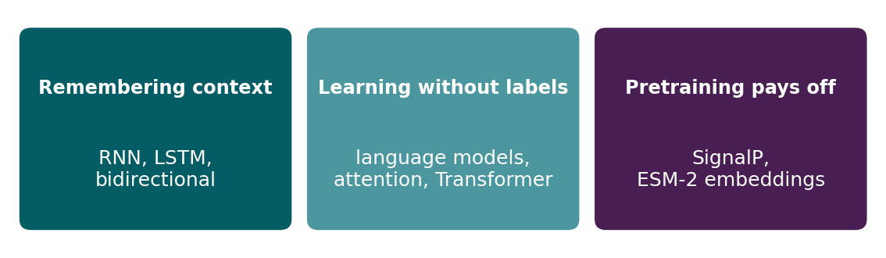
BEFORE WE START
In up to three words: what do you want to learn today?
Answer now
Scan the code, or go to
quiz.bioinfo.se/live
Notes:
A word cloud: the bigger the word, the more students wrote it. Come back to it at the end of the lecture.

Slide 10
BEFORE WE START
What you want to learn today
What the room wants to learn
Show the results ▸ quiz.bioinfo.se/live/report

Slide 11
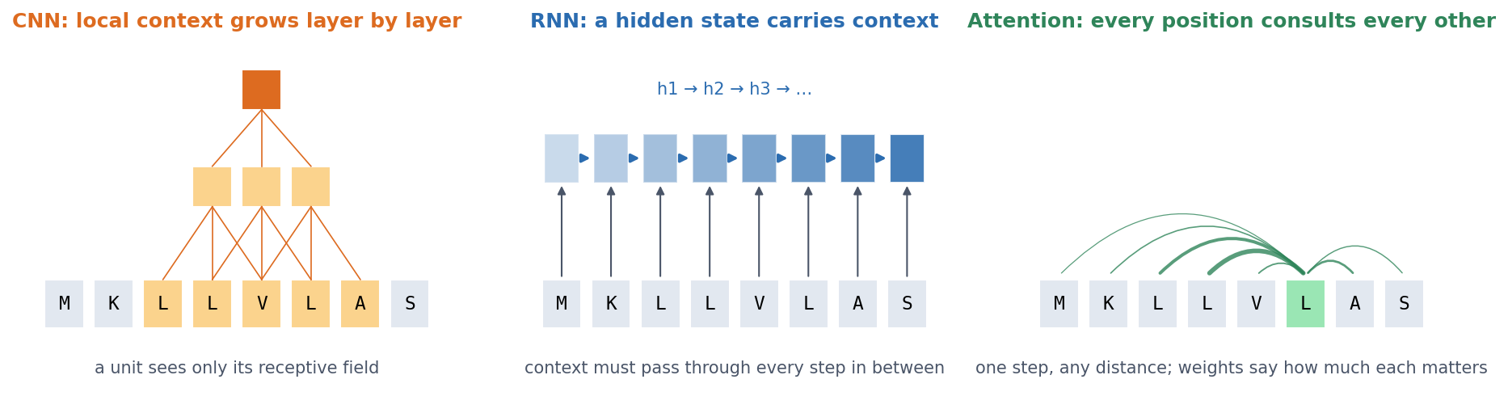
SESSION 11 · THE MAP
How can a model use context from the rest of a sequence?
CNN: local context grows layer by layer (Session 10). RNN: a hidden state carries context step by step. Attention: every position consults every other directly. And: how do we learn representations when labels are scarce but sequences abundant?
See course.bioinfo.se/session11.html, 'Learning goals'.
Notes:
The whole session answers two questions: how a model can use context from the rest of a biological sequence, and how we can learn useful representations when labels are scarce but unlabelled sequences are abundant. Block 1 covers the RNN, Block 2 attention and language models, Block 3 what pretraining does for SignalP.

Slide 12
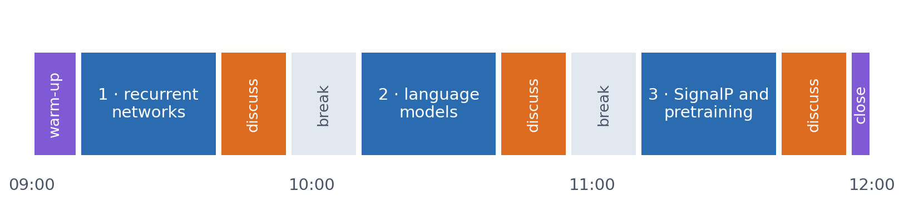
SESSION 11 · THE MORNING
Three blocks: about 30 min talk and 15 min discussion
Block 1: recurrent networks and residue labelling. Block 2: language models, attention and the Transformer. Block 3: SignalP, and why pretraining helps most when labels are scarce.
Times are approximate: a 10 min start (warm-up quiz and your questions), two 15 min breaks and a 5 min close. Each block ends with a quiz question: guess, run the notebook and work out why it behaves as it does, discuss, answer again.

Slide 13
BLOCK 1 · ABOUT 30 MIN
How can a model remember sequence context?

Slide 14
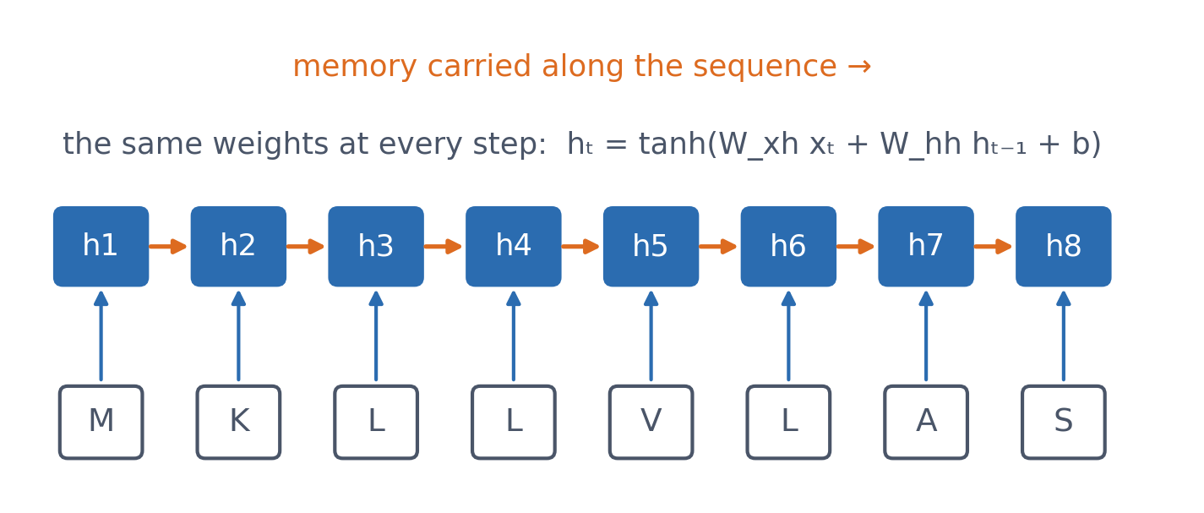
1 · RECURRENT NETWORKS
A hidden state carried along the sequence
New memory = f(current residue, old memory), with the same weights at every position. One network handles proteins of any length.
See course.bioinfo.se/session11.html, 'A hidden state carried along the sequence'.
Notes:
A recurrent neural network reads one position at a time and keeps a hidden state, a vector that summarises what it has read so far. The orange arrows are the memory; the blue arrows bring in each residue.

Slide 15
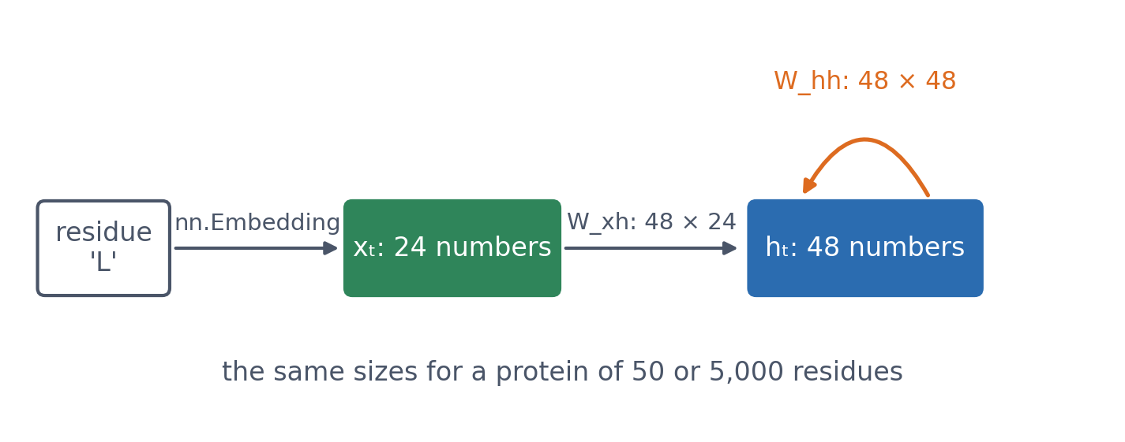
1 · RECURRENT NETWORKS
The notebook's RNN in numbers
Each residue enters as a learned embedding of 24 numbers (a trainable vector per amino acid instead of a one-hot vector); the memory has 48 numbers.
Notebook: session11-rnns-lstm-gru-in-code.ipynb, Part 1.
Notes:
W_xh is 48 x 24 and W_hh is 48 x 48, whatever the length of the protein. nn.Embedding is a lookup table: one row of trainable numbers per amino acid. Session 7 showed that this is a linear layer applied to a one-hot vector.

Slide 16
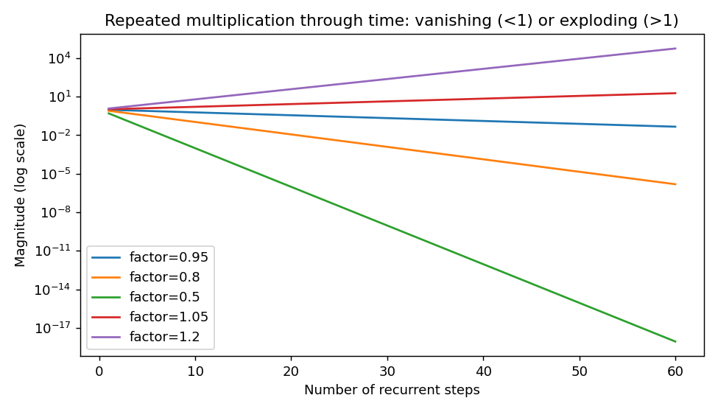
1 · RECURRENT NETWORKS
Backpropagation through time: vanish or explode
▪ One factor per step
▪ ×0.8 for 60 steps: 1.5 × 10⁻⁶
▪ ×1.2 for 60 steps: 5.6 × 10⁴
▪ Session 9, along the sequence
Notebook, Part 1.
Notes:
Training an RNN backpropagates through every step it took. The gradient reaching an early position is a product of many factors, each involving the recurrent weights and the derivative of the activation. If their effective size is repeatedly below 1, the product vanishes; above 1, it can explode.

Slide 17
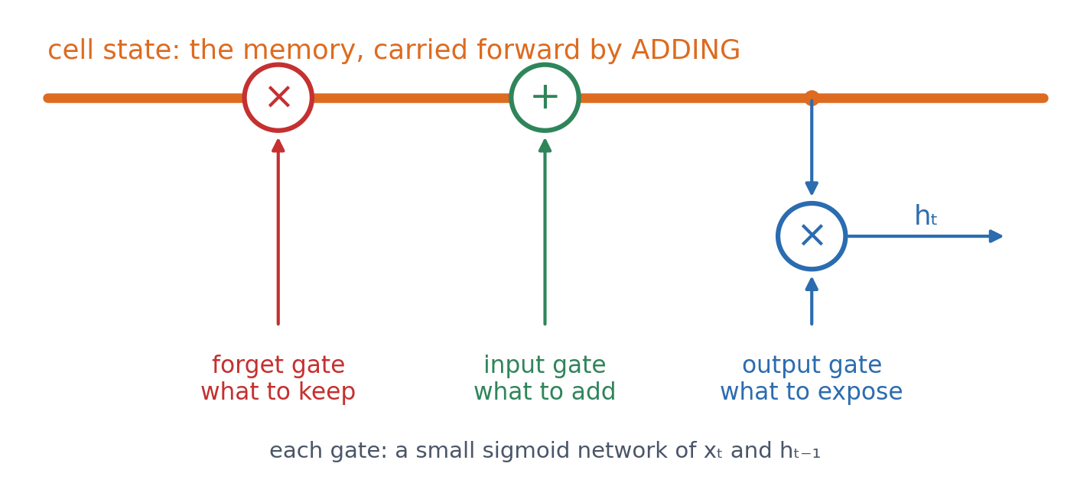
1 · RECURRENT NETWORKS
LSTM: an additive memory path
▪ Memory updated by adding
▪ Gates: keep, add, expose
▪ Error flows back over many steps
▪ GRU: fewer gates, no cell state
Hochreiter & Schmidhuber (1997), Neural Computation 9:1735.
Notes:
Because the cell state is carried forward by addition, the error signal does not shrink at every step. LSTMs make much longer dependencies trainable than a simple RNN, although how long in practice depends on the task. The notebook writes the gate equations out and checks them against nn.LSTMCell (max difference 0.0).

Slide 18
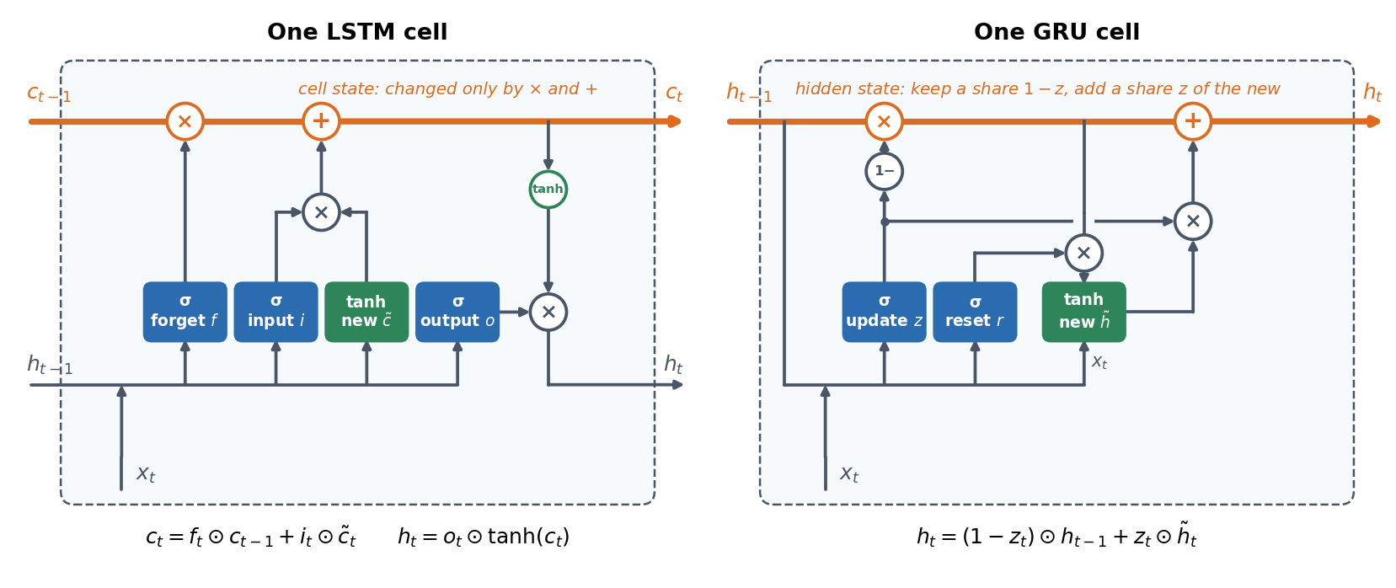
1 · RECURRENT NETWORKS
Inside an LSTM cell and a GRU cell
Blue: sigmoid gates (0 to 1). Green: a new candidate value. LSTM: the cell state (orange) is changed only by × and +, the additive memory path. GRU: no cell state; the update gate z mixes old and new, the reset gate r decides how much of the old state the candidate sees.
Hochreiter & Schmidhuber (1997); Cho et al. (2014).
Notes:
Follow the orange line: it is changed only by a multiplication with the forget gate and an addition, with no squashing function, so the gradient can flow back along it over many steps, as long as the forget gates stay close to 1. This mitigates vanishing gradients; it does not abolish them. The forget gate f scales the old memory; the input gate i decides how much of the new candidate to add; the output gate o decides how much to expose as h. The GRU does the same job with two gates and one state.

Slide 19
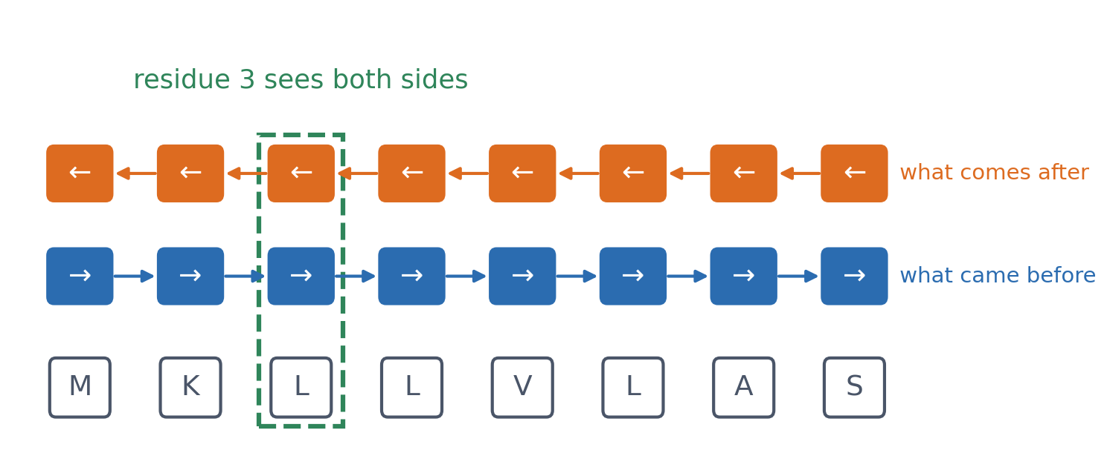
1 · RECURRENT NETWORKS
Bidirectional: read the sequence both ways
▪ One LSTM left to right
▪ One LSTM right to left
▪ Combined at every position
Schuster & Paliwal (1997).
Notes:
A forward LSTM knows only what came before each position. A bidirectional LSTM combines a forward and a backward one, so every position also sees what comes after it. This is only possible when the whole sequence is known: fine for annotation, impossible for generating a sequence one residue at a time.

Slide 20
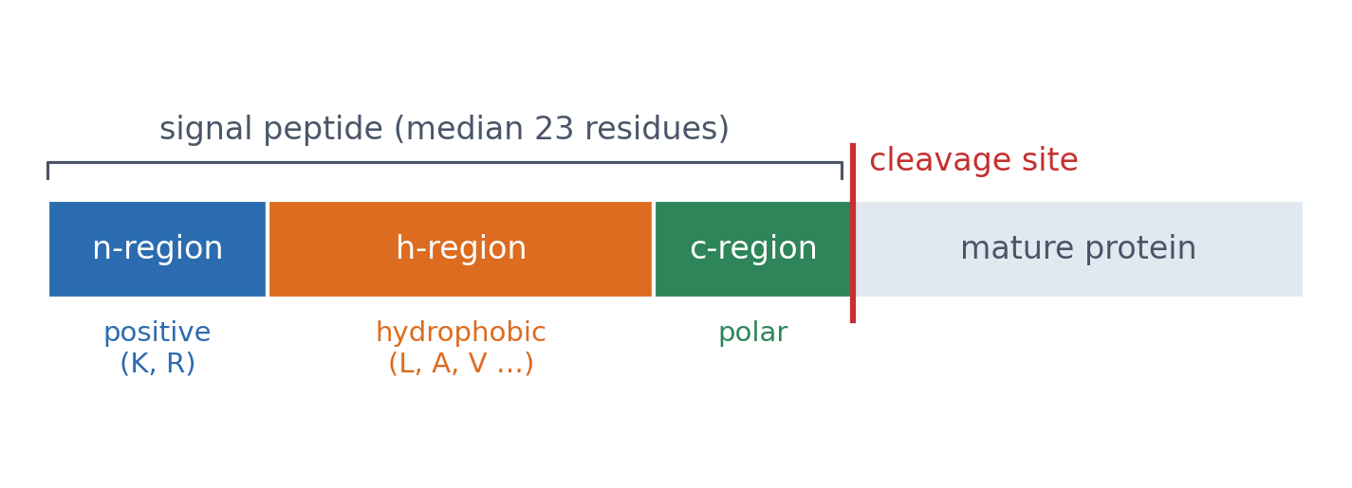
1 · CASE STUDY
Which residues belong to a signal peptide?
▪ Sends a protein to the secretory pathway
▪ Three regions, then a cleavage site
▪ Blobel: Nobel Prize 1999
See course.bioinfo.se/session11.html, 'Case study'.
Notes:
A positively charged n-region, a hydrophobic h-region and a polar c-region that ends at the cleavage site. The task: label each of the first 70 residues as signal peptide or not.

Slide 21
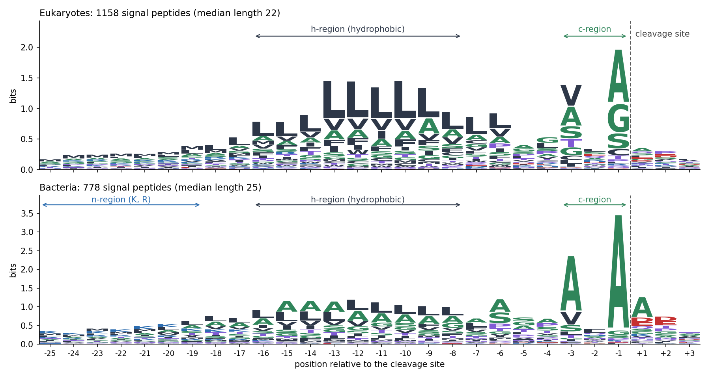
1 · CASE STUDY
The regions are visible in the data
Experimentally supported signal peptides aligned on the cleavage site (dashed). Leucines fill the h-region; small residues at −3 and −1 mark the cut (the −3, −1 rule); in bacteria the n-region is rich in K and R. The two logos have different y-scales.
Our dataset: 1,158 eukaryotic and 778 bacterial signal peptides (ECO:0000269).
Notes:
Stack height is the information content of the position; letter height is its frequency. Colours: hydrophobic dark grey, small green, positive blue, negative red, other polar purple. Signal peptides differ in length, so the left columns mix residues from different regions: the n-region is blurred.

Slide 22
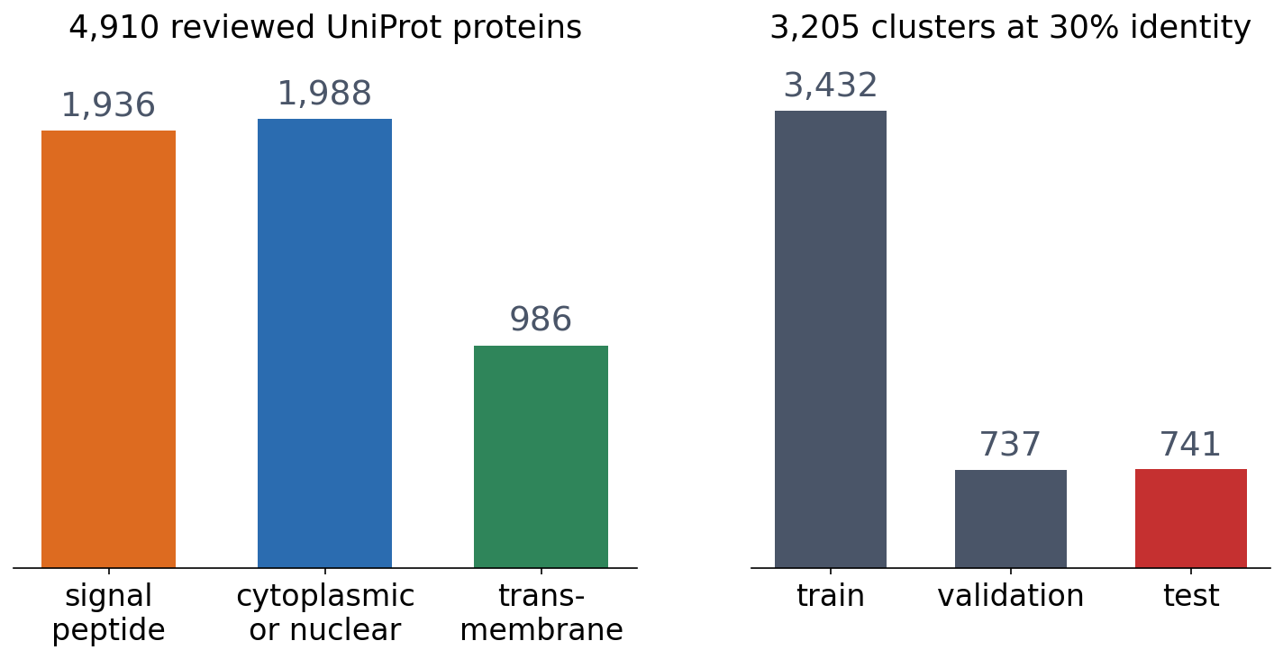
1 · CASE STUDY
The data: 4,910 proteins, homology-aware split
▪ Experimentally supported signal peptides only
▪ Transmembrane: hard negatives
▪ Split by MMseqs2 clusters (Session 8)
Notebook, Part 1.
Notes:
Only signal peptides with evidence code ECO:0000269: many UniProt signal peptides are predicted by SignalP itself, and training on those would teach a model to imitate SignalP. Transmembrane proteins are hard negatives because a transmembrane helix is also a hydrophobic stretch. Signal-peptide fraction 0.39 / 0.39 / 0.40 in train / validation / test.

Slide 23
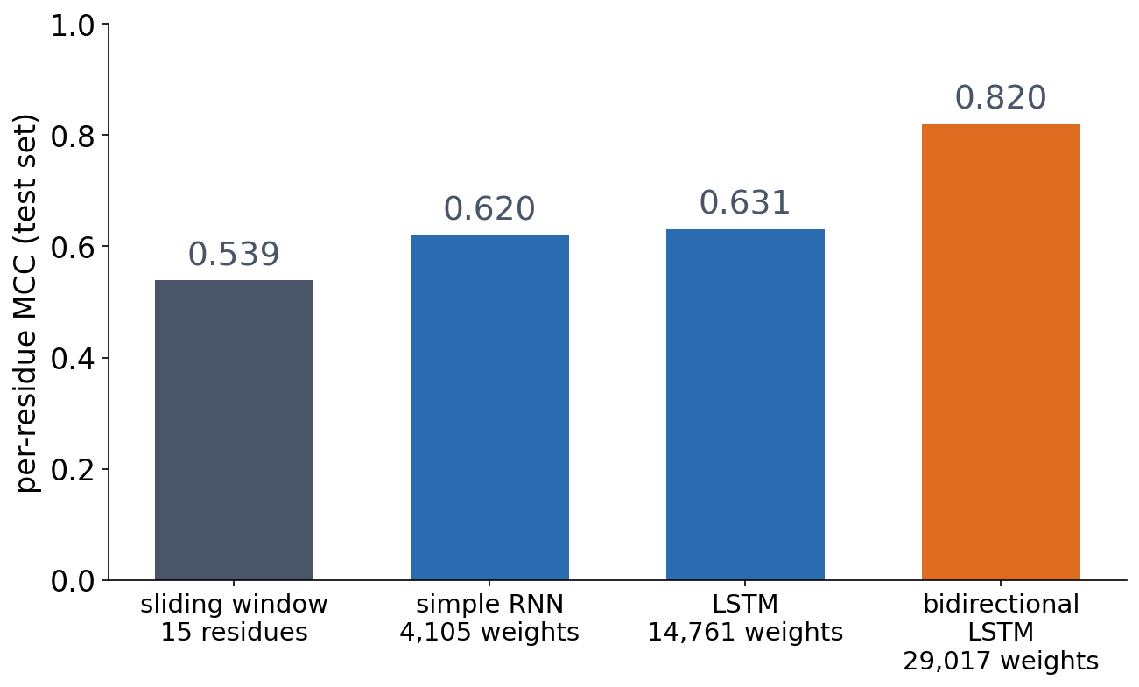
1 · CASE STUDY
Bidirectional wins clearly
▪ BiLSTM: MCC 0.820
▪ Forward LSTM: 0.631
▪ More memory alone helps little
Notebook, Part 1; homology-aware test set.
Notes:
AUPR: window 0.681, RNN 0.770, LSTM 0.767, BiLSTM 0.920. The jump from RNN to LSTM is small; the jump to reading both directions is large. Ask the room why before the next slide.

Slide 24
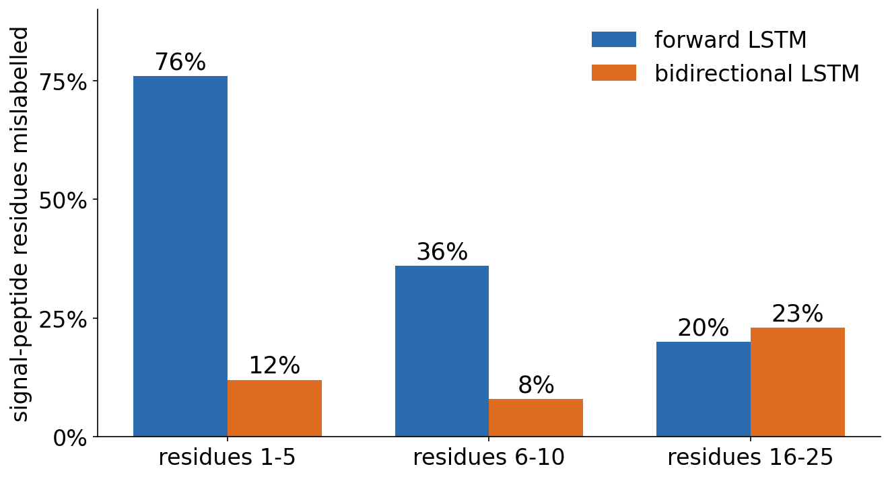
1 · CASE STUDY
The evidence comes after the residue
▪ Residue 3 has seen only M-x-x
▪ The h-region comes later
▪ Near the cleavage site: a tie
Discussion notebook 1.
Notes:
Forward LSTM: 76% of the first five signal-peptide residues mislabelled, bidirectional 12%. Residues 16-25: 0.20 vs 0.23. The forward model also calls the N-terminus of proteins without a signal peptide 'signal peptide' (residues 1-10: 0.118 vs 0.053), because it cannot yet see that no h-region follows. Do not reveal before the discussion if you run it first.

Slide 25
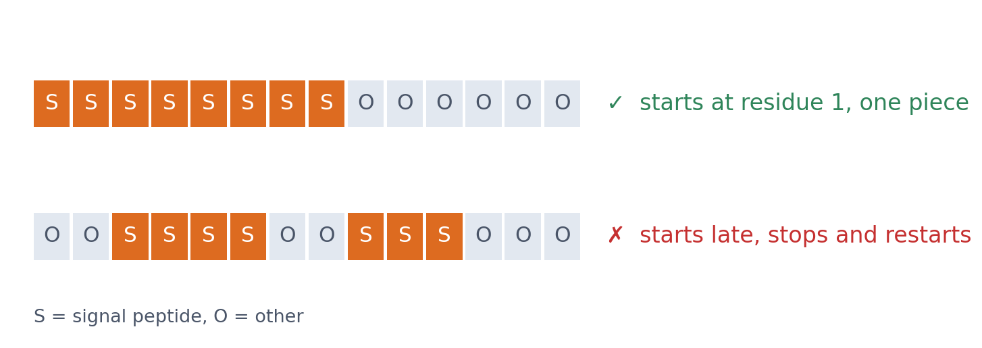
1 · CASE STUDY
SignalP 5.0: BiLSTM + CRF
▪ CRF: a structured output layer
▪ Favours plausible label sequences
Almagro Armenteros et al. (2019), Nat Biotechnol 37:420.
Notes:
A conditional random field scores the whole label sequence, not each residue on its own, so a signal peptide that starts at residue 1 and does not stop and restart is preferred.

Slide 26
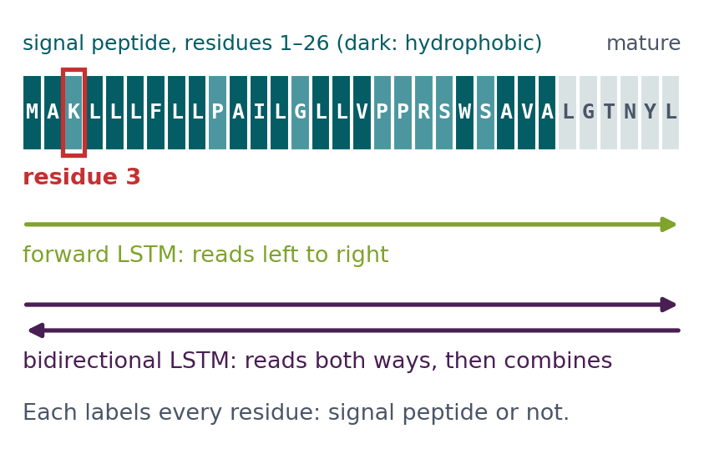
BLOCK 1 · QUIZ
Where is the gap between the two LSTMs largest?
Forward and bidirectional LSTMs label each residue: signal peptide or not.
A At residues 1–5: the h-region is not yet seen
B Near the cleavage site: the hardest residues
C Evenly: bidirectional is better everywhere
D Nowhere: memory makes direction irrelevant
Guess on your own
Scan the code, or go to
quiz.bioinfo.se/live
Notes:
The old block 1 discussion. Residue 3 of a signal peptide is in the positively charged n-region; what identifies a signal peptide is the hydrophobic h-region that follows. Let them guess before computing.

Slide 27
BLOCK 1 · QUIZ
Where is the gap between the two LSTMs largest?
How did the room answer?
Halt the round when most have answered, then show the results.
Show the results ▸ quiz.bioinfo.se/live/report
Notes:
Halt submission in the Control view, then open the results. Do not say which answer is right.

Slide 28
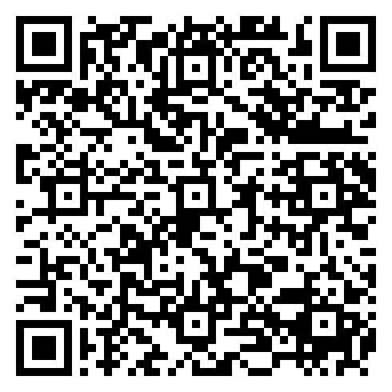
BLOCK 1 · QUIZ
Where is the gap between the two LSTMs largest?
Fix it, run it, discuss
Open the notebook: scan the code
Fix the line marked FIX, then run the cells
Did it come out as you guessed? Discuss with your neighbour
The notebook: https://colab.research.google.com/github/ElofssonLab/kb8029-book/blob/main/notebooks/session11-discussion-1.ipynb
Notes:
About 8 minutes; training both LSTMs takes under a minute on Colab. The FIX line builds the LSTM with bidirectional=False whatever the Tagger is asked for, so both models give identical numbers (0.76, 0.36, 0.20): the fourth answer. Fixed (bidirectional=bidirectional): the bidirectional model gives 0.12, 0.08, 0.23.

Slide 29
BLOCK 1 · QUIZ
Where is the gap between the two LSTMs largest?
Answer again
Same question, after the discussion.
quiz.bioinfo.se/live
Notes:
Open the second round (post) in the Control view.

Slide 30
BLOCK 1 · QUIZ
Where is the gap between the two LSTMs largest?
Results, and who explains
Both rounds side by side.
Draw two to explain: one of you says how you reasoned.
Show the results ▸ quiz.bioinfo.se/live/report
To check it with code afterwards: discussion notebook 1 https://colab.research.google.com/github/ElofssonLab/kb8029-book/blob/main/notebooks/session11-discussion-1.ipynb
Notes:
At residues 1-5: forward 0.76 mislabelled, bidirectional 0.12. When the forward LSTM labels residue 3 of Q39487 it has seen only MAK. Near the cleavage site both are about equal (0.20 and 0.23): by then both have seen the h-region. A model that generates a sequence must read one way: GPT against BERT in block 2.

Slide 31
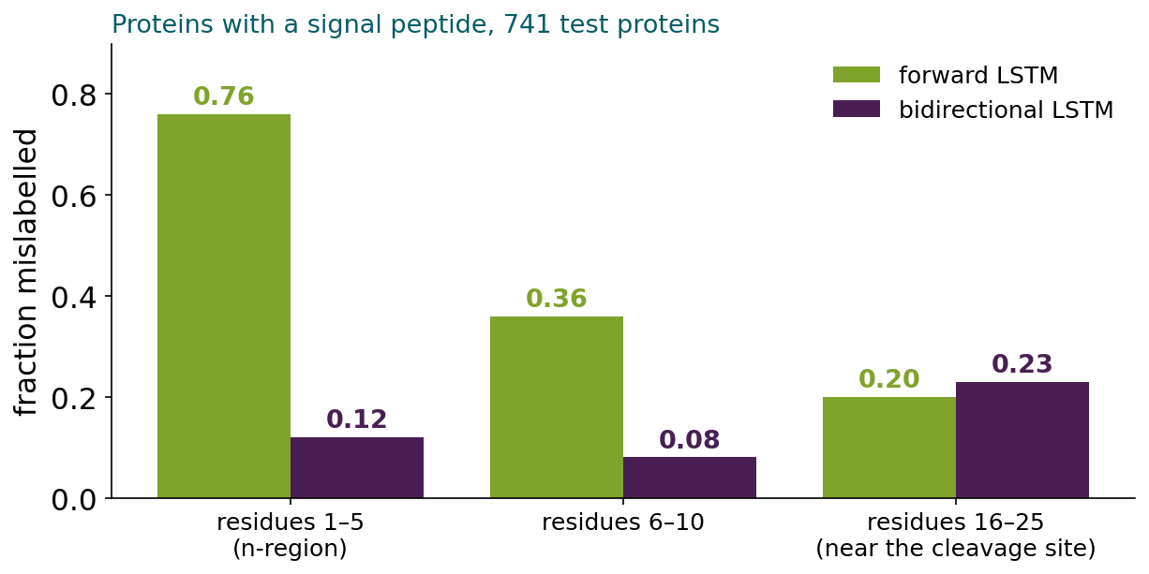
BLOCK 1 · QUIZ
The answer: at the first residues, before the h-region
Whether residue 3 belongs to a signal peptide is decided by the hydrophobic h-region that comes after it. The forward LSTM has not seen it yet and mislabels three quarters of residues 1–5; the bidirectional one has. Near the cleavage site both have seen it, and both are about equally good.

Slide 32
BLOCK 1 DONE
Break

Slide 33
BLOCK 2 · ABOUT 30 MIN
Can we learn from sequences without labels?

Slide 34
2 · LANGUAGE MODELS
Labels are scarce; sequences are abundant
Labels
Sequences
expensive
hundreds of millions
▪ Need experiments
▪ Our dataset: 1,936 experimentally supported signal peptides
▪ In UniProt (Session 3)
▪ Free, but unlabelled
See course.bioinfo.se/session11.html, 'Can we learn from sequences without labels?'
Notes:
Can a model learn useful biology from the sequences alone? A language model does, by predicting missing or future tokens: the sequences provide their own training signal.

Slide 35
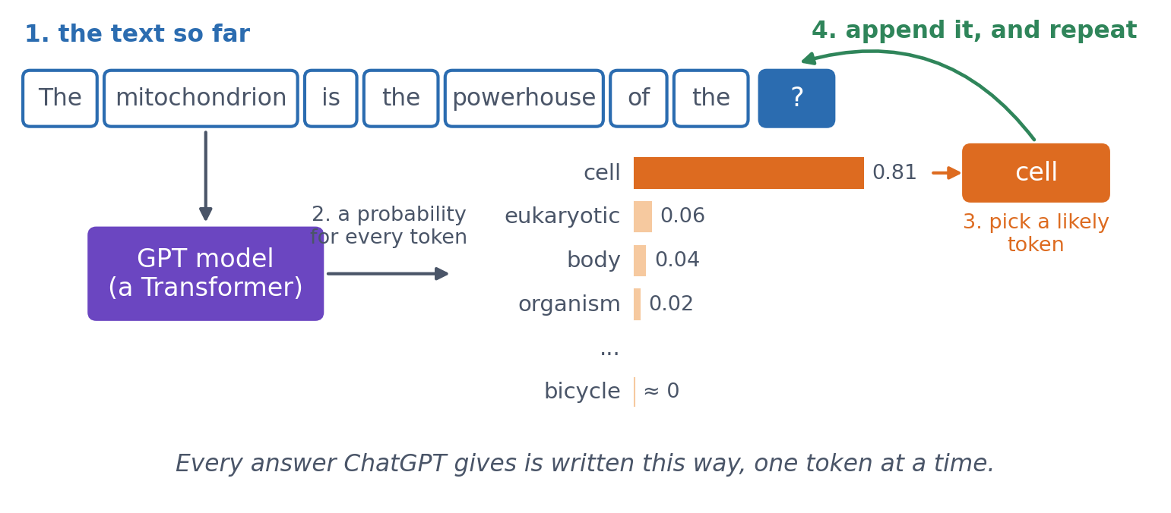
2 · LANGUAGE MODELS
You have used one: how ChatGPT writes
A language model gives a probability for every possible next token. GPT = Generative Pre-trained Transformer: to write, it predicts, picks a likely token, appends it and repeats. To predict well it must learn grammar, facts and arguments; for proteins, biochemistry.
Schematic; the probabilities are illustrative. See course.bioinfo.se/session11.html, 'What a language model is'.
Notes:
Start from what they know: the word suggestions on a phone keyboard, and ChatGPT. Both predict what comes next. Generative: it produces text. Pre-trained: it first learns from huge amounts of unlabelled text (GPT-3, 2020: 175 billion weights, about 300 billion tokens). Transformer: the architecture of this block. ChatGPT (November 2022) is a GPT model further trained on example conversations and on human ratings of its answers, so that it answers like an assistant instead of just continuing the text. Why the trivial task teaches so much: to continue 'The capital of Sweden is' it must know a fact. Self-supervised: the next token is the label, so no labelling is needed. Proteins: tokens are amino acids, the vocabulary is 20, the data are UniProt; to predict a hidden residue in a signal peptide the model must learn that its middle is hydrophobic. Next slide: GPT predicts the next token, but protein models such as ESM-2 mostly fill in masked ones.

Slide 36
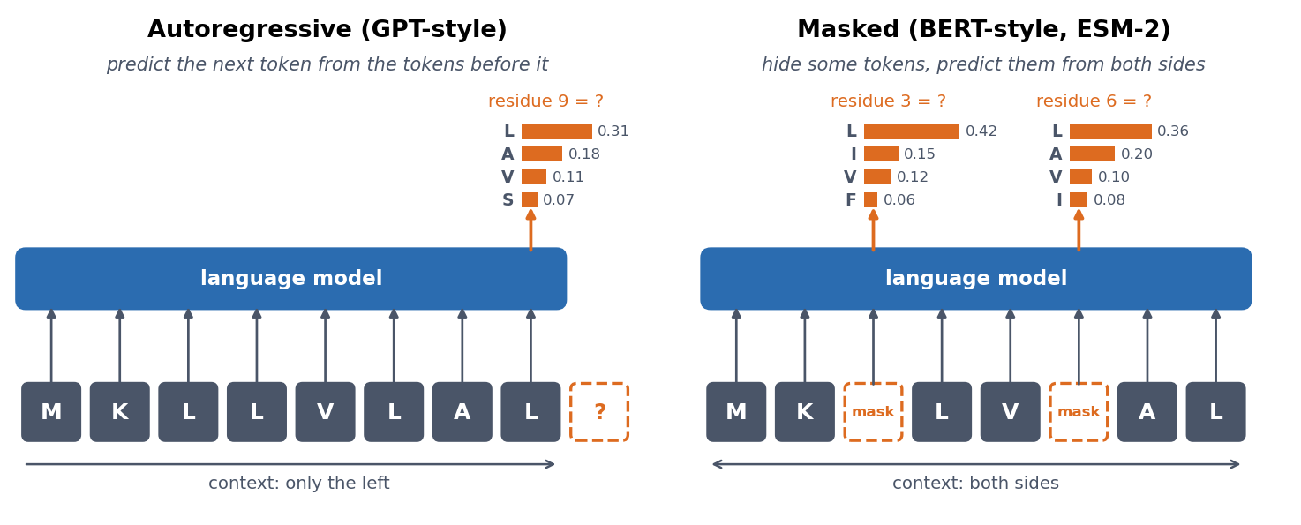
2 · LANGUAGE MODELS
Two ways to learn without labels
Autoregressive (GPT-style): predict the next token from the previous ones. Masked (BERT-style, ESM-2): hide some tokens and predict them from both sides.
See course.bioinfo.se/session11.html, 'What a language model is'.
Notes:
To predict well, a model must learn what tends to go with what. These regularities are stored in its internal vectors, the embeddings, which turn out to be useful for many other tasks.

Slide 37
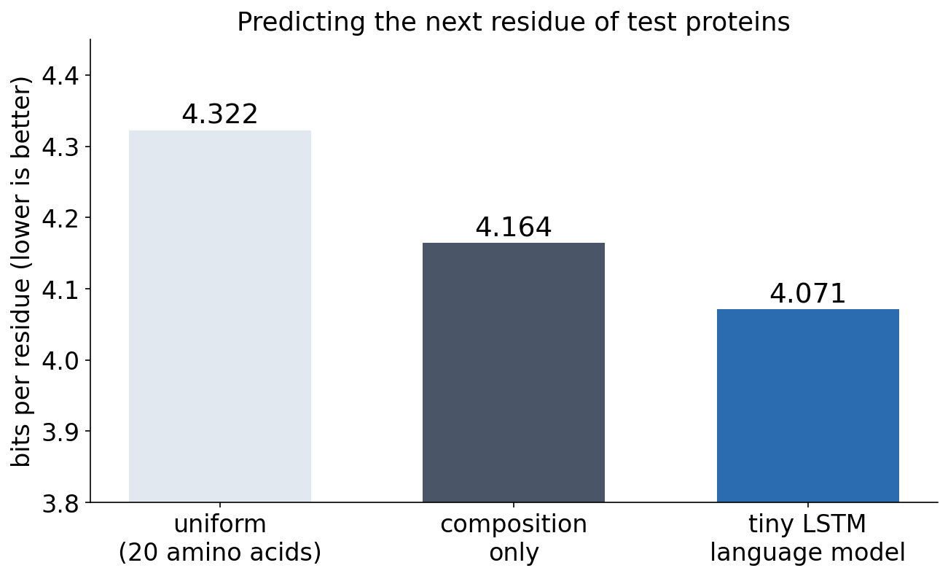
2 · LANGUAGE MODELS
A tiny language model in the notebook
▪ Next-residue LSTM: 4.071 bits
▪ Composition: 4.164 bits
▪ Only a little better
▪ Large models: far more data, better architecture
Notebook, Part 2.
Notes:
Uniform guessing over 20 amino acids costs log2(20) = 4.322 bits per residue. Knowing the composition saves a little, and an LSTM that reads the previous residues saves a little more. The better architecture is attention.

Slide 38
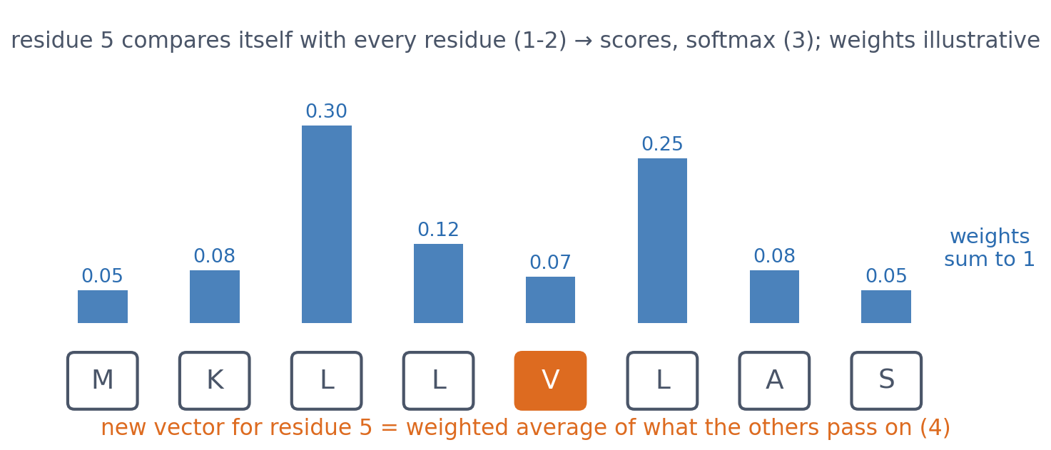
2 · ATTENTION
Self-attention: which positions should I listen to?
For residue i: (1) compare with every residue j, (2) give each a relevance score, (3) normalise the scores with softmax so they sum to 1, (4) update i with a weighted average.
See course.bioinfo.se/session11.html, 'Attention, from scratch'.
Notes:
The weights in the figure are illustrative. The notebook computes real ones for a toy sentence: each row of the attention matrix sums to 1.0.

Slide 39
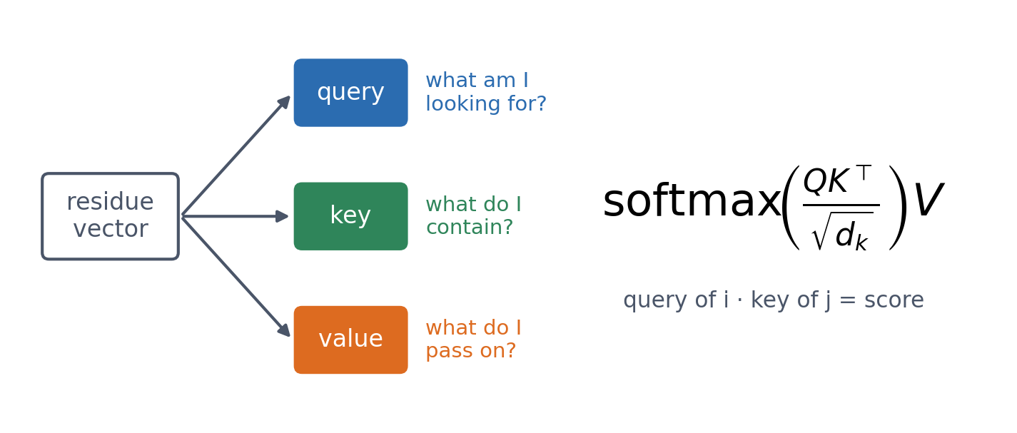
2 · ATTENTION
Query, key and value
Three learned linear maps turn each residue's vector into a query, a key and a value. The score of j for i is the match between the query of i and the key of j.
Vaswani et al. (2017); 3Blue1Brown ch. 6 is embedded on the page.
Notes:
In matrix form for all positions at once: softmax(QK^T / sqrt(d_k)) V. In the notebook Q, K and V are each 1 x 6 x 8 for the six-token sentence, and the attention matrix is 6 x 6.

Slide 40
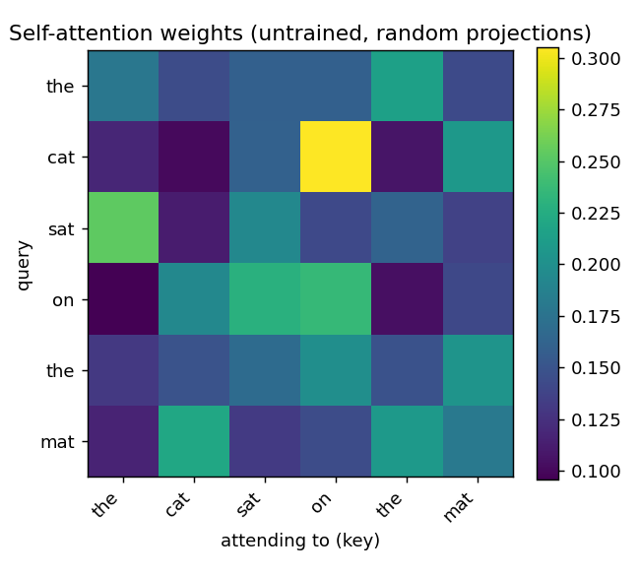
2 · ATTENTION
Any two positions, in one step
▪ Each row sums to 1
▪ Any distance, one step
▪ All positions in parallel
▪ High weight ≠ contact, ≠ explanation
Notebook, Part 2 (random, untrained projections).
Notes:
Unlike an RNN, attention connects any two positions in one step and computes all positions at once. A high weight means j contributes strongly when i is updated. It does not prove a 3D contact, and it is not by itself a biological explanation; the second discussion tests how much structural signal attention maps carry.

Slide 41
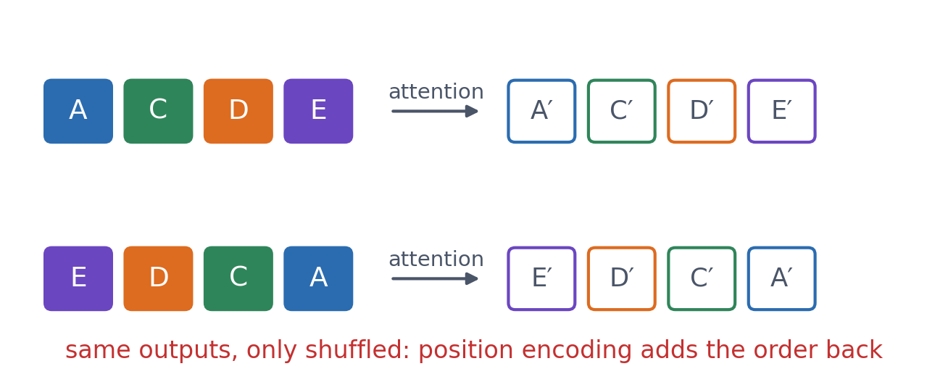
2 · ATTENTION
Attention alone has no sense of order
Shuffle the input and the outputs are only shuffled: 'ACDE' and 'EDCA' give the same set of vectors. The Transformer adds position encoding.
See course.bioinfo.se/session11.html, 'Attention, from scratch'.

Slide 42
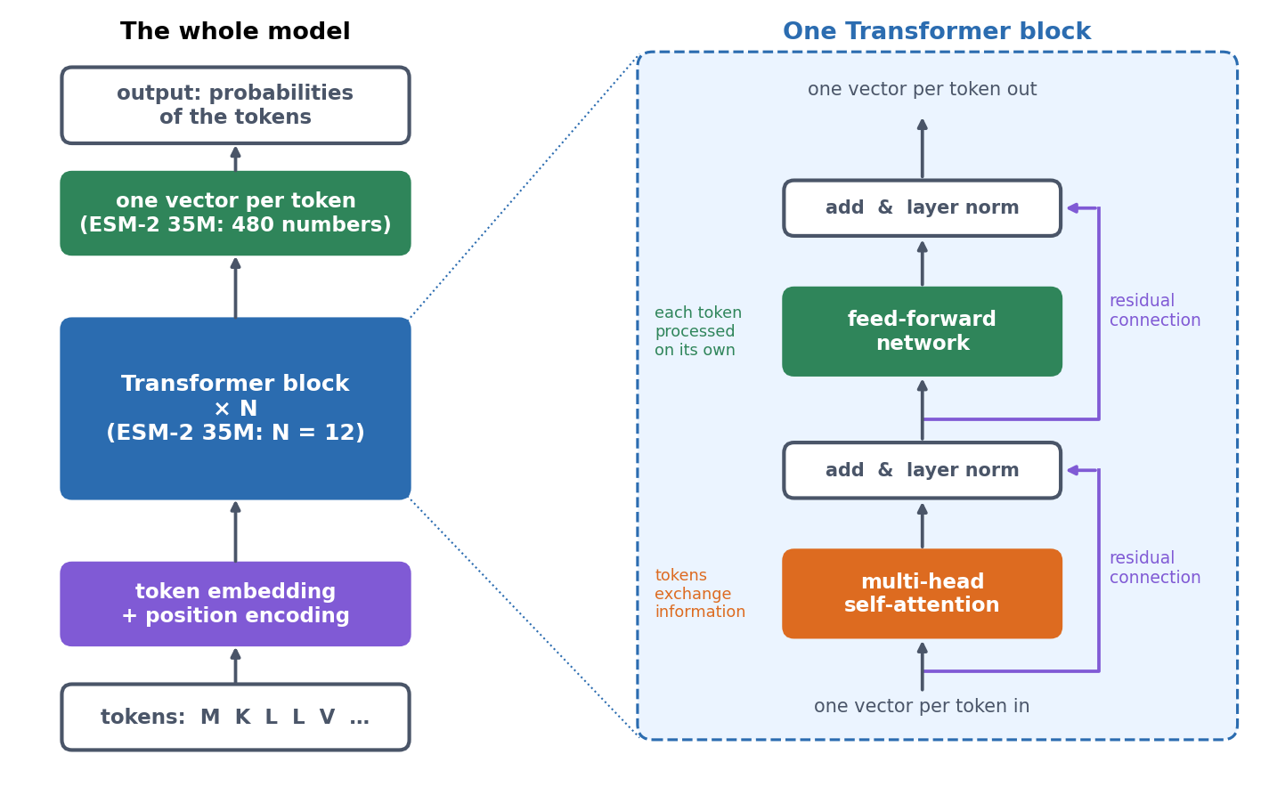
2 · THE TRANSFORMER
The Transformer: attention plus four tricks
Several heads · a feed-forward network per token (Session 7's MLP) · residual connections and layer normalisation (Session 10's ResNet) · position encoding.
Vaswani et al. (2017); 3Blue1Brown ch. 5 is embedded on the page.
Notes:
Attention moves information between tokens; the feed-forward network processes it within each token. Residual connections let gradients survive dozens of blocks. Many newer models, ESM-2 among them, apply the layer normalisation before each step instead of after it.

Slide 43
2 · THE TRANSFORMER
ESM-2 in the notebook
▪ A stack of identical blocks
▪ One vector per residue in and out
▪ Largest ESM-2: 48 blocks, 15 billion weights
12
blocks
20
attention heads
480
numbers
per residue
33.5M
weights
See course.bioinfo.se/session11.html, 'The Transformer: attention plus four tricks'.

Slide 44
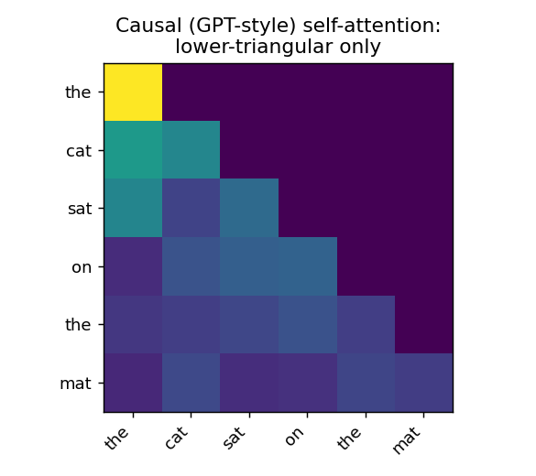
2 · THE TRANSFORMER
BERT vs GPT is one mask
▪ GPT: mask the future
▪ Can generate sequences
▪ BERT, ESM-2: see both sides
▪ Fine for annotation
Notebook, Part 2: the weight on any future position is exactly 0.0.
Notes:
The same distinction as between a forward and a bidirectional LSTM. A GPT-style decoder sees only earlier positions and learns by predicting the next token, which is what lets it generate. A BERT-style encoder lets every position attend to every other and learns by filling in masks.

Slide 45
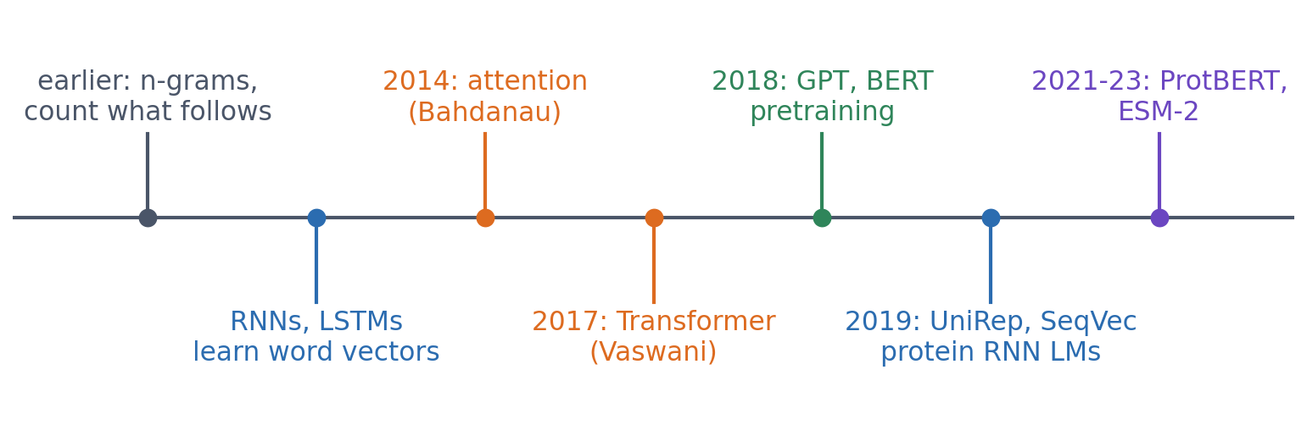
2 · WHAT ACTUALLY HAPPENED
From counting words to protein language models
Attention was first added to recurrent translation models; the Transformer kept only the attention and processed all positions in parallel, which made large-scale pretraining practical.
Bahdanau et al. 2014; Vaswani et al. 2017; Radford et al. 2018; Devlin et al. 2018; Lin et al. 2023.
Notes:
An early precursor: the network program SignalP's group used before SignalP could erase the central residue of a window and predict it, 'presumably the first machine learning language model' in biological sequence analysis (Nielsen et al. 2024). The attention maps of protein language models turned out to contain contact information, although they were never trained on structures (Rao et al. 2021). The largest ESM-2 models predict 3D structure (ESMFold): Session 12.

Slide 46
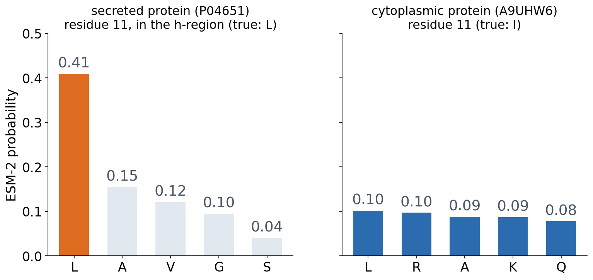
2 · PROTEIN LANGUAGE MODELS
ESM-2 knows what a signal peptide looks like
▪ h-region: L, 0.41
▪ Cytoplasmic: no residue above 0.11
▪ Nobody told it about signal peptides
Notebook, Part 2: ESM-2 35M, residue 11 masked.

Slide 47
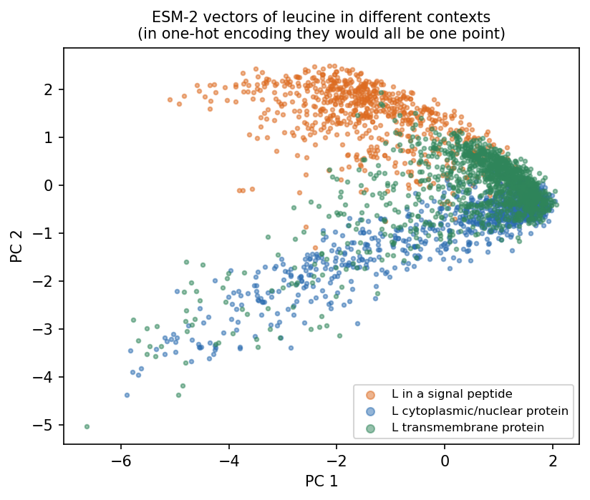
2 · PROTEIN LANGUAGE MODELS
Same residue, different context, different vector
▪ One-hot: every leucine the same
▪ ESM-2: each computed from its surroundings
▪ A contextual embedding
Notebook: 2,924 leucines from the first 70 residues of 450 proteins.
Notes:
Probably the single most important idea of this block. In Session 6, Foldseek's 3Di alphabet was another learned representation of a residue's environment.

Slide 48
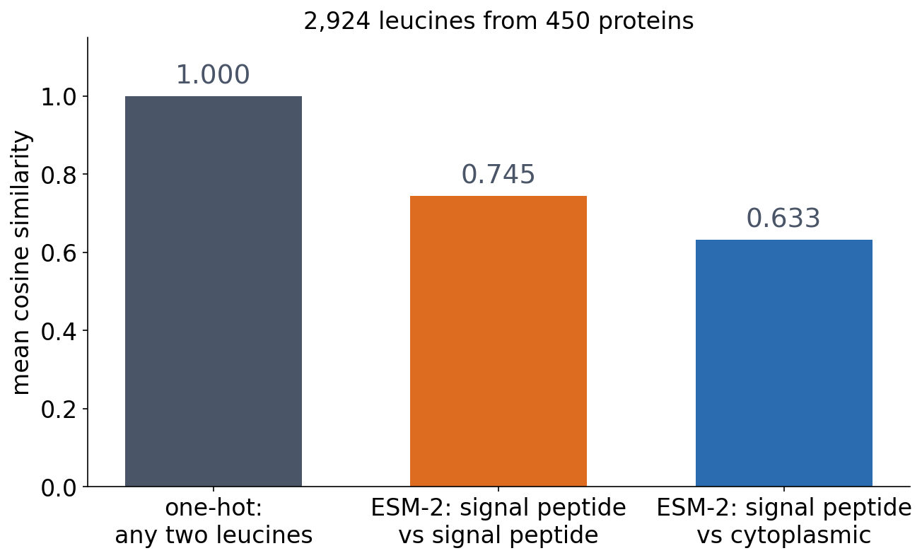
2 · PROTEIN LANGUAGE MODELS
The vector carries the surroundings
▪ One-hot: cosine 1 for any pair
▪ ESM-2: 0.745 within signal peptides
▪ 0.633 against cytoplasmic leucines
Notebook, Part 2.
Notes:
Transmembrane leucines: 0.742 with each other, 0.682 with signal-peptide leucines. This is what a classifier on top of a protein language model gets to work with.

Slide 49
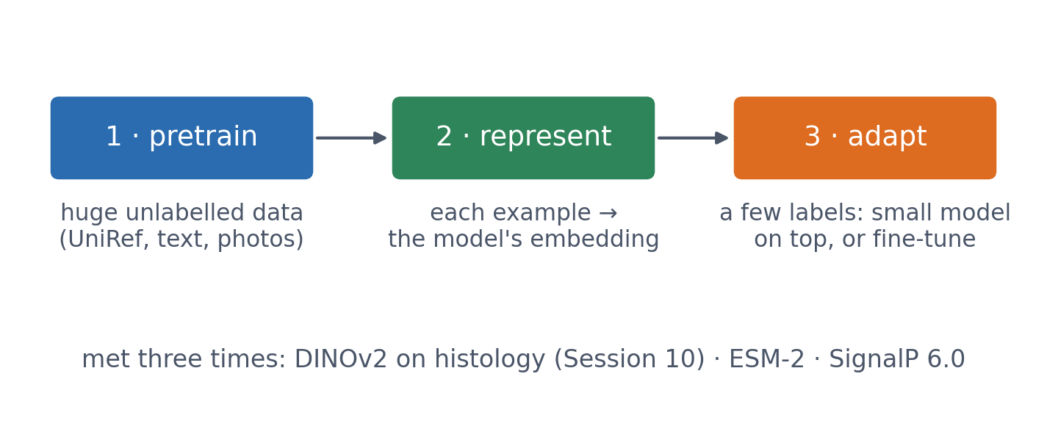
2 · FOUNDATION MODELS
Pretrain once, reuse everywhere
A foundation model helps most when labelled data are scarce, but it does not remove the need for an honest split.
Bommasani et al. (2021), arXiv:2108.07258.

Slide 50
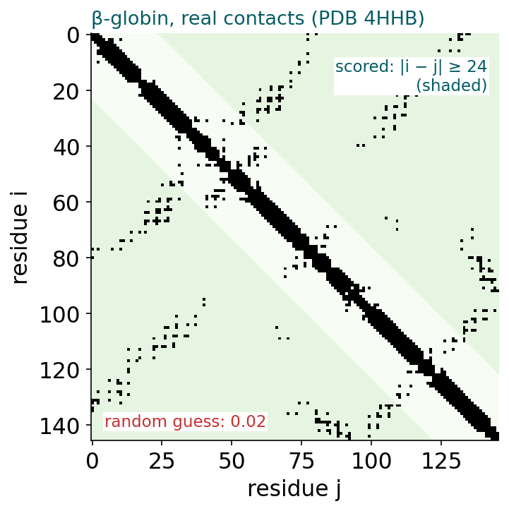
BLOCK 2 · QUIZ
Does ESM-2 know β-globin's contacts?
Trained only on masked residues. Top-L/5 long-range precision from 8M to 650M parameters?
A About 0.9 at every size
B Near 0 at every size
C Near 0 at 8M, about 0.9 at 650M
D Highest for the smallest: big models overfit
Guess on your own
Scan the code, or go to
quiz.bioinfo.se/live
Notes:
The old block 2 discussion. β-globin, 146 residues, 150 true long-range contacts (|i - j| ≥ 24); a random guess is right 0.02 of the time.

Slide 51
BLOCK 2 · QUIZ
Does ESM-2 know β-globin's contacts?
How did the room answer?
Halt the round when most have answered, then show the results.
Show the results ▸ quiz.bioinfo.se/live/report
Notes:
Halt submission in the Control view, then open the results. Do not say which answer is right.

Slide 52
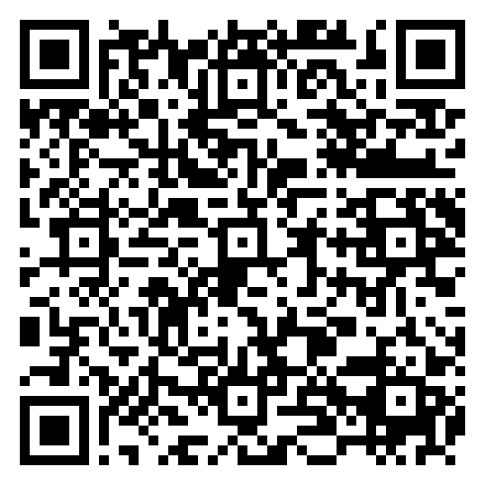
BLOCK 2 · QUIZ
Does ESM-2 know β-globin's contacts?
Fix it, run it, discuss
Open the notebook: scan the code
Fix the line marked FIX, then run the cells
Did it come out as you guessed? Discuss with your neighbour
The notebook: https://colab.research.google.com/github/ElofssonLab/kb8029-book/blob/main/notebooks/session11-discussion-2.ipynb
Notes:
About 8 minutes; the 8M, 35M and 150M models download in about a minute. The FIX line sorts ascending, so it scores the pairs each model is least sure of: 0.03, 0.00, 0.00, the second answer. Fixed (np.argsort(-P[i, j])): 0.000, 0.172, 0.621; the notebook gives 0.897 for 650M as a reference.

Slide 53
BLOCK 2 · QUIZ
Does ESM-2 know β-globin's contacts?
Answer again
Same question, after the discussion.
quiz.bioinfo.se/live
Notes:
Open the second round (post) in the Control view.

Slide 54
BLOCK 2 · QUIZ
Does ESM-2 know β-globin's contacts?
Results, and who explains
Both rounds side by side.
Draw two to explain: one of you says how you reasoned.
Show the results ▸ quiz.bioinfo.se/live/report
To check it with code afterwards: discussion notebook 2 https://colab.research.google.com/github/ElofssonLab/kb8029-book/blob/main/notebooks/session11-discussion-2.ipynb
Notes:
The third answer: 0.00, 0.17, 0.62, 0.90. Structure comes from evolution: residues in contact co-vary across the family, and filling in masked residues well forces the model to learn it. A high attention weight is neither a contact nor an explanation.

Slide 55
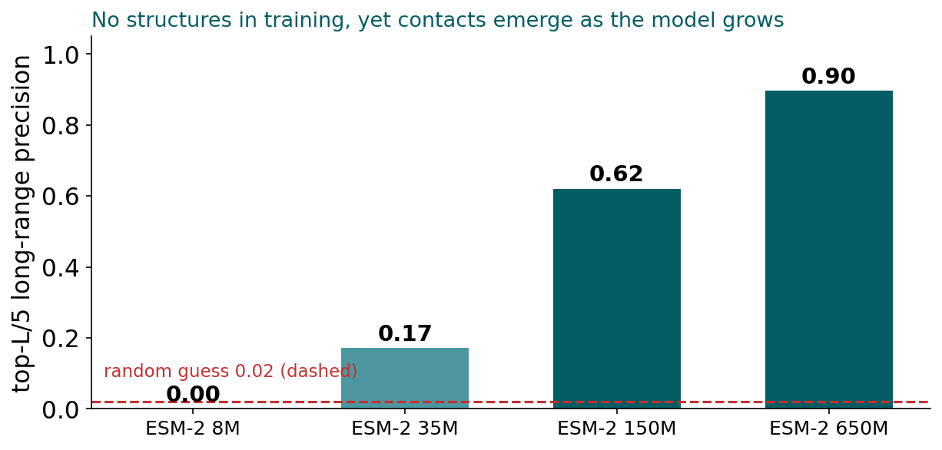
BLOCK 2 · QUIZ
The answer: contacts emerge as the model grows
None of the models saw a structure. The smallest finds no long-range contacts; the 650M model gets nine of ten right. Residues in contact co-vary across a protein family, and a model large enough to fill in masked residues well learns which positions inform each other.

Slide 56
BLOCK 2 DONE
Break

Slide 57
BLOCK 3 · ABOUT 30 MIN
Pretraining changes biological prediction

Slide 58
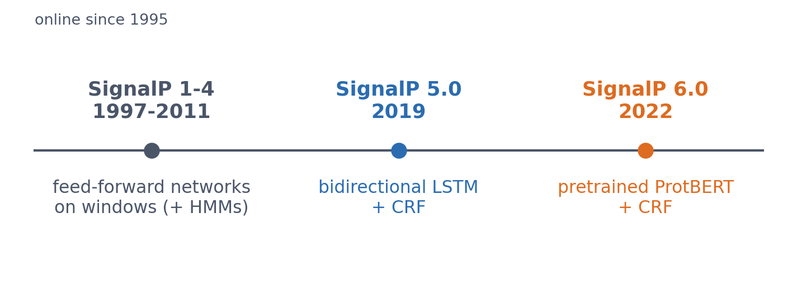
3 · SIGNALP
SignalP: thirty years in three steps
Each model type of the course appears: feed-forward networks on windows (Session 7) with hidden Markov models (Session 5), a deep recurrent network (Block 1), and a pretrained protein language model (Block 2).
Nielsen et al. 1997; Almagro Armenteros et al. 2019; Teufel et al. 2022; Nielsen et al. 2024.
Notes:
SignalP has been online since 1995 and is one of the most used tools in bioinformatics. HMMs were combined with the networks in versions 2-3.

Slide 59
3 · SIGNALP 6.0
What pretraining changed
▪ Rare types: predictable for the first time
▪ No organism input needed
▪ Partitioning redone (GraphPart): Session 8
36 / 113
training sequences
of two rare types
< 60%
identity: 6.0 beats 5.0
Teufel et al. (2022), Nat Biotechnol 40:1023; Teufel et al. (2023).
Notes:
'Confirms the importance of LMs for low-data problems.' The two versions were equal on close homologs of the training data. The language model infers the taxonomic context from the sequence, so SignalP 6.0 works on metagenomic proteins of unknown origin. Even with GraphPart the authors could not get below 30% identity between folds.

Slide 60
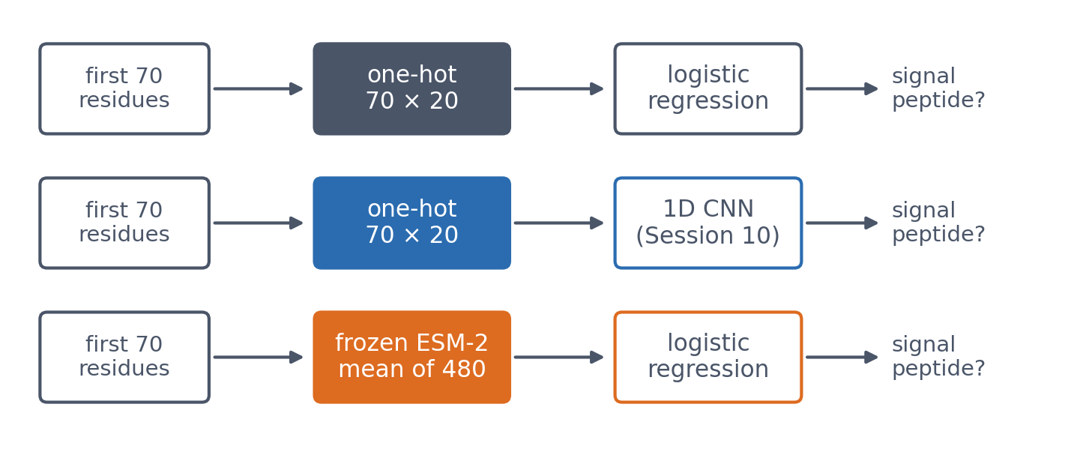
3 · AT CLASSROOM SCALE
Does this protein have a signal peptide? Three classifiers
Same 4,910 proteins, first 70 residues. ESM-2 35M stands in for the larger ProtBERT; its residue vectors are averaged into 480 numbers and kept frozen.
Notebook, Part 3.

Slide 61
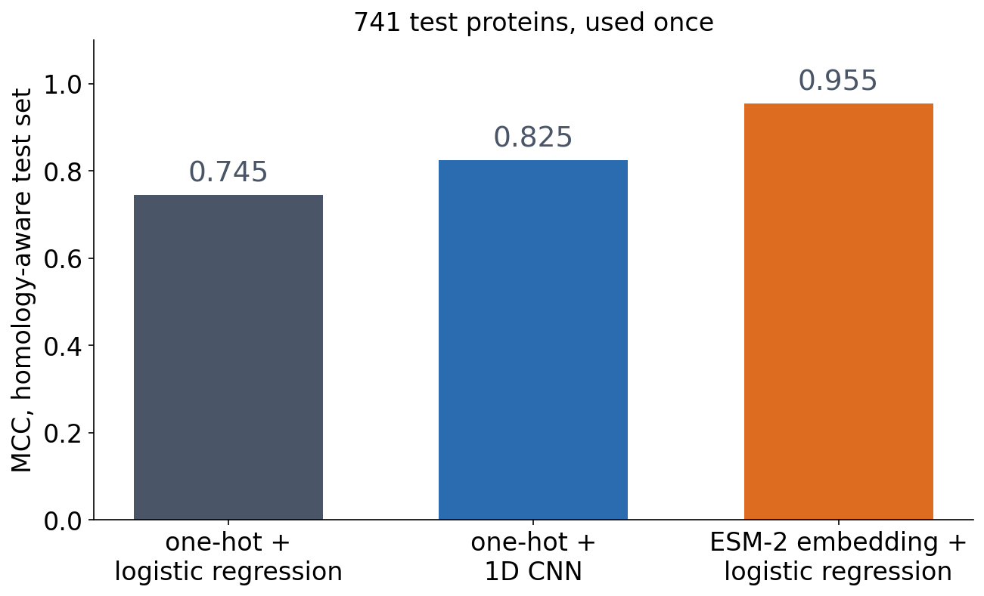
3 · AT CLASSROOM SCALE
Frozen ESM-2 wins on the honest test
▪ ESM-2: MCC 0.955
▪ One-hot CNN: 0.825
▪ One-hot linear: 0.745
Notebook, Part 3; homology-aware split.
Notes:
Accuracy 0.879, 0.916, 0.978. The ESM-2 model is a logistic regression on frozen embeddings: Session 10's transfer learning.

Slide 62
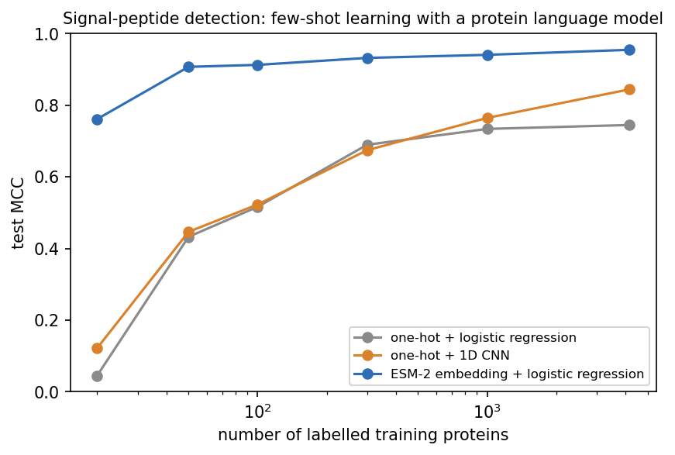
3 · AT CLASSROOM SCALE
Few labels: where pretraining pays off
▪ 20 proteins: 0.762 vs 0.045 / 0.122
▪ 50 with ESM-2 (0.907) beat 4,169 with one-hot
▪ The labels only point at what the model already knows
Notebook, Part 3.
Notes:
This is the central result of the session: pretraining transfers information learned from millions of unlabelled sequences into a task where labelled examples are scarce. With all 4,169 training proteins: one-hot 0.745, one-hot CNN 0.845, ESM-2 0.955.

Slide 63
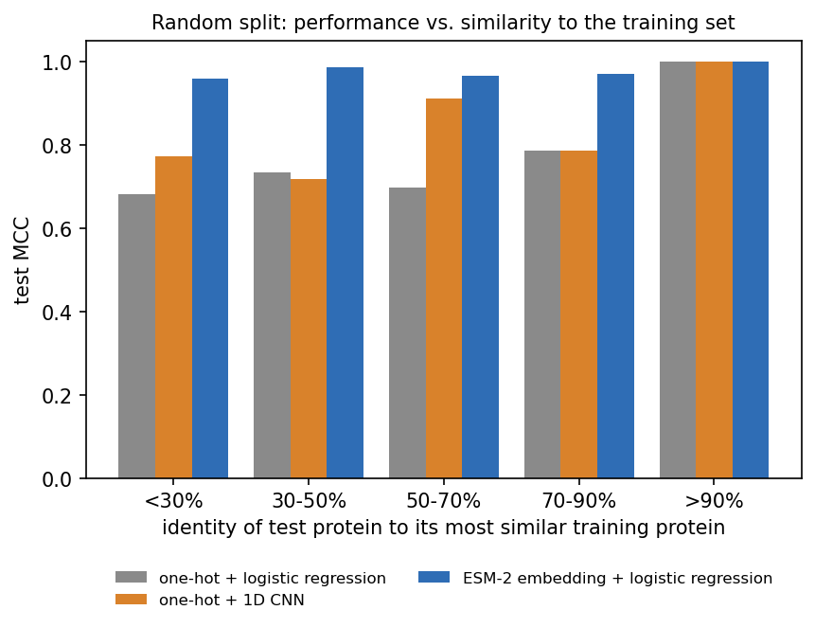
3 · AT CLASSROOM SCALE
Gains where there is no close homolog
▪ > 90% identity: all perfect
▪ < 30%: one-hot 0.68-0.77, ESM-2 0.96
▪ The SignalP 6.0 pattern
▪ Random split: a diagnostic only
Notebook, Part 3: random 80/20 split, identity to the most similar training protein by MMseqs2.
Notes:
441 of the 982 test proteins fall in the lowest bin, and 37% of the test set has no detectable homolog at all. The homology-aware result remains the honest estimate for new families. Caveats: our task is easier than SignalP's, our model smaller and not fine-tuned; ESM-2 saw these sequences during pretraining, but never their labels, as did ProtBERT inside SignalP 6.0.

Slide 64
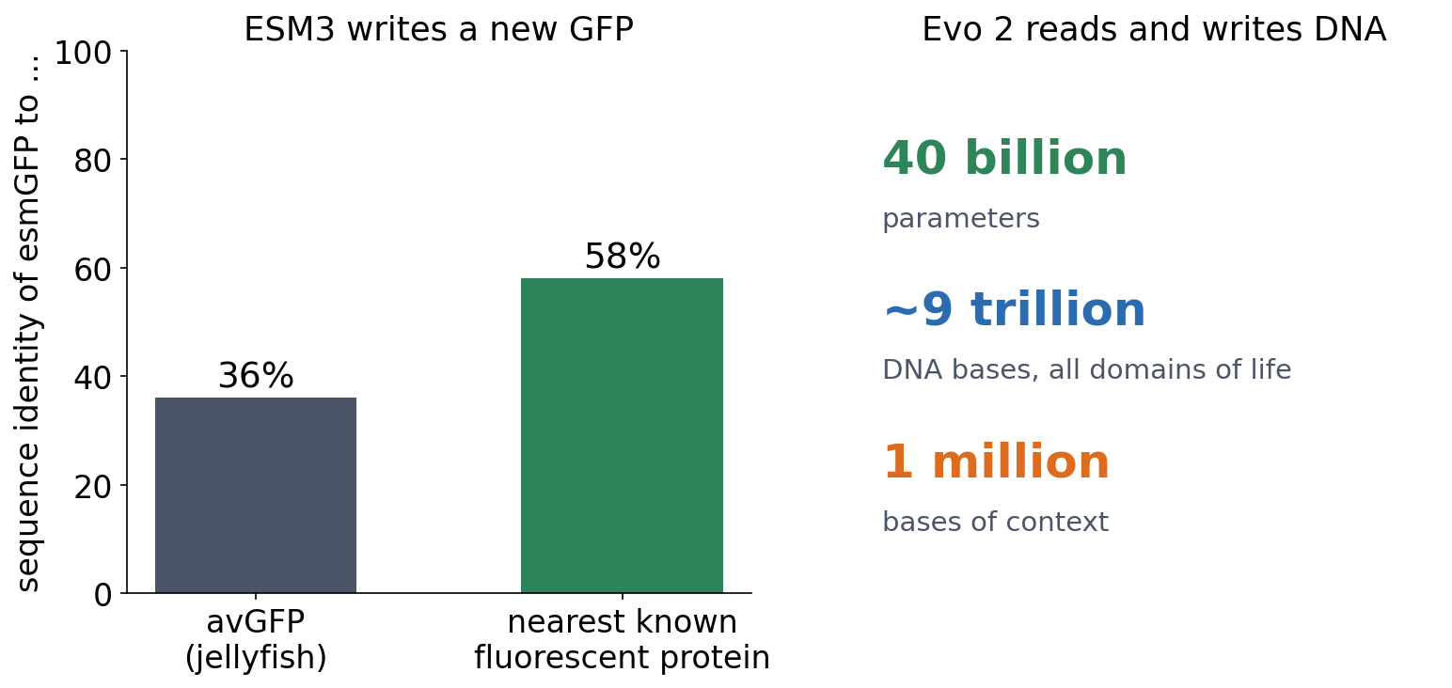
3 · OUTLOOK
From reading sequences to writing them
▪ ESM3 designed a new, glowing GFP
▪ Evo 2: genomes, all domains of life
▪ Next: virtual cells (Alpha Cell, Session 10)
▪ Does a protein language model understand biology, or only model sequences?
Hayes et al. (2025), Science 387:850; Brixi et al. (2026), Nature (Evo 2, Arc Institute); scilifelab.se/alpha-cell.
Notes:
ESM3 (98 billion parameters, sequence, structure and function tokens) was prompted to generate fluorescent proteins; one of them, esmGFP, glows, yet is only 36% identical to the jellyfish GFP and 58% identical to the most similar known fluorescent protein. The authors estimate that this distance corresponds to over 500 million years of natural evolution. Evo 2 (Arc Institute with NVIDIA; 40 billion parameters, about 9 trillion bases from all domains of life, a context of a million bases) predicts the effect of mutations, including clinically relevant BRCA1 variants, without fine-tuning, and generates genome-scale sequences; it is fully open, including the training data. The same models are building blocks for 'virtual cell' projects, such as SciLifeLab's Alpha Cell (Session 10) and Biohub's Virtual Biology Initiative, which the Human Protein Atlas supports. For the question: a model that predicts a working protein far from anything known has learned something real about proteins; whether that is 'understanding' is the discussion.

Slide 65
SUMMARY
Three ways to use context, two ways to learn a representation
CNN: local context grows layer by layer. RNN: context carried step by step. Attention: any position, directly. A supervised model learns its representation from labels; a protein language model learns it first from millions of unlabelled sequences, so that a few labels go a long way.
See course.bioinfo.se/session11.html, 'What's next'.
Notes:
Ask the room to name, for each of the three architectures, one thing it cannot do (CNN: long range without depth; forward RNN: see the future; attention alone: order).

Slide 66
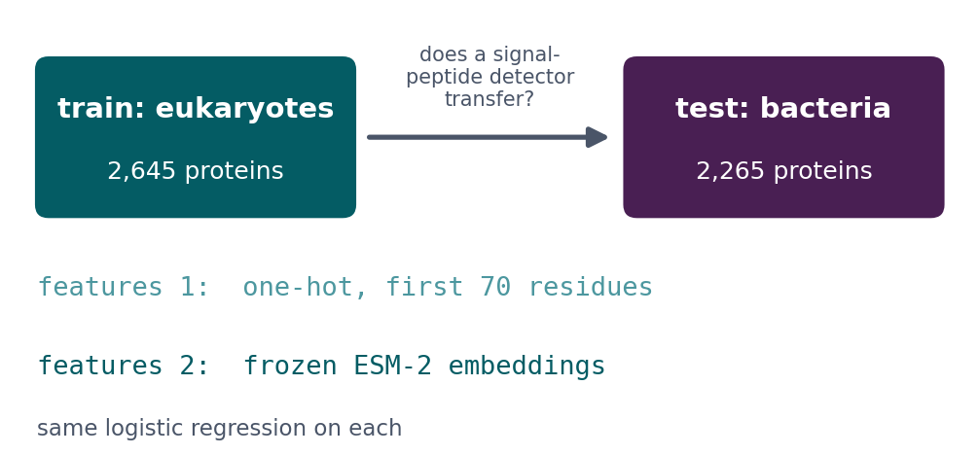
BLOCK 3 · QUIZ
Does a signal-peptide detector transfer across kingdoms?
Trained on eukaryotes, tested on bacteria: one-hot residues against frozen ESM-2 embeddings.
A Both keep nearly all their performance
B One-hot does better
C ESM-2 keeps most; one-hot loses much more
D Both fall to near zero
Guess on your own
Scan the code, or go to
quiz.bioinfo.se/live
Notes:
The old block 3 discussion. SignalP 5.0 needed the organism group; SignalP 6.0 does not. Eukaryotes 2,645 proteins (1,158 with a signal peptide), bacteria 2,265 (778).

Slide 67
BLOCK 3 · QUIZ
Does a signal-peptide detector transfer across kingdoms?
How did the room answer?
Halt the round when most have answered, then show the results.
Show the results ▸ quiz.bioinfo.se/live/report
Notes:
Halt submission in the Control view, then open the results. Do not say which answer is right.

Slide 68
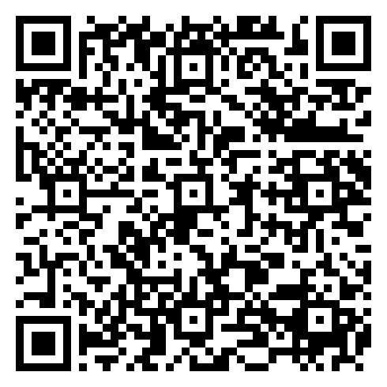
BLOCK 3 · QUIZ
Does a signal-peptide detector transfer across kingdoms?
Fix it, run it, discuss
Open the notebook: scan the code
Fix the line marked FIX, then run the cells
Did it come out as you guessed? Discuss with your neighbour
The notebook: https://colab.research.google.com/github/ElofssonLab/kb8029-book/blob/main/notebooks/session11-discussion-3.ipynb
Notes:
About 8 minutes; the ESM-2 embeddings are precomputed, so it runs in seconds. The FIX line tests each model on its own training kingdom: one-hot 1.000 both ways, ESM-2 0.96 and 0.98, the first answer (or the second). Fixed (tested = test): one-hot 0.647 and 0.478, ESM-2 0.953 and 0.787.

Slide 69
BLOCK 3 · QUIZ
Does a signal-peptide detector transfer across kingdoms?
Answer again
Same question, after the discussion.
quiz.bioinfo.se/live
Notes:
Open the second round (post) in the Control view.

Slide 70
BLOCK 3 · QUIZ
Does a signal-peptide detector transfer across kingdoms?
Results, and who explains
Both rounds side by side.
Draw two to explain: one of you says how you reasoned.
Show the results ▸ quiz.bioinfo.se/live/report
To check it with code afterwards: discussion notebook 3 https://colab.research.google.com/github/ElofssonLab/kb8029-book/blob/main/notebooks/session11-discussion-3.ipynb
Notes:
The third answer. Euk -> bac: one-hot 0.65, ESM-2 0.95; bac -> euk: 0.48 and 0.79. One-hot memorised its training proteins; ESM-2's representation comes from millions of sequences from all kingdoms. Before calling organism information unnecessary: archaea, other signal-peptide types, more than one split.

Slide 71
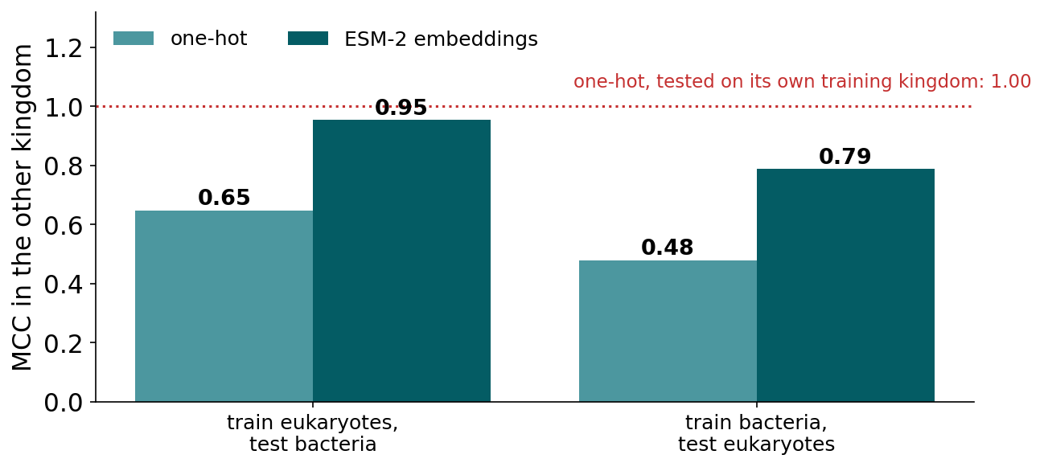
BLOCK 3 · QUIZ
The answer: ESM-2 transfers, one-hot much less
On its own training kingdom the one-hot model looks perfect (MCC 1.00), but in the other kingdom it falls to 0.65 and 0.48. Frozen ESM-2 embeddings keep 0.95 and 0.79: the representation was learnt from unlabelled sequences of all kingdoms, which supports SignalP 6.0's choice.

Slide 72
BEFORE YOU LEAVE
In up to three words: what was the hardest part of today?
Answer now
Scan the code, or go to
quiz.bioinfo.se/live
Notes:
A word cloud: the bigger the word, the more students wrote it. It shows what to repeat next time.

Slide 73
BEFORE YOU LEAVE
The hardest part of today
What the room found hardest
Show the results ▸ quiz.bioinfo.se/live/report

Slide 74
Session 12 next
AlphaFold: attention and pair representations reason about 3D structure
Where long-range structural information comes from, and what a confident model means

