Slide 1

Session 12: AlphaFold and Generative Models of Protein Structure
KB8029 — Bioinformatics & Deep Learning
Arne Elofsson

Slide 2

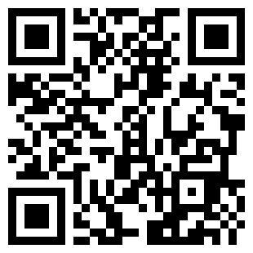
BEFORE WE START
Log in to the lecture quiz
Log in to the quiz
Scan the code, or go to quiz.bioinfo.se/live
Log in with your university account
Answering counts as being at the lecture: up to 3 bonus points on the exam
Right or wrong is never graded, only whether you answered. Results are shown without names.
quiz.bioinfo.se/live
Notes:
The quiz is not anonymous, because answering is how attendance is counted: 3 bonus points on the main exam for answering in all 12 lectures, one point less per missed lecture (preliminary). Whether an answer is right or wrong is never used. The projected results never show names; the only names shown are the two drawn to explain their reasoning. Start the session on quiz.bioinfo.se before the lecture: quiz.bioinfo.se/live then leads to it.

Slide 3
BEFORE WE START
Warm-up: what do you know already?
3 quick questions
On the topics of today, one at a time, about 30 seconds each
Answer on your own, and guess if you do not know
It shows me where to start; right or wrong is never graded
Notes:
About 2 minutes in all. Open each question's round, halt it after about 30 seconds and glance at the results; do not explain the answers now, the lecture does that.

Slide 4
WARM-UP · 1 OF 3
Residues that touch tend to mutate together over evolution. What is this called?
A Conservation
B Homology
C Coevolution
D Convergent evolution
Answer now
Scan the code, or go to
quiz.bioinfo.se/live
Notes:
Right: Coevolution. Block 1: coevolution, and how it is fooled by indirect effects.

Slide 5
WARM-UP · 2 OF 3
A region of an AlphaFold model has pLDDT 30. What does that mean?
A 30% of its atoms are wrong
B It is a β-strand
C It is predicted very accurately
D AlphaFold is unsure of it; often it is disordered
Answer now
Scan the code, or go to
quiz.bioinfo.se/live
Notes:
Right: AlphaFold is unsure of it; often it is disordered. Block 2: confidence. Low pLDDT is not the same as disorder, but often goes with it.

Slide 6
WARM-UP · 3 OF 3
How does a diffusion model generate a new example?
A It copies the nearest training example
B It starts from noise and removes it step by step
C It folds the chain with a force field
D It searches the PDB for a match
Answer now
Scan the code, or go to
quiz.bioinfo.se/live
Notes:
Right: It starts from noise and removes it step by step. Block 3: diffusion, AlphaFold3 and design.

Slide 7
BEFORE WE START
What the room knows already
Where we start
Which topics most of you know, and which we take slowly today.
Show the results ▸ quiz.bioinfo.se/live/report
Notes:
Optional: show two or three of the results, the ones that most got wrong.

Slide 8
BEFORE WE START
Your questions before today
What you asked
The questions you sent in on Canvas before the lecture
The most common ones now; the others in the block where they belong
Notes:
About 5 minutes. Read the answers to this session's Canvas survey 'Questions before the lecture' the evening before (it closes at 18:00 the day before the lecture), pick the two or three most common questions, and answer them briefly now or say in which block they come.

Slide 9
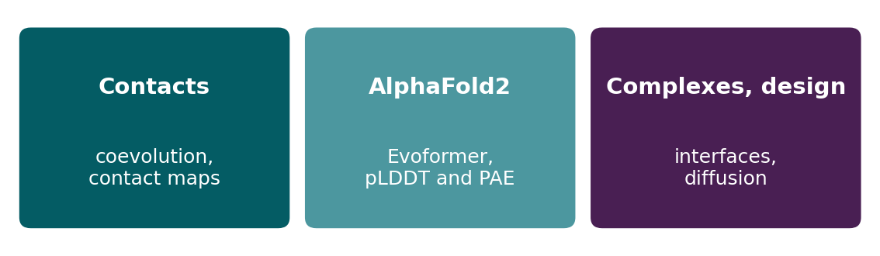
BEFORE WE START
In up to three words: what do you want to learn today?
Answer now
Scan the code, or go to
quiz.bioinfo.se/live
Notes:
A word cloud: the bigger the word, the more students wrote it. Come back to it at the end of the lecture.

Slide 10
BEFORE WE START
What you want to learn today
What the room wants to learn
Show the results ▸ quiz.bioinfo.se/live/report

Slide 11
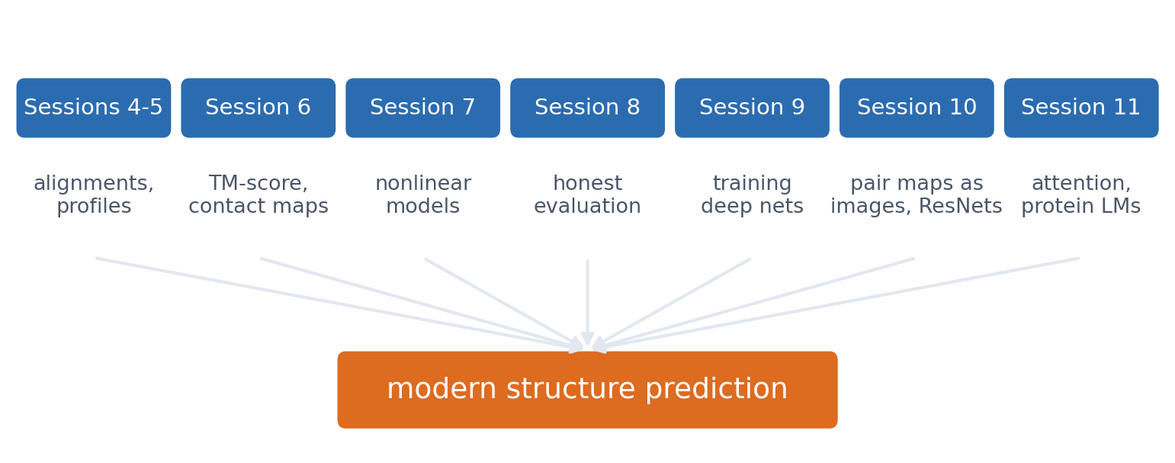
SESSION 12 · THE MAP
Every session contributes a piece
The question of the day: what information is missing if we predict a residue's structure from its local sequence alone? Contacts with residues far away in the sequence.
See course.bioinfo.se/session12.html, introduction.
Notes:
Session 6 treated structure as the answer; now we ask how that answer can be predicted from sequence. The rest of the session: where long-range information comes from, how AlphaFold2 learned to use it, and what we can trust in the result.

Slide 12
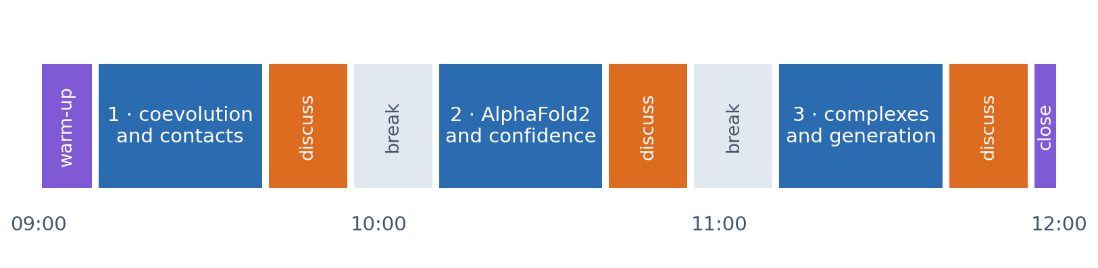
SESSION 12 · THE MORNING
Three blocks: about 30 min talk and 15 min discussion
Block 1: where long-range structural information comes from. Block 2: how AlphaFold2 combines the course's ideas, and what its confidence means. Block 3: complexes, and generative models.
Times are approximate: a 10 min start (warm-up quiz and your questions), two 15 min breaks and a 5 min close. Each block ends with a quiz question: guess, run the notebook and work out why it behaves as it does, discuss, answer again.

Slide 13
BLOCK 1 · ABOUT 30 MIN
Where does long-range structural information come from?

Slide 14
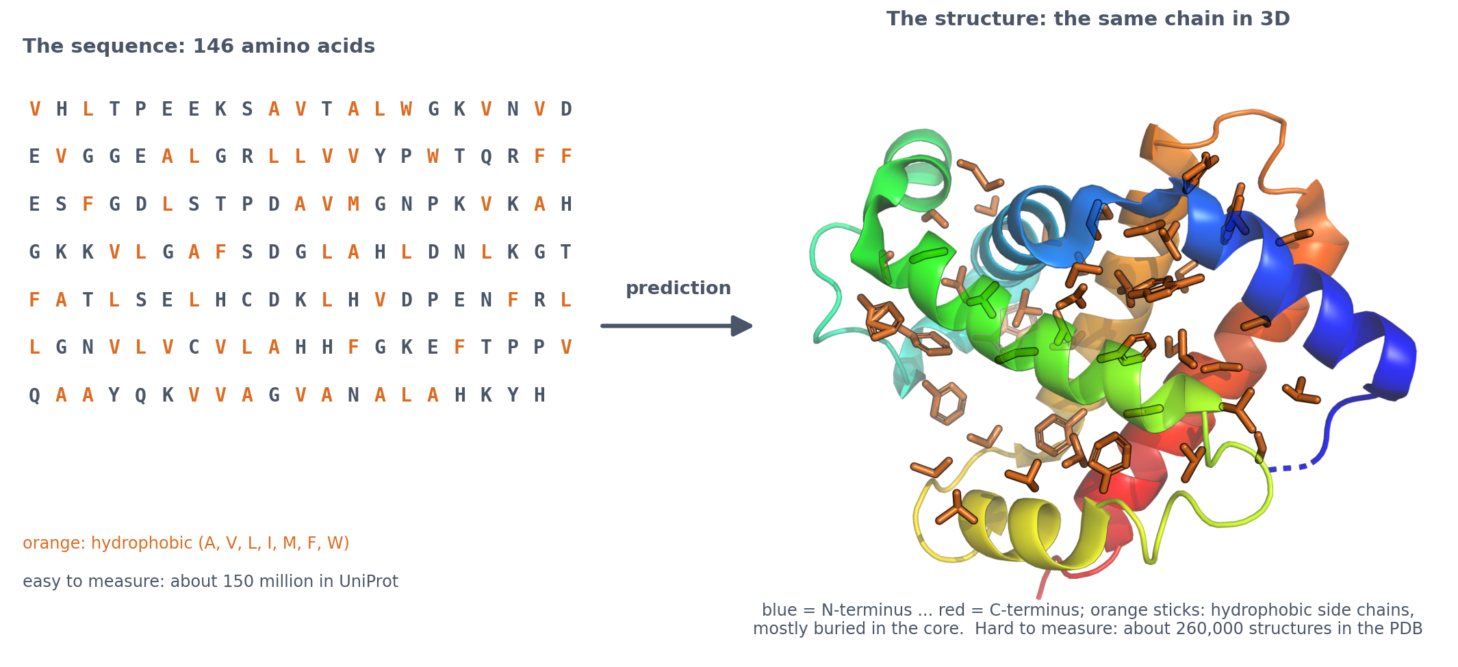
1 · THE STARTING POINT
From a line of letters to a 3D object
A chain of amino acids folds because hydrophobic side chains (orange) are buried away from water, the backbone forms hydrogen bonds (helices, strands) and the core packs tightly. Sequences are easy to measure (about 150 million in UniProt), structures hard (about 260,000 in the PDB): fewer than 1 in 500.
PDB 4HHB chain B, rendered with PyMOL; tools/builders/make_session12_intro.py. See course.bioinfo.se/session12.html, 'The starting point'.
Notes:
Bring everyone to the same starting point; Session 6 covered structure, not folding or prediction. Four levels: primary (sequence), secondary (helices, strands), tertiary (the fold), quaternary (chains together). Folding drivers: the hydrophobic effect is the main one; backbone hydrogen bonds give secondary structure; packing constrains which residues sit together. The native state is only slightly more stable than the unfolded chain, so one mutation can matter: β-globin Glu6Val, a hydrophobic residue on the surface, is sickle-cell disease. Structures by X-ray, NMR or cryo-EM take months to years: prediction fills the gap.

Slide 15
1 · THE STARTING POINT
Two classic observations
Anfinsen
Levinthal
the sequence decides
3¹⁰⁰ ≈ 5 × 10⁴⁷ conformations
▪ Ribonuclease unfolded with urea and a reducing agent
▪ Refolds on its own, with the right 4 of 105 possible disulphide pairings
▪ So prediction is possible in principle
▪ Not for all: chaperones, partners, switches, disorder
▪ At 10¹³ per second: 5 × 10³⁴ s to try them all
▪ Age of the universe: 4 × 10¹⁷ s
▪ Real proteins fold in µs to s: a guided funnel, not a random search
▪ Lesson: every method needs a smarter search
Anfinsen (1973), Science 181:223; Levinthal (1969). See course.bioinfo.se/session12.html.
Notes:
Anfinsen, Nobel Prize 1972: no cell, no template, just the sequence and the right conditions. Levinthal: three backbone states per residue for 100 residues. The resolution is the folding funnel: local structure forms fast and every step that buries hydrophobic groups lowers the free energy, so the chain is guided downhill.

Slide 16
1 · THE STARTING POINT
Before deep learning: four ways to predict a structure
Homology modelling
Threading
Fragment assembly
Molecular dynamics
copy a relative
find a fold that fits
Rosetta
simulate the physics
▪ Align to a template (Sessions 4-5)
▪ Works above ~30% identity
▪ No template: nothing to copy
▪ Thread the sequence onto every known fold
▪ Score burial and contacts
▪ Finds templates sequence search misses
▪ 3- and 9-residue pieces of known structures
▪ Monte Carlo + knowledge-based energy
▪ New folds, but small proteins only
▪ Newton's laws, 2 fs steps
▪ Anton folded 12 small proteins (2011)
▪ Far too slow for ordinary proteins
Šali & Blundell 1993; Jones, Taylor & Thornton 1992; Simons et al. 1997; Lindorff-Larsen et al. 2011. See course.bioinfo.se/session12.html, 'How structures were predicted before deep learning'.
Notes:
Structure is more conserved than sequence (Chothia & Lesk 1986), which is why homology modelling works; the model is only as good as the alignment. Threading later gave way to profile-profile search (Session 5). Rosetta: local sequence biases local structure (Session 7); thousands of decoys, keep the best-scoring; grew into protein design (Baker, Nobel 2024). MD: folding needs 10^9 to 10^15 steps. What they shared: getting the long-range contacts right. That is the question of this block.

Slide 17
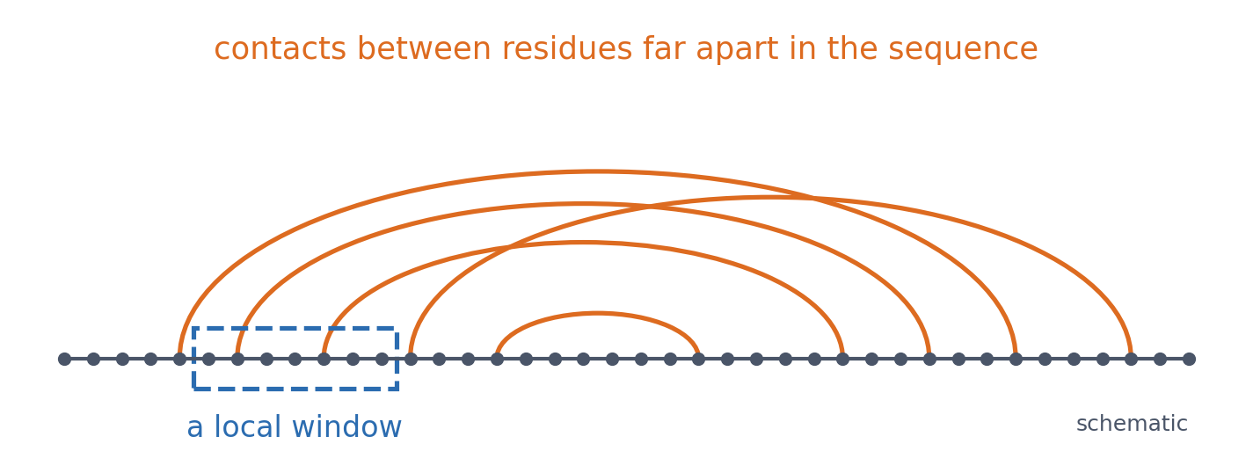
1 · THE FOLDING PROBLEM
Local sequence is not enough
▪ Same ten residues: helix or strand
▪ (Session 7's chameleons)
▪ What is missing: contacts far away
See course.bioinfo.se/session12.html, 'The starting point'.
Notes:
For many proteins the sequence determines the structure (Anfinsen 1973), but a protein cannot find it by trying every conformation: a random search would take longer than the age of the universe, while real proteins fold in microseconds to seconds (Levinthal's paradox, 1969).

Slide 18
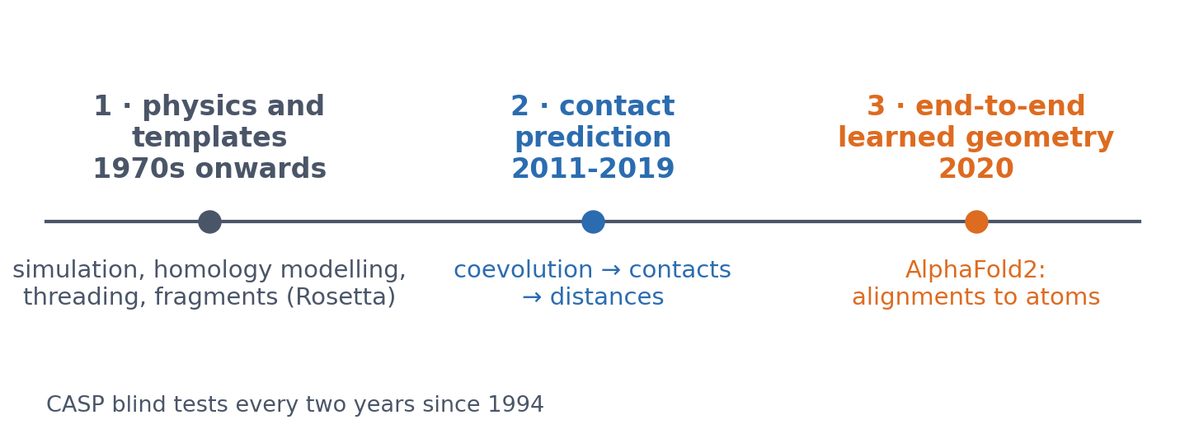
1 · THE FOLDING PROBLEM
Three generations of structure prediction
Physics and templates gave steady progress for proteins with a template and little for the rest. What all early approaches lacked was long-range information.
Dill & MacCallum (2012), Science 338:1042; Moult et al. (1995).
Notes:
Molecular dynamics is possible only for small, fast-folding proteins. Homology modelling copies a relative; threading finds the known fold a sequence fits best (Session 5's profile idea applied to structures); Rosetta assembles fragments with a knowledge-based energy. The docking history and our own PconsC lineage are optional boxes on the page.

Slide 19
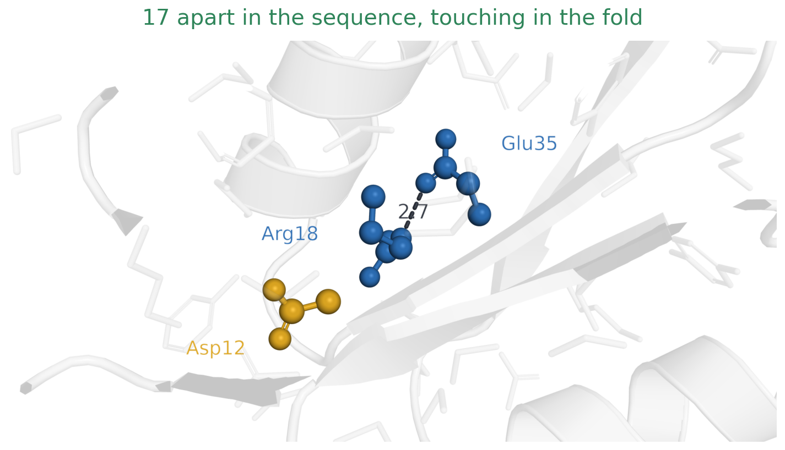
1 · COEVOLUTION
Why residues in contact change together
Arg18 and Glu35 sit 17 apart in the sequence and form a buried salt bridge: one positive, one negative, 2.7 Å apart. Blue is the residue as CheY actually has it; gold is Asp12, which comes back at the end. Every other side chain is drawn faintly, to show how tightly packed the neighbourhood is.
CheY (PDB 3CHY), the course's running example for contact prediction.
Notes:
This is the same protein the contact-prediction figure later in this block uses, so the geometry is worth a moment. Two residues far apart in the sequence are touching in the folded structure -- that is what a contact is, and it is what everything in this block tries to predict. The picture is a close-up inside one chain: nothing here involves a second protein. Point out that the faint sticks are the rest of the side chains. A residue is not sitting in space, it is wedged among twenty others, and that is why its identity is constrained at all.

Slide 20
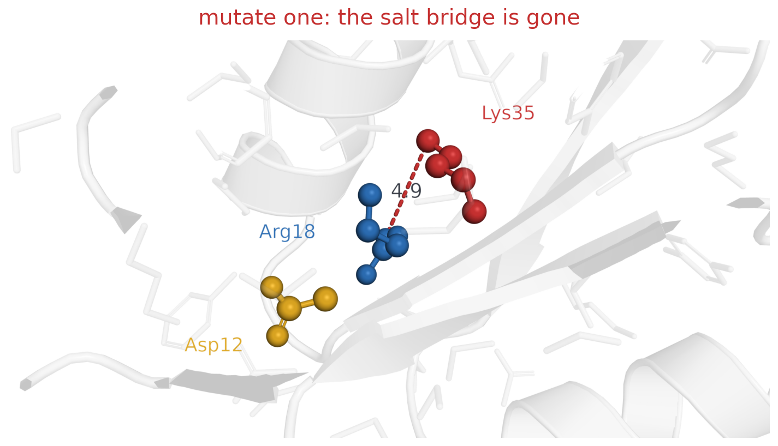
1 · COEVOLUTION
Why residues in contact change together
Replace Glu35 with a lysine — red, because it is the one that has been swapped — and the partner is still positive: 4.9 Å, and two like charges where there was a salt bridge. The structure is destabilised, and selection removes the variant.
CheY (PDB 3CHY), the course's running example for contact prediction.
Notes:
Built with PyMOL's mutagenesis wizard, taking the least strained rotamer -- this is where a lysine would really sit. The point is not the exact number but the sign of it: a single mutation at a contact position is usually deleterious, so it does not survive to be counted in an alignment. Ask the room what they therefore expect to see in the family alignment at this position. The answer is a conserved column, which is ordinary conservation (Session 5), not coevolution yet.

Slide 21
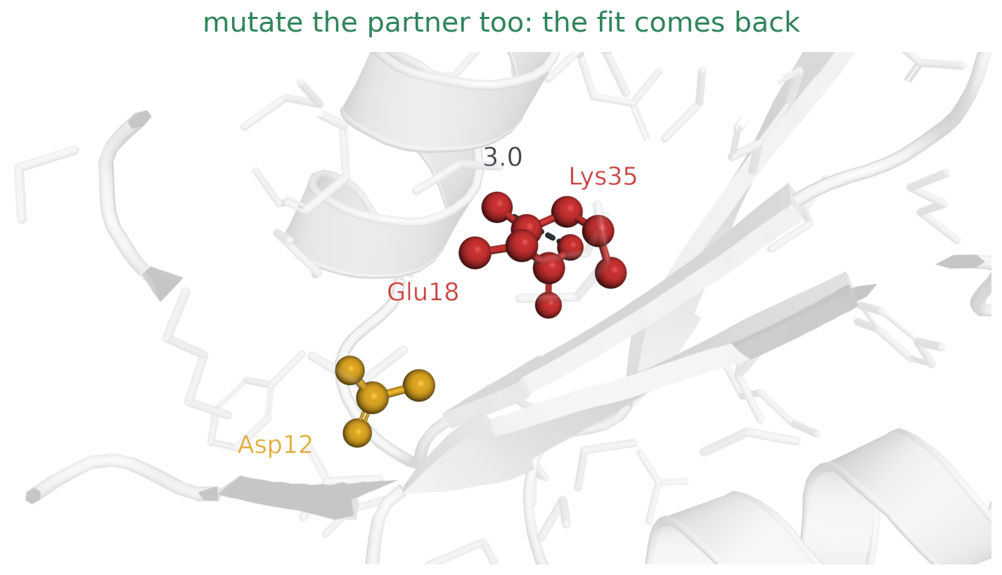
1 · COEVOLUTION
Why residues in contact change together
Now change the partner as well, Arg18 to a glutamate. Both positions are red, both have been swapped, the charges have changed places, the salt bridge is back at 3.0 Å, and the double mutant is as fit as the original.
CheY (PDB 3CHY), the course's running example for contact prediction.
Notes:
The charge swap is the classic compensating pair, and it is exactly what the toy alignment on the next slide shows: where position i is positive, position j is negative, and the other way round. Because the double mutant survives, the family accumulates both versions, and neither column is conserved -- yet they are not independent either. That dependence is the whole signal. Everything that follows, from mutual information to the pair representation inside AlphaFold2, is a way of measuring it well. The rotamer here was chosen to put the new charged group at salt-bridge distance; a real protein would also relax around it.

Slide 22

1 · COEVOLUTION
Why residues in contact change together
The wild type laid back over the double mutant: pale blue is Arg18 and Glu35 as CheY has them, solid red the glutamate and lysine that replaced them. The charges have changed places, the pair still fits — and a third residue has been sitting there, in gold, since the first slide.
CheY (PDB 3CHY), the course's running example for contact prediction.
Notes:
The two versions in one picture, so the swap is seen rather than remembered across three slides: the blue pair behind is what the family started with, the red pair in front is what it ended with, and they occupy the same corner of the fold. The number comes off here so that the pair is read as a shape rather than as a measurement, and so that the eye has somewhere to go: Asp12, which has been drawn in gold on every slide and not yet mentioned. Ask the room what they think it is doing there. The next slide answers it.

Slide 23
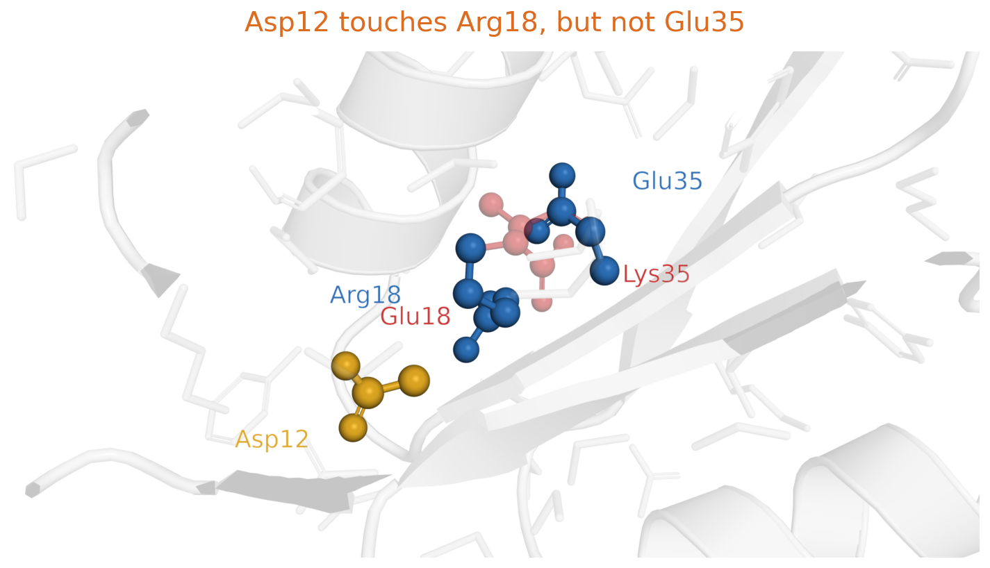
1 · COEVOLUTION
Why residues in contact change together
Back to the real CheY, with Asp12 in the gold it has had all along: it touches Arg18, and Arg18 touches Glu35, but Asp12 and Glu35 never touch — 8.2 Å between Cβ atoms, against 5.1 Å and 4.9 Å for the two real contacts. Both are nonetheless constrained by Arg18, so in an alignment they appear coupled. The double mutant is still there as the faint red copy behind: whichever residue sits at 18, it is the one Asp12 is pressed against.
CheY (PDB 3CHY), the course's running example for contact prediction.
Notes:
This is the indirect coupling that the next slide but one is about, in the same three residues. Arg18 is a hub: it is constrained by Asp12 on one side and Glu35 on the other. Each of those pairs covaries for the reason just shown, and the consequence is that Asp12 and Glu35 covary too, through Arg18, although they are never in contact. Simple correlation cannot tell the two cases apart; DCA fits one model to the whole alignment, so the 12-18 and 18-35 couplings already explain the 12-35 correlation and the 12-35 coupling stays near zero. The transparency is the reverse of the previous slide: the wild type is in front now and the double mutant is the faint copy behind it, which is worth saying out loud, because it shows that the Asp12-Arg18 contact is there in both versions and is not an artefact of the one being drawn. Asp12 keeps its gold, because it is never swapped and red has meant swapped throughout. The numbers in the caption are Cβ-Cβ distances, because that is what a contact map is defined on, and 8 Å is the usual threshold. 8.2 Å is only just outside it -- which is the point, since indirect coupling bites hardest exactly where residues are near but not touching.

Slide 24
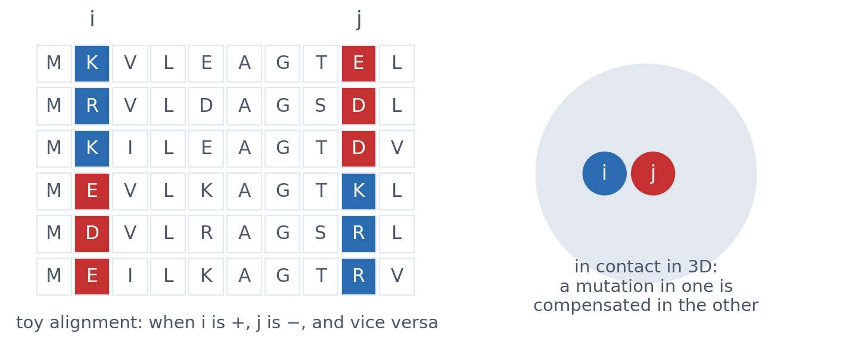
1 · COEVOLUTION
Residues in contact change together
▪ A mutation in one is compensated in the other
▪ Visible across a large family
▪ 1994: Göbel, Sander, Schneider & Valencia; Shindyalov, Kolchanov & Sander
▪ Real signal, but too weak to fold a protein
▪ A Potts model; fitted by mean field, or plmDCA/GREMLIN
Göbel et al. (1994), Proteins 18:309; Shindyalov et al. (1994), Protein Eng. 7:349. See course.bioinfo.se/session12.html, 'Coevolution'.
Notes:
The alignment is a toy example. In 1994 two groups around Chris Sander at EMBL (with Alfonso Valencia, and with Shindyalov and Kolchanov) found that the most correlated pairs of positions were in contact more often than by chance, but most predicted pairs were wrong. Three developments made the idea work two decades later: better statistics (DCA), bigger families (hundreds to thousands of effective sequences), and machine learning on top.

Slide 25
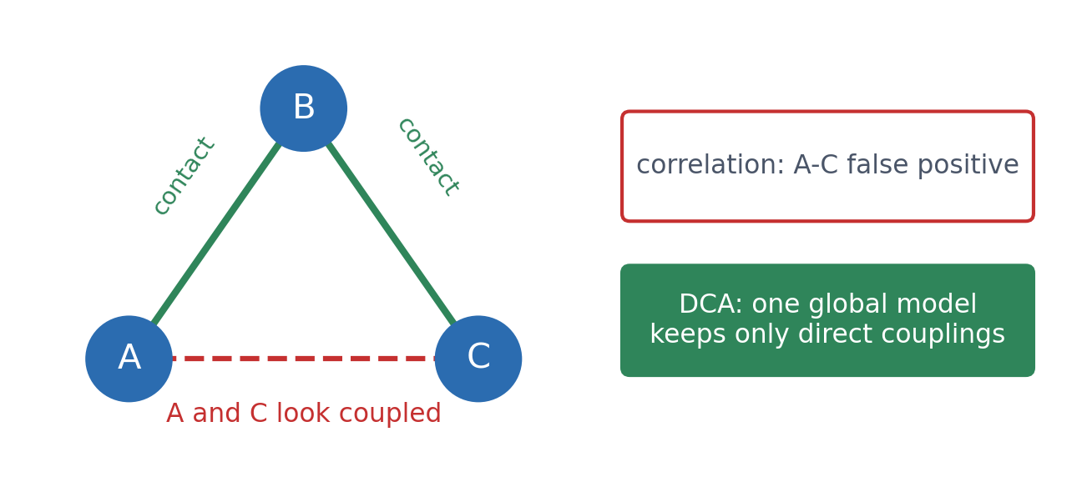
1 · COEVOLUTION
Correlation is fooled by indirect effects
▪ A-B and B-C contacts
▪ make A and C look coupled
▪ DCA: one global model
▪ Shown by Lapedes et al. in 1999, but barely noticed
Lapedes et al. (1999), IMS Lect. Notes 33:236; Lapedes, Giraud & Jarzynski (2002), arXiv:1207.2484; Weigt et al. (2009); Morcos et al. (2011), PNAS 108:E1293.
Notes:
Two traps for simple correlation: phylogeny (related sequences share residues by descent) and indirect couplings (A-B and B-C make A and C change together, although they never touch). DCA fits one model to the whole alignment: a field per residue and position, a coupling per residue pair and position pair. Fitted together, the A-B and B-C couplings already explain the A-C correlation, so the A-C coupling stays near zero. In CheY, precision rises from 0.49 (mutual information) to 0.73 (DCA). Direct coupling analysis fits the maximum-entropy model that reproduces the single-column and column-pair frequencies of the alignment (Session 1). Lapedes and colleagues at Los Alamos named both problems (phylogeny and indirect couplings) in 1999, in a statistics lecture-note series few biologists read, and fitted this model to protein alignments in a 2002 manuscript that was only posted on arXiv in 2012, after DCA (2009, 2011) had made the idea famous. Because these couplings capture epistasis, the same model also predicts mutation effects better than an independent profile (EVmutation): the interactions Session 9 measured in GB1, now learned from an alignment.

Slide 26
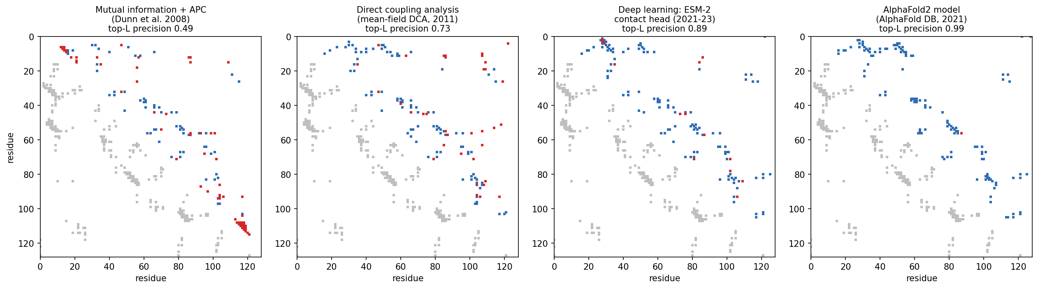
1 · COEVOLUTION
From mutual information to deep learning: CheY
Same 11,084-sequence alignment; the top 128 predicted contacts (blue true, red false) over the real map. Precision: mutual information 0.49, DCA 0.73, deep learning (ESM-2 contact head) 0.89, AlphaFold2 model 0.99.
Notebook, Part 1; Dunn 2008; Morcos 2011; Rao 2021; Jumper 2021.
Notes:
L = 128, the length of CheY (PDB 3CHY); effective number of sequences 8,920. Mutual information's false positives cluster in blocks, from phylogeny and conservation; DCA's are scattered. The ESM-2 contact head stands in for the contact predictors of 2017-2019, whose software no longer installs.

Slide 27
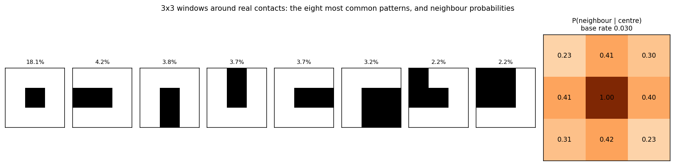
1 · DEEP LEARNING ON TOP
Contacts are not independent pixels
3 × 3 windows around real contacts in eight structures: only 146 of the 256 possible patterns occur. If the centre pair is in contact, a neighbouring pair is in contact 23-42% of the time, against a base rate of 3.0%.
Notebook, Part 1.
Notes:
Helices give bands, strand pairs give lines along or across the diagonal, so a network that looks at a neighbourhood of the map (Session 10's convolution) can clean up the noisy coevolution signal. Exactly what a learned pair representation exploits. The first discussion asks how alpha and beta proteins differ, so do not reveal that here.

Slide 28
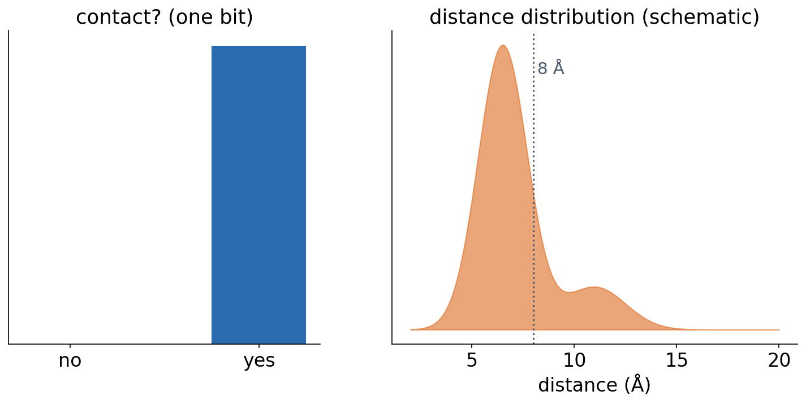
1 · DEEP LEARNING ON TOP
From contacts to distances
▪ Predict a distance distribution
▪ per residue pair
▪ Fold by minimising against it
▪ AlphaFold 1, trRosetta (2018-20)
Senior et al. (2020), Nature 577:706; Yang et al. (2020), PNAS 117:1496.
Notes:
Both used deep residual networks (Session 10). trRosetta also predicted orientations.

Slide 29
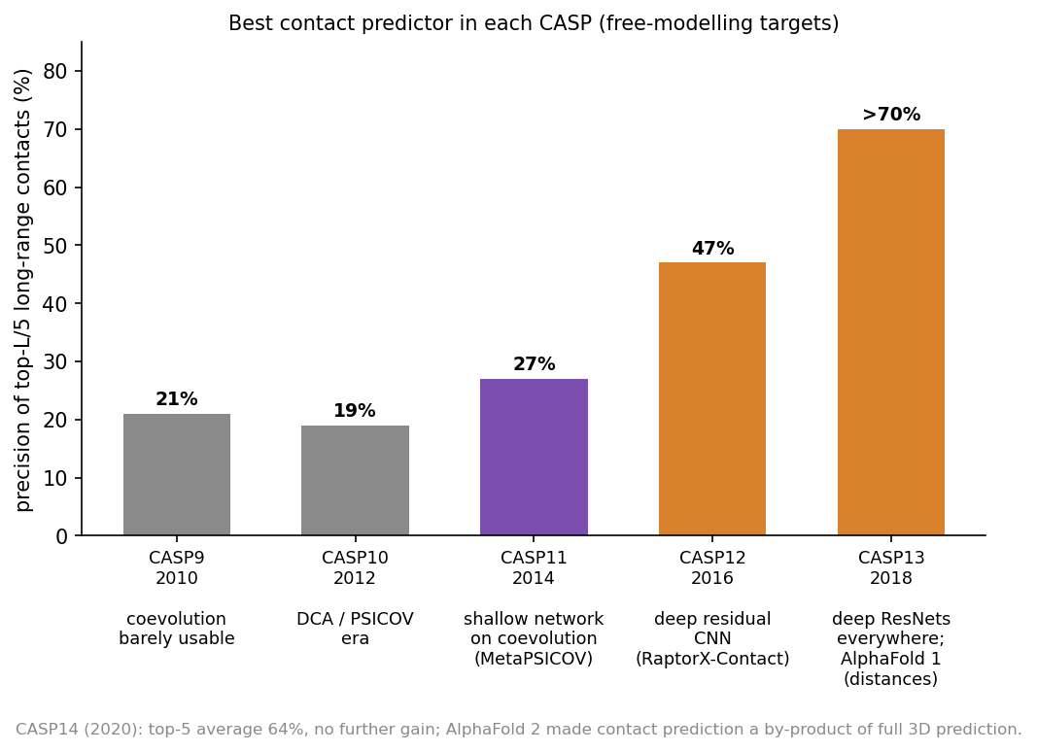
1 · DEEP LEARNING ON TOP
CASP: a sudden change
▪ 2010-2014: 20-27%
▪ 2016: 47%
▪ 2018: more than 70%
▪ 2020: contacts a by-product of AlphaFold2
Official CASP assessment papers (CASP10-CASP14).
Notes:
Precision of the best group's top-L/5 long-range contact predictions on free-modelling targets.

Slide 30
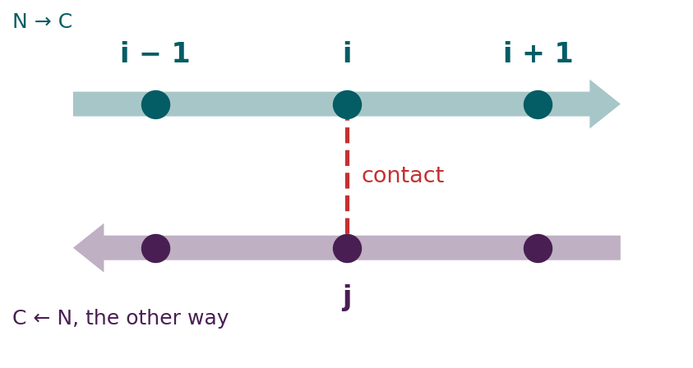
BLOCK 1 · QUIZ
Which neighbouring pair is in contact too?
Two antiparallel β-strands; residue i is in contact with residue j. The strands run in opposite directions.
A (i + 1, j + 1): along the diagonal
B (i + 1, j − 1): across the diagonal
C (i + 1, j) and (i, j + 1) most
D All neighbours equally
Guess on your own
Scan the code, or go to
quiz.bioinfo.se/live
Notes:
The old discussion problem 1, as a guess. Follow the arrows: one step along the upper strand faces one step back along the lower one. Do not draw the map yet.

Slide 31
BLOCK 1 · QUIZ
Which neighbouring pair is in contact too?
How did the room answer?
Halt the round when most have answered, then show the results.
Show the results ▸ quiz.bioinfo.se/live/report
Notes:
Halt submission in the Control view, then open the results. Do not say which answer is right.

Slide 32
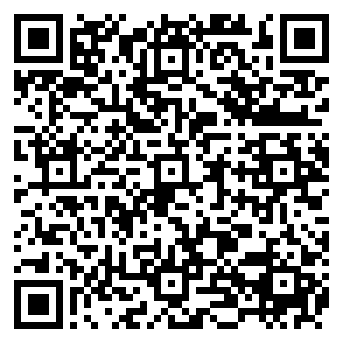
BLOCK 1 · QUIZ
Which neighbouring pair is in contact too?
Fix it, run it, discuss
Open the notebook: scan the code
Fix the line marked FIX, then run the cells
Did it come out as you guessed? Discuss with your neighbour
The notebook: https://colab.research.google.com/github/ElofssonLab/kb8029-book/blob/main/notebooks/session12-discussion-1.ipynb
Notes:
About 8 minutes. Six PDB structures, a few seconds. The FIX line reads the corners (i−1, j+1) and (i+1, j−1) as 'the diagonal', so as it is the cell says the diagonal wins (0.40 against 0.27), the first answer. Fixed (P[0, 0] + P[2, 2]): along 0.27, across 0.40. Early finishers: why the all-α neighbourhood is weaker.

Slide 33
BLOCK 1 · QUIZ
Which neighbouring pair is in contact too?
Answer again
Same question, after the discussion.
quiz.bioinfo.se/live
Notes:
Open the second round (post) in the Control view.

Slide 34
BLOCK 1 · QUIZ
Which neighbouring pair is in contact too?
Results, and who explains
Both rounds side by side.
Draw two to explain: one of you says how you reasoned.
Show the results ▸ quiz.bioinfo.se/live/report
To check it with code afterwards: discussion notebook 1 https://colab.research.google.com/github/ElofssonLab/kb8029-book/blob/main/notebooks/session12-discussion-1.ipynb
Notes:
(i + 1, j − 1). In antiparallel strands, i → i + 1 faces j → j − 1: in the map, the contacts form a line perpendicular to the diagonal. Parallel strands give lines parallel to it. The side neighbours are contacts too (0.47), and all are far above the 3% base rate: contacts are not independent pixels, which is why predictors look at patches of the map.

Slide 35
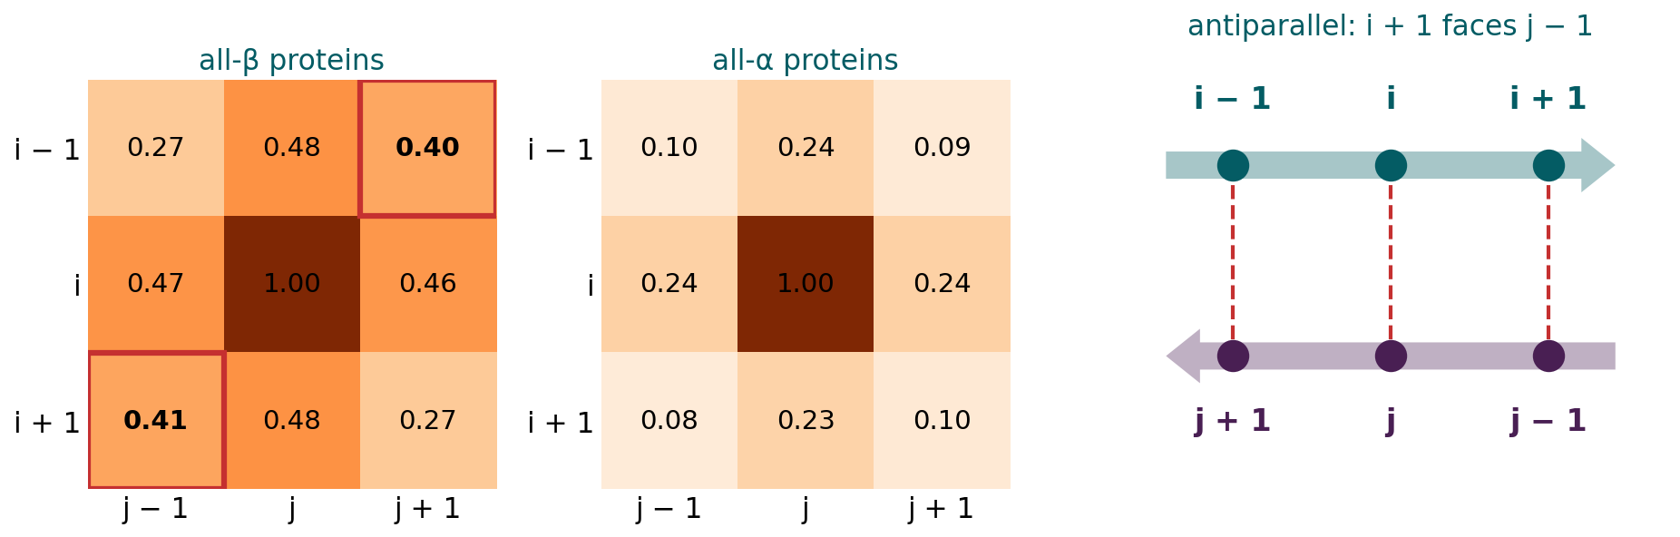
BLOCK 1 · QUIZ
The answer: (i + 1, j − 1), across the diagonal
Three all-β and three all-α structures, every contact with j − i ≥ 12. In the β-proteins, (i + 1, j − 1) is a contact 40% of the time, (i + 1, j + 1) 27%: antiparallel strands run in opposite directions, so i + 1 faces j − 1. Helices give a weaker neighbourhood, since only every third or fourth residue faces the partner. A predictor that looks at a patch of the map can use this: PconsC2, the CNNs, AlphaFold2's pair updates.

Slide 36
BLOCK 1 DONE
Break

Slide 37
BLOCK 2 · ABOUT 30 MIN
How AlphaFold2 combines the course's ideas

Slide 38
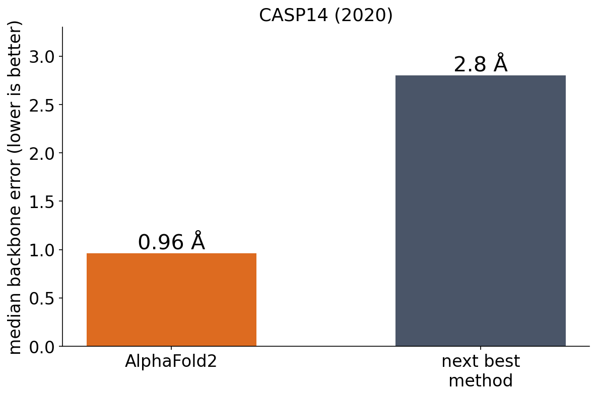
2 · ALPHAFOLD2
Atomic accuracy, even without a similar structure
▪ Trained end to end
▪ Sequence, alignment, templates → atoms
▪ Unlike ESMFold: a single sequence
Jumper et al. (2021), Nature 596:583.
Notes:
'The first computational method that can regularly predict protein structures with atomic accuracy even in cases in which no similar structure is known.'

Slide 39
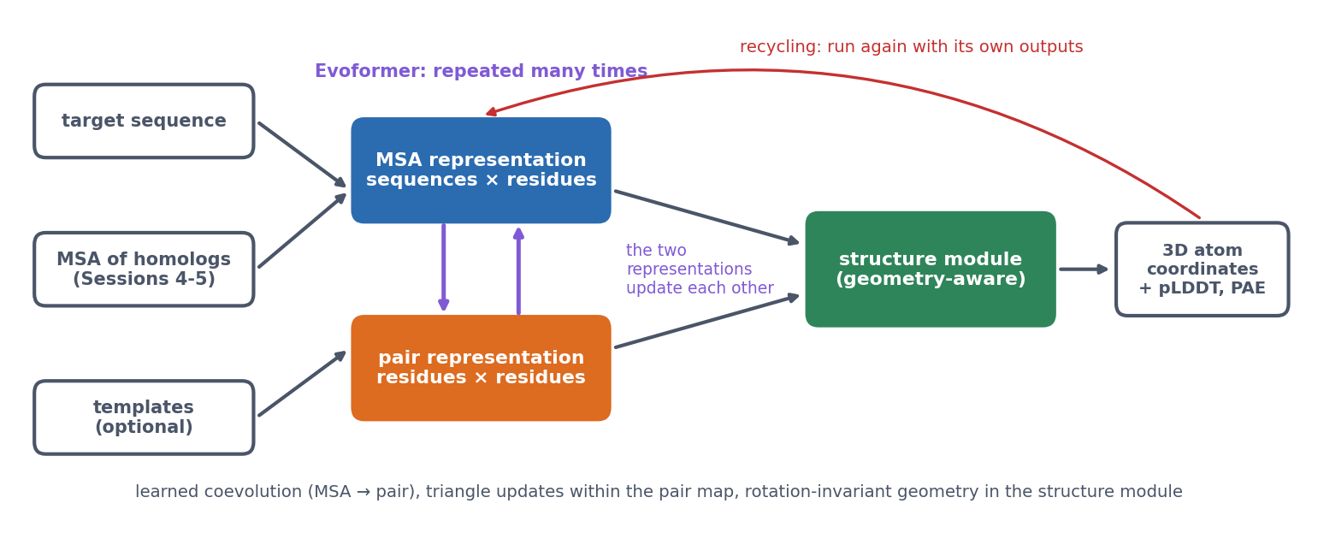
2 · ALPHAFOLD2
AlphaFold2: the data flow
Inputs are embedded into an MSA representation and a pair representation, which the Evoformer updates many times. A geometry-aware structure module builds 3D coordinates with confidence scores; recycling runs the network again on its own outputs.
Jumper et al. (2021).

Slide 40
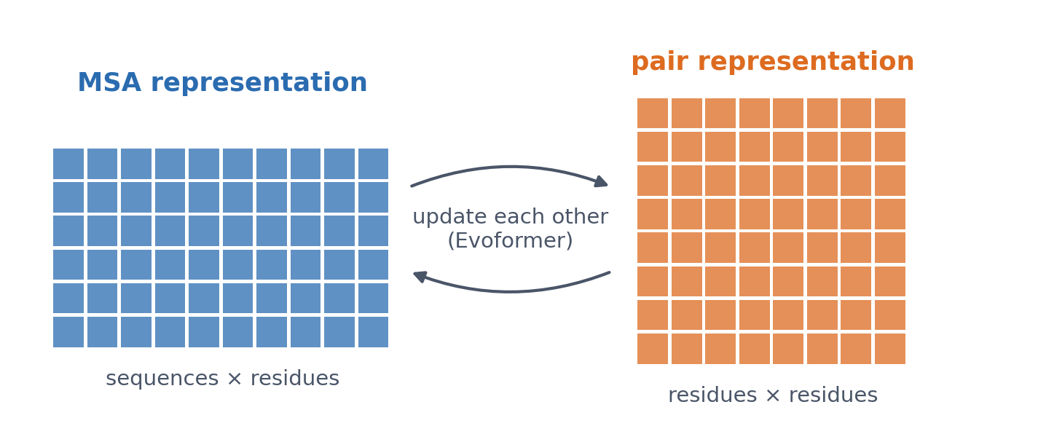
2 · ALPHAFOLD2
Two representations
▪ MSA: a vector per residue per sequence
▪ Pair: a vector per residue pair
▪ A richer contact map
See course.bioinfo.se/session12.html, 'The data flow'.
Notes:
The pair representation is a learned, much richer version of the contact and distance maps of Block 1 and of the distance map of β-globin in Session 6.

Slide 41
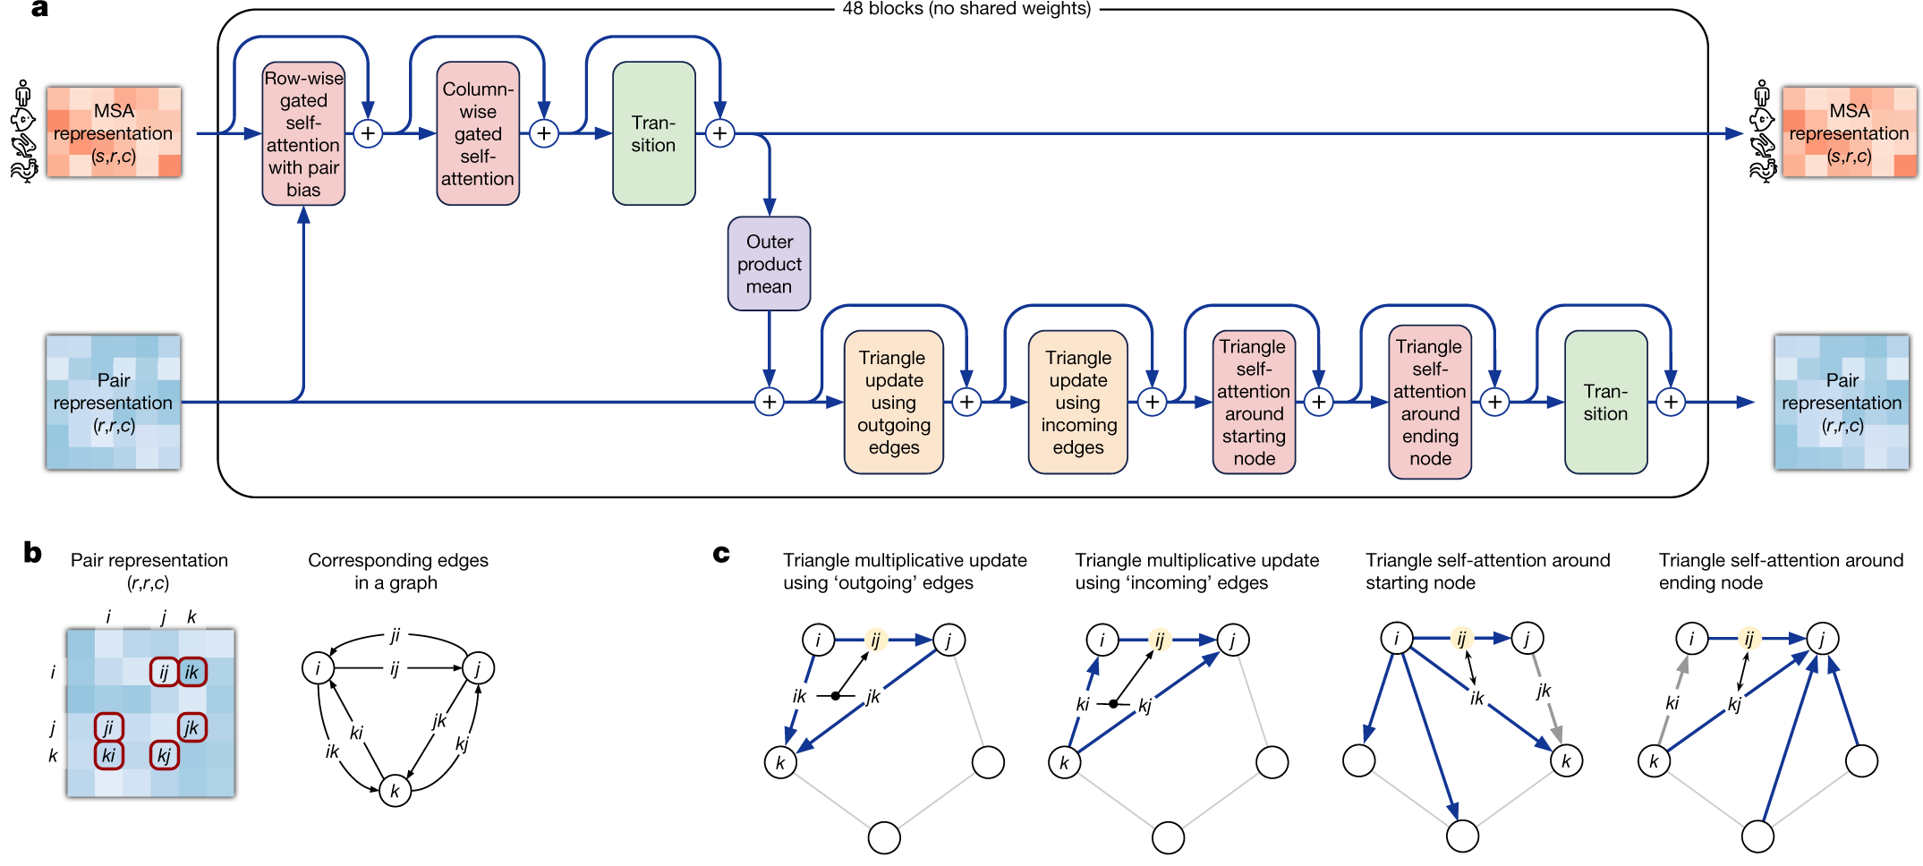
2 · INSIDE THE EVOFORMER
One Evoformer block, repeated 48 times
(a) MSA row (top): row attention biased by the pair, column attention, transition. Outer product mean: MSA → pair. Pair row (bottom): four triangle operations, transition. Every ⊕ is a residual connection. (b, c) The pair as graph edges; each triangle update combines edges via a third residue k.
Jumper et al. (2021), Nature 596:583, Fig. 3a-c (cropped). CC BY 4.0.
Notes:
Read panel a from left to right. Shapes: s sequences, r residues, c channels. The transition is a small feed-forward network applied to each vector. The 48 blocks do not share weights. The next three slides take the three key operations one at a time.

Slide 42
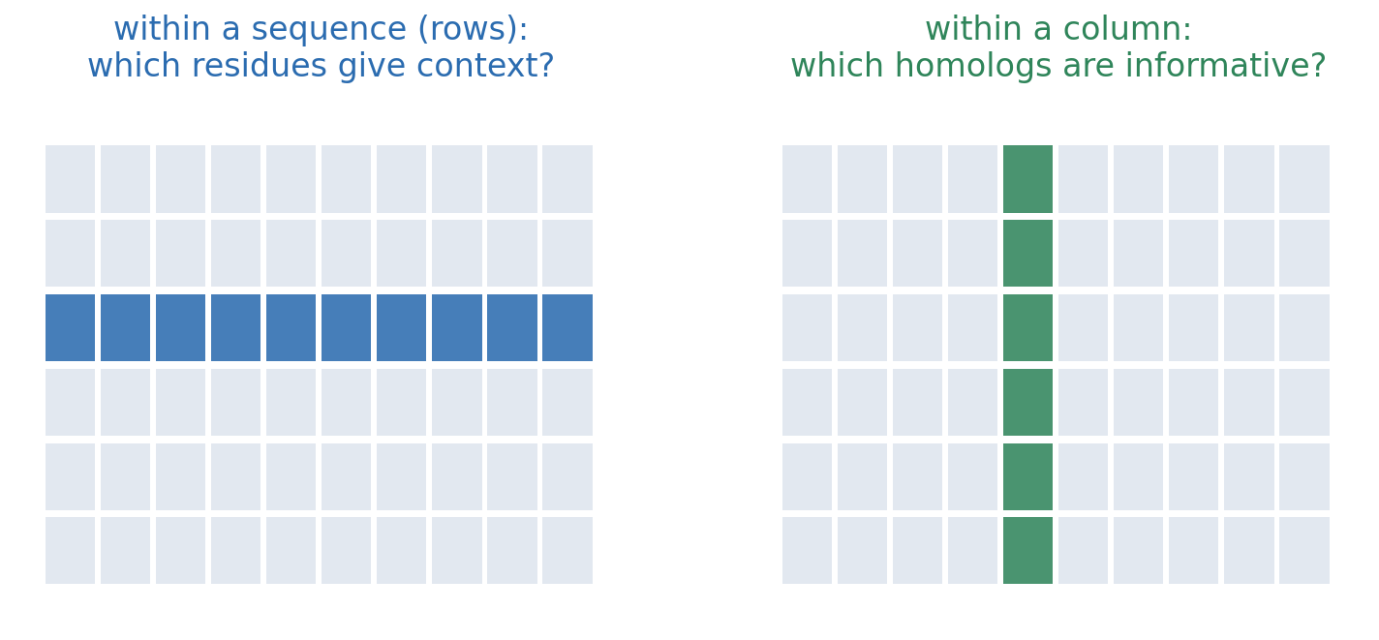
2 · INSIDE THE EVOFORMER
MSA attention: rows and columns
Within each aligned sequence, residues attend to each other (Session 11's attention, biased by the pair representation). Within each column, sequences attend to each other.
Jumper et al. (2021).

Slide 43
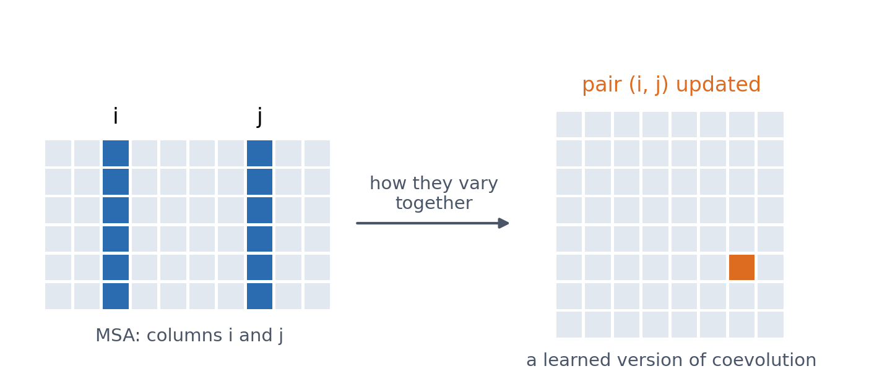
2 · INSIDE THE EVOFORMER
MSA → pair: learned coevolution
▪ How two columns vary together
▪ updates pair (i, j)
▪ Block 1, as a learned operation
Jumper et al. (2021): the outer product mean.

Slide 44
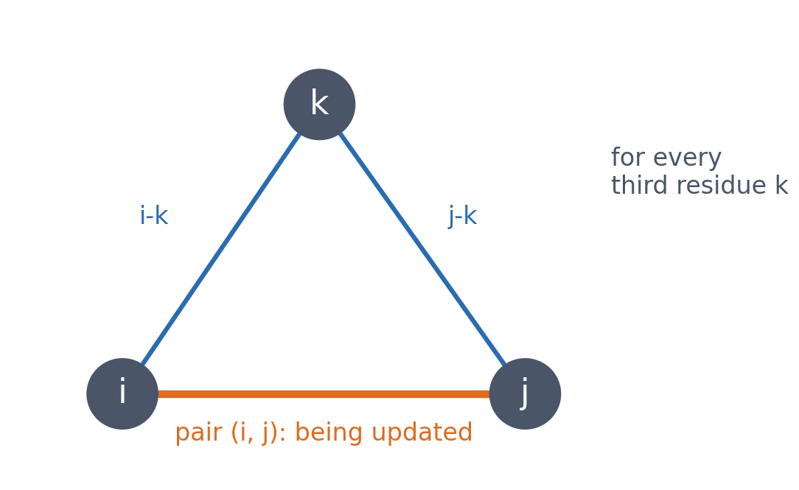
2 · INSIDE THE EVOFORMER
Triangle updates
▪ (i, j) informed via every k
▪ Pairs are not independent
▪ Inspired by the triangle inequality
▪ Learned, not enforced
Jumper et al. (2021).
Notes:
If i is close to k and j is close to k, that constrains how i and j can be related. The authors were inspired by geometric constraints, but the updates are learned operations, not rules that enforce them.

Slide 45
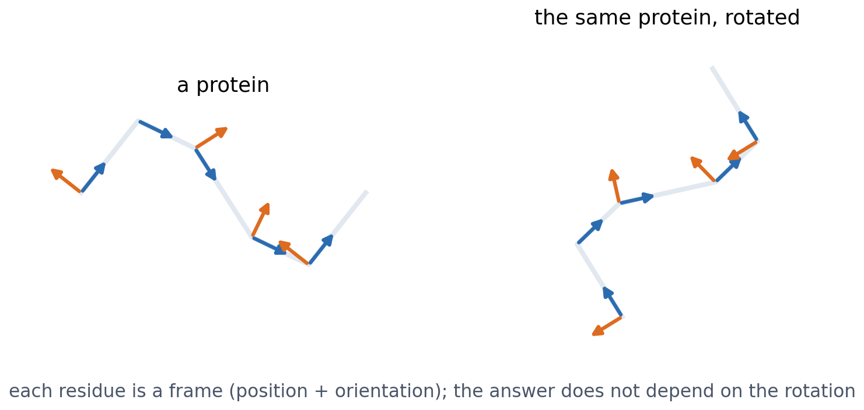
2 · STRUCTURE MODULE
Residue frames, and invariance in 3D
Each residue is a rigid frame (backbone position and orientation). Invariant point attention does not depend on how the whole protein is rotated or translated: Session 10's invariance, in three dimensions. Recycling then refines the prediction a few times.
Jumper et al. (2021).
Notes:
In short: AlphaFold2 kept the ingredients of the second generation (alignments, coevolution, contacts, distances, physical plausibility) and turned each into a learnable operation inside one network, trained on the final coordinates.

Slide 46
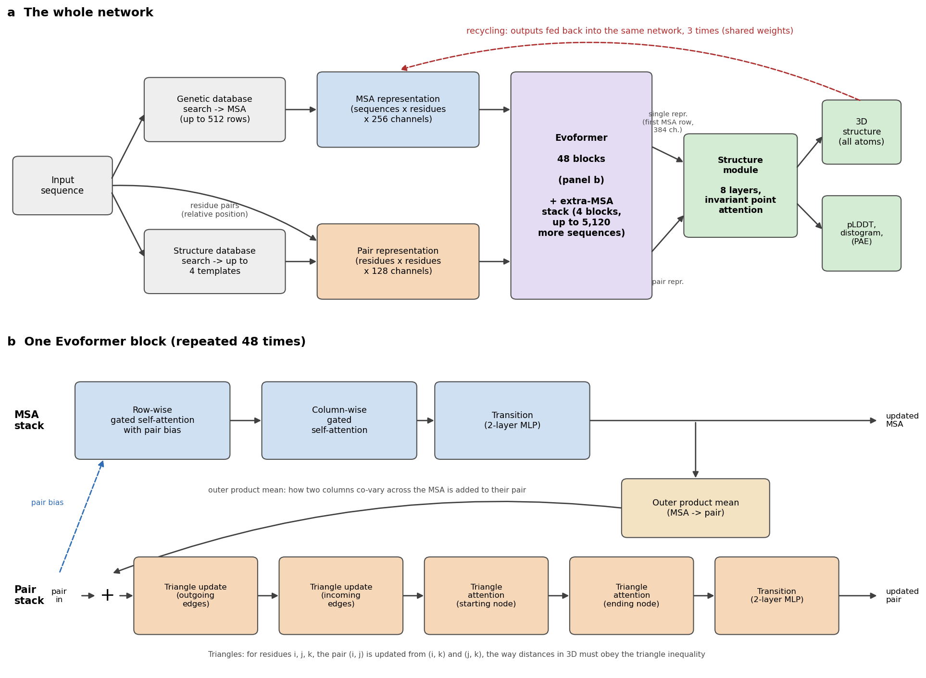
2 · FOR REFERENCE
AlphaFold2 in detail
MSA representation (256 channels) and pair representation (128 channels) through 48 Evoformer blocks; an 8-layer structure module; 3 recycles. Panel b: the operations of one Evoformer block.
Drawn after Jumper et al. (2021) and its Supplementary Information.
Notes:
Optional slide: skip it if time is short.

Slide 47
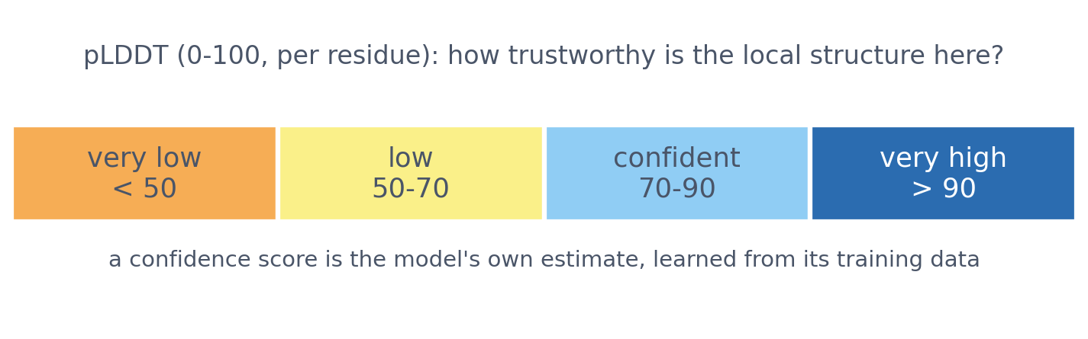
2 · CONFIDENCE
pLDDT: how trustworthy is the local structure?
A predicted structure is only useful if we know how far to trust it: the confidence scores are as important as the structure itself.
See course.bioinfo.se/session12.html, 'Confidence: pLDDT and PAE'.

Slide 48
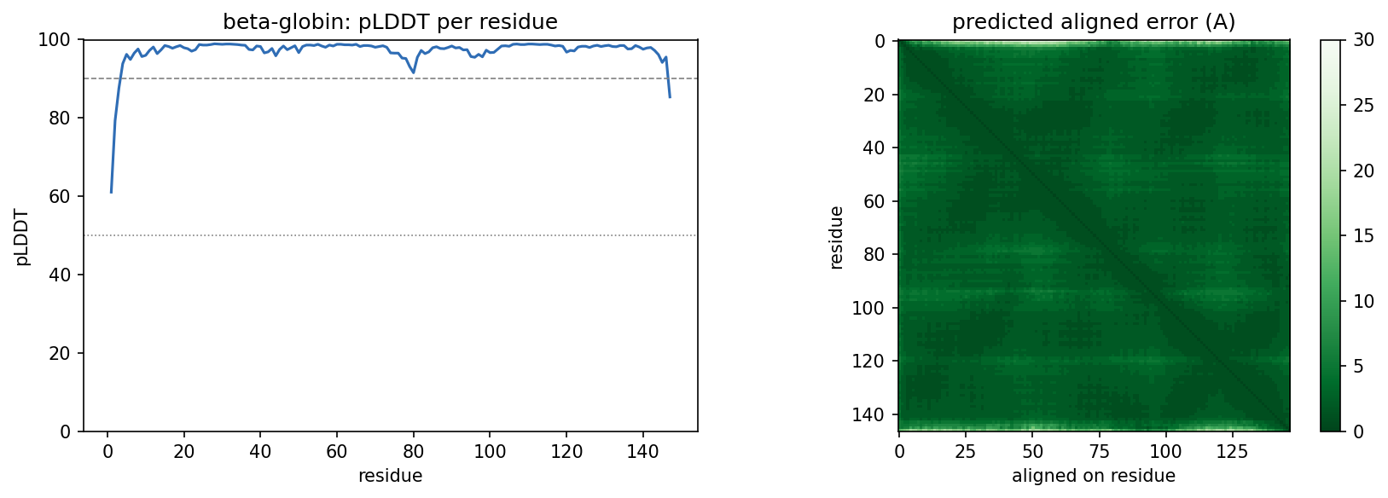
2 · CONFIDENCE
PAE: aligned on A, how sure is B?
▪ Per pair of residues
▪ Domains right, orientation unknown
▪ β-globin: pLDDT 97.2, TM 0.988
Notebook, Part 2: AlphaFold DB model vs crystal structure 4HHB.
Notes:
Low PAE within a domain and high PAE between two domains means each domain may be right while their relative orientation is unknown. This matters for multi-domain proteins, flexible regions and complexes. β-globin: RMSD 0.51 Å over the aligned residues.

Slide 49
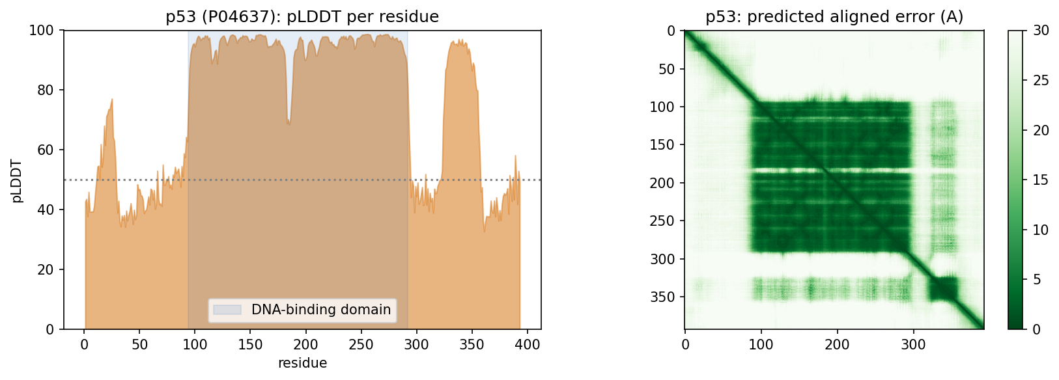
2 · CONFIDENCE
p53: one confident domain
30% of the residues have pLDDT below 50. DNA-binding domain: mean 95.3; N-terminal transactivation region 47.6; C-terminus 45.8. Here low confidence matches biology: these regions are known to be intrinsically disordered.
Notebook, Part 2: AlphaFold DB, P04637.

Slide 50
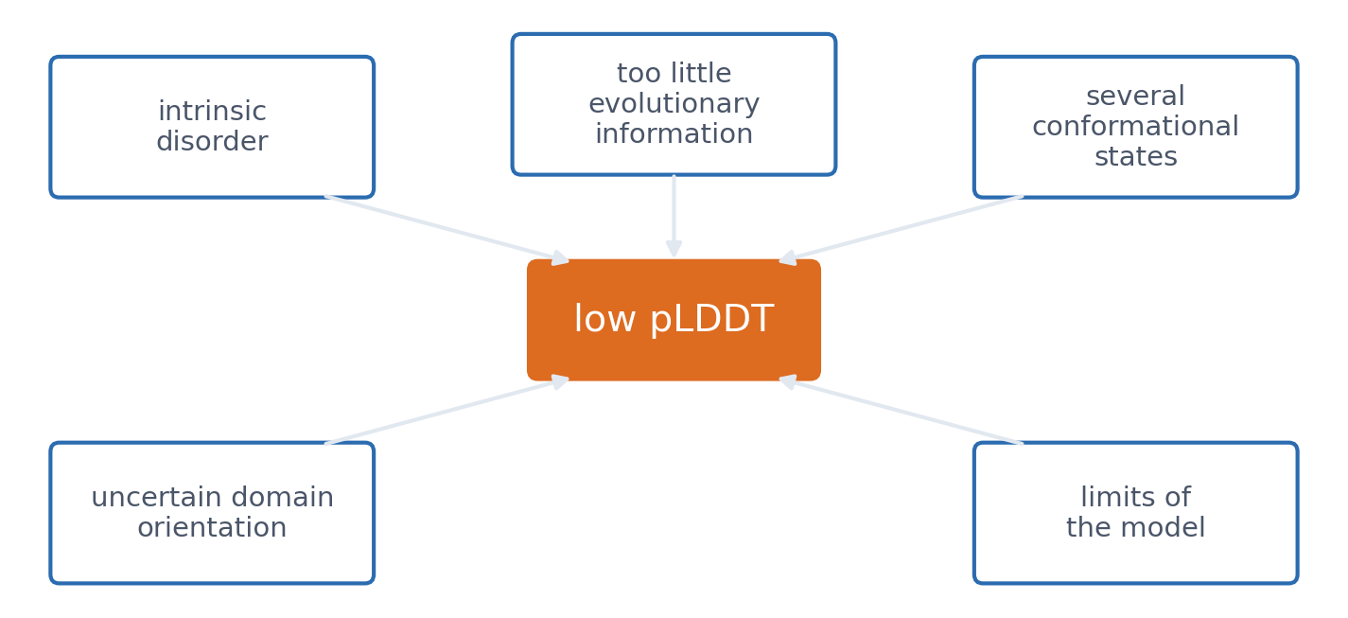
2 · CONFIDENCE
Low pLDDT is not the same as disorder
▪ Confidence ≠ correctness
▪ The model's own estimate
▪ Famous proteins: in the training data
See course.bioinfo.se/session12.html, 'Confidence: pLDDT and PAE'.
Notes:
Checking how well pLDDT tracks the real error is harder than it looks, because well-studied proteins are likely to have close relatives in the training data (Session 8). The second discussion tests this.

Slide 51
2 · SCALE AND TOOLS
Structures for every protein
▪ AlphaFold DB: essentially all of UniProt
▪ ColabFold: MMseqs2 + AlphaFold in Colab
▪ ESMFold: one sequence, no alignment
0.941
TM-score, ESMFold
Ephrin-A5 (1SHW)
2024
Nobel Prize: Hassabis,
Jumper; Baker
Tunyasuvunakool et al. 2021; Varadi et al. 2024; Mirdita et al. 2022; Lin et al. 2023.
Notes:
ESMFold predicts Ephrin-A5 in seconds in the notebook (mean pLDDT 86.0, RMSD 1.27 Å). Hassabis and Jumper shared half of the Nobel Prize in Chemistry 'for protein structure prediction'; the other half went to Baker 'for computational protein design'.

Slide 52
2 · KNOWN LIMITS
What AlphaFold cannot tell you
Cannot tell
Often unreliable
from one prediction
for
▪ whether a sequence folds at all
▪ how a mutation changes the structure
▪ alternative conformational states
▪ domain arrangement in large flexible proteins
▪ membranes, protein-DNA complexes
From the lecture; see course.bioinfo.se/session12.html, 'Known limits'.
Notes:
It 'does not know what a membrane is'. In a protein-DNA complex it can place another protein where the DNA should be.

Slide 53
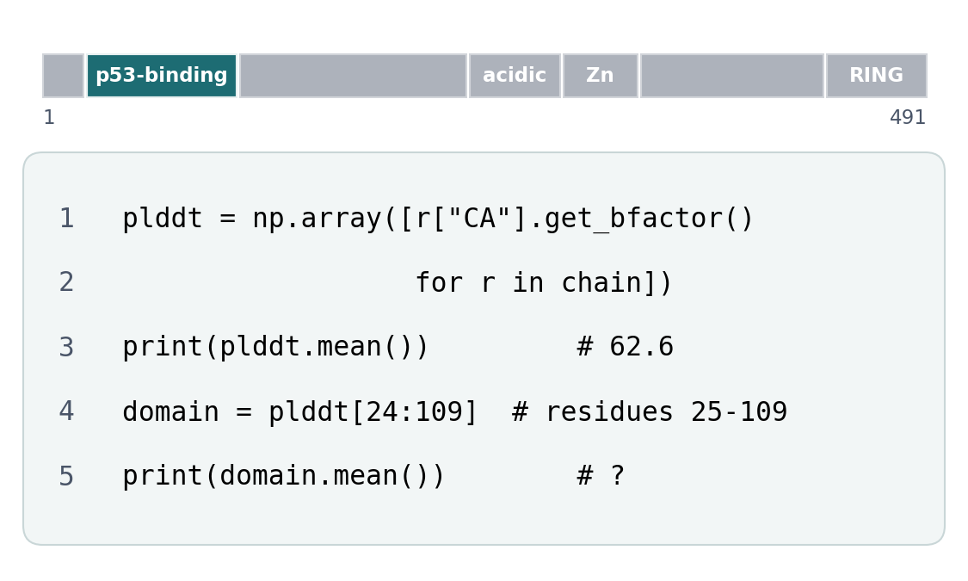
BLOCK 2 · QUIZ
What is the mean pLDDT of the p53-binding domain?
MDM2, which binds p53. Full-length human MDM2, AlphaFold DB model: 491 residues, mean pLDDT 63.
A About 63: like the whole chain
B About 95: the rest pulls the mean down
C About 40: no part can be trusted
D Cannot say without a crystal structure
Guess on your own
Scan the code, or go to
quiz.bioinfo.se/live
Notes:
The lecture showed p53 itself; this is its partner MDM2 (the p53 TAD : MDM2 example of the four regions). pLDDT is stored in the B-factor column. AlphaFold's scale: above 90 very high, 70-90 confident, 50-70 low, below 50 very low.

Slide 54
BLOCK 2 · QUIZ
What is the mean pLDDT of the p53-binding domain?
How did the room answer?
Halt the round when most have answered, then show the results.
Show the results ▸ quiz.bioinfo.se/live/report
Notes:
Halt submission in the Control view, then open the results. Do not say which answer is right.

Slide 55
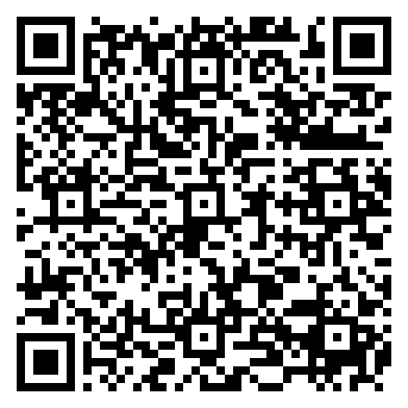
BLOCK 2 · QUIZ
What is the mean pLDDT of the p53-binding domain?
Fix it, run it, discuss
Open the notebook: scan the code
Fix the line marked FIX, then run the cells
Did it come out as you guessed? Discuss with your neighbour
The notebook: https://colab.research.google.com/github/ElofssonLab/kb8029-book/blob/main/notebooks/session12-discussion-2.ipynb
Notes:
About 8 minutes. One download from the AlphaFold DB. The FIX line prints plddt.mean(), the whole chain, a second time, so as it is the cell prints 62.6 twice: the first answer. Fixed (domain.mean()): 94.7. Early finishers: residues 110-429 average 50.

Slide 56
BLOCK 2 · QUIZ
What is the mean pLDDT of the p53-binding domain?
Answer again
Same question, after the discussion.
quiz.bioinfo.se/live
Notes:
Open the second round (post) in the Control view.

Slide 57
BLOCK 2 · QUIZ
What is the mean pLDDT of the p53-binding domain?
Results, and who explains
Both rounds side by side.
Draw two to explain: one of you says how you reasoned.
Show the results ▸ quiz.bioinfo.se/live/report
To check it with code afterwards: discussion notebook 2 https://colab.research.google.com/github/ElofssonLab/kb8029-book/blob/main/notebooks/session12-discussion-2.ipynb
Notes:
About 95 (94.7). The middle of MDM2, residues 110-429, averages 50: mostly disordered, apart from a short zinc finger; the C-terminal RING domain is confident again. A mean hides confident domains joined by stretches AlphaFold does not place, as in p53.

Slide 58
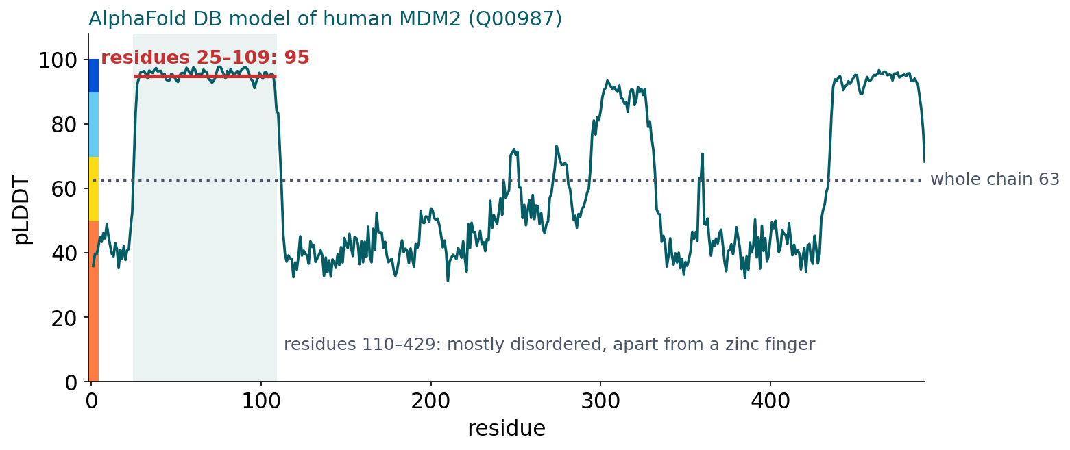
BLOCK 2 · QUIZ
The answer: about 95; the mean hides a confident domain
The p53-binding domain of MDM2 has a mean pLDDT of 95; residues 110–429 average 50. A mean of 63 is not a mediocre model everywhere: it is confident domains joined by long stretches AlphaFold does not place, in MDM2 mostly disordered, as in p53. Look at pLDDT along the chain, and at the PAE between domains, never only at the mean.

Slide 59
BLOCK 2 DONE
Break

Slide 60
BLOCK 3 · ABOUT 30 MIN
From single chains to interactions, and generative models

Slide 61
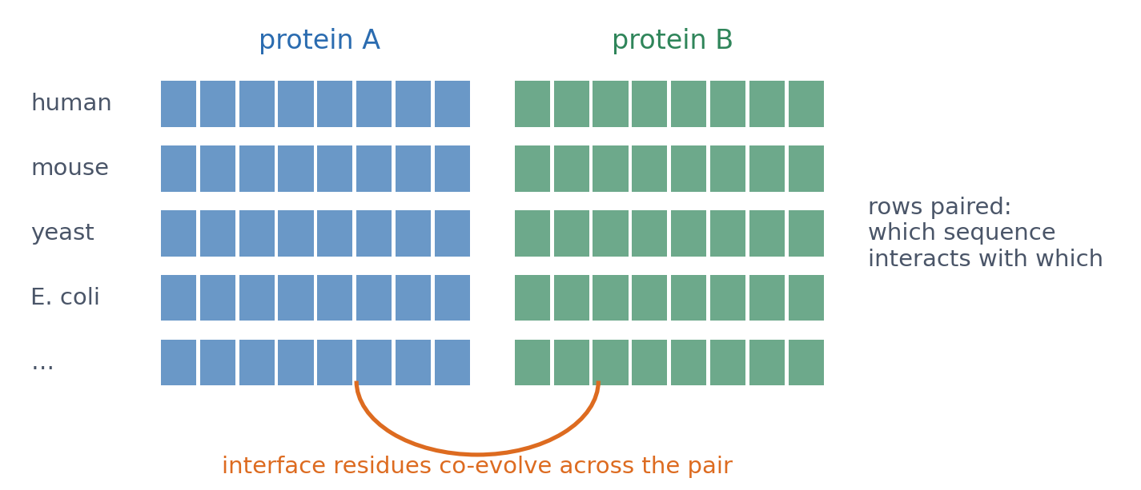
3 · COMPLEXES
Complexes: pair the alignments
▪ Interfaces co-evolve too
▪ FoldDock: AlphaFold2 on joined chains
▪ AlphaFold-Multimer: retrained
Bryant, Pozzati & Elofsson (2022), Nat Commun 13:1265; Evans et al. (2021).
Notes:
AlphaFold2 was trained on single chains, yet it can predict complexes when the chains are given together. Pairing is the hard part: which sequence in one family interacts with which in the other.

Slide 62
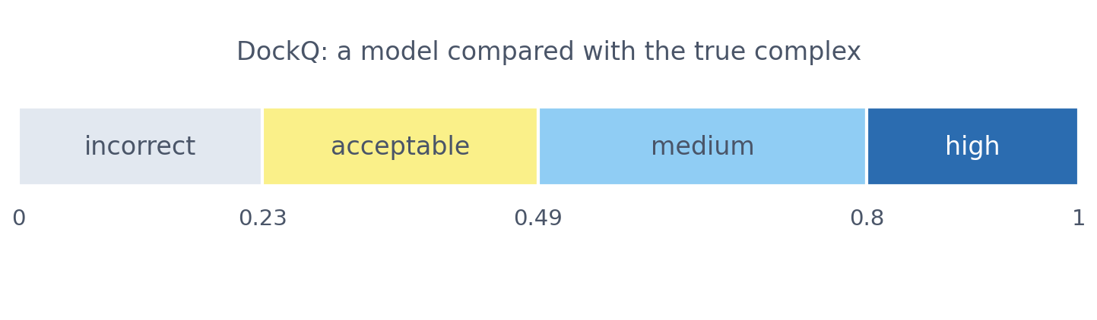
3 · COMPLEXES
Interfaces need their own scores
The model's own interface confidence: ipTM (AlphaFold-Multimer) or pDockQ (FoldDock: interface pLDDT and number of contacts). Against the true complex: DockQ, from 0 to 1. Each chain can be right while their placement is wrong: the PAE between chains.
Basu & Wallner (2016); Bryant et al. (2022); Evans et al. (2021).

Slide 63
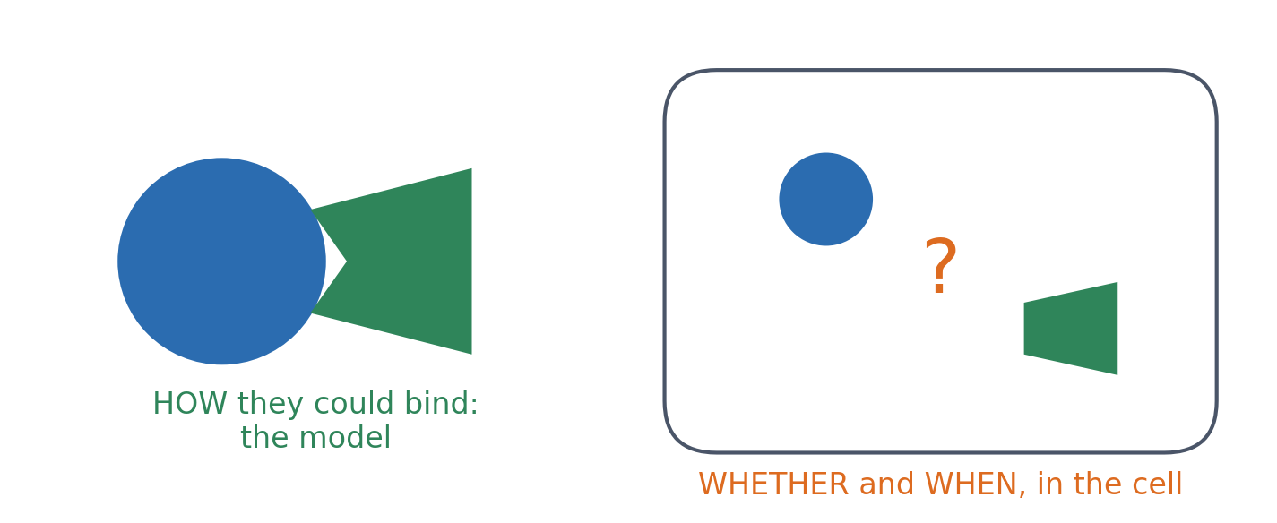
3 · COMPLEXES
A model shows how, not whether
▪ Plausible complex ≠ evidence of interaction
▪ Combine with other evidence
Elofsson et al. (2024), eLife 13:RP93131.
Notes:
One of the most important messages of the session. A structure predictor can suggest how two supplied molecules could interact; it does not establish whether they interact in the cell, or when. Combined with other evidence it can lead to biology: all-against-all modelling of 14 fertilisation proteins pointed to a pentameric complex of sperm IZUMO1, SPACA6, TMEM81 and egg JUNO, CD9.

Slide 64
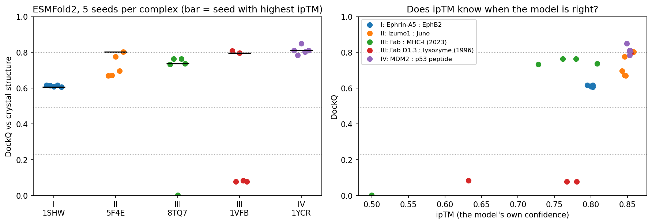
3 · COMPLEXES
Sampling quality is not ranking quality
ESMFold2, five seeds per complex. The highest-ipTM seed is good for every complex, but three of five D1.3 seeds are wrong, and no single ipTM threshold separates right from wrong. Antibody-antigen: the best of 200 models reaches DockQ above 0.5, the top-ranked one is much worse.
Fromm, Ludaic & Elofsson (2026); notebook: ESMFold2, five seeds per complex.
Notes:
On 110 antibody-antigen complexes unseen in training, sampling 200 models raised the average DockQ of the best model from below 0.3 to above 0.5, but confidence often cannot identify the best. In the notebook, the highest-ipTM seed is good for every complex (DockQ 0.61-0.85), but three of five D1.3 seeds put the antibody in the wrong place, and correct Fab : MHC-I models (ipTM 0.73) score below wrong D1.3 models (0.78). Trimming a construct to its interacting domains raises ipTM with the same interface; ipSAE counts only well-placed pairs (Dunbrack 2025).

Slide 65
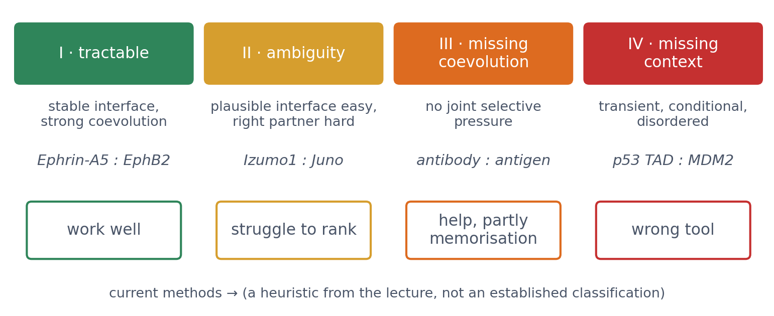
3 · COMPLEXES
When to trust a complex prediction: four regions
A heuristic from the lecture, not an established classification. In the lab, each group predicts one complex per region on the AlphaFold Server and checks whether confidence tracks how hard the problem really is.
See course.bioinfo.se/session12.html, 'When can a complex prediction be trusted?'
Notes:
Region II examples on the page: proteasome paralogs, Izumo1 and its competing partners. The lab targets: 1SHW, 5F4E, 8TQ7, 1YCR.

Slide 66
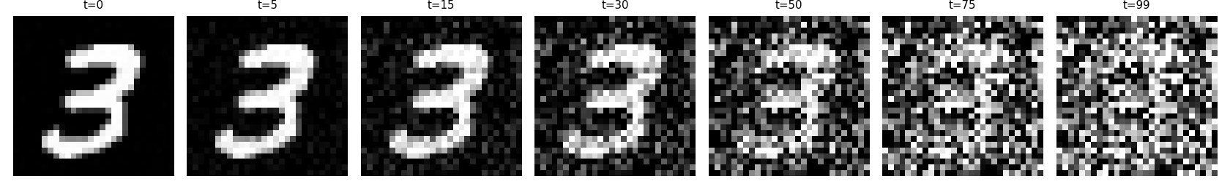
3 · GENERATIVE MODELS
Diffusion: learn to remove noise
(1) Forward: add a little Gaussian noise step by step (no learning). (2) Train: predict the added noise from a noisy example and its step. (3) Generate: start from pure noise and denoise many times.
Sohl-Dickstein et al. (2015); Ho, Jain & Abbeel (2020).
Notes:
Behind image generators such as DALL-E. Relatives: flow matching learns a smooth path from noise to data and needs fewer steps; a variational autoencoder decodes samples from a learned low-dimensional space.

Slide 67
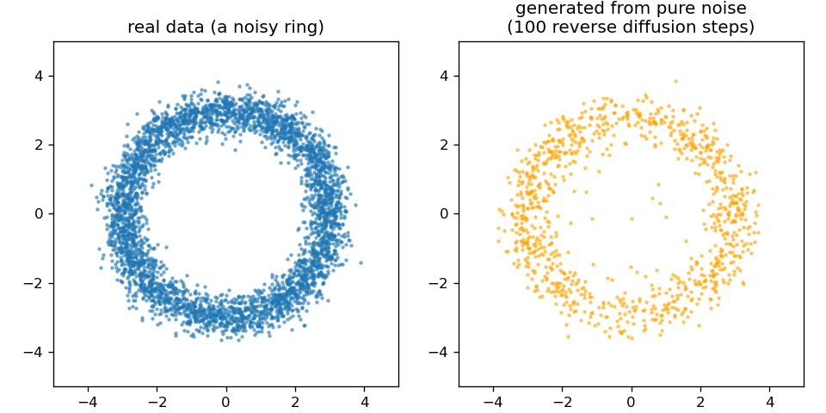
3 · GENERATIVE MODELS
A ring from pure noise
▪ 1,000 points generated
▪ 100 denoising steps
▪ Learns the shape of the data
Notebook, Part 3.
Notes:
Noise-prediction error falls from 0.939 at step 1 to 0.638 at step 2,000. The third discussion asks whether such a model learns the distribution or memorises its training examples.

Slide 68
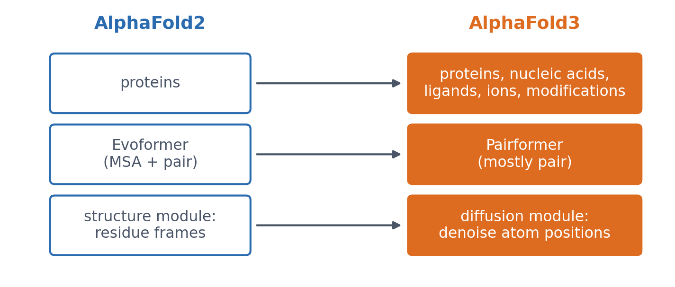
3 · GENERATIVE MODELS
AlphaFold3: what changed
All atoms at once, any molecule made of atoms. Sampling brings back the ranking problem, and the model can hallucinate structure in disordered regions. CASP16: 'slightly better for protein complexes', but the difference disappears with massive AlphaFold2 sampling.
Abramson et al. (2024), Nature 630:493; Elofsson (2026), Proteins 94:154.

Slide 69
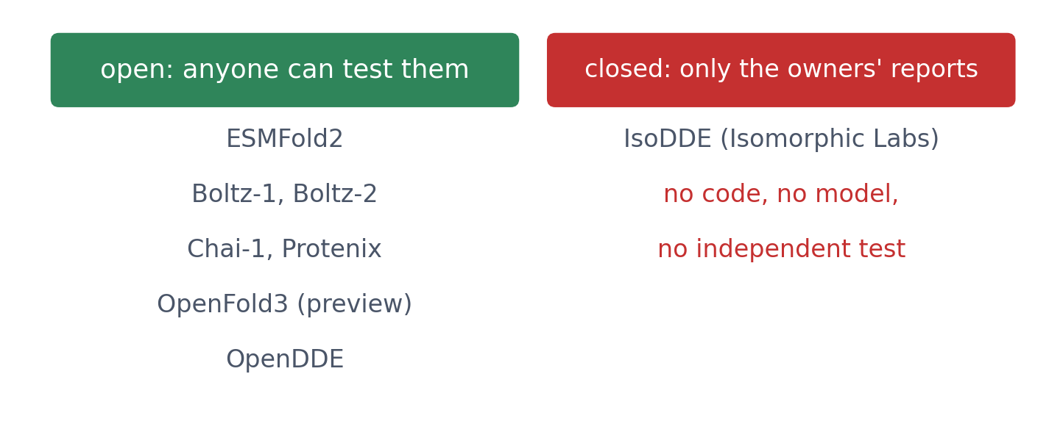
3 · WHERE THE FIELD IS (2026)
Open systems can be tested; closed ones only claimed
AlphaFold3 was released without training code, and open reproductions followed. IsoDDE's company reports its largest gains on examples unlike the training set, where AlphaFold3 is weakest, but there is no independent test.
Optional section on the page, and it will age quickly.
Notes:
ESMFold2: a frozen 6-billion-parameter ESMC language model plus an AlphaFold3-style diffusion module, about 7 billion parameters in all, MIT licence. OpenDDE (Aureka Research, Apache licence): its developers report higher performance on antibody-antigen complexes. A separate single-developer OpenDDE chains existing open tools behind one web interface. RNA: methods 'recognize recurring motifs rather than generalize to novel RNA folds' (Ludaic & Elofsson 2026).

Slide 70
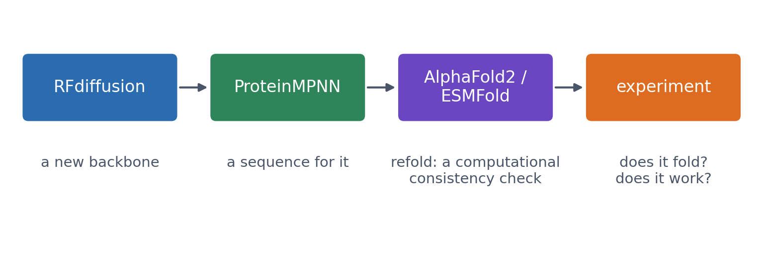
3 · DESIGN
Designing new proteins: one pipeline
Refolding is only a computational consistency check, not experimental validation. Hundreds of RFdiffusion designs were tested in the lab, including an influenza-haemagglutinin binder whose cryo-EM structure was 'nearly identical to the design model'.
Watson et al. (2023), Nature 620:1089; Dauparas et al. (2022), Science 378:49.

Slide 71
3 · ENSEMBLES
One structure, or many?
AFsample
AlphaFlow
BioEmu
sample the same network hard
retrain AlphaFold as generative
a learned shortcut for MD
▪ Dropout left ON at prediction
▪ ~6,000 models per target, not 25
▪ Top of CASP15 protein assembly
▪ Flow matching
▪ Each run draws a different structure from a distribution
▪ Trained on >200 ms of simulation + stabilities
▪ Thousands of structures per hour on one GPU
▪ Free energies to ~1 kcal/mol
Wallner (2023), Bioinformatics 39:btad573; Jing et al. (2024), arXiv:2402.04845; Lewis et al. (2025), Science 389:eadv9817.
Notes:
A protein is not one structure: loops move, domains swing, and many proteins switch states (haemoglobin T and R, Session 6). AlphaFold gives one, and says nothing about which state or how likely it is. MD is honest but far too slow, so these methods try to make a predictor produce an ensemble instead. The caution: a set of models is only an ensemble if the proportions are right, and that is much harder to check than a single structure. Variety is not the same as the right variety.

Slide 72
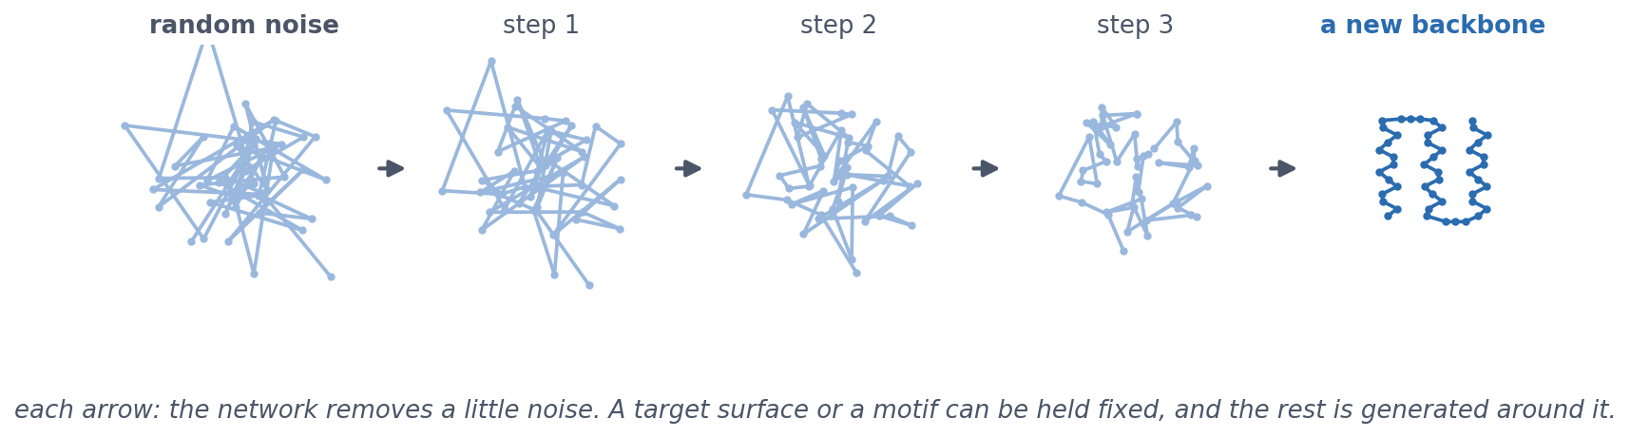
3 · DESIGN
RFdiffusion: a backbone out of noise
The diffusion idea of this block, applied to coordinates: start from randomly placed residues and denoise, with a fine-tuned RoseTTAFold. A target surface or a functional motif can be held fixed while the rest is generated around it.
Watson et al. (2023), Nature 620:1089. Schematic. See course.bioinfo.se/session12.html, 'Designing new proteins'.
Notes:
Step 1 of the pipeline: where the backbone comes from. Same three steps as the toy diffusion model earlier in this block, with protein coordinates instead of points on a ring. Conditioning is what makes it useful: hold the target's surface fixed and generate a binder against it, or hold a binding site fixed and build a stable scaffold around it. Hundreds of designs tested in the lab; the influenza-haemagglutinin binder's cryo-EM structure was nearly identical to the design model.

Slide 73
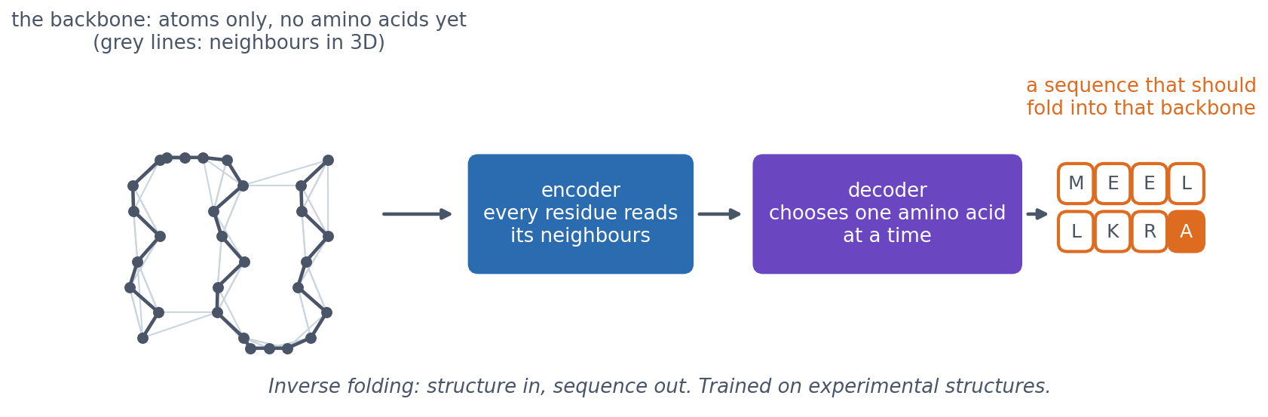
3 · DESIGN
ProteinMPNN: which sequence folds into this backbone?
Inverse folding: the structure is given, the sequence is the unknown. An encoder lets each residue read its neighbours in 3D; a decoder then chooses the amino acids one at a time, as a language model writes text. 52.4% native sequence recovery, against 32.9% for Rosetta.
Dauparas et al. (2022), Science 378:49. See course.bioinfo.se/session12.html, 'Designing new proteins'.
Notes:
Step 2 of the pipeline. The backbone is a graph: each residue linked to its nearest neighbours in space, not in sequence. Encoder-decoder, as in an autoencoder, but not a VAE: there is no latent Gaussian to sample from. The randomness comes from the decoder sampling each amino acid from its predicted probabilities, with a temperature, so the same backbone gives different sequences each run. Optional box on the page explains autoencoders and VAEs. It rescued designs that had previously failed in the lab.

Slide 74
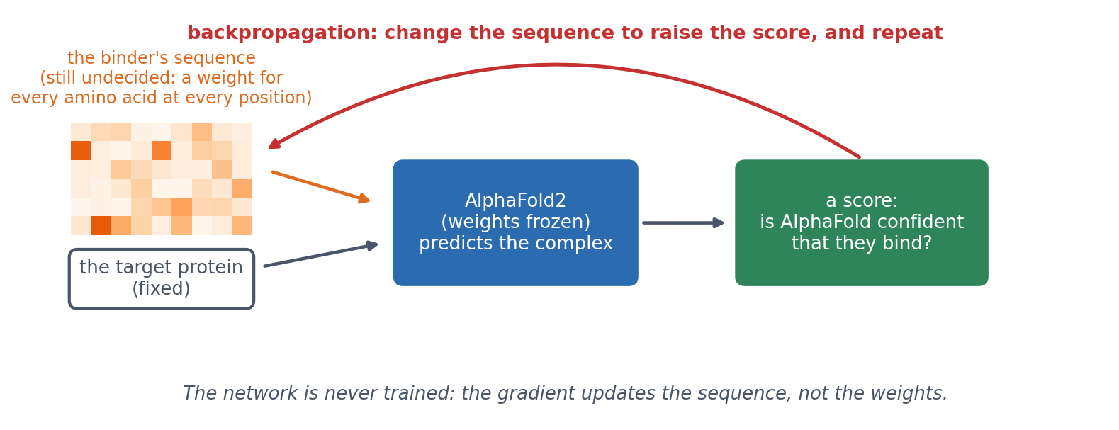
3 · DESIGN
BindCraft: optimise the input, not the weights
AlphaFold2 is differentiable, so backpropagation (Session 9) can run in reverse: freeze the weights and change the binder's sequence until AlphaFold is confident that it binds the target. Experimental success rates of 10-100%, with no high-throughput screening.
Pacesa et al. (2025), Nature 646:483; Anishchenko et al. (2021), Nature 600:547. See course.bioinfo.se/session12.html.
Notes:
The Session 9 question in reverse. Training: the input is fixed and the gradient changes the weights. Here: the weights are frozen and the gradient changes the input. The sequence starts undecided, a weight for every amino acid at every position, and is optimised until the score (AlphaFold's confidence in the complex) is as high as it can be made. The idea began as hallucination (Anishchenko 2021): optimise a sequence until a predictor is confident it folds into something. BindCraft targets included cell-surface receptors, allergens, de novo designed proteins and Cas9; designed binders reduced IgE binding to birch allergen in patient samples. The warning for all three tools: they optimise against a predictor, so a design is a hypothesis. Every one of these papers ends in the lab.

Slide 75
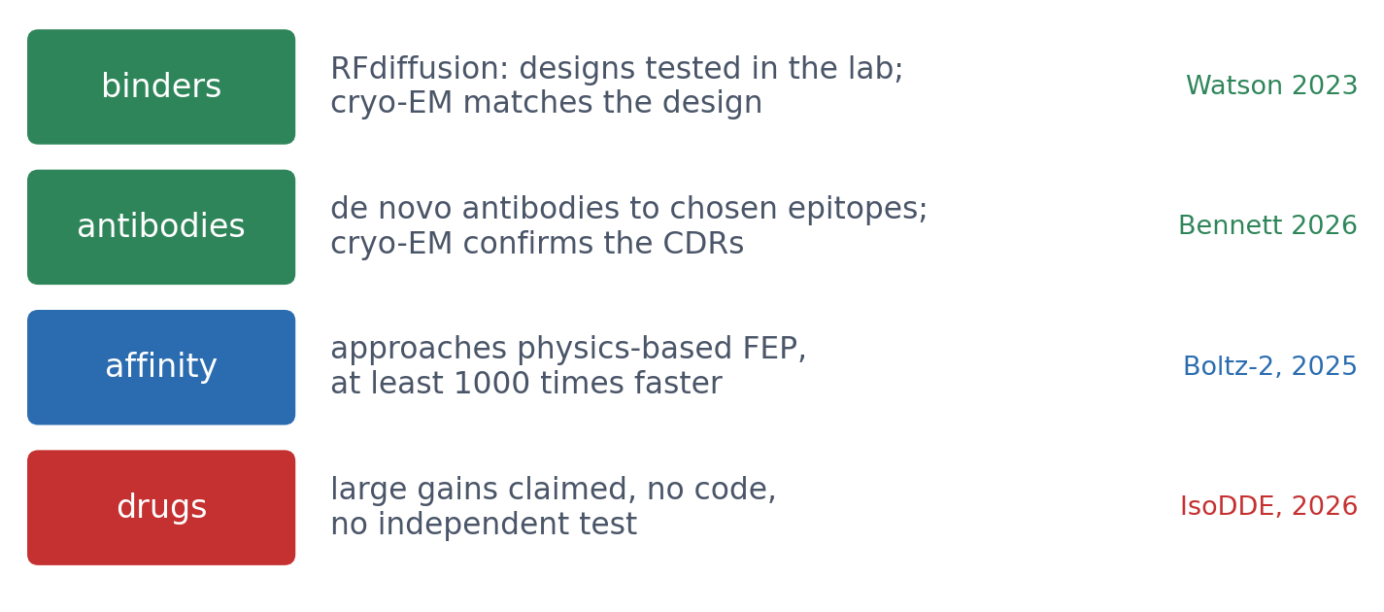
3 · OUTLOOK
From predicting structures to designing molecules
▪ Designed binders work in the lab
▪ Antibodies: designed, then matured
▪ Separate results from claims
▪ What is left for experiments?
Watson et al. (2023), Nature 620:1089; Bennett et al. (2026), Nature 649:183; Passaro et al. (2025), Boltz-2, bioRxiv; Isomorphic Labs (2026), IsoDDE technical report.
Notes:
The previous slide's pipeline (RFdiffusion, ProteinMPNN, refolding, experiment) now designs binders that work in the lab. Bennett et al. (2026) designed antibodies (VHHs, scFvs and full antibodies) that bind chosen epitopes; cryo-EM confirmed the designed binding pose and CDR loops at atomic accuracy. The first designs bound only modestly, and affinity maturation (OrthoRep) was needed to reach single-digit nanomolar binders: the experiment is still part of the loop. Boltz-2 predicts binding affinity and approaches physics-based free-energy perturbation (FEP) on held-out benchmarks while being at least 1000 times faster. Drug-design engines such as IsoDDE report large gains but release no code, model or independent test (Block 3 slide): claims, not results. Next steps are dynamics and whole cells, as in Alpha Cell (Session 10). For the question: experiments still decide whether a design works, measure what models cannot (affinity in a cell, toxicity), and produce the data the next model is trained on.

Slide 76
SUMMARY
The course in one line
Modern structure prediction combines alignment and evolution with neural networks, attention, pair representations and geometry. A model is a hypothesis with confidence estimates, not an experiment.
See course.bioinfo.se/session12.html, 'The course in one line'.

Slide 77

BLOCK 3 · QUIZ
What does the model trained on 20 points generate?
A toy diffusion model; trained on 4000 points of a ring, it generates points spread evenly along the ring.
A Spread evenly, as with 4000
B On the ring, bunched around the 20
C Exact copies of the 20 points
D Noise: 20 are too few
Guess on your own
Scan the code, or go to
quiz.bioinfo.se/live
Notes:
The old discussion problem 3, the book page's toy diffusion model. The same question as AlphaFold3 on antibodies: learning or memorising?

Slide 78
BLOCK 3 · QUIZ
What does the model trained on 20 points generate?
How did the room answer?
Halt the round when most have answered, then show the results.
Show the results ▸ quiz.bioinfo.se/live/report
Notes:
Halt submission in the Control view, then open the results. Do not say which answer is right.

Slide 79

BLOCK 3 · QUIZ
What does the model trained on 20 points generate?
Fix it, run it, discuss
Open the notebook: scan the code
Fix the line marked FIX, then run the cells
Did it come out as you guessed? Discuss with your neighbour
The notebook: https://colab.research.google.com/github/ElofssonLab/kb8029-book/blob/main/notebooks/session12-discussion-3.ipynb
Notes:
About 8 minutes; training takes about 30 seconds on Colab. The FIX line trains both models on ring(4000), so as it is both look like the 4000-point model, the first answer. Fixed (ring(n_train)): trained on 20, the generated points are 0.28 from the nearest training point, against 0.53 for a perfect ring sampler, and 0.04 from the ring.

Slide 80
BLOCK 3 · QUIZ
What does the model trained on 20 points generate?
Answer again
Same question, after the discussion.
quiz.bioinfo.se/live
Notes:
Open the second round (post) in the Control view.

Slide 81
BLOCK 3 · QUIZ
What does the model trained on 20 points generate?
Results, and who explains
Both rounds side by side.
Draw two to explain: one of you says how you reasoned.
Show the results ▸ quiz.bioinfo.se/live/report
To check it with code afterwards: discussion notebook 3 https://colab.research.google.com/github/ElofssonLab/kb8029-book/blob/main/notebooks/session12-discussion-3.ipynb
Notes:
On the ring, but bunched around the 20 training points: twice as close to them as fresh ring points would be, with gaps between them. Something of the shape is learned, and much of the examples memorised. With 4000 points there is nothing separate to memorise. Is memorisation always bad? Not when a known structure is the right answer.

Slide 82

BLOCK 3 · QUIZ
The answer: on the ring, bunched around the 20 examples
Trained on 20 points, the toy model generates points on the ring (0.04 from it), but about twice as close to the training points as a perfect ring sampler would (0.28 against 0.53): it has learned some of the shape and memorised much of the examples. AlphaFold3's high accuracy on complexes like those in its training set raises the same question; only a test set built to exclude them can answer it.

Slide 83
BEFORE YOU LEAVE
In up to three words: what was the hardest part of today?
Answer now
Scan the code, or go to
quiz.bioinfo.se/live
Notes:
A word cloud: the bigger the word, the more students wrote it. It shows what to repeat next time.

Slide 84
BEFORE YOU LEAVE
The hardest part of today
What the room found hardest
Show the results ▸ quiz.bioinfo.se/live/report

Slide 85
Next: the capstone project
Secondary structure again, with every tool from Sessions 5-12
A model is a hypothesis with confidence estimates, not an experiment

