Slide 1
International Marketing Analytics
Set-up and registration
Session 1 · WT 2026/27
Notes:
Today we set up every laptop together. Nothing had to be installed before this session.

Slide 2




Today: from zero to a working set-up
Accounts
Tools
Repo
Project
Check
AI
What you need
Have at hand
How we work
Your laptop and charger
Windows 10/11 or a recent macOS
About 10 GB free disk space
Admin rights to install software
Your WU e-mail and its password
Your phone, for two-factor sign-in
Your student ID or enrolment confirmation
One step at a time, all together
Check your neighbour's screen
Stuck? Raise your hand, keep going with the next step
Goal: by the end of today the check script prints “ready” on every laptop.
Notes:
Six steps. Start the GitHub Education application first, because approval can take a few days; everything else runs while it is pending.

Slide 3
Register your accounts
Part 1 of 6 · GitHub, GitHub Education, DataCamp
Notes:
Accounts first: they need e-mail confirmations and, for GitHub Education, an approval that can take days.

Slide 4




Three registrations
Accounts
Tools
Repo
Project
Check
AI
GitHub
Stores code and its history; hosts the course and group repositories
GitHub Education
Free student benefits, including GitHub Copilot
DataCamp
Online Python courses; four certificates count 20 %
github.com/signup
education.github.com/pack
Invitation link on Canvas
Same e-mail everywhere: your WU student address unlocks the free plans.
Notes:
All three are free for students. Use the WU e-mail address everywhere, so the student benefits apply.

Slide 5

GitHub account
Accounts
Tools
Repo
Project
Check
AI
Open github.com/signup
Why it matters
1
WU e-mail: sign up with your student address
Your username appears on every commit you make
A clean GitHub profile is part of your CV
You need it for the group repository of the case study
The free plan is all you need
2
Username: short and professional, e.g. anna-berger
3
Verify the code GitHub sends to your inbox
4
Two-factor sign-in: GitHub Mobile or an authenticator app
5
Notes:
Two-factor authentication is required by GitHub for accounts that contribute code. GitHub Mobile is the easiest second factor.

Slide 6



GitHub Education and Copilot
Accounts
Tools
Repo
Project
Check
AI
Add WU e-mail
to GitHub
Apply for
benefits
Upload
proof
Wait for
approval
Turn on
Copilot
Apply
After approval
Go to education.github.com/pack
Your WU address must be verified in GitHub's e-mail settings
Proof: a photo of your student ID or enrolment confirmation
Turn on Copilot at github.com/settings/copilot
Copilot Student is free while you study
Until then, Copilot Free works with monthly limits
Do this first: approval can take a few days, so apply today, then carry on.
Notes:
Approval is often quick but can take several days, and benefits can take up to 72 hours more to appear. Check the Copilot Student plan status the week before term; it was paused once in 2026.

Slide 7
DataCamp classroom
Accounts
Tools
Repo
Project
Check
AI
Open the invitation link on Canvas
1
6
months free premium access
Sign up with your WU e-mail, or log in
2
4
courses with certificates
Join the classroom International Marketing Analytics
3
Find the four assigned courses under Assignments
4
20 %
of the final grade
Upload each certificate to Canvas by its deadline
5
Notes:
DataCamp for the Classroom gives students free premium access for six months. Nobody needs to pay.

Slide 8
Install the tools
Part 2 of 6 · Python, Positron, Quarto, GitHub Desktop, the course repository
Notes:
Show the overview first, so students know why each tool is there before they install it.

Slide 9







How the pieces fit together
GitHub.com
course and group repositories
Your laptop
GitHub Desktop
clone, pull and push
↔
Course folder
data, code, requirements.txt
↔
Positron
where you write and run code
Inside Positron you use
Python + packages
in a private .venv folder
Quarto
turns .qmd files into reports
AI assistant
writes and explains code
Notes:
GitHub is the shared cloud copy. GitHub Desktop syncs it with a folder on the laptop. Positron is where students work on that folder, using Python, Quarto and an AI assistant.

Slide 10


Step 2: install Python 3.14.8
Accounts
Tools
Repo
Project
Check
AI
Windows
macOS
Download: Python install manager
Install it with a double-click
Start menu → Terminal: py install 3.14
Download: macOS installer (Python 3.14.8)
Open the .pkg and click through
Apple silicon and Intel
py -3.14 --version
python3.14 --version
Both downloads: python.org/downloads
Or let Positron install it: Command Palette → Python: Install Python via uv
Notes:
Python 3.14.8 (30 September 2026) is the latest release; every course package installs and runs on it. Windows and macOS do not come with Python, so it is always installed once. On Windows, python.org now distributes Python through the Python install manager, which installs and updates Python itself. Positron can also install Python for you: Command Palette, Python: Install Python via uv.

Slide 11



Step 2: install Positron, Quarto and GitHub Desktop
Accounts
Tools
Repo
Project
Check
AI
Positron
Quarto
GitHub Desktop
The editor for code, data and charts
Version 2026.09, free
Welcome page checks that Python is ready
Turns text and code into reports and slides
Check in a terminal: quarto --version
Clone, pull and push with clicks
Installs Git for you
Sign in with your GitHub account
positron.posit.co/download
quarto.org/docs/get-started
desktop.github.com
Restart Positron after installing Quarto, so it finds it.
Notes:
Install Python first, then these three. Current Positron: 2026.09 (September 2026); it updates monthly and offers updates itself. Its welcome page checks whether Python is ready. GitHub Desktop brings its own Git.

Slide 12
Step 3: get the course repository
Accounts
Tools
Repo
Project
Check
AI
Copy the URL
(below)
GitHub Desktop:
Clone repository
Pick a folder
without spaces
Positron:
Open Folder
Course repository (public)
Clone: your own copy of a repository; a public one needs no sign-in
https://github.com/arnefloh-wu/
international-marketing-analytics-teaching
Pull: get the latest materials; do it before every session
Folder: e.g. C:\Users\anna\wu\ima or ~/wu/ima. Avoid spaces, umlauts and OneDrive or iCloud folders.
Commit and push: save and upload your changes (group repository)
In Positron: File → Open Folder. The cloned folder is now your project.
Notes:
The course repository is public: anyone can clone it without sign-in or access rights. Students pull updates before each session. The cloned folder is the project they open in Positron.

Slide 13

Step 4: set up the project's Python
Accounts
Tools
Repo
Project
Check
AI
Create
Environment
Venv
Python
3.14.8
Install
packages
.venv
selected
Positron then
Interpreter picker
top right
Python 3.14.8 (.venv) ▾
Start: Command Palette → Python: Create Environment
Creates .venv inside the project
Installs all course packages
Starts Python from .venv
Packages missing? Positron console
%pip install -r requirements.txt
Once per project: Positron remembers the .venv and starts it whenever you open the folder.
Notes:
Python: Create Environment makes a .venv inside the open project folder with the chosen Python, offers to install the packages from requirements.txt, and selects the new interpreter. The first install takes a few minutes because PyMC is large. If packages were not installed, the console line does it, on Windows and macOS alike.

Slide 14

Step 5: run the check
Accounts
Tools
Repo
Project
Check
AI
Positron console (Windows and macOS)
%run setup/check_setup.py
Example output (shortened)
Reading it
Packages
[ok] polars 1.44.2 data wrangling
[ok] plotnine 0.15.8 charts
[ok] great_tables 1.0.0 tables
[ok] statsmodels 0.15.0 regression
...
ready
[ok]: in place
[!!]: the line says what to fix
Ends with “ready”: done
Next: the full test with test_stack.qmd (next slide).
Notes:
The script lives in setup/check_setup.py. Every line marked !! says what to fix. test_stack.qmd then runs polars, plotnine and statsmodels on the course data and renders with Quarto. Alternatively open the file and press the Run button at the top right of the editor.

Slide 15
Step 5: test the whole stack
test_stack.qmd · cell 1
cell 2
# polars: sum 2025 revenue by country
import polars as pl
sales = pl.read_csv(
"data/mmm/alpenglow_weekly.csv",
try_parse_dates=True)
summary = (
sales
.filter(pl.col("week").dt.year() == 2025)
.group_by("country")
.agg(pl.col("revenue_eur_k").sum())
.sort("revenue_eur_k", descending=True)
)
summary
# plotnine: weekly sales, AT and DE
from plotnine import ggplot, aes, geom_line
two = sales.filter(
pl.col("country").is_in(["AT", "DE"]))
ggplot(two, aes("week", "sales_units_k",
color="country")) + geom_line()
cell 3
# statsmodels: regression for Austria
import statsmodels.formula.api as smf
at = (sales.filter(pl.col("country") == "AT")
.to_pandas())
model = smf.ols(
"sales_units_k ~ price_eur + spend_tv_k"
" + spend_paid_search_k", data=at).fit()
model.params.round(2)
Result: a table, a chart and four coefficients
Run it: open test_stack.qmd in Positron and press Preview (Ctrl/Cmd + Shift + K).
Notes:
test_stack.qmd sits at the top of the course repository. Open it and press Preview: Quarto runs the three cells with the project's .venv and shows a report with a table, a chart and the regression coefficients. The text under it says the model explains 43 % of the weekly variation.

Slide 16

Step 6: connect your AI assistant
Accounts
Tools
Repo
Project
Check
AI
Command Palette: Configure Language Model Providers
Providers
1
GitHub Copilot: chat and completions; free with Copilot Student or Copilot Free
Posit AI Pass: chat and completions; about USD 20 a month
Anthropic API key: chat; pay as you go
Choose GitHub Copilot and sign in with GitHub
2
Open the chat: View: Show Posit Assistant
3
Our rule: the AI writes, you check. Run the code, read the output and keep a short prompt log for each submission.
Notes:
Posit Assistant replaced Positron Assistant and Databot in Positron 2026.07; older videos show the old menus. GitHub Copilot gives chat and code completions and is the cheapest provider for students; in Positron it is still marked Preview.

Slide 17
How Positron works
Part 3 of 6 · panes, running code, projects, shortcuts, Posit Assistant
Notes:
Positron 2026.09. A five-minute tour with the live application next to the slides works best.

Slide 18
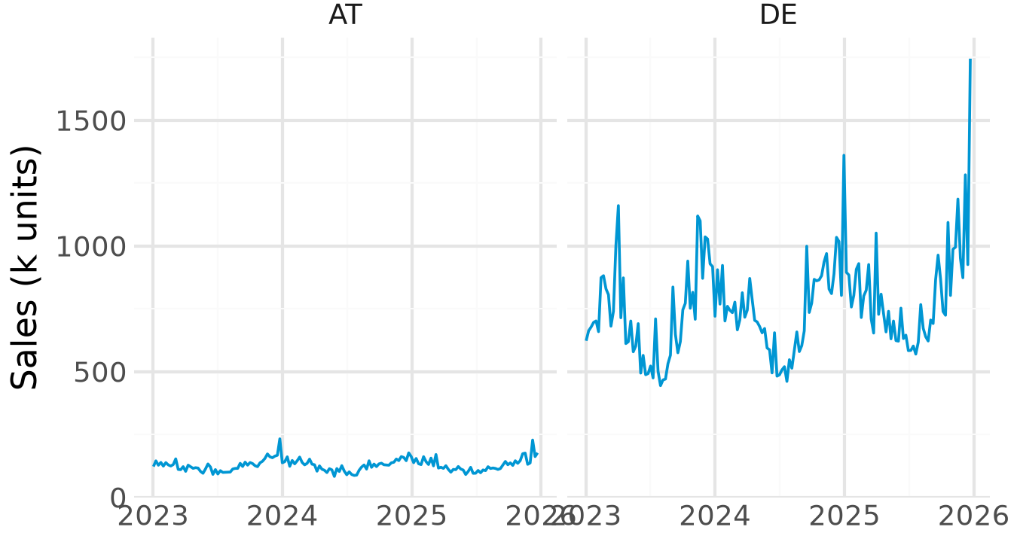
Positron at a glance
New ▾ Open ▾
case-study ▾
Python 3.14.8 (.venv) ▾
1
Explorer
files of the open folder
2
Editor
write .py and .qmd files
4
Variables
Session pane: what is in memory
sales 936 × 18
data/
analysis.py
report.qmd
requirements.txt
# %%
sales = pl.read_csv(...)
sales.head()
summary 6 × 3
model OLS results
5
Plots
Session pane: your charts
3
Console and Terminal
the Panel: code runs, results print
>>> sales.height
936
Notes:
Names as in the Positron documentation: Activity Bar and Primary Side Bar on the left, Editor in the middle with the Panel (Console, Terminal) below, Secondary Side Bar on the right with the Session pane (Variables, Plots). The Top Bar holds the project switcher and the Interpreter picker.

Slide 19



From code to result
Write code
in the editor
Ctrl/Cmd
+ Enter
It runs in
the console
Objects in
Variables
Charts in
Plots
Run code
Look at results
Ctrl/Cmd + Enter: the selection or current statement
Ctrl/Cmd + Shift + Enter: the whole file, or the current cell
# %% starts a cell in a .py file
Variables: every object, its type and size
Data Explorer: click a table, or type %view sales
Plots: earlier charts, zoom, save as PNG
Console or terminal? The console speaks Python. The terminal speaks to your computer: pip, git and quarto commands go there.
Notes:
Show it live: write one line, press Ctrl+Enter, point at the console, the Variables pane and the plot. %view df opens a table in the Data Explorer from the console.

Slide 20
Projects in Positron: one folder for everything
A project is a folder
Open the folder, not single files: File → Open Folder
case-study/
├── .venv/ private Python + packages
├── .git/ version history
├── .gitignore what Git leaves out
├── data/ raw data, never edit by hand
├── analysis.py code, split into # %% cells
├── report.qmd text, code and results
└── requirements.txt packages and versions
Positron remembers the interpreter and open files per folder
Relative paths: data/sales.csv works on every laptop
Switch projects with the project switcher, top right
.venv stays on your laptop: .gitignore keeps it out of GitHub. requirements.txt travels instead, so your group rebuilds the same environment with one command.
Notes:
In Positron a project is simply a folder opened with File > Open Folder (a workspace). Positron finds the .venv at the folder root and remembers the interpreter for that folder. Open folders, not single files.

Slide 21

Start a new project from a template
New Folder
from Template
Python
Project
Name and
location
Python 3.14
+ venv
Create
Positron sets up
Then, in the Positron console
%pip install polars plotnine great-tables
%pip freeze > requirements.txt
The folder with a .venv inside
Git: .git and a .gitignore
A running Python session
An empty file to start with
Line 1 installs packages, line 2 writes their versions to requirements.txt.
Where: New ▾ (top left), the project switcher, or Command Palette → Workspaces: New Folder from Template.
Notes:
New Folder from Template sets up the folder, a .venv, Git and a running session in one dialog. Open it from the New menu (top left), the project switcher or the Command Palette (Workspaces: New Folder from Template).

Slide 22
Shortcuts worth knowing
Action | Windows | macOS
Run selection or current statement | Ctrl + Enter | Cmd + Enter
Run the file or current cell | Ctrl + Shift + Enter | Cmd + Shift + Enter
Insert a code cell (# %%) | Ctrl + Shift + I | Cmd + Shift + I
Restart the Python session | Ctrl + Shift + 0 | Cmd + Shift + 0
Clear the console | Ctrl + L | Ctrl + L
Preview a Quarto document | Ctrl + Shift + K | Cmd + Shift + K
Command Palette | Ctrl + Shift + P | Cmd + Shift + P
Help for the word under the cursor | F1 | F1
Accept an AI suggestion | Tab | Tab
Notes:
Positron-specific shortcuts from the Positron documentation, plus the Quarto preview. On macOS, Cmd replaces Ctrl except where noted. The Command Palette finds every other command by name.

Slide 23


Posit Assistant: the AI inside Positron
What it sees
What it does
How you steer it
Your open files and project
Loaded data, variables and plots
Console history
Explains, writes and fixes code
Runs code after you approve
Fix and Explain on any error
/plan: a plan before any code
@file: point it to a file
Permission mode: keep Normal
Open it
View: Show Posit Assistant
Command Palette, or the Assistant icon in the Activity Bar
Memory: an AGENTS.md file in your project tells it your conventions, for example “use polars and plotnine”.
Notes:
Posit Assistant has been Positron's built-in AI since 2026.07, replacing Positron Assistant and Databot. It uses session context (variable names and types, plots, console history). Permission modes: Normal asks before acting, Restricted allows less, YOLO runs without asking; we use Normal.

Slide 24


Working with AI in Positron
Completions: ghost text
Chat: Posit Assistant
Grey suggestions appear as you type
Tab accepts, Ctrl/Cmd + → word by word
Esc or keep typing to dismiss
Ask in plain English, one step at a time
Check every result it reports
Export the chat: your prompt log
Good prompts
"Sum revenue by country for 2025 with polars and sort it."
"Explain this error in two sentences, then fix it."
Privacy: prompts, variable names and types go to the model provider; rows of data only if you ask. Never paste personal data.
Notes:
Export a conversation (Markdown) and attach it as the prompt log. Posit's FAQ: prompts and session information such as variable names and types go to the model provider; row-level data only when you ask for it.

Slide 25
Work with GitHub Desktop
Part 4 of 6 · the window, the everyday workflow, your group project
Notes:
GitHub Desktop is the bridge between the folder on the laptop and GitHub. Show it live with the course repository.

Slide 26
GitHub Desktop at a glance
Current repository
ima-teaching ▾
Current branch
main ▾
Fetch origin
↻ now
1
Current repository
which project you work on
1
2
3
4
Changes (2) History
6
report.qmd
2
Current branch
main is all we need
analysis.py
at = sales.filter(...)
Fetch / Pull / Push origin
sync with GitHub
3
report.qmd
- at.head()
+ ggplot(at, aes("week",
4
Changes
files edited since last commit
Add Austria sales chart
+ "sales_units_k"))
5
Summary + Commit
save a snapshot with a message
Commit to main
+ + geom_line()
5
summary, then commit
6
Diff
red removed, green added
Course repository: you only pull. Your own work goes in your files or in your group repository.
Notes:
Names as in GitHub Desktop: the toolbar shows Current repository, Current branch and the sync button, which reads Fetch origin, Pull origin or Push origin depending on what is waiting. The Changes tab lists edited files; the diff on the right shows removed lines in red and added lines in green.

Slide 27



The everyday workflow
Fetch, then
Pull origin
Work in
Positron
Review
Changes
Summary +
Commit
Push
origin
Course repository
Group repository
Good commits
Pull before every session
Read-only for you: copy files into your own folder before editing
Pull, work, commit, push
One person per file where you can
Push before others start
Small steps, often
Summary says what changed: “Add AT sales chart”
Push when you stop
Merge conflict? Open the file, keep the lines you want, delete the conflict markers (<<< === >>>), then commit and push.
Notes:
Pull before you start, commit small steps, push when you stop. A merge conflict happens when two people change the same lines; GitHub Desktop lists the files, and Posit Assistant can explain the markers.

Slide 28

Your case study as a shared project
github.com:
new repository
Invite
the group
Desktop:
clone
Positron:
Open Folder
Create
.venv
github.com
GitHub Desktop
Positron
One member creates the repository: Python .gitignore, README
Settings → Collaborators: invite the group
Pull before you start
Commit small steps with a clear message
Push when you stop
Open the cloned folder
Create Environment from requirements.txt (Step 4)
Work, save, then back to Desktop
Fewer conflicts: pull first, push often, and one person per file where you can.
Notes:
GitHub in the browser is where the repository is created and the group is invited; GitHub Desktop keeps each laptop's copy in sync; Positron is where the work happens.

Slide 29
Write reports with Quarto
Part 5 of 6 · how it works, the YAML header, code cells, output formats
Notes:
All labs and the case study report are Quarto documents. One file holds text, code and results.

Slide 30

Quarto: text, code and results in one file
report.qmd
Python runs
the cells
Markdown
+ results
Pandoc
converts
HTML, PDF,
Word, slides
report.qmd
1 YAML header: settings between the two --- lines
---
title: "Alpenglow: sales in Austria"
author: "Anna Berger"
format: html
---
## Weekly sales
```{python}
at = sales.filter(pl.col("country") == "AT")
at.head()
```
Austria is our smallest market.
2 Markdown: headings (##), **bold**, lists, links
3 Code cells: ```{python} … ``` run Python; the output lands under the cell
Preview: Ctrl/Cmd + Shift + K in Positron. Render: quarto render report.qmd
Notes:
Quarto runs the Python cells through Jupyter, writes the results into Markdown and lets Pandoc turn it into HTML, PDF, Word or slides. Since Positron 2026.08 cell output also shows inline in the editor, with Fix and Explain buttons on errors.

Slide 31
The YAML header: settings for the whole document
Top of report.qmd
title, author
shown at the top
---
title: "Alpenglow: sales in Austria"
author: "Anna Berger"
date: today
format:
html:
toc: true
code-fold: true
execute:
warning: false
---
date: today
the day you render
format: html
the output; its options indented below
toc: true
table of contents
code-fold: true
code hidden behind a “Code” button
warning: false
no warnings in the output
Indentation matters: two spaces per level, no tabs, and a space after every colon.
Notes:
YAML is key: value pairs. Nesting is done by indentation, two spaces per level, never tabs. Options for one format sit under that format's name.

Slide 32

Code cells: options and numbers in the text
Inside report.qmd
#| label: fig-sales
names the cell; fig- makes it a figure
```{python}
#| label: fig-sales
#| fig-cap: "Weekly sales in Austria"
#| echo: false
ggplot(at, aes("week", "sales_units_k")) + geom_line()
```
The chart covers `{python} at.height` weeks (@fig-sales).
#| fig-cap:
the caption under the chart
#| echo: false
show the result, hide the code
`{python} …`
a computed number in the text
@fig-sales
“Figure 1”, with a link
Why it matters: when the data change, you render again and every chart, table and number in the text updates. No copy and paste into Word.
Notes:
Cell options start with #| at the top of a cell. A label starting with fig- makes the chart a numbered figure that @fig-sales refers to. Inline code puts a computed number into the sentence, so the text updates when the data change.

Slide 33
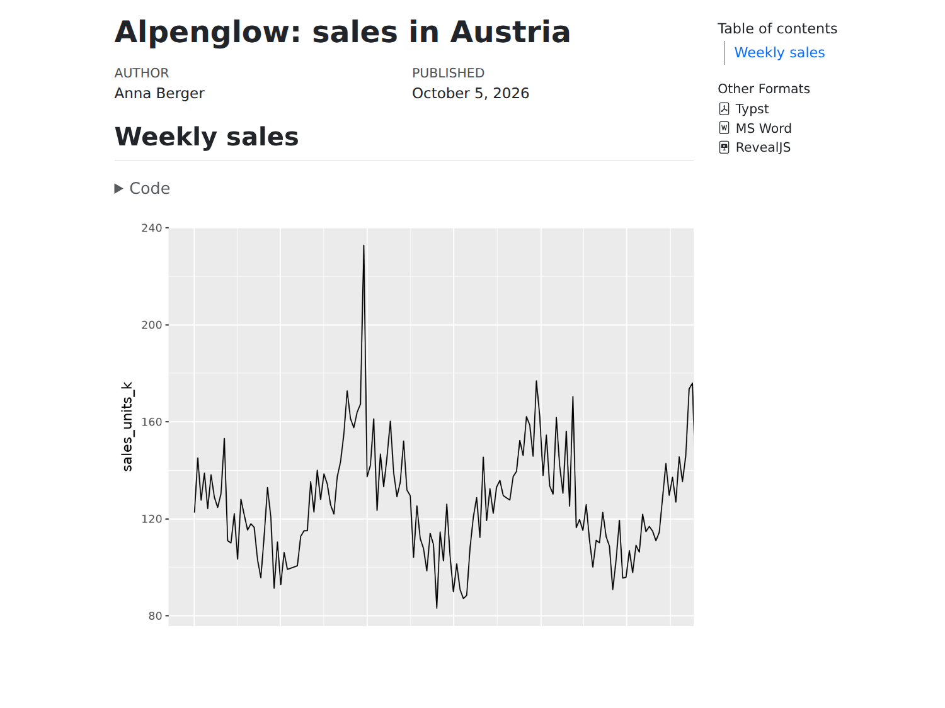
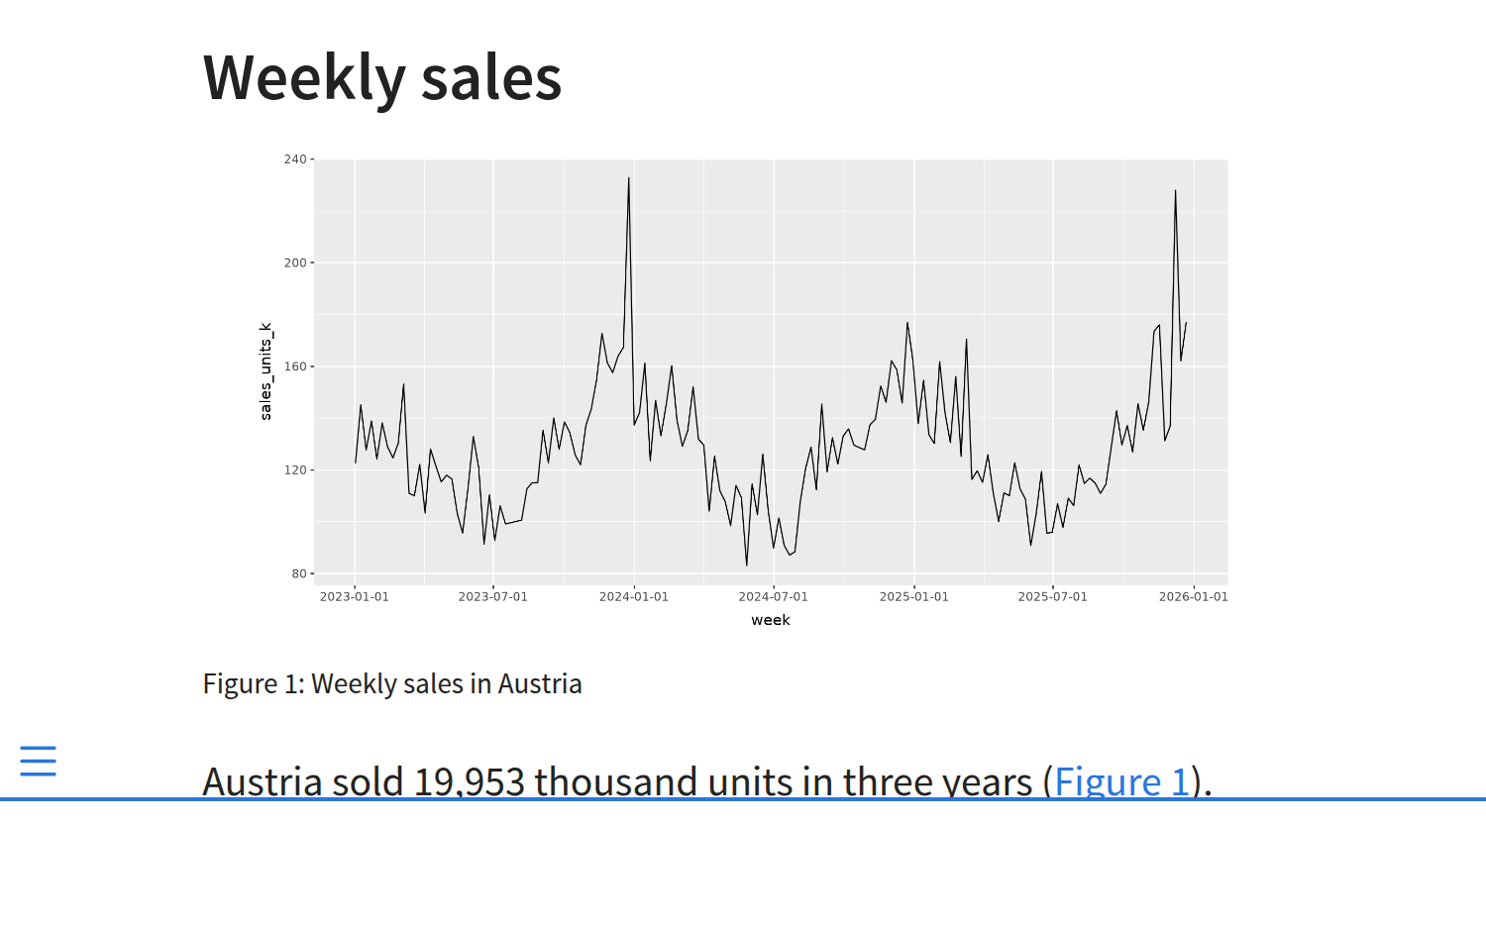
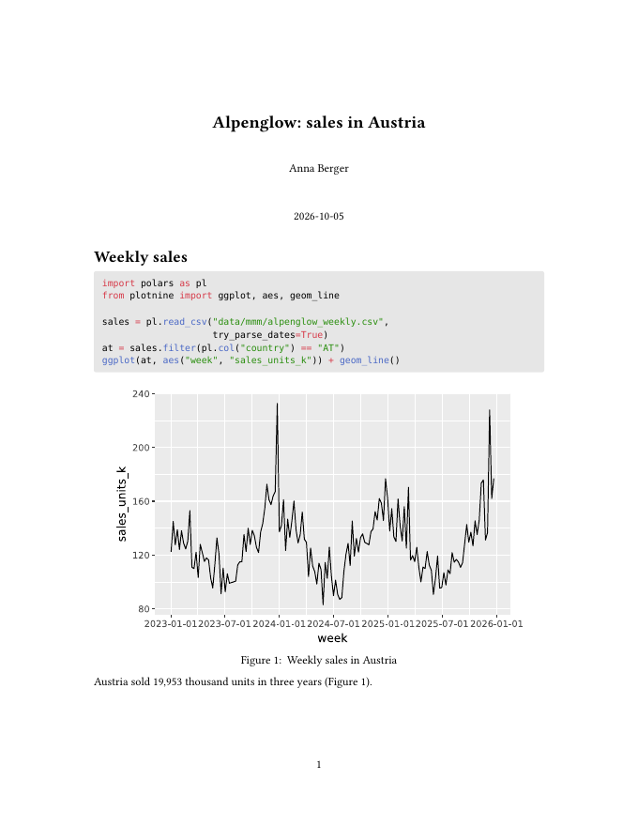
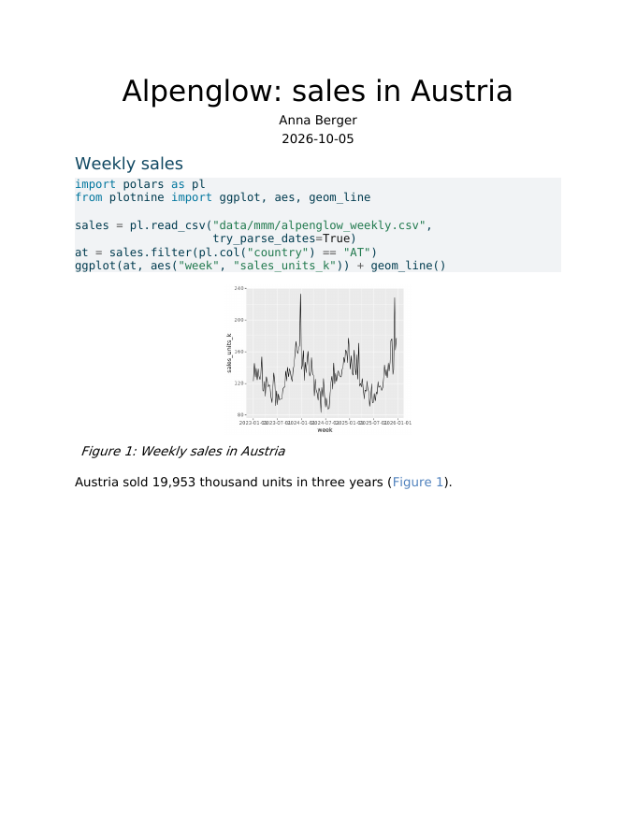
One source, many output formats
html
web page (default)
revealjs
slides in the browser
typst
PDF, no LaTeX needed
docx
Word, to edit further
YAML: several formats
Terminal: all formats, or one
format:
html: default
revealjs: default
typst: default
docx: default
quarto render report.qmd
quarto render report.qmd --to docx
Also: pptx, dashboard, pdf (LaTeX)
Notes:
The four pictures are the same report.qmd rendered four ways (slides/quarto_demo/report.qmd). Typst makes PDFs without installing LaTeX. Positron's Preview shows the first format listed.

Slide 34
Python packages for this course
Part 6 of 6 · install and load; polars, plotnine, Great Tables, statsmodels
Notes:
Install and load first, then one slide per package with code that runs on the course data.

Slide 35

Install packages: three ways
1 Windows and macOS: Positron console (easiest)
%pip install polars plotnine great-tables
2 Windows: Positron terminal
.venv\Scripts\python -m pip install -r requirements.txt # all course packages
.venv\Scripts\python -m pip install polars # one package
3 macOS: Positron terminal
.venv/bin/python -m pip install -r requirements.txt # all course packages
.venv/bin/python -m pip install polars # one package
Install name and import name can differ: pip install great-tables → import great_tables; scikit-learn → sklearn; pymc-marketing → pymc_marketing.
Notes:
All three install into the course .venv. The terminal lines call the Python inside .venv directly, so no activation is needed. %pip in the Positron console installs into the running session; restart the session afterwards if Positron asks.

Slide 36

The Packages pane: install without code
Packages icon
(Activity Bar)
Install
Package
Search name,
pick version
Restart session
when asked
PACKAGES Python 3.14.8 (.venv)
What else it does
great-tables
1.0.0
Shows which packages are loaded (attached)
Update one, or Update All Packages
Flags known security issues
Keeps versions in line with requirements.txt
Offers to install a missing package after an error
pandas
3.0.6
● attached
plotnine
0.15.8
polars
1.44.2
● attached
statsmodels
0.15.0
● attached
…
Notes:
The Packages pane arrived in Positron 2026.07. It works on the active session's environment, uses the workspace requirements.txt to keep versions consistent, flags outdated packages and known security issues, and prompts for a session restart after changes.

Slide 37

Load packages: import at the top of every file
Install once
per laptop
Import in every
file and session
Use the short
name: pl.read_csv()
Windows and macOS: the same code
Conventions
import polars as pl
import statsmodels.formula.api as smf
from plotnine import ggplot, aes, geom_line
from great_tables import GT
print(pl.__version__) # 1.44.2
pl and smf are the usual short names
Imports go at the top
Import only what you use
ModuleNotFoundError? Either the wrong interpreter is selected (pick the one in .venv) or the package is missing: %pip install it.
Notes:
Loading is the same on Windows and macOS. Installing happens once per laptop; importing in every file and every new session.

Slide 38





Your toolkit, from data to report
1 Wrangle
2 Visualise
3 Model
4 Report
polars fast tables
pandas for model packages
plotnine charts by grammar
statsmodels regression
pymc-marketing Bayesian MMM
great_tables tables
Quarto documents
22
packages pinned in requirements.txt
1
command installs them all
0
euros: all open source
Online you will also meet pandas and matplotlib: older but common; the ideas carry over.
Notes:
The four stages repeat in every lab and in the case study.

Slide 39

polars: data wrangling
Revenue and TV spend per country, 2025
DataFrame: a table with typed columns
import polars as pl
sales = pl.read_csv("data/mmm/alpenglow_weekly.csv",
try_parse_dates=True)
summary = (
sales
.filter(pl.col("week").dt.year() == 2025)
.group_by("country")
.agg(pl.col("revenue_eur_k").sum().alias("revenue"),
pl.col("spend_tv_k").sum().alias("tv"))
.sort("revenue", descending=True)
)
Expressions: pl.col("tv").sum() says what to compute
Chaining: one step per line, read top to bottom
Fast: multi-threaded, written in Rust
Result: six rows, one per country. Germany leads with about EUR 131 million revenue in 2025. Need pandas? Add .to_pandas().
Notes:
Read the chain top to bottom: keep 2025, group by country, sum two columns, sort. statsmodels and PyMC expect pandas, so convert at the end with .to_pandas().

Slide 40
plotnine: charts with the grammar of graphics
Weekly sales, Austria and Germany
(ggplot(sales.filter(
pl.col("country").is_in(["AT", "DE"])),
aes(x="week", y="sales_units_k"))
+ geom_line(color="#0096D3")
+ facet_wrap("country")
+ scale_x_date(date_breaks="1 year",
date_labels="%Y")
+ labs(x="", y="Sales (k units)")
+ theme_minimal())
The output of the code on the left
ggplot()
the data
aes()
columns to x, y
geom_
the marks
facet_
one panel per group
theme_
the look
Data + mapping + marks + panels + theme: each + adds one layer.
Notes:
Same grammar as ggplot2 in R, so R tutorials transfer almost one to one. Each + adds one layer.

Slide 41
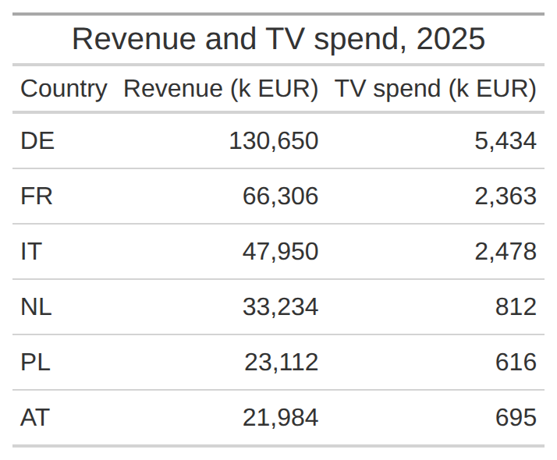
Great Tables: tables for reports
The polars summary as a table
from great_tables import GT
(GT(summary)
.tab_header(title="Revenue and TV spend, 2025")
.fmt_number(columns=["revenue", "tv"], decimals=0)
.cols_label(country="Country",
revenue="Revenue (k EUR)",
tv="TV spend (k EUR)"))
Header and labels: readable names instead of column codes
Number formats: thousands separators, currency, percent
Works with polars and pandas; renders in Quarto reports
Notes:
GT takes the polars summary from the polars slide directly. In a Quarto HTML report the table renders by itself; .save() writes a PNG.

Slide 42

statsmodels: regression
Weekly sales in Austria, 2023 to 2025
Coefficient
Estimate
import statsmodels.formula.api as smf
at = sales.filter(pl.col("country") == "AT").to_pandas()
model = smf.ols(
"sales_units_k ~ price_eur + spend_tv_k"
" + spend_paid_search_k",
data=at).fit()
print(model.summary())
Intercept
250.63
price_eur
−48.31
spend_tv_k
0.41
spend_paid_search_k
4.03
R² (n = 156)
0.43
Reading it: EUR 1,000 more paid search in a week goes with about 4,000 more units sold, holding price and TV constant.
Later in the course: scikit-learn for logistic regression and pymc-marketing for Bayesian MMM.
Notes:
A first look only: Sessions 1 and 2 explain how to read, check and improve such a model. The formula reads: sales explained by price, TV spend and paid search spend.

Slide 43
When something goes wrong
Problem | Fix
Windows: python or py is not recognised | Reinstall the Python install manager, then run py install 3.14
No .venv in the Interpreter picker | Open the course folder, not a single file; then pick Python 3.14.8 (.venv)
ModuleNotFoundError | Select the .venv interpreter, then %pip install the package
macOS: externally-managed-environment | You used the system Python: select the project's .venv first
Quarto preview does not start | Restart Positron; run quarto check in the terminal
Clone fails in GitHub Desktop | Sign in again under Accounts in the settings; check the URL
Copilot is not offered | GitHub Education still pending: use Copilot Free meanwhile
Notes:
Most problems are an old terminal window or the wrong interpreter.

Slide 44


Checklist: before you leave today
Accounts
Laptop
GitHub account with two-factor sign-in
Python 3.14, Positron, Quarto, GitHub Desktop
GitHub Education application sent
Course repository cloned and open
DataCamp classroom joined
.venv created and selected
“ready” and the test report renders
Posit Assistant connected
Not ready yet? Post the failing step in the Q&A forum on Canvas before Session 2.
Notes:
Students tick these off. Anything still open goes to the Q&A forum on Canvas before Session 2.

Slide 45
Notes:
Questions? Contact details on the card.

