Slide 1
International Marketing Analytics
Course content and style
Winter term 2026/27
Notes:
Welcome. This deck explains what the course is about, how it is taught and how it is assessed.

Slide 2

The journey begins
Notes:
Ice-breaker: who is in the room, which countries, which prior exposure to analytics.

Slide 3
Module Convenor – Dr Arne Floh
Personal Information
Contact Information
Senior Lecturer in International Marketing – WU Vienna
Deputy Program Director Export- und Internationalisierungsmanagement
WWW: https://www.wu.ac.at/en/welthandel/arne-floh/
LinkedIn: http://www.linkedin.com/arnefloh
T: 01 31336 6367
E: arne.floh@wu.ac.at
Room D1.5.068
Office Hours: by appointment

Slide 4





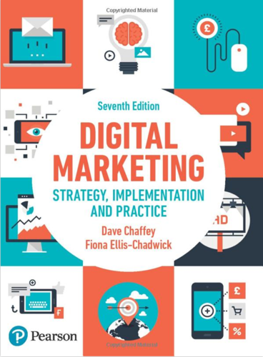






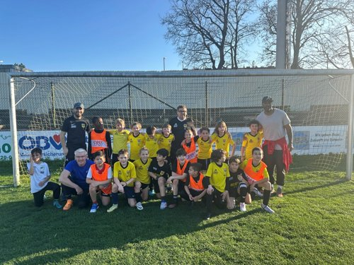

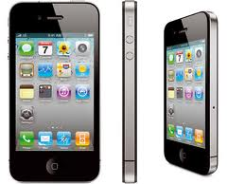

Module Convenor – Dr Arne Floh
  Work Experience
    International & Industry Background
    Teaching Experience > 25 Years
  Teaching
    International Marketing
    International Business Projects
    Marketing Research and Marketing Analytics
    Global Branding
    Supervision (BSc, MSc, PhD)
  Research
    Dynamic Capabilties and Firm Performance
    GenAI and Marketing
    SMEs and Internationalization
  Private
    Football
    Electronic Gadgets
    Austrian Wine

Slide 5





Module content
Marketing analytics turns marketing data into decisions on markets, prices, channels and budgets, and checks whether they worked.
One budget question: how should a fixed media budget be split across countries and channels?
Marketing mix modelling is back at the centre since privacy rules weakened user-level tracking. Managers who can read and challenge it own the budget debate.
One running case: Alpenglow, a Vienna-based premium chocolate brand selling in Austria, Germany, France, Italy, the Netherlands and Poland.
Python with AI assistants: the assistant does most of the typing; you specify, run, check and communicate the analysis.
Notes:
Frame the course as one budget decision studied from five angles. Alpenglow is fictional; the data are synthetic with a known truth revealed in Session 5.

Slide 6
Five sessions, five decisions
Session 1
Session 2
Session 3
Session 4
Session 5
Tue 6 Oct
Is our price too high in Poland?
→ Price and promotion elasticities
Tue 13 Oct
What did TV do for us in Germany?
→ Adstock, saturation and ROAS
Tue 20 Oct
Where should the next euro go?
→ Budget allocation across countries and channels
Tue 27 Oct
Can we trust the model?
→ Forecasts, geo-lift tests and attribution
Tue 3 Nov
Board meeting
→ Groups pitch and defend their 2027 budget
The question behind all five sessions: how should Alpenglow split a fixed media budget across six countries and five channels?
Notes:
Each session starts from a decision an international marketing manager has to take and works backwards to the model that answers it. Session 5 is the board meeting where groups defend their budget.

Slide 7

Learning outcomes
On successful completion of this module, students will be able to:
Model the market
1 Explain marketing mix modelling: carryover, saturation, baseline versus incremental sales, ROAS versus marginal ROAS.
2 Estimate response models in Python, from OLS and log-log elasticities to fixed effects and Bayesian MMM.
Decide on budgets
3 Allocate budgets across countries and channels and defend the allocation under uncertainty.
4 Forecast sales and evaluate the forecasts as the baseline for planning.
Test the evidence
5 Design experiments: analyse a geo-lift test and use it to validate and calibrate an MMM.
6 Compare attribution: explain why last-touch, regression-based and Shapley attribution disagree across markets.
Notes:
Outcomes 1 to 6 are the analytical core of the course; 7 to 11 on the next slide are the working skills.

Slide 8


Learning outcomes (continued)
Work with tools
7 Work reproducibly: use Python, Positron, Quarto and GitHub to build analyses that colleagues can rerun and audit.
8 Use AI assistants responsibly: direct an AI coding assistant, verify its output and document the prompts behind an analysis.
Work with people
9 Communicate: present analytical findings to a board audience in a written report and a pitch.
10 Work in teams: collaborate in version-controlled projects and take collective, data-driven decisions.
11 Think critically: evaluate data sources, model assumptions and findings in an international marketing context.

Slide 9


Methods of teaching and learning
Every session
Concept lecture
60 min
Guided lab
90 min
Team exercise
60 min
Debrief
and quiz
Between sessions
In the classroom
Read the book chapters and materials in advance
Online quiz after Sessions 1 to 4
Lab check-ins after Sessions 2 and 4
Group project in your team repository
Q&A forum on Canvas; consulting hours on request
Five Tuesdays, 6 October to 3 November 2026
Bring your laptop with Python, Positron, Quarto and GitHub
AI-assisted coding: you direct, the assistant types, you check
Pull, commit and push from Session 1
Notes:
In person, five Tuesdays. Bring your own laptop with the environment installed; a setup clinic runs at the start of Session 1. Between sessions: read, take the quiz, work on the project.

Slide 10
Module roadmap
Session | Date | Topic | Methods | Chapter
1 | Tue 6 Oct | Course content and style, toolkit, regression foundations | Descriptive statistics, OLS, log-log elasticities, dummies and interactions | 1, 11
2 | Tue 13 Oct | Marketing mix modelling I: one country | Adstock, saturation, decomposition, ROAS, diagnostics | 3
3 | Tue 20 Oct | Marketing mix modelling II: many countries, one budget | Panel fixed effects, hierarchical Bayesian MMM, budget optimisation | 3
4 | Tue 27 Oct | Forecasting, experiments and attribution | Time series regression, difference-in-differences, logistic regression, Shapley values | 9, 4
5 | Tue 3 Nov | Group project pitches and wrap-up | Board presentation, ground-truth reveal | 11
Notes:
Chapter numbers refer to the 2025 Python edition of Yildirim and Kübler. Times and rooms are on Canvas.

Slide 11

Assessment strategy
Weight in the final grade
Rules
Groups: 5 students; enrol on Canvas by the end of Session 1
Grades: WU scale, 1 from 90 %, 2 from 80 %, 3 from 70 %, 4 from 60 %
Attendance: at least 80 % of sessions
Late work: minus 10 points per day unless agreed
AI tools: expected; you own every number you report
Notes:
Six components. The group project is the centrepiece; quizzes and check-ins keep everyone on track between sessions. Certificates and self-reflection are small but required.

Slide 12

Online certificates and set-up
5 h
Kaggle Learn: Python. Free course with a certificate on completion.
1 h
GitHub Skills: Introduction to GitHub. Free, runs in the browser.
45 min
Course environment. Install Python (via uv), Positron, Quarto and GitHub Desktop with the setup guide, then run the installation check.
Deadline: upload both certificates and a screenshot of the passing installation check on Canvas by Mon 12 Oct, 11:59 pm.
Notes:
Both courses are free. The installation check is the command in the setup guide that prints 'ready'. Bring problems to the setup clinic at the start of Session 1.

Slide 13


Quizzes and lab check-ins
Online quizzes
Lab check-ins
After each of Sessions 1 to 4
Open Wednesday 9 am, close Monday 11:59 pm
10 multiple-choice questions in 10 minutes
Closed book: concepts, not code
After Sessions 2 and 4
Replicate the lab for another country or dataset
Submit notebook, HTML, result files and prompt log
Auto-checked for plausibility, reviewed for interpretation
5 % per quiz, 20 % in total
10 % per check-in, 20 % in total
Both are individual: quizzes check that you understand the concepts, check-ins that you can run, check and explain an analysis on your own.
Notes:
Quizzes test concepts, not code. Check-ins replicate a lab for another country and are auto-checked for plausibility before grading.

Slide 14




Group project
Timeline
Session 1
form groups
By S2
repo and data
By S4
first model
Mon 2 Nov
submit
Tue 3 Nov
pitch
Quarto report
max 12 pages, rendered to HTML
Allocation file
CSV with weekly spend per country and channel
Pitch deck
max 8 slides for a 10-minute pitch
Repository
code, data pipeline and a prompt log
The task: as Alpenglow's analytics team, recommend to the board how the 2027 media budget should be split across six countries and five channels.
Notes:
The brief, rubric and starter repository are in the course GitHub organisation. Online consulting hours need registration.

Slide 15
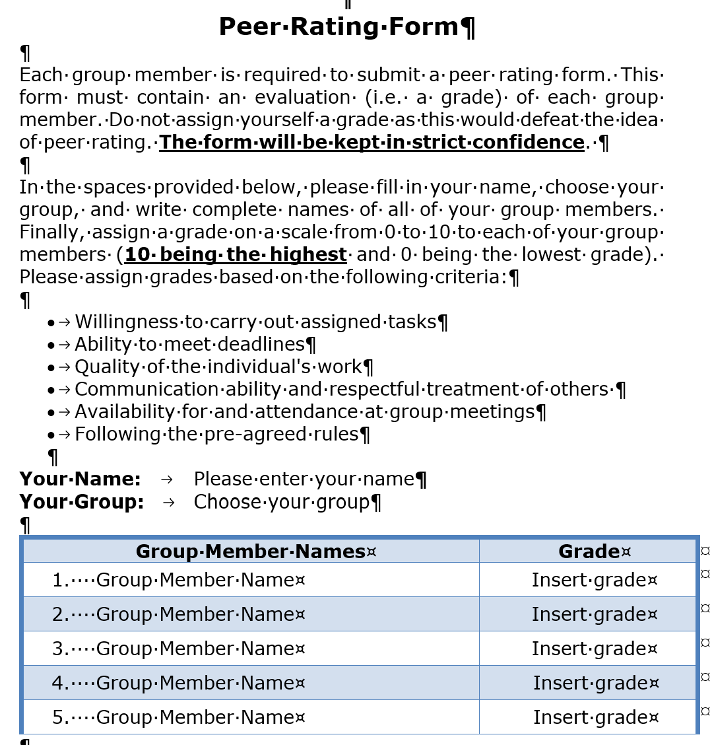
Peer rating
Who: every group member rates the other members on a 0 to 10 scale
Criteria: tasks carried out, deadlines met, quality of work, communication and respect, attendance, pre-agreed rules
Confidential: feeds the peer review component (10 %)
When: submit on Canvas with the final project
Notes:
The peer rating form is on Canvas. Each member rates the others; self-ratings are not allowed.

Slide 16
Notes:
Any questions? Contact details on the card.

