Slide 1
International Marketing Analytics
Introduction to marketing mix modelling
Session 1 · WT 2026/27
Notes:
This lecture introduces marketing mix modelling, the method the whole course builds towards. No prior analytics training is needed: we start from the business question and add the statistics step by step. The content rests on a structured search of books, papers, industry reports and software documentation; the sources are on the slides and on the further-reading slide at the end.

Slide 2




Where should the next euro go?
Your situation
Contribution: what did each channel add to sales?
1
Many markets: different prices, media costs and cultures
Return: which euro earned more, TV in France or paid social in Poland?
Many channels: TV, online video, search, social, out-of-home
2
One budget: fixed, and negotiated every year
Allocation: how should next year's fixed budget be split?
3
The CEO's brief: next year's budget stays flat. Move money only where the next euro earns more.
Notes:
An international brand manager runs one budget across many markets and channels. Every year the country managers ask for last year's budget plus a few per cent, because nobody can say what a euro of paid social in Poland returns compared with a euro of TV in France. That comparison is what marketing mix modelling (MMM) delivers. This session explains how it works, what it can and cannot do, and how it fits the reading for today.

Slide 3
What marketing mix modelling is
Part 1 of 7 · definition, inputs and outputs, MMM versus attribution and experiments, history
Notes:
First what MMM is and what it delivers, then how it relates to the other measurement tools, and why it is popular again.

Slide 4



Marketing mix modelling in one sentence
MMM explains weekly sales with marketing and non-marketing drivers, splits sales into a base and the contribution of each activity, and turns these into budget decisions.
Aggregate data
A regression model
Decisions
Weekly totals per country and channel
No tracking of individuals, so privacy-safe
Sales explained by spend, price, season and more
Plus carryover and diminishing returns
What each euro returned
Where the next euro should go
Little (1979): a model must capture
carryover
diminishing returns
competition
interaction
dynamics
Sources: Little 1979; Hanssens, Parsons & Schultz 2001; Hanssens & Pauwels 2016
Notes:
MMM is a statistical model of aggregate sales. It is old (the founding papers are from the 1970s) and rests on the market response models of Hanssens, Parsons and Schultz. Little (1979) listed what such a model must capture: carryover, diminishing returns, competition, interaction and dynamics. Hanssens and Pauwels (2016) frame it as the link from marketing spend to financial value.

Slide 5




Inputs, model, outputs
Inputs
Outputs
Sales: units or revenue per week
Media: spend by channel
Marketing: price, promotion, distribution
Season: trend, holidays, weather
Context: economy, competitors
Contributions: sales per driver
ROAS: revenue per euro spent
Marginal ROAS: revenue from the next euro
Response curves: sales at each spend level
Allocation: the best budget split
Model
regression with carryover and saturation
In practice: one row per week and country, from finance, media agencies and market research.
Notes:
Inputs: everything that moves sales, not only media. Leaving out price, distribution or season makes the model credit media for their effect. Outputs: contributions (how many sales each driver added), ROI or ROAS (return on ad spend: revenue per euro), marginal ROAS (revenue from the next euro, which is what budget decisions need), response curves and an optimised budget split. In practice the data come from finance (sales, prices), media agencies (spend) and market research (distribution, competitors), one row per week and country.

Slide 6

Three ways to measure marketing
 | Marketing mix modelling | Multi-touch attribution | Experiments
Data | weekly totals per channel and country | clicks and views of individual users | test and control groups or regions
Answers | what each channel added, offline too | which touchpoints came before a sale | the causal lift of one change
Strength | all channels; privacy-safe | detailed and fast | most credible evidence of cause
Limit | correlation; needs variation in spend | digital only; credit is not cause | one channel, one period; costly
Triangulate: experiments calibrate the MMM, the MMM covers every channel, attribution steers digital campaigns day to day.
Sources: Google Modern Measurement Playbook 2023; IAB & MMA 2019; Gordon et al. 2019
Notes:
Multi-touch attribution (MTA) follows individual users' clicks and views and shares the credit for a conversion among the touchpoints; it only sees digital channels and suffers from cookie loss. Experiments (lift tests, geo experiments) switch spend on or off for a random group of users or regions and are the most credible causal evidence, but cover one channel at a time. Google's Modern Measurement Playbook calls the three a measurement tripod: use them together. Gordon et al. (2019) show with 15 large Facebook experiments that observational methods often miss the true lift by a wide margin.

Slide 7

An old method, popular again
1976
1979
2001
2017
2020s
Clarke: how long ad effects last
Little: what a response model needs
Hanssens et al.: Market Response Models
Jin et al. (Google): Bayesian MMM
Open source: Robyn, PyMC-Marketing, Meridian
Why now
64 %
of senior marketing leaders use MMM (Gartner 2024)
GDPR, cookie loss and Apple's tracking rules weaken user-level tracking (Part 2)
MMM needs no personal data
13 %
of advertisers turn it into insight quickly (WFA 2026)
Sources: Clarke 1976; Little 1979; Hanssens et al. 2001; Jin et al. 2017; Gartner 2024; WFA & Ebiquity 2026
Notes:
MMM grew out of econometric market response models in the 1970s. Since the late 2010s, privacy rules (GDPR), the loss of third-party cookies and Apple's App Tracking Transparency have made user-level tracking less complete, so aggregate models that need no personal data are back. Google, Meta and PyMC Labs released open-source MMM software. Gartner (2024) found that 64 % of senior marketing leaders had adopted MMM; the WFA and Ebiquity (2026) report that 80 % of advertisers use MMM but only 13 % turn the data into insight quickly.

Slide 8
Why attribution is not enough
Part 2 of 7 · where the money goes, last click, why attribution misleads, real-world tests
Notes:
How much money is at stake, how most firms decide today which ad deserves the credit for a sale, and why that is not enough. This is why MMM is back.

Slide 9


Where the advertising money goes
$1.14 tn
global advertising spend in 2025, +8.8 %
What this means
Digital ads are bought click by click
The platforms that sell the ads also report their success
Small measurement errors move billions
73 %
of it is digital: search, social, video, retail media
€119 bn
digital advertising in Europe in 2024, +16 %
67 %
of all ad spend in Europe is digital
The question of this part: who gets the credit for a sale, and is it deserved?
Sources: WPP Media, This Year Next Year, mid-year 2025; IAB Europe, AdEx Benchmark 2024
Notes:
WPP Media's This Year Next Year (mid-year 2025) puts global advertising revenue at about $1.14 trillion in 2025, up 8.8 %, with digital at about 73 % (search, social, online video, retail media); its forecasts for 2026 are around $1.3 trillion. In Europe, IAB Europe's AdEx Benchmark 2024 counts €118.9 billion of digital advertising, up 16 %, 67 % of all ad spend. Most of this money is bought click by click and judged by reports from the platforms that sell it. That is the problem of this part.

Slide 10






Attribution: who gets the credit?
TV spot
not tracked
Instagram ad
click
YouTube video
view
Google search
the brand name
Order
EUR 40
Credit for the order
TV
Instagram
YouTube
Search
Last click
0 %
0 %
0 %
100 %
First click
0 %
100 %
0 %
0 %
Linear
0 %
33 %
33 %
33 %
Data-driven (GA4)
0 %
e.g. 25 %
e.g. 15 %
e.g. 60 %
All four models share out one sale: none asks if it would have happened without ads.
Sources: Google Analytics 4 documentation; journey and data-driven shares are illustrative
Notes:
Attribution splits the credit for one tracked sale between the ads a customer clicked or saw before buying. The journey: a TV spot (not tracked), an Instagram ad click, a YouTube video, then a Google search for the brand name and an order of EUR 40. Last click gives everything to search, first click to Instagram, linear splits equally; data-driven attribution (the GA4 default) estimates shares from paths that did and did not end in a purchase. The numbers in the last row are illustrative. TV gets nothing in every model, because no click is recorded. And no model asks whether the sale would have happened without any ad: that is a causal question for experiments and MMM.

Slide 11


Last click: simple, common and biased
How it works
Who wins, who loses
100 % of the credit to the last ad clicked before the order
Easy to compute, easy to explain
GA4 and Google Ads: since 2023 only last click and data-driven are left
Wins: branded search, retargeting, coupon and affiliate sites
Loses: TV, online video, social, posters
Ignores: views without a click, offline sales
The catch: the last click often comes from people who had already decided to buy
Example: after a TV spot, a viewer searches the brand name: search gets the sale, TV gets nothing
The result: budgets drift to the end of the funnel, and the demand that feeds it slowly dries up
Sources: Search Engine Land 2023 (Google Ads and GA4); Li & Kannan 2014 (Journal of Marketing Research)
Notes:
Last-click attribution gives all the credit to the last ad clicked before the purchase. It is easy to compute and explain, and it is still the default in many shop systems and affiliate contracts. In 2023 Google removed first click, linear, time decay and position-based models from Google Ads and GA4, leaving data-driven and last click; fewer than 3 % of conversions had used the removed models. Last click favours channels that sit at the end of the journey (branded search, retargeting, coupon and affiliate sites), which often catch people who had already decided to buy. Upper-funnel media that create the demand look worthless. Li and Kannan (2014) show with path data that last click misallocates credit and over-credits search.

Slide 12





Six problems of attribution models
Correlation only
Tracking gaps
Offline is invisible
Ads target people who buy anyway
Credit is not extra sales
Cookie consent, ad blockers, Apple's ATT
2021: 4 % of US iPhone users allowed tracking
TV, radio, posters, word of mouth
Sales in shops have no click
Double counting
Click fraud
Many devices
Each platform counts its own orders
Sum of reports > real orders
Affiliates claim sales that come anyway
Uber: fake clicks on free installs
Phone on the sofa, laptop at work
One buyer looks like three
The remedy: experiments (ads off in some regions) and MMM, which needs no tracking.
Sources: Gordon et al. 2019 (Marketing Science); Flurry Analytics 2021; WARC 2019 (Uber)
Notes:
1 Correlation, not cause: ads are targeted at people who are likely to buy anyway (retargeting, branded search), so credit is not the same as extra sales. 2 Tracking gaps: cookie consent, ad blockers, browser limits and Apple's App Tracking Transparency (iOS 14.5, 2021); at launch only about 4 % of US users and 12 % worldwide allowed tracking (Flurry). 3 Offline is invisible: TV, radio, posters, word of mouth, and sales in shops. 4 Every platform counts its own conversions with its own rules and windows, so the sum of the reports is larger than the real number of orders. 5 Fraud and poaching: affiliates and ad networks can 'claim' sales that would have happened anyway; Uber found fake clicks attached to organic installs. 6 Many devices: one person on phone, tablet and laptop looks like three customers.

Slide 13
When the ads were switched off
99.5 %
eBay: brand-keyword traffic that came back through the free links when the ads were paused
$100 m
Uber: of $150 m yearly performance ads switched off, with no change in app installs
$200 m
P&G: of digital ads cut in 2017; reach rose about 10 %
95 %
Airbnb: of web traffic kept in 2020 after cutting marketing by more than half
15
Facebook experiments: click-based methods often missed the true lift, mostly overstating it
Lesson: test what the ads add; do not trust the click report.
Sources: Blake, Nosko & Tadelis 2015; WARC 2019; Adweek 2018; Campaign Asia 2021; Gordon et al. 2019
Notes:
eBay (Blake, Nosko and Tadelis 2015, Econometrica): when eBay stopped paying for brand keywords, 99.5 % of that traffic came back through the free search results; in a test across US regions, non-brand search mainly reached people who would have bought anyway, and the return was far below what the click reports showed. Uber: Kevin Frisch turned off $100 million of $150 million yearly performance ads and saw no change in rider app installs; much of the spend was fraud. P&G cut $200 million of digital ads in 2017 that did not reach real people, moved money to TV, audio and e-commerce, and its reach rose about 10 %. Airbnb cut marketing from $1.62 billion (2019) to $0.55 billion (2020), mostly performance ads, and kept about 95 % of its traffic; Covid is a confound, but Airbnb kept the shift. Gordon et al. (2019) compared 15 Facebook experiments with observational methods, which often missed the true lift, mostly overstating it.

Slide 14
How MMM works
Part 3 of 7 · base and incremental sales, the equation, adstock, saturation, seasonality
Notes:
Five building blocks. Each one is a variable or a transformation in the regression you will estimate.

Slide 15
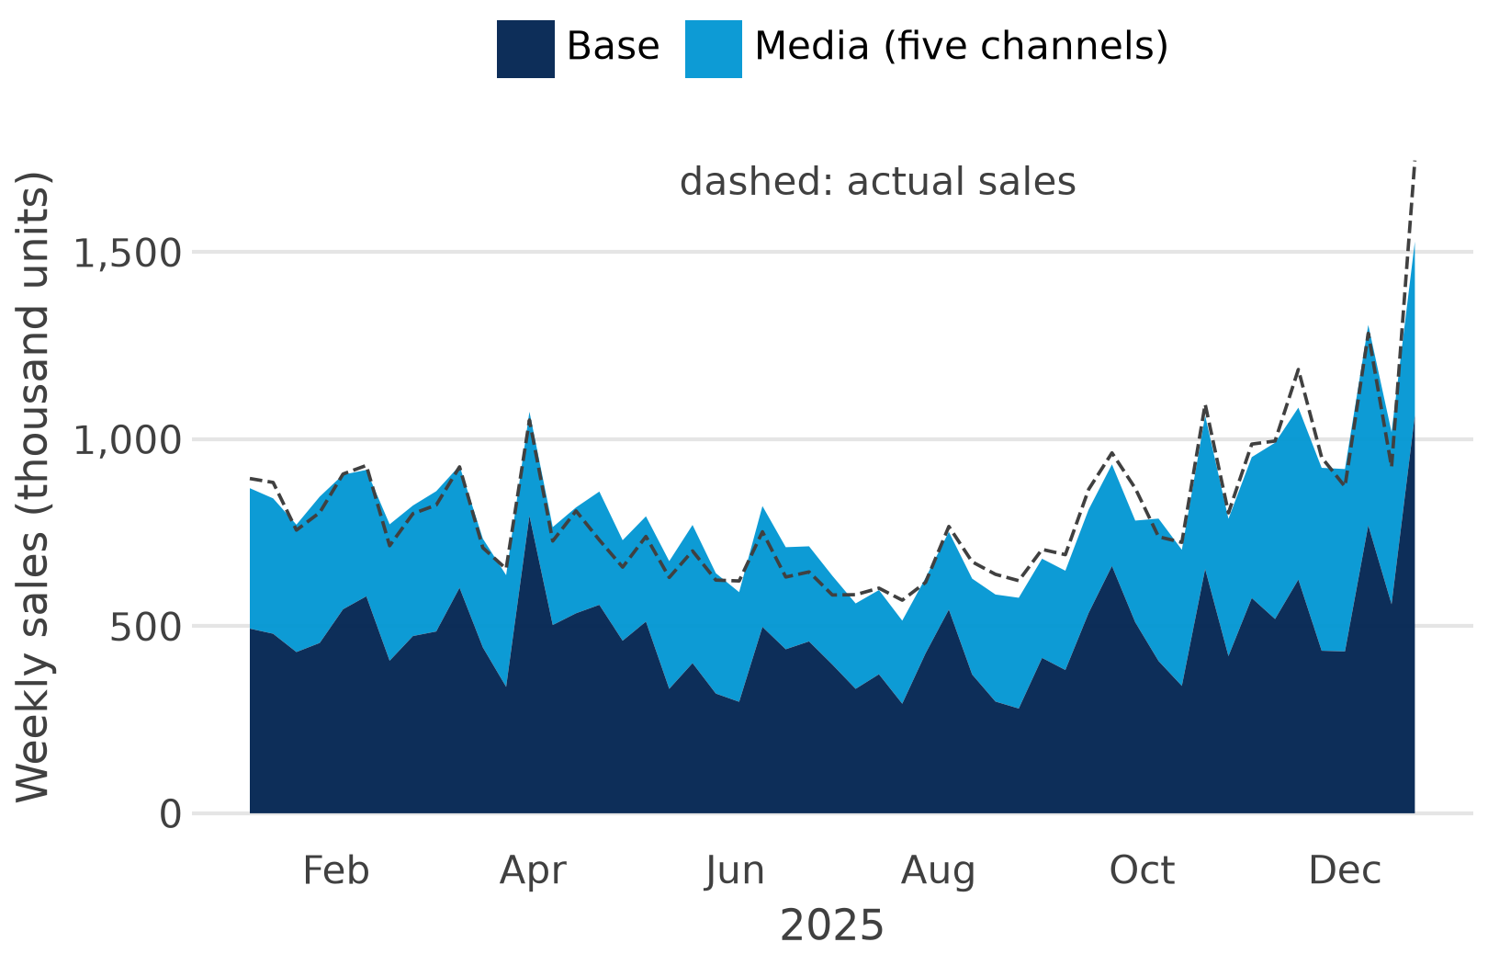
Sales = base + incremental
Base: what would sell without media: price, distribution, season, trend
Incremental: what media add on top, channel by channel
Contribution: the sales that would disappear if a channel were switched off
Naive model: media ≈ 41 %, too high
Simulated data, Germany, 2025, naive regression: budgets follow Christmas demand (see the pitfalls).
Sources: Hanssens et al. 2001; Jin et al. 2017; own calculation on simulated data
Notes:
The chart (simulated data for one brand) splits German weekly sales in 2025 into a base and the part the model attributes to media. It comes from a deliberately simple regression (all five channels with the same carryover of 0.5, no saturation); in this first model media account for about 41 % of fitted sales. That number is too high: the brand raises its budgets before Christmas, when people buy anyway, so a naive model credits media with part of the seasonal demand (the endogeneity pitfall later in this deck). Session 2 builds a proper model and the media share falls considerably. The dashed line is actual sales; the gap to the coloured area is what the model cannot explain.

Slide 16

The regression behind it
Spend per
channel
Adstock:
carryover
Saturation:
less per €
× β:
the effect
Sales
contribution
Additive form
Log-log form
sales_t = β0 + Σ βc·f(spend_c,t)
+ γ·controls_t + ε_t
ln sales_t = β0 + βp·ln price_t
+ Σ βc·ln(1 + adstock_c,t) + … + ε_t
βc: extra units per unit of transformed spend
Good for: contributions in units or euros
β: elasticity, % change in sales per 1 % change
Good for: comparing countries and drivers
Controls: price, promotion, distribution, trend, season, holidays, weather, economy, competitor spend.
Sources: Hanssens et al. 2001; Tellis 2006; Jin et al. 2017
Notes:
Each channel's weekly spend is first transformed (carryover, then diminishing returns) and multiplied by a coefficient; the controls form the base. In the additive form a coefficient is extra units per unit of transformed spend. In the log-log form coefficients are elasticities: the per cent change in sales for a 1 % change in the driver. Log-log is the classic constant-elasticity model of Hanssens et al.; Tellis (2006) gives a compact primer. In Session 2 you estimate both with statsmodels.

Slide 17
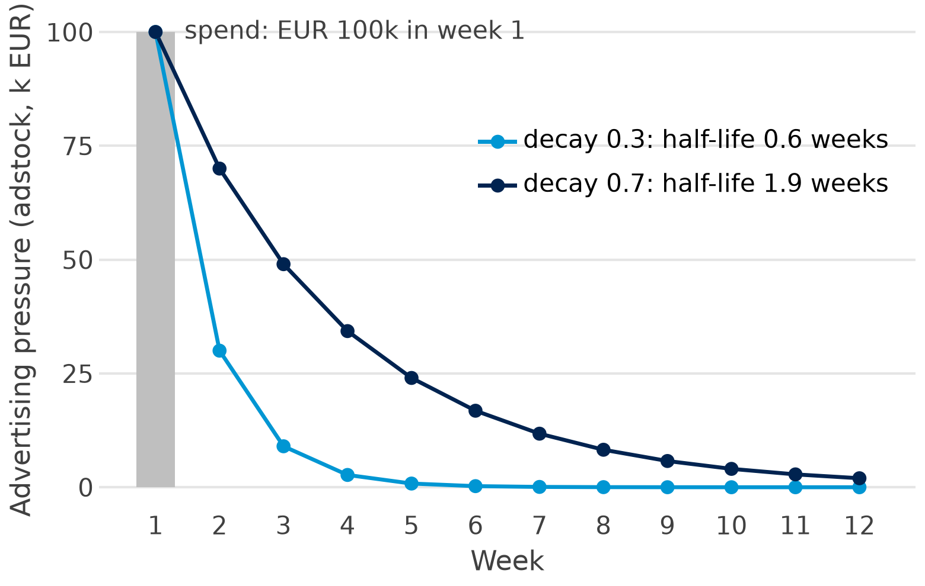

Adstock: advertising keeps working
Geometric adstock
A_t = spend_t + λ·A_(t−1)
λ (decay): share of last week's pressure that carries over
Half-life: ln 0.5 / ln λ = 0.6 or 1.9 weeks here
Total effect: 1/(1−λ) × week 1: 1.4× versus 3.3×
Without adstock, the weeks after a campaign are credited to whatever else happened then.
Sources: Little 1979; Jin et al. 2017; Robyn documentation (geometric and Weibull adstock)
Notes:
Geometric adstock carries a share lambda (the decay) of last week's advertising pressure into this week. The chart shows one burst of EUR 100k: with decay 0.3 the effect is almost gone after three weeks; with 0.7 it lasts about two months. Half-life is the number of weeks until half the pressure is gone: ln 0.5 / ln lambda. The total pressure is 1/(1 - lambda) times the first week: 1.4 versus 3.3. Jin et al. (2017) also use a delayed adstock with a peak after some weeks; Robyn offers Weibull variants. Synthetic example, made in make_mmm_figures.py.

Slide 18
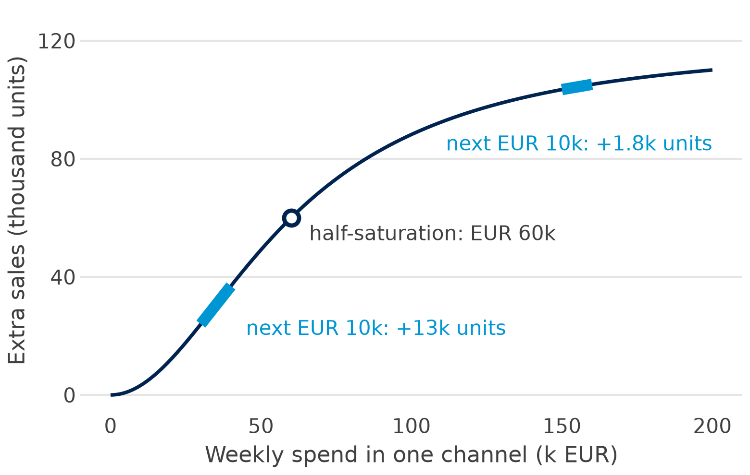

Saturation: each extra euro buys less
Hill saturation
Hill(x) = x^s / (x^s + K^s)
K: spend at half the maximum effect
s: shape; above 1 gives an S-curve
Marginal ROAS: revenue from the next euro, the slope of the curve
Decide at the margin: move money to where the next euro earns most.
Sources: Jin et al. 2017; Google Meridian documentation (media saturation and lagging)
Notes:
The Hill curve rises slowly, then steeply, then flattens. K is the spend at which half the maximum effect is reached; the slope s sets the shape: s of 1 or less bends from the start (C-shape), s above 1 gives an S-shape. In this synthetic example the next EUR 10k buys about 13,000 extra units at EUR 30k a week, but fewer than 2,000 at EUR 150k. Average ROAS can look good while marginal ROAS is poor: budgets should move to where the next euro earns most. Hill is the default in Meridian and Robyn; a logistic curve is an alternative. Adstock and saturation are hard to separate in the data (Meridian documentation).

Slide 19
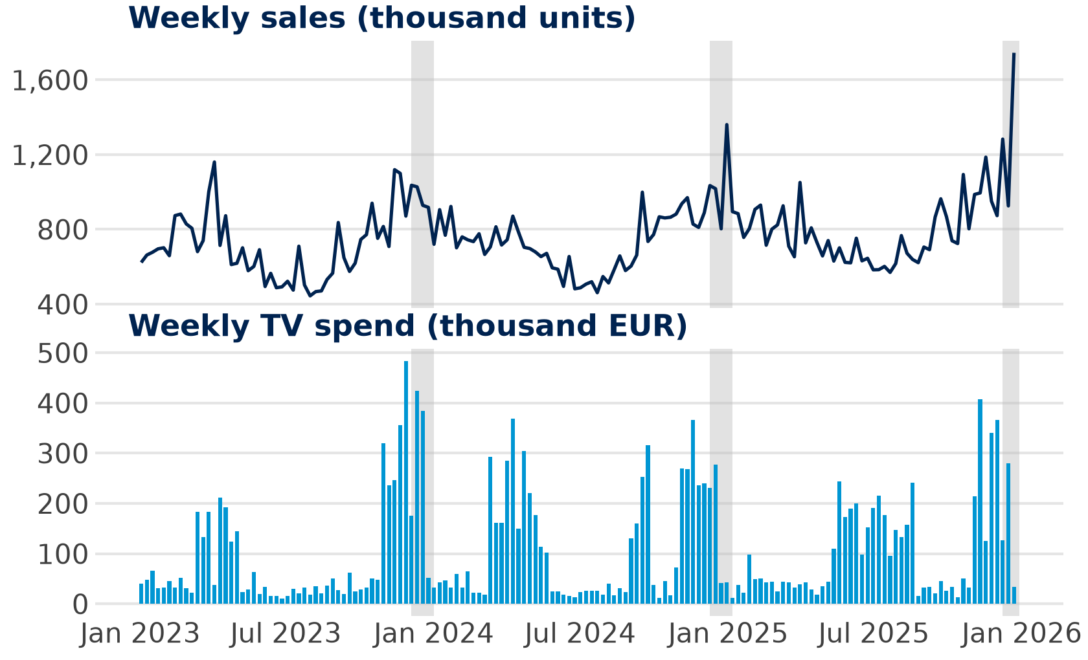

Seasonality, trend and holidays
Trend: slow growth or decline, a week counter
Seasonality: the yearly wave, Fourier terms
Holidays: dummies for Christmas, Easter, Valentine's
Weather, economy: temperature, consumer confidence
Simulated data, Germany, 2023–2025; grey: Christmas weeks.
TV peaks when sales peak: does TV drive Christmas, or Christmas the TV budget?
Notes:
Simulated data for a confectionery brand: German weekly sales peak before Christmas, Easter and Valentine's Day and dip in summer. TV spend peaks at the same time: in Christmas weeks it averages about EUR 188k a week, against about EUR 100k in other weeks. Without controls for season and holidays, the model would give TV the credit for Christmas. Seasonality is usually modelled with a few Fourier terms (pairs of sine and cosine waves), as in Prophet, PyMC-Marketing and Meridian; Hyndman and Athanasopoulos explain how many to use.

Slide 20





Key terms (1): what the model splits
Marketing mix
Base sales
Incremental sales
The levers a brand controls: product, price, place (distribution) and promotion.
Example: price, promotions, shelf listings and five media channels
What would sell without media: driven by price, distribution, season and trend.
The dark area in the decomposition chart
What a channel adds on top of the base: the sales lost if it were switched off.
Also called the channel's contribution
Adstock
Saturation
Control variables
Advertising keeps working after the week it runs; the decay is the share that carries over.
Decay 0.7: half the effect is gone after about 2 weeks
Each extra euro buys less: the response flattens as spend grows.
The next EUR 10k buys far fewer units at high spend
Non-media drivers in the model, so media are not credited with their effect.
Price, promotions, holidays, temperature, competitors
Notes:
Six words you will use every week: the definition, then an example.

Slide 21





Key terms (2): what the model tells you
Elasticity
Response curve
ROAS and ROI
The % change in sales for a 1 % change in a driver; the coefficient in a log-log model.
−2: a 10 % lower price sells 20 % more units (HBR reading)
Incremental sales at each spend level: adstock and saturation in one picture.
Read it to see where a channel stops paying off
ROAS: incremental revenue per euro spent. ROI: incremental profit per euro spent.
ROAS 3: each euro returned EUR 3 of revenue
Marginal ROAS
Holdout
Calibration
The return on the next euro: the slope of the response curve.
Move budget to the highest marginal, not average, ROAS
Fit on past weeks, predict weeks the model has not seen, compare the errors.
Fit two years, forecast the third, report the MAPE
Checking or anchoring model effects with experiments such as geo lift tests.
Geo test: more spend in some regions, compare with the rest
Notes:
These six words turn model output into decisions. Marginal ROAS is the one that moves budgets.

Slide 22
What we know: empirical generalisations
Part 4 of 7 · elasticities, carryover and wear-out, differences between countries
Notes:
Decades of studies give benchmarks. Use them to judge whether your own model's results are plausible and, in a Bayesian model, as priors.

Slide 23
Elasticities: price versus advertising
Advertising: the meta-analyses
Price, for comparison
0.12
short-term elasticity, mean (Sethuraman et al. 2011)
−2.62
mean price elasticity, 1,851 estimates (Bijmolt et al. 2005)
0.24
long-term elasticity, mean (same study)
−2
Event Network: 10 % lower price, 20 % more units (HBR reading)
0.09
mean in an international database (Henningsen et al. 2011)
Per per cent, price moves sales about 20 times more than advertising.
≈ ½
of 389 TV weight tests: no significant sales effect (Lodish et al. 1995)
Reading 0.12: 10 % more advertising lifts sales by about 1.2 %.
Notes:
An elasticity is the per cent change in sales for a 1 % change in a driver. Sethuraman, Tellis and Briesch (2011) pooled published brand advertising elasticities: on average 0.12 in the short term and 0.24 in the long term. Henningsen, Heuke and Clement (2011) find 0.09 in an international database. Lodish et al. (1995): about half of 389 TV weight tests showed no significant sales effect, and Shapiro, Hitsch and Tuchman (2021) find small TV elasticities and negative marginal ROI for most of 288 brands. On the right, price: Bijmolt, van Heerde and Pieters (2005) pool 1,851 price elasticities from 81 studies, mean -2.62; the reading's Event Network example uses -2. Per per cent, price moves sales about 20 times more than advertising does. Session 2 estimates both, by country.

Slide 24

Carryover and wear-out
How long effects last
Data interval matters
60 %
of the effect came after week 13 (141 UK brands; Ebiquity & Thinkbox 2024)
Monthly or annual data suggest longer carryover than weekly data (Clarke 1976; Köhler et al. 2017)
2×
long-term elasticity versus short-term: 0.24 against 0.12 (Sethuraman et al. 2011)
Wear-in and wear-out
Ads may need repetition to work, and lose effect when shown too often or too long (Tellis 2004; Vakratsas & Ambler 1999)
For your model: estimate carryover per channel from weekly data and check half-lives against these benchmarks.
Notes:
Profit Ability 2 (Ebiquity for Thinkbox, 2024) pooled UK models for 141 brands: about 60 % of the profit effect of advertising arrived after the first 13 weeks. The long-term elasticity in Sethuraman et al. is about twice the short-term one. Clarke (1976) showed that estimated carryover depends on the data interval: annual or monthly data imply much longer effects than weekly data, a bias that Köhler et al. (2017) confirm in their meta-analysis of carryover. Wear-in and wear-out (Tellis 2004; Vakratsas and Ambler 1999): an ad may need repetition before it works and loses effect when shown too often or too long.

Slide 25



Effects differ between countries
Market type: advertising matters more in emerging markets; price and distribution effects differ too (Bahadir et al. 2015, 14 markets)
Business cycle: in downturns price sensitivity rises and advertising works less (van Heerde et al. 2013)
Culture: how strongly ad budgets follow the economy depends on national culture (Deleersnyder et al. 2009, 37 countries)
Payoff: reallocating across countries with elasticities: about EUR 500m more profit at Bayer (Fischer et al. 2011)
For international brands: expect markets to respond differently. Hierarchical models let countries differ while borrowing strength from each other (Sun et al. 2017).
Notes:
Bahadir, Bharadwaj and Srivastava (2015) model 14 emerging and developed markets: advertising and product innovation matter more in emerging markets, while price and distribution effects differ by country type. Deleersnyder et al. (2009): across 37 countries and 25 years advertising budgets rise and fall with the economy, and how strongly depends on national culture. Van Heerde et al. (2013): in downturns price sensitivity rises and advertising effectiveness falls. Fischer et al. (2011) used response elasticities to reallocate Bayer's budget across countries, products and activities and report a profit improvement of about EUR 500 million. Country data such as GDP per capita, cultural scores and retail concentration help explain such differences.

Slide 26
Doing it well
Part 5 of 7 · data, pitfalls, validation, Bayesian priors, open-source tools
Notes:
Most MMM failures are data and identification problems, not software problems.

Slide 27



What the data must offer
Two to three years, weekly
Variation in spend
Seasons must repeat: three years are 156 weeks per country
Channels must move up and down, and not always together
Fine geography
All drivers
Countries or regions, not one national total (Nielsen 2022)
Price, distribution, season and competitors, not only media
+68 %
A media-only model overstated advertising ROI by 68 % compared with a model that included the other drivers (Nielsen 2022).
Notes:
Two to three years of weekly data is the usual starting point: the seasonal pattern must repeat before a model can separate it from media: three years are 156 weeks per country. Spend must vary: a channel that runs at the same level every week, or always together with another, cannot be measured. Nielsen's best-practice guide (with Google and Meta, 2022) recommends modelling at the most granular geography available and including non-marketing drivers: in its comparison a media-only model overstated advertising ROI by 68 %.

Slide 28



Four pitfalls
Endogeneity
Multicollinearity
Budgets follow demand: TV peaks before Christmas, when people buy anyway
Channels that move together cannot be told apart; check the VIF
Overfitting
Identification
Many parameters, few weeks: the fit looks great, the forecast fails
Saturation and effects that change over time can mimic each other
10.6 vs 4.2
Paid-search ROAS: a standard MMM against geo experiments at Zalando (Heusch 2026).
Sources: Chan & Perry 2017; Dew et al. 2024; Heusch 2026
Notes:
Chan and Perry (2017) list why MMM is hard. Endogeneity: budgets follow demand, so spend and sales rise together even without any effect; TV budgets peak before Christmas, when people buy anyway. Multicollinearity: channels launched together cannot be separated; check variance inflation factors (VIF). Overfitting: five channels with a decay, a shape and an effect each are many parameters for 156 weeks. Identification: saturation and effects that change over time can mimic each other (Dew, Padilla and Shchetkina 2024). Heusch (2026, Zalando) shows a standard MMM reporting a paid-search ROAS of 10.6 where geo experiments found 4.2.

Slide 29



Validate before you trust
Fit
Holdout
forecast
Plausibility
checks
Calibrate with
experiments
Holdout
Plausibility
Experiments
Fit to two years
Forecast the third
Compare errors (MAPE)
Media effects positive
Half-lives and elasticities near benchmarks
Stable when data change
Spend up or off in test regions
Lift = test minus control
Geo tests: test versus control regions
Why experiments: across 663 Facebook experiments, non-experimental estimates were often far from the true lift (Part 2 showed the switch-off tests).
Sources: Vaver & Koehler 2011; Gordon et al. 2019; Gordon, Moakler & Zettelmeyer 2023
Notes:
A good in-sample fit says little. First, hold back the last weeks and forecast them. Second, check plausibility: positive media effects, half-lives and elasticities in the ranges of Part 3. Third, calibrate with experiments: geo experiments switch spend up or down in some regions and compare them with control regions (Vaver and Koehler 2011). Gordon et al. (2019) showed with 15 large Facebook experiments, and Gordon, Moakler and Zettelmeyer (2023) with 663, that non-experimental estimates are often far off. A typical geo test raises one channel's spend in a random set of regions for six to eight weeks and compares sales with the other regions.

Slide 30



Bayesian MMM: start from what we know
Prior
+
Data
→
Posterior
what we believe first: elasticities near 0.1, a lift-test result
156 weeks of sales, spend and controls per country
updated belief: every effect and ROAS with a range
Why it suits MMM
What to watch
Short series, many parameters: priors keep estimates sensible
Uncertainty for every output
Experiments enter as priors
Weak data: the prior decides; compare prior and posterior
Check that the sampler converged
State and justify every prior
Sources: Jin et al. 2017; Hanssens 2018; Zhang et al. 2024 (Google)
Notes:
Bayesian estimation combines a prior (what we believe before seeing the data) with the data and returns a posterior: a full distribution for every effect, so each ROAS comes with a range. Priors can come from empirical generalisations such as Sethuraman et al. (Hanssens 2018 argues for this use) or from lift tests: Google's calibration paper (Zhang et al. 2024) puts experiment-based priors on each channel's ROI, the approach Meridian, Robyn and PyMC-Marketing now support. Jin et al. (2017) is the reference model. The risk: with weak data the prior decides, so compare prior and posterior.

Slide 31

Open-source MMM tools
 | Robyn | Meridian | PyMC-Marketing
Maker | Meta | Google | PyMC Labs
Language | R (Python beta) | Python | Python
Method | ridge regression with automated search | hierarchical Bayesian, by geo | Bayesian, modular
Strengths | calibration, budget allocator, widely used | many geos, reach and frequency, ROI priors | lift-test calibration, time-varying effects, optimiser
Version | 3.12.0 (Dec 2024) | 2.1.0 (Sep 2026) | 1.2.0 (Sep 2026)
In this course: PyMC-Marketing and Meridian in Python, Session 5.
Sources: Runge et al. 2024; Meridian and PyMC-Marketing documentation; open-source MMM review (2026)
Notes:
All three are free. Robyn (Meta) fits ridge regressions and searches over adstock and saturation settings with an evolutionary algorithm (Nevergrad), then picks models on fit and plausibility; its Python port is still a beta. Meridian (Google) is a hierarchical Bayesian model across geos with reach and frequency and ROI priors; it replaced LightweightMMM, which Google archived in January 2026. PyMC-Marketing (PyMC Labs) offers adstock and saturation building blocks, lift-test calibration, time-varying effects, geo models and a budget optimiser. Version numbers as listed on PyPI and GitHub on 5 October 2026. A 2026 open-access review in Customer Needs and Solutions compares the three.

Slide 32
Reading: Analytics for Marketers
Part 6 of 7 · Fantini & Narayandas (HBR 2023) and an in-class discussion
Notes:
Reading for this session: Fantini, F. & Narayandas, D. (2023). Analytics for Marketers: when to rely on algorithms and when to trust your gut. Harvard Business Review, May–June 2023 (on Canvas).

Slide 33



Three approaches to analytics
Descriptive:
humans decide
Predictive: machines
predict, humans choose
Prescriptive:
machines decide
What happened?
What if …?
What to do?
Dashboards of aggregated past data
Managers add experience and gut feeling
Low pain, low gain
Regression, elasticities, forecasts
Finer, tactical decisions
Few variables, uncertain inputs
Optimises towards goals and rules set by managers
Learns from many cheap experiments
Costly to build and run
Keep in mind: where does MMM sit? You decide in the discussion.
Sources: Fantini & Narayandas 2023 (Harvard Business Review)
Notes:
The article sorts analytics by who decides. Descriptive: humans read aggregated past data (business intelligence, dashboards) and decide; cheap, but coarse and dependent on the manager's intuition and biases. Predictive: models estimate what will happen for different inputs (regression, elasticities, forecasts, segments); humans choose. Prescriptive: machines decide within objectives, rules and constraints set by managers, learning from many low-cost experiments and modelling uncertainty and costs; expensive to set up. MMM is mostly predictive; a budget optimiser on top makes it prescriptive.

Slide 34



When to use which approach
Humans lead: strategy, innovation, entering a new market
Prescriptive
rich data, many decisions
Predictive
the middle ground
Predictive fits: planning, noisy customer data, small gains from fine-tuning
business case
Descriptive
little data, high uncertainty
Prescriptive pays: prices, stock, marketing spend, decided often with rich data
relevant data, decisions repeated often
Sources: Fantini & Narayandas 2023 (Harvard Business Review); simplified illustration
Notes:
Two factors decide: how relevant and plentiful the data are, and the business case (how much profit better decisions can unlock). Little data and high uncertainty: descriptive gives direction. Many repeated, granular decisions with rich data: prescriptive pays for its cost. In between, and for long horizons, noisy granular data or small gains from extreme optimisation: predictive. Strategy and innovation stay with humans, because asking the right question matters more than an accurate answer.

Slide 35

Case: markdowns at Event Network
1 Descriptive
2 Predictive
3 Prescriptive
Discount SKUs with the most days of stock
Until the markdown budget is spent
Ignores customers and context
Regression of volume on price
Elasticity by category, store and week
Crude, but better than the rule
Machine learning plus optimisation
Many data sources, 100,000+ SKUs
Learns and improves over time
−2
+20 %
+8 %
10–20 %
price elasticity
units after a 10 % price cut
revenue: $1,000 → $1,080
of sales explained by price
Lesson: a crude model can still beat a rule of thumb.
Sources: Fantini & Narayandas 2023 (Harvard Business Review)
Notes:
Event Network runs gift shops in museums, zoos and aquariums in the US and Canada, with more than 100,000 SKUs. Descriptive: discount the SKUs with the highest coverage ratio (days of stock left) until the markdown budget is spent; ignores customers. Predictive: regress volume on price by category, store and week to get elasticities. With an elasticity of −2, a 10 % price cut raises units by 20 %: 100 units at $10 ($1,000) become 120 units at $9 ($1,080), 8 % more revenue. Price explained only 10 to 20 % of sales, yet the crude model beat the descriptive rule. Prescriptive: machine learning and automated optimisation over many data sources decide which products to discount, when and by how much.

Slide 36

Accuracy is not the goal
Data scientists
Business scientists
Aim: the most accurate model
Judge by statistical fit
Aim: the most profitable decision
Judge by the cost of each error
False positive: predicted a win that does not come: wasted sales and marketing effort
False negative: predicted a loss that would have been a win: a lost opportunity
In this course: Session 3 and case task C7 set the churn threshold by profit, not accuracy
The manager's new role: “from the person who has all the answers to the one who asks the right questions”
Sources: Fantini & Narayandas 2023 (Harvard Business Review)
Notes:
Data scientists tend to maximise accuracy; business scientists maximise impact by weighing the cost of each kind of error. A false positive (predicted win, no win) wastes sales and marketing effort; a false negative (predicted loss, but it would have been a win) loses the opportunity. A model that cuts false positives but misses many real chances can be accurate and still unprofitable. Session 3 and task C7 of the case study do exactly this: choose the churn threshold by profit. The closing quote is the article's main message about the manager's role.

Slide 37
In-class discussion (1): classify the decisions
 | Decision of an international brand manager | How often | Data available
1 | Split the global media budget over 20 countries and 6 channels | once a year | 3 years of weekly sales and spend per country
2 | Set the bids for search keywords in each market | every day | clicks, costs and sales per keyword
3 | Set the launch price in a newly entered market | once per market | almost none from that market
4 | Decide whether to enter Brazil | once | market studies, no own sales
5 | Mark down 10,000 SKUs in 300 stores after the season | every season | sales and stock per SKU and store
6 | Shift digital budget between channels by last-click reports | every month | clicks of tracked users only
Your task: classify each decision as descriptive, predictive or prescriptive, using the article's two criteria, and say who should decide.
Notes:
25 minutes in total for both slides: 15 in groups of 3 to 4, 10 in plenary. Suggested answers, with the article's two criteria (relevant data, business case). 1 Global media budget: predictive (MMM response curves; rare, high-stakes decision, moderate data); an optimiser can propose, managers approve. 2 Search bids: prescriptive (thousands of small, repeated decisions with rich data; automated bidding). 3 Launch price in a new market: descriptive plus judgement, then predictive once sales data exist; prices from similar markets help. 4 Entering a new country: descriptive and human judgement (one-off, little relevant data, strategy). 5 Markdowns: prescriptive, the Event Network case. 6 Last-click budget shifts: a descriptive rule dressed up as precision; it reads past clicks, not causes (Part 2).

Slide 38
In-class discussion (2): MMM for international brands
Groups of 3–4:
15 minutes
Plenary:
10 minutes
Hand in: one
photo of your answers
1
MMM in the framework: descriptive, predictive or prescriptive? What would make it prescriptive?
2
International brand managers: how can MMM help them? Name two decisions across countries it improves.
3
Crude models: Event Network's price model explained 10–20 % of sales. Is a rough MMM for a small market still worth it?
4
Errors: the MMM says TV does not pay in one country. What would a false negative cost?
5
The manager's job: name one international decision no model should make, with the article's argument.
Sources: Reading: Fantini & Narayandas 2023, Analytics for Marketers, Harvard Business Review (on Canvas)
Notes:
Expected points. Q1: MMM is predictive (it estimates what happens for different budgets); a budget optimiser on top makes it prescriptive, but the yearly budget is rare, high-stakes and political, so managers approve. Q2: compare the return of a euro across countries and channels; spot saturated markets; separate price from advertising effects by country; set a defensible budget split; plan local campaigns from benchmarks of similar markets (hierarchical models). Q3: yes, if it beats the current rule (last year plus a few per cent) and its errors are cheap; small markets borrow strength from others; validate with a geo test. Q4: a false negative (cutting a channel that works) can cost long-term brand strength that weekly data hardly show; a false positive wastes budget; weigh both in money. Q5: entering a market, brand positioning, adapting the brand to a culture: little relevant data, ambiguous goals, the question matters more than the answer.

Slide 39
MMM in this course
Part 7 of 7 · how the sessions build the skills, the group case study
Notes:
Every session adds one piece of the model. By Session 5 you can build and judge a full MMM.

Slide 40
Five sessions, one model
Introduction and linear regression
OLS, model fit and interpretation
→ the base regression
1
Advanced regression
log-log elasticities, dummies, non-linear effects, moderation and mediation, adstock and saturation, diagnostics
→ the MMM itself
2
Logistic regression
binary outcomes: purchase, churn; odds ratios
→ customer-level questions
3
ARIMA
trend, seasonality, ARIMA and ARIMAX forecasts
→ the sales baseline
4
Advanced MMM tools
Bayesian MMM, budget optimisation
→ the full workflow
5
Notes:
Session 1: ordinary least squares regression and how to read model fit, the base of every MMM. Session 2: the MMM itself, with log-log elasticities, dummies for holidays, non-linear effects, moderation (does an effect depend on another variable?) and mediation (does TV work through search?), adstock and saturation, and diagnostics. Session 3: logistic regression for yes/no outcomes such as purchase or churn. Session 4: ARIMA and ARIMAX for the sales baseline and forecasts. Session 5: Bayesian MMM tools and budget optimisation.

Slide 41



The group case study
S1: what drives
weekly orders?
S2: price and
advertising
S3: who will
cancel?
S4: Q1 2026
baseline
The brief
The data
You deliver
Alpenglow's web shop in AT, DE and CH
Four questions from the Head of E-commerce
Weekly shop data, 3 countries × 156 weeks
Club subscribers
The Q1 2026 plan
A Quarto report with all code
Groups of at most 4
30 % of the grade
Every number from code: the report renders from a fresh copy of your project folder.
Brief, data and assessment criteria: assignments/group-project/ and Canvas
Notes:
The case study applies Sessions 1 to 4 to new data: Alpenglow's own web shop in Austria, Germany and Switzerland, plus its subscription club. Each block of the course answers one of the Head of E-commerce's questions. Details, data and assessment criteria are in the brief in assignments/group-project/ and on Canvas.

Slide 42
Key takeaways
MMM explains weekly sales with marketing and other drivers and splits them into base and incremental
1
Adstock and saturation capture carryover and diminishing returns; decide on marginal, not average, ROAS
2
Benchmarks: advertising elasticities around 0.1 short term, larger price effects, differences by country
3
Clicks are not causes: attribution shares out sales; validate MMM on a holdout and calibrate it with experiments
4
Open-source Bayesian tools make it doable in Python: you will build one
5
The question stays the same: where should the next euro go?
Notes:
If students remember one thing: decisions are made at the margin, and an MMM is only as good as the variation in its data and the experiments that check it.

Slide 43


Further reading
Foundations and evidence
Modern MMM, attribution, reading
Hanssens, D. M., Parsons, L. J. & Schultz, R. L. (2001). Market Response Models. 2nd ed. Kluwer.
Sethuraman, R., Tellis, G. J. & Briesch, R. A. (2011). How well does advertising work? Journal of Marketing Research 48(3), 457–471.
doi.org/10.1509/jmkr.48.3.457
Gordon, B. R., Zettelmeyer, F., Bhargava, N. & Chapsky, D. (2019). A comparison of approaches to advertising measurement. Marketing Science 38(2), 193–225.
doi.org/10.1287/mksc.2018.1135
Chan, D. & Perry, M. (2017). Challenges and opportunities in media mix modeling. Google.
research.google/pubs/pub45998/
Jin, Y., Wang, Y., Sun, Y., Chan, D. & Koehler, J. (2017). Bayesian methods for media mix modeling with carryover and shape effects. Google.
research.google/pubs/pub46001/
Runge, J., Skokan, I., Zhou, G. & Pauwels, K. (2024). Packaging up media mix modeling: Robyn's open-source approach. arXiv 2403.14674.
arxiv.org/abs/2403.14674
Fantini, F. & Narayandas, D. (2023). Analytics for marketers. Harvard Business Review 101(3). Today's reading, on Canvas.
Blake, T., Nosko, C. & Tadelis, S. (2015). Consumer heterogeneity and paid search effectiveness. Econometrica 83(1), 155–174.
doi.org/10.3982/ECTA12423
Notes:
Start with Chan and Perry (short, free) and Jin et al. (free) for the modern model, Sethuraman et al. for benchmarks, and Gordon et al. for why experiments matter. Hanssens et al. is the reference book (WU library). The full annotated list is in instructor/resources/mmm-resource-guide.md.

Slide 44
Notes:
Questions? Contact details on the card; office hours via the booking link.

