Slide 1
Module Convenor – Dr Arne Floh
Personal Information
Contact Information
Senior Lecturer in International Marketing – WU Vienna
Deputy Program Director Export- und Internationalisierungsmanagement
WWW: https://www.wu.ac.at/en/welthandel/arne-floh/
LinkedIn: http://www.linkedin.com/arnefloh
T: 01 31336 6367
E: arne.floh@wu.ac.at
Room D1.5.068
Office Hours: by appointment

Slide 2












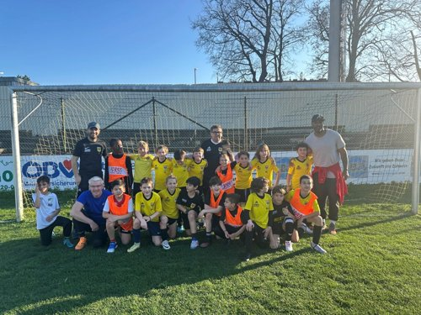



Module Convenor – Dr Arne Floh
  Work Experience
    International & Industry Background
    Teaching Experience > 25 Years
  Teaching
    International Marketing
    International Business Projects
    Marketing Research and Marketing Analytics
    Global Branding
    Supervision (BSc, MSc, PhD)
  Research
    Dynamic Capabilties and Firm Performance
    GenAI and Marketing
    SMEs and Internationalization
  Private
    Football
    Electronic Gadgets
    Austrian Wine

