Slide 1
WU Presentation Template incl. Samples
Format 16:10
Information about presentation (author, version no. etc.)
State: July 2017

Slide 2
Basics
This sample presentation contains information about possible applications of the corporate design in presentations. It also offers some tips for using this template.
Please note that for technical reasons, the slide names are in German.
You can use these slides as a basis for your presentation or as a guide.
Please delete any unneeded slides.

Slide 3
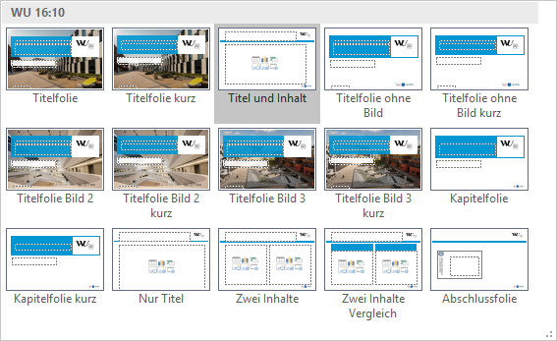
Available slide layouts – overview

Slide 4
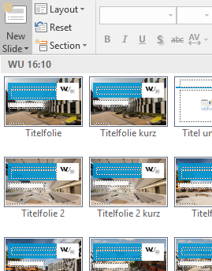
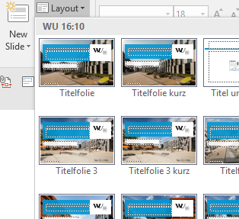
Make use of the slide layouts
The WU PowerPoint templates offer several slide layouts to choose from when creating a new slide. Please click on the lower part of the button New Slide (ribbon Home > Slides). Select the appropriate layout.
You can also change a slide layout later:
click on Layout (ribbon Home > Slides) and select the desired layout from the dropdown menu. In some cases it might be necessary to reset the layout of your slide by selecting Reset (ribbon Home > Slides).

Slide 5

Designing text slides
Please use the placeholders located on the layouts to enter your text or other elements. Avoid using manually placed text boxes.
The sample slides show information about font sizes, which are
pre-set in the placeholders. As the font Verdana (used for running text) is very easy to read even in smaller sizes, the font size of 16 pt is recommended for running text.
By using Bullets (1) or List Levels (2) in the
ribbon Home > Paragraph you can easily structure
your text and modify its appearance.
1
2

Slide 6
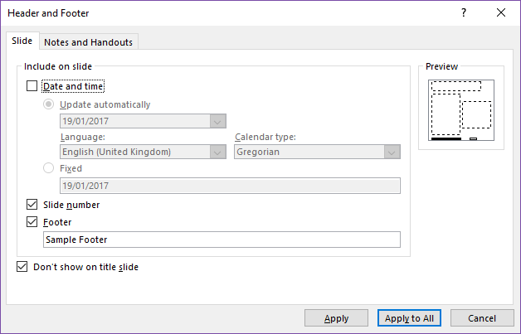
Insert footer information
To insert information in the footer:
Choose Header & Footer (in ribbon Insert > Text).
Activate the desired checkboxes and enter a footer text when prompted.
Please make sure the checkbox next to Don’t show on title slide is activated.
Confirm by selecting Apply to all.
Please do not change the footer/ slide number/date on the slide master – this can cause problems!

Slide 7
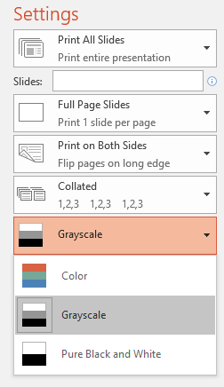
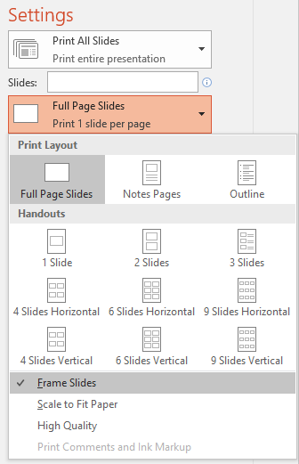
Toner- and ink-reduced printing
The optimized WU PowerPoint templates allow you to save toner and ink when printing.
Select Print (ribbon File) > Settings > Greyscale – this disables the printing of background images. All other graphic elements will be printed in greyscale.
If a printer does not offer colour printing, PowerPoint automatically switches to this option.
Please also select Frame Slides, in order to present slides more clearly, especially when several slides are printed per page.

Slide 8
Sample Slides
This slide is based on the layout
„Kapitelfolie kurz“

Slide 9
Layout „Titelfolie“ – font Georgia 32 pt
Subtitle of presentation
Information about presentation (author, version no. etc.)
This is the default title slide

Slide 10
Layout „Titelfolie kurz“
Subtitle of presentation
Alternative layout „Titelfolie kurz“ for short title (one line) available. Please choose the required layout by selecting either New Slide or Layout (both in the ribbon Home > Slides).

Slide 11
Layout „Titelfolie ohne Bild“ – for 2 lines of text
Subtitle – Verdana 18 pt
Information about presentation (author, version no. etc.)
in Verdana – 12 pt

Slide 12
Titleslide w/o pic. short
Subtitle of presentation
Layout „Titelfolie ohne Bild kurz“ – alternative to layout „Titelfolie ohne Bild“ – especially for short title (one line). Please choose the required layout by selecting Layout (in the ribbon Home > Slides).

Slide 13
Layout „Titelfolie Bild 2“ – for 2 lines of text
Alternative layout „Titelfolie Bild 2 kurz“ for short title (one line) available. Please choose the required layout by selecting either New Slide or Layout (both in the ribbon Home > Slides).

Slide 14
Layout „Titelfolie Bild 3“ – for 2 lines of text
Alternative layout „Titelfolie Bild 4 kurz“ for short title (one line) available. Please choose the required layout by selecting either New Slide or Layout (both in the ribbon Home > Slides).

Slide 15
Layout „Titel und Inhalt“ for title and content – font Georgia 24 pt
Running text in Verdana 16 pt (default).
Sample text showing the use of bullets, which also can be deactivated (see page 4):
  Abgeschieden wohnen sie in Buchstabhausen an der Küste des Semantik, eines großen Sprachozeans. Ein kleines Bächlein namens Duden fließt durch ihren Ort und versorgt sie mit den nötigen Regelialien.
    Es ist ein paradiesmatisches Land, in dem einem gebratene Satzteile in den Mund fliegen.
    Nicht einmal von der allmächtigen Interpunktion werden die Blindtexte beherrscht – ein geradezu unorthographisches Leben.
  Manchmal benutzt man Worte wie Hamburgefonts, Rafgenduks oder Handgloves, um Schriften zu testen.
Weit hinten, hinter den Wortbergen, fern der Länder Vokalien und Konsonantien leben die Blindtexte.

Slide 16
Layout without footer for large graphics, tables or charts

Slide 17
Layout “Zwei Inhalte” with two placeholders for different content types
Sample text: Dies ist ein Typoblind-text. An ihm kann man sehen, ob alle Buchstaben da sind und wie sie aussehen.
Manchmal benutzt man Worte wie Hamburgefonts, Rafgenduks oder Handgloves, um Schriften zu testen.
Manchmal Sätze, die alle Buch-staben des Alphabets enthalten - man nennt diese Sätze »Pangrams«.
Sample text: Dies ist ein Typoblind-text. An ihm kann man sehen, ob alle Buchstaben da sind und wie sie aussehen.
Manchmal benutzt man Worte wie Hamburgefonts, Rafgenduks oder Handgloves, um Schriften zu testen.
Manchmal Sätze, die alle Buch-staben des Alphabets enthalten - man nennt diese Sätze »Pangrams«.

Slide 18
Layout „Vergleich“ – e.g. for comparison
Advantages
Disadvantages
Sample text: Dies ist ein Typoblind-text. An ihm kann man sehen, ob alle Buchstaben da sind und wie sie aussehen.
Manchmal benutzt man Worte wie Hamburgefonts, Rafgenduks oder Handgloves, um Schriften zu testen.
Manchmal Sätze, die alle Buch-staben des Alphabets enthalten - man nennt diese Sätze »Pan-grams«.
Sample text: Dies ist ein Typoblind-text. An ihm kann man sehen, ob alle Buchstaben da sind und wie sie aussehen.
Manchmal benutzt man Worte wie Hamburgefonts, Rafgenduks oder Handgloves, um Schriften zu testen.
Manchmal Sätze, die alle Buch-staben des Alphabets enthalten - man nennt diese Sätze »Pan-grams«.

Slide 19
Layout „Titelfolie Kontakt“
Subtitle of presentation

Slide 20
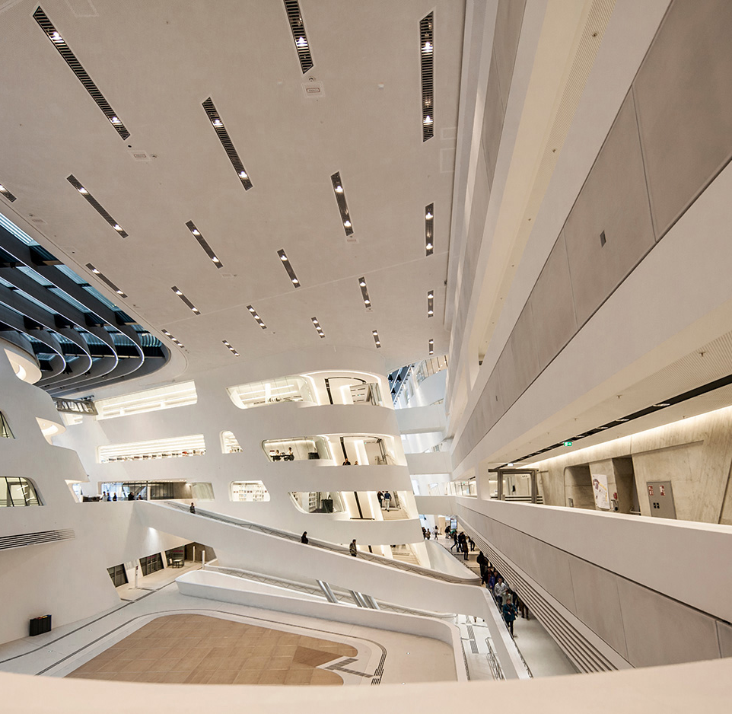
Layout „Inhalt und Bild mit Logo“ – text, picture and logo
Text on the left, picture on the right
  Click the icon in the large placeholder to insert a photo; it is cropped to fit
  The small square placeholder in its corner holds a logo, e.g. of a partner company
Use for introducing a company, product or person

Slide 21
Layout „Titel und Tabelle“ – title with table placeholder
Table header | Sample text 1 | Sample text 2
Sample text Column 1 | Sample text Column 2 | Sample text Column 3
Sample text Column 1 | Sample text Column 2 | Sample text Column 3
Sample text Column 1 | Sample text Column 2 | Sample text Column 3
Sample text Column 1 | Sample text Column 2 | Sample text Column 3
Sample text Column 1 | Sample text Column 2 | Sample text Column 3
Sample text Column 1 | Sample text Column 2 | Sample text Column 3

Slide 22
Sample table
Table header | Sample text 1 | Sample text 2
Sample text Column 1 | Sample text Column 2 | Sample text Column 3
Sample text Column 1 | Sample text Column 2 | Sample text Column 3
Sample text Column 1 | Sample text Column 2 | Sample text Column 3
Sample text Column 1 | Sample text Column 2 | Sample text Column 3
Sample text Column 1 | Sample text Column 2 | Sample text Column 3
Sample text Column 1 | Sample text Column 2 | Sample text Column 3

Slide 23
Sample for simple graphics
(based on SmartArt)
Title 1
Text
Title 2
Text
Title 3
Text
Title 4
Text
Text

Slide 24
Sample organizational chart
(based on SmartArt)
Manager
Stabstelle
Vorgesetzter 1
Vorgesetzter 2
Vorgesetzter 3
Mitarbeiter A
Mitarbeiter B
Mitarbeiter C
Mitarbeiter D
Mitarbeiter E
Mitarbeiter F

Slide 25
Sample for bar chart

Slide 26
Sample for column chart

Slide 27
Sample for line chart

Slide 28
Sample for doughnut chart

