Slide 1
The impact of globalization can be felt on several levels
Supra-National
National
Industry
Unit #1
Units #2-3
Units #4-5
Firm
Units #6-8

Slide 2
Firm strategy
What is strategy?
“A planned set of actions that managers employ to make best use of the firm’s resources and core competencies to gain competitive advantage.”
Notes:
The term “business model" refers to a company's logic - how it operates, creates & captures value in a competitive market
The term "strategy" is the plan to create a unique and valuable position involving a distinctive set of activities.
That definition implies that the enterprise has made a choice about how it wishes to compete in the marketplace. The system of choices and consequences is a reflection of the strategy, but it isn’t the strategy; it’s the business model.
Strategy refers to the contingent plan about which business model to use.
Tactics are choices open to a company by virtue of the business model. In other words, business model determines the tactics available to compete in the marketplace.
Strategy focuses on building competitive advantage by defending a unique position or exploiting a valuable and idiosyncratic set of resources.
Mission is a general statement of how you will achieve your vision. Strategies are a series of ways of using the mission to achieve the vision. Goals are statements of what needs to be accomplished to implement the strategy. Objectives are specific actions and timelines for achieving the goal

Slide 3


Video: Michael Porter on “What is strategy?”
https://www.youtube.com/watch?v=NY4myVa5Wkw
Notes:
Strategy is about:
How are we going to be unique?
How are we creating an advantage?
How will we sustain that advantage?

Slide 4
Two major areas of firm strategy
Corporate strategy
Scope of firm in terms of industries and markets
Where to compete?
Firm strategy
Business strategy
Competitive approach in industries and markets
How to compete?
Source: Grant, 2010
Notes:
Short summary of corporate strategy vs business strategy → focus of course on corporate strategy → fit between the two essential

Slide 5
In-class discussion
What is the basis for defining strategy?
Notes:
Brief in-class discussion

Slide 6
What is the basis for defining strategy?
Industry environment
Firm resources & capabilities
Who are our business partners?
How do we create customer value?
Competitive advantage
What is our extended business domain?
National environment
Strategy definition is based on internal & external analysis
Source: Grant, 2010
Notes:
Strategy is based on internal and external factors → analysis is essential step of defining a strategy

Slide 7
Approaches for external strategic analysis
Political
Economic
Societal
Technological
(+ Environm.)
(+ Legal)
Industry analysis
MACRO
Tool:
“Porter Five Forces”
Tool:
“PEST(-EL)”
INFLUENCES
MICRO
Notes:
Brief discussion how macro factors affect micro factors

Slide 8
Strategy links the firm and its external environment
Focal firm
Internal analysis
Goals & values
Resources & capabilities
Structure & systems
Strengths
Weaknesses
Strategy to build and sustain competitive advantage
Opportunities
Threats
Competitors
Customers
Suppliers
Micro environment
External analysis
Macro environment
Source: Grant, 2010
Notes:
Brief summary of steps in strategic analysis

Slide 9

Video: “The Five Competitive Forces that Shape Strategy”
http://www.youtube.com/watch?v=mYF2_FBCvXw

Slide 10
Porter’s Five Forces: Analyzing industry attractiveness
Five forces shape the attractiveness of international industries and subsequently determine firms’ performance
New Entrants
Threats of entry (e.g. international competitors)
Complementary products
Influence of complementary products
Industry Competitors
Rivalry among existing firms
Suppliers
Bargaining power of international suppliers
Buyers
Bargaining power of international buyers
Substitutes
Threat of substitutes (e.g. via exports)
Source: Porter, 1996
Notes:
Very brief – mention that 5 forces are all forces that affect a firm‘s ability to demand higher margins
-> Use FMCG industry (or even better sub-industry of FMCG) as example to explain 5 forces (first task on next slide)
-> The two readings focus on macro factors that shape the 5 forces

Slide 11
Porter’s Five Forces: Industry competitors
Rivalry among existing competitors results in price discounting, advertising campaigns and service improvements -> all of which limit profitability
Whether within industry competition reduces profitability, depends on its intensity and its basis -> price vs. differentiation
Rivalry among competitors
High
Low
Low industry concentration
High industry concentration
Low degree of product differentiation
High degree of product differentiation
High economies of scale to and ratio of fixed to variable costs
Low economies of scale to and ratio of fixed to variable costs
Source: Campbell, Edgar, & Stonehouse, 2011; Grant, 2008; Porter, 2008

Slide 12
Porter’s Five Forces: Suppliers and buyers (1/2)
Competitive dynamics within the value chain influence the share of total profitability each party obtains
Suppliers and buyers use their bargaining power vis-à-vis firms in the focal industry to obtain a larger share of total profitability
Bargaining power of suppliers
High
Low
Low number of suppliers and high volume of purchases
High number of suppliers and low volume of purchases
High switching costs and low availability of appropriate substitutes
Low switching costs and high availability of appropriate substitutes
High degree of product differentiation
Low degree of product differentiation
Source: Campbell, Edgar, & Stonehouse, 2011; Grant, 2008; Porter, 2008

Slide 13
Porter’s Five Forces: Suppliers and buyers (2/2)
Competitive dynamics within the value chain influence the share of total profitability each party obtains
Suppliers and buyers use their bargaining power vis-à-vis firms in the focal industry to obtain a larger share of total profitability
Bargaining power of buyers
High
Low
Low number of customers and high volume of purchases
High number of customers and low volume of purchases
Low switching costs and high availability of appropriate substitutes
High switching costs and low availability of appropriate substitutes
Low degree of product differentiation
High degree of product differentiation
Source: Campbell, Edgar, & Stonehouse, 2011; Grant, 2008; Porter, 2008

Slide 14
Porter’s Five Forces: New entrants and substitutes
New entrants into an industry can strengthen competition and reduce profits
Firms incur costs (e.g. discounts, advertising) to deter these new entrants
When suitable substitutes for products or services exist outside the focal industry, spillover effects can reduce industry profitability
Threat of new entrants
High
Low
Low capital costs
High capital costs
Low brand loyalty and customer switching costs
High brand loyalty and customer switching costs
Open access to input and distribution channels
Restricted access to input and distribution channels
Threat of substitute products
High
Low
The price and performance of the substitute can match the industry’s product
The price and performance of the substitute cannot match the industry’s product
Source: Campbell, Edgar, & Stonehouse, 2011; Grant, 2008; Porter, 2008

Slide 15
In-class discussion
What is specific about
“International Strategy”?
Notes:
Brief in-class discussion

Slide 16
What is specific about international strategy?
Industry environment
Firm resources & capabilities
Competitive advantage
Different competitive forces across industries?
Are they valuable in all markets?
Different trends and challenges across countries?
National environment
Multinationality results in additional layers of analysis
Source: Grant, 2010
Notes:
Main difference between „national“ strategy and „international“ strategy relates to different layers of analysis (countries, regions…) and how they interact

Slide 17
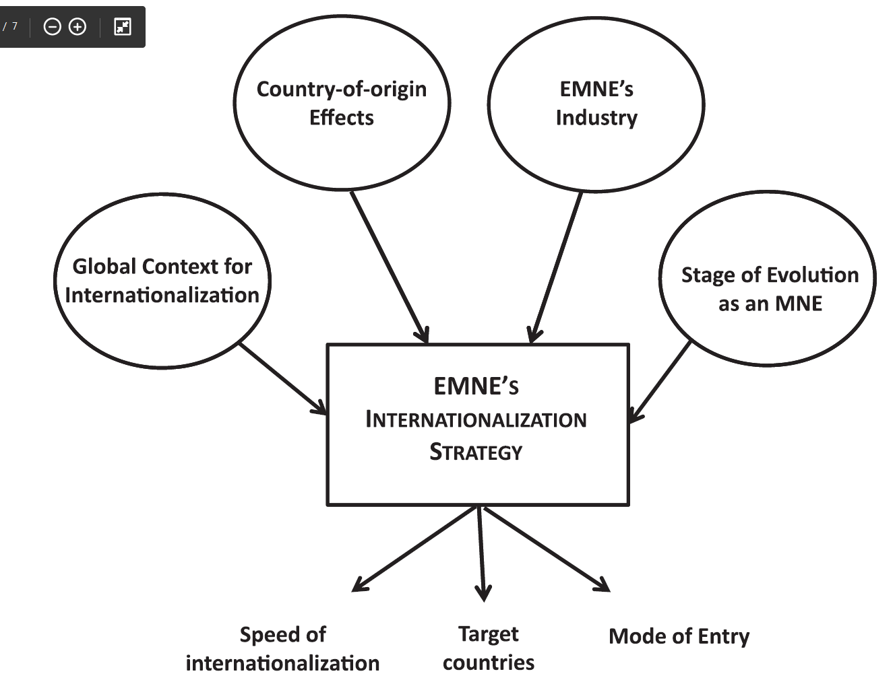
Origins of MNCs can affect their international strategy
Cope with high-uncertainty environments
From low value-adding to high value-adding activities
Used to do business in a globalized world
Different stages of internationalization process
Country of origin shapes competitive advantages of MNCs
Notes:
Discussion why MNCs from different regions behave differently → example emerging market MNCs
Result from analysis: Not only host countries as layers in international strategy analysis, but also home country as very important layer affecting competitive advantages

Slide 18
Firms face multidimensional and contradictory objectives
MNCs can build competitive advantage through…
Pressures for integration
Efficiency in international value chains
Pressures for responsiveness
Flexibility facing risks / opportunities
Learning from global operations
MNC strategy must balance pressures for integration and responsiveness to achieve these goals
Source: Ghoshal, 1987
Notes:
Brief introduction to I/R logic:
Multinationalism offers three distinct means to achieve strategic goals; firms have to achieve these goals simultaneously → In pursuit of these goals, MNCs face (contradicting) pressures for integration and responsiveness → discussion about definition and examples
Strategic goals can be derived from DCF model → NPV of infinite rent = CF_t1 / (ir – gr) → efficiency affects CF, flexibility affects risk / interest rate, learning affects growth rate
Result from this analysis: MNC strategy is not one-dimensional (integration OR responsiveness), but two-dimensional (degrees of integration AND responsiveness)
Efficiency: lowering costs of firm operations and activities, how to organize R&D, manufacturing, sourcing, production, customer service
Flexibility: accommodate diverse country-specific risks and opportunities. Direct vs. indirect investments, adapt marketing and HR practices, exchange rate fluctuations
Learning: learn from operating in international environments and exploit this learning on a worldwide basis; gain new technical and managerial know how, new product ideas, improved R&D capabilities, skills -> disseminate throughout corporation

Slide 19

Example: I/R frame work in the FMCG industry
Discussion
What pressures for (local) responsiveness shape the industry?
What competitive forces push the industry towards integration?
How are technology and competition changing the pressures for integration / responsiveness?
Notes:
What competitive forces push the industry towards integration?
-> Discuss generally what pressures for I/R exist in the FMCG industry
-> Consumer needs: allergies, clothing sizes, quickly changing trends
-> These factors are in addition influenced by social / cultural factors -> link to IB
What competitive forces push the industry towards integration?
-> Aim is to link I/R framework to 5 Forces
-> Discuss in combination with next question
How are technology and competition changing the pressures for I/R
-> Show that I/R is not static and influenced macro and micro factors
-> Importance of economies of scale in production (supplier power) and retail (buyer power) result in pressures for integration
-> Importance of data / flexibility in adaption to customers is increases pressure for responsiveness
-> Smaller, more local competition increases pressure for responsiveness
-> Smaller, more local suppliers increase pressure for responsiveness
-> Decreasing importance of economies of scale decrease pressure for integration

Slide 20
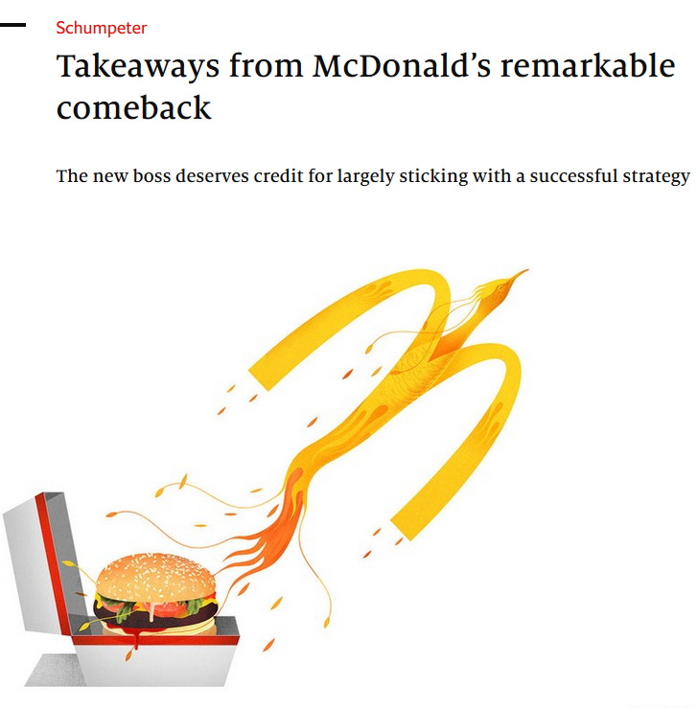
Example: I/R frame work and McDonald’s
Discussion
What factors can you identify that forced McDonald’s to reconsider their integration/responsiveness?
How did McDonald’s react to these pressures in the industry?
Notes:
Pressures in the industry that forced McDonald’s to reconsider their I/R position:
Current situation – McDonald’s engaged in a lot of responsiveness actions:
-> Many items on the menu (that many could not afford)
-> Some flawing int’l operations / lower franchise ratio back then (82% in 2015/ to 93% now)
-> attempt to compete with innovative start-ups
-> parasite on society (paying low wages/promoting obesity)
McDonald’s went back to basics -> More tightly integrated their operations:
-> streamlined sprawling int’l operations
-> reduced the items on the menu (price/quality) (lower cost and faster service in the kitchen)
-> increased the franchise share up to 93% (steadier income)
Shows how pursuing a more integrated (or responsive / transnational) strategy can lead a turnaround.
Transnational features:
-> Bought a tech firm, that personalizes the drive-through
-> Customized menus with standardized products

Slide 21
The IR-framework can be broken down to the task level
I
I
I
R
Industries
I
R
Companies
R
Functions
R
Tasks
Based on this analysis MNCs configure their value chain activities to achieve optimal usage of resources
Source: Bartlett, 1985; Porter, 1984
Notes:
I/R logic can be broken down from industry level to task level – use example

