Slide 1
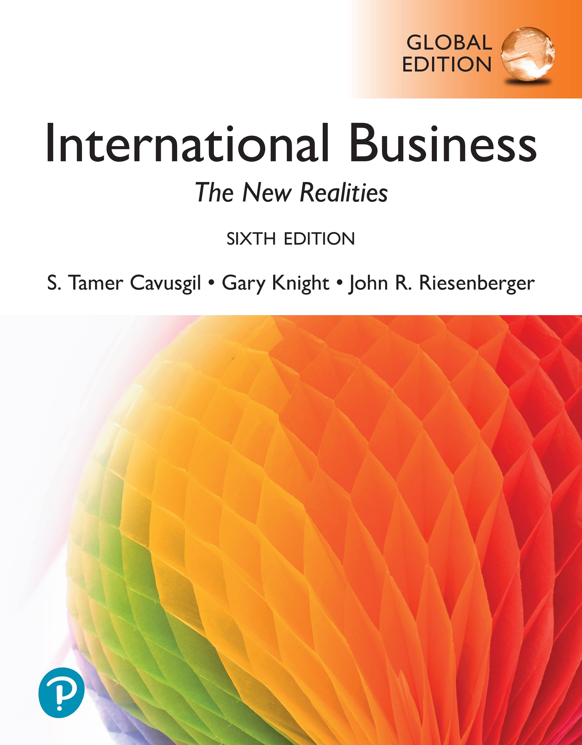

International Business: The New Realities
Sixth Edition, Global Edition
Chapter 1
Introduction: What Is International Business?
© 2025 Pearson Education Ltd. All Rights Reserved.
Notes:
If this PowerPoint presentation contains mathematical equations, you may need to check that your computer has the following installed:
1) MathType Plugin
2) Math Player (free versions available)
3) NVDA Reader (free versions available)

Slide 2
Learning Objectives
1.1 Describe the key concepts in international business.
1.2 Understand how international business differs from domestic business.
1.3 Identify major participants in international business.
1.4 Explain why firms internationalize.
1.5 Appreciate why you should study international business.
1.6 Learn the C K R Intangible Human
and the C K R
Tangible Process
to improve your employability
and success in the workplace.

Slide 3
Instagram: A Global Phenomenon
Instagram exemplifies the globalization of business and converging lifestyles worldwide.
Instagram has more than 2 billion active monthly users.
Instagram is available in 32 languages and enjoys a massive following worldwide. Some 90 percent of users live outside the firm’s home country, the United States.
Instagram uses foreign direct investment to establish offices around the world.
Instagram illustrates how converging lifestyles, modern communications technologies, and entrepreneurship are facilitating the emergence of global enterprises.

Slide 4
The Nature of International Business
All value-adding activities-including sourcing, manufacturing, and marketing-can be performed in international locations.
International trade can involve products, services, capital, technology, know-how, and labor.
Firms internationalize through various entry strategies, such as exporting and foreign direct investment.
Globalization both compels and facilitates firms to expand abroad.

Slide 5
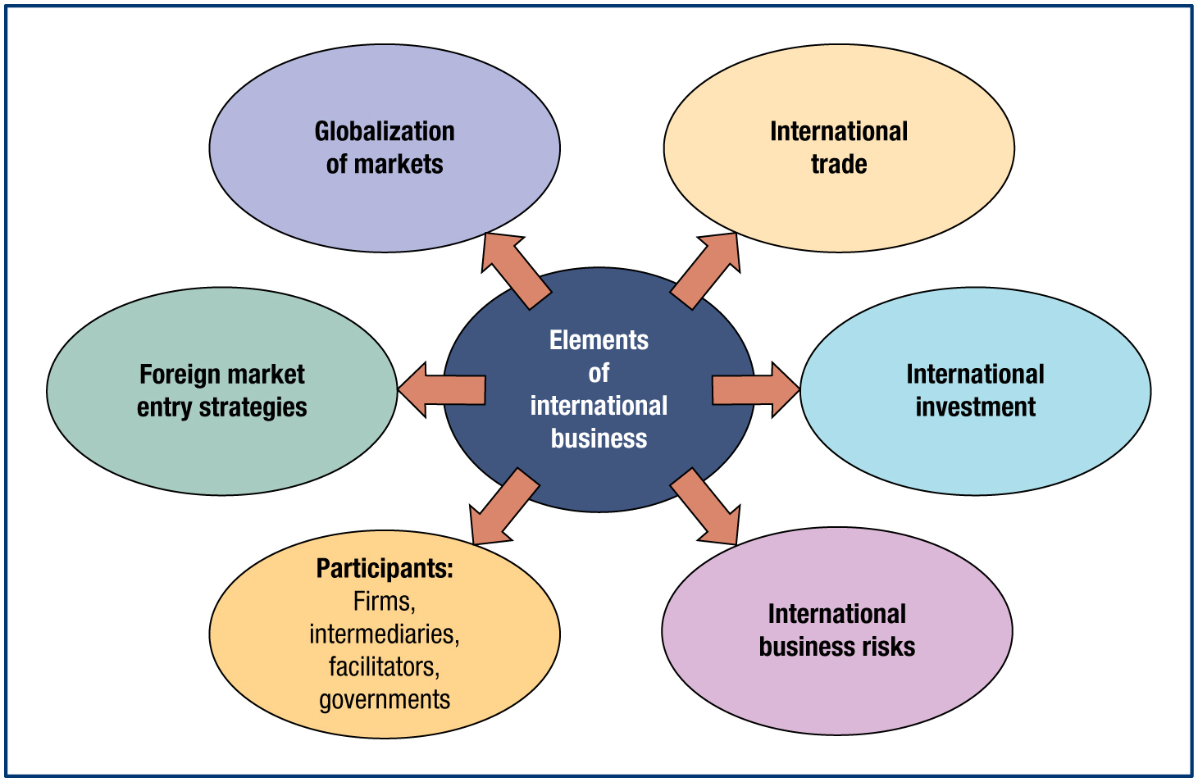
Dimensions of International Business
Notes:
Long Description:
The flow diagram shows the following information: Elements of international business includes foreign market entry strategies, globalization of markets, international trade, international investment, international business risks, and participants: firms, intermediaries, facilitators, governments.

Slide 6
Key Concepts in International Business (1 of 3)
International business: Performance of trade and investment activities by firms across national borders.
Globalization of markets: Ongoing economic integration and growing interdependency of countries worldwide.
International trade: Exchange of products and services across national borders; typically through exporting and importing.
Notes:
International business refers to the performance of trade and investment activities by firms across national borders. Because it emphasizes crossing national boundaries, we also refer to international business as cross-border business. Firms organize, source, manufacture, market, and conduct other value-adding activities on an international scale. They seek foreign customers and engage in collaborative relationships with foreign business partners. While international business is performed mainly by individual firms, governments and international agencies also undertake international business activities. Firms and nations exchange many physical and intellectual assets, including products, services, capital, technology, know-how, and labor. In this book, we are mainly concerned with the international business activities of the individual firm. The growth of international business activity coincides with the broader phenomenon of globalization of markets. The globalization of markets refers to the ongoing economic integration and growing interdependency of countries worldwide. While internationalization of the firm refers to the tendency of companies to systematically increase the international dimension of their business activities, globalization refers to a macro trend of intense economic interconnectedness between countries. Globalization is associated with the internationalization of countless firms and dramatic growth in the volume and variety of cross-border transactions in goods, services, and capital flows. It has led to widespread diffusion of products, technology, and knowledge worldwide.
International trade refers to an exchange of products and services across national borders. Trade involves both products (merchandise) and services (intangibles). Exchange can be through exporting, an entry strategy involving the sale of products or services to customers located abroad, from a base in the home country or a third country. Exchange can also take the form of importing or global sourcing—the procurement of products or services from suppliers located abroad for consumption in the home country or a third country. While exporting represents the outbound flow of products and services, importing is an inbound activity. Both finished products and intermediate goods, such as raw materials and components, are subject to importing and exporting.

Slide 7
Key Concepts in International Business (2 of 3)
Exporting: Sale of products or services to customers located abroad, from a base in the home country or a third country. Boeing and Airbus export billions in commercial aircraft every year.
Importing or global sourcing: Procurement of products or services from suppliers located abroad for consumption in the home country or a third country. Toyota imports many parts from China when it manufactures cars in Japan.

Slide 8

Key Concepts in International Business (3 of 3)
International investment: Transfer of assets to another country or the acquisition of assets in that country. Also known as “foreign direct investment” (F D I), we will focus on this type of investment.
International portfolio investment: Passive ownership of foreign securities such as stocks and bonds, in order to generate financial returns.
Notes:
International investment refers to the transfer of assets to another country or the acquisition of assets in that country. These assets include capital, technology, managerial talent, and manufacturing infrastructure. Economists refer to such assets as factors of production. Trade implies that products and services cross national borders. By contrast, investment implies the firm itself crosses borders to secure ownership of assets located abroad.
The two essential types of cross-border investment are international portfolio investment and foreign direct investment. International portfolio investment refers to the passive ownership of foreign securities such as stocks and bonds for the purpose of generating financial returns. It does not entail active management or control over these assets. The foreign investor has a relatively short-term interest in the ownership of these assets.
Foreign direct investment (F D I) is an internationalization strategy in which the firm establishes a physical presence abroad through acquisition of productive assets such as capital, technology, labor, land, plant, and equipment. It is a foreign-market entry strategy that gives investors partial or full ownership of a productive enterprise typically dedicated to manufacturing, marketing, or management activities. Investing such resources abroad is generally for the long term and involves extensive planning.

Slide 9
Globalization of Markets
Unprecedented growth of international trade. In 1960, global trade was $300 billion per year. Today, world exports amount to some $22 trillion annually!
Trade between nations, accompanied by substantial flows of capital, technology, and knowledge.
Development of sophisticated global financial systems and mechanisms that facilitate the cross-border flow of products, money, technology, and knowledge.
Greater collaboration among nations through multilateral regulatory agencies such as the World Trade Organization and the International Monetary Fund.
Notes:
The globalization of markets is evident in several related trends. First is the unprecedented growth of international trade. In 1960, cross-border trade was modest. Today, it accounts for a substantial proportion of the world economy, with world exports amounting to some $16 trillion annually—that is, $16,000,000,000,000! Second, trade between nations is accompanied by substantial flows of capital, technology, and knowledge. Third is the development of highly sophisticated global financial systems and mechanisms that facilitate the cross-border flow of products, money, technology, and knowledge. Fourth, globalization has brought about a greater degree of collaboration among nations through multilateral regulatory agencies such as the World Trade Organization and the International Monetary Fund.
International trade in services accounts for about one-quarter of all international trade and is growing rapidly. In recent years, services trade has been growing faster than products trade. As with products, larger advanced economies account for the greatest proportion of world services trade. This is expected, because services typically comprise more than two-thirds of the G D P s of these countries. Although services trade is growing rapidly, the value of merchandise trade is still much larger. One reason is that services face greater challenges and barriers in cross-border trade than merchandise goods.
https://www.wto.org
http://www.imf.org/

Slide 10
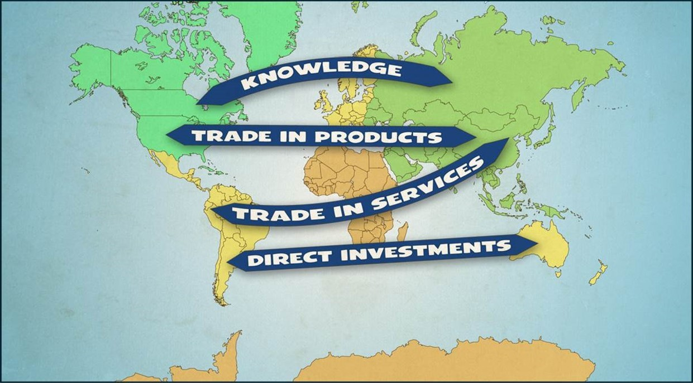
The “Flows” of International Business

Slide 11
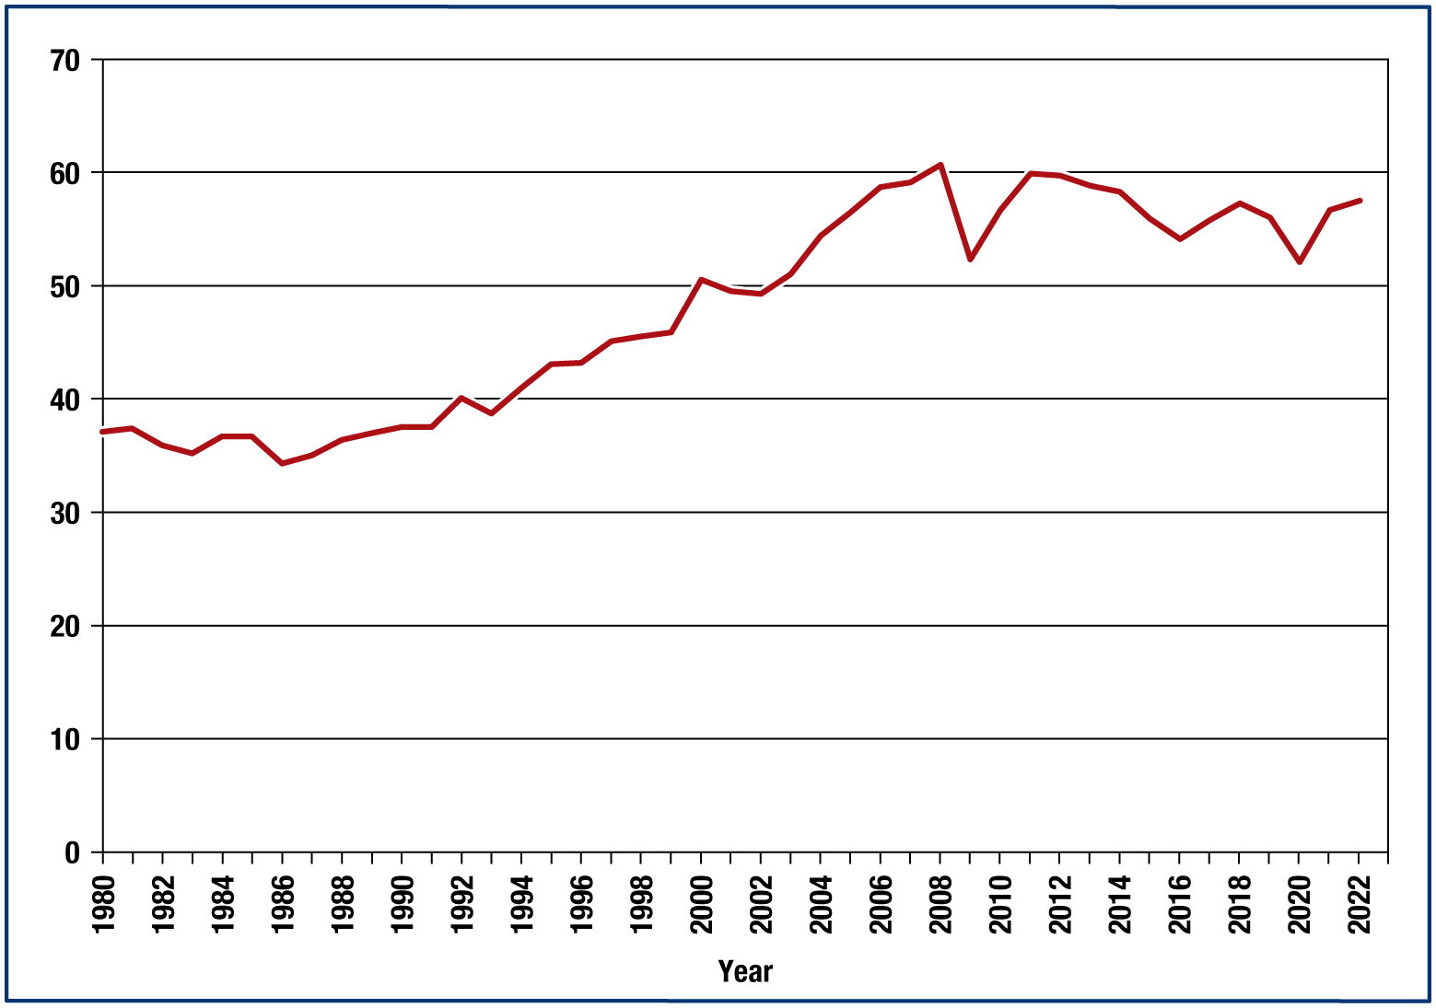
World Trade and G D P
Source: Based on data from the International Monetary Fund, World Economic Outlook Database, April, 2023. Exhibit shows the volume of world trade (the sum of world exports and imports) as a percentage of world G D P
Notes:
The exhibit contrasts the growth of total world exports to the growth of total world gross domestic product (G D P). G D P is the total value of products and services produced in a country over the course of a year. Following a 27-year boom, world trade declined in 2009 due to the global recession. The hardest hit imports were consumer goods, cars, and car parts. However, trade revived sharply and returned to normal levels by 2012. Trade was a key factor reducing the impact of the global recession. Overall, however, in the past few decades world exports have grown more than thirty-fold, while world G D P grew only tenfold.
To illustrate this point, consider the journey of a shirt sold in France. Initially, the cotton to produce the shirt is exported from the United States to China. After the shirt is manufactured in China, it is exported to France. Eventually, after the French owner discards her used shirt, it is exported once again and sold on the used clothing market in Africa. In total, the value generated in exporting the shirt greatly exceeds the cost to produce it.
Much of the difference in the growth of exports versus G D P is due to advanced (or developed) economies such as Britain and the United States now sourcing many of the products they consume from low-cost manufacturing locations such as China and Mexico. For example, although the United States once produced most of the products it consumed, today it depends much more on imports. Rapid integration of world economies is fueled by such factors as advances in information and transportation technologies, decline of trade barriers, liberalization of markets, and the remarkable growth of emerging market economies.
http://www.imf.org/
Long Description:
The horizontal axis represents years ranging from 1980 to 2022 in increments of 2. The vertical axis ranges from 0 to 70 in increments of 10. The graph shows a line from (1980, 37) to (2022, 57). This line has an increasing trend with fluctuations and passes through the points showing peaks at (1986, 34), (1992, 40), (2000, 50.5), (2008, 60.5), (2009, 53), (2011, 60), (2016, 54.4), (2018, 57), and (2020, 52). All values are approximate.

Slide 12
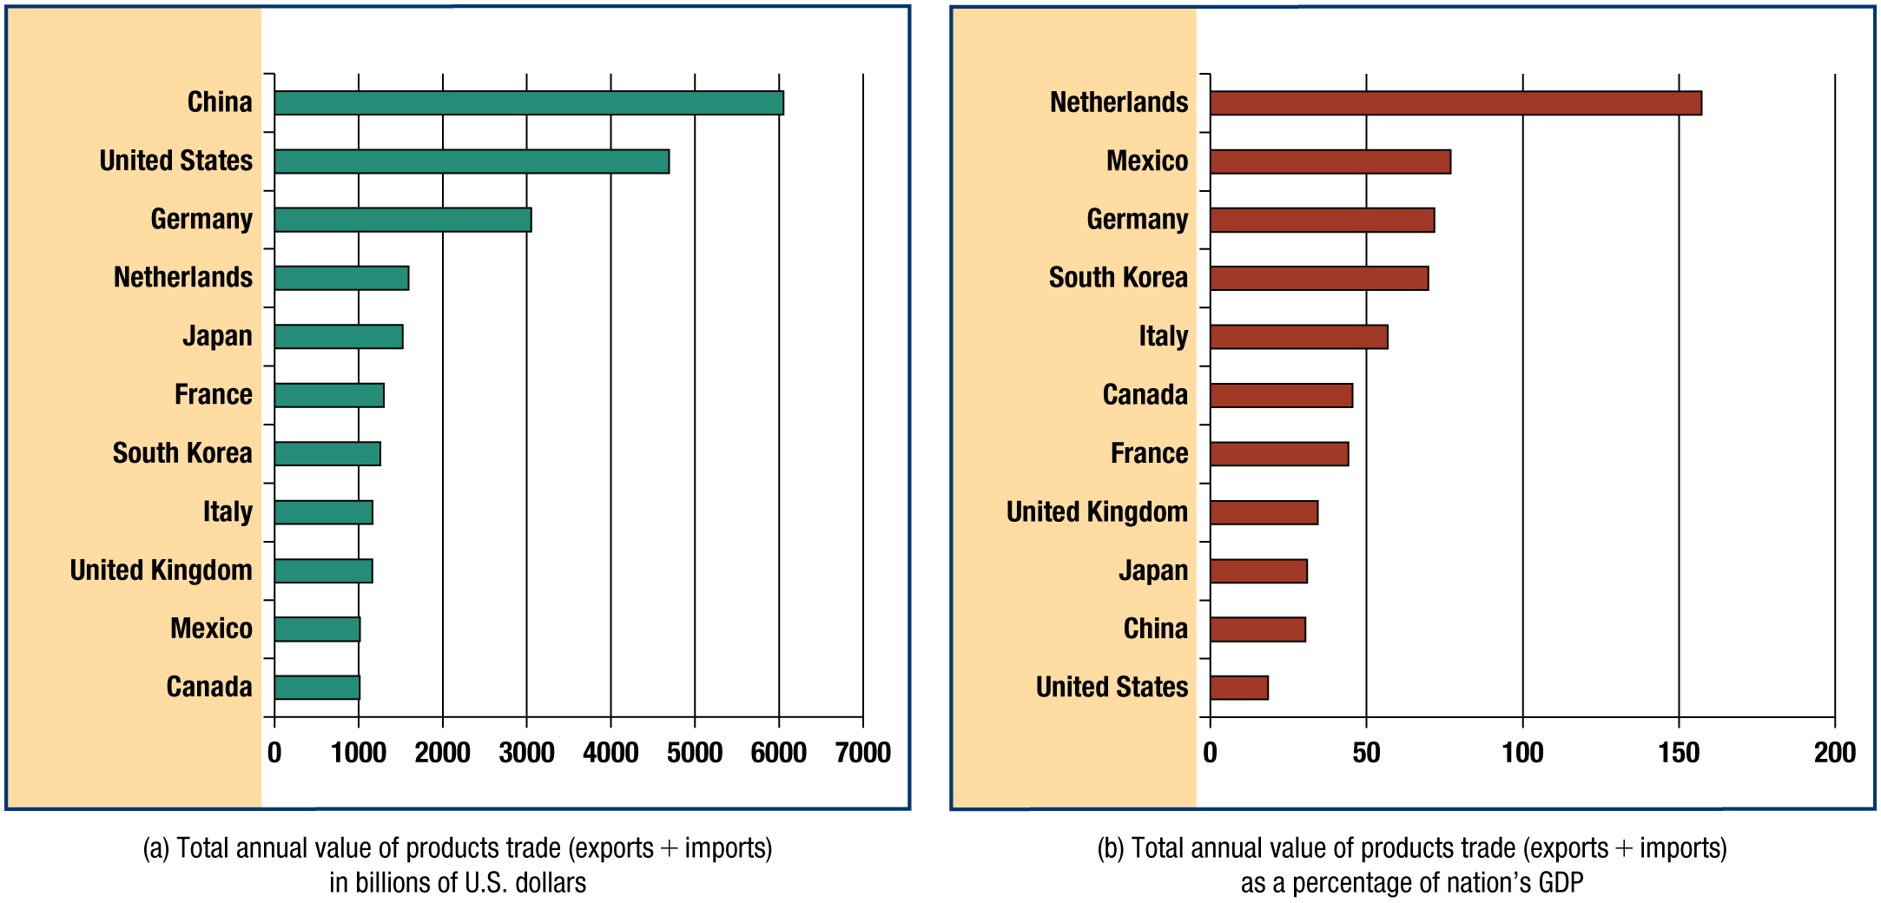
Leading Countries in International Merchandise Trade, by Total Annual Value, U S$ Billions
Sources: Based on data from the World Bank, World Development Indicators, World Bank, Washington, World Trade Based on data from the World Trade Organization, Statistics Database, Geneva: World Trade Organization (2023),
Notes:
The exhibit identifies the nations that lead in the exporting and importing of products (but not services)—that is, international merchandise trade. Recently, China surpassed the United States as the world’s leading exporter. China is a leading country in terms of the absolute value of total merchandise trade. Trade accounts for a large proportion of China’s G D P. Some countries depend very heavily on international trade relative to the value of all goods and services they produce domestically.
www.unctad.org
www.wto.org
Long Description:
Graph shows the total annual value of products trade (exports plus imports) in billions of U. S. dollars. Its horizontal axis ranges from 0 to 7000 in increments of 1000. The vertical axis represents the countries. The graph shows the following data: China: 6025. United States: 4800. Germany: 3025. Netherlands: 1550. Japan: 1500. France: 1250. South Korea: 1200. Italy: 1150. United Kingdom: 1150. Mexico: 1000. Canada: 1000.

Slide 13
Leading Countries in International Merchandise Trade, Total Value as a % of G D P
Sources: Based on data from the World Bank, World Development Indicators, World Bank, Washington, World Trade Based on data from the World Trade Organization, Statistics Database, Geneva: World Trade Organization (2023),
Notes:
The exhibit shows the annual value of products traded as a percentage of each nation’s G D P. While the United States is a leading country in terms of the absolute value of total merchandise trade, trade accounts for a much smaller percentage of its G D P. In contrast, merchandise trade is a much larger component of economic activity in countries such as Belgium, the Netherlands, and Germany. Thus, some economies are very dependent on international trade relative to the value of all goods and services they produce domestically. Indeed, in Singapore, Hong Kong, South Korea, and Malaysia, trade accounts for more than 100 percent of G D P. These countries are known as entrepôt economies. Entrepôt is from the French for ‘intermediate depot’. Such countries import a large volume of products, some of which they process into higher value-added products and some they simply re-export to other destinations. For example, Singapore is a major entrepôt for petroleum products received from the Middle East, which it then exports to China and other destinations in Asia.
www.unctad.org
www.wto.org
Long Description:
Graph shows the total annual value of products trade (exports plus imports) as a percentage of nation’s G D P. Its horizontal axis ranges from 0 to 200 in increments of 50. The vertical axis represents the countries. The graph shows the following data: Netherlands: 157. Mexico: 77. Germany: 71. South Korea: 70. Italy: 56. Canada: 48. France: 47. United Kingdom: 35. Japan: 31. China: 30. United States: 19. All values are approximate.

Slide 14
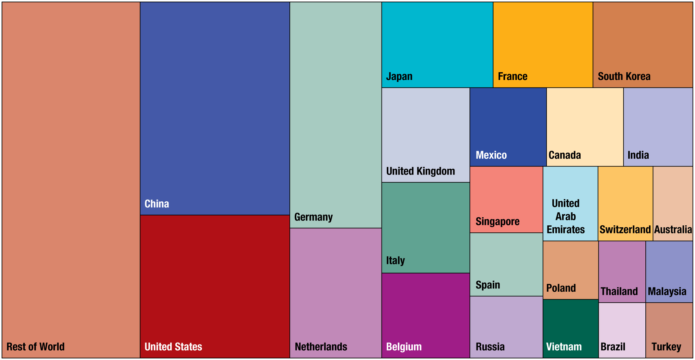
Top 25 Countries in International Merchandise Trade
Sources: Based on data from the World Bank, World Development Indicators, Washington, D C: World Bank (2023),
www.worldbank.org
; World Trade Organization, Statistics Database, Geneva: World Trade Organization (2023),
www.wto.org
; U N C T A D, World Investment Report, New York: United Nation (2023),
www.unctad.org
. Note: The
exhibit reflects the value of each country’s combined exports and imports as a percentage of total world trade
Notes:
www.worldbank.org
www.wto.org
www.unctad.org
Long Description:
The illustration depicts the top 25 countries from high to low value, as follows: 1. Rest of the world, 2. China, 3. United States, 4. Germany, 5. Netherlands, 6. Japan, 7. France, 8. South Korea, 9. United Kingdom, 10. Italy, 11. Belgium, 12. Mexico, 13. Canada, 14. India, 15. Singapore, 16. Spain, 17. Russia, 18. United Arab Emirates, 19. Switzerland, 20. Australia, 21. Poland, 22. Vietnam, 23. Thailand, 24. Malaysia, 25. Turkey, 26. Brazil.

Slide 15
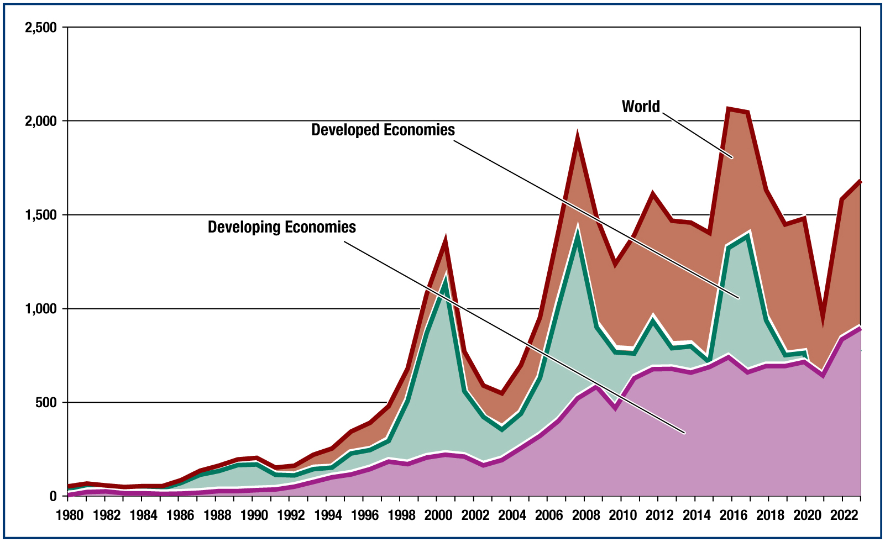
F D I Inflows into World Regions (in Billions of U.S. Dollars per Year)
Sources: U N C T A D, U N C T A D S T A T Database, Inward F D I Flows, Annual (2023); O E C D, F D I Flows (2023),
https://data.oecd.org/fdi/fdi-flows.htm
; World Bank, Foreign Direct Investment, Net Inflows (BoP, Current U S$) (2023),
http://data.worldbank.org
.
Notes:
The exhibit illustrates the dramatic growth of F D I into various world regions since the 1980s. The exhibit reveals that the dollar volume of F D I has grown immensely since the 1980s, especially in advanced economies such as Japan, Europe, and North America. F D I inflows were interrupted in 2001 as investors panicked following the September 11 terrorist attacks in the United States, but the trend has remained strong and growing over time. Particularly significant is the growth of F D I into developing economies, which are nations with lower incomes, less-developed industrial bases, and less investment capital than the advanced economies. Most of the developing economies are located in parts of Africa, Asia, and Latin America. Despite lower income levels, developing economies collectively comprise a substantial and growing proportion of international trade and investment.
https://data.oecd.org/fdi/%20fdi-flows.htm
http://data.worldbank.org/
Long Description:
The horizontal axis represents the year ranging from 1980 to 2022 in increments of 2. The vertical axis ranges from 0 to 2,500 in increments of 500. The area for developing economies shows an increasing trend from 0 in 1980 to 800 in 2023 with fluctuations. It passes through (1992, 50), (2000, 250), (2003, 220), (2008, 550), (2016, 750). The area for developed economies shows an increasing trend from 20 in 1980 to 750 in 2020 and through (1997, 300) with high fluctuations and sharp peaks. The peaks after deep drops are at (2000, 620), (2007, 1450), (2012, 990), (2017, 1450). The area for the world shows an increasing trend from 50 in 1980 to 1650 in 2023 and through (1997, 490) with high fluctuations and sharp peaks. The peaks after deep drops are at (2000, 1400), (2007, 1960), (2012, 1600), (2016, 2050). All values are approximate.

Slide 16
Service Industries That Are Rapidly Internationalizing
Industry | Representative Activities | Representative Companies
Architectural, construction, and engineering | Construction, power utilities, design, engineering services, for airports, hospitals, dams | A B , Bechtel Group, Halliburton, Kajima, Philip Holzman, Skanska A B
Banking, finance, and insurance | Banks, insurance, risk evaluation, management | Bank of America, C I G N A, Barclays, H S B C, Ernst & young
Education, training, and publishing | Management training, technical training, language training | Berlitz, Kumon Math & Reading Centers, N O V A, Pearson, Elsevier
Entertainment | Movies, recorded music, Internet- based entertainment | Time Warner, Sony, Virgin, M G M
Information services | E-commerce, e-mail, funds transfer, data interchange, data processing, computer services | Infosys, E D I, Hitachi, Qualcomm, Cisco
Professional business services | Accounting, advertising, legal, management consulting | Leo Burnett, EYLaw, McKinsey, A.T. Kearney, Booz Allen Hamilton
Transportation | Aviation, ocean shipping, railroads, trucking, airports | Maersk, Santa Fe, Port Authority of New Jersey, S N C F (French railroads)
Travel and tourism | Transportation, lodging, food and beverage, aircraft travel, ocean carriers, railways | Carlson Wagonlit, Marriott, British Airways

Slide 17
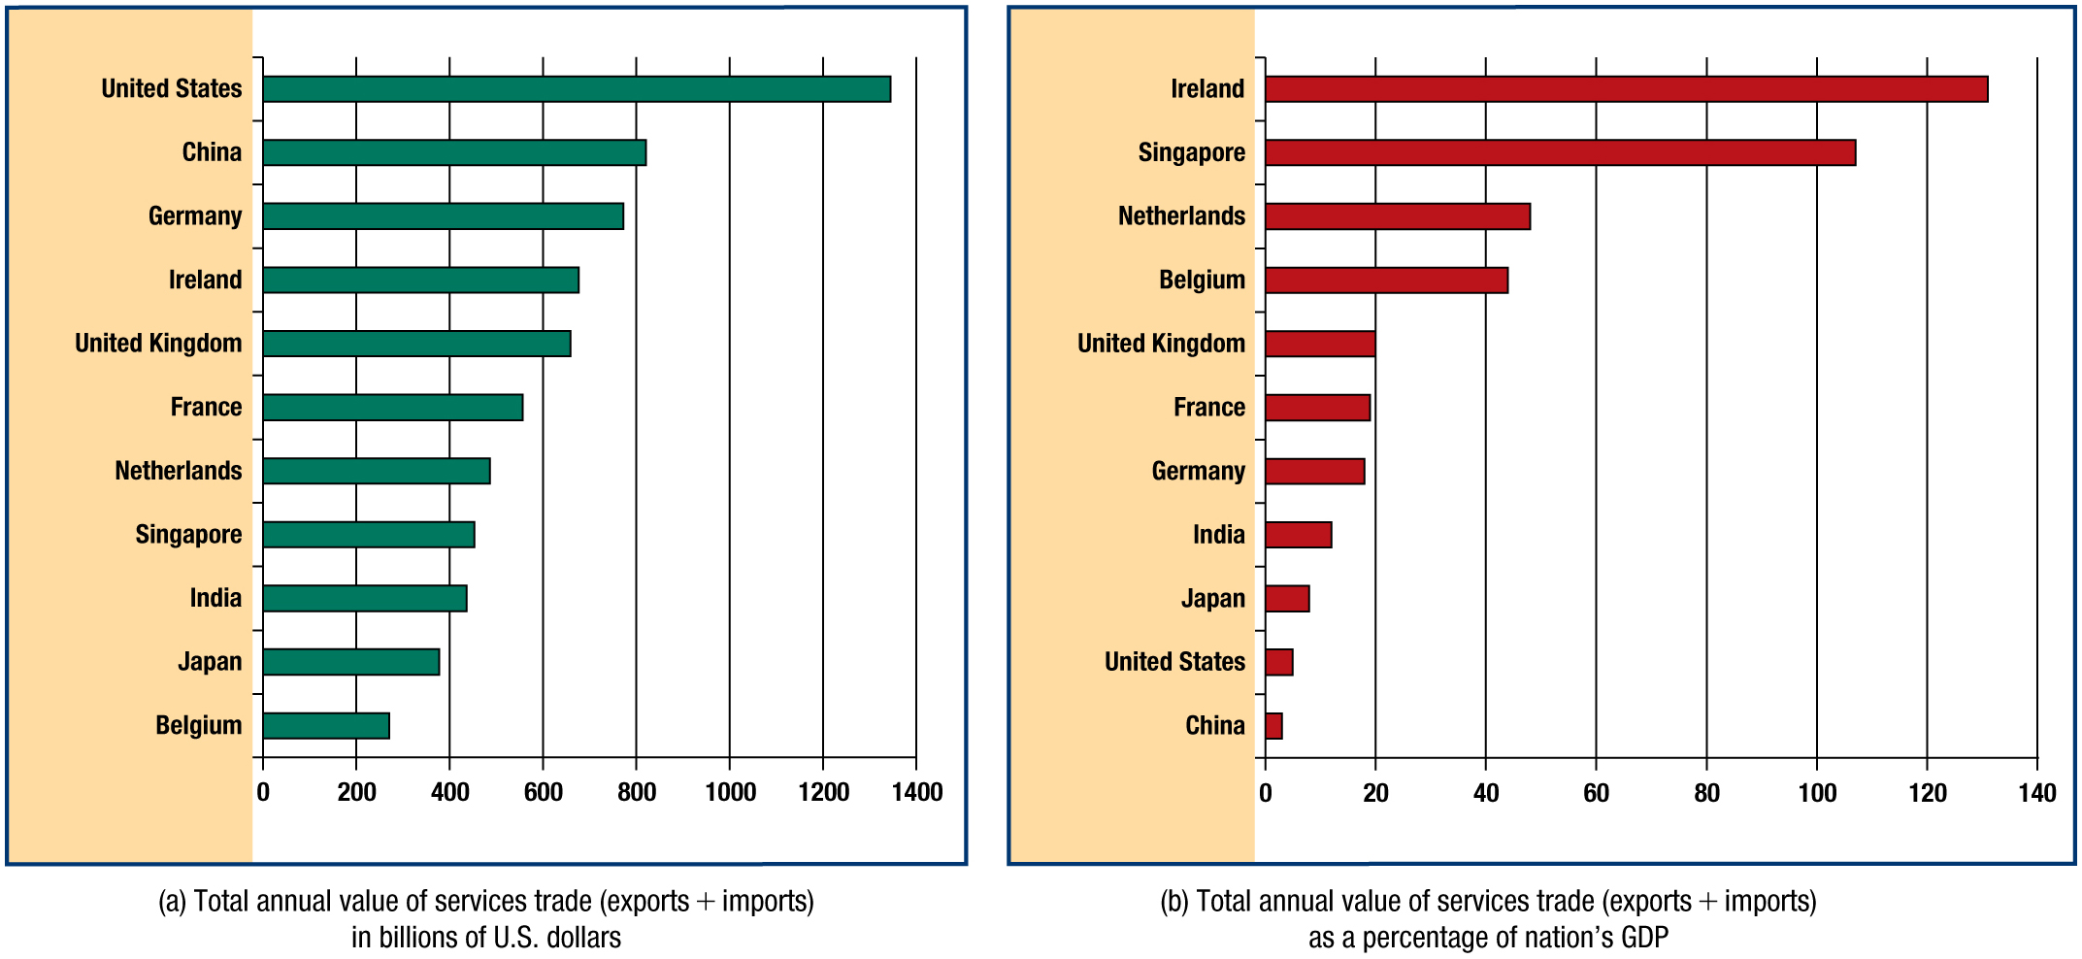
Leading Countries in International Services Trade, by Total Annual Value, $Billions
Based on data from the World Bank, World Development Indicators, Washington, D C: World Bank (2023),
www.worldbank.org
; World Trade Organization, Statistics Database, Geneva: World Trade Organization (2023),
www.wto.org
; U N C T A D, “International Trade in Goods and Services,” U N C T A D S T A T (2023),
www.unctad.org
.
Notes:
Historically, international trade and investment were mainly the domain of companies that make and sell products—tangible merchandise such as clothing, computers, and cars. Today, firms that produce services (intangibles) are key international business players as well. Services are deeds, performances, or efforts performed directly by people working in banks, consulting firms, hotels, construction companies, retailers, and countless other firms in the services sector. For example, if you own a house, your mortgage may be underwritten by the Dutch bank A B N Amro. Perhaps you eat lunch in a cafeteria owned by the French firm Sodexho, which manages the food and beverage operations on numerous university campuses.
In the United States and several European countries, travel and tourism are now the number-one source of revenue from foreigners. International trade in services accounts for about one-quarter of all international trade and is growing rapidly.
In recent years, services trade has been growing faster than products trade. The exhibit identifies the leading countries in total international services trade, including both exports and imports. The exhibit shows the total annual value of services trade in billions of U.S. dollars.
www.worldbank.org
http://www.wto.org/
http://www.unctad.org/
Long Description:
Graph shows the total annual value of product trade (exports plus imports) in billions of U. S. dollars. Its horizontal axis ranges from 0 to 1400 in increments of 200. The vertical axis represents the countries. The graph shows the following data: United States: 1330. China: 815. Germany: 780. Ireland: 660. United Kingdom: 640. France: 570. Netherlands: 470. Singapore: 440. India: 420. Japan: 390. Belgium: 270.

Slide 18
Leading Countries in International Services Trade, Total Value as a % of G D P
Based on data from the World Bank, World Development Indicators, Washington, D C: World Bank (2023),
www.worldbank.org
; World Trade Organization, Statistics Database, Geneva: World Trade Organization (2023),
www.wto.org
;U N C T A D, “International Trade in Goods and Services,” U N C T A D S T A T (2023),
www.unctad.org
.
Notes:
Historically, international trade and investment were mainly the domain of companies that make and sell products—tangible merchandise such as clothing, computers, and cars. Today, firms that produce services (intangibles) are key international business players as well. Services are deeds, performances, or efforts performed directly by people working in banks, consulting firms, hotels, construction companies, retailers, and countless other firms in the services sector. For example, if you own a house, your mortgage may be underwritten by the Dutch bank A B N Amro. Perhaps you eat lunch in a cafeteria owned by the French firm Sodexho, which manages the food and beverage operations on numerous university campuses.
In the United States and several European countries, travel and tourism are now the number-one source of revenue from foreigners. International trade in services accounts for about one-quarter of all international trade and is growing rapidly.
In recent years, services trade has been growing faster than products trade. The exhibit identifies the leading countries in total international services trade, including both exports and imports. The exhibit shows the total annual value of services trade in billions of U.S. dollars.
www.worldbank.org
http://www.wto.org/
http://www.unctad.org/
Long Description:
Graph shows the total annual value of services trade (exports plus imports) as a percentage of the nation’s G D P. Its horizontal axis ranges from 0 to 140 in increments of 20. The vertical axis represents the countries. The graph shows the following data: Ireland: 130. Singapore: 107. Netherlands: 48. Belgium: 43. United Kingdom: 20. France: 19.5. Germany: 19. India: 11. Japan: 8. United States: 5. China: 3. All values are approximate.

Slide 19
International and Domestic Business: How They Differ
International business ….
is conducted across national borders.
uses distinctive business methods.
is in contact with countries that differ in terms of culture, language, political system, legal system, economic situation, infrastructure, and other factors.
Stated differently, when they venture abroad, firms encounter four major types of risk.
Notes:
Firms that engage in international business operate in environments characterized by unique economic conditions, national culture, and legal and political systems. For example, the economic environment of Colombia differs sharply from that of Germany. The legal environment of Saudi Arabia does not resemble that of Japan. The cultural environment of China is very distinct from that of Kenya. Not only does the firm find itself in unfamiliar surroundings, it encounters many uncontrollable variables—factors over which management has little control. These factors introduce new or elevated business risks.

Slide 20
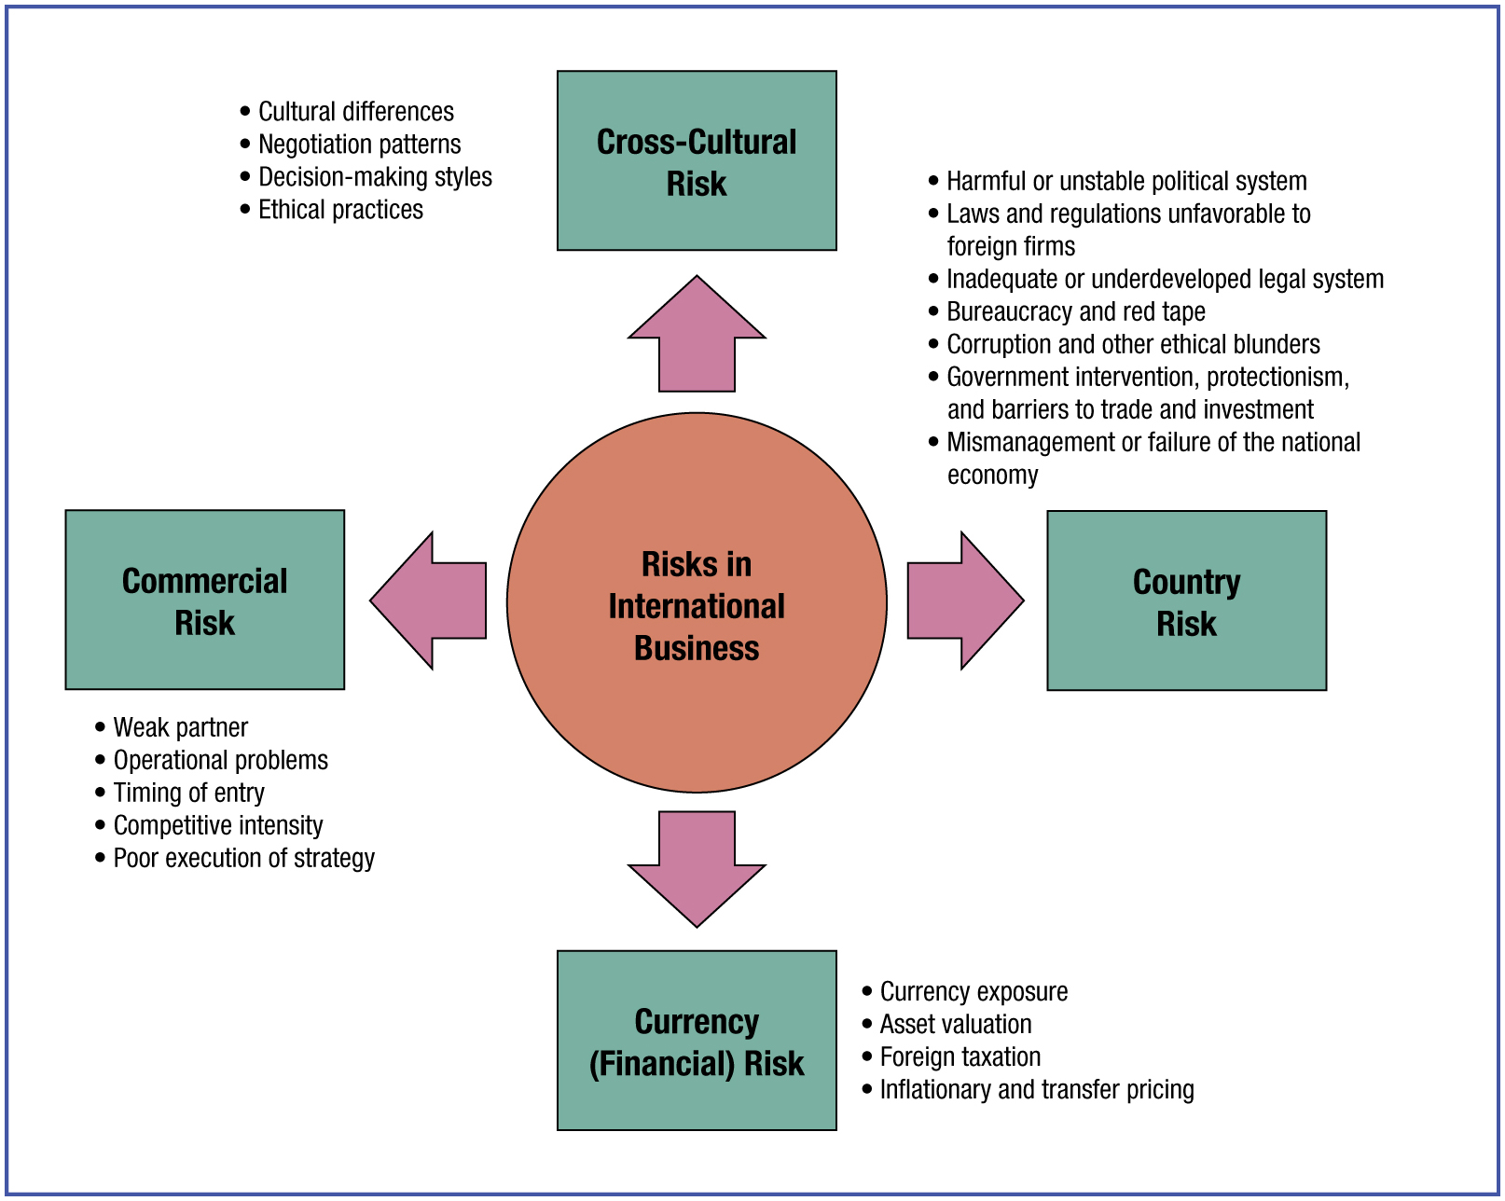
The Four Risks of International Business
Notes:
Long Description:
The illustration shows the following. Risks in international business include cross-cultural risks, commercial risks, currency (financial) risks, and country risks. Cross-cultural risk lists cultural differences. negotiation patterns, decision-making styles, and ethical practices. Commercial risk lists weak partner, operational problems, timing of entry, competitive intensity, and poor execution of strategy. Currency (financial) risk lists currency exposure, asset valuation, foreign taxation, and inflationary and transfer pricing. Country risk lists harmful or unstable political system; laws and regulations unfavorable to foreign firms; inadequate or underdeveloped legal system, bureaucracy and red tape; corruption and other ethical blunders; government intervention, protectionism, and barriers to trade and investment; and mismanagement or failure of the national economy.

Slide 21
Cross-Cultural Risk (1 of 2)
Cultural Differences. Risk arising from differences in language, lifestyle, attitudes, customs, and religion, where a cultural miscommunication jeopardizes a culturally-valued mindset or behavior.
Negotiation Patterns. Negotiations are required in many types of business transactions. For example, where Mexicans are friendly and emphasize social relations, Americans are assertive and get down to business quickly.
Notes:
Cross-cultural risk occurs when a cultural misunderstanding puts some human value at stake. Cross-cultural risk arises from differences in language, lifestyles, mindsets, customs, and religion. Values unique to a culture tend to be long-lasting and transmitted from one generation to the next. These values influence the mindset and work style of employees and the shopping patterns of buyers. Foreign customer characteristics differ significantly from those of buyers in the home market.
Language is a critical dimension of culture. In addition to facilitating communication, language is a window on people’s value systems and living conditions. For example, Inuit (Eskimo) languages have various words for snow, while the South American Aztecs used the same basic word stem for snow, ice, and cold. When translating from one language to another, it is often difficult to find words that convey the same meanings. For example, a one-word equivalent to aftertaste does not exist in many languages. Such challenges impede effective communication and cause misunderstandings. Miscommunication due to cultural differences gives rise to inappropriate business strategies and ineffective relations with customers. Cross-cultural risk most often occurs in encounters in foreign countries. However, the risk also can occur domestically, as when management meets with customers or business associates who visit company headquarters from abroad.

Slide 22
Cross-Cultural Risk (2 of 2)
Decision-Making Styles. Managers make decisions continually on the operations and future direction of the firm. For example, Japanese take considerable time to make important decisions. Canadians tend to be decisive, and “shoot from the hip”.
Ethical Practices. Standards of right and wrong vary considerably around the world. For example, bribery is relatively accepted in some countries in Africa, but is generally unacceptable in Sweden.
Notes:
Appropriate behavior in one culture may be viewed as unethical behavior elsewhere. In China, counterfeiters frequently publish translated versions of imported books without compensating the original publisher or authors, an illegal practice in most of the world. In parts of Africa, accepting expensive gifts from suppliers is acceptable, even if inappropriate elsewhere. In the United States, some C E O s receive compensation hundreds of times greater than that of their most junior employees, a practice widely considered unacceptable. Ethical standards also change over time. Although slavery is no longer tolerated, some multinational firms today tolerate working conditions that are akin to it.

Slide 23
Ethical Connections
In the fashion industry, hundreds of factory workers die annually from dangerous working conditions.
In the production of faded denim jeans, thousands of garment workers develop deadly lung diseases from constant exposure to crystalline silica used to sandblast jeans to give them the worn, vintage look.
Illegal in Europe and the United States, such production methods are still widely used in low-income countries, from where the jeans are then distributed to affluent consumers worldwide.
Source: G. Brown, “Fashion Kills: Industrial Manslaughter in the Global Supply Chain,” E H S Today, September 2010, p. 59.
Notes:
Commercial risk refers to the firm’s potential loss or failure from poorly developed or executed business strategies, tactics, or procedures. Managers may make poor choices in such areas as the selection of business partners, timing of market entry, pricing, creation of product features, and promotional themes. While such failures also exist in domestic business, the consequences are usually more costly when committed abroad. For example, in domestic business a company may terminate a poorly performing distributor simply with advance notice. In foreign markets, however, terminating business partners can be costly due to regulations that protect local firms. Marketing inferior or harmful products, falling short of customer expectations, or failing to provide adequate customer service may damage the firm’s reputation and profitability. Commercial risk is also often affected by currency risk, because fluctuating exchange rates can affect various types of business deals.

Slide 24
Country Risk (Political Risk) (1 of 2)
Government intervention, protectionism, and barriers to trade and investment.
Bureaucracy, red tape, administrative delays, and corruption.
Lack of legal safeguards for intellectual property rights.
Legislation unfavorable to foreign firms.
Economic failures and mismanagement.
Social and political unrest and instability.
Notes:
Country risk (also known as political risk) refers to the potentially adverse effects on company operations and profitability caused by developments in the political, legal, and economic environment in a foreign country. Country risk includes the possibility of foreign government intervention in firms’ business activities. For example, governments may restrict access to markets, impose bureaucratic procedures on business transactions, and limit the amount of income that firms can bring home from foreign operations.
The degree of government intervention in commercial activities varies from country to country. For example, Singapore and Ireland are characterized by substantial economic freedom—that is, a fairly liberal economic environment. By contrast, the Chinese and Russian governments regularly intervene in business affairs.
Country risk also includes laws and regulations that potentially hinder company operations and performance. Critical legal dimensions include property rights, intellectual property protection, product liability, and taxation policies. Nations also experience potentially harmful economic conditions, often due to high inflation, national debt, and unbalanced international trade. Indeed, the global financial crisis plunged many nations into a deep recession in 2009.

Slide 25
Country Risk (Political Risk) (2 of 2)
Examples
The United States imposes tariffs on imports of sugar and other agricultural products.
Doing business in Russia often requires paying bribes to government officials.
Venezuela’s government has interfered much with the operations of foreign firms.
Argentina has suffered high inflation and other economic turmoil.
Notes:
Country risk (also known as political risk) refers to the potentially adverse effects on company operations and profitability caused by developments in the political, legal, and economic environment in a foreign country. Country risk includes the possibility of foreign government intervention in firms’ business activities. For example, governments may restrict access to markets, impose bureaucratic procedures on business transactions, and limit the amount of income that firms can bring home from foreign operations.
The degree of government intervention in commercial activities varies from country to country. For example, Singapore and Ireland are characterized by substantial economic freedom—that is, a fairly liberal economic environment. By contrast, the Chinese and Russian governments regularly intervene in business affairs.
Country risk also includes laws and regulations that potentially hinder company operations and performance. Critical legal dimensions include property rights, intellectual property protection, product liability, and taxation policies. Nations also experience potentially harmful economic conditions, often due to high inflation, national debt, and unbalanced international trade. Indeed, the global financial crisis plunged many nations into a deep recession in 2009.

Slide 26
Currency Risk (Financial Risk) (1 of 2)
Currency exposure. General risk of unfavorable exchange rate fluctuations.
Asset valuation. Risk that exchange rate fluctuations will adversely affect the value of the firm’s assets and liabilities.
Foreign taxation. Income, sales, and other taxes vary widely worldwide, with implications for company performance and profitability.
Inflationary pricing. High inflation, common to many countries, complicates business planning, and the pricing of inputs and finished goods.
Notes:
Currency risk (also known as financial risk) refers to the risk of adverse fluctuations in exchange rates. Fluctuation is common for exchange rates—the value of one currency in terms of another. Currency risk arises because international transactions are often conducted in more than one national currency. For example, when U.S. fruit processor Graceland Fruit Inc. exports dried cherries to Japan, it is normally paid in Japanese yen. When currencies fluctuate significantly, the value of the firm’s earnings can be reduced. The cost of importing parts or components used in manufacturing finished products can increase dramatically if the value of the currency in which the imports are denominated rises sharply. Inflation and other harmful economic conditions experienced in one country may have immediate consequences for exchange rates due to the interconnectedness of national economies.

Slide 27
Currency Risk (Financial Risk) (2 of 2)
Examples
The Japanese yen has fluctuated a lot in recent years.
The United States has relatively high corporate income taxes.
Argentina and Turkey have experienced very high inflation.
Notes:
Currency risk (also known as financial risk) refers to the risk of adverse fluctuations in exchange rates. Fluctuation is common for exchange rates—the value of one currency in terms of another. Currency risk arises because international transactions are often conducted in more than one national currency. For example, when U.S. fruit processor Graceland Fruit Inc. exports dried cherries to Japan, it is normally paid in Japanese yen. When currencies fluctuate significantly, the value of the firm’s earnings can be reduced. The cost of importing parts or components used in manufacturing finished products can increase dramatically if the value of the currency in which the imports are denominated rises sharply. Inflation and other harmful economic conditions experienced in one country may have immediate consequences for exchange rates due to the interconnectedness of national economies.

Slide 28
Commercial Risk
Weak partner
Operational problems
Timing of entry
Competitive intensity
Poor execution of strategy
General commercial risks such as these lead to sub-optimal formulation and implementation of the firm’s international value-chain activities.
Notes:
Commercial risk refers to the firm’s potential loss or failure from poorly developed or executed business strategies, tactics, or procedures. Managers may make poor choices in such areas as the selection of business partners, timing of market entry, pricing, creation of product features, and promotional themes. While such failures also exist in domestic business, the consequences are usually more costly when committed abroad. For example, in domestic business a company may terminate a poorly performing distributor simply with advance notice. In foreign markets, however, terminating business partners can be costly due to regulations that protect local firms. Marketing inferior or harmful products, falling short of customer expectations, or failing to provide adequate customer service may damage the firm’s reputation and profitability. Commercial risk is also often affected by currency risk, because fluctuating exchange rates can affect various types of business deals.

Slide 29
The Four Risks of International Business: Conclusion
Always present but manageable.
Managers need to understand, anticipate, and take proactive action to reduce their effects.
Some risks are extremely challenging.
Example
The Covid-19 pandemic generated many commercial, currency, and country risks, affecting companies worldwide. This led to large declines in national stock markets and normal business activity.
Notes:
Commercial risk refers to the firm’s potential loss or failure from poorly developed or executed business strategies, tactics, or procedures. Managers may make poor choices in such areas as the selection of business partners, timing of market entry, pricing, creation of product features, and promotional themes. While such failures also exist in domestic business, the consequences are usually more costly when committed abroad. For example, in domestic business a company may terminate a poorly performing distributor simply with advance notice. In foreign markets, however, terminating business partners can be costly due to regulations that protect local firms. Marketing inferior or harmful products, falling short of customer expectations, or failing to provide adequate customer service may damage the firm’s reputation and profitability. Commercial risk is also often affected by currency risk, because fluctuating exchange rates can affect various types of business deals.

Slide 30
Who Participates in International Business? (1 of 2)
Multinational enterprise (M N E): A large company with substantial resources that performs various business activities through a network of subsidiaries and affiliates located in multiple countries (e.g., Disney, Microsoft, Samsung, Unilever, Vodafone).
Small and medium-sized enterprise (S M E): Typically, companies with 500 or fewer employees, comprising over 90% of all firms in most countries. S M E s increasingly engage in international business.
Born global firm: A young, entrepreneurial S M E that undertakes substantial international business at or near its founding.
Notes:
Multinational enterprises (also known as multinational corporations) historically have been the most important type of focal firm. A multinational enterprise (M N E) is a large company with substantial resources that performs various business activities through a network of subsidiaries and affiliates located in multiple countries. M N E s carry out research and development (R&D), procurement, manufacturing, and marketing activities wherever in the world the firm can reap the most advantages.
For example, Alcon is a Swiss pharmaceutical firm that established major R&D facilities in the United States to take advantage of the country’s superior know-how in the chemicals sector. Verizon Wireless has located much of its technical support operations in India, to take advantage of high-quality, low-cost customer support personnel located there. Royal Dutch Shell owns several oil refineries and nearly 2,000 gasoline stations in Canada. In addition to a home office or headquarters, the typical M N E owns a worldwide network of subsidiaries. It collaborates with numerous suppliers and independent business partners abroad (sometimes termed affiliates). Typical M N E s include Barclays, Caterpillar, Disney, D H L, Four Seasons Hotels, Samsung, Unilever, Vodafone, and Nippon Life Insurance. In recent years, the largest M N E s have been firms in the oil industry (such as Exxon-Mobil and Royal Dutch Shell) and the automotive industry (General Motors and Honda), as well as retailing (Walmart).
Many small and medium-sized enterprises (S M E s) participate in international business as well. An SME is a company with less than 500 employees, as defined in Canada and the United States. In the European Union, S M E s are defined as firms with less than 250 employees. In addition to accounting for smaller market shares of their respective industries, S M E s tend to have limited managerial and other resources and primarily use exporting to expand internationally. However, in most nations, S M E s constitute the great majority of all firms. With the globalization of markets, advances in various technologies, and other facilitating factors, many more S M E s are pursuing international opportunities. S M E s account for about one third of exports from Asia and about a quarter of exports from the affluent countries in Europe and North America. In some countries—for example, Italy, South Korea, and China—S M E s contribute roughly 50 percent of total national exports.
One type of contemporary international S M E is the born global firm, a young entrepreneurial company that initiates international business activity very early in its evolution, moving rapidly into foreign markets. Born globals are found in advanced economies, such as Australia and Japan, and in emerging markets, such as China and India. International business requires specialized knowledge, commitment of resources, and considerable time to develop foreign business partnerships. How do S M E s succeed in international business despite resource limitations? First, compared to large M N E s, smaller firms are often more innovative and adaptable and have quicker response times when it comes to implementing new ideas and technologies and meeting customer needs. Second, S M E s are better able to serve niche markets around the world that hold little interest for M N E s. Third, smaller firms are usually avid users of information and communication technologies, including the Internet. Fourth, as they usually lack substantial resources, smaller firms minimize overhead or fixed investments. They rely on external facilitators such as FedEx and D H L, as well as independent distributors in foreign markets. Fifth, smaller firms tend to thrive on private knowledge that they possess or produce. They access and mobilize resources through their cross-border knowledge networks or their international social capital.

Slide 31
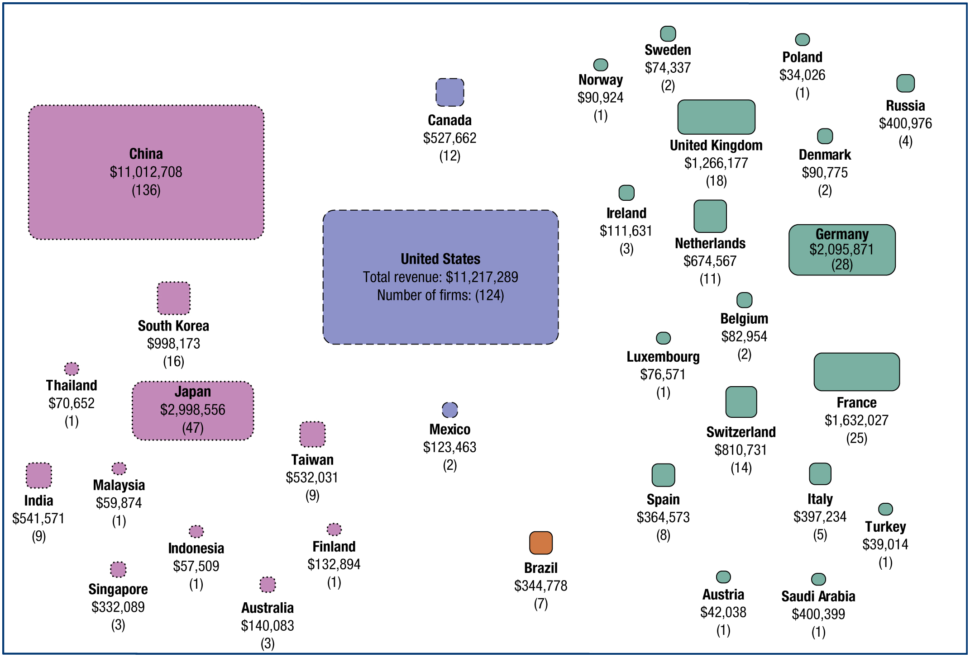
Geographic Locations of the 500 Largest Multinational Enterprises
Source: Fortune, “Global 500,” 2022,
http://fortune.com
; Fortune, “Visualize the Global 500,” 2023,
http://fortune.com
The exhibit shows country name, total revenues of Global 500 firms in U.S. dollars, and total number of Global 500 firms.
Notes:
Typical M N E s include Barclays, Caterpillar, Disney, D H L, Four Seasons Hotels, Samsung, Unilever, Vodafone, and Nippon Life Insurance. In recent years, the largest M N E s have been firms in the oil industry (such as Exxon-Mobil and Royal Dutch Shell) and the automotive industry (General Motors and Honda), as well as retailing (Walmart). The Exhibit shows the geographic distribution of the world’s largest M N E s, drawn from Fortune’s Global 500 list. As shown, these firms are concentrated in the advanced economies. The United States is home to a large but falling number of the top 500 M N E s. China now has the second-most M N E s, followed by Germany. Collectively, the European Union countries have more top 500 firms than the United States.
In recent years, large M N E s have begun to appear in emerging market countries, such as China, Mexico, and Russia. China hosts the second largest number of the top 500 M N E s, a number that has increased dramatically in the past decade. Most of China’s top firms are state enterprises, that is, owned by the Chinese government, which provides them substantial advantages.
The “new global challenger” firms from emerging markets are fast becoming key contenders in world markets. For example, the Mexican firm Cemex is one of the world’s largest cement producers. In Russia, Lukoil has big ambitions in the global energy sector. China Mobile dominates the cell phone industry in Asia. The new global challengers make best use of home-country natural resources and low-cost labor to succeed in world markets. Thousands of firms from emerging markets have big global dreams and pose competitive challenges to companies from the advanced economies.
http://fortune.com/
Long Description:
The illustration shows data in the format country name: total revenues of the Global 500 firms in billions of U. S. dollars, total number of Global 500 firms as follows: Thailand: 70,652 dollars, 1; India: 541,571 dollars, 9; China: 11,012,708 dollars, 136; South Korea: 998,173 dollars, 16; Malaysia: 59,874 dollars, 1; Singapore: 332,089 dollars, 3; Japan: 2,998,556 dollars, 47; Indonesia: 57,509 dollars, 1; Taiwan: 532,031 dollars, 9; Australia: 140,083 dollars, 3; Canada: 527,662 dollars, 12; United States: Total revenue: 11,217,289 dollars, Number of firms: 124; Finland: 132,894 dollars, 1; Mexico: 123,463 dollars, 2; Brazil: 344,778 dollars, 7; Norway: 90,924 dollars, 1; Sweden: 74,337 dollars, 2; Ireland: 111,631 dollars, 3; United Kingdom: 1,266,177 dollars, 18; Netherlands: 674,567 dollars, 11; Luxembourg: 76,571 dollars, 1; Spain: 364,573 dollars, 8; Belgium: 82,954 dollars, 2; Switzerland: 810,731 dollars, 14; Austria: 42,038 dollars, 1; Poland: 34,026 dollars, 1; Denmark: 90,775 dollars, 2; Germany: 2,095,871 dollars, 28; France: 1,632,027 dollars, 25; Italy: 397,234 dollars, 5; Russia: 400,976 dollars, 4; Saudi Arabia: 400,399 dollars, 1; Turkey: 39,014; dollars, 1.

Slide 32
Who Participates in International Business? (2 of 2)
Governments: Associated with government intervention and specific political systems
Non-governmental organizations(N G O s): Many such non-profit organizations conduct cross-border activities. They pursue special causes and serve as advocates for social issues, education, politics, and research.
Examples
The Bill and Melinda Gates Foundation and the British Welcome Trust both support health and educational initiatives.
C A R E is an international non-profit organization dedicated to reducing poverty.
Notes:
Commercial risk refers to the firm’s potential loss or failure from poorly developed or executed business strategies, tactics, or procedures. Managers may make poor choices in such areas as the selection of business partners, timing of market entry, pricing, creation of product features, and promotional themes. While such failures also exist in domestic business, the consequences are usually more costly when committed abroad. For example, in domestic business a company may terminate a poorly performing distributor simply with advance notice. In foreign markets, however, terminating business partners can be costly due to regulations that protect local firms. Marketing inferior or harmful products, falling short of customer expectations, or failing to provide adequate customer service may damage the firm’s reputation and profitability. Commercial risk is also often affected by currency risk, because fluctuating exchange rates can affect various types of business deals.

Slide 33

Nongovernmental Organizations
The British Welcome Trust funds nongovernmental organizations (N G O s)and research initiatives to work in collaboration with private businesses to develop remedies for diseases in Africa and other less-developed areas.
Notes:
The British Welcome Trust funds’ non-governmental organizations (N G O s) and research initiatives work in collaboration with private businesses to develop remedies for diseases in Africa and other less developed areas around the world.

Slide 34
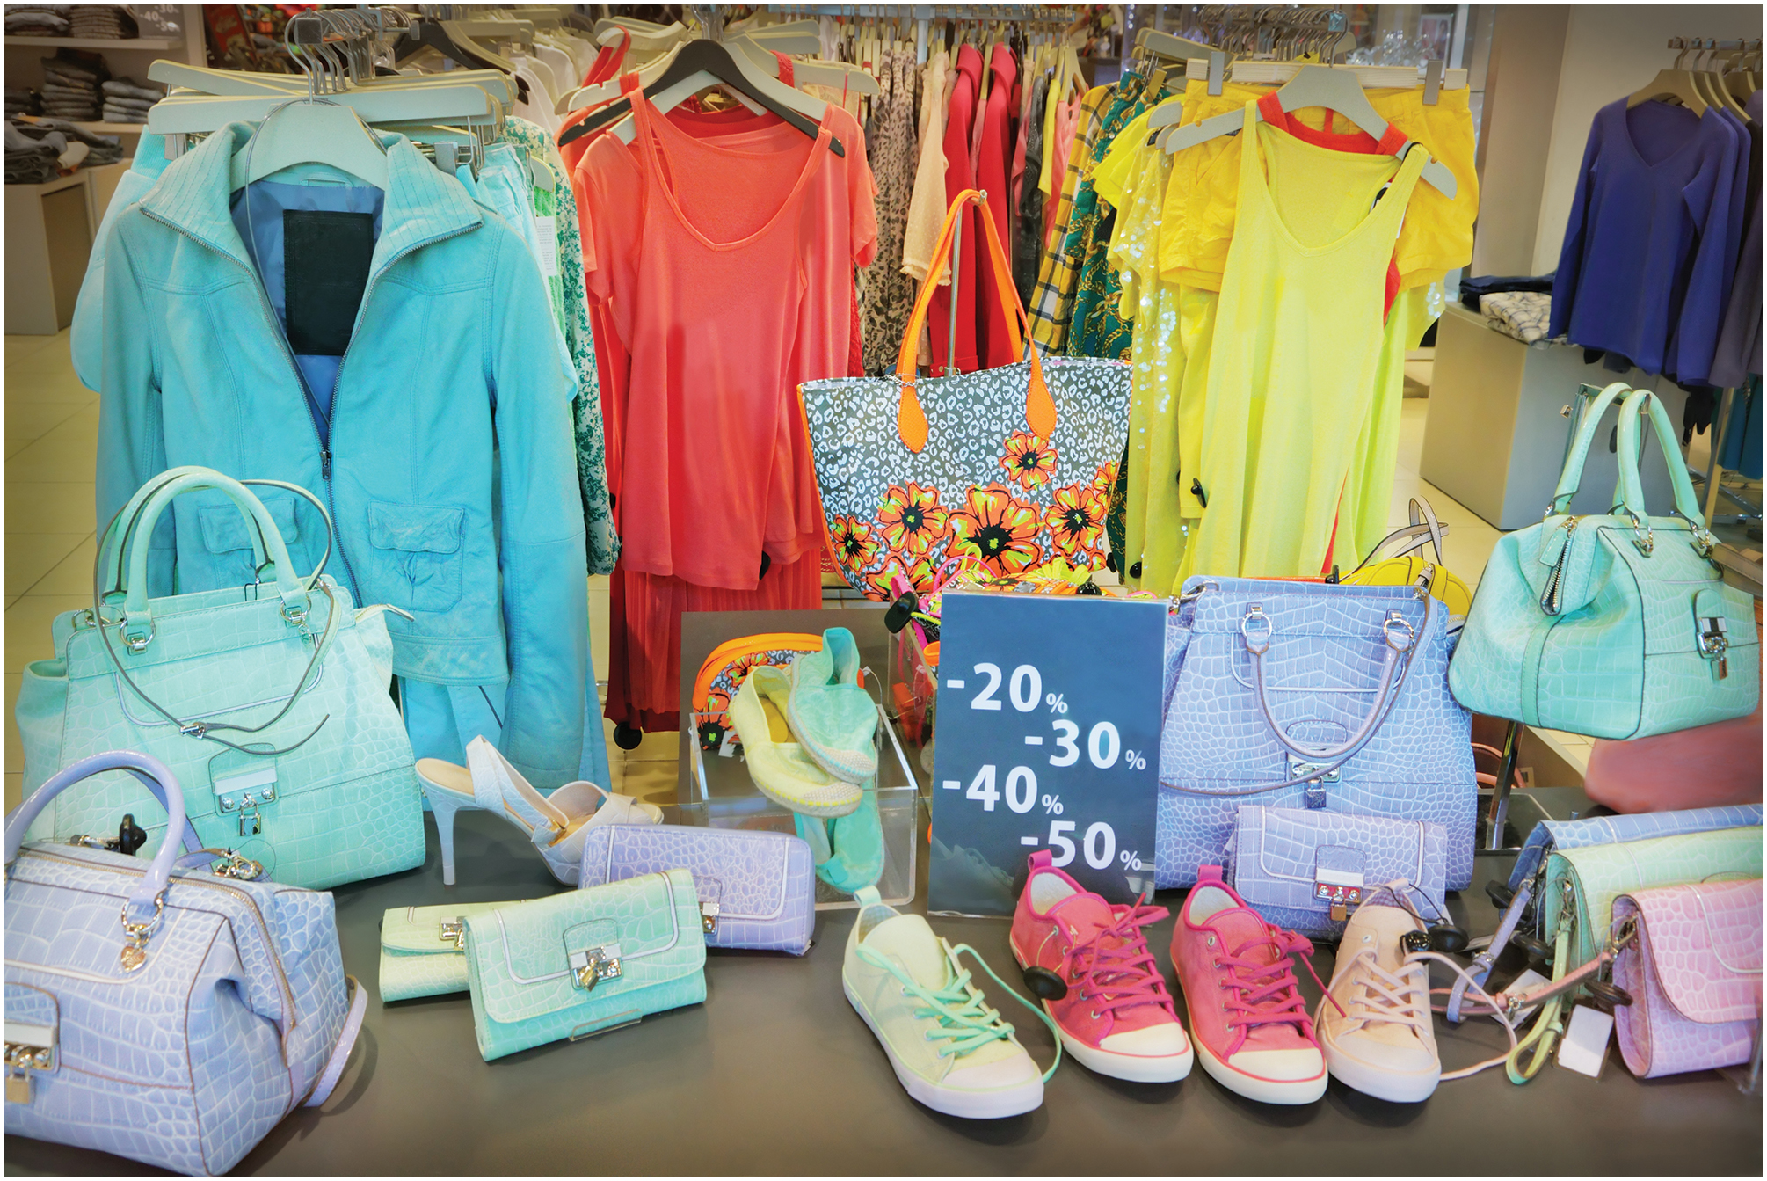
Why Do Firms Internationalize?
Seek opportunities for growth through market diversification. For example, Harley-Davidson, I K E A, H&M.
Earn higher margins and profits. Often, foreign markets are more profitable.
Gain new ideas about products, services, and business methods. For example, G M refined its knowledge for making small, fuel-efficient cars in Europe. Retailer H&M gains new product ideas by following fashion trends around the world.
Notes:
Seek opportunities for growth through market diversification. Many firms—for example, Gillette, Siemens, Sony, Biogen—derive more than half of their sales from international markets. In addition to offering sales opportunities that often cannot be matched at home, foreign markets can extend the marketable life of products or services that have reached maturity in the home market. One example is the internationalization of automatic teller machines (A T M s). The first A T M was installed outside a London branch of Barclays Bank in 1967. The machines were next adopted in the United States and Japan. As growth of A T M s began to slow in these countries, they were marketed throughout the rest of the world. Today there are more than 1.5 million A T M s worldwide; a new one is installed somewhere every few minutes. Earn higher margins and profits. For many types of products and services, market growth in mature economies is sluggish or flat. Competition is often intense, forcing firms to get by on slim profit margins. By contrast, most foreign markets may be underserved (typical of high-growth emerging markets) or not served at all (typical of developing economies). Less intense competition, combined with strong market demand, implies that companies can command higher margins for their offerings. For example, compared to their home markets, bathroom fixture manufacturers American Standard and Toto (of Japan) have found more favorable competitive environments in rapidly industrializing countries such as Indonesia, Mexico, and Vietnam. Just imagine the demand for bathroom fixtures in the thousands of office buildings and residential complexes going up from Shanghai to Singapore!
Gain new ideas about products, services, and business methods. International markets are characterized by tough competitors and demanding customers with various needs. Unique foreign environments expose firms to new ideas for products, processes, and business methods. The experience of doing business abroad helps firms acquire new knowledge for improving organizational effectiveness and efficiency. For example, just-in-time inventory techniques were refined by Toyota in Japan and then adopted by other manufacturers around the world. Numerous foreign suppliers learned about just-in-time from Toyota and then applied the method to manufacturing in their own countries.

Slide 35
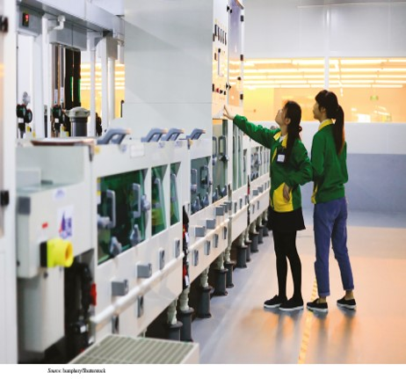
Why Do Firms Participate in I B? (1 of 2)
Serve key customers that have relocated abroad. For example, when Toyota launched its operations in Britain, many of its suppliers followed suit.
Be closer to supply sources, benefit from global sourcing advantages, or gain flexibility in the sourcing of products. For example, Apple sources parts and components from the best suppliers worldwide.
Gain access to lower-cost or better-value factors of production. For example, Sony does much manufacturing in China.
Notes:
Better serve key customers that have relocated abroad. In a global economy, many firms internationalize to better serve clients that have moved into foreign markets. For example, when Nissan opened its first factory in the United Kingdom, many Japanese auto parts suppliers followed, establishing their own operations there.
Be closer to supply sources, benefit from global sourcing advantages, or gain flexibility in product sourcing. Companies in extractive industries such as petroleum, mining, and forestry establish international operations where these raw materials are located. One example is the aluminum producer Alcoa, which established operations in Brazil, Guinea, Jamaica, and elsewhere to extract aluminum’s base mineral bauxite from local mines. Some firms internationalize to gain flexibility from a greater variety of supply bases. Dell Computer has assembly facilities in Asia, Europe, and the Americas that allow management to quickly shift production from one region to another. This flexibility provides Dell with competitive advantages over less agile rivals—a distinctive capability that allows Dell to outperform competitors and skillfully manage fluctuations in currency exchange rates.

Slide 36
Why Do Firms Participate in I B? (2 of 2)
Develop economies of scale in sourcing, production, marketing, and R & D. For example, Airbus lowers its overall costs by sourcing, manufacturing, and selling aircraft worldwide.
Confront international competitors more effectively or thwart the growth of competition in the home market. Chinese appliance maker Haier established operations in the United States, partly to gain competitive knowledge about Whirlpool, its chief U S rivals.
Invest in a potentially rewarding relationship with a foreign partner. French computer firm Groupe Bull partnered with Toshiba in Japan to gain insights for developing information technology.
Notes:
Gain access to lower-cost or better-value factors of production. Internationalization enables the firm to access capital, technology, managerial talent, and labor at lower costs, higher quality, or better value. For example, some Taiwanese computer manufacturers established subsidiaries in the United States to access low-cost capital. The United States is home to numerous capital sources in the high-tech sector, such as stock exchanges and venture capitalists, which have attracted countless firms from abroad seeking funds. More commonly, firms venture abroad in search of skilled or low-cost labor. For example, the Japanese firm Canon relocated much of its production to China to profit from that country’s inexpensive and productive workforce.
Develop economies of scale in sourcing, production, marketing, and R&D. Economies of scale reduce the per-unit cost of manufacturing due to operating at high volume. For example, the per-unit cost of manufacturing 100,000 cameras is much cheaper than the per-unit cost of making just 100 cameras. By expanding internationally, the firm greatly increases the size of its customer base, thereby increasing the volume of products it manufactures. On a per-unit-of-output basis, the greater the volume of production, the lower the total cost. Economies of scale are also present in R&D, sourcing, marketing, distribution, and after-sales service.

Slide 37

I B Contributes to National Economic Well-Being
A popular shopping street in Beijing, China
Notes:
Facilitator of the Global Economy and Interconnectedness. Since the 1980s, emerging markets have provided new impetus to worldwide economic interconnectedness. These fast-growth developing economies—some thirty countries, including Brazil, Russia, India, and China, the so-called B R I C s—are experiencing substantial market liberalization, privatization, and industrialization, which are fueling global economic transformation. Located on every continent, they are gradually breaking away from the stagnation typical of developing economies. The emerging markets are home to the largest proportion of world population and participate increasingly in foreign trade. The rise of information and communication technologies, as well as production and process technologies, has dramatically reduced the cost of conducting business with customers around the world. E-commerce makes international business increasingly imperative for firms of all sizes and resource levels.
Contributor to National Economic Well-Being. International business contributes to economic prosperity, helps countries use their resources more efficiently, and provides interconnectedness to the world economy and access to a range of products and services. It is estimated that every $1 billion increase in exports creates more than 20,000 new jobs. In the United States, cross-border trade directly supports at least twelve million jobs. One of every seven dollars of U.S. sales is made abroad. One of every three U.S. farm acres and one of every six U.S. jobs is producing for export markets. On average, exporting firms create jobs faster and provide better pay than non-exporting firms. There is a strong relationship between national prosperity and participation in international trade and investment. Nations once suffering from economic stagnation are now increasingly prosperous. For example, China, India, and Eastern European nations are active international traders. The proportion of affluent citizens in these countries is growing rapidly.
A Competitive Advantage for the Firm. To sustain a competitive advantage in the global economy, firms must readily participate in cross-border business and acquire the necessary skills, knowledge, and competence. Procter & Gamble sells shampoo, disposable diapers, and other consumer products in more than 150 countries. M T V broadcasts its programming in some 140 countries. Nestlé sells its food and beverage products worldwide, obtaining nearly all its revenue from foreign operations. In addition, international business allows firms to maximize the efficiency of their operations. Companies secure cost-effective factor inputs by establishing manufacturing in emerging markets. For example, Microsoft cuts the costs of its operations by having much of its software written in India. Renault achieves efficiency by assembling cars at low-cost factories in Romania. International business helps firms reduce the costs of new product development, after-sales service, and other critical business activities. Companies access foreign sources of information and knowledge that provide the basis for future R&D, improved production and administrative processes, and other innovations. Finally, internationalization broadens the firm’s options for dealing with competitors.

Slide 38
Why Study International Business?
Facilitator of the global economy and interconnectedness. I B brings nations closer together.
Contributor to national economic well-being. I B fuels economic growth and rising living standards.
A competitive advantage for the firm. I B provides companies with many benefits, leading to profitability and competitive advantages.
A competitive advantage for you. Working internationally offers a range of enlightening experiences, new knowledge, and other benefits that enhance careers….and it’s exciting!
An opportunity to support ethics, sustainability and corporate citizenship. Firms must be responsible in their dealings because I B affects numerous constituents
Notes:
Facilitator of the Global Economy and Interconnectedness. Since the 1980s, emerging markets have provided new impetus to worldwide economic interconnectedness. These fast-growth developing economies—some thirty countries, including Brazil, Russia, India, and China, the so-called BRICs—are experiencing substantial market liberalization, privatization, and industrialization, which are fueling global economic transformation. Located on every continent, they are gradually breaking away from the stagnation typical of developing economies. The emerging markets are home to the largest proportion of world population and participate increasingly in foreign trade. The rise of information and communication technologies, as well as production and process technologies, has dramatically reduced the cost of conducting business with customers around the world. E-commerce makes international business increasingly imperative for firms of all sizes and resource levels.
Contributor to National Economic Well-Being. International business contributes to economic prosperity, helps countries use their resources more efficiently, and provides interconnectedness to the world economy and access to a range of products and services. It is estimated that every $1 billion increase in exports creates more than 20,000 new jobs. In the United States, cross-border trade directly supports at least twelve million jobs. One of every seven dollars of U.S. sales is made abroad. One of every three U.S. farm acres and one of every six U.S. jobs is producing for export markets. On average, exporting firms create jobs faster and provide better pay than non-exporting firms. There is a strong relationship between national prosperity and participation in international trade and investment. Nations once suffering from economic stagnation are now increasingly prosperous. For example, China, India, and Eastern European nations are active international traders. The proportion of affluent citizens in these countries is growing rapidly.
A Competitive Advantage for the Firm. To sustain a competitive advantage in the global economy, firms must readily participate in cross-border business and acquire the necessary skills, knowledge, and competence. Procter & Gamble sells shampoo, disposable diapers, and other consumer products in more than 150 countries. M T V broadcasts its programming in some 140 countries. Nestlé sells its food and beverage products worldwide, obtaining nearly all its revenue from foreign operations. In addition, international business allows firms to maximize the efficiency of their operations. Companies secure cost-effective factor inputs by establishing manufacturing in emerging markets. For example, Microsoft cuts the costs of its operations by having much of its software written in India. Renault achieves efficiency by assembling cars at low-cost factories in Romania. International business helps firms reduce the costs of new product development, after-sales service, and other critical business activities. Companies access foreign sources of information and knowledge that provide the basis for future R&D, improved production and administrative processes, and other innovations. Finally, internationalization broadens the firm’s options for dealing with competitors.

Slide 39

You Can Do It: Mary Lyles (1 of 2)
Mary is a real person, who got her undergraduate degree from a state university a few years ago. Read her profile in Chapter 1.
Mary’s majors: International business and Spanish.
Success factors: Networking, setting goals, developing a global mindset.
Source: Courtesy of Mary Lyles

Slide 40
You Can Do It: Mary Lyles (2 of 2)
Mary’s jobs since college:
Buyer and private label project manager
Sourcing analyst for Starbucks
Senior sourcing analyst for Starbucks
Dealing with cultural differences is challenging.
Mary’s passion for international business is paying off.

Slide 41
Career Preparation: Travel Abroad
Traveling internationally requires thorough preparation.
Documents required for international travel include a passport and a visa.
It is best to comply with security, safety, and health care requirements of countries that your visit.
Adapt to differences in currency and electricity standards in the countries your visit.
Understand local laws and obtain an international driving permit if you intend to drive a car abroad.

Slide 42

Copyright
This work is protected by United Kingdom copyright laws and is provided solely for the use of instructors in teaching their courses and assessing student learning. Dissemination or sale of any part of this work (including on the World Wide Web) will destroy the integrity of the work and is not permitted. The work and materials from it should never be made available to students except by instructors using the accompanying text in their classes. All recipients of this work are expected to abide by these restrictions and to honor the intended pedagogical purposes and the needs of other instructors who rely on these materials.

