Slide 1
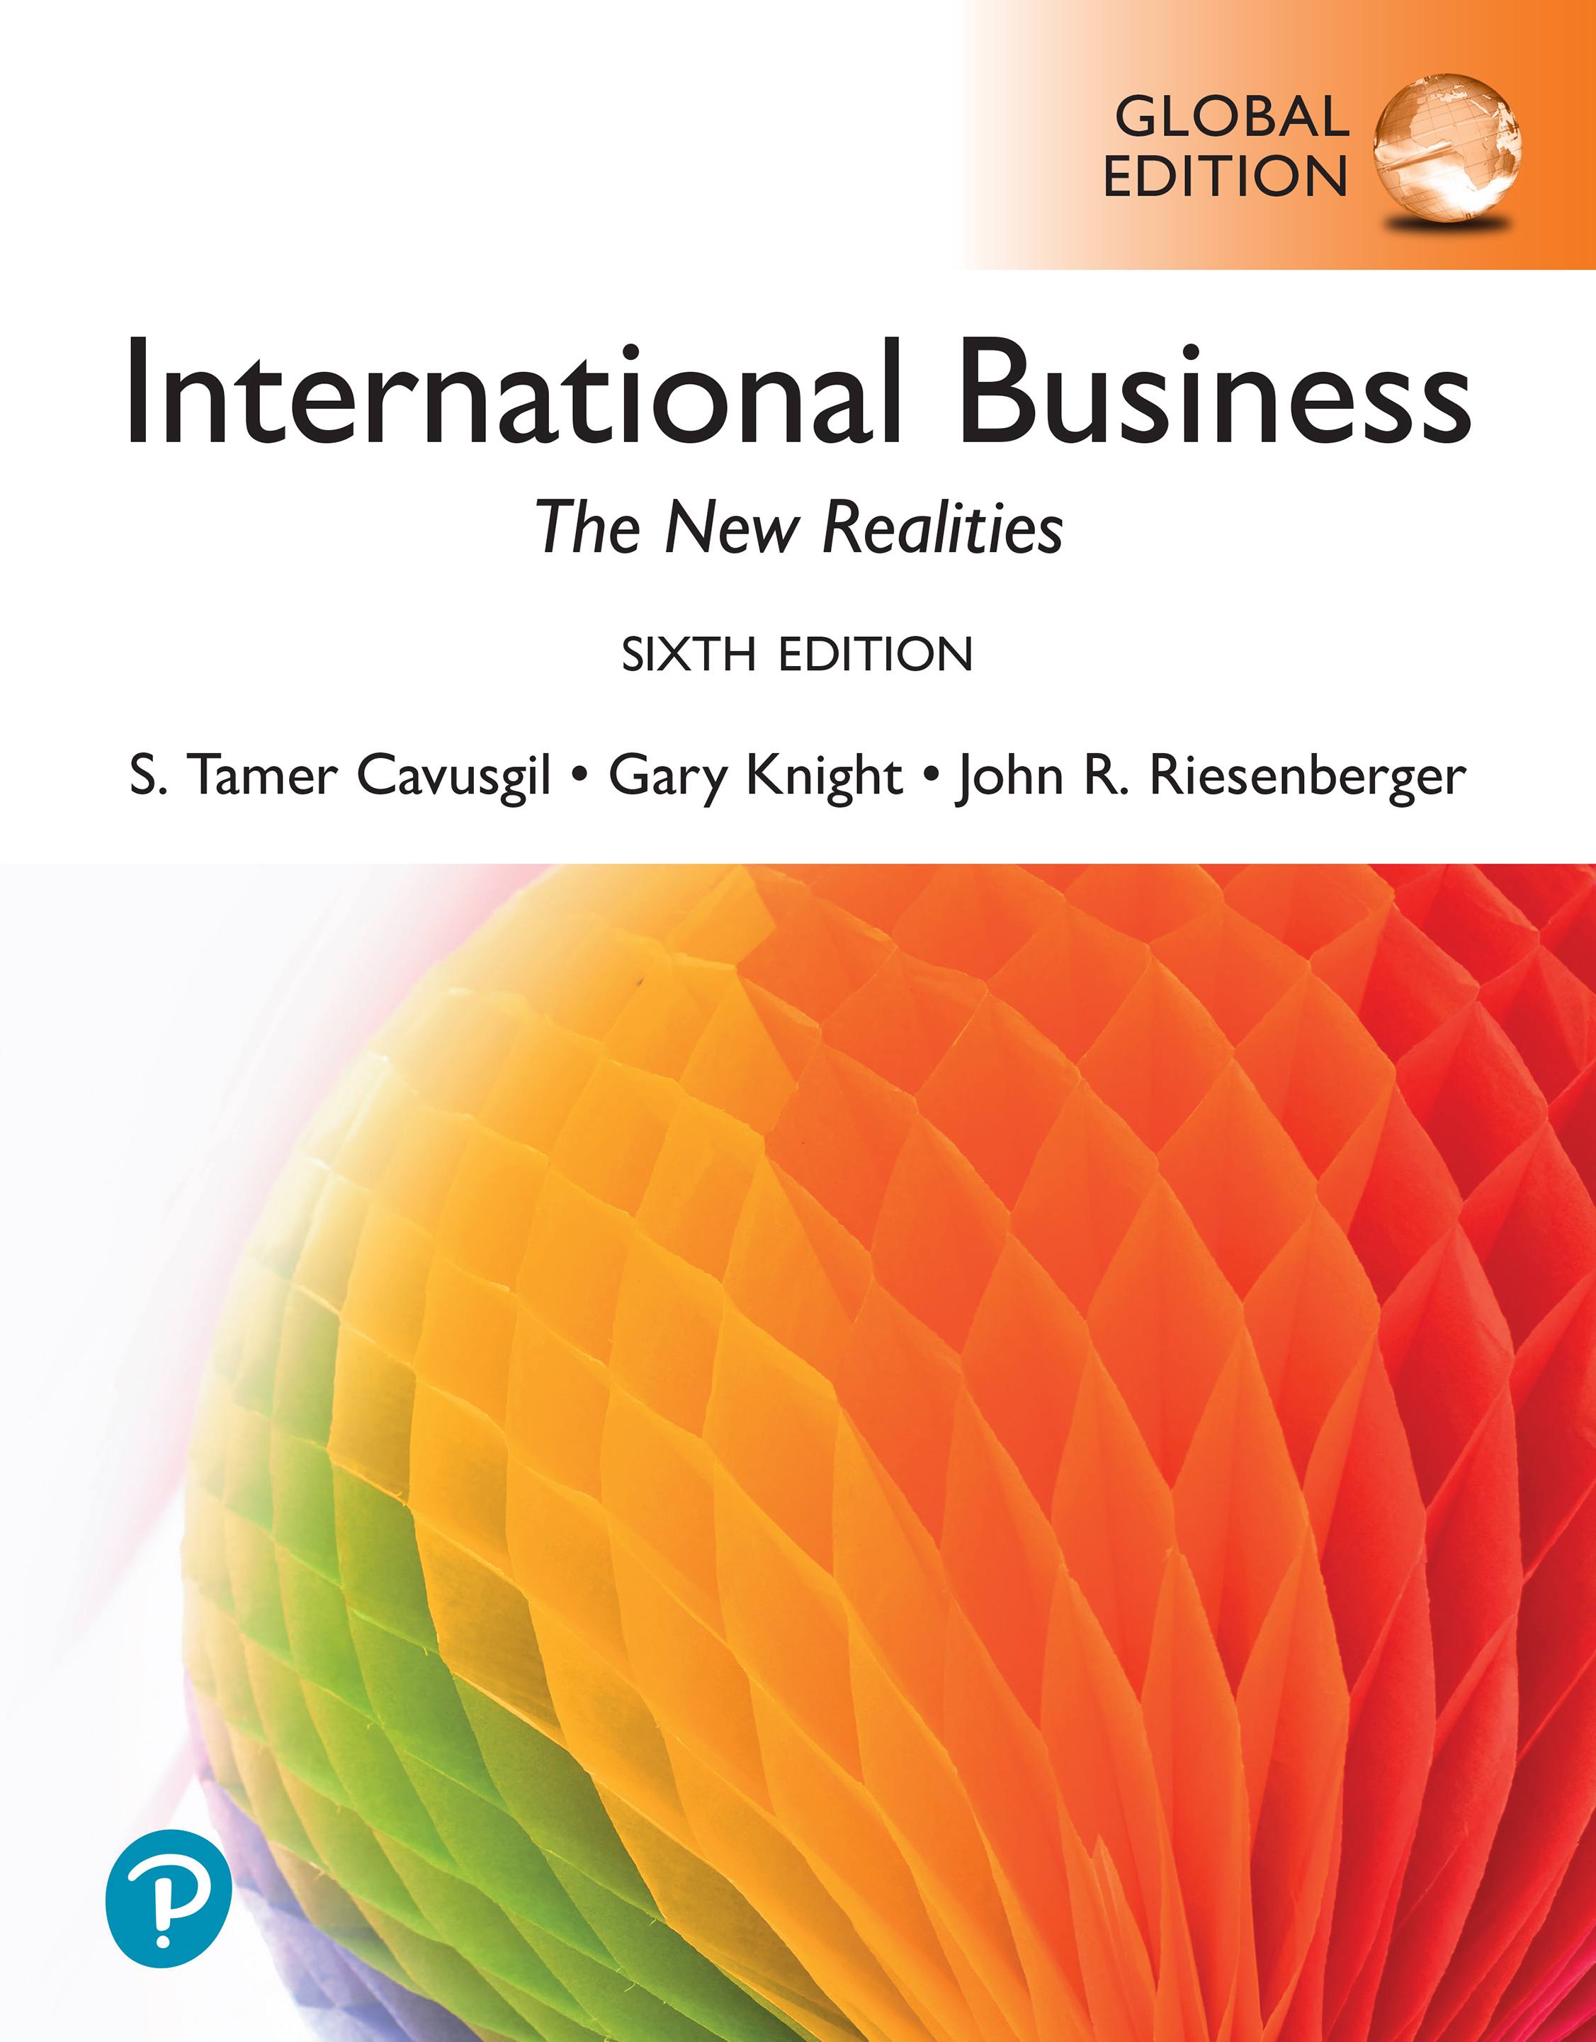
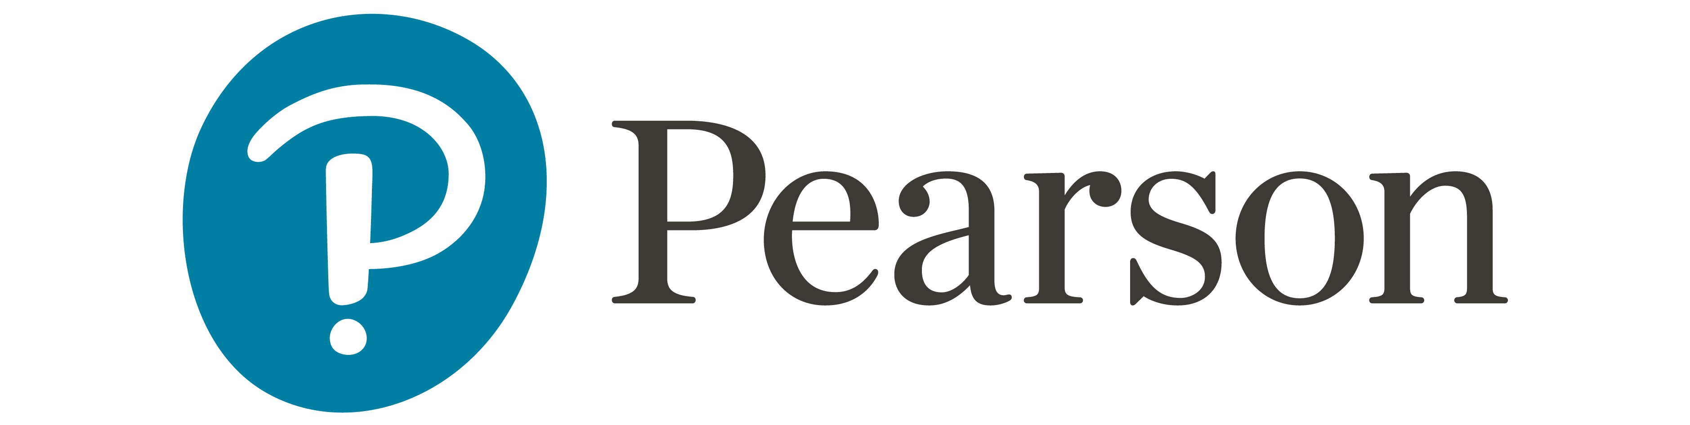
International Business: The New Realities
Sixth Edition, Global Edition
Chapter 14
Foreign Direct Investment and Collaborative Ventures
© 2025 Pearson Education Ltd. All Rights Reserved.
Notes:
If this PowerPoint presentation contains mathematical equations, you may need to check that your computer has the following installed:
1) MathType Plugin
2) Math Player (free versions available)
3) NVDA Reader (free versions available)

Slide 2
Learning Objectives
14.1 Understand international investment and collaboration.
14.2 Describe the characteristics of foreign direct investment.
14.3 Explain the motives for F D I and collaborative ventures.
14.4 Identify the types of foreign direct investment.
14.5 Understand international collaborative ventures.
14.6 Discuss the experience of retailers in foreign markets.

Slide 3
F D I and Collaborative Ventures
Foreign direct investment (F D I): Strategy in which the firm establishes a physical presence abroad by acquiring productive assets such as capital, technology, labor, land, plant, and equipment.
International collaborative venture: A cross-border business alliance in which partnering firms pool their resources and share costs and risks of a venture.
Joint venture (J V): A form of collaboration between two or more firms to create a jointly-owned enterprise.
Notes:
Consider the following example from the beer industry. In 2004, Brazilian private equity firm 3G Capital launched the Belgium-based brewer InBev. In 2008, Inbev established a major presence in the U.S. beer market by purchasing Anheuser-Busch for $52 billion. The new firm, called Anheuser-Busch InBev, in 2016 acquired SABMiller, based in London, which itself had been formed when South African Breweries purchased the American firm Miller Brewing. In 2013, Anheuser-Busch InBev also acquired Mexico’s largest brewer, Grupo Modelo, known for its Corona and Modelo Especial brands of beer. In 2017, Anheuser-Busch InBev formed a joint venture with Anadolu Efes, a Turkish brewery, with the goal of marketing beer in Russia. Through numerous F D I and collaborative ventures, Anheuser-Busch InBev has become the world’s largest brewer and operates more than 140 breweries across Asia, Europe, and North and South America. Brazilian investor 3 G Capital maintains a 23 percent stake in the firm.

Slide 4
Examples of F D I
Volkswagen spent $1 billion to build a factory in Poland to manufacture delivery vans.
The convenience retail giant 7-Eleven Inc., headquartered in Japan, acquired Speedway, the convenience store arm of Marathon Petroleum in the United States, for $21 billion.
Denmark’s Lego Group spent more than 100 million euros to build a toy factory in China.
Japan’s Toshiba formed a joint venture with the U.S. firm United Technologies to establish R&D centers in Europe and India to support joint innovation in the heating and air conditioning industry.

Slide 5
The Surprising Location of Top Brands
Brand | Country where brand is based
7-Eleven | Japan
KitKat chocolate bars | Switzerland
Miller beer | Canada
Budweiser beer | Belgium
Chrysler | Netherlands
Thinkpad laptops | China
D H L express delivery | Germany
Starkist Tuna | South Korea
Absolut Vodka | France
Godiva chocolate | Turkey
Holiday Inn | United Kingdom
Panera Bread Co. | Germany
Trader Joe’s | Germany
Notes:
This slide can also be set up as a game, a cascading set of slides in which students must guess the country associated with each brand.

Slide 6
World’s Most International M N E s, Based on Value of Foreign Assets
Approximate Assets (billions of U.S. dollars)
Approximate Sales (billions of U.S. dollars)
Company | Home Country | Industry | Total | Foreign | Total | Foreign
Shell | Belgium | Food and beverages | 404 | 368 | 262 | 240
Toyota Motor | United Kingdom | Motor vehicles | 522 | 319 | 279 | 206
TotalEnergies | France | Petroleum | 332 | 298 | 218 | 172
Volkswagen Group | Germany | Motor vehicles | 599 | 263 | 296 | 243
Exxon Mobil | United States | Petroleum | 339 | 197 | 277 | 172
Stellantis | Netherlands | Motor vehicles | 195 | 195 | 177 | 158
BP | United Kingdom | Petroleum | 287 | 192 | 158 | 106
Anheuser-Busch InBev | Belgium | Food and beverages | 218 | 179 | 54 | 46
British American Tobacco | United Kingdom | Tobacco | 185 | 172 | 35 | 27
Chevron | United States | Petroleum | 240 | 161 | 162 | 90
Sources: Based on Hoovers company database at
www.hoovers.com
,2023; UNCTAD, “Web Table 19. The World’s Top
100 Non-Financial MNEs, Ranked by Foreign Assets,” June 9, 2022,
www.unctad.org
.
Notes:
www.hoovers.com
www.unctad.org
Royal Dutch Shell, Toyota, and other firms in the exhibit are listed based on the value of factories, subsidiaries, and other assets they own in foreign countries. For example, Toyota has numerous subsidiaries around the world. Individual Toyota subsidiaries engage in various value-chain activities, including R&D, manufacturing, marketing, sales, and customer service. The most internationally active MNEs are in the automotive and petroleum industries.

Slide 7

Service Multinationals
Firms that offer services—Such as lodging, construction, and personal care—must offer them when and where they are consumed.
Service firms establish either a permanent presence via F D I (e.g., retailing), or a temporary relocation of personnel (e.g., construction industry).
Many support services— Advertising, insurance, accounting, and package delivery are best provided at the customer’s location.
Notes:
Companies in the services sector, such as retailing, construction, and personal care, must offer their services where they are consumed. This requires establishing either a permanent presence through F D I (as in retailing) or a temporary relocation of the service company personnel (as in the construction industry). Management consulting is a service usually embodied in experts who interact directly with clients to dispense advice. To reach their customers, firms such as McKinsey and Cap Gemini have established numerous offices in foreign markets. Many support services, such as advertising, insurance, accounting, legal work, and overnight package delivery, are also best provided at the customer’s location. F D I is vital for internationalizing services. Intrawest, Inc., which is building several ski resorts in China, has offices at various locations in China. Banks establish branches around the world because banking services are usually provided directly to customers wherever they do business.

Slide 8
World’s Most International M N E s in the Services Sector, Based on Value of Foreign Assets
Approximate Assets (billions of U.S. dollars)
Approximate Sales (billions of U.S. dollars)
Company | Home Country | Industry | Total | Foreign | Total | Foreign
Deutsche Telekom | Germany | Telecommunications | 319 | 259 | 129 | 99
Enel | Italy | Utilities | 234 | 166 | 99 | 48
EDF | France | Utilities | 409 | 160 | 100 | 42
Vodafone | United Kingdom | Telecommunications | 171 | 156 | 53 | 46
CK Hutchinson | China | Retailing | 156 | 148 | 57 | 52
Microsoft | United States | Data processing | 334 | 136 | 168 | 84
RWE | Germany | Utilities | 161 | 130 | 29 | 18
Iberdrola | Spain | Utilities | 161 | 121 | 46 | 29
Alphabet | United States | Data processing | 359 | 99 | 238 | 139
Telefonica | Spain | Telecommunications | 124 | 95 | 46 | 32
Sources: Based on Hoovers company database at
www.hoovers.com
,2023; UNCTAD, “Web Table 19. The World’s Top
100 Non-Financial MNEs, Ranked by Foreign Assets,” June 9, 2022,
www.unctad.org
.
Notes:
www.forbes.com
www.fortune.com
www.hoovers.com
www.unctad.org

Slide 9

Leading Destinations for F D I
Advanced economies in Europe (especially Britain), Japan, and North America, are popular F D I destinations, mainly as attractive markets.
In recent years, emerging markets and developing economies have gained appeal as F D I destinations.
Firms target China, Mexico, and Eastern Europe to do low-cost manufacturing and to easily access huge adjoining regional markets.
Notes:
Advanced economies such as Australia, Britain, Canada, Japan, Netherlands, and the United States have long been popular destinations for F D I because of their strong G D P per capita, G D P growth rate, density of knowledge workers, and superior business infrastructure, such as telephone systems and energy sources. Dublin, Ireland is a popular destination for M N E s in high-tech industries; Dublin is a gateway to the European Union. In recent years, emerging markets are also gaining appeal as F D I destinations. According to A. T. Kearney’s Global Location Index, the top destinations for foreign investment today are China and India (www.atkearney.com). China is popular because of its size, rapid growth rate, and low labor costs. It is an important platform where M N E s manufacture products for export to key markets in Asia and elsewhere. India is popular because of its managerial talent, well-educated workforce, and relatively fewer cultural barriers. China and India are also attractive for strategic reasons: They have much long-term potential as target markets and new sources of competitive advantage.

Slide 10
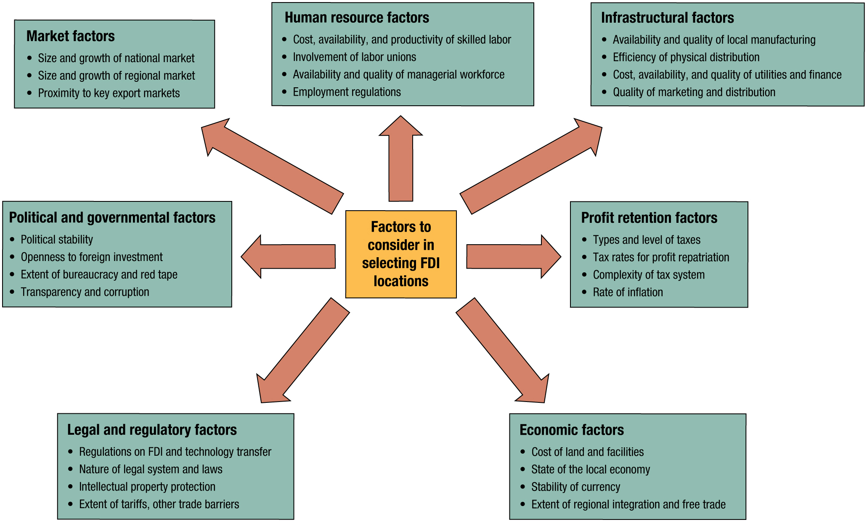
Factors Relevant to Selecting Locations for F D I
Notes:
M N E s have been investing in Eastern Europe for numerous important reasons, especially low-cost and high-quality labor. Europe is popular due to market factors. Eastern European countries have established themselves as popular destinations in terms of political and government factors, legal and regulatory factors, infrastructure, and economic factors, generally. In the Czech Republic, giant Chinese electronics manufacturer Sichuan Changhong (www.changhong.com) built a $30 million factory that produces up to one million flat-screen televisions per year. Numerous automakers, from Ford to Nissan, have built factories in the region. Firms find the region attractive for various reasons. First, wages in Eastern Europe are relatively low; engineers in Slovakia earn half of what Western engineers make, and assembly line workers one-third to one-fifth. Second, East European governments offer incentives, from financing to low taxes, as in Slovakia where all taxes are a simple 19 percent. By comparison, personal income tax rates often exceed 30 percent in Germany. Third, local manufacturing allows firms to avoid trade barriers. Sichuan Changhong’s presence in the Czech Republic helps it avoid tariffs the European Union imposes on imports from China. Fourth, companies prefer Eastern Europe because of its physical proximity to the huge E U market. Many Eastern European countries are E U members themselves. Just as Eastern Europe has become a popular F D I destination, production of cars and other products is falling in much of Western Europe due to higher manufacturing costs, taxes, and strict labor rules. As these examples imply, managers examine a combination of criteria when making decisions about where in the world to establish operations via F D I.
Long Description:
The following factors point to the factors to consider in selecting F D I locations: 1. Human resource factors: cost, availability, and productivity of skilled labor; involvement of labor unions; availability and quality of managerial workforce; employment regulations. 2. Infrastructural factors: availability and quality of local manufacturing; efficiency of physical distribution; cost, availability, and quality of utilities and finance; quality of marketing and distribution. 3. Profit retention factors: types and level of taxes; tax rates for profit repatriation; complexity of tax system; rate of inflation. 4. Economic factors: cost of land and facilities; state of the local economy; stability of currency; extent of regional integration and free trade. 5. Legal and regulatory factors: regulations on F D I and technology transfer; nature of legal system and laws; intellectual property protection; extent of tariffs, other trade barriers. 6. Political and governmental factors: political stability; openness to foreign investment; extent of bureaucracy and red tape; transparency and corruption. 7. Market factors: size and growth of national market; size and growth of regional market; proximity to key export markets.

Slide 11
Nature of Foreign Direct Investment
The most advanced, expensive, complex, and riskiest entry strategy, involving the establishment of manufacturing plants, marketing subsidiaries, or other facilities abroad.
Undertaken by firms from both the advanced economies and emerging markets.
Target countries are both advanced economies and emerging markets.
Occasionally raises patriotic sentiments among citizens (e.g., Haier and Maytag; Dubai Ports).
Notes:
There are several F D I-related trends in the contemporary global economy. First, companies from both advanced economies and emerging markets are active in F D I. Second, destination or recipient countries for such investments include both advanced economies and emerging markets. Third, companies employ multiple strategies to enter foreign markets as investors, including acquisitions and collaborative ventures. Fourth, companies from all types of industries, including services, are active in F D I and collaborative ventures. For example, major retailers began expanding abroad in the 1970s, including Walmart (United States), Carrefour (France), Royal Ahold (Netherlands), Metro AG (Germany), and Tesco (United Kingdom). Finally, direct investment by foreign companies occasionally raises patriotic sentiments among citizens. For example, the possibility of a Haier takeover of Maytag Corporation in 2005 stirred anxiety in the United States over East Asian companies gobbling up U.S. businesses. A bid by Chinese oil company C N O O C Ltd. to buy California-based Unocal Corporation for $18.5 billion raised concerns over the possibility of a Chinese state enterprise gaining control in the critical U.S. energy sector. Consequently, the U.S. Congress banned the deal.

Slide 12
Key Features of Foreign Direct Investment
Represents substantial resource commitment.
Implies local presence and operations.
Firms invest in countries that provide specific comparative advantages.
Substantial risk and uncertainty.
Direct investors deal more intensively with specific social and cultural variables in the host market.
Notes:
FDI is far more taxing on the firm’s resources and capabilities than any other entry strategy. The U.S. firm General Electric owns more than $400 billion in factories, subsidiaries, and other operations outside the United States.
2. Through F D I, management establishes direct contact with customers, intermediaries, facilitators, and the government sector. Although based in Switzerland, Nestlé generates more than 90 percent of its sales from abroad. The Indian M N E Tata Consultancy Services generates most of its revenues in North America, while rival I B M, a U.S. company, obtains nearly two-thirds of its sales from abroad.
3. Managers choose particular countries in which to invest, based on the advantages these locations offer. Thus, firms tend to: perform R&D activities in those countries with leading-edge knowledge and experience for their industry; source from countries where suppliers provide the best-value products; build production facilities at locations that provide the best ratio of productivity to labor costs; and establish marketing subsidiaries in countries with the greatest sales potential.
4. Compared to other entry strategies, establishing a permanent, fixed presence in a foreign country makes the firm vulnerable to country risk and intervention by local government on issues such as wages, hiring practices, and product pricing. Direct investors also must contend with inflation, recessions, and other local economic conditions. French automaker Renault recently paid $1 billion to obtain a 25 percent stake in AvtoVAZ (www.lada-auto.ru), a car factory in Russia. Renault management wants to produce Lada brand cars for the local market. But the AvtoVAZ plant is 40 years old and plagued by inefficient operations and a slow-moving workforce with origins in the Soviet era of communism, and has a history of organized crime.
5. Even a large, well-established company like Disney experienced several failures in its foreign investing. When Disney established Tokyo Disneyland, its management incorrectly assumed the Disneyland experience could not be successfully transferred to Japan. So instead of investing, Disney opted to license rights in Japan for nominal profits. Tokyo Disneyland proved to be a huge success. Not wanting to repeat the same mistake, management opted to retain an F D I stake in its next theme park—Disneyland Paris. But it proved to be a financial sinkhole. Having learned from these experiences, Disney has made the latest theme park, Hong Kong Disneyland, more successful. Disney owns just 46 percent of the venture, making the Hong Kong government the major partner.

Slide 13
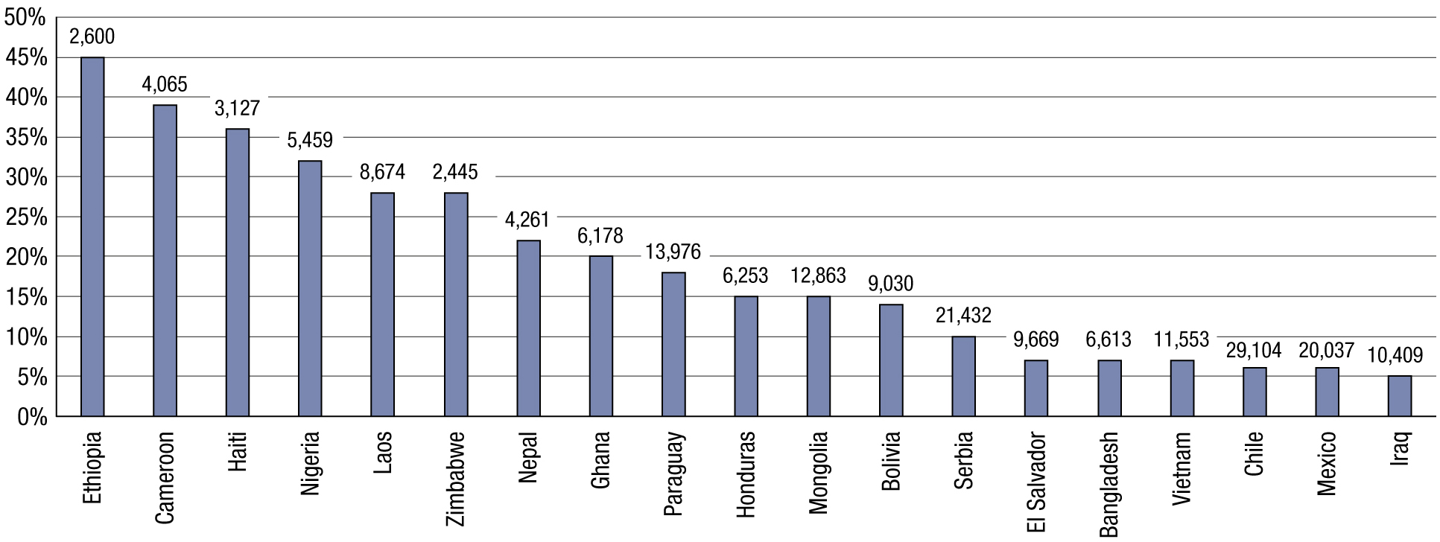
Percentage of Children Aged 5–17 Engaged in Child Labor and GDP per Capita, Various Countries
Note: The vertical axis shows percentage of children, ages 5–17, engaged in child labor. The value above each bar is the country’s per-capita GDP in purchasing power parity (P P P) terms.
Sources: U N I C E F (2023), “Percentage of Children Ages 5–17 Years Engaged in Child Labour,”
https://data.unicef.org
;
U N I C E F and I L O (2020), “Child Labour: Global Estimates 2020, Trends and the Road Forward,”
www.ilo.org
; World Bank
(2023), “G D P per Capita, in Purchasing Power Parity (P P P) Terms (current international dollar),”
https://data.worldbank.org
.
Notes:
FDI is far more taxing on the firm’s resources and capabilities than any other entry strategy. The U.S. firm General Electric owns more than $400 billion in factories, subsidiaries, and other operations outside the United States.
2. Through F D I, management establishes direct contact with customers, intermediaries, facilitators, and the government sector. Although based in Switzerland, Nestlé generates more than 90 percent of its sales from abroad. The Indian M N E Tata Consultancy Services generates most of its revenues in North America, while rival I B M, a U.S. company, obtains nearly two-thirds of its sales from abroad.
3. Managers choose particular countries in which to invest, based on the advantages these locations offer. Thus, firms tend to: perform R&D activities in those countries with leading-edge knowledge and experience for their industry; source from countries where suppliers provide the best-value products; build production facilities at locations that provide the best ratio of productivity to labor costs; and establish marketing subsidiaries in countries with the greatest sales potential.
4. Compared to other entry strategies, establishing a permanent, fixed presence in a foreign country makes the firm vulnerable to country risk and intervention by local government on issues such as wages, hiring practices, and product pricing. Direct investors also must contend with inflation, recessions, and other local economic conditions. French automaker Renault recently paid $1 billion to obtain a 25 percent stake in AvtoVAZ (www.lada-auto.ru), a car factory in Russia. Renault management wants to produce Lada brand cars for the local market. But the AvtoVAZ plant is 40 years old and plagued by inefficient operations and a slow-moving workforce with origins in the Soviet era of communism, and has a history of organized crime.
5. Even a large, well-established company like Disney experienced several failures in its foreign investing. When Disney established Tokyo Disneyland, its management incorrectly assumed the Disneyland experience could not be successfully transferred to Japan. So instead of investing, Disney opted to license rights in Japan for nominal profits. Tokyo Disneyland proved to be a huge success. Not wanting to repeat the same mistake, management opted to retain an F D I stake in its next theme park—Disneyland Paris. But it proved to be a financial sinkhole. Having learned from these experiences, Disney has made the latest theme park, Hong Kong Disneyland, more successful. Disney owns just 46 percent of the venture, making the Hong Kong government the major partner.
Long Description:
The horizontal axis lists countries. The vertical axis shows percentage ranges from 0 percent to 50 percent in increments of 5. Ethiopia, 2,600; Cameroon, 4,065; Haiti, 3,127; Nigeria, 5,459; Laos, 8,674; Zimbabwe, 2,445; Nepal, 4,261; Ghana, 6,178; Paraguay, 13,976; Honduras, 6,253; Mongolia, 12,863; Bolivia, 9,030; Serbia, 21,432; El Salvador, 9,669; Bangladesh, 6,613; Vietnam, 11,553; Chile, 29,104; Mexico, 20,037; Iraq, 10,409.

Slide 14
Motives for Foreign Direct Investment
Market-seeking motives | Resource- or asset-seeking motives | Efficiency-seeking motives
Gain access to new markets or opportunities | Access raw materials | Reduce sourcing and production costs
Follow key customers | Gain access to knowledge or other assets | Locate production near customers
Compete with key rivals in their own markets | Access technological and managerial know-how available in a key market | Take advantage of government incentives
Blank | Blank | Avoid trade barriers

Slide 15
Market-Seeking Motives (1 of 2)
Gain access to new markets or opportunities. The existence of a large market motivates many firms to produce goods at or near customer locations. Boeing, Coca-Cola, I B M, McDonald's, and Toyota all generate more sales abroad than they do at home.
Follow key customers. Firms often follow their key customers abroad to preempt other vendors from servicing them. For example, Tredegar Industries supplies the plastic that its customer Procter & Gamble uses to make disposable diapers. When P&G built a plant in China, Tredegar established production there too.
Notes:
Market-Seeking Motives
Managers may seek new market opportunities as a result of either unfavorable developments in their home market (that is, they may be pushed into international markets) or attractive opportunities abroad (they may be pulled into international markets). There are three primary market-seeking motivations:
1. Gain access to new markets or opportunities. The existence of a substantial market motivates many firms to produce offerings at or near customer locations. Local production improves customer service and reduces the cost of transporting goods to buyer locations. Coca-Cola, Samsung, and Siemens all generate more sales abroad than in their home markets. The giant chip-maker Intel expects big sales from China, where incomes are still rising and few Chinese families have bought a computer yet.
2. Follow key customers. Firms often follow their key customers abroad to preempt other vendors from serving them. Establishing local operations also positions the firm to better serve customer needs. Tradegar Industries supplies the plastic that its customer Procter & Gamble uses to manufacture disposable diapers. When P&G built a plant in China, Tradegar established production there as well.

Slide 16

Market-Seeking Motives (2 of 2)
Compete with key rivals in their own markets. Some M N E s choose to compete with competitors directly in their home markets. The purpose is to weaken and force the rival to expend resources defending its own market. For example, Caterpillar entered Japan to tie up arch-rival Komatsu, to hamper Komatsu’s ability to expand its activities in the U S A.
Notes:
3. Compete with key rivals in their own markets. Some M N E s may choose to confront current or potential competitors directly, in the competitors’ home market. The strategic purpose is to weaken the competitor by forcing it to expend resources to defend its market. In the earth-moving equipment industry, Caterpillar entered a joint venture with Mitsubishi to put pressure on the market share and profitability of their common rival, Japan’s Komatsu. The expenditure of substantial resources to defend its home market hampered Komatsu’s ability to expand its activities abroad.

Slide 17

Resource or Asset-Seeking Motives
Access raw materials needed in extractive and agricultural industries. For example, firms in the mining and oil industries must go where the raw materials are located.
Gain access to knowledge or other assets. When Whirlpool entered Europe, it partnered with Philips to access a well-known brand name and distribution network.
Access technological and managerial know-how available in a key market. The firm may benefit by establishing a presence in a key industrial cluster, such as the robotics industry in Japan, chemicals in Germany, fashion in Italy, and software in the United States.
Notes:
Resource- or Asset-Seeking Motives
Firms frequently want to acquire production factors that are more abundant or less costly in a foreign market. They may also seek complementary resources and capabilities of partner companies headquartered abroad. Specifically, F D I or collaborative ventures may be motivated by the firm’s desire to attain the following assets.
1. Raw materials needed in extractive and agricultural industries. Firms in the mining, oil, and crop-growing industries have little choice but to go where the raw materials are located. In the wine industry, companies establish wineries in countries suited for growing grapes, such as France and Chile. Oil companies establish refineries in countries with abundant petroleum reserves such as Kuwait.
2. Knowledge or other assets. By establishing a local presence through F D I, the firm is better positioned to deepen its understanding of target markets. F D I provides the foreign firm better access to market knowledge, customers, distribution systems, and control over local operations. By collaborating in R&D, manufacturing, and marketing, the focal firm can benefit from the partner’s know-how. When Whirlpool entered Europe, it partnered with Philips to benefit from the latter’s well-known brand name and distribution network. General Motors and Toyota jointly established N U M M I, Inc., in California to build vehicles for the U.S. market. Through this venture, G M learned about Toyota’s production techniques for manufacturing high-quality vehicles. Toyota obtained technology and design expertise from G M that allowed it to develop cars better suited for U.S. consumers.
3. Technological and managerial know-how. The firm may benefit by establishing a presence in a key industrial cluster, such as the robotics industry in Japan, chemicals in Germany, fashion in Italy, or software in the United States. Companies can obtain many advantages from locating at the hub of knowledge development and innovation in a given industry. Denmark, Finland, Israel, New Zealand, Sweden, and the United States are considered ideal for R&D in the biotechnology industry because they all have abundant pools of biotech knowledge workers.

Slide 18

Efficiency Seeking Motives (1 of 2)
Reduce sourcing and production costs by accessing inexpensive labor and other cheap inputs to the production process. This motive accounts for the massive development of manufacturing facilities in China, Mexico, Eastern Europe, and India.
Locate production near customers. In the fashion industry, Spain’s Zara and Sweden’s H&M locate much of their garment production in key markets such as Spain and Turkey.
Notes:
Efficiency-Seeking Motives
M N E s usually concentrate production in only a few locations as a way to increase the efficiency of manufacturing.10 Firms typically disseminate their best practices in production and other activities to all their foreign subsidiaries to increase the efficiency of their operations worldwide. Many develop global brands to increase the efficiency of marketing activities. There are four major efficiency-seeking motives:
1. Reduce sourcing and production costs by accessing inexpensive labor and other cheap inputs to the production process. This motive accounts for the massive investment by foreign firms in factories and service-producing facilities in China, Mexico, Eastern Europe, and India. M N E s establish factories in such locations to reduce production costs.
2. Locate production near customers. In industries that need to be especially sensitive to customer needs or in which tastes change rapidly, managers often locate factories or assembly operations near important customers. Zara and Forever 21 locate much of their garment production in key fashion markets such as Europe. Production is more expensive, but the clothing gets into shops faster and more closely represents the latest fashion trends.

Slide 19
Efficiency Seeking Motives (2 of 2)
Take advantage of government incentives. In addition to restricting imports, governments may offer subsidies and tax concessions to foreign firms to encourage them to invest locally.
Avoid trade barriers. By establishing a physical presence within a country, the investor obtains the same advantages as local firms. The desire to avoid trade barriers helps explain why Japanese automakers set up factories in the United States.
Notes:
3. Take advantage of government incentives. In addition to restricting imports, governments frequently offer subsidies and tax concessions to foreign firms to encourage them to invest locally. Governments encourage inward F D I because it provides local jobs and capital, increases tax revenue, and transfers skills and technologies.
4. Avoid trade barriers. Companies often enter markets via F D I to avoid tariffs and other trade barriers, as these usually apply only to exporting. By establishing a physical presence inside a country or an economic bloc, the foreign company obtains the same advantages as local firms. Partnering with a local firm also helps overcome regulations or trade barriers and satisfy local content rules. The desire to avoid trade barriers helps explain why numerous Japanese automakers established factories in the United States.

Slide 20
F D I Provides Economies of Scale
Falling fixed costs. Many industries and productive tasks have high per-unit fixed costs that decline the more the task is performed. F D I helps concentrate production and/or results in high sales volumes.
Managerial resource efficiencies. Highly international firms employ a relatively fixed number of headquarters staff across more subsidiaries and affiliates.
Specialization of labor. F D I facilitates hiring more specialized workers, which increases efficiencies.
Financial economies. Large firms with extensive international operations usually can access capital at lower cost.

Slide 21
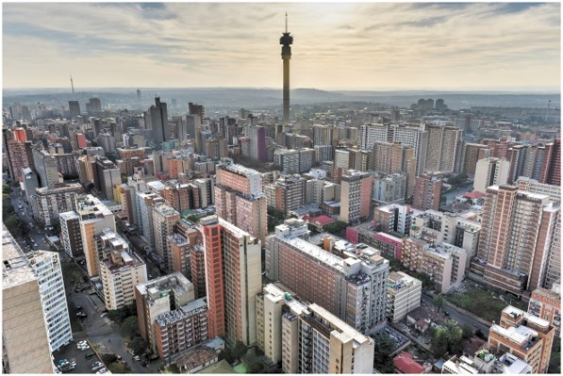
Types of F D I
Greenfield investment vs. mergers and acquisitions
Nature of ownership: Wholly owned direct investment vs. equity joint venture
Level of integration: Vertical vs. horizontal F D I
South Africa, shown here, has benefited greatly from inward F D I

Slide 22
Greenfield Investment vs. M&As
Greenfield investment: The firm invests to build a new manufacturing, marketing or administrative facility, as opposed to acquiring existing facilities.
Merger: Special type of acquisition in which two firms join to form a new, larger company.
Acquisition: Direct investment or purchase an existing company or facility.
Notes:
Greenfield investment occurs when a firm invests to build a new manufacturing, marketing, or administrative facility, as opposed to acquiring existing facilities. As the name greenfield implies, the investing firm typically buys an empty plot of land and builds a production plant, marketing subsidiary, or other facility there for its own use. This is exactly what Ford did, for example, when it established its large factory outside Valencia, Spain.
An acquisition is the purchase of an existing company or facility. When Home Depot entered Mexico, it acquired the stores and assets of an existing retailer of building products, Home Mart. The Chinese personal computer manufacturer Lenovo made an ambitious acquisition of I B M’s P C business, which now accounts for some two-thirds of its annual revenue. The deal provided Lenovo with valuable strategic assets such as brands and distribution networks and helped it rapidly extend its market reach and become a global player. Multinational enterprises may favor acquisition over greenfield F D I because, by acquiring an existing company, they gain access to its accumulated assets. They gain ownership of existing assets such as plant, equipment, and human resources, as well as access to existing suppliers and customers. Unlike greenfield F D I, acquisition provides an immediate stream of revenue and accelerates the M N E’s return on investment.
A merger is a special type of acquisition in which two companies join to form a new, larger firm. Mergers are more common between companies of similar size because they are capable of integrating their operations on a relatively equal basis. One example is the merger between Lucent Technologies in the United States and Alcatel in France. This deal created the world’s largest firm in the global telecommunications equipment industry (Alcatel-Lucent). Like joint ventures, mergers can generate many positive outcomes, including interpartner learning and resource sharing, increased economies of scale, cost savings from elimination of duplicative activities, a broader range of products and services for sale, and greater market power. Cross-border mergers confront many challenges due to national differences in culture, competition policy, corporate values, and operating methods. Success requires substantial advance research, planning, and commitment.

Slide 23
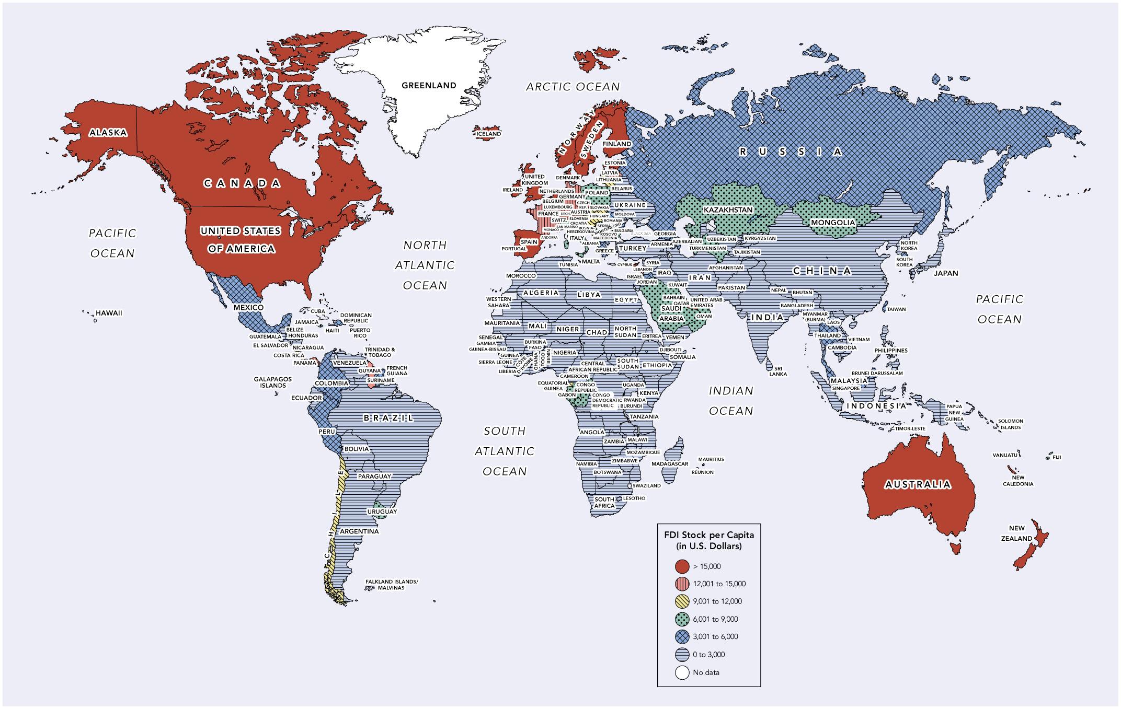
Stock of Foreign Direct Investment Per Capita
Sources: Based on data from U N C T A D, “Foreign Direct Investment: Inward and Outward Flows and Stock, Annual” 2022,
http://unctadstat.unctad.org
; and World Bank, “Population, Total,” 2022,
https://data.worldbank.org
.
Notes:
One way to illustrate the pattern of F D I worldwide is to examine F D I stock. F D I stock refers to the total value of assets that M N E s own in foreign countries. The map portrays the volume of F D I stock per capita by country. High levels of F D I stock suggest that a country is a popular investment destination and that M N E managers are confident about the country’s economic health and prospects.
Long Description:
Seven sets of data are the F D I stock per capita in U.S. dollars plotted in the map. Greater than 15,000: Alaska; Canada; United States of America; Iceland; United Kingdom; Norway; Sweden; Finland; Estonia; Denmark; Ireland; Netherlands; Spain; Portugal; Cyprus; Australia; New Caledonia; New Zealand; Belgium; Czech Republic; Austria; United Arab Emirates; 12,001 to 15,000: Panama; Guyana; Suriname; Germany; Belgium; Luxembourg; France; Switzerland; Monaco; Latvia; Lebanon; 9,001 to 12,000: Chile; Lithuania; Slovakia; Hungary; Equatorial Guinea; 6,001 to 9,000: Jamaica; Trinidad and Tobago; Uruguay; Poland; Slovenia; Croatia; San Marino; Bosnia; Herzegovina; Italy; Albania; Serbia; Montenegro; Bulgaria; Kosovo; Macedonia; Kazakhstan; Mongolia; Turkmenistan; Uzbekistan; Kuwait; Bahrain; Qatar; Saudi Arabia; Oman; Congo Republic; Gabon; Fiji; 3,001 to 6,000: Mexico; Dominican Republic; Colombia; Peru; Russia; Moldova; Romania; Greece; Israel; Jordan; Georgia; Azerbaijan; Thailand; Malaysia; Singapore; Brunei Darussalam; South Korea; Taiwan; 0 to 3,000: Guatemala; Belize; El Salvador; Honduras; Nicaragua; Haiti; Venezuela; Ecuador; Brazil; Bolivia; Paraguay; Argentina; Belarus; Ukraine; South Africa; Lesotho; Botswana; Namibia; Zimbabwe; Mozambique; Malawi; Zambia; Angola; Tanzania; Burundi; Rwanda; Kenya; Uganda; Democratic Congo Republic; Kenya; Uganda; Cameroon; Central African Republic; South Sudan; Somalia; Ethiopia; Cote D’Ivoire; Gambia; Djibouti; Eritrea; North Sudan; Chad; Egypt; Tunisia; Algeria; Morocco; Mauritania; Mali; Niger; Senegal; Guinea-Bissau; Guinea; Sierra Leone; Liberia; Burkina Faso; Ghana; Togo; Benin; Nigeria; Yemen; Albania; Greece; Turkey; Armenia; Syria; Iraq; Iran; Uzbekistan; Kyrgyzstan; Tajikistan; Afghanistan; Pakistan; China; Nepal; Bhutan; Bangladesh; Myanmar; India; Sri Lanka; Myanmar (Burma); Laos; Vietnam; Cambodia; North Korea; Japan; Philippines; Indonesia; Papua New Guinea; Solomon Islands; Madagascar; no data: Greenland; Cuba; Swaziland; French Guiana; Falkland Islands or Malvinas; Western Sahara; Timor-Leste.

Slide 24
The Nature of Ownership
Equity participation: Acquisition of partial ownership in an existing firm.
Wholly owned direct investment: Investor fully owns the foreign assets
Equity joint ventures: Partnership in which a separate firm is created through the investment of assets by two or more parent firms that gain joint ownership of a new legal entity.
Notes:
Control is accomplished through full or partial ownership, resulting in a commensurate degree of control over decision making on such issues as product development, expansion, and profit distribution. Firms can choose between a wholly owned or joint venture to secure control, which also determines the extent of their financial commitment. If the focal firm is pursuing partial ownership in an existing firm, known as equity participation.
Using wholly owned direct investment, many foreign automotive firms have established fully owned manufacturing plants in the United States to serve this large market from within. In contrast to wholly owned direct investment, an equity joint venture is a type of partnership in which a separate firm is created through the investment or pooling of assets by two or more parent firms that gain joint ownership of the new legal entity. A partner in a joint venture may hold majority, equal (50–50), or minority ownership. Minority ownership provides little control over the operation.
Many firms find joint ventures attractive because of the complexity of foreign markets. Collaborating with a local partner increases the foreign entrant’s ability to navigate the local market. Collaborative ventures also benefit small and medium-sized enterprises by providing them with needed capital and other assets. For example, Shanghai based Tri Star International acquired a majority stake in Illinois-based Adams Pressed Metals, a manufacturer of parts for tractors and other earth-moving equipment. The cash infusion saved forty jobs at Adams and gave Tri Star access to the U.S. market and marketing know-how.
A joint venture with a local partner may sometimes be the only entry strategy available to the focal firm, as when the government of a target country seeks to protect its important industries by prohibiting 100 percent foreign ownership in local enterprises. However, governments are relaxing such regulations in most industries, and they are now relatively receptive to F D I.

Slide 25
Level of Integration
Vertical integration: The firm owns, or seeks to own, multiple stages of a value chain for producing, selling, and delivering a product. For example, Toyota owns some Toyota car dealerships around the world. Ford once owned steel mills that produced steel used to make Ford cars.
Horizontal integration: Arrangement whereby the firm owns, or seeks to own, the activities involved in a single stage of its value chain. For example, Microsoft acquired a Montreal-based firm that makes software used to create movie animation.
Notes:
Another way of classifying F D I is by whether integration takes place vertically or horizontally. Vertical integration is an arrangement whereby the firm owns, or seeks to own, multiple stages of a value chain for producing, selling, and delivering a product or service. Vertical F D I takes two forms. In forward vertical integration, the firm develops the capacity to sell its outputs by investing in downstream value-chain facilities—that is, in marketing and selling operations. Forward vertical integration is less common than backward vertical integration, in which the firm acquires the capacity abroad to provide inputs for its foreign or domestic production processes by investing in upstream facilities, typically factories, assembly plants, or refining operations. Firms can own both backward and forward vertical integration. In various countries, Honda owns both suppliers of car parts and dealerships that sell and distribute cars.
Horizontal integration is an arrangement whereby the firm owns, or seeks to own, the activities performed in a single stage of its value chain. Microsoft’s primary business is developing computer software. In addition to producing operating systems, word processing, and spreadsheet software, it has also developed subsidiaries abroad that make other types of software, such as a Montreal-based firm that produces software for creating movie animations. As this example suggests, companies invest abroad in their own industry to expand their capacity and activities. A firm may acquire another firm engaged in an identical value-chain activity to achieve economies of scale, expand its product line, increase its profitability, or, in some cases, eliminate a competitor.

Slide 26
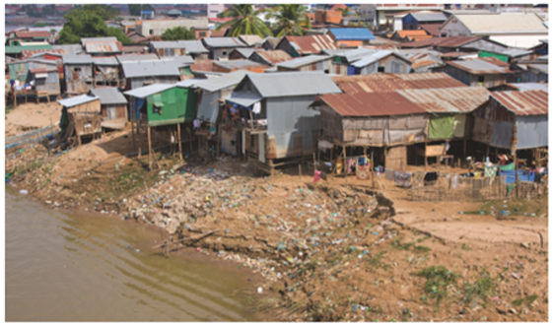
Ethical Connections
F D I offers numerous benefits to recipient countries.
However, F D I side effects can harm the natural environment, especially in countries with weak environmental laws. Pollution and ecological destruction may emerge alongside rapid economic growth.
One M N E, a food additive manufacturer, allowed untreated wastewater to flow into the ThiVai river in Vietnam. Pollution hurt the livelihood of thousands of downstream farmers.
M N E s must behave responsibly in their international dealings. Governments must not allow development goals to compromise citizen well-being.
Source: OlegD/Shutterstock

Slide 27

You Can Do It: Jennifer Knippen (1 of 2)
In college, Jennifer majored in Economics and International Business.
She was inspired to pursue an international career following a study-abroad program in Valencia, Spain. After graduation, she returned to Spain for five months of intensive training in Spanish and travel.
Jennifer next took a sales position with the U.S. subsidiary K O N E, Inc., a leading manufacturer of elevators and escalators based in Helsinki, Finland.

Slide 28
You Can Do It: Jennifer Knippen (2 of 2)
After experiencing the challenges and benefits of working for the local subsidiary of a large, multinational firm, Jennifer returned to school and obtained a Masters degree in Global Management from Thunderbird, a graduate school specialized in international business.
International travel, study abroad, and learning Spanish enhanced her credentials to pursue a career in global management.
Jennifer set career goals and worked hard to achieve them.

Slide 29
International Collaborative Venture
A partnership between two or more firms.
Includes equity joint ventures and non-equity, project-based ventures.
Sometimes called partnerships or strategic alliances.
Collaboration helps overcome the often substantial risk and high costs of international business. It makes possible the achievement of projects that exceed the capabilities of the individual firm.
Notes:
Collaborative ventures, sometimes called international partnerships or international strategic alliances, are essentially partnerships between two or more firms. They help companies overcome together the often substantial risks and costs involved in achieving international projects that might exceed the capabilities of any one firm operating alone. Groups of firms sometimes form partnerships to accomplish large-scale goals such as developing new technologies or completing major projects such as power plants. By collaborating, the focal firm can draw on a range of complementary technologies, accessible only from other firms, to innovate and develop new products. Advantages like these help explain why the volume of such partnerships has grown substantially in the last few decades.
While collaboration can take place at similar or different levels of the value chain, it is typically focused on R&D, manufacturing, or marketing. International collaborative ventures have been on the rise and have led to joint R&D in knowledge-intensive, high-technology sectors such as robotics, semiconductors, aircraft manufacturing, medical instruments, and pharmaceuticals.

Slide 30
Equity vs. Project-Based Joint Ventures
Equity joint ventures are normally formed when no one party has all the assets needed to exploit an opportunity. Typically, the local partner contributes a factory, market navigation know-how, connections, or low-cost labor.
A project-based joint venture has a narrow scope and limited timetable. No new legal entity is created. Typically, partners collaborate on joint development of new technologies, products, or share other expertise with each other. Such cooperation helps them catch up with rivals in technology development.
Notes:
Joint ventures are normally formed when no one party possesses all the assets needed to exploit an available opportunity. In a typical international deal, the foreign partner contributes capital, technology, management expertise, training, or some type of product. The local partner contributes the use of its factory or other facilities, knowledge of the local language and culture, market navigation know-how, useful connections to the host country government, or lower-cost production factors such as labor or raw materials. Procter & Gamble (P&G) is in a joint venture with Dolce & Gabbana, an Italian fashion house. Under the deal, P&G produces perfumes, while the Italian firm markets them in Europe, leveraging the local strength of its brand name. The partnership provides both firms superior access to each other’s strategic assets in R&D, production, branding, distribution, and market knowledge.
Increasingly common in cross-border business, the project-based, nonequity venture is a collaboration in which the partners create a project with a relatively narrow scope and a well-defined timetable, without creating a new legal entity. Combining staff, resources, and capabilities, the partners collaborate on new technologies or products until the venture bears fruit or they no longer consider collaboration valuable. Such partnering reduces the enormous fixed costs of R&D, especially in technology and knowledge intensive industries, and helps firms catch up with rivals. Sony developed the microprocessor used in Playstation 3 in partnership with IBM and Toshiba. The venture led to the creation of the Cell chip, which is ten times faster than Intel’s most powerful Pentium chip and permits more graphics-intensive gaming.
I B M entered a strategic partnership for a limited period in which it provided outsourcing services to N T T, the Japanese telecommunications carrier, and N T T in turn provided outsourcing services and contacts for IBM to offer computer services sales to customers in Japan. Germany’s Siemens teamed with Motorola to develop the next generation of 300-mm 12-inch wafers, an important innovation in the global semiconductor industry. Motorola provided its expertise in advanced logic products and leading-edge.

Slide 31
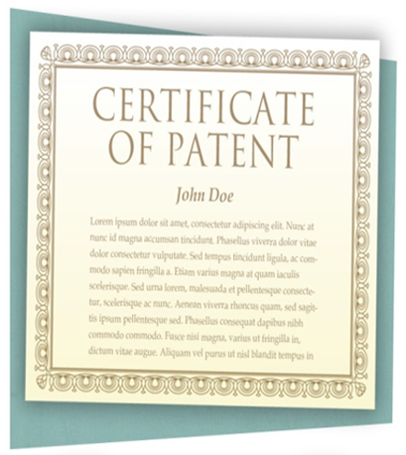
Other Types of Collaborative Ventures
Consortium: Project-based, usually non-equity venture with multiple partners fulfilling a large-scale project. For example, Commercial aircraft manufacturing (Boeing and Airbus).
Cross-licensing agreement: Type of a project-based, non-equity venture where partners agree to access licensed technology developed by the other, on preferential terms. For example, Telecommunications industry for inventing new technologies.
Notes:
A consortium is a project-based, usually nonequity venture initiated by multiple partners to fulfill a large-scale project. It is typically formed with a contract, which delineates the rights and obligations of each member. Work is allocated to the members on the same basis as profits. Thus, each partner in a three-partner consortium performs one-third of the work and earns one-third of the resulting profits. Consortia are popular for innovation in industries such as commercial aircraft, computers, pharmaceuticals, and telecommunications, where the costs of developing and marketing a new product often reach hundreds of millions of dollars and require sweeping expertise. For example, Boeing, Fuji, Kawasaki, and Mitsubishi joined forces to design and manufacture major components of the Boeing 767 aircraft.
Often, several firms pool their resources to bid on a major project, such as building a power plant or a high-tech manufacturing facility. Each brings a unique specialty to the project but would be unable to win the bid on its own. No formal legal entity is created; each firm retains its individual identity. In this way, if one party withdraws, the consortium can continue with the remaining participants. iNavSat is a consortium formed among several European firms to develop and manage Europe’s global satellite navigation system.
Across-licensing agreement is a type of a project-based, nonequity venture whose partners each agree to access licensed intellectual property developed by the other on preferential terms. For example, Microsoft entered such an agreement with Japan’s JVC to share patented knowledge on software and other products. Two firms also might enter a cross-distribution agreement, in which each partner has the right to distribute products or services produced by the other on preferential terms. For instance, the Star Alliance is an agreement among over twenty-five airlines—including Air Canada, United, Lufthansa, SAS, Singapore Airlines, and a cross-distribution agreement, in which each partner has the right to distribute products or services produced by the other on preferential terms. For instance, the Star Alliance is an agreement among over twenty-five airlines—including Air Canada, United, Lufthansa, SAS, and Singapore Airlines.

Slide 32
Advantages and Disadvantages of Collaborative Ventures (1 of 2)
Blank | Advantages | Disadvantages
Equity joint ventures | Afford greater control over future directions Facilitate transfer of knowledge between the partners Common goals drive the joint venture | Complex management structure Coordination between the partners may be a concern Difficult to terminate Greater exposure to political risk

Slide 33
Advantages and Disadvantages of Collaborative Ventures (2 of 2)
Blank | Advantages | Disadvantages
Project-based, nonequity Ventures | Easy to setup Simple management structure; can be adjusted easily Takes advantage of partners' respective strengths Can respond quickly to changing technology and market conditions Easy to terminate | Knowledge transfer may be less straightforward between the partners No equity commitment; thus, puts greater emphasis on trust, good communications, and developing relationships Conflicts may be harder to resolve Division of costs and benefits may strain relationship
Notes:
The potential partner may be a current or potential competitor, is likely to have its own agenda, and will likely gain important competitive advantages from the relationship. Management must protect its hard-won capabilities and other organizational assets to preserve its bargaining power and ability to compete. Harmony is not necessarily the most important goal, and accepting some conflict and tension between the partners may be preferable to surrendering core skills. The firm does not want to become too dependent on its partner. In collaborations with partners in China, Intel has been careful not to share too much of its proprietary technology. It has avoided building computer chip factories there because Intel’s microprocessor devices are the heart of its intellectual property. In a country known for weak intellectual property rights, management worries about theft of not only its chip designs but also of its design and manufacturing methods.

Slide 34
Managing Collaborative Ventures: Key Questions
How dependent will we be on our partner?
How will responsibilities and competencies be shared with the partner?
Are our assets at risk? How can we protect them?
What other risks do we face by partnering?
Will we close growth opportunities due to this venture?
How will the venture be managed? What burdens will be created on managerial, financial, or other resources?
Notes:
The potential partner may be a current or potential competitor, is likely to have its own agenda, and will likely gain important competitive advantages from the relationship. Management must protect its hard-won capabilities and other organizational assets to preserve its bargaining power and ability to compete. Harmony is not necessarily the most important goal, and accepting some conflict and tension between the partners may be preferable to surrendering core skills. The firm does not want to become too dependent on its partner. In collaborations with partners in China, Intel has been careful not to share too much of its proprietary technology. It has avoided building computer chip factories there because Intel’s microprocessor devices are the heart of its intellectual property. In a country known for weak intellectual property rights, management worries about theft of not only its chip designs but also of its design and manufacturing methods.

Slide 35
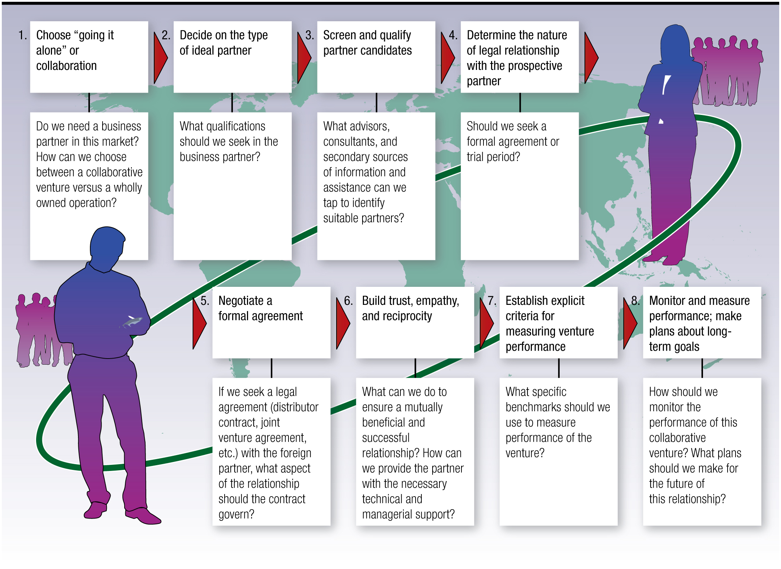
A Systematic Process to International Business Partnering
Notes:
When managers first contemplate internationalization via F D I, they usually think in terms of a wholly owned operation. Many are accustomed to retaining the control and sole access to profits that come with 100 percent ownership. The nature of the industry or product may also make partnering less desirable. But management should consider collaboration an option. Typically, the firm enters a collaborative venture when it discovers a weak or missing link in its value chain and chooses a partner that can remedy the deficiency. China is an increasingly popular venue for collaboration in the Internet service-provider industry. Both Microsoft and Google entered this huge market via joint ventures with local partners. But eBay and Yahoo entered China primarily via wholly owned F D I. Each firm chose the entry strategy most appropriate for its situation.
Long Description:
The steps in the process are as follows: 1. Choose going it alone or collaboration: do we need a business partner in this market? How can we choose between a collaborative venture versus a wholly owned operations? 2. Decide on the type of ideal partner: what qualifications should we seek in the business partner? 3. Screen and qualify partner candidates: what advisors, consultants, and secondary sources of information and assistance can we tap to identify suitable partners? 4. Determine the nature of legal relationship with the prospective partner: should we seek a formal agreement of trial period? 5. Negotiate a formal agreement: if we seek a legal agreement (distributor contract, joint venture agreement, etcetera) with the foreign partner, what aspect of the relationship should the contract govern? 6. Build trust, empathy, and reciprocity: what can we do to ensure a mutually beneficial and successful relationship? How can we provide the partner with the necessary technical and managerial support? 7. Establish explicit criteria for measuring venture performance: what specific benchmarks should we use to measure performance of the venture? 8. Monitor and measure performance; make plans about long-term goals: how should we monitor the performance of this collaborative venture? What plans should we make for the future of this relationship?

Slide 36
Success Factors in Collaborative Ventures
Half of all global collaborative ventures fail in the first five years of operations due to unresolved disagreements, confusion, and frustration. Thus, partners should:
Be aware of cultural differences;
Pursue common goals;
Pay attention to planning and management of the venture;
Safeguard core competencies; and
Adjust to shifting environmental circumstances.
Notes:
French food giant Danone (www.danone.com) terminated its joint venture with a local Chinese partner in 2009 after years of contentious relations. Danone had formed the partnership in 1996 at a time when the Chinese government often required such ventures from foreign firms. In later years, however, the Chinese partner established a mirror business in which it sold, on the side, the same products the joint venture was marketing. The partner claimed that contract terms were unfair and accused Danone of trying to gain control of its other businesses. To ensure success:
Be cognizant of cultural differences. International collaborations require that both parties learn and appreciate each other’s corporate and national cultures. Cultural incompatibility can cause anger, frustration, and inefficiency. The partners may never arrive at a common set of values and organizational routines, especially if they’re from very distinct cultures—say, Norway and Nigeria.
Pursue common goals. When partners have differing goals, or their goals change over time, they can find themselves operating at cross-purposes. Japanese firms tend to value market share over profitability, while U.S. firms value profitability over market share. Because different strategies are required to maximize each of these performance goals, a joint venture between Japanese and U.S. firms may fail.
Give due attention to planning and management of the venture. Without agreement on questions of management, decision making, and control, each partner may seek to control all the venture’s operations, which can strain the managerial, financial, and technological resources of both. In some cases, equal governance and a sense of shared enterprise are best because they help partners view themselves as equals and reach consensus.
Safeguard core competencies. Collaboration takes place between current or potential competitors that must walk a fine line between cooperation and competition. Volkswagen and General Motors succeeded in China by partnering with the Chinese firm, Shanghai Automotive Industry Corporation (SAIC; www.saicmotor.com). The Western firms transferred much technology and know-how to their Chinese partner. Having learned much from them, SAIC may now become a player in the global car industry.

Slide 37
Retailers: A Special Case of Internationalization
Retailers typically internationalize via F D I and collaborative ventures. Retailing takes various forms:
Department stores (e.g., Marks & Spencer, Macy's);
Specialty retailers (Body Shop, Gap, Disney Store);
Supermarkets (Sainsbury, Safeway, Sparr);
Convenience stores (Circle K, 7-Eleven, Tom Thumb); discount stores (Zellers, Tati, Target);
“Big box stores” (Home Depot, I K E A, Toys “R” Us).
Walmart has more than 400 stores and 100,000 employees in China, sourcing almost all its merchandise locally and providing thousands of local jobs.
Notes:
The major drivers of retailer internationalization have been saturation of home country markets, deregulation of international investment, and opportunities to benefit from lower costs abroad. Home Depot expanded abroad because the home improvement market in Canada and the United States is becoming increasingly saturated. Most emerging markets exhibit pent-up demand, fast economic growth, a growing middle class, and increasingly sophisticated consumers. In densely populated developing countries, consumers are flocking to discount retailers that sell a wide selection of merchandise at low prices.
Retailers usually choose between F D I and franchising as a foreign market entry strategy. The larger, more experienced firms, such as Carrefour, Royal Ahold, and Walmart, tend to internationalize via F D I; that is, they typically own their stores and maintain direct control over operations and proprietary assets. Smaller and less internationally experienced firms such as Borders bookstores tend to rely on networks of independent franchisees. In franchising, the retailer adopts a business system from, and pays an ongoing fee to, a franchise operator. Other firms may employ a dual strategy— using F D I in some markets and franchising in others. While franchising facilitates rapid internationalization, compared to F D I, it affords the firm less control over its foreign operations, which can be risky in countries with unstable political or economic situations or weak intellectual property laws.
Many retailers have floundered in foreign markets. When the French department store Galleries Lafayette opened in New York City, it could not compete with the city’s numerous posh competitors. In its home market in Britain, Marks & Spencer succeeds with store layouts that blend food and clothing offerings in relatively small spaces, a formula that translated poorly in Canada and the United States. I K E A experienced problems in Japan, where consumers value high-quality furnishings, not the low-cost products I K E A offers.

Slide 38
Barriers to Retailer Success Abroad
Culture and language barriers. For example, Differing product and service portfolio, store hours, store layout, relations between management and labor.
Consumers tend to develop strong loyalty to indigenous retailers. For example, Both Galleries Lafayette in New York, and Walmart in Germany failed.
Legal and regulatory barriers. Countries have idiosyncratic laws that affect retailing. For example, Germany limits store hours and requires recycling.
Retailers often must develop local sources of supply. For example, McDonald’s in Russia; K F C in China.
Notes:
Four barriers stand in the way of successfully transplanting home market success to international markets.
First, culture and language are a significant obstacle. Compared to most businesses, retailers are close to customers. They must respond to local market requirements by customizing their product and service portfolio, adapting store hours, modifying store size and layout, training local workers, and meeting labor union demands.
Second, consumers tend to develop strong loyalty to indigenous retailers. As Galleries Lafayette in New York and Walmart in Germany discovered, local firms usually enjoy great allegiance from local consumers.
Third, managers must address legal and regulatory barriers that can be idiosyncratic. Germany limits store hours, and retailers must close on Sundays. Japan’s Large-Scale Store Law required foreign warehouse and discount retailers to get permission from existing small retailers before setting up shop. Although it has been relaxed in recent years, the law presented a major obstacle to the entry of stores like Toys “R” Us. In 2009, IKEA abandoned efforts to expand in India, due to restrictions imposed on foreign retailers.
Fourth, when entering a new market, retailers must develop local sources for thousands of products, including some that local suppliers may be unwilling or unable to provide. When Toys “R” Us entered Japan, local toy manufacturers were reluctant to work with the U.S. firm. Some retailers end up importing many of their offerings, which requires establishing complex and costly international supply chains.

Slide 39
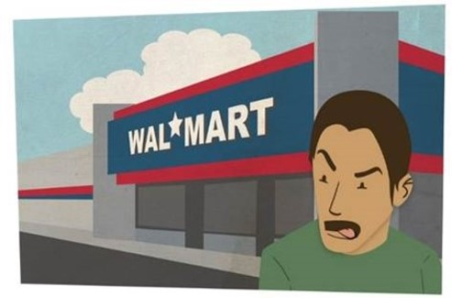
Walmart’s Mixed Experience
Germany: Failing to understand the market, Walmart could not compete with local firms, and left the market.
Mexico: Built huge U.S.-style parking lots. But most Mexicans lack cars, and city bus stops were far away, so shoppers could not haul their purchases home.
Brazil: Families do their big shopping on payday. Aisles were too narrow to accommodate the rush.
Argentina: Walmart’s red-white-and-blue banners, reminiscent of the U.S. flag, offended local tastes.
Notes:
Walmart has more than 240 stores and tens of thousands of employees in China. It sources almost all its merchandise locally, providing jobs for thousands more Chinese. Walmart (www.walmart.com) is the world’s largest retailer but failed in Germany because it could not compete with local competitors and eventually exited the market. In Mexico, Walmart constructed massive U.S.-style parking lots for its new super centers. But most Mexicans don’t have cars and city bus stops were too far away, so shoppers could not haul their goods home. In Brazil, most families do their big shopping once a month on payday. Walmart built aisles too narrow and crowded to accommodate the rush and stocked shelves in urban São Paulo with unneeded leaf blowers. In Argentina, Walmart’s red, white, and blue banners, reminiscent of the U.S. flag, offended local tastes. Sam’s Club, Walmart’s food discounting operation, flopped in Latin America partly because its huge multipack items were too big for local shoppers with low incomes and small apartments.

Slide 40
Success Factors for Retailers
Advance research and planning. French retailer Carrefour spent 12 years building its business in Taiwan, to better understand Chinese culture.
Establish logistics and purchasing networks in each market. Well-organized sourcing and logistics ensure inventory is always maintained.
Assume entrepreneurial, creative approach. Virgin megastore expanded to Asia, Europe, and North America, using creative approaches.
Adjust business model to suit local conditions. In Mexico, Home Depot packages merchandise to suit smaller budgets and offers flexible payment plans.
Notes:
The most successful retailers pursue a systematic approach to international expansion.
First, advanced research and planning is essential. In the run-up to launching stores in China, management at the giant French retailer Carrefour spent 12 years building up its business in Taiwan, where it developed a deep understanding of Chinese culture. It also learned how to forge alliances with local governments. These preparations helped Carrefour become China’s biggest foreign retailer, rapidly developing a network of hypermarkets in twenty-five cities.
Second, establish efficient logistics and purchasing networks. Scale economies in procurement are especially critical.
Third, assume an entrepreneurial, creative approach to foreign markets. For example, Virgin Megastore expanded to numerous markets throughout Europe, North America, and Asia, using creative approaches. The stores were big, well lit, and stocked music albums in a logical order. Thus, sales turnover was much faster than that of smaller music retailers.
Fourth, adjust business model to suit local conditions. Home Depot offers merchandise in Mexico that suits the small budgets of do-it yourself builders. It has introduced payment plans and promotes the do-it-yourself mind-set in a country where most cannot afford to hire professional builders. The major dimensions along which retailers differentiate themselves abroad include selection, price, marketing, store design, and the ways in which goods are displayed. They must proceed cautiously while adapting to local conditions, to avoid diluting or destroying the unique features that first made them successful.
I K E A, the world’s largest furniture retailer, has enjoyed great success, launching over 200 furniture megastores in dozens of countries. Superior performance derives from strong leadership and skillful management of human resources, and from the careful balancing of global integration of operations with responsiveness to local tastes. In each store, I K E A (www.ikea.com) offers as many standardized products as possible while maintaining sufficient flexibility to accommodate specific local conditions. It tests the waters first and learns in smaller markets before entering big markets. For instance, I K E A perfected its retailing model in German-speaking Switzerland before entering Germany.

Slide 41

Copyright
This work is protected by United Kingdom copyright laws and is provided solely for the use of instructors in teaching their courses and assessing student learning. Dissemination or sale of any part of this work (including on the World Wide Web) will destroy the integrity of the work and is not permitted. The work and materials from it should never be made available to students except by instructors using the accompanying text in their classes. All recipients of this work are expected to abide by these restrictions and to honor the intended pedagogical purposes and the needs of other instructors who rely on these materials.

