Slide 1
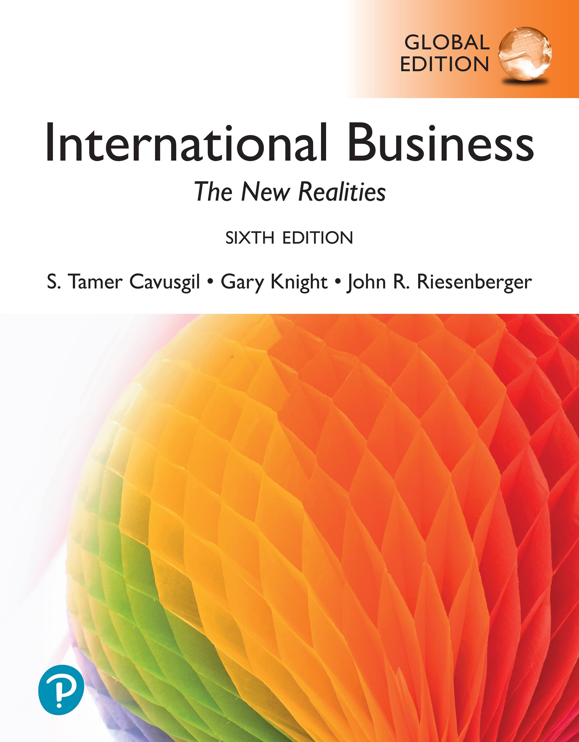

International Business: The New Realities
Sixth Edition, Global Edition
Chapter 15
Licensing, Franchising, and Other Contractual Strategies
© 2025 Pearson Education Ltd. All Rights Reserved.
Notes:
If this PowerPoint presentation contains mathematical equations, you may need to check that your computer has the following installed:
1) MathType Plugin
2) Math Player (free versions available)
3) NVDA Reader (free versions available)

Slide 2
Learning Objectives
15.1 Explain contractual entry strategies.
15.2 Understand licensing as an entry strategy.
15.3 Describe the advantages and disadvantages of licensing.
15.4 Understand franchising as an entry strategy.
15.5 Explain the advantages and disadvantages of franchising.
15.6 Understand other contractual entry strategies.
15.7 Understand infringement of intellectual property, a global problem.

Slide 3
Foundation Concepts
Contractual entry strategies in international business: Cross-border exchanges in which the relationship between the focal firm and its foreign partner is governed by an explicit contract.
Intellectual property: Ideas or works created by firms or individuals, such as patents, trademarks, and copyrights. Includes such knowledge-based assets of the firm or individuals as industrial designs, trade secrets, inventions, works of art, literature, and other “creations of the mind”.
Notes:
Contractual entry strategies in international business are cross-border exchanges in which the relationship between the focal firm and its foreign partner is governed by an explicit contract. Intellectual property describes ideas or works that individuals or firms create, including discoveries and inventions; artistic, musical, and literary works; and words, phrases, symbols, and designs. Harry Potter is a leading example. Intellectual property is safeguarded through intellectual property rights, the legal claim through which proprietary assets are protected from unauthorized use by other parties.

Slide 4
Contractual Relationships (1 of 2)
Licensing: An arrangement in which the owner of intellectual property grants another firm the right to use that property for a specified period of time in exchange for royalties or other compensation.
Franchising: Arrangement in which the firm allows another the right to use an entire business system in exchange for fees, royalties or other compensation.
Royalty: A fee paid periodically to compensate a licensor for the temporary use of its intellectual property, often based on a percentage of gross sales generated from the use of the licensed asset.

Slide 5
Examples of Contractual Relationships
Japanese company Sanrio has licensed “Hello Kitty” to many manufacturers of cosmetics, food, calendars, toys, clothing, and numerous other products.
C B S signed a licensing deal with P P T V, China's leading video streaming service, to give streaming rights for C B S and Showtime programming in China.
Pfizer (U S) and Novartis (Switzerland) periodically license pharmaceutical inventions to each other.
7-Eleven has some 78,000 stores in 18 countries. While the parent firm in Japan owns most of the stores, many stores in Canada, Mexico, Asia, and Europe operate via licensing or franchising agreements.

Slide 6
Unique Aspects of Contractual Relationships
Governed by a contract that provides the firm a moderate level of control over the foreign partner. Control reflects the ability of the firm to influence the decisions, operations, and strategic resources of a foreign venture.
Typically involves exchange of intangibles (intellectual property) and services. Examples include technical assistance, know-how, and trademarks.
Can be pursued independently or with other foreign market entry strategies, such as F D I and exporting.
Notes:
FDI is far more taxing on the firm’s resources and capabilities than any other entry strategy. The U.S. firm General Electric owns more than $400 billion in factories, subsidiaries, and other operations outside the United States.
2. Through F D I, management establishes direct contact with customers, intermediaries, facilitators, and the government sector. Although based in Switzerland, Nestlé generates more than 90 percent of its sales from abroad. The Indian M N E Tata Consultancy Services generates most of its revenues in North America, while rival I B M, a U.S. company, obtains nearly two-thirds of its sales from abroad.
3. Managers choose particular countries in which to invest, based on the advantages these locations offer. Thus, firms tend to: perform R&D activities in those countries with leading-edge knowledge and experience for their industry; source from countries where suppliers provide the best-value products; build production facilities at locations that provide the best ratio of productivity to labor costs; and establish marketing subsidiaries in countries with the greatest sales potential.
4. Compared to other entry strategies, establishing a permanent, fixed presence in a foreign country makes the firm vulnerable to country risk and intervention by local government on issues such as wages, hiring practices, and product pricing. Direct investors also must contend with inflation, recessions, and other local economic conditions. French automaker Renault recently paid $1 billion to obtain a 25 percent stake in AvtoVAZ (www.lada-auto.ru), a car factory in Russia. Renault management wants to produce Lada brand cars for the local market. But the AvtoVAZ plant is 40 years old and plagued by inefficient operations and a slow-moving workforce with origins in the Soviet era of communism, and has a history of organized crime.
5. Even a large, well-established company like Disney experienced several failures in its foreign investing. When Disney established Tokyo Disneyland, its management incorrectly assumed the Disneyland experience could not be successfully transferred to Japan. So instead of investing, Disney opted to license rights in Japan for nominal profits. Tokyo Disneyland proved to be a huge success. Not wanting to repeat the same mistake, management opted to retain an F D I stake in its next theme park—Disneyland Paris. But it proved to be a financial sinkhole. Having learned from these experiences, Disney has made the latest theme park, Hong Kong Disneyland, more successful. Disney owns just 46 percent of the venture, making the Hong Kong government the major partner.

Slide 7
Contractual Relationships (2 of 2)
Provide dynamic, flexible choice, where firms may use contractual agreements to make their initial entry in foreign markets. Then, as conditions evolve, they switch to another entry strategy, such as F D I.
Can reduce perceptions of the firm as a foreign enterprise. A contractual relationship with a local firm facilitates blending into the local market.
Generate a consistent earnings from foreign operations, compared with F D I, as contractual arrangements are less susceptible to volatility and risk.

Slide 8

Typical Types of Intellectual Property
A patent provides the right to prevent others from using an invention for a fixed period. It is granted to anyone who invents a new process, product, or useful improvement.
A trademark is a distinctive design or symbol that identifies a product or service. For example, Nike’s swoosh symbol.
A copyright protects original works of authorship. Typically covers works of music, art, literature, movies, or software.

Slide 9
Intellectual Property Rights
The legal claim through which the proprietary assets of firms and individuals are protected from unauthorized use by other parties.
Provide inventors with a monopoly advantage, for a specified period of time, so they can exploit their inventions and create commercial advantage.
Without legal protection and the assurance of commercial rewards, most firms and individuals would have little incentive to invent.

Slide 10
Licensing (1 of 2)
A licensing agreement specifies the nature of the relationship between the licensor (owner of intellectual property) and the licensee (the user).
Examples:
Intel licensed the right to a new process for manufacturing computer chips to a firm in Germany.
Warner licenses images from the Harry Potter books and movies to companies worldwide.
Disney licenses the right to use its cartoon characters in producing shirts and hats to clothing manufacturers in Asia.

Slide 11
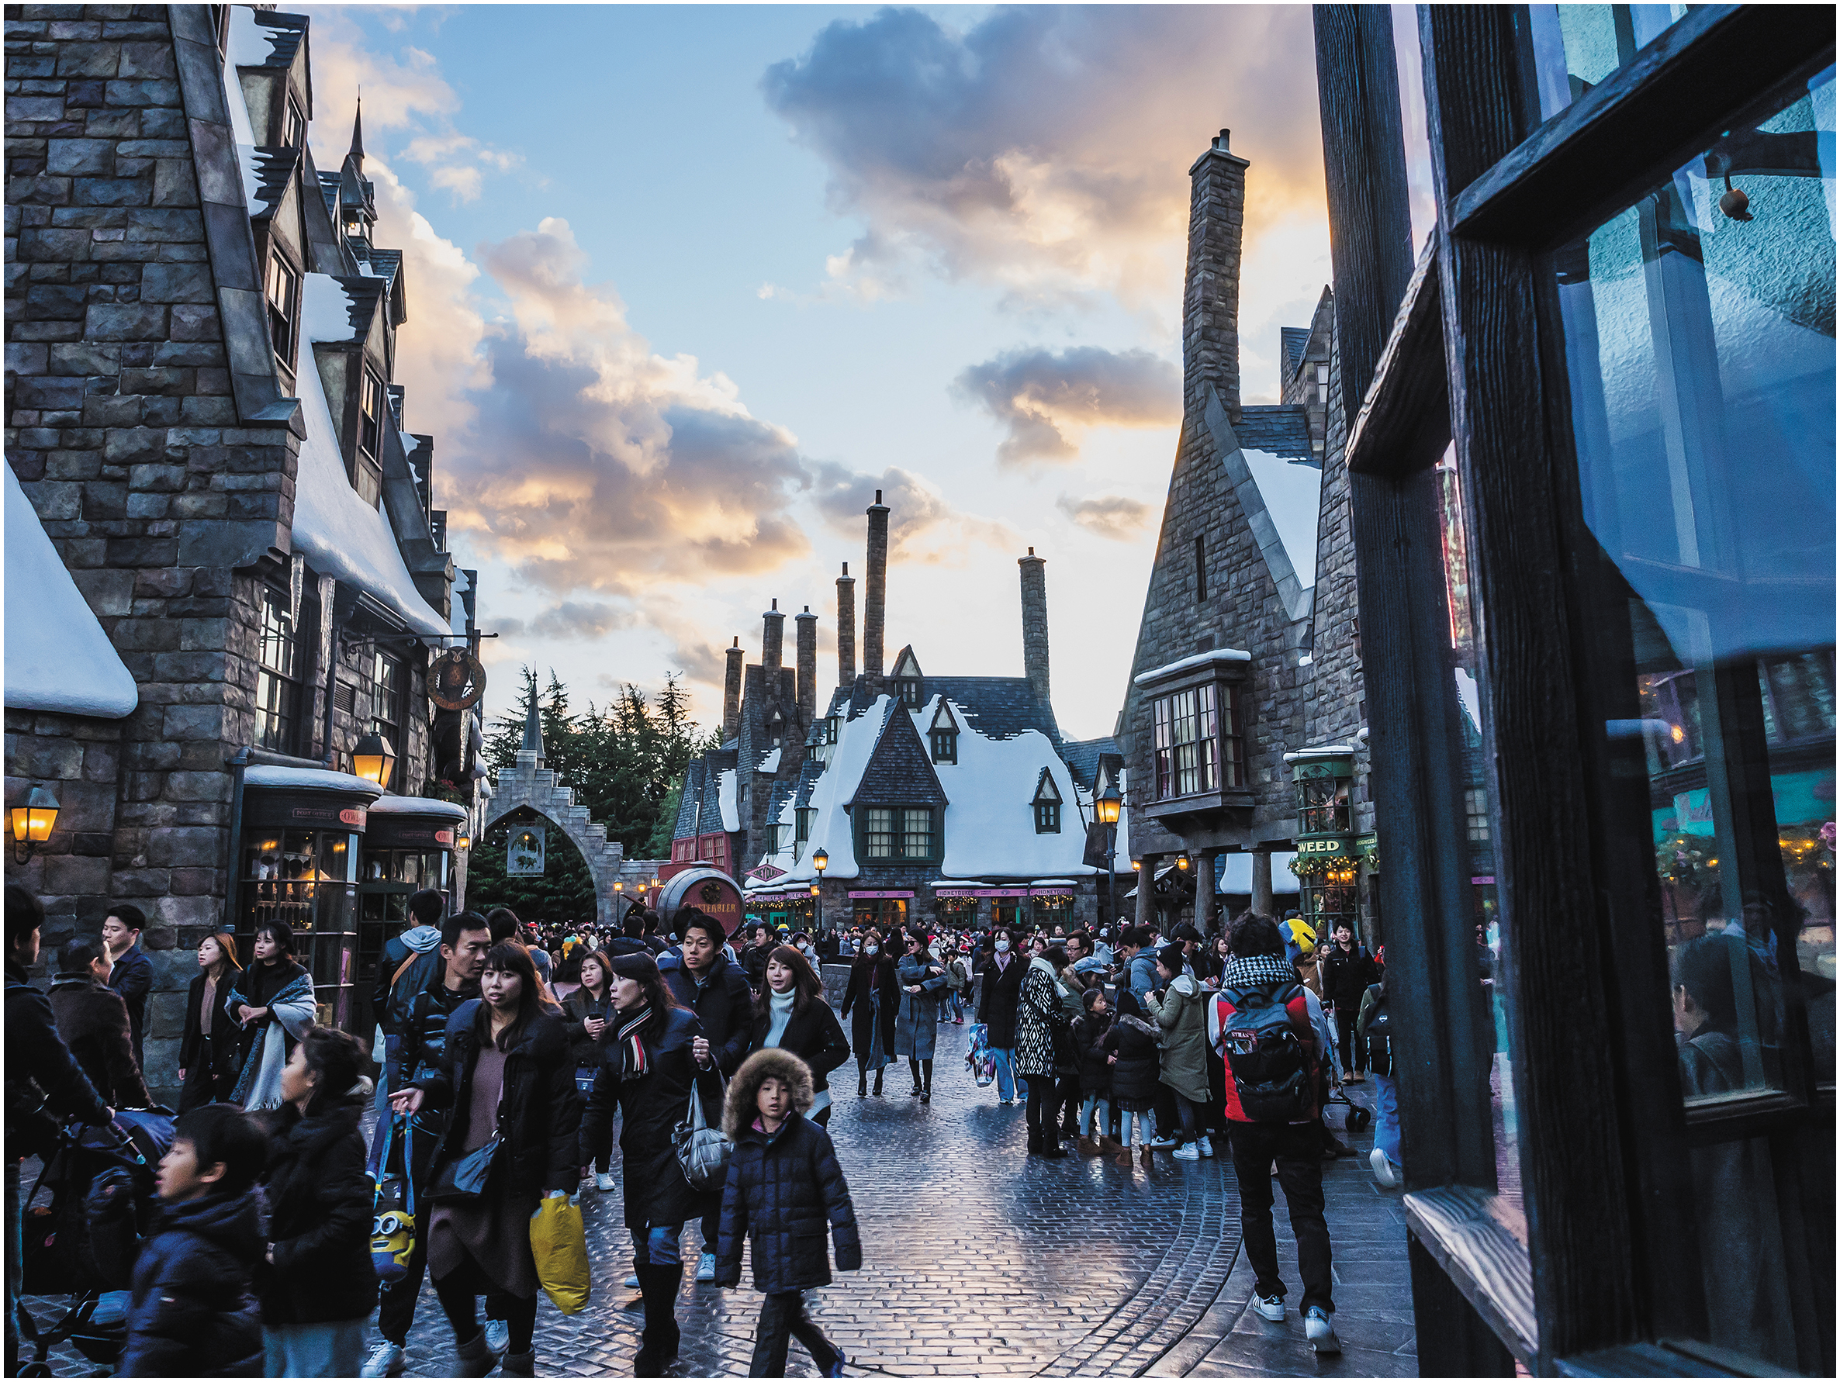
Licensing (2 of 2)
In a typical deal, the licensee pays the licensor a fixed amount upfront and an ongoing royalty (usually 2–5 percent) on gross sales generated from using the licensed asset.
The fixed amount covers the licensor’s initial costs of transferring the licensed asset to the licensee, including training, engineering, or adaptation.
The Wizarding World of Harry Potter, Universal Studios, Japan is a venue for many licensed products
Certain types of licensable assets, such as copyrights and trademarks, have much lower transfer costs.

Slide 12
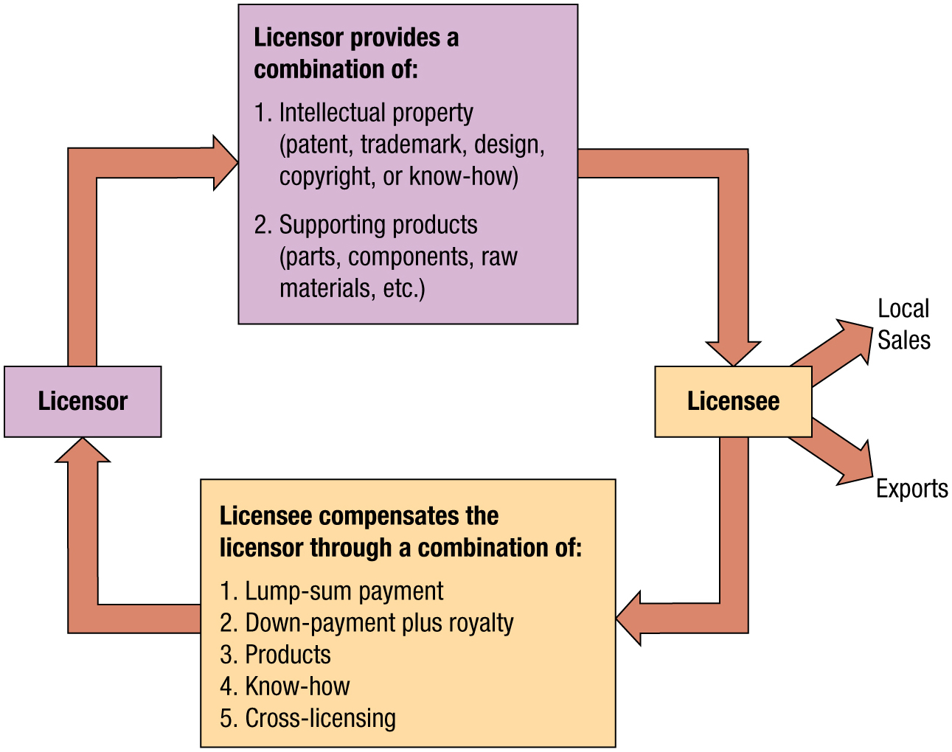
Licensing as a Foreign Market Entry Strategy
Notes:
Long Description:
The elements follow one after the next as follows: licensor; licensor provides the licensee a combination of: 1. Intellectual property (patent, trademark, design, copyright, or know-how); 2. Supporting products (parts, components, raw materials, etcetera); Licensee divides into two sections local sales and exports; licensee compensates the licensor through a combination of: 1. Lump-sum payment; 2. Down-payment plus royalty; 3. Products; 4. Know-how; 5. Cross-licensing.

Slide 13
International Licensing Is Fairly Common
Planters and Sunkist are owned by U.S. firms and sold in Britain and Japan via licensing agreements.
Budweiser is brewed in Japan by Kirin under license from Anheuser Busch
Kit Kat chocolate bars are owned by Switzerland’s Nestlé and distributed in the United States through a licensing agreement with Nestlé’s competitor, Hershey.
Game shows such as Price Is Right and Family Feud are owned by FremantleMedia, a U K company that licenses these programs for broadcast around the world.
A review of 120 of the largest multinational food companies revealed that at least half are involved in some form of international product licensing.

Slide 14
Trademark Licensing (1 of 2)
Involves a firm granting another firm permission to use its proprietary names, characters, or logos for a specified period of time in exchange for a royalty.
Trademarks appear on clothing, food, toys, home furnishings, and numerous other goods and services. For example, Coca Cola, Harley-Davidson, Laura Ashley, Disney, Michael Jordan, and your favorite university.
A trademark like Harry Potter generates millions of dollars for the owner with little effort.
Worldwide retail sales of licensed merchandise exceed $260 billion annually.

Slide 15
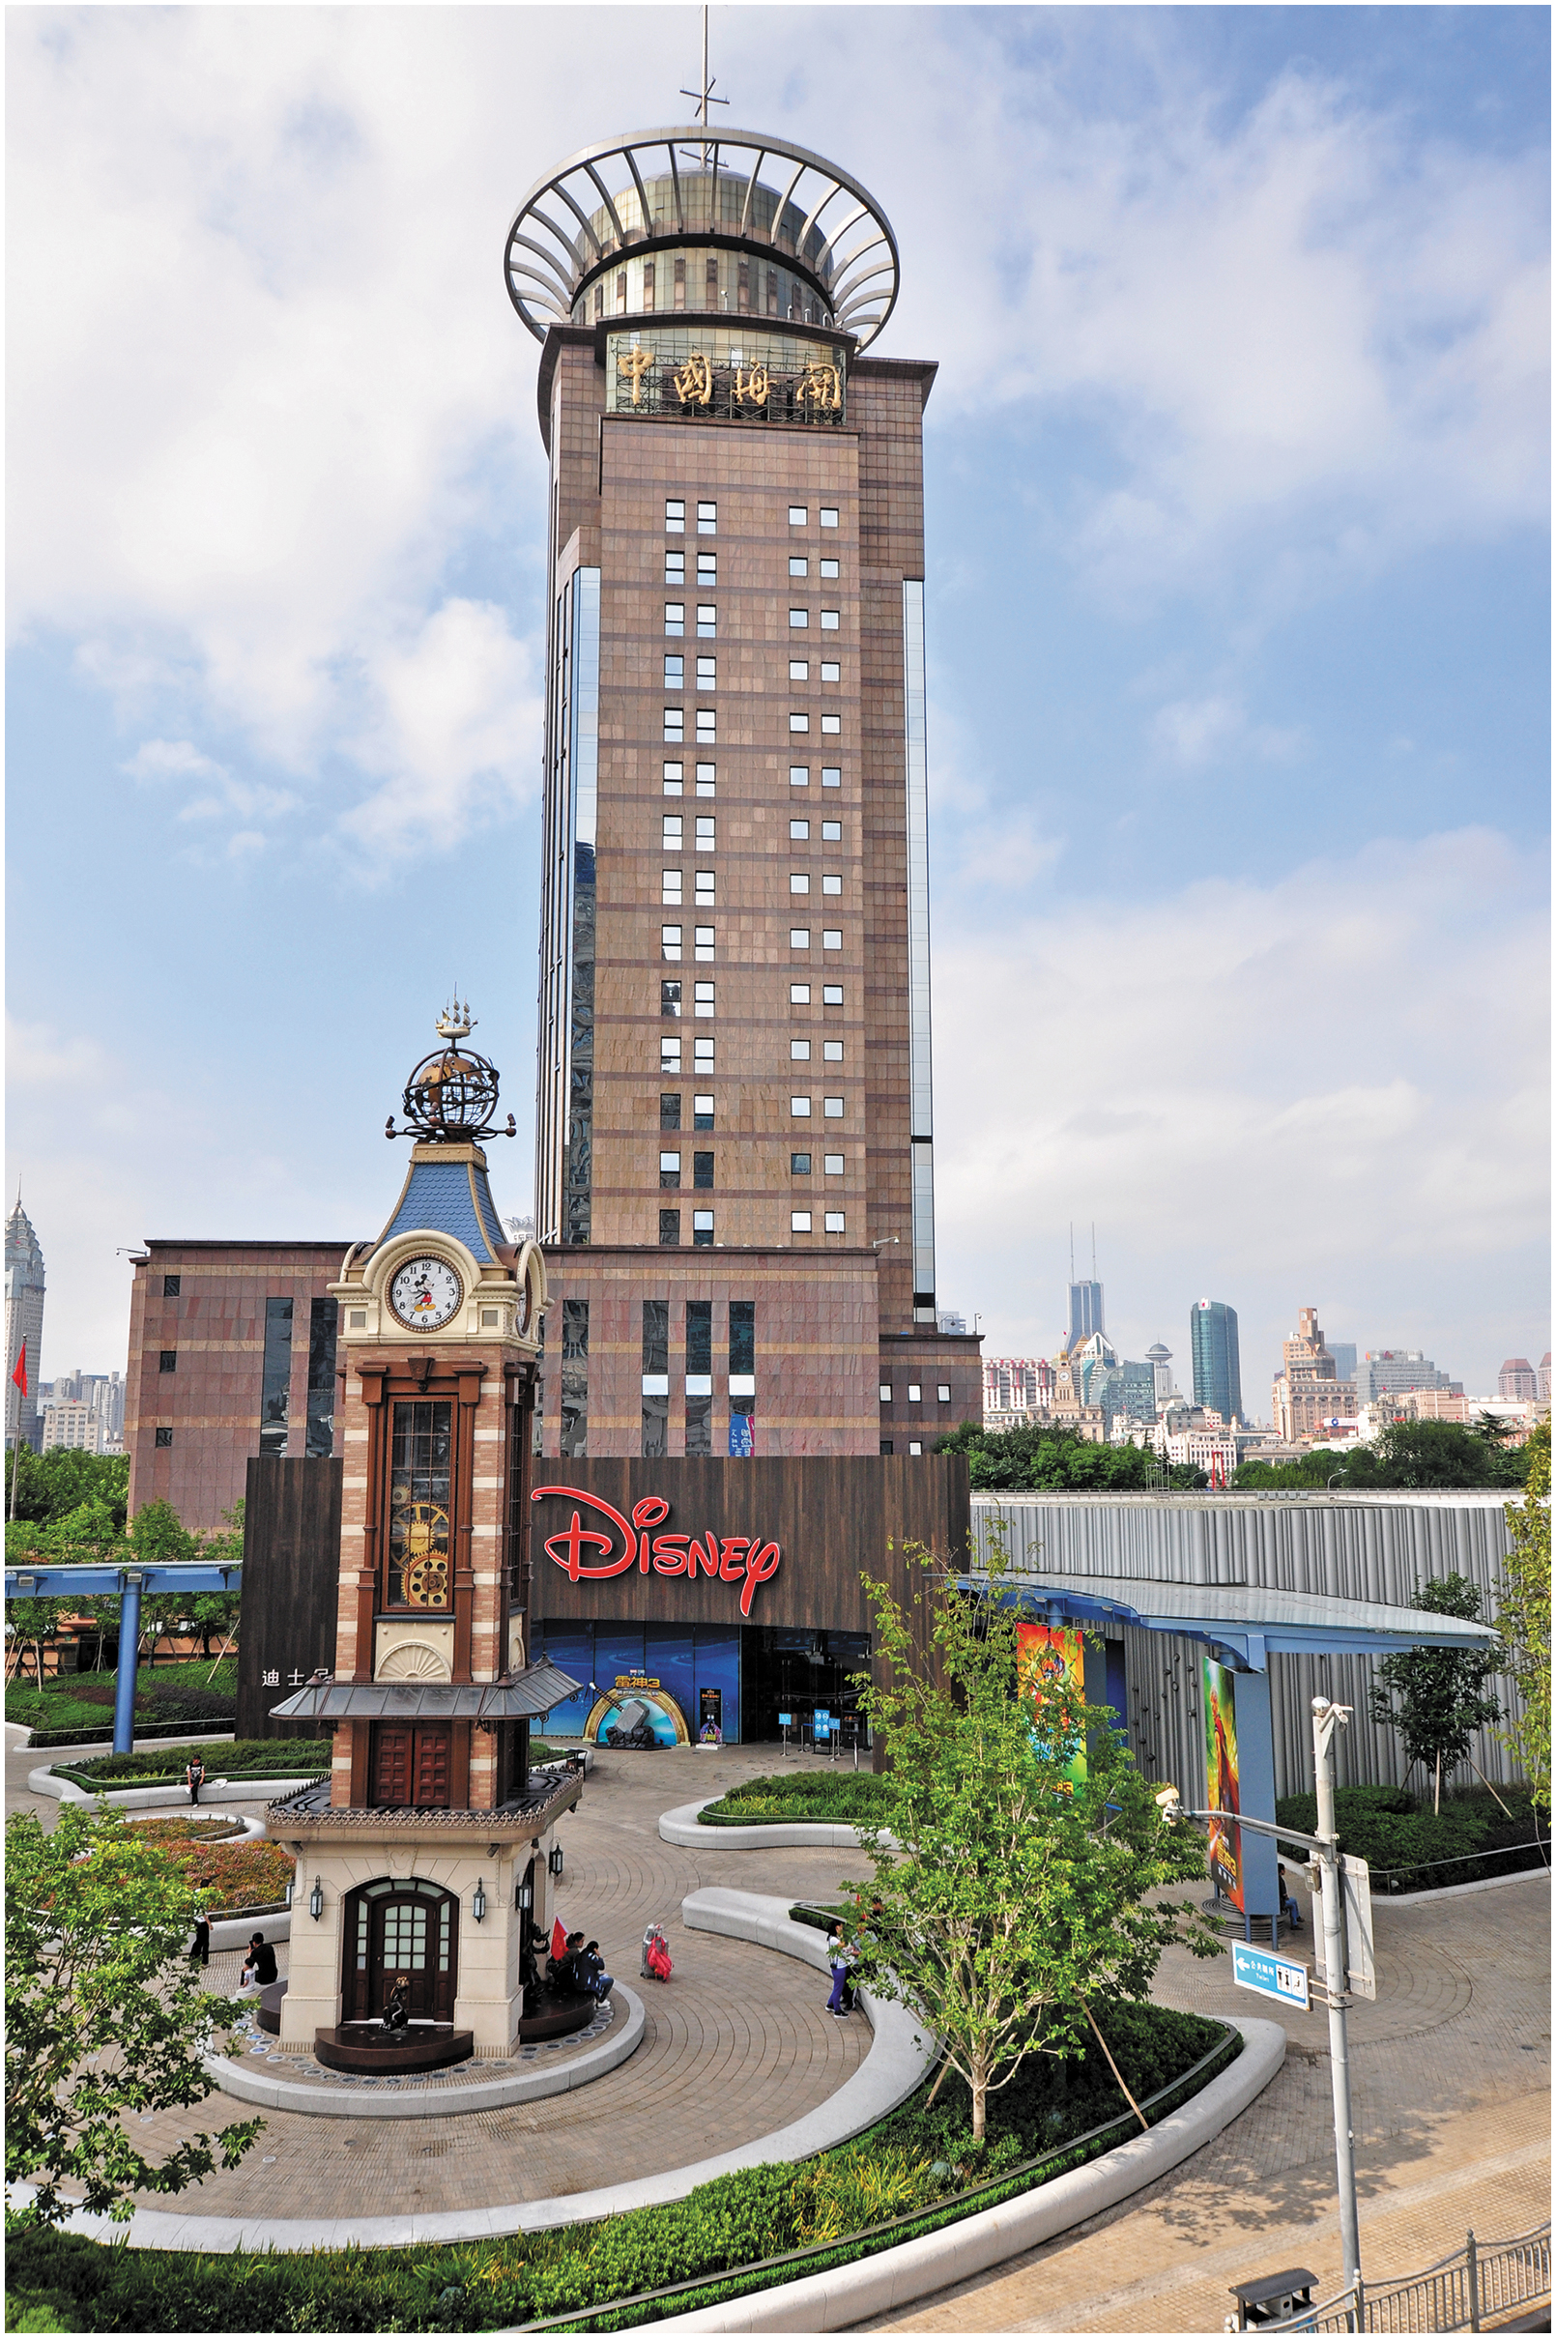
Trademark Licensing (2 of 2)
The Walt Disney Company licenses its trademark characters to apparel and accessory manufacturers, generating substantial revenue. Shown is the Disney store in Shanghai, China.

Slide 16
Copyright Licensing
A copyright gives the owner the exclusive right to reproduce art, music, literature, software, and other such works, as well as prepare derivative works, distribute copies, or perform or display the work publicly.
The term of protection varies by country, but the creator’s life plus 50 years is typical.
Many countries offer little or no copyright protection.
Thus, it is wise to investigate local copyright laws before publishing a work abroad.

Slide 17
Know-How Licensing
Involves a contract in which the focal firm provides technological or management knowledge about how to design, manufacture, or deliver a product or a service.
The licensor makes its patents, trade secrets, or other know-how available to a licensee in exchange for a royalty.
The royalty may be a lump sum, a “running royalty” based on the volume of products produced from the know-how, or a combination of both.

Slide 18
Leading Licensors by Licensing Revenues
Rank | Firm Name | Annual Licensing Revenues (U.S. $ billions) | Typical Deals
1 | The Walt Disney Company | $56.6 | Toy and apparel licensing for Disney movies such as Little Mermaid and Toy Story and characters such as Winnie the Pooh and the Frozen princesses
2 | Dotdash Meredith | 35.9 | Bedding, furniture, and other products related to the Better Homes and Gardens brand
3 | Authentic Brands Group | 21.7 | Apparel licensing for such brands as Izod and Forever 21
4 | WarnerMedia/Warner Bros. Consumer Products | 15.0 | Toy and apparel licensing from movies such as Batman, Harry Potter, and The Hobbit
5 | The Pokémon Company International | 8.5 | Video game software, anime television series, films, and home entertainment products based on the Pokémon characters
6 | Hasbro | 8.4 | Toy and apparel licensing for TV programs and movies such as My Little Pony and Transformers
7 | NBC Universal / Universal Brand Development | 8.3 | Toys and digital products licensing for movies such as The Secret Life of Pets and Despicable Me
8 | Mattel | 7.4 | Licensing for popular Mattel toys and games like Barbie, Fisher-Price, and American Girl
9 | Bluestar Alliance | 6.5 | Sportswear and accessories licensing for popular brands like Hurley, Justice, Tahari, and Brookstone
10 | Paramount Global / Paramount Consumer Products & Experiences | 6.0 | Licensing for entertainment offerings like Baby Shark, Teenage Mutant Ninja Turtles, SpongeBob SquarePants, and Star Trek.
Source: Based on annual reports of the individual firms; company profiles at
www.hoovers.com
; “The Top Global Licensors
Report 2022,” License Global, July 1, 2022,
www.licenseglobal.com
.
Notes:
www.hoovers.com
www.licensemag.com/license-global/top-150-global-licensors-3

Slide 19
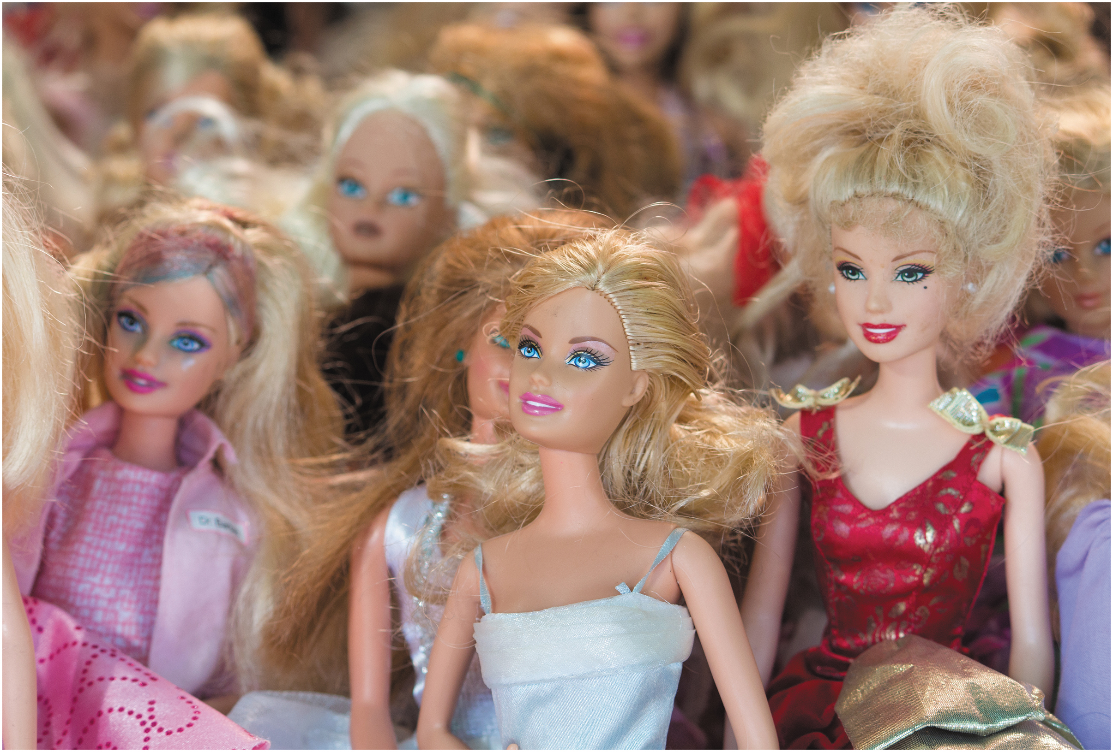
Main Advantages and Disadvantages of Licensing
Advantages for licensor
Low investment
Low involvement
Low effort, once established
Low-cost initial entry strategy
Disadvantages for licensor
Performance depends on the foreign licensee
Licensor has limited control over its asset(s) abroad
Runs the risk of creating a future competitor

Slide 20
Franchising
Most typical arrangement is business format franchising, in which franchisor transfers to the franchisee a total business method—including production and marketing methods, sales systems, procedures, training, and the use of its name.
More comprehensive and longer-term than licensing.
Master franchiser: An independent company authorized to establish, develop, and manage the entire franchising network in its market. For example, McDonald's in Japan, Hertz in Denmark.
Notes:
Franchising is an advanced form of licensing in which the focal firm, the franchisor, allows an entrepreneur, the franchisee, the right to use an entire business system in exchange for compensation. As with licensing, an explicit contract defines the terms of the relationship. McDonald’s, Subway, Hertz, and FedEx are well-established international franchisors. Others that use franchising to expand abroad include Benetton, Body Shop, Yves Rocher, and Marks & Spencer.
Franchising is common in international retailing. However, some retailers such as I K E A and Starbucks favor direct investment and internationalize through company-owned outlets. Ownership provides these firms with greater control over foreign operations but also typically restricts their ability to expand more rapidly abroad.

Slide 21
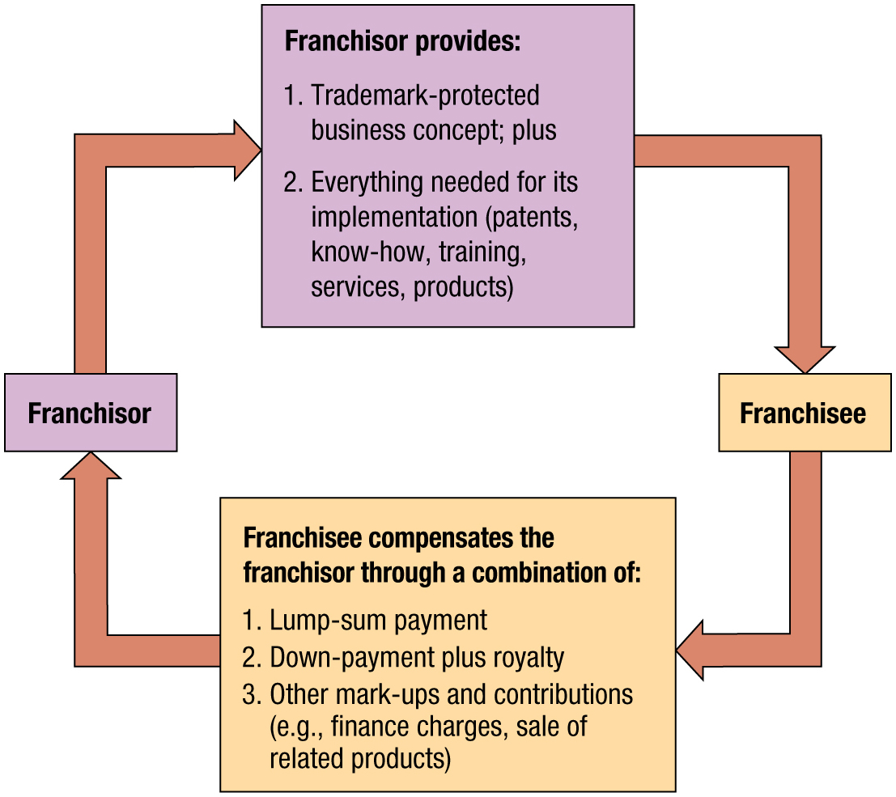
Franchising as an Entry Strategy
Notes:
Long Description:
The elements follow one after the next is as follows: franchisor; franchisor provides: 1. Trademark-protected business concept; plus; 2. Everything needed for its implementation (patents, know-how, training, services, products); franchisee; franchisee compensates the franchisor through a combination of: 1. Lump-sum payment; 2. Down-payment plus royalty; 3. Other mark-ups and contributions (for example, finance charges, sale of related products).

Slide 22
Examples of Leading International Franchises
Franchisor | Type of Business | Total Number of Franchises | International Franchises | Example Markets
7-Eleven | Convenience stores | 78,413 | 69,874 franchises in 18 countries | Australia, Denmark, India, Mexico
McDonald’s | Hamburger restaurants | 40,031 | 23,644 franchises in 120 countries | France, China, United Kingdom, Australia,
Subway | Sandwiches, salad restaurants | 37,147 | 21,796 franchises in 113 countries | Australia, Brazil, Canada, Mexico
K F C | Chicken restaurants | 26,934 | 23,039 franchises in 150 countries | Brazil, Canada, Japan, France
Burger King | Hamburger restaurants | 19,247 | 11,990 franchises in 102 countries | Ecuador, Finland, South Africa, Thailand
Domino’s | Pizza and pasta restaurants | 18,848 | 12,128 franchises in 83 countries | Canada, Ireland, Thailand, U S A
Pizza Hut | Pizza and pasta restaurants | 18,381 | 14,808 franchises in 92 countries | China, Brazil, Canada, Japan
Dunkin Donuts / Dunkin | Donut and coffee shops | 12,957 | 4,457 franchises in 42 countries | China, Germany, India, South Korea
Circle K | Convenience stores | 11,154 | 5,230 franchises in 27 countries | Cambodia, Indonesia, Ireland, Mexico
Sources: Based on FranchiseTimes, “Franchise Times Top 500,” 2023,
www.franchisetimes.com
; Entrepreneur, “2023
Top Global Franchises Ranking,”
www.entrepreneur.com
; Franchise Direct, “2023 Top 100 Franchises Report,”
www.franchisedirect.com
; company profiles from
Hoovers.com
; company websites and reports.
Notes:
www.entrepreneur.com
www.franchisedirect.com Hoovers.com

Slide 23
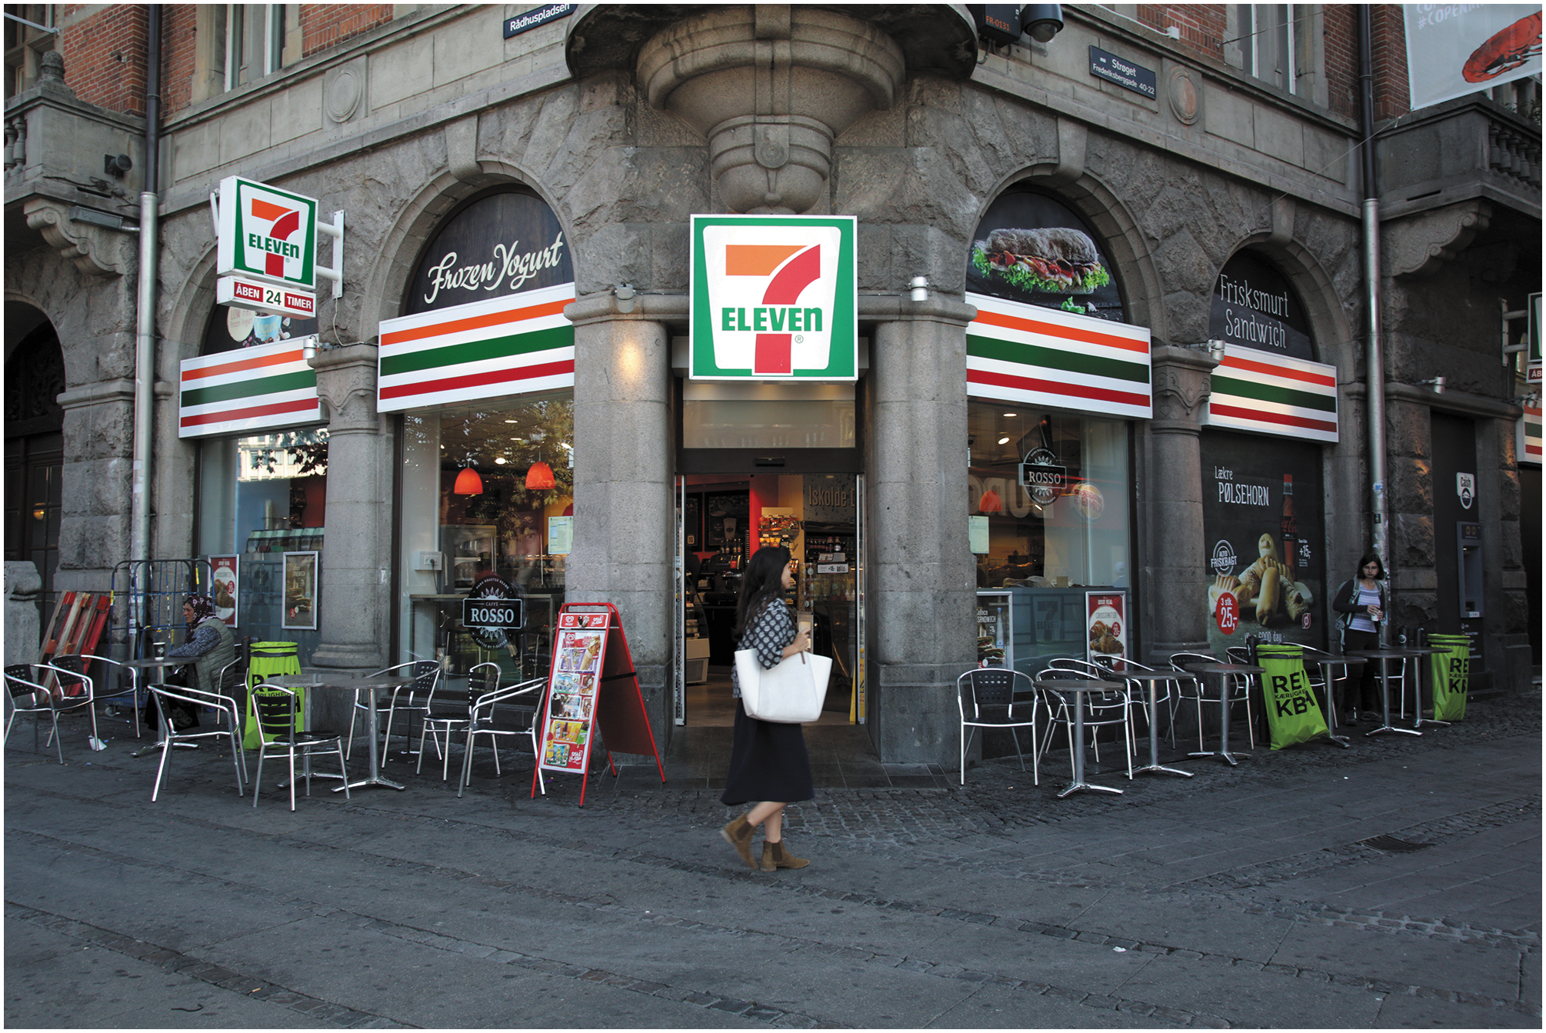
Advantages and Disadvantages of Franchising
Advantages for franchiser:
Low investment;
Can internationalize quickly to many markets;
Low effort, once established; and Can leverage franchisees’ local knowledge.
Disadvantages for franchiser:
Maintaining control over franchisees may be difficult;
Franchiser has limited control over its assets abroad; and
Risks creating a future competitor.

Slide 24
Franchising in Emerging Markets
China and India are home to more than 2.8 billion people and are promising markets for fast-food franchising. For example, K F C and Pizza Hut are big in China.
Most residents of developing economies and emerging markets lack sufficient income to patronize restaurants.
Most do not live in the major urbanized areas where international franchisors are concentrated.
Laws in such countries vary and often evolve quickly.
Food and eating habits are rooted in national culture.
Successful franchisors carefully study economic, demographic, legal, and cultural dimensions before targeting foreign countries them with franchises.

Slide 25
Example: Yum! Brands
Yum! Brands, based in Kentucky, U S A, is the owner and operator of several restaurant chains, including K F C, Pizza Hut, and Taco Bell.
Yum! operates about 53,000 fast food outlets, the most worldwide, and most as franchises.
In 2015, about one-half of Yum!’s revenues came from one country—China.
In 2016, Yum! spun off the China division to create Yum China, the country’s largest restaurant company.
In China, Pizza Hut is the largest casual dining restaurant chain and K F C is the largest fast-food chain.

Slide 26
Other Contractual Arrangements
Turnkey contracting: Arrangement where a firm plans, finances, organizes, manages, and implements all phases of a project abroad, and hands it over to a foreign country after training local personnel. Typical in the construction and engineering services industries.
Under a management contract, a contractor supplies managerial know-how to operate a hotel, resort, airport, hospital, or other facility, in exchange for compensation.
With international leasing, the lesser rents out machinery or equipment to clients abroad, often for several years at a time. For example, Airlines lease aircraft.
Notes:
Licensing and franchising are especially salient contractual entry strategies. In addition, firms employ other contract-based approaches to venture abroad.. Other types of contractual agreements deal with building major construction projects, manufacturing products under contract, providing management and marketing services, or leasing major assets.

Slide 27
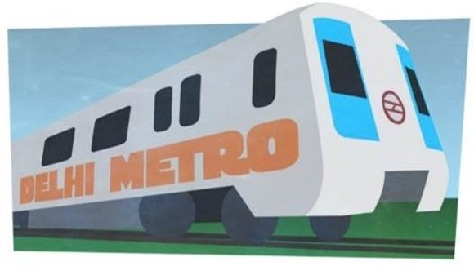
Example of Turnkey Projects (1 of 2)
The most popular projects are extensions and upgrades to metro systems, such as bridges, roadways, and railways. Other projects include airports, oil refineries, and hospitals.
One of the world's largest publicly-funded turnkey projects is in Delhi, India, to build roads and tunnels that run through the city.
In Abu Dhabi, a collection of M N E s are under contract to build an integrated processing plant for natural gas.

Slide 28
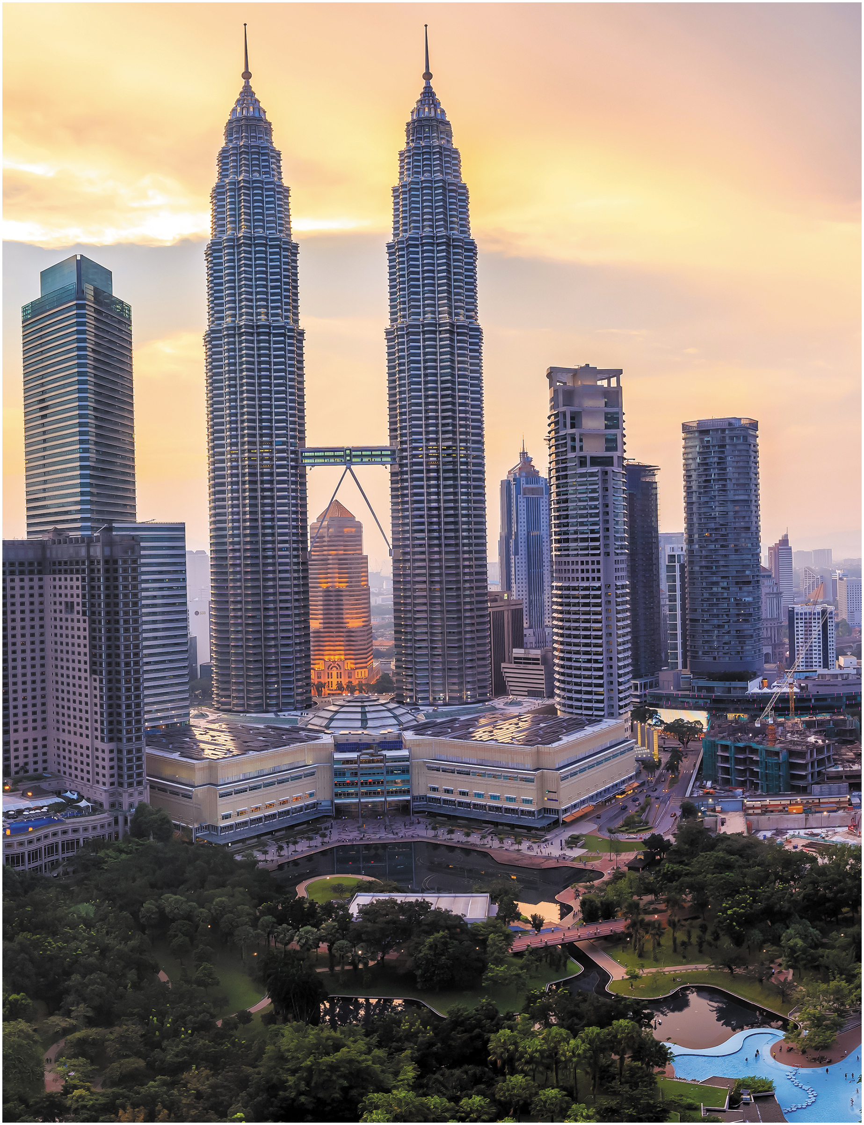
Example of Turnkey Projects (2 of 2)
The spectacular Petronas Twin Towers complex in Kuala Lumpur, Malaysia, was a seven-year turnkey project built by Bovis Lend Lease, one of the world’s leading project management and construction companies. Among the firms with offices in the Towers are Accenture, Al Jazeera English, Huawei Technologies, Microsoft, and Reuters.

Slide 29
Management of Licensing and Franchising
Licensing and franchising are complex undertakings, requiring skillful research, planning, and execution.
The firm must research in advance the host country's laws on intellectual property rights, repatriation of royalties, and contracting with local partners.
Key challenges include: establishing whose national law takes precedence for the contract; deciding whether to grant an exclusive or nonexclusive arrangement; and determining the geographic scope of territory to be granted to the foreign partner.

Slide 30
Infringement of Intellectual Property
The unauthorized use, publication, or reproduction of products or services protected by a patent, copyright, trademark, or other intellectual property right.
Especially a problem in emerging markets and developing economies, where people are especially vulnerable.
Negatively affects consumer attitudes about the branding and quality of legitimate goods.
The quality of counterfeit goods is almost always inferior to that of original, proprietary goods.
Hinders company inventiveness and innovation.

Slide 31
Counterfeiting
Total value of counterfeit and pirated goods traded internationally exceeds U.S. 2 trillion dollars.
Typical knockoffs include clothing, fashion accessories, watches, medicines, and appliances.
While companies such as Rolex, Louis Vuitton, and Tommy Hilfiger are well-known victims, counterfeiting is widespread even in industrial products.
Other examples: pharmaceutical products, medical devices, car parts.

Slide 32
Guidelines for Safeguarding Intellectual Property
Intellectual property laws are weak in many countries.
Key international treaties include:
Paris Convention for the Protection of I P.
Berne Convention for the Protection of Literary and Artistic Works.
Rome Convention for the Protection of Performers and Broadcasting Organizations.
The W T O created the Agreement on Trade-Related Aspects of Intellectual Property Rights (T R I P S).

Slide 33
Safeguarding Intellectual Property (1 of 2)
Research I P laws and protections in target countries.
Register core I P in top countries for business.
Separate value-chain activities to maintain I P secrecy. For example, Keep R&D and manufacturing separate so no one can learn the entire production process.
Emphasize leading-edge or hard-to-understand technologies, which are usually harder to imitate.
Hire employees who maintain high ethical standards.
Collaborate with ethical partners. Choose reputable suppliers with no history of I P violations.

Slide 34
Safeguarding Intellectual Property (2 of 2)
Regularly educate employees and partners about the harm of violating I P rights.
Include provisions in partner contracts to protect I P.
Develop trusting relations with partners.
Perform audits to ensure partners protect your I P.
Pursue I P violators via prosecution, other legal means.
Educate customers on the harm of infringing on I P.
Cultivate contacts in local and national governments involved in I P laws and enforcement.
Lobby governments for stronger I P protections.

Slide 35
Ethical Connections
Counterfeiting is not confined to lower-income countries.
Raids of retail outlets in the United States net millions of dollars’ worth of counterfeit products every year.
For example, city and federal authorities in New York arrested numerous people on charges of possessing millions of dollars in counterfeit fashions, including Gucci watches, Louis Vuitton handbags, North Face jackets, and much more.
Source: C B P Office of International Trade, “Intellectual Property Rights,” 2017,
www.cbp.gov
WWD: Women’s Wear
Daily, “Raid by N.Y. Police and Feds Nets $2 Million in Fakes,” December 10, 2014, p. 1.
Notes:
www.cbp.gov

Slide 36
Recent Grad in I B: Juanita Velez (1 of 2)
Juanita’s degrees: Bachelor’s degree in psychology, master’s degree in international business
Internships during college: International marketing intern, Convention and Visitors’ Bureau, Atlanta, Georgia, USA
Jobs held since graduating:
Director of digital marketing, Georgia Hispanic Chamber of Commerce, Atlanta, Georgia, U S A
International digital integrated communications supervisor, U P S, Georgia, U S A
International social media strategist and senior manager for diversity, equity and inclusion operations, Delta Air Lines, Atlanta, Georgia, U S A
Notes:
www.cbp.gov

Slide 37

Recent Grad in I B: Juanita Velez (2 of 2)
Success Factors
Sought the advice of mentors
Developed and leveraged her skills in communications and relationship-building
Read inspirational and self-help books to better understand how to achieve her goals
Advice for an International Career
Gain international experience
Develop a solid educational background
Learn to become a professional
Notes:
www.cbp.gov

Slide 38

Copyright
This work is protected by United Kingdom copyright laws and is provided solely for the use of instructors in teaching their courses and assessing student learning. Dissemination or sale of any part of this work (including on the World Wide Web) will destroy the integrity of the work and is not permitted. The work and materials from it should never be made available to students except by instructors using the accompanying text in their classes. All recipients of this work are expected to abide by these restrictions and to honor the intended pedagogical purposes and the needs of other instructors who rely on these materials.

