Slide 1
Global Marketing Ninth Edition
Part II
Deciding which markets to enter
Chapter 8
The international market selection process

Slide 2
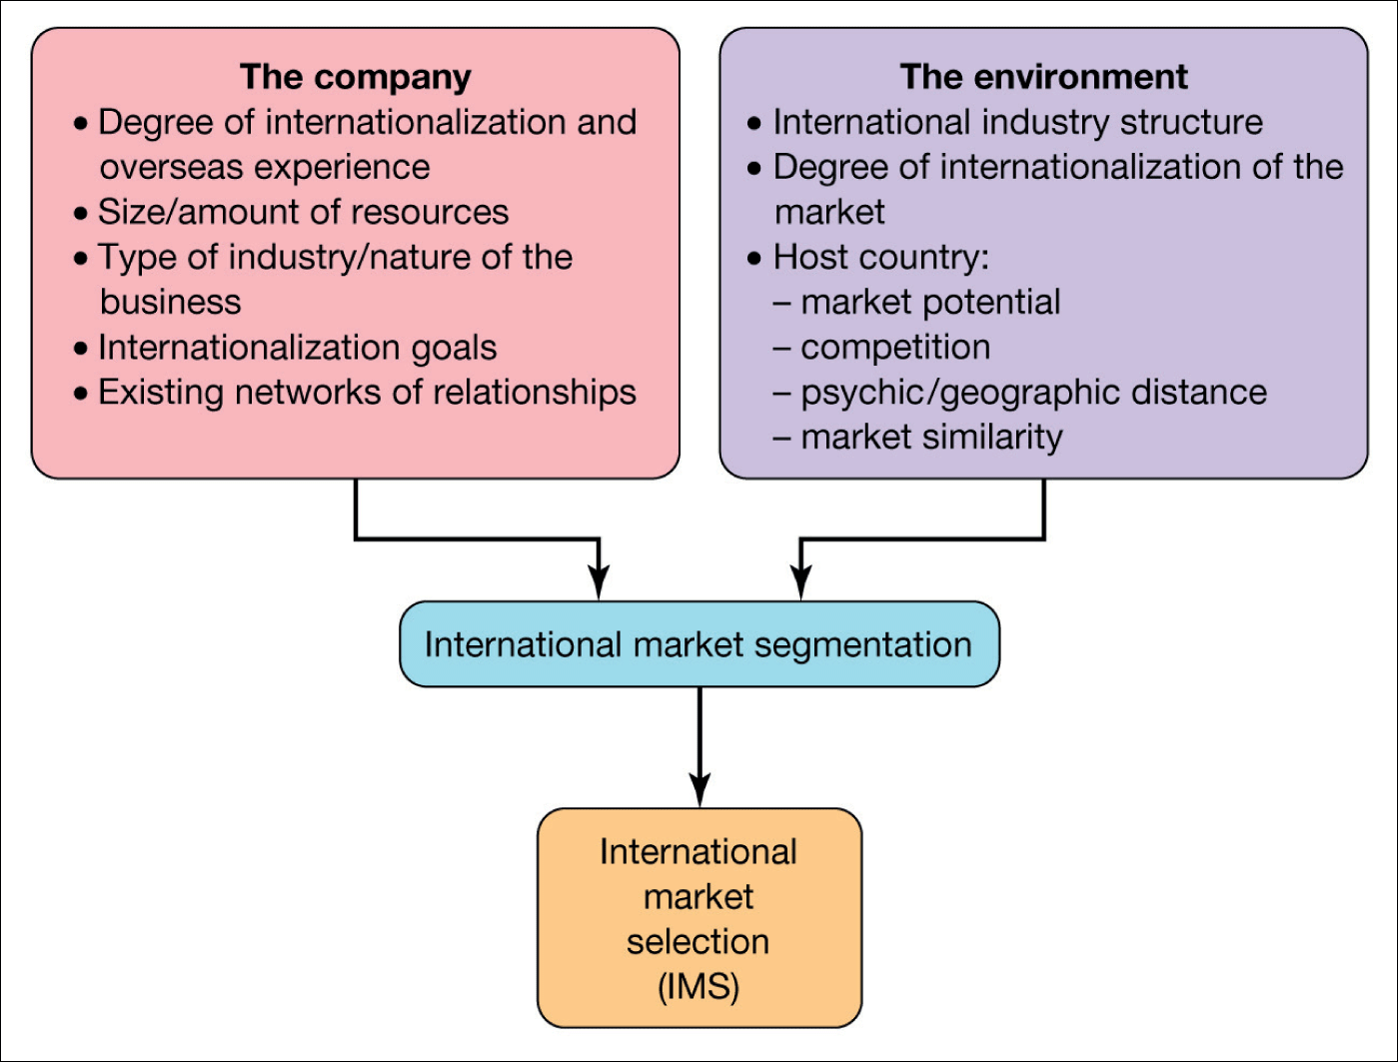
Figure 8.1 Potential determinants of the company’s choice of foreign markets
Svend Hollensen.

Slide 3
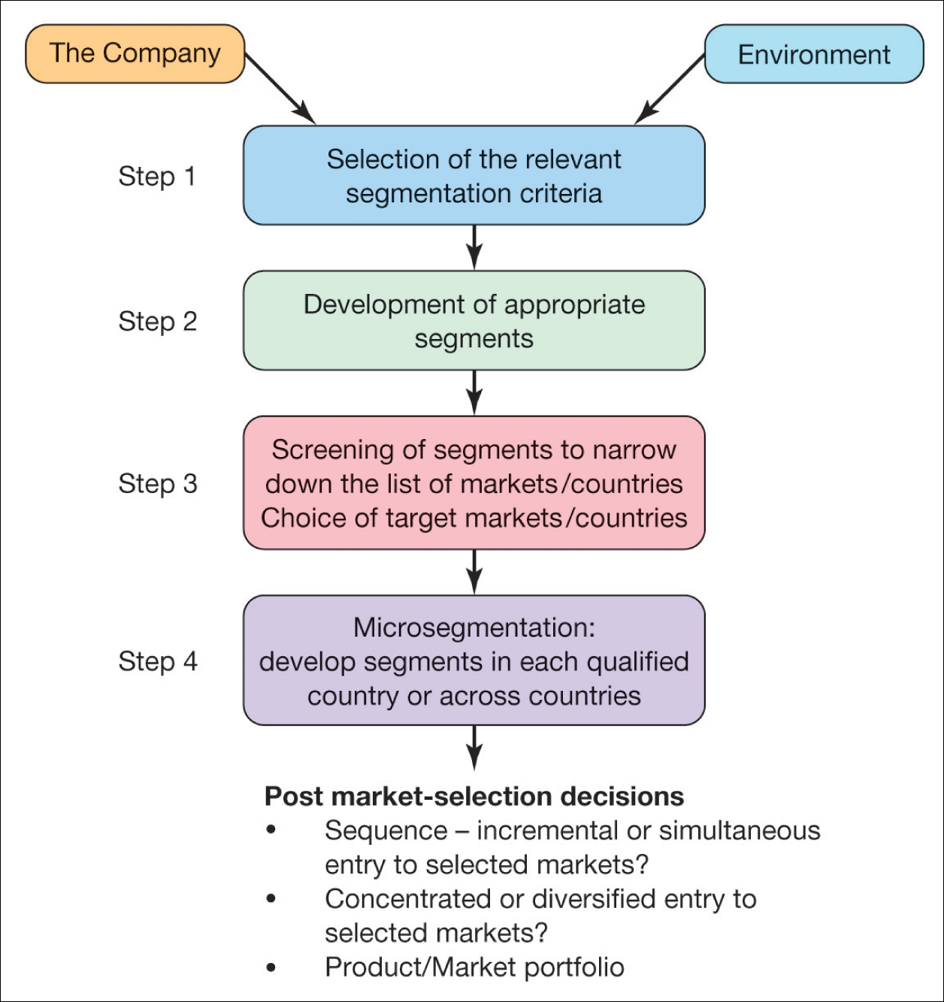
Figure 8.2 International market segmentation
Svend Hollensen.

Slide 4
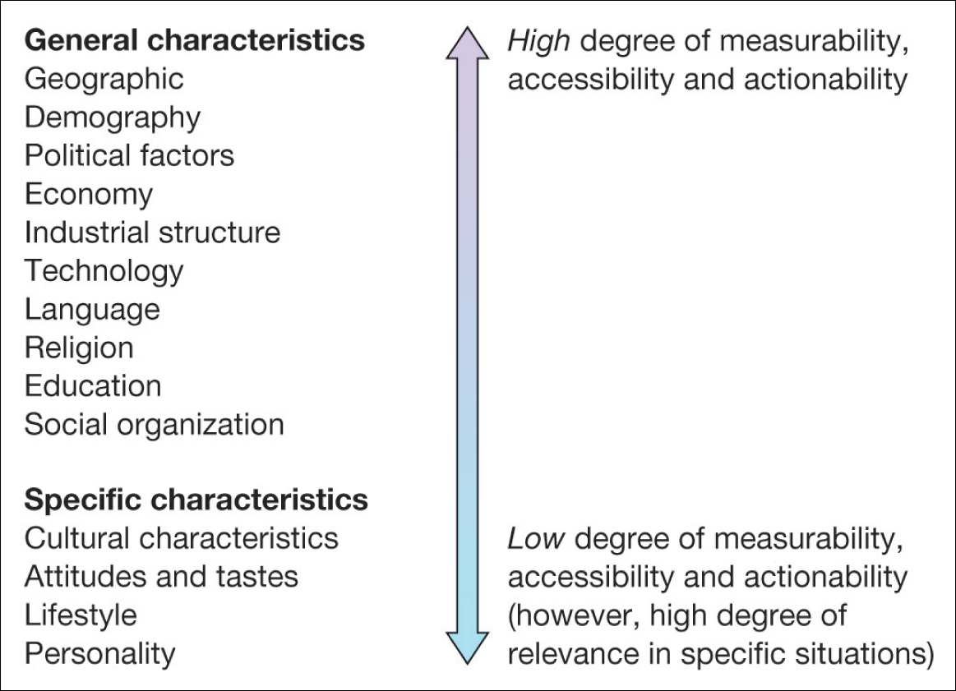
Figure 8.3 The basis of international market segmentation

Slide 5
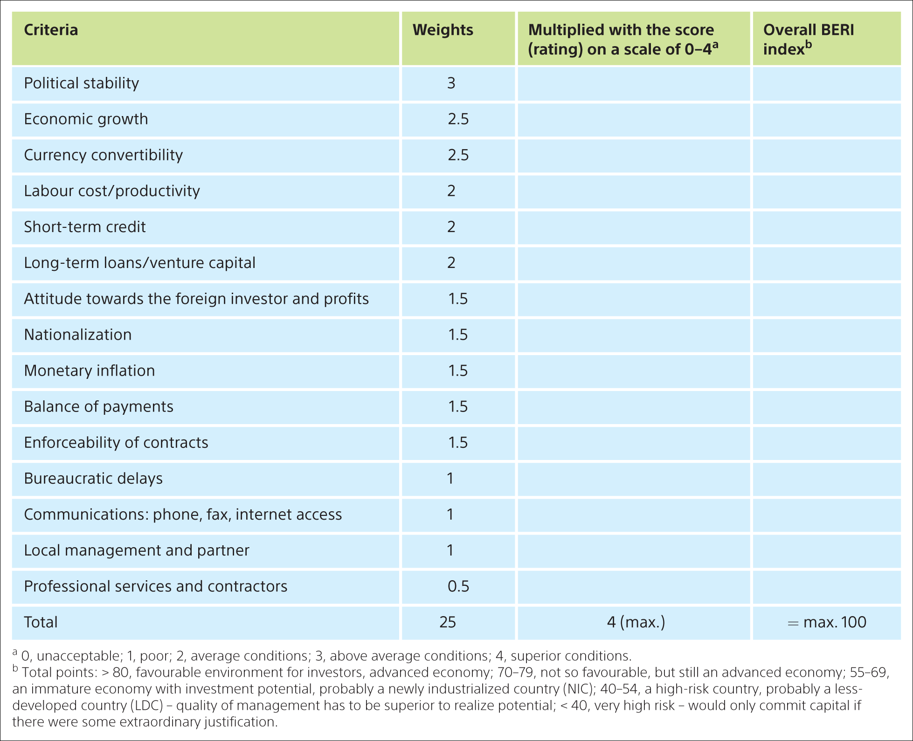
Table 8.1 Criteria included in the overall BERI index
Svend Hollensen.

Slide 6
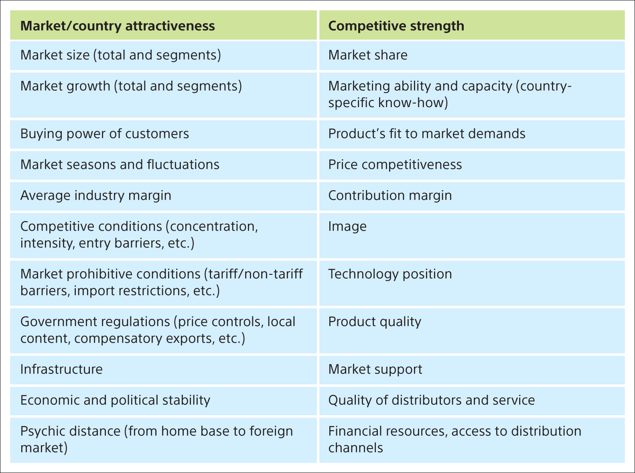
Table 8.2 Dimensions of market/country attractiveness and competitive strength (MACS)
Svend Hollensen.

Slide 7
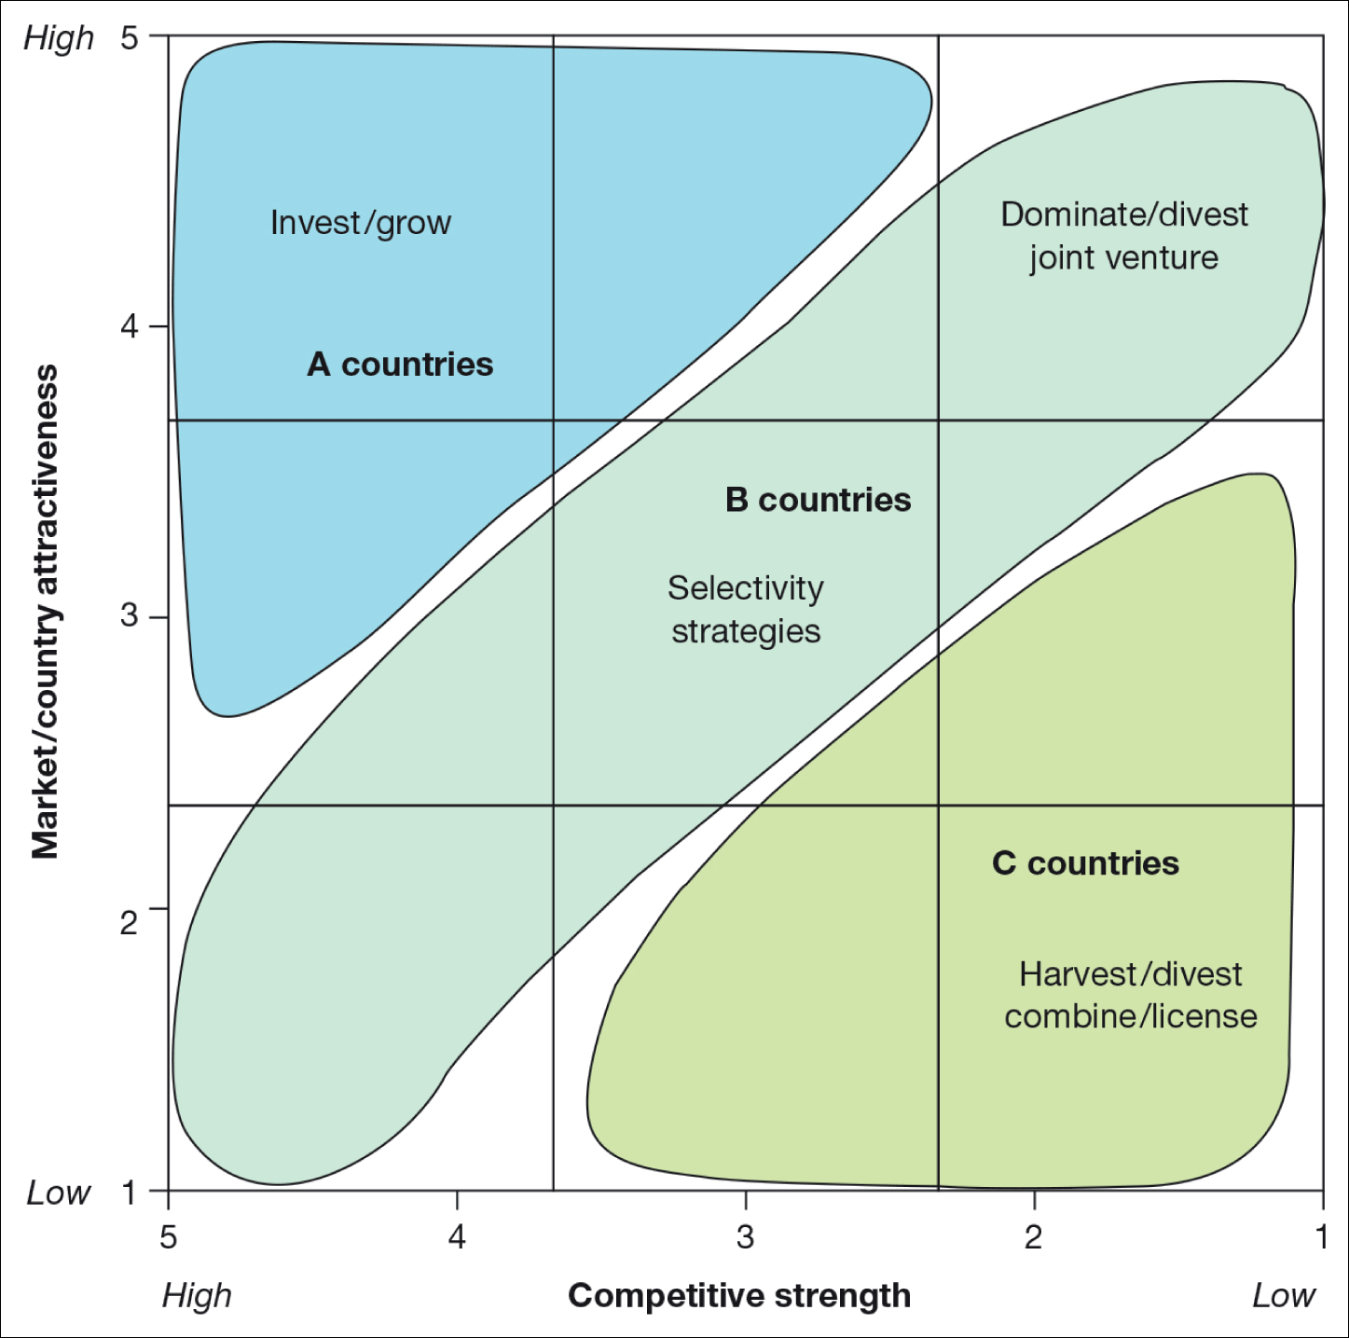
Figure 8.4 The market attractiveness/competitive strength (MACS) matrix
Svend Hollensen.

Slide 8
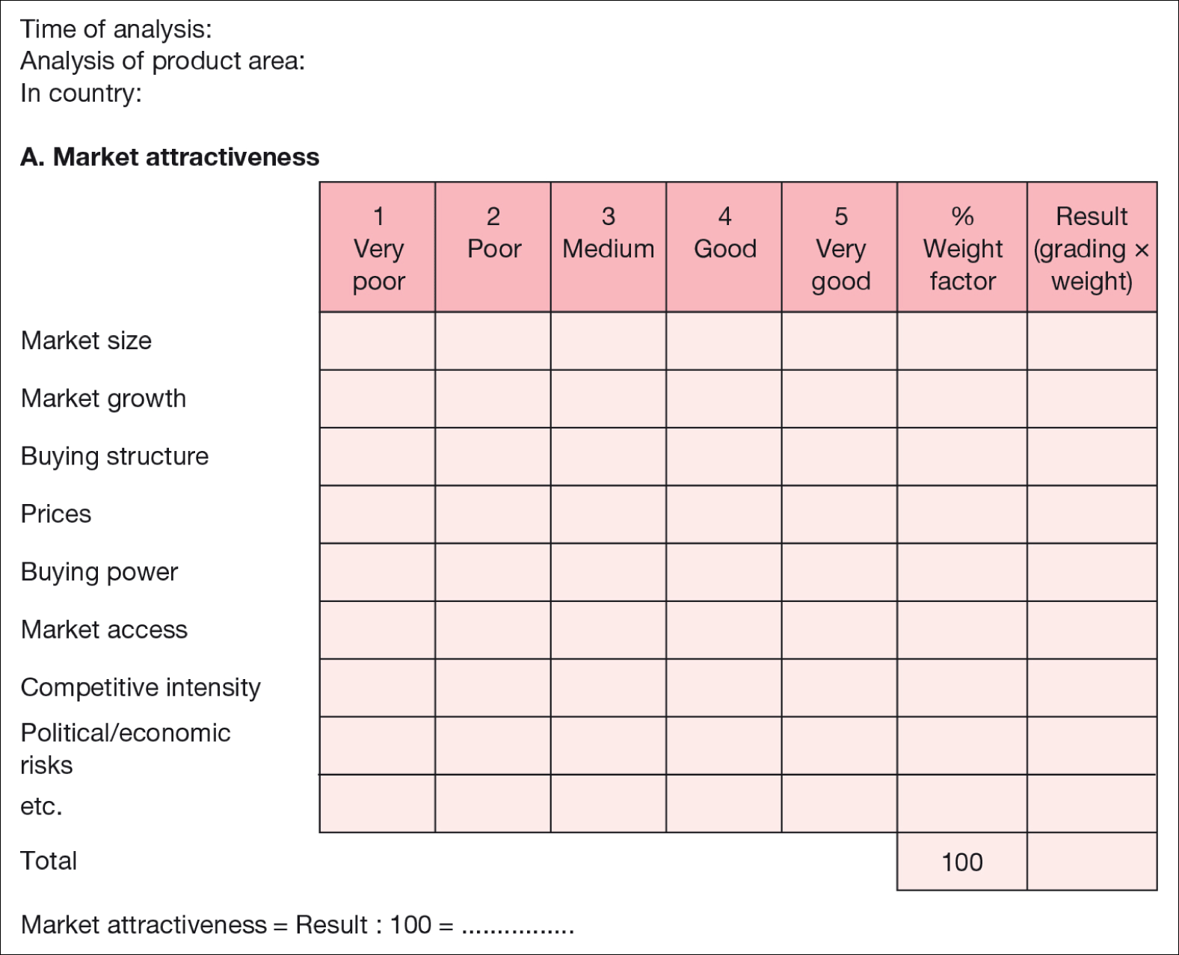
Svend Hollensen.
Notes:
Figure 8.5 Underlying questionnaire for locating countries on a market attractiveness/competitive strength (MACS) matrix

Slide 9
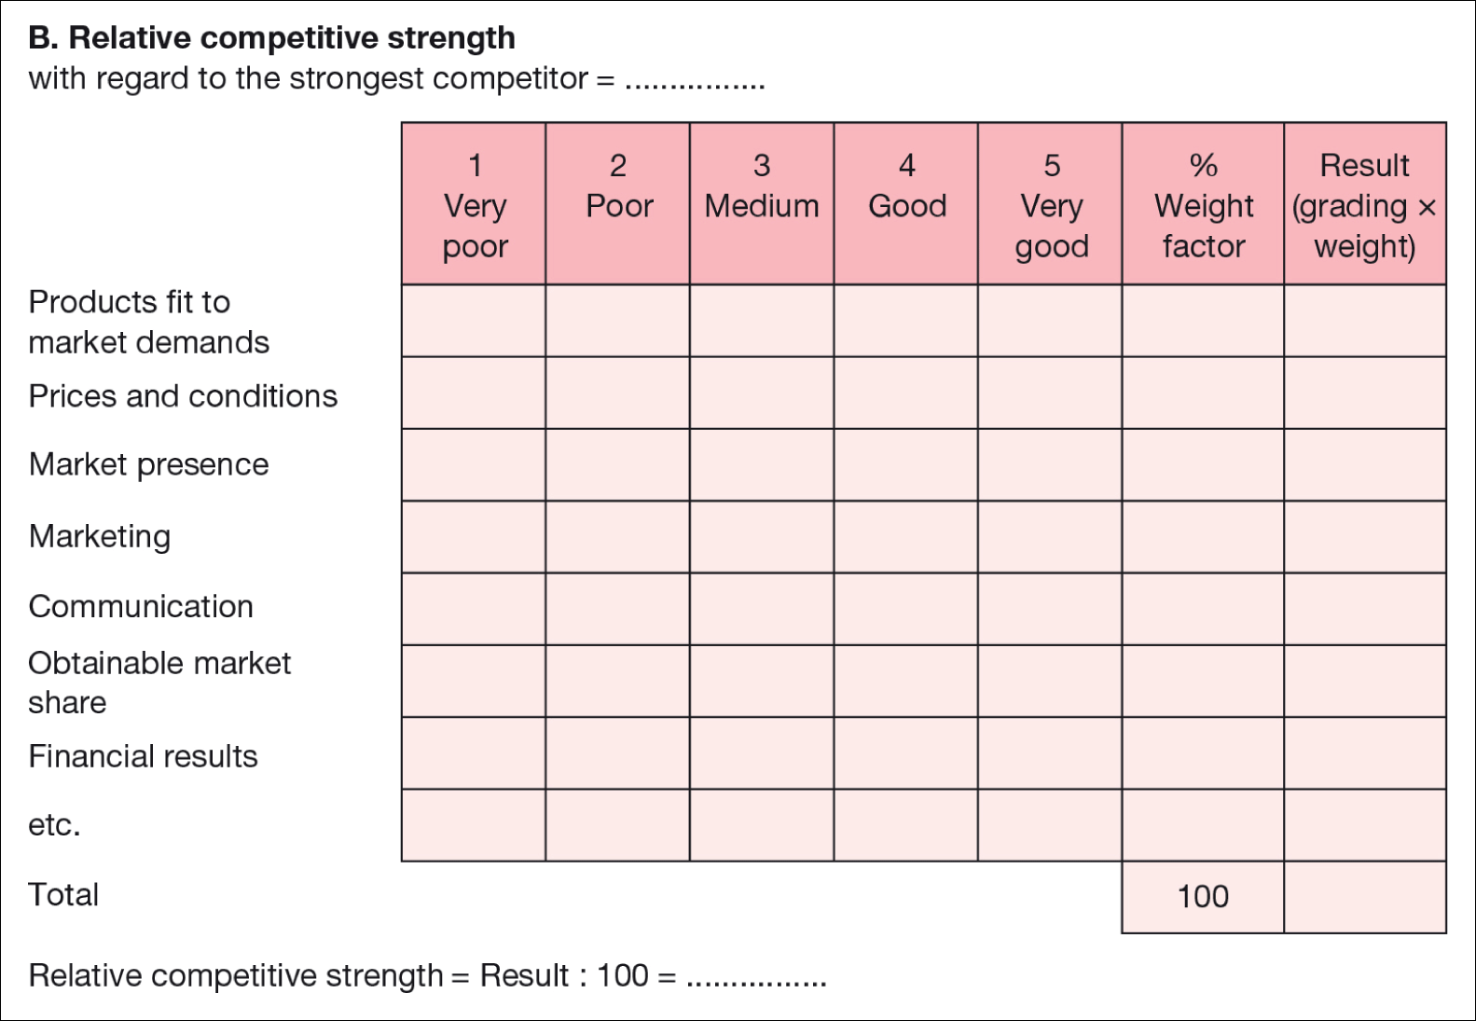
Svend Hollensen.
Notes:
Figure 8.5 (Continued) Underlying questionnaire for locating countries on a market attractiveness/competitive strength (MACS) matrix

Slide 10
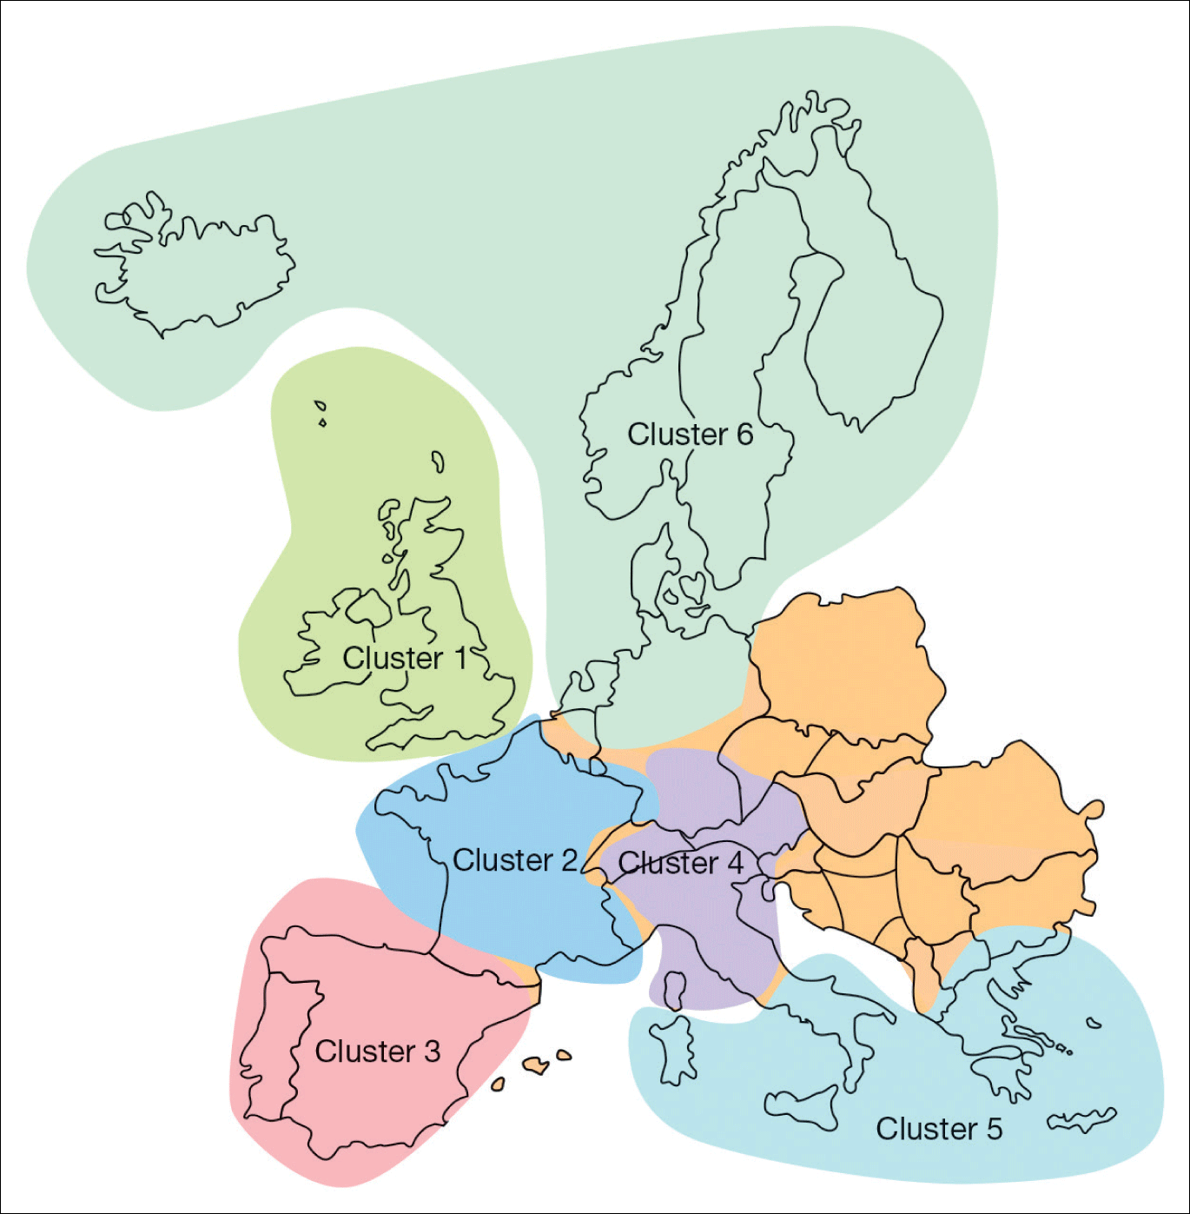
Figure 8.6 Transnational clustering of the Western European market
Source: adapted from European Business: An Issue-Based Approach, Pearson Education Ltd (Welford, R. and Prescott, K. 1996). Copyright © Pearson Education Ltd.

Slide 11
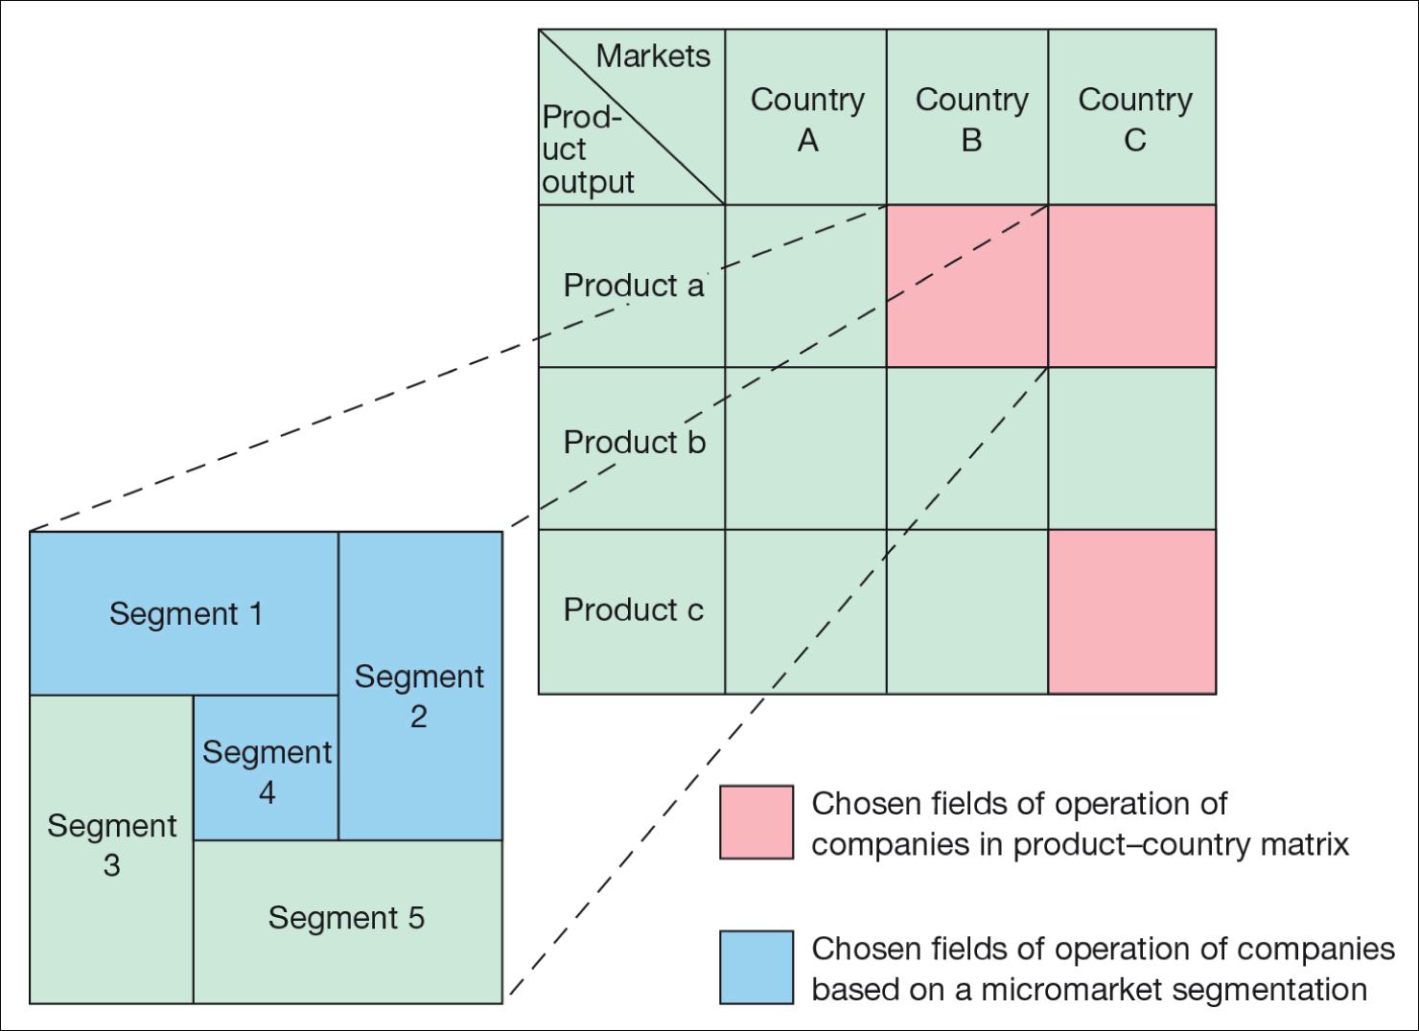
Figure 8.7 Micromarket segmentation
Svend Hollensen.

Slide 12
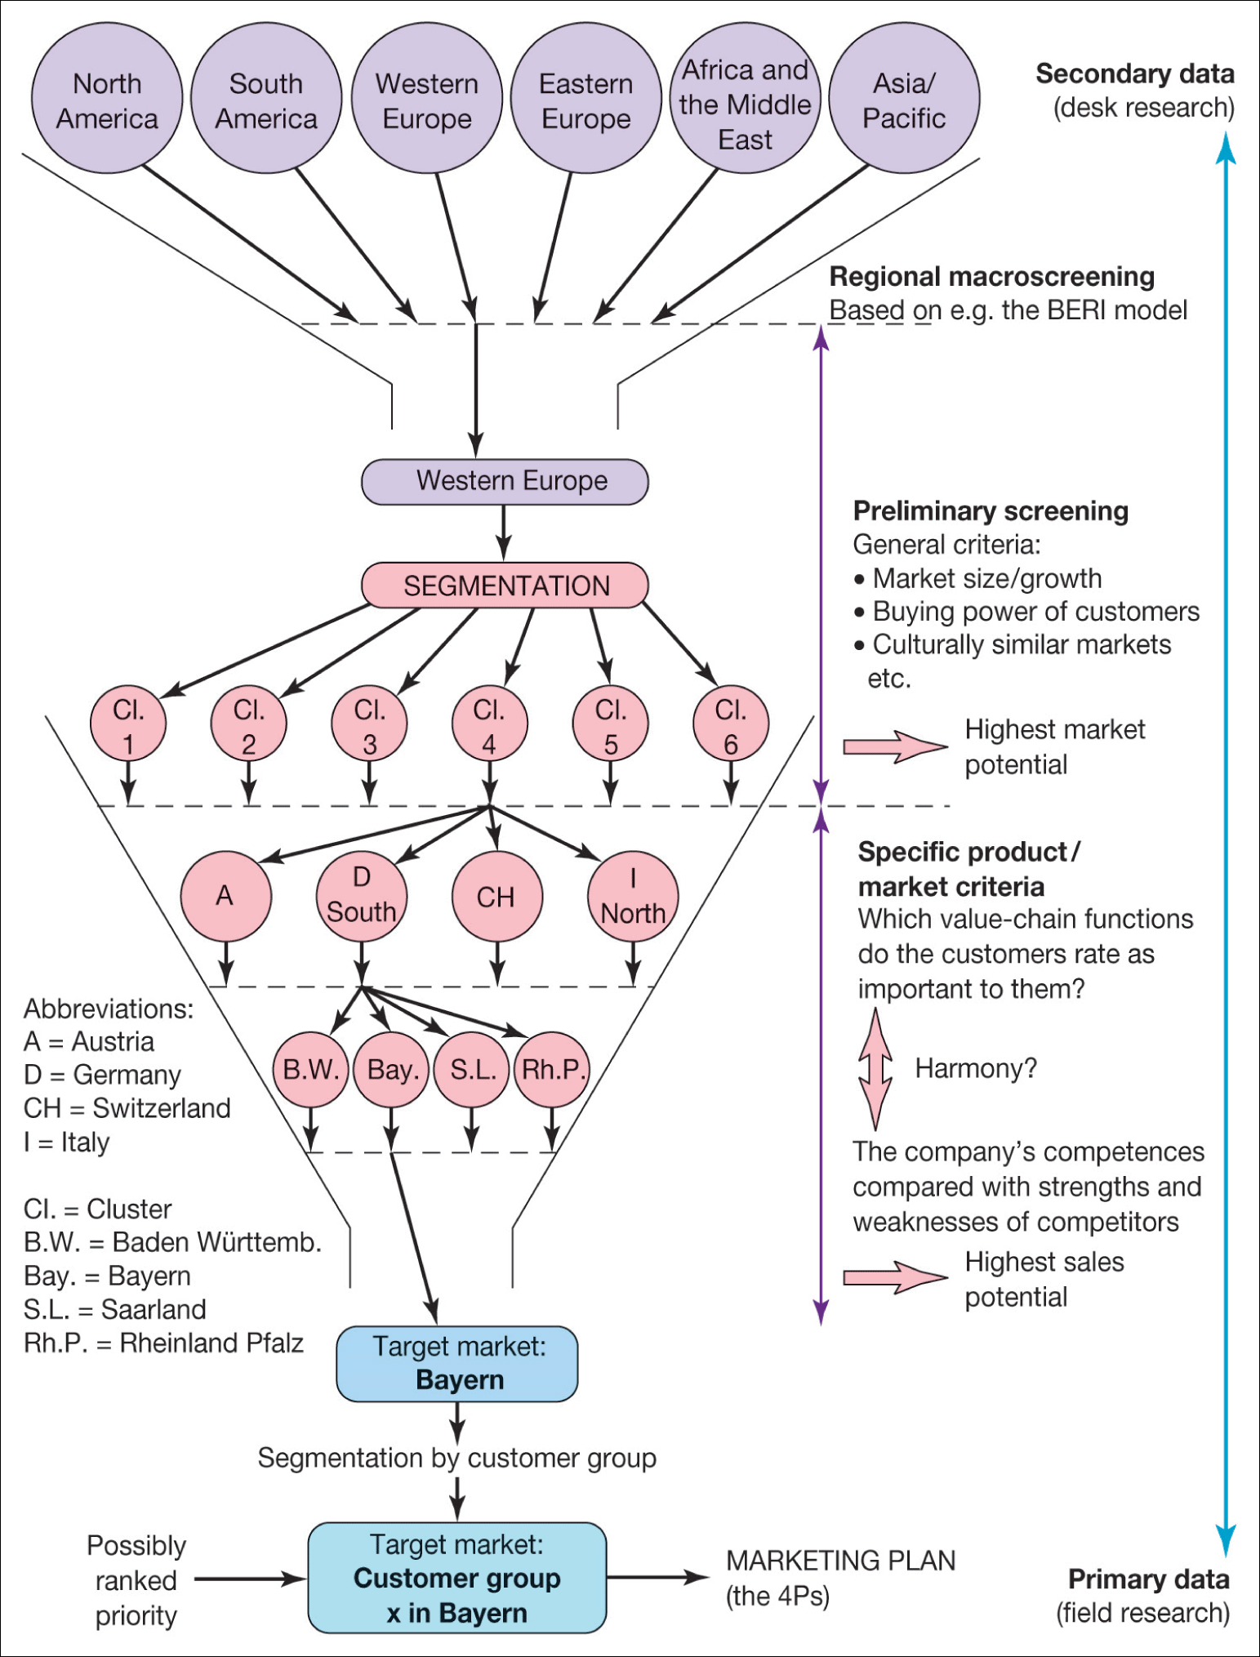
Svend Hollensen.
Notes:
Figure 8.8
The international market segmentation/screening process: an example of the proactive and systematic approach

Slide 13
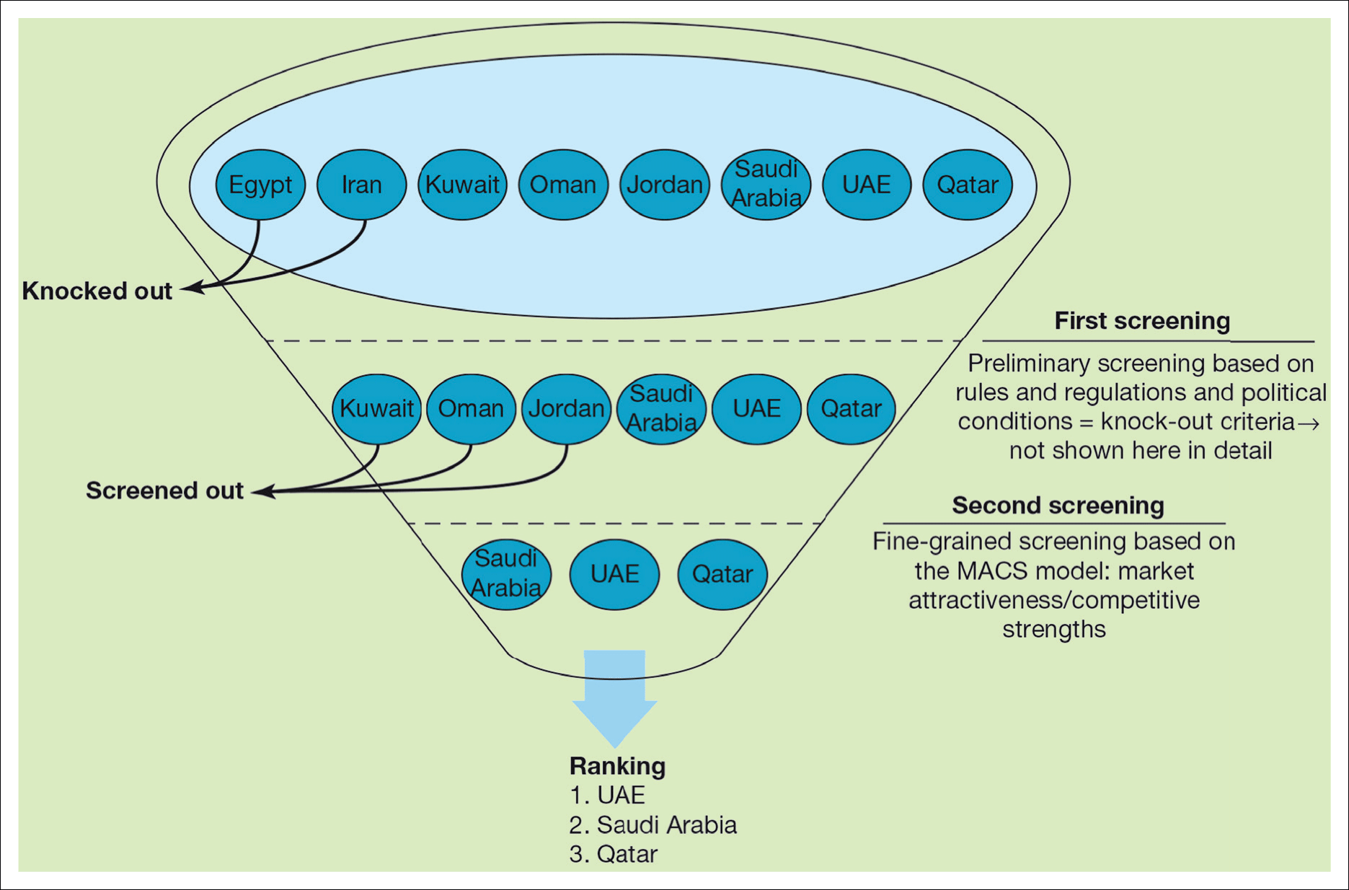
Figure 8.9 International market screening for Bosch Security System: Fire Detection Systems in the Middle East
Svend Hollensen.

Slide 14
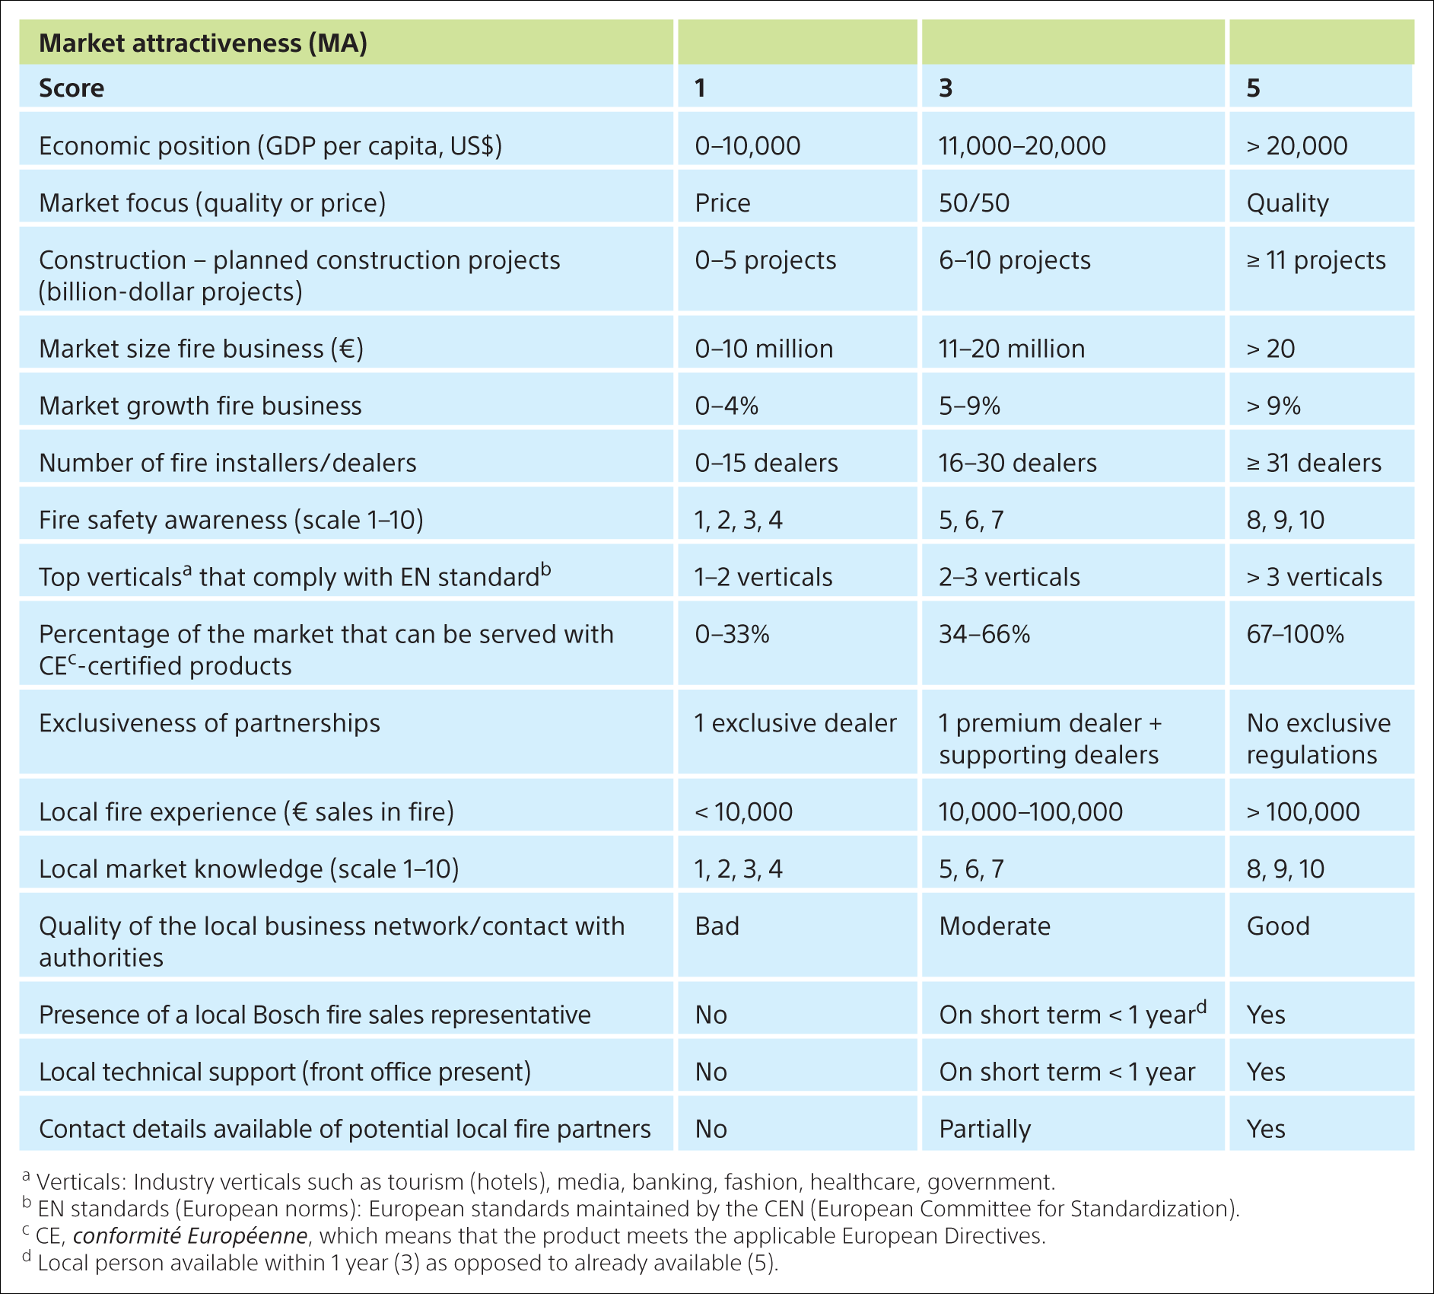
Table 8.3 Classification variables in the MACS model
Svend Hollensen.

Slide 15
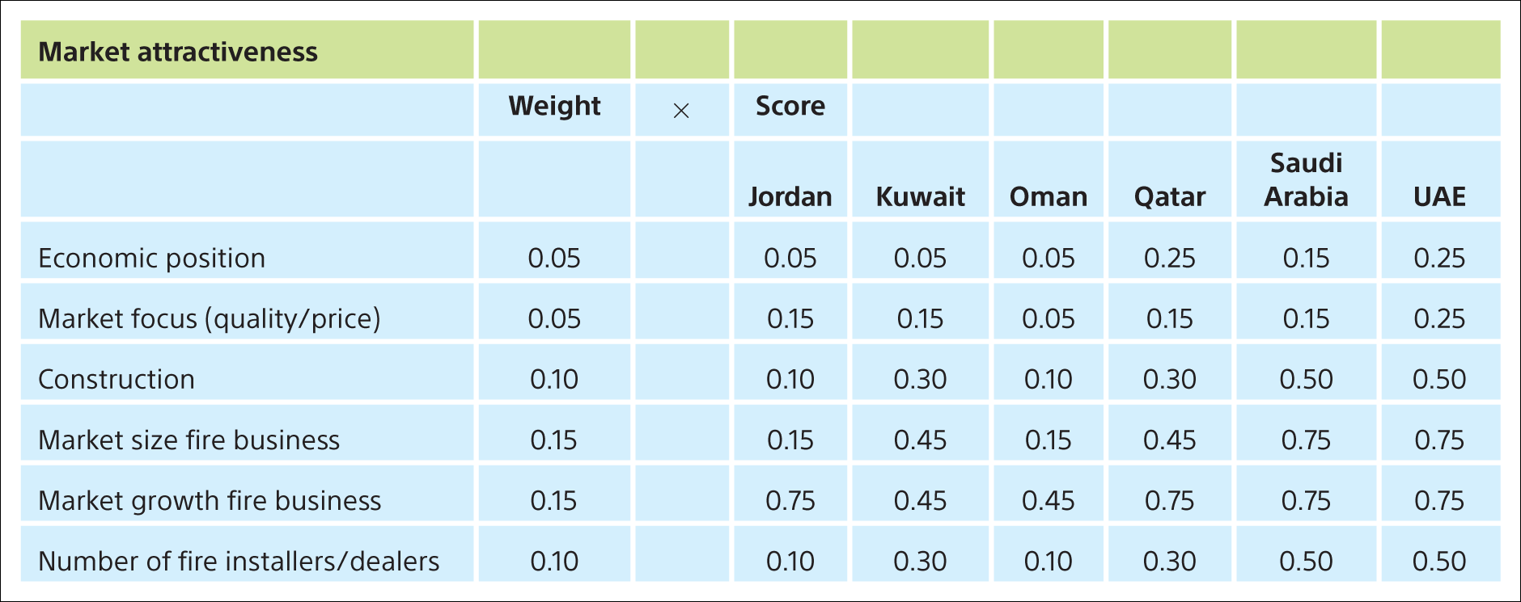
Table 8.4 Measurement/evaluation of screening variables

Slide 16
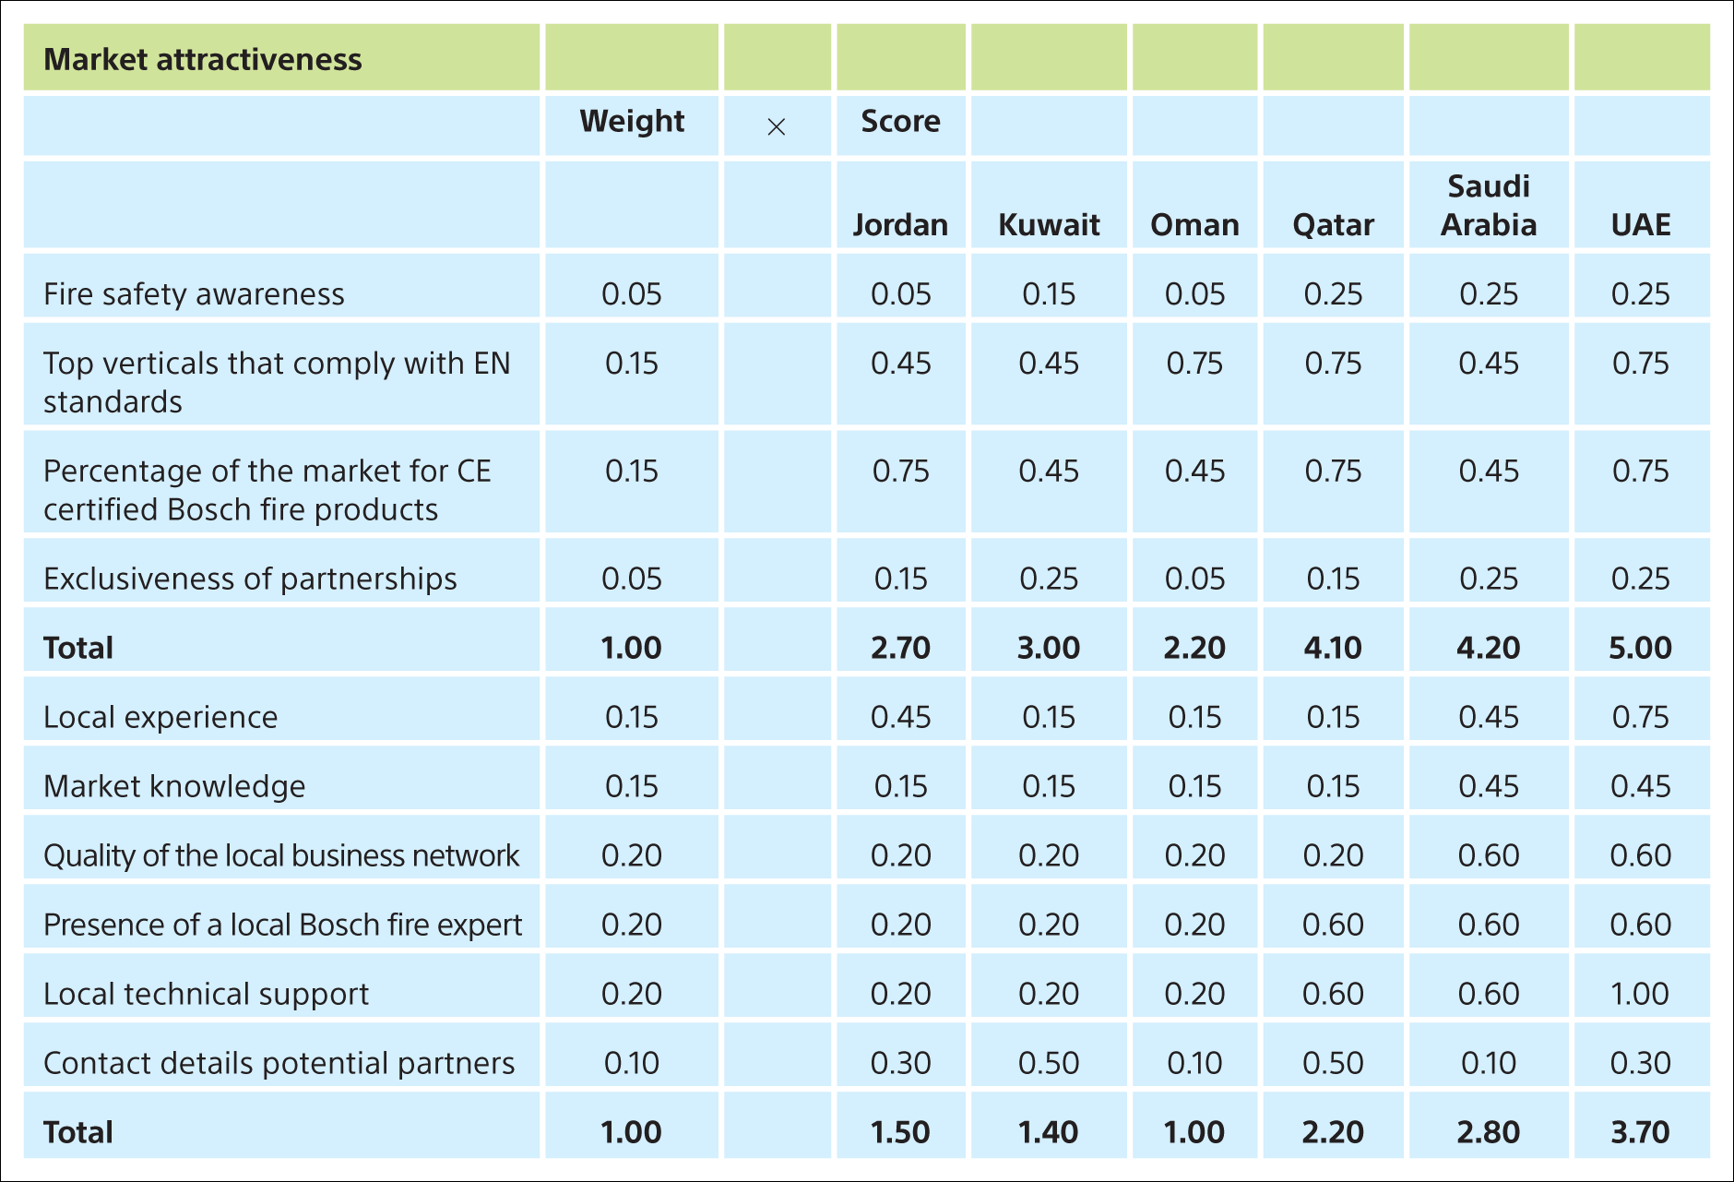
Table 8.4 Measurement/evaluation of screening variables (Continued)

Slide 17
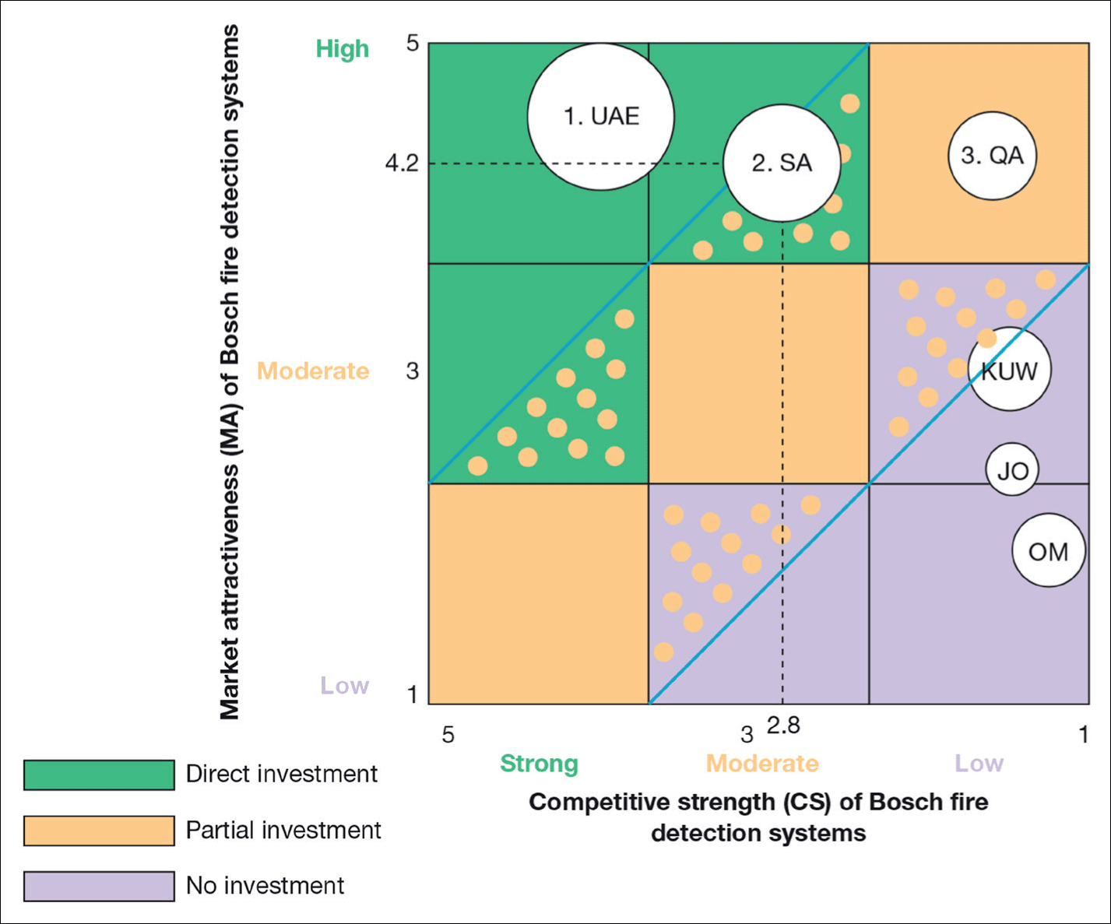
Figure 8.10 Bosch Fire Detection Systems MACS matrix
Svend Hollensen.

Slide 18
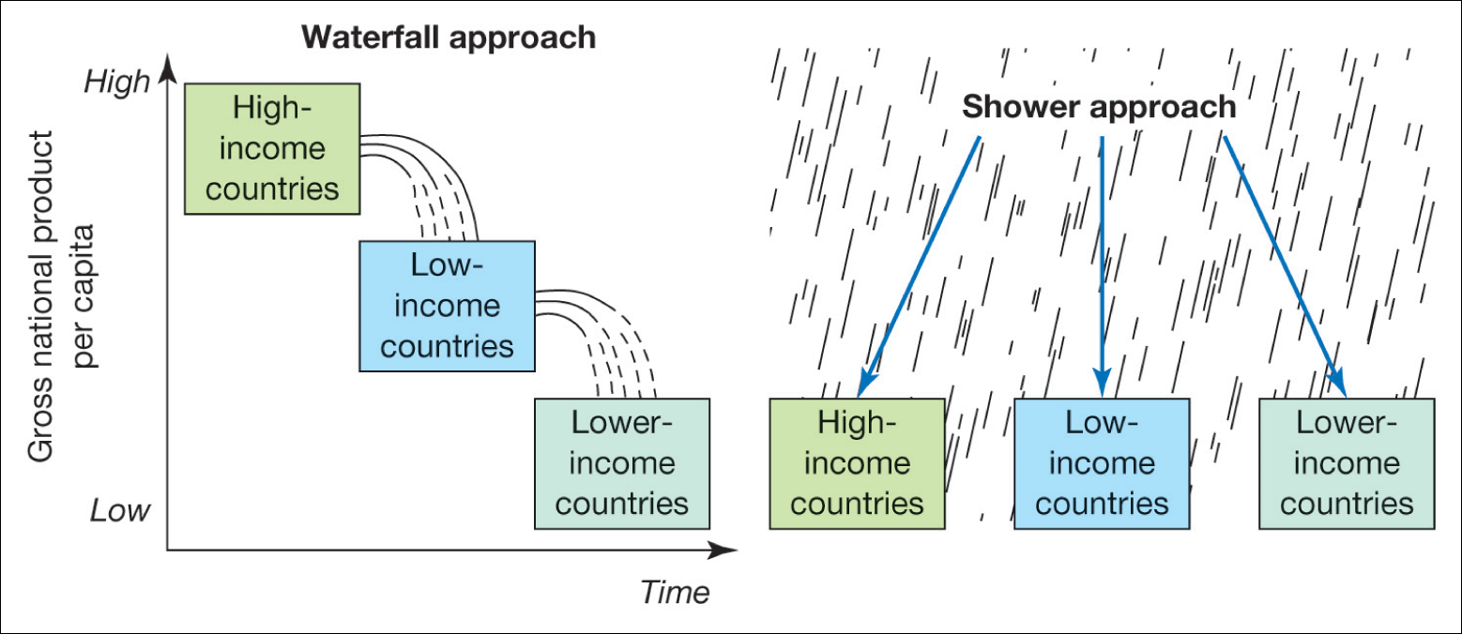
Figure 8.11 The incremental strategy (waterfall approach) and simultaneous strategy (the shower approach)
Source: Keegan, Warren J.; Green, Mark, Global Marketing Management , 2nd edn, p. 410; © 2000. Electronically reproduced by permission of Pearson Education, Inc., Upper Saddle River, New Jersey.

Slide 19
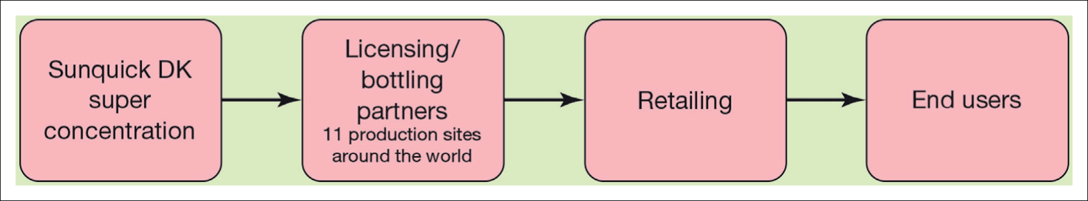
Figure 8.12 Sunquick’s worldwide value chain
Svend Hollensen.

Slide 20
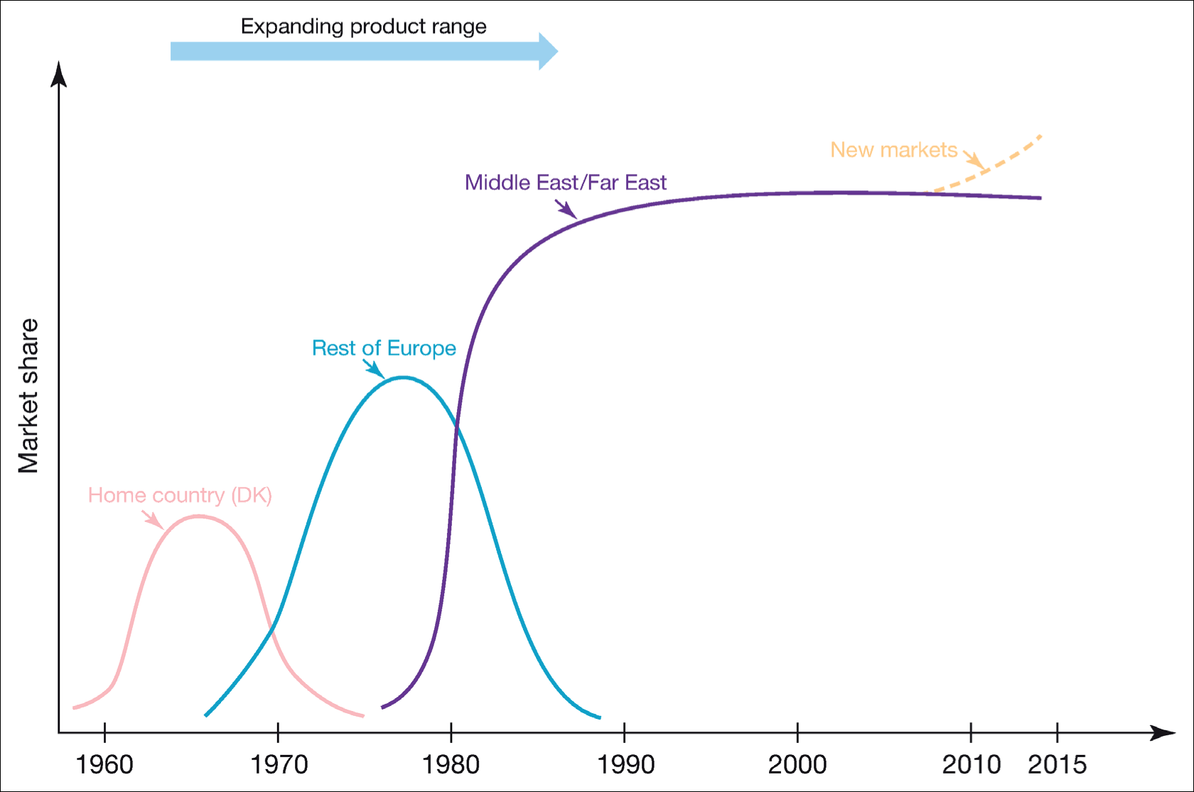
Figure 8.13 Change in Sunquick’s market shares over time
Svend Hollensen.

Slide 21
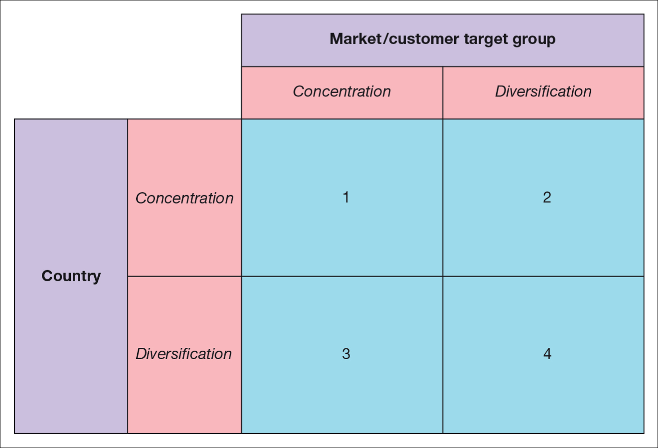
Figure 8.14 The market expansion matrix
Source: Adapted from Ayal, I. and Zif, J. (1979) ‘Market expansion strategies in multinational marketing’, Journal of Marketing, 43, pp. 84–94. https://doi.org/10.1177/002224297904300209.

Slide 22
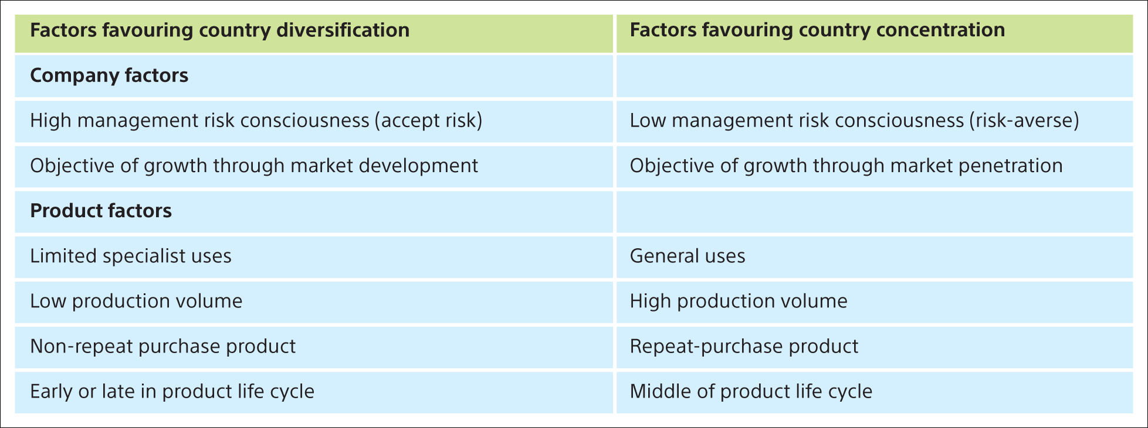
Table 8.5 International market diversification versus market concentration
Sources: adapted from Ayal and Zif (1979); Piercy (1981); Katsikeas et al. (2005).

Slide 23
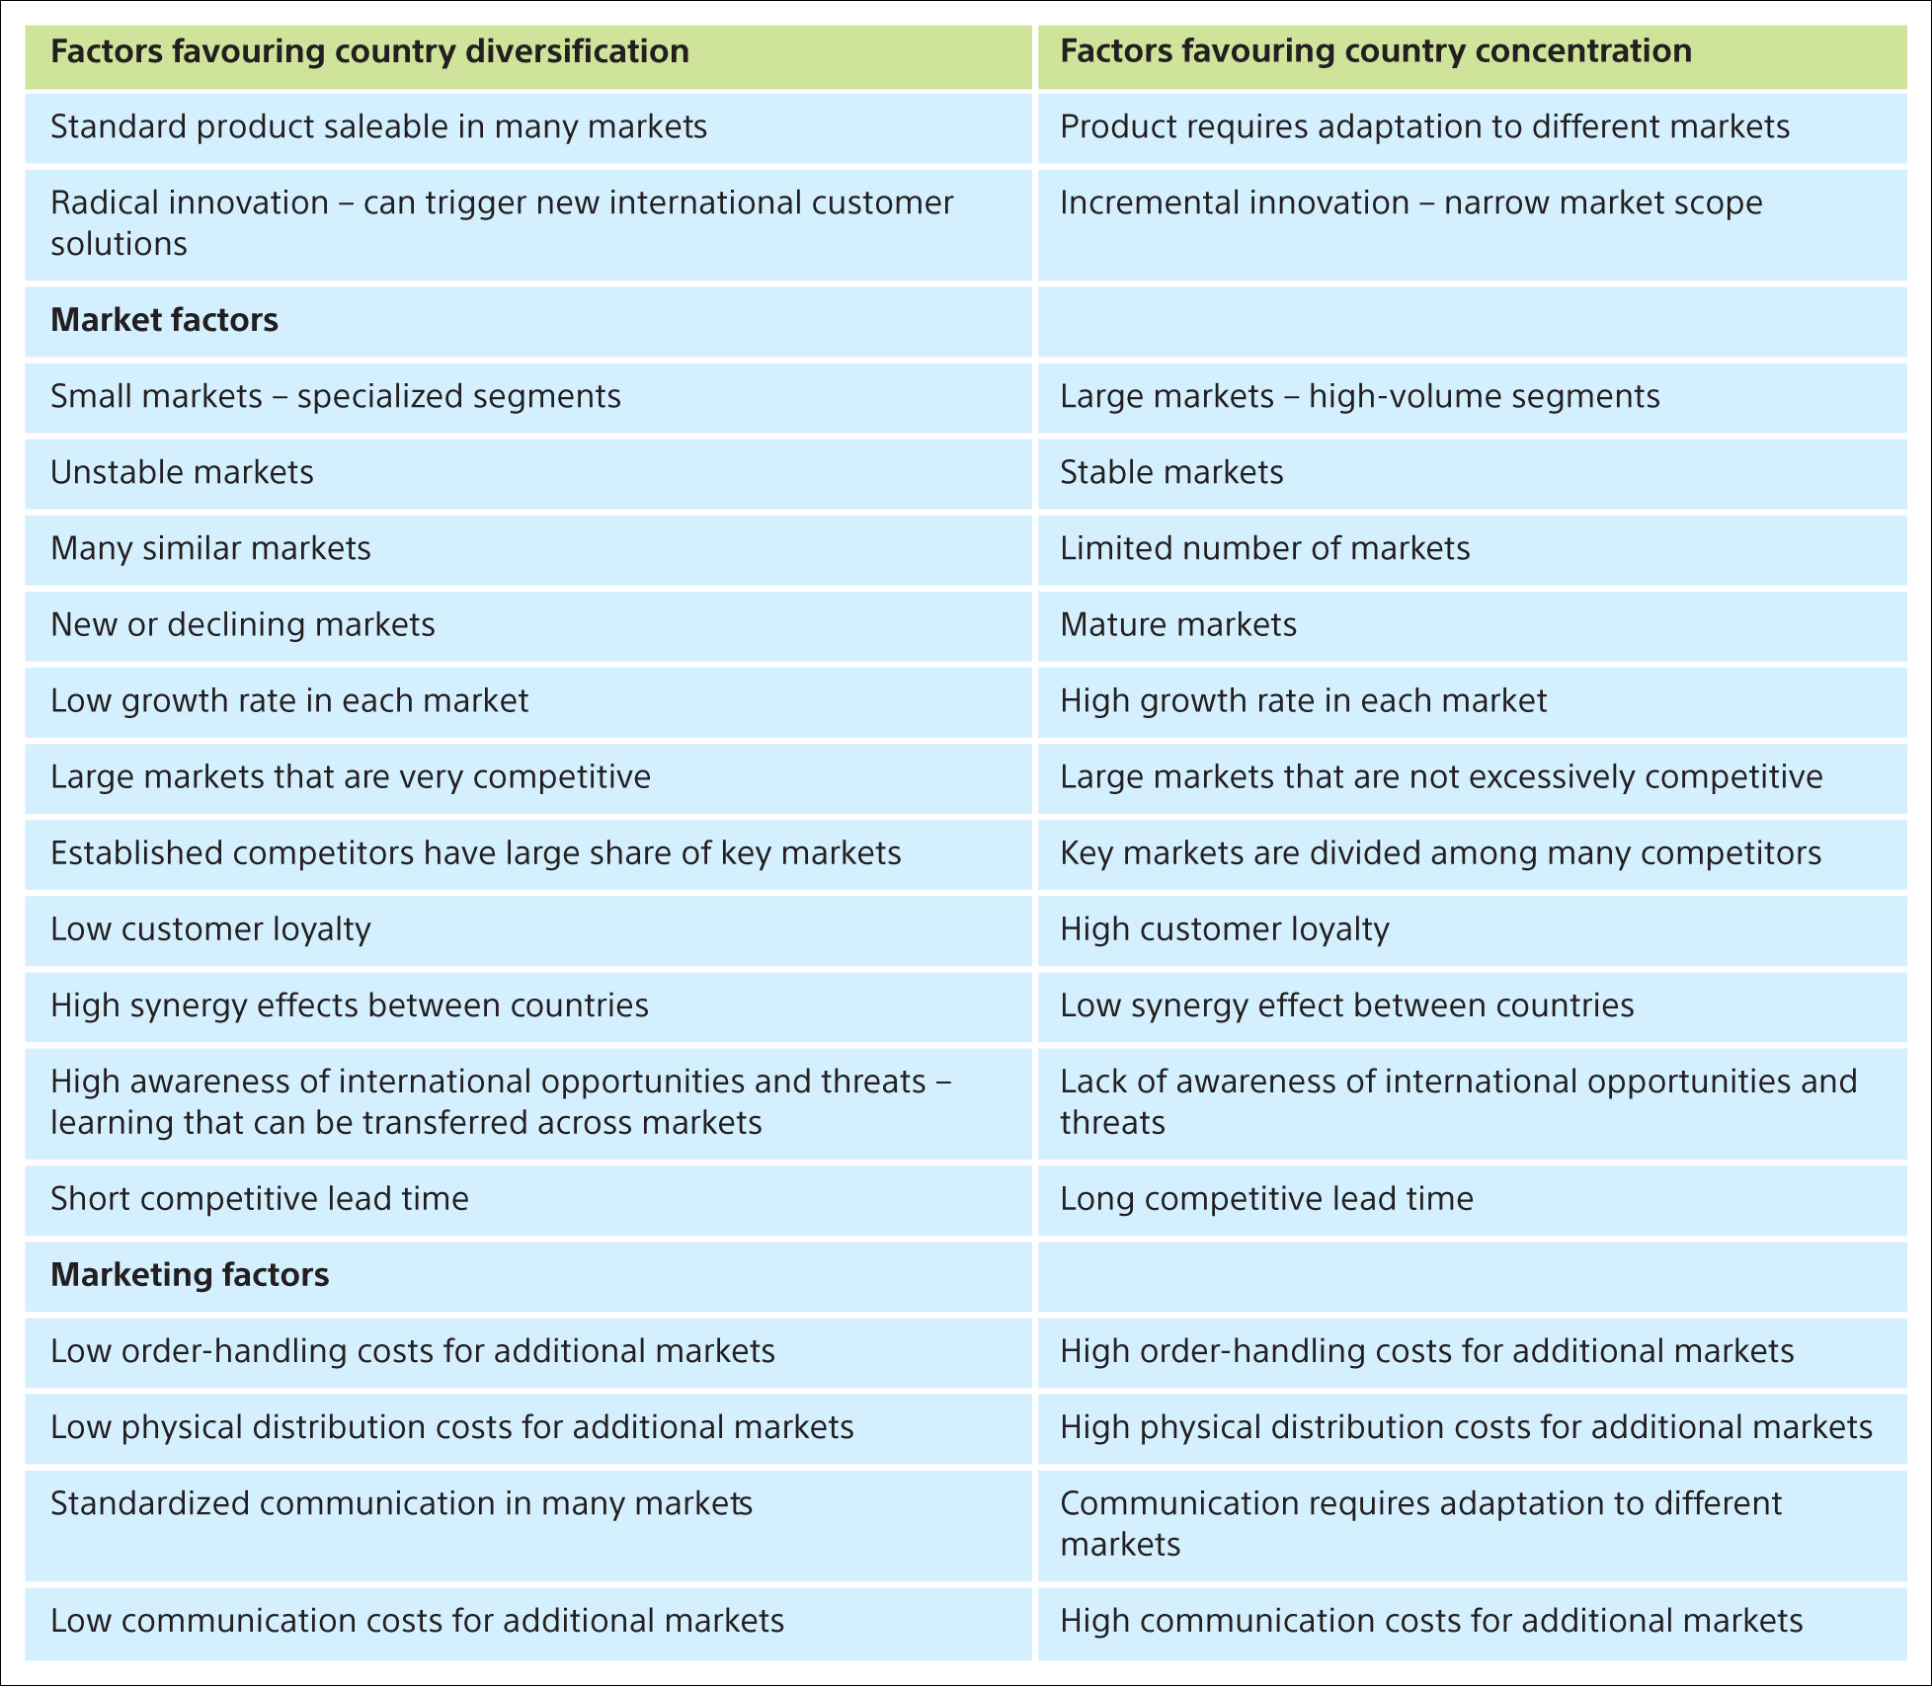
Sources: adapted from Ayal and Zif (1979); Piercy (1981); Katsikeas et al. (2005).
Notes:
Table 8.5 International market diversification versus market concentration (Continued)

Slide 24
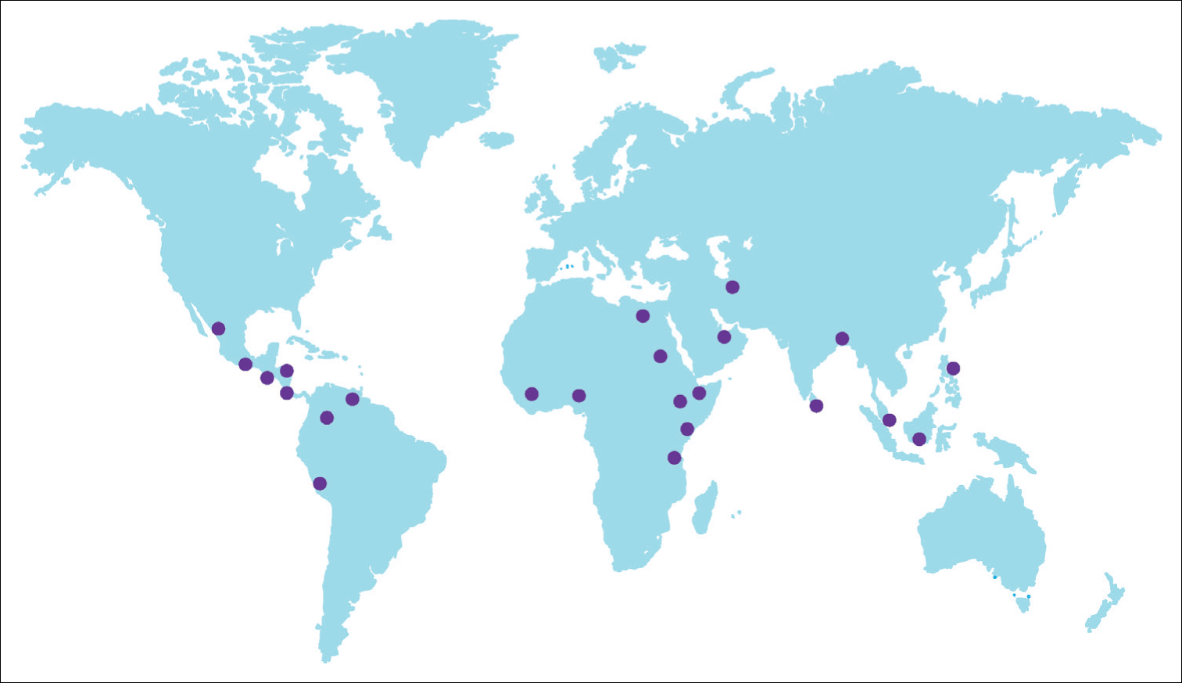
Figure 8.15 Location of Bajaj’s international dealers
Source: www.bajajauto.com.

Slide 25
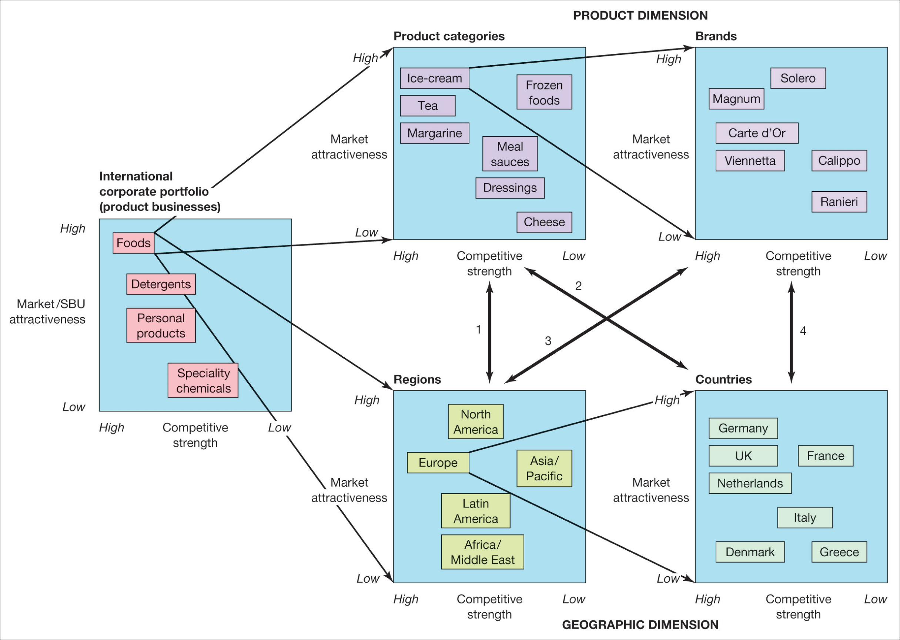
Svend Hollensen.
Notes:
Figure 8.16
Unilever’s global portfolio

