Slide 1
Global Marketing Ninth Edition
Part III
Market entry strategies and modes
Chapter 9
Some approaches to the choice of entry mode

Slide 2
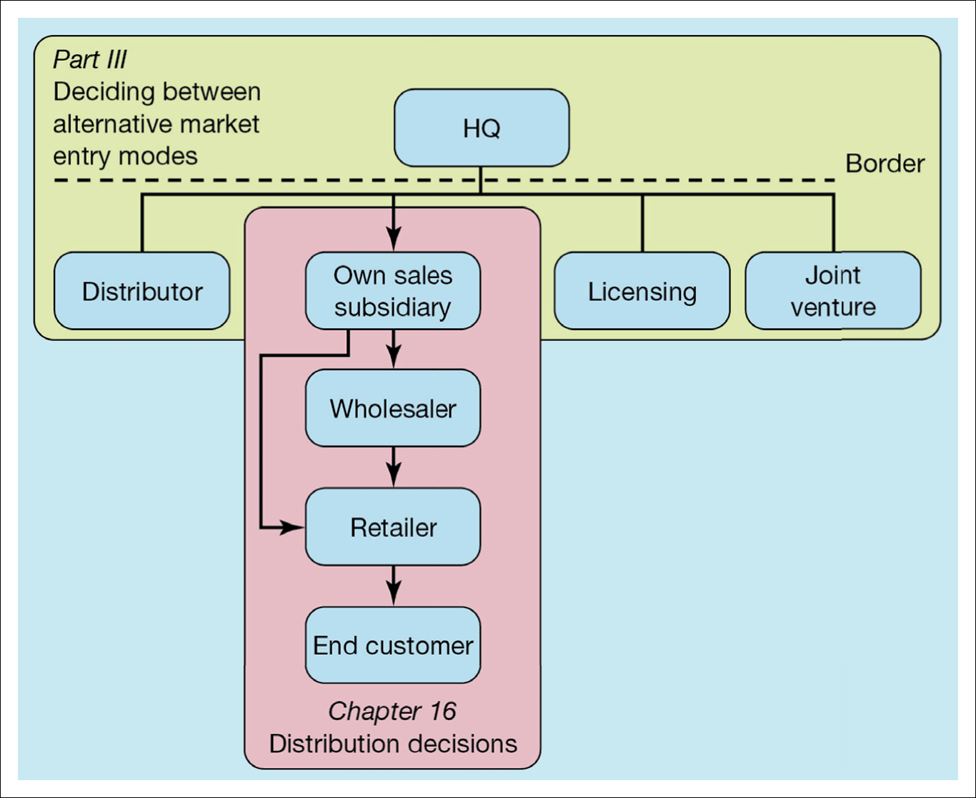
Figure III.1 Examples of different market entry modes and the distribution decision
Svend Hollensen.

Slide 3
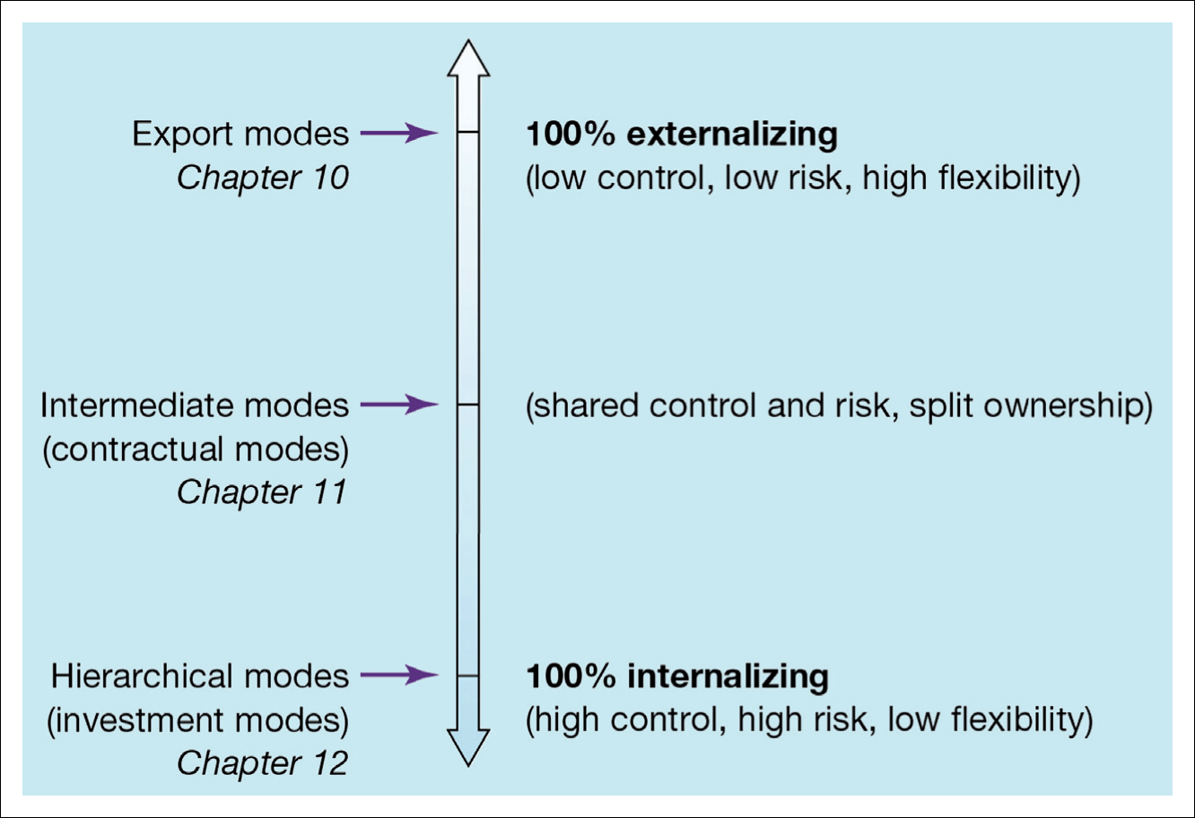
Figure III.2 Classification of market entry modes
Svend Hollensen.

Slide 4
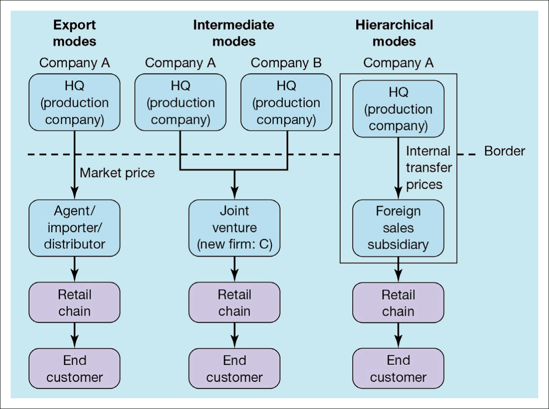
Figure III.3 Examples of the different market entry modes in the consumer market

Slide 5
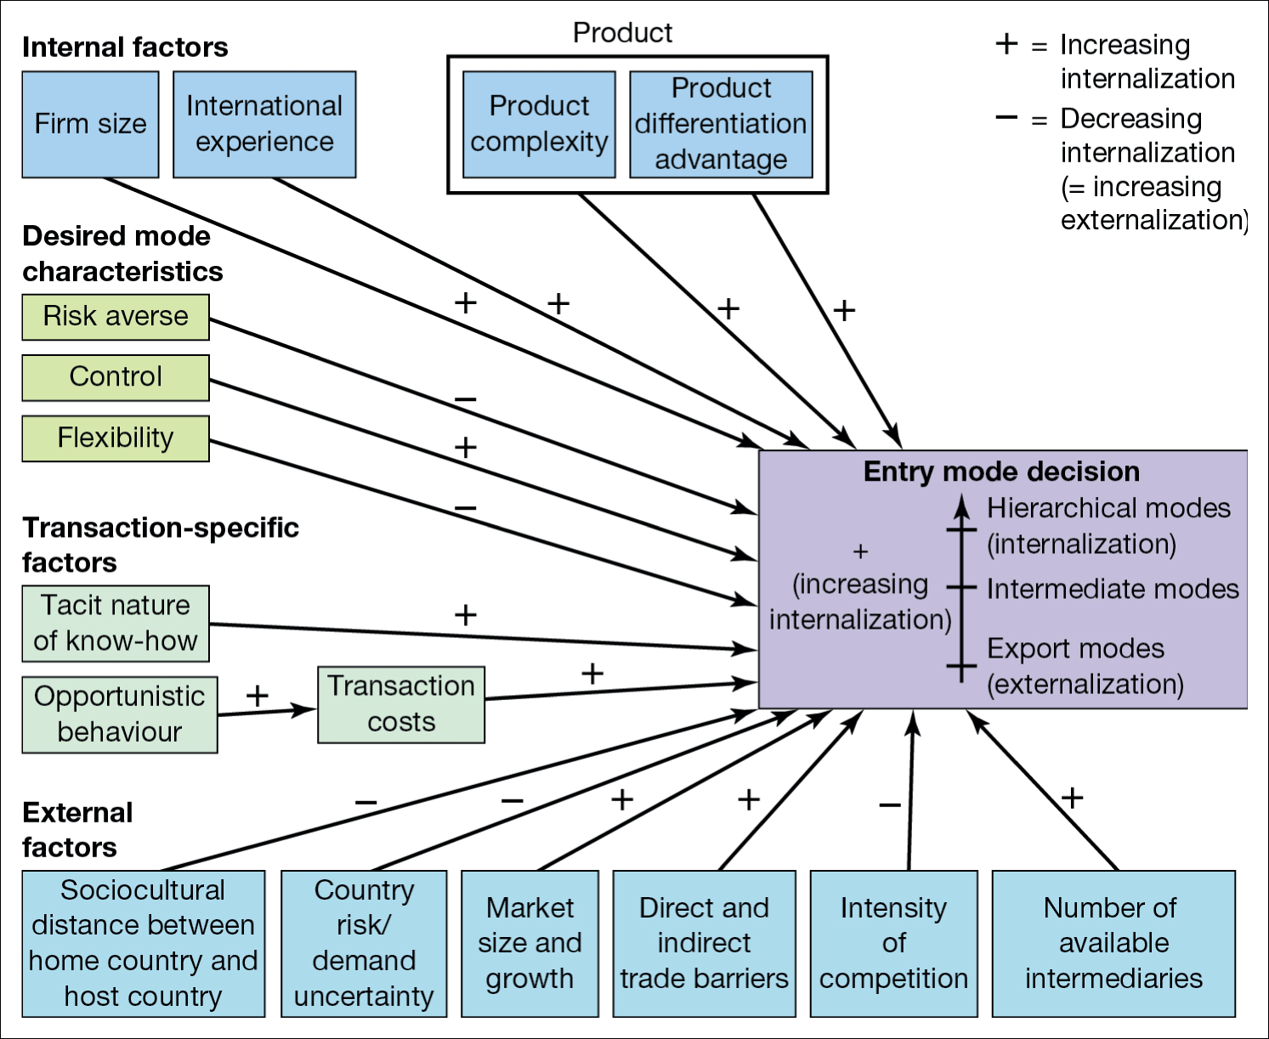
Figure 9.1 Factors affecting the foreign market entry mode decision in a specific country
Svend Hollensen.

Slide 6
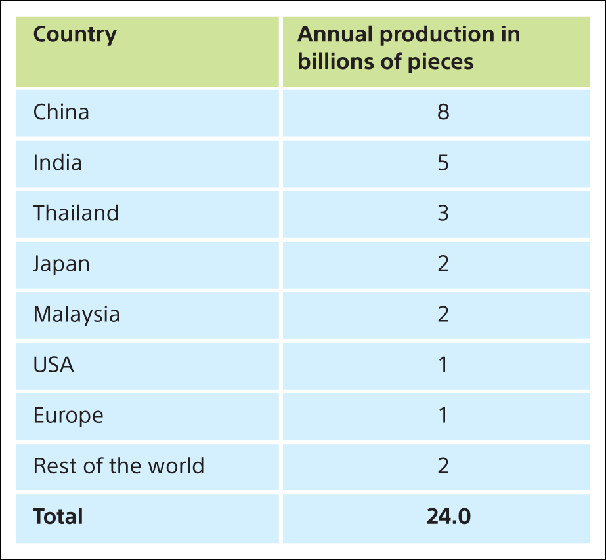
Table 1 Estimated 2018 condom production by country
Svend Hollensen.

Slide 7
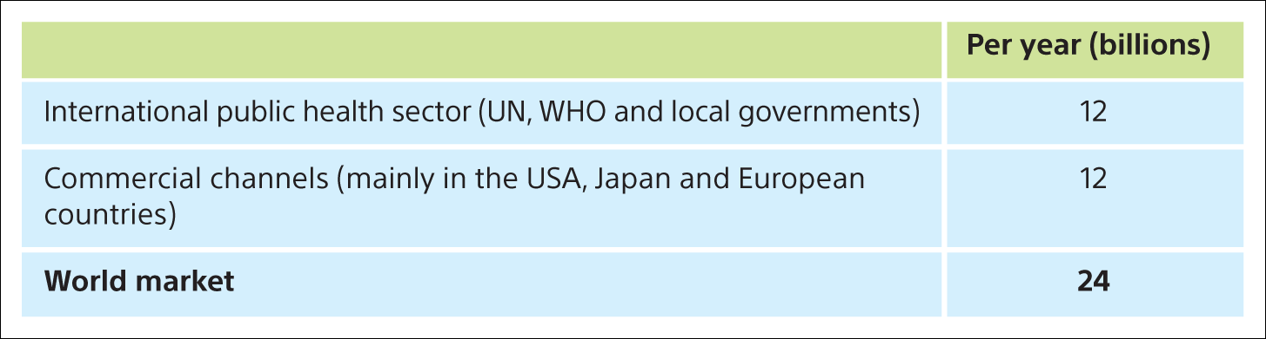
Table 2 World market for male condoms (2014)
Svend Hollensen.

Slide 8
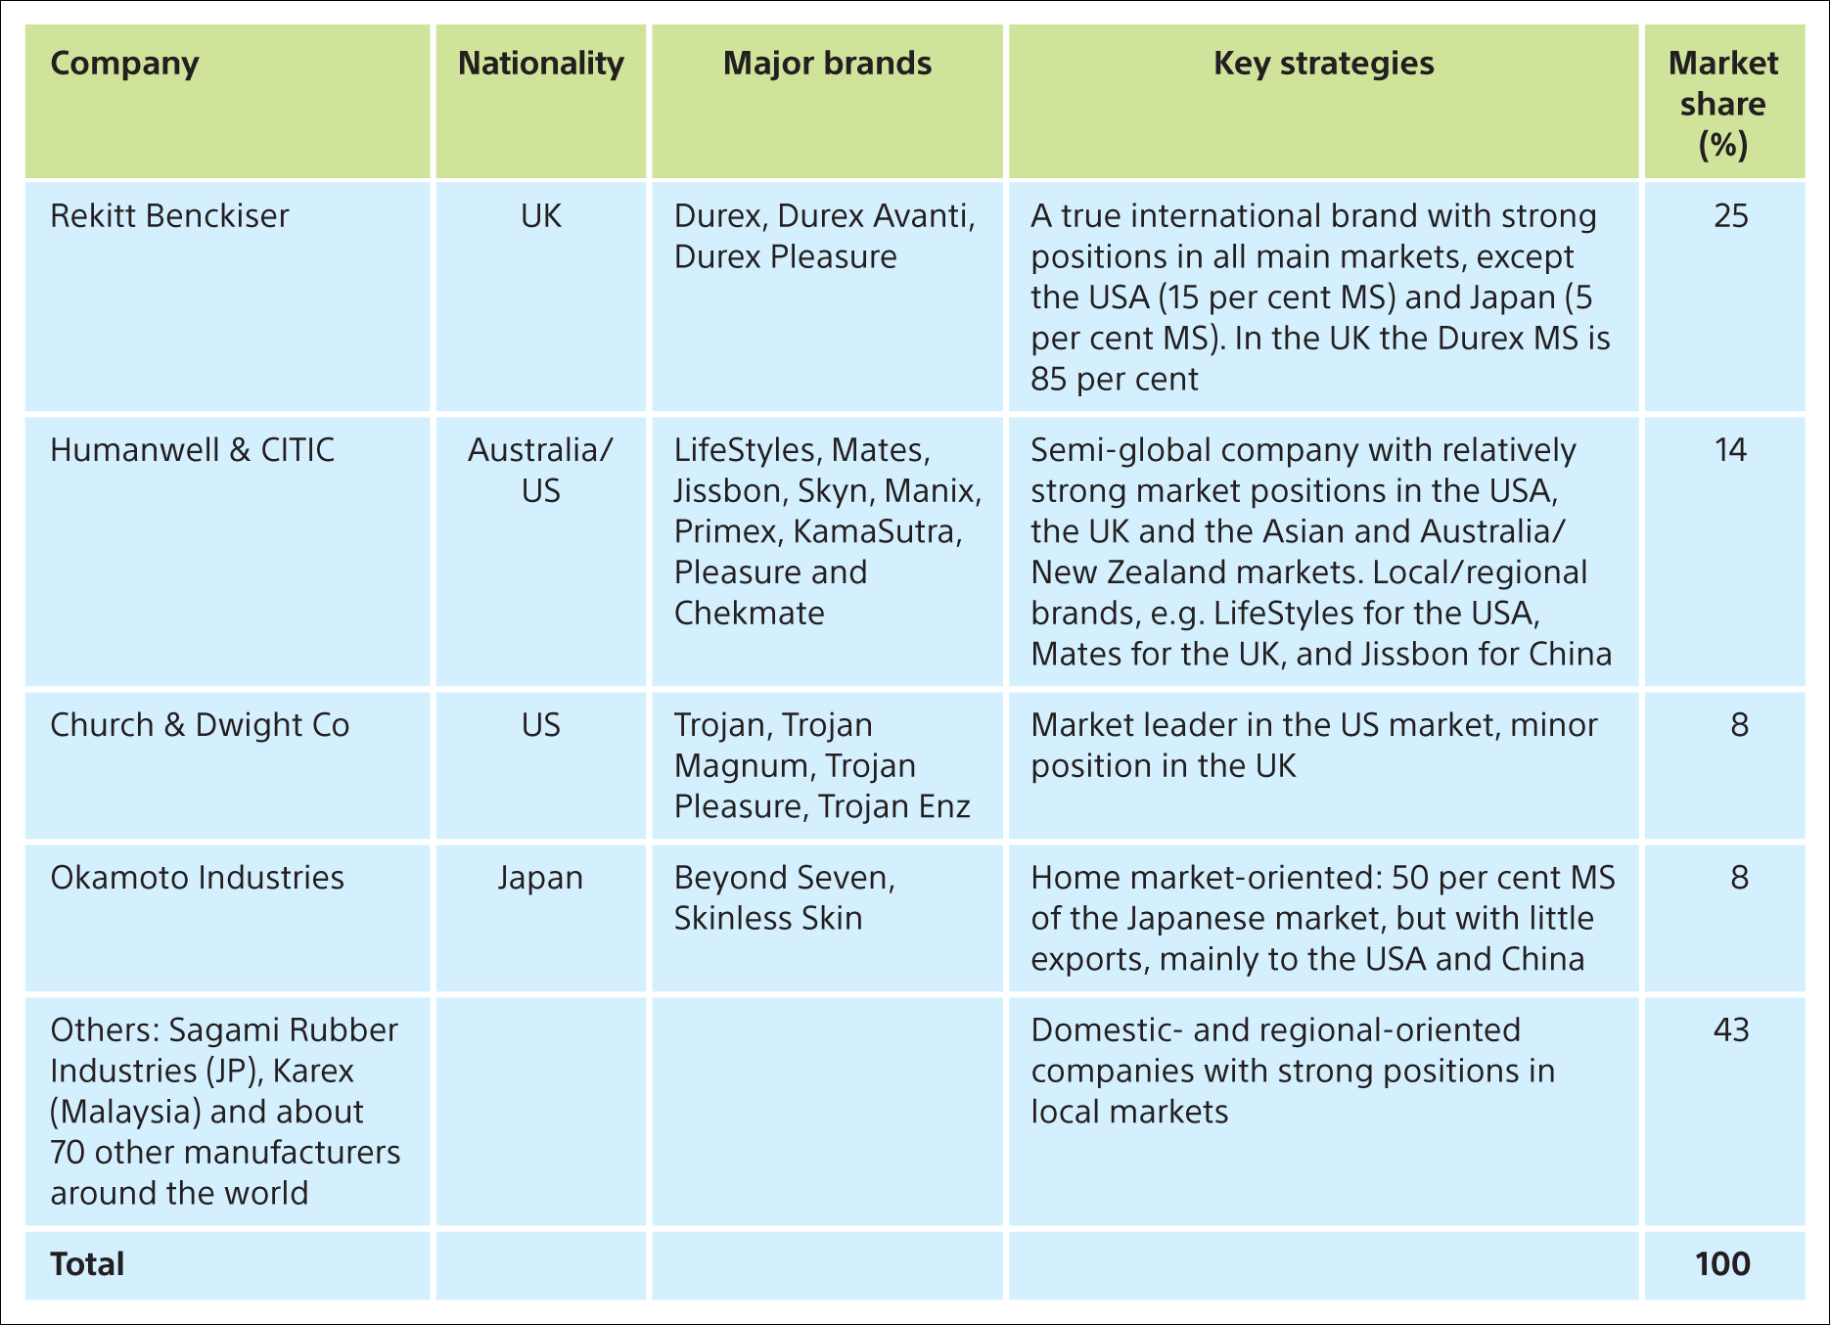
Table 3 Company shares on the world market for male condoms (2014)
MS: market share. Svend Hollensen.

