Slide 1
Global Marketing Ninth Edition
Part III
Market entry strategies and modes
Chapter 10
Export modes

Slide 2
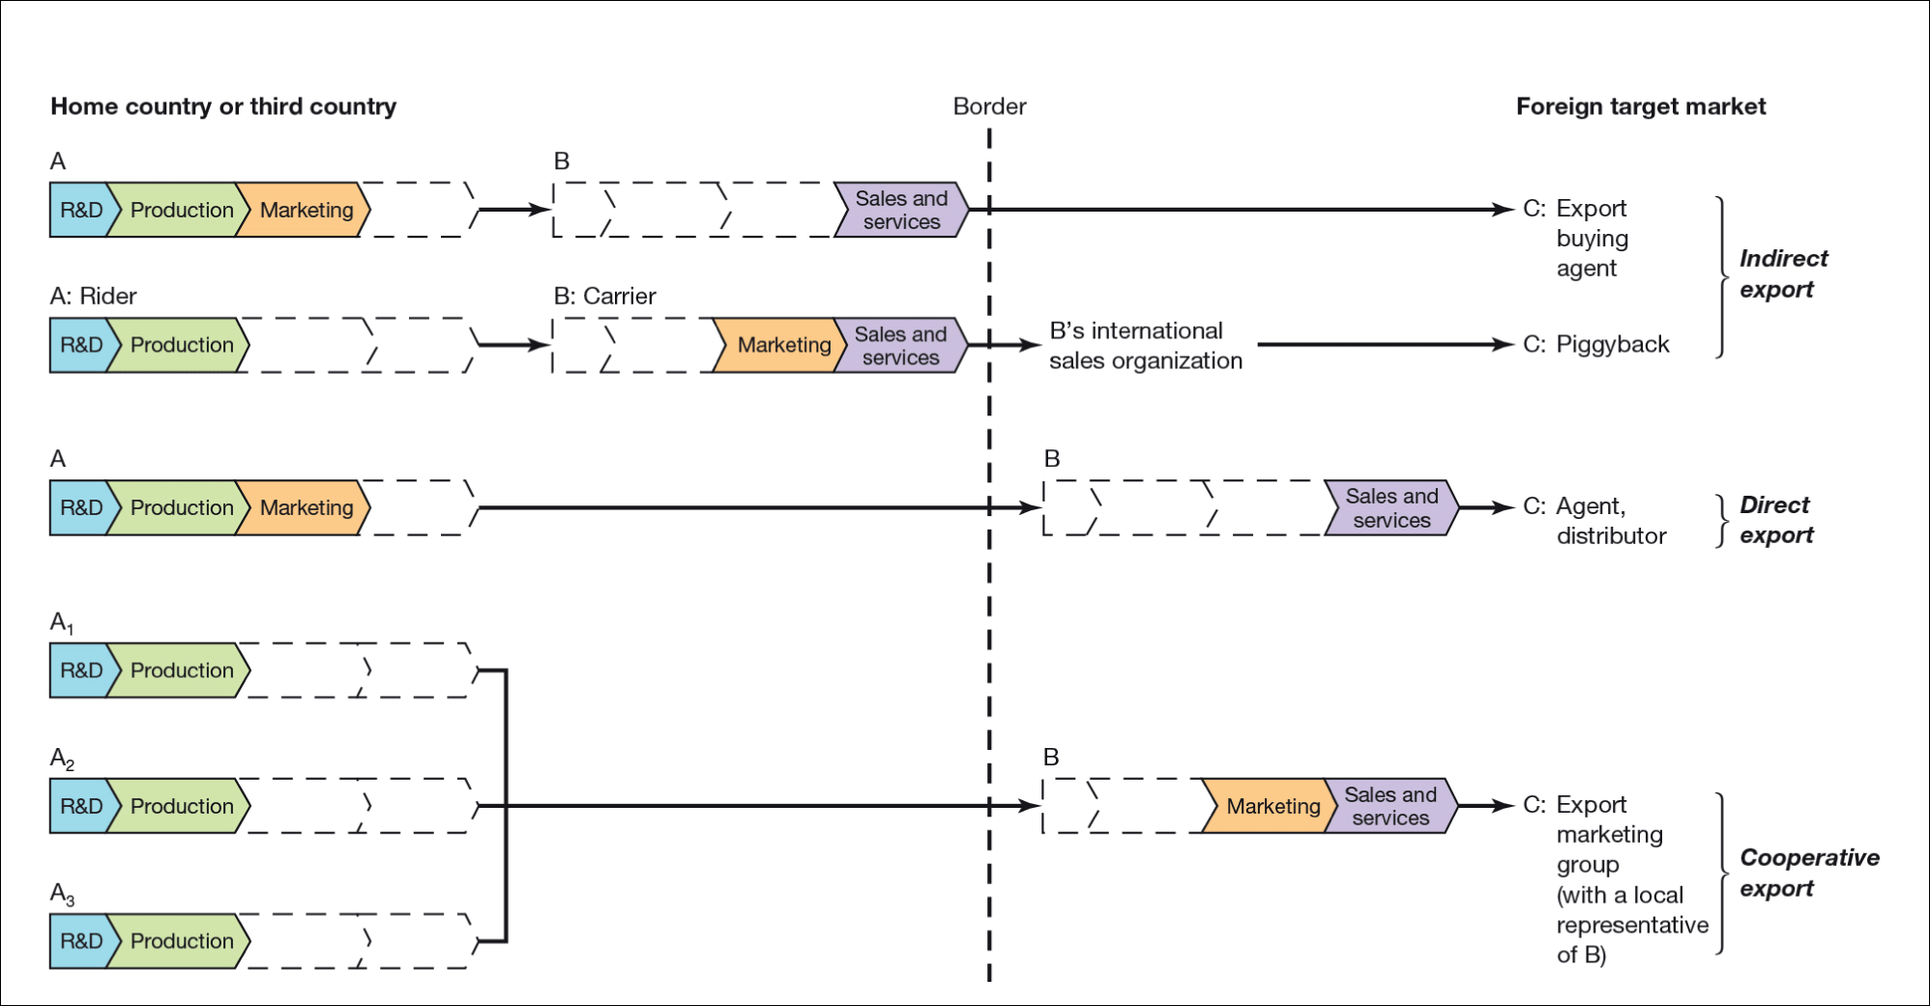
Figure 10.1 Export modes
Note: A, A₁, A₂ and A₃ are manufacturers of products/services; B is an independent intermediary (agent); C is the customer.
Svend Hollensen.

Slide 3
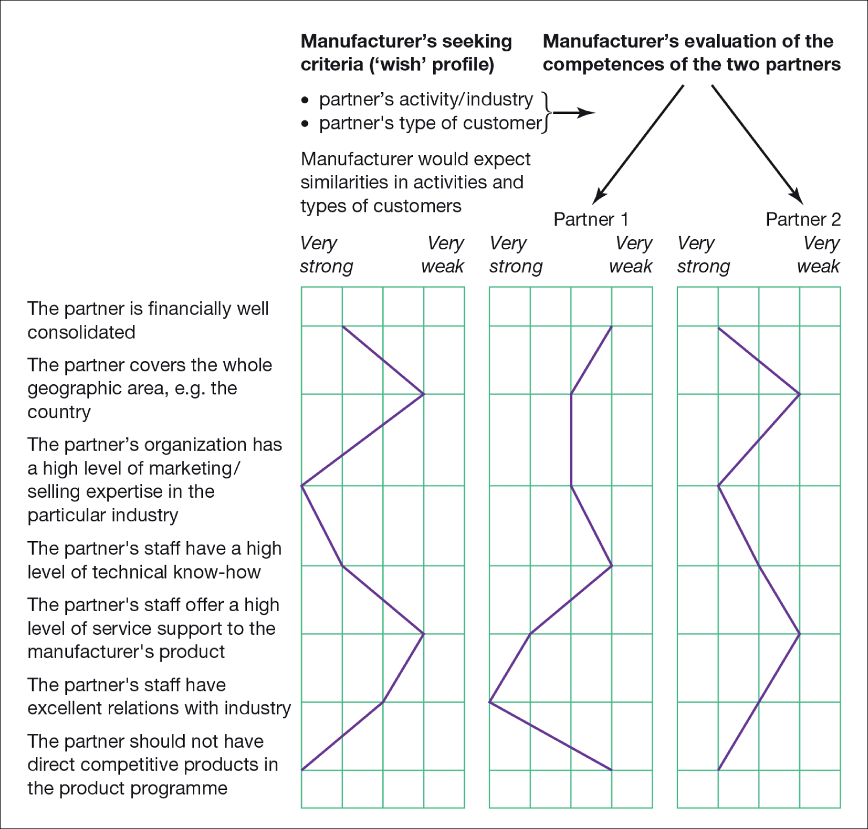
Svend Hollensen.
Notes:
Figure 10.2
An example of matchmaking between a manufacturer and two potential distribution partners

Slide 4
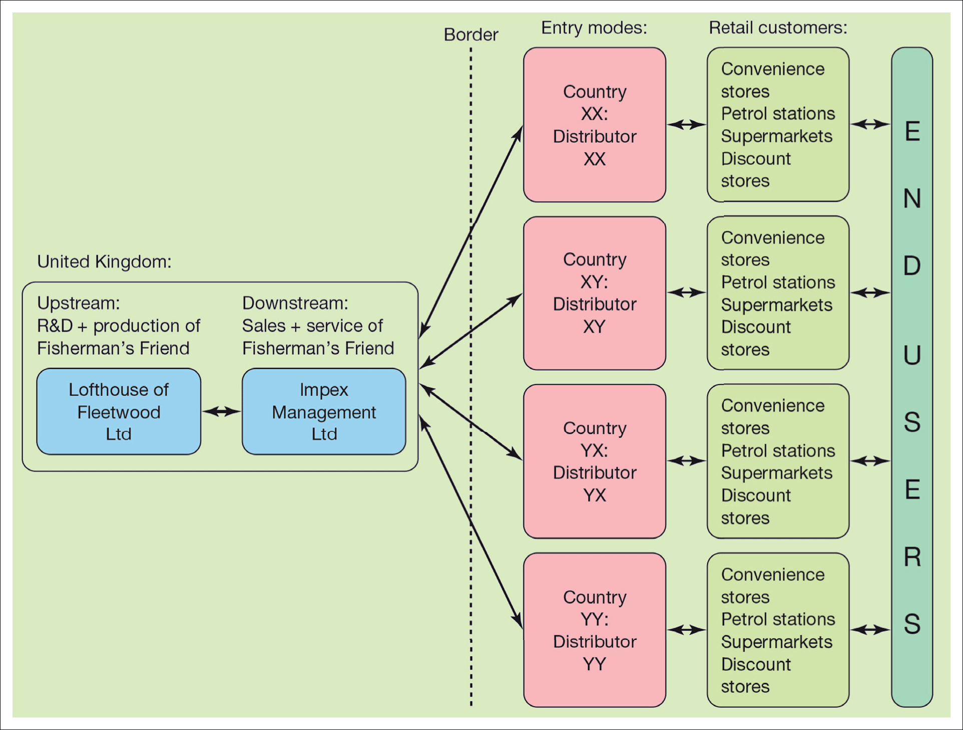
Figure 10.3 International distribution system of Fisherman’s Friend
Svend Hollensen.

Slide 5
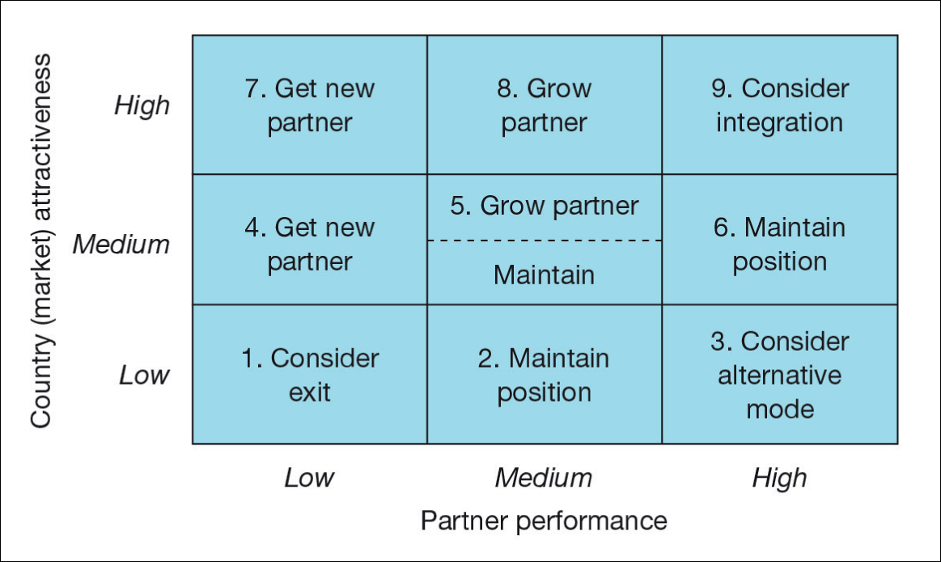
Figure 10.4 International partner matrix
Svend Hollensen.

Slide 6
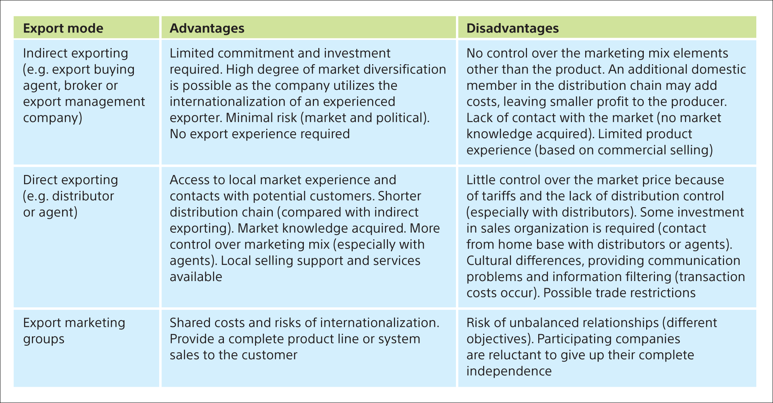
Table 10.1 Advantages and disadvantages of the different export modes for the manufacturer

