Slide 1
Global Marketing Ninth Edition
Part III
Market entry strategies and modes
Chapter 11
Intermediate modes

Slide 2
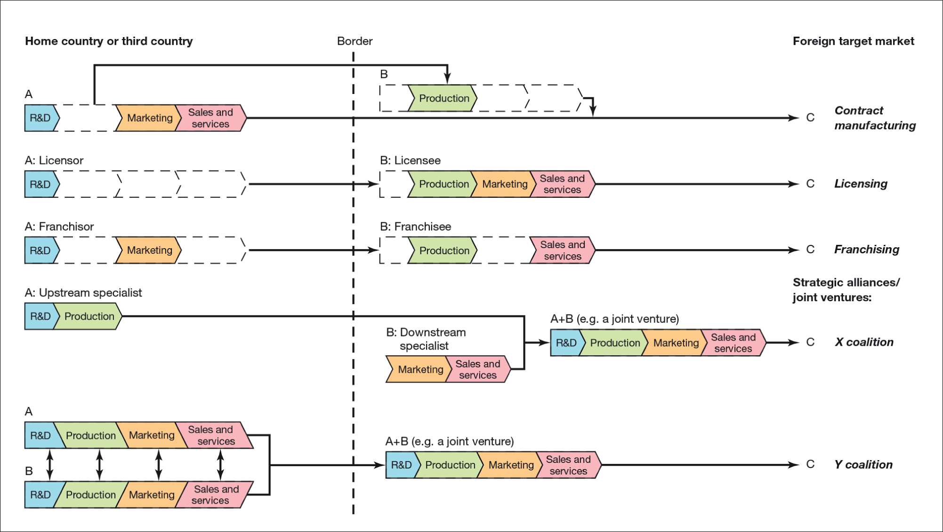
Figure 11.1 Intermediate modes
Note: A is the manufacturer, B is the partner and C is the customer.
Svend Hollensen.

Slide 3
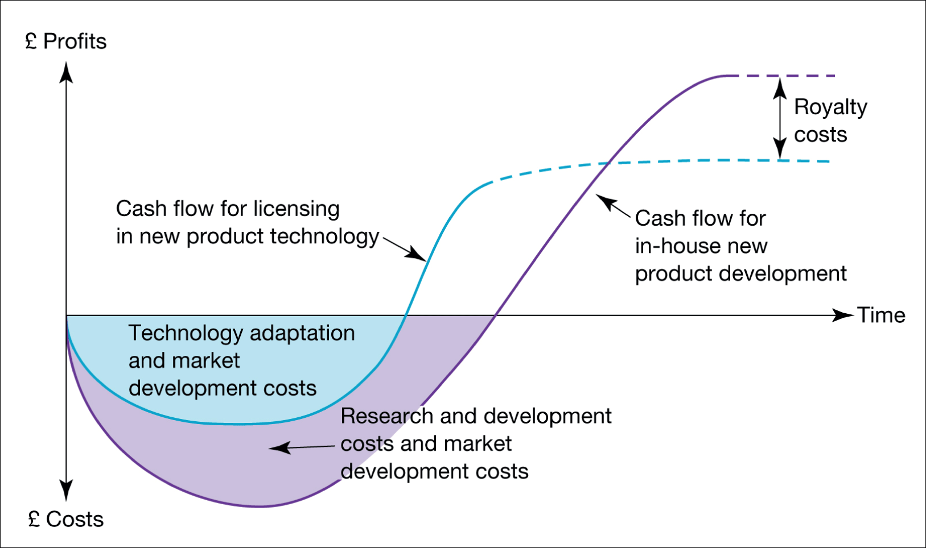
Figure 11.2 Life cycle benefits of licensing

Slide 4
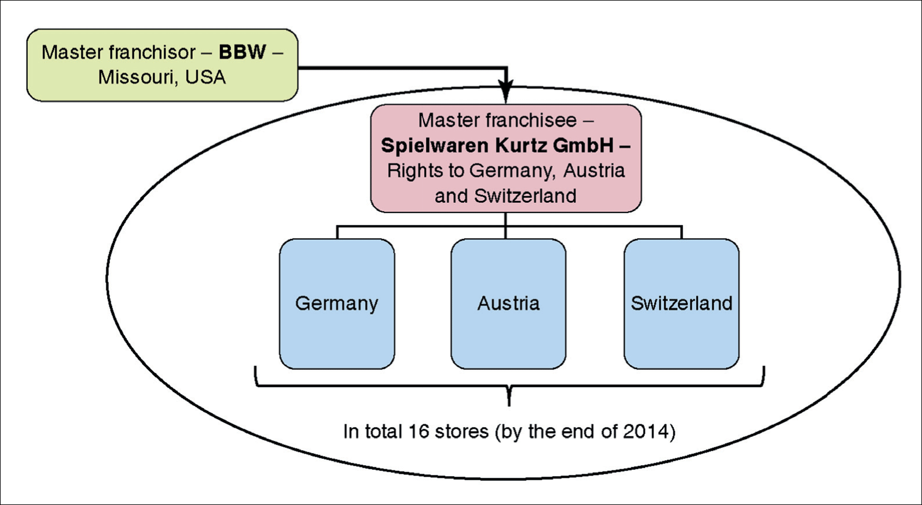
Figure 11.3 Direct and indirect franchising models
Sources: Based on Google and NASA in a Joint Venture Bruce Clay, Inc March 1st, 2021 at https://www.bruceclay.com/blog/google-and-nasa-in-a-joint-venture/.

Slide 5
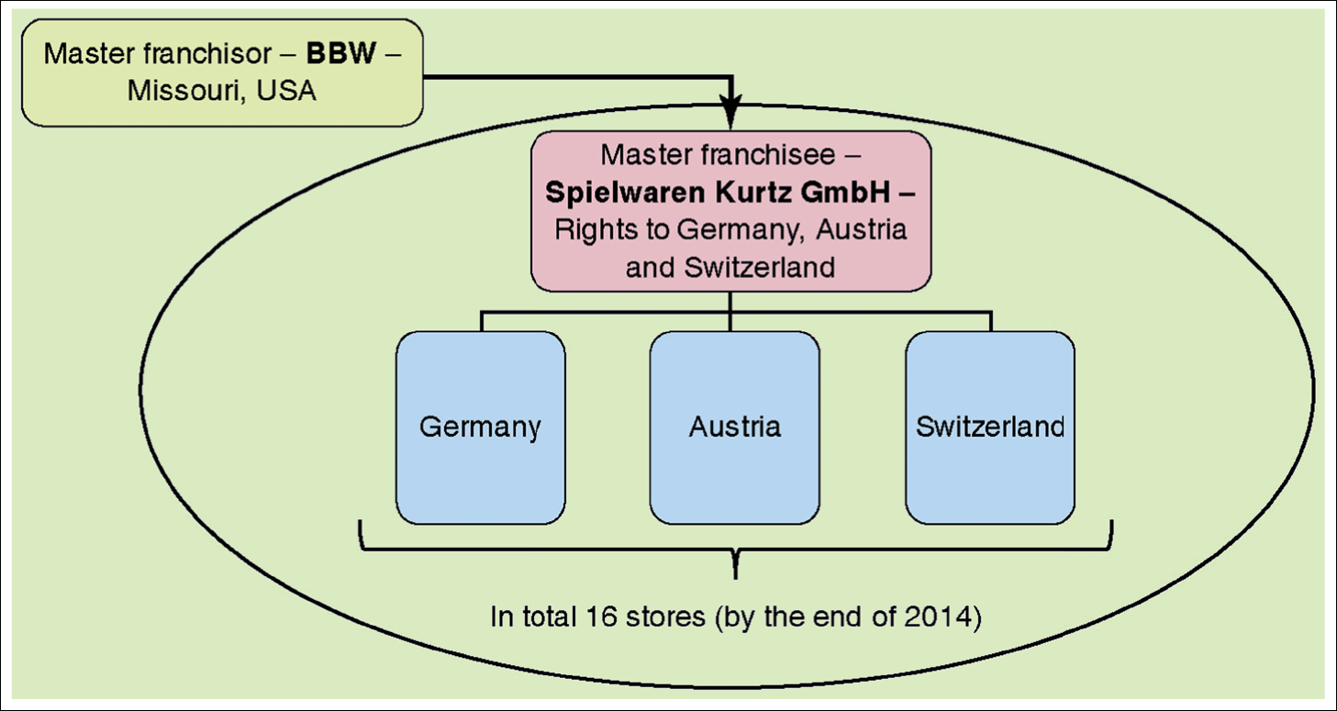
Figure 11.4 The BBW indirect franchising model for Germany, Austria and Switzerland
Source: based on www.buildabear.com and other publicly available sources.

Slide 6
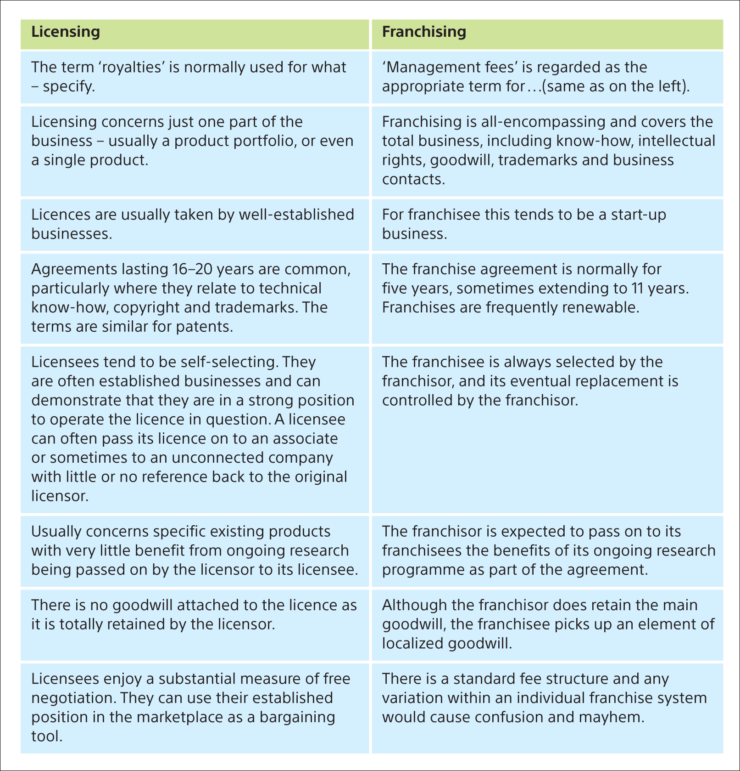
Table 11.1 How licensing and franchising differ
Sources: based on Perkins (1987, pp. 22, 157); Young et al. (1989, p. 148).

Slide 7
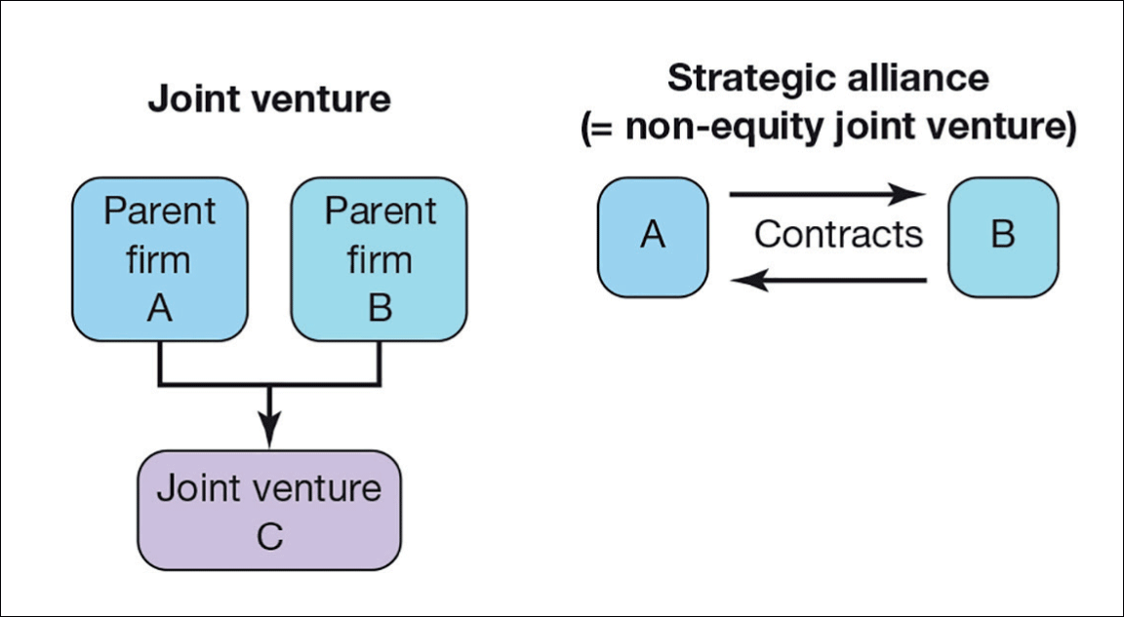
Figure 11.5 Joint ventures and strategic alliances
Svend Hollensen.

Slide 8
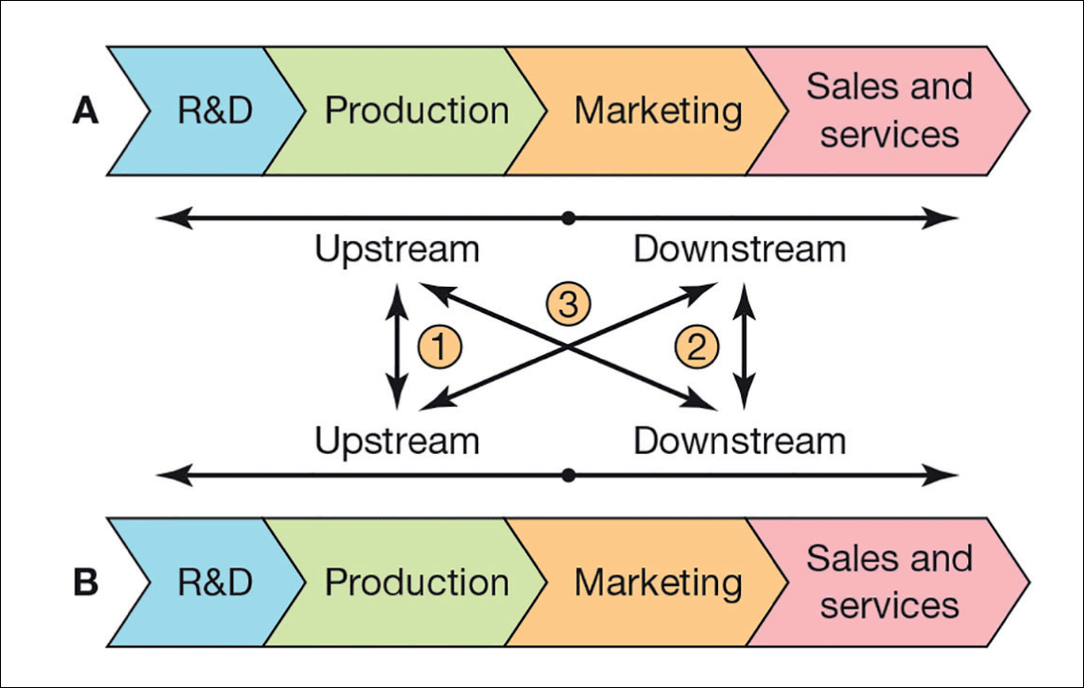
Figure 11.6 Collaboration possibilities for partners A and B in the value chain
Source: Adapted from Lorange, P. and Roos, J. (1995) Strategiske allianser i globale strategier. Norges Eksportråd, Oslo. (p. 16).

Slide 9
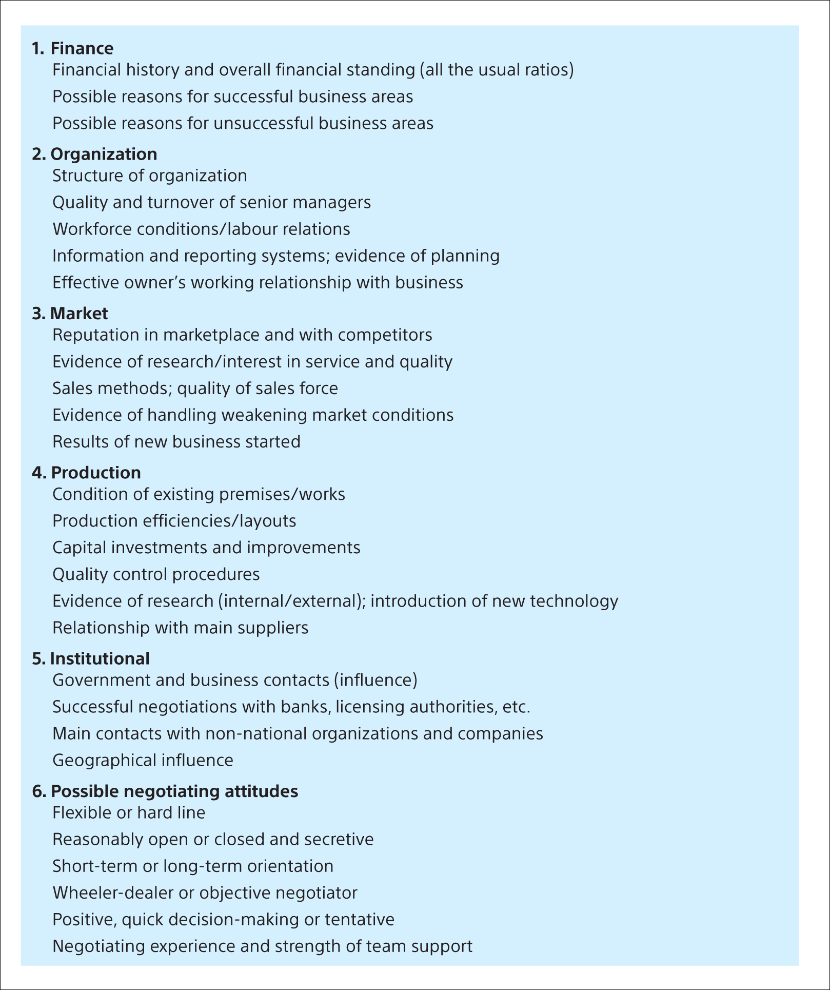
Sources: based on Walmsley (1982) and Paliwoda (1993).

Slide 10
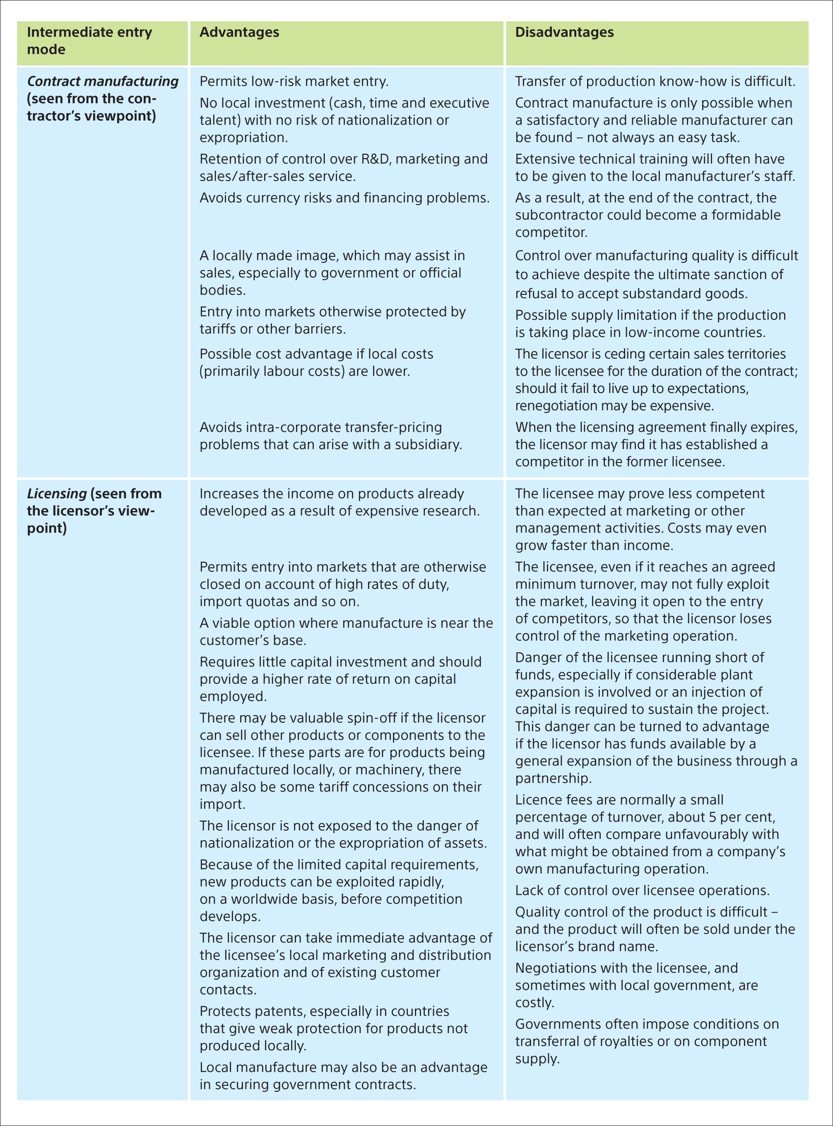
Svend Hollensen.

Slide 11
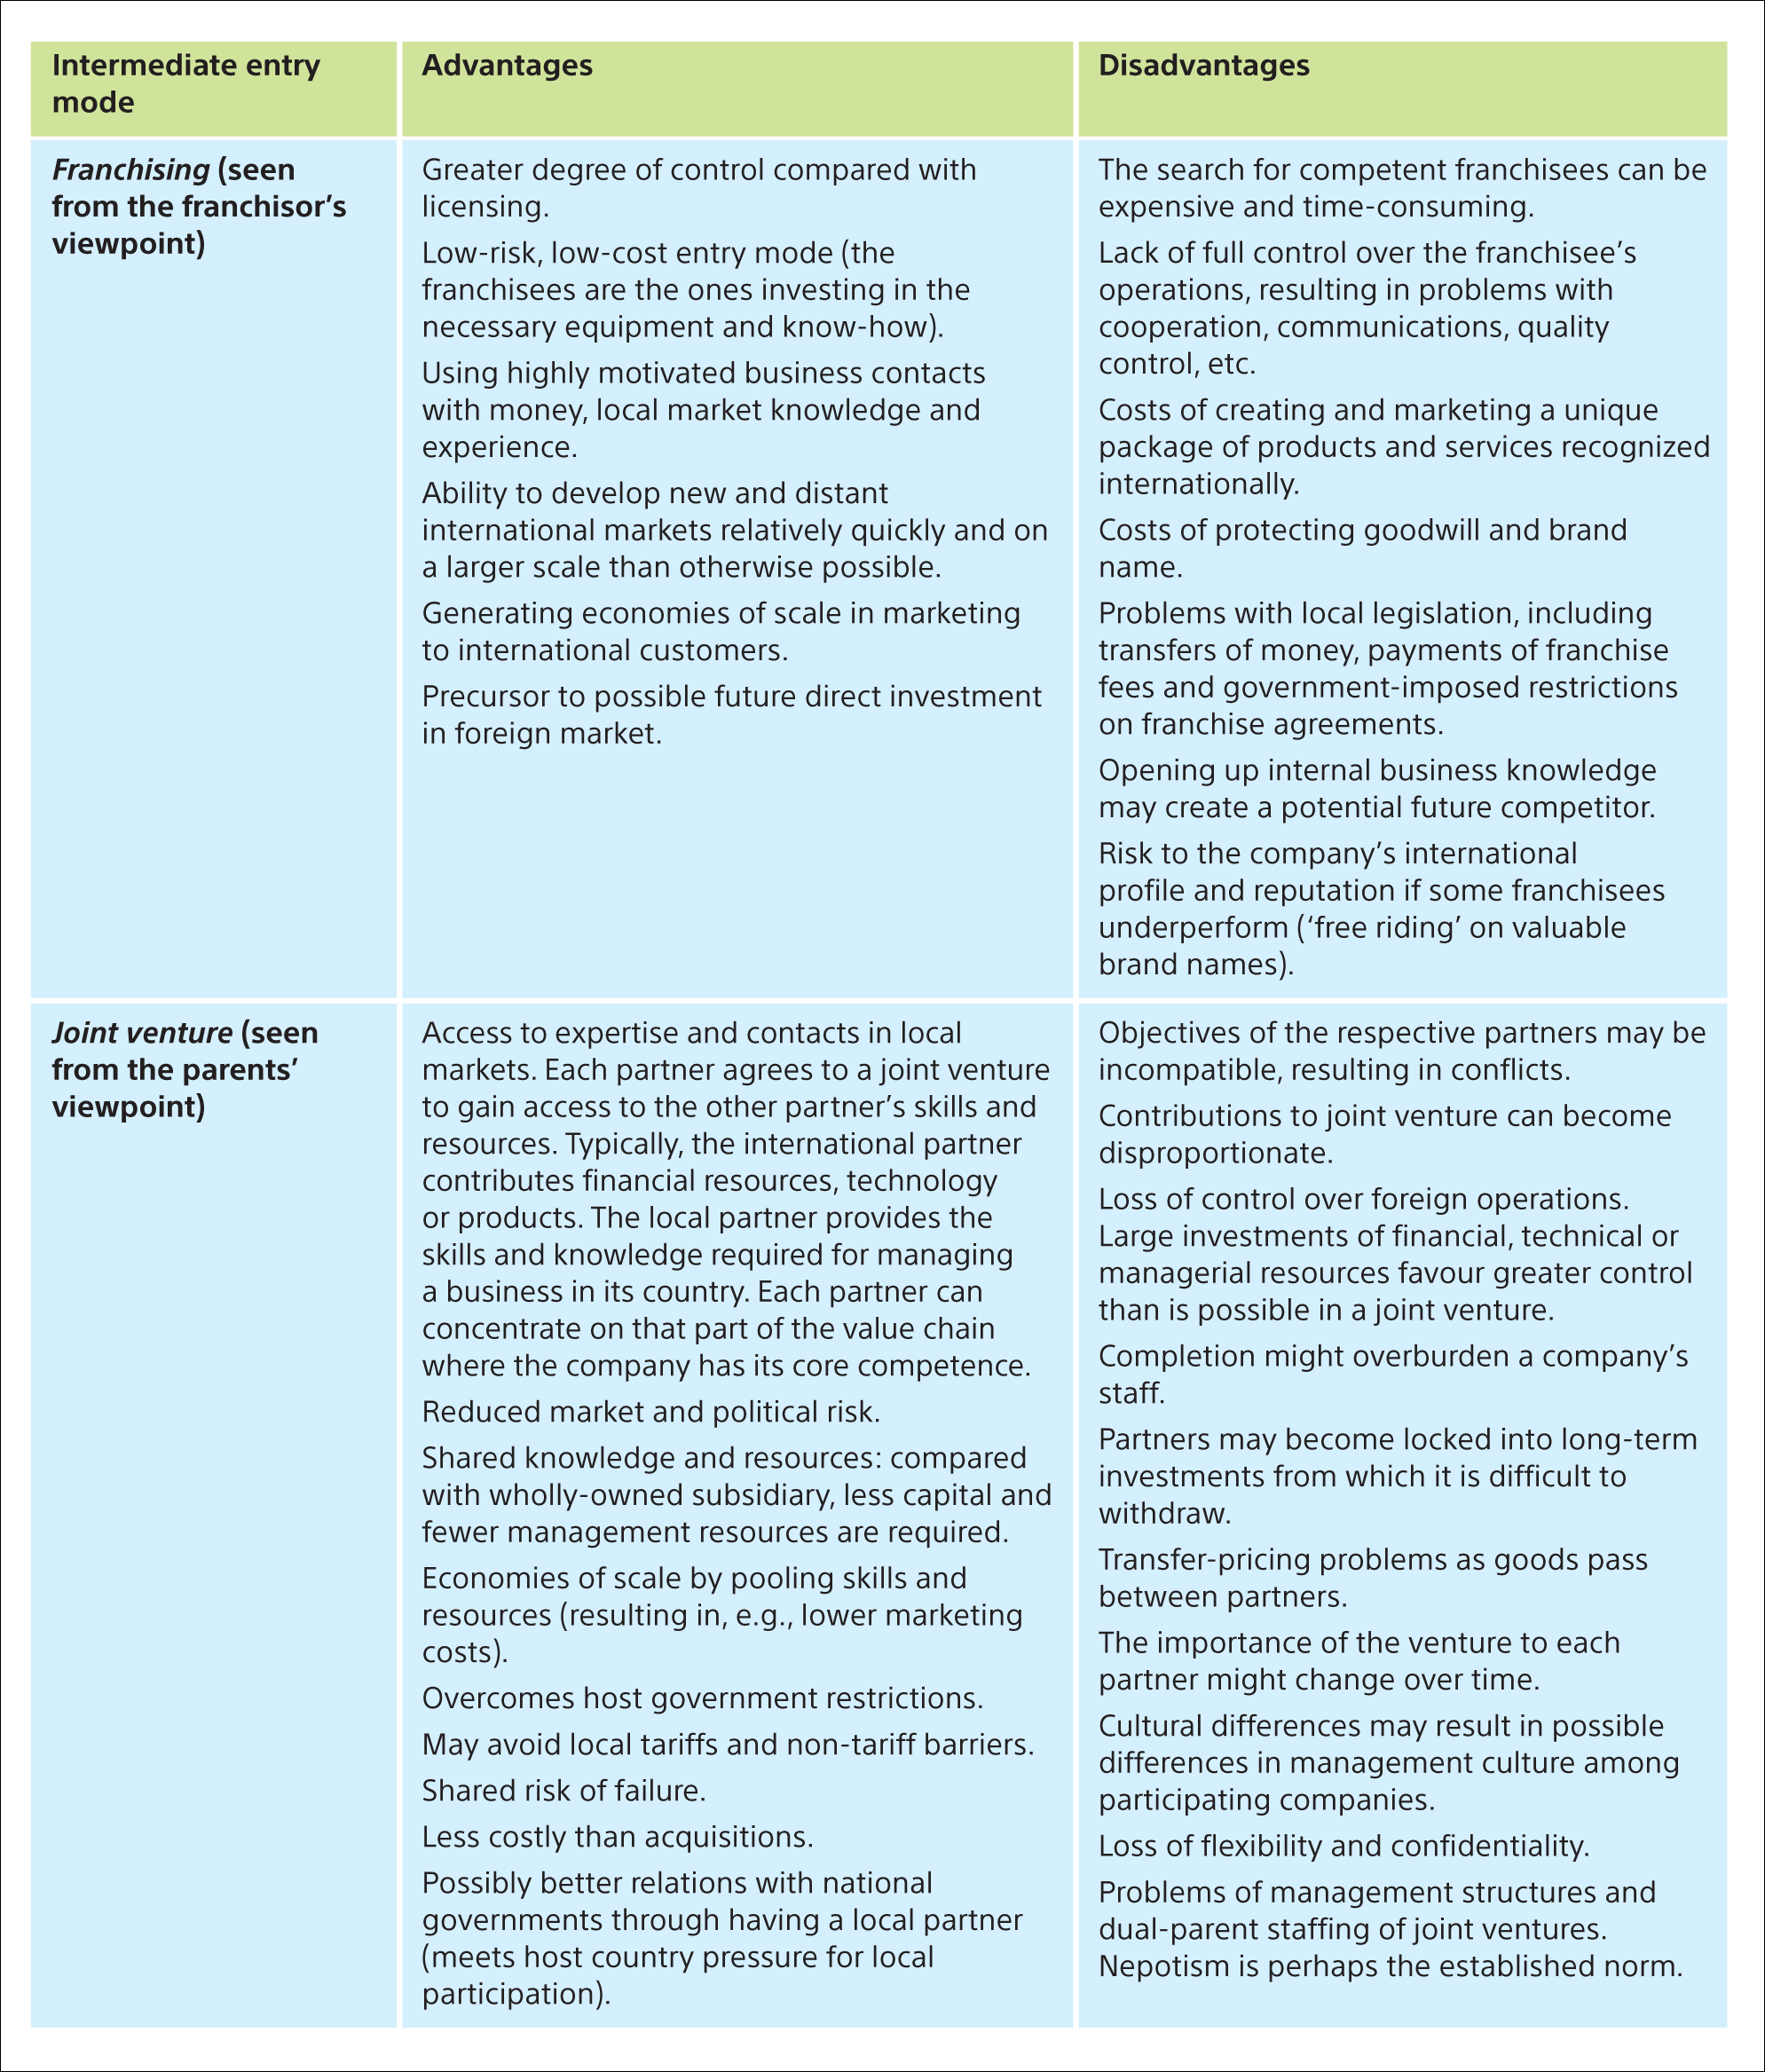
Svend Hollensen.

Slide 12
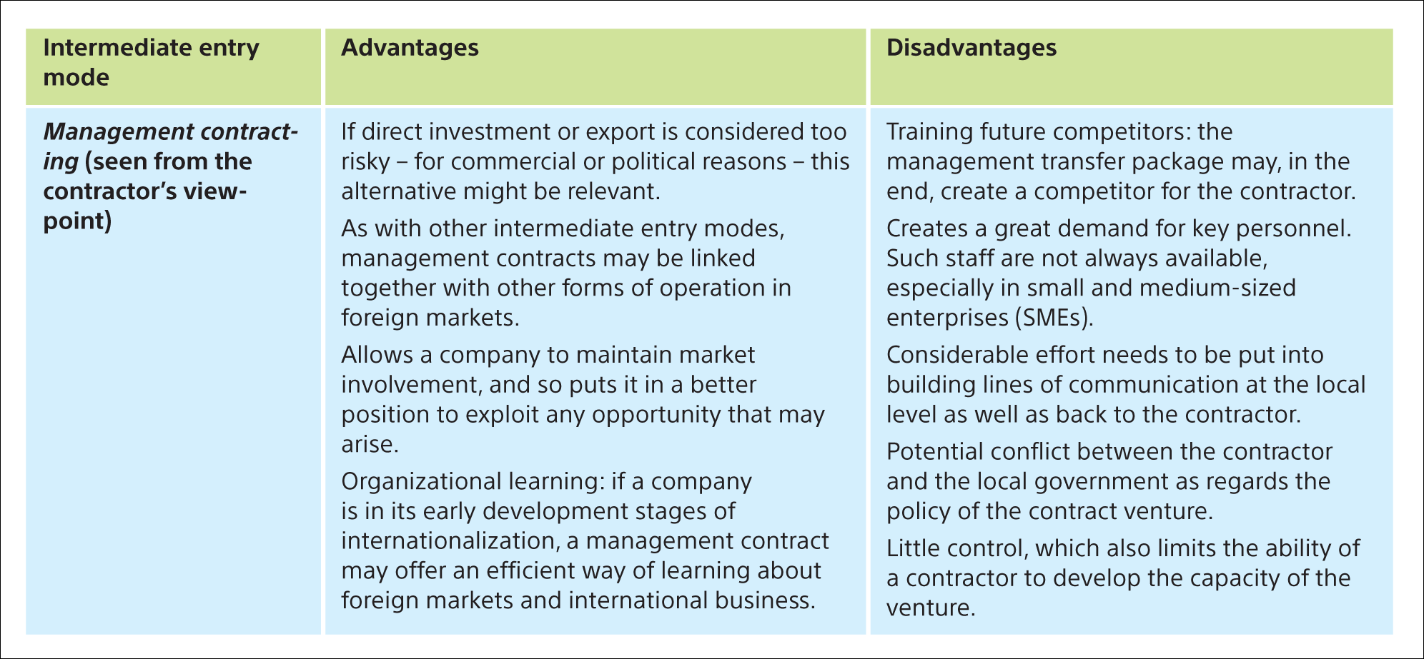
Svend Hollensen.

