Slide 1
Global Marketing Ninth Edition
Part III
Market entry strategies and modes
Chapter 12
Hierarchical modes

Slide 2
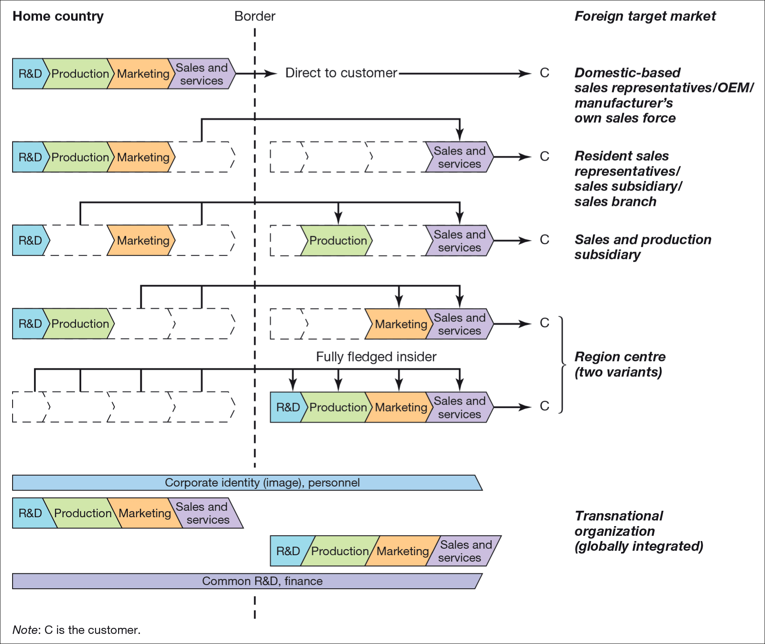
Svend Hollensen.
Notes:
Figure 12.1
Hierarchical modes in a value chain perspective

Slide 3
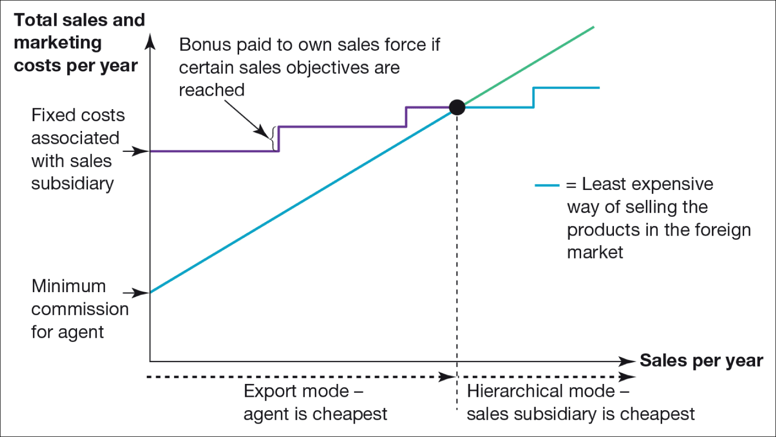
Figure 12.2 Break-even shifting from agent to sales subsidiary
Source: Adapted from Hollensen, S. (2008) Essentials of Global Marketing, FT/Prentice Hall, p. 245. Pearson Education Limited.

Slide 4
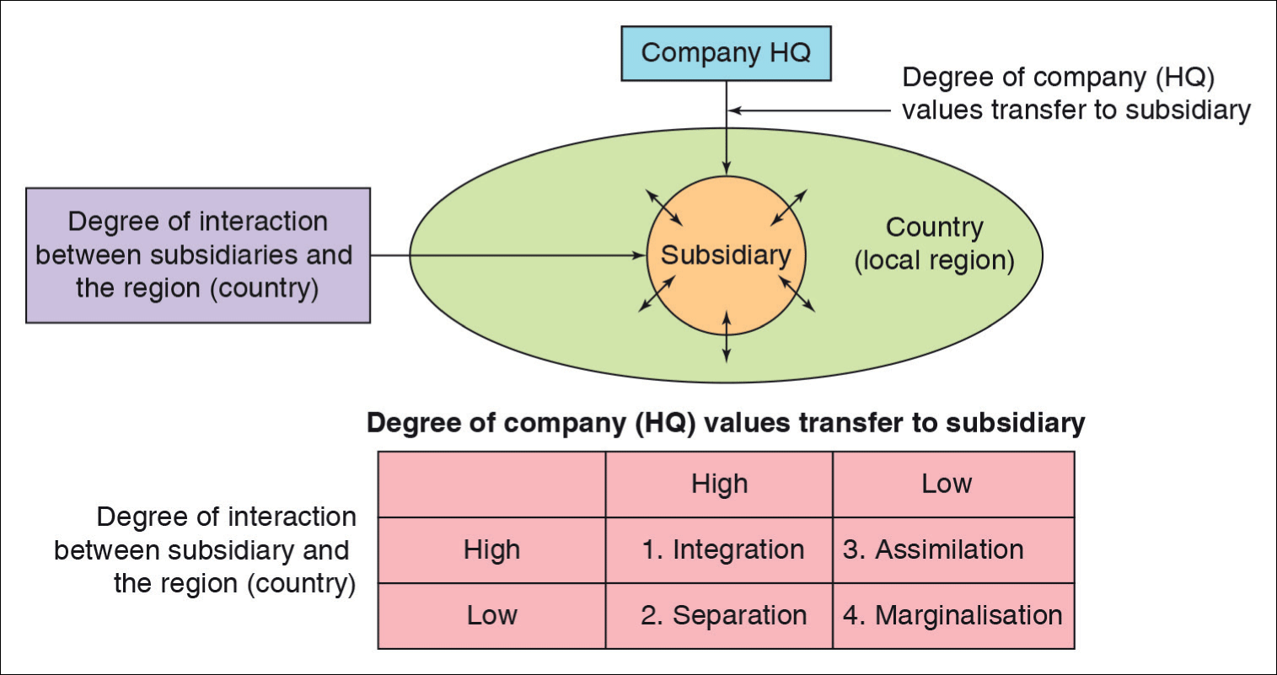
Figure 12.3 Types of transfer of company (HQ) culture to the subsidiary
Source: based on Sasaki and Yoshikawa (2014, p. 460).

Slide 5
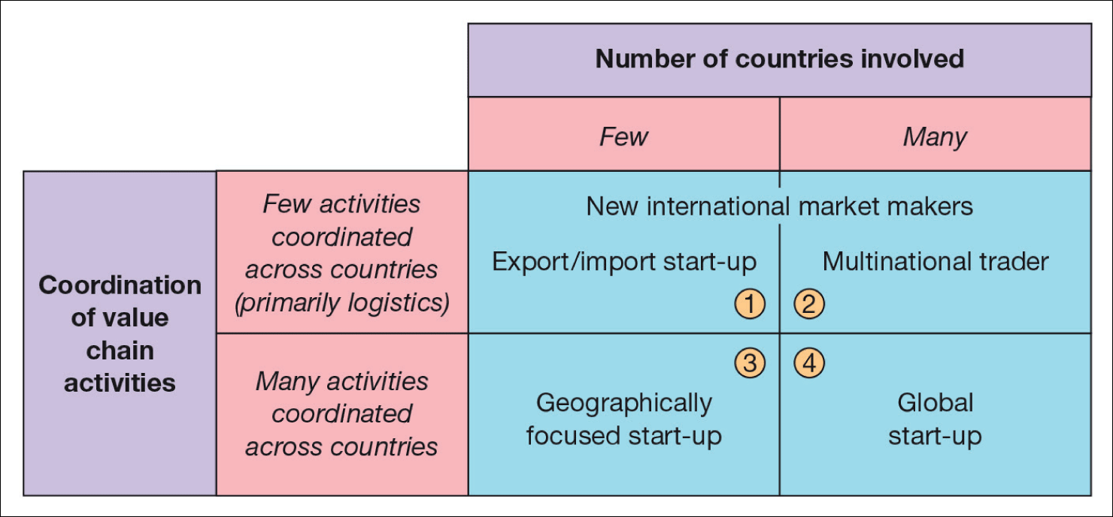
Figure 12.4 Types of international new venture
Source: reproduced with permission of Palgrave Macmillan: Journal of International Business Studies, Vol. 25, No. 1, pp. 45–64, Toward a theory of international new ventures, by Oviatt, B.M. and McDougall, P.P., copyright 1994, published by Palgrave Macmillan.

Slide 6
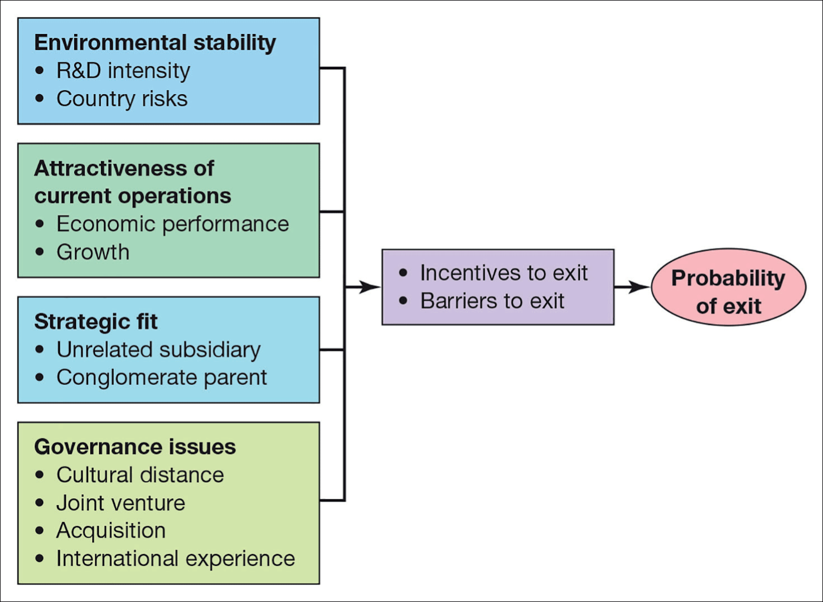
Figure 12.6 Divestment of foreign operation: a framework
HOLLO12F6
Source: Benito, G. (1996) Why are Subsidiaries Divested? A Conceptual Framework. Working Paper No. 3–93, Institute of International Economics and Management, Copenhagen Business School.

Slide 7
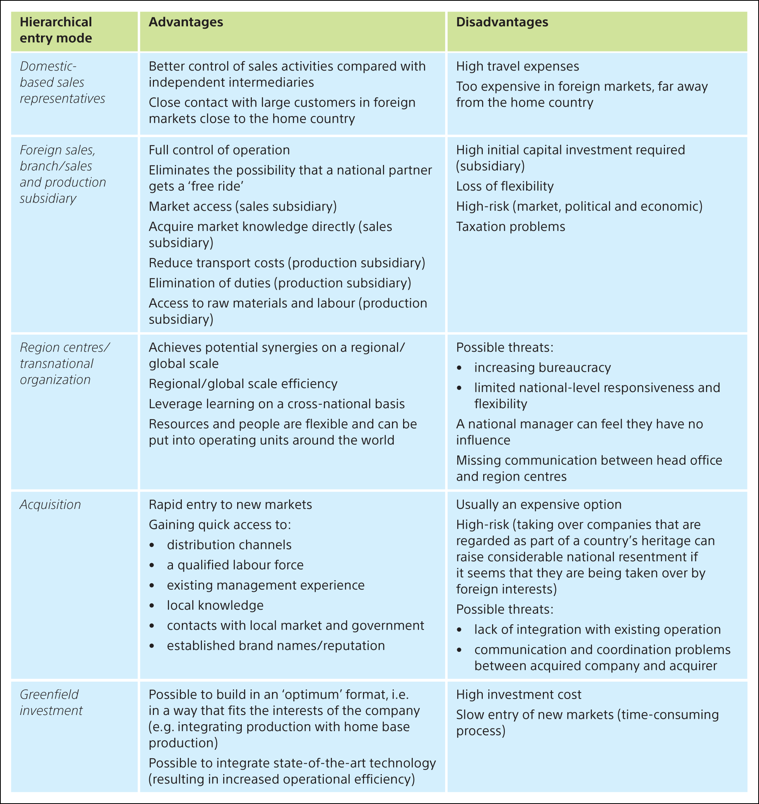
Svend Hollensen.

