Slide 1
Forecasting and time series
International Marketing Analytics
WT 2026/27
Notes:
Welcome to the session on forecasting and time series. Forecasting is planning: how much will we sell next week, next quarter, next December? We start with two tiny shops whose numbers fit on a calculator, so that you can check every forecast by hand. Then we take real monthly retail data and end with the same analysis in Python. The code is in sessions/01-foundations/forecasting.qmd.

Slide 2



Today
Concepts
By
hand
How
good?
Real
data
Python
In class
Theory, Parts 1 to 3
Practice, Parts 4 to 6
Trend, season, cycle; stationary or not?
Simple forecasts and smoothing by hand
How good is a forecast?
Real data: clothing sales in Australia
Python: a code ladder in ten steps
Online quiz and its answers
Coding exercise and Posit Assistant
Question of the day: how much will we sell next month, and how sure can we be?
Notes:
Three theory parts on two tiny shops, then real data, Python and the in-class exercise. Part 1 names what we see in a time plot and says in plain words what stationary means. Part 2 computes simple forecasts by hand, week by week in tables, so every one of them can be checked with a calculator, and smooths a series with a rolling average. Part 3 asks which forecast to trust. Parts 4 to 6 bring a real series, the Python code as a ladder of ten small steps, and the exercise. Keep the question of the day in mind: every part answers a piece of it.

Slide 3





Our example: planning demand in two shops
The problem: a marketing manager must plan before demand arrives.
The question: how much will we sell next week, next quarter, next Christmas?
Stock
Staff
Media budget
order before the peak
shifts for the busy weeks
spend when buyers are there
Two tiny shops first: a phone shop (contracts per week) and a chocolate web shop (sales per quarter); real data in Part 4.
Invented round numbers (hand_examples.csv), built for this course
Notes:
Start with the business question. A marketing manager has to decide before demand arrives: how much stock to order before the peak, how many staff to put on the busy weeks, and when to spend the media budget. A third use: the lift of a campaign is actual sales minus the forecast without the campaign. Our two shops are invented, so that every number can be checked by hand; the phone shop can be read as one shop of the mobile operator from the churn session. Ask the room: what do you forecast in your own job or internship?

Slide 4
The data: one row per period
Phone shop: new contracts per week
Week
1
2
3
4
5
6
7
8
Contracts
40
44
42
46
50
49
53
54
Chocolate shop: sales per quarter, k EUR
Q1
Q2
Q3
Q4
period: the time step: week 1 to 8, quarter 1 to 12
Year 1
20
16
20
30
value: what we forecast
Year 2
24
20
23
35
Year 3
28
24
26
40
rules: time order, equal steps, no gaps
File: data/forecasting/hand_examples.csv invented, 20 rows: example, period, value
Invented round numbers (hand_examples.csv)
Notes:
A time series is one value per period, in time order, with equal steps. Each value here is one period: a week for the phone shop, a quarter for the chocolate shop. The long file has the columns example, period, value, 20 rows; the first row is contracts, 1, 40, the last row is webshop, 12, 40. Unlike the churn data, the rows cannot be shuffled: the order is the information. Real data later have a date column (the month) instead of a period number. Ask: which row would you forecast next?

Slide 5
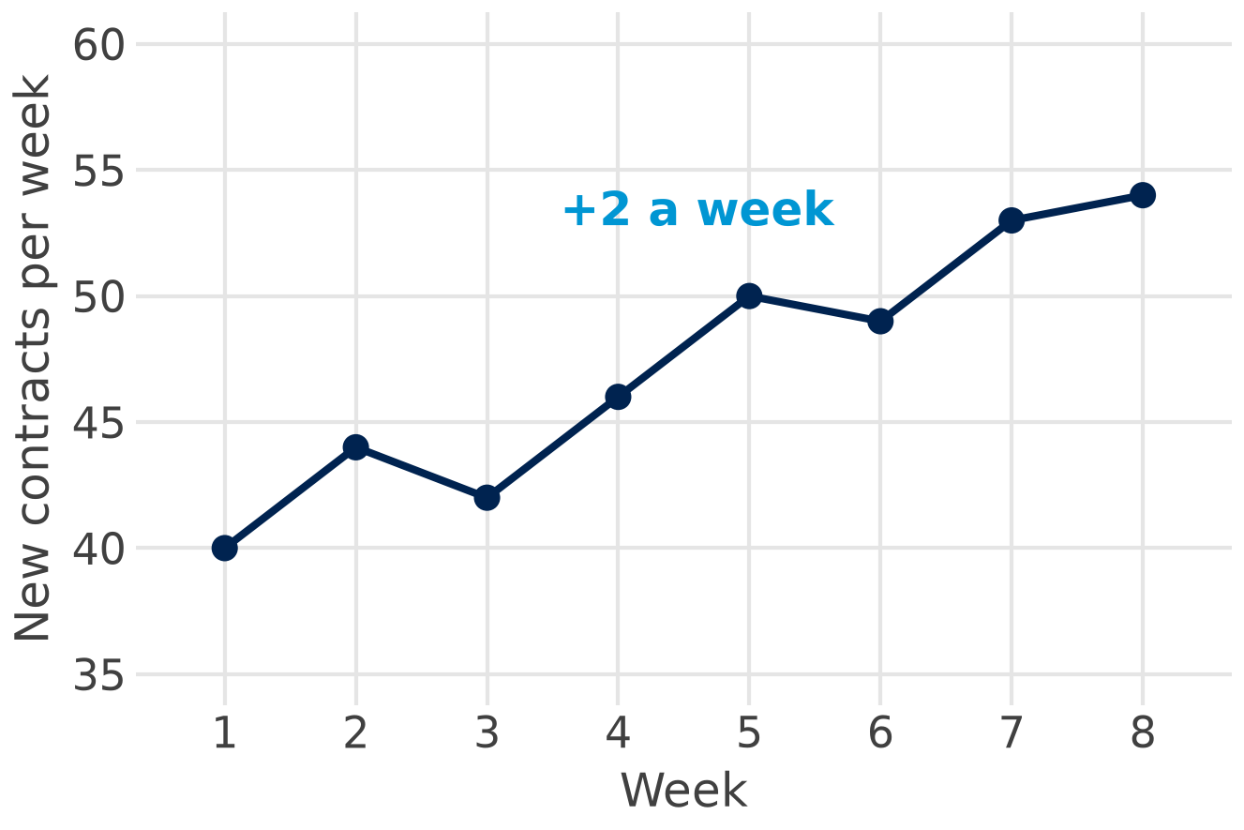
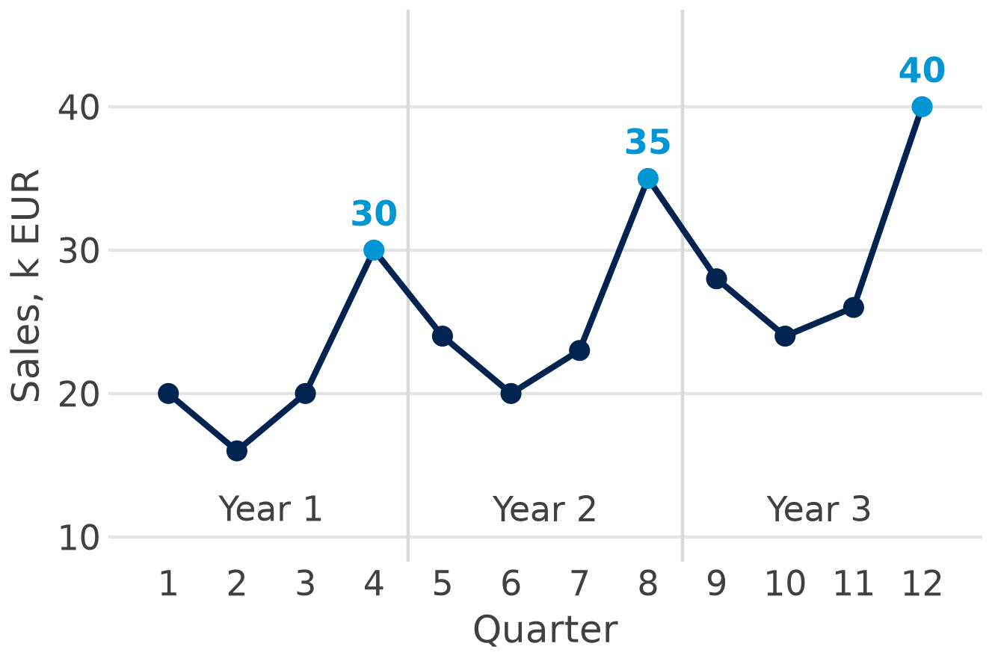
First look: plot the series
Trend: up about 2 a week
Trend and season: every Q4 peaks
Plot first: the eye finds trend and season before any model.
Invented round numbers (hand_examples.csv)
Notes:
A time plot, with the period on the x axis and the value on the y axis, is step one of every forecast. The phone shop rises by about 2 contracts a week, with two small dips in weeks 3 and 6. The chocolate shop rises every year and peaks at Christmas: Q4 sales are 30, 35 and 40 k EUR. Ask the room for a guess for week 9 and for Q4 of year 4, and keep the guesses for Part 2 (slides 12 to 19).

Slide 6
Time series concepts
Part 1 of 6 · trend, season, cycle, stationarity
Notes:
Part 1 gives us four words for what we see in a time plot: trend, season, cycle and irregular. Then one question about the size of the season: does it stay the same or grow with the level? And finally the one property most forecasting methods need, first in plain words with six small examples, then the fix: a stationary series.

Slide 7
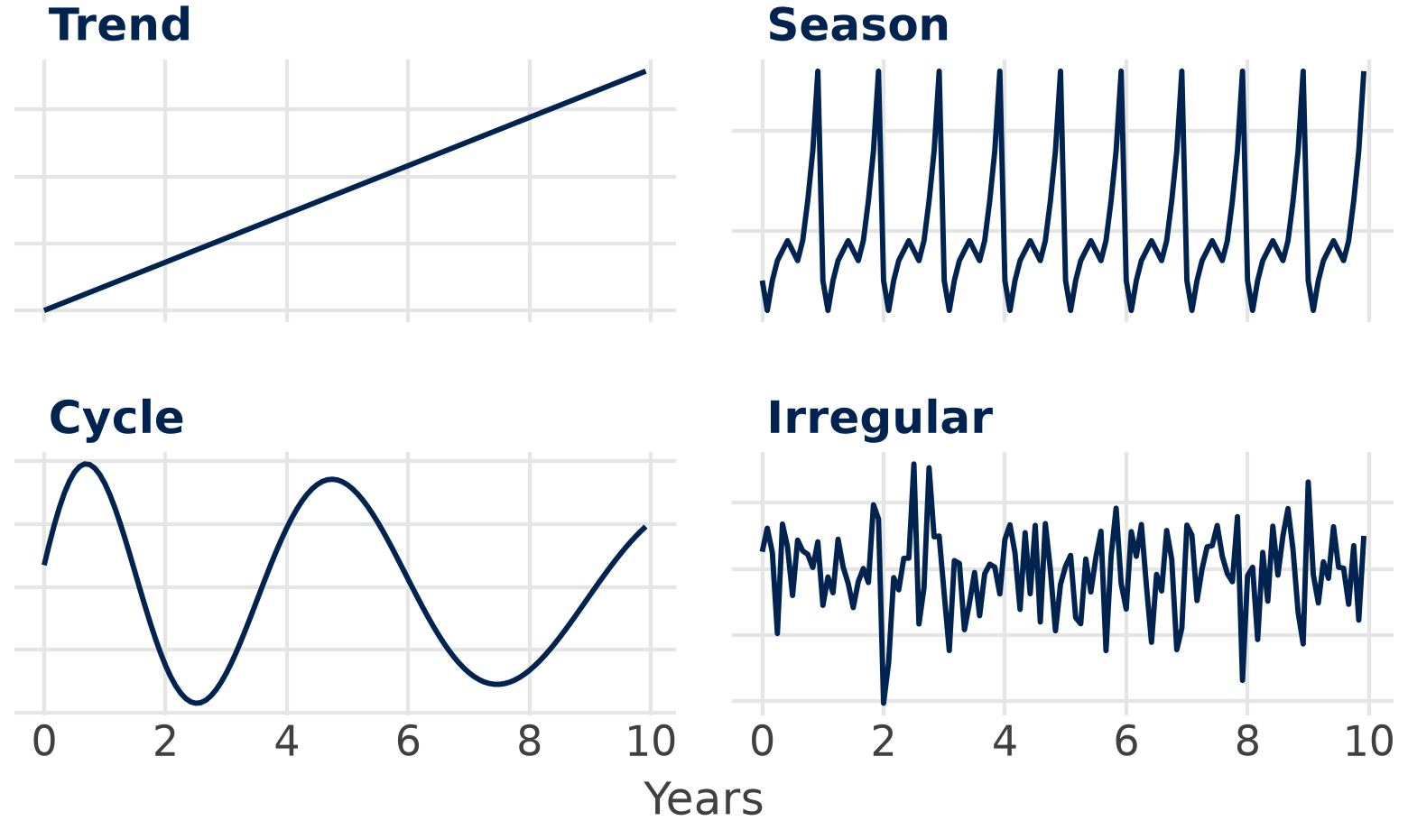
Trend, season, cycle and irregular
Trend: the long-run direction
Season: repeats every year, fixed length (Christmas)
Cycle: ups and downs over years, no fixed length (the economy)
Irregular: what is left: noise, one-off events
Series = trend + season + cycle + irregular (or ×, slide 8): a forecast extends the first three.
Simulated series for illustration
Notes:
A series can be read as four parts. The trend is the long-run direction; the season is a pattern that repeats every year with a fixed length, such as Christmas or summer; the cycle is ups and downs over several years without a fixed length, driven by the economy; the irregular part is what is left: noise and one-off events. Trend and cycle are often estimated together as the trend-cycle (Hyndman and Athanasopoulos, FPP3, chapter 3). The clothing series of Part 4 shows a cycle: flat to 2012, then growth (slide 27). The irregular part cannot be forecast, which is why every forecast needs a band (slide 31).

Slide 8
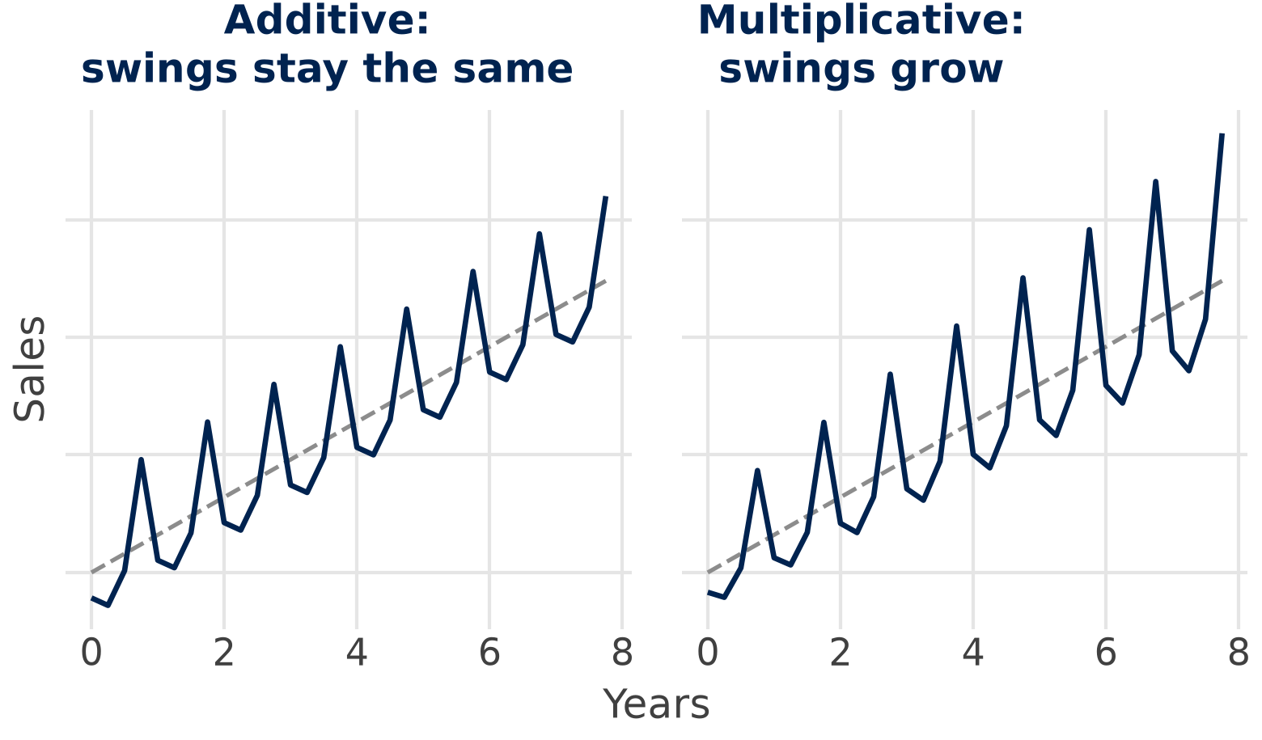
Additive or multiplicative season?
+9.5
chocolate shop: Q4 about 9.5 k EUR above the year mean on average (8.5 to 10.5): additive
× 1.59
clothing (Part 4): December 59 % above an average month, and the swing grows: multiplicative
Multiplicative season: use a multiplicative model or take logs, which makes it additive.
Simulated series for illustration; chocolate shop: invented; clothing: ABS Retail Trade (8501.0), CC BY 4.0
Notes:
The season can stay the same size or grow with the level. In the chocolate shop the Q4 gaps to the year mean are +8.5, +9.5 and +10.5 k EUR: close to constant, so an additive season is fine. In the Australian clothing data the December swing grows from about +890 AUD m in 2009 to +1,257 AUD m in 2018: a multiplicative season. So in Part 4 we use logs or multiplicative models (slides 27 and 29). Logs turn percentages into constant gaps, which makes a multiplicative season additive.

Slide 9

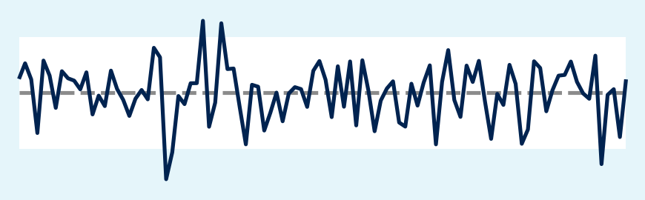
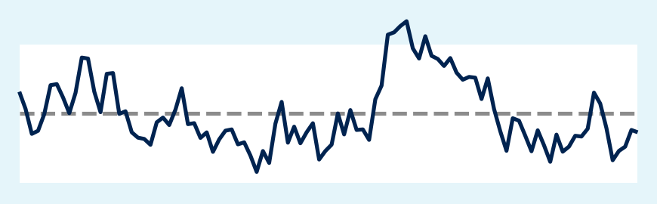
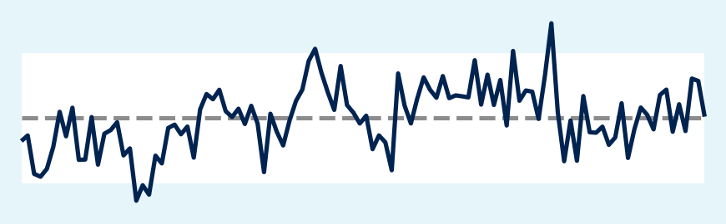
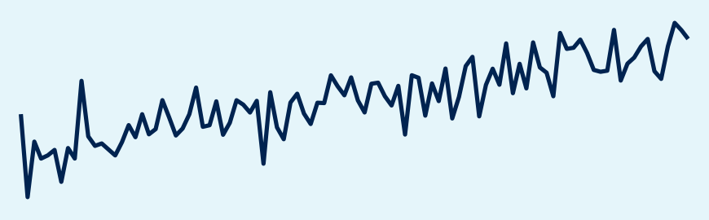
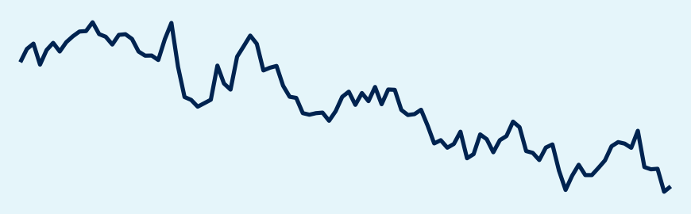
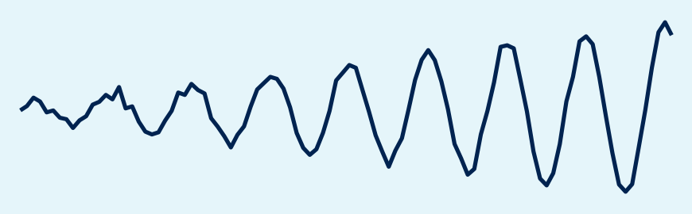
What does stationary mean?
Stationary: the level and the ups and downs stay the same over time; any stretch of the series looks like any other stretch.
Stationary
noise around a fixed mean
Stationary
wobbles, returns to its mean
Stationary
clothing: change on last year
Not stationary
a trend: the level rises
Not stationary
a random walk wanders off
Not stationary
a season whose swings grow
Simulated series for illustration; clothing: ABS Retail Trade (8501.0), CC BY 4.0
Notes:
Start with the plain definition: a series is stationary when its level and its ups and downs stay the same over time, so any stretch of it looks like any other stretch. Cover half of a chart with your hand: if the visible half tells you nothing about where you are in time, the series is stationary. The top row passes the test: pure noise, a series that wobbles but is always pulled back to its mean (an AR(1) process), and real data: clothing sales minus the same month a year earlier, which moves around +51 AUD m a month (slide 25). The bottom row fails: a trend moves the level, a random walk wanders off and never comes back, and a season whose swings grow changes the ups and downs. Why it matters: many methods, ARIMA among them, assume that the past looks like the future; qmd Extra B simulates the noise and the random walk. A test comes in Part 4: the ADF test (slide 28) gives p 0.003 for the yearly change of clothing sales. Ask: is the phone shop stationary?

Slide 10
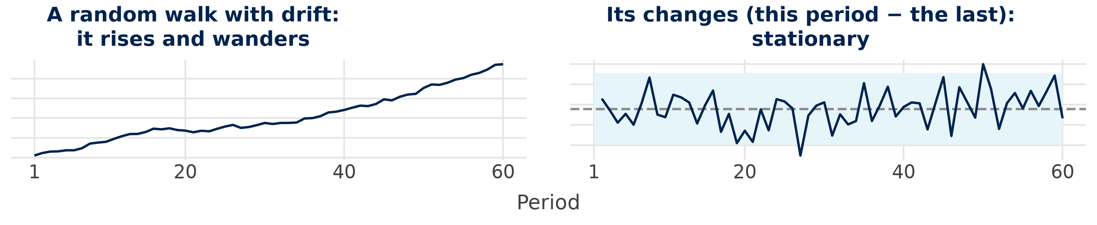
Not stationary? Differencing is the fix
Week
1
2
3
4
5
6
7
8
Average
Contracts
40
44
42
46
50
49
53
54
Change
–
+4
−2
+4
+4
−1
+4
+1
+2
Differencing: this period − the last; for a season: minus the same period last year. ARIMA-type models need it.
Simulated series for illustration; phone shop: invented round numbers
Notes:
Slide 9 showed what stationary looks like; this slide shows the fix when a series is not. Differencing means: this period minus the previous one. The random walk on the left rises and wanders; its changes on the right move around one fixed mean, the average change, so they are stationary again. The phone shop works the same way: the contracts rise, the changes +4, −2, +4, +4, −1, +4, +1 do not, and their average, +2 a week, is the drift of slide 12. For a season, take the change on the same period last year (December minus last December), as for the clothing example of slide 9. ARIMA-type models difference the series for us (slides 28 and 29); code: qmd Extra B. Ask: is the chocolate shop stationary?

Slide 11
Simple forecasts by hand
Part 2 of 6 · five methods and smoothing
Notes:
This part gives a manager five ideas that work on a calculator: no change, same change, averages, smoothing and regression. They give six forecasts for the same number, new contracts in week 9 of the phone shop, from the 8 weeks we know: naive, drift, the mean, a moving average, exponential smoothing and the trend regression. Each method gets a week-by-week table, so you can follow every step, and one slide shows how a rolling average smooths a series instead of forecasting it. Then we add the season, with the chocolate shop and its Christmas quarter. Keep the results in mind: Part 3 tests which rule would have been best. Bring out your calculator.

Slide 12
No change and same change: naive and drift
Week
Contracts
Naive
Error = change
54
naive for week 9:
= week 8
1
40
–
–
2
44
40
+4
3
42
44
−2
4
46
42
+4
5
50
46
+4
56
drift for week 9:
54 + the mean error
(54 − 40) / 7 = +2
6
49
50
−1
7
53
49
+4
8
54
53
+1
Naive's errors are the weekly changes; drift adds their average, +2.
Invented round numbers (hand_examples.csv)
Notes:
A forecast is the value we predict for a future period; the horizon is how many periods ahead, here one week. Read the table row by row: naive, or no change, forecasts each week with the week before, so week 2 gets 40 and week 8 gets 53; for week 9 it says 54. The error is actual − forecast, and for naive it is simply the change on last week, the changes of slide 10. Drift, or same change, adds the average of these errors: they add up to 54 − 40, so their average is (54 − 40) / 7 = 2, and week 9 is 54 + 2 = 56 (week 10 would be 58). Naive sounds too simple, but it is hard to beat for prices and anything that wanders like a random walk. Ask the room: which of the two would you trust after a one-off promotion in week 8? The table in Python: qmd Extra A.

Slide 13
Averages: the mean and a moving average
Week
Contracts
Calculation
Forecast
Error
47.25
mean:
378 / 8
1
40
–
–
–
2
44
–
–
–
3
42
–
–
–
4
46
(40 + 44 + 42) / 3
42
+4
52
week 9: moving average of weeks 6 to 8
5
50
(44 + 42 + 46) / 3
44
+6
6
49
(42 + 46 + 50) / 3
46
+3
7
53
(46 + 50 + 49) / 3
48.33
+4.67
8
54
(50 + 49 + 53) / 3
50.67
+3.33
Sum: 40 + 44 + 42 + 46
+ 50 + 49 + 53 + 54 = 378
Averages lag behind a trend: every error of the moving average is positive, the forecast is too low.
Invented round numbers (hand_examples.csv)
Notes:
The mean is the average of all past values: 378 / 8 = 47.25. It treats week 1 like week 8, which is fine for a series without trend and poor here. A moving average keeps only the last k weeks; with k = 3 the forecast for week 4 is (40 + 44 + 42) / 3 = 42, and the table moves the window on one week at a time, until week 9: (49 + 53 + 54) / 3 = 52. Look at the error column: every error is positive, on average +4.20, so the moving average is always too low. Averages smooth out noise but lag behind a trend; a small k reacts faster, a large k smooths more. The next slide uses the same averages to smooth the series instead of forecasting it. In Python: shift(1) and rolling_mean(3), qmd Extra A.

Slide 14
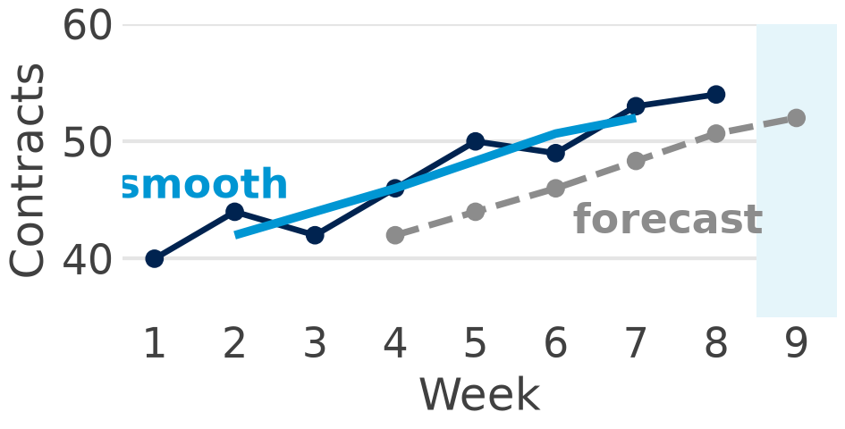
Rolling averages: smooth or forecast?
Week
Contracts
Centred window
Smooth
Forecast
1
40
–
–
–
2
44
(40 + 44 + 42) / 3
42
–
3
42
(44 + 42 + 46) / 3
44
–
4
46
(42 + 46 + 50) / 3
46
42
5
50
(46 + 50 + 49) / 3
48.33
44
6
49
(50 + 49 + 53) / 3
50.67
46
Smooth: the week before, the week and the week after
7
53
(49 + 53 + 54) / 3
52
48.33
8
54
–
–
50.67
Forecast: only the 3 weeks before (slide 13)
9
?
–
–
52
Same averages, different place: centre the window to see the trend; look only back to forecast.
Invented round numbers (hand_examples.csv)
Notes:
A rolling average averages a window of weeks that moves along the series, one week at a time. To smooth a series, centre the window: week 2 gets the average of weeks 1, 2 and 3, (40 + 44 + 42) / 3 = 42. That looks back and forward, so the smooth line runs through the middle of the data and shows the trend without the noise. To forecast, we may only look back: the same 42 becomes the forecast for week 4 (slide 13). Same numbers, two weeks later: that is why the forecast lags behind a growing shop. In Part 4 a 12-month rolling average shows the trend of clothing sales (slide 26), and STL does a smarter version of the same idea (slide 27). Code: rolling_mean(12, center=True) for the clothing series, Step 5 (slide 39). Ask: why can the smooth line not forecast week 9?

Slide 15
Exponential smoothing, step by step
Week
Contracts
Level
Calculation (α 0.5)
Rule
1
40
40
start: the first value
new level = α × value
+ (1 − α) × old level
forecast = last level
2
44
42
0.5 × 44 + 0.5 × 40
3
42
42
0.5 × 42 + 0.5 × 42
52.25
forecast
for week 9 (α 0.5)
4
46
44
0.5 × 46 + 0.5 × 42
5
50
47
0.5 × 50 + 0.5 × 44
6
49
48
0.5 × 49 + 0.5 × 47
47.89
α 0.2: slower
α 1 = naive (54)
7
53
50.5
0.5 × 53 + 0.5 × 48
8
54
52.25
0.5 × 54 + 0.5 × 50.5
Recent weeks count most: α near 1 follows the data fast, α near 0 averages.
Invented round numbers (hand_examples.csv)
Notes:
Simple exponential smoothing keeps one number, the level, and updates it every week: α times the new value plus 1 − α times the old level. Read the table row by row: week 2 is 0.5 × 44 + 0.5 × 40 = 42, and so on, until the level after week 8, 52.25, which is the forecast for week 9. It is a weighted average whose weights shrink by 1 − α per week back: with α 0.5 the last week counts 0.5, the week before 0.25, then 0.125. We start with the first value as the first level (software estimates the start); α 0.2 moves more slowly, with levels 40, 40.80, 41.04, 42.03, 43.63, 44.70, 46.36, 47.89, so it gives 47.89; α 1 is naive (54). The forecast is flat, so it lags behind a trend: Holt adds a trend and Holt-Winters a season (slide 29); statsmodels picks α by minimising the errors (α 0.078 for clothing in Part 4).

Slide 16
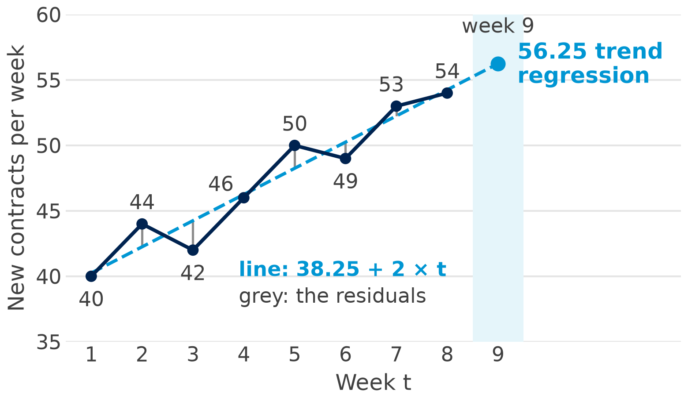
Regression on time: the trend line
By hand
t̄ = 4.5 ȳ = 47.25
b1 = Σ(t − t̄)(y − ȳ) / Σ(t − t̄)²
= 84 / 42 = 2
b0 = ȳ − b1 × t̄
= 47.25 − 2 × 4.5 = 38.25
week 9: 38.25 + 2 × 9 = 56.25
0.926
R² = 1 − 13.5 / 181.5
the line fits well
The trend line uses every week: it assumes the trend goes on – and that the errors are independent (slide 32).
Invented round numbers (hand_examples.csv)
Notes:
This is the ordinary regression from the statistics session, with time t = 1, 2, … 8 as the only x. By hand: t̄ = 4.5 and ȳ = 47.25; the deviations t − t̄ run from −3.5 to +3.5, their squares add up to 42, and the products (t − t̄)(y − ȳ) add up to 84. So the slope is 84 / 42 = 2 contracts a week, the same as drift here, and the line goes through the middle point: b0 = 38.25; slide 17 shows every step in a table. Week 9 is 56.25, week 10 58.25; R² = 1 − 13.5 / 181.5 = 0.926: the squared residuals add up to 13.5, the squared deviations of the weeks from their mean ȳ to 181.5, so the line explains most of the ups and downs. For seasonal data we add dummies (slide 19); in Python smf.ols("value ~ period", ...), qmd Extra A. Warn early: OLS assumes independent errors, which time series often violate (slide 32).

Slide 17
The trend line by hand, week by week
Week t
Contracts y
t − t̄
y − ȳ
(t − t̄)(y − ȳ)
(t − t̄)²
Fitted
Residual
1
40
−3.5
−7.25
+25.375
12.25
40.25
−0.25
2
44
−2.5
−3.25
+8.125
6.25
42.25
+1.75
3
42
−1.5
−5.25
+7.875
2.25
44.25
−2.25
4
46
−0.5
−1.25
+0.625
0.25
46.25
−0.25
5
50
+0.5
+2.75
+1.375
0.25
48.25
+1.75
6
49
+1.5
+1.75
+2.625
2.25
50.25
−1.25
7
53
+2.5
+5.75
+14.375
6.25
52.25
+0.75
8
54
+3.5
+6.75
+23.625
12.25
54.25
−0.25
Sum
378
0
0
84
42
378
0
Means: t̄ = 4.5, ȳ = 47.25. Fitted = 38.25 + 2 × t; residual = y − fitted.
b1 = 84 / 42 = 2, b0 = 47.25 − 2 × 4.5 = 38.25: two sums give the trend line.
Invented round numbers (hand_examples.csv)
Notes:
The table is the calculation of slide 16, one week per row. First the means: t̄ = 4.5 and ȳ = 47.25. Then each week's distance from them: week 1 is −3.5 weeks and −7.25 contracts away. Their product is +25.375; the products add up to 84, the squared time distances to 42, so the slope is b1 = 84 / 42 = 2; the intercept is b0 = 47.25 − 2 × 4.5 = 38.25. The fitted value of each week is 38.25 + 2 × t, and the residual is what the line misses: actual − fitted, from −2.25 to +1.75, adding up to 0. Both distance columns add up to 0 too, which is a quick check of your sums. The trend line in Python: qmd Extra A. Ask: which week does the line miss most?

Slide 18
Season by hand: the chocolate shop
Sales, k EUR
Q1
Q2
Q3
Q4
Year mean
Year 1
20
16
20
30
21.5
Year 2
24
20
23
35
25.5
Year 3
28
24
26
40
29.5
Season: average gap
−1.5
−5.5
−2.5
+9.5
sum 0
Q4: gaps 30 − 21.5 = +8.5, then +9.5, +10.5
average (8.5 + 9.5 + 10.5) / 3 = +9.5
Trend: year means 21.5 → 25.5 → 29.5
+4 a year, about +1 a quarter (slide 19)
Season = the average gap to the year mean: Q4 sells 9.5 k EUR more than an average quarter.
Invented round numbers (hand_examples.csv)
Notes:
The gap of a quarter is its value minus the mean of its year: Q4 of year 1 is 30 − 21.5 = +8.5. The year mean is the year total divided by 4, e.g. 86 / 4 = 21.5. Averaged over the three years, the gaps give the seasonal effect of each quarter: −1.5, −5.5, −2.5, +9.5; the four effects add up to zero. This is a classical additive decomposition by hand (slide 8); qmd Extra A fits the seasonal regression of slide 19. Ask the room: what is the seasonally adjusted value of Q4 in year 3?

Slide 19
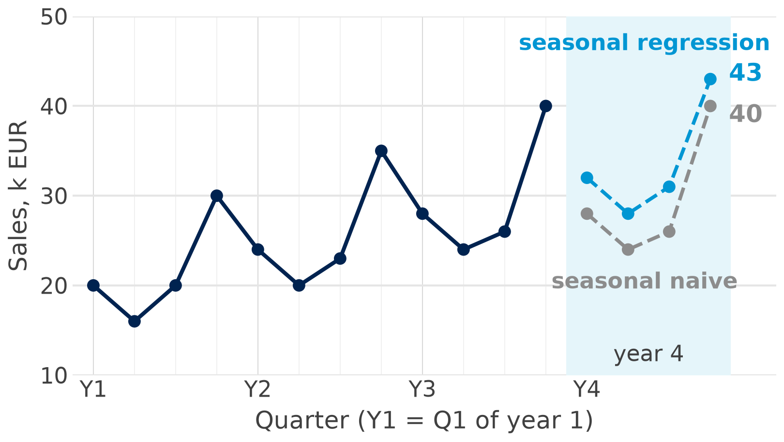
Two seasonal forecasts for year 4
40
seasonal naive:
Q4 of year 4
= Q4 of year 3
43
seasonal regression:
19 + 1 × 16 + 8
the trend at t = 16 plus the Q4 effect
Regression, R² 0.992:
19 + 1 × t − 5 Q2 − 3 Q3 + 8 Q4
Q2, Q3, Q4 = 1 in that quarter, else 0
(Q1 = base)
Seasonal naive repeats last year; the regression adds the trend of +1 a quarter.
Invented round numbers (hand_examples.csv)
Notes:
Seasonal naive is to seasonal data what naive is to data without a season: the benchmark (slide 23). It repeats the same quarter of last year: 28, 24, 26, 40. The regression has a trend t = 1 … 12 and three dummies for Q2, Q3 and Q4 (Q1 is the baseline), so Q4 sits 8 above Q1 at the same t; year 4 is t = 13 to 16: 19 + 1 × 13 = 32; 19 + 1 × 14 − 5 = 28; 19 + 1 × 15 − 3 = 31; 19 + 1 × 16 + 8 = 43. Seasonal naive with drift (last year plus the average yearly change) would give 32, 28, 29, 45. The software estimates the coefficients; on the slide you only plug in t and the quarter dummies. In Python smf.ols("value ~ period + C(quarter)", ...), qmd Extra A. Ask the room: which forecast would you order Christmas stock with?

Slide 20
How good is a forecast?
Part 3 of 6 · hold out, measure, compare
Notes:
Part 2 gave us six rules for week 9, and they give six different answers. Which one should the phone shop trust when it orders handsets and plans staff? The only fair judge is the future, and we do not have it yet. So we pretend that part of the past is the future: we hide the last weeks, forecast them and measure how far off each method is. That is all this part does: hold out, measure, compare.

Slide 21
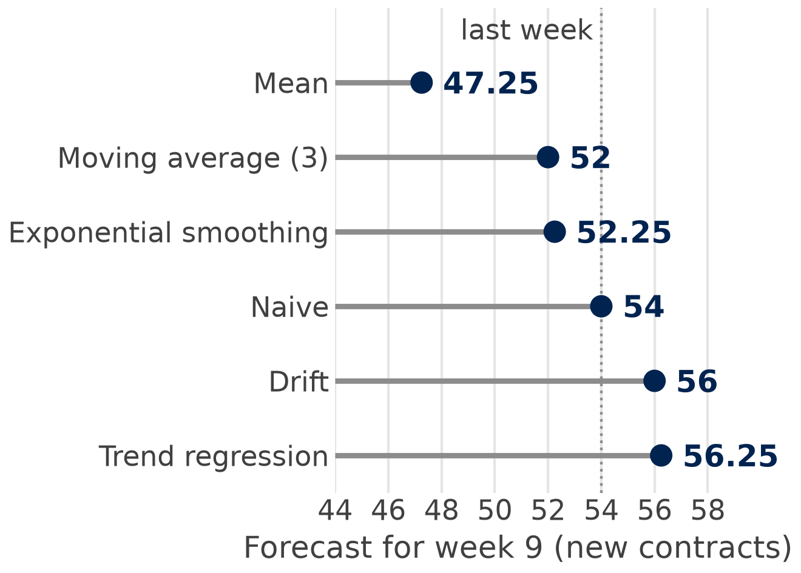

Six forecasts for week 9: which to trust?
1
2
3
4
5
6
7
8
40
44
42
46
50
49
53
54
training period
holdout: weeks 6–8
Step 1: fit each method on weeks 1–5
Step 2: forecast weeks 6–8, compare with 49, 53, 54
Never at random: test weeks come last.
Six methods, six answers, 9 contracts apart: test each on weeks it has not seen.
Invented round numbers (hand_examples.csv)
Notes:
Here are the six week-9 forecasts from slides 12 to 16, sorted: from 47.25 (mean) to 56.25 (trend regression), 9 contracts apart. A good fit to the past says little about the future, because every method can be tuned to fit the weeks it has seen. The holdout imitates real life: we fit each method on what we knew in week 5, forecast weeks 6–8 and check against the actual 49, 53, 54. A random split, as in the churn session, would let the model see the future (week 7 to forecast week 6), so the test weeks always come last. With the real data in Part 4 we do the same, training period 2009–2016 and holdout 2017–2018 (slide 25); a more thorough test moves the forecast origin forward one period at a time (rolling origin, FPP3 §5.10).

Slide 22
Errors and three measures, by hand
Week
Actual
Naive
Error
|Error|
Error²
|Error| / actual
Week 6
49
50
−1
1
1
2.0 %
Week 7
53
50
+3
3
9
5.7 %
Week 8
54
50
+4
4
16
7.4 %
Mean
2.67
8.67
5.0 %
Naive from week 5: 50 for weeks 6, 7 and 8
2.67
MAE:
mean of |⁠error⁠|
2.94
RMSE:
√8.67, big errors count more
5.0 %
MAPE:
mean of |⁠error⁠| / actual
Error = actual − forecast: a plus means the forecast was too low.
Invented round numbers (hand_examples.csv)
Notes:
Naive from week 5 forecasts 50 for weeks 6–8. The error is actual minus forecast: −1, +3, +4; we drop the sign before averaging, because −1 and +3 must not cancel (the mean error with its sign, +2.0, is the bias: naive is too low in a rising series). MAE (2.67) is in contracts and easy to explain; RMSE squares first (1, 9, 16, mean 8.67, root 2.94), so one big miss counts more: use it when big misses are expensive, such as stock-outs before Christmas. MAPE (5.0 %) is in per cent and compares series of different size, but breaks down near zero sales (FPP3 §5.8; Hyndman and Koehler, 2006, compare these measures). Slide 30 uses the same measures on real data, and Step 4 (slide 38) computes the MAE in Python in one line. Ask a student for the MAE of drift (forecasts 52.5, 55, 57.5).

Slide 23
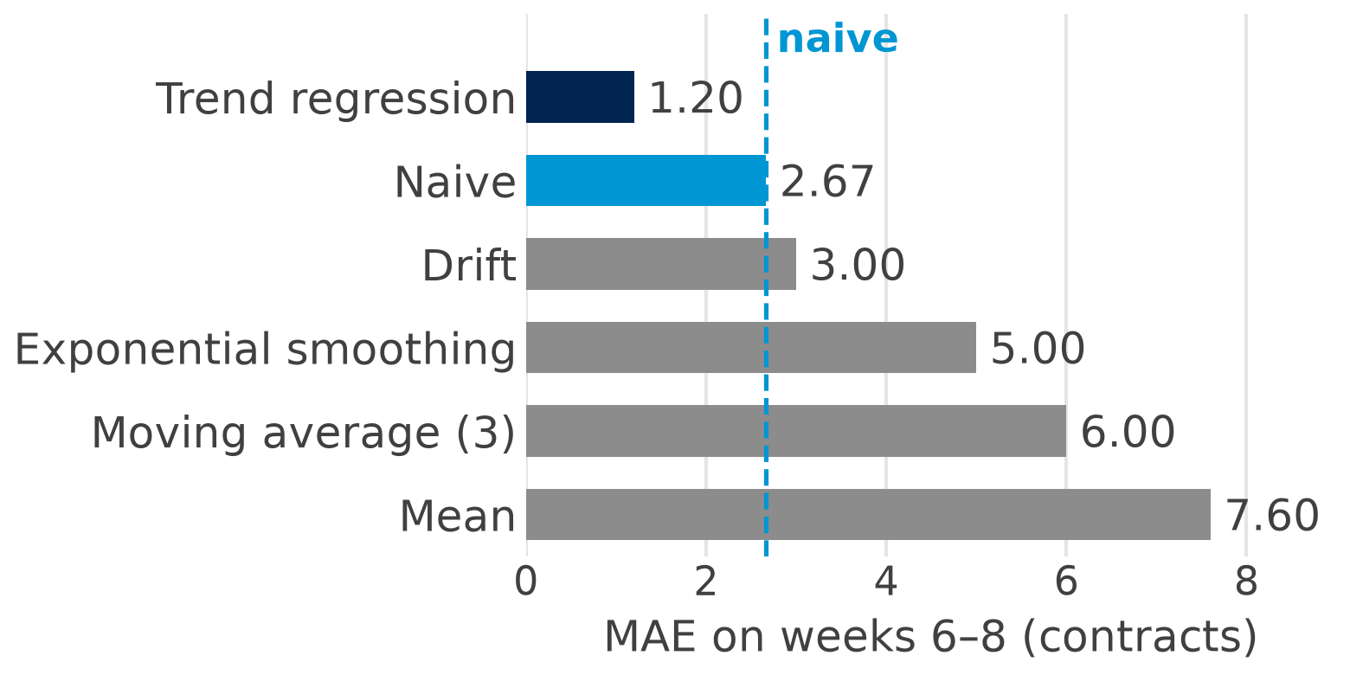
The ranking: beat the simplest benchmark
1.20
trend regression: the only method that beats naive (2.67)
4.00
chocolate shop, year 3 (MAE, k EUR): seasonal naive 4.00 vs naive 8.00, so seasonal data need a seasonal benchmark
Forecasts for weeks 6–8, fitted on weeks 1–5: trend regression 37.8 + 2.2 × week = 51, 53.2, 55.4; naive 50; drift 52.5, 55, 57.5; exponential smoothing 47; moving average (3) 46; mean 44.4. RMSE and MAPE give the same order.
Simplest benchmark first: naive, or seasonal naive for seasonal data; keep what beats it.
Invented round numbers (hand_examples.csv)
Notes:
Fitted on weeks 1–5, the six methods forecast weeks 6–8 as follows: trend regression 37.8 + 2.2 × week = 51, 53.2, 55.4; naive 50; drift 52.5, 55, 57.5; exponential smoothing 47; moving average (3) 46; mean 44.4; against the actual 49, 53, 54 this gives the MAE ranking trend regression 1.20, naive 2.67, drift 3.00, exponential smoothing 5.00, moving average (3) 6.00, mean 7.60. With a clear trend the trend line wins and the averages lose, because they lag behind the trend; drift is close to naive here. RMSE (1.41, 2.94, 3.08, 5.45, 6.38, 7.90) and MAPE (2.4, 5.0, 5.8, 9.5, 11.4, 14.5) give the same order. For the chocolate shop, fitted on years 1–2 and tested on year 3, the regression with quarter dummies reaches MAE 0.75, the seasonal naive 4.00, the mean 6.00 and naive 8.00: for seasonal data the seasonal naive is the bar to beat (slide 30 uses it for the real series). Large forecasting competitions such as M4 (Makridakis et al., 2020) also found simple benchmarks hard to beat, but three test weeks are very few: real data next (Part 4; the MAE in Python: Step 4, slide 38).

Slide 24
Real data: clothing sales in Australia
Part 4 of 6 · trend, season, holdout, 2019
Notes:
Part 4 asks the questions of Parts 1 to 3 again, now on ten years of real monthly sales. The frame is a fashion retailer that plans its stock for 2019 from the market's monthly sales. We look at the series, smooth it with a 12-month rolling average, split it into trend and season, check whether it is stationary, compare the methods on a holdout and forecast 2019 with a band. The last slide of the part asks whether we can trust that band.

Slide 25

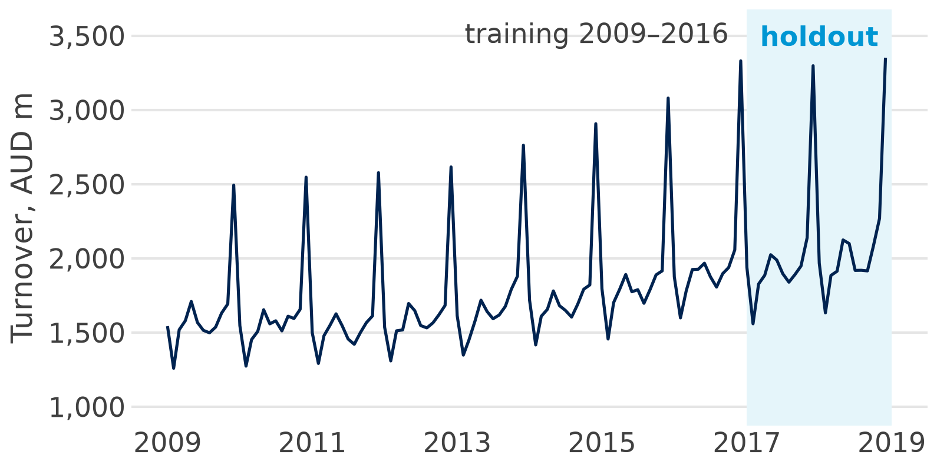
The data: monthly clothing sales, 2009–2018
The task: a fashion retailer plans stock for 2019 from the market's monthly sales.
Source: Australian Bureau of Statistics (ABS), Retail Trade, open licence (CC BY 4.0)
Unit: turnover, AUD million a month, not seasonally adjusted
Period: Jan 2009 to Dec 2018, 120 months: 96 to fit, 24 holdout
File: data/forecasting/aus_clothing_retail.csv one row per month: month, value
Source: ABS, Retail Trade, Australia (8501.0), Table 11, clothing, footwear and personal accessories; CC BY 4.0
Notes:
The series is the monthly turnover of clothing, footwear and personal accessory retailing in all of Australia, published by the ABS every month since April 1982. It is not seasonally adjusted, so the December peak stays in (official statistics often publish both versions), and it is in current prices, not adjusted for inflation. We use ten years, 2009–2018, which end before COVID-19, so the holdout has no structural break. Why Australia: the licence is open and FPP3 uses the same series, so you can compare your results with the textbook. The lowest month is February 2009 (1,259 AUD m), the highest December 2018 (3,352); code: Step 1, slide 35.

Slide 26
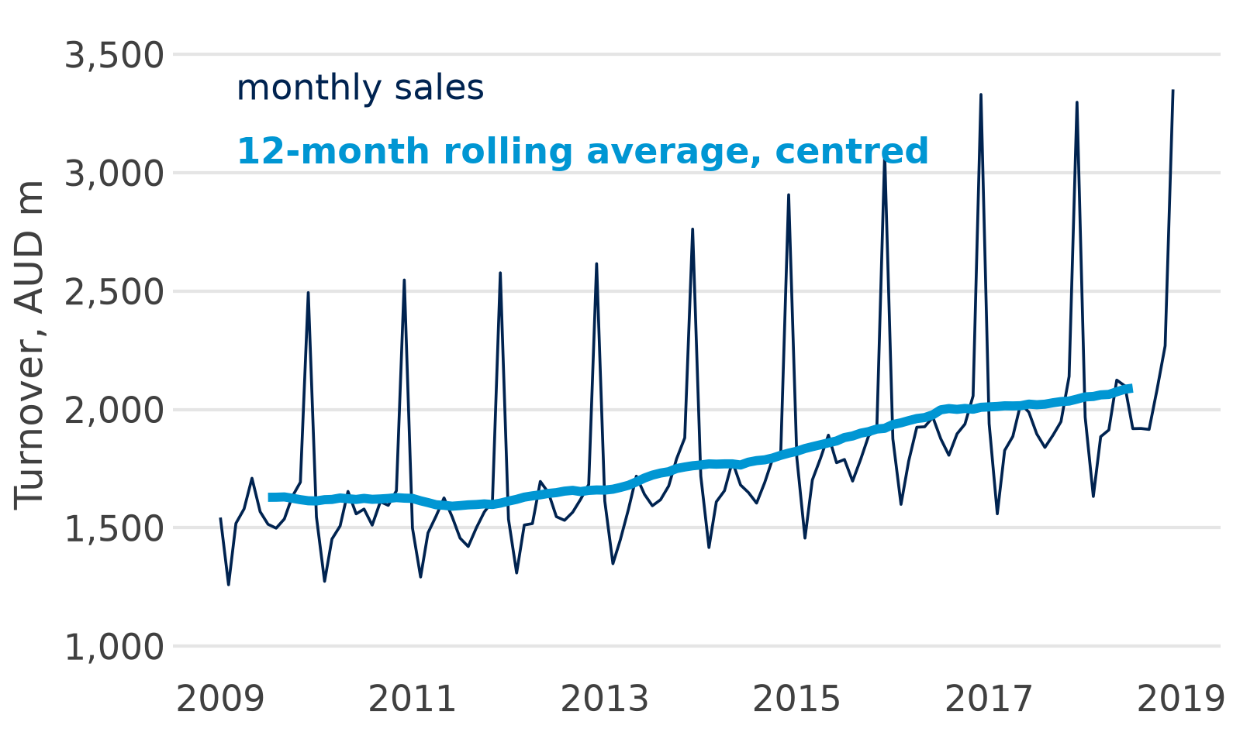
A 12-month rolling average shows the trend
1,629
Jul 2009: the average month of 2009 (19,546 / 12)
2,090
Jul 2018: the average month of 2018 (25,077 / 12): +28 %
1,591
lowest, Jun 2011: flat to 2012, then growth: the cycle
Twelve months around each month cancel the season: STL (next slide) is a smarter version.
Source: ABS Retail Trade (8501.0), clothing; CC BY 4.0
Notes:
A rolling average of 12 months contains every month of the year exactly once, one December, one February, so the season cancels out and the trend is left, as the 3-week rolling average did for the phone shop (slide 14). We centre it: each month gets the average of the 12 months around it, the 6 before, the month itself and the 5 after (polars puts an even window that way). So Jul 2009 holds the average month of 2009, 1,629 AUD m = 19,546 / 12, and Jul 2018 the average month of 2018, 2,090 = 25,077 / 12: +28 %. The first 6 and last 5 months have no value, because the window needs months on both sides. The line is flat to Jun 2011 (1,591), then it grows: the cycle of slide 27. A trailing average (only the past 12 months, the moving average of a forecast) would show the same line about half a year late. STL on the next slide does a smarter version of the same idea: a flexible trend that follows the data, and a season that may change slowly. Code: Step 5, slide 39.

Slide 27
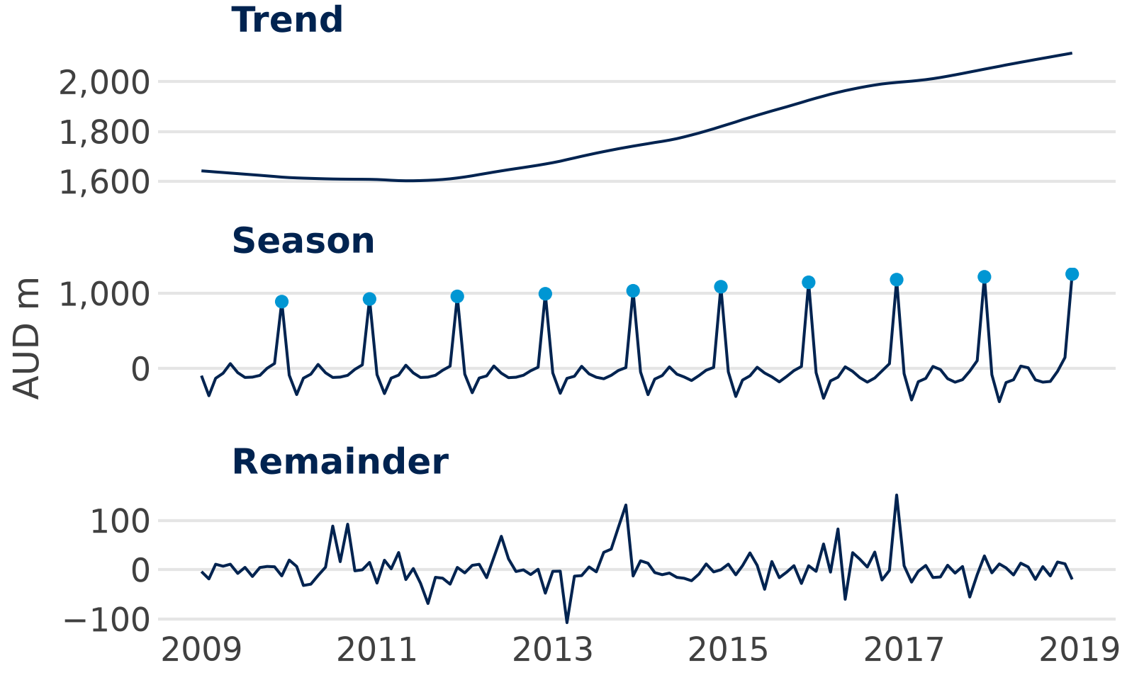
Trend, season and cycle in the real series
× 1.59
December vs an average month; February × 0.80
+28 %
2009 to 2018; flat to 2012 (a cycle), then about +4 % a year
1,257
December swing in 2018, AUD m (2009: 890): it grows with the level
Strong trend and season: a good method must model both.
Source: ABS Retail Trade (8501.0), clothing; CC BY 4.0
Notes:
STL is a smarter version of the rolling average of slide 26: it fits the trend with local, flexible averages and takes out the season at the same time. It splits the series as we did by hand for the chocolate shop (slide 18), but lets trend and season change slowly over the years. On a scale from 0 to 1 the strength of the season is 0.99 and of the trend 0.97: both very strong. December alone brings 13.4 per cent of a year's sales, and December 2018 was 47.7 per cent above November. Year totals were flat from 2009 to 2012 (19,546 to 19,780 AUD m) and then grew to 25,077 in 2018: that slow swing is the cycle. The December swing grows with the level, from +890 to +1,257, so the season is multiplicative (slide 8) and we use logs or multiplicative models; code: qmd Extra C.

Slide 28
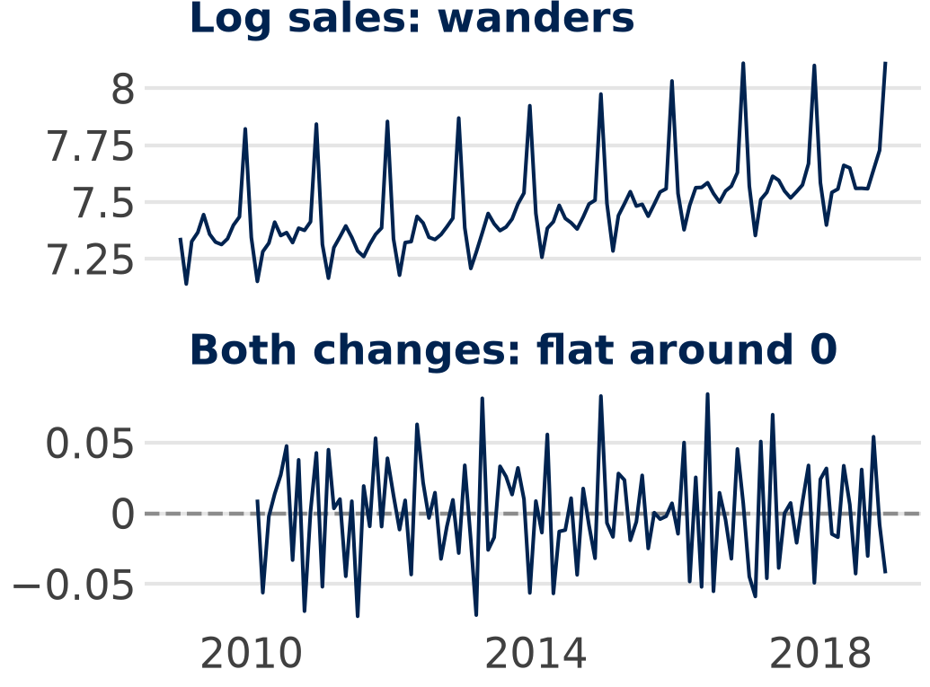
Is it stationary? The ADF test
Series
ADF p
Stationary?
Sales (levels)
0.992
no
Log sales
0.987
no
Change on last month
0.011
yes (season stays)
Change on last year
0.003
yes
Both changes, log sales
< 0.001
yes
ADF in plain words: does it wander without a fixed mean? Small p (below 0.05): no, stationary.
Difference until it is stationary: SARIMA does it for us (next slide).
Source: ABS Retail Trade (8501.0), clothing; CC BY 4.0
Notes:
ADF stands for the augmented Dickey–Fuller test (Dickey & Fuller, 1979). Its null hypothesis is “the series wanders” (a unit root), so a small p is good news here. Sales and log sales clearly wander (p 0.992 and 0.987). One change on last month or one change on the same month last year already passes at 5 per cent (0.011 and 0.003); both changes of the log together pass clearly. ADF checks wandering, not the season; that is why we take both changes: the change on last month still has the December peak in it, and the row “change on last year” means the change on the same month a year ago. A second test, KPSS, has the opposite null (stationary) and agrees for the double difference (p 0.100, which means 0.10 or more); do not difference more than needed (FPP3 §9.1; code: qmd Extra C).

Slide 29


Two models that learn trend and season
Holt-Winters / ETS
SARIMA
Smooths level, trend and season (multiplicative)
Each has its own weight α, β, γ (slide 15)
ETS: the same idea as a statistical model, so it also gives bands
Differences remove trend and season
Then it models the memory: how much of last month's and last year's surprise carries on
Ours: SARIMA(0,1,1)(0,1,1)₁₂ on log sales
log sales
change on last month
change on last year
memory of surprises
Both learn trend and season from the data; the holdout decides which forecasts better.
Notes:
Holt-Winters is simple exponential smoothing (slide 15) with two more smoothed parts, trend and season. Fitted on 2009–2016, the multiplicative version has α 0.156, β 0.090 and γ 0.000; γ = 0 means it keeps its first seasonal pattern. ETS(M,A,M), with multiplicative errors, additive trend and multiplicative season, is the state-space version (Hyndman et al., 2008): it is fitted differently and here forecasts better than Holt-Winters. SARIMA's two memory terms are θ −0.525 for last month and Θ −0.713 for last year; its residuals show no autocorrelation left (Ljung–Box at lag 24, p 0.265); it is the classic “airline model” of Box & Jenkins, and its first step is the differencing of slide 28. The full ARIMA family of the original deck (AR, MA, ACF fingerprints) is in FPP3 chapter 9 for those who want more. Code: Steps 6 and 8, slides 40 and 42.

Slide 30
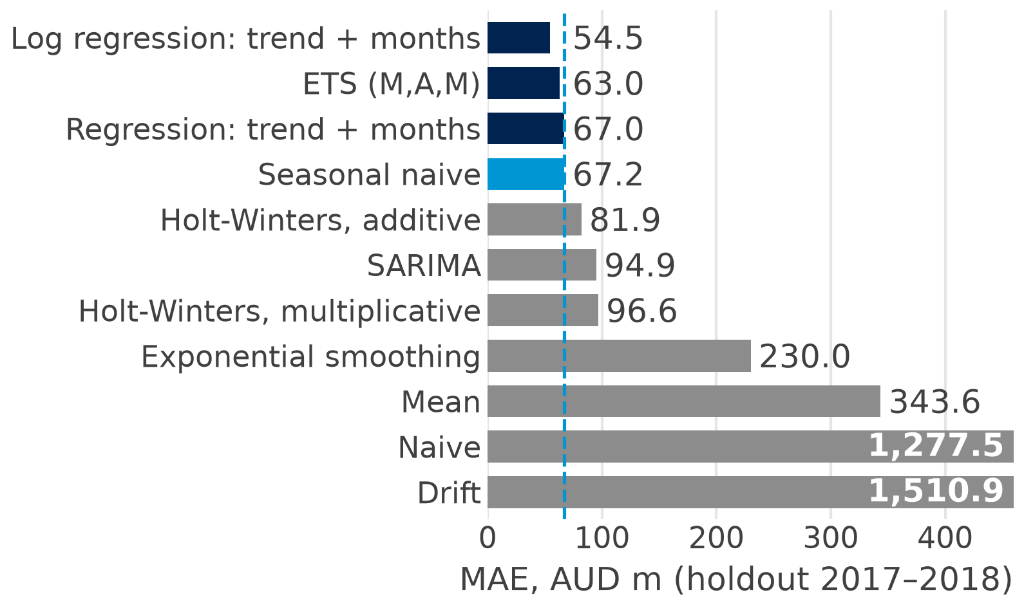
Holdout 2017–2018: beat the seasonal naive
3
of the other 14 methods beat the seasonal naive (67.2)
54.5
best: log regression, trend + months (MAPE 2.5 %)
3,331
December trap: naive repeats Dec 2016 for 24 months (MAE 1,277.5)
On seasonal data the seasonal naive is the benchmark: only three methods beat it.
Source: ABS Retail Trade (8501.0), clothing; CC BY 4.0; holdout 2017–2018
Notes:
All methods are fitted on 2009–2016 and forecast the 24 months of 2017–2018, 1 to 24 months ahead; the log regression wins on MAE, RMSE and MAPE (54.5, 69.3, 2.5 %), though it was too low in 20 of the 24 months. The plain regression (67.0) beats the seasonal naive (67.2) by only 0.2, a tie, and Holt-Winters (96.6) and SARIMA (94.9) lose to it here: test, do not assume. Naive repeats December 2016 (3,330.5) and drift adds 18.81 a month, so both forecast a Christmas every month (mean errors −1,275.8 and −1,510.9). Not in the chart: the moving averages of 12 and 3 months (226.9, 534.2) and the trend regression and Holt (233.0 both; Holt has α = β = 0.000); Steps 3 to 9 (slides 37 to 43) compute five of them, the December trap included, and in the M4 competition, too, simple benchmarks were hard to beat. Ask the room: why does naive work for the phone shop but fail here?

Slide 31
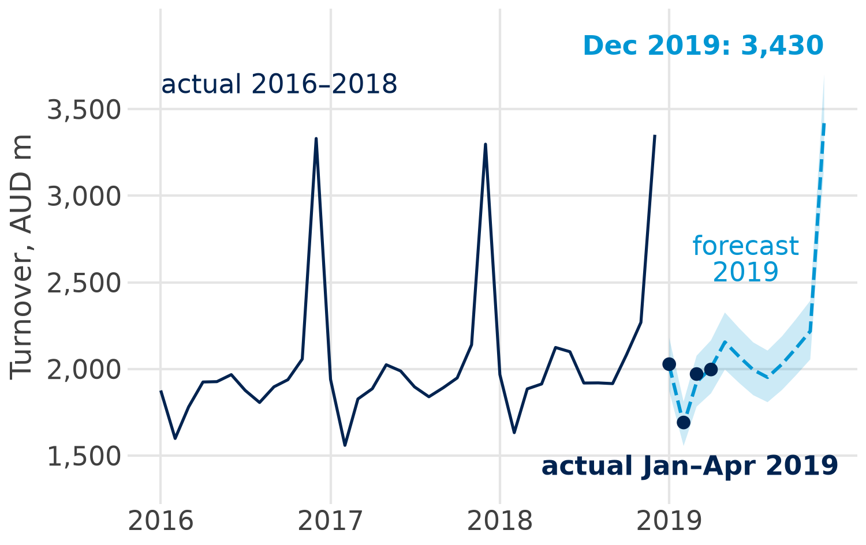
The 2019 forecast with a 95 % band
3,430
December 2019; 95 % band 3,178 to 3,702: should hold the actual in 95 of 100 cases
1.0 %
error Jan–Apr 2019 (MAPE); all 4 inside the band
25,595
forecast for 2019 (2018: 25,077)
Refit the winner on all 120 months, then report the forecast with its band.
Source: ABS Retail Trade (8501.0), clothing; CC BY 4.0
Notes:
The winner, the log regression, is refitted on all 120 months and forecasts the twelve months of 2019. The band says: in 95 of 100 Decembers like this one, sales should fall between 3,178 and 3,702 AUD m; for stock this is the useful number, so order towards the upper part of the band if a stock-out is expensive. The log model is back-transformed with exp(), which gives the median, not the mean (no bias correction). January to April 2019 are real outcomes the model never saw: MAE 19.0, MAPE 1.0 %. SARIMA forecasts December at 3,509 (band 3,227 to 3,816) and ETS at 3,456, close to the regression. Next slide: can we trust this band (code: Step 10, slide 44)?

Slide 32
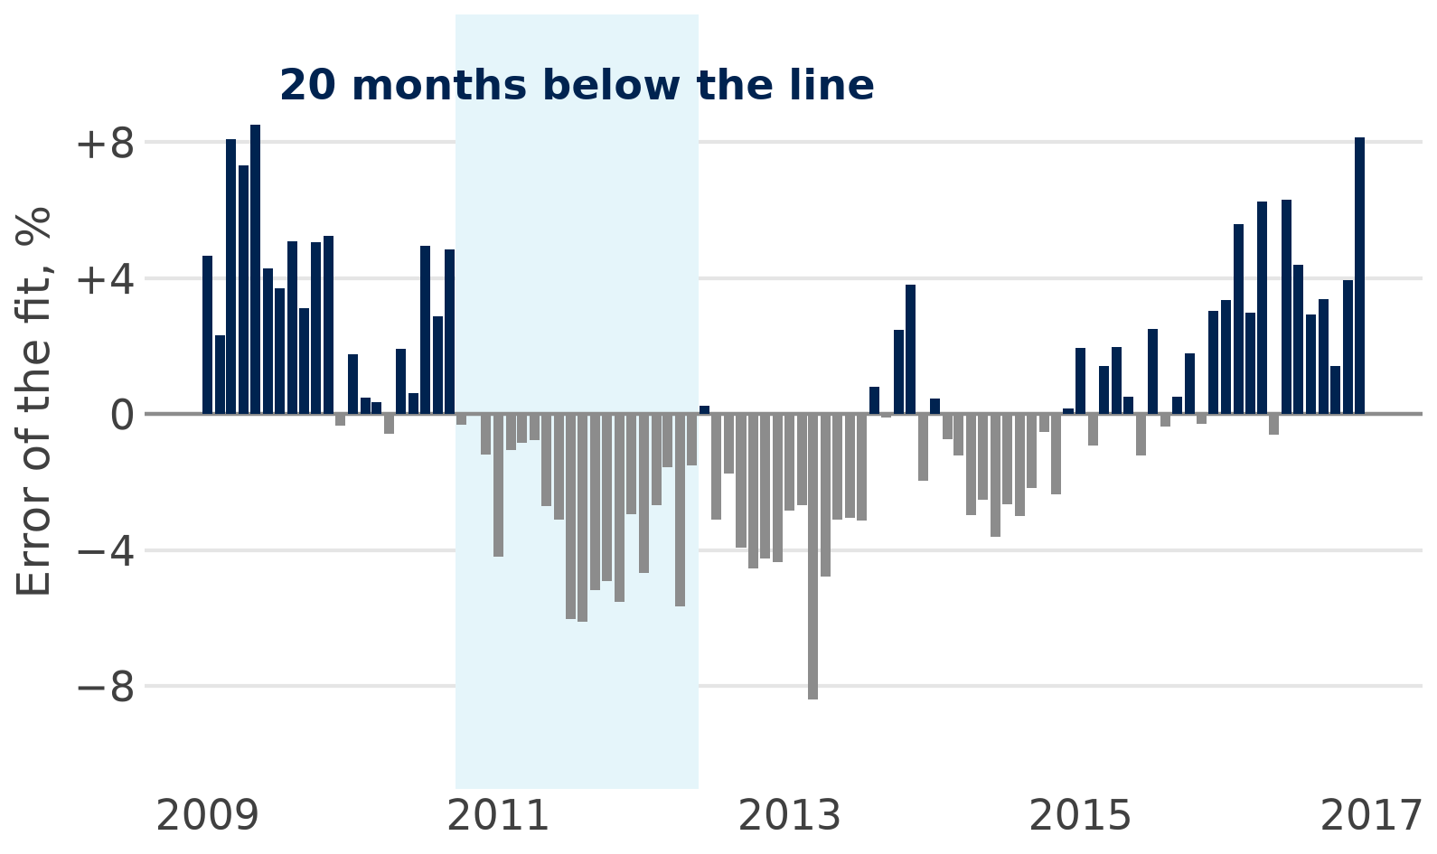
Autocorrelation: errors that stick together
0.72
autocorrelation: this month's error is like last month's (0 = none)
0.49
Durbin–Watson: 2 = no autocorrelation
524
December band width, AUD m (regression); SARIMA's widens from 209 in Jan to 589
Errors that stick together: the regression band does not widen with the horizon; for later months use the SARIMA band.
Source: ABS Retail Trade (8501.0), clothing; CC BY 4.0; training months 2009–2016
Notes:
Autocorrelation is the correlation of a series, here of the errors, with itself one period earlier; the log regression's errors on the training months run in long waves, 20 months in a row below zero from October 2010 to May 2012 (Ljung–Box p about 2e-50). OLS assumes each month brings independent news, so it treats 96 months as 96 independent pieces of information, and its band has the same width on the log scale 1 and 12 months ahead. SARIMA models the memory and leaves none (residual autocorrelation −0.05, Ljung–Box p 0.265), so its band widens from 209 in January to 589 in December. To be fair: in January the regression band is wider (309), and January to April 2019 fell inside both bands. The same problem fakes significance when two wandering series are regressed on each other (spurious regression, Granger & Newbold, 1974), so check the errors before you trust a regression on time series (qmd Extra D).

Slide 33
Forecasting in Python
Part 5 of 6 · a code ladder, one step at a time
Notes:
Live in Positron, with sessions/01-foundations/forecasting.qmd open: run it chunk by chunk. We start with loading and plotting the clothing series and add one new thing per step, ten steps in all: load and look, split, naive and seasonal naive, the MAE, a rolling average, exponential smoothing, the regression, SARIMA, a comparison and the 2019 forecast. Every slide shows the full code of its step, character for character as in the qmd, the part of the output to look at and one sentence on how to read it.

Slide 34
The packages and functions
Task | Package | Function
Load and look | polars | pl.read_csv(); filter(); head()
Plot the series | plotnine | ggplot() + geom_line()
Forecast and MAE | numpy | np.repeat(); np.resize(); np.mean()
Smooth | polars | rolling_mean(12, center=True)
Exponential smoothing | statsmodels | tsa.ExponentialSmoothing()
Regression | statsmodels | smf.ols("np.log(value) ~ t + C(m)")
SARIMA | statsmodels | tsa.SARIMAX()
Forecast with band | statsmodels | get_prediction(new).summary_frame()
Notes:
Nothing new to install: polars, numpy, plotnine and statsmodels are the packages of Session 1. polars loads and filters the data, numpy repeats values and computes the MAE in one line, plotnine draws the line chart. statsmodels has two parts: statsmodels.tsa.api, imported as tsa, holds the time-series models (ExponentialSmoothing, SARIMAX), and statsmodels.formula.api, imported as smf, fits the regression with a formula, as in the regression sessions.

Slide 35

Step 1: load and look
1 Load
2 Split
3 Naive
4 MAE
5 Smooth
6 Holt-W
7 Regress
8 SARIMA
9 Compare
10 2019
forecasting.qmd · Step 1
df.head()
value
import polars as pl
from plotnine import aes, geom_line, ggplot
# load the monthly sales and keep 2009-2018
file = "../../data/forecasting/aus_clothing_retail.csv"
df = pl.read_csv(file, try_parse_dates=True)
df = df.filter(
pl.col("month").dt.year().is_between(2009, 2018))
print(df.head())
# plot the series
ggplot(df, aes("month", "value")) + geom_line()
Jan 2009
1,543.2
Feb 2009
1,259.1
Mar 2009
1,518.6
Look first: sales grow, and the December peak grows with them (slide 25).
Notes:
polars reads the csv; the qmd sits in sessions/01-foundations, hence the path two folders up. try_parse_dates=True turns the month column into dates, and filter keeps the ten years 2009 to 2018, 120 months. print(df.head()) shows the first five rows; the chart is the one on slide 25: an upward trend and a December peak that grows every year. Look at the plot before you fit anything. Code: forecasting.qmd, Step 1.

Slide 36
Step 2: split: fit and holdout
1 Load
2 Split
3 Naive
4 MAE
5 Smooth
6 Holt-W
7 Regress
8 SARIMA
9 Compare
10 2019
forecasting.qmd · Step 2
Part
Months
Period
# the sales as numbers, in time order
y = df["value"].to_numpy()
# fit on the first 96 months, hold out the last 24
train, test = y[:-24], y[-24:]
print(len(train), len(test))
train
96
2009–2016
test
24
2017–2018
Test on the future: fit on 2009–2016, forecast 2017–2018; never split at random.
Notes:
to_numpy() turns the value column into a plain array of numbers, in time order. y[:-24] is every month except the last 24, y[-24:] the last 24: the rows are in time order, so the holdout is the future. 96 months (2009–2016) to fit, 24 months (2017–2018) to test. Never shuffle a time series. Code: forecasting.qmd, Step 2.

Slide 37

Step 3: naive and seasonal naive
1 Load
2 Split
3 Naive
4 MAE
5 Smooth
6 Holt-W
7 Regress
8 SARIMA
9 Compare
10 2019
forecasting.qmd · Step 3
2017
naive
snaive
import numpy as np
# naive: repeat the last training month 24 times
naive = np.repeat(train[-1], 24)
# seasonal naive: repeat the last training year twice
snaive = np.resize(train[-12:], 24)
print(naive[:12])
print(snaive[:12])
Jan
3,330.5
1,875.7
Jun
3,330.5
1,967.1
Dec
3,330.5
3,330.5
Naive forecasts a Christmas every month; the seasonal naive repeats 2016.
Notes:
np.repeat(train[-1], 24) repeats the last training month, December 2016 (3,330.5 AUD m), 24 times: the naive forecast of slide 12. np.resize(train[-12:], 24) repeats the last training year, 2016, twice: the seasonal naive, as for the chocolate shop (slide 19). The prints show the first 12 forecasts of each, January to December 2017. Code: forecasting.qmd, Step 3.

Slide 38

Step 4: how good? The MAE
1 Load
2 Split
3 Naive
4 MAE
5 Smooth
6 Holt-W
7 Regress
8 SARIMA
9 Compare
10 2019
forecasting.qmd · Step 4
Method
MAE
# MAE: the mean absolute error on the holdout
mae_snaive = np.mean(np.abs(test - snaive))
mae_naive = np.mean(np.abs(test - naive))
print(mae_snaive, mae_naive)
snaive
67.2
naive
1,277.5
The December trap: naive misses by 1,277.5 a month; beat the seasonal naive.
Notes:
test - snaive gives the 24 errors, actual minus forecast; np.abs drops the signs and np.mean averages them: the MAE of slide 22 in one line. The seasonal naive misses by 67.2 AUD m a month, naive by 1,277.5, because it repeats the December peak for 24 months: the December trap of slide 30. On seasonal data the seasonal naive is the benchmark every other method must beat. Code: forecasting.qmd, Step 4.

Slide 39

Step 5: smooth: a rolling average
1 Load
2 Split
3 Naive
4 MAE
5 Smooth
6 Holt-W
7 Regress
8 SARIMA
9 Compare
10 2019
forecasting.qmd · Step 5
trend
AUD m
# 12-month rolling average, centred: the trend
smooth = df.with_columns(
trend=pl.col("value").rolling_mean(12, center=True))
print(smooth.drop_nulls())
# the sales and the trend in one chart
chart = ggplot(smooth, aes("month", "value")) + geom_line()
chart + geom_line(aes(y="trend"), color="blue")
Jul 2009
1,628.8
Jul 2018
2,089.8
The season cancels out: the trend is flat to 2012, then grows (+28 %).
Notes:
rolling_mean(12, center=True) gives each month the average of the 12 months around it: the 6 before, the month itself and the 5 after. Every month of the year is in the window once, so the season cancels out and the trend is left (slide 26). Jul 2009 holds the average month of 2009, 1,628.8 AUD m, and Jul 2018 the average month of 2018, 2,089.8: +28 %. drop_nulls() leaves out the first 6 and last 5 months, which have no value. The chart is the one on slide 26. Code: forecasting.qmd, Step 5.

Slide 40

Step 6: exponential smoothing
1 Load
2 Split
3 Naive
4 MAE
5 Smooth
6 Holt-W
7 Regress
8 SARIMA
9 Compare
10 2019
forecasting.qmd · Step 6
Method
MAE
import statsmodels.tsa.api as tsa
# Holt-Winters: a trend and a season that grows
hw = tsa.ExponentialSmoothing(
train, trend="add", seasonal="mul",
seasonal_periods=12,
initialization_method="estimated").fit()
hw_fc = hw.forecast(24)
mae_hw = np.mean(np.abs(test - hw_fc))
print(mae_hw)
Holt-Winters
96.6
snaive
67.2
Smarter is not always better: Holt-Winters loses to the seasonal naive.
Notes:
Holt-Winters (slide 29): trend="add" adds a smoothed trend, seasonal="mul" a season that grows with the level, seasonal_periods=12 says the data are monthly, and initialization_method="estimated" lets statsmodels find the starting values. The fitted weights are α 0.156, β 0.090 and γ 0.000 (hw.params). hw.forecast(24) forecasts the holdout, and the MAE is the line of Step 4. MAE 96.6: worse than the seasonal naive (67.2). Code: forecasting.qmd, Step 6.

Slide 41

Step 7: regression: trend and months
1 Load
2 Split
3 Naive
4 MAE
5 Smooth
6 Holt-W
7 Regress
8 SARIMA
9 Compare
10 2019
forecasting.qmd · Step 7
Method
MAE
import statsmodels.formula.api as smf
# t counts the months 1-120, m is the month 1-12
d = df.with_columns(
t=pl.int_range(1, pl.len() + 1),
m=pl.col("month").dt.month()).to_pandas()
# log sales on trend + month dummies, first 96 months
reg = smf.ols("np.log(value) ~ t + C(m)",
data=d[:-24]).fit()
reg_fc = np.exp(reg.predict(d[-24:]))
mae_reg = np.mean(np.abs(test - reg_fc))
print(mae_reg)
regression
54.5
snaive
67.2
The first winner: trend + months on log sales beats the seasonal naive.
Notes:
with_columns adds two columns: t counts the months 1 to 120 and m is the month of the year. C(m) turns m into 11 dummies with January as the baseline, as for the quarters of the chocolate shop (slide 19). We fit on the first 96 rows, d[:-24], on log sales, because the season grows with the level; np.exp() brings the forecast back to AUD m. MAE 54.5: the first method that beats the seasonal naive. reg.summary() shows the coefficients. Code: forecasting.qmd, Step 7.

Slide 42

Step 8: SARIMA
1 Load
2 Split
3 Naive
4 MAE
5 Smooth
6 Holt-W
7 Regress
8 SARIMA
9 Compare
10 2019
forecasting.qmd · Step 8
Method
MAE
# SARIMA on log sales: a change on last month
# and on last year, and the memory of surprises
sar = tsa.SARIMAX(
np.log(train), order=(0, 1, 1),
seasonal_order=(0, 1, 1, 12)).fit(disp=0)
sar_fc = np.exp(sar.forecast(24))
mae_sar = np.mean(np.abs(test - sar_fc))
print(mae_sar)
SARIMA
94.9
snaive
67.2
Test, do not assume: SARIMA also loses to the seasonal naive here.
Notes:
SARIMA on log sales (slides 28 and 29): order=(0, 1, 1) takes the change on last month and one memory term, seasonal_order=(0, 1, 1, 12) the same for the change on last year; disp=0 silences the optimiser. The memory terms are θ −0.525 and Θ −0.713. np.exp() brings the forecast back to AUD m. MAE 94.9: also worse than the seasonal naive on this holdout. Test, do not assume. Code: forecasting.qmd, Step 8.

Slide 43

Step 9: compare the four
1 Load
2 Split
3 Naive
4 MAE
5 Smooth
6 Holt-W
7 Regress
8 SARIMA
9 Compare
10 2019
forecasting.qmd · Step 9
method
MAE
# the four MAEs side by side
pl.DataFrame({
"method": ["snaive", "hw", "reg", "sarima"],
"MAE": [mae_snaive, mae_hw, mae_reg, mae_sar]})
snaive
67.2
hw
96.6
reg
54.5
sarima
94.9
The regression wins: the same ranking as slide 30.
Notes:
A small polars table, written out by hand: one column with the names, one with the four MAEs of Steps 4, 6, 7 and 8. The regression wins (54.5), the seasonal naive (67.2) comes second, ahead of SARIMA (94.9) and Holt-Winters (96.6). Slide 30 shows the same ranking with eleven methods. Ask the room: which method would you use for 2019?

Slide 44
Step 10: forecast 2019
1 Load
2 Split
3 Naive
4 MAE
5 Smooth
6 Holt-W
7 Regress
8 SARIMA
9 Compare
10 2019
forecasting.qmd · Step 10
2019
mean
low
high
# refit the winner on all 120 months
reg_all = smf.ols("np.log(value) ~ t + C(m)",
data=d).fit()
# 2019: t = 121 to 132, m = 1 to 12
new = pl.DataFrame({"t": range(121, 133),
"m": range(1, 13)}).to_pandas()
# the forecast and its 95 % band, back from logs
band = reg_all.get_prediction(new).summary_frame()
np.exp(band[["mean", "obs_ci_lower", "obs_ci_upper"]])
Jan
2,020.4
1,871.9
2,180.6
Dec
3,430.2
3,178.2
3,702.2
Plan December with 3,430 AUD m: the 95 % band runs from 3,178 to 3,702.
Notes:
The winner is refitted on all 120 months (data=d). new holds the twelve months of 2019, t = 121 to 132 and m = 1 to 12. get_prediction(new).summary_frame() gives the forecast (mean) and the 95 per cent band (obs_ci_lower, obs_ci_upper) on the log scale; np.exp() brings them back to AUD m. December 2019, row 11: 3,430.2, with a band from 3,178.2 to 3,702.2, as on slide 31. Can we trust this band? Slide 32 and Extra D of the qmd. Code: forecasting.qmd, Step 10.

Slide 45
In-class exercise
Part 6 of 6 · quiz, exercise, Posit Assistant
Notes:
The last part hands the methods over to you. First a five-question online quiz on the whole session, then we go through it together. Then you work in pairs on a second real series, café and restaurant sales in Australia, with the code of forecasting.qmd. Finally you repeat the same tasks with Posit Assistant and check its numbers against your own.

Slide 46
Online quiz: forecasting in five questions
1 Sales: 50, 54, 58. The drift (same change) forecast for the next period is …
A 58 B 62 C 54
2 Exponential smoothing with α 0.5: level 40, new value 50. The new level is …
A 45 B 50 C 42
3 Holdout errors: −2, +2, +4. The MAE is …
A 1.33 B 4.00 C 2.67
4 Monthly sales with a December peak. The benchmark to beat is …
A naive (last month) B seasonal naive (same month last year) C the mean
5 ADF test on sales levels: p 0.99. The series is …
A stationary B white noise C not stationary: difference it
3 minutes alone, then compare with your neighbour.
Notes:
Online quiz on Canvas: three minutes alone, then compare with your neighbour. Question 1 goes back to drift on slide 12, question 2 to exponential smoothing on slide 15, question 3 to the error measures on slide 22, question 4 to the December trap on slide 30 and question 5 to the ADF test on slide 28. Ask for a show of hands per option before you move on.

Slide 47
Answers: in class
Notes:
The answers follow in class.

Slide 48
Your turn: forecast café sales in Python
Pairs:
35 minutes
Plenary:
5 minutes
Posit Assistant:
10 minutes
1
By hand: café bookings: five forecasts for week 7, MAE on weeks 5–6 (Steps 3, 4; Extra A)
2
Look: plot 2009–2018; trend, season, ADF (Step 1; Extra C)
3
Test: five methods on the 2017–2018 holdout: MAE, RMSE, MAPE (Steps 3, 6–9)
4
Forecast: 2019 with the winner and SARIMA, 95 % bands; check Jan–Apr (Step 10; Extra D)
Deliverable: one slide per pair: the 2019 forecast and two sentences.
File: sessions/01-foundations/forecasting_exercise.qmd (reuse: forecasting.qmd)
Notes:
Work in pairs with the packages for 35 minutes, then five minutes in the plenary, then ten minutes with Posit Assistant (next slide). Open forecasting_exercise.qmd: the setup cell loads the cafés series and the café bookings of task 1 are typed in it; the other cells are empty, and the step numbers point to the code in forecasting.qmd. Task 1 is on paper first, then a check in Python. Fast pairs do the extra task: ETS(M,A,M) with tsa.ETSModel, added to the table of task 3.

Slide 49

Then: the same tasks with Posit Assistant
How: code first, then open Posit Assistant, type @forecasting_exercise.qmd, one task per prompt
Prompt for task 1
Prompt for task 2
@forecasting_exercise.qmd Task 1. Café
bookings 20, 24, 22, 26, 27, 31: naive,
drift, mean, moving average (3) and SES
(α 0.5) for week 7, step by step.
Task 2. Plot aus_cafes_retail.csv for
2009-2018 with plotnine. Describe trend
and season; run the ADF test on levels
and on the first difference.
Prompt for task 3
Prompt for task 4
Task 3. Hold out 2017-2018. Compare
seasonal naive, Holt-Winters, SARIMA and
two regressions by MAE, RMSE and MAPE
in a great_tables table.
Task 4. Forecast 2019 with the best
method and with SARIMA, 95 % bands.
Which band would you trust for stock
planning, and why?
Check every number against your own code: you own the result.
Notes:
The routine of the earlier sessions. Solve the tasks with your own code first and keep the setup cell run, so Posit Assistant sees cafes, df, y, train, test and BOOKINGS. Open the chat, type @forecasting_exercise.qmd and give one task per prompt; the four prompts are also in the Posit section of forecasting_exercise.qmd. Typical slips to watch: a random train/test split, the log forecast not transformed back with np.exp(), the seasonal naive misaligned (it must repeat the last 12 training months), accuracy measured on the training months, and the regression band trusted although its errors are autocorrelated. Stay in Normal mode and read every edit before you accept it.

Slide 50


Open data for forecasting
ABS Retail Trade
Eurostat
M5 (Walmart)
Monthly turnover in Australia since 1982, by state and industry
Monthly retail trade and tourism nights by EU country
Daily unit sales of 3,049 products in 10 US stores, 2011–2016
Licence: CC BY 4.0
Licence: free reuse, cite the source
Licence: competition data: check the terms
The licence decides: commit only data you may share; link the rest.
Links and loading code: forecasting.qmd (appendix)
Sources: ABS, Eurostat and M5 dataset pages (links in forecasting.qmd)
Notes:
Three open sources for your own forecasting project; the links and loading code are in the appendix of forecasting.qmd. The ABS file 8501.0, Table 11, has every state and retail industry; the workbook copy we used is named in data/get_forecasting_data.py. The Eurostat datasets are sts_trtu_m (retail trade) and tour_occ_nim (tourism nights), the codes of the original deck's task 4, useful for a cross-country project in this course: compare the same series across EU markets. M5 is the data of the 2020 M5 competition (Makridakis, Spiliotis & Assimakopoulos 2022): hierarchical store and product sales with prices and calendar events. The licence decides what may go into a public repository.

Slide 51
Key takeaways
1
Plot and smooth first: trend, season, cycle; additive or multiplicative; stationary or not?
2
Start simple: naive, drift, averages, smoothing and a trend line: all on a calculator
3
Test on the future: hold out the last periods; compare MAE, RMSE and MAPE
4
Beat the simplest benchmark: on seasonal data, the seasonal naive
5
Report the band, check the errors: autocorrelated errors make a band too narrow
Next: run the ten steps of sessions/01-foundations/forecasting.qmd, then the exercise.
Notes:
One sentence per takeaway. Plot the series first, smooth it with a rolling average to see the trend, and name what you see: trend, season, cycle and irregular, whether the season is additive or multiplicative, and whether the series is stationary. Start with the simple forecasts you can compute on a calculator. Judge every method on held-out periods with MAE, RMSE and MAPE, never on the months it was fitted on, and keep a method only if it beats the simplest benchmark, the seasonal naive on seasonal data. Report the 95 per cent band with the forecast and check the residuals: autocorrelated errors make the band too narrow. Next: run the ten steps of forecasting.qmd, the code ladder of slides 35 to 44, chunk by chunk; the extras A to D after them repeat a few theory slides in Python.

Slide 52


References
Forecasting methods
Competitions, data and software
Hyndman, R. J. & Athanasopoulos, G. (2021). Forecasting: Principles and Practice (3rd ed.). OTexts. otexts.com/fpp3
Box, G. E. P., Jenkins, G. M., Reinsel, G. C. & Ljung, G. M. (2015). Time Series Analysis: Forecasting and Control (5th ed.). Wiley.
Hyndman, R. J. & Koehler, A. B. (2006). Another look at measures of forecast accuracy. International Journal of Forecasting, 22(4), 679–688.
Cleveland, R. B. et al. (1990). STL: A seasonal-trend decomposition procedure based on loess. Journal of Official Statistics, 6(1), 3–73.
Makridakis, S., Spiliotis, E. & Assimakopoulos, V. (2020). The M4 Competition: 100,000 time series and 61 forecasting methods. International Journal of Forecasting, 36(1), 54–74.
Makridakis, S. et al. (2022). M5 accuracy competition: Results, findings, and conclusions. International Journal of Forecasting, 38(4), 1346–⁠1364.
Australian Bureau of Statistics (2019). Retail Trade, Australia, April 2019, cat. no. 8501.0, Table 11. CC BY 4.0.
Seabold, S. & Perktold, J. (2010). statsmodels: Econometric and statistical modeling with Python. Proceedings of the 9th Python in Science Conference.
Free textbook: otexts.com/fpp3 · Python edition: otexts.com/fpppy
Notes:
Start with the free textbook by Hyndman and Athanasopoulos: chapter 3 on time series decomposition, chapter 5 on the simple benchmark methods and forecast accuracy, chapter 8 on exponential smoothing and chapter 9 on ARIMA models; a Python edition is online too. Box, Jenkins, Reinsel and Ljung is the classic reference for ARIMA, Cleveland et al. for the STL decomposition on slide 27, and Hyndman and Koehler for the error measures on slide 22. The M-competitions are the evidence behind “beat the simplest benchmark first”: in the M4 competition simple benchmarks were hard to beat and combinations of methods did well; M5 is the Walmart data of slide 50.

Slide 53
Thank you. Questions and discussion
Notes:
Questions? Contact details on the card; office hours via the booking link.

