Slide 1
Experiments and A/B testing
International Marketing Analytics
WT 2026/27
Notes:
Welcome to the session on experiments and A/B testing. Today's question is simple to ask and hard to answer: does a change in our marketing cause a change in customer behaviour, or do we only see the two together? We use one running example all day: the retention e-mail of the mobile operator from the churn session. We end with the same analyses in Python; the code is in sessions/01-foundations/ab_testing.qmd.

Slide 2



Today
Why
experiments
A/B test
2 × 2
designs
Python
In class
Theory, Parts 1 to 3
Practice, Parts 4 and 5
Why only a random split shows cause and effect
Design and read an A/B test
Factorial designs and interactions
polars, scipy, statsmodels, plotnine
Online quiz and its answers
Coding exercise: the operator's e-mails
The same tasks with Posit Assistant
Question of the day: which e-mail makes more customers click, and how do we know it was the e-mail?
Notes:
Three theory parts, then Python, then the in-class exercise. Part 1 shows why only a random split shows cause and effect. Part 2 designs and reads one A/B test of the operator's e-mail. Part 3 is new in this course: factorial designs, where we change two things at once and look for an interaction. Keep the question of the day in mind: every part answers a piece of it.

Slide 3



Before we start: did the ad triple sales?
Customers who saw a retailer's Facebook ad bought about four times as often as those who did not (+316 %).
Who decided who saw the ad?
Was it a coin flip?
Why might viewers buy more anyway?
Name one reason that is not the ad.
What should we compare instead?
Think of two groups that are alike.
Source: Gordon et al. (2019), Marketing Science, Study 4
Notes:
Work in pairs for two minutes: did the ad triple sales? Most people say yes at first. Collect a few answers and reasons, but do not resolve it yet: slide 12 does. Push on the first question: who decided who saw the ad?

Slide 4

Our example: a retention e-mail in two markets
The operator: the mobile operator from the churn session e-mails customers in Germany and Spain about its loyalty offers.
The question: which subject line makes more customers click?
Inbox
A
Inbox
B
Loyalty team
Loyalty team
Your loyalty offers are here
Anna, your loyalty offers are here
A = generic (control)
B = with the first name (variant)
Two tests: A versus B on 40,000 customers, then a 2 × 2 test of first name × discount on 40,000 more.
Simulated data (email_ab.csv, email_factorial.csv), built for this course
Notes:
Here is our story for the whole session. The mobile operator from the churn session sends a retention e-mail that invites customers to its loyalty offers page, in Germany and in Spain. The outcome is a click on the link, because a click is what the e-mail can change at once. The idea comes from a real field experiment in which a first name in the subject line raised opens by about 20 % (Sahni, Wheeler & Chintagunta 2018, Marketing Science [V]). Our numbers are simulated, so we know the truth and can check every method against it. The A/B test has 20,000 customers per market, 10,000 per version and market.

Slide 5
The data: one row per customer
Column | Meaning | email_ab.csv | email_factorial.csv
customer_id | customer number | 8 | 100044
country | DE or ES | DE | DE
device | mobile or desktop: where the e-mail was read | mobile | mobile
version | A = generic, B = first name; A/B test only | A | –
personal | 1 = first name in the subject line; 2 × 2 only | – | 1
discount | 1 = 10 % off the next bill; 2 × 2 only | – | 1
clicked | 1 = clicked the link: the outcome | 1 | 1
unsubscribed | 1 = left the mailing list | 0 | 0
Files: data/abtest/email_ab.csv, email_factorial.csv simulated, 40,000 customers each
Notes:
Each row is one customer who got the e-mail; the two right-hand columns show one real row of each file (customer 8 and customer 100044). The outcome is clicked, 0 or 1. Version is what we changed in the A/B test; personal and discount are the two changes of the second test (Part 3). Device and country let us ask later: for whom does it work? Question for the room: which column is the independent variable and which the dependent one?

Slide 6
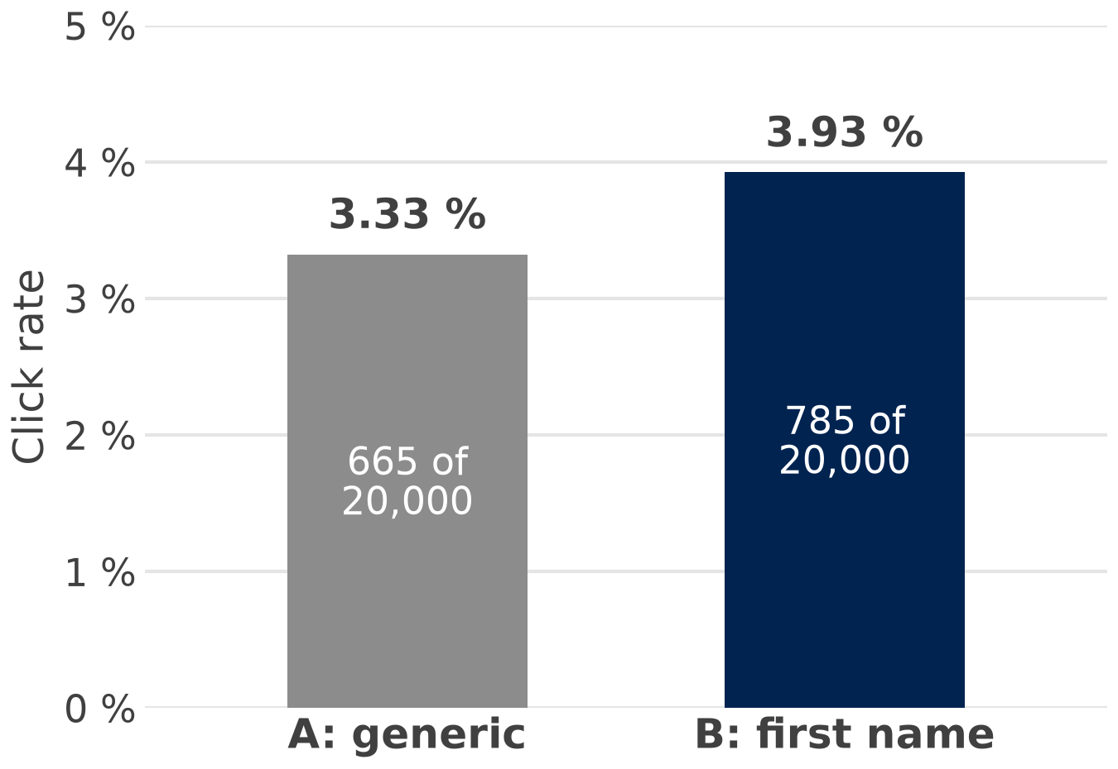
First look: click rates of e-mail A and B
+0.60 pp
percentage points:
3.93 % − 3.33 %
+18 %
relative lift:
0.60 / 3.33
Two questions for today: did the name cause the gap, and is it more than chance?
Simulated data (email_ab.csv)
Notes:
E-mail A reached 665 clicks out of 20,000 customers (3.33 %), e-mail B 785 out of 20,000 (3.93 %). The gap is +0.60 pp: percentage points are the difference of two percentages. Managers often say '+18 %' and mean the relative lift, 0.60 / 3.33; we report percentage points, and say which one we mean. Two questions follow: did the name cause the gap (Part 1), and is it more than chance (Part 2, slide 15)? The code is Step 1 of ab_testing.qmd.

Slide 7
Why experiments
Part 1 of 5 · cause, counterfactual, coin flip
Notes:
Part 1 shows why comparing customers who got something with customers who did not can mislead, and why a coin flip fixes it. We meet three traps, the idea of the counterfactual, and the A/B test as the simplest experiment. At the end we come back to the warm-up.

Slide 8

Correlation is not causation: three traps
Confounder
Reverse causality
Selection
Active customer
Tool picks
likely clickers
Clicked
last month
Gets more
e-mails
Opens
many
e-mails
?
Clicks
offers
?
Gets
e-mail B
?
Clicks
Activity drives both.
Clicks drive the mailing, not the other way round.
The algorithm, not the e-mail, made B look good.
The fix: a coin flip decides who gets which e-mail, so nothing else can drive both.
Notes:
Three ways in which two things move together without one causing the other. A confounder is a third factor that drives both: people searching 'buy running shoes' see more shoe ads and buy more shoes. Reverse causality means the outcome drives the 'cause': ad budgets set as a share of last year's sales. Selection means someone picked who got the treatment: algorithms pick likely buyers, and active users buy more anyway. Selection is a confounder created by whoever chose who got the treatment. In each diagram the dashed arrow is the effect we would like to claim. Ask the room for one more example from their own work.

Slide 9
The counterfactual: two worlds, one customer
World B: e-mail B (her name)
Does she click?
Problem: we only ever see one world for Anna.
Effect for Anna =
World B − World A
Solution: a random group A stands in for the world Anna did not live.
Anna
World A: e-mail A (generic)
Does she click?
Average effect = click rate B − click rate A: +0.60 pp.
Notes:
The causal effect of the name for Anna is a comparison within one person: her click with e-mail B minus her click with e-mail A. We can never observe it, because Anna lives in only one of the two worlds. Randomisation gives us two groups that are, on average, the same people, so group A shows what group B would have done without the name. That is why the average effect is simply click rate B minus click rate A: 3.93 % − 3.33 % = +0.60 pp. Anna is an illustration, not a customer in the data.

Slide 10


A coin flip makes the groups alike
Customers
Group A: generic
A
Group B: first name
B
In our data
Group A
Group B
Customers
20,000
20,000
heavy clickers
occasional
Read on mobile
59.5 %
59.9 %
rare
In Spain
50.0 %
50.0 %
Random assignment: the groups differ only by chance and by the e-mail.
Simulated data (email_ab.csv); dots: illustration
Notes:
The colours stand for three kinds of customers. A coin flip for each customer puts a similar mix into A and B, so the only systematic difference is the e-mail they get. With 20 people the mix is only roughly equal; with 20,000 per group it is equal to a fraction of a point: 59.5 % vs 59.9 % read on mobile. This also holds for things we never measured, such as interest or mood. The split was random within each country (10,000 A and 10,000 B per market), which is why Spain is exactly 50.0 % in both groups. Technically we shuffled the customers in each country and gave exactly half e-mail B, which is why the counts are equal and SRM p is 1.000 (slide 17).

Slide 11




What is an A/B test?
Customers
Random
split
A or B
Measure
clicks
Decide
A = control: the current e-mail
B = variant: the same e-mail with one change, the treatment
A/B/n
Factorial
A/A
several versions of one part
two changes at once
the same e-mail twice
Effect = click rate B − click rate A, measured on the same day, with the same kind of customers.
Notes:
An A/B test is a randomised experiment on live customers: A is the control, B the variant, and the two are compared on a metric chosen in advance (Kohavi, Tang & Xu 2020 [V]). The treatment is the one change we make on purpose, here the first name. In practice the e-mail tool assigns customers by a hash of the customer number, which works like a coin flip. A/B/n tests compare several versions of one element; factorial tests change two things and their combinations (Part 3); an A/A test sends the same e-mail twice to check the tool (slide 17). The effect is measured on the same day with the same kind of customers, so nothing systematic other than the e-mail can explain the gap (chance aside).

Slide 12
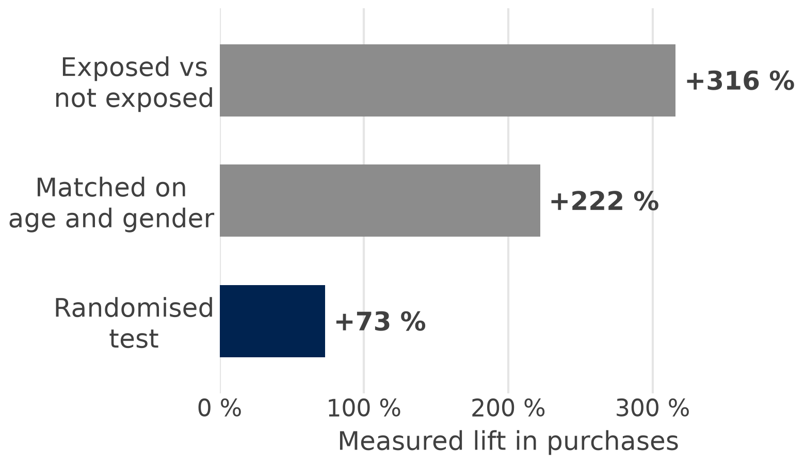

The warm-up resolved: naive vs randomised
4×
the naive comparison overstates the effect: 316 vs 73
Why? The platform showed the ad to people who were more likely to buy anyway.
The ad finds buyers more than it creates them: only a random control group shows the effect.
Source: Gordon et al. (2019), Marketing Science, Study 4
Notes:
Back to the warm-up. The same Facebook campaign measured three ways: exposed vs not exposed gives +316 %, matching on age and gender still +222 %, and the randomised test +73 % [V] (Gordon et al. 2019, Study 4). The platform showed the ad to people who were more likely to buy anyway, so the naive comparison is about four times too high. The same pattern appears elsewhere: a Yahoo display ad, +1,198 % naive vs +5.4 % randomised (Lewis, Rao & Reiley 2011 [V]); eBay search ads, a naive ROI of over 1,400 % but −63 % in the experiment (Blake, Nosko & Tadelis 2015 [V]). Bridge: now we design such a test ourselves.

Slide 13
Designing and analysing an A/B test
Part 2 of 5 · variables, power, checks
Notes:
Part 2 takes the A/B test of the subject line apart. Students learn to name the variables of an experiment, to read the result with its confidence interval, to plan the sample before the send, to check the set-up, and to ask for whom and where the result holds. Everything uses the same file, email_ab.csv, and the steps of ab_testing.qmd.

Slide 14


What we change, what we measure
Independent variable
Dependent variable
causes?
The treatment: the subject line
The outcome: clicked (1/0), summarised as the click rate
A generic
B first name
1 clicked
0 no click
Key metric: the click rate decides – fixed before the e-mail is sent
Guardrail: the unsubscribe rate must not get worse
Held constant: body text, send day, offer page
One change, one key metric: decide both before the start.
Notes:
In an experiment we set the independent variable ourselves: we decide who gets A and who gets B. That is what makes it an experiment rather than an observation. The dependent variable is what we observe afterwards: did the customer click (1) or not (0); averaged over a group it is the click rate. Everything else is held constant (body text, send day, offer page) or randomised (who the customers are). The key metric is fixed before the send: a metric chosen afterwards invites cherry-picking among many numbers; Kohavi, Tang & Xu (2020) call it the overall evaluation criterion [V]. The guardrail is a number that must not get worse, here the unsubscribe rate. Ask the room: in the 2 × 2 test of Part 3, how many independent variables are there?

Slide 15
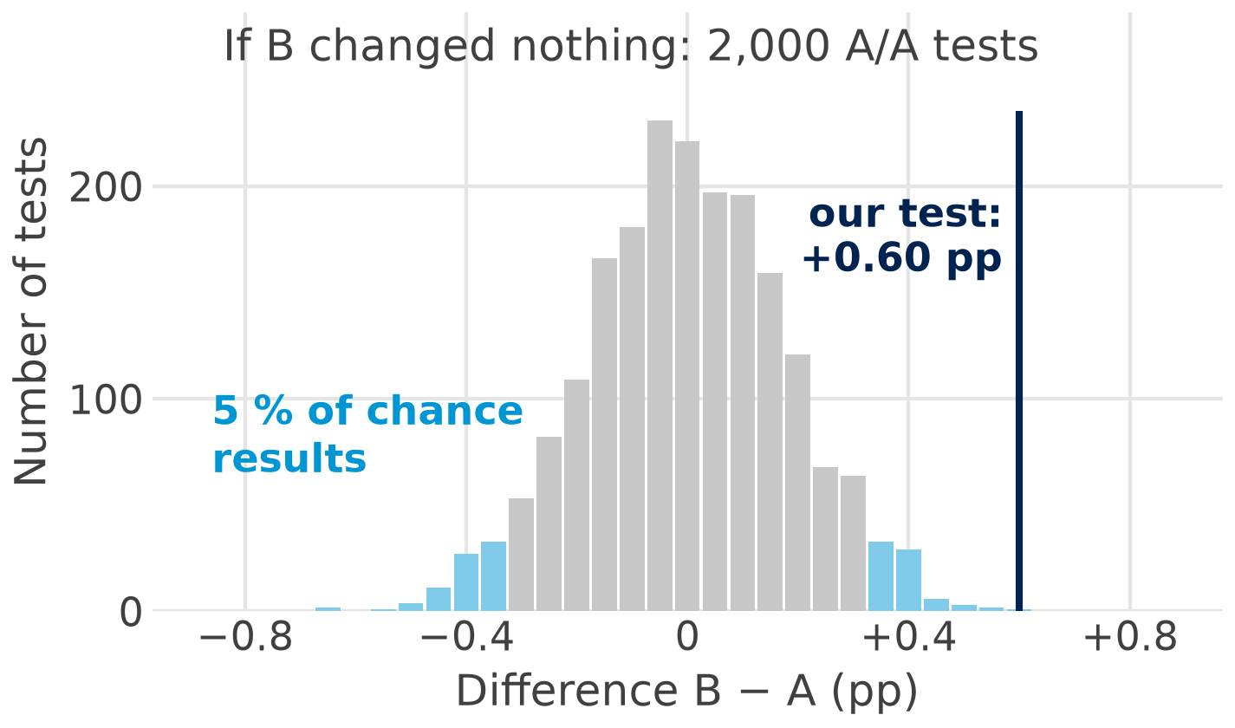
Is +0.60 pp more than chance?
+0.60 pp
B − A: 3.93 % − 3.33 %
0.0013
p-value: how often chance alone gives a gap at least this large
0.23–0.97
95 % CI in pp: the effect is plausibly between these
Guardrail: unsubscribes 0.31 % (A) vs 0.41 % (B), p 0.079
Report the effect in pp with its CI, not only the p-value.
Simulated data (email_ab.csv); 2,000 simulated A/A tests
Notes:
The logic of the test in four steps. First, what chance alone looks like: we simulate 2,000 A/A tests, the same e-mail to two groups of 20,000 with a click rate of 3.3 %; the differences scatter around zero with a standard deviation of about 0.18 pp. Second, our +0.60 pp lies far outside that cloud: only 0.15 % of the chance results are as large. Third, the p-value is about that share: how often chance alone gives a gap at least this large (0.15 % here, 0.13 % from the z-test: p 0.0013, z 3.21). Fourth, the 95 % confidence interval, 0.23 to 0.97 pp, is the range of effect sizes the data are compatible with. The guardrail rose by about 0.1 pp (0.31 % to 0.41 %, p 0.079): within noise, but watch it in the next send. Slide 17 uses the same picture as a check of the tool. In the qmd: Steps 2 and 4.

Slide 16
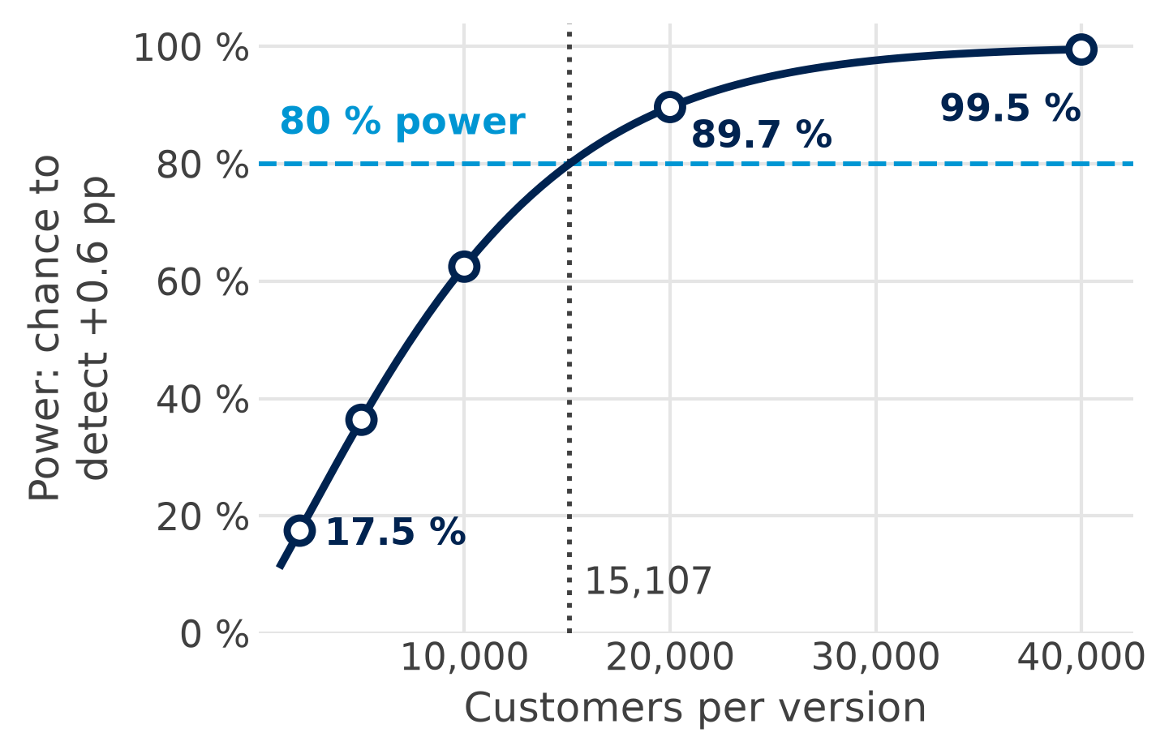
How many customers? Sample size and power
15,107
per version for +0.6 pp (3.3 → 3.9 %), 80 % power
58,072
for +0.3 pp: half the effect, four times the customers
5,715
for +1.0 pp: a large effect needs few
Plan the sample before you send, and do not stop early when p dips below 0.05.
Simulated data (email_ab.csv); power for 3.3 → 3.9 %, 5 % level
Notes:
Power is the chance that the test detects a true effect of a given size. Here: if B really adds 0.6 pp (3.3 to 3.9 %), how often would a test with n customers per version give p below 0.05? With 15,107 per version the chance is 80 %, the usual target. Our test had 20,000 per version: power 89.7 %. With 2,000 per version it would be only 17.5 %: most real effects of this size would be missed. Half the effect (0.3 pp) needs about four times the customers (58,072). Do not peek: checking every day and stopping at the first p below 0.05 raises the false alarms well above 5 %. In the qmd: Steps 2 and 4.

Slide 17
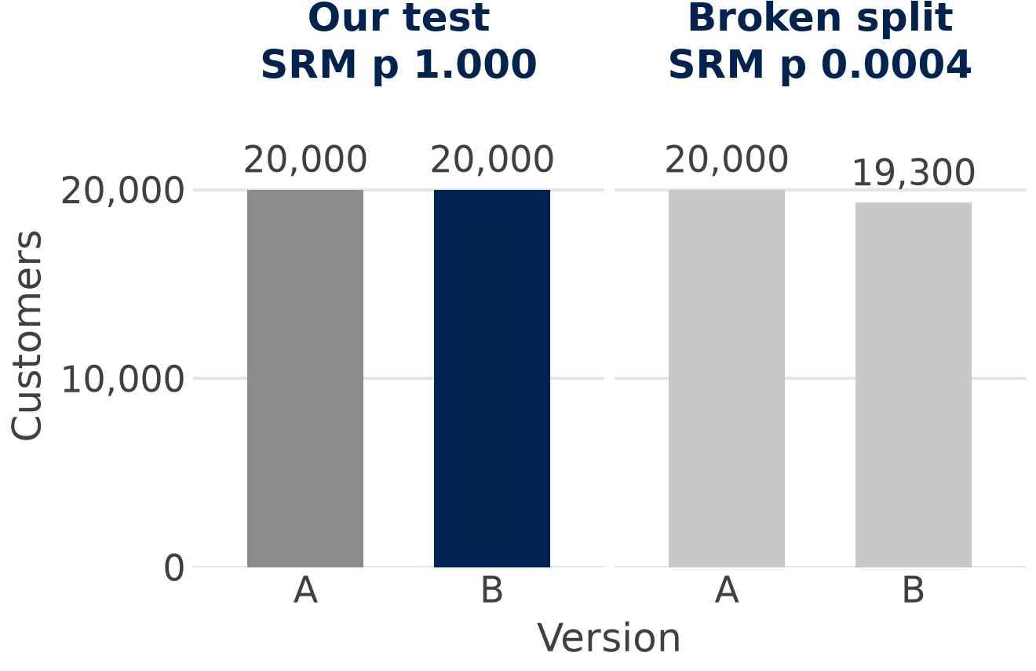
Check the set-up: the split and an A/A test
Sample ratio mismatch (SRM)
Planned 50:50, got something else by more than chance? Stop: find the cause before reading any result.
A/A test
The same e-mail to both groups: about 5 % come out “significant” (5.9 % in our 2,000 runs).
Check first: if the split test gives p below 0.001, fix the set-up before you read any result.
Simulated data (email_ab.csv); the broken split is invented
Notes:
Before reading any result, check the split. The sample ratio mismatch (SRM) test is a chi-square test of the counts against the plan (scipy: stats.chisquare). Our test: 20,000 vs 20,000, SRM p 1.000. The invented broken split, 20,000 vs 19,300, looks harmless in the chart but gives p 0.0004: 700 customers of B went missing, perhaps through a filter, a bounce list or a tracking bug, and the missing ones are rarely a random set. SRMs are not rare: about 6 % of Microsoft experiments had one (Fabijan et al. 2019 [V]). An A/A test sends the same e-mail to both groups and checks the whole pipeline: about 5 % come out “significant” by chance, 5.9 % in our 2,000 runs (the histogram of slide 15). In the qmd: Steps 1 and 4.

Slide 18
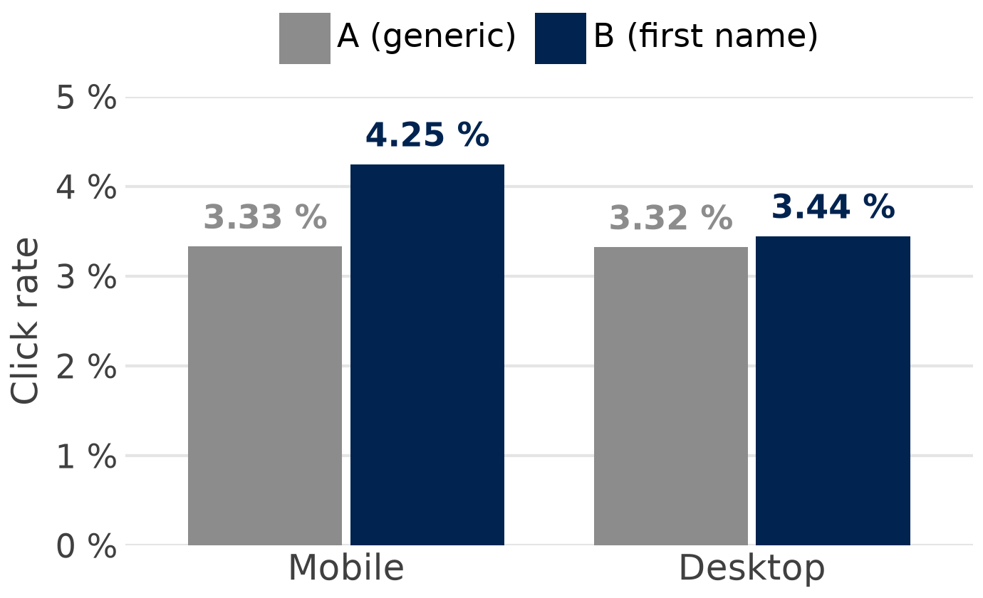
Does B work for everyone? Mobile vs desktop
+0.92 pp
on mobile (23,885 customers)
+0.13 pp
on desktop (16,115 customers)
+0.79 pp
Interaction: the effect of B depends on the device (p 0.038)
Labels rounded; gaps from unrounded values
A segment found after the test is a hypothesis: test it again (Part 3).
Simulated data (email_ab.csv)
Notes:
Split by device, B adds +0.92 pp on mobile (p < 0.001) and only +0.13 pp on desktop (p 0.661). A plausible story: the inbox on a phone shows only a few characters, so the name is what customers see first; this is an illustration, not a finding. The device is a moderator: it changes the size of the effect. The interaction is a difference of two differences, +0.92 − 0.13 ≈ +0.79 pp (from unrounded values, OLS clicked ~ B * device, p 0.038). Careful: with many segments some differ by chance, and the test was planned for the total effect, not for segments. In the qmd: Step 5; Part 3 builds this idea into the design (slides 22 and 27).

Slide 19



Can we trust it? Internal and external validity
Internal validity
External validity
Did the e-mail cause it here? random split, same day, same kind of customers
Threat: a broken split, or a platform that shows A and B to different people
Check: the split, and who actually got A and B
Will it hold elsewhere? other markets, seasons, channels, customers
Threat: a winner here may fail elsewhere
Check: repeat before roll-out (slide 27)
Ad A
delivery
algorithm
older people
A vs B = ad plus audience
Ad B
younger people
Randomisation buys internal validity; external validity needs a repeat.
Source: Braun & Schwartz (2025), Journal of Marketing
Notes:
Two questions after every test, after Shadish, Cook & Campbell (2002) [V]. Internal validity: did the e-mail cause the difference here? The random split, the same send day and the same kind of customers make that likely, provided the split works. External validity: will the result hold in other markets, seasons, channels and customer groups? E-mail tests are clean because we control who gets what. On ad platforms the delivery algorithm sends each ad to the people it predicts will respond; in the picture ad A reaches mostly older and ad B mostly younger people, so an A/B test there compares ad plus audience (divergent delivery, Braun & Schwartz 2025 [V]). Our own external-validity check comes in Part 3 with Germany vs Spain (slide 27).

Slide 20
Factorial designs and interactions
Part 3 of 5 · factors and interactions
Notes:
The operator's next campaign tests two changes at once: the first name in the subject line and a discount of 10 % off the next bill. In this part you learn the words of a factorial design: factor, level, cell, simple effect, main effect and interaction. You will read an interaction plot, compute the effects by hand from four click rates, and then analyse them with a regression and a two-way ANOVA. At the end we ask whether the result differs between Germany and Spain.

Slide 21
From A/B to 2 × 2: two factors, four cells
Factor 1:
first name
Factor 2: discount
Factor: an independent variable we change (here: first name, discount)
No discount
10 % discount
Generic
Inbox
10,000 customers
Inbox
10,000 customers
Loyalty team
control
Loyalty team
Your loyalty offers are here
Your loyalty offers are here
Level: a version of a factor (no / yes)
10 % off your next bill
First name
Inbox
10,000 customers
Inbox
10,000 customers
Loyalty team
Loyalty team
Cell: one combination: 2 × 2 = 4 e-mails
Anna, your loyalty offers are here
Anna, your loyalty offers are here
10 % off your next bill
Randomised: each customer gets one of the four e-mails at random.
Notes:
The operator sends the next retention e-mail to 40,000 new customers, and each gets one of four e-mails at random, 10,000 per e-mail, randomised within each market. The first factor is our version B again, the first name in the subject line; the second is new, a discount of 10 % off the next bill. An A/B test is a factorial design with one factor and two levels; here we have two factors with two levels each, so 2 × 2 = 4 cells. What we gain: both effects from the same customers, and the answer to a new question, whether the two changes work together. Ask: which of the four e-mails would you bet on?

Slide 22
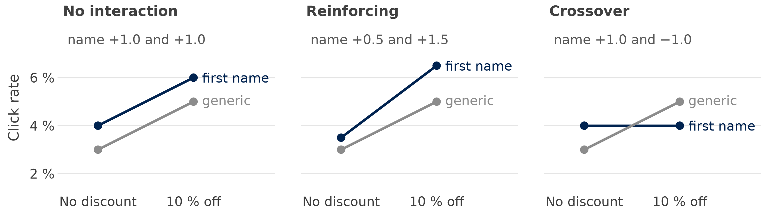
Interaction: a difference in differences
Interaction = simple effect of the name with discount − without (the gap between the lines): 0, +1.0, −2.0 pp
Parallel lines: no interaction. Fan out or cross: the effect of one factor depends on the other.
Illustration: invented round numbers
Notes:
Three made-up results with round numbers; in each panel the discount raises the click rate. The simple effect of the name is its effect at one level of the discount, the gap between the two lines at No discount and again at 10 % off; the interaction is the difference of the two simple effects, a difference in differences. Left, the gap is +1.0 pp at both levels: parallel lines, no interaction; middle, it grows from +0.5 to +1.5 pp: the lines fan out, interaction +1.0 pp. Right, the name helps without the discount and hurts with it: the lines cross, interaction −2.0 pp, and the average effect of the name is zero although the name matters in each cell. Slide 18's device result had the shape of the middle panel. Ask: which shape do you expect for name and discount, and why?

Slide 23
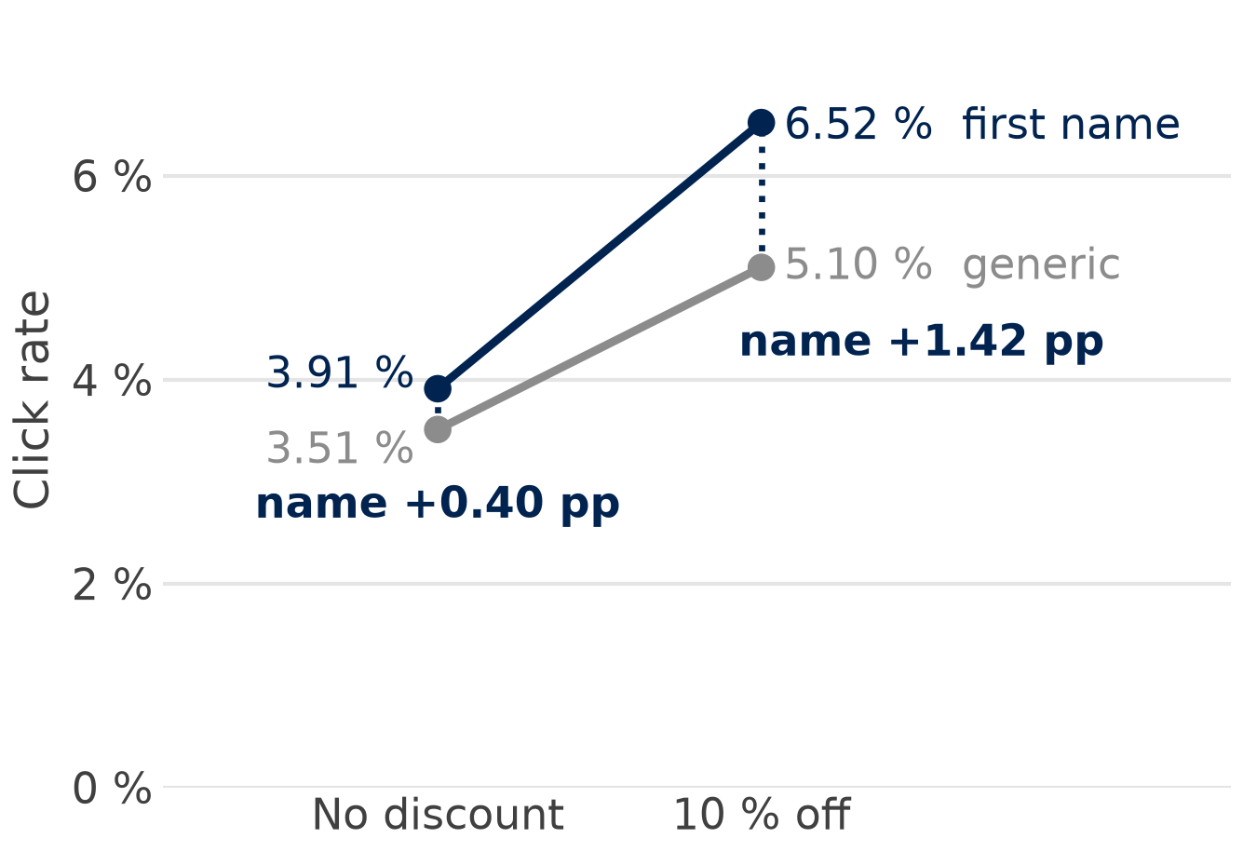
Our 2 × 2 result: the name works with the discount
No discount
10 % discount
Generic
3.51 %
5.10 %
First name
3.91 %
6.52 %
Click rate per cell, 10,000 customers per cell
Name alone
+0.40 pp
Name + discount
+1.42 pp
The name adds 0.40 pp alone and 1.42 pp with the discount: an interaction of +1.02 pp.
Simulated data (email_factorial.csv)
Notes:
Read the plot like slide 22: the lines fan out, as in the middle panel. Without the discount the first name adds +0.40 pp (3.51 % to 3.91 %); with the discount it adds +1.42 pp (5.10 % to 6.52 %; p < 0.001, 95 % CI [0.83, 2.01] pp). The discount works in both rows: +1.59 pp for the generic e-mail, +2.61 pp with the first name. The best e-mail combines the first name and the discount, 6.52 % click, and it also had the fewest unsubscribes (0.24 %, against 0.34 % for the control). Table and plot: Step 3 of the sample code. Ask: is the name worth it without the discount?

Slide 24
By hand: simple effects, main effects, interaction
Effect of the first name
Calculation
pp
Rule
Simple effect, no discount
3.91 − 3.51
+0.40
simple effect
= within one level
main effect
= average of the
simple effects
interaction
= difference of the
simple effects
Simple effect, with discount
6.52 − 5.10
+1.42
Main effect (average)
(0.40 + 1.42) / 2
+0.91
Interaction (difference)
1.42 − 0.40
+1.02
Discount, the same way: +1.59 and +2.61 pp, main effect +2.10 pp, interaction +1.02 pp
With an interaction, report the simple effects: the average (+0.91 pp) fits neither e-mail.
Simulated data (email_factorial.csv)
Notes:
Everything comes from the four click rates of slide 23: a simple effect compares two cells within one level of the other factor (+0.40 pp without, +1.42 pp with the discount), the main effect is their average (+0.91 pp) and the interaction their difference (+1.02 pp). The discount, the same way: +1.59 and +2.61 pp, main effect +2.10 pp, and again an interaction of +1.02 pp, so the interaction is the same number whichever factor you start from. The main effect is also the plain comparison of all 20,000 first-name customers with all 20,000 generic ones (5.215 % vs 4.305 %); the rates rounded as in the numbers file (5.22 % and 4.30 %) would give 0.92, so subtract unrounded rates. Main effects are what a factorial buys you when there is no interaction; with one, they average two different effects. Ask the room to check one line with a calculator (Step 6 of the sample code).

Slide 25

Regression and ANOVA: one model, two read-outs
smf.ols("clicked ~ personal * discount", data=d) coefficients × 100 = pp
Term
Coef. (pp)
p
Reads as
Two-way ANOVA
F
Intercept
3.51 %
generic, no discount
personal
18.32
personal
+0.40
0.183
name, without discount
discount
97.56
discount
+1.59
< 0.001
discount, generic e-mail
personal:discount
5.75
personal:discount
+1.02
0.017
the interaction
Interaction: p 0.017, the same test
'personal' is not the main effect: with a product term it is the name's effect without discount (n.s.); the ANOVA row tests the main effect.
Same data, same interaction test: +1.02 pp, p 0.017.
Simulated data (email_factorial.csv); OLS on 0/1 clicks (linear probability model)
Notes:
We fit an ordinary regression to the 0/1 clicks, the linear probability model: coefficients times 100 are percentage points, and with all four cells in the model it reproduces the four click rates exactly. Each coefficient is a cell difference from slide 24: the intercept is the control (3.51 %), 'personal' the name without discount (+0.40 pp, p 0.183), 'discount' the discount for the generic e-mail, the product term the interaction (+1.02 pp, p 0.017). The two-way ANOVA splits the variation into the two main effects and the interaction (F = signal / noise); use anova_lm(…, typ=2) or effect coding (−0.5 / +0.5, which gives the main effects +0.91 and +2.10 pp directly), because Type III with 0/1 dummies tests the simple effect instead (F 1.77, p 0.183). Controlling for the market changes nothing (+1.02 pp, p 0.016). Do not drop an interaction because p > 0.05 and refit the short model: 19 of 27 factorial experiments in top economics journals used the short model (Muralidharan, Romero & Wüthrich 2025, Review of Economics and Statistics); code in Steps 3 and 6.

Slide 26
The logit reads it differently: use pp
Same four cells
Name alone
Name with discount
Interaction
p
Click rate, pp (OLS)
+0.40
+1.42
+1.02
0.017
Log-odds (logit)
+0.11
+0.26
+0.15
0.124
Why they differ: the discount raises the base rate, and the same odds lift adds more pp at 5.10 % than at 3.51 %. The logit removes that part, so less interaction is left (+0.15 in log-odds).
Two questions: the logit asks whether the odds ratio changes; the manager asks how many more customers click.
Read interactions in percentage points, as in the logit deck (slide 21).
Simulated data (email_factorial.csv)
Notes:
The same four cells on two scales: in click rates the name adds +0.40 and +1.42 pp, an interaction of +1.02 pp (p 0.017, significant at 5 %); in log-odds, the scale of the logit, it adds +0.11 and +0.26, a product term of 0.149 (odds ratio 1.16, p 0.124). Why they differ: the discount raises the base rate, and the same odds lift adds more pp at 5.10 % than at 3.51 %; the logit removes that part, so less interaction is left (+0.15 in log-odds). The logit fits the four rates exactly, so its predicted probabilities still give +1.02 pp; only the product term asks another question, whether the odds ratio of the name is bigger with the discount, and here the answer is 'not clearly'. In nonlinear models the product term is not the interaction in probabilities (Ai & Norton 2003, Economics Letters [V]); report the second difference of predicted probabilities (Mize 2019, Sociological Science), as in the logit deck, slide 21. Code: Step 7 of the sample code.

Slide 27
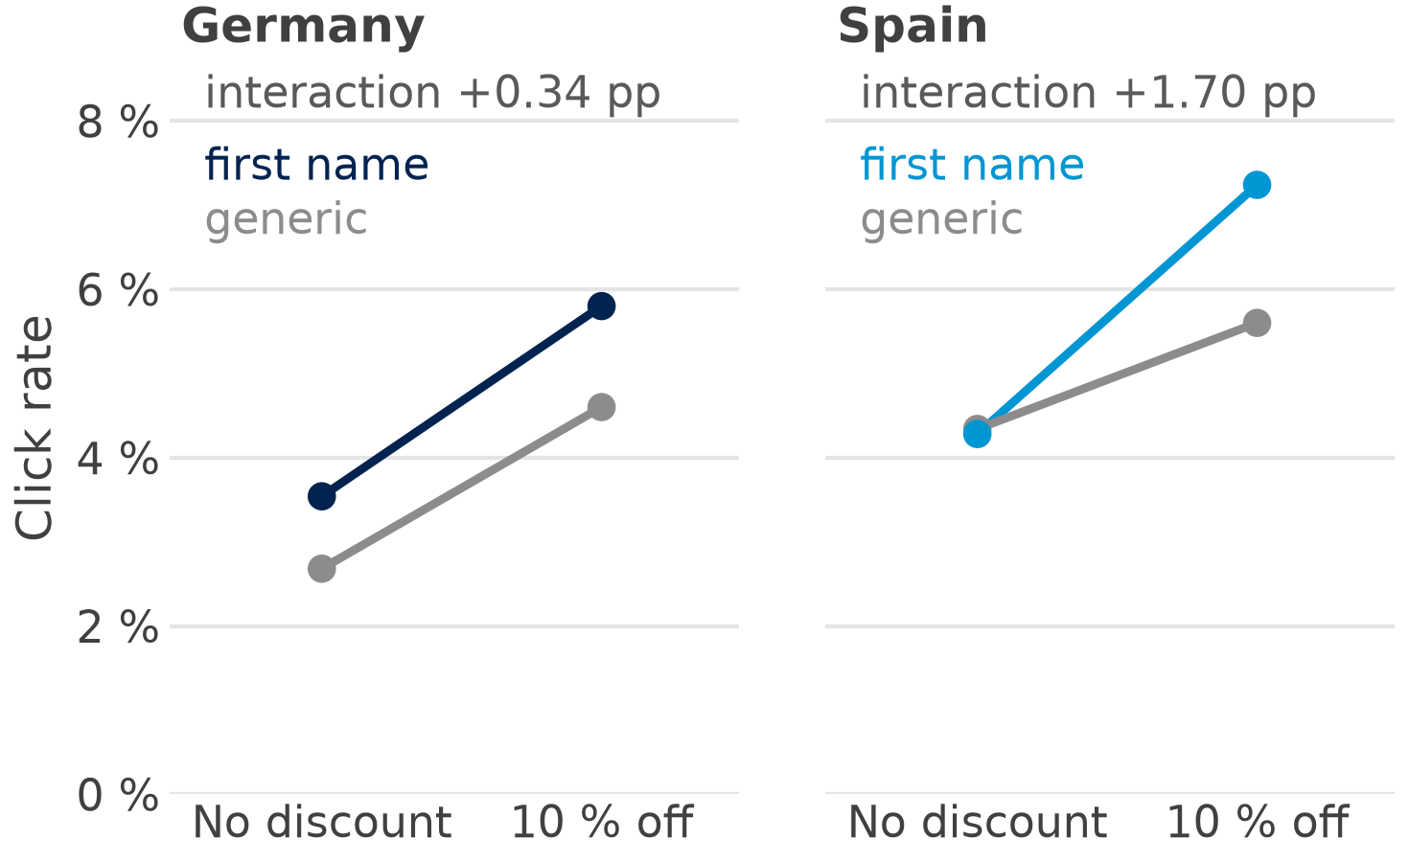
The market as a moderator: Germany vs Spain
+0.34 pp
Germany (p 0.546)
+1.70 pp
Spain (p 0.008)
p 0.110
Spain − Germany (+1.36 pp): within chance
'Significant in Spain, not in Germany' is not evidence of a difference: test the moderator, then repeat per market.
Simulated data (email_factorial.csv)
Notes:
A moderator is a variable that changes the size of an effect, like the device on slide 18. In Germany the interaction is +0.34 pp (p 0.546), in Spain +1.70 pp (p 0.008), and the tempting conclusion is that it works in Spain, not in Germany; but the test of the moderator, the three-way interaction personal × discount × country, gives a difference of +1.36 pp, p 0.110, within chance. Be honest about our data: they were simulated with the same true interaction (+1.0 pp) in both markets, so the gap is sampling noise, and so is Spain's name-alone effect of −0.06 pp. Each market has half the customers, so its standard error is larger (0.56 and 0.64 vs 0.43 pp), and testing each subgroup separately often gives 'significant in one subgroup only' without a true difference (Brookes et al. 2004, Journal of Clinical Epidemiology: 7–64 % of simulations). For external validity (slide 19), still repeat the 2 × 2 in each market before a roll-out (Step 8 of the sample code).

Slide 28
Design rules for factorial tests
Two separate A/B tests · 40,000 customers
Twice the use of each customer: every main effect compares 20,000 with 20,000.
1
10,000
10,000
Name: 10,000 vs 10,000
10,000
10,000
Discount: 10,000 vs 10,000
Interactions need more: about four times the customers of a main effect of the same size (SE 0.43 vs 0.21 pp).
2
One 2 × 2 · 40,000 customers
10,000
10,000
Name: 20,000 vs 20,000
Keep it small: 2 × 2 or 2 × 3; a factorial with 4 × 6 = 24 cells (in industry: a multivariate test) spreads customers thin.
10,000
10,000
Discount: 20,000 vs 20,000
3
+ the interaction: only the factorial can test it
Plan the interaction in advance: which one, how big, how many customers.
Illustration
Notes:
Left, the same 40,000 customers used in two ways: two separate A/B tests compare 10,000 with 10,000 for each question, one 2 × 2 compares 20,000 with 20,000 for each main effect and also tests the interaction (Collins, Dziak & Li 2009, Psychological Methods); with a strong interaction the main effects are averages (slide 24). Interactions need more: the standard error of the interaction is twice that of a main effect (0.43 vs 0.21 pp), so the same size needs about four times the customers (sample size: slide 16). A trial with 80 % power for the main effect has only 29 % for a same-sized interaction, so the sample must be inflated fourfold (Brookes et al. 2004). Keep it small: the Obama 2008 sign-up page tested 4 buttons × 6 media = 24 versions with about 13,000 visitors each (Siroker 2010, the campaign's own account [V][C]); industry calls such a factorial with many cells a multivariate test. Many teams run separate A/B tests on the same customers at once, an unplanned factorial; interactions between them are possible but usually rare and small, so overlapping tests are the default.

Slide 29
The analyses in Python
Part 4 of 5 · polars, scipy, statsmodels, plotnine
Notes:
Part 4 repeats the analyses of Parts 2 and 3 in Python, in three steps: load and check the split; the difference with the z-test, the interval and the sample size; and the 2 × 2 regression with its plot. The code on the next slides is complete and comes from sessions/01-foundations/ab_testing.qmd, Steps 1 to 3: open it in Positron and run it cell by cell. The qmd has eight steps and reproduces every number of this deck, including the A/A tests, the power curve, the device and market checks and the logit.

Slide 30
The packages and functions
Task | Package | Function
Load and count | polars | pl.read_csv(); group_by().agg()
Check the split (SRM) | scipy | stats.chisquare(counts)
z-test and CI | statsmodels | proportions_ztest(); confint_proportions_2indep()
Sample size and power | statsmodels | proportion_effectsize(); NormalIndPower().solve_power()
Factorial regression | statsmodels | smf.ols("clicked ~ personal * discount")
Two-way ANOVA | statsmodels | anova_lm(m, typ=2)
Tables and plots | great_tables, plotnine | GT(); ggplot, geom_line
Notes:
The import lines are all at the top of ab_testing.qmd, so you write them once. One trap: you install great-tables with a hyphen but import great_tables with an underscore. proportions_ztest and confint_proportions_2indep live in statsmodels.stats.proportion, NormalIndPower in statsmodels.stats.power and anova_lm in statsmodels.stats.anova. smf.ols works as in the regression session: a formula, the data, fit; the star in personal * discount adds the product term for you.

Slide 31
Step 1: load and check the split
Python: polars, scipy
Version
n
Clicks
Rate
import polars as pl
from scipy import stats
ab = pl.read_csv("../../data/abtest/email_ab.csv")
split = (ab.group_by("version")
.agg(pl.len().alias("n"),
pl.col("clicked").sum().alias("clicks"),
pl.col("clicked").mean().alias("click_rate"))
.sort("version"))
stats.chisquare(split["n"].to_list()).pvalue # SRM
split
A
20,000
665
3.33 %
B
20,000
785
3.93 %
SRM p
1.000
Customers and clicks per version
Check the split first: an SRM p below 0.001 means stop and fix the set-up.
Notes:
The qmd sits in sessions/01-foundations, so the data file is two folders up. group_by and agg give one row per version: the number of customers, the clicks and the click rate; the mean of a 0/1 column is a share, so the 0.03325 of version A is 3.33 %. stats.chisquare tests the two counts against an even split: 20,000 and 20,000 give SRM p 1.000, so the split is as planned. The qmd adds the balance check by device and country (slide 10) and the same check for the 2 × 2 file, where the four cells also give SRM p 1.000. Ask the room: what do you do when the SRM p is below 0.001?

Slide 32

Step 2: difference, z-test, CI and power
Python: statsmodels
Result
Value
from statsmodels.stats.proportion import (
proportions_ztest, confint_proportions_2indep,
proportion_effectsize)
from statsmodels.stats.power import NormalIndPower
x, n = split["clicks"].to_list(), split["n"].to_list()
z, p = proportions_ztest([x[1], x[0]], [n[1], n[0]])
lo, hi = confint_proportions_2indep(x[1], n[1],
x[0], n[0]) # B - A
es = proportion_effectsize(0.039, 0.033)
NormalIndPower().solve_power(es, alpha=0.05, power=0.8)
Difference B − A
+0.60 pp
z
3.21
p
0.0013
95 % CI
[0.23, 0.97] pp
n for +0.6 pp
15,107
n: customers per version for 80 % power
Read it as: B adds about 0.6 pp; the sample was planned for this size.
Notes:
Index 0 is version A and index 1 is version B, because the table of Step 1 is sorted by version. The test and the interval both take B first, so the sign is B − A: +0.60 pp, z 3.21, p 0.0013. confint_proportions_2indep returns shares; times 100 gives percentage points, the interval [0.23, 0.97] pp. solve_power returns 15,106.9 customers per version for 3.3 % → 3.9 %; round up to 15,107, which our 20,000 per version exceed. The qmd also checks the guardrail, unsubscribes (+0.105 pp, p 0.079), and draws the power curve of slide 16 (Step 4).

Slide 33

Step 3: the factorial regression and plot
Python: statsmodels, plotnine
Term
pp
p
import statsmodels.formula.api as smf
from plotnine import aes, geom_line, geom_point, ggplot
fa = pl.read_csv("../../data/abtest/email_factorial.csv")
m = smf.ols("clicked ~ personal * discount",
data=fa.to_pandas()).fit()
m.params * 100 # in pp
cells = (fa.group_by("personal", "discount")
.agg(pl.col("clicked").mean().alias("rate")))
(ggplot(cells, aes("discount", "rate",
colour="factor(personal)"))
+ geom_line() + geom_point())
Intercept
3.51 %
–
personal
+0.40
0.183
discount
+1.59
< 0.001
personal:discount
+1.02
0.017
Each coefficient is a cell difference (slide 25)
Read the product term in pp: +1.02, p 0.017; the plot shows it as lines that fan out.
Notes:
personal * discount expands to personal + discount + personal:discount: two main terms and the product term. Times 100 turns probability units into percentage points. The intercept is the control cell (3.51 %), personal is the name's effect without the discount (+0.40 pp), discount is the discount's effect with the generic subject line (+1.59 pp), and the product term is the extra effect when both come together (+1.02 pp, p 0.017). The plot uses the four cell means of slide 23: discount on the x-axis, one line per subject line; lines that fan out show the interaction. The qmd adds the cell table, the two-way ANOVA (Step 6), the logit (Step 7) and the markets (Step 8).

Slide 34
In-class exercise
Part 5 of 5 · quiz, exercise, Posit Assistant
Notes:
The last part hands the method over to you. First a five-question online quiz on the whole session, then the answers. Then you work in pairs on the same two files, email_ab.csv and email_factorial.csv, with the code of ab_testing.qmd. Finally you repeat the tasks with Posit Assistant and check its numbers against your own.

Slide 35
Online quiz: experiments in five questions
1 Why can we read B − A as the effect of the first name?
A both groups are large B the coin flip made A and B alike C clicks have no noise
2 Click rate 3.0 % with A, 3.6 % with B. The difference is …
A +0.6 pp, or +20 % relative B +0.6 % C +20 pp
3 15,107 customers per version detect +0.6 pp. For +0.3 pp you need about …
A 7,500 B 30,000 C 60,000
4 Planned 50:50, got 20,000 in A and 19,300 in B (SRM p < 0.001). You …
A report the result B stop and look for the bug C drop 700 customers from A
5 2 × 2: the name adds +0.4 pp without, +1.4 pp with the discount. The interaction is …
A +1.0 pp B +0.9 pp C +1.8 pp
3 minutes alone, then compare with your neighbour.
Notes:
Online quiz on Canvas: three minutes alone, then compare with your neighbour. Question 1 goes back to the coin flip on slide 10, question 2 to percentage points on slide 6, question 3 to sample size and power on slide 16, question 4 to the split check on slide 17 and question 5 to the 2 × 2 by hand on slide 24. Questions 2, 4 and 5 use invented round numbers. Ask for a show of hands per option before you move on.

Slide 36
Answers: in class
Notes:
The answers follow in class.

Slide 37
Your turn: test the e-mails in Python
Pairs, with packages:
35 minutes
Plenary, answers:
5 minutes
Posit Assistant:
10 minutes
1
Check: the split and the share on mobile per version, in each market (Step 1)
2
Test: B − A in Germany and in Spain, in pp with 95 % CI; does it differ? (Steps 2, 5)
3
Plan: customers per version for 3.3 % → 3.8 % with 80 % power (Step 2)
4
2 × 2: cell table, interaction plot, regression; which e-mail should be sent? (Steps 3, 6)
Deliverable: one slide per pair with the interaction plot and two sentences for the CRM manager.
File: sessions/01-foundations/ab_exercise.qmd (code to reuse: ab_testing.qmd)
Notes:
Work in pairs with the packages for 35 minutes, then five minutes of answers in the plenary, then ten minutes with Posit Assistant (next slide). The file ab_exercise.qmd has the setup cell and an empty cell per task; the step numbers point to the code to reuse in ab_testing.qmd. Check after ten minutes that every pair has the split per market. Fast pairs do the extra task: the market as a moderator of the 2 × 2 interaction (Step 8). Debrief: which e-mail would you send, and which number convinces the CRM manager?

Slide 38
Then: the same tasks with Posit Assistant
How: code first, then open Posit Assistant, type @ab_exercise.qmd, one task per prompt
Prompt for task 1
Prompt for task 2
@ab_exercise.qmd Task 1. Check the split of
email_ab.csv in each country: counts,
SRM p-value and the share on mobile
per version.
Task 2. Estimate B − A in Germany and
in Spain in pp with a 95 % CI. Do the
markets differ, and how would you
test that?
Prompt for task 3
Prompt for task 4
Task 3. How many customers per version
detect 3.3 % → 3.8 % with 80 % power?
Explain power in one sentence for
a manager.
Task 4. Fit clicked ~ personal * discount.
Explain each coefficient in pp and
recommend one e-mail; check the
unsubscribes too.
Check every number against your own code: you own the result.
Notes:
The routine of the earlier sessions. Solve the tasks with your own code first and keep the setup cell run, so Posit Assistant sees ab and fa. Open the chat from the Posit Assistant icon in the activity bar, type @ab_exercise.qmd and give one task per prompt; ask it to explain, not only to compute. Typical slips to watch: a relative per cent reported as percentage points, the sign A − B instead of B − A, the personal coefficient read as the main effect, the logit product term read as “no interaction”, and the split check forgotten. Stay in Normal mode and read every edit before you accept it. The prompts match the Posit Assistant section of ab_exercise.qmd.

Slide 39



Open data for A/B labs
Hillstrom e-mail
Upworthy
Criteo uplift
64,000 customers of a retailer
Design: 3 random groups: men's e-mail, women's e-mail, none
Outcome: visits, purchases, spend
Access: free CSV, no licence stated
4,873 headline tests of a news site
Design: random within each test
Outcome: clicks
Licence: CC BY 4.0 (OSF)
14 million rows, version 2.1
Design: random treatment
Channel: online ads
Licence: CC BY-NC-SA
The licence decides: commit only data you may share; link the rest.
Links and loading code: ab_testing.qmd (appendix)
Sources: dataset checks, Oct 2026
Notes:
Three open datasets for your own A/B lab; the links and the loading code are in the appendix of ab_testing.qmd. Hillstrom is the MineThatData E-Mail Analytics Challenge (2008): 64,000 customers of a US retailer randomised to a men's e-mail, a women's e-mail or no e-mail, about 21,300 each, with visits, purchases and spend over two weeks; free CSV, no formal licence found, so link it rather than commit it. The Upworthy Research Archive (Matias, Munger, Le Quere & Ebersole 2021, Scientific Data) holds headline tests of a news site; the exploratory file has 22,666 variants in 4,873 tests, CC BY 4.0 on osf.io/jd64p; compare variants only within a test, because that is where the randomisation happened. Criteo Uplift v2.1 has 13,979,592 rows (297 MB) under a non-commercial licence. The licence decides what may go into a public repository.

Slide 40
Key takeaways
1
Seeing is not causing: compare random groups, not those who got it with the rest
2
A coin flip makes A and B alike: B − A is the effect; report it in pp with its CI
3
Plan and check: the sample size before the send, the split before the result
4
Factorial designs test two changes at once: with an interaction, report the simple effects
5
Read interactions in pp, test moderators: “significant here, not there” is not a difference
Next: run sessions/01-foundations/ab_testing.qmd (or ab_testing.py); it reproduces the results on the slides.
Notes:
One sentence per takeaway. Seeing is not causing: compare random groups, not people who got something with those who did not. A coin flip makes A and B alike, so B − A is the effect; report it in percentage points with its confidence interval. Plan the sample size before the send and check the split before the result. A factorial design tests two changes at once; with an interaction, report the simple effects. Read interactions in percentage points and test a moderator before you claim that the market matters. Next: run ab_testing.qmd from top to bottom; it reproduces the results on the slides.

Slide 41


References
Experiments and methods
Advertising and e-mail
Kohavi, Tang & Xu (2020). Trustworthy Online Controlled Experiments. Cambridge University Press.
Gerber & Green (2012). Field Experiments. Norton.
Shadish, Cook & Campbell (2002). Experimental and Quasi-Experimental Designs for Generalized Causal Inference. Houghton Mifflin.
Ai & Norton (2003). Interaction terms in logit and probit models. Economics Letters, 80(1), 123–129.
Collins, Dziak & Li (2009). Design of experiments with multiple independent variables. Psychological Methods, 14(3), 202–224.
Gordon, Zettelmeyer, Bhargava & Chapsky (2019). Marketing Science, 38(2).
Lewis, Rao & Reiley (2011). WWW Conference.
Blake, Nosko & Tadelis (2015). Econometrica.
Sahni, Wheeler & Chintagunta (2018). Marketing Science, 37(2).
Braun & Schwartz (2025). Where A/B testing goes wrong. Journal of Marketing.
Code and data: sessions/01-foundations/ab_testing.qmd
Notes:
What to read first: Kohavi, Tang & Xu (2020) for the practice of online A/B tests (split checks, A/A tests, key metric and guardrails), Gerber & Green (2012) for the logic of random assignment, and Shadish, Cook & Campbell (2002) for internal and external validity. Collins, Dziak & Li (2009) explain why one factorial design can replace separate experiments. Ai & Norton (2003) is the reading behind slide 26: the logit product term is not the interaction in percentage points. The right card holds the advertising and e-mail studies of slides 3, 12 and 19 and the real study behind our example (Sahni, Wheeler & Chintagunta 2018).

Slide 42
Thank you. Questions and discussion
Notes:
Questions? Contact details on the card; office hours via the booking link.

