Slide 1
International Marketing Analytics
Set-up and registration
Session 1 · WT 2026/27
Notes:
Today we set up every laptop together. Nothing had to be installed before this session.

Slide 2




Today: from zero to a working set-up
Accounts
Tools
Repo
Project
Check
AI
What you need
Have at hand
How we work
Your laptop and charger
Windows 10/11 or a recent macOS
About 10 GB free disk space
Admin rights to install software
Your WU e-mail and its password
Your phone, for two-factor sign-in
Your student ID or enrolment confirmation
One step at a time, all together
Check your neighbour's screen
Stuck? Raise your hand, keep going with the next step
Goal: by the end of today the check script prints “ready” on every laptop.
Notes:
Six steps. Start the GitHub Education application first, because approval can take a few days; everything else runs while it is pending.

Slide 3
Register your accounts
Part 1 of 7 · GitHub, GitHub Education, DataCamp
Notes:
Accounts first: they need e-mail confirmations and, for GitHub Education, an approval that can take days.

Slide 4




Three registrations
Accounts
Tools
Repo
Project
Check
AI
GitHub
Stores code and its history; hosts the course repository
GitHub Education
Free student benefits, including GitHub Copilot
DataCamp
Online Python courses; four certificates count 20 %
github.com/signup
education.github.com/pack
Invitation link on Canvas
Same e-mail everywhere: your WU student address unlocks the free plans.
Notes:
All three are free for students. Use the WU e-mail address everywhere, so the student benefits apply.

Slide 5

GitHub account
Accounts
Tools
Repo
Project
Check
AI
Open github.com/signup
Why it matters
1
WU e-mail: sign up with your student address
Your username appears on every commit you make
A clean GitHub profile is part of your CV
Optional: share your group's case study in a repository
The free plan is all you need
2
Username: short and professional, e.g. anna-berger
3
Verify the code GitHub sends to your inbox
4
Two-factor sign-in: GitHub Mobile or an authenticator app
5
Notes:
Two-factor authentication is required by GitHub for accounts that contribute code. GitHub Mobile is the easiest second factor.

Slide 6



GitHub Education and Copilot
Accounts
Tools
Repo
Project
Check
AI
Add WU e-mail
to GitHub
Apply for
benefits
Upload
proof
Wait for
approval
Turn on
Copilot
Apply
After approval
Go to education.github.com/pack
Your WU address must be verified in GitHub's e-mail settings
Proof: a photo of your student ID or enrolment confirmation
Turn on Copilot at github.com/settings/copilot
Copilot Student is free while you study
Until then, Copilot Free works with monthly limits
Do this first: approval can take a few days, so apply today, then carry on.
Notes:
Approval is often quick but can take several days, and benefits can take up to 72 hours more to appear. Check the Copilot Student plan status the week before term; it was paused once in 2026.

Slide 7
DataCamp classroom
Accounts
Tools
Repo
Project
Check
AI
Open the invitation link on Canvas
1
6
months free premium access
Sign up with your WU e-mail, or log in
2
4
courses with certificates
Join the classroom International Marketing Analytics
3
Find the four assigned courses under Assignments
4
20 %
of the final grade
Upload each certificate to Canvas by its deadline
5
Notes:
DataCamp for the Classroom gives students free premium access for six months. Nobody needs to pay.

Slide 8
Install the tools
Part 2 of 7 · Python, Positron, Quarto, GitHub Desktop, the course repository
Notes:
Show the overview first, so students know why each tool is there before they install it.

Slide 9







How the pieces fit together
GitHub.com
the course repository
Your laptop
GitHub Desktop
clone and pull; push optional
↔
Course folder
data, code, requirements.txt
↔
Positron
where you write and run code
Inside Positron you use
Python + packages
in a private .venv folder
Quarto
turns .qmd files into reports
AI assistant
writes and explains code
Notes:
GitHub is the shared cloud copy. GitHub Desktop syncs it with a folder on the laptop. Positron is where students work on that folder, using Python, Quarto and an AI assistant.

Slide 10


Step 2: install Python 3.14.8
Accounts
Tools
Repo
Project
Check
AI
Windows
macOS
Download: Python install manager
Install it with a double-click
Start menu → Terminal: py install 3.14
Download: macOS installer (Python 3.14.8)
Open the .pkg and click through
Apple silicon and Intel
py -3.14 --version
python3.14 --version
Both downloads: python.org/downloads
Or let Positron install it: Command Palette → Python: Install Python via uv
Notes:
Python 3.14.8 (30 September 2026) is the latest release; every course package installs and runs on it. Windows and macOS do not come with Python, so it is always installed once. On Windows, python.org now distributes Python through the Python install manager, which installs and updates Python itself. Positron can also install Python for you: Command Palette, Python: Install Python via uv.

Slide 11



Step 2: install Positron, Quarto and GitHub Desktop
Accounts
Tools
Repo
Project
Check
AI
Positron
Quarto
GitHub Desktop
The editor for code, data and charts
Version 2026.09, free
Welcome page checks that Python is ready
Turns text and code into reports and slides
Check in a terminal: quarto --version
Clone and pull with clicks; push if your group shares a repository
Installs Git for you
Sign in with your GitHub account
positron.posit.co/download
quarto.org/docs/get-started
desktop.github.com
Restart Positron after installing Quarto, so it finds it.
Notes:
Install Python first, then these three. Current Positron: 2026.09 (September 2026); it updates monthly and offers updates itself. Its welcome page checks whether Python is ready. GitHub Desktop brings its own Git.

Slide 12
Step 3: get the course repository
Accounts
Tools
Repo
Project
Check
AI
Copy the URL
(below)
GitHub Desktop:
Clone repository
Pick a folder
without spaces
Positron:
Open Folder
Course repository (public)
Clone: your own copy of a repository; a public one needs no sign-in
https://github.com/arnefloh-wu/
international-marketing-analytics-teaching
Pull: get the latest materials; do it before every session
Folder: e.g. C:\Users\anna\wu\ima or ~/wu/ima. Avoid spaces, umlauts and OneDrive or iCloud folders.
Commit and push: optional: share work in a group repository
In Positron: File → Open Folder. The cloned folder is now your project.
Notes:
The course repository is public: anyone can clone it without sign-in or access rights. Students pull updates before each session. The cloned folder is the project they open in Positron.

Slide 13

Step 4: set up the project's Python
Accounts
Tools
Repo
Project
Check
AI
Create
Environment
Venv
Python
3.14.8
Install
packages
.venv
selected
Positron then
Interpreter picker
top right
Python 3.14.8 (.venv) ▾
Start: Command Palette → Python: Create Environment
Creates .venv inside the project
Installs all course packages
Starts Python from .venv
Packages missing? Positron console
%pip install -r requirements.txt
Once per project: Positron remembers the .venv and starts it whenever you open the folder.
Notes:
Python: Create Environment makes a .venv inside the open project folder with the chosen Python, offers to install the packages from requirements.txt, and selects the new interpreter. The first install takes a few minutes because PyMC is large. If packages were not installed, the console line does it, on Windows and macOS alike.

Slide 14

Step 5: run the check
Accounts
Tools
Repo
Project
Check
AI
Positron console (Windows and macOS)
%run setup/check_setup.py
Example output (shortened)
Reading it
Packages
[ok] polars 1.44.2 data wrangling
[ok] plotnine 0.15.8 charts
[ok] great_tables 1.0.0 tables
[ok] statsmodels 0.15.0 regression
...
ready
[ok]: in place
[!!]: the line says what to fix
Ends with “ready”: done
Next: the full test with test_stack.qmd (next slide).
Notes:
The script lives in setup/check_setup.py. Every line marked !! says what to fix. test_stack.qmd then runs polars, plotnine and statsmodels on the course data and renders with Quarto. Alternatively open the file and press the Run button at the top right of the editor.

Slide 15
Step 5: test the whole stack
test_stack.qmd · cells 1 and 2
cell 5
# 1 Install: run once with Ctrl/Cmd + Enter
%pip install polars plotnine great-tables \
statsmodels pyarrow jupyter
# 2 Load
import polars as pl
import statsmodels.formula.api as smf
from great_tables import GT
from plotnine import ggplot, aes, geom_line
# 5 plotnine: weekly sales, AT and DE
two = sales.filter(
pl.col("country").is_in(["AT", "DE"]))
ggplot(two, aes("week", "sales_units_k",
color="country")) + geom_line()
cell 6
cells 3 and 4
# 6 statsmodels: regression for Austria
at = sales.filter(
pl.col("country") == "AT").to_pandas()
model = smf.ols("sales_units_k ~ price_eur"
" + spend_tv_k + spend_paid_search_k",
data=at).fit()
# 3-4 polars and great_tables
sales = pl.read_csv(URL, try_parse_dates=True)
summary = (sales
.filter(pl.col("week").dt.year() == 2025)
.group_by("country")
.agg(pl.col("revenue_eur_k").sum()))
GT(summary)
No module named 'yaml'? Install into the .venv:
.venv\Scripts\python -m pip install …
Download: test_stack.qmd on GitHub (button Download raw file) or on Canvas
Run it: pick Python 3.14.8 (.venv), run cell 1 once, then Preview (Ctrl/Cmd + Shift + K)
Notes:
test_stack.qmd is a single file: it installs the packages, loads them and reads the data from the course repository on GitHub, so it also works outside the course folder (internet needed). Run cell 1 once with Ctrl/Cmd + Enter, because Quarto cannot install its own helpers (jupyter) while it renders; pyarrow lets polars hand data to plotnine and statsmodels. Then press Preview: a table, a chart and the regression coefficients appear, and the text says the model explains 43 % of the weekly variation. If the folder has a .venv, Quarto runs the file with it, so pick Python 3.14.8 (.venv) before running cell 1. Error 'No module named yaml' or 'unactivated Python environment in .venv': the packages went to another Python. Fix in Positron's terminal: Windows .venv\Scripts\python -m pip install polars plotnine great-tables statsmodels pyarrow jupyter; macOS .venv/bin/python -m pip install (same list).

Slide 16

Step 6: connect your AI assistant
Accounts
Tools
Repo
Project
Check
AI
Command Palette: Configure Language Model Providers
Providers
1
GitHub Copilot: chat and completions; free with Copilot Student or Copilot Free
Posit AI Pass: chat and completions; about USD 20 a month
Anthropic API key: chat; pay as you go
Choose GitHub Copilot and sign in with GitHub
2
Open the chat: View: Show Posit Assistant
3
Our rule: the AI writes, you check. Run the code, read the output and keep a short prompt log for each submission.
Notes:
Posit Assistant replaced Positron Assistant and Databot in Positron 2026.07; older videos show the old menus. GitHub Copilot gives chat and code completions and is the cheapest provider for students; in Positron it is still marked Preview.

Slide 17
How Positron works
Part 3 of 7 · panes, running code, projects, shortcuts, Posit Assistant, Claude
Notes:
Positron 2026.09. A five-minute tour with the live application next to the slides works best.

Slide 18
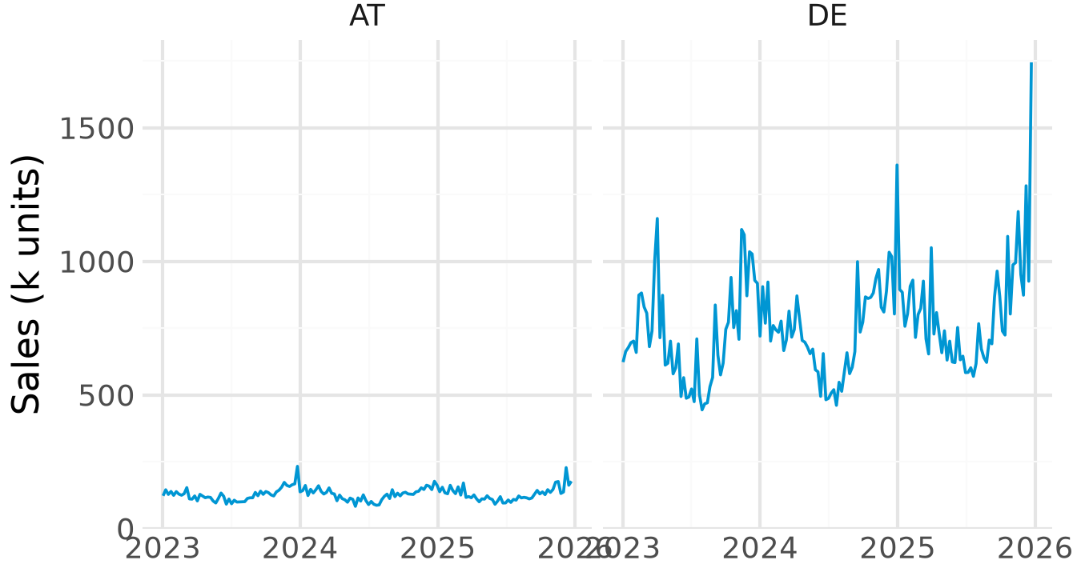
Positron at a glance
New ▾ Open ▾
case-study ▾
Python 3.14.8 (.venv) ▾
1
Explorer
files of the open folder
2
Editor
write .py and .qmd files
4
Variables
Session pane: what is in memory
sales 936 × 18
data/
analysis.py
report.qmd
requirements.txt
# %%
sales = pl.read_csv(...)
sales.head()
summary 6 × 3
model OLS results
5
Plots
Session pane: your charts
3
Console and Terminal
the Panel: code runs, results print
>>> sales.height
936
Notes:
Names as in the Positron documentation: Activity Bar and Primary Side Bar on the left, Editor in the middle with the Panel (Console, Terminal) below, Secondary Side Bar on the right with the Session pane (Variables, Plots). The Top Bar holds the project switcher and the Interpreter picker.

Slide 19



From code to result
Write code
in the editor
Ctrl/Cmd
+ Enter
It runs in
the console
Objects in
Variables
Charts in
Plots
Run code
Look at results
Ctrl/Cmd + Enter: the selection or current statement
Ctrl/Cmd + Shift + Enter: the whole file, or the current cell
# %% starts a cell in a .py file
Variables: every object, its type and size
Data Explorer: click a table, or type %view sales
Plots: earlier charts, zoom, save as PNG
Console or terminal? The console speaks Python. The terminal speaks to your computer: pip, git and quarto commands go there.
Notes:
Show it live: write one line, press Ctrl+Enter, point at the console, the Variables pane and the plot. %view df opens a table in the Data Explorer from the console.

Slide 20
Projects in Positron: one folder for everything
A project is a folder
Open the folder, not single files: File → Open Folder
case-study/
├── .venv/ private Python + packages
├── .git/ version history
├── .gitignore what Git leaves out
├── data/ raw data, never edit by hand
├── analysis.py code, split into # %% cells
├── report.qmd text, code and results
└── requirements.txt packages and versions
Positron remembers the interpreter and open files per folder
Relative paths: data/sales.csv works on every laptop
Switch projects with the project switcher, top right
.venv stays on your laptop: .gitignore keeps it out of GitHub. requirements.txt travels instead, so your group rebuilds the same environment with one command.
Notes:
In Positron a project is simply a folder opened with File > Open Folder (a workspace). Positron finds the .venv at the folder root and remembers the interpreter for that folder. Open folders, not single files.

Slide 21

Start a new project from a template
New Folder
from Template
Python
Project
Name and
location
Python 3.14
+ venv
Create
Positron sets up
Then, in the Positron console
%pip install polars plotnine great-tables
%pip freeze > requirements.txt
The folder with a .venv inside
Git: .git and a .gitignore
A running Python session
An empty file to start with
Line 1 installs packages, line 2 writes their versions to requirements.txt.
Where: New ▾ (top left), the project switcher, or Command Palette → Workspaces: New Folder from Template.
Notes:
New Folder from Template sets up the folder, a .venv, Git and a running session in one dialog. Open it from the New menu (top left), the project switcher or the Command Palette (Workspaces: New Folder from Template).

Slide 22
Shortcuts worth knowing
Action | Windows | macOS
Run selection or current statement | Ctrl + Enter | Cmd + Enter
Run the file or current cell | Ctrl + Shift + Enter | Cmd + Shift + Enter
Insert a code cell (# %%) | Ctrl + Shift + I | Cmd + Shift + I
Restart the Python session | Ctrl + Shift + 0 | Cmd + Shift + 0
Clear the console | Ctrl + L | Ctrl + L
Preview a Quarto document | Ctrl + Shift + K | Cmd + Shift + K
Command Palette | Ctrl + Shift + P | Cmd + Shift + P
Help for the word under the cursor | F1 | F1
Accept an AI suggestion | Tab | Tab
Notes:
Positron-specific shortcuts from the Positron documentation, plus the Quarto preview. On macOS, Cmd replaces Ctrl except where noted. The Command Palette finds every other command by name.

Slide 23


Posit Assistant: the AI inside Positron
What it sees
What it does
How you steer it
Your open files and project
Loaded data, variables and plots
Console history
Explains, writes and fixes code
Runs code after you approve
Fix and Explain on any error
/plan: a plan before any code
@file: point it to a file
Permission mode: keep Normal
Open it
View: Show Posit Assistant
Command Palette, or the Assistant icon in the Activity Bar
Memory: an AGENTS.md file in your project tells it your conventions, for example “use polars and plotnine”.
Notes:
Posit Assistant has been Positron's built-in AI since 2026.07, replacing Positron Assistant and Databot. It uses session context (variable names and types, plots, console history). Permission modes: Normal asks before acting, Restricted allows less, YOLO runs without asking; we use Normal.

Slide 24


Working with AI in Positron
Completions: ghost text
Chat: Posit Assistant
Grey suggestions appear as you type
Tab accepts, Ctrl/Cmd + → word by word
Esc or keep typing to dismiss
Ask in plain English, one step at a time
Check every result it reports
Export the chat: your prompt log
Good prompts
"Sum revenue by country for 2025 with polars and sort it."
"Explain this error in two sentences, then fix it."
Privacy: prompts, variable names and types go to the model provider; rows of data only if you ask. Never paste personal data.
Notes:
Export a conversation (Markdown) and attach it as the prompt log. Posit's FAQ: prompts and session information such as variable names and types go to the model provider; row-level data only when you ask for it.

Slide 25
Claude in Positron: two ways
1 Claude in Posit Assistant
2 Claude Code, the agent
Command Palette → Authentication: Configure Language Model Providers → Anthropic
Paste an API key from the Claude Console
Pick a Claude model in the chat
Extensions view: search Claude Code (Anthropic), Install
Or run claude in the Positron terminal
Sign in with a paid Claude plan or Console account
Costs: API keys are paid per use; Claude Pro or Max does not include API access.
Optional: the course default is GitHub Copilot, free with GitHub Education. Never share your API key.
Notes:
Optional: the course default stays GitHub Copilot in Posit Assistant, free with GitHub Education. Way 1 uses Claude as the model behind Posit Assistant: Authentication, Configure Language Model Providers, Anthropic, and an API key from the Claude Console (console.anthropic.com, API keys, Create Key). API use is paid per token; a Claude Pro or Max subscription does not include API access. Way 2 is Claude Code, Anthropic's coding agent: the Claude Code extension from the Extensions view (Positron uses the Open VSX registry), or the command-line tool in Positron's terminal. It needs a paid Claude plan or a Claude Console account. It works on the open project folder, runs code and proposes edits you approve.

Slide 26
Working with Claude Code in your project
Open your
project
Start
Claude
Ask in plain
English
Approve
changes
Run and
check
Positron terminal: Windows, macOS, then start
CLAUDE.md: standing instructions
irm https://claude.ai/install.ps1 | iex
curl -fsSL https://claude.ai/install.sh | bash
claude
use polars, plotnine, great_tables and
statsmodels only; explain every model
in two sentences
Good prompts
"Read test_stack.qmd and explain each cell in one sentence."
"Add a residual plot to my regression; do not change the data."
Same rules as for any AI: you own every number, keep a prompt log, and never paste personal data.
Notes:
Claude Code starts in the open project folder. It reads the files, explains code, writes and runs it, and asks before it changes a file or runs a command. A CLAUDE.md file in the project holds standing instructions, like AGENTS.md for Posit Assistant. Installation in the terminal, as documented by Anthropic: macOS curl -fsSL https://claude.ai/install.sh | bash; Windows PowerShell irm https://claude.ai/install.ps1 | iex. The course rules apply unchanged: you own every number, and the prompts go into your prompt log.

Slide 27
Work with GitHub Desktop
Part 4 of 7 · the window, the everyday workflow, working as a group
Notes:
GitHub Desktop is the bridge between the folder on the laptop and GitHub. Show it live with the course repository.

Slide 28
GitHub Desktop at a glance
Current repository
ima-teaching ▾
Current branch
main ▾
Fetch origin
↻ now
1
Current repository
which project you work on
1
2
3
4
Changes (2) History
6
report.qmd
2
Current branch
main is all we need
analysis.py
at = sales.filter(...)
Fetch / Pull / Push origin
sync with GitHub
3
report.qmd
- at.head()
+ ggplot(at, aes("week",
4
Changes
files edited since last commit
Add Austria sales chart
+ "sales_units_k"))
5
Summary + Commit
save a snapshot with a message
Commit to main
+ + geom_line()
5
summary, then commit
6
Diff
red removed, green added
Course repository: you only pull. Work in your own folder; a group repository is optional.
Notes:
Names as in GitHub Desktop: the toolbar shows Current repository, Current branch and the sync button, which reads Fetch origin, Pull origin or Push origin depending on what is waiting. The Changes tab lists edited files; the diff on the right shows removed lines in red and added lines in green.

Slide 29



The everyday workflow
Fetch, then
Pull origin
Copy files into
your own folder
Work in
Positron
Optional:
commit, push
Course repository
Group repository
Good commits
Required: pull before every session
Read-only for you: copy files into your own folder before editing
Optional: one member publishes a private repository
Pull, work, commit, push
One person per file where you can
If you commit: small steps, often
Summary says what changed: “Add AT sales chart”
Push when you stop
Merge conflict in a group repository? Open the file, keep the lines you want, delete the markers (<<< === >>>), then commit and push.
Notes:
Required: pull the course repository before every session and work in your own folder, not inside the course repository, so your edits never clash with our updates. Optional: a group repository with commit and push. A merge conflict happens only there, when two people change the same lines; GitHub Desktop lists the files, and Posit Assistant can explain the markers.

Slide 30
Working on the case study together
Pull course
repository
Copy into
your folder
Positron:
.venv
Combine:
2 ways
Upload
to Canvas
Project folder
Way 1: simple
Way 2: GitHub
Copy data/case, report.qmd and requirements.txt
report.qmd next to the data folder
Create Environment from requirements.txt
One member keeps report.qmd
The others send code chunks and text
Render the combined file every week
Optional: Publish repository, private
Invite on github.com: Collaborators
Pull, commit, push
Only Canvas counts: upload report.qmd and report.html; your commit history is not assessed.
Notes:
Required for everyone: pull the course repository, copy the case material into the group's own project folder and create the environment there. Groups then choose how to combine their work: the simple way (one member keeps report.qmd, the others send code chunks and text) or a private GitHub repository published from GitHub Desktop. Only the two files uploaded to Canvas are assessed.

Slide 31
Write reports with Quarto
Part 5 of 7 · how it works, the YAML header, code cells, output formats
Notes:
All labs and the case study report are Quarto documents. One file holds text, code and results.

Slide 32

Quarto: text, code and results in one file
report.qmd
Python runs
the cells
Markdown
+ results
Pandoc
converts
HTML, PDF,
Word, slides
report.qmd
1 YAML header: settings between the two --- lines
---
title: "Alpenglow: sales in Austria"
author: "Anna Berger"
format: html
---
## Weekly sales
```{python}
at = sales.filter(pl.col("country") == "AT")
at.head()
```
Austria is our smallest market.
2 Markdown: headings (##), **bold**, lists, links
3 Code cells: ```{python} … ``` run Python; the output lands under the cell
Preview: Ctrl/Cmd + Shift + K in Positron. Render: quarto render report.qmd
Notes:
Quarto runs the Python cells through Jupyter, writes the results into Markdown and lets Pandoc turn it into HTML, PDF, Word or slides. Since Positron 2026.08 cell output also shows inline in the editor, with Fix and Explain buttons on errors.

Slide 33
The YAML header: settings for the whole document
Top of report.qmd
title, author
shown at the top
---
title: "Alpenglow: sales in Austria"
author: "Anna Berger"
date: today
format:
html:
toc: true
code-fold: true
execute:
warning: false
---
date: today
the day you render
format: html
the output; its options indented below
toc: true
table of contents
code-fold: true
code hidden behind a “Code” button
warning: false
no warnings in the output
Indentation matters: two spaces per level, no tabs, and a space after every colon.
Notes:
YAML is key: value pairs. Nesting is done by indentation, two spaces per level, never tabs. Options for one format sit under that format's name.

Slide 34

Code cells: options and numbers in the text
Inside report.qmd
#| label: fig-sales
names the cell; fig- makes it a figure
```{python}
#| label: fig-sales
#| fig-cap: "Weekly sales in Austria"
#| echo: false
ggplot(at, aes("week", "sales_units_k")) + geom_line()
```
The chart covers `{python} at.height` weeks (@fig-sales).
#| fig-cap:
the caption under the chart
#| echo: false
show the result, hide the code
`{python} …`
a computed number in the text
@fig-sales
“Figure 1”, with a link
Why it matters: when the data change, you render again and every chart, table and number in the text updates. No copy and paste into Word.
Notes:
Cell options start with #| at the top of a cell. A label starting with fig- makes the chart a numbered figure that @fig-sales refers to. Inline code puts a computed number into the sentence, so the text updates when the data change.

Slide 35
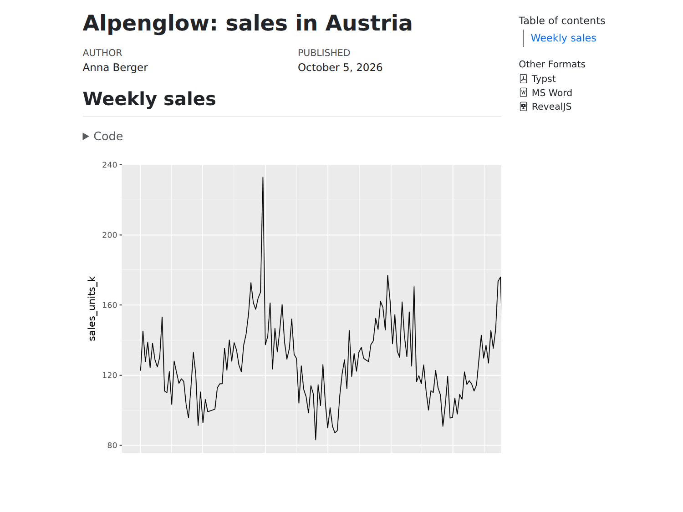
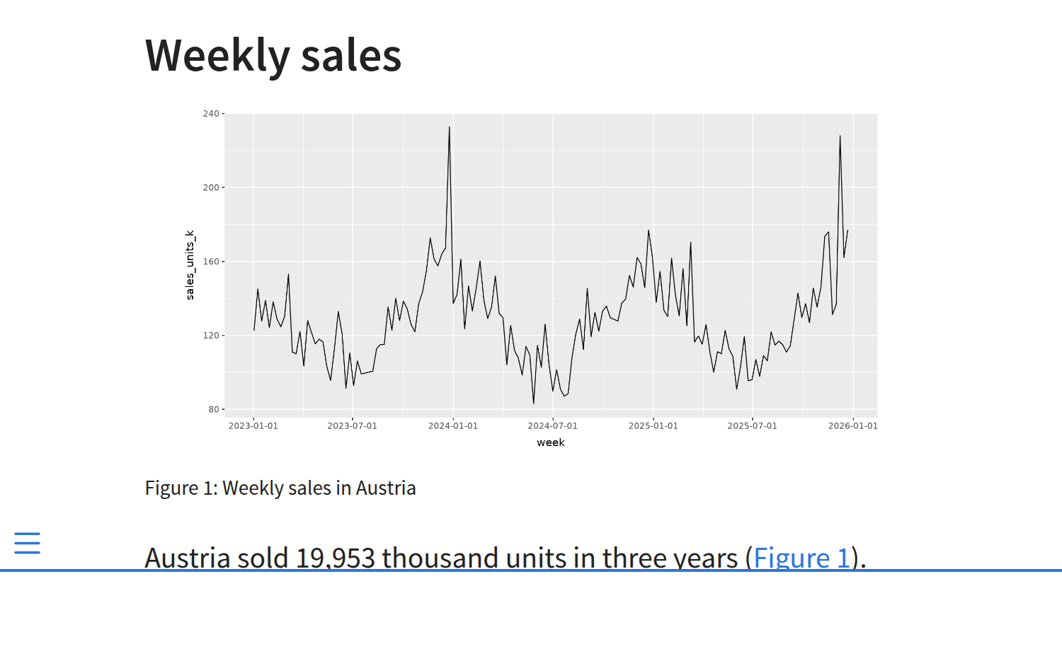
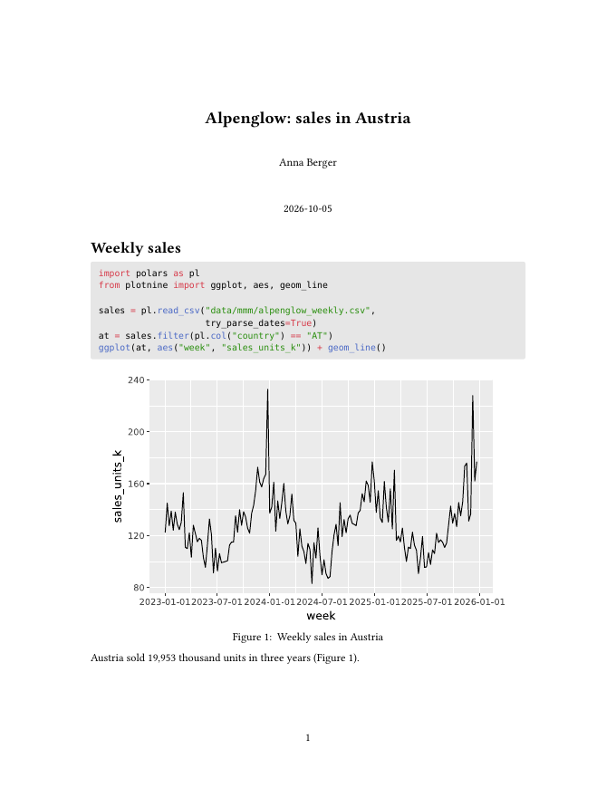
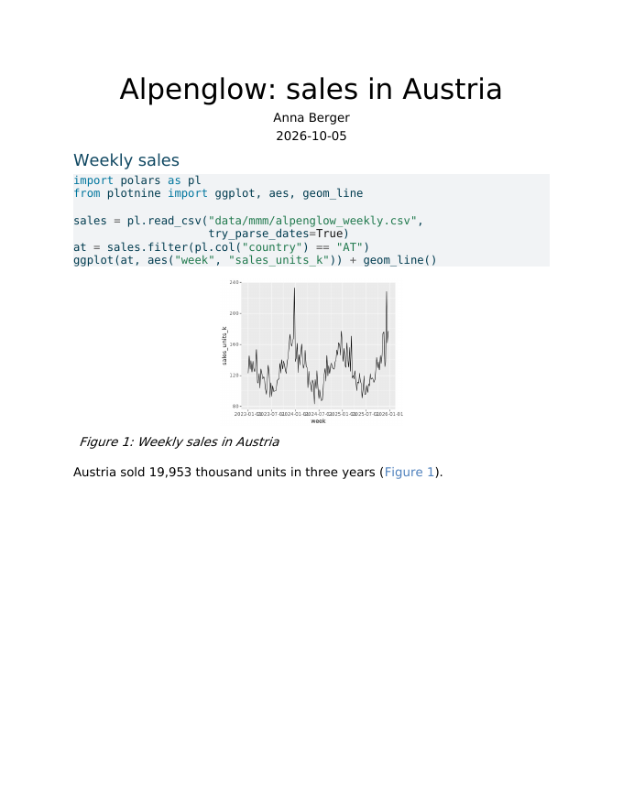
One source, many output formats
html
web page (default)
revealjs
slides in the browser
typst
PDF, no LaTeX needed
docx
Word, to edit further
YAML: several formats
Terminal: all formats, or one
format:
html: default
revealjs: default
typst: default
docx: default
quarto render report.qmd
quarto render report.qmd --to docx
Also: pptx, dashboard, pdf (LaTeX)
Notes:
The four pictures are the same report.qmd rendered four ways (slides/quarto_demo/report.qmd). Typst makes PDFs without installing LaTeX. Positron's Preview shows the first format listed.

Slide 36
Python packages for this course
Part 6 of 7 · install and load; polars, plotnine, Great Tables, statsmodels
Notes:
Install and load first, then one slide per package with code that runs on the course data.

Slide 37

Install packages: three ways
1 Windows and macOS: Positron console (easiest)
%pip install polars plotnine great-tables
2 Windows: Positron terminal
.venv\Scripts\python -m pip install -r requirements.txt # all course packages
.venv\Scripts\python -m pip install polars # one package
3 macOS: Positron terminal
.venv/bin/python -m pip install -r requirements.txt # all course packages
.venv/bin/python -m pip install polars # one package
Install name and import name can differ: pip install great-tables → import great_tables; scikit-learn → sklearn; pymc-marketing → pymc_marketing.
Notes:
All three install into the course .venv. The terminal lines call the Python inside .venv directly, so no activation is needed. %pip in the Positron console installs into the running session; restart the session afterwards if Positron asks.

Slide 38

The Packages pane: install without code
Packages icon
(Activity Bar)
Install
Package
Search name,
pick version
Restart session
when asked
PACKAGES Python 3.14.8 (.venv)
What else it does
great-tables
1.0.0
Shows which packages are loaded (attached)
Update one, or Update All Packages
Flags known security issues
Keeps versions in line with requirements.txt
Offers to install a missing package after an error
pandas
3.0.6
● attached
plotnine
0.15.8
polars
1.44.2
● attached
statsmodels
0.15.0
● attached
…
Notes:
The Packages pane arrived in Positron 2026.07. It works on the active session's environment, uses the workspace requirements.txt to keep versions consistent, flags outdated packages and known security issues, and prompts for a session restart after changes.

Slide 39

Load packages: import at the top of every file
Install once
per laptop
Import in every
file and session
Use the short
name: pl.read_csv()
Windows and macOS: the same code
Conventions
import polars as pl
import statsmodels.formula.api as smf
from plotnine import ggplot, aes, geom_line
from great_tables import GT
print(pl.__version__) # 1.44.2
pl and smf are the usual short names
Imports go at the top
Import only what you use
ModuleNotFoundError? Either the wrong interpreter is selected (pick the one in .venv) or the package is missing: %pip install it.
Notes:
Loading is the same on Windows and macOS. Installing happens once per laptop; importing in every file and every new session.

Slide 40





Your toolkit, from data to report
1 Wrangle
2 Visualise
3 Model
4 Report
polars fast tables
pandas for model packages
plotnine charts by grammar
statsmodels regression
pymc-marketing Bayesian MMM
great_tables tables
Quarto documents
22
packages pinned in requirements.txt
1
command installs them all
0
euros: all open source
Online you will also meet pandas and matplotlib: older but common; the ideas carry over.
Notes:
The four stages repeat in every lab and in the case study.

Slide 41

polars: data wrangling
Revenue and TV spend per country, 2025
DataFrame: a table with typed columns
import polars as pl
sales = pl.read_csv("data/mmm/alpenglow_weekly.csv",
try_parse_dates=True)
summary = (
sales
.filter(pl.col("week").dt.year() == 2025)
.group_by("country")
.agg(pl.col("revenue_eur_k").sum().alias("revenue"),
pl.col("spend_tv_k").sum().alias("tv"))
.sort("revenue", descending=True)
)
Expressions: pl.col("tv").sum() says what to compute
Chaining: one step per line, read top to bottom
Fast: multi-threaded, written in Rust
Result: six rows, one per country. Germany leads with about EUR 131 million revenue in 2025. Need pandas? Add .to_pandas().
Notes:
Read the chain top to bottom: keep 2025, group by country, sum two columns, sort. statsmodels and PyMC expect pandas, so convert at the end with .to_pandas().

Slide 42
plotnine: charts with the grammar of graphics
Weekly sales, Austria and Germany
(ggplot(sales.filter(
pl.col("country").is_in(["AT", "DE"])),
aes(x="week", y="sales_units_k"))
+ geom_line(color="#0096D3")
+ facet_wrap("country")
+ scale_x_date(date_breaks="1 year",
date_labels="%Y")
+ labs(x="", y="Sales (k units)")
+ theme_minimal())
The output of the code on the left
ggplot()
the data
aes()
columns to x, y
geom_
the marks
facet_
one panel per group
theme_
the look
Data + mapping + marks + panels + theme: each + adds one layer.
Notes:
Same grammar as ggplot2 in R, so R tutorials transfer almost one to one. Each + adds one layer.

Slide 43
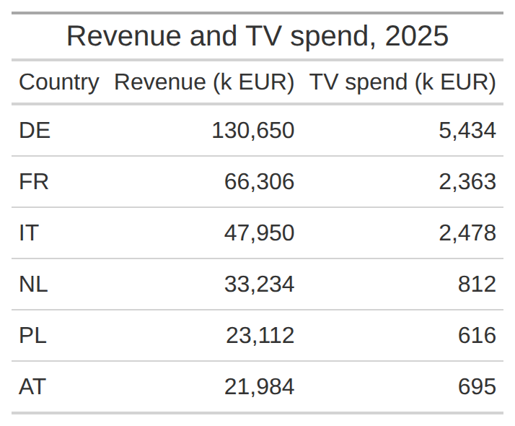
Great Tables: tables for reports
The polars summary as a table
from great_tables import GT
(GT(summary)
.tab_header(title="Revenue and TV spend, 2025")
.fmt_number(columns=["revenue", "tv"], decimals=0)
.cols_label(country="Country",
revenue="Revenue (k EUR)",
tv="TV spend (k EUR)"))
Header and labels: readable names instead of column codes
Number formats: thousands separators, currency, percent
Works with polars and pandas; renders in Quarto reports
Notes:
GT takes the polars summary from the polars slide directly. In a Quarto HTML report the table renders by itself; .save() writes a PNG.

Slide 44

statsmodels: regression
Weekly sales in Austria, 2023 to 2025
Coefficient
Estimate
import statsmodels.formula.api as smf
at = sales.filter(pl.col("country") == "AT").to_pandas()
model = smf.ols(
"sales_units_k ~ price_eur + spend_tv_k"
" + spend_paid_search_k",
data=at).fit()
print(model.summary())
Intercept
250.63
price_eur
−48.31
spend_tv_k
0.41
spend_paid_search_k
4.03
R² (n = 156)
0.43
Reading it: EUR 1,000 more paid search in a week goes with about 4,000 more units sold, holding price and TV constant.
Later in the course: scikit-learn for logistic regression and pymc-marketing for Bayesian MMM.
Notes:
A first look only: Sessions 1 and 2 explain how to read, check and improve such a model. The formula reads: sales explained by price, TV spend and paid search spend.

Slide 45
Update within Positron
Part 7 of 7 · Positron, Python, the project's .venv, packages
Notes:
Everything can be kept up to date from inside Positron. Course materials still come with a pull in GitHub Desktop.

Slide 46
Keep your set-up up to date
Positron itself
Updates itself; restart to apply
By hand: Help → Check for Updates
Python
Python: Install Python via uv
Command Palette; pick 3.14
The project's .venv
Tied to the Python that made it
New Python? Rebuild the .venv (next slide)
Packages
After a pull: %pip install -r requirements.txt
One package: %pip install --upgrade polars
Course materials: not in Positron. Pull in GitHub Desktop before every session.
Notes:
Positron checks for updates by itself: on Mac and Windows (user installation) it downloads new versions in the background and applies them on restart; Help, Check for Updates checks by hand. Python: Command Palette, Python: Install Python via uv lists the supported versions (3.9 to 3.14) and installs the one you pick; the Start Session button offers the same. A project's .venv cannot be upgraded to a new Python: it is rebuilt (next slide). Packages: when the course requirements.txt changes after a pull, install it again from the console; single packages with --upgrade, or in the Packages pane.

Slide 47
Move a project to Python 3.14
Install 3.14: Command Palette → Python: Install Python via uv → 3.14
Interpreter picker
1
Stop Python: power icon in the Console
Python 3.13.5 (.venv)
2
before
Delete .venv: Explorer, right-click the .venv folder → Delete
Python 3.14.8 (.venv) ✓
3
after
Create Environment: Venv → Python 3.14.8, tick requirements.txt
4
The check then reports 3.14.8 and ends with ready.
Check: pick Python 3.14.8 (.venv), then %run setup/check_setup.py
5
Why rebuild? a .venv cannot be upgraded; the old Python can stay installed.
Notes:
For anyone whose check shows Python 3.13 or older, or whose .venv was made with an older Python. All steps stay inside Positron. Stop the Python session first (power icon in the Console), otherwise .venv is in use and cannot be deleted. If the folder sits in OneDrive or Dropbox, pause syncing, or better, move the course folder out of synced folders. Terminal alternative on Windows: py install 3.14, then Remove-Item -Recurse -Force .venv; on macOS the python.org installer and rm -rf .venv.

Slide 48
When something goes wrong
Problem | Fix
Windows: py is not recognised | Reinstall the Python install manager; py install 3.14
No .venv in the picker | Open the course folder, not a file; pick Python 3.14.8 (.venv)
Check shows Python 3.13 or older | Move the project to Python 3.14 (Part 7)
No module named … (also 'yaml') | Not in the .venv: select it, then %pip install the package
macOS: externally-managed | System Python in use: select the project's .venv
Quarto preview does not start | Restart Positron; run quarto check in the terminal
Clone fails in GitHub Desktop | Sign in again under Accounts in the settings
Copilot is not offered | GitHub Education pending: use Copilot Free meanwhile
Notes:
Most problems are an old terminal window or the wrong interpreter.

Slide 49


Checklist: before you leave today
Accounts
Laptop
GitHub account with two-factor sign-in
Python 3.14, Positron, Quarto, GitHub Desktop
GitHub Education application sent
Course repository cloned and open
DataCamp classroom joined
.venv created and selected
“ready” and the test report renders
Posit Assistant connected
Not ready yet? Post the failing step in the Q&A forum on Canvas before Session 2.
Notes:
Students tick these off. Anything still open goes to the Q&A forum on Canvas before Session 2.

Slide 50
Notes:
Questions? Contact details on the card.

