Slide 1
International Marketing Analytics
Statistics refresher
Session 1 · WT 2026/27
Notes:
A refresher before regression: the eight ideas every later session uses. One small running example (a chocolate kiosk) so that everything can be followed with a calculator, then the same calculations by hand in Python, in Positron.

Slide 2



Today
Scale types
Centre and
spread
Normal
distribution
Covariance and
correlation
Python in
Positron
The concepts
The practice
Scale types: what you may calculate
Mean, median, variance, standard deviation
Standard error and standardisation (z)
Normal and standard normal distribution
Covariance and correlation
One small example you can follow with a calculator
Every formula by hand on the slide
The same steps by hand in Python
Check against polars' built-in functions
Why now: regression output is made of these pieces: means, standard errors, z-values and correlations.
Notes:
Four blocks of theory, each on the kiosk numbers, then Python: we calculate mean, standard deviation, z-scores, covariance and correlation by hand in code and check them against the built-in functions.

Slide 3

Our example: a chocolate kiosk
Five weeks, five prices
One week, day by day
Week
Price (EUR)
Bars sold
Day
Bars sold
1
2.00
110
Mon
10
2
2.50
100
Tue
12
3
3.00
80
Wed
11
4
3.50
70
Thu
13
5
4.00
40
Fri (event)
54
Small on purpose: every number today can be checked with a calculator, then in Python.
Notes:
A kiosk at the university sells one chocolate bar. Over five weeks the owner tried five prices. Small numbers on purpose: every result today can be checked with a calculator. The daily sales of one week (right) serve for mean and median.

Slide 4
Scale types
Part 1 of 5 · nominal, ordinal, interval, ratio
Notes:
The scale decides which statistics and which charts make sense.

Slide 5

Four scale types
Scale | What you can say | Kiosk example | Typical statistics
Nominal | same or different | brand, payment method | counts, mode
Ordinal | more or less | rating 1 to 5 stars, size S/M/L | median, percentiles
Interval | how much more (no true zero) | temperature in °C | mean, standard deviation
Ratio | how many times (true zero) | price, bars sold, revenue | all, incl. ratios
Two groups: nominal and ordinal are categorical; interval and ratio are metric (numbers you can average).
In regression: categorical variables enter as dummies (0/1), metric variables as they are.
Notes:
Nominal: categories without order (brand, country, payment method): count them, report the mode. Ordinal: ordered categories with unequal or unknown distances (star rating, size S/M/L): median and percentiles. Interval: equal distances but no true zero (temperature in °C): differences and means are fine, ratios are not. Ratio: true zero (price, bars sold, revenue): everything, including 'twice as much'. Interval and ratio together are called metric; nominal and ordinal categorical.

Slide 6

Why the scale matters
20 °C is not twice as warm as 10 °C: no true zero
Quick quiz: which scale?
Country of the customer
Satisfaction from 1 to 7
Age in years
Discount: yes or no
Temperature on the day
Mean of star ratings: treats ordinal as metric; say so
Store ID 17: a number, but only a label: nominal
Rule: check the scale before you average, chart or put a variable into a model.
Notes:
20 °C is not twice as warm as 10 °C (in Kelvin it is 293 versus 283). An average of star ratings treats an ordinal scale as metric: common in practice, but a decision you should state. An 'average brand' means nothing. Quiz answers: country nominal; satisfaction 1 to 7 ordinal (often treated as metric); age in years ratio; store ID nominal (a number, but only a label); discount yes/no nominal (binary, a dummy); temperature interval.

Slide 7
Centre and spread
Part 2 of 5 · mean, median, variance, standard deviation, standard error
Notes:
Where are the data, how far do they scatter, and how precise is our average?

Slide 8
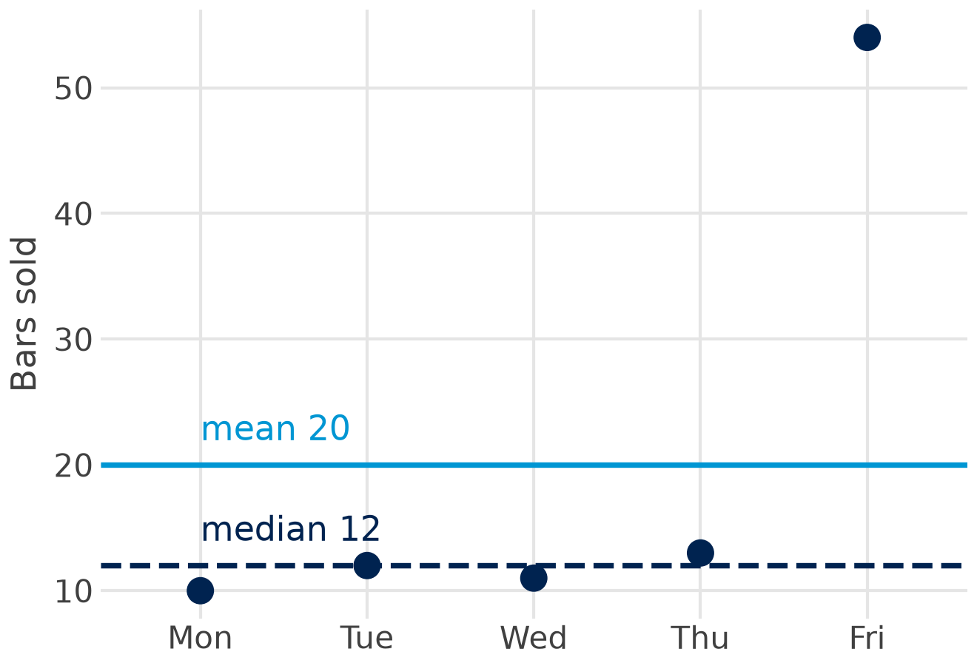

Mean and median
mean x̄ = Σ x / n = 100 / 5 = 20
median middle of 10 11 12 13 54 = 12
Mean uses every value; one event day pulls it up
Median is robust: half the days below, half above
Use the median for skewed data and ordinal scales
Totals need the mean: 20 bars a day × 5 days = 100 bars in the week.
Notes:
The mean adds all values and divides by n. The median is the middle value of the sorted data (with an even n, the average of the two middle values). One event day with 54 bars pulls the mean to 20, but the median stays at 12, which describes a normal day much better. Use the median for skewed data (income, basket values, sales with promotions) and for ordinal scales; the mean for symmetric metric data, and whenever totals matter (20 x 5 = 100 bars sold).

Slide 9
Variance and standard deviation, by hand
Week
Bars x
x − x̄
(x − x̄)²
Variance and standard deviation
1
110
30
900
x̄ = 400 / 5 = 80
s² = 3,000 / (5 − 1) = 750
s = √750 = 27.4 bars
2
100
20
400
3
80
0
0
Variance is in squared units (bars²)
4
70
−10
100
5
40
−40
1,600
Standard deviation is in bars: the typical distance from the mean
Sum
400
0
3,000
Why n − 1? deviations from the sample mean are a little too small; dividing by n − 1 corrects this. polars and pandas do it by default.
Notes:
Step by step for weekly bars sold: subtract the mean (80), square the deviations so that plus and minus do not cancel, add them up (3,000), divide by n - 1 = 4: the variance is 750 (bars squared). The square root brings us back to bars: the standard deviation is 27.4 bars, the typical distance of a week from the mean. Why n - 1: the deviations are measured from the sample mean, which sits closer to the data than the true mean; dividing by n - 1 corrects this. polars, pandas and statsmodels use n - 1 for samples.

Slide 10
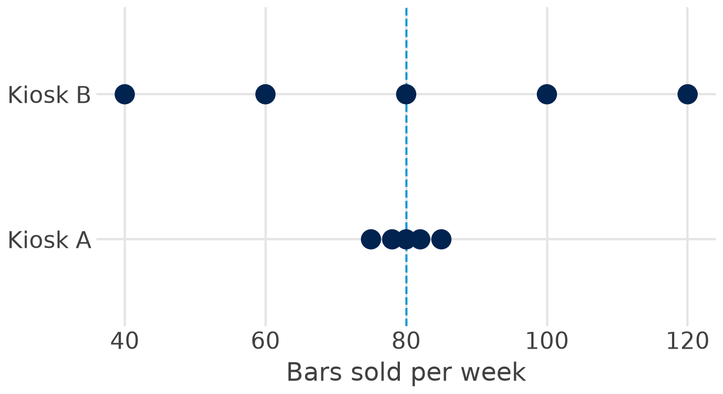

Same mean, different spread
3.8
bars: sd of kiosk A
31.6
bars: sd of kiosk B
For the manager: both sell 80 a week, but kiosk B needs much more safety stock and its forecasts are less certain.
Notes:
Two kiosks sell 80 bars a week on average. Kiosk A varies between 75 and 85 (sd 3.8), kiosk B between 40 and 120 (sd 31.6). The mean alone hides this. For planning: kiosk B needs far more safety stock, and a forecast for kiosk B is much less certain.

Slide 11

Standard error: how precise is the mean?
SE = s / √n 95% confidence interval ≈ x̄ ± 1.96 · SE
EUR 1.00
EUR 0.50
10.04–13.96
SE with 16 customers: 4 / √16
SE with 64 customers: 4 / √64
95 % interval for a mean spend of EUR 12 (n = 16)
sd describes how much customers differ: spending varies by about EUR 4
SE describes how precise the average is: it shrinks with √n; four times the sample, half the SE
In every regression table: the column 'std err' is the standard error of a coefficient.
Notes:
The standard deviation describes the customers; the standard error describes the precision of the average we calculate from a sample. SE = s / square root of n. Spending per customer has sd EUR 4: with 16 customers the SE of the mean is EUR 1, with 64 customers EUR 0.50. Four times the sample halves the standard error. A 95 % confidence interval is roughly mean plus or minus 2 SE (1.96 exactly): EUR 12 plus or minus 1.96 gives 10.04 to 13.96. Every 'std err' in a regression table is a standard error.

Slide 12
Standardisation and the normal distribution
Part 3 of 5 · z-scores, normal and standard normal distribution
Notes:
z-scores make different scales comparable; the normal distribution tells us how unusual a value is.

Slide 13

Standardisation: z-scores
z = (x − x̄) / s a standardised variable has mean 0 and standard deviation 1
Kiosk
Bars this week
Mean
sd
z
Vienna
140
120
10
+2.0
Graz
75
60
15
+1.0
Our kiosk, week 5
40
80
27.4
−1.46
Read it: Vienna's week lies 2 standard deviations above normal, Graz's only 1: Vienna's week was the more unusual one.
Use: compare across stores, countries or units; spot outliers (|z| > 3); standardised coefficients.
Notes:
A z-score says how many standard deviations a value lies above or below the mean. It removes the units, so values on different scales become comparable. Vienna sold 140 bars in a week (mean 120, sd 10): z = 2.0. Graz sold 75 (mean 60, sd 15): z = 1.0. Vienna's week was the more unusual one, although Graz's increase looks large. In our kiosk, week 5 with 40 bars has z = (40 - 80) / 27.4 = -1.46. A standardised variable always has mean 0 and standard deviation 1; standardised regression coefficients use exactly this.

Slide 14
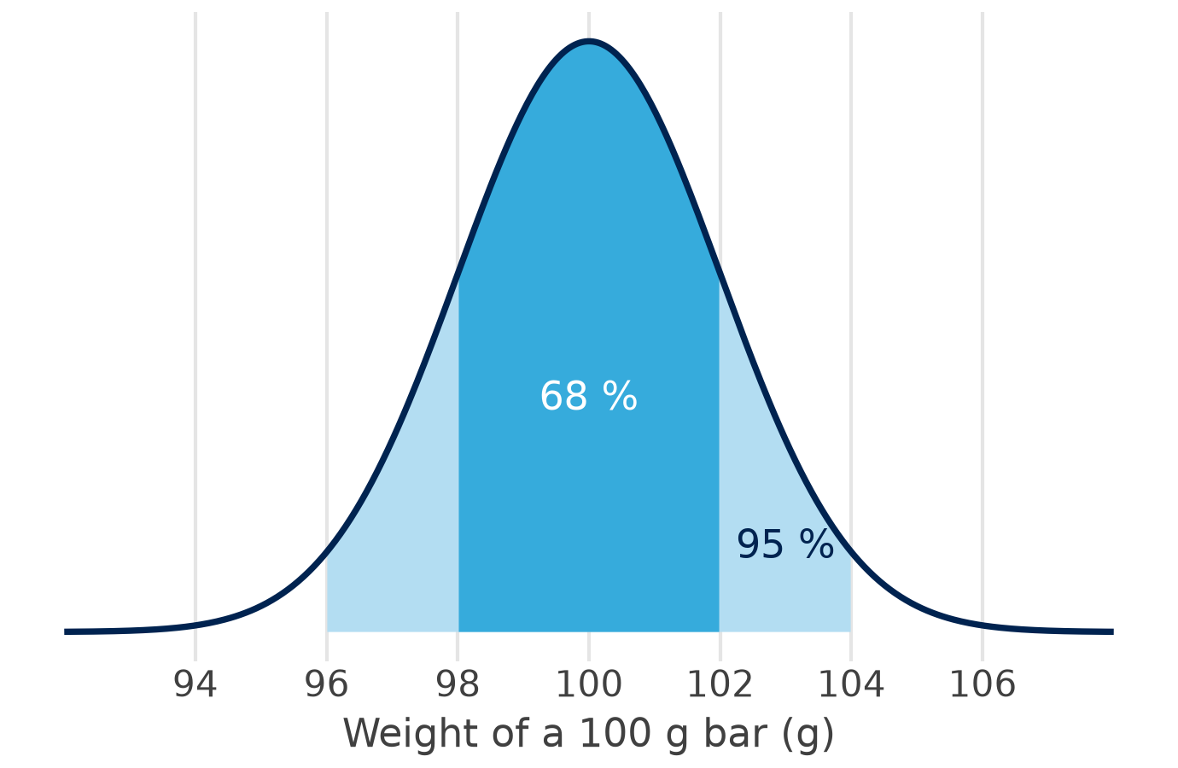
The normal distribution
68 %
within ±1 sd: 98 to 102 g
95 %
within ±2 sd: 96 to 104 g
99.7 %
within ±3 sd: 94 to 106 g
Why it matters: averages and regression coefficients are approximately normal (central limit theorem), so we can test them.
Notes:
A machine fills 100 g bars; the weights are normally distributed with mean 100 g and sd 2 g. The bell curve is fully described by mean and standard deviation. The 68-95-99.7 rule: 68 % of bars lie within one sd (98 to 102 g), 95 % within two (96 to 104 g; exactly 1.96 sd), 99.7 % within three (94 to 106 g). Many sums and averages are approximately normal even when single values are not (central limit theorem): this is why means and regression coefficients can be tested with the normal curve.

Slide 15
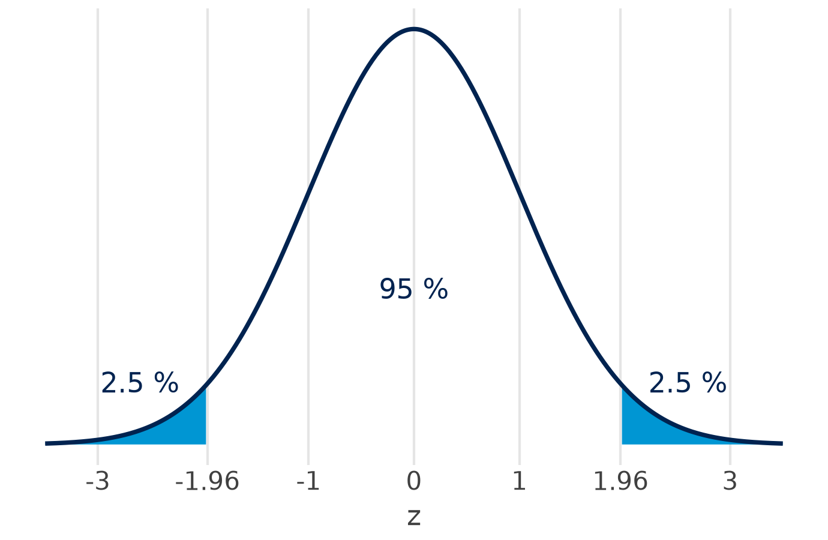
The standard normal distribution
z
share below z
1.00
84.1 %
1.645
95.0 %
1.96
97.5 %
2.576
99.5 %
Bars under 97 g? z = (97 − 100) / 2 = −1.5, so 6.7 % of all bars
1.96: the number behind 95 % confidence intervals and two-sided tests at 5 %.
Notes:
Standardising any normal variable gives the standard normal distribution: mean 0, sd 1. One table (or one line of Python) then answers every question. Share of bars below 97 g: z = (97 - 100) / 2 = -1.5, P(Z < -1.5) = 6.7 %. The value 1.96 cuts off 2.5 % in each tail: it is the 1.96 in confidence intervals and the critical value of a two-sided test at 5 %.

Slide 16
Covariance and correlation
Part 4 of 5 · do two variables move together, and how strongly?
Notes:
From one variable to two: price and bars sold at the kiosk.

Slide 17
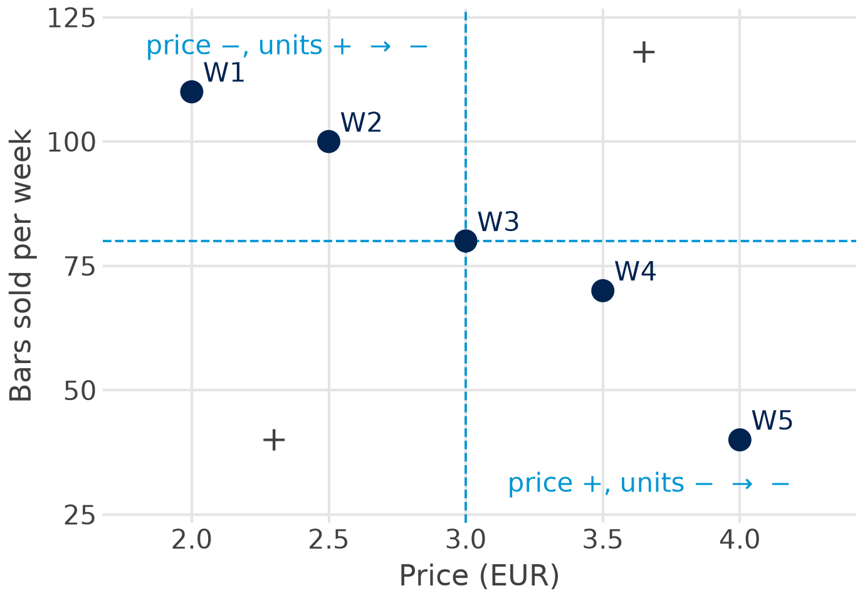

Covariance: do price and sales move together?
Week
p − p̄
x − x̄
product
1
−1.0
30
−30
2
−0.5
20
−10
3
0
0
0
4
0.5
−10
−5
5
1.0
−40
−40
Sum
−85
cov = −85 / (5 − 1) = −21.25
Sign = direction; the size depends on the units (EUR × bars).
Notes:
Multiply the deviation of price by the deviation of bars sold for every week. When one is above its mean while the other is below, the product is negative (weeks 1, 2, 4 and 5); week 3 sits exactly on both means. The sum is -85; divided by n - 1 = 4 the covariance is -21.25. The sign gives the direction: negative, higher prices go with fewer bars. The size depends on the units (EUR x bars), so -21.25 alone says little about strength.

Slide 18
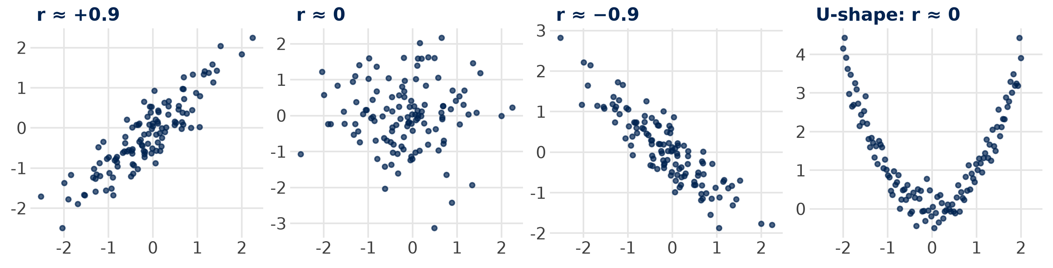

Correlation: covariance without units
r = cov / (s_p · s_x) = −21.25 / (0.79 · 27.39) = −0.98 −1 ≤ r ≤ +1
Two warnings: r only measures straight-line relationships (the U has r ≈ 0), and correlation is not causation.
Sources: Bojinov, Parzen & Hamilton 2025 (HBS note 9-622-100)
Notes:
Dividing the covariance by both standard deviations removes the units: r = -21.25 / (0.79 x 27.39) = -0.98. r always lies between -1 and +1; -0.98 is an extremely strong negative relationship (rule of thumb in Bojinov et al.: above 0.8 extremely strong). The gallery shows strong positive, none, strong negative, and a U-shape where r is zero although x and y are clearly related: r only measures linear relationships.

Slide 19

From correlation to regression
Not causation: ice-cream sales and sunburn rise together; sunshine drives both
Correlation says how strongly two variables move together, from −1 to +1
Regression says by how much y changes when x changes by one unit
slope b = cov(p, x) / var(p) = −21.25 / 0.625 = −34 bars per EUR
line through the means: x = 80 − 34 · (p − 3)
Next: the least-squares line, built from exactly these pieces.
Notes:
Ice-cream sales and sunburn correlate because sunshine drives both: correlation is not causation. The regression slope through the five weeks is cov / var(price) = -21.25 / 0.625 = -34: each euro more, 34 bars fewer. The same building blocks (means, deviations, covariance, variance) produce the least-squares line of the next deck.

Slide 20
Python in Positron
Part 5 of 5 · mean, standard deviation, z-scores, covariance and correlation by hand, then checked
Notes:
Open sessions/01-foundations/stats_refresher.qmd and run it cell by cell with Ctrl/Cmd + Enter. Each step first calculates by hand, then checks with the built-in function.

Slide 21

Step 1: the data and the mean
Python: polars
Result
Value
import polars as pl
kiosk = pl.DataFrame({
"week": [1, 2, 3, 4, 5],
"price": [2.0, 2.5, 3.0, 3.5, 4.0],
"units": [110, 100, 80, 70, 40],
})
n = kiosk.height # 5
mean_units = kiosk["units"].sum() / n # by hand
kiosk["units"].mean() # check
kiosk["units"].median()
n
5
mean, by hand
80.0
mean(), check
80.0
median()
80.0
Run it: click into a cell and press Ctrl/Cmd + Enter; the result appears in the Console.
Notes:
A polars data frame from three lists. The mean by hand is the sum divided by the number of rows; polars' mean() gives the same 80.0.

Slide 22

Step 2: variance, standard deviation, standard error
Python: by hand, then checked
Result
Value
dev = kiosk["units"] - mean_units
dev # 30, 20, 0, -10, -40
var_units = (dev ** 2).sum() / (n - 1) # 750.0
sd_units = var_units ** 0.5 # 27.39
kiosk["units"].std() # check: n - 1
se_units = sd_units / n ** 0.5 # 12.25
variance
750.0
sd, by hand
27.39
std(), check
27.39
standard error
12.25
Note: std() divides by n − 1 (ddof=1), like the formula on the slide.
Notes:
The same steps as on the slide by hand: deviations, squares, sum, divide by n - 1, square root. polars' std() uses n - 1 by default (ddof=1), so it matches. The standard error of the mean is sd / sqrt(n).

Slide 23

Step 3: standardise
Python: z-scores
Week
Bars
z
kiosk = kiosk.with_columns(
z_units=(pl.col("units") - pl.col("units").mean())
/ pl.col("units").std()
)
kiosk
kiosk["z_units"].mean() # 0
kiosk["z_units"].std() # 1
1
110
1.10
2
100
0.73
3
80
0.00
4
70
−0.37
5
40
−1.46
Read it: week 5 lies 1.46 standard deviations below an average week.
Notes:
with_columns adds a new column; the expression subtracts the mean and divides by the standard deviation. The z-scores have mean 0 and standard deviation 1. Week 5 lies 1.46 standard deviations below the mean.

Slide 24
Step 4: covariance and correlation
Python: by hand, then checked
Result
Value
dev_p = kiosk["price"] - kiosk["price"].mean()
dev_u = kiosk["units"] - kiosk["units"].mean()
cov = (dev_p * dev_u).sum() / (n - 1) # -21.25
r = cov / (kiosk["price"].std()
* kiosk["units"].std()) # -0.981
kiosk.select(
pl.cov("price", "units").alias("cov"),
pl.corr("price", "units").alias("r")) # check
covariance
−21.25
correlation
−0.981
pl.cov, check
−21.25
pl.corr, check
−0.981
Same numbers as by hand: the computer only saves the typing.
Notes:
Deviations of both variables, multiplied week by week, summed and divided by n - 1: the covariance. Divided by both standard deviations: the correlation. pl.cov and pl.corr check both in one line.

Slide 25

Step 5: look at it
Python: plotnine
from plotnine import (ggplot, aes,
geom_point, labs)
(ggplot(kiosk, aes("price", "units"))
+ geom_point(size=3)
+ labs(x="Price (EUR)",
y="Bars sold per week"))
Plot first: a correlation can hide a curve, an outlier or two groups.
Notes:
plotnine takes the polars data frame directly. Always plot two variables before you trust a correlation: the U-shape on the correlation slide had r = 0.

Slide 26
Your turn: by hand, then in Python
Pairs, paper:
10 minutes
Python check:
10 minutes
Day
Temp. °C
Bars
1
Scales: which scale is each column?
Mon
10
60
2
Centre: mean and median of bars sold
Tue
15
55
3
Spread: variance and sd of bars, by hand
Wed
20
50
Thu
25
40
4
z: z-score of the hottest day's sales
Fri
30
35
5
Together: covariance and r of temperature and bars; then check all in Python
Notes:
Answers: 1 day nominal-ordinal (weekday order), temperature interval, bars sold ratio. 2 mean 48, median 50. 3 deviations 12, 7, 2, -8, -13; squares sum 430; variance 107.5; sd 10.37. 4 z of the hottest day: (35 - 48) / 10.37 = -1.25. 5 temperature deviations -10, -5, 0, 5, 10; products -120, -35, 0, -40, -130, sum -325; covariance -81.25; sd temperature 7.91; r = -0.99. Warmer days, fewer chocolate bars.

Slide 27

In-class quiz: five questions
1 Satisfaction from 1 to 5 stars is measured on which scale?
A nominal B ordinal C ratio
2 Daily sales 10, 12, 11, 13, 54: what describes a typical day best?
A the mean (20) B the median (12) C the standard deviation
3 You survey four times as many customers. The standard error of the mean …
A halves B falls to a quarter C stays the same
4 A week's sales have z = −2. That week was …
A 2 bars below the mean B 2 standard deviations below the mean C 2 % below the mean
5 Price and bars sold have r = −0.98. What does this mean?
A higher prices cause lower sales B opposite directions, nearly linear C 0.98 bars fewer per EUR
3 minutes alone, then compare with your neighbour. Same format as the online quiz and the exam.
Notes:
Three minutes alone, then compare with your neighbour; reveal the answers one by one. Answers: 1 B (ordinal: ordered, but the distances between stars are unknown). 2 B (the median, 12; the event day pulls the mean to 20). 3 A (SE = sd / square root of n: four times the sample halves it). 4 B (z counts standard deviations; about 2.3 % of weeks lie that low in a normal distribution, so C is wrong). 5 B (r measures the strength of a straight-line relationship; it says nothing about cause, and the slope per euro is the regression coefficient, -34 bars here).

Slide 28
Key takeaways
Scale first: it decides which statistics make sense
1
Mean and median: the median resists outliers; totals need the mean
2
sd describes the data; SE = sd / √n describes the precision of the mean
3
z = (x − x̄) / s makes values comparable; 95 % of a normal lies within ±1.96 sd
4
Covariance gives the direction, correlation the strength (−1 to +1), regression the size
5
Next: linear regression on real chocolate data.
Notes:
The vocabulary for the rest of the course: every regression table reports means, standard errors, z- or t-values and builds on covariances.

Slide 29

References
Books and readings
Online
Field, A. (2024). Discovering Statistics Using IBM SPSS Statistics, 6th ed. SAGE. Chapters 1 to 2 and 8.
Bojinov, I. I., Parzen, M. & Hamilton, P. J. (2025). Linear Regression. HBS note 9-622-100: correlation.
Hair, J. F. et al. (2019). Multivariate Data Analysis, 8th ed. Cengage. Chapter 2.
Stock, J. H. & Watson, M. W. (2019). Introduction to Econometrics, 4th ed. Pearson. Chapters 2 to 3.
Seeing Theory. Brown University: interactive visual introduction to probability and statistics (free).
StatQuest. Videos on the normal distribution, standard deviation vs standard error, covariance and correlation (free).
polars documentation. mean, median, std, cov, corr.
Gelman, Hill & Vehtari (2020). Regression and Other Stories, ch. 3 to 4 (free PDF).
Notes:
Field is the friendliest textbook for students without a statistics background; Seeing Theory and StatQuest visualise every concept of today.

Slide 30
Notes:
Questions? Contact details on the card; office hours via the booking link.

