Slide 1
Open-source marketing mix modelling
International Marketing Analytics
WT 2026/27
Notes:
Welcome to the session on marketing mix modelling. Its question is the oldest in marketing: what did our advertising bring, and where should the next euro go? We start with a tiny invented coffee brand whose numbers fit on a calculator and learn the main concepts with it. Then we meet the three open-source tools, PyMC-Marketing, Meridian and Robyn, model the real data of a web shop and end with the same analysis in nine short Python steps (sessions/02-mmm-one-country/open_source_mmm.qmd). The in-class assignment needs no coding.

Slide 2



Today
Concepts
By
hand
Three
tools
Real
data
Python
In class
Theory, Parts 1 to 3
Practice, Parts 4 to 6
The model in one line, carryover, saturation, ROI
A small example by hand
PyMC-Marketing, Meridian, Robyn
Real data: a sports web shop in Austria
Python: a code ladder in nine steps
Online quiz and an in-class assignment (no coding)
Question of the day: where should the next euro go, and how sure can we be?
Notes:
Three theory parts on one tiny brand, then real data, Python and the assignment. Part 1 names the main concepts: the model in one line, carryover, saturation and the ROI. Part 2 computes them by hand in tables, so every number can be checked with a calculator. Part 3 explains the three open-source tools and how they differ. Parts 4 to 6 bring the real data of a sports web shop, the Python code as a ladder of nine small steps, an online quiz and the in-class assignment. Keep the question of the day in mind: every part answers a piece of it.

Slide 3





Our example: where should the next euro go?
The problem: a brand spends on TV and online and must split next year's budget.
The question: what did each channel bring, and where should the next euro go?
Measure
Explain
Plan
sales from each channel
baseline vs media
move budget to the best next euro
A tiny coffee brand first: 10 weeks, TV and online, by hand; a real web shop in Part 4.
Invented round numbers (hand_example.csv)
Notes:
A marketing mix model, MMM for short, is a regression of weekly sales on media spend and controls, with two twists: carryover and saturation (slides 8 and 9). It needs only totals per week, no data about single users (slide 6). It does three jobs: measure what each channel brought, explain sales as baseline plus media, and plan where the next euro goes. Our coffee brand is invented, so that every number can be checked. Ask the room: which channels does your brand or employer pay for, and who decides the split?

Slide 4
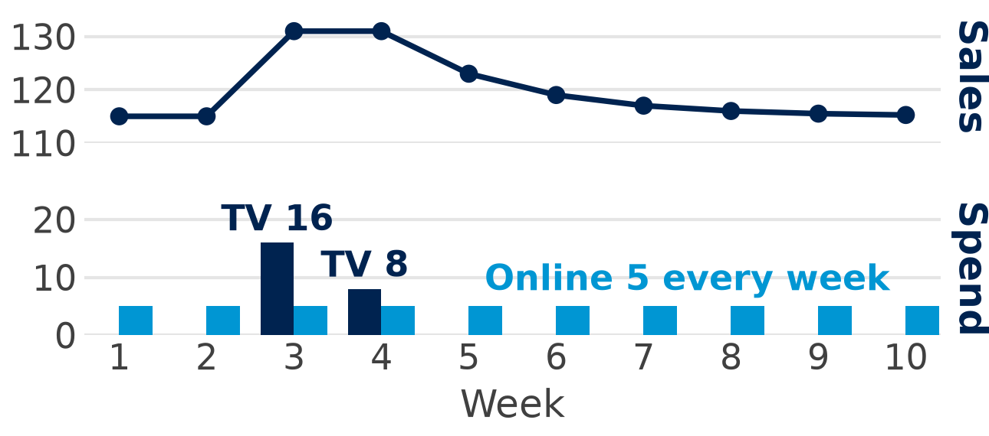
The data: ten weeks, one row per week
Coffee brand: spend and sales per week, k EUR
Week
1
2
3
4
5
6
7
8
9
10
TV
0
0
16
8
0
0
0
0
0
0
Online
5
5
5
5
5
5
5
5
5
5
Sales
115
115
131
131
123
119
117
116
115.5
115.25
Sales jump in the TV weeks 3 and 4: 131
and fade slowly: 123, 119, 117 …
Online: 5 k EUR every week
Invented round numbers (hand_example.csv)
Notes:
Each column of the grid is one week: what the brand spent on TV and online, and what it sold, all in k EUR. Real MMM data look the same, with more weeks and channels: the web shop of Part 4 has 134 weeks. Sales jump to 131 when TV runs in weeks 3 and 4 and then stay above the 115 of weeks 1 and 2 for several weeks without any TV: that is carryover. Online spend never changes, so the data alone cannot tell us its effect; slide 9 comes back to that. Ask: what would you guess TV brought? Part 2 (slides 12 to 14) computes it.

Slide 5
The main concepts
Part 1 of 6 · the model in one line, carryover, saturation, ROI
Notes:
Part 1 explains why marketers came back to marketing mix modelling, writes the model as one equation and adds the two ideas that turn a plain regression into an MMM: carryover and saturation. It ends with the difference between the average ROI and the ROI of the next euro, which is what a budget decision needs.

Slide 6



Why MMM is back
Tracking breaks
No user data
Free tools
Apple's opt-in rule and the GDPR hide many user journeys from the ad platforms.
Only weekly totals of sales and spend per market.
PyMC-Marketing, Meridian and Robyn are open source.
Old idea, new tools: MMM dates back to the 1960s; Bayesian methods and free code made it affordable.
MMM works where tracking fails: it needs only weekly totals per market.
Notes:
Click-based attribution follows single users from the ad to the purchase, and that tracking breaks. Aridor et al. (2025, Management Science) found that click-through on Meta conversion ads fell by 37 per cent after Apple's App Tracking Transparency, across more than 4,200 advertisers [S]. Wernerfelt et al. (2025, Marketing Science 44(2)) showed in a test with more than 70,000 advertisers that without offsite data the median cost per incremental customer rose by 31 per cent; two of the authors worked at Meta [S]. Goldberg, Johnson and Shriver (2024, AEJ: Economic Policy 16(1)) report about 12 per cent fewer recorded EU pageviews and revenue after the GDPR, partly lost recording rather than lost sales [S]. MMM needs none of this: weekly totals per market are enough. Ask: how would you measure a TV campaign with click data?

Slide 7



The model in one line
Sales = baseline + media effects + controls + noise
Baseline
Media effects
Controls
what you would sell with no media: trend, season, holidays
each channel after carryover and saturation
price, promotions, competitors, weather
Coffee brand, week 3: 100 + 1 × 16 + 3 × 5 = 131
baseline 100 · TV adstock × 1 · online × 3
The output: the contribution and ROI of each channel, response curves, a budget plan.
Invented round numbers (hand_example.csv)
Notes:
Every MMM has this additive form, as in Jin et al. (2017, Google) and the three tools; Meridian and PyMC-Marketing also allow a multiplicative, log form. The baseline is everything the brand would sell with no media at all: trend, season, holidays; for the coffee brand 100 a week. The media effect of a channel is its part of sales each week; added up over the weeks it is the channel's contribution (slide 13). Controls are other drivers such as price, promotions, competitors, weather. Here we tell you the numbers 100, 1 and 3; in real data the regression estimates them (Part 5). The noise is zero only because the brand is invented.

Slide 8
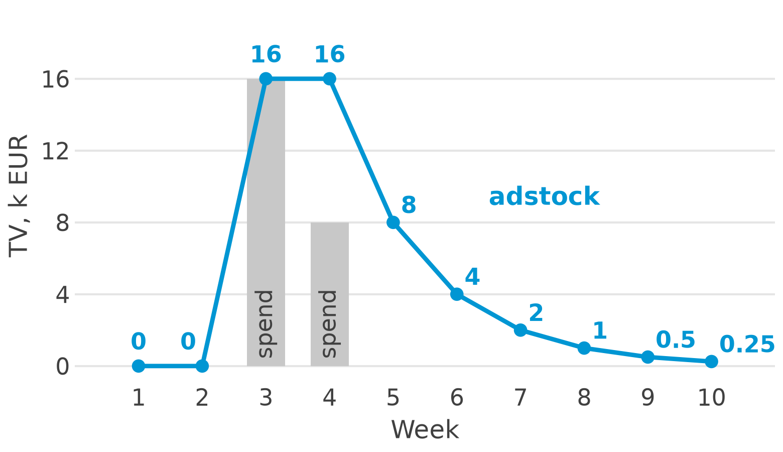
Carryover: this week's spend keeps working
Adstock = this week's spend + decay × last week's adstock
0.5
decay: half of last week's adstock is left this week
× 2
each euro works twice:
1 + 0.5 + 0.25 + 0.125 + … = 2
Carryover: TV in weeks 3–4 still sells in weeks 5–10.
Invented round numbers (hand_example.csv)
Notes:
This is geometric adstock: each week, the decay keeps a share of last week's adstock, here 0.5, so half of it. PyMC-Marketing calls the decay alpha, Robyn theta. Week 4: 8 + 0.5 × 16 = 16. The 24 k EUR of TV spend become 47.75 of adstock in 10 weeks, and the tail after week 10 adds the rest up to 48: each euro works twice. All three tools apply adstock first, then saturation. Ask: which channel carries over longest, TV or paid search?

Slide 9
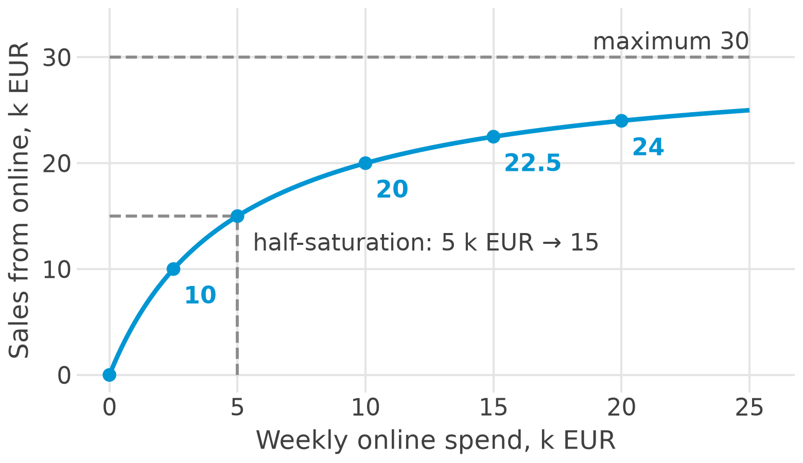
Saturation: each extra euro buys less
Online effect =
30 × spend / (spend + 5)
30
maximum: the most online can bring per week
5
half-saturation: at 5 k EUR online brings half of it, 15
Saturation: 10 k EUR bring 20, not twice 15.
Invented round numbers (hand_example.csv)
Notes:
This shape is called a Hill or Michaelis–Menten curve; PyMC-Marketing's default is a logistic curve with the same idea. The maximum, 30, is the most online can bring per week however much is spent; at the half-saturation point, 5 k EUR, online brings half of it, 15. At today's spend of 5 the curve gives exactly 3 × 5 = 15, as the line of slide 7, so both agree where we have data. But the brand never spent anything else on online, so the data alone could not show the curve: that is why priors and experiments matter (slides 17 and 21). The parameters are illustrative, not estimates; Step 7 (slide 37) meets the same problem on real data.

Slide 10
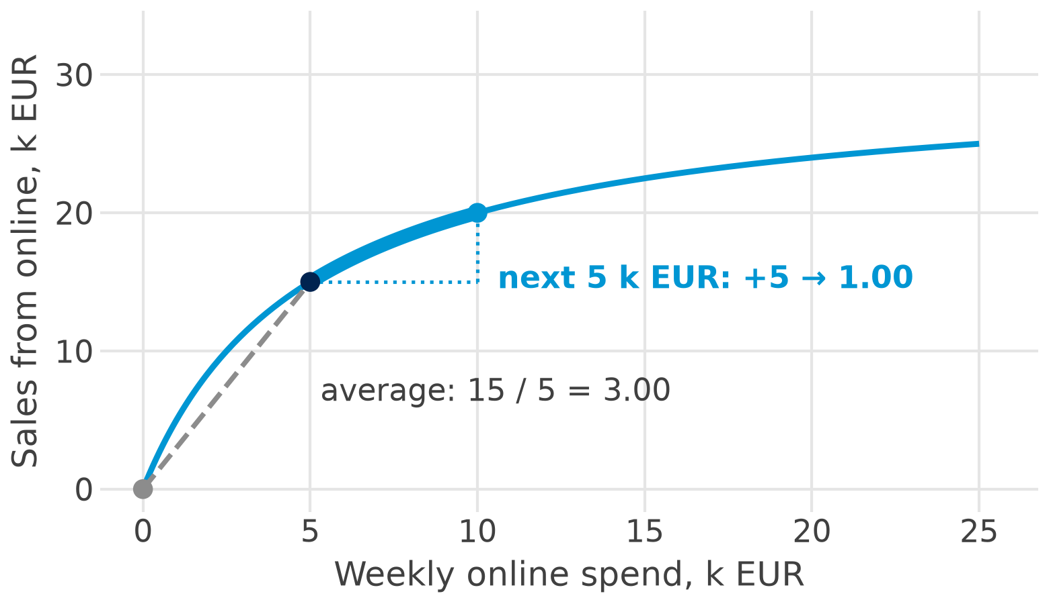
ROI and the response curve
3.00
average ROI: 15 / 5: 3 EUR of sales per euro
1.00
next 5 k EUR: (20 − 15) / 5 = 1.00
Response curve: weekly sales from a channel against its weekly spend
The shape of the curve, not the average ROI, decides where the next euro goes.
Invented round numbers (hand_example.csv)
Notes:
ROI is the sales contribution divided by spend; here it counts sales, not profit, so multiply by the margin before you judge profitability. PyMC-Marketing calls it ROAS, return on ad spend. The average ROI looks back: 15 / 5 = 3.00. The marginal ROI looks forward: the next 5 k EUR bring only 5, so 1.00; from 10 to 20 k EUR the next euros bring only 0.40 each. Ask: if online's average ROI is 3.00, should the brand double online?

Slide 11
A small example by hand
Part 2 of 6 · adstock, contributions, ROI, a budget question
Notes:
Part 1 named the ideas; this part does the arithmetic with the same small coffee brand: ten weeks, TV and online spend, sales in k EUR. Three slides, and a calculator is enough: the TV adstock week by week, the contribution and ROI of each channel, and a budget question that the average ROI answers wrongly. Every number on these slides can be checked by hand from what is on the slide. Step 4 of the code ladder and Extra A of the qmd do the same in Python.

Slide 12
Adstock week by week
Week
1
2
3
4
5
6
7
8
9
10
TV spend
0
0
16
8
0
0
0
0
0
0
+ 0.5 × last
0
0
0
8
8
4
2
1
0.5
0.25
= adstock
0
0
16
16
8
4
2
1
0.5
0.25
Week 4: 8 + 0.5 × 16 = 16
new spend + half of last week's adstock
24
TV spend
in k EUR
Week 5: 0 + 0.5 × 16 = 8
no new spend: half is left
47.75
TV adstock
weeks 1–10
Each euro works twice: 24 k EUR of TV spend count as 47.75 in ten weeks, 48 in the long run.
Invented round numbers (hand_example.csv)
Notes:
The rule is the one of slide 8: adstock = this week's spend + 0.5 × last week's adstock. Read the table column by column: in week 3 the brand spends 16, so the adstock is 16; in week 4 it spends 8 and half of last week's 16 is added: 8 + 0.5 × 16 = 16. From week 5 on there is no new spend and the adstock halves every week, down to 0.25 in week 10. The decay 0.5 is an assumption here; the Bayesian tools estimate it from the data (slide 17). In ten weeks the 24 k EUR of spend work as 47.75; the 0.25 still left after week 10 is why the ten-week ROI of slide 13 (1.99) is a bit below the long-run 2.00. In Python this is one line, lfilter (Step 4, slide 34). Ask: what would the adstock be with decay 0?

Slide 13
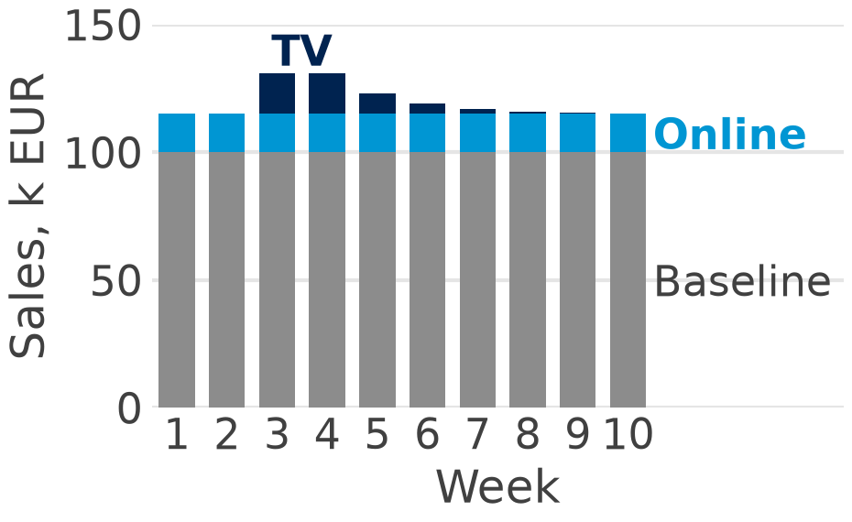
Contributions and ROI by hand
Part
Calculation
Sales
Spend
ROI
Baseline
100 × 10 weeks
1,000
–
–
TV
1 × 47.75 adstock
47.75
24
1.99
Online
3 × 50 spend
150
50
3.00
Total
1,197.75
74
–
Sales per week: baseline, online, TV
ROI = sales ÷ spend. Shares of 1,197.75: baseline 83.5 %, online 12.5 %, TV 4.0 %
Ignore carryover and TV looks half as good: 24 / 24 = 1.00 instead of 1.99.
Invented round numbers (hand_example.csv)
Notes:
Each week's sales split exactly into the three parts: week 3 is 100 + 1 × 16 + 3 × 5 = 131. Add up the ten weeks and you get the contributions: the baseline 1,000, TV 47.75 and online 150, together 1,197.75 k EUR. ROI is contribution divided by spend: TV brings 47.75 k EUR in ten weeks for 24 k EUR of spend, 1 × 47.75 / 24 = 1.99; in the long run each euro of TV works twice, so its ROI tends to 2.00. A last-click view that credits only the week of spending would see 24 k EUR of sales and an ROI of 1.00. ROI here is sales, not profit: with a gross margin of 40 per cent, for instance, an ROI of 1.99 would not pay back. In Python: Step 6 (slide 36) and Extra A of the qmd. Ask: which channel has the higher ROI?

Slide 14


The budget question: 5 k EUR more a week
The question: the brand has 5 k EUR more a week. TV or online?
TV
Online
5 k EUR more TV work twice (carryover):
1 × 5 × 2 = 10 k EUR of sales
ROI of the next euro: 10 / 5 = 2.00
Its curve (slide 9): 15 at 5, 20 at 10 k EUR:
20 − 15 = 5 k EUR of sales
ROI of the next euro: 5 / 5 = 1.00
Average ROI: online 3.00, TV 1.99: the average would pick the wrong channel.
Decide at the margin: put the next euro where the next euro sells most.
Invented round numbers (hand_example.csv)
Notes:
Online already runs at 5 k EUR a week, on the flat part of its curve (slide 9): 5 k EUR more lift its effect only from 15 to 20, so the next euro brings 1.00. TV is not saturated in our model: 5 k EUR more work twice through carryover, 1 × 5 × 2 = 10 k EUR, an ROI of 2.00 for the next euro. We assume TV's straight line still holds at 5 k EUR more a week – in real data the TV curve would flatten too, and that is why we test before we move money (lift tests, slide 21). The same logic on real data: slide 29 (Google vs Meta) and Task 1 of the assignment (slide 44). Ask: what would change the answer?

Slide 15
Three open-source tools
Part 3 of 6 · PyMC-Marketing, Meridian, Robyn
Notes:
Part 3 introduces the three free tools that do what we did by hand in Part 2, on real data and with many more weeks and channels. For each tool we ask who builds it, what is under the hood and when it fits a brand. Then three questions that matter for international marketing: how each tool uses experiments, how it handles many countries, and which tool to pick. The last slide shows how to read the case studies that the makers of the tools publish.

Slide 16
The three tools at a glance
 | PyMC-Marketing | Google Meridian | Meta Robyn
Maintainer | PyMC Labs | Google | Meta Marketing Science
Version (Oct 2026) | 1.3.0 | 2.1.0 | 3.12.1 (CRAN)
Language | Python | Python | R (Python port in beta)
Approach | Bayesian | Bayesian, geo-level | Ridge regression + search
Engine | PyMC | JAX | glmnet, Nevergrad, Prophet
Licence | Apache-2.0 | Apache-2.0 | MIT
All free and open, but two come from the largest ad platforms (slide 24).
Sources: PyPI, CRAN and the tools' repositories, checked 26 Oct 2026
Notes:
[V] The versions were checked on PyPI and CRAN on 26 Oct 2026: PyMC-Marketing 1.3.0 of 22 Oct 2026, google-meridian 2.1.0 and Robyn 3.12.1 on CRAN of 2 Jul 2025; the Python port of Robyn, robynpy 0.3.6, is still beta. LightweightMMM, Meridian's predecessor, was archived on 19 Jan 2026. PyMC-Marketing had its first release in Feb 2023 and reached 1.0 in Aug 2026; Meridian became generally available in Jan 2025, and 2.0 (Sep 2026) moved it to JAX. The APIs changed in Aug and Sep 2026, so pin the version and check the date of any tutorial. Our course runs PyMC-Marketing 0.19.2, the last version for Python 3.11 (1.3.0 needs Python 3.12); the code of Part 5 runs on both. Engine: PyMC and JAX do the sampling; glmnet fits the ridge regressions, Nevergrad does the search and Prophet splits trend, season and holidays.

Slide 17
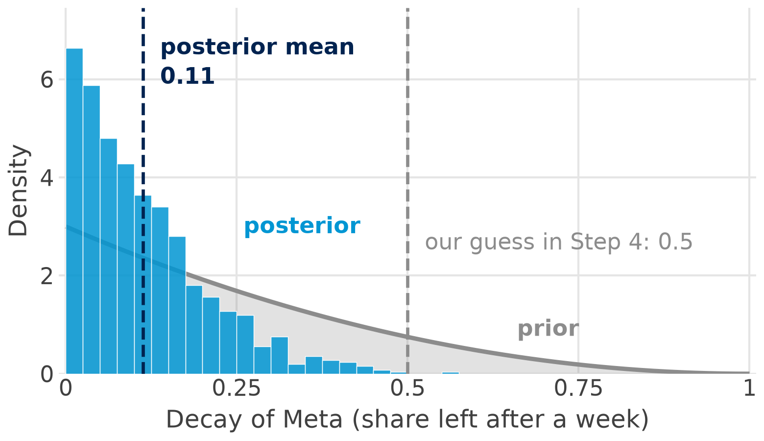
Bayesian in one picture: prior and posterior
Prior: what we believe before the data (here: the decay is probably small, Beta(1, 3))
Posterior: the belief after the data: mean 0.11, 94 % interval 0.00 to 0.29
Check: R-hat 1.00, no divergences: the sampler agrees with itself
Bayesian MMM: every parameter gets a prior; the result is a range, not one number.
Prior: PyMC-Marketing default; posterior: the Austrian model of Step 8
Notes:
Bayesian MMM gives every parameter a prior, a belief before we see the data, and the data turn it into a posterior. The chart shows the decay of Meta in our Austrian model of Step 8 (slides 38 and 39): the prior Beta(1, 3), PyMC-Marketing's default, says the decay is probably small but could be anything from 0 to 1; after the data the mean is 0.11 and the 94 per cent interval runs from 0.00 to 0.29. Our guess of 0.5 in Step 4 was far too high for Meta. [V] PyMC-Marketing and Meridian draw the posterior with NUTS, an MCMC sampler; R-hat compares the chains: 1.00 means they agree, above 1.01 do not trust the result yet. Our quick fit uses 2 chains × 500 draws, so the largest R-hat over all parameters is 1.01; real work uses 4 chains and more draws. The default priors are decay Beta(1, 3), lam Gamma(3, 1), beta HalfNormal(2). With few data the prior matters more, with many data the data win. Question: what prior would you give TV's decay?

Slide 18
PyMC-Marketing: Bayesian MMM in Python
What: PyMC Labs' free Python package (Apache-2.0), built on PyMC
open_source_mmm.qmd · Step 8
mmm = MMM(date_column="week", target_column="sales",
channel_columns=["google", "meta"],
control_columns=["week_no"],
adstock=GeometricAdstock(l_max=6),
saturation=LogisticSaturation(),
yearly_seasonality=2)
How: a prior on every parameter; adstock, then saturation; every result comes with a range
Strengths: flexible; countries and brands in one model; lift tests and a budget optimiser built in
After the fit you get
Slide
a posterior for every parameter
17, 39
Best for: many markets or brands, a budget split across them, a team that codes in Python
contributions and ROI with a range
28
response curves, a budget plan
29
Our tool in Part 5: six lines define the model, one call fits it (Step 8).
Notes:
PyMC-Marketing is the tool of our code ladder (Part 5). In plain words: we write down the model, adstock then saturation, give each parameter a prior, and the sampler returns a range for every result. [V] It sets pooling per parameter with dims=("geo",), so countries or brands can share a mean; its optimiser allocates a budget over channel × geo in one run, and add_lift_test_measurements adds experiments (slide 21). Version 1.0 (Aug 2026) made the multidimensional model the default class; our import from pymc_marketing.mmm.multidimensional works in 0.19.2 and in 1.3.0. The fit on our Austrian data takes about 25 s (slide 38). [V] Bolt (Estonia) moved to PyMC-Marketing across its markets (Bolt tech blog, June 2024): an example, not a proof.

Slide 19
Meridian: Google's Bayesian geo model
What: Google's free Python package (Apache-2.0); runs on JAX, a GPU helps
Not run here: not in the course environment
from meridian.data import (
data_frame_input_data_builder as db)
from meridian.model import model, spec
builder = db.DataFrameInputDataBuilder(
kpi_type="non_revenue",
default_kpi_column="conversions")
builder = (builder.with_kpi(df)
.with_population(df)
.with_media(df,
media_cols=["Channel0_impression"],
media_spend_cols=["Channel0_spend"],
media_channels=["Channel0"]))
mmm = model.Meridian(input_data=builder.build(),
model_spec=spec.ModelSpec())
mmm.sample_posterior(n_chains=10, n_adapt=1000,
n_burnin=500, n_keep=1000)
How: priors, as in PyMC-Marketing; regions (geos) in one model, each around a shared mean
Strengths: lift tests become ROI priors; reach and frequency for video; a guided Colab notebook
Best for: data by region and Google-heavy media
Geo first: Meridian needs population per region and models sales per head.
Source: Meridian Getting Started notebook, github.com/google/meridian (commit ef585b5); not run here
Notes:
Meridian is Google's Bayesian MMM. In plain words: like PyMC-Marketing it puts priors on the parameters, but it is built for data by region: every region (geo) gets its own media effect, drawn around a shared mean, and sales are modelled per head of population. [V] A lift test becomes the ROI prior of that channel (Zhang et al. 2024, Google Research); 2.0 (Sep 2026) moved to JAX and loads GeoX results directly. [D] The README (29 Oct 2026) asks for Python 3.11 to 3.13 and recommends at least one GPU. The snippet is shortened: the notebook also adds revenue per KPI, controls, a promotion, organic media and an ROI prior, and samples the prior first; the code is in qmd Extra D. [C] Pandora (Denmark) tested Meridian first in markets without other measurement (Think with Google); bonprix Germany with the Vienna agency e-dialog, a certified Meridian partner, reports +30 per cent ROI: vendor claims, see slide 24.

Slide 20
Robyn: Meta's ridge regression and search
What: Meta's free R package (MIT); a Python port is in beta
Not run here: Robyn is an R package
library(Robyn)
InputCollect <- robyn_inputs(
dt_input = dt_simulated_weekly,
dt_holidays = dt_prophet_holidays,
date_var = "DATE", dep_var = "revenue",
dep_var_type = "revenue",
prophet_vars = c("trend", "season", "holiday"),
prophet_country = "DE",
paid_media_spends = c("tv_S", "search_S"),
adstock = "geometric",
hyperparameters = hyperparameters)
OutputModels <- robyn_run(
InputCollect = InputCollect,
iterations = 2000, trials = 5)
How: ridge regression (it shrinks the effects to keep them stable); a search tries thousands of adstock and saturation settings
Strengths: a quick first read-out; holidays for 123 countries built in; no sampler to check
Pick: the Pareto front keeps the models no other beats on fit and plausibility; the analyst picks one
Trade-off: priors make assumptions explicit; the Pareto front makes the analyst's choice explicit.
Source: Robyn demo.R, github.com/facebookexperimental/Robyn (commit aab4226); not run here
Notes:
Robyn is Meta's MMM in R. In plain words: it does not use priors; it fits a ridge regression, a regression that shrinks the coefficients towards zero so they stay stable, and lets a search try thousands of adstock and saturation settings. [V] Nevergrad searches the hyperparameters (adstock, saturation, penalty) against NRMSE (fit), DECOMP.RSSD (distance between spend share and effect share) and MAPE.LIFT (calibration), as described by Runge, Skokan, Zhou & Pauwels (2024), arXiv 2403.14674. The Pareto front is the set of models that no other model beats on both fit and plausibility; the analyst picks one. In the snippet, hyperparameters is a list of ranges per channel defined earlier in demo.R; the code is in qmd Extra D. [S] Unilever Poland and Wittchen are on Meta's Robyn case list. Question: is 'effects close to spend shares' a sensible assumption in a new market?

Slide 21

Calibrating with experiments
Meridian: the lift test becomes the ROI prior of that channel
Lift test
Switch a channel on or off in some regions and measure the difference.
Example: more Meta in half of the regions, none in the rest.
Calibration: use that difference to anchor the model.
PyMC-Marketing: each test is a point on the response curve, per country if needed
Robyn: tests are an extra objective; models far from the lift lose
International angle: tests often run only in large markets; a pooled Bayesian model passes that evidence on to the small ones.
Notes:
A model learns from what happened; an experiment shows what a channel causes. A lift test switches a channel on or off in some regions or for some users and measures the difference; calibration uses that number to anchor the model. [V] Meridian: Zhang et al. (2024, Google Research) reparameterise the model by ROI, so a lift test sets the ROI prior. PyMC-Marketing: add_lift_test_measurements treats each test as a noisy point on the saturation curve. Robyn: calibration_input plus the MAPE.LIFT objective. Pitfall for all three: the test's counterfactual and spend level must match what the model estimates. For our Austrian shop (slide 29) a geo test, some Austrian regions with more Meta and some without, would settle whether Meta is really that good.

Slide 22
Many countries: three ways to pool
No pooling
Full pooling
Partial pooling
DE
AT
DE + AT
shared mean
DE
AT
one model per country; small markets get noisy estimates
Robyn
one effect for all countries; hides real differences
rarely sensible
country effects around a shared mean; small markets borrow strength
Meridian, PyMC-Marketing
Our brand: Austria sold 3,180 k EUR in the same 134 weeks in which Germany sold 11,270
One currency first: Switzerland is in CHF; convert before you pool (ECB rates).
Data: Conjura MMM dataset (Anderson 2024), CC BY 4.0
Notes:
Pooling is how much the countries share. [V] Sun et al. (2017, Google): a geo-level hierarchical MMM gives tighter intervals than national models; Meridian draws each geo's coefficient around a shared mean, PyMC-Marketing sets pooling per parameter with dims=("geo",), and Robyn's maintainer recommends one model per geo (GitHub Discussion #856). Our brand: Austria sold 3,180 k EUR in 134 weeks, Germany 11,270: with partial pooling Austria's estimates move towards the shared mean unless its own data say otherwise. Preparing many countries: one currency (ECB rates; none of the tools converts, Meridian's currency_code only labels the output; Switzerland is in CHF and has only 81 weeks), local holidays (python-holidays or Robyn's tables; 8 December is a holiday in Austria, not in Germany), the same KPI definition, population for per-capita KPIs, and a channel missing in a country is zero, not missing. Market response does differ across countries ([S] Datta et al. 2022, 14 economies; [S] Gielens & Steenkamp 2025, drift in 98.5 per cent of 16,000+ brands in 34 countries), so allow country effects and refresh the models; [V] Steenkamp & Geyskens (2014): global integration, local adaptation, worldwide learning. Extra C of the qmd fits Germany with the same code.

Slide 23


Which tool for which situation?
PyMC-Marketing
Meridian
Robyn
many countries or brands in one model
a budget split across markets
a team that codes in Python
geo-level data and Google-heavy media
reach and frequency for video
a guided Colab workflow
one market, few channels, R users
a quick first read-out
country holidays built in
Our shop: 2.6 years of weekly data in Austria; Germany next door
Rule of thumb: two or more years of weekly data per market; with less, pool countries or use informative priors.
Notes:
Three cards, one rule of thumb. The decision rules are adapted from practitioner comparisons ([V] Impression, June 2026; [V] Jaywing, Jan 2025) and an Austrian agency view on how much data is needed (Blck Alpaca 2026, in German). Our shop has 2.6 years of weekly data in Austria, just above the rule of thumb, and Germany next door in the same file. This is also Task 4 of the assignment (slide 43). Question: which tool for our sports brand with Germany, Austria and Switzerland?

Slide 24


Reading vendor claims: four questions
Who wrote it? Google, Meta or a partner may favour their own channels.
1
Compared with what? An uplift needs a baseline and a time window.
2
Tested how? A holdout period or a lift test, not only in-sample fit.
3
Which version? Results on old releases may no longer hold.
4
Free software is not a free model: the platforms that sell the media also wrote two of the tools that judge it.
Notes:
Four questions before you believe a case study. [V] AdExchanger (July 2026) asked whether platform-built MMMs are a 'gift to measurement or Trojan horses'. [V] PPC Land (Apr 2026): a Robyn model at Resident coincided with a higher Facebook budget share. [V] PyMC Labs' own benchmark (Sept 2025) favours PyMC-Marketing and used versions since superseded. [V] AnalyticaHouse (Turkey) claims 7x ROI with no baseline or time window. [V] Michael Kaminsky on Mobile Dev Memo (July 2026): 'the default assumption should be that MMMs in general are wrong'. Examples to grade, all from the tool maker or a partner and not checked independently: [C] Nürnberger Versicherung (PyMC Labs case 2026, cost per lead more than 27 per cent lower), [C] bonprix with e-dialog (+30 per cent ROI), [C] Bouygues Telecom with fifty-five (an internal Meridian platform). Task 3 of the assignment (slide 43) grades one claim with these four questions.

Slide 25
Real data: a sports web shop
Part 4 of 6 · the data, a warning, the model, the next euro
Notes:
Part 4 asks the questions of Parts 1 and 2 again, now on 134 real weeks: what did Google and Meta bring, and where should the next euro go? The data are the weekly sales and ad spend of a real web shop. We first look at the data and at one warning, then read what a Bayesian model says. The model itself is fitted in Part 5 (Steps 8 and 9); here we only read its results.

Slide 26
The data: 134 weeks of a real web shop
File: sports_weekly.csv, Austria (AT)
3,180
k EUR of sales in 134 weeks
week
sales
google
meta
26 Jul 2021
7.46
1.02
0.39
2 Aug 2021
9.32
1.36
0.27
9 Aug 2021
8.61
1.28
0.26
561
k EUR of spend: Google 87.5 %, Meta 12.5 %
… 134 weeks in all
sales: goods ordered in the web shop, k EUR
2.6
years: Germany and Switzerland are in the file too
google: spend on all Google ads, k EUR
meta: spend on Facebook and Instagram ads, k EUR
Data: Anderson (2024), Conjura multi-region MMM dataset, figshare, CC BY 4.0; weekly sums by the course
Notes:
About 100 eCommerce brands share their anonymised daily data in the Conjura dataset; Conjura is an analytics platform in Dublin. We summed the days of one sports brand, whose home market is Germany, to Monday-to-Sunday weeks (data/get_mmm_open_data.py): 26 Jul 2021 to the week that ends 18 Feb 2024. Only digital channels are in the file, Google and Meta, no TV; sales are the value of the goods ordered before discounts, and Meta spend is 0 in 20 of the 134 weeks. The brand is anonymised, so we do not know who it is; the licence is CC BY 4.0 as stated by the GitHub copy we used. Ask the room: what is missing that a brand manager would add?

Slide 27
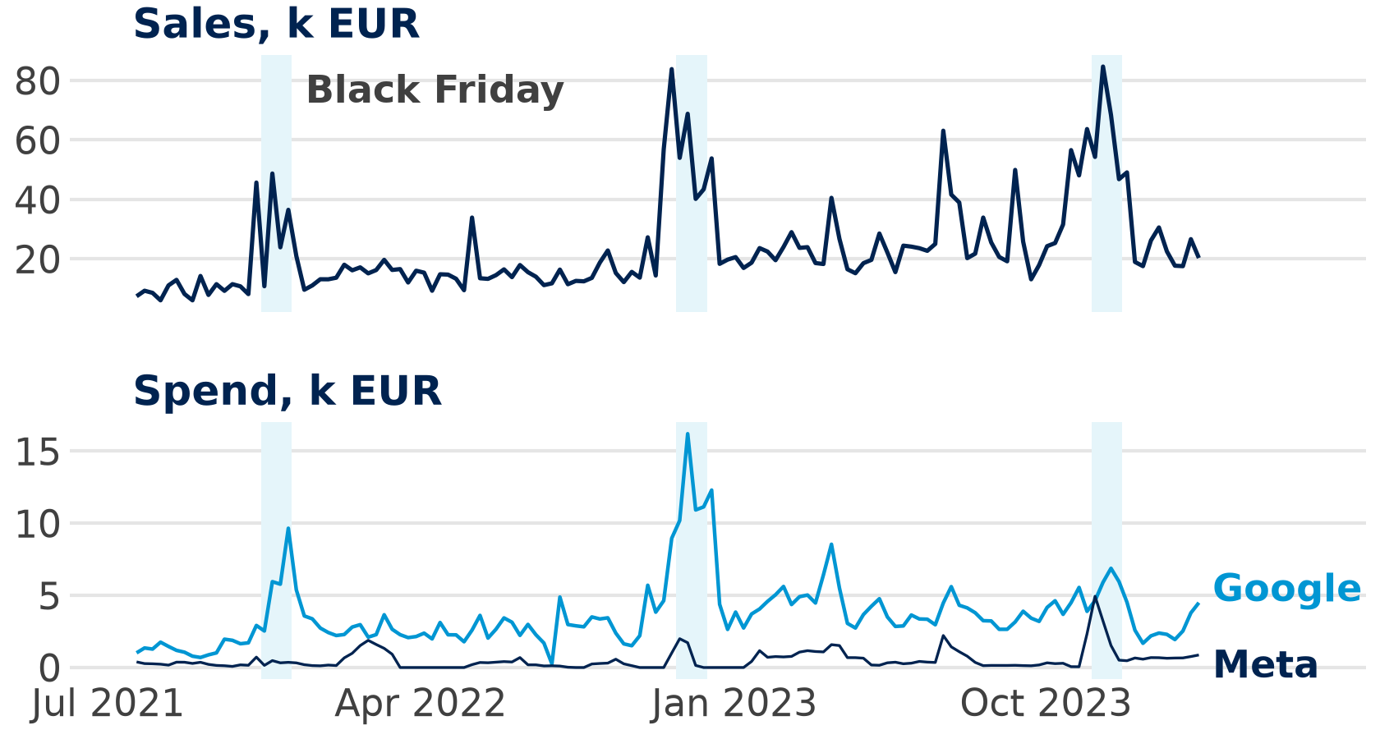
Spend follows demand: a warning
7.03
k EUR on Google a week in the 10 best weeks …
3.39
… and in the other 124 weeks
0.68
correlation of sales and Google spend
Spend follows demand: shopping ads spend more when more people search.
Data: Conjura MMM dataset (Anderson 2024), CC BY 4.0
Notes:
The best week was the Black Friday week of 20 Nov 2023, with 84.68 k EUR of sales; the 10 best weeks fell in July, October and November, the sale seasons. In those weeks the shop spent 7.03 k EUR a week on Google, in the other 124 weeks 3.39 k EUR: Google Shopping and Performance Max budgets grow automatically with searches, so spend goes up when the buyers are already there. A regression cannot tell whether the spend caused the sales or the demand caused the spend, so the model may credit Google with sales it only caught. Sales also doubled from the first year (15.31 k EUR a week) to the last (30.39): a trend we must control for (Step 3). The remedy is an experiment (slide 21).

Slide 28
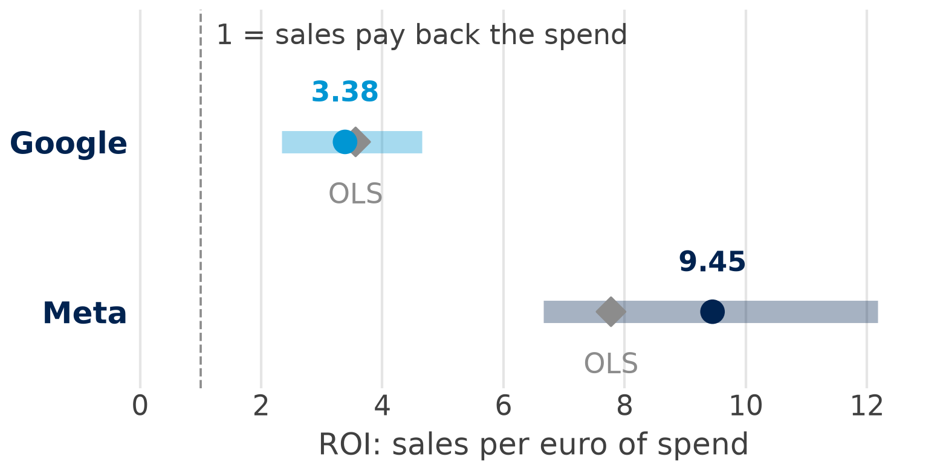
What the model says: contributions and ROI
52 %
of sales from Google (1,660 k EUR)
21 %
from Meta (660 k EUR)
27 %
baseline, trend and season
ROI with 94 % interval (PyMC-Marketing); ◆ OLS of Step 6
Meta: 9.45 per euro (6.66 to 12.18); Google: 3.38 (2.33 to 4.65).
Data: Conjura MMM dataset (Anderson 2024), CC BY 4.0; model: Step 8
Notes:
These are the results of the PyMC-Marketing model of Step 8: Google brings 52.2 per cent of sales (1,660 k EUR), Meta 20.8 per cent (660 k EUR), and 27.0 per cent are baseline, trend and season. OLS with carryover gave the same picture (Step 6): ROI 3.56 and 7.78, baseline 28.0 per cent. The 94 per cent interval says how sure the model is: with 94 per cent probability Meta's ROI lies between 6.66 and 12.18, if the model is right. ROI here is sales per euro, not profit: multiply by the margin before you call a channel profitable. And 73 per cent of sales from two digital channels is a lot for a shop with direct and organic visitors: remember slide 27; in Germany the same model even gives 95 per cent (assignment Task 2).

Slide 29
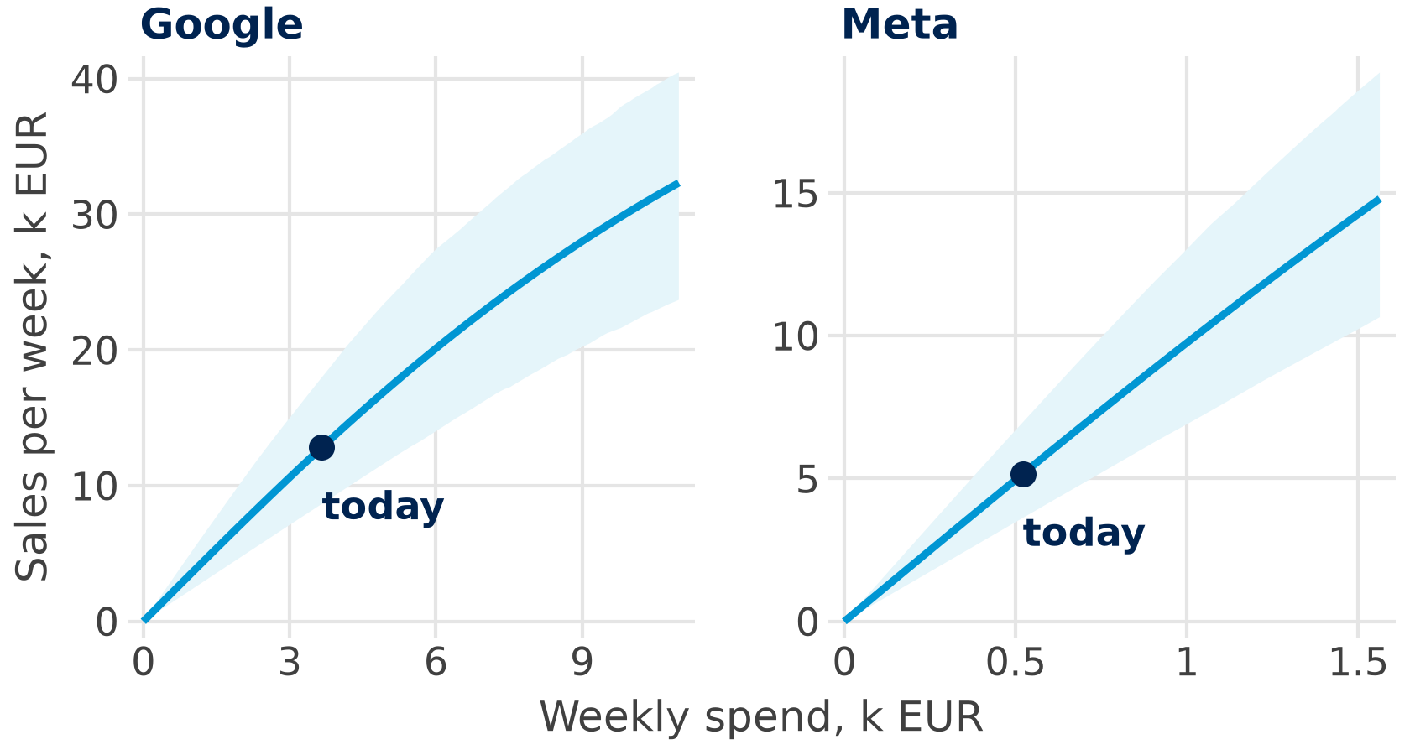
Response curves: where the next euro works
9.77
Meta: next-euro ROI at today's 0.52 k EUR a week
3.28
Google: next-euro ROI at 3.66 k EUR a week
+3.1
k EUR of sales a week if 0.5 k EUR move from Google to Meta
Shift a little, then test: a geo lift test in Austria before the big move.
Data: Conjura MMM dataset (Anderson 2024), CC BY 4.0; curves: posterior of Step 8
Notes:
The curves are the weekly response curves of the posterior of Step 8 (2 chains × 500 draws), the band their 94 per cent range. Google is already on the flatter part (average ROI at today's spend 3.50, next euro 3.28), Meta is still steep (next euro 9.77). Moving 0.5 k EUR a week from Google to Meta gains 3.1 k EUR a week (1.56 to 4.87), about 162 k EUR a year, and pays in 100 per cent of the draws. But the model is only as good as its assumptions: Meta's spend would double to 1.02 k EUR a week, Meta's curve rests on low spend, and Google's spend follows demand; a geo lift test calibrates the curve (slide 21). It is the decision rule of slide 14 and of Task 1: put the next euro where its ROI is highest.

Slide 30
MMM in Python
Part 5 of 6 · a code ladder, one step at a time
Notes:
Live in Positron, with sessions/02-mmm-one-country/open_source_mmm.qmd open: run it chunk by chunk. The ladder has 9 steps, one new thing each: load, a first regression, the trend, adstock, carryover, ROI, saturation, PyMC-Marketing, check and read. Every slide shows the full code of its step, character for character as in the qmd, the part of the output to look at and one sentence on how to read it. Steps 1 to 7 need polars, statsmodels and scipy; Steps 8 and 9 need PyMC-Marketing, which is installed in the course environment.

Slide 31

Step 1: load and look
1 Load
2 Regress
3 Trend
4 Adstock
5 Carry
6 ROI
7 Saturate
8 PyMC
9 Read
open_source_mmm.qmd · Step 1
week
sales
google
meta
import polars as pl
# load the weekly data and keep Austria
file = "../../data/mmm_open/sports_weekly.csv"
df = pl.read_csv(file, try_parse_dates=True)
at = df.filter(pl.col("country") == "AT")
print(at.head())
# total sales and spend, k EUR
at.select(pl.col("sales", "google", "meta").sum())
26 Jul 2021
7.46
1.02
0.39
2 Aug 2021
9.32
1.36
0.27
9 Aug 2021
8.61
1.28
0.26
total
3,180
491
70
Look first: 134 weeks; Google gets 7 of every 8 euros.
Notes:
polars reads the csv; the qmd sits in sessions/02-mmm-one-country, hence the path two folders up. try_parse_dates=True turns the week column into dates, and filter keeps Austria, 134 weeks. print(at.head()) shows the first five weeks, the last line the totals in k EUR: those of slide 26. Look at the data before you fit anything. Code: open_source_mmm.qmd, Step 1.

Slide 32

Step 2: a first regression
1 Load
2 Regress
3 Trend
4 Adstock
5 Carry
6 ROI
7 Saturate
8 PyMC
9 Read
open_source_mmm.qmd · Step 2
term
coef
import statsmodels.formula.api as smf
# sales on the spend of both channels
m1 = smf.ols("sales ~ google + meta",
data=at.to_pandas()).fit()
m1.params
Intercept
5.14
google
3.93
meta
8.10
R²
0.58
Before any control: a k EUR on Meta goes with 8.10 k EUR of sales.
Notes:
smf.ols fits a regression with a formula, as in the regression sessions; .fit() estimates it and m1.params shows the coefficients. Both are k EUR of sales per k EUR of spend, so they read like ROIs: Google 3.93, Meta 8.10; R² 0.58. Nothing controls for the trend or for carryover yet. Code: open_source_mmm.qmd, Step 2. Ask the room: why might Meta's 8.10 be too high?

Slide 33

Step 3: add the trend
1 Load
2 Regress
3 Trend
4 Adstock
5 Carry
6 ROI
7 Saturate
8 PyMC
9 Read
open_source_mmm.qmd · Step 3
term
coef
# week_no counts the weeks 1 to 134: the trend
at = at.with_columns(
week_no=pl.int_range(1, pl.len() + 1))
m2 = smf.ols("sales ~ google + meta + week_no",
data=at.to_pandas()).fit()
m2.params
Intercept
0.57
google
3.60
meta
6.93
week_no
0.09
R²
0.62
The trend takes its share: sales grew without the channels too.
Notes:
pl.int_range(1, pl.len() + 1) counts the weeks 1 to 134, and with_columns adds them as week_no. week_no 0.0944 k EUR a week means that week 134 sells about 133 × 0.0944 ≈ 12.6 k EUR more than week 1, with the same spend. Both channels lose some credit to the trend (Meta 8.10 → 6.93, Google 3.93 → 3.60); R² rises to 0.62. The trend is part of the baseline. Code: open_source_mmm.qmd, Step 3.

Slide 34
Step 4: adstock in one line
1 Load
2 Regress
3 Trend
4 Adstock
5 Carry
6 ROI
7 Saturate
8 PyMC
9 Read
open_source_mmm.qmd · Step 4
week
meta
meta_ad
from scipy.signal import lfilter
# adstock: this week's spend + 0.5 x last stock
at = at.with_columns(
meta_ad=lfilter([1], [1, -0.5], at["meta"]))
at.select("week", "meta", "meta_ad").head()
26 Jul 2021
0.389
0.3890
2 Aug 2021
0.273
0.4675
9 Aug 2021
0.259
0.4928
16 Aug 2021
0.231
0.4774
23 Aug 2021
0.167
0.4057
As by hand: 0.273 + 0.5 × 0.389 = 0.4675 (slide 12).
Notes:
lfilter([1], [1, -0.5], x) from scipy is the adstock rule of slide 8 in one line: each value is this week's spend plus 0.5 × the last result. Week 2: 0.273 + 0.5 × 0.389 = 0.4675, as we did by hand on slide 12. The decay 0.5 is our assumption; Step 9 shows that the data prefer 0.11. Code: open_source_mmm.qmd, Step 4.

Slide 35

Step 5: regression with carryover
1 Load
2 Regress
3 Trend
4 Adstock
5 Carry
6 ROI
7 Saturate
8 PyMC
9 Read
open_source_mmm.qmd · Step 5
term
coef
# Meta with its carryover, Google without
m3 = smf.ols("sales ~ google + meta_ad + week_no",
data=at.to_pandas()).fit()
m3.params
Intercept
0.58
google
3.56
meta_ad
3.93
week_no
0.09
R²
0.60
Per k EUR of adstock: each euro of Meta counts about twice (Step 6).
Notes:
Google stays without adstock: search answers demand in the same week. Meta enters with its adstock, so its coefficient 3.93 is per k EUR of adstock; the adstock total is about twice the spend (138.15 vs 69.87 k EUR), so Meta's ROI in Step 6 is about twice 3.93. R² 0.60, a bit lower than in Step 3 (0.62): the decay 0.5 does not help the fit. Code: open_source_mmm.qmd, Step 5.

Slide 36

Step 6: contributions and ROI
1 Load
2 Regress
3 Trend
4 Adstock
5 Carry
6 ROI
7 Saturate
8 PyMC
9 Read
open_source_mmm.qmd · Step 6
channel
contrib.
ROI
# contribution = coefficient x column total
b = m3.params
c_google = b["google"] * at["google"].sum()
c_meta = b["meta_ad"] * at["meta_ad"].sum()
print(c_google, c_meta)
# ROI = contribution / spend
print(c_google / at["google"].sum())
print(c_meta / at["meta"].sum())
google
1,746
3.56
meta
543
7.78
baseline
891
–
Meta returns more per euro, Google brings more sales.
Notes:
A contribution is the coefficient times the column total: Google 3.56 × 490.6, Meta 3.93 × the adstock total. The ROI is the contribution divided by the spend: Google 3.56, Meta 7.78. The baseline is what is left, 891 k EUR or 28.0 per cent of sales. It is the same arithmetic as slide 13. Code: open_source_mmm.qmd, Step 6.

Slide 37
Step 7: saturation in one line
1 Load
2 Regress
3 Trend
4 Adstock
5 Carry
6 ROI
7 Saturate
8 PyMC
9 Read
open_source_mmm.qmd · Step 7
model
R²
Google ROI
# saturation: half-saturation at 20 k EUR a week
at = at.with_columns(
google_sat=at["google"] / (at["google"] + 20))
m4 = smf.ols(
"sales ~ google_sat + meta_ad + week_no",
data=at.to_pandas()).fit()
print(m3.rsquared, m4.rsquared)
# the Google ROI of the curved model
b4 = m4.params
c_sat = b4["google_sat"] * at["google_sat"].sum()
print(c_sat / at["google"].sum())
straight
0.60
3.56
curved
0.60
4.79
Same fit, other answer: the data cannot choose the curve.
Notes:
x / (x + 20) is the saturation curve of slide 9 with a half-saturation point of 20 k EUR a week, our assumption (Google spends 3.66 a week on average, 16.20 at most). R² 0.6044 vs 0.6019: the same fit, but Google's ROI is 4.79 instead of 3.56 and the baseline only 9.1 per cent instead of 28.0 per cent. The data cannot choose the curve: priors (Step 8) and experiments (slide 21) must. Code: open_source_mmm.qmd, Step 7.

Slide 38
Step 8: PyMC-Marketing
1 Load
2 Regress
3 Trend
4 Adstock
5 Carry
6 ROI
7 Saturate
8 PyMC
9 Read
open_source_mmm.qmd · Step 8
setting
value
from pymc_marketing.mmm import (
GeometricAdstock, LogisticSaturation)
from pymc_marketing.mmm.multidimensional import MMM
# the Bayesian MMM: adstock, then saturation
mmm = MMM(date_column="week", target_column="sales",
channel_columns=["google", "meta"],
control_columns=["week_no"],
adstock=GeometricAdstock(l_max=6),
saturation=LogisticSaturation(),
yearly_seasonality=2)
X = at.select("week", "google", "meta", "week_no")
mmm.fit(X.to_pandas(), at["sales"].to_pandas(),
draws=500, tune=500, chains=2,
random_seed=1, progressbar=False)
chains × draws
2 × 500
adstock window
6 weeks
season
yearly, 2 waves
runtime
about 25 s
One model, all at once: adstock, saturation, trend and season, with priors.
Notes:
MMM is the multidimensional model class of PyMC-Marketing (the default class from 1.0 on; this import works in 0.19.2 and 1.3.0). GeometricAdstock(l_max=6) lets spend work for up to 6 weeks, LogisticSaturation() is its default curve, yearly_seasonality=2 adds a smooth yearly season and week_no is the trend as a control. fit samples 2 chains × 500 draws after 500 tuning steps; random_seed=1 makes it repeatable. It takes about 25 s (about 75 s the first time, while PyTensor compiles). This is a quick fit for class: for real work use 4 chains and more draws. Code: open_source_mmm.qmd, Step 8.

Slide 39

Step 9: check and read
1 Load
2 Regress
3 Trend
4 Adstock
5 Carry
6 ROI
7 Saturate
8 PyMC
9 Read
open_source_mmm.qmd · Step 9
result
google
meta
import arviz as az
# the decay of each channel, with R-hat
print(az.summary(mmm.idata,
var_names=["adstock_alpha"]))
# ROI per channel: mean and 94 % interval
roi = mmm.summary.roas(frequency="all_time")
roi
decay
0.05
0.11
R-hat
1.00
1.00
ROI
3.38
9.45
94 % interval
2.33–4.65
6.66–12.18
Same ranking as OLS, now with a range: and Meta's decay is 0.11, not 0.5.
Notes:
az.summary shows the decay (PyMC-Marketing calls it alpha) with its interval and R-hat: 1.00 for both; the maximum over all parameters is 1.01, with 0 divergences. mmm.summary.roas(frequency="all_time") gives the ROI (PyMC-Marketing says ROAS) with a 94 per cent interval: the same ranking as OLS (3.56, 7.78). Meta's decay of 0.11 (0.00 to 0.29) is far below our 0.5 of Step 4. Slides 28 and 29 read these results; Extra B of the qmd draws the response curves. Code: open_source_mmm.qmd, Step 9.

Slide 40
In-class assignment
Part 6 of 6 · quiz, four tasks, no coding
Notes:
The last part hands the ideas over to you. First a five-question online quiz on the whole session, then we go through it together. Then groups of three review a marketing mix model in four short tasks: a budget move, a model check, a vendor claim and a tool choice. No laptops and no code: a calculator is enough.

Slide 41
Online quiz: MMM in five questions
1 Decay 0.5, last week's adstock 6, spend this week 10. This week's adstock is …
A 16 B 13 C 8
2 A channel brought 120 k EUR of sales for 40 k EUR of spend. Its ROI is …
A 0.33 B 3.00 C 80
3 Sales 30 at 10 k EUR a week, 36 at 20 k EUR a week. The ROI of the extra 10 k EUR is …
A 3.00 B 1.80 C 0.60
4 Which tool fits many ridge regressions and lets the analyst pick from a Pareto front?
A PyMC-Marketing B Meridian C Robyn
5 A new market has six months of weekly data. The best start is …
A a model of its own B partial pooling with the other markets C the biggest market's ROI
3 minutes alone, then compare with your neighbour.
Notes:
Online quiz on Canvas: three minutes alone, then compare with your neighbours. Question 1 goes back to adstock on slides 8 and 12, question 2 to the ROI on slides 10 and 13, question 3 to the next euro on slides 10 and 14, question 4 to Robyn on slide 20 and question 5 to pooling on slide 22. Ask for a show of hands per option before you move on.

Slide 42
Answers: in class
Notes:
The answers follow in class.

Slide 43
Your turn: an MMM review in four tasks
Groups of three:
35 minutes
Plenary:
10 minutes
1
Budget: three response curves of an e-bike brand: where should 10 k EUR a week go? (slide 44)
2
Model check: the German model credits Google and Meta with 95 % of sales. Plausible? What would you test?
3
Vendor claim: grade one case study with the four questions (slide 24)
4
Tool choice: PyMC-Marketing, Meridian or Robyn for two brands, with two reasons each (slide 23)
Deliverable: one slide per group: the budget move, the verdict on Germany, the grade, the two tools.
Handout: sessions/02-mmm-one-country/mmm_assignment.qmd (no code needed)
Notes:
Groups of three for 35 minutes, then a 10-minute plenary. Hand out mmm_assignment.qmd printed or project it; a calculator is enough, no laptops needed. Give each task 8 to 9 minutes; in the plenary two groups present Task 1 and one group each Tasks 2 to 4. Task 1 uses the curves on the next slide, Task 2 the German model of the same sports brand (Extra C of open_source_mmm.qmd), Task 3 the four questions of slide 24 and Task 4 the tool cards of slide 23.

Slide 44
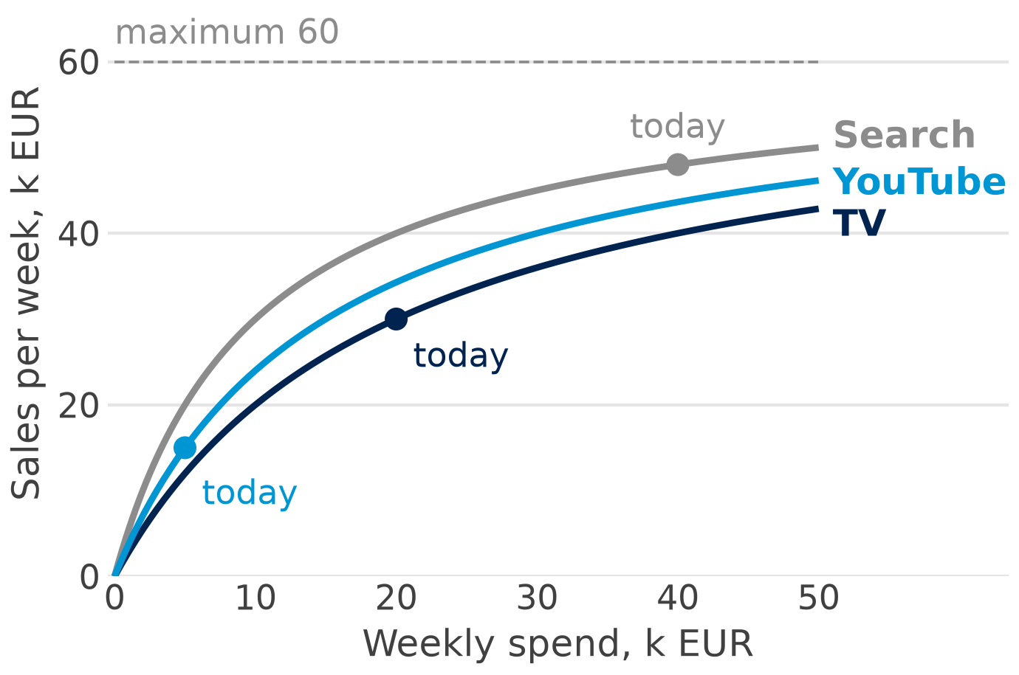
Task 1: three response curves
Now
Spend
Sales
Avg ROI
TV
20
30
1.50
YouTube
5
15
3.00
Search
40
48
1.20
Sales at
−10 k EUR
+10 k EUR
TV
20
36
YouTube
–
30
Search
45
50
Your move: which channel gives 10 k EUR a week, which one gets it, and why?
Invented round numbers (assignment)
Notes:
The material of Task 1, also in the handout. All values are k EUR per week. The curves are invented, not estimated: weekly sales = 60 × spend / (spend + half-saturation), with half-saturation 20 for TV, 15 for YouTube and 10 for Search, so groups can compute more points. Students read the tables; the chart is for the why. Ask also: which number on this slide would you distrust first?

Slide 45



Open data for MMM projects
Conjura eCommerce MMM
Meridian geo data
Real, anonymised daily data of about 100 web shops; Google, Meta, TikTok
Licence: CC BY 4.0 (our Part 4)
Simulated weekly panels, many regions, reach and frequency
Use: geo vs national model
PyMC-Marketing data
Robyn demo data
A two-region panel with true parameters, lift-test data
Use: can the model find the truth?
Simulated weekly spend and revenue; holidays of 123 countries
Use: an R lab, holiday effects
The licence decides: commit only data you may share; link the rest.
Country controls: Eurostat and World Bank (prices, population, internet use)
Sources: dataset pages; links in open_source_mmm.qmd (appendix)
Notes:
Four open sources for your own MMM project; the links are in the appendix of open_source_mmm.qmd. The Conjura dataset is on figshare (doi 10.6084/m9.figshare.25314841.v3); we used the copy in the GitHub repository jpcca/marketing-mix-modelling because figshare was not reachable. Meridian's simulated geo datasets (geo_all_channels.csv and others) are in the google/meridian repository; the PyMC-Marketing data folder keeps the true parameters in a separate file; Robyn ships dt_simulated_weekly, and Meta's siMMMulator simulates data with a known ROI. For country controls take Eurostat and the World Bank, and cite the source. People and communities to follow: the Meridian Discord and GitHub Discussions, the PyMC-Marketing GitHub Discussions, the Vienna Data Science Group and PyCon Austria.

Slide 46
Key takeaways
1
One line: sales = baseline + media effects + controls + noise
2
Carryover and saturation: spend keeps working, and each extra euro buys less
3
Decide at the margin: the next euro, not the average ROI
4
Three tools: two Bayesian tools that pool markets, one ridge tool per market
5
Be sceptical: spend follows demand; calibrate with experiments; ask who wrote the case
Next: run sessions/02-mmm-one-country/open_source_mmm.qmd; it reproduces Parts 4 and 5.
Notes:
One sentence per takeaway. A marketing mix model explains weekly sales as baseline plus media effects plus controls plus noise, and needs only weekly totals per market. Spend keeps working after the week it is spent (carryover), and each extra euro buys less (saturation). Decide at the margin: the ROI of the next euro, read off the response curve, not the average ROI. PyMC-Marketing and Meridian are Bayesian and pool markets; Robyn fits ridge regressions, one market per model. Be sceptical: spend follows demand, so calibrate with experiments, and ask who wrote a case study. Next: run open_source_mmm.qmd chunk by chunk; it reproduces Parts 4 and 5.

Slide 47


References
MMM methods
Tools and data
Jin, Y., Wang, Y., Sun, Y., Chan, D. & Koehler, J. (2017). Bayesian methods for media mix modeling with carryover and shape effects. Google Inc.
Sun, Y., Wang, Y., Jin, Y., Chan, D. & Koehler, J. (2017). Geo-level Bayesian hierarchical media mix modeling. Google Inc.
Zhang et al. (2024). Google Research: calibration with Bayesian priors (ROI priors from lift tests).
Runge, Skokan, Zhou & Pauwels (2024). arXiv 2403.14674: the method behind Robyn.
Runge & Pauwels (2026). Customer Needs and Solutions; free as MSI Working Paper 26-106.
Gelman et al. (2020). Bayesian Workflow, arXiv 2011.01808.
PyMC-Marketing (PyMC Labs). Apache-2.0, github.com/pymc-labs/pymc-marketing.
Meridian (Google). Apache-2.0, github.com/google/meridian.
Robyn (Meta Marketing Science). MIT, github.com/facebookexperimental/Robyn.
Anderson, A. (2024). Multi-Region Marketing Mix Modelling (MMM) Dataset for Several eCommerce Brands (v3). figshare. doi.org/10.6084/m9.figshare.25314841.v3. CC BY 4.0.
Free to read: MSI Working Paper 26-106 (Runge & Pauwels), arXiv 2011.01808 (Bayesian workflow)
Notes:
Jin et al. and Sun et al. are the two Google papers behind carryover, shape effects and the geo model of Meridian; Zhang et al. show how a lift test becomes an ROI prior; Runge, Skokan, Zhou and Pauwels describe the method behind Robyn. Runge and Pauwels is free as MSI Working Paper 26-106; the Google papers and the Bayesian Workflow paper are free too; journal articles cited in the notes need WU library access. The original deck's resource guide, the Google Sheet of open-source MMM teaching resources with 262 sources, has the access notes.

Slide 48
Thank you. Questions and discussion
Notes:
Questions? Contact details on the card; office hours via the booking link.

