Slide 1
International Marketing Analytics
Linear regression
Session 1 · WT 2026/27
Notes:
Linear regression is the workhorse of the course: every marketing mix model is a regression with transformed variables. Today: the theory, the assumptions and how to test them, real-world uses, and a first model on real chocolate scanner data in Python. Readings: Bojinov, Parzen and Hamilton (2025), Skiera, Reiner and Albers (2022).

Slide 2




Today
Theory
Tests
Practice
Python
In class
Exercise
Understand
Check
Code
What OLS does and what a coefficient means
t-test, p-value, confidence interval, R²
Logs and elasticities
Seven assumptions behind OLS
Residual plots and four tests
What to do when a test fails
A first regression with statsmodels
Simple charts with plotnine
A pricing recommendation from data
Readings: Bojinov, Parzen & Hamilton (2025), Linear Regression (HBS); Skiera, Reiner & Albers (2022), Regression Analysis.
Notes:
Six blocks. Theory and assumptions in the lecture; the chocolate data live in Positron; then an in-class assignment in groups and the instructions for the first individual coding exercise.

Slide 3
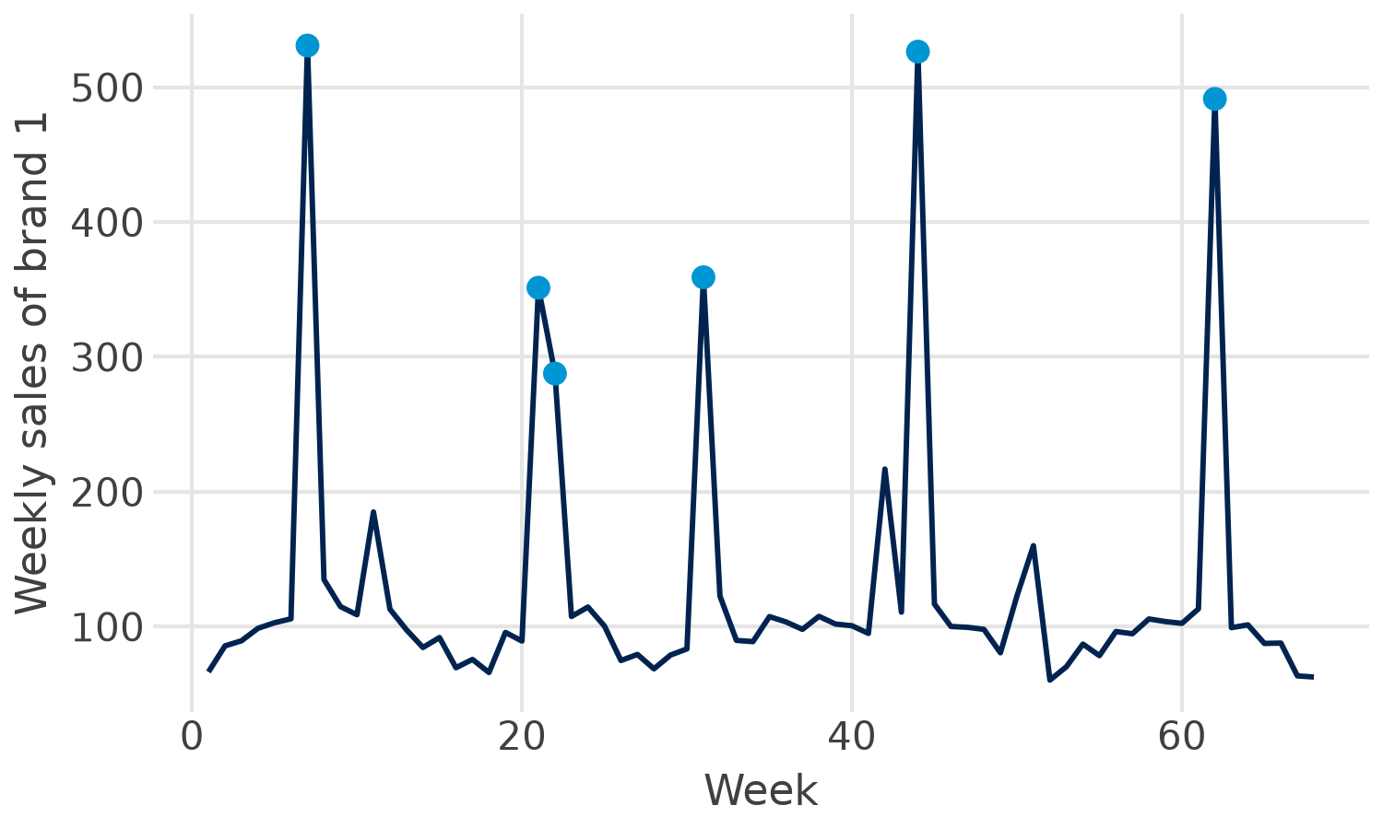

The question: what does a price cut sell?
Data: 68 weeks of real scanner data, 4 brands
Normal week: price about 1.50, sales about 100
Price-cut week: price about 1.03, sales up to 530
Also in the data: competitor prices, features, displays, temperature, holidays
Weekly sales of brand 1; blue: weeks with a price cut (price below 1.20).
The manager asks: how much does 1 % lower price sell, and is the regular price right?
Notes:
Real weekly scanner data for one chocolate brand (brand 1) and three competitors: 68 weeks of unit sales, prices, feature ads and in-store displays, plus temperature and holiday weeks. Brand 1 cut its price from about 1.50 to about 1.03 in seven weeks (blue dots); sales jumped to up to five times the normal level. The brand manager wants to know how strongly sales respond to price, and whether the regular price is right.

Slide 4
Theory
Part 1 of 6 · correlation, simple and multiple regression, inference, fit, logs, from elasticity to price
Notes:
Concepts first, each shown on the chocolate data. Bojinov et al. (2025) and Skiera et al. (2022) cover the same steps in more depth.

Slide 5

Correlation: direction and strength
Rule of thumb for |r|
−0.94
sales and own price of brand 1: an extremely strong negative relationship
|r|
Interpretation
0 to 0.2
very weak
0.2 to 0.4
weak to moderate
Linear only: a perfect U-shape has r = 0
0.4 to 0.6
medium to substantial
0.6 to 0.8
very strong
Not causation: ice cream and sunburn rise together; the sun drives both
0.8 to 1.0
extremely strong
Correlation describes; regression quantifies: how many units does one euro of price cost?
Sources: Bojinov, Parzen & Hamilton 2025 (HBS note 9-622-100)
Notes:
The correlation r lies between -1 and +1 and measures the direction and strength of a linear relationship. The rule of thumb in the HBS note: below 0.2 very weak, up to 0.4 weak to moderate, up to 0.6 medium to substantial, up to 0.8 very strong, above extremely strong. Sales and own price of brand 1 correlate at -0.94. Two warnings: r only measures linear association (a perfect U-shape has r = 0), and correlation is not causation.

Slide 6
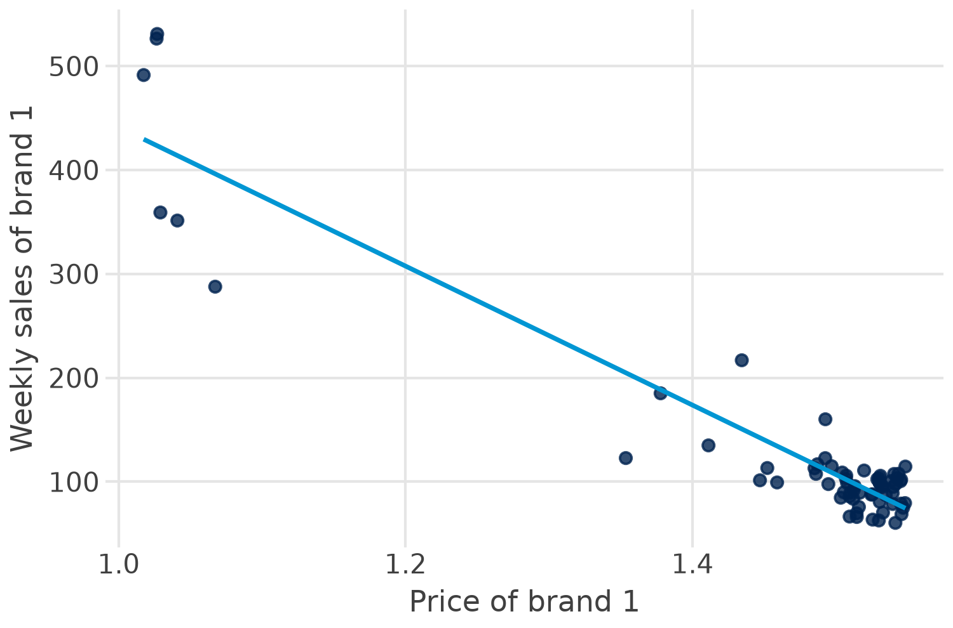

Simple linear regression
sales = b0 + b1 · price1 + e
b0 = 1,110: intercept, sales at price 0 (not meaningful here)
b1 = −669: 10 cents more price, about 67 units fewer a week
e: residual, what the line does not explain
Look at the chart: the points curve, so a straight line misses the price-cut weeks.
Notes:
The line sales = 1,110 - 669 x price1 is the least-squares line for brand 1. The slope says: one unit (one euro) more price, 669 units fewer per week; more useful, 10 cents more price, about 67 units fewer. R-squared is 0.88. But look at the chart: the points curve. The line overshoots in the middle and misses the promotion weeks, a first hint that a straight line is the wrong form (logs follow).

Slide 7
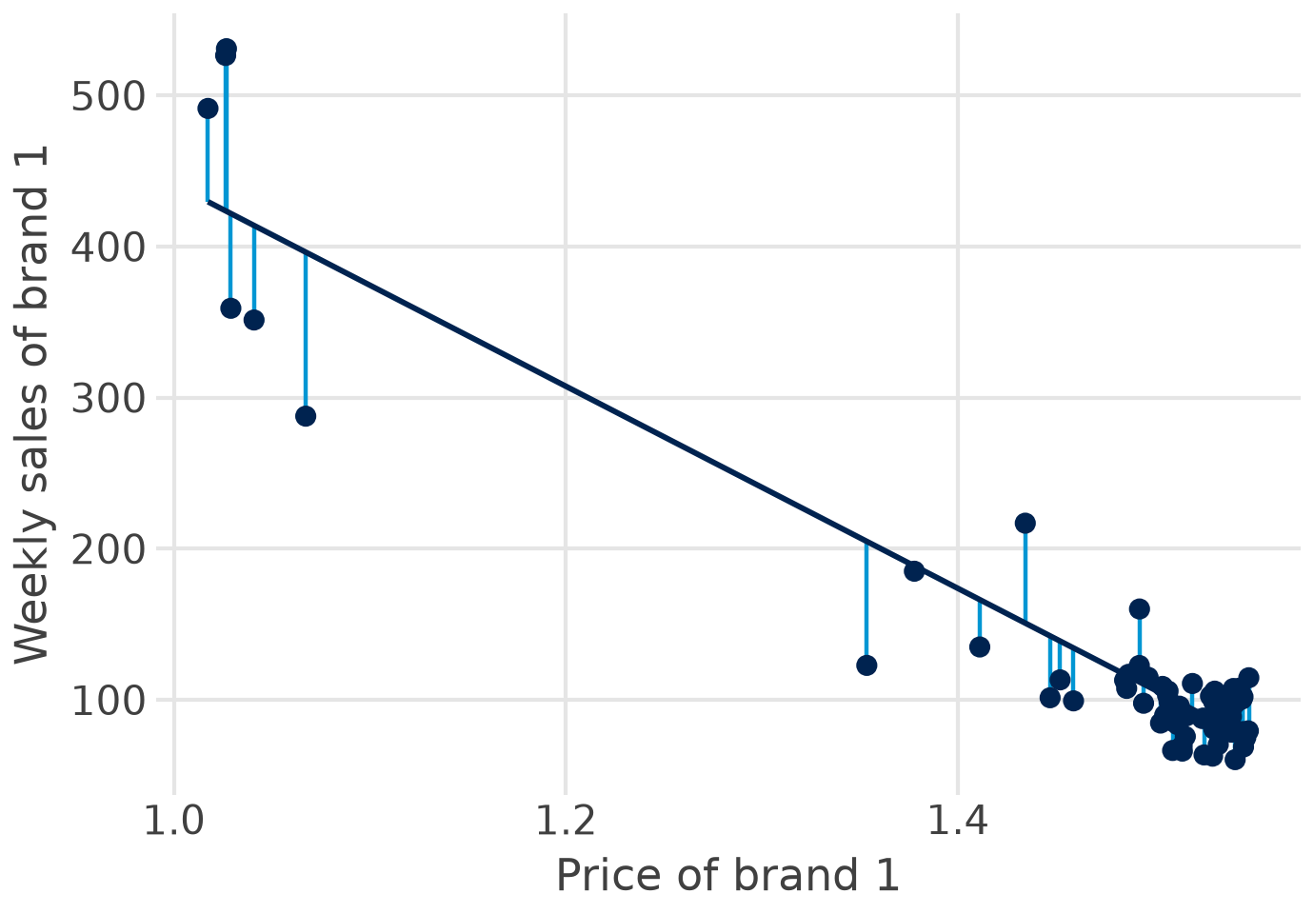
Least squares: the line with the smallest squared errors
residual: e_i = y_i − ŷ_i
OLS: minimise Σ e_i²
Squared: misses above and below do not cancel
Large misses count much more than small ones
One line: the unique best fit for these data
Sources: Skiera, Reiner & Albers 2022; Bojinov, Parzen & Hamilton 2025
Notes:
Each residual is the vertical distance between an observed week and the line. Ordinary least squares (OLS) chooses intercept and slope so that the sum of squared residuals is as small as possible. Squaring makes positive and negative misses count equally and weighs large misses more, which is also why single extreme weeks can pull the line (outliers, Part 2).

Slide 8




Multiple regression: holding other things constant
ln sales = b0 + b1·ln price1 + b2·ln price2 + b3·ln price3 + b4·ln price4
+ b5·feature1 + b6·temp + b7·december + e
Own mix
Competitors
Context
Price of brand 1
Feature ads, displays
Prices of brands 2 to 4
Their features and displays
Temperature
December and Easter weeks
Each b: the effect of one variable with all others held constant (ceteris paribus).
Left out a relevant variable? Its effect ends up in the others (omitted variable bias).
Notes:
With several explanatory variables each coefficient measures the effect of one variable while the others are held constant (ceteris paribus). This is exactly the marketing mix question: what does a price cut do if feature ads, competitor prices and the season stay the same? A variable left out of the model hands its effect to the variables that are in it (omitted variable bias).

Slide 9



Is the effect real? t-test, p-value, interval, F-test
t-test
p-value
t = b / se
Own price: −3.64 / 0.30 = −12.1
Below 0.05: significant
Own price: p < 0.001; brand 4: p = 0.86
95 % confidence interval
F-test
About b ± 2 se
Own price: −4.24 to −3.04
Are all slopes together zero?
F = 59.5, p < 0.001
Significant is not important: read the size of b and its interval, not just the stars.
Sources: Bojinov, Parzen & Hamilton 2025; Skiera, Reiner & Albers 2022
Notes:
Every coefficient comes with a standard error. t = b / se tests whether the true coefficient is zero; the p-value is the probability of a t this extreme if it were zero; below 0.05 we call it significant. The 95 % confidence interval is about b plus or minus two standard errors. The F-test asks whether all slopes together are zero. For brand 1: own-price elasticity -3.64, se 0.30, t -12.1, interval -4.24 to -3.04; F = 59.5, p < 0.001.

Slide 10

How well does the model fit?
0.874
R²: the model explains 87 % of the weekly variation in log sales
Careful
R² never falls when you add a variable
Compare R² only for the same outcome (sales vs log sales)
High R² does not mean causal
0.859
adjusted R²: R² with a penalty for each extra variable
0.169
RMSE: the typical weekly miss, about 17 % in a log model
Main model for brand 1: log-log, own and competitor prices, feature, temperature, December; 68 weeks.
Sources: Bojinov, Parzen & Hamilton 2025; Skiera, Reiner & Albers 2022
Notes:
R-squared is the share of the variation in the outcome that the model explains; it never falls when a variable is added, so adjusted R-squared penalises extra variables. The residual standard error (or RMSE) is the typical miss in the units of the outcome: in a log model, 0.169 means about 17 % per week. Compare R-squared only between models with the same outcome: the simple model (sales) has 0.88, the log model (log sales) 0.87, and these are not comparable.

Slide 11

Functional forms and dummy variables
Model | Equation | b means | Brand 1
Linear | sales = a + b·price | +1 unit price: b units | b = −669 units
Log-log | ln sales = a + b·ln price | +1 % price: b % | b = −3.64 (elasticity)
Log-linear | ln sales = a + b·temp | +1 °C: about 100·b % | b = −0.0066: −0.66 %
Dummy in log model | ln sales = a + b·december | e^b − 1, vs other weeks | b = −0.385: −32 %
Why logs? sales respond in per cent, not in units, and the elasticity can be compared across brands and countries.
Sources: Skiera, Reiner & Albers 2022; Wooldridge 2025, ch. 6 to 7
Notes:
Logs turn a multiplicative sales response function into a linear regression (Skiera et al. 2022): in the log-log form the coefficient is an elasticity, the per cent change in sales for a 1 % change in the driver. A dummy (0/1) in a log model shifts sales by exp(b) - 1 per cent: December -0.385 means exp(-0.385) - 1 = -32 %. For small b, b x 100 is a good approximation.

Slide 12
From elasticity to a pricing decision
optimal price p* = marginal cost × ε / (1 + ε) (valid for ε < −1)
$52
Skiera et al.: ε = −2.34, unit cost $30 → p* = 30 × 2.34 / 1.34
×1.38
Brand 1: ε = −3.64 → price 38 % above marginal cost
Short term: promotion weeks inflate the elasticity; regular-price elasticities are smaller
Competitors react, and the retailer takes its margin
Sources: Skiera, Reiner & Albers 2022; Hanssens, Parsons & Schultz 2001
Notes:
With a constant elasticity e below -1, the profit-maximising price is marginal cost times e / (1 + e) (the Amoroso-Robinson relation). Skiera et al. estimate e = -2.34 with unit cost $30, which gives about $52. For brand 1 e = -3.64 gives a price 1.38 times marginal cost, a 38 % markup. Caveats: this is a short-term, promotion-driven elasticity; regular-price elasticities are usually smaller, competitors react, and the retailer takes a margin.

Slide 13
Assumptions and tests
Part 2 of 6 · what OLS assumes, how to look, how to test, what to do
Notes:
Look first (residual plots), then test, then decide. Skiera et al. (2022) recommend checking multicollinearity, autocorrelation and heteroscedasticity in every model.

Slide 14
Seven assumptions behind OLS
Assumption | If violated | Look or test (statsmodels)
1 Linear form | biased coefficients | residuals vs fitted; try logs
2 Exogeneity, no omitted variables | biased, not causal | theory, controls, experiments
3 Constant error variance | wrong standard errors | funnel in plot; Breusch-Pagan
4 No autocorrelation | standard errors too small | residuals over time; Durbin-Watson ≈ 2
5 Normal residuals | tests unreliable in small samples | histogram; Jarque-Bera
6 No multicollinearity | unstable b, large se | correlations; VIF below 10 (better 5)
7 Enough data, no dominant week | fragile results | n ≥ 3 to 5 × coefficients; Cook's distance
Sources: Skiera, Reiner & Albers 2022; Hair et al. 2019; Wooldridge 2025
Notes:
Linearity and no omitted variables protect the coefficients themselves; homoscedasticity, no autocorrelation and normal residuals protect the standard errors and therefore the t- and F-tests. Normality matters least: with enough observations (Skiera et al.: even 10 to 20) the tests still work. Skiera et al. recommend at least three, better five times as many observations as coefficients. Exogeneity is the one no test can prove: it needs a good design (next slides).

Slide 15
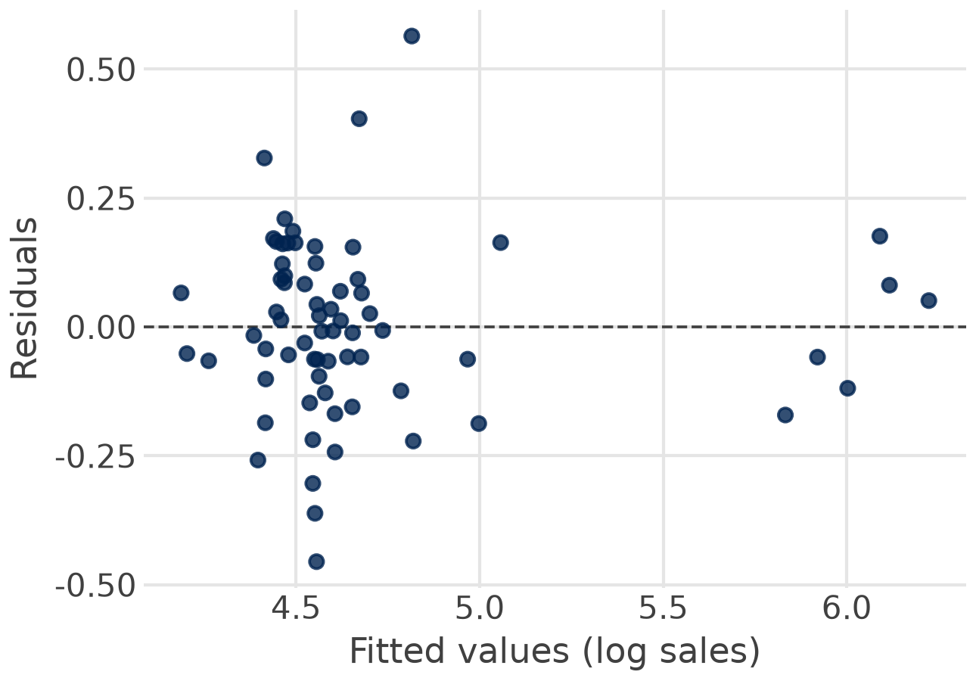
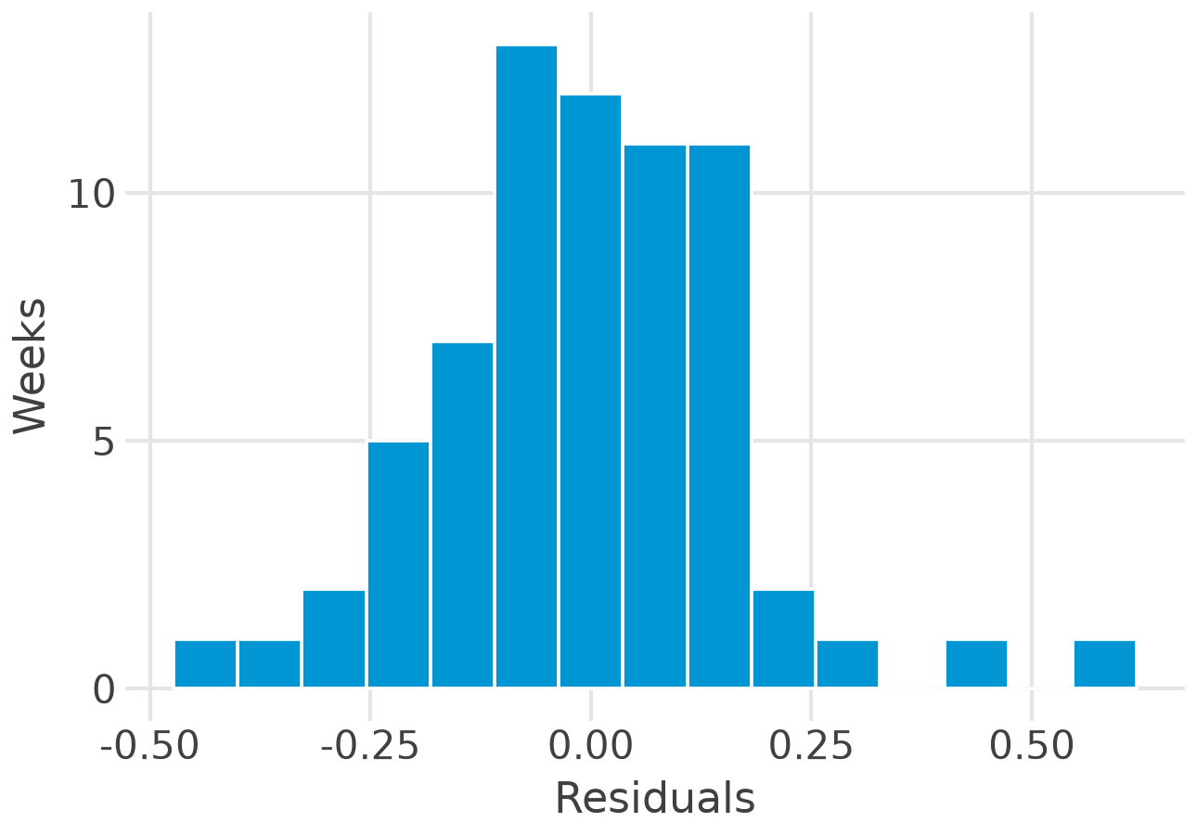
Look first: two residual plots
Look for: a curve (wrong form) or a funnel (unequal variance)
Look for: a rough bell shape, no extreme weeks
Brand 1: no curve, no funnel, a roughly bell-shaped histogram.
Notes:
Left: residuals against fitted values for the main brand-1 model. No curve and no funnel, so the linear log form and constant variance look acceptable; a few price-cut weeks sit to the right. Right: the histogram is roughly bell-shaped with slightly heavy tails.

Slide 16
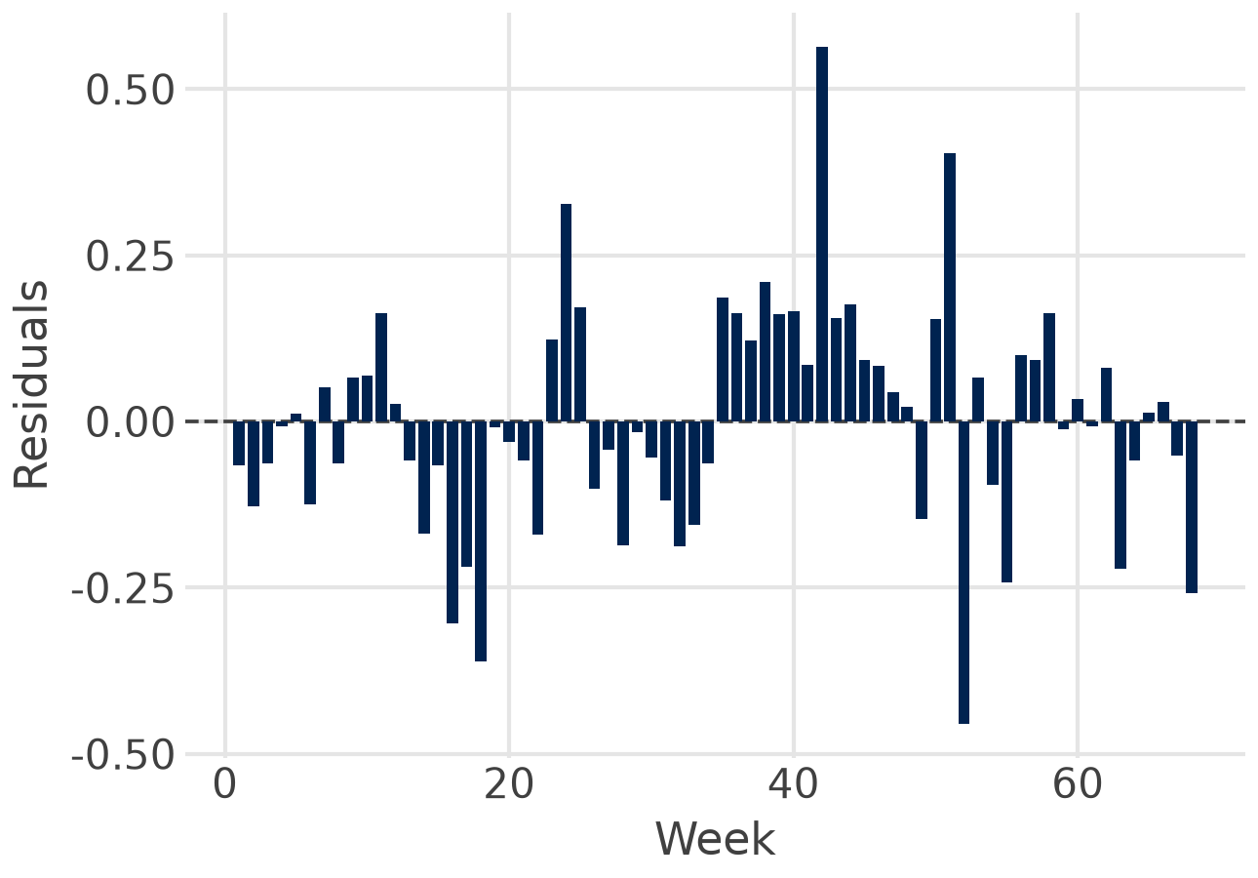
Then test: four numbers for the brand 1 model
1.41
Durbin-Watson: below 2, some autocorrelation between weeks
0.14
Breusch-Pagan p: no evidence of unequal variance
0.07
Jarque-Bera p: residuals roughly normal
2.4
largest VIF: no multicollinearity
Verdict: usable. Report Newey-West (HAC) standard errors because of the autocorrelation: 0.32 instead of 0.30 for own price.
Notes:
Durbin-Watson 1.41: below 2, some positive autocorrelation between neighbouring weeks, which makes the usual standard errors a little too small; Newey-West (HAC) standard errors correct this (0.32 instead of 0.30 for own price). Breusch-Pagan p = 0.14 and Jarque-Bera p = 0.07: no evidence against constant variance and normal residuals at 5 %. Largest VIF 2.4: no multicollinearity.

Slide 17
When a test fails: what to do
Problem | Remedy | In statsmodels
Curve in residuals | logs, squares, interactions | np.log(x), I(x**2)
Unequal variance | robust standard errors | fit(cov_type="HC3")
Autocorrelation | HAC standard errors; lags; ARIMA errors (Session 4) | fit(cov_type="HAC", cov_kwds={"maxlags": 1})
Multicollinearity | more variation, combine variables, experiments | variance_inflation_factor
Dominant weeks | check data, report with and without | get_influence().cooks_distance
Endogeneity | experiments, instruments, fixed effects | Sessions 2 to 5
Sources: Skiera, Reiner & Albers 2022; statsmodels documentation
Notes:
Most fixes are one argument in statsmodels: cov_type='HC3' for heteroscedasticity-robust standard errors, cov_type='HAC' with maxlags for autocorrelation (Newey-West). Multicollinearity has no econometric cure: more variation in the data, combine variables, or run an experiment (Skiera et al.). Outliers: check the data first, report results with and without, never delete silently. Endogeneity needs design: experiments, instruments, panel data.

Slide 18



Three warnings from real data
Displays
One Easter week
Mailings
Only 4 display weeks
VIF 11.4 and 10.9
Effects cannot be separated
A dummy for one week fits it exactly
Leverage 1.00
No real estimate of Easter
Skiera et al.: mailings and salespersons r = 0.989
VIF 53
Salesperson effect flips sign
The real fix: vary the marketing instruments independently, ideally in a field experiment.
Sources: Skiera, Reiner & Albers 2022; own calculation on the chocolate data
Notes:
Multicollinearity: brand 1 ran displays in only four weeks, mostly together with features and price cuts; adding display1 and fand1 gives VIFs of 11.4 and 10.9. Influence: there is a single Easter week; an Easter dummy fits that week perfectly (leverage 1.00), so its coefficient says nothing. Skiera et al.: mailings and salespersons correlate at 0.989; with both in the model the VIF is 53 and the salesperson coefficient turns negative and insignificant.

Slide 19
Endogeneity: when marketing follows demand
The assumption: explanatory variables are unrelated to the error term
Marketing breaks it: budgets go where managers expect success, so spend and unexplained sales rise together
Brand 1: price cuts come with features, so the price effect partly measures the feature
Evidence: in 15 Facebook experiments, regression often overstated the true lift, sometimes 3 times
Remedies: experiments (A/B, geo tests), instrumental variables such as cost shifters, panel data with fixed effects.
Sources: Skiera, Reiner & Albers 2022; Gordon, Zettelmeyer, Bhargava & Chapsky 2019
Notes:
OLS assumes that the explanatory variables are unrelated to the error. Marketing breaks this whenever managers spend more where they expect success: then high spend and high unexplained sales go together and the coefficient is too large (Skiera et al.). Price cuts are often timed with features and displays, so the price coefficient also carries their effect. Gordon et al. (2019) compared 15 Facebook experiments with regression-based estimates: the observational methods often overstated the lift, sometimes by a factor of three or more.

Slide 20
Regression in the real world
Part 3 of 6 · benchmarks, companies, what transfers to MMM
Notes:
Regression is everywhere in marketing practice, usually with a different name.

Slide 21
Benchmarks from decades of regressions
−2.62
mean price elasticity, 1,851 estimates (Bijmolt et al. 2005)
0.12
mean short-term advertising elasticity (Sethuraman et al. 2011)
−0.42
mean price elasticity in 14 Asia-Pacific countries, lower with high power distance (Datta et al. 2022)
−3.64
brand 1, chocolate: promotion-driven, many substitutes
Use benchmarks to judge whether your own estimate is plausible.
Notes:
Bijmolt, van Heerde and Pieters (2005) pool 1,851 price elasticities: mean -2.62. Sethuraman, Tellis and Briesch (2011): short-term advertising elasticity 0.12 on average. Datta et al. (2022): across 14 Asia-Pacific countries the average price elasticity is -0.42 and lower where power distance is high. Brand 1's -3.64 is more price-sensitive than the average brand: chocolate has many close substitutes and the estimate is driven by promotion weeks.

Slide 22







Where companies use regression
Meta Robyn
Booking.com
Google
MMM in production:
ridge regression on media
With Microsoft: CUPED,
regression makes A/B tests faster
Geo experiments: test vs
control regions by regression
Walmart (M5)
statworx
Bayer
Sales forecasts need price,
promotion and event regressors
Frankfurt consultancy: price
elasticities, log-log
Budget across countries
from estimated elasticities
Session 2: the marketing mix model is this regression with adstock and saturation.
Sources: Robyn docs; Deng et al. 2013; Vaver & Koehler 2011; Makridakis et al. 2022; Fischer et al. 2011
Notes:
Meta's Robyn is a ridge regression on adstocked and saturated media variables: MMM in production. Microsoft and Booking.com add the pre-period metric as a covariate in A/B tests (CUPED), which cuts the sample size needed. Google estimates ad effectiveness from geo experiments with regressions of test on control regions. Walmart's M5 competition showed that forecasts need price, promotion and event regressors. statworx (Frankfurt) estimates price elasticities from retail sales with log-log regressions. Bayer reallocated its budget across countries with estimated elasticities (Fischer et al. 2011).

Slide 23
The chocolate data in Python
Part 4 of 6 · load and plot, the first regression, the log-log model, the checks
Notes:
Live in Positron. The code on the next slides is complete: copy it into a Quarto file and run it cell by cell.

Slide 24
The data: 68 weeks of chocolate scanner data
Column | Meaning
week | 1 to 68
sales | weekly unit sales of brand 1
price1 to price4 | prices of brands 1 to 4
feature1 to feature4 | share of stores with a feature ad, 0 to 1
display1 to display4 | share of stores with an in-store display
fand1, fand3, fand4 | share with feature and display together
temp | temperature, °C
december, easter | 1 in December and Easter weeks
File: data/legacy/chocolate_dataset.csv
Notes:
data/legacy/chocolate_dataset.csv in the course repository (also as the original .xlsx). Feature, display and fand (feature and display) are shares of stores between 0 and 1. Sales and prices are for brand 1 unless numbered otherwise; units are as delivered by the data provider.

Slide 25
Step 1: load and look
Python: polars and plotnine
import polars as pl
from plotnine import (ggplot, aes, geom_point,
geom_smooth, labs)
choc = pl.read_csv(
"data/legacy/chocolate_dataset.csv")
choc.select("sales", "price1",
"price2").describe()
(ggplot(choc, aes("price1", "sales"))
+ geom_point()
+ geom_smooth(method="lm")
+ labs(x="Price of brand 1",
y="Weekly sales"))
Look before you model: ranges, outliers, the shape of the relationship.
Notes:
polars reads the CSV; describe() gives counts, means and ranges. plotnine draws the scatter plot with the least-squares line in three lines of code. Always look before you model.

Slide 26
Step 2: the first regression
Python: statsmodels
coef
std err
P>|t|
import statsmodels.formula.api as smf
df = choc.to_pandas()
simple = smf.ols("sales ~ price1",
data=df).fit()
print(simple.summary())
simple.params # b0, b1
simple.rsquared # 0.884
Intercept
1,110.0
44.0
0.000
price1
−668.8
29.8
0.000
R² = 0.884, n = 68
Read it: 10 cents more price, about 67 units fewer per week; the price explains 88 % of the weekly variation.
But: the residuals curve. Next: the log-log model with the marketing mix.
Notes:
statsmodels takes a pandas data frame, so .to_pandas() converts the polars frame (pyarrow does the work in the background). The formula reads like the equation. summary() prints the full table; params, bse, pvalues and rsquared give single numbers for the text.

Slide 27
Step 3: the log-log model with the marketing mix
Python: statsmodels
coef
p
import numpy as np
model = smf.ols(
"np.log(sales) ~ np.log(price1)"
" + np.log(price2) + np.log(price3)"
" + np.log(price4) + feature1"
" + temp + december",
data=df).fit()
print(model.summary())
ln price1
−3.64
0.000
ln price2
−0.80
0.076
ln price3
0.36
0.109
ln price4
−0.03
0.855
feature1
0.18
0.307
temp
−0.007
0.045
december
−0.38
0.009
R² = 0.874, adjusted 0.859, n = 68
Read it: 1 % higher price, 3.6 % fewer sales; December weeks 32 % lower; each degree warmer 0.7 % lower.
Notes:
np.log inside the formula transforms the variables; numpy comes with statsmodels. Own price: elasticity -3.64, highly significant. Competitor prices are not significant at 5 %; the sign for brand 2 is negative, which would mean a complement and is not plausible, so we do not interpret it. December -0.385: exp(-0.385) - 1 = -32 %. Temperature: -0.66 % per degree.

Slide 28
Step 4: check the assumptions
Python: tests and robust errors
Residual plot
from statsmodels.stats.stattools import (
durbin_watson, jarque_bera)
from statsmodels.stats.diagnostic import het_breuschpagan
from statsmodels.stats.outliers_influence import (
variance_inflation_factor)
durbin_watson(model.resid) # 1.41
het_breuschpagan(model.resid, model.model.exog)[1] # 0.14
jarque_bera(model.resid)[1] # 0.07
X = model.model.exog
[variance_inflation_factor(X, i) for i in range(1, 8)]
hac = model.model.fit(cov_type="HAC",
cov_kwds={"maxlags": 1})
from plotnine import geom_hline
df["fit"] = model.fittedvalues
df["res"] = model.resid
(ggplot(df, aes("fit", "res"))
+ geom_point()
+ geom_hline(yintercept=0))
Decide: report the HAC result; the own-price elasticity stays −3.64, its standard error rises to 0.32.
Notes:
Four functions, four numbers. Then refit with HAC standard errors because Durbin-Watson is below 2. The residual plot uses the same plotnine grammar as before.

Slide 29

In-class quiz: five questions
1 What does OLS minimise?
A the sum of residuals B the sum of absolute residuals C the sum of squared residuals
2 In ln sales = a + b · ln price, b = −3.64 means …
A 1 EUR more, 3.64 units fewer B 1 % higher price, 3.6 % fewer sales C 3.64 fewer per week
3 A VIF of 11 signals …
A autocorrelation B multicollinearity C heteroscedasticity
4 Weekly data, Durbin-Watson = 1.41. This suggests …
A positive autocorrelation B no problem C unequal variance
5 R² rises from 0.85 to 0.86 after adding a variable. This shows …
A the variable matters B nothing: R² never falls C the model is causal
3 minutes alone, then compare with your neighbour. Same format as the online quiz and the exam.
Notes:
Three minutes alone, then compare with your neighbour; reveal the answers one by one. Answers: 1 C (the sum of squared residuals). 2 B (log-log: an elasticity, 1 % higher price, 3.6 % fewer sales). 3 B (multicollinearity; VIF above 10 is a warning). 4 A (below 2: positive autocorrelation between neighbouring weeks, so the usual standard errors are too small; report HAC errors). 5 B (R-squared never falls when a variable is added; compare adjusted R-squared or test the coefficient). Questions 1 and 3 adapted from the quantmethods exam bank.

Slide 30
In-class assignment
Part 5 of 6 · groups of 3, 25 minutes, on the chocolate data
Notes:
Run the code from Part 4, then answer the four questions. One group presents per question.

Slide 31
In-class assignment: pricing brand 1
Groups of 3:
20 minutes
Plenary:
5 minutes
Competition: plot sales against price2, price3 and price4. Which brand competes most?
1
Displays: add display1 and fand1 to the log-log model. What happens to the VIFs and coefficients, and why?
2
Price: marginal cost is 0.80. What price does ε = −3.64 suggest? Why is the real price about 1.50?
3
The manager: write one sentence for the brand manager, with a number and one caveat.
4
File: sessions/01-foundations/regression_chocolate.qmd (the code of Part 4 and these questions)
Notes:
Expected answers. 1 A falling cloud is weak for brands 3 and 4; brand 2 shows little relation: weak competition at the price level in these data. 2 With display1 and fand1 the VIFs exceed 10 and the display coefficients swing and lose significance: the four display weeks cannot separate the effects. 3 With marginal cost 0.80: p* = 0.80 x 1.38 = 1.10; the actual regular price is about 1.50, because the -3.64 is a short-term promotion elasticity, the retailer adds its margin and competitors would react. 4 For example: 'Promotions sell, but a permanent price cut to 1.10 would rest on a promotion elasticity; test it in a few stores first.'

Slide 32
Coding exercise 1
Part 6 of 6 · individual, 5 % of the grade
Notes:
The first of four coding exercises. It applies the code of this session to a similar task.

Slide 33
Coding exercise 1: what to do
1
Explore: a great_tables summary and two plotnine charts: sales over time, sales against price1
2
Simple model: sales ~ price1; interpret the slope for a 10-cent price change
3
Log-log model: own and competitor prices, feature1, display1, temp, december; interpret 3 coefficients
4
Assumptions: residual plot, histogram, Durbin-Watson, Breusch-Pagan, Jarque-Bera, VIF; one sentence each
5
Robust errors: refit with HAC standard errors; what changes and what does not?
6
Recommend: the optimal price for marginal cost 0.90, with two caveats, in at most 100 words
Brief: exercises/exercise-1.qmd in the course repository and on Canvas
Notes:
Individual work. The exercise reuses the data of this session with a different specification (display1 added, marginal cost 0.90), so the in-class code transfers but the answers differ. The file must render from top to bottom; deadline and upload on Canvas. AI assistants are allowed; the prompt log at the end shows how they were used.

Slide 34

Coding exercise 1: submission and grading
Submit on Canvas
Criterion
Points
Code runs, charts and tables clean
5
exercise1_lastname.qmd and the rendered .html
Renders from top to bottom without errors
Every number in the text from code
Prompt log at the end: what you asked, what you changed
Deadline: see Canvas
Interpretation of the coefficients
6
Assumption checks and conclusion
5
Recommendation with caveats
2
Prompt log
2
Total (5 % of the grade)
20
Individual work: discuss ideas, but write and check your own code. AI assistants are allowed; you own every number.
Notes:
Grading on 20 points, scaled to 5 % of the final grade. Interpretation counts most, because the AI writes much of the code. Deadline: see Canvas.

Slide 35

Key takeaways
OLS draws the line with the smallest squared errors; each b holds the other variables constant
1
Logs turn coefficients into elasticities: brand 1, −3.64
2
Look, then test: residual plots, Durbin-Watson, Breusch-Pagan, Jarque-Bera, VIF
3
Fix what fails: robust or HAC errors, better form, more variation; experiments for causality
4
Decide: p* = cost × ε / (1 + ε), with the caveats
5
Next session: the marketing mix model, a regression with adstock and saturation.
Notes:
If students remember one thing: in a log-log model the coefficient is an elasticity, and an elasticity turns into a price with one formula, but only if the assumptions hold and the data vary enough.

Slide 36
References
Academic
Learning resources
Bojinov, I. I., Parzen, M. & Hamilton, P. J. (2025). Linear Regression. HBS note 9-622-100 (Canvas).
Skiera, B., Reiner, J. & Albers, S. (2022). Regression analysis. In Homburg et al. (eds), Handbook of Market Research, 299–327. Springer.
Wooldridge, J. M. (2025). Introductory Econometrics, 8th ed. Cengage.
Hanssens, D. M., Parsons, L. J. & Schultz, R. L. (2001). Market Response Models. Kluwer.
Bijmolt, T., van Heerde, H. & Pieters, R. (2005). Journal of Marketing Research 42(2).
Gordon, B. R. et al. (2019). Marketing Science 38(2).
James, G. et al. (2023). ISLP, ch. 3 and the Python lab (free).
Schwarz, Chapman & Feit (2020). Python for Marketing Research and Analytics, ch. 7. Springer.
statsmodels. Documentation and example notebooks.
Turrell, A. Coding for Economists: regression and diagnostics (free).
StatQuest. Linear regression, clearly explained (video).
DataCamp. Introduction to Regression with statsmodels in Python.
Notes:
Core readings first. All sources are listed with notes in instructor/resources/regression-resource-guide.md.

Slide 37
Notes:
Questions? Contact details on the card; office hours via the booking link.

