Slide 1
International Marketing Analytics
Assumptions, dummies, logs and curves
Deck 01e · WT 2026/27
Notes:
The second regression deck. Deck 01b fitted the first models on the chocolate data; this deck asks whether we may trust them (assumptions and tests), how to put categories into a regression (dummy coding), how to read logs, and what to do when the relationship is not a straight line. Same data throughout: 68 weeks of real scanner data for brand 1.

Slide 2



Today
Assump-
tions
Dummy
coding
Log-log
Non-
linear
Python
In class
Theory, Parts 1 to 4
Practice, Parts 5 and 6
Six assumptions: look, test, fix
Dummies for categories, the reference group
Log-log and the other log forms
Curves: squares, logs, the turning point
statsmodels tests, polars dummies, plotnine plots
Online quiz 3 and its answers
Two coding cases: chocolate and fashion
The same tasks with Posit Assistant
Readings: Skiera, Reiner & Albers (2022), Regression Analysis; Bojinov, Parzen & Hamilton (2025), Linear Regression (HBS).
Notes:
Four topics, then the same analyses in Python with the packages, then the in-class exercise with online quiz 3 and Posit Assistant. The homework, coding exercise 2, uses a personal version of the chocolate data for every student.

Slide 3

Where we are: two models for brand 1
linear: sales = b0 + b1·price1 + b2·feature1 + b3·display1 + b4·temp + b5·december
log-log: ln sales = b0 + b1·ln price1 + b2·ln price2 + b3·ln price3 + b4·ln price4
+ b5·feature1 + b6·display1 + b7·temp + b8·december
Linear
Log-log
Own price
−678 units per EUR
−3.68 (elasticity)
R²
0.896
0.903
Outcome
sales (units)
log sales
Same data, two models: which one may we trust? R² cannot tell, because the outcomes differ. The residuals can.
Sources: make_assumptions_figures.py on data/legacy/chocolate_dataset.csv; deck 01b, Parts 6 to 9
Notes:
Two models on the same 68 weeks carry the whole deck. The linear model explains sales in units; the log-log model explains log sales and gives elasticities. Both fit well by R-squared (0.90), but R-squared of a model for sales and one for log sales cannot be compared. Today's question: which of the two may we trust? The answer comes from the residuals.

Slide 4
Assumptions and how to test them
Part 1 of 6 · look first, then test, then fix
Notes:
Every assumption gets the same three steps: a plot to look at, a test with a p-value, and a fix in statsmodels. Skiera et al. (2022) recommend checking at least multicollinearity, autocorrelation and heteroscedasticity in every model.

Slide 5
Six assumptions, three steps each
Assumption | Look | Test (H0: assumption holds) | Fix
1 Linear form | residuals vs fitted: curve? | RESET | logs, squares
2 Constant variance | residuals vs fitted: funnel? | Breusch-Pagan | logs; HC3 errors
3 Normal residuals | Q-Q plot, histogram | Jarque-Bera, Shapiro-Wilk | logs; large n helps
4 Independent errors | residuals over time | Durbin-Watson ≈ 2 | HAC errors; Session 4
5 No multicollinearity | correlation matrix | VIF below 5 (10) | drop, combine, more data
6 No dominant week | Cook's distance by week | above 4/n: inspect | check data, with and without
Sources: Skiera, Reiner & Albers 2022; Wooldridge 2025, ch. 8 to 9; Hair et al. 2019
Notes:
Linearity and exogeneity protect the coefficients themselves; constant variance, independence and normality protect the standard errors and so the t- and F-tests. Multicollinearity and influential weeks make results unstable. Exogeneity (no omitted variables, marketing not following demand) was covered in deck 01b and cannot be tested; it needs design. Autocorrelation matters for weekly data; we treat it in theory today and return to it in Session 4 (time series).

Slide 6

How to read an assumption test
H0 = the assumption holds: constant variance, normal residuals, the right form
1
p below 0.05: evidence against H0, so the assumption is violated: act
2
p above 0.05: no evidence of a problem; not a proof that all is well
3
Always look as well: small samples miss problems, very large samples flag tiny ones
4
Mind the direction: in a coefficient test a small p is good news (an effect); in an assumption test it is bad news.
Notes:
Every test here has the same logic: the null hypothesis says the assumption holds (constant variance, normal residuals, correct form). A small p-value (below 0.05) is evidence against it, so a small p means a problem. A large p does not prove the assumption, it only finds no evidence against it. Tests depend on the sample size: with 68 weeks small problems may go unnoticed, with 10,000 rows tiny ones become significant. That is why we always look at the plot as well.

Slide 7
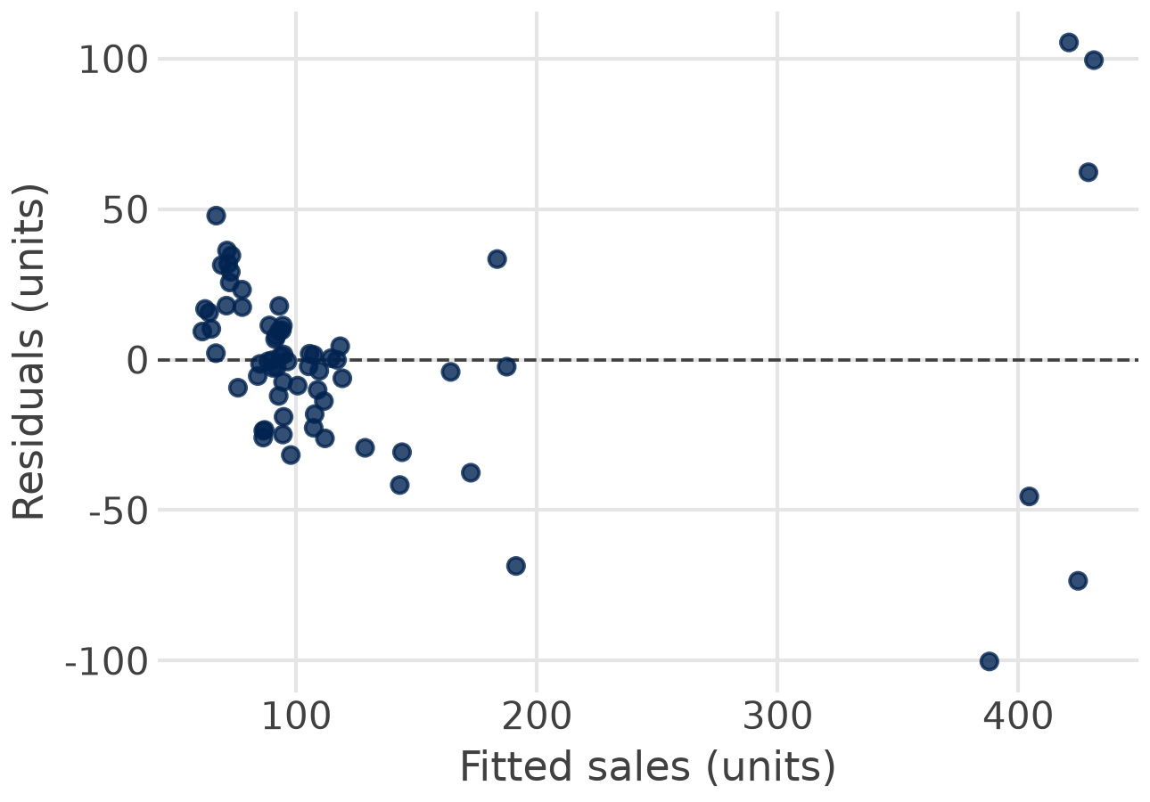
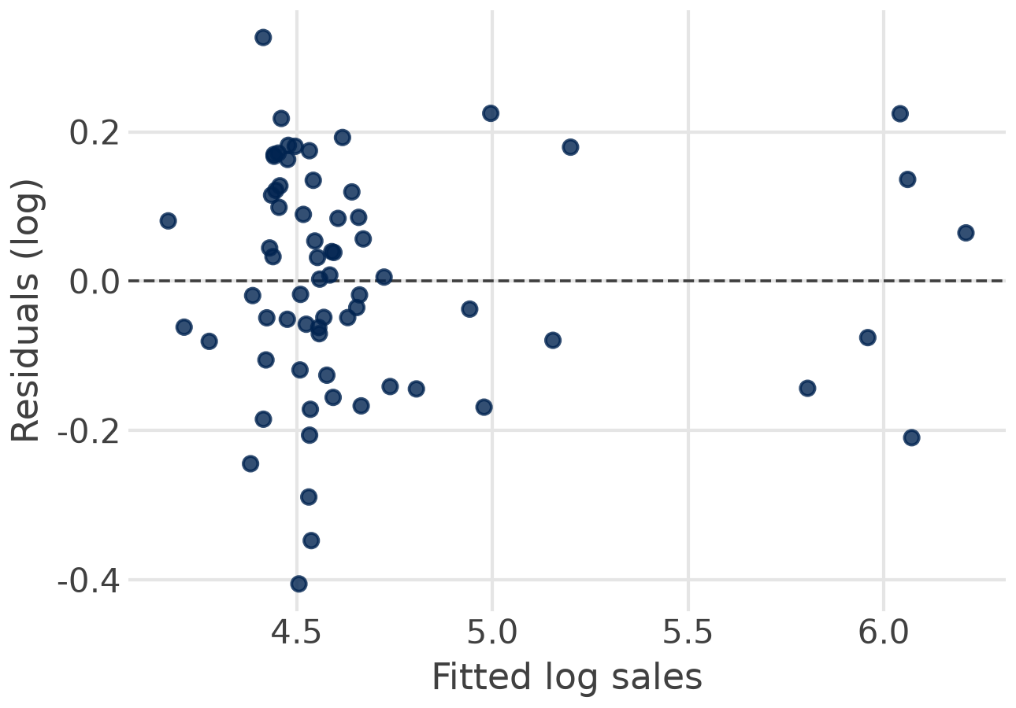

1 Linear form: look for a curve
Linear model: a U-shape. RESET p < 0.001.
Log-log model: no curve. RESET p = 0.32.
RESET: adds the squared fitted values; if they help, the form is wrong.
Notes:
Residuals against fitted values for the linear model. The residuals are positive for small and large fitted values and negative in between: a U-shape. The straight line underestimates the normal weeks and the deep price cuts. Ramsey's RESET test adds the squared fitted values to the model; if they help, the form is wrong: p < 0.001. The log-log model shows no curve, RESET p = 0.32.

Slide 8

2 Constant variance: look for a funnel
< 0.001
Breusch-Pagan p, linear model: unequal variance
0.68
Breusch-Pagan p, log-log model: no evidence
110
se of price1 in the linear model with HC3 errors (usual: 44)
Fix: logs, because sales vary in per cent; or robust errors with fit(cov_type="HC3").
Notes:
The same linear residual plot: the spread is about ±30 units in normal weeks and ±100 in price-cut weeks. This is heteroscedasticity. The coefficients stay unbiased, but the usual standard errors are wrong, and so are t-values and p-values. Breusch-Pagan regresses the squared residuals on the explanatory variables: p < 0.001. Two fixes: model in logs (the spread is in per cent, not in units; Breusch-Pagan p = 0.68), or keep the model and report robust HC3 standard errors: the price coefficient's se rises from 44 to 110.

Slide 9
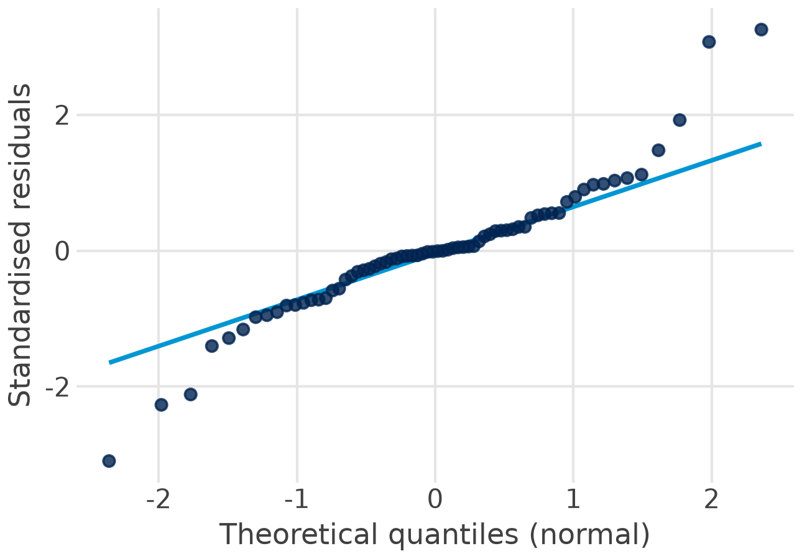
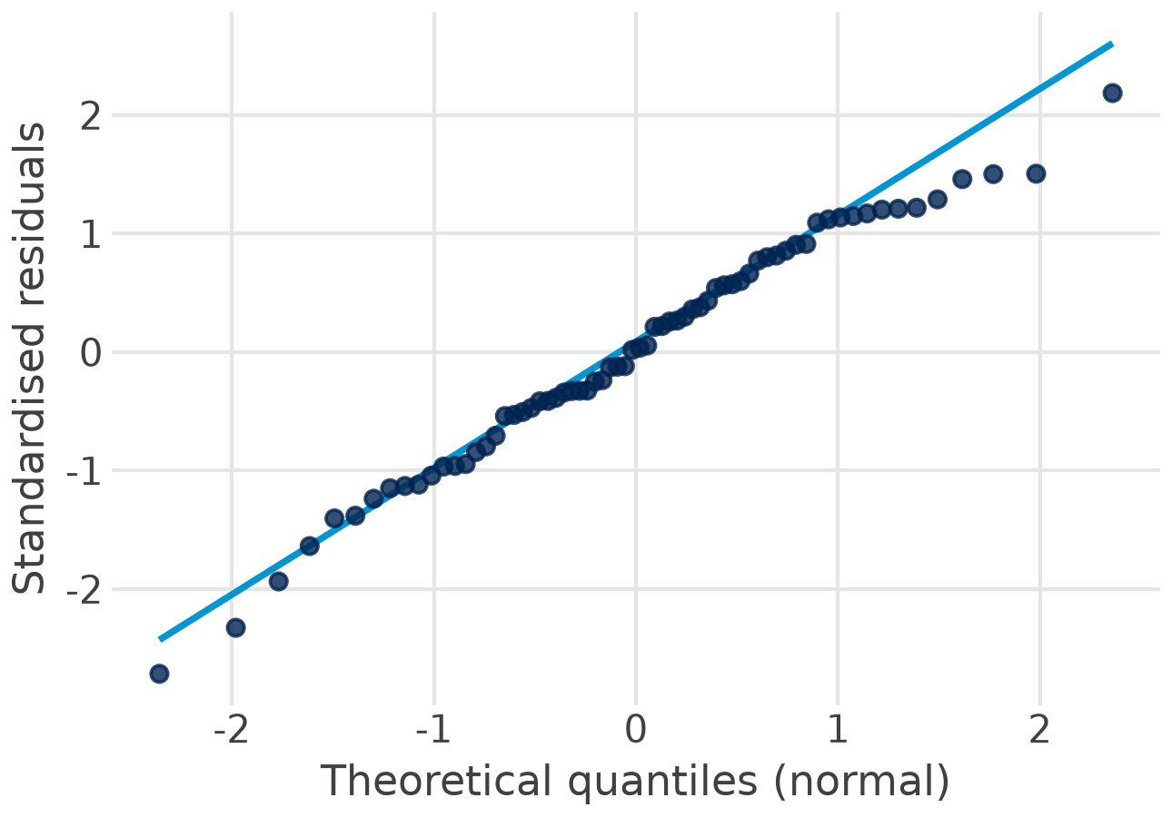

3 Normal residuals: the Q-Q plot
Linear: heavy tails. Jarque-Bera p < 0.001.
Log-log: on the line. Jarque-Bera p = 0.50.
Matters least: with many observations the tests still work; extreme weeks matter more.
Notes:
A Q-Q plot sorts the standardised residuals and plots them against the values a normal distribution would give. On the line means normal. The linear model's residuals bend away at both ends: heavy tails, from the price-cut weeks. Jarque-Bera p < 0.001, Shapiro-Wilk p = 0.001. The log-log residuals follow the line: both p = 0.50. Normality matters least of all assumptions: with enough weeks the t-tests still work (central limit theorem); with 68 weeks and heavy tails it is still worth fixing.

Slide 10

4 Independent errors: weeks follow weeks
≈ 2
Durbin-Watson without autocorrelation (range 0 to 4)
1.13
log-log model: positive autocorrelation between weeks
0.31
se of the elasticity with HAC errors, 1 lag (usual: 0.27)
Theory only today: Session 4 (time series) models autocorrelation with lags. Not in the exercise or the homework.
Notes:
In weekly data a good week is often followed by another good week: the errors are autocorrelated. Coefficients stay unbiased, but the usual standard errors are too small, so effects look more certain than they are. Durbin-Watson lies between 0 and 4; about 2 means no first-order autocorrelation. The log-log model gives 1.13: positive autocorrelation. Newey-West (HAC) standard errors correct for it: 0.31 instead of 0.27 for own price. Session 4 (time series) models it properly with lags. Not part of today's exercise or the homework.

Slide 11

5 Multicollinearity: the VIF
VIF_j = 1 / (1 − R²_j)
Log-log model
VIF
ln price1
2.3
R²_j: variable j regressed on all others
feature1
2.4
display1
1.1
Above 5: warning; above 10: problem
… plus fand1:
Effect: large standard errors, unstable signs
display1
7.6
fand1
7.8
Only three display weeks, mostly together with features: their effects cannot be separated.
Notes:
The variance inflation factor shows how much the variance of a coefficient grows because the variable is explained by the others: VIF = 1 / (1 - R² of that variable on all the others). Rules of thumb: above 5 a warning, above 10 a problem. In the log-log model the largest VIF is 2.4 (feature1). Add fand1, the share of stores with feature and display together, and display1 and fand1 jump to 7.6 and 7.8: brand 1 ran displays in only three weeks, mostly together with features. Fixes: drop or combine variables; better data come from varying instruments independently (experiments).

Slide 12
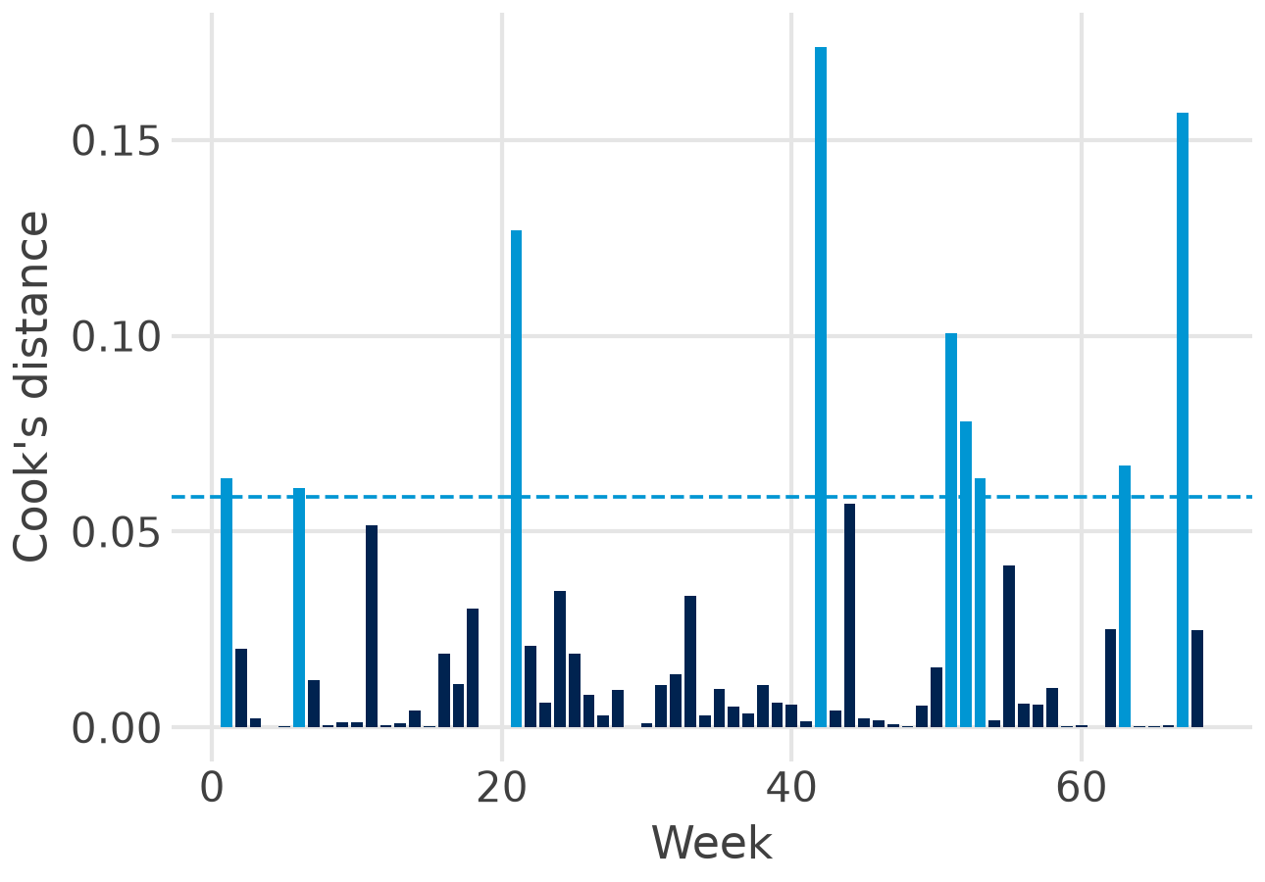

6 Influential weeks: Cook's distance
Flag: 4/n = 0.059; nine weeks above
Week 42: 0.17; display 70 %, feature 42 %
Without it: elasticity −3.76 (−3.68)
But: display effect 0.45 instead of 0.61
Never delete silently: check the data, report with and without the week.
Notes:
Cook's distance measures how much all fitted values move when one week is left out. A common flag is 4/n, here 0.059: nine weeks lie above it, mostly price-cut and display weeks. The largest is week 42 (0.17): a display in 70 % of stores and a feature in 42 % at a normal price. Without week 42 the elasticity barely moves (-3.76 instead of -3.68), but the display effect drops from 0.61 to 0.45. Never delete a week silently: check the data, then report with and without.

Slide 13
The scorecard: logs fix three assumptions at once
Test
H0
Linear
Log-log
RESET p
right form
< 0.001 ✗
0.32 ✓
Breusch-Pagan p
constant variance
< 0.001 ✗
0.68 ✓
Jarque-Bera p
normal residuals
< 0.001 ✗
0.50 ✓
Shapiro-Wilk p
normal residuals
0.001 ✗
0.50 ✓
Largest VIF
below 5
2.3 ✓
2.4 ✓
Durbin-Watson
about 2
1.48 ✗
1.13 ✗
Report the log-log model: sales respond in per cent, so errors grow with the level; logs fix that.
Notes:
All tests for both models. The linear model fails linearity, constant variance and normality; the log-log model passes all three. The reason is the same for all three: sales respond in per cent. A price cut multiplies sales, so errors grow with the level of sales; logs turn multiplication into addition. Multicollinearity is fine in both. Autocorrelation remains (Durbin-Watson below 2); report HAC errors or wait for Session 4. Decision: report the log-log model.

Slide 14
Dummy coding
Part 2 of 6 · 0/1 variables, categories, the reference group, the dummy trap
Notes:
Regression needs numbers. Dummies turn yes/no and categories into 0/1 columns; each coefficient is a difference to a reference group.

Slide 15

A dummy: 1 if yes, 0 if no
Week
december
sales
Linear: December −25 units, p = 0.32
1
1
66
Log-log: b = −0.319, p = 0.02
2
0
86
…
…
…
In per cent: e^b − 1 = e^−0.319 − 1 = −27 %
53
1
70
Reading a dummy: the difference to the weeks with 0, other variables held constant.
Small b (|b| < 0.1): 100 × b is close enough; larger b: use e^b − 1
Notes:
december is 1 in the two Christmas weeks and 0 otherwise. Its coefficient is the difference between December weeks and all other weeks, holding price constant. In the linear model: 25 units fewer, not significant (p = 0.32), because the funnel inflates the errors. In the log-log model: b = -0.319, so exp(-0.319) - 1 = -27 % in December weeks, p = 0.02. The same dummy, read in units or in per cent. For small b, 100 x b is close to the per cent; for -0.32 the exact formula matters.

Slide 16
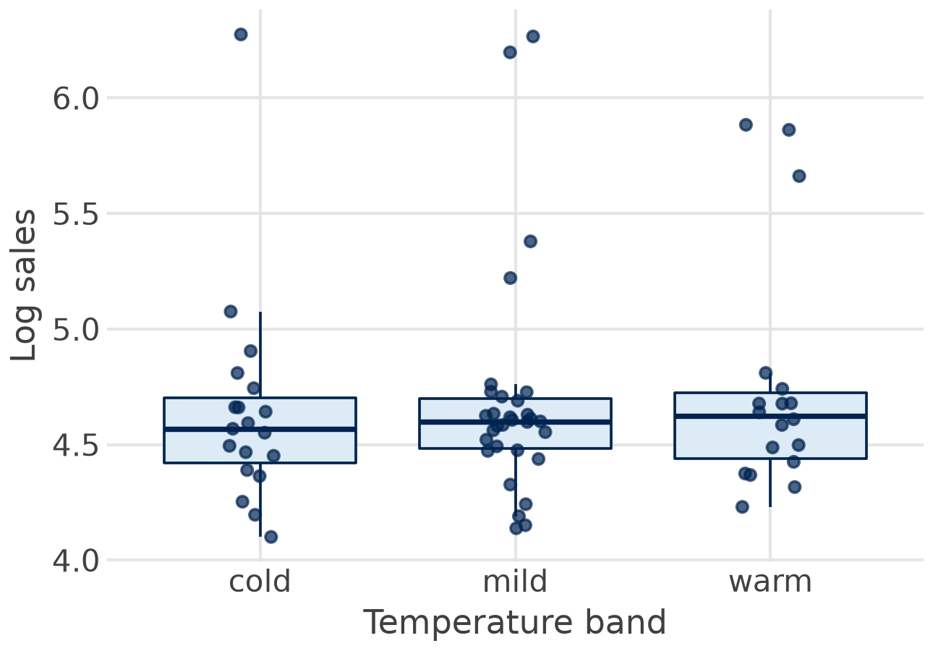

A category with k groups needs k − 1 dummies
Band
Weeks
cold
warm
cold, < 5 °C
19
1
0
mild, 5 to 14 °C
31
0
0
warm, ≥ 15 °C
18
0
1
mild = reference: the row of zeros
cold vs mild: +0.4 %, p = 0.94
warm vs mild: −7.1 %, p = 0.18
Result: with price and December in the model, the season adds little (F-test p = 0.33).
Notes:
Temperature in three bands: cold (below 5 °C, 19 weeks), mild (5 to 14 °C, 31 weeks), warm (15 °C and above, 18 weeks). Three groups need two dummies; the third group, the reference, is the row of zeros. Each coefficient is the difference to the reference. With mild as reference: cold +0.4 %, warm -7.1 %, neither significant (p = 0.94 and 0.18; F-test of both together p = 0.33): once price and December are in the model, the season adds little. The box plot shows the same: similar medians.

Slide 17


The dummy trap and the choice of reference
The dummy trap
The reference group
cold + mild + warm = 1 in every week
= the intercept column: perfect collinearity
Always leave one group out
Coefficients: differences to it
Changes the reading, not the fit (R² 0.900)
Pick the normal case: mild
statsmodels formula
C(season) # reference: cold, first in the alphabet
C(season, Treatment("mild")) # reference: mild
statsmodels avoids the trap when you write C(); with hand-made dummies, leave one out yourself.
Notes:
With an intercept, a dummy for every group adds up to the intercept column: perfect collinearity, and OLS cannot be computed (the dummy variable trap). So always leave one group out. statsmodels does it for you: C(season) uses the first group in the alphabet (cold) as reference; Treatment('mild') picks another. The choice changes what the coefficients mean, not the fit: R-squared is 0.900 either way. Choose the reference that answers the question, usually the normal case.

Slide 18




Three pitfalls with dummies
One Easter week
3 display weeks
Level, not slope
1 in one week only
fits it exactly (leverage 1.00)
no real Easter effect
b = 0.61 rests on 3 weeks
without week 42: 0.45
count the 1s first
a dummy shifts the line
a different slope needs
an interaction
Before you trust a dummy: count how many 1s it has, e.g. (choc["display1"] > 0).sum().
Notes:
One Easter week: a dummy that is 1 in a single week fits that week exactly (leverage 1.00); its coefficient is just that week's residual, not an Easter effect. Two December weeks are barely more. Display: three weeks only, so the large coefficient (0.61) rests on three observations, and one of them (week 42) moves it to 0.45. Finally, a dummy shifts the level only; if the price effect differs in December, you need an interaction (price x december), with even fewer weeks behind it.

Slide 19
Log-log regression
Part 3 of 6 · why logs, four log forms, reading and comparing them
Notes:
Logs are the most important transformation in marketing response models: they turn a multiplicative sales response into a linear regression.

Slide 20



Why logs: sales respond in per cent
sales = a · price1^b · e^(c·december) · error (multiplicative)
ln sales = ln a + b · ln price1 + c · december + ln error (linear in logs)
Elasticities
Comparable
Better errors
b: per cent change in sales
for 1 % more price
across brands, markets
and countries
constant in per cent:
the funnel disappears
No log of zero: shares with zeros (feature1 in 22 weeks) and dummies stay in levels.
Sources: Skiera, Reiner & Albers 2022; Hanssens, Parsons & Schultz 2001
Notes:
The multiplicative sales response function (Skiera et al. 2022; Hanssens et al. 2001): sales = a x price^b x e^(c x december) x error. Take logs and it becomes linear: ln sales = ln a + b ln price + c december + ln error. Three benefits: the coefficient b is an elasticity, comparable across brands and countries; effects are in per cent, so a price cut multiplies sales whether they are 50 or 500 units; and errors in per cent are roughly constant, which fixed the funnel in Part 1. Limit: no log of zero or negative values, so shares such as feature1 (zero in 22 weeks) and dummies stay in levels.

Slide 21

Four forms, four readings of b
Form | Equation | b means | Brand 1
Linear | sales = a + b·price | +1 EUR: b units | −669: 10 cents, −67 units
Log-log | ln sales = a + b·ln price | +1 %: b % (elasticity) | −3.94: 1 %, −3.9 %
Log-linear | ln sales = a + b·price | +1: (e^b − 1)·100 % | −3.10: 10 cents, −27 %
Linear-log | sales = a + b·ln price | +1 %: b/100 units | −853: 1 %, −8.5 units
Log on the left: per cent change in sales. Log on the right: per cent change in the driver.
Sources: Wooldridge 2025, ch. 6; Skiera, Reiner & Albers 2022
Notes:
Own price of brand 1 in four forms, one regressor each. Linear: 10 cents more, 67 units fewer. Log-log: 1 % more, 3.9 % fewer (elasticity). Log-linear: 10 cents more, exp(-3.10 x 0.1) - 1 = -27 %. Linear-log: 1 % more, 853 / 100 = 8.5 units fewer. Only the two models with log sales pass RESET and Breusch-Pagan. Between them: the log-log gives the elasticity, which the pricing formula needs.

Slide 22
Comparing a linear and a log model
Not R² or AIC: sales and log sales are different outcomes (0.884 vs 0.835 says nothing)
Residuals and tests: curve, funnel, Q-Q plot, RESET, Breusch-Pagan (Part 1)
Plausibility: sign and size of the coefficients, benchmarks such as the mean elasticity −2.6
Back on the sales scale: exp(fitted) for the log model, then compare predictions in units
Brand 1: the log-log model passes the tests, the linear one fails three. Report the log-log model.
Sources: Wooldridge 2025, ch. 6; Bijmolt, van Heerde & Pieters 2005
Notes:
R-squared measures explained variation of the outcome. Sales and log sales are different outcomes, so 0.896 and 0.903, or 0.884 and 0.835 for the one-regressor models, cannot be compared. The same holds for AIC. Compare instead what both models share: the residual plots and assumption tests, the plausibility of the coefficients, and predictions on the original scale. To predict sales from a log model, take exp of the fitted value; this gives roughly the median, slightly below the mean.

Slide 23
Non-linear relationships
Part 4 of 6 · curves in a linear regression: squares, logs, the turning point
Notes:
Linear regression means linear in the coefficients, not in the variables: squares and logs of a variable are allowed.

Slide 24



Linear in b, not in x
Diminishing
U or inverted U
Thresholds
each step adds less
logs; square root
an optimum or minimum
x and x²
effect only above a level
dummies for ranges
sales = b0 + b1·price1 + b2·price1² still linear in b0, b1, b2
smf.ols("sales ~ price1 + I(price1**2)", data=df)
Session 2: the marketing mix model adds saturation curves for media: the same idea.
Notes:
Marketing effects are rarely straight lines: each extra euro of price cut sells less than the one before at some point, advertising saturates, temperature can have an optimum. OLS can fit all of these as long as the model is linear in the coefficients: add x squared, take logs, or use dummies for ranges (piecewise). Session 2 adds the saturation curves of the marketing mix model.

Slide 25
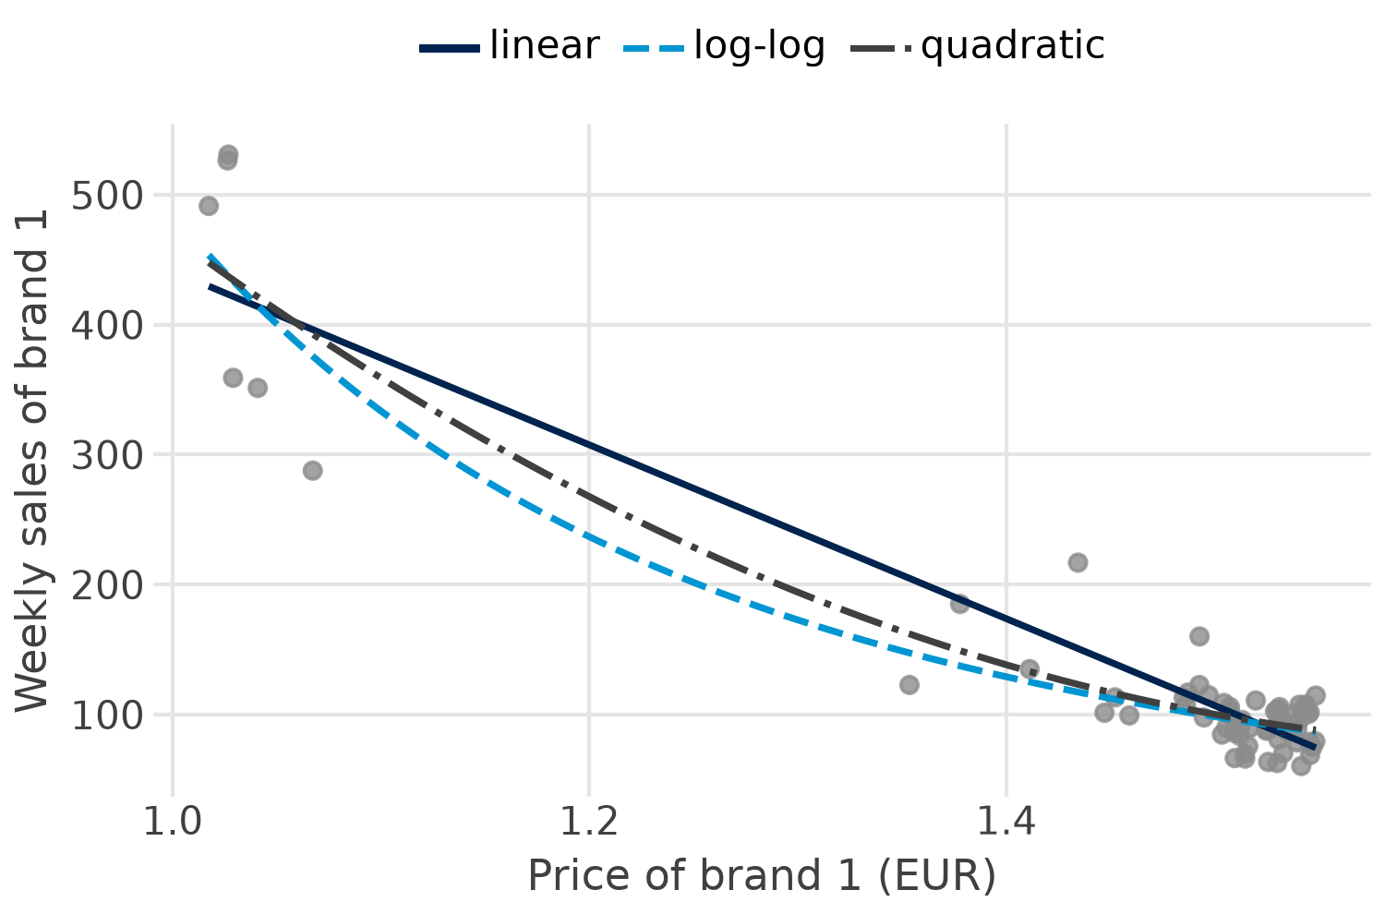
Three curves through the same weeks
Linear: R² 0.884; RESET p = 0.002
Quadratic: R² 0.900; RESET p < 0.001
Log-log: R² 0.835 (log sales); RESET p = 0.37
Thin middle: few weeks between 1.10 and 1.35
Look: all three agree where the data are; they differ where weeks are few.
Notes:
Sales against own price with three fitted curves. The straight line overshoots in the middle and undershoots at both ends. The quadratic bends (R-squared 0.900 instead of 0.884). The log-log curve bends most at low prices: a constant elasticity means each 1 % price cut sells the same per cent more, so in units the effect is largest when sales are already high. The data between 1.10 and 1.35 are thin: only a few weeks decide the shape there.

Slide 26
The quadratic: the effect depends on the price
sales = 2,533 − 2,952·price1 + 886·price1² slope = b1 + 2·b2·price1
Price (EUR)
Slope per EUR
10 cents more
1.67
turning point −b1 / (2·b2), in EUR: outside the data (1.02 to 1.55)
1.00
−1,179
−118 units
1.25
−736
−74 units
1.50
−293
−29 units
Never read a curve beyond the data: above 1.67 the quadratic says sales rise with price.
Still: RESET and Breusch-Pagan fail; the log-log model remains the better form
Notes:
sales = 2,533 - 2,952 price1 + 886 price1². With a square, the slope is no longer one number: it is b1 + 2 b2 x price. At 1.00 EUR, 10 cents more cost 118 units; at 1.25, 74; at 1.50, 29. The turning point is -b1 / (2 b2) = 1.67 EUR: beyond it the curve would rise again, so sales would grow with price. It lies outside the data (prices 1.02 to 1.55): never read the curve beyond the data. RESET still fails and the funnel remains, so the quadratic fixes the form only partly.

Slide 27
Choosing the form: four questions
Theory: saturation, an optimum, effects in per cent?
1
Look and test: residuals against fitted, RESET
2
Compare like with like: same outcome: adjusted R² or AIC; else tests and predictions
3
Plausible in the data range: signs, turning points, no extrapolation
4
Example: temp² in the full log-log model, p = 0.14: keep temperature linear.
Notes:
A practical order. Theory first: does the effect plausibly saturate, have an optimum, act in per cent? Then the residual plot and RESET. Compare candidate models with the same outcome by adjusted R-squared or AIC (lower is better); for different outcomes, use the tests and predictions instead. Finally, plausibility within the data range. Here: temperature squared adds nothing in the full log-log model (p = 0.14), so temperature stays linear.

Slide 28
The analyses in Python
Part 5 of 6 · packages, two models, plots, tests, dummies, curves
Notes:
Live in Positron. The code on the next slides is complete; it is also in sessions/01-foundations/regression_assumptions.qmd: open it and run it cell by cell. Packages first, then the in-class exercise, then Posit Assistant.

Slide 29
The packages and functions
Task | Package | Function
Fit the models | statsmodels | smf.ols(formula, data).fit()
Curve: RESET | statsmodels | linear_reset(model, power=2, use_f=True)
Funnel: Breusch-Pagan | statsmodels | het_breuschpagan(resid, exog)
Normality | statsmodels, scipy | jarque_bera(resid); stats.shapiro(resid)
Multicollinearity | statsmodels | variance_inflation_factor(exog, i)
Influence | statsmodels | model.get_influence().cooks_distance
Dummies | polars, statsmodels | pl.when().then(); C(season, Treatment("mild"))
Plots | plotnine | geom_point, geom_qq, geom_qq_line
Notes:
Everything is in the packages installed in Session 1: statsmodels brings the tests, scipy the Shapiro-Wilk test, polars builds the dummies, plotnine draws the residual and Q-Q plots. No new installation needed.

Slide 30

Step 1: fit both models
Python: polars and statsmodels
Linear
Log-log
import numpy as np
import polars as pl
import statsmodels.formula.api as smf
choc = pl.read_csv(
"data/legacy/chocolate_dataset.csv")
df = choc.to_pandas()
lin = smf.ols("sales ~ price1 + feature1 + display1"
" + temp + december", data=df).fit()
ll = smf.ols("np.log(sales) ~ np.log(price1)"
" + np.log(price2) + np.log(price3)"
" + np.log(price4) + feature1 + display1"
" + temp + december", data=df).fit()
Own price
−678
−3.68
R²
0.896
0.903
n
68
68
Keep both: every next step uses lin and ll.
Notes:
The same set-up as in deck 01b: polars reads the data, .to_pandas() hands it to statsmodels. Two formulas, two fitted models. Keep both: every step after this uses lin and ll.

Slide 31
Step 2: look at the residuals
Python: plotnine
from plotnine import (aes, geom_hline, geom_point,
geom_qq, geom_qq_line, ggplot, labs)
df["fit"], df["res"] = lin.fittedvalues, lin.resid
(ggplot(df, aes("fit", "res"))
+ geom_point()
+ geom_hline(yintercept=0, linetype="dashed")
+ labs(x="Fitted sales", y="Residuals"))
df["z"] = (df["res"] - df["res"].mean()) / df["res"].std()
(ggplot(df, aes(sample="z"))
+ geom_qq() + geom_qq_line()
+ labs(x="Normal quantiles", y="Residuals"))
lin: curve and funnel. Then the same for ll.
Run it twice: for lin and for ll; compare curve, funnel and the Q-Q line.
Notes:
Two plots per model. The residual plot puts fitted values and residuals into the data frame and uses the plotnine grammar of deck 01b. The Q-Q plot uses geom_qq with geom_qq_line; standardise the residuals first, so the line has slope 1. Run both for lin and for ll and compare.

Slide 32
Step 3: test the assumptions
Python: statsmodels and scipy
p / VIF
lin
ll
from scipy import stats
from statsmodels.stats.diagnostic import (
het_breuschpagan, linear_reset)
from statsmodels.stats.stattools import jarque_bera
from statsmodels.stats.outliers_influence import (
variance_inflation_factor)
for m in (lin, ll):
X = m.model.exog
print(linear_reset(m, power=2, use_f=True).pvalue,
het_breuschpagan(m.resid, X)[1],
jarque_bera(m.resid)[1],
stats.shapiro(m.resid).pvalue,
max(variance_inflation_factor(X, i)
for i in range(1, X.shape[1])))
RESET
< .001
0.32
BP
< .001
0.68
JB
< .001
0.50
SW
0.001
0.50
max VIF
2.3
2.4
Robust errors if needed: lin.model.fit(cov_type="HC3").
Notes:
Each test returns a tuple; [1] picks the p-value (het_breuschpagan returns LM, p, F, F p). linear_reset returns a test result with .pvalue. VIF needs the design matrix model.model.exog and skips column 0, the intercept. The loop prints the scorecard of Part 1.

Slide 33
Step 4: dummies from a category
Python: polars and statsmodels
vs mild
e^b − 1
p
choc = choc.with_columns(
pl.when(pl.col("temp") < 5).then(pl.lit("cold"))
.when(pl.col("temp") < 15).then(pl.lit("mild"))
.otherwise(pl.lit("warm")).alias("season"))
choc["season"].value_counts() # 19, 31, 18
df = choc.to_pandas()
sea = smf.ols("np.log(sales) ~ np.log(price1)"
" + np.log(price2) + np.log(price3)"
" + np.log(price4) + feature1 + display1"
" + december"
" + C(season, Treatment('mild'))",
data=df).fit()
np.exp(sea.params) - 1 # per cent
cold
+0.4 %
0.94
warm
−7.1 %
0.18
december
−28.5 %
0.01
k − 1 dummies: C() leaves the reference out for you.
Notes:
polars builds the category with when/then/otherwise, the same logic as an if-else. statsmodels turns C(season) into k - 1 dummies; Treatment('mild') sets the reference. pl.Series.to_dummies() shows the 0/1 columns if you want to see them; do not put all three into a model with an intercept (the dummy trap). exp(b) - 1 turns each log coefficient into per cent.

Slide 34
Step 5: a curve and its turning point
Python: statsmodels
Result
Value
quad = smf.ols("sales ~ price1 + I(price1**2)",
data=df).fit()
b1 = quad.params["price1"]
b2 = quad.params["I(price1 ** 2)"]
turn = -b1 / (2 * b2) # 1.67
choc["price1"].min(), choc["price1"].max()
for p in (1.00, 1.25, 1.50): # slope at p
print(p, (b1 + 2 * b2 * p) / 10) # per 10 cents
linear_reset(quad, power=2, use_f=True).pvalue
b1
−2,952
b2
886
Turning point
1.67 EUR
Price range
1.02 to 1.55
RESET p
< 0.001
Outside the data: the turning point says nothing about real prices.
Notes:
I() protects the arithmetic inside a formula: I(price1**2) is price1 squared. The turning point follows from the two coefficients. Compare it with the price range from polars. For the log-log curve on the sales scale, take exp of the predictions.

Slide 35
In-class exercise
Part 6 of 6 · online quiz, then the chocolate data in Python, then with Posit Assistant
Notes:
Same four steps as before: online quiz 3, a coding exercise on the chocolate data with the packages, the answers in the plenary, then the same tasks with Posit Assistant.

Slide 36
Online quiz 3: assumptions, dummies, logs in five questions
1 Breusch-Pagan gives p = 0.001. This means …
A constant variance B unequal variance (heteroscedasticity) C normal residuals
2 Four store formats in one model with an intercept need …
A 4 dummies B 3 dummies C 1 dummy
3 In a log model the December dummy is b = −0.36. December weeks sell …
A 0.36 units fewer B 36 % fewer C about 30 % fewer
4 A quadratic in price turns at 1.67 EUR; prices in the data run 1.02 to 1.55. So …
A do not read it: outside the data B raise the price above 1.67 C sales rise with price
5 Linear model R² 0.88, log-log R² 0.84. Which is better?
A the linear one B R² cannot tell: different outcomes C the log-log one
Online on Canvas: 3 minutes alone, then compare with your neighbour.
Notes:
Online quiz on Canvas: three minutes alone, then compare with your neighbour.

Slide 37
Your turn: which model may brand 1 trust?
Pairs, with packages:
15 minutes
Plenary, answers:
5 minutes
Posit Assistant:
10 minutes
1
Look: sales ~ price1 and np.log(sales) ~ np.log(price1); residual plot of each: curve, funnel?
2
Test: RESET, Breusch-Pagan and Jarque-Bera for both models; which fails what?
3
Dummies: season from temp with polars; add december and C(season, Treatment("mild")); read both in per cent
4
Curve: sales ~ price1 + I(price1**2); turning point; inside the price range?
5
The manager: which model do you report, and one sentence with a number
File: sessions/01-foundations/assumptions_exercise.qmd (data, tasks, Posit Assistant)
Notes:
Work on the tasks; we discuss them together.

Slide 38
Then: the same tasks with Posit Assistant
1
Code first: solve the tasks with the packages; keep the cells run, so Posit Assistant sees choc, df and the models
2
Open the chat: Posit Assistant icon in the activity bar, or Ctrl/Cmd + Shift + P → View: Show Posit Assistant
3
Give context: type @assumptions_exercise.qmd, then one task per prompt: the file, the packages, the output
4
Ask for meaning: let it explain each test result in one sentence; check the direction of p
5
Compare: its code, numbers and wording with yours and the answers
Stay in Normal mode: never /yolo. Read every edit before you accept it. You own every number and every sentence.
Notes:
The routine of the earlier exercises. Posit Assistant sees the attached file and, once Python runs, the data frames and models. Ask it to explain the tests, not only to run them: 'what does Breusch-Pagan p < 0.001 mean here?' Check the direction: in an assumption test a small p is bad news. Typical slips: Shapiro-Wilk on sales instead of the residuals, all three season dummies plus the intercept, 100 x b instead of exp(b) - 1, a turning point read outside the data.

Slide 39
Prompts for the assumption checks
Prompt for task 2
Prompt for task 3
@assumptions_exercise.qmd Task 2.
Run RESET, Breusch-Pagan and
Jarque-Bera with statsmodels for
lin1 and ll1. Show the p-values
in one table and explain in one
sentence each which assumption
fails.
Task 3. Build season from temp
with polars when/then (cold < 5,
mild < 15, warm). Fit the model
with C(season, Treatment("mild"))
and give each dummy in per cent
with exp(b) - 1.
Name three things: the file, the packages (polars, statsmodels, scipy), the output
Check the direction: in an assumption test a small p means a problem
Watch for slips: tests on sales instead of residuals, three dummies plus intercept, 100 × b
Notes:
Two example prompts: each names the file or task, the packages and the output, and asks for an explanation. Watch for the slips listed at the bottom; if a step is wrong, say so in the same chat and ask again.

Slide 40
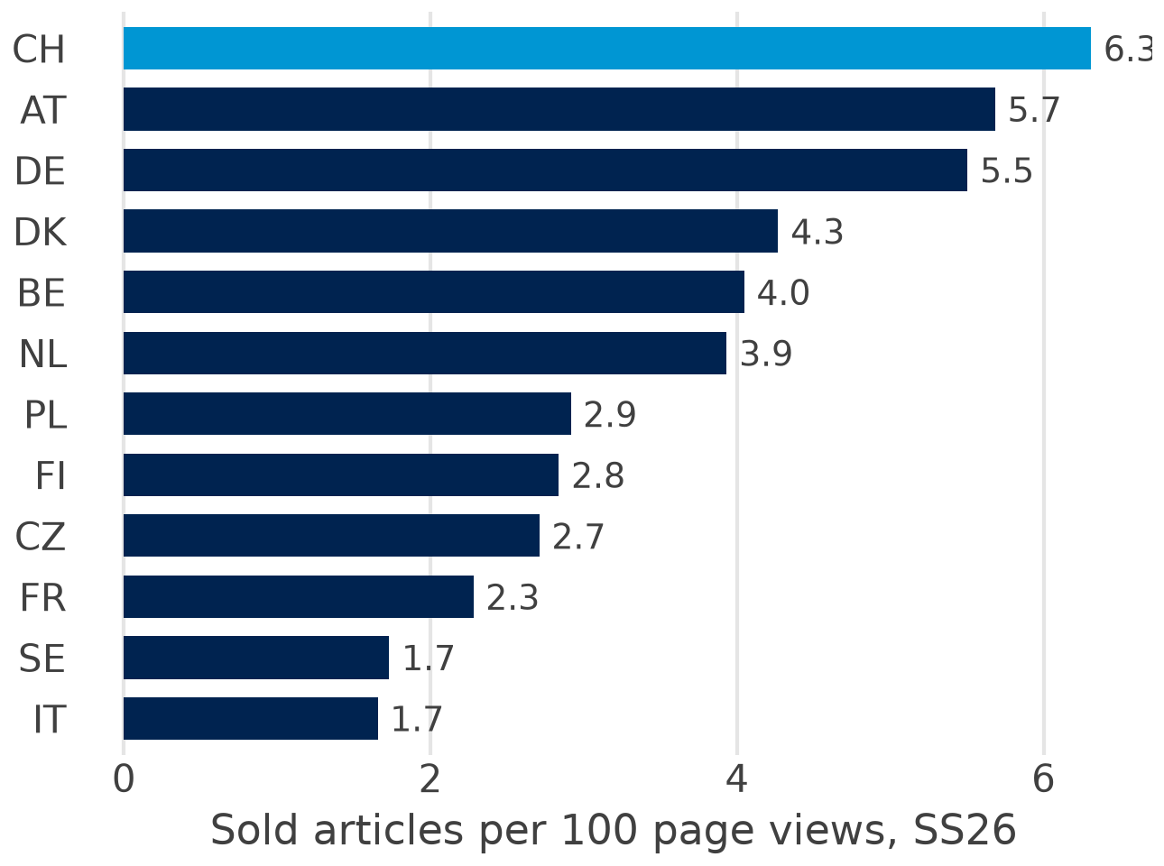

Second case: one fashion brand, twelve countries
Data: 403 rows, season × country × article type
Funnel: page views → add to basket → sold → returns
Markets: DE, CH, AT = 71 % of NMV in SS26
New in SS26: Switzerland converts best at once
The manager asks: where do page views turn into sales, and should we invest in Switzerland?
Notes:
Real data, anonymised: one fashion brand on a large online fashion platform, sales by article type and country for the Spring/Summer 2025 and 2026 collections, 403 rows. Volumes and money are rescaled, shares and conversion are original. Each row adds up a whole season, so the data are cross-sectional: good for log-log models and country dummies, not for a marketing mix model (no weeks, no media spend). DE, CH and AT make 71 % of NMV in SS26. Switzerland is new in SS26 and converts best at once; Italy and Sweden convert worst. The brand manager's questions: where do page views turn into sales, and should we invest in Switzerland?

Slide 41
Your turn: the fashion brand in Python
Pairs, with packages:
20 minutes
Plenary, answers:
5 minutes
Posit Assistant:
10 minutes
1
Markets: SS26 by country: NMV, sales, sold per 100 views, return rate; a great_tables table
2
Funnel: np.log(sold_articles) ~ np.log(pdp_views), rows with sales only; read the elasticity
3
Country dummies: + C(country, Treatment("DE")) + C(season); per cent effects; two reasons
4
Price, discount, sizes: add them; is the price coefficient a price elasticity? Check with HC3
5
Switzerland: CH vs DE and AT; why is nmv / (sold × price) higher? Invest or not?
File: sessions/01-foundations/fashion_exercise.qmd (data: data/fashion/fashion_countries.csv)
Notes:
Same routine: pairs with the packages (20 minutes), plenary, then Posit Assistant. The file has the data table, five tasks and a Posit Assistant section with example prompts. Watch for: np.log of zero sales (filter them), the alphabetical reference country (AT) instead of Treatment('DE'), unweighted means of return rates, and the price coefficient read as a price elasticity.

Slide 42

Key takeaways
Look, then test, then fix: residual and Q-Q plots; RESET, Breusch-Pagan, Jarque-Bera, VIF, Cook's distance
1
In assumption tests a small p is bad news
2
Dummies: k − 1 for k groups; each b is a difference to the reference; count the 1s
3
Logs: elasticities, per cent effects, better residuals; compare models by tests, not R²
4
Curves: squares and logs keep OLS linear in b; never read a curve beyond the data
5
Homework: coding exercise 2 with your personal data, brief on Canvas.
Notes:
If students remember one thing: look at the residuals before you trust a regression; for sales data the log-log model usually fixes the form, the funnel and the tails at once.

Slide 43
References
Academic
Learning resources
Skiera, B., Reiner, J. & Albers, S. (2022). Regression analysis. In Homburg et al. (eds), Handbook of Market Research, 299–327. Springer.
Bojinov, I. I., Parzen, M. & Hamilton, P. J. (2025). Linear Regression. HBS note 9-622-100 (Canvas).
Wooldridge, J. M. (2025). Introductory Econometrics, 8th ed. Cengage. Ch. 6 to 9.
Hanssens, D. M., Parsons, L. J. & Schultz, R. L. (2001). Market Response Models. Kluwer.
Hair, J. F. et al. (2019). Multivariate Data Analysis, 8th ed. Cengage. Ch. 5.
James, G. et al. (2023). ISLP, ch. 3.3 and the Python lab (free).
statsmodels. Regression diagnostics and specification tests (documentation).
Gelman, Hill & Vehtari (2020). Regression and Other Stories, ch. 11 to 12 (free PDF).
Turrell, A. Coding for Economists: regression diagnostics (free).
polars. when/then/otherwise and to_dummies (documentation).
Notes:
Core readings first. Wooldridge covers every test in more depth; ISLP chapter 3 has a Python lab on residual plots and non-linear terms.

Slide 44
Notes:
Questions? Contact details on the card; office hours via the booking link.

