Slide 1
International Marketing Analytics
Statistics refresher and linear regression
Session 1 · WT 2026/27
Notes:
Two halves. First a statistics refresher on a small chocolate kiosk that can be followed with a calculator, calculated by hand in Python. Then linear regression, the workhorse of the course: every marketing mix model is a regression with transformed variables. Theory, assumptions and tests, real-world uses, and a first model on real chocolate scanner data. Readings: Bojinov, Parzen and Hamilton (2025), Skiera, Reiner and Albers (2022).

Slide 2



Today
Refresher
Python
by hand
OLS
theory
Tests
Chocolate
in Python
In class,
exercise
Refresher, Parts 1 to 5
Regression, Parts 6 to 11
Scale types: what you may calculate
Mean, median, standard deviation, standard error
z-scores and the normal distribution
Covariance and correlation
All of it by hand in Python; quiz 1
OLS, inference, fit, logs and elasticities
Seven assumptions and four tests
Regression in the real world
statsmodels and plotnine on real data; quiz 2
In-class assignment, coding exercise 1
Readings: Bojinov, Parzen & Hamilton (2025), Linear Regression (HBS); Skiera, Reiner & Albers (2022), Regression Analysis.
Notes:
Two halves, eleven short parts. The refresher (Parts 1 to 5) builds the vocabulary of every regression table: means, standard errors, z-values, correlations. Regression (Parts 6 to 11) uses it on real chocolate data. Each half ends with a five-question quiz.

Slide 3

Our example: a chocolate kiosk
Five weeks, five prices
One week, day by day
Week
Price (EUR)
Bars sold
Day
Bars sold
1
2.00
110
Mon
10
2
2.50
100
Tue
12
3
3.00
80
Wed
11
4
3.50
70
Thu
13
5
4.00
40
Fri (event)
54
Small on purpose: every number today can be checked with a calculator, then in Python.
Notes:
A kiosk at the university sells one chocolate bar. Over five weeks the owner tried five prices. Small numbers on purpose: every result today can be checked with a calculator. The daily sales of one week (right) serve for mean and median.

Slide 4
Scale types
Part 1 of 11 · nominal, ordinal, interval, ratio
Notes:
The scale decides which statistics and which charts make sense.

Slide 5

Four scale types
Scale | What you can say | Kiosk example | Typical statistics
Nominal | same or different | brand, payment method | counts, mode
Ordinal | more or less | rating 1 to 5 stars, size S/M/L | median, percentiles
Interval | how much more (no true zero) | temperature in °C | mean, standard deviation
Ratio | how many times (true zero) | price, bars sold, revenue | all, incl. ratios
Two groups: nominal and ordinal are categorical; interval and ratio are metric (numbers you can average).
In regression: categorical variables enter as dummies (0/1), metric variables as they are.
Notes:
Nominal: categories without order (brand, country, payment method): count them, report the mode. Ordinal: ordered categories with unequal or unknown distances (star rating, size S/M/L): median and percentiles. Interval: equal distances but no true zero (temperature in °C): differences and means are fine, ratios are not. Ratio: true zero (price, bars sold, revenue): everything, including 'twice as much'. Interval and ratio together are called metric; nominal and ordinal categorical.

Slide 6

Why the scale matters
20 °C is not twice as warm as 10 °C: no true zero
Quick quiz: which scale?
Country of the customer
Satisfaction from 1 to 7
Age in years
Discount: yes or no
Temperature on the day
Mean of star ratings: treats ordinal as metric; say so
Store ID 17: a number, but only a label: nominal
Rule: check the scale before you average, chart or put a variable into a model.
Notes:
20 °C is not twice as warm as 10 °C (in Kelvin it is 293 versus 283). An average of star ratings treats an ordinal scale as metric: common in practice, but a decision you should state. An 'average brand' means nothing. Quiz answers: country nominal; satisfaction 1 to 7 ordinal (often treated as metric); age in years ratio; store ID nominal (a number, but only a label); discount yes/no nominal (binary, a dummy); temperature interval.

Slide 7
Centre and spread
Part 2 of 11 · mean, median, variance, standard deviation, standard error
Notes:
Where are the data, how far do they scatter, and how precise is our average?

Slide 8
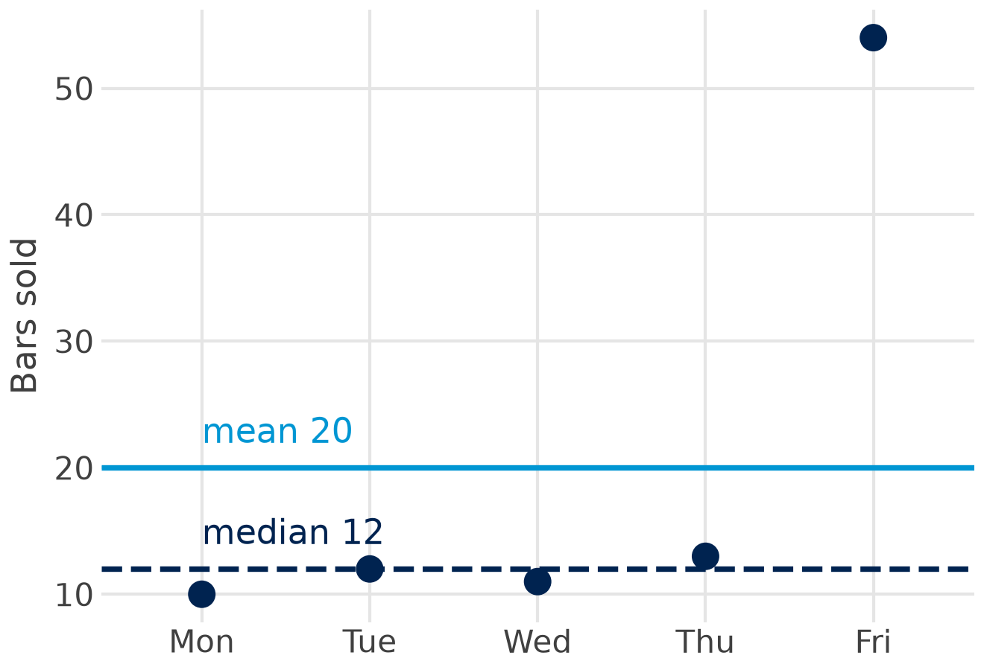

Mean and median
mean x̄ = Σ x / n = 100 / 5 = 20
median middle of 10 11 12 13 54 = 12
Mean uses every value; one event day pulls it up
Median is robust: half the days below, half above
Use the median for skewed data and ordinal scales
Totals need the mean: 20 bars a day × 5 days = 100 bars in the week.
Notes:
The mean adds all values and divides by n. The median is the middle value of the sorted data (with an even n, the average of the two middle values). One event day with 54 bars pulls the mean to 20, but the median stays at 12, which describes a normal day much better. Use the median for skewed data (income, basket values, sales with promotions) and for ordinal scales; the mean for symmetric metric data, and whenever totals matter (20 x 5 = 100 bars sold).

Slide 9
Variance and standard deviation, by hand
Week
Bars x
x − x̄
(x − x̄)²
Variance and standard deviation
1
110
30
900
x̄ = 400 / 5 = 80
s² = 3,000 / (5 − 1) = 750
s = √750 = 27.4 bars
2
100
20
400
3
80
0
0
Variance is in squared units (bars²)
4
70
−10
100
5
40
−40
1,600
Standard deviation is in bars: the typical distance from the mean
Sum
400
0
3,000
Why n − 1? deviations from the sample mean are a little too small; dividing by n − 1 corrects this. polars and pandas do it by default.
Notes:
Step by step for weekly bars sold: subtract the mean (80), square the deviations so that plus and minus do not cancel, add them up (3,000), divide by n - 1 = 4: the variance is 750 (bars squared). The square root brings us back to bars: the standard deviation is 27.4 bars, the typical distance of a week from the mean. Why n - 1: the deviations are measured from the sample mean, which sits closer to the data than the true mean; dividing by n - 1 corrects this. polars, pandas and statsmodels use n - 1 for samples.

Slide 10
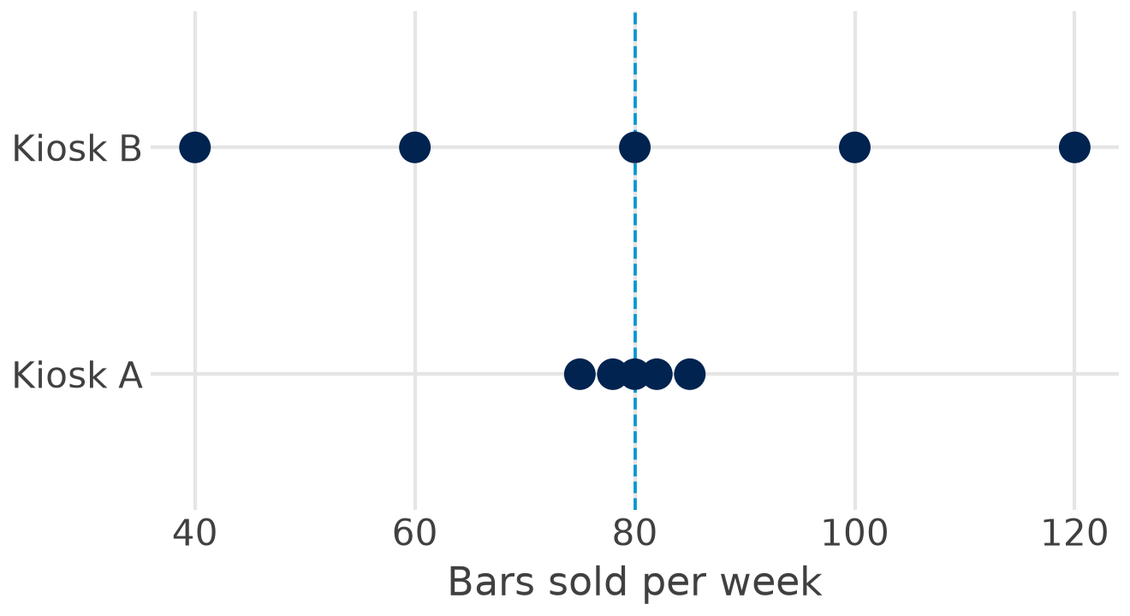

Same mean, different spread
3.8
bars: sd of kiosk A
31.6
bars: sd of kiosk B
For the manager: both sell 80 a week, but kiosk B needs much more safety stock and its forecasts are less certain.
Notes:
Two kiosks sell 80 bars a week on average. Kiosk A varies between 75 and 85 (sd 3.8), kiosk B between 40 and 120 (sd 31.6). The mean alone hides this. For planning: kiosk B needs far more safety stock, and a forecast for kiosk B is much less certain.

Slide 11

Standard error: how precise is the mean?
SE = s / √n 95% confidence interval ≈ x̄ ± 1.96 · SE
EUR 1.00
EUR 0.50
10.04–13.96
SE with 16 customers: 4 / √16
SE with 64 customers: 4 / √64
95 % interval for a mean spend of EUR 12 (n = 16)
sd describes how much customers differ: spending varies by about EUR 4
SE describes how precise the average is: it shrinks with √n; four times the sample, half the SE
In every regression table: the column 'std err' is the standard error of a coefficient.
Notes:
The standard deviation describes the customers; the standard error describes the precision of the average we calculate from a sample. SE = s / square root of n. Spending per customer has sd EUR 4: with 16 customers the SE of the mean is EUR 1, with 64 customers EUR 0.50. Four times the sample halves the standard error. A 95 % confidence interval is roughly mean plus or minus 2 SE (1.96 exactly): EUR 12 plus or minus 1.96 gives 10.04 to 13.96. Every 'std err' in a regression table is a standard error.

Slide 12
Standardisation and the normal distribution
Part 3 of 11 · z-scores, normal and standard normal distribution
Notes:
z-scores make different scales comparable; the normal distribution tells us how unusual a value is.

Slide 13

Standardisation: z-scores
z = (x − x̄) / s a standardised variable has mean 0 and standard deviation 1
Kiosk
Bars this week
Mean
sd
z
Vienna
140
120
10
+2.0
Graz
75
60
15
+1.0
Our kiosk, week 5
40
80
27.4
−1.46
Read it: Vienna's week lies 2 standard deviations above normal, Graz's only 1: Vienna's week was the more unusual one.
Use: compare across stores, countries or units; spot outliers (|z| > 3); standardised coefficients.
Notes:
A z-score says how many standard deviations a value lies above or below the mean. It removes the units, so values on different scales become comparable. Vienna sold 140 bars in a week (mean 120, sd 10): z = 2.0. Graz sold 75 (mean 60, sd 15): z = 1.0. Vienna's week was the more unusual one, although Graz's increase looks large. In our kiosk, week 5 with 40 bars has z = (40 - 80) / 27.4 = -1.46. A standardised variable always has mean 0 and standard deviation 1; standardised regression coefficients use exactly this.

Slide 14
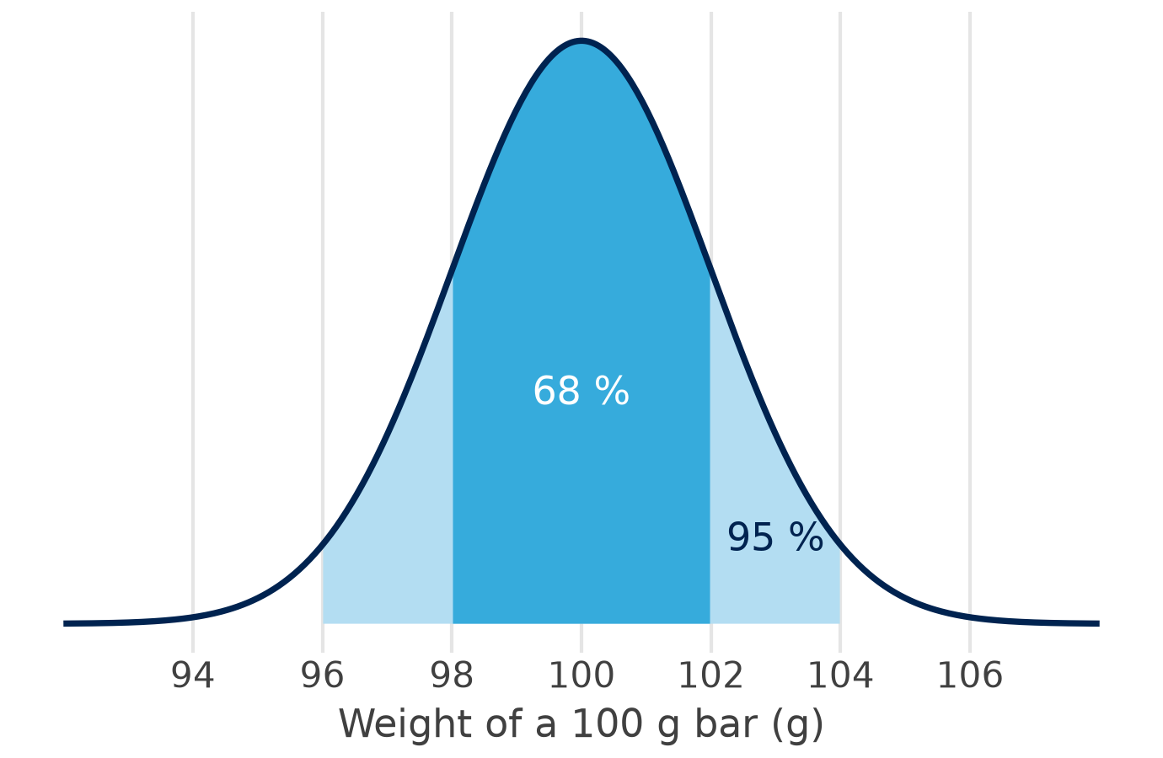

The normal distribution
68 %
within ±1 sd: 98 to 102 g
95 %
within ±2 sd: 96 to 104 g
99.7 %
within ±3 sd: 94 to 106 g
Why it matters: averages and regression coefficients are approximately normal (central limit theorem), so we can test them.
Notes:
A machine fills 100 g bars; the weights are normally distributed with mean 100 g and sd 2 g. The bell curve is fully described by mean and standard deviation. The 68-95-99.7 rule: 68 % of bars lie within one sd (98 to 102 g), 95 % within two (96 to 104 g; exactly 1.96 sd), 99.7 % within three (94 to 106 g). Many sums and averages are approximately normal even when single values are not (central limit theorem): this is why means and regression coefficients can be tested with the normal curve.

Slide 15
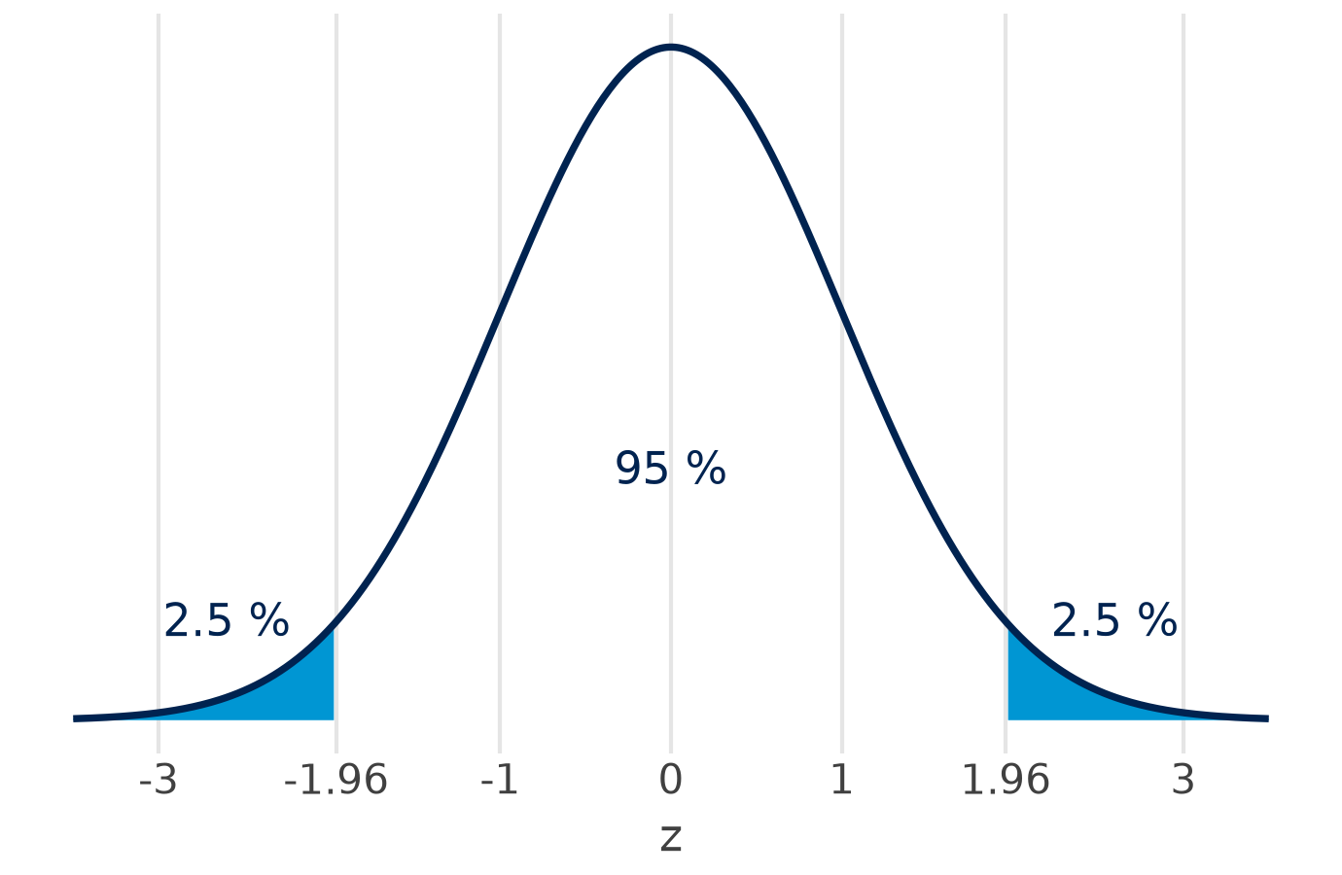
The standard normal distribution
z
share below z
1.00
84.1 %
1.645
95.0 %
1.96
97.5 %
2.576
99.5 %
Bars under 97 g? z = (97 − 100) / 2 = −1.5, so 6.7 % of all bars
1.96: the number behind 95 % confidence intervals and two-sided tests at 5 %.
Notes:
Standardising any normal variable gives the standard normal distribution: mean 0, sd 1. One table (or one line of Python) then answers every question. Share of bars below 97 g: z = (97 - 100) / 2 = -1.5, P(Z < -1.5) = 6.7 %. The value 1.96 cuts off 2.5 % in each tail: it is the 1.96 in confidence intervals and the critical value of a two-sided test at 5 %.

Slide 16
Covariance and correlation
Part 4 of 11 · do two variables move together, and how strongly?
Notes:
From one variable to two: price and bars sold at the kiosk.

Slide 17
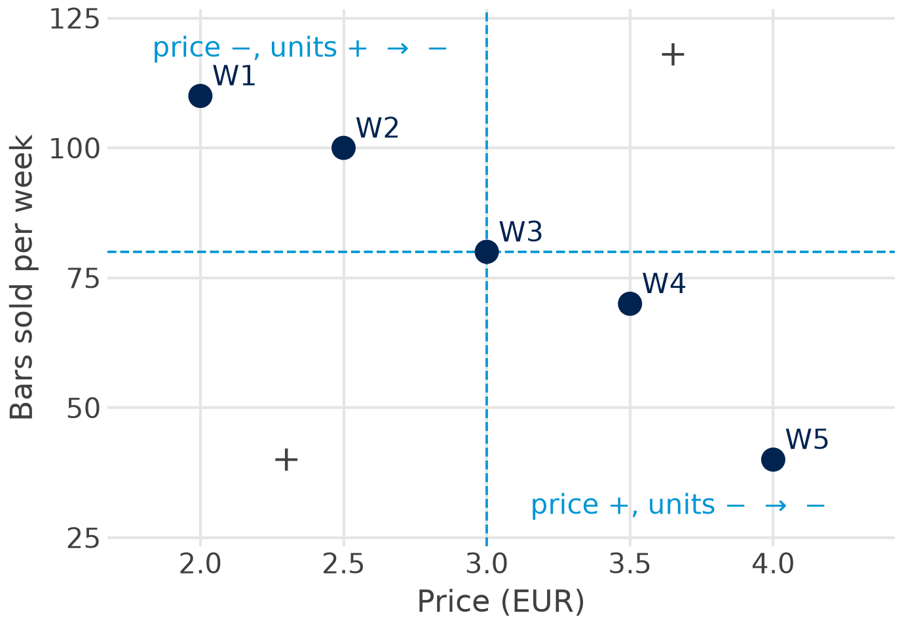

Covariance: do price and sales move together?
Week
p − p̄
x − x̄
product
1
−1.0
30
−30
2
−0.5
20
−10
3
0
0
0
4
0.5
−10
−5
5
1.0
−40
−40
Sum
−85
cov = −85 / (5 − 1) = −21.25
Sign = direction; the size depends on the units (EUR × bars).
Notes:
Multiply the deviation of price by the deviation of bars sold for every week. When one is above its mean while the other is below, the product is negative (weeks 1, 2, 4 and 5); week 3 sits exactly on both means. The sum is -85; divided by n - 1 = 4 the covariance is -21.25. The sign gives the direction: negative, higher prices go with fewer bars. The size depends on the units (EUR x bars), so -21.25 alone says little about strength.

Slide 18
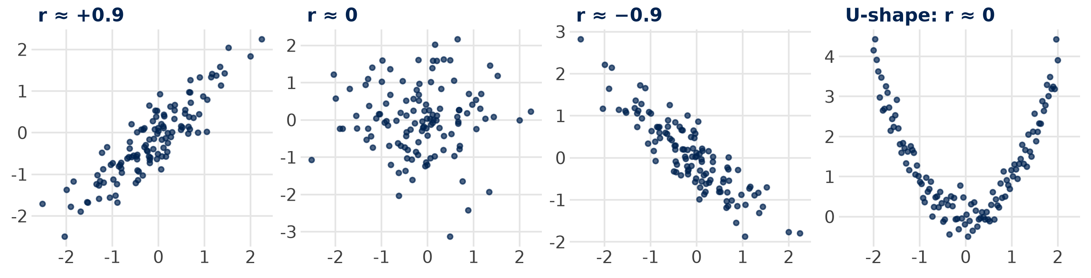

Correlation: covariance without units
r = cov / (s_p · s_x) = −21.25 / (0.79 · 27.39) = −0.98 −1 ≤ r ≤ +1
Two warnings: r only measures straight-line relationships (the U has r ≈ 0), and correlation is not causation.
Sources: Bojinov, Parzen & Hamilton 2025 (HBS note 9-622-100)
Notes:
Dividing the covariance by both standard deviations removes the units: r = -21.25 / (0.79 x 27.39) = -0.98. r always lies between -1 and +1; -0.98 is an extremely strong negative relationship (rule of thumb in Bojinov et al.: above 0.8 extremely strong). The gallery shows strong positive, none, strong negative, and a U-shape where r is zero although x and y are clearly related: r only measures linear relationships.

Slide 19
From correlation to regression
Not causation: ice-cream sales and sunburn rise together; sunshine drives both
Correlation says how strongly two variables move together, from −1 to +1
Regression says by how much y changes when x changes by one unit
slope b = cov(p, x) / var(p) = −21.25 / 0.625 = −34 bars per EUR
line through the means: x = 80 − 34 · (p − 3)
Next: the least-squares line, built from exactly these pieces.
Notes:
Ice-cream sales and sunburn correlate because sunshine drives both: correlation is not causation. The regression slope through the five weeks is cov / var(price) = -21.25 / 0.625 = -34: each euro more, 34 bars fewer. The same building blocks (means, deviations, covariance, variance) produce the least-squares line of Part 6.

Slide 20
Python in Positron
Part 5 of 11 · mean, standard deviation, z-scores, covariance and correlation by hand, then checked
Notes:
Open sessions/01-foundations/stats_refresher.qmd and run it cell by cell with Ctrl/Cmd + Enter. Each step first calculates by hand, then checks with the built-in function.

Slide 21

Step 1: the data and the mean
Python: polars
Result
Value
import polars as pl
kiosk = pl.DataFrame({
"week": [1, 2, 3, 4, 5],
"price": [2.0, 2.5, 3.0, 3.5, 4.0],
"units": [110, 100, 80, 70, 40],
})
n = kiosk.height # 5
mean_units = kiosk["units"].sum() / n # by hand
kiosk["units"].mean() # check
kiosk["units"].median()
n
5
mean, by hand
80.0
mean(), check
80.0
median()
80.0
Run it: click into a cell and press Ctrl/Cmd + Enter; the result appears in the Console.
Notes:
A polars data frame from three lists. The mean by hand is the sum divided by the number of rows; polars' mean() gives the same 80.0.

Slide 22

Step 2: variance, standard deviation, standard error
Python: by hand, then checked
Result
Value
dev = kiosk["units"] - mean_units
dev # 30, 20, 0, -10, -40
var_units = (dev ** 2).sum() / (n - 1) # 750.0
sd_units = var_units ** 0.5 # 27.39
kiosk["units"].std() # check: n - 1
se_units = sd_units / n ** 0.5 # 12.25
variance
750.0
sd, by hand
27.39
std(), check
27.39
standard error
12.25
Note: std() divides by n − 1 (ddof=1), like the formula on the slide.
Notes:
The same steps as on the slide by hand: deviations, squares, sum, divide by n - 1, square root. polars' std() uses n - 1 by default (ddof=1), so it matches. The standard error of the mean is sd / sqrt(n).

Slide 23

Step 3: standardise
Python: z-scores
Week
Bars
z
kiosk = kiosk.with_columns(
z_units=(pl.col("units") - pl.col("units").mean())
/ pl.col("units").std()
)
kiosk
kiosk["z_units"].mean() # 0
kiosk["z_units"].std() # 1
1
110
1.10
2
100
0.73
3
80
0.00
4
70
−0.37
5
40
−1.46
Read it: week 5 lies 1.46 standard deviations below an average week.
Notes:
with_columns adds a new column; the expression subtracts the mean and divides by the standard deviation. The z-scores have mean 0 and standard deviation 1. Week 5 lies 1.46 standard deviations below the mean.

Slide 24
Step 4: covariance and correlation
Python: by hand, then checked
Result
Value
dev_p = kiosk["price"] - kiosk["price"].mean()
dev_u = kiosk["units"] - kiosk["units"].mean()
cov = (dev_p * dev_u).sum() / (n - 1) # -21.25
r = cov / (kiosk["price"].std()
* kiosk["units"].std()) # -0.981
kiosk.select(
pl.cov("price", "units").alias("cov"),
pl.corr("price", "units").alias("r")) # check
covariance
−21.25
correlation
−0.981
pl.cov, check
−21.25
pl.corr, check
−0.981
Same numbers as by hand: the computer only saves the typing.
Notes:
Deviations of both variables, multiplied week by week, summed and divided by n - 1: the covariance. Divided by both standard deviations: the correlation. pl.cov and pl.corr check both in one line.

Slide 25

Step 5: look at it
Python: plotnine
from plotnine import (ggplot, aes,
geom_point, labs)
(ggplot(kiosk, aes("price", "units"))
+ geom_point(size=3)
+ labs(x="Price (EUR)",
y="Bars sold per week"))
Plot first: a correlation can hide a curve, an outlier or two groups.
Notes:
plotnine takes the polars data frame directly. Always plot two variables before you trust a correlation: the U-shape on the correlation slide had r = 0.

Slide 26
Your turn: by hand, then in Python
Pairs, paper:
10 minutes
Python check:
10 minutes
Day
Temp. °C
Bars
1
Scales: which scale is each column?
Mon
10
60
2
Centre: mean and median of bars sold
Tue
15
55
3
Spread: variance and sd of bars, by hand
Wed
20
50
Thu
25
40
4
z: z-score of the hottest day's sales
Fri
30
35
5
Together: covariance and r of temperature and bars; then check all in Python
Notes:
Answers: 1 day nominal-ordinal (weekday order), temperature interval, bars sold ratio. 2 mean 48, median 50. 3 deviations 12, 7, 2, -8, -13; squares sum 430; variance 107.5; sd 10.37. 4 z of the hottest day: (35 - 48) / 10.37 = -1.25. 5 temperature deviations -10, -5, 0, 5, 10; products -120, -35, 0, -40, -130, sum -325; covariance -81.25; sd temperature 7.91; r = -0.99. Warmer days, fewer chocolate bars.

Slide 27

Quiz 1: statistics in five questions
1 Satisfaction from 1 to 5 stars is measured on which scale?
A nominal B ordinal C ratio
2 Daily sales 10, 12, 11, 13, 54: what describes a typical day best?
A the mean (20) B the median (12) C the standard deviation
3 You survey four times as many customers. The standard error of the mean …
A halves B falls to a quarter C stays the same
4 A week's sales have z = −2. That week was …
A 2 bars below the mean B 2 standard deviations below the mean C 2 % below the mean
5 Price and bars sold have r = −0.98. What does this mean?
A higher prices cause lower sales B opposite directions, nearly linear C 0.98 bars fewer per EUR
3 minutes alone, then compare with your neighbour. Same format as the online quiz and the exam.
Notes:
Three minutes alone, then compare with your neighbour; reveal the answers one by one. Answers: 1 B (ordinal: ordered, but the distances between stars are unknown). 2 B (the median, 12; the event day pulls the mean to 20). 3 A (SE = sd / square root of n: four times the sample halves it). 4 B (z counts standard deviations; about 2.3 % of weeks lie that low in a normal distribution, so C is wrong). 5 B (r measures the strength of a straight-line relationship; it says nothing about cause, and the slope per euro is the regression coefficient, -34 bars here).

Slide 28
Refresher: key takeaways
Scale first: it decides which statistics make sense
1
Mean and median: the median resists outliers; totals need the mean
2
sd describes the data; SE = sd / √n describes the precision of the mean
3
z = (x − x̄) / s makes values comparable; 95 % of a normal lies within ±1.96 sd
4
Covariance gives the direction, correlation the strength (−1 to +1), regression the size
5
Next: linear regression on real chocolate scanner data, Parts 6 to 11.
Notes:
The vocabulary for the rest of the course: every regression table reports means, standard errors, z- or t-values and builds on covariances.

Slide 29
Linear regression: theory
Part 6 of 11 · real data, simple and multiple regression, inference, fit, logs, from elasticity to price
Notes:
From the kiosk to real scanner data. Concepts first, each shown on the chocolate data. Bojinov et al. (2025) and Skiera et al. (2022) cover the same steps in more depth.

Slide 30
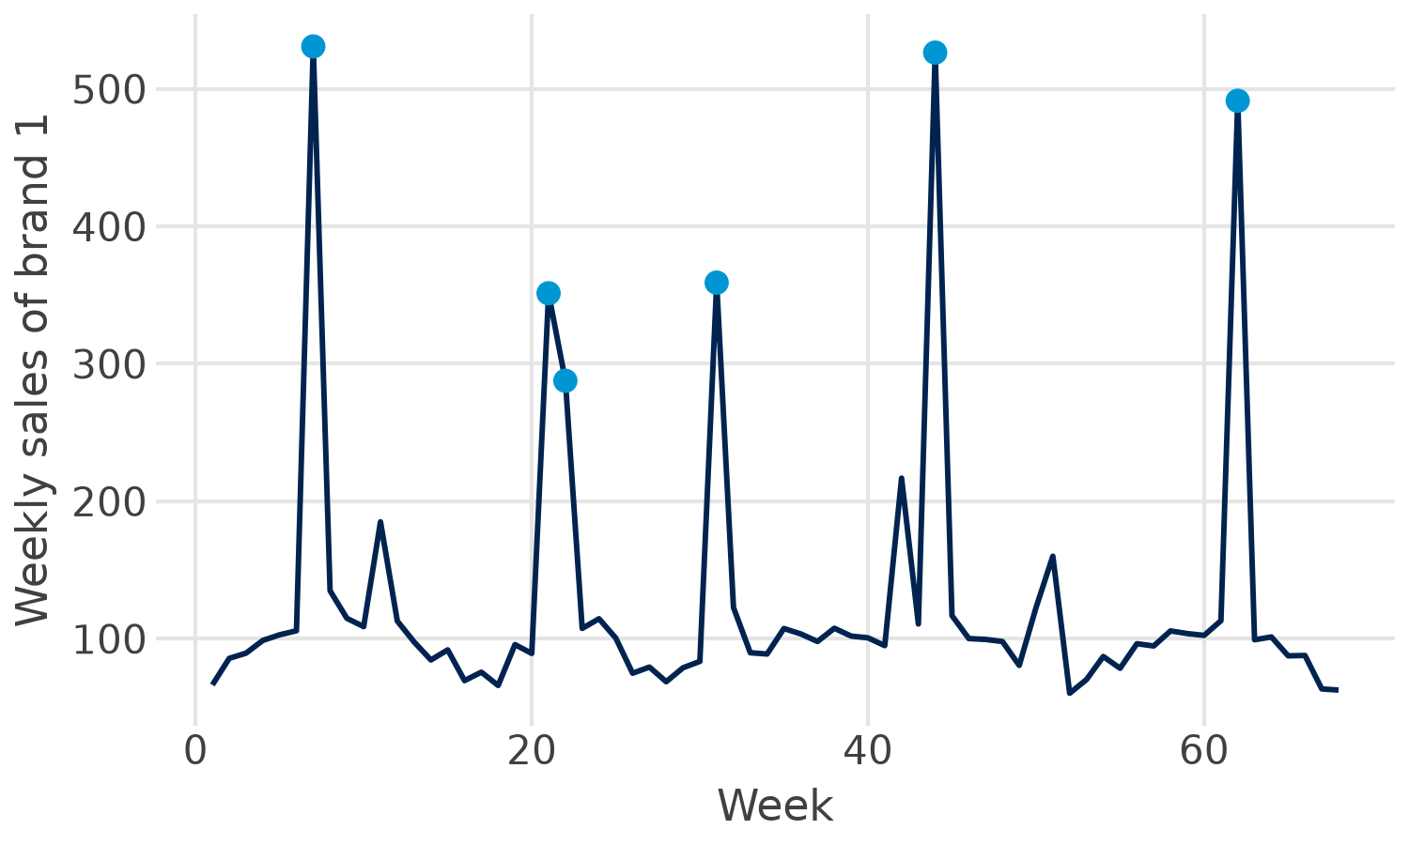
The question: what does a price cut sell?
Data: 68 weeks of real scanner data, 4 brands
Normal week: price about 1.50, sales about 100
Price-cut week: price about 1.03, sales up to 530
Also in the data: competitor prices, features, displays, temperature, holidays
Weekly sales of brand 1; blue: weeks with a price cut (price below 1.20).
The manager asks: how much does 1 % lower price sell, and is the regular price right?
Notes:
Real weekly scanner data for one chocolate brand (brand 1) and three competitors: 68 weeks of unit sales, prices, feature ads and in-store displays, plus temperature and holiday weeks. Brand 1 cut its price from about 1.50 to about 1.03 in seven weeks (blue dots); sales jumped to up to five times the normal level. The brand manager wants to know how strongly sales respond to price, and whether the regular price is right.

Slide 31
Correlation on real data: how strong is strong?
Rule of thumb for |r|
−0.94
sales and own price of brand 1: an extremely strong negative relationship
|r|
Interpretation
0 to 0.2
very weak
0.2 to 0.4
weak to moderate
Kiosk: r = −0.98, five made-up weeks (Part 4)
0.4 to 0.6
medium to substantial
0.6 to 0.8
very strong
Both: extremely strong, yet far from a perfect line
0.8 to 1.0
extremely strong
Real data are never a perfect line: competitors, features and the season move sales too.
Sources: Bojinov, Parzen & Hamilton 2025 (HBS note 9-622-100)
Notes:
The correlation r lies between -1 and +1 and measures the direction and strength of a linear relationship. The rule of thumb in the HBS note: below 0.2 very weak, up to 0.4 weak to moderate, up to 0.6 medium to substantial, up to 0.8 very strong, above extremely strong. Sales and own price of brand 1 correlate at -0.94 over 68 real weeks, close to the kiosk's -0.98 from five made-up weeks. Real data are never a perfect line: competitors, features and the season also move sales, which is why we need multiple regression. The warnings from Part 4 still hold: linear only, not causal.

Slide 32
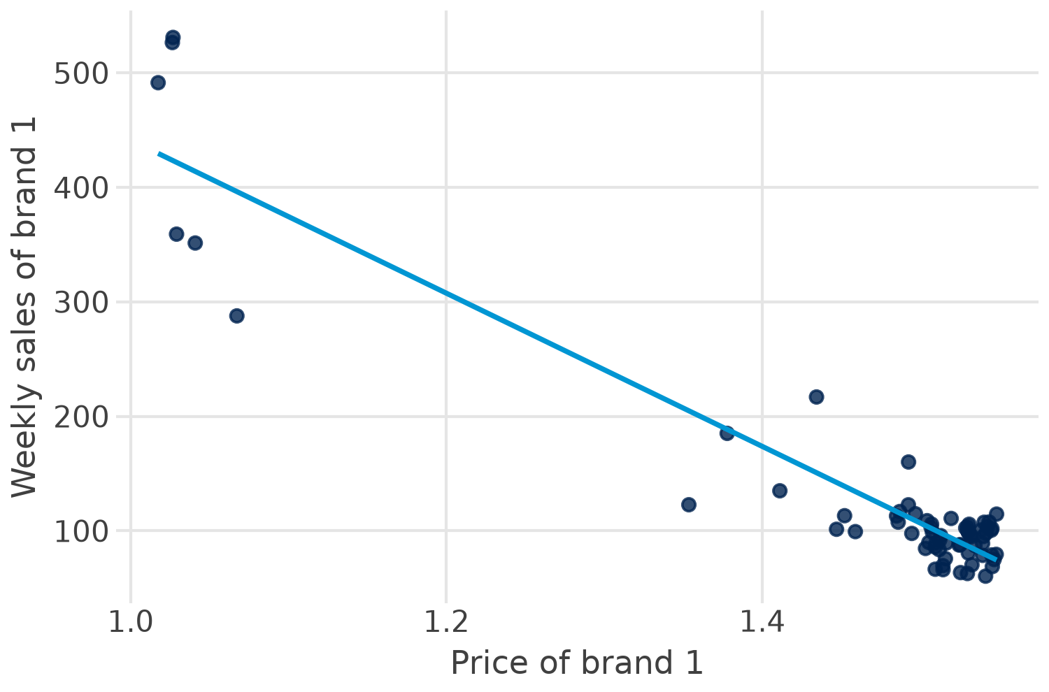

Simple linear regression
sales = b0 + b1 · price1 + e
b0 = 1,110: intercept, sales at price 0 (not meaningful here)
b1 = −669: 10 cents more price, about 67 units fewer a week
e: residual, what the line does not explain
Look at the chart: the points curve, so a straight line misses the price-cut weeks.
Notes:
The line sales = 1,110 - 669 x price1 is the least-squares line for brand 1, built from the same pieces as the kiosk slope in Part 4 (cov / var). The slope says: one unit (one euro) more price, 669 units fewer per week; more useful, 10 cents more price, about 67 units fewer. R-squared is 0.88. But look at the chart: the points curve. The line overshoots in the middle and misses the promotion weeks, a first hint that a straight line is the wrong form (logs follow).

Slide 33
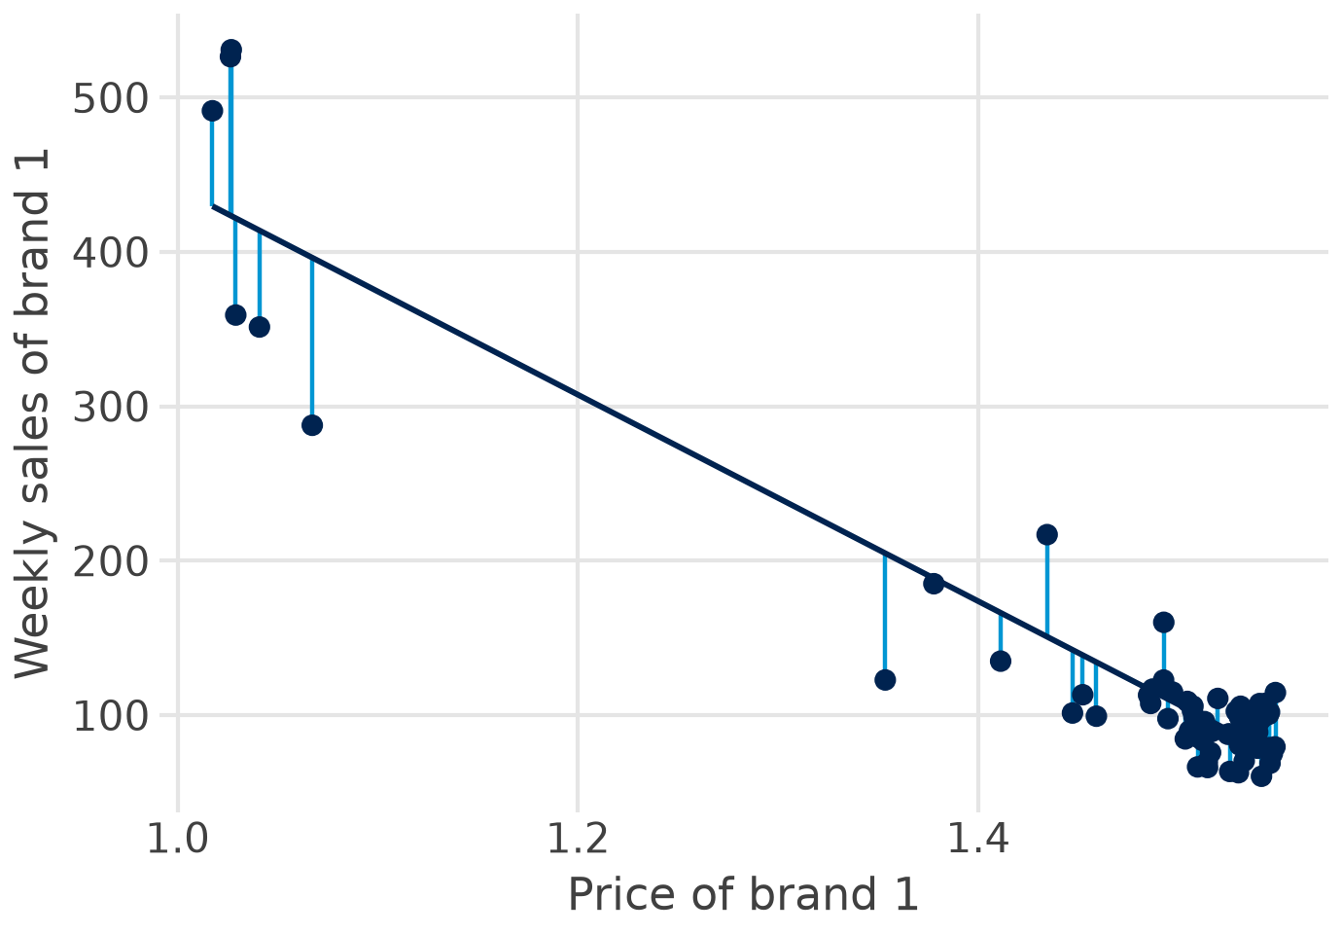
Least squares: the line with the smallest squared errors
residual: e_i = y_i − ŷ_i
OLS: minimise Σ e_i²
Squared: misses above and below do not cancel
Large misses count much more than small ones
One line: the unique best fit for these data
Sources: Skiera, Reiner & Albers 2022; Bojinov, Parzen & Hamilton 2025
Notes:
Each residual is the vertical distance between an observed week and the line. Ordinary least squares (OLS) chooses intercept and slope so that the sum of squared residuals is as small as possible. Squaring makes positive and negative misses count equally and weighs large misses more, which is also why single extreme weeks can pull the line (outliers, Part 2).

Slide 34



Multiple regression: holding other things constant
ln sales = b0 + b1·ln price1 + b2·ln price2 + b3·ln price3 + b4·ln price4
+ b5·feature1 + b6·temp + b7·december + e
Own mix
Competitors
Context
Price of brand 1
Feature ads, displays
Prices of brands 2 to 4
Their features and displays
Temperature
December and Easter weeks
Each b: the effect of one variable with all others held constant (ceteris paribus).
Left out a relevant variable? Its effect ends up in the others (omitted variable bias).
Notes:
With several explanatory variables each coefficient measures the effect of one variable while the others are held constant (ceteris paribus). This is exactly the marketing mix question: what does a price cut do if feature ads, competitor prices and the season stay the same? A variable left out of the model hands its effect to the variables that are in it (omitted variable bias).

Slide 35


Is the effect real? t-test, p-value, interval, F-test
t-test
p-value
t = b / se
Own price: −3.64 / 0.30 = −12.1
Below 0.05: significant
Own price: p < 0.001; brand 4: p = 0.86
95 % confidence interval
F-test
About b ± 2 se
Own price: −4.24 to −3.04
Are all slopes together zero?
F = 59.5, p < 0.001
Significant is not important: read the size of b and its interval, not just the stars.
Sources: Bojinov, Parzen & Hamilton 2025; Skiera, Reiner & Albers 2022
Notes:
Every coefficient comes with a standard error (Part 2). t = b / se tests whether the true coefficient is zero; the p-value is the probability of a t this extreme if it were zero; below 0.05 we call it significant. The 95 % confidence interval is about b plus or minus two standard errors. The F-test asks whether all slopes together are zero. For brand 1: own-price elasticity -3.64, se 0.30, t -12.1, interval -4.24 to -3.04; F = 59.5, p < 0.001. The 1.96 from Part 3 is behind the 'about 2'.

Slide 36

How well does the model fit?
0.874
R²: the model explains 87 % of the weekly variation in log sales
Careful
R² never falls when you add a variable
Compare R² only for the same outcome (sales vs log sales)
High R² does not mean causal
0.859
adjusted R²: R² with a penalty for each extra variable
0.169
RMSE: the typical weekly miss, about 17 % in a log model
Main model for brand 1: log-log, own and competitor prices, feature, temperature, December; 68 weeks.
Sources: Bojinov, Parzen & Hamilton 2025; Skiera, Reiner & Albers 2022
Notes:
R-squared is the share of the variation in the outcome that the model explains; it never falls when a variable is added, so adjusted R-squared penalises extra variables. The residual standard error (or RMSE) is the typical miss in the units of the outcome: in a log model, 0.169 means about 17 % per week. Compare R-squared only between models with the same outcome: the simple model (sales) has 0.88, the log model (log sales) 0.87, and these are not comparable.

Slide 37
Functional forms and dummy variables
Model | Equation | b means | Brand 1
Linear | sales = a + b·price | +1 unit price: b units | b = −669 units
Log-log | ln sales = a + b·ln price | +1 % price: b % | b = −3.64 (elasticity)
Log-linear | ln sales = a + b·temp | +1 °C: about 100·b % | b = −0.0066: −0.66 %
Dummy in log model | ln sales = a + b·december | e^b − 1, vs other weeks | b = −0.385: −32 %
Why logs? sales respond in per cent, not in units, and the elasticity can be compared across brands and countries.
Sources: Skiera, Reiner & Albers 2022; Wooldridge 2025, ch. 6 to 7
Notes:
Logs turn a multiplicative sales response function into a linear regression (Skiera et al. 2022): in the log-log form the coefficient is an elasticity, the per cent change in sales for a 1 % change in the driver. A dummy (0/1) in a log model shifts sales by exp(b) - 1 per cent: December -0.385 means exp(-0.385) - 1 = -32 %. For small b, b x 100 is a good approximation.

Slide 38
From elasticity to a pricing decision
optimal price p* = marginal cost × ε / (1 + ε) (valid for ε < −1)
$52
Skiera et al.: ε = −2.34, unit cost $30 → p* = 30 × 2.34 / 1.34
×1.38
Brand 1: ε = −3.64 → price 38 % above marginal cost
Short term: promotion weeks inflate the elasticity; regular-price elasticities are smaller
Competitors react, and the retailer takes its margin
Sources: Skiera, Reiner & Albers 2022; Hanssens, Parsons & Schultz 2001
Notes:
With a constant elasticity e below -1, the profit-maximising price is marginal cost times e / (1 + e) (the Amoroso-Robinson relation). Skiera et al. estimate e = -2.34 with unit cost $30, which gives about $52. For brand 1 e = -3.64 gives a price 1.38 times marginal cost, a 38 % markup. Caveats: this is a short-term, promotion-driven elasticity; regular-price elasticities are usually smaller, competitors react, and the retailer takes a margin.

Slide 39
Assumptions and tests
Part 7 of 11 · what OLS assumes, how to look, how to test, what to do
Notes:
Look first (residual plots), then test, then decide. Skiera et al. (2022) recommend checking multicollinearity, autocorrelation and heteroscedasticity in every model.

Slide 40
Seven assumptions behind OLS
Assumption | If violated | Look or test (statsmodels)
1 Linear form | biased coefficients | residuals vs fitted; try logs
2 Exogeneity, no omitted variables | biased, not causal | theory, controls, experiments
3 Constant error variance | wrong standard errors | funnel in plot; Breusch-Pagan
4 No autocorrelation | standard errors too small | residuals over time; Durbin-Watson ≈ 2
5 Normal residuals | tests unreliable in small samples | histogram; Jarque-Bera
6 No multicollinearity | unstable b, large se | correlations; VIF below 10 (better 5)
7 Enough data, no dominant week | fragile results | n ≥ 3 to 5 × coefficients; Cook's distance
Sources: Skiera, Reiner & Albers 2022; Hair et al. 2019; Wooldridge 2025
Notes:
Linearity and no omitted variables protect the coefficients themselves; homoscedasticity, no autocorrelation and normal residuals protect the standard errors and therefore the t- and F-tests. Normality matters least: with enough observations (Skiera et al.: even 10 to 20) the tests still work. Skiera et al. recommend at least three, better five times as many observations as coefficients. Exogeneity is the one no test can prove: it needs a good design (next slides).

Slide 41
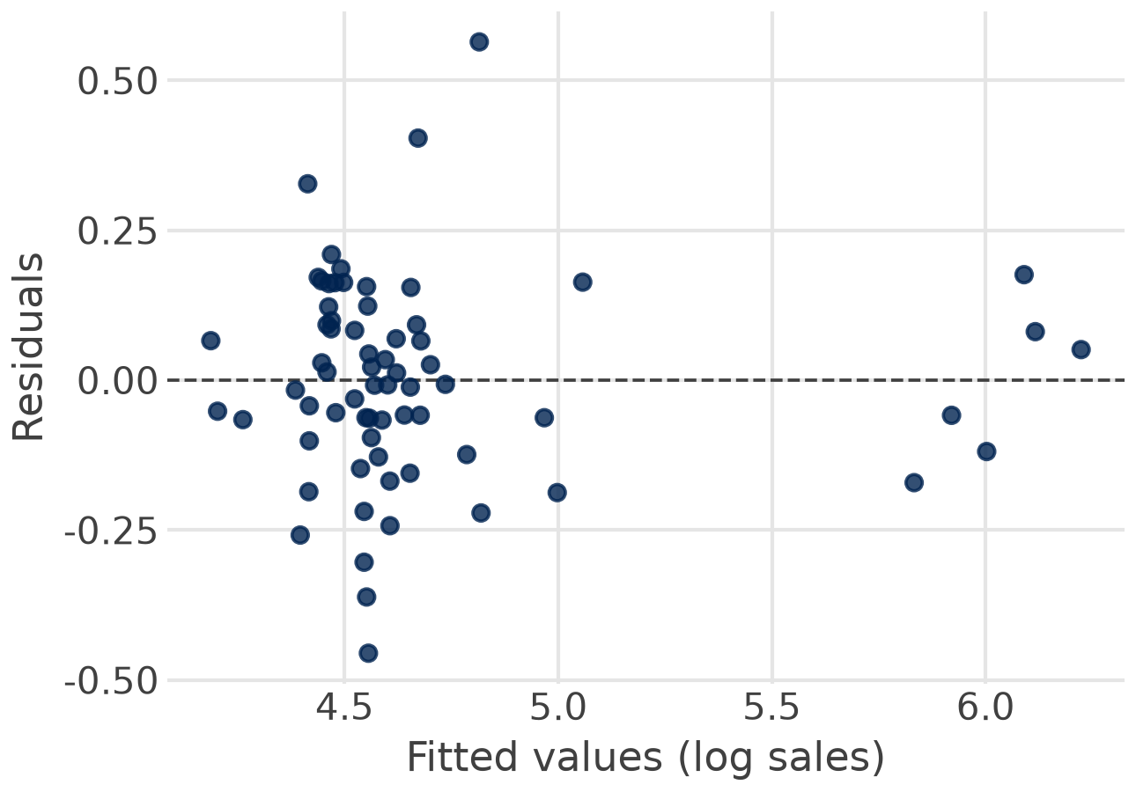
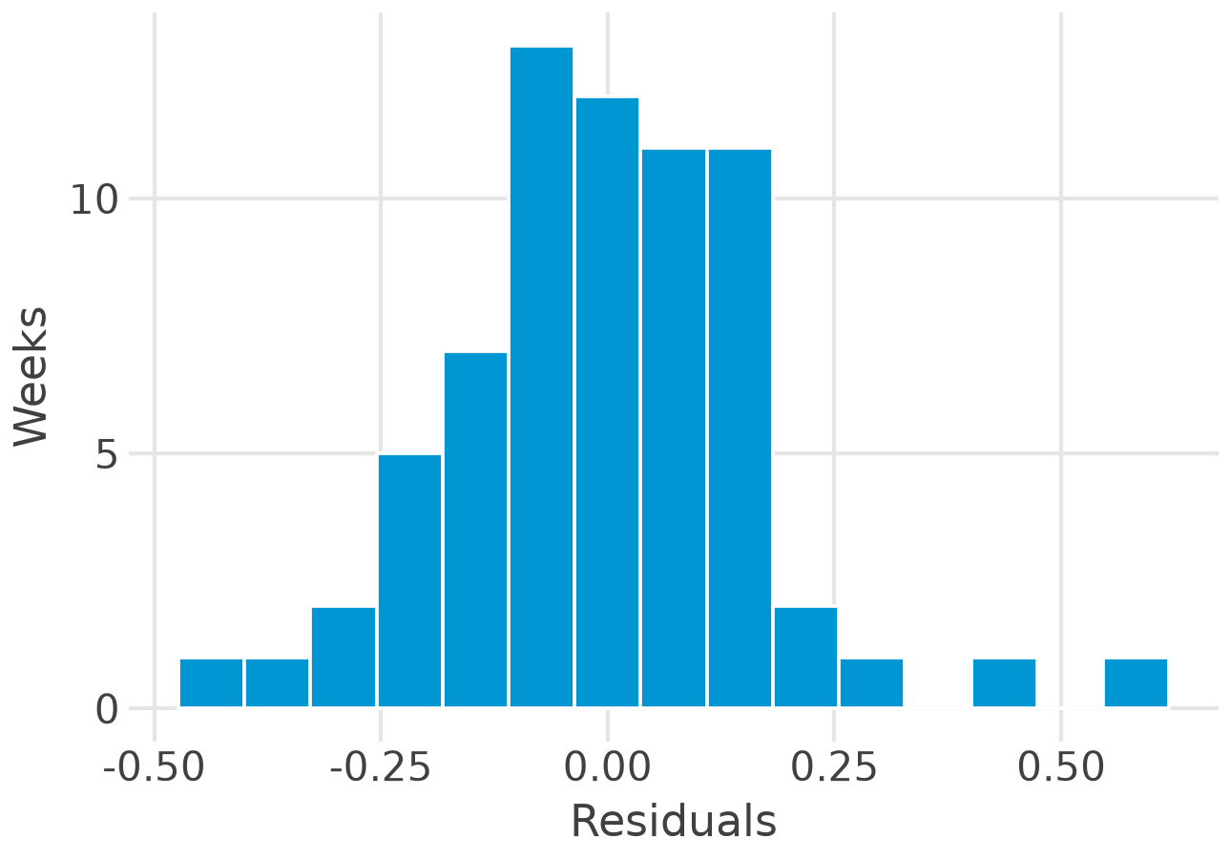
Look first: two residual plots
Look for: a curve (wrong form) or a funnel (unequal variance)
Look for: a rough bell shape, no extreme weeks
Brand 1: no curve, no funnel, a roughly bell-shaped histogram.
Notes:
Left: residuals against fitted values for the main brand-1 model. No curve and no funnel, so the linear log form and constant variance look acceptable; a few price-cut weeks sit to the right. Right: the histogram is roughly bell-shaped with slightly heavy tails.

Slide 42
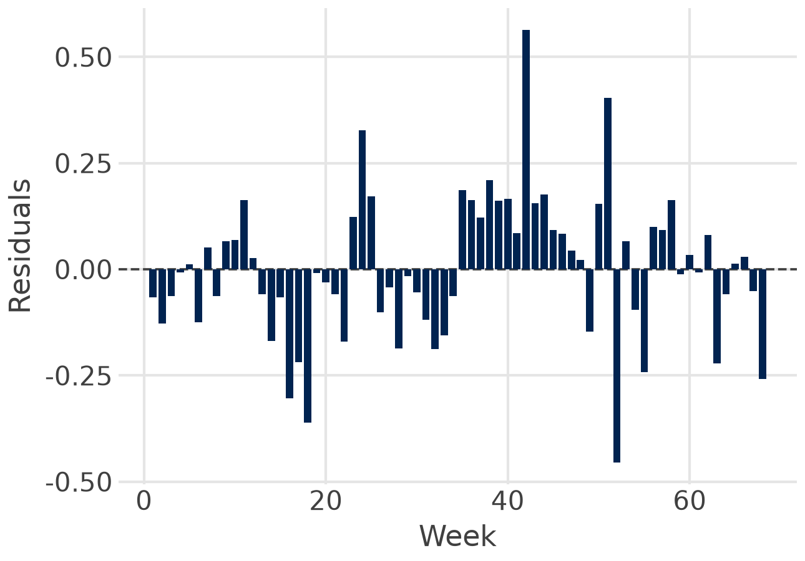

Then test: four numbers for the brand 1 model
1.41
Durbin-Watson: below 2, some autocorrelation between weeks
0.14
Breusch-Pagan p: no evidence of unequal variance
0.07
Jarque-Bera p: residuals roughly normal
2.4
largest VIF: no multicollinearity
Verdict: usable. Report Newey-West (HAC) standard errors because of the autocorrelation: 0.32 instead of 0.30 for own price.
Notes:
Durbin-Watson 1.41: below 2, some positive autocorrelation between neighbouring weeks, which makes the usual standard errors a little too small; Newey-West (HAC) standard errors correct this (0.32 instead of 0.30 for own price). Breusch-Pagan p = 0.14 and Jarque-Bera p = 0.07: no evidence against constant variance and normal residuals at 5 %. Largest VIF 2.4: no multicollinearity.

Slide 43
When a test fails: what to do
Problem | Remedy | In statsmodels
Curve in residuals | logs, squares, interactions | np.log(x), I(x**2)
Unequal variance | robust standard errors | fit(cov_type="HC3")
Autocorrelation | HAC standard errors; lags; ARIMA errors (Session 4) | fit(cov_type="HAC", cov_kwds={"maxlags": 1})
Multicollinearity | more variation, combine variables, experiments | variance_inflation_factor
Dominant weeks | check data, report with and without | get_influence().cooks_distance
Endogeneity | experiments, instruments, fixed effects | Sessions 2 to 5
Sources: Skiera, Reiner & Albers 2022; statsmodels documentation
Notes:
Most fixes are one argument in statsmodels: cov_type='HC3' for heteroscedasticity-robust standard errors, cov_type='HAC' with maxlags for autocorrelation (Newey-West). Multicollinearity has no econometric cure: more variation in the data, combine variables, or run an experiment (Skiera et al.). Outliers: check the data first, report results with and without, never delete silently. Endogeneity needs design: experiments, instruments, panel data.

Slide 44



Three warnings from real data
Displays
One Easter week
Mailings
Only 4 display weeks
VIF 11.4 and 10.9
Effects cannot be separated
A dummy for one week fits it exactly
Leverage 1.00
No real estimate of Easter
Skiera et al.: mailings and salespersons r = 0.989
VIF 53
Salesperson effect flips sign
The real fix: vary the marketing instruments independently, ideally in a field experiment.
Sources: Skiera, Reiner & Albers 2022; own calculation on the chocolate data
Notes:
Multicollinearity: brand 1 ran displays in only four weeks, mostly together with features and price cuts; adding display1 and fand1 gives VIFs of 11.4 and 10.9. Influence: there is a single Easter week; an Easter dummy fits that week perfectly (leverage 1.00), so its coefficient says nothing. Skiera et al.: mailings and salespersons correlate at 0.989; with both in the model the VIF is 53 and the salesperson coefficient turns negative and insignificant.

Slide 45
Endogeneity: when marketing follows demand
The assumption: explanatory variables are unrelated to the error term
Marketing breaks it: budgets go where managers expect success, so spend and unexplained sales rise together
Brand 1: price cuts come with features, so the price effect partly measures the feature
Evidence: in 15 Facebook experiments, regression often overstated the true lift, sometimes 3 times
Remedies: experiments (A/B, geo tests), instrumental variables such as cost shifters, panel data with fixed effects.
Sources: Skiera, Reiner & Albers 2022; Gordon, Zettelmeyer, Bhargava & Chapsky 2019
Notes:
OLS assumes that the explanatory variables are unrelated to the error. Marketing breaks this whenever managers spend more where they expect success: then high spend and high unexplained sales go together and the coefficient is too large (Skiera et al.). Price cuts are often timed with features and displays, so the price coefficient also carries their effect. Gordon et al. (2019) compared 15 Facebook experiments with regression-based estimates: the observational methods often overstated the lift, sometimes by a factor of three or more.

Slide 46
Regression in the real world
Part 8 of 11 · benchmarks, companies, what transfers to MMM
Notes:
Regression is everywhere in marketing practice, usually with a different name.

Slide 47
Benchmarks from decades of regressions
−2.62
mean price elasticity, 1,851 estimates (Bijmolt et al. 2005)
0.12
mean short-term advertising elasticity (Sethuraman et al. 2011)
−0.42
mean price elasticity in 14 Asia-Pacific countries, lower with high power distance (Datta et al. 2022)
−3.64
brand 1, chocolate: promotion-driven, many substitutes
Use benchmarks to judge whether your own estimate is plausible.
Notes:
Bijmolt, van Heerde and Pieters (2005) pool 1,851 price elasticities: mean -2.62. Sethuraman, Tellis and Briesch (2011): short-term advertising elasticity 0.12 on average. Datta et al. (2022): across 14 Asia-Pacific countries the average price elasticity is -0.42 and lower where power distance is high. Brand 1's -3.64 is more price-sensitive than the average brand: chocolate has many close substitutes and the estimate is driven by promotion weeks.

Slide 48






Where companies use regression
Meta Robyn
Booking.com
Google
MMM in production:
ridge regression on media
With Microsoft: CUPED,
regression makes A/B tests faster
Geo experiments: test vs
control regions by regression
Walmart (M5)
statworx
Bayer
Sales forecasts need price,
promotion and event regressors
Frankfurt consultancy: price
elasticities, log-log
Budget across countries
from estimated elasticities
Session 2: the marketing mix model is this regression with adstock and saturation.
Sources: Robyn docs; Deng et al. 2013; Vaver & Koehler 2011; Makridakis et al. 2022; Fischer et al. 2011
Notes:
Meta's Robyn is a ridge regression on adstocked and saturated media variables: MMM in production. Microsoft and Booking.com add the pre-period metric as a covariate in A/B tests (CUPED), which cuts the sample size needed. Google estimates ad effectiveness from geo experiments with regressions of test on control regions. Walmart's M5 competition showed that forecasts need price, promotion and event regressors. statworx (Frankfurt) estimates price elasticities from retail sales with log-log regressions. Bayer reallocated its budget across countries with estimated elasticities (Fischer et al. 2011).

Slide 49
The chocolate data in Python
Part 9 of 11 · load and plot, the first regression, the log-log model, the checks
Notes:
Live in Positron. The code on the next slides is complete: copy it into a Quarto file and run it cell by cell.

Slide 50
The data: 68 weeks of chocolate scanner data
Column | Meaning
week | 1 to 68
sales | weekly unit sales of brand 1
price1 to price4 | prices of brands 1 to 4
feature1 to feature4 | share of stores with a feature ad, 0 to 1
display1 to display4 | share of stores with an in-store display
fand1, fand3, fand4 | share with feature and display together
temp | temperature, °C
december, easter | 1 in December and Easter weeks
File: data/legacy/chocolate_dataset.csv
Notes:
data/legacy/chocolate_dataset.csv in the course repository (also as the original .xlsx). Feature, display and fand (feature and display) are shares of stores between 0 and 1. Sales and prices are for brand 1 unless numbered otherwise; units are as delivered by the data provider.

Slide 51
Step 1: load and look
Python: polars and plotnine
import polars as pl
from plotnine import (ggplot, aes, geom_point,
geom_smooth, labs)
choc = pl.read_csv(
"data/legacy/chocolate_dataset.csv")
choc.select("sales", "price1",
"price2").describe()
(ggplot(choc, aes("price1", "sales"))
+ geom_point()
+ geom_smooth(method="lm")
+ labs(x="Price of brand 1",
y="Weekly sales"))
Look before you model: ranges, outliers, the shape of the relationship.
Notes:
polars reads the CSV; describe() gives counts, means and ranges. plotnine draws the scatter plot with the least-squares line in three lines of code. Always look before you model.

Slide 52
Step 2: the first regression
Python: statsmodels
coef
std err
P>|t|
import statsmodels.formula.api as smf
df = choc.to_pandas()
simple = smf.ols("sales ~ price1",
data=df).fit()
print(simple.summary())
simple.params # b0, b1
simple.rsquared # 0.884
Intercept
1,110.0
44.0
0.000
price1
−668.8
29.8
0.000
R² = 0.884, n = 68
Read it: 10 cents more price, about 67 units fewer per week; the price explains 88 % of the weekly variation.
But: the residuals curve. Next: the log-log model with the marketing mix.
Notes:
statsmodels takes a pandas data frame, so .to_pandas() converts the polars frame (pyarrow does the work in the background). The formula reads like the equation. summary() prints the full table; params, bse, pvalues and rsquared give single numbers for the text.

Slide 53
Step 3: the log-log model with the marketing mix
Python: statsmodels
coef
p
import numpy as np
model = smf.ols(
"np.log(sales) ~ np.log(price1)"
" + np.log(price2) + np.log(price3)"
" + np.log(price4) + feature1"
" + temp + december",
data=df).fit()
print(model.summary())
ln price1
−3.64
0.000
ln price2
−0.80
0.076
ln price3
0.36
0.109
ln price4
−0.03
0.855
feature1
0.18
0.307
temp
−0.007
0.045
december
−0.38
0.009
R² = 0.874, adjusted 0.859, n = 68
Read it: 1 % higher price, 3.6 % fewer sales; December weeks 32 % lower; each degree warmer 0.7 % lower.
Notes:
np.log inside the formula transforms the variables; numpy comes with statsmodels. Own price: elasticity -3.64, highly significant. Competitor prices are not significant at 5 %; the sign for brand 2 is negative, which would mean a complement and is not plausible, so we do not interpret it. December -0.385: exp(-0.385) - 1 = -32 %. Temperature: -0.66 % per degree.

Slide 54
Step 4: check the assumptions
Python: tests and robust errors
Residual plot
from statsmodels.stats.stattools import (
durbin_watson, jarque_bera)
from statsmodels.stats.diagnostic import het_breuschpagan
from statsmodels.stats.outliers_influence import (
variance_inflation_factor)
durbin_watson(model.resid) # 1.41
het_breuschpagan(model.resid, model.model.exog)[1] # 0.14
jarque_bera(model.resid)[1] # 0.07
X = model.model.exog
[variance_inflation_factor(X, i) for i in range(1, 8)]
hac = model.model.fit(cov_type="HAC",
cov_kwds={"maxlags": 1})
from plotnine import geom_hline
df["fit"] = model.fittedvalues
df["res"] = model.resid
(ggplot(df, aes("fit", "res"))
+ geom_point()
+ geom_hline(yintercept=0))
Decide: report the HAC result; the own-price elasticity stays −3.64, its standard error rises to 0.32.
Notes:
Four functions, four numbers. Then refit with HAC standard errors because Durbin-Watson is below 2. The residual plot uses the same plotnine grammar as before.

Slide 55
Quiz 2: regression in five questions
1 What does OLS minimise?
A the sum of residuals B the sum of absolute residuals C the sum of squared residuals
2 In ln sales = a + b · ln price, b = −3.64 means …
A 1 EUR more, 3.64 units fewer B 1 % higher price, 3.6 % fewer sales C 3.64 fewer per week
3 A VIF of 11 signals …
A autocorrelation B multicollinearity C heteroscedasticity
4 Weekly data, Durbin-Watson = 1.41. This suggests …
A positive autocorrelation B no problem C unequal variance
5 R² rises from 0.85 to 0.86 after adding a variable. This shows …
A the variable matters B nothing: R² never falls C the model is causal
3 minutes alone, then compare with your neighbour. Same format as the online quiz and the exam.
Notes:
Three minutes alone, then compare with your neighbour; reveal the answers one by one. Answers: 1 C (the sum of squared residuals). 2 B (log-log: an elasticity, 1 % higher price, 3.6 % fewer sales). 3 B (multicollinearity; VIF above 10 is a warning). 4 A (below 2: positive autocorrelation between neighbouring weeks, so the usual standard errors are too small; report HAC errors). 5 B (R-squared never falls when a variable is added; compare adjusted R-squared or test the coefficient). Questions 1 and 3 adapted from the quantmethods exam bank.

Slide 56
In-class assignment
Part 10 of 11 · groups of 3, 25 minutes, on the chocolate data
Notes:
Run the code from Part 4, then answer the four questions. One group presents per question.

Slide 57
In-class assignment: pricing brand 1
Groups of 3:
20 minutes
Plenary:
5 minutes
Competition: plot sales against price2, price3 and price4. Which brand competes most?
1
Displays: add display1 and fand1 to the log-log model. What happens to the VIFs and coefficients, and why?
2
Price: marginal cost is 0.80. What price does ε = −3.64 suggest? Why is the real price about 1.50?
3
The manager: write one sentence for the brand manager, with a number and one caveat.
4
File: sessions/01-foundations/regression_chocolate.qmd (the code of Part 4 and these questions)
Notes:
Expected answers. 1 A falling cloud is weak for brands 3 and 4; brand 2 shows little relation: weak competition at the price level in these data. 2 With display1 and fand1 the VIFs exceed 10 and the display coefficients swing and lose significance: the four display weeks cannot separate the effects. 3 With marginal cost 0.80: p* = 0.80 x 1.38 = 1.10; the actual regular price is about 1.50, because the -3.64 is a short-term promotion elasticity, the retailer adds its margin and competitors would react. 4 For example: 'Promotions sell, but a permanent price cut to 1.10 would rest on a promotion elasticity; test it in a few stores first.'

Slide 58
Coding exercise 1
Part 11 of 11 · individual, 5 % of the grade
Notes:
The first of four coding exercises. It applies the code of this session to a similar task.

Slide 59
Coding exercise 1: what to do
1
Explore: a great_tables summary and two plotnine charts: sales over time, sales against price1
2
Simple model: sales ~ price1; interpret the slope for a 10-cent price change
3
Log-log model: own and competitor prices, feature1, display1, temp, december; interpret 3 coefficients
4
Assumptions: residual plot, histogram, Durbin-Watson, Breusch-Pagan, Jarque-Bera, VIF; one sentence each
5
Robust errors: refit with HAC standard errors; what changes and what does not?
6
Recommend: the optimal price for marginal cost 0.90, with two caveats, in at most 100 words
Brief: exercises/exercise-1.qmd in the course repository and on Canvas
Notes:
Individual work. The exercise reuses the data of this session with a different specification (display1 added, marginal cost 0.90), so the in-class code transfers but the answers differ. The file must render from top to bottom; deadline and upload on Canvas. AI assistants are allowed; the prompt log at the end shows how they were used.

Slide 60

Coding exercise 1: submission and grading
Submit on Canvas
Criterion
Points
Code runs, charts and tables clean
5
exercise1_lastname.qmd and the rendered .html
Renders from top to bottom without errors
Every number in the text from code
Prompt log at the end: what you asked, what you changed
Deadline: see Canvas
Interpretation of the coefficients
6
Assumption checks and conclusion
5
Recommendation with caveats
2
Prompt log
2
Total (5 % of the grade)
20
Individual work: discuss ideas, but write and check your own code. AI assistants are allowed; you own every number.
Notes:
Grading on 20 points, scaled to 5 % of the final grade. Interpretation counts most, because the AI writes much of the code. Deadline: see Canvas.

Slide 61

Regression: key takeaways
OLS draws the line with the smallest squared errors; each b holds the other variables constant
1
Logs turn coefficients into elasticities: brand 1, −3.64
2
Look, then test: residual plots, Durbin-Watson, Breusch-Pagan, Jarque-Bera, VIF
3
Fix what fails: robust or HAC errors, better form, more variation; experiments for causality
4
Decide: p* = cost × ε / (1 + ε), with the caveats
5
Next session: the marketing mix model, a regression with adstock and saturation.
Notes:
If students remember one thing: in a log-log model the coefficient is an elasticity, and an elasticity turns into a price with one formula, but only if the assumptions hold and the data vary enough.

Slide 62

References: statistics refresher
Books and readings
Online
Field, A. (2024). Discovering Statistics Using IBM SPSS Statistics, 6th ed. SAGE. Chapters 1 to 2 and 8.
Hair, J. F. et al. (2019). Multivariate Data Analysis, 8th ed. Cengage. Chapter 2.
Stock, J. H. & Watson, M. W. (2019). Introduction to Econometrics, 4th ed. Pearson. Chapters 2 to 3.
Seeing Theory. Brown University: interactive visual introduction to probability and statistics (free).
StatQuest. Videos on the normal distribution, standard deviation vs standard error, covariance and correlation (free).
polars documentation. mean, median, std, cov, corr.
Gelman, Hill & Vehtari (2020). Regression and Other Stories, ch. 3 to 4 (free PDF).
Notes:
Field is the friendliest textbook for students without a statistics background; Seeing Theory and StatQuest visualise every concept of today.

Slide 63
References: linear regression
Academic
Learning resources
Bojinov, I. I., Parzen, M. & Hamilton, P. J. (2025). Linear Regression. HBS note 9-622-100 (Canvas).
Skiera, B., Reiner, J. & Albers, S. (2022). Regression analysis. In Homburg et al. (eds), Handbook of Market Research, 299–327. Springer.
Wooldridge, J. M. (2025). Introductory Econometrics, 8th ed. Cengage.
Hanssens, D. M., Parsons, L. J. & Schultz, R. L. (2001). Market Response Models. Kluwer.
Bijmolt, T., van Heerde, H. & Pieters, R. (2005). Journal of Marketing Research 42(2).
Gordon, B. R. et al. (2019). Marketing Science 38(2).
James, G. et al. (2023). ISLP, ch. 3 and the Python lab (free).
Schwarz, Chapman & Feit (2020). Python for Marketing Research and Analytics, ch. 7. Springer.
statsmodels. Documentation and example notebooks.
Turrell, A. Coding for Economists: regression and diagnostics (free).
StatQuest. Linear regression, clearly explained (video).
DataCamp. Introduction to Regression with statsmodels in Python.
Notes:
Core readings first. All sources are listed with notes in instructor/resources/regression-resource-guide.md.

Slide 64
Notes:
Questions? Contact details on the card; office hours via the booking link.

