Slide 1
Logistic regression across countries
International Marketing Analytics
WT 2026/27
Notes:
Welcome to the session on logistic regression across countries. Logistic regression is the standard model for yes/no outcomes in marketing: buy or not, click or not, stay or leave. Our example is customer churn at a mobile operator in four European countries. We start with small numbers that you can check on a calculator and end with the same analysis in Python. The code is in sessions/01-foundations/logit_churn.qmd.

Slide 2



Today
Odds
Churn
logit
Countries
Using the
model
Python
In class
Theory, Parts 1 to 4
Practice, Parts 5 and 6
Odds, odds ratios, the S-curve
Reading the churn logit
Comparing countries
Predict, rank, target
polars, statsmodels, plotnine
Online quiz and its answers
Coding exercise: churn in four countries
The same tasks with Posit Assistant
Question of the day: who will cancel, and does it differ by country?
Notes:
Four theory parts, then the same analyses in Python, then the in-class exercise. Part 1 explains odds and the S-curve with a small calculator example. Part 2 reads the output of a churn logit. Part 3 compares countries, the trickiest part of the day. Part 4 uses the model to decide whom to call. Keep the question of the day in mind: every part answers a piece of it.

Slide 3



Our example: a mobile operator in four countries
The problem: a mobile operator in four countries is losing customers.
The question: who will cancel in the next 12 months, and what can we do?
4,000
1,500
3,000
2,500
customers in
Germany
customers in
Austria
customers in
Spain
customers in
Poland
Churn = 1: the customer cancelled within the next 12 months; 0: the customer stayed.
Simulated data (telco_churn.csv), built for this course
Notes:
Here is the story. A mobile operator in Germany, Austria, Spain and Poland is losing customers. Management wants to know who will cancel in the next 12 months and what to do about it. We have 11,000 customers, most of them in Germany. Churn means: the customer cancelled within the next 12 months, coded 1, otherwise 0. Say clearly that the data are simulated for this course, so we know the true effects and can check every method against them.

Slide 4
The data: one row per customer
Column | Meaning | Customer 47
customer_id | customer number | 47
country | DE, AT, ES or PL | DE
age | age in years | 20
tenure_months | months with the operator | 10
monthly | 1 = month-to-month contract, 0 = 24-month | 1
monthly_fee | fee in EUR per month | 27.22
price_increase | 1 = price rise in the last six months | 0
complaints | complaint calls in the last six months | 1
satisfaction | survey score, 1 to 5 | 2
retention_offer | 1 = got the retention offer (random pilot) | 0
churn | 1 = cancelled within the next 12 months | 1
File: data/churn/telco_churn.csv simulated, 11,000 customers
Notes:
Each row is one customer, 11,000 rows and 11 columns. The right-hand column shows a real row: customer 47, a 20-year-old German customer on a month-to-month contract, with the operator for 10 months, one complaint call and a satisfaction score of 2; this customer churned. The outcome is churn, 0 or 1. Most other columns are 0/1 dummies or counts. Ask the room: which columns would you expect to raise churn?

Slide 5
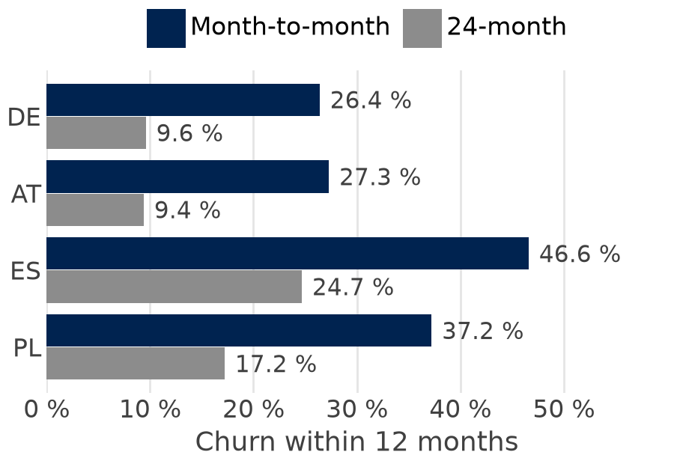
First look: churn by country and contract
1 in 4
month-to-month customers in Germany churn (26.4 %)
1 in 10
24-month customers in Germany churn (9.6 %)
The contract matters everywhere – how much? That needs a model for a yes/no outcome.
Simulated data (telco_churn.csv)
Notes:
Month-to-month customers churn more than 24-month customers in every country. In Germany about one in four month-to-month customers churns (26.4 %), against about one in ten on a 24-month contract (9.6 %). 24-month vs month-to-month by country: Germany 9.6 % vs 26.4 %; Austria 9.4 % vs 27.3 %; Spain 24.7 % vs 46.6 %; Poland 17.2 % vs 37.2 %. Spain and Poland churn more overall. The question for the rest of the session: how much does the contract matter, and does it matter more in some countries? For a yes/no outcome like churn we need a model that keeps probabilities between 0 and 1.

Slide 6
From churn rates to odds
Part 1 of 6 · odds, odds ratios, the S-curve
Notes:
This part gives everyone the same toolkit: probability, odds and log-odds, and how to move between them. We use one small table of German customers with round numbers that you can check on a calculator. At the end you do the same for Spanish customers. Bring out your calculator or open Python.

Slide 7
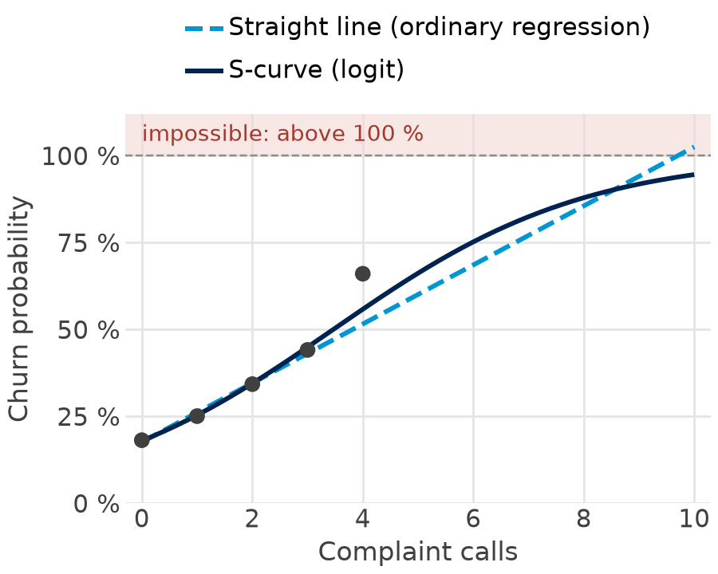
Why not ordinary regression for churn?
Straight line: easy to read, but no limits: 103 % churn at 10 complaint calls.
S-curve (logit): always between 0 and 100 %; at 10 calls 95 %.
The price of the S-curve: a coefficient no longer says directly how much the probability changes.
Simulated data (telco_churn.csv); dots: churn rate at 0 to 4 calls
Notes:
Start from what students know: ordinary regression on a 0/1 churn variable fits a straight line, the linear probability model. Its coefficient is easy to read, a change in churn probability: here 8.5 percentage points per complaint call. But a straight line has no limits: at 10 complaint calls it predicts 103 per cent churn, which is impossible. The logit bends into an S-curve and predicts 95 per cent. The dots are the churn rates in the data for 0 to 4 calls (simulated data; more calls are rare). The price of the S-curve: a coefficient no longer tells you directly how many percentage points churn changes, so the rest of this part learns to read it.

Slide 8
Worked example: 100 + 100 German customers
German customers
Churners
Customers
Probability p
Odds = p / (1 − p)
Month-to-month
25
100
0.25
0.25 / 0.75 = 0.33
24-month
10
100
0.10
0.10 / 0.90 = 0.11
Formula
Odds 0.33 = 1/3: one churner per three stayers
p = churners / customers
odds = p / (1 − p)
= churners / stayers
Odds 0.11 = 1/9: one churner per nine stayers
Odds = churners per stayer: 0 means nobody churns, 1 means 50:50.
Invented round numbers, close to the simulated data (Germany: 26 % vs 10 %)
Notes:
A small table you can check with a calculator: 200 German customers, 100 on each contract. The counts are invented round numbers, close to the data (26 % vs 10 % in Germany). Probability is churners divided by customers: 0.25 and 0.10. Odds are churners per stayer: month-to-month 25 churners and 75 stayers, so odds of 0.33, one churner per three stayers; 24-month 10 churners and 90 stayers, odds 0.11, one per nine. Ask the room: what are the odds if half of the customers churn? (1, or 50:50.)

Slide 9
Odds ratio and log-odds: the same example
3.0
Odds ratio = 0.33 / 0.11
a month-to-month contract triples the odds of churn
1.10
Log-odds = ln odds: ln(1/3) − ln(1/9) = −1.10 − (−2.20)
= ln 3: the logit coefficient of month-to-month
0.25
Back to probability: p = odds / (1 + odds)
0.33 / 1.33 = 0.25
Not “3 times as likely”: churn rises from 10 % to 25 %: 2.5 times, +15 percentage points (pp).
Invented round numbers, close to the simulated data (slide 8)
Notes:
The odds ratio divides the two odds: 0.33 / 0.11 = 3.0. A month-to-month contract triples the odds of churn. The log-odds are the natural log of the odds: −1.10 and −2.20; their difference, 1.10, is ln 3, and that is exactly the coefficient a logit of churn on the contract gives for these 200 customers (fig_s1.py checks it with statsmodels). Keep the exact odds 1/3 and 1/9 in the calculator: ln 0.33 gives −1.11. Back to probability with p = odds / (1 + odds). Stress the callout: churn rises from 10 % to 25 %, which is 2.5 times as likely, or +15 pp; percentage points (pp) are the difference of two percentages.

Slide 10
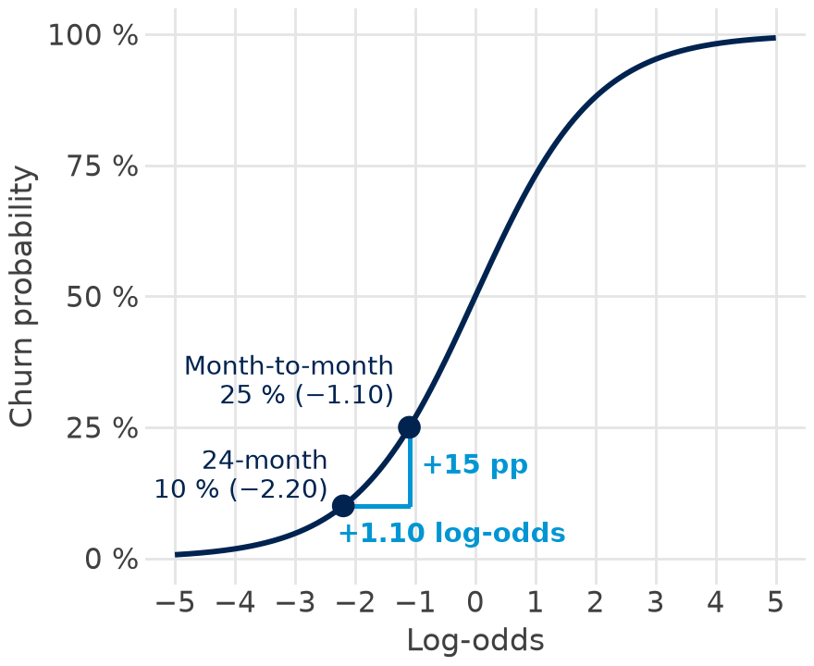
One model, three scales
Log-odds: −2.20 → −1.10, +1.10. Effects add up; the output table shows these.
Odds: 0.11 → 0.33, × 3.0. Effects multiply: the odds ratio.
Probability: 10 % → 25 %, +15 pp. What a manager wants; the change depends on the start.
Worked example of slide 8; curve: p = 1 / (1 + e^(−log-odds))
Notes:
The chart puts the worked example on the S-curve. The 24-month group sits at log-odds −2.20 (churn 10 %), the month-to-month group at −1.10 (25 %). The same step can be read on three scales: the logit adds 1.10 to the log-odds, multiplies the odds by 3, and raises the churn probability by 15 pp. The software reports log-odds; a manager asks about probabilities. Ask: would the same step of 1.10 log-odds add more or fewer percentage points near 50 per cent? (More, because the curve is steepest there.)

Slide 11
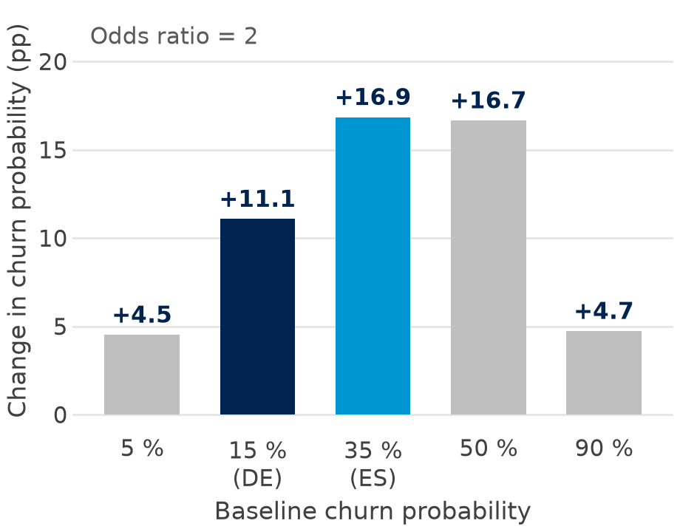
An odds ratio of 2 is not “twice as likely”
× 1.9
5 % → 9.5 %
nearly twice as likely
× 1.5
35 % → 51.9 %
1.5 times as likely, +16.9 pp
“Twice as likely” only works for rare outcomes, below about 10 %. Churn of 15 to 35 % is not rare.
Own calculation: p₁ = OR·p₀ / (1 − p₀ + OR·p₀), with p₀ the starting churn rate
Notes:
The chart applies the same odds ratio of 2 to five starting churn rates. At 5 per cent churn becomes 9.5 per cent, nearly twice as likely. At 35 per cent, about the Spanish rate in our data, it becomes 51.9 per cent: only 1.5 times as likely, but +16.9 percentage points. At 90 per cent it becomes 94.7 per cent, +4.7 pp. So “twice as likely” works only for rare outcomes, below about 10 per cent, and churn within 12 months is not rare. Ask which number a manager needs to plan a campaign: the percentage points.

Slide 12
Your turn: Spanish customers, with a calculator
Spanish customers
Churners
Customers
p
Odds
Log-odds
Month-to-month
45
100
?
?
?
24-month
25
100
?
?
?
1
p and odds of both groups
2
the odds ratio, and the difference in log-odds
3
compare with Germany (odds ratio 3.0, +15 pp): odds ratio and gap in percentage points
Pairs, 5 minutes: where does the contract matter more, Germany or Spain?
Invented round numbers, close to the simulated data (Spain: 47 % vs 25 %)
Notes:
Pairs, five minutes, with a calculator or Python. The table has the same structure as the German one: 200 invented Spanish customers, close to the data (47 % vs 25 % in Spain). Those who finish early fit smf.logit("churn ~ monthly") on the 200 rows and compare the coefficient with their hand calculation. Collect the answers in the room, then ask which country the contract affects more.

Slide 13
The churn logit
Part 2 of 6 · reading the output, three numbers to report
Notes:
We now fit one logit to all 11,000 customers in the four countries. First we read the output table, using the odds ratios of Part 1. Then we name the three numbers a report should contain. Part 3 uses these numbers to compare countries.

Slide 14
The churn logit: reading the table
Term
Coefficient
Odds ratio
Contract, OR 2.62: month-to-month multiplies the odds of churn by 2.6
1
Month-to-month
0.962
2.62
1
Price rise
0.602
1.83
2
Complaint calls (each)
0.452
1.57
Complaints, OR 1.57: each call raises the odds by 57 %
2
ln tenure (months)
−0.240
0.79
Austria (vs Germany)
−0.010
0.99
Spain, OR 2.88: higher churn odds than Germany at equal drivers
3
Spain (vs Germany)
1.057
2.88
3
Poland (vs Germany)
0.618
1.86
Above 1 raises the odds, below 1 lowers them; percentage points come next.
Simulated data (telco_churn.csv); one logit for all countries, Germany = reference
Notes:
This is one logit for all 11,000 customers with four drivers and a dummy for each country; Germany is the reference. The coefficients are in log-odds, the odds ratios are e to the power of the coefficient. The month-to-month contract multiplies the odds of churn by 2.62. Each complaint call multiplies them by 1.57, so the odds rise by 57 per cent per call. Spain's 2.88 is not a driver: it says that Spanish customers have higher churn odds than German customers with the same contract, calls and tenure, the baseline. All terms have p < 0.001 except Austria (p = 0.907): Austria and Germany share one baseline. Ask the room: does the table say how many percentage points the contract adds? (No, that is the next slide.)

Slide 15



Three numbers to report
Odds ratio
Marginal effect
Prediction
Multiplies the odds of churn
Use: inside one model
Change in churn probability, in pp
Use: compare countries
Churn probability of one profile
Use: talk to managers
2.62
month-to-month
+15.6 pp
month-to-month, on average
DE 38.1 %
95 % CI 34.1–42.2 %
ES 58.0 %
95 % CI 54.0–62.0 %
Report percentage points and probabilities; keep odds ratios in the table.
Simulated data (telco_churn.csv); prediction: month-to-month, price rise, one complaint, 12 months
Notes:
Three numbers, three uses. The odds ratio, 2.62 for the month-to-month contract, multiplies the odds and is fine inside one model. The average marginal effect, AME, is the change in churn probability in percentage points: on average the month-to-month contract adds 15.6 points (95 per cent CI 13.8 to 17.4). The predicted probability is the churn chance of one profile, here a month-to-month customer with a price rise, one complaint call and 12 months of tenure: 38.1 % in Germany and 58.0 % in Spain, from one model per country. Ask: which of the three would you put in a slide for the retention manager?

Slide 16
Comparing countries
Part 3 of 6 · coefficients, probabilities, survey scores
Notes:
Slide 12 ended with a puzzle: Germany had the larger odds ratio, Spain the larger gap in percentage points. This part solves it with the churn data. We compare coefficients and probabilities across countries, then look at survey scores and at interactions.

Slide 17



The puzzle: where does the contract matter more?
One logit per country:
month-to-month coefficient
Germany 1.19
Spain 0.81
Does the contract matter more in Germany?
Show of hands: yes or no?
What else differs?
Churn: 15.4 % in Germany, 34.7 % in Spain
What did slide 12 show?
Odds ratios and pp can rank countries differently
Simulated data (telco_churn.csv); one logit per country, four drivers
Notes:
Now the same puzzle as on slide 12, with real model output: one logit per country with the four drivers. The month-to-month coefficient is 1.19 in Germany and 0.81 in Spain, odds ratios 3.28 and 2.25. Give pairs two minutes, then ask for a show of hands: who thinks the contract matters more in Germany?

Slide 18
Same effect, different coefficients
Country
True effect
Noise scale
Coefficient
Rule of thumb
Germany
1.3
1.0
1.19
coefficient ≈
true effect / noise
Germany 1.3 / 1.0 = 1.30
Spain 1.3 / 1.5 ≈ 0.87
Austria
1.3
1.0
1.02
Spain
1.3
1.5
0.81
Poland
1.3
1.2
0.90
Coefficients from one logit per country
Noise scale: how much churn depends on things the model does not see
Naive test: 1.19 vs 0.81 seems a real gap (z = 2.8)
Smaller coefficient, same effect: more noise in Spain shrinks the coefficient.
Simulated data (telco_churn.csv); true effect and noise set in the simulation
Notes:
We built the data ourselves, so we know the truth: the contract has the same effect, 1.3, in every country. But Spanish churn depends more on things the model does not see, such as moods, offers from rivals or family plans; we call this the noise scale, 1.5 in Spain against 1.0 in Germany. A logit measures effects in units of this noise, so the coefficient is roughly the true effect divided by the noise: 1.3 / 1.5 is about 0.87 in Spain. A naive test of the gap between 1.19 and 0.81 gives z = 2.8 and calls it significant, although the true effect is identical. Ask: what would a manager conclude from the coefficients alone?

Slide 19
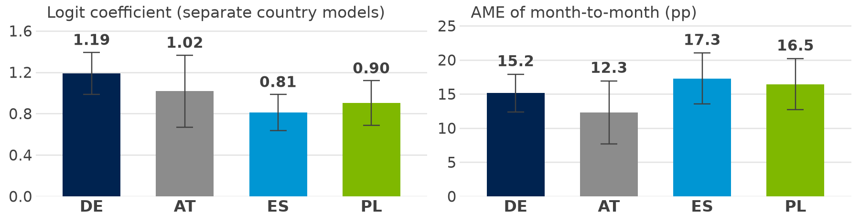
On the probability scale the gap disappears
Lines: 95 % CIs. Gap Spain − Germany 2.1 pp: within sampling error
Noise: more of it shrinks Spain's coefficient (1.5 vs 1.0)
Baseline: at 34.7 % churn the S-curve is steeper than at 15.4 %
Simulated data (telco_churn.csv); one logit per country
Notes:
Left, the coefficients of the four country logits: Germany leads with 1.19, Spain is last with 0.81. Right, the same models in percentage points: Spain leads with 17.3, Germany has 15.2. The gap of 2.1 points has z = 0.9 (95 per cent CI −2.5 to 6.8), so the data show no difference between the two countries. Two forces work in opposite directions: the noise shrinks Spain's coefficient, and Spain's higher churn puts it on the steep part of the S-curve of slide 10, where a change in log-odds moves the probability more. Rule for the rest of the session: compare countries in percentage points, not in coefficients.

Slide 20
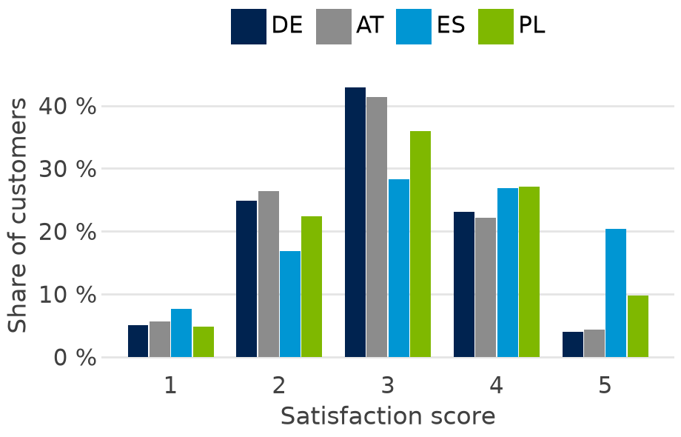
Survey scores differ by country too
20.3 %
give a 5 in Spain (Germany 4.0 %)
3.35
mean score in Spain (Germany 2.96)
Equal
true satisfaction in every country (simulation)
Same satisfaction, different scores: standardise within each country before you pool.
Simulated data (telco_churn.csv); answer styles set in the simulation
Notes:
The same care applies to survey answers. In the simulation, true satisfaction is equally high in every country, but Spanish customers answer more enthusiastically: 20.3 % give the top score of 5, against 4.0 % in Germany, and the mean score is 3.35 against 2.96. A 4 in Spain therefore means less satisfaction than a 4 in Germany. If we pooled the raw scores, Spain would look more satisfied and the satisfaction effect would be wrong. A simple fix is to standardise the scores within each country (z-scores); with real data, test the scale first. Ask: have you seen this in rating sites or in course evaluations?

Slide 21
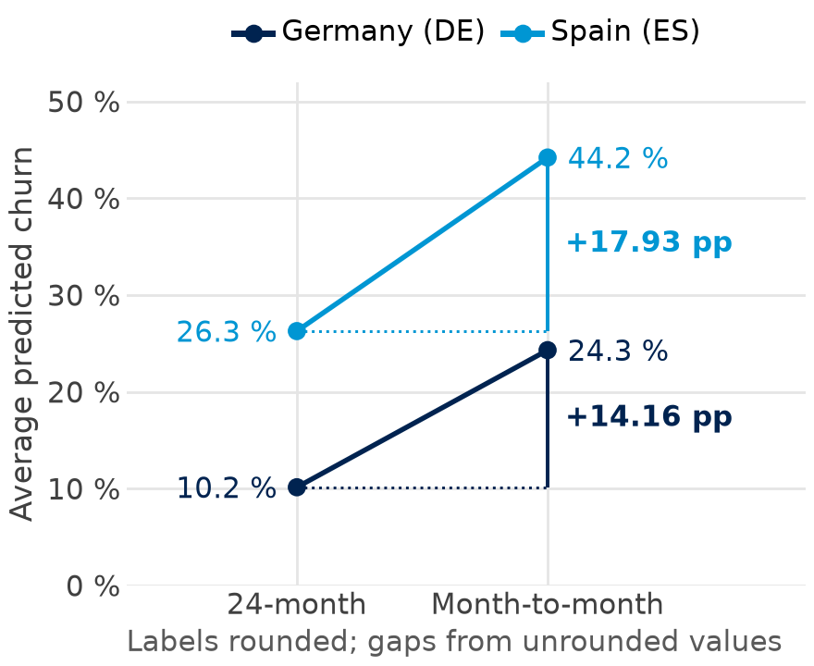
Interactions: read them in percentage points
−0.245
Product term in log-odds: “weaker in Spain”
+3.8 pp
In pp: 17.93 (Spain) minus 14.16 (Germany): “stronger”
Read interactions in pp. Here the 95 % CI (−0.7 to +7.2 pp) includes zero: no clear difference.
Simulated data (telco_churn.csv); one logit with contract × country
Notes:
An interaction lets the contract effect differ by country: here contract times Spain, in one model for all customers. The product term is −0.245 (p = 0.047) and seems to say that the contract matters less in Spain. In percentage points it is the other way round: the contract raises churn from 26.3 % to 44.2 % in Spain (17.93 points) and from 10.2 % to 24.3 % in Germany (14.16 points), a difference of +3.8 pp. Its 95 per cent CI, −0.7 to +7.2 pp, includes zero, so the honest reading is: no clear difference, and certainly not weaker in Spain. The product term misleads for the same reason as slide 18: the noise scale and the baseline.

Slide 22
Using a churn model
Part 4 of 6 · predict, rank, target
Notes:
So far we have read the model: odds ratios, percentage points, countries. Now we use it as a retention manager would, and the question changes from “what drives churn?” to “whom do we call?”. Three slides: flag customers with a threshold, rank them by risk, and check whether calling the riskiest customers actually pays off. Every number comes from the simulated data and from customers the model has not seen.

Slide 23
Who will churn? The threshold and the confusion matrix
Fit on 70 %
Test on 30 %
Pick a threshold
Call the flagged
Threshold 0.5
Churned
Stayed
77.9 %
accuracy; “nobody churns” scores 75.8 %
Flagged
175
106
22 %
of churners caught at 0.5; 56 % at 0.3
Not flagged
619
2,384
Flagged: predicted churn probability ≥ 0.5
Accuracy misleads when most customers stay: count the churners you catch; lower the threshold if missing one costs more than a wasted offer.
Simulated data (telco_churn.csv), 3,284 test customers
Notes:
We fit the model on a random 70 per cent of the customers and test it on the other 30 per cent, 3,284 customers it has not seen, of whom 24.2 % churn. A customer is flagged when the predicted churn probability is at least the threshold. At 0.5 the model flags only 8.6 per cent of the customers and catches 175 of 794 churners (22 per cent), yet its accuracy of 77.9 per cent looks fine, because saying “nobody churns” already scores 75.8 per cent. Lowering the threshold to 0.3 catches 446 churners (56 per cent) but flags 29 per cent of the customers, and only 47 per cent of the flagged ones churn. The right threshold follows from the costs: a missed churner usually costs far more than a wasted offer, so it sits below 0.5. Ask the room: is 77.9 per cent accuracy good?

Slide 24
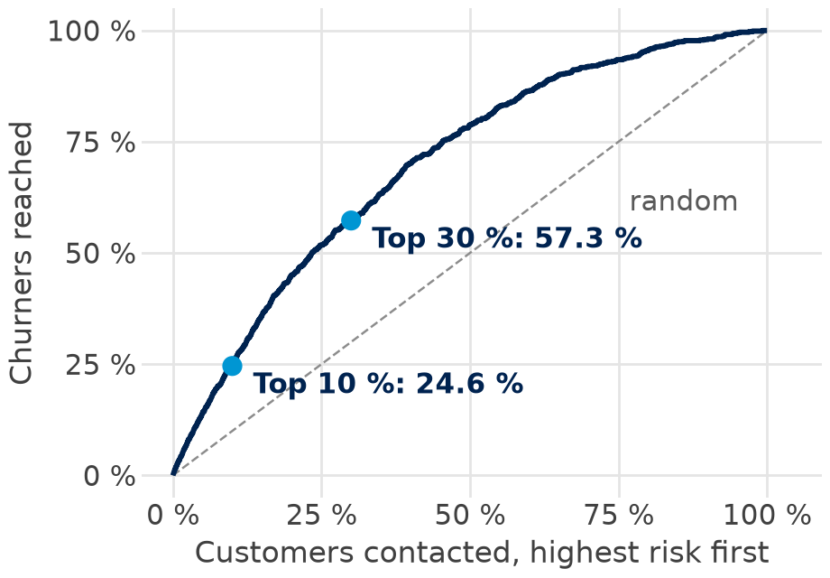
Ranking customers: the top-decile lift
2.46
top-decile lift: 59.5 % churn in the top 10 %, 24.2 % overall
24.6 %
of all churners are in the top 10 %
57.3 %
of all churners are in the top 30 %
Fixed budget? Call from the top of the ranked list.
Sources: Neslin et al. (2006); simulated data (telco_churn.csv), test customers
Notes:
Instead of a yes or no, sort the test customers by predicted churn, highest first, and call from the top of the list. Of the 10 per cent at the top, 59.5 % churn, against 24.2 % of all test customers: the top-decile lift is 59.5 % ÷ 24.2 % = 2.46. The gains chart turns this into a budget: calling the top 10 per cent reaches 24.6 % of all churners, about a quarter, and the top 30 per cent reaches 57.3 %, more than half; calling at random would reach 10 and 30 per cent. Neslin et al. (2006) used top-decile lift to compare churn models in a tournament. A threshold-free summary of the same ranking is the AUC, 0.764 here: a random churner gets a higher score than a random stayer in 76 per cent of pairs.

Slide 25
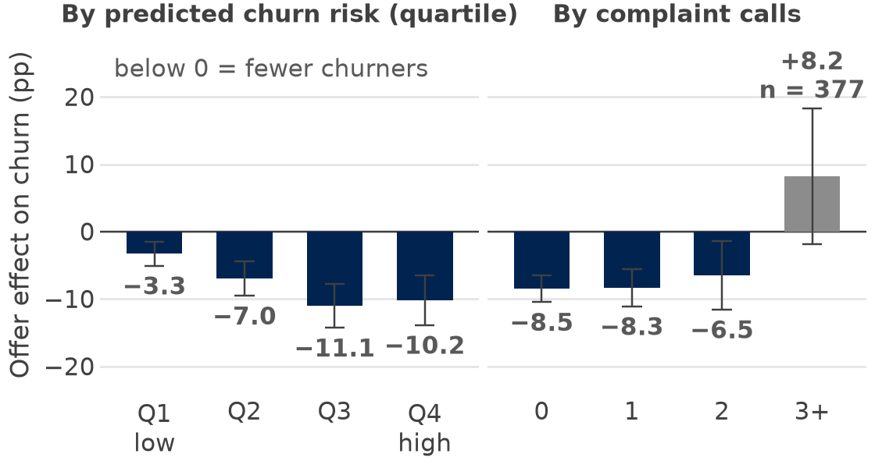
Whom to call? Risk is not uplift
Pilot: a random half got a retention offer; uplift = churn with minus without it
Highest risk ≠ largest effect: Q4 −10.2 pp, Q3 −11.1 pp
No response from 3 complaint calls on (377 customers; the interval includes 0)
Call the customers the offer moves, not the riskiest: it takes a random control group.
Sources: Ascarza (2018); simulated data (telco_churn.csv), offer pilot
Notes:
In a pilot a random half of the customers received a retention offer. Because the offer was random, the difference in churn between customers with and without it is the offer's effect, the uplift; below zero means fewer churners. The offer helps least in the lowest-risk quartile (−3.3 pp), but the highest-risk quartile gains no more than the third (−10.2 pp vs −11.1 pp). Customers with three or more complaint calls do not respond at all: +8.2 pp with an interval from −1.9 pp to +18.3 pp on only 377 customers. So the customers most likely to leave are not always the ones the offer saves. Ascarza (2018) shows the same in two field experiments. Ask: if you can call only one quartile, which one?

Slide 26
The analyses in Python
Part 5 of 6 · polars, statsmodels, plotnine
Notes:
Live in Positron. The code on the next slides is complete and comes from sessions/01-foundations/logit_churn.qmd: open it and run it cell by cell. Packages first, then three steps: load and look, fit the logit, evaluate the model. Everything runs with the packages installed in Session 1.

Slide 27
The packages and functions
Task | Package | Function
Load and look | polars | pl.read_csv(); group_by().agg()
Fit the logit | statsmodels | smf.logit(formula, data).fit()
Odds ratios | numpy | np.exp(m.params)
Marginal effects (pp) | statsmodels | m.get_margeff(dummy=True)
Predictions with CI | statsmodels | m.get_prediction(profiles).summary_frame()
Test split and lift | numpy | np.random.default_rng(1); np.argsort(-p)
Plots | plotnine | ggplot, geom_line, geom_ribbon
Notes:
Nothing new to install: polars, statsmodels, numpy and plotnine are the packages of Session 1. smf.logit works exactly like smf.ols: a formula, the data, fit. np.exp turns the coefficients into odds ratios, get_margeff gives the average marginal effects in probability units, and get_prediction the churn probability of a profile with a 95 % interval. The test split and the lift need only numpy. The qmd also formats its tables with great_tables.

Slide 28

Step 1: load and look
Python: polars
All
Month-to-month
24-month
import polars as pl
churn = pl.read_csv("../../data/churn/telco_churn.csv")
df = churn.to_pandas()
overview = (churn
.group_by("country", maintain_order=True)
.agg(pl.col("churn").mean().alias("churn_rate"),
pl.col("churn").filter(pl.col("monthly") == 1)
.mean().alias("churn_month_to_month"),
pl.col("churn").filter(pl.col("monthly") == 0)
.mean().alias("churn_24_month")))
overview
DE
15.4 %
26.4 %
9.6 %
AT
14.6 %
27.3 %
9.4 %
ES
34.7 %
46.6 %
24.7 %
PL
28.5 %
37.2 %
17.2 %
Churn rate by country and contract
Look first: month-to-month customers churn two to three times as often, in every country.
Notes:
polars reads the csv; to_pandas() hands the data to statsmodels, which Step 2 imports together with numpy, as in the earlier decks. The qmd sits in sessions/01-foundations, hence the path two folders up. group_by with maintain_order keeps the countries in the order of the file, and filter inside agg gives the churn rate of each contract type. The qmd then prints the customers per country and customer 47 of slide 4. In Germany 26.4 % of month-to-month customers churn against 9.6 % on a 24-month contract; in Spain 46.6 % against 24.7 %.

Slide 29

Step 2: fit the logit and the marginal effects
Python: statsmodels
Line
Month-to-month
import numpy as np
import statsmodels.formula.api as smf
m = smf.logit(
"churn ~ monthly + price_increase"
" + complaints + np.log(tenure_months)"
" + C(country, Treatment('DE'))",
data=df).fit()
m.get_margeff(dummy=True).summary()
ame(m, df, "monthly") # by country
m.get_prediction(profiles).summary_frame()
get_margeff
+15.6 pp, all customers
ame
DE 12.4 pp, ES 20.1 pp
get_prediction
DE 35.1 %, ES 60.9 %
Profile: price rise, 1 complaint call, 12 months
One slope for all countries: it overstates the gap; compare countries with country models.
Notes:
smf.logit works like smf.ols: a formula, the data, fit; the coefficients are on the log-odds scale. get_margeff(dummy=True) gives average marginal effects in probability units and treats month-to-month as a 0/1 switch: +15.6 percentage points over all customers. ame() is a three-line helper defined in the qmd (Step 2): it predicts every customer once with monthly = 1 and once with 0 and averages the difference by country, here 12.4 pp in Germany and 20.1 pp in Spain. get_prediction gives the churn probability of a profile, month-to-month with a price rise, one complaint call and 12 months of tenure, with a 95 % interval: 35.1 % in Germany and 60.9 % in Spain. The pooled model forces one slope on all countries, which overstates the country gap; for comparisons use the country models of Part 3. Code: qmd Step 2.

Slide 30

Step 3: evaluate the model
Python: statsmodels and numpy
Result
Value
# FORMULA: the churn formula of Step 2 (qmd Step 0)
rng = np.random.default_rng(1)
test = rng.random(len(df)) < 0.3
fit = smf.logit(FORMULA + " + satisfaction + C(country)",
data=df[~test]).fit()
p = fit.predict(df[test]).to_numpy()
y = df.loc[test, "churn"].to_numpy()
top = np.argsort(-p)[:round(0.1 * len(y))]
lift = y[top].mean() / y.mean() # 2.46
Test customers
3,284
Churn, all
24.2 %
Churn, top 10 %
59.5 %
Top-decile lift
2.46
Judge on new customers: fit on 70 %, test on the other 30 %.
Notes:
This is the code of qmd Step 3, line for line. One uniform random number per customer with seed 1 sends 30 per cent to the test set, 3,284 customers. The model, the churn formula plus satisfaction and country dummies, is fitted on the training customers only and predicts the test customers. argsort(-p) sorts them from the highest predicted churn down; the first 10 per cent are the top decile, and their churn rate (59.5 %) divided by the overall rate (24.2 %) is the lift, 2.46. The qmd continues with the confusion matrix, the gains chart and the uplift of the offer pilot.

Slide 31
In-class exercise
Part 6 of 6 · quiz, coding exercise, Posit Assistant
Notes:
The last part hands the method over to you, in the same four steps as in the earlier sessions. First a five-question online quiz on the whole session, then the answers. Then you work in pairs on the four-country exercise with telco_churn.csv and the code in logit_churn.qmd. Finally you repeat the same tasks with Posit Assistant and check its numbers against your own.

Slide 32
Online quiz: logit and churn in five questions
1 In Austria, 20 of 100 month-to-month customers churn. The odds of churn are …
A 0.20 B 0.25 C 4.0
2 An odds ratio of 2 at a baseline churn rate of 20 %. The new churn probability is …
A 33 % B 40 % C 22 %
3 Month-to-month coefficient: 1.19 in Germany, 0.81 in Spain. So …
A bigger effect in Germany B not clear yet: compare in pp C bigger effect in Spain
4 Product term month-to-month × Spain: −0.245. In pp, the effect in Spain …
A is smaller than in Germany B can still be larger than in Germany C is zero
5 Who should get the retention offer?
A the highest predicted risk B those whose churn it lowers most C most complaint calls
3 minutes alone, then compare with your neighbour.
Notes:
Online quiz on Canvas: three minutes alone, then compare with your neighbour. Question 1 goes back to the odds on slide 8, question 2 to slides 9 and 11, question 3 to the puzzle of Part 3 (slides 17 to 19), question 4 to the interaction on slide 21 and question 5 to slide 25. Ask for a show of hands per option before you move on.

Slide 33
Answers: in class
Notes:
The answers follow in class.

Slide 34
Your turn: churn across four countries, in Python
Pairs, with packages:
35 minutes
Plenary, answers:
5 minutes
Posit Assistant:
10 minutes
1
Fit: the pooled churn logit with country dummies; the month-to-month AME per country (Step 2)
2
Compare: the AMEs with the separate country coefficients; two memo sentences (Part 3)
3
Evaluate: confusion matrix at 0.5 and top-decile lift on the 30 % test set (Step 3)
4
Target: the offer effect by complaint calls; who should get the offer? (Step 4)
Deliverable: one slide per pair with a plot and two sentences for the retention manager.
File: sessions/01-foundations/churn_exercise.qmd (code to reuse: logit_churn.qmd)
Notes:
Work in pairs with the packages for 35 minutes, then five minutes of answers in the plenary, then ten minutes with Posit Assistant (next slide). The tasks are the “Your turn” section of logit_churn.qmd; the step numbers point to the code to reuse. Check after ten minutes that every pair has a pooled model with Germany as the reference country. Fast pairs do task 5 in the file: the model of Step 3 trained on Polish customers and used in every country. Debrief: which number would you put in a board memo, and why?

Slide 35

Then: the same tasks with Posit Assistant
How: code first, then open Posit Assistant, type @logit_churn.qmd, one task per prompt
Prompt for task 1
Prompt for task 2
@logit_churn.qmd Task 1. Fit the pooled
churn logit with Treatment('DE') and give
the month-to-month AME per country
in percentage points.
Task 2. Put these AMEs next to the
separate country coefficients. Why can
the two rank Germany and Spain
differently?
Prompt for task 3
Prompt for task 4
Task 3. On the 30 % test set, compute
the confusion matrix at 0.5 and the
top-decile lift. Explain both in one
sentence each for a manager.
Task 4. Estimate the offer effect by
complaint calls from the pilot. Who
should get the offer, and why not
the riskiest customers?
Check every number against your own code: you own the result.
Notes:
The routine of the earlier sessions. Solve the tasks with your own code first and keep the cells run, so Posit Assistant sees churn, df and the models. Open the chat from the Posit Assistant icon in the activity bar, type @logit_churn.qmd and give one task per prompt. Ask it to explain, not only to compute. Typical slips: a reference country other than Germany, AMEs read as odds ratios, the lift computed on the training data, and the riskiest customers picked for the offer. Stay in Normal mode and read every edit before you accept it.

Slide 36


Open churn data for your project
IBM Telco Churn
Bank churn
Online Retail II
7,043 customers, USA (fictional)
Churn: Left in the last month
Use: Learn the mechanics
Licence: Credit IBM
Churn_Modelling: 10,000 customers in France, Germany, Spain
Churn: Closed the account
Use: A country effect
Licence: Unclear: link only
1.07 m transactions, 43 countries
Churn: You define it
Use: Real data, own label
Licence: CC BY 4.0
The licence decides: commit only data you may share; link the rest.
Guide: sessions/01-foundations/churn_readings_and_data.md (links, polars code, traps)
Sources: dataset checks, Oct 2026 (churn_readings_and_data.md)
Notes:
Three open datasets for your own project; the links, loading code in polars and the traps are in sessions/01-foundations/churn_readings_and_data.md. The licence decides what may go into a public repository. IBM Telco sits in an Apache-2.0 code repository, but IBM never confirmed a licence for the data, so credit IBM as “IBM sample data”. The bank file Churn_Modelling has no stated licence and is almost certainly simulated: download it from Kaggle yourself and never commit it, also not to your group repository. Online Retail II is real and CC BY 4.0, so it may be shared with attribution (Chen 2019), but you have to define churn yourself, for example no purchase in a chosen window. For an international angle, the bank file has a large Germany effect: 32.4 per cent churn against about 16 per cent in France and Spain.

Slide 37
Key takeaways
1
Odds are not probabilities: odds = churners per stayer; OR 3 is not “3 times as likely”
2
Report three numbers: odds ratio, AME in percentage points, predicted probability with CI
3
Compare countries in pp: not in coefficients, which carry each country's noise
4
Interactions and survey scores: read interactions in pp; check scores before pooling
5
Rank by risk (lift), target by uplift: the offer goes to those it changes
Next: run sessions/01-foundations/logit_churn.qmd; it reproduces the model results.
Notes:
One sentence per takeaway. Odds count churners per stayer, and an odds ratio is not a ratio of probabilities: say the baseline. Report three numbers: the odds ratio, the average marginal effect in percentage points and a predicted probability with its confidence interval. Compare countries on the probability scale, because coefficients carry each country's noise scale, and read interactions in percentage points too. Use the model to rank customers, with the lift as the check, but give the offer to the customers it changes. Next: run logit_churn.qmd from top to bottom; it reproduces every model number of the deck.

Slide 38


References
Logit methods
Churn
Mood, C. (2010). Logistic regression: why we cannot do what we think we can do, and what we can do about it. European Sociological Review, 26(1), 67–82.
Allison, P. D. (1999). Comparing logit and probit coefficients across groups. Sociological Methods & Research, 28(2), 186–208.
Long, J. S. & Mustillo, S. A. (2021). Using predictions and marginal effects to compare groups in regression models for binary outcomes. Sociological Methods & Research, 50(3), 1284–1320.
Ai, C. & Norton, E. C. (2003). Interaction terms in logit and probit models. Economics Letters, 80(1), 123–129.
Ascarza, E. et al. (2018). In pursuit of enhanced customer retention management: review, key issues, and future directions. Customer Needs and Solutions, 5(1–2), 65–81.
Neslin, S. A. et al. (2006). Defection detection: measuring and understanding the predictive accuracy of customer churn models. JMR, 43(2), 204–211.
Verbeke, W. et al. (2012). New insights into churn prediction in the telecommunication sector: a profit driven data mining approach. EJOR, 218(1), 211–⁠229.
Ascarza, E. (2018). Retention futility: targeting high-risk customers might be ineffective. JMR, 55(1), 80–98.
Full list with DOIs: sessions/01-foundations/churn_readings_and_data.md
Notes:
Core readings first. For the method, Mood (2010) and Long & Mustillo (2021) are the most readable; Allison (1999) explains why coefficients cannot be compared across groups, Ai & Norton (2003) why the product term alone does not give the interaction in percentage points. For churn, start with the review by Ascarza et al. (2018), open access via LBS Research Online; Neslin et al. (2006) and Verbeke et al. (2012) cover prediction and its evaluation, Ascarza (2018) why risk is not uplift. The full list with DOIs is in churn_readings_and_data.md.

Slide 39
Thank you. Questions and discussion
Notes:
Questions? Contact details on the card; office hours via the booking link.

